Slide 1

Reflectometry Concepts
Copenhagen
Malmö
Öresund bridge
Lund
Hanna Wacklin
Instrument Scientist
European Spallation Source ESS AB Lund, Sweden
MAX IV
&
ESS
KU 2012-08-15

Slide 2
Reflectometry Concepts
Copenhagen
Reflection from a planar interface
Reflection from thin films
Experiment
Analysis
Malmö
Öresund bridge
Lund
MAX IV
&
ESS

Slide 3
Reflection from a Planar Interface
Reflection and transmission of neutrons:
k = 2π/λ
k_{icr}
k_{sr}
k_{i}
k_{osr}
ρ₁
ρ₁≠ ρ₂
θ_{i}
θ_{f}
z
ρ₂
y
x
k_{t}
The initial neutron with wave vector k_{i} may undergo specular reclection (sr), off-specular reflection (osr), incoherent reflection (icr) or transmission (t), which change its wavevector but not its energy (elastic scattering).
In specular reflection, the reflection angle θ_{f} equals the incident angle θ_{i}.
For a homogeneous material the potential is the same all over the x,y-plane – consider only z-component of k. (largest application today is disordered surfaces)

Slide 4
Neutron wavefunction
Schrödinger equation for an elastically scattered neutron:
(1)
Ψ(r) is the neutron wavefunction
E is the neutron energy – does not change in elastic scattering
V(r) is the nuclear potential of the material which the neutron travels through:
(2)
V(r) = is only non-zero when neutron position R = r_{j} (nuclear radius ~10⁻¹⁵m)
-> nuclei scatter like point objects (have no form factor)
Scattering length density in a homogeneous material:
constant potential
(3)

Slide 5
Neutron wavefunction
The neutron wavefunction is a complex plane wave:
(averaging over y)
(4)
k_{x} is the wavevector that describes the neutron motion parallel to the interface
– does not change in elastic scattering
Combining (1) and (4):
(5)
(6)
where
is the momentum transfer or scattering vector normal to the interface.

Slide 6

Reflection from a Planar Interface
Δq = 2q₁
k = 2π/λ
k_{sr}
k_{i}
q₁
-q₁
ρ₁≠ ρ₂
ρ₁
θ_{i}
θ_{f}
ρ₂
z
q₂
y
x
k_{t}
In specular reflection, the reflection angle θ_{f} equals the incident angle θ_{i}.
For a homogeneous material the potential is the same all over the x,y-plane – consider only z-component of k.

Slide 7
Reflection and Transmission coefficients
The neutrons are partially reflected and transmitted:
z ≥ 0
z ≤ 0
(7)
Where r and t are the reflection and transmission coefficients. The boundary condition is that Ψ(z) and its derivatives are continuous at z=0:
(8)
and
q₁and q₂ are the scattering vectors above and below the interface. This gives:
and
(9)
These are the Fresnel reflection and transmission coefficients.

Slide 8
Q and Scattering length density
The neutrons are partially reflected and transmitted:
Δq = Q = 2q₁
= 2k₁sinθ
k₁ reflection
k_{i}
ρ₁
q_{1z} = k₁sinθ
θ₁
θ₁
k_{x} = k₁cosθ₁ = k₂cosθ₂
z
θ₂
ρ₂
y
q_{2z} = k₂sinθ
x
k₂ transmission
For elastic scattering:
(10)
Using (6) :
(11)

Slide 9
Q and Scattering length density
The refractive index is the ratio between the wavevectors in 2 media:
or
Snell’s Law
(12)
Using (3), (11) and the de Broglie relation for the neutron energy (h²/2mλ²) gives the neutron refractive index and its relation to the scattering length densities of the two media.
(13)
Total internal reflection occurs when θ₂ = 0 for transmission and the critical angle is
(14)
(15)
The critical momentum transfer vector q_{c} depends on ρ₁ and ρ₂ for any λ.

Slide 10
Reflection from a homogeneous thin film
The neutrons are partially reflected and transmitted:
k₁
k₁
k_{i}
ρ₀
θ₀
θ₀
θ₀
β phase thickness of the film
n is the neutron refractive index
τ is the film thickness
ρ₁
θ₁
ρ₂
θ₂
k₂
The reflection amplitude and intensity are given by:
(16)
The intensity maxima and minima occur at cos2β=±1, which allows the film thickness to be estimated from the separation of minima in q:
(17)

Slide 11
Reflection from a multilayer film
For a multilayer film with several sublayers with different scattering length density:
r₀₁
r₁₂
r₂₃
r₃₄
The Fresnel reflection coefficient r can be modified to include the effects of interfacial roughness:
ρ₀
θ₀
(18)
θ₁
t₀₁
ρ₁
θ₂
t₁₂
ρ₂
For each layer the reflected amplitude is described by a characteristic Abeles matrix:
θ₃
t₂₃
ρ₃
t₃₄
ρ₄
(19)
The total reflection amplitude is given by the product of all the layers
(20)
The total reflection intensity is
(21)

Slide 12
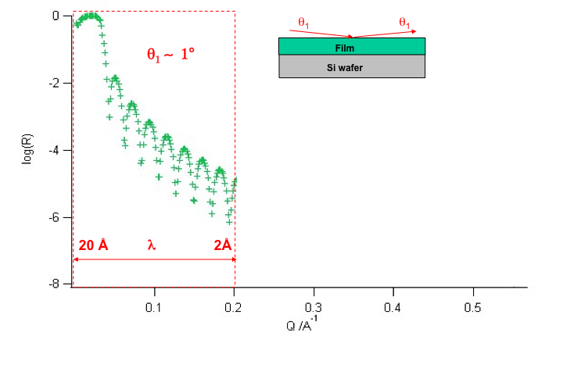
The Experiment
Since q = 4πsinθ/λ, reflectivity R(q) can be measured in two ways:
using a monochromatic beam and scanning the angle of incidence θ
using a polychromatic beam covering a range of q-values at any given θ
In practice, method 2 is useful a the range of q is measured simultaneously, which allows structural changes to be monitored as a function of time.

Slide 13
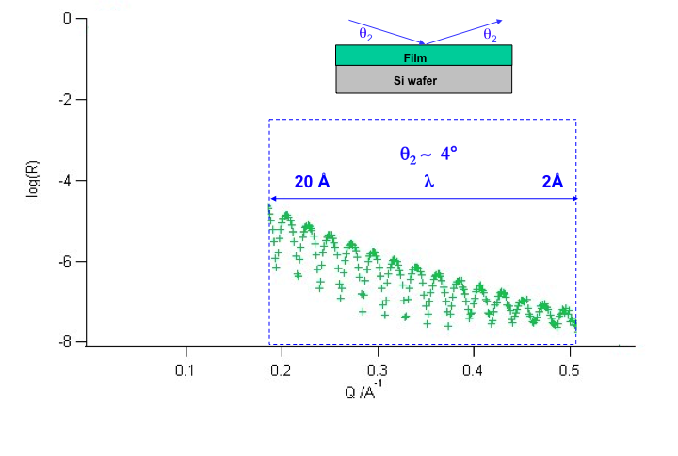
The Experiment
Since q = 4πsinθ/λ, reflectivity R(q) can be measured in two ways:
using a monochromatic beam and scanning the angle of incidence θ
using a polychromatic beam covering a range of q-values at any given θ
In practice, method 2 is useful a the range of q is measured simultaneously, which allows structural changes to be monitored as a function of time.

Slide 14
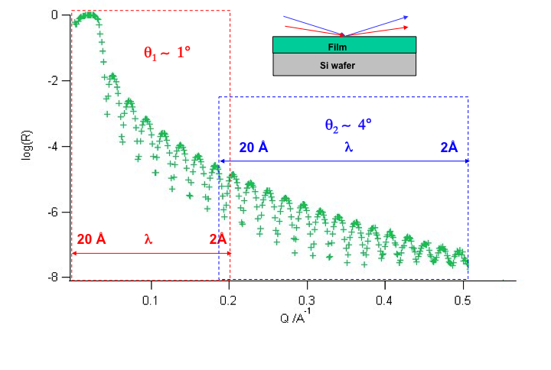
The Experiment
Since q = 4πsinθ/λ, reflectivity R(q) can be measured in two ways:
using a monochromatic beam and scanning the angle of incidence θ
using a polychromatic beam covering a range of q-values at any given θ
In practice, method 2 is useful a the range of q is measured simultaneously, which allows structural changes to be monitored as a function of time.

Slide 15
The Experiment
Since q = 4πsinθ/λ, reflectivity R(q) can be measured in two ways:
using a monochromatic beam and scanning the angle of incidence θ (x-rays)
using a polychromatic beam covering a range of q-values at any given θ (neutrons)
In practice, method 2 is useful a the range of q is measured simultaneously, which allows structural changes to be monitored as a function of time.
When using polychromatic beam, the neutron wavelength distribution is determined from their time-of-flight, since the neutron velocity depends on their wavelength:
neutron velocity
time-of-flight distance
neutron wavelength

Slide 16
The Experiment
Reflectivity is presented as the ratio of reflected intensity to the incident beam:
below the critical q, I_{R}/R₀= 1 which is used for normalisation to an absolute scale
for a time-of-flight experiment, only 10% of the incident beam is reflected as above the critical angle the intensity falls with ~q⁻⁴
The critical q value is a property of the reflecting interface:
for silicon ρ₁ = 2.07 x 10⁻⁶ Å⁻²
for D₂O ρ₂ = 6.35 x 10⁻⁶ Å⁻²
q_{c} (Si-D₂O) = 0.0147 Å⁻¹
ρ₂ > ρ₁ → total external reflection
I_{o}
I_{R} x 10
q_{c} ~0.0147 Å⁻¹ (Si –D₂O)
I₀/ I_{R}
λ_{c} ~10.35 Å
log(I₀/ I_{R})

Slide 17
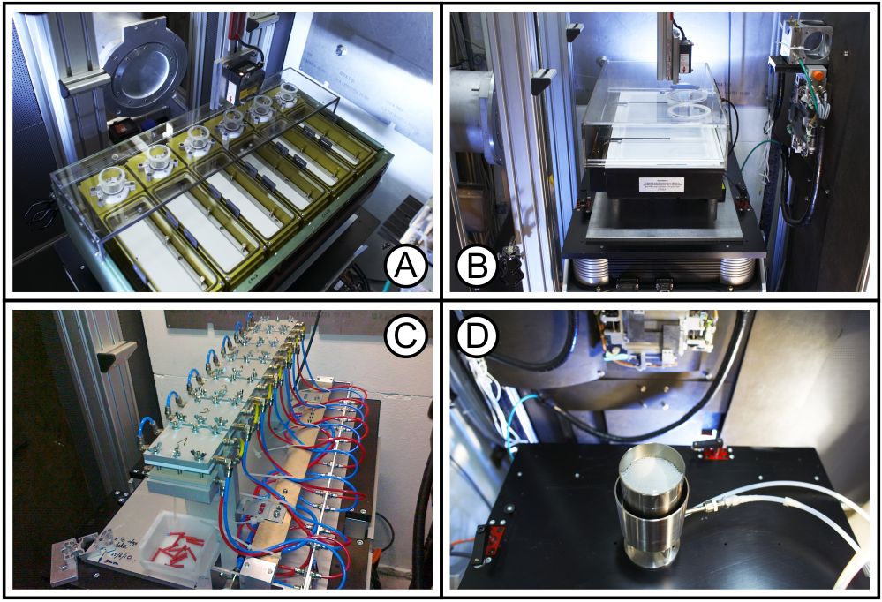
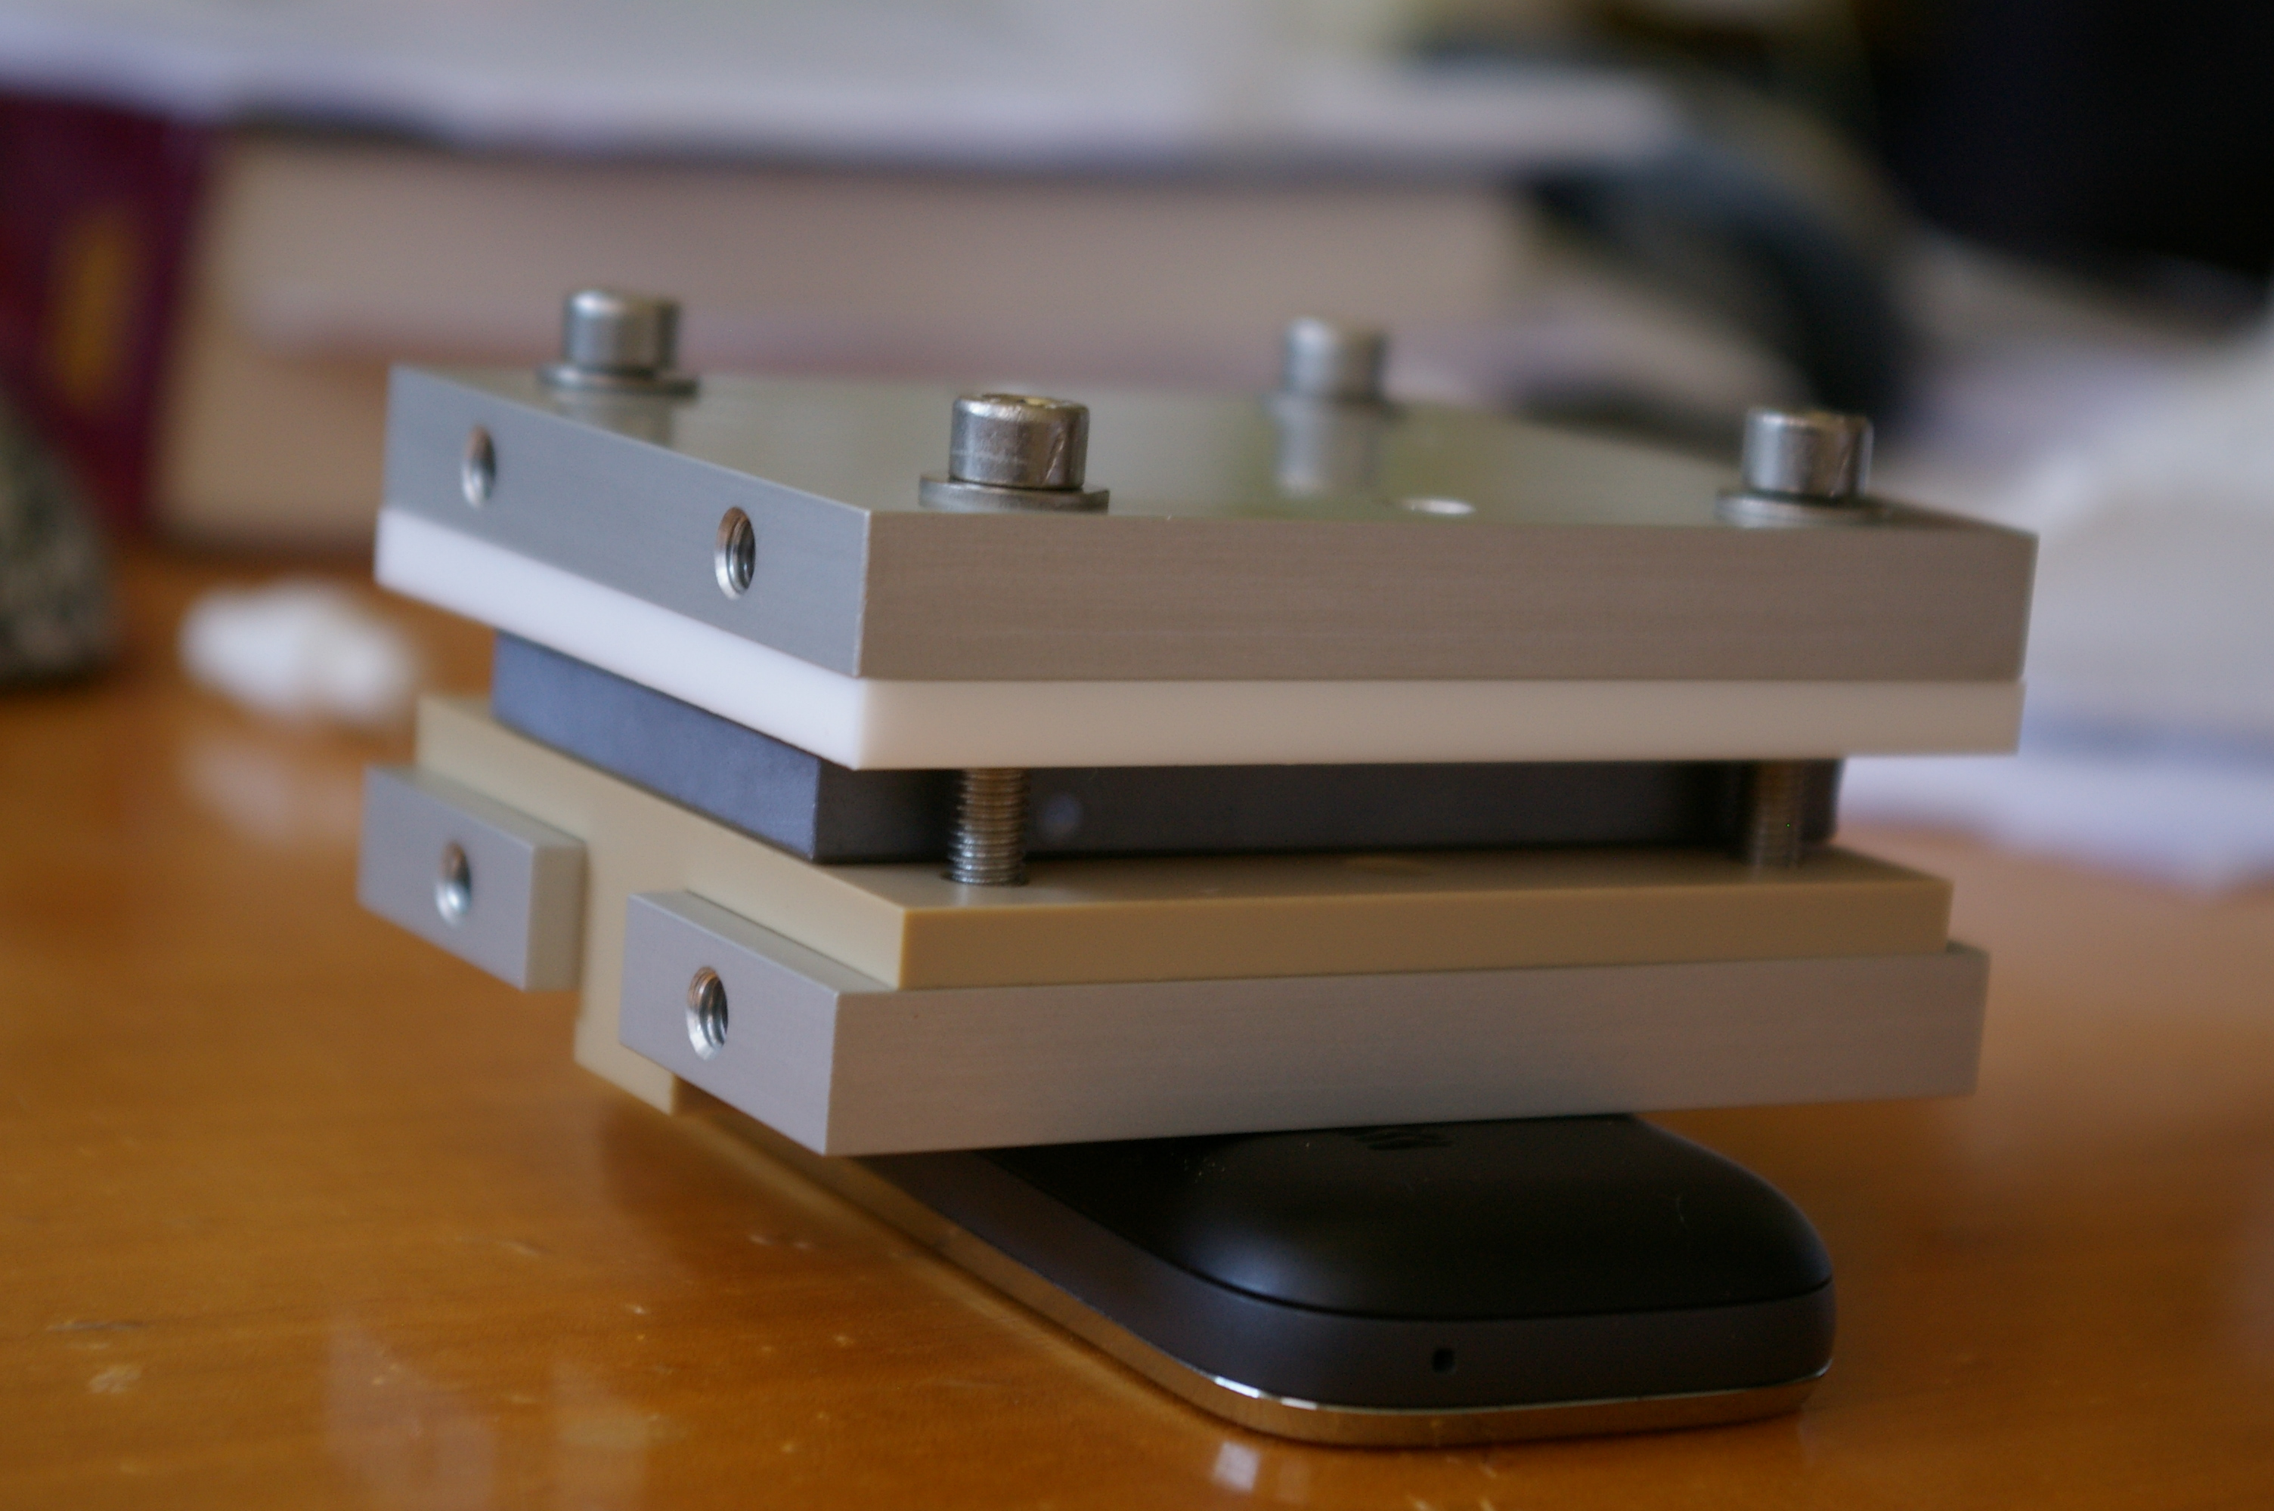
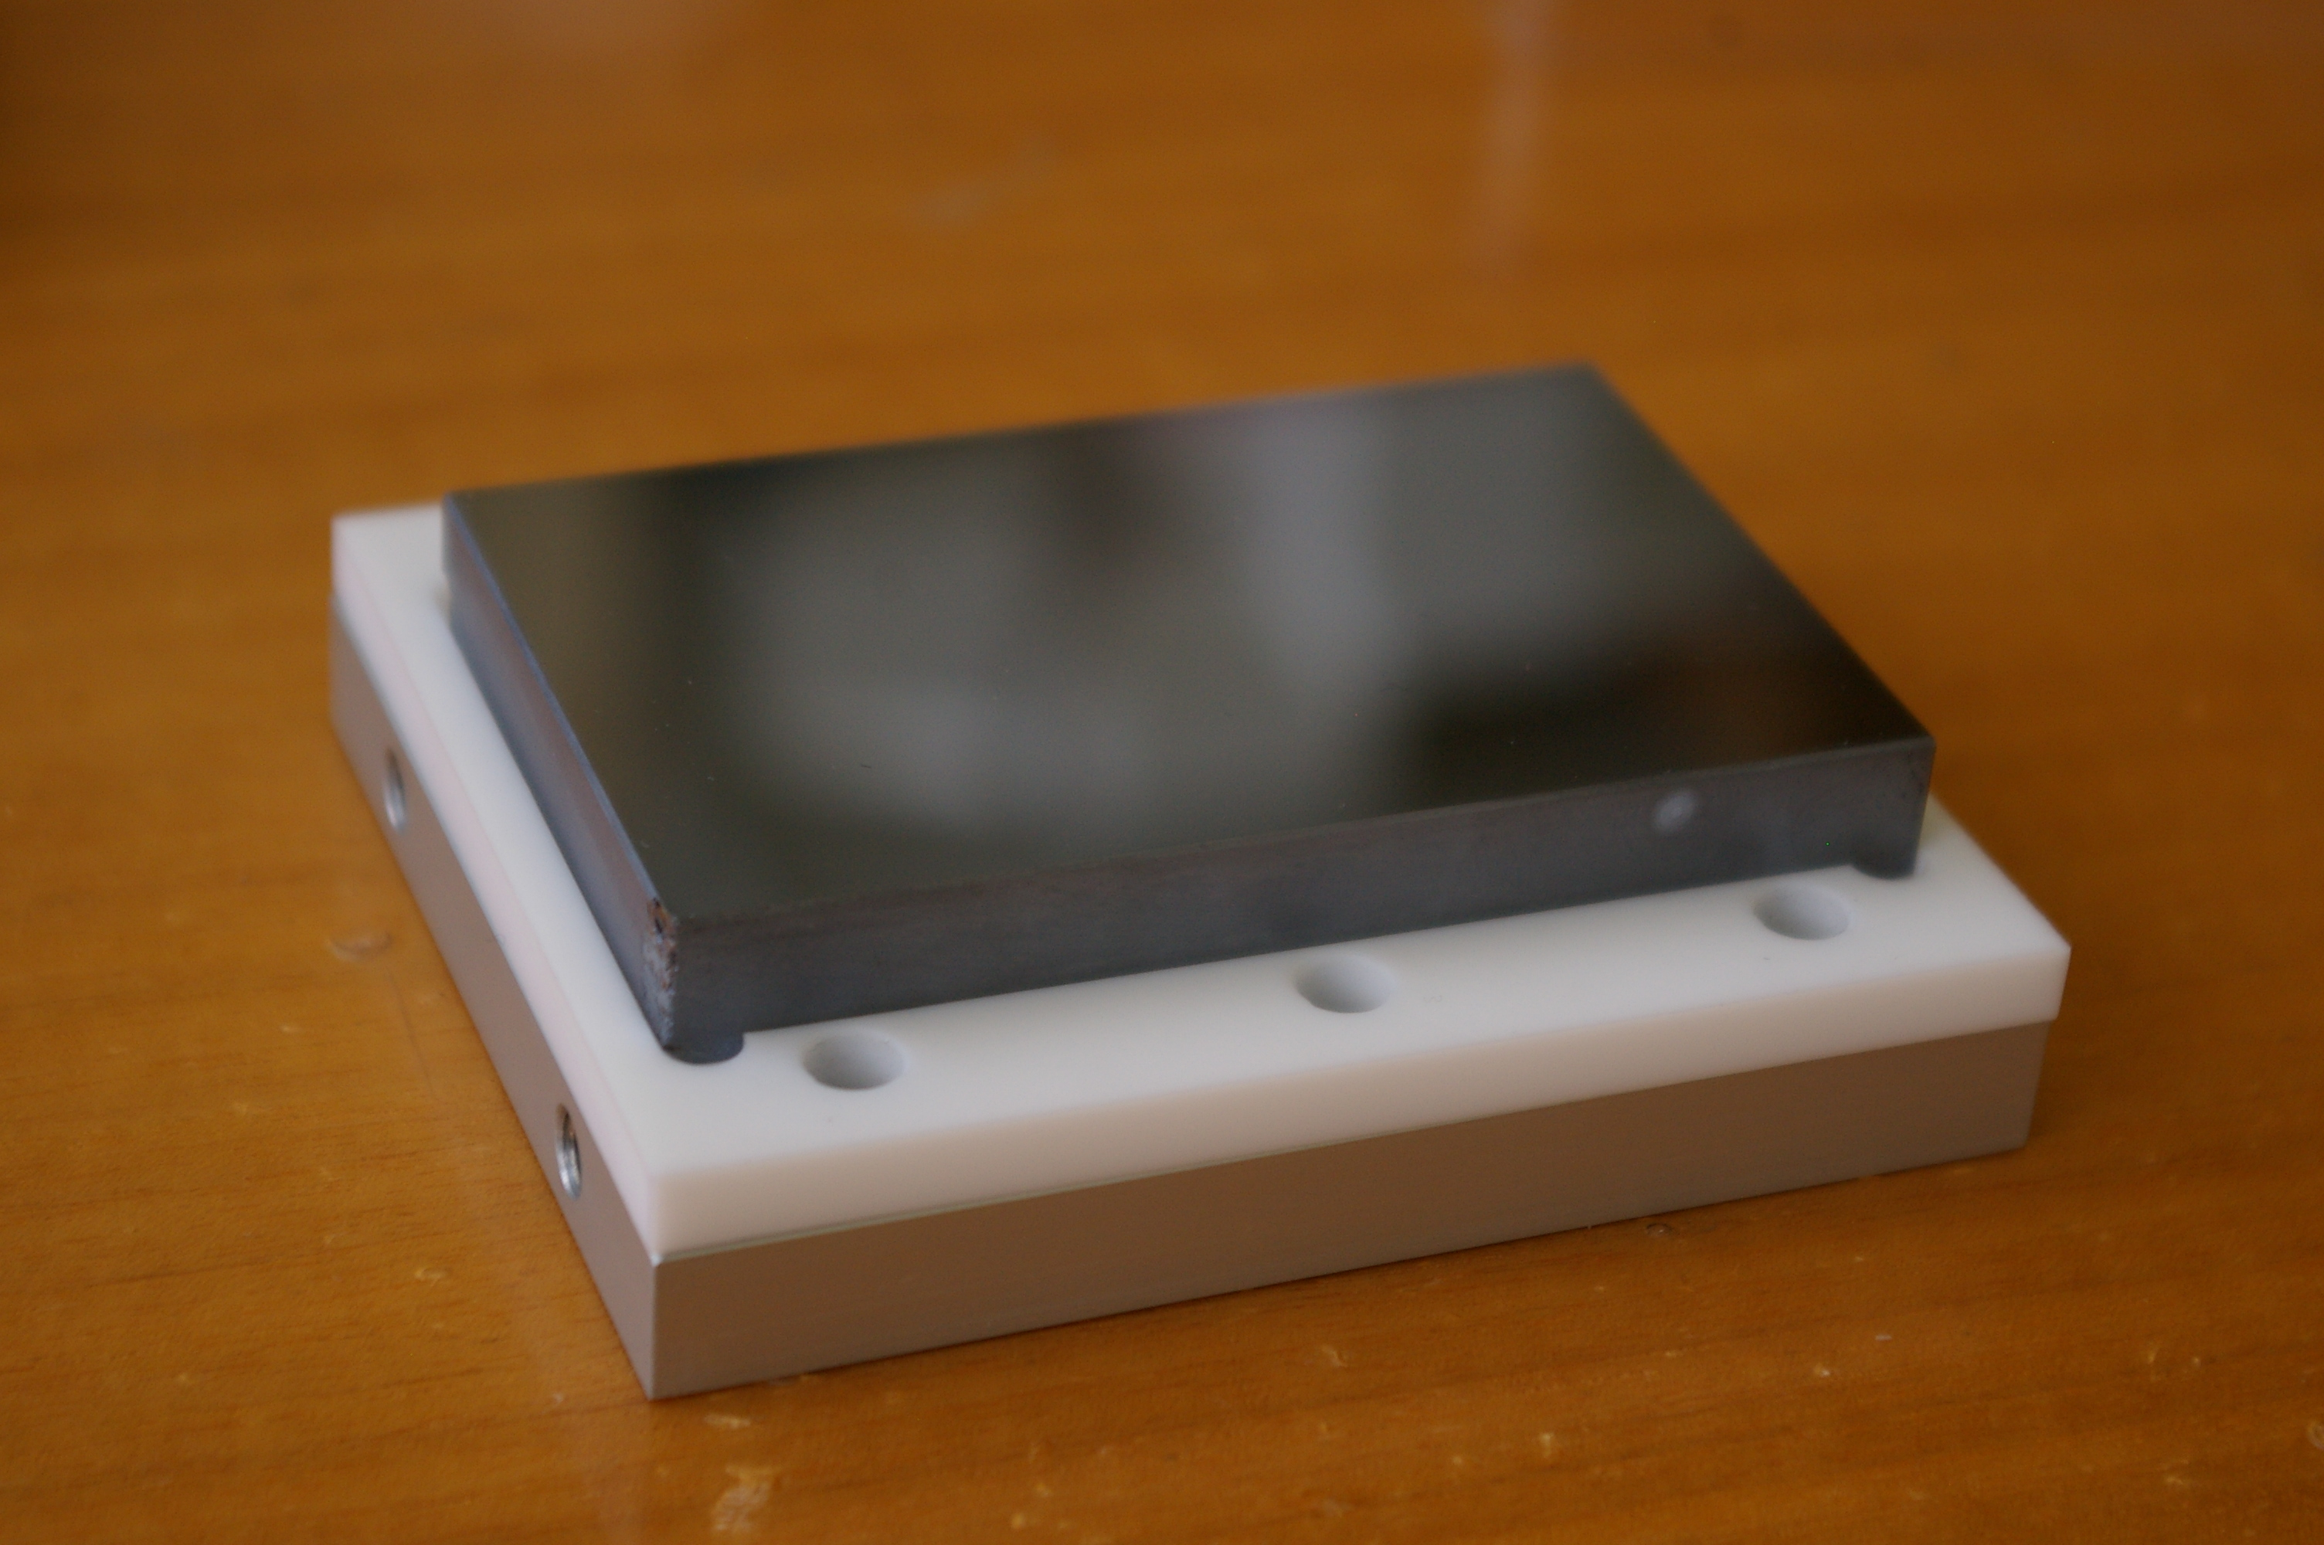
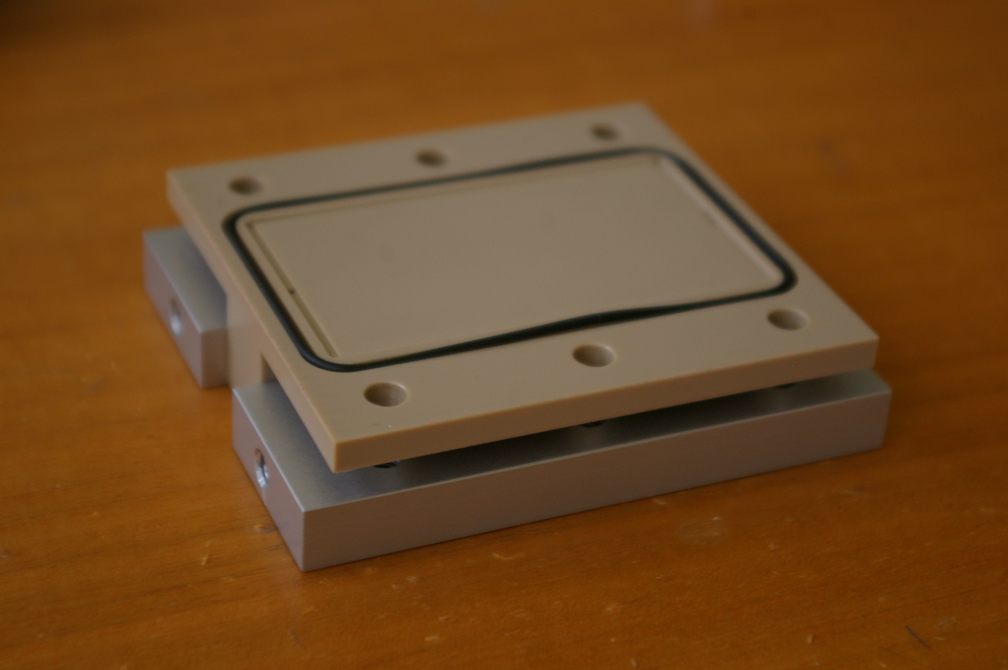
The Experiment
Neutrons penetrate materials easily, but…they are strongly scattered by liquids (incoherent scattering = contains no structural information), and also absorbed by others.
Many solid materials are almost transparent to neutrons (they don’t absorb neutrons) and can be used to deliver the beam to buried interfaces, e.g. the solid-liquid interface
many kinds of sample cells and environments are used for liquid surfaces, e.g.
A typical solid-liquid flow cell:
air-liquid troughs
Langmuir troughs
Aluminium holder
I_{o}
liquid trough/flow cell
Silicon crystal
Aluminium holder
Si (111): 80×50×10 mm
multi-rack for S/L cells
overflowing cylinder

Slide 18
Reflection data – what does it reveal?
Neutrons reflection measures the film thickness and scattering length density.
From these is is possible to work out:
volume fraction ϕ or the water fraction (1- ϕ)
the thickness t of a film (or extension length of a molecule from the interface)
the area per molecule A and the surface excess of a film Γ
volume of water
Using deuterium labeling it is also possible to resolve:
the fraction of a component in a multicomponent film
the location of components in a multicomponent film
the orientation of selectively labeled molecules

Slide 19
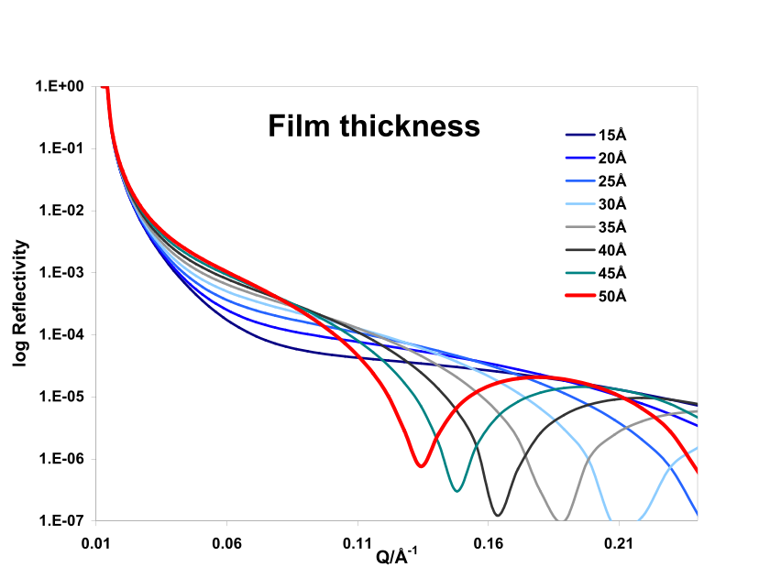
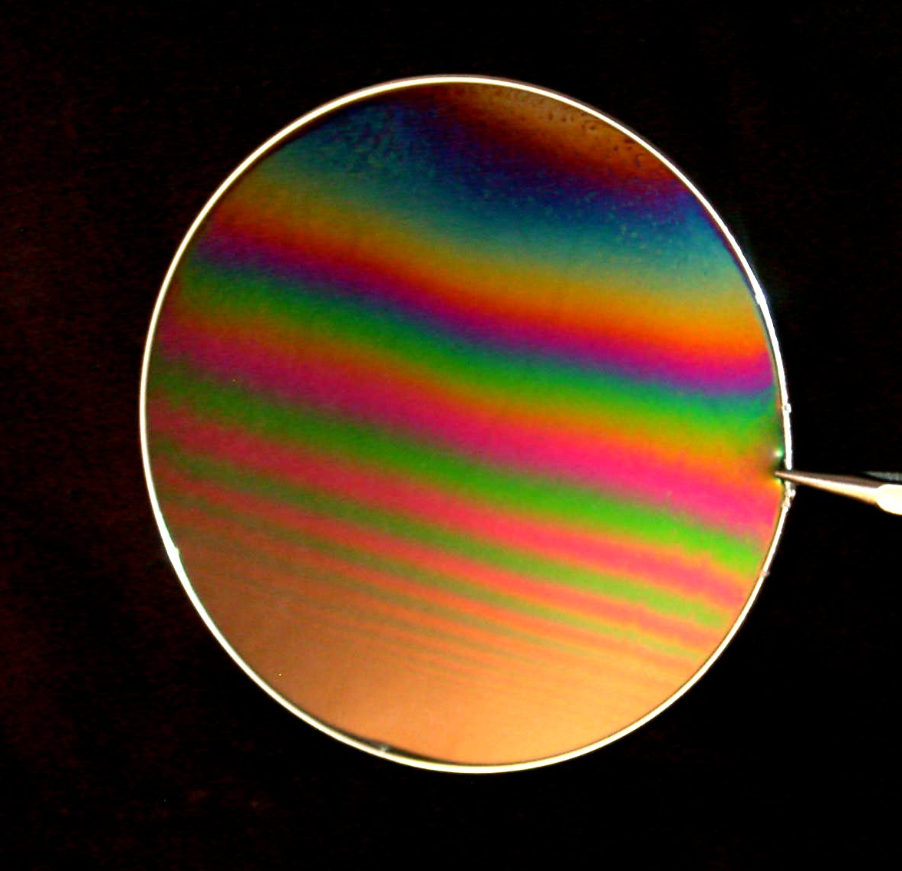
Reflection data – what does it reveal?
Log R
Neutron wavelength << light wavelength
nanothin films e.g. lipid membranes (~ 5nm)
Optical Matrix modeling
liquid = D₂O
D₂O
z
Solid = Si-SiO₂
SiO₂
Model structure of lipid membrane
= layered model of structure & composition
Scattering length density profile ρ(z)
= neutron refractive index profile

Slide 20
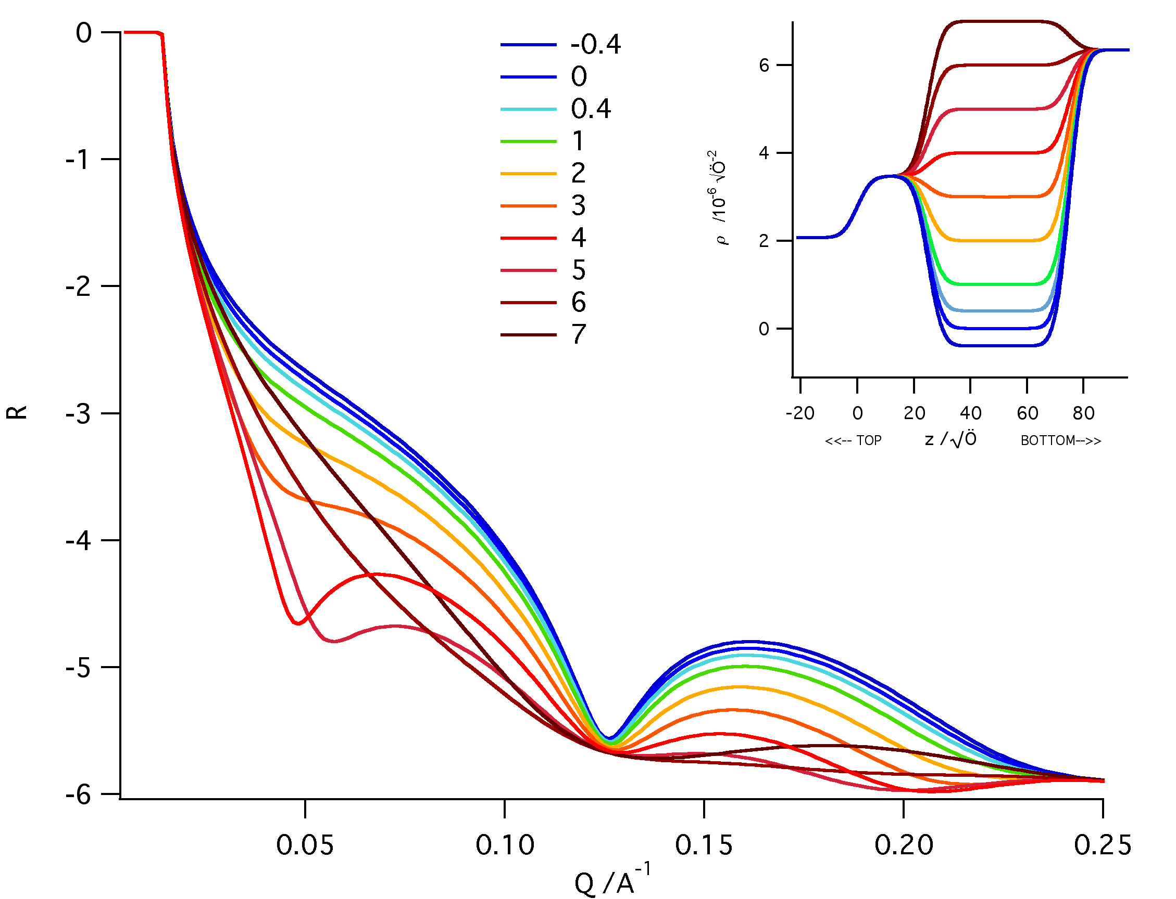
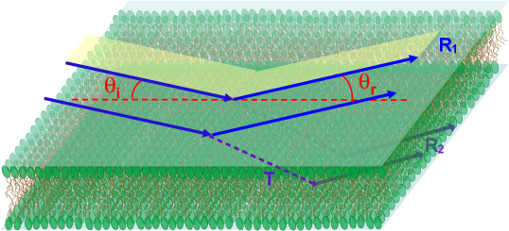
Reflection data – what does it reveal?
ρ(z)
ρ
h-lipid
Log R
d-lipid
thickness
z
liquid = D₂O
D₂O
z
Solid = Si-SiO₂
SiO₂
Model structure of lipid membrane
= layered model of structure & composition
Scattering length density profile ρ(z)
= neutron refractive index profile

Slide 21
Reflection data – what does it reveal?
ρ(z)
ρ
h-lipid
Log R
d-lipid
thickness
z
liquid = D₂O
D₂O
z
Solid = Si-SiO₂
SiO₂
Model structure of lipid membrane
= layered model of structure & composition
Scattering length density profile ρ(z)
= neutron refractive index profile

Slide 22
Reflection data – what does it reveal?
ρ(z)
ρ
h-lipid
Log R
d-lipid
thickness
z
liquid = D₂O
D₂O
z
z
Solid = Si-SiO₂
SiO₂
Model structure of lipid membrane
= layered model of structure & composition
Scattering length density profile ρ(z)
= neutron refractive index profile

Slide 23
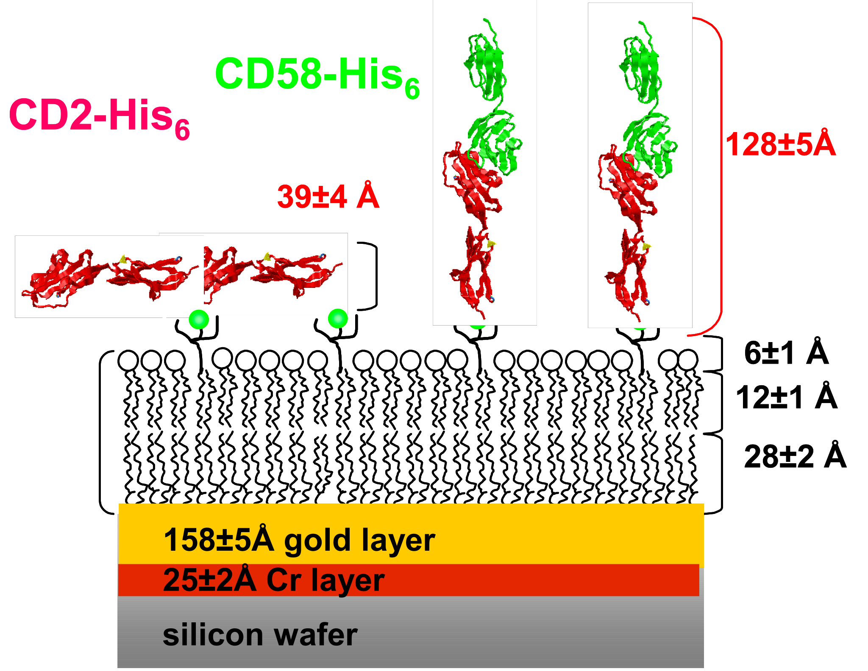
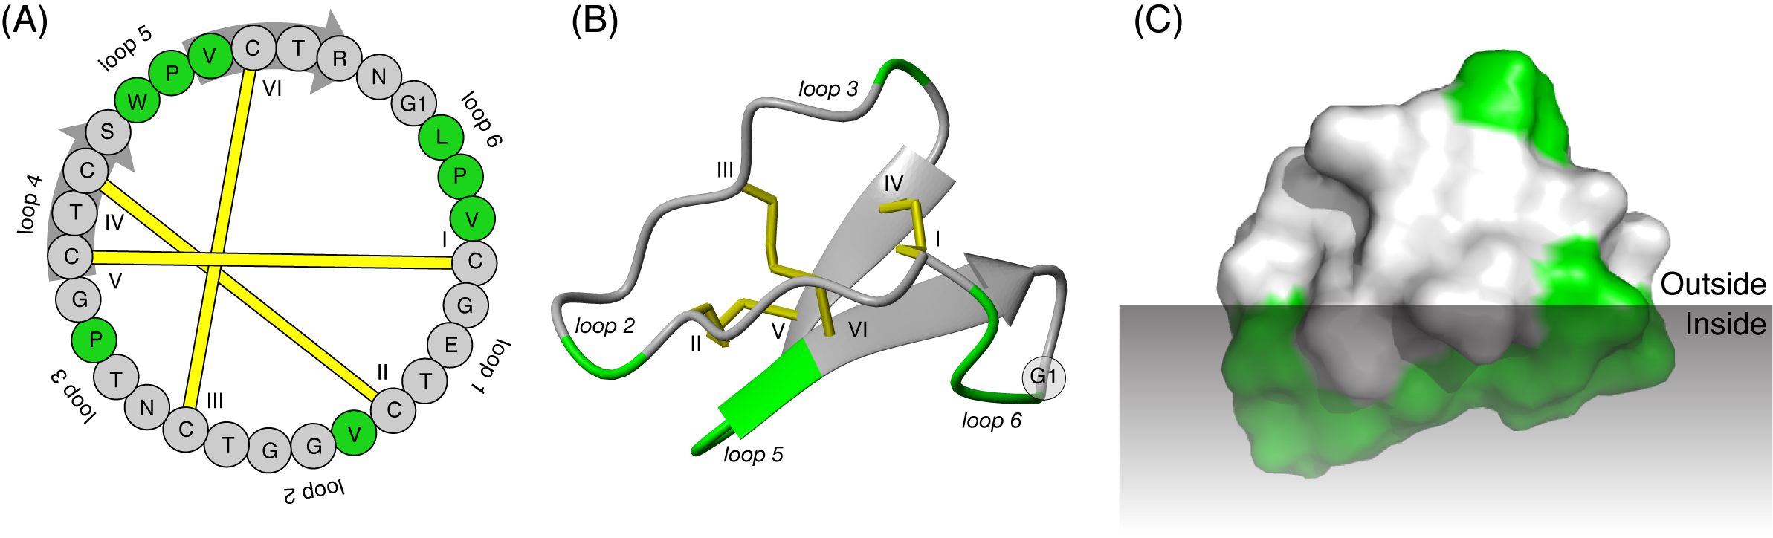
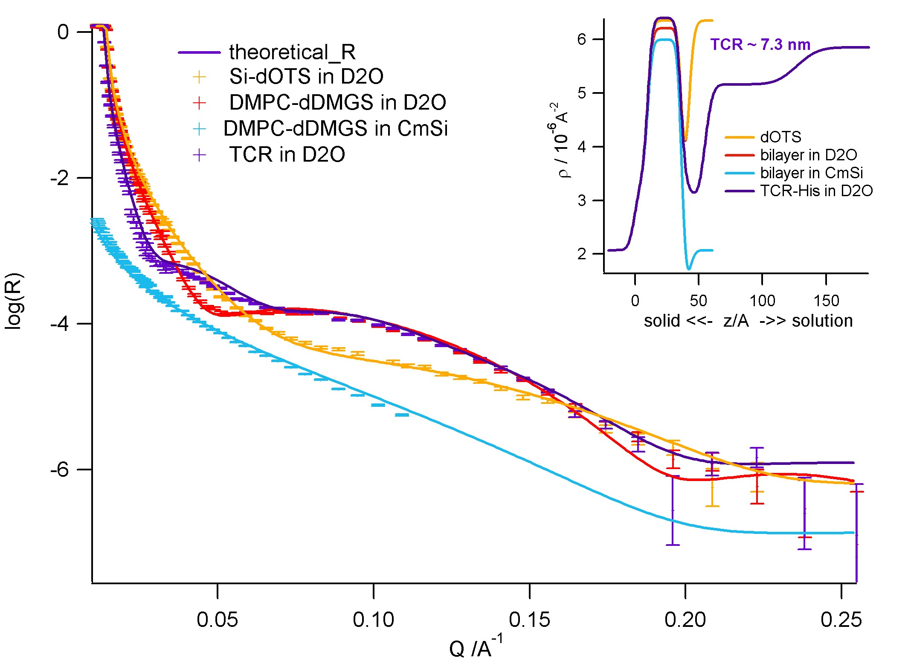
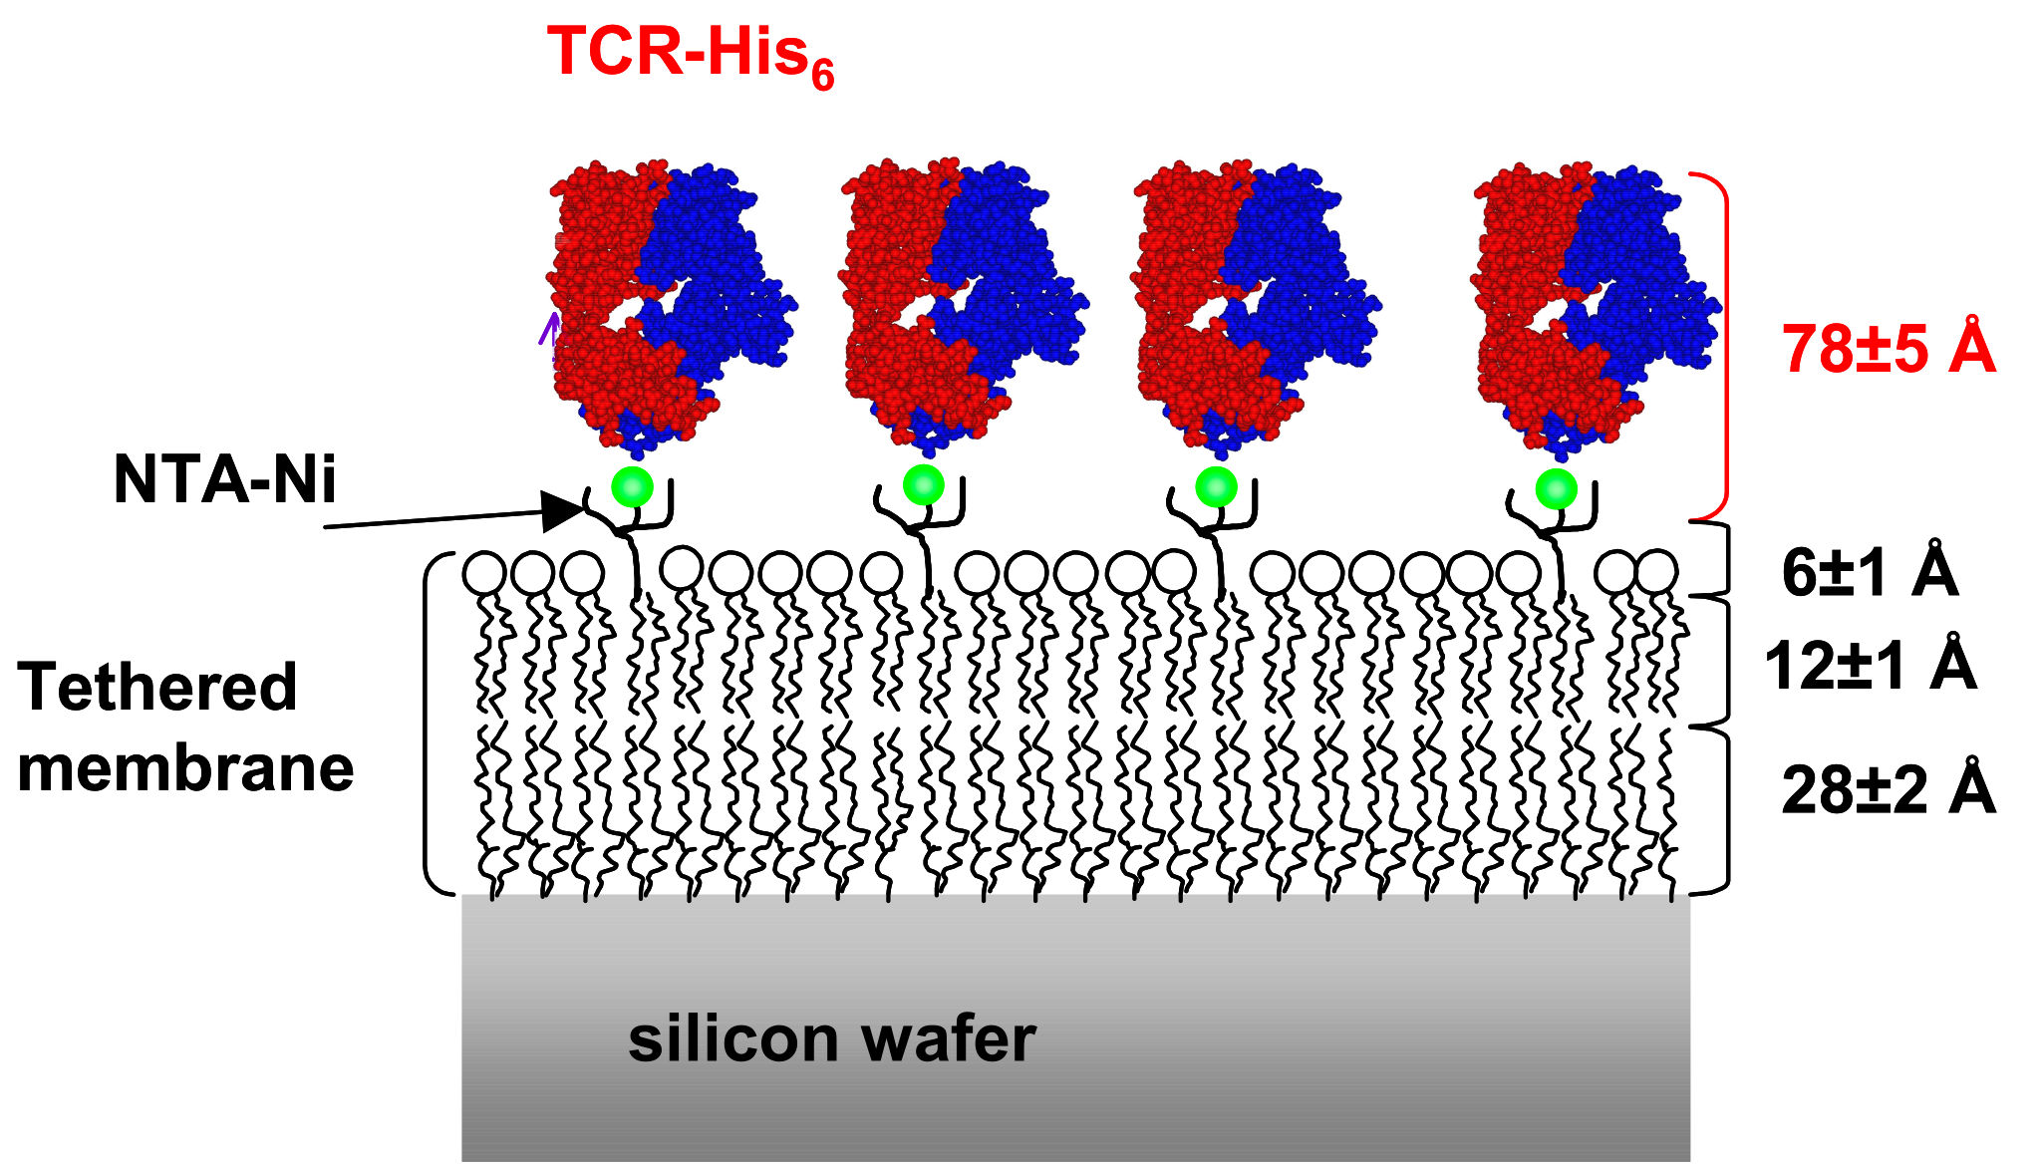
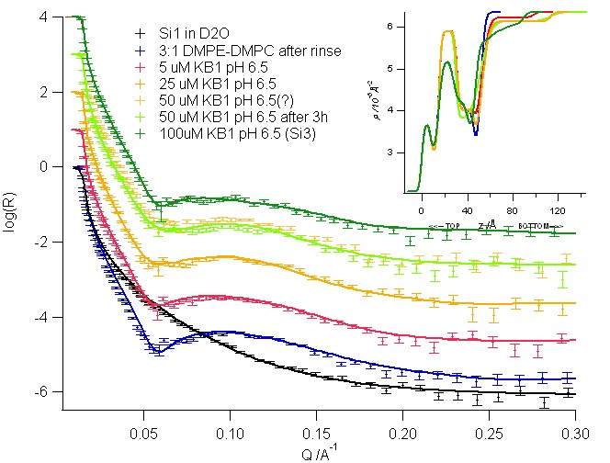
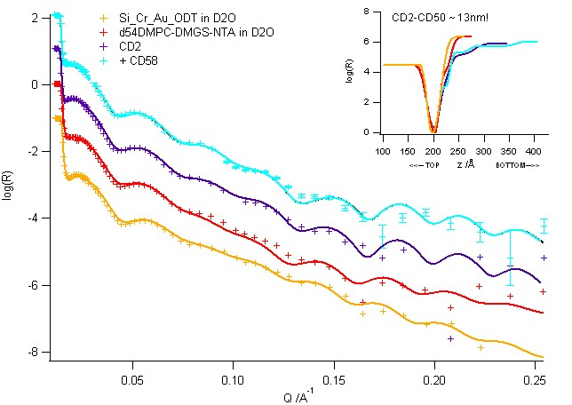
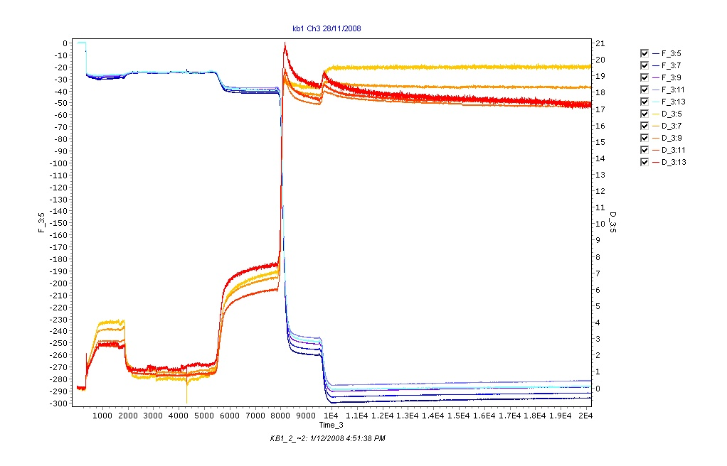
Membrane lysis by peptides
Membrane proteins
5%
Pore
50%
11%
50uM
Kalata peptides: cyclic plant insecticides/Herbal medicine
T cell immune receptors and ligands
5%
5uM
25uM
Collaboration with D.Craik/C.Wang, UQLD Brisbane
Collaboration with A. van der Merwe, University of Oxford

Slide 24
More applications…
spontaneous adsorption of surfactants, polymers and proteins to interfaces structural changes in response to external parameters: e.g thermo- and pH-responsive polymers and polymer brushes
wetting, dewetting, solvent peneration and drying of films
effect of an interface on organization of ordered mesophases, e.g. liquid crystals, micelles
Some limitations…
surfaces have to be smooth – rms < 5Å desirable
surfaces have to be flat
surfaces need a relatively large area – 5 x 5 cm² today – at ESS aiming for 5 x 5 mm²
measurement times relatively long – 10s possible today but on large surfaces – at ESS aiming for millisecond-second range
for maximum benefit, materials need to be deuterated – sometimes difficult! setting up a deuteration facility at ESS will be essential.
Information only in surface normal direction (z)

Slide 25
Off-specular reflection:
What about lateral ordering or correlations on surfaces - 2D structures?
off-specular reflectivity (when q has an x-component) probes structure in the direction of the beam along the surface – e.g. fluctuations. Limited by neutron coherence length (~100μm) – large scale stuctures in e.g. magnetism
The diffraction pattern below TSC consists of a series of sharp peaks as a function of Q. This is characteristic of a stripe-like magnetic domain pattern x in real space.
J.Chakhalian et al. Nature physics, VOL 2, 2006

Slide 26
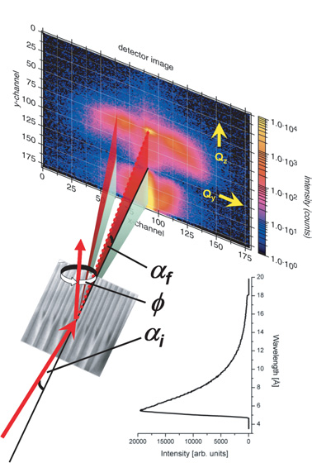
Grazing incidence scattering:
What about lateral ordering or correlations on surfaces - 2D structures?
Grazing Incidence Small Angle Scattering (GISAS) probes by x-and y-directions. The difference between GISAS and reflectivity measurements is the beam collimation:
Reflectivity data is measured with a divergent wide beam in the y-direction – this averages lateral structure in the sample plane
GISAS
GISAS data is measured with a narrow low-divergence beam in the y-direction – this determines the lateral resolution to structure in the sample plane
W.Kreutzpaintner et al. Eur. Phys. J. Special Topics 167, 73–79 (2009)

Slide 27
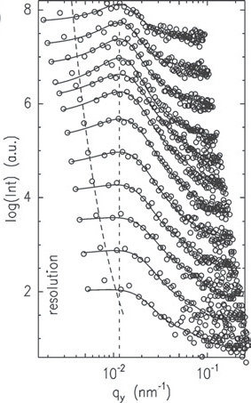
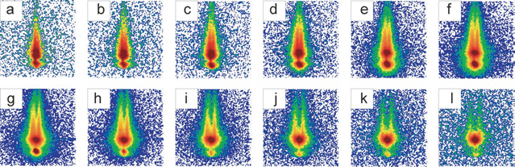
Grazing incidence scattering:
What about lateral ordering or correlations on surfaces - 2D structures?
Grazing Incidence Small Angle Scattering (GISAS) probes by x-and y-directions – the difference is that the beam needs to be well-collimated in both directions.
With time-of-flight GISANS can probe surface structure at different depths from interface, because at a given angle, the penetration depth increases with decreasing wavelength!
d_{p}
λ
GISANS can probe buried interfaces that are not accessible by AFM
Fig. 1. Selection of twelve 2d intensities measured simultaneously by TOF-GISANS from a nanospolymer nanodot film.
The corresponding mean wavelengths are a) 0.50, b) 0.55, c) 0.61, d) 0.68, e) 0.75, f) 0.82, g) 0.91,
h) 1.00, i) 1.11, j) 1.22, k) 1.35 and l) 1.48 nm. P. Müller-Bushbaum et al. Eur. Phys. J. Special Topics 167, 107–112 (2009)

Slide 28
Summary
Specular Reflectivity
probes structure in the surface normal direction only – lateral structure is averaged
composition of film, location (and sometimes orientation) of components is obtained from scattering length density profiles
Off-specular Reflectivity
arises when the sample has in-plane structure along the beam direction (x) – resolution limited by neutron coherence length
applications in magnetism, fluctuations, large domain structures
Grazing Incidence Small Angle Scattering (GISAS)
probes by x-and y-directions with pinhole beam
= SANS from the surface only
time-of-flight GISANS probes different depths from interface as function of wavelength
many applications in both soft and hard condensed matter – new technique with analysis still in development
X-rays has higher resolution but neutrons have the isotopic sensitivity
→ X-rays for single materials, neutrons for multicomponent systems

