Slide 1
XAFS Spectroscopy
Katarina Norén

Slide 2

X-ray Absorption Theory
The absorpion coefficient - μ
Transmission of intensity through a material
Lambert Beers’s Law:

Slide 3
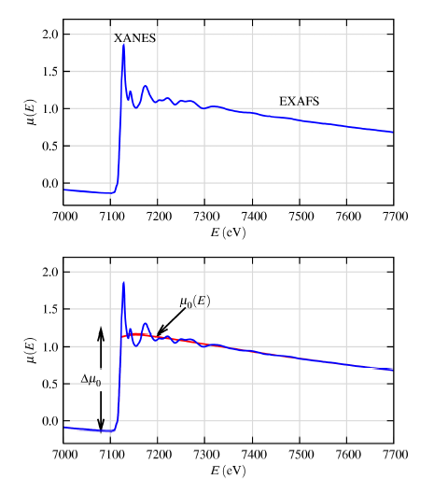
X-ray Absorption Theory
XANES = X-ray Absorption Near-Edge Structure
EXAFS = Extended X-ray Absorption Fine Structure
Variation in X-ray absorption coefficient as function of energy related to structural or electronic properties of sample

Slide 4
Early Developments of XAFS
First noted in literature by students of Manne Siegbahn in Lund: Wilhelm Stenstöm and Hugo Fricke 1918-1920
Lots of early experimental and theoretical work in first 60 years of the 20th century

Slide 6
Modern History
1960s and later: XAFS is a routine X-ray technique
Applications in catalysis, materials research, biology/life science, environmental and geosciences and others
SciFinder Search:
2001-2012: EXAFS/XAFS ~9900/3400 Publications
1960-1975: EXAFS/XAFS = 18/0 Publications
2011: EXAFS/XAFS ~800/350 Publications

Slide 7
An Element Specific Technique
Chemistry and physics
Biochemistry
Thin-film
Catalysis
Coordination chemistry
Nano-structures
Metalloproteins
Enzymes
Environmental science
Low concentrations of metals
(Hg, Pb, Cr3+/Cr6+)
XAFS is applicable to systems in liquid, solid, solution and gaseous phase

Slide 8
An Element Specific Technique
Chemistry and physics
Biochemistry
Thin-film
Catalysis
Coordination chemistry
Nano-structures
Metalloproteins
Enzymes
Environmental science
Low concentrations of metals
(Hg, Pb, Cr3+/Cr6+)
XAFS is applicable to systems in liquid, solid, solution and gaseous phase

Slide 9
Properties of Synchrotron Light
High brightness: synchrotron light is extremely intense and highly collimated
Wide energy spectrum: synchrotron light is emitted with energies ranging from infrared light to hard x-rays
Tunable: it is possible to obtain an intense beam of any selected wavelength
Polarised: the synchrotron emitts highly polarised radiation

Slide 10
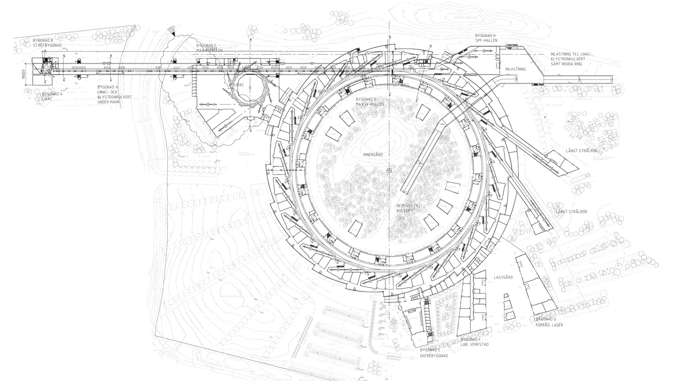
MAX IV – A Synchrotron Light Facility
Insertion device
Linear accelerator
Electron injector
Storage ring
Beamlines

Slide 11
Why Beamlines?
The storage ring and the insertion devices, also called light sources (bending magnets, undulators and wigglers) form the heart of the synchrotron radiation facility. However, the light sources as themselves are pretty useless for experiments.
The properties of the source are practically always manipulated: most importantly, the optical properties
Wavelength
Portion of high-order light
Coherence
but also geometrical properties like the size of the light spot used for experiments.
All this manipulation is done using the so-called beam lines.

Slide 12
Main Functions of a Beamline
The beam line's main tasks are:
Monochromatize the radiation, this means that we need an energy dispersive element before the experiment
Transport the source to the experiment’s sample region as effectively as possible using (mostly) mirrors
Transport
Focus
Take out the heat load (as early as possible)
Connects the experiment to the UHV environment of the storage ring

Slide 13
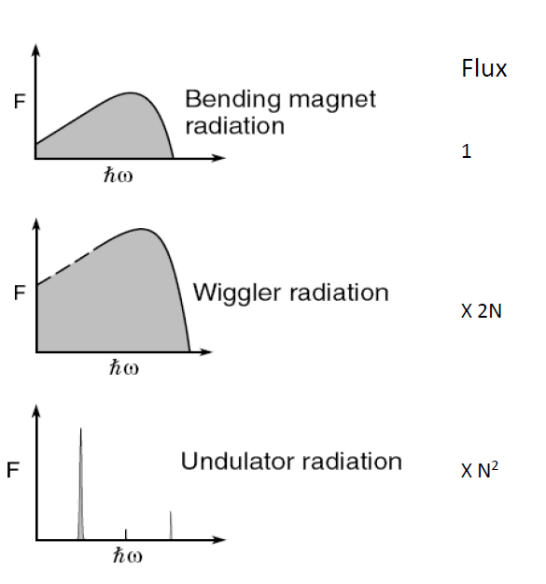
Location of a Beamline
The location of a beamline is dictated weather the experimental techniques requires high energies (Wiggler beamline), high brightness (undulator beamlines) or very low energies and modest flux (bending magnets)

Slide 14
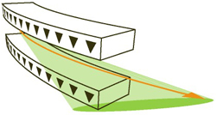
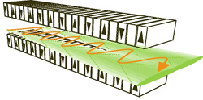
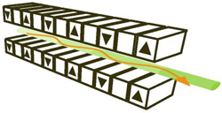
Insertion Devices

Slide 15
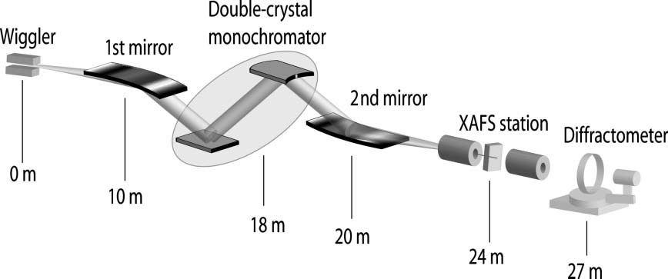
XAFS at Beamline I811
Optical design

Slide 16
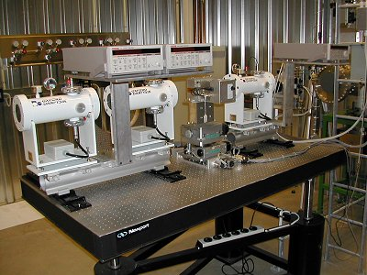
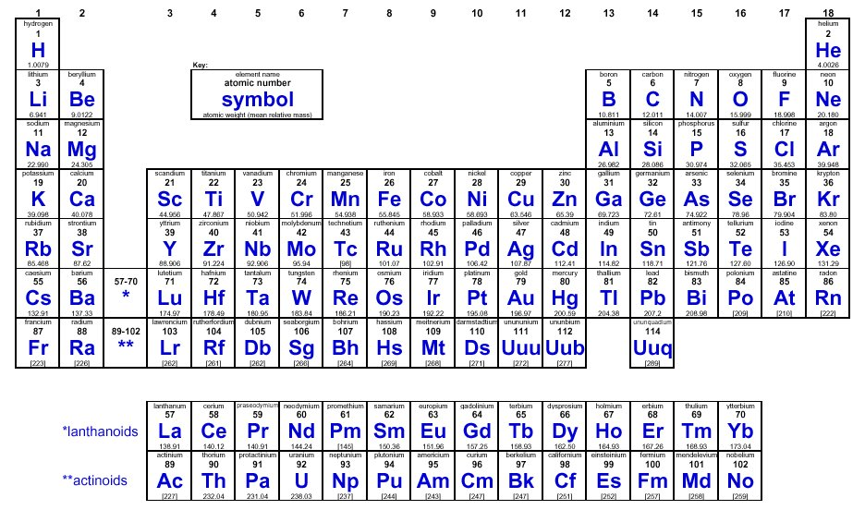
XAFS at Beamline I811
Experiment station
K
L
Si (111) crystals:
K-edge: S K-edge to As K-edge
L-edge: Zr L-edge to Au L-edge
Si (311) crystals:
K-edge: Fe K-edge to Mo K-edge
L-edge: Lu L-edge to Am L-edge

Slide 17
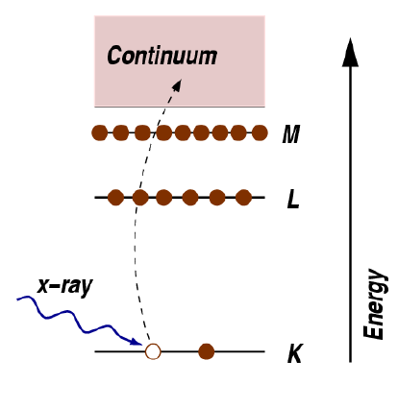
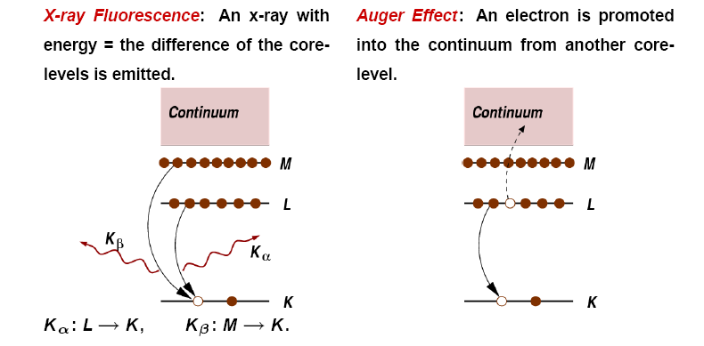
X-ray Absorption Theory
The absorption of an x-ray photon
Absorption
Fluorescence
Auger effect

Slide 18
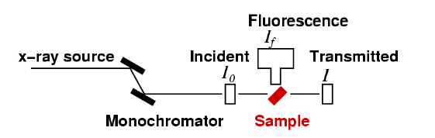
X-ray Absorption Theory
The absorption of an x-ray photon
Typical experiment:
Transmission of intensity through a material:
Absorption: μ(E) = log(I₀/I)
Fluorescence: μ(E) ∝ I_{f}/I₀

Slide 19
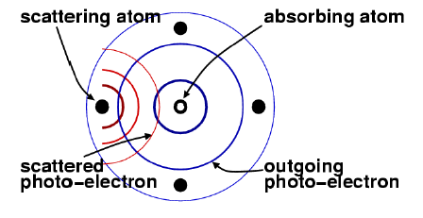
X-ray Absorption Theory
The absorption of an x-ray photon

Slide 20
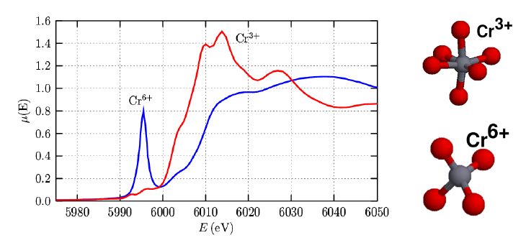
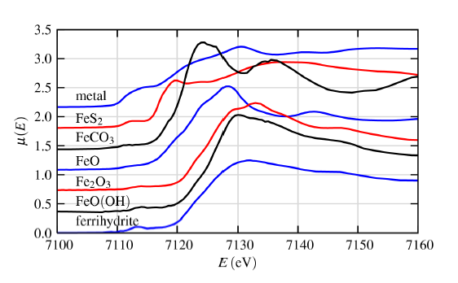
Scientific Results - XANES data

Slide 21

The Vasa
1628 - 1961

Slide 22
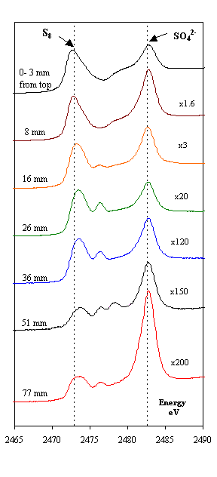
S-XANES

Slide 23
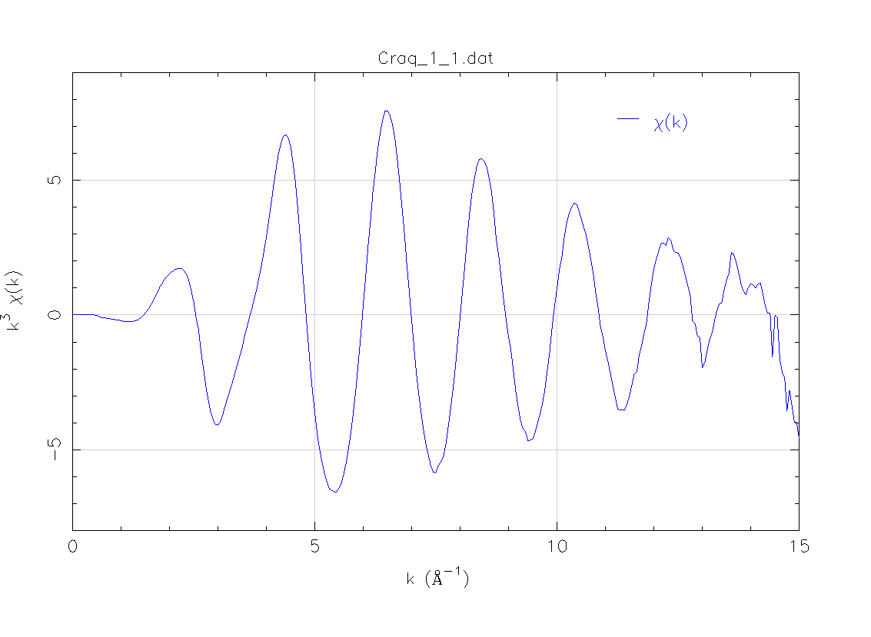


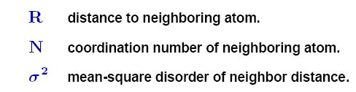
Scientific Results- EXAFS data
A little bit of data analysis
Fe³⁺(aq)

Slide 24
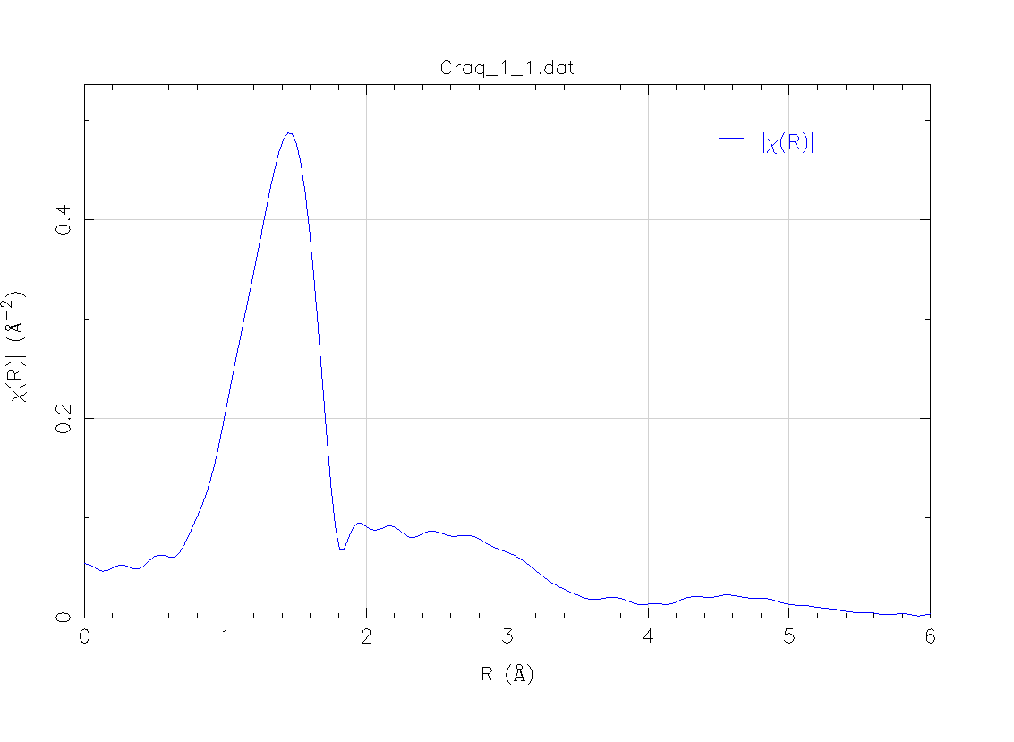
Scientific Results
A little bit more data analysis
Fe³⁺(aq)
F.T.

Slide 25
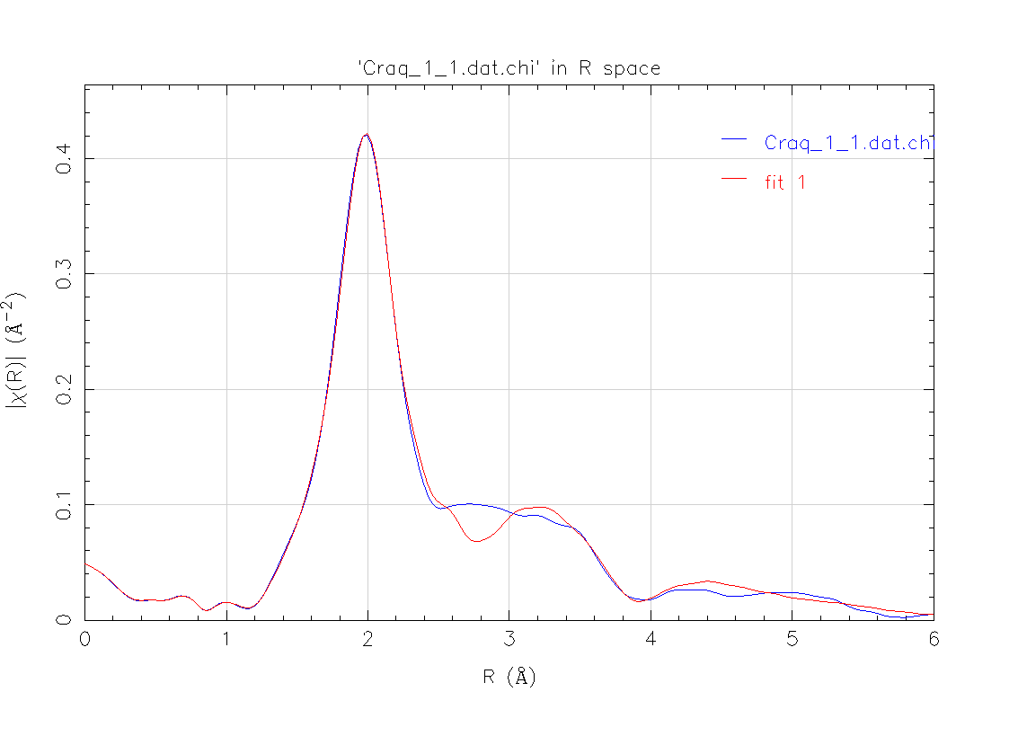
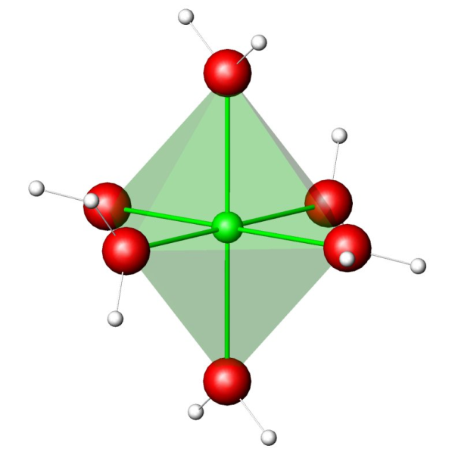
Result: Fe – O distance
Fe – O distance
Model: 1.949 Å
XAFS: 1.977 Å

Slide 26
Conclusions
Oxidaton state
Coordination chemistry
Structural information (distances, angles, types of atoms)
Low detection limits (ppm)
Simple and fast technique

