Slide 1
Discovery Strategy day
The purpose today is to kick-start an application for a center extension 2015-2020.
We have to agree on what is INTERESTING and FEASIBLE to do in the future – and be right!
We also must learn to present past achievements as well as possible.

Slide 2

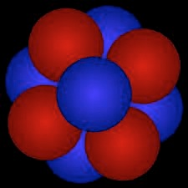
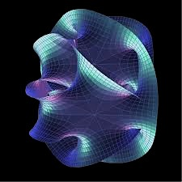
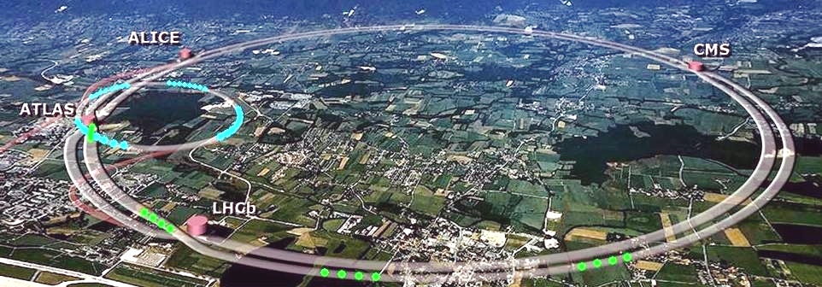
The journey to
Discoveries

Slide 3
From the largest scales to the smallest ever reached

Slide 4


DISCOVERY Center of Excellence in Particle Physics AND COSMOLOGY
Notes:
Good morning. I am XX and will present an overview of the Discovery center.

Slide 5
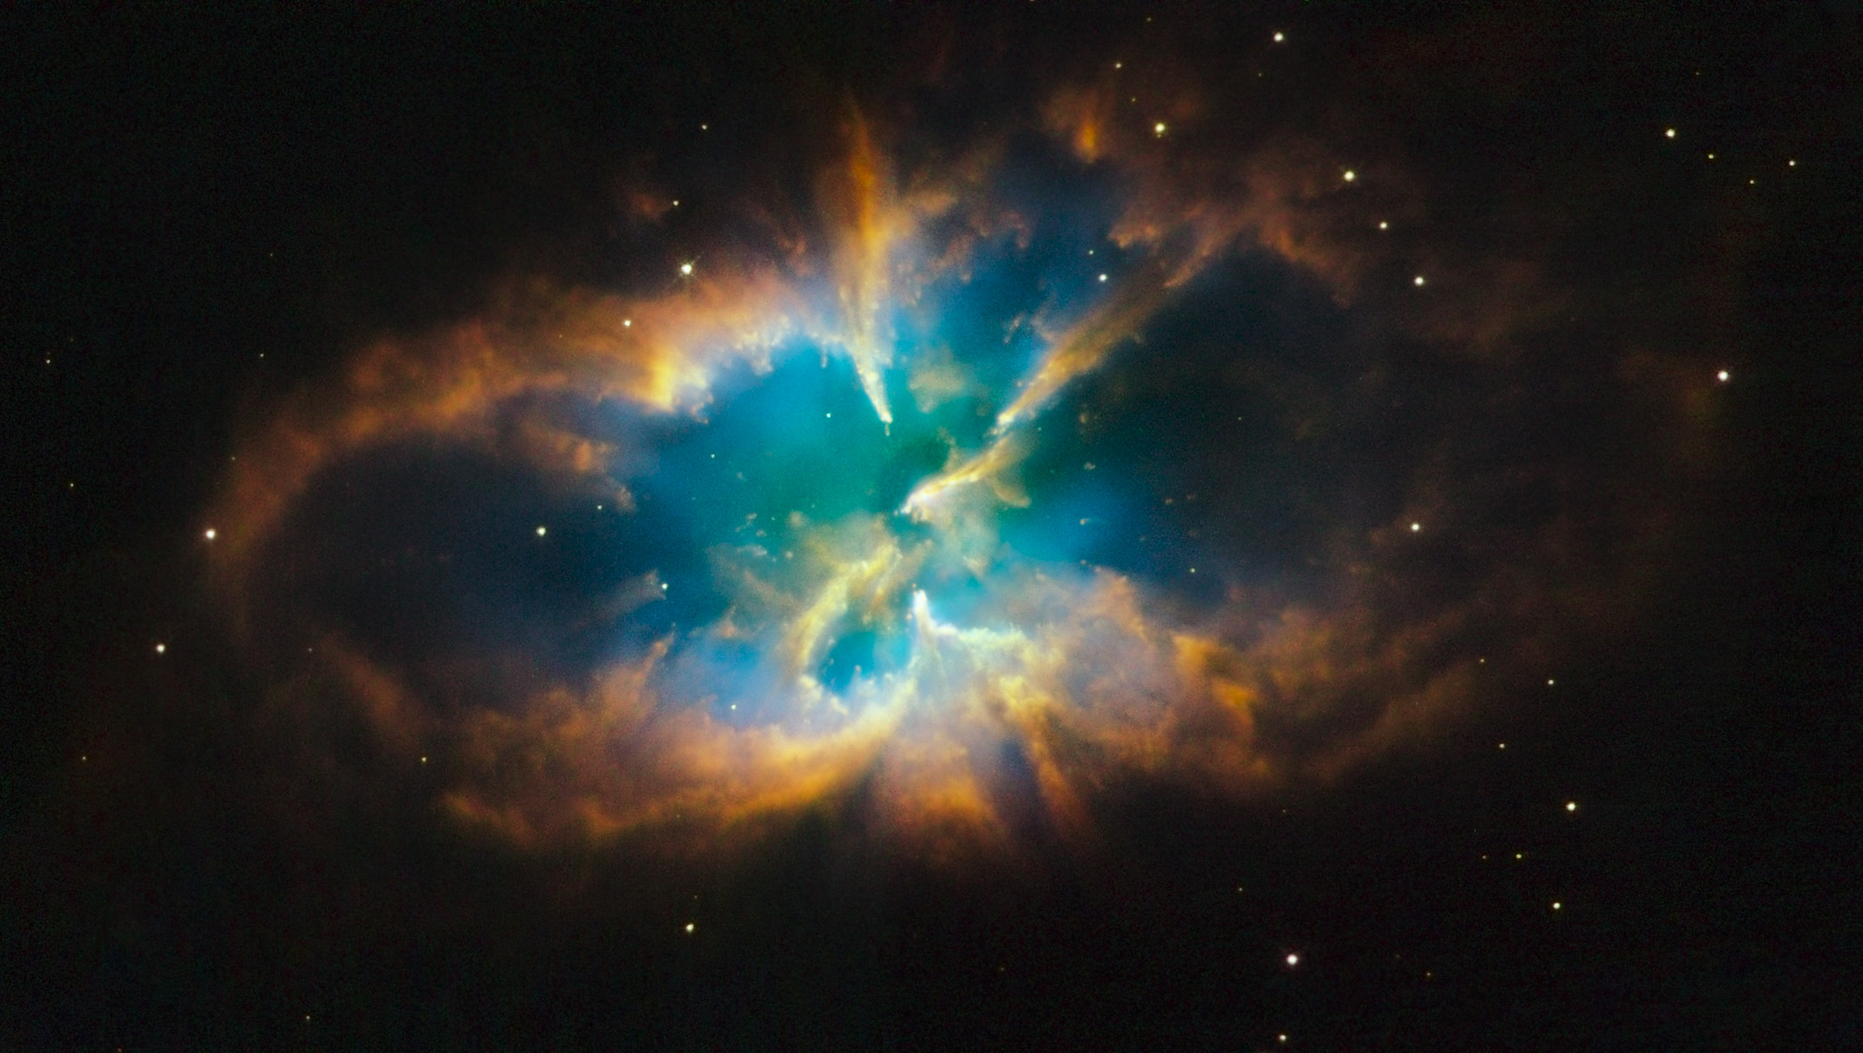

Slide 6
Discovery Center
The only center in the World
that combines access to data
from the LHC and the Planck
Satellite with theory

Slide 7
For the first time, cosmology
must go hand-in-hand with
particle physics:
The circle closes

Slide 8
FOUR STRONG GROUPS UNITE
DISCOVERY CENTER
Fundamental theory
Cosmology of the earliest accessible time of the Universe
Physics of the most dense state of matter ever reached
Fundamental particle physics

Slide 9
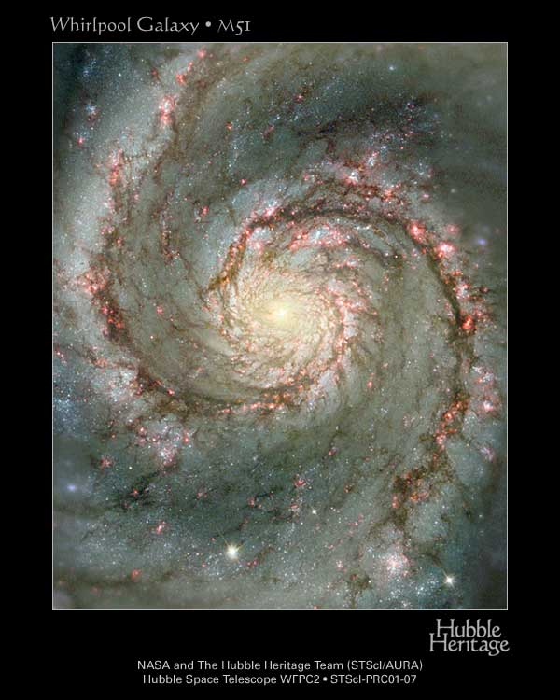
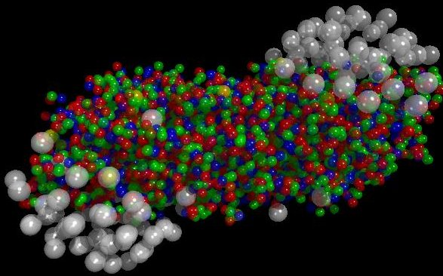
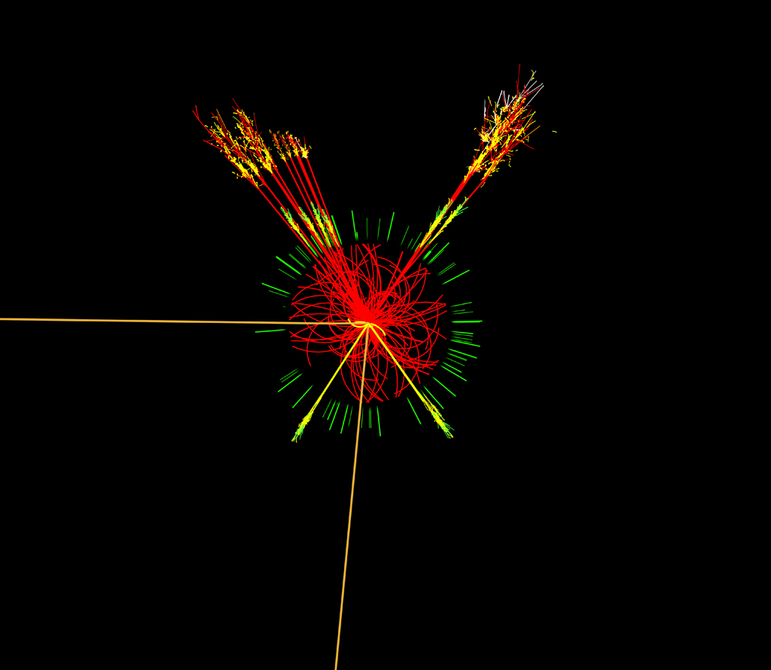
DISCOVERY RESEARCH
Galaxies:
300 MYears.
DISCOVERY unifies research in theory and experiment on the smallest and largest scales
The ultimately different scales share a remarkable commonality:
Energy and momentum is conserved in all cases!
The GQP era:
< 10⁻⁶ sec.
The Higgs era:
Connections from the smallest scales of particles governed by the electroweak and strong interaction to the scale of the Universe governed by gravitation.

Slide 10
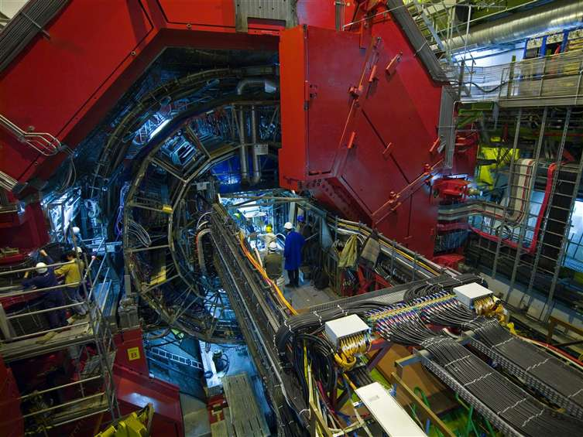
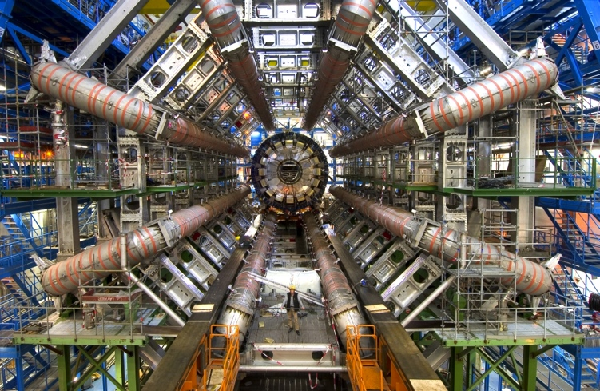
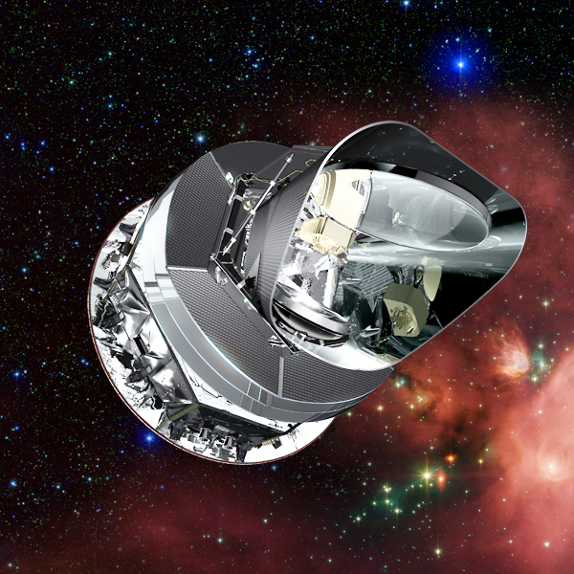
DISCOVERY A Center with Unique Opportunities
Unique access to data from the most interesting experiments available today :
The Large Hadron Collider (LHC) at CERN with highest energies ever reached
The Planck satellite mission with unique resolution and coverage of the sky
And in addition a reknown theory group that ties everything together

Slide 11
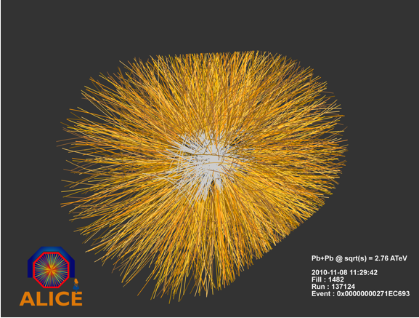
Main Themes
Understanding every detail of the Standard Model
Finding and exploring the Higgs boson
Searching for physics beyond the Standard Model
Exploring the quark-gluon phase of matter
Understanding fluctuations in the early universe
Establishing the theory of inflation, the origin of Dark Matter and Dark Energy
Developing new directions in the theory of fundamental processes at smallest scales ever reached

Slide 12
Discover the Synergy
Strong and Electroweak interactions, Parton distributions,
Standard Model and beyond, Higgs, Dark Matter.
Strong interactions, QCD matter, fluctuations, correlations, flow and thermalization,
heavy quarks,
Color Glass Condensate
ALICE
ATLAS
DISCOVERY
Amplitudes, Parton distributions, Strong and Electroweak interactions , Standard Model and beyond, Cosmology, Gravity
Cosmic Microwave Background, the
Earliest Universe, Dark Matter, fluctuations, flow
THEORY
PLANCK

Slide 13

Discovery at work
Papers
INTERNATIONAL
NETWORKS
DISCOVERY
THEORY GROUPS
Papers
Ideas and inspiration
Computing
Seminars
PhD Schools
Physics generators
ALICE, ATLAS, PLANCK
Working Groups
Subdetectors
Editorial boards
DISCOVERY EXPERIMENTAL
GROUPS
Papers
50% Technical Service Work
50% Physics Analysis

Slide 14

Discovery Organization
Internal Advisory board
J.R. Hansen
A. Jackson
PI
Peter Hansen
International Advisory board
J. Schukraft
C. Quigg
A. Linde
DISCOVERY BOARD
J.J. Gaardhøje (Chair), P.H. Damgaard, M. Dam, P. Naselsky
Discovery
Scientific Associates
Intl. Ph.D Schools
Workshops/Conferences
Youngster Symposia, Seminars, Discovery Colloquia, Journal Clubs
Outreach
Recruitment
Education

Slide 15


Discovery production
Activity Overview: 2009 2010 2011 2012 (Nov 1)
Scientific staff 19 30 33 40
PhD students 6 12 18 19
Master students 15 14 21 14
Disc Visitors 0 27 45 40
Disc Conferences 0 7 6 5
Disc Seminars 0 10 24 27
Publications ATLAS 8 29 94 100
Citations ? 1647 3549 5264
Publications ALICE 5 15 15 17
Citations ? 1415 283 262
Publications Planck 4 7 26 8
Citations ? 219 1363 8
Publications theory ? 17 52 35
Citations ? ? 481 248
Total publications 17 68 187 160
Great boost for particle physics and cosmology!

Slide 16
What do we want?
Five more years! Five more years! Five more..
How do we get it?
Highlight past achievements (this morning)
Propose new interesting projects (afternoon).
How do we do a good job on this?
Join in discussions with each other today!

