Slide 1
PLANCK TEAM of the DISCOVERY Center

Slide 2
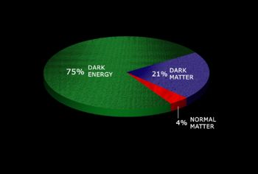
The most mysterious problems
(DM+NM)/DE~$π$

Slide 3
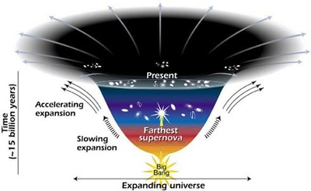

Slide 4
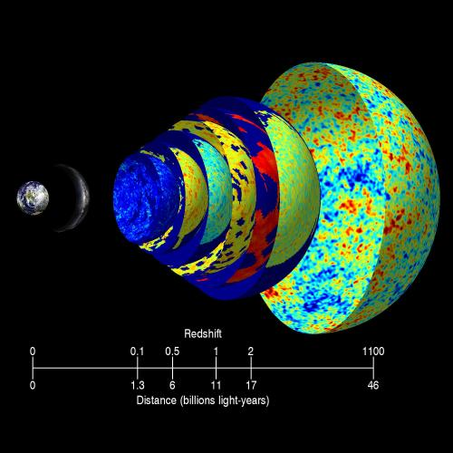

Slide 5
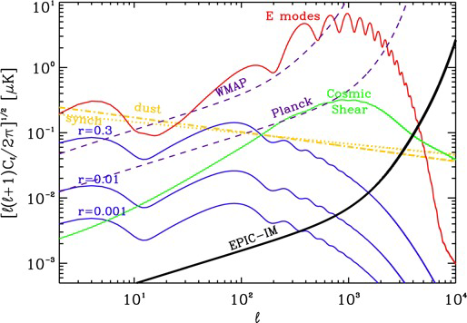
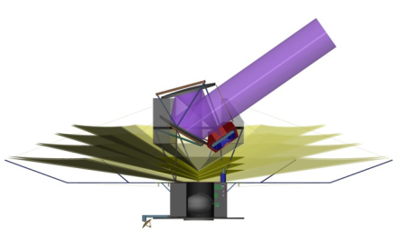
Measure E-mode
spectrum to cosmic
variance to damping
tail
CMBpol , BPol
• Precision cosmology
• Departure from scale inv.
• Reionization history
Measure Inflationary
B-mode spectrum at
r = 0.01 to
astrophysical limits
• GUT energy scale
• Large field inflation
Measure B-mode
cosmic shear
spectrum to cosmic
limits
• Neutrino mass hierarchy
• Dark energy at z > 2
Large Focal Plane
- high sensitivity for Inflationary B-modes
equates to 3600 Planck missions!
- wide band coverage for foregrounds
- high frequencies for Galactic science
2013+5+5>2023

Slide 6
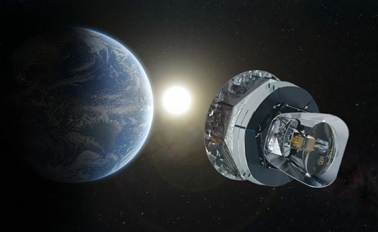
Discovery Center application
2015-2020
Since 2013 we have at least 10 years of
scientific exploration of the PLANCK data !
> 100 PLANCK papers !
The PLANCK cosmological results would be released within the first quarter of 2013. (The temperature and polarization power spectra for very broad range of multipoles with controlled systematics, determination of the cosmological parameters with unprecedented accuracy,new constrains on the neutrino masses, new constrain or detection of the primordial non-Gaussianity from inflation, statistical anisotropy of the CMB, …).

Slide 7
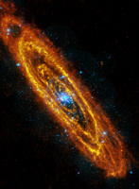
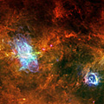
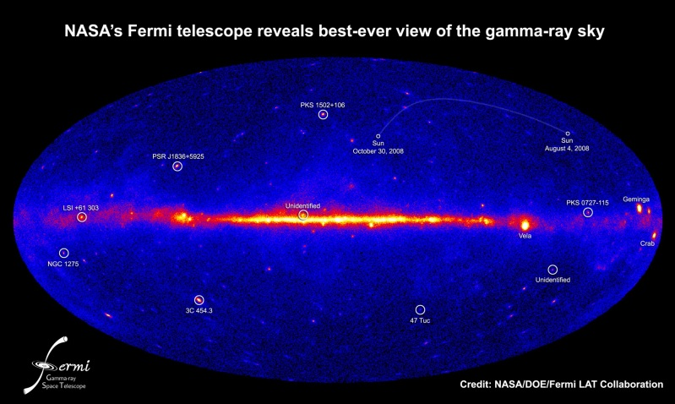
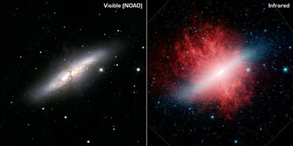
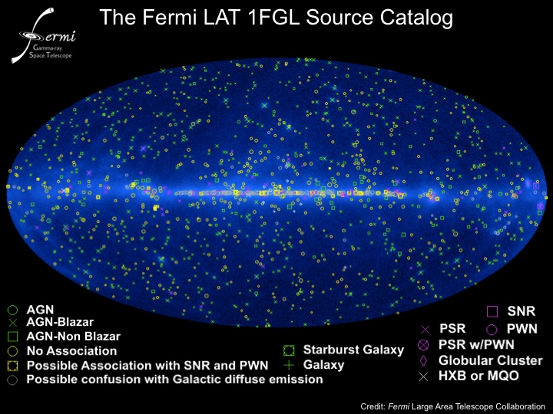
Discovery Planck team: The goal is to change the accent from “PLANCK for cosmology” to “Astroparticle physics and cosmology”
FERMI-LAT +PLANCK
HERSCHEL +PLANCK

Slide 8
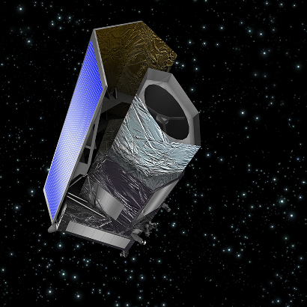
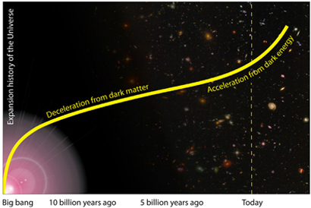
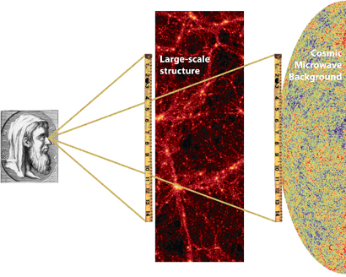
ESA COSMIC VISION PROGRAM (2015-2025)
EUCLID +PLANCK
Expansion history of the Universe
Baryonic acoustic oscillations (BAO)

Slide 9
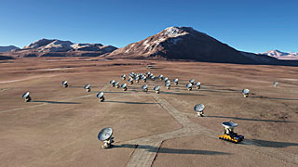
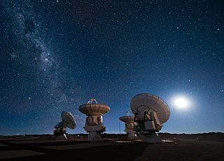
ESO ALMA
ALMA (the Atacama Large Millimeter/submillimeter Array) is one of the largest ground-based astronomy projects of the next decade and will be the major new facility for observations in the millimeter/submillimeter regime.

Slide 10
IceCube

Slide 11
The DISCOVERY Center has very solid theoretical basis for successful development of this new direction of science in Denmark , based on current activity of the Discovery Planck team and new established Astroparticle team (Subir Sarkar)
These new directions are :
High energy Galactic cosmic rays and anomalies of the synchrotron emission -the PLANCK haze problem ( in progress already). Exploitation of the PLANCK temperature and polarization data (including reconstruction of the galactic magnetic field) for development of realistic model of the CR propagation in the Milky Way.
Cross-analysis of the 30MeV-1TeV the Fermi-LAT data and the PLANCK temperature and polarization maps, including new high precision synchrotron, CO and dust emissivity. The goal is to resolve the problem of unidentified Fermi-LAT point- like sources and their manifestation in the CMB . Cross-search of the mini haloes .
Development of the concept of constrained cosmological principle for explanation of the low multipole anomalies of the CMB (in progress)
New directions of the theory of the Dark Energy and their cosmological verification through anisotropy of the CMB power, statistics of voids , reconstruction of the power of metric perturbations at very large scales.

Slide 12
These new directions are not included into the PLANCK team activity for the next 5 years and they are based on theoretical investigations at the DISCOVERY center in combination with Astroparticle physics group at NBI&NBIA.

