Slide 1
Theory perspectives
Discovery Center
N. Emil J. Bjerrum-Bohr

Slide 2
Motivation
LHC / Planck
New ideas
DiscoveryMP
Discovery
Synergy
Experiment
Theory

Slide 3
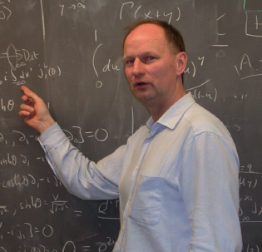
Discovery Theory Group 2012
Poul Henrik Damgaard
Non-perturbative lattice calculations of supersymmetry
LHC structure functions and splitting functions from conformal symmetry

Slide 4

Discovery Theory Group 2012
Emil Bjerrum-Bohr
Quantum corrections to Newtonian gravity
No-triangle property for supergravity, links between quantum gravity and Yang-Mills theory
Novel approaches for amplitude computations in QCD

Slide 5

Discovery Theory Group 2012
Simon Badger
Extremely efficient numerical on-shell constructions for amplitudes in QCD
Direct results for next-to-leading order jet events
New approaches to multi-loop computations
Joined Discovery Center in 2010

Slide 6

Discovery Theory Group 2012
Donal O’Connell
Phenomenology of the Standard Model; why is e.g. the mass of the Higgs around 125 GeV?
Relations between Gravity and Yang-Mills theory
Color-kinematics duality for amplitudes in Yang-Mills theory
Joined Discovery Center in 2010

Slide 7
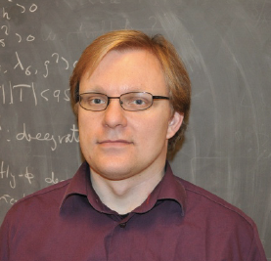
Discovery Theory Group 2012
Anders Tranberg
Electroweak Baryogenesis
Why there is more matter than antimatter in the Universe?
Computing matter/
antimatter asymmetry numerically
Joined Discovery Center in 2010

Slide 8
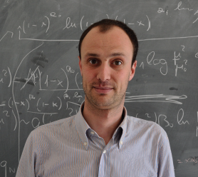
Discovery Theory Group 2012
Alberto Guffanti
Research related to particle-particle collisions and to particle-nuclei collisions
Phenomenology of QCD
Determination of Parton Distribution Functions
(PDFs) of the proton
Joined Discovery Center in 2011

Slide 9

Discovery Theory Group 2012
Simon Caron-Huot
Strong interactions and theoretical description of Quark-Gluon plasma (see his talk)
Novel computational methods for amplitudes in Yang-Mills theory and QCD
Joined Discovery Center in 2012

Slide 10

Discovery Theory Group 2012
Kim Splittorff (see his talk)
Strongly interacting matter
Non perturbative methods
Random Matrix Theory
Chiral Perturbation Theory
Lattice QCD (Sign problem)
Replica theories,
Toda lattices
Sapire Aude 2011. Associate with Discovery Center

Slide 11

Discovery Theory Group 2012
Subir Sarkar (see his talk)
Theoretical aspects of baryogenesis
Dark matter
Cosmological phase
transitions
Inflation and large-scale structure formation
Cosmology of neutrinos
Niels Bohr Professor at NBIA 2012. Associate with Discovery Center

Slide 12
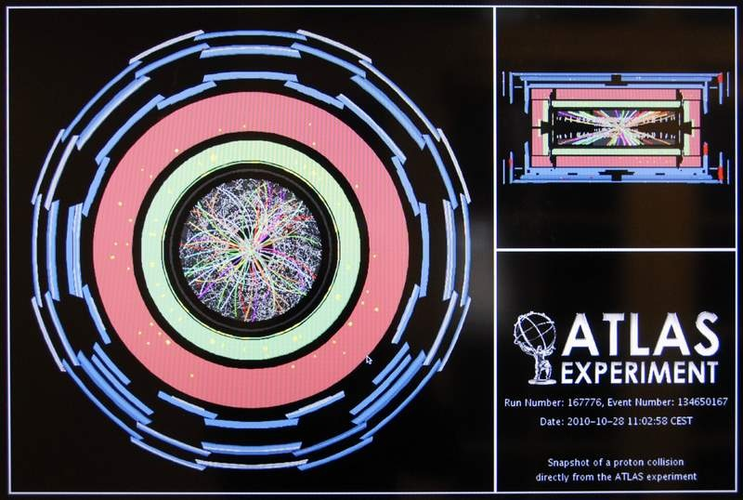
Large Hadron Collider
LHC ’event’
Proton
Jets
A big mess!!!
Jets:
Reconstruction immensely complicated..
Loop amplitudes: crucial importance for resolution
Jets
…
Proton

Slide 13
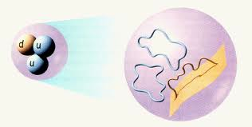
Theory
Field theory
Amplitudes
String theory
Measure for probability

Slide 14
Loop amplitudes essential
Standard Model
Background
Signals for new physics
Loop amplitudes:
p + p -> gluons, Z, W, quarks + superpartners?
Explosion of terms (impossible..)
Textbook solution

Slide 15
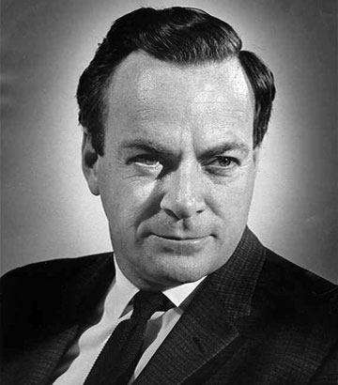
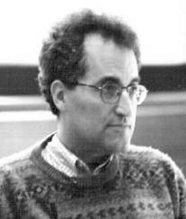
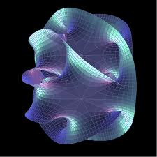
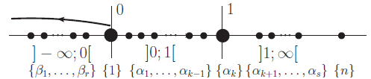
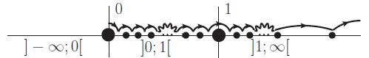
Tree amplitude revolution!
1
M
1
Rich hidden
structure
1
2
s₁₂
s_{1M}
s₁₂₃
+
+
...
2
3
Factorial growth ~ billions of terms!!
On-shell recursion
MHV one term!
Twistor inspiration
2
1
x
3
x
x
x
.
M
.
New amazing relations
String Theory

Slide 16
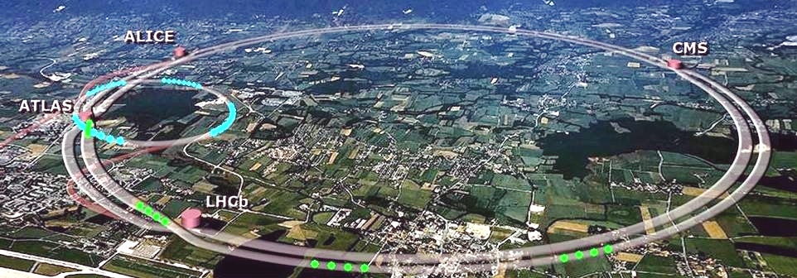
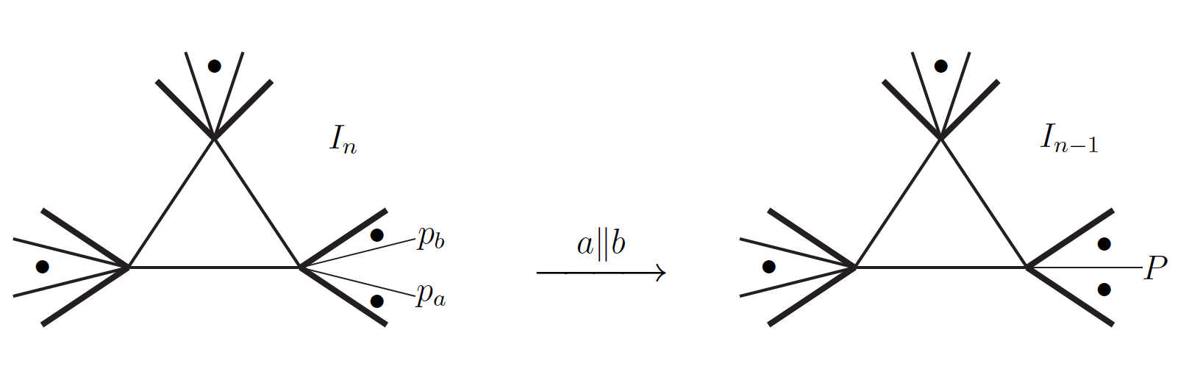
….from compact trees to loops
Compact, on-shell tree Amplitudes
Automated computation
Quadruple cuts
Recursive techniques
On-shell simplification
Powerful computational methods
Impossible by Feynman diagrams
Revolution in doable computations
Integral basis
Rational
polynomials
Triple cuts
Recursion
for loops

Slide 17
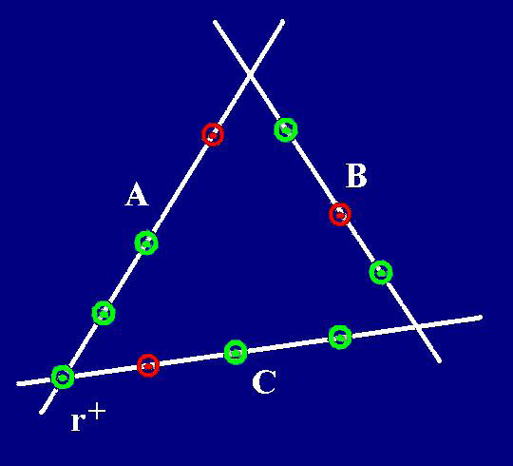
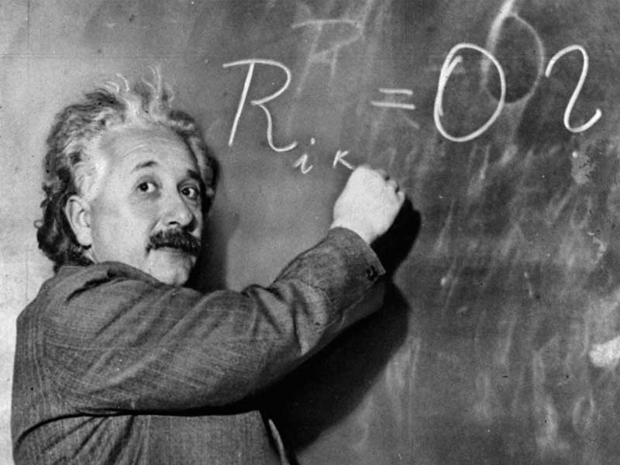
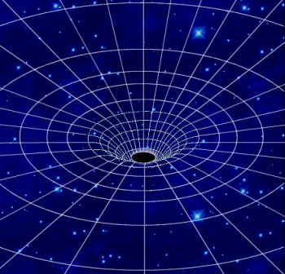
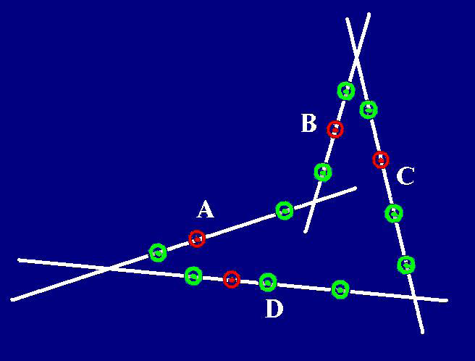
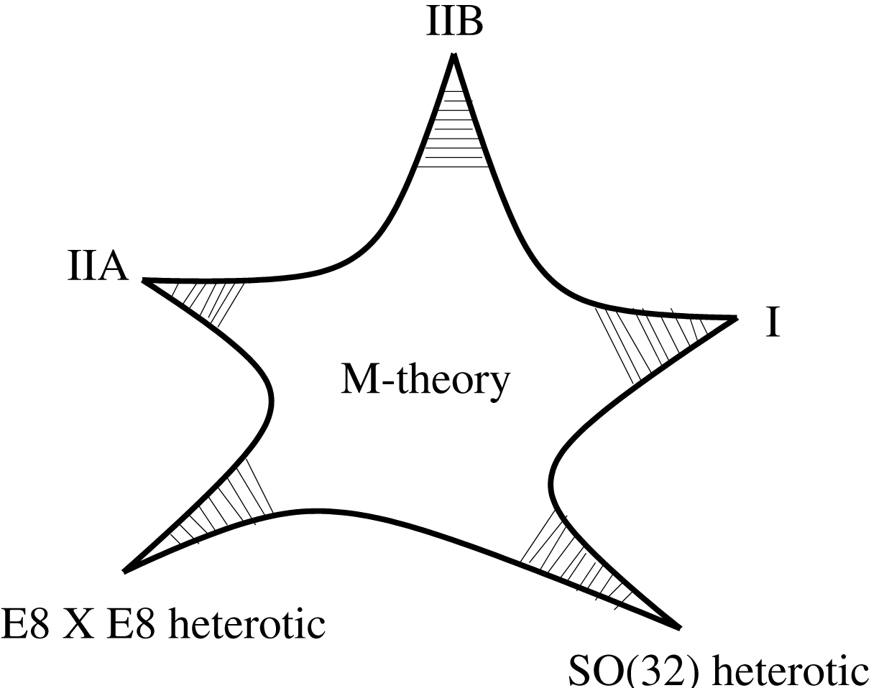
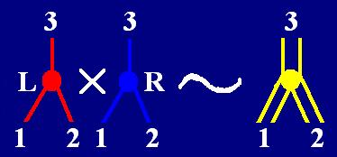
Research
Gravity
’Vanishing’ relations for
QCD!!!
1
M
1
1
2
s₁₂
s_{1M}
s₁₂₃
+
+
...
2
3

Slide 18
Discovery Theory Group
Concrete results
p + p ! n jets
Research:
Know-how
International collaboration
Push for new results
Development of new techniques
Find symmetries
Solve problems

Slide 19
Discovery Theory Group
Further focus on QCD phenomenology
and SUSY breaking
BLACKHAT collaboration; possibility of joined position
Baryogenesis: a current search and new position

Slide 20
Discovery Theory Group 2012
Focus on a broad range of
fields.
Diverse and strong group
Cosmology
Dark matter
Inflation
QCD
perturbative
non-perturbative
Synergy
Big Bang
Barogenesis
N=4 SYM
N=8 SUGRA
String Theory

