Slide 1

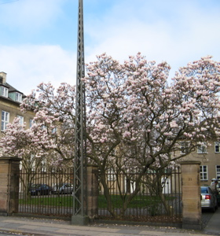
ALICE: Upgrades & Perspectives

Slide 2
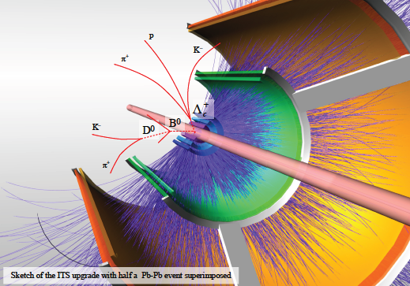
Physics Motivation
Core Upgrade
High Rate Capabilities
ITS Upgrade
Physics Performance Examples
Possible Additions
VHMPID, MFT, FoCal
Summary

Slide 3
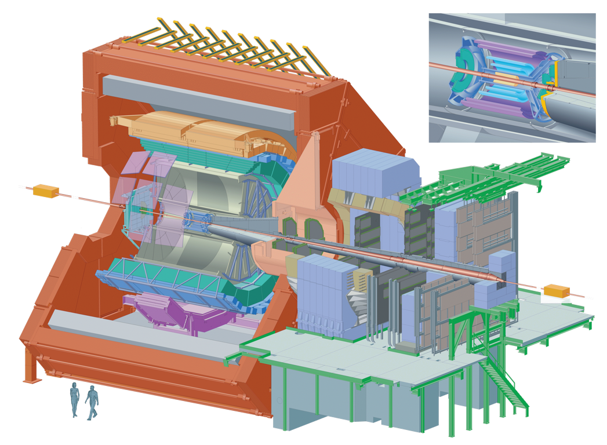
The ALICE Setup

Slide 4
Physics Motivation
Thermalization of heavy quarks in QGP:
Baryon/meson for charm :Λ_{c} /D (maybe also Λ_{b} /B?)
Elliptic flow
Thermal production of charm? (D to low p_{T} )
Quark mass dependence of energy loss in QGP:
R_{AA} for D and B mesons:
Beauty via displaced D⁰ → Κπ
Beauty via displaced J/ψ → ee
Exotic nuclear physics (hyper- and anti-nuclei)
Low-x structure and saturation (CGC?)

Slide 5
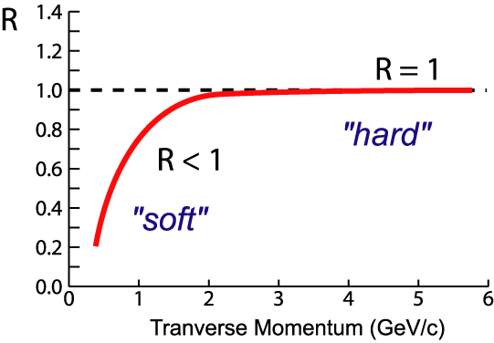
Nuclear Modification
Quantified by:
- yield relative to that from
N+N collisions, scaled for
the nuclear geometry (N_{bin})
Cronin Enhancement
Shadowing/Saturation
Jet-quenching

Slide 6
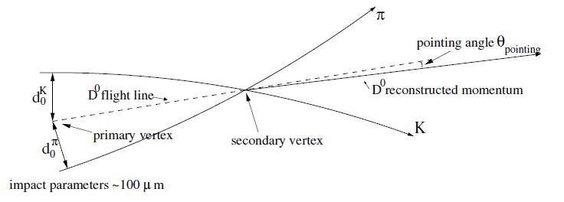
Require
Improved ”impact parameter” resolution (ID)
Higher rates (statistics)

Slide 7
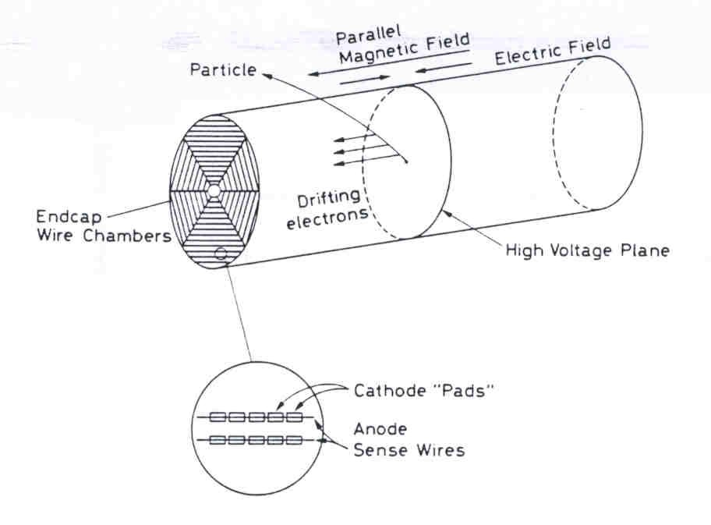
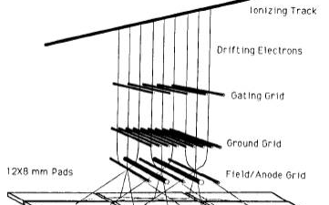
Current TPC:
Effective dead time of 280µs, rate ≤3.5kHz

Slide 8
The ALICE Setup
TPC
5m

Slide 9
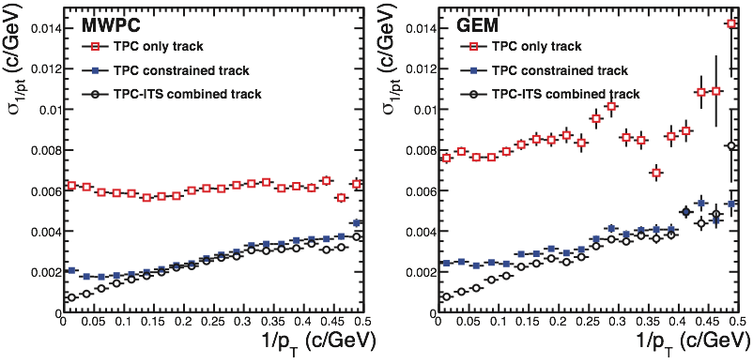
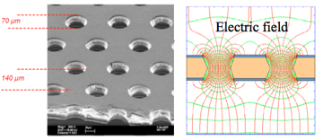
TPC Upgrade
new readout chambers
replace MWPC with GEMs
no gating, small ion feedback
usage of existing pad-planes possible
momentum resolution for constrained tracks not affected
continuous sampling at 10 MHz, ship data unsuppressed off detector
needs new electronics
extensive R&D program ongoing with lab tests
confirm low ion feedback
goal: 0.25% at gain of 2000
gain stability?
9

Slide 10
Also need:
Upgrade of all readout electronics
pipelined readout of major ALICE detectors
New, more performant, DAQ/HLT
data compression requires on-line calibration and tracking
common computing framework (DAQ/HLT/Offline)

Slide 11
Event Size and Rates
event size of major systems, I/O rates of online system
assume average minbias rate to tape of 20 kHz
data reduction for TPC: clustering, reconstruction
Detector | Event Size (MByte) After Zero After Data Suppression Compression |  | Input to Online System (GByte/s) | Compressed Output to data storage (GByte/s) Peak Average
ITS | 0.8 | 0.2 | 40 | 10.0 | 4.0
TPC | 20.0 | 1.0 | 1000 | 50.0 | 20.0
TRD (20 kHz) | 0.3 | 0.1 | 6 | 2.0 | 2.0
Others (1) | 0.5 | 0.25 | 25 | 12.5 | 5.0
Total | 21.6 | 1.55 | 1071 | 74.5 | 31.0
Data Format | Data Reduction Factor | Event Size (MB Pb-Pb) (MByte)
Raw data | 1 | 700
Zero suppression (FEE) | 35 | 20
Clustering (HLT) | 5-7 | ~3
Remove clusters not associated to relevant tracks (HLT) | 2 | ~1.5
Data format optimization (HLT) | 2-3 | < 1

Slide 12
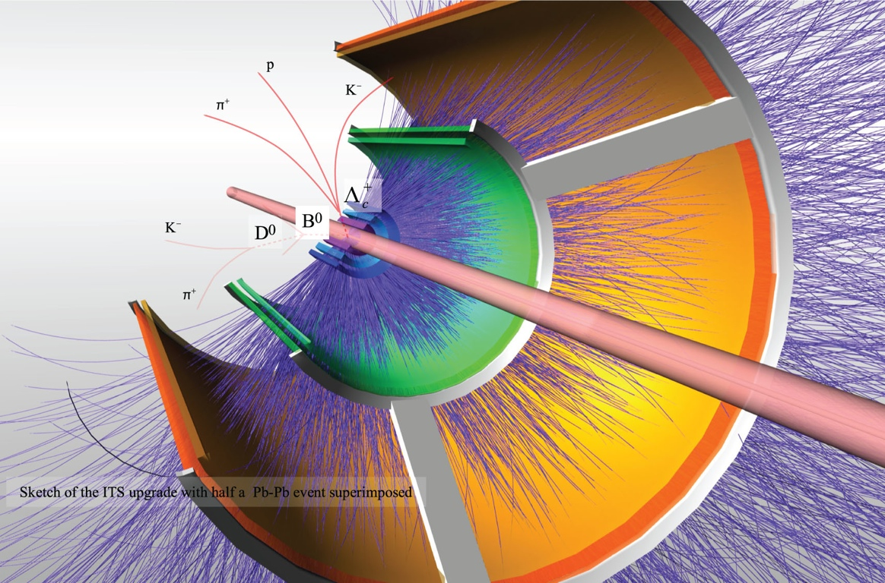
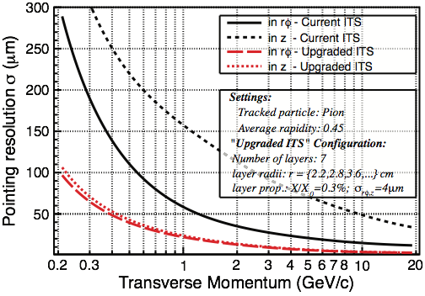
ITS Upgrade
factor 3 better secondary vertex resolution:
inner layer close to VTX(R = 2.2 cm)
smaller material budget
thin sensors
thinner beam pipe (ΔR = 800 µm)
fast readout
allow 50 kHz rate in Pb+Pb

Slide 13

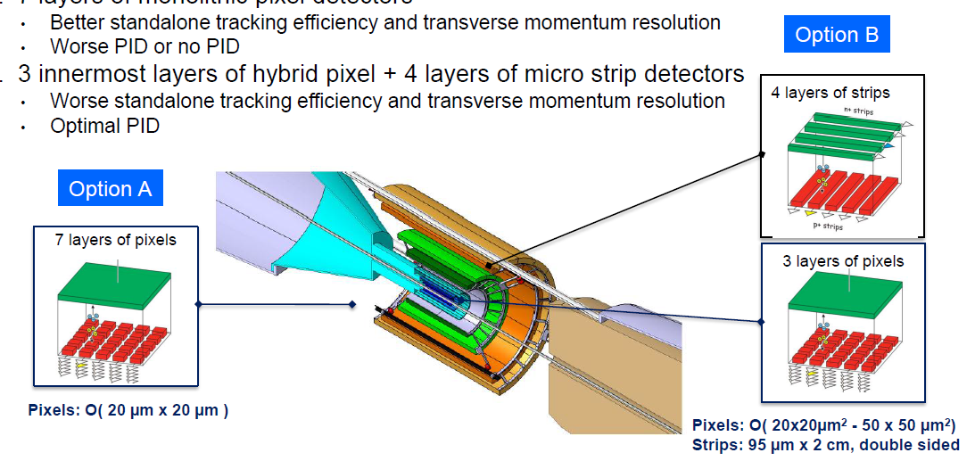
Upgrade Options
Two design options are being studied:
(Option A) 7 layers of pixel detectors
better standalone tracking efficiency and p_{T} resolution
worse PID
(Option B)3 inner layers of pixel detectors and 4 outer layers of strip detectors
worse standalone tracking efficiency and momentum resolution
better PID
Radiation levels for layer 1:
1 Mrad/1.6 x 10¹³ n_{eq}cm⁻² per year
with safety factor 4
6

Slide 14
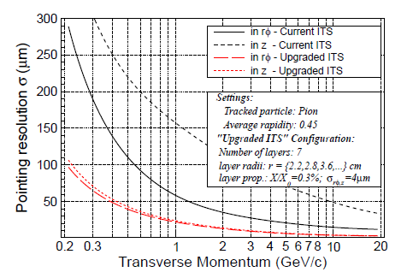
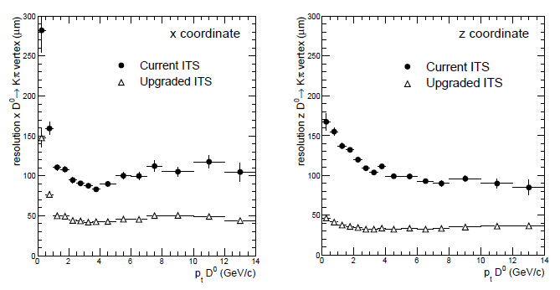
Improvement of Impact Parameter Resolution
D⁰ → Κ⁻π⁺
Example: secondary vertex resolutions for D⁰ → Κ⁻π⁺
7

Slide 15
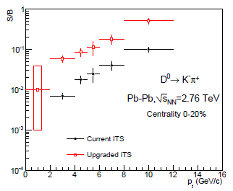
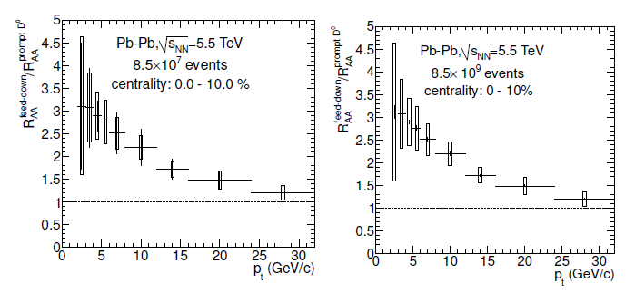
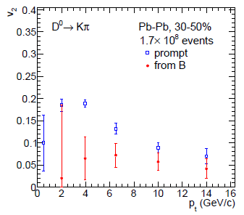
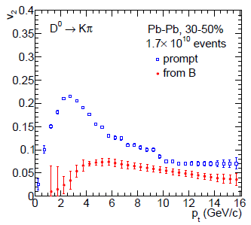
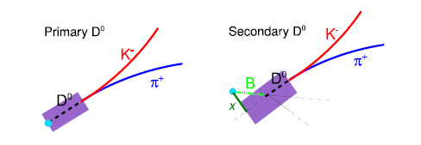
R_{AA} and v₂ of Prompt and Displaced D Mesons
L_{int} = 0.1 nb⁻¹
L_{int} = 10 nb⁻¹
Access to B meson via
B → D⁰ (→ Κ⁻π⁺)
10

Slide 16
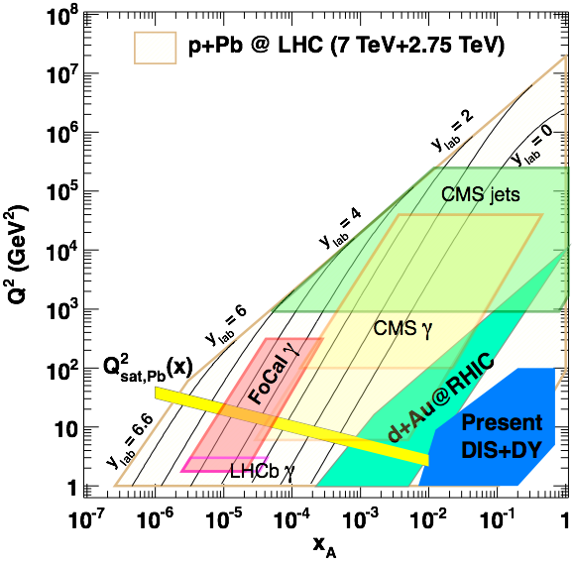
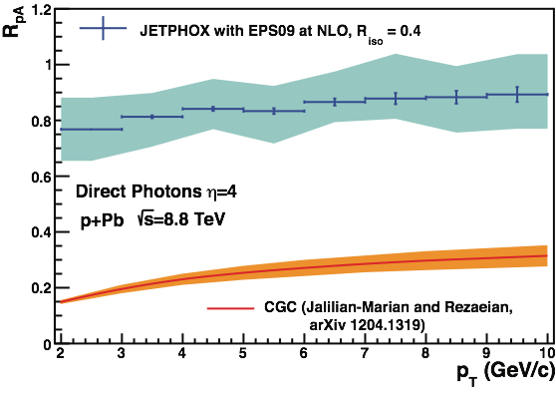
Small-x Physics
enters new regime at LHC
larger phase space than at RHIC
unique opportunity for ALICE
use highest rapidity possible (η > 3), with significant pT range
direct photon measurement cleanest!
x-sensitivity, no final state effects
studies of gluon saturation
expect transition from pQCD to CGC

Slide 17
Nuclear Modification
Quantified by:
- yield relative to that from
N+N collisions, scaled for
the nuclear geometry (N_{bin})
Cronin Enhancement
Shadowing/Saturation
Jet-quenching

Slide 18
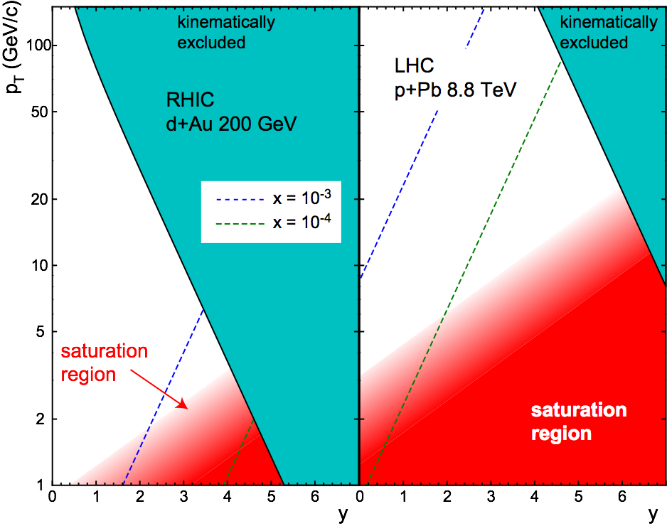
Saturation at RHIC and LHC
BRAHMS
larger phase space for saturation effects at LHC

Slide 19
The ALICE Setup

Slide 20
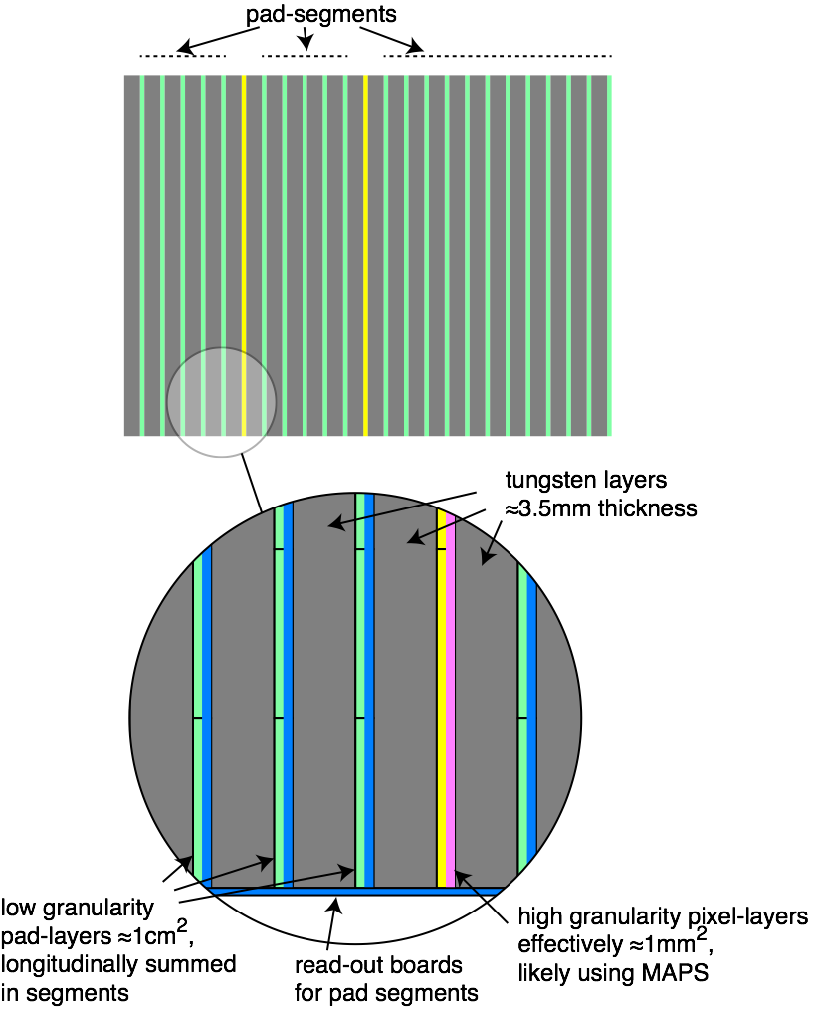
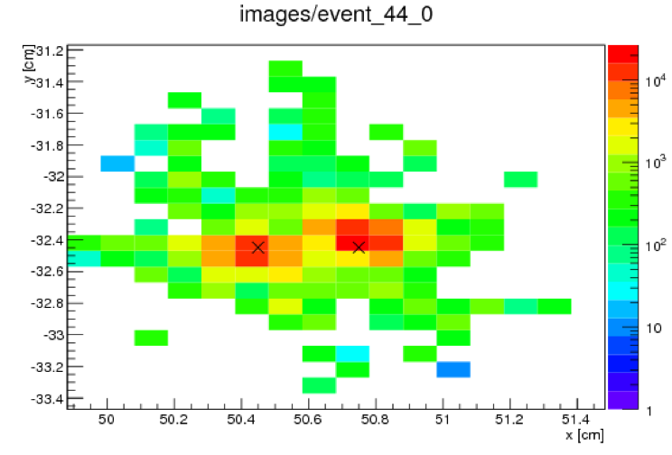

FoCal
SiW electromagnetic calorimeter
two options for location
3.5 m from IP, 2.5 < η < 4.2
8 m from IP, 3.3 < η < 5.0
optional hadronic calorimeter
2 technologies
low-granularity conventional Si-pads
high-granularity ≈ 1 mm²
needed for π⁰/γ discrimination
likely using MAPS
also allows studies of γ-jet correlations
posters by T. Gunji (ID 498, 143),
N. Poljak (ID 118)
4mm separation clearly detected

Slide 21
ALICE Upgrade Physics Reach
p_{T} coverage (p_{T}^{min}) and statistical error for current ALICE with approved programme and upgraded ALICE with extended programme. Error in both cases at p_{T}^{min} of “approved”.
Topic | Observable | Approved (1/nb delivered, 0.1/nb m.b.) | Upgrade (10/nb delivered, 10/nb m.b.)
Heavy flavour | D meson R_{AA} | p_{T}>1, 10% | p_{T}>0, 0.3%
 | D from B R_{AA} | p_{T}>3, 30% | p_{T}>2, 1%
 | D meson elliptic flow (for v₂=0.2) | p_{T}>1, 50% | p_{T}>0, 2.5%
 | D from B elliptic flow (for v₂=0.1) | not accessible | p_{T}>2, 20%
 | Charm baryon/meson ratio (Λ_{c}/D) | not accessible | p_{T}>2, 15%
 | D_{s} R_{AA} | p_{T}>4, 15% | p_{T}>1, 1%
Charmonia | J/ψ R_{AA} (forward y) | p_{T}>0, 1% | p_{T}>0, 0.3%
 | J/ψ R_{AA} (central y) | p_{T}>0, 5% | p_{T}>0, 0.5%
 | J/ψ elliptic flow (forward y, for v₂ =0.1) | p_{T}>0, 15% | p_{T}>0, 5%
 | ψ’ | p_{T}>0, 30% | p_{T}>0, 10%
Dielectrons | Temperature IMR | not accessible | 10% on T
 | Elliptic flow IMR (for v₂=0.1) | not accessible | 10%
 | Low-mass vector spectral function | not accessible | p_{T}>0.3, 20%
Heavy nuclei | hyper(anti)nuclei, H-dibaryon | 35% (⁴_{Λ}H) | 3.5% (⁴_{Λ}H)

Slide 22
Possible running scenario
ALICE plans to run 6 years with upgraded detector, i.e. until 2026
(assuming start in 2019 and 2 years break of LS3)
Possible scenario:
2019 – Pb–Pb 2.85 nb⁻¹
2020 – Pb–Pb 2.85 nb⁻¹ (low magnetic field)
2021 – pp reference run
2022 – LS3
2023 – LS3
2024 – Pb–Pb 2.85 nb⁻¹
2025 – ½ Pb–Pb 1.42 nb⁻¹ + ½ p–Pb 50 nb⁻¹
2026 – Pb–Pb 2.85 nb⁻¹
This would not require pp running during high-luminosity runs, only a short time before a heavy-ion run for setting up and commissioning.

Slide 23
Summary
ALICE has strong physics program for precision QGP studies
unique in rare low-pT probes
requires ITS upgrade, enhanced rate capabilities + running beyond LS3
significant R&D program for upgrades
further enhancement of the ALICE setup under investigation, possibly
strengthening muon measurement and high pT hadron ID
exploring forward physics

