Slide 1
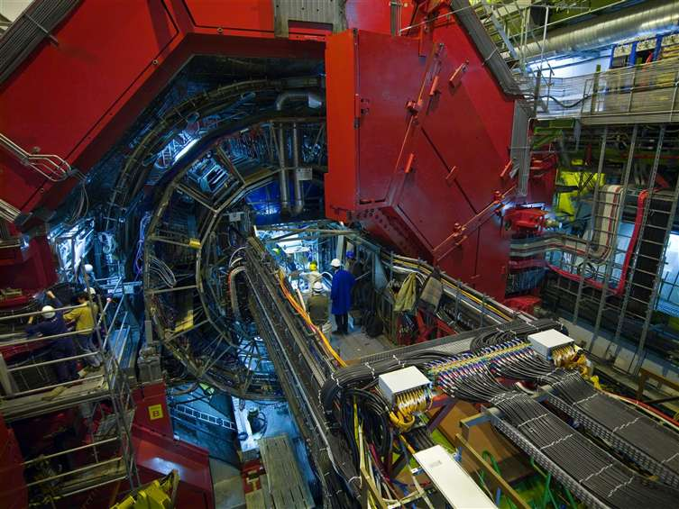

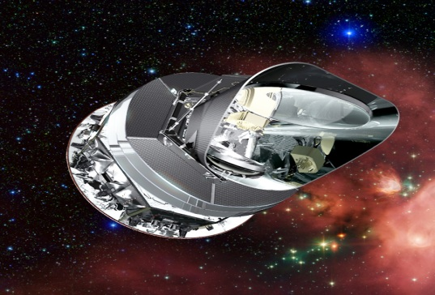
DISCOVERY
A Unique Center with Unique Opportunities
DISCOVERY unites strong groups in:
Theory,
Fundamental Particle Physics,
Quark Gluon Plasma Physics
Cosmic Microwave Radiation Physics,
…which most places rarely work together.
Direct and unique access to data from the most powerful experiments available today :
  The Large Hadron Collider (LHC) at CERN exploring p+p and Pb+Pb collisions at unprecedented high energies (ATLAS and ALICE experiments)
  The Planck satellite mission with unique resolution and sensitivity of the sky.

Slide 2

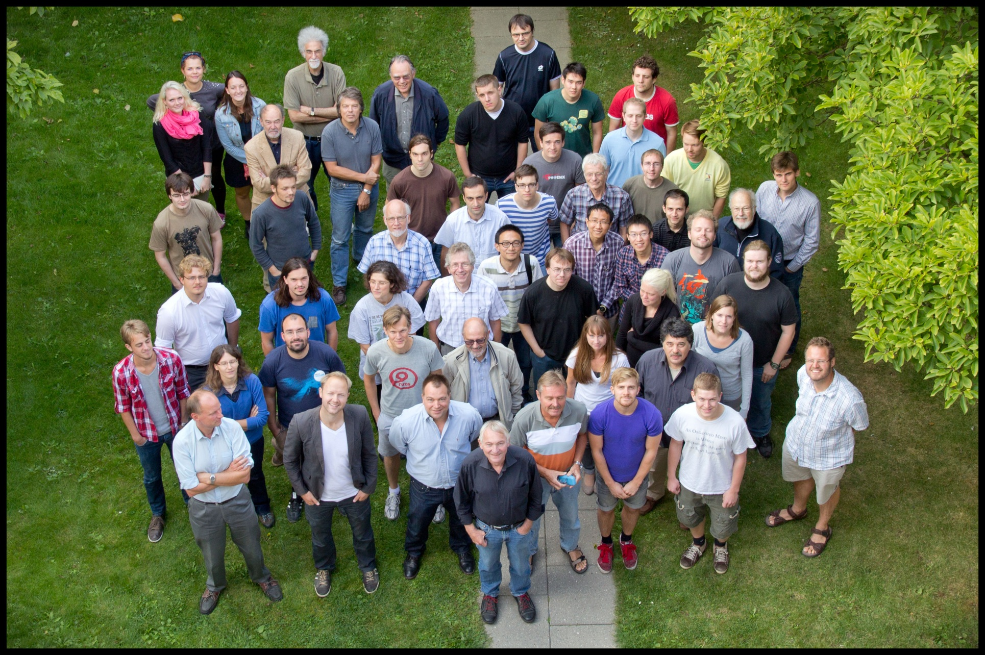

Slide 3

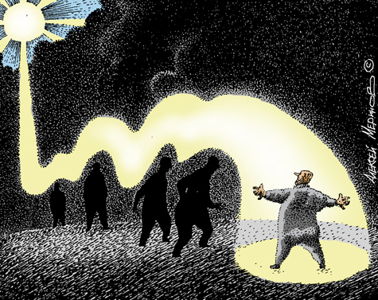
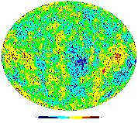
DISCOVERY
Center of Excellence
in Particle Physics, Phenomenology & COSMOlogy
DC PLANCK Team 2010-2020

Slide 4
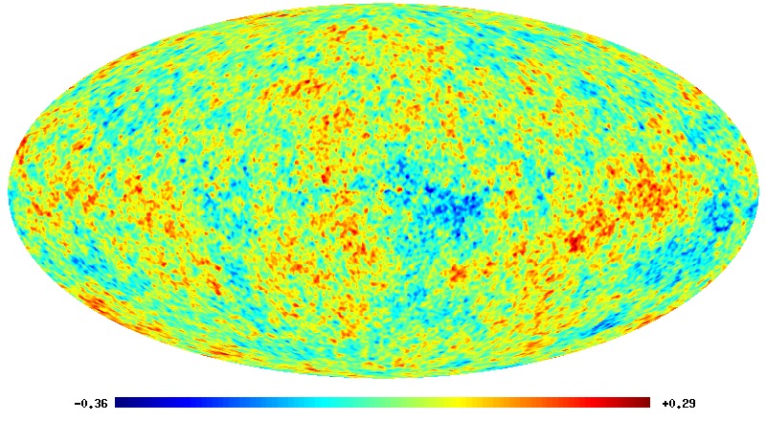
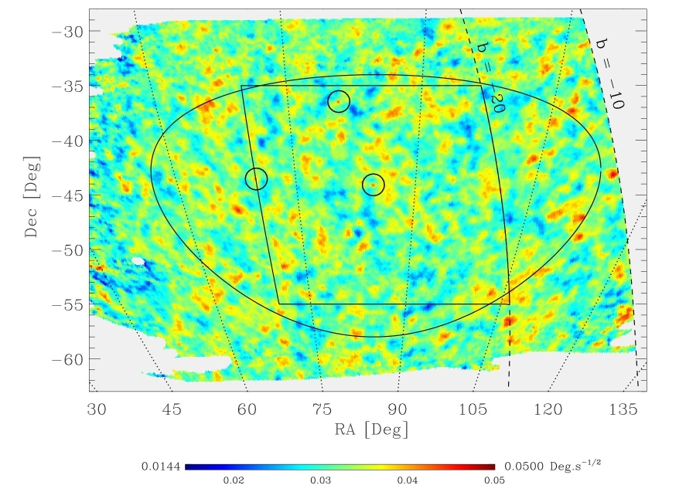
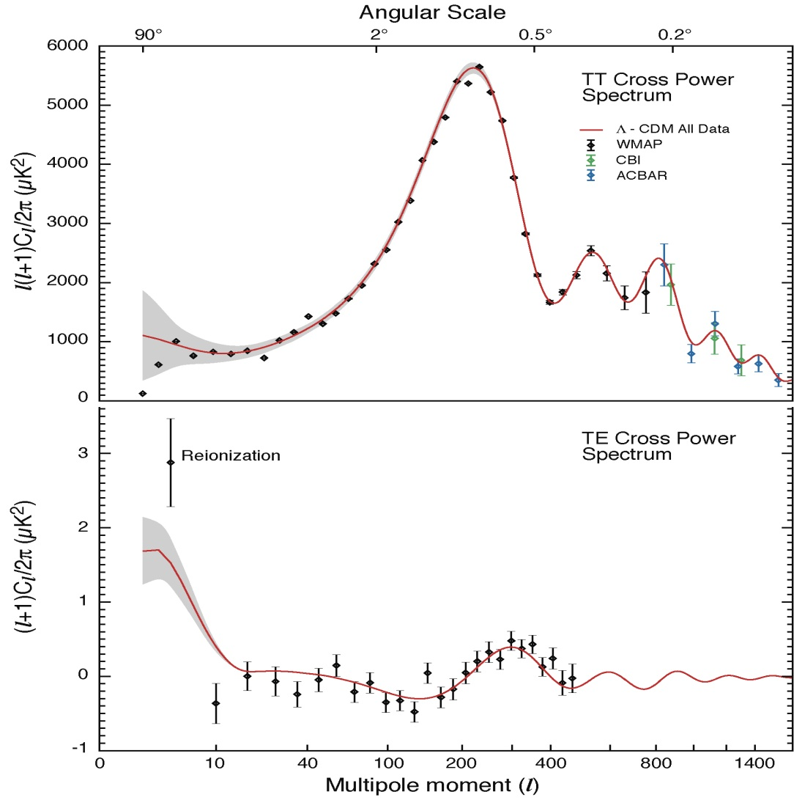
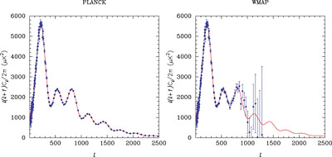
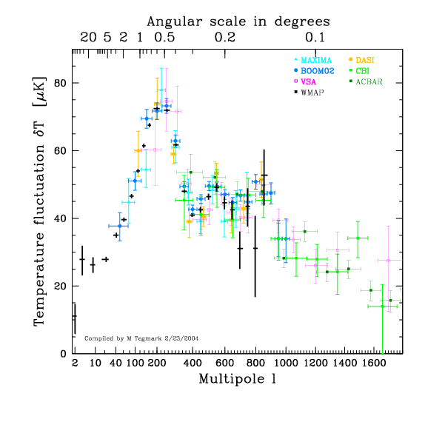
Boomerang map
WMAP

Slide 5
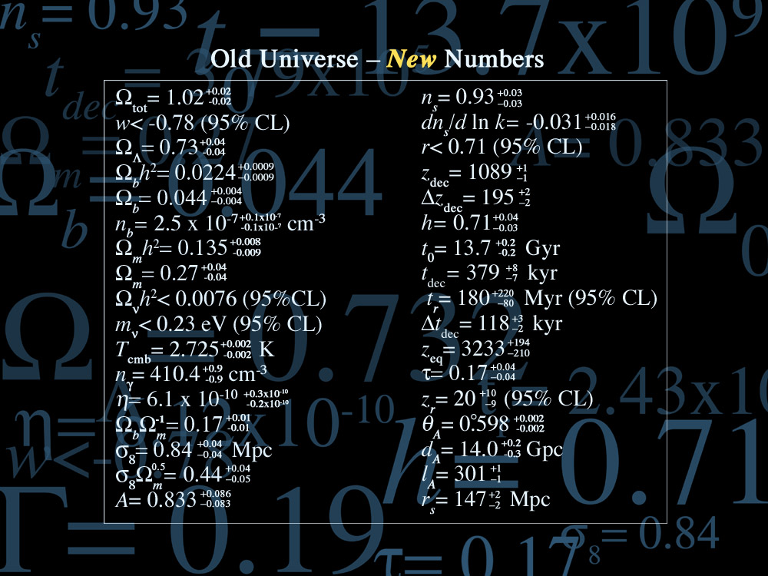
?

Slide 6
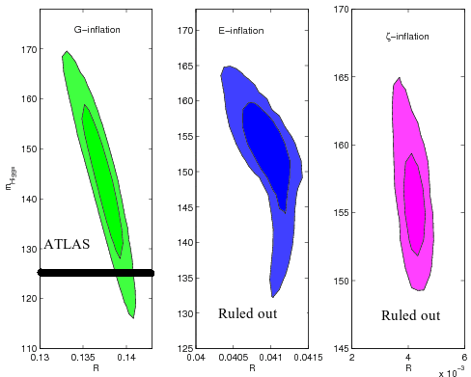
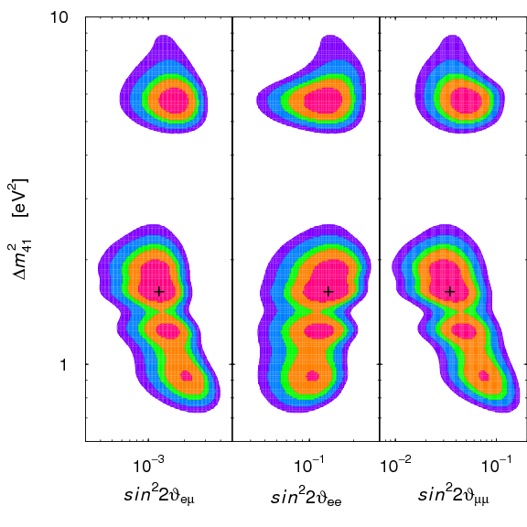
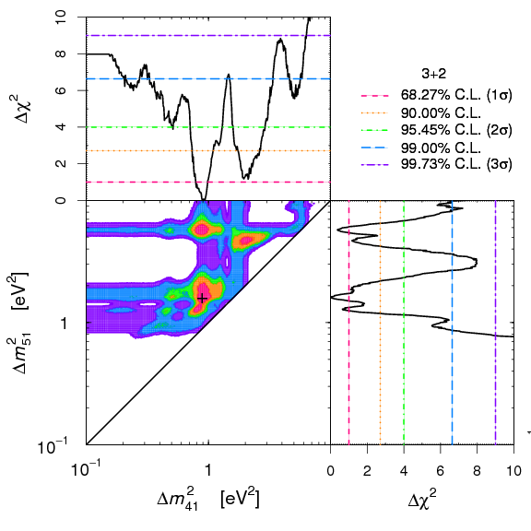
Discovery Synergy “at large”
TT1. Testing new models of inflation.
TT1a. The Higgs boson driven inflation.
Theoretical basis of these models was widely
discussed in the paper “Observational consequences
of the Standard Model Higgs inflation variants”
L.A. Popa JCAP10(2011)025 .
TT2. Testing 3+1 and 3+2 neutrino mass models with cosmology and short baseline experiments
TT3. Single field inflation or curvaton scenario ?

Slide 7
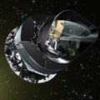
Pre-cosmological science from
PLANCK ( 2010-2012)
1. Calibration and foregrounds

Slide 8
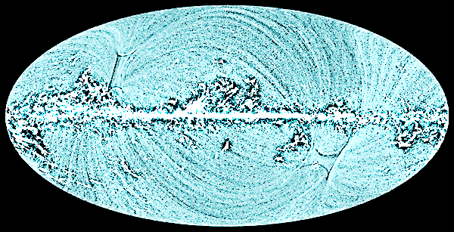
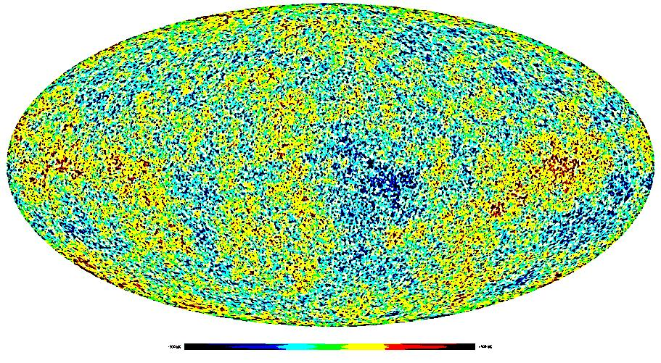
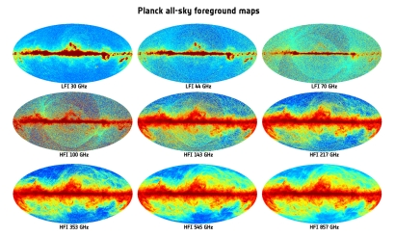
The epoch of precision astro-particle physics and cosmology
1.”Full” control of
systematic effects
2. Unprecedented accuracy in reconstruction of the foregrounds

Slide 9
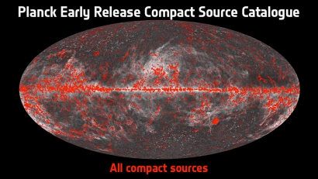
1. Discovery and prediction of new kind of foreground.
Extragalactic foreground
Galactic foregrounds
NBI Discovery center ,2012
Synchrotron
Dust emission
Solar system
(Kuiper belt objects)
PLANCK discoveries
Spinning dust,
Cold core objects
Free-free
Q
V
W

Slide 10
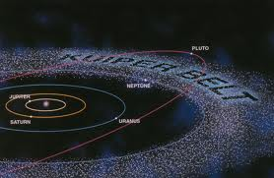
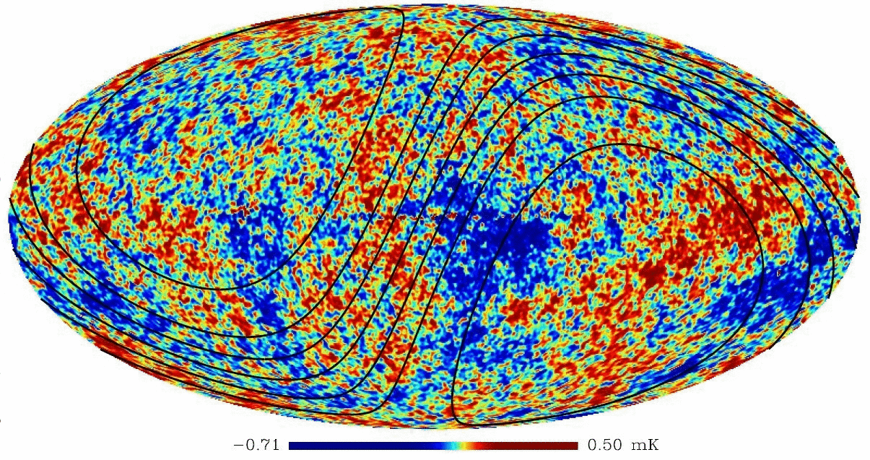
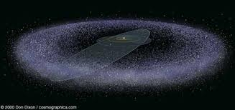
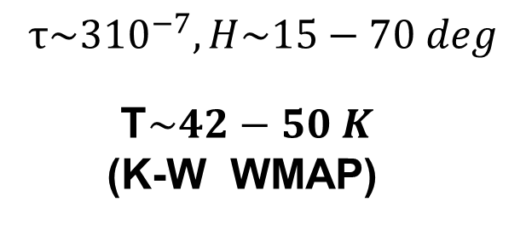
Can KBO foreground resolve the maximum number of
problems of CMB anomalies?
DC contribution to Working Group “Fundamental physics with PLANCK”
$$τ\sim 3{10}^{−7}, H\sim 15−70 deg$$
T$\sim 42−50 K$
(K-W WMAP)

Slide 11
Pre-cosmological science from
PLANCK ( 2010-2012)
2. Astro-particle physics and the Dark Matter

Slide 12
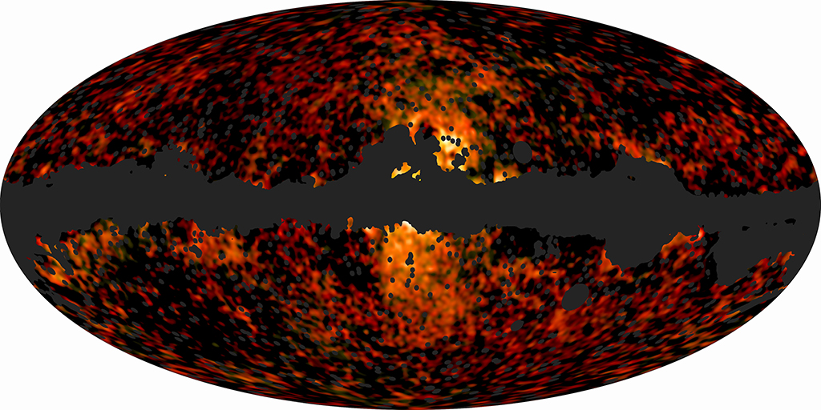
The PLANCK HAZE
Most likely we have detected the synchrotron emission from the
center of the Milky Way

Slide 13
2. Planck data and templates
Planck (Tauber et al. 2010; Planck Collaboration I 2011) is the third generation space mission to measure the anisotropy of the cosmic microwave background (CMB).
It observes the sky in nine frequency bands covering 30–857GHz with high sensitivity and angular resolution from 31′ to 5′.
The Low Frequency Instrument (LFI; Mandolesi et al. 2010; Bersanelli et al. 2010;Mennella et al. 2011) covers the 30, 44, and 70GHz bands with
amplifiers cooled to 20K.
The High Frequency Instrument (HFI; Lamarre et al. 2010; Planck HFI Core Team 2011a) covers the 100, 143, 217, 353, 545, and 857GHz bands with bolometers cooled to 0.1K.
Polarisation is measured in all but the highest two bands (Leahy et al. 2010; Rosset et al. 2010)

Slide 14
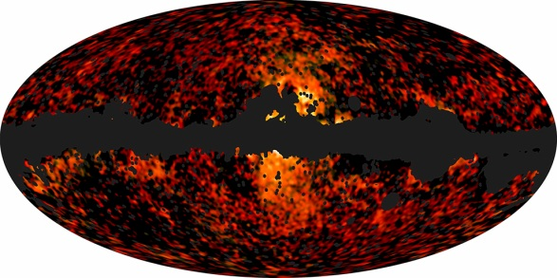
Suggestions include
enhanced supernova rates (Biermann et al.2010), a Galactic wind (Crocker & Aharonian 2011),
a jet generated by accretion onto the central black hole (Guo & Mathews
2011; Guo et al. 2011),
and co-annihilation of dark matter (DM) particles in the Galactic halo (Finkbeiner 2004b; Hooper et al.2007; Lin et al. 2010; Dobler et al. 2011).
However, while each of these scenarios can reproduce some of the properties of the haze/bubbles well, none can completely match all of the observed
characteristics.

Slide 15
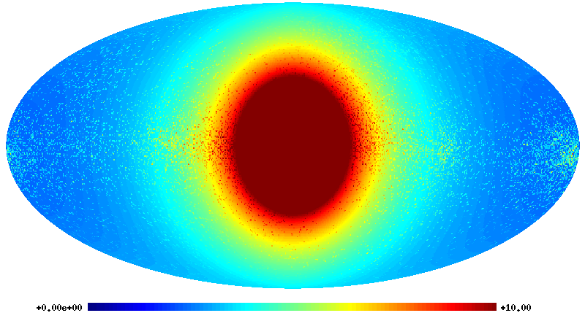
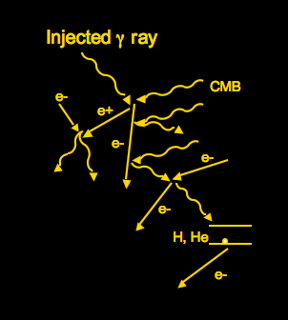
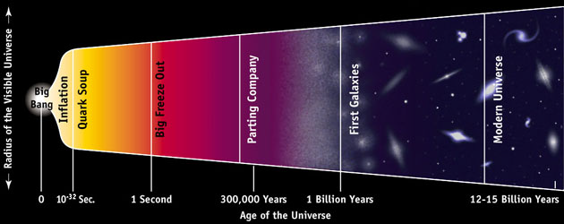
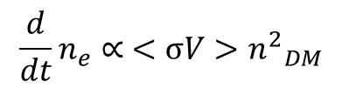
1. Hard spectrum of injection : $\frac{dN}{dE}∝E^{−2.1}$
2. Fingerprint of the synchrotron haze in polarization
3. Anomalies of the TT , TE, EE power spectra
$${\frac{d}{dt}n}_{e}∝ <σV>{n^{2}}_{DM}^{}$$
Hydrogen recombination

Slide 16
TT2. Testing the properties of the DARK MATTER and long living particles in the Universe through ionization history of the cosmic plasma. (DC contribution to FPP )
TT2a. Annihilating Dark Matter and TT-power spectrum.
WMAP

Slide 17
Cosmological science from
PLANCK ( 2013-2020)
2. Cosmology, theory of inflation, anomalies

Slide 18
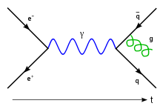
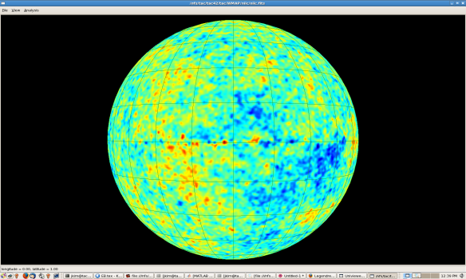
Parity test of the CMB. (DC contribution to FPP).
PT(r)=-T(r)-most represented !
Parity asymmetry of the CMB:
Parity violation in Weak interactions
P(r)=-r
From micro-
to macro scales
Possible explanations:
Local violation of Copernican principle
Non-trivial topology of space and time
New physics,
New sources of
emissivity from the space ,
Improvement of the data sets and creditability of the PLANCK mission.
Local foreground . Debris of the solar system formation?
Effects of systematics and calibration
Notes:
Parity asymmetry: that the signal in one direction of the Universe is the opposite of the signal in the exact opposite direction.

Slide 19


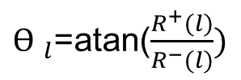
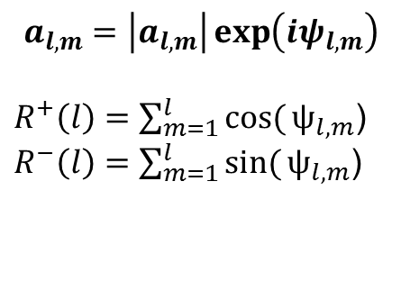
Pearson’s random walk in the space of phases
$$a_{l,m}=\left|a_{l,m}\right|\exp\left(iψ_{l,m}\right)$$
$R^{+}\left(l\right)=\sum_{m=1}^{l}{cos⁡(}ψ_{l,m}$)
$R^{−}\left(l\right)=\sum_{m=1}^{l}{sin⁡(}ψ_{l,m}$)
$Ɵ _{l}$=atan($\frac{R^{+}(l)}{R^{−}(l)})$
$r^{+}(l)=\frac{1}{\sqrt{l}}\sum_{n=2}^{l}{cos⁡(Ɵ_{n}}$)
Even
Odd
$r^{−}(l)=\frac{1}{\sqrt{l}}\sum_{n=2}^{l}{sin⁡(Ɵ_{n}}$)
Two components “gas” of even
and odd phases.
Separation !!

Slide 20
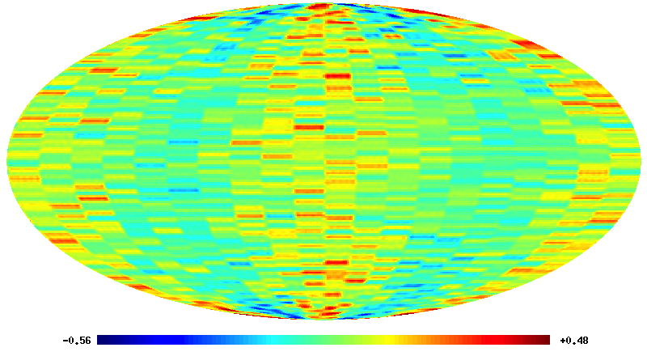
Synergy of Discovery Center
CMB-ALICE-T

Slide 21

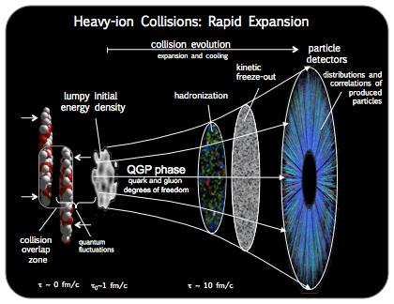
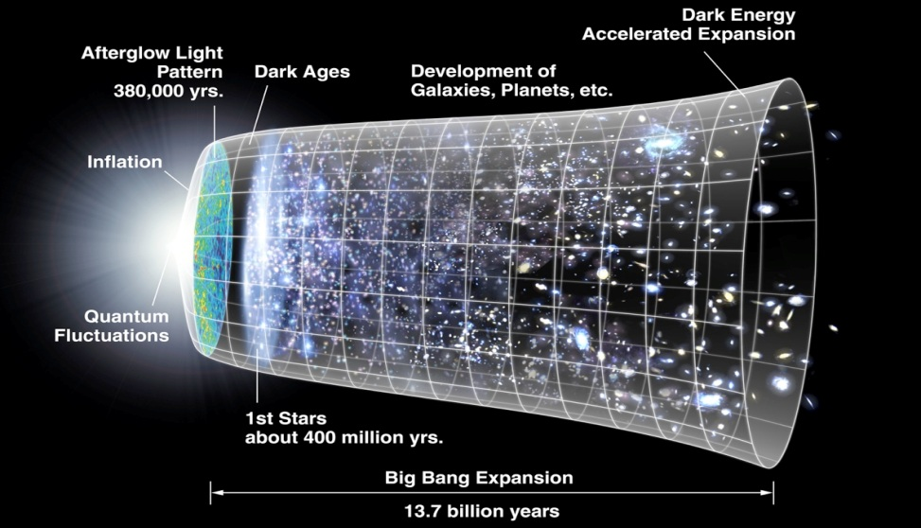
Early Universe vs. Collisions of Heavy Ions. Synergy of Discovery.
CMB sky
Heavy Ion Collision

Slide 22
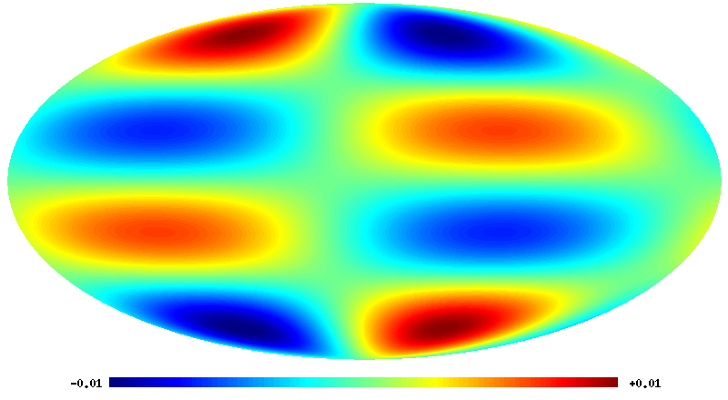
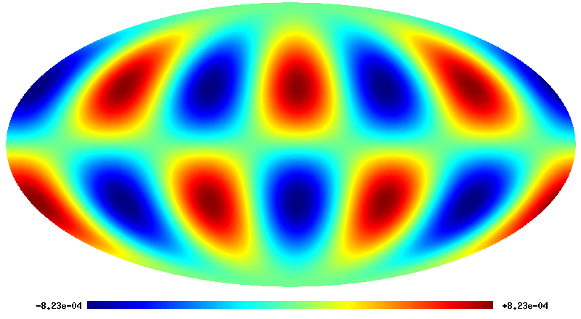
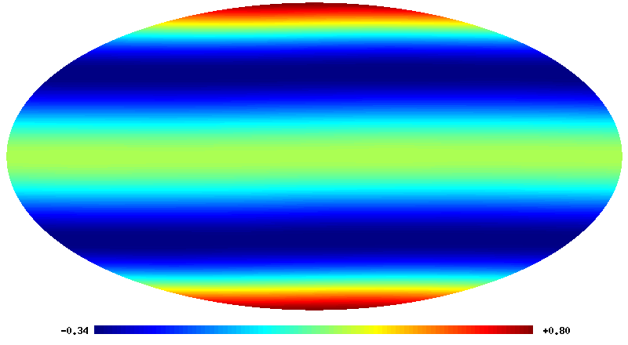
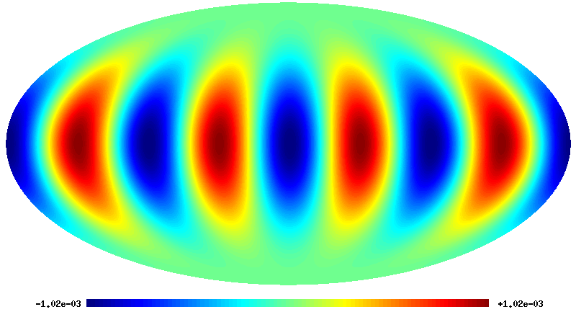
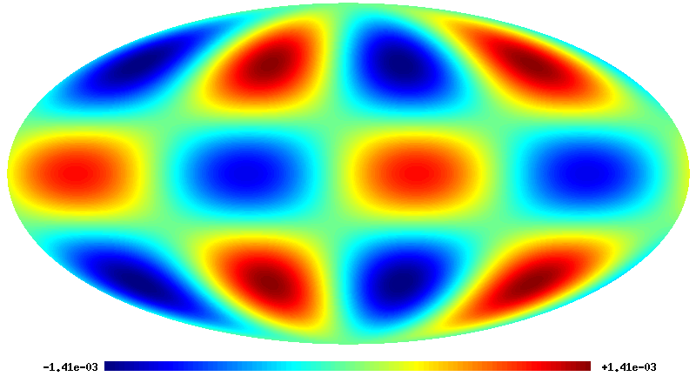
Spherical harmonics. Resonance to Vn
m=1
V2
m=2
(m=2)-(n=2)
L=4,m=0
V4
m=4
(m=4)-(n=4)
m=3

Slide 23
Conclusion
1. List of hirings (post doc, ph.d. ):
since 2010 the DC Planck team has 1 post doc (J.Kim (01.08.2010-01.07.2012), 1 PhD student (M. Hansen, 01.09.2011-01.09.2013)+ new hired PhD student A.M. Frejsel (01.09.2012- ).
In addition 1 PhD student has association with Discovery Planck team (S. Ramazanov ) and 1 post doc ( Hao Liu, 01.09.2012- )
2. Since 2010 we have attended in 34 conferences and schools
3. funds attracted : 6.1 Mkr
4. Summary of papers and citations, talks given :
52 papers, 1609 citations(NASA ADS), 32 talks
New proposal- second part of the meeting.

