Slide 1
Status and achievements of DISCOVERY 2010-2012
Evaluation
Application for DISCOVERY II

Slide 2
Towards DISCOVERY II
Self-Evaluation of DISCOVERY I
We are asked to submit:
a ”self-evaluation” by February 2013
names for 3 possible external referees
=>
A new application for 5 years: DISCOVERY II

Slide 3
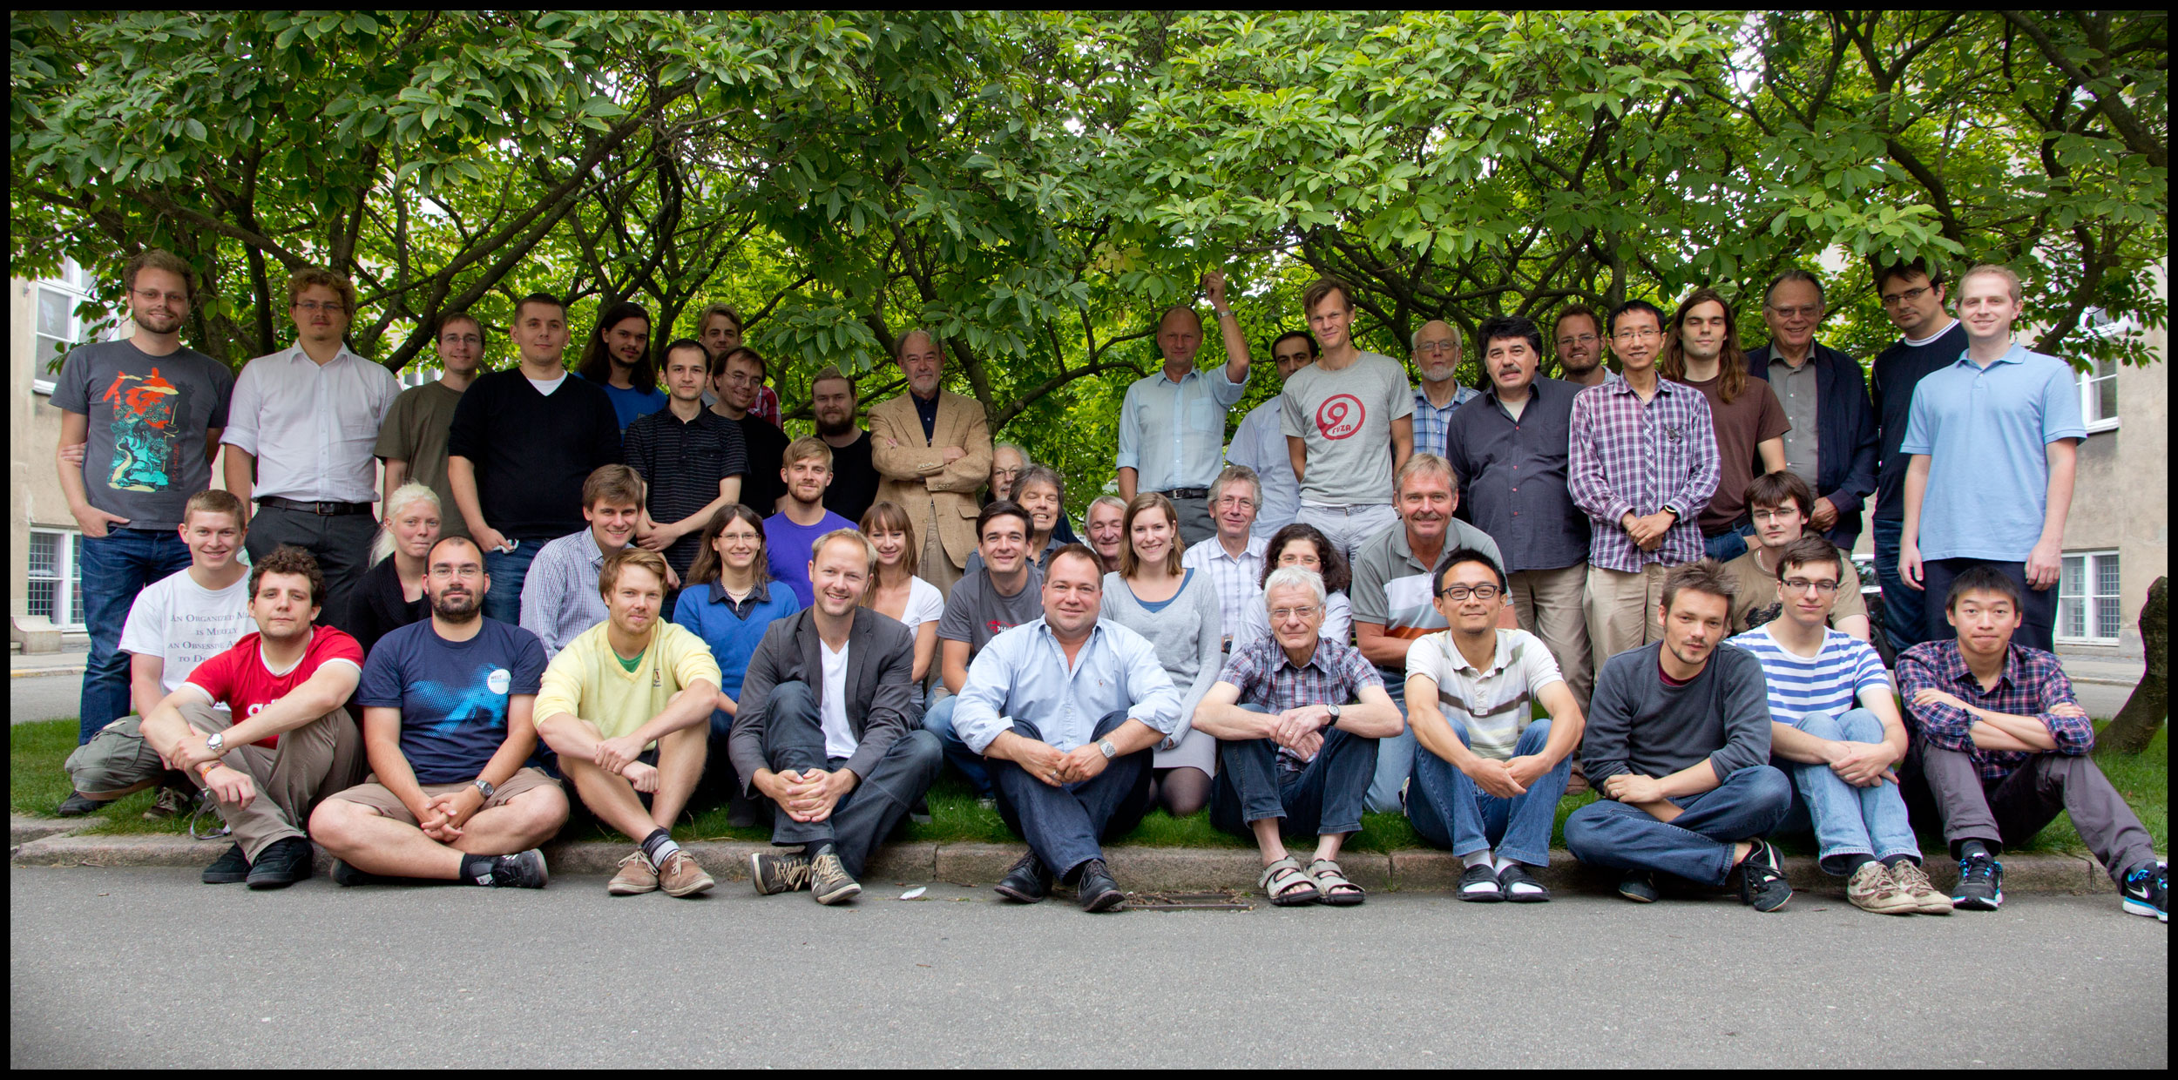
The DISCOVERY team
August 2012.
> 50 members

Slide 4
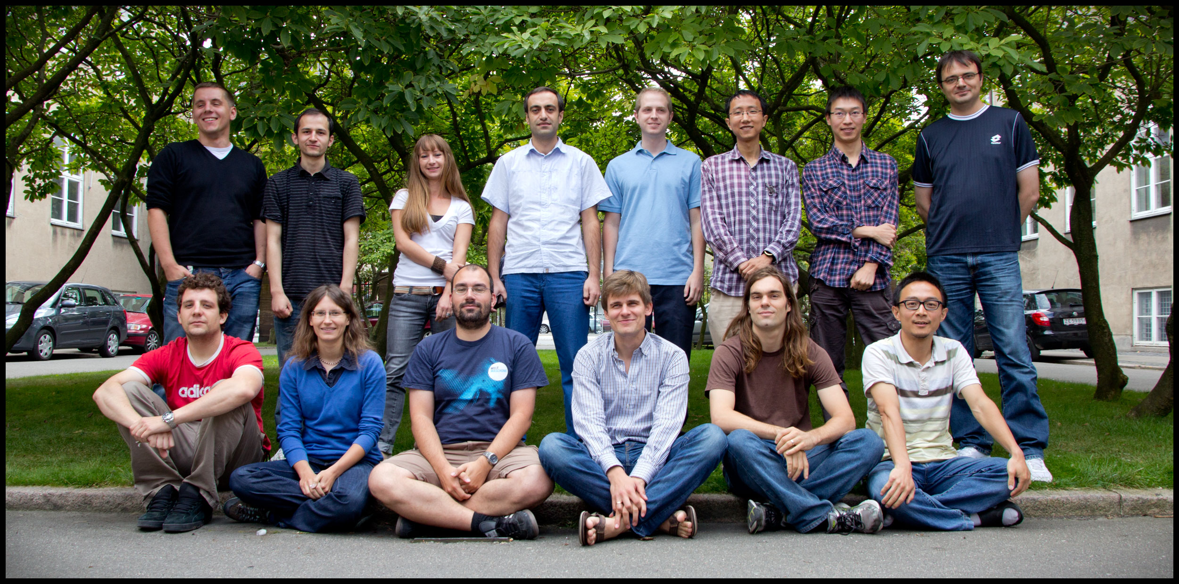
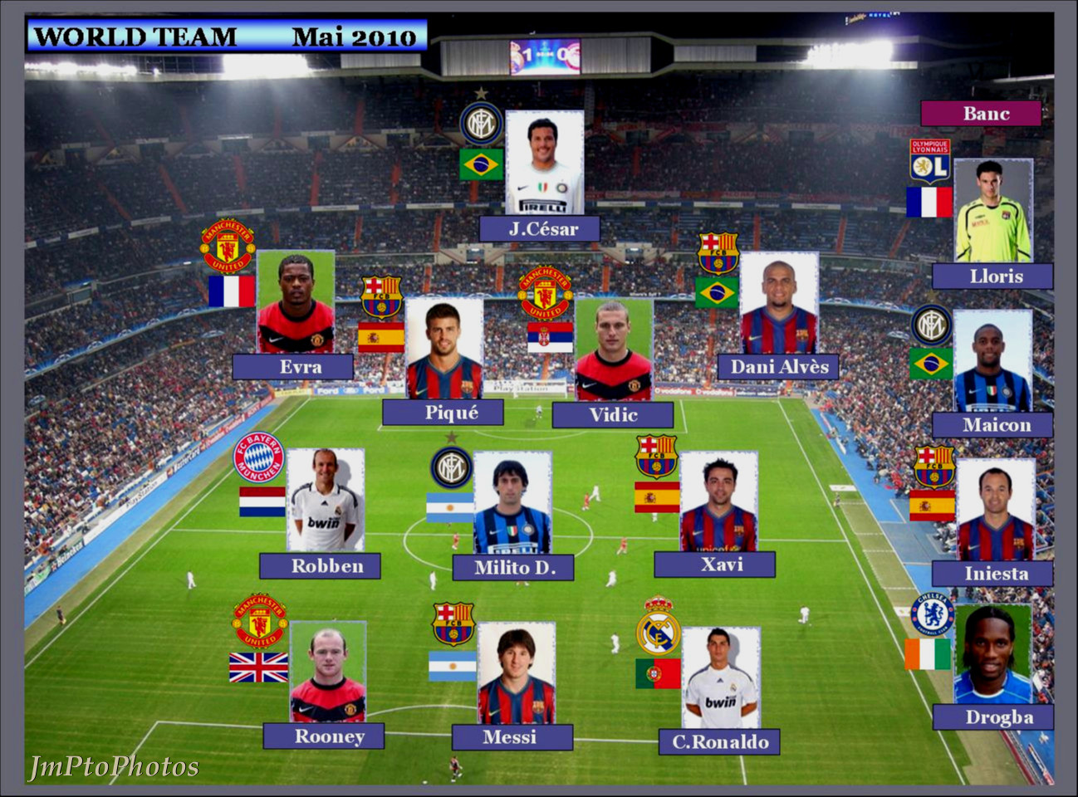
A young & International Group

Slide 5
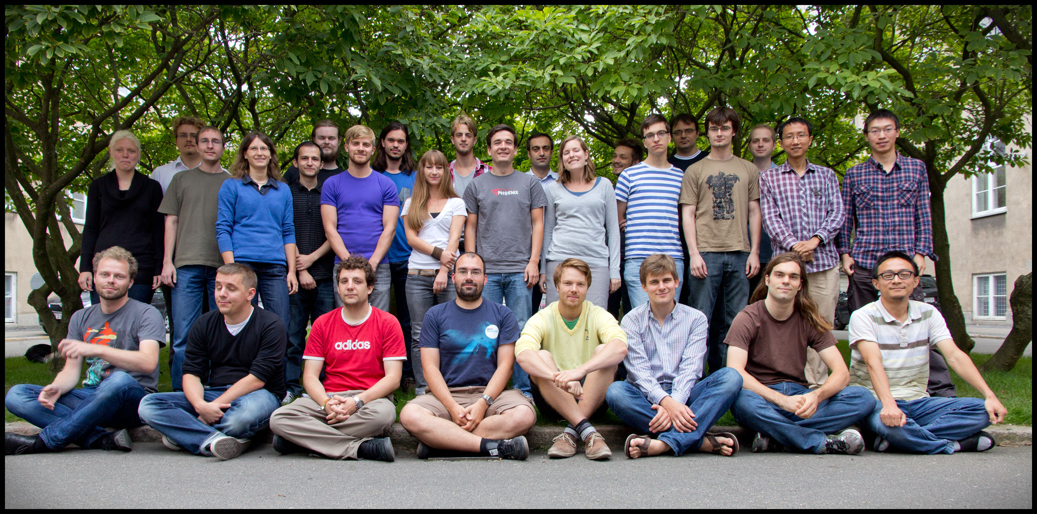
Many students and post docs.

Slide 6
What did we write ?
DISCOVERY focuses on three scientific themes:
The precise exploration of the unknown mechanism that breaks the electroweak symmetry,
along with the predictions for various proposals for this mechanism,
The exploration of detailed expectations of both the perturbative and nonperturbative aspects of QCD at the TeV scale —the energy scale appropriate for the Large Hadron Collider
The search for connections between particle physics and cosmology in the discoveries made by the Planck mission’s measurements studies of the fluctuations in the cosmic microwave background radiation.
The work in DISCOVERY will be organized in four subgroups interacting closely with each other:
The experimental ATLAS group, studying pp collisions at the energy and luminosity frontier.
The experimental ALICE group, studying nuclear collisions at very high energy.
The theoretical phenomenology group, studying the consequences of the strong interaction
The theoretical cosmology group, analyzing and interpreting the cosmic microwave background as measured by the PLANCK satellite.

Slide 7
The proposed Projects & Milestones
Optimizing the performance of the LHC detectors. ☑
Search for Higgs in the tau-tau channel ☑
The production and decay of electroweak vector bosons.
Generic Searches for new physics ☑
Boson-boson couplings
Parton showers and hadronization.
Neural network fit to structure functions. ☑
Further effects of small-x resummations. ☑
New QCD amplitude calculations. ☑
Particle production from hot and dense quark-gluon matter ☑
Tomography of Quark Gluon Matter ☑
Inflation and the fine structure of the early Universe ☑
The ionization history of the cosmic plasma. ☑

Slide 8
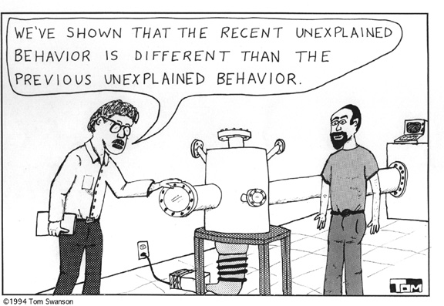

Slide 9
The HIGGS was Discovered
Higgs ruled out by data for most masses
But not here!!!
Probability of observation in a model without Higgs is very small:
Need Higgs at m=126 GeV to explain data!
All masses below 560 GeV excluded at 95% confidence level except around 126 GeV.
Data does not allow exclusion there!!

Slide 10
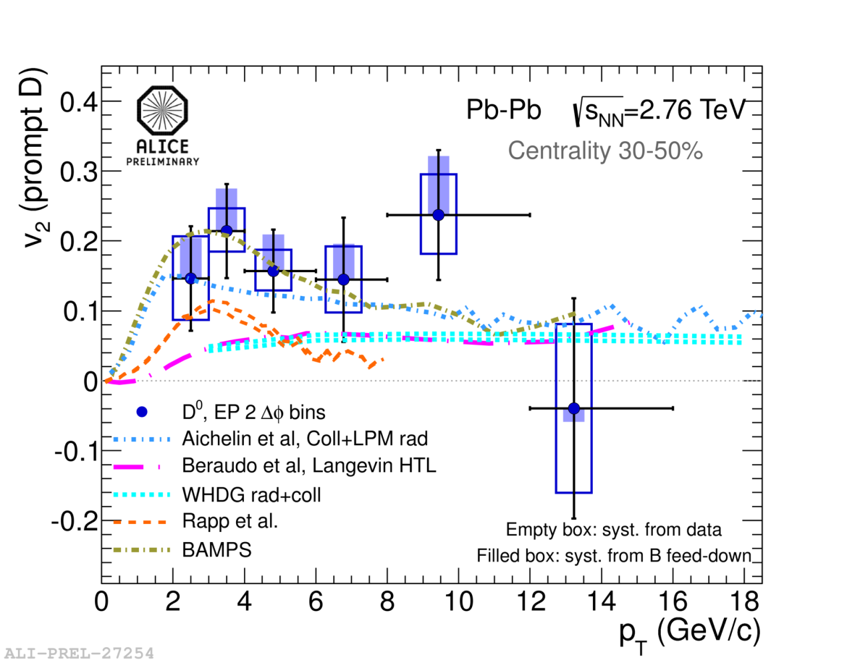
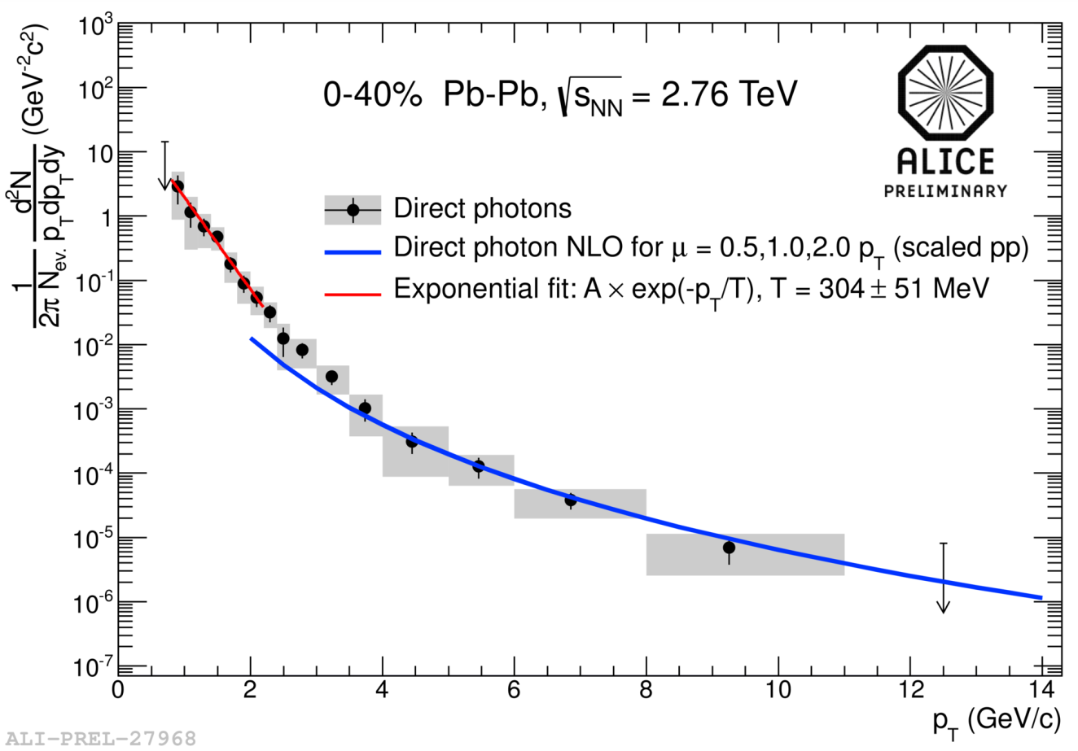
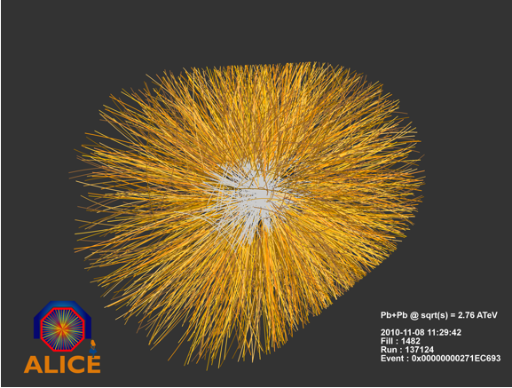
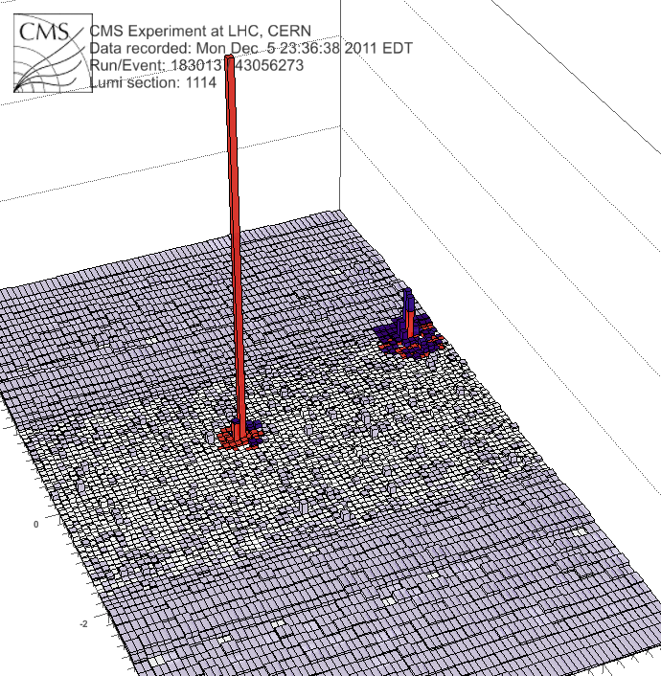
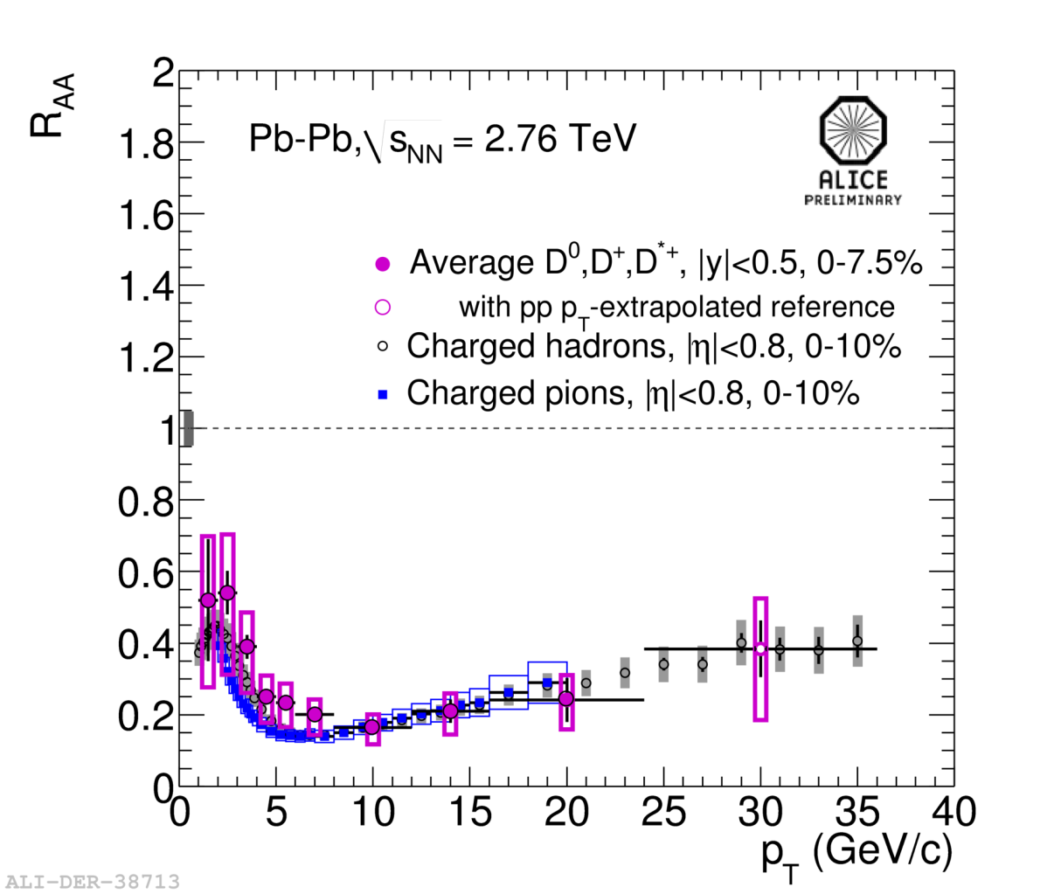
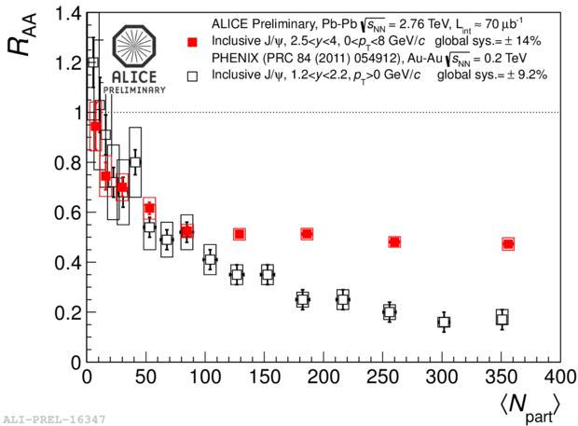
The QGP is hot, deconfined, dense and it flows
Thermal radiation from QG: T= 304 MeV.
Hottest system ever in human lab.
Heavy quarks are also suppressed and they flow. => new transport theory for quark matter
J/Psi regeneration=> direct proof of deconfined large system
Jet suppression

Slide 11
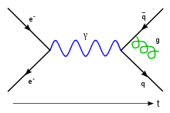
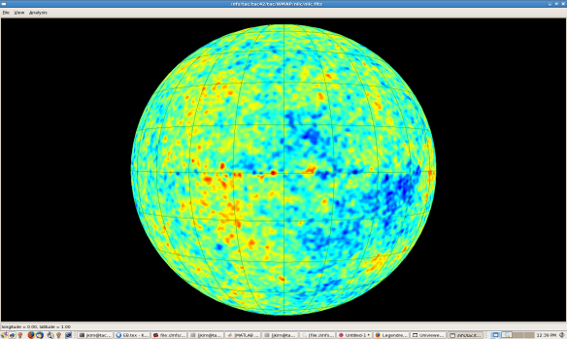
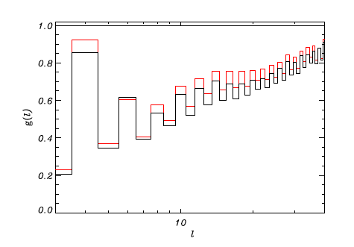
Discovery from Discovery Center: Parity asymmetry of the CMB.
Parity asymmetry of the CMB:
Parity violation in Weak interactions
From micro-
to macro scale
PT(r)=-T(r)-most represented !
P(r)=-r
Pψ(r)=±ψ(r)
Possible explanations:
Theoretical prediction from Inflation
Local violation of Copernicus principle
WMAP 5 and 7
Chance probability:
2/1000 !
Non-trivial topology of space and time
New physics,
New sources of
Emissivity from the space ,
Improvement of the data sets and
creditability of the PLANCK mission.
Local foreground . Debris of the solar system formation.
Effects of systematic and calibration
Notes:
Parity asymmetry: that the signal in one direction of the Universe is the opposite of the signal in the exact opposite direction.

Slide 12
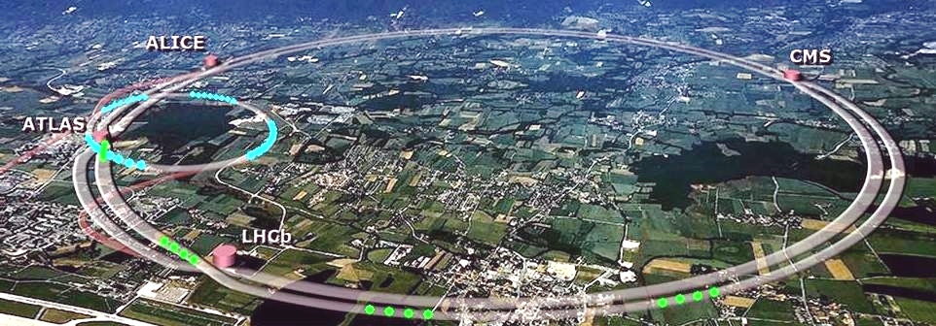

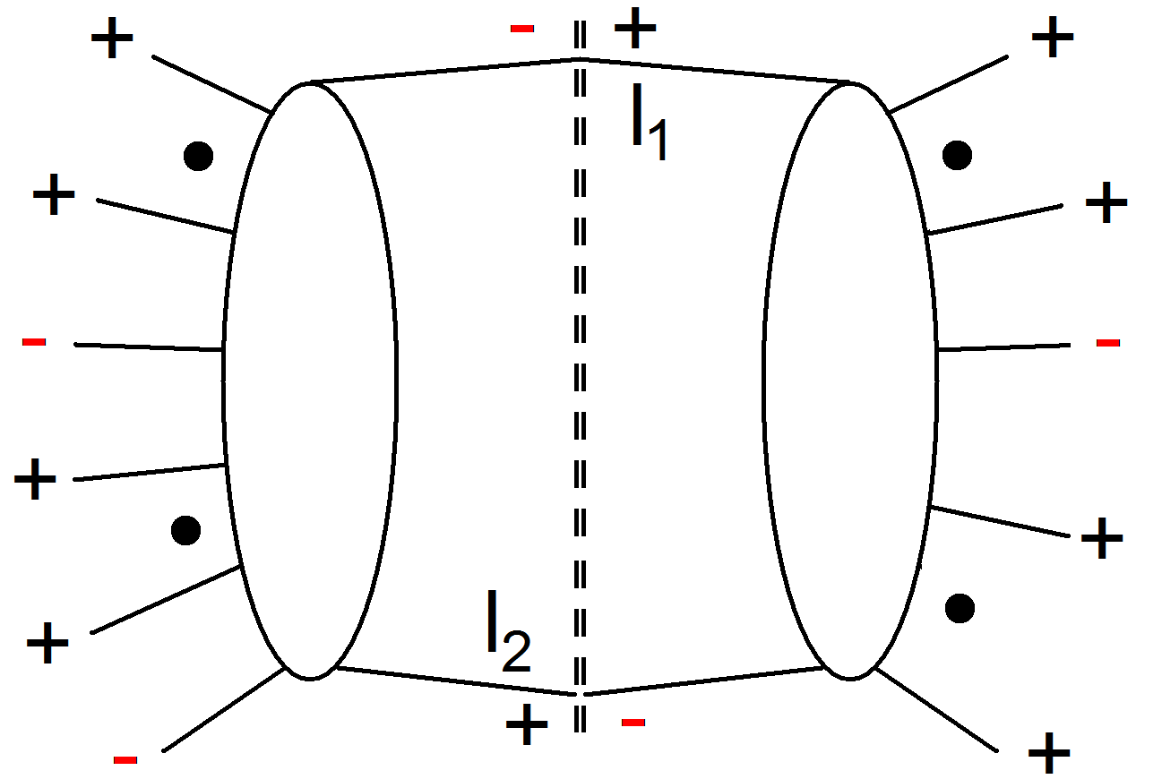
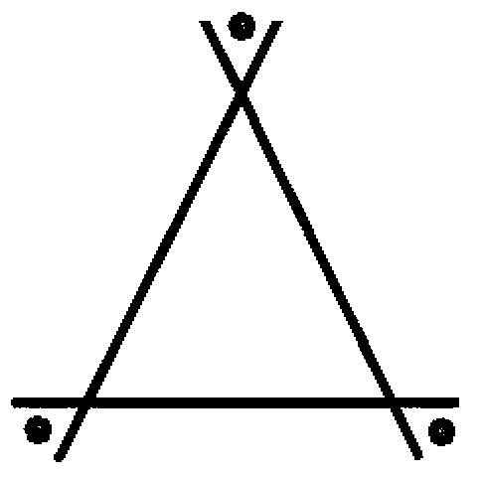
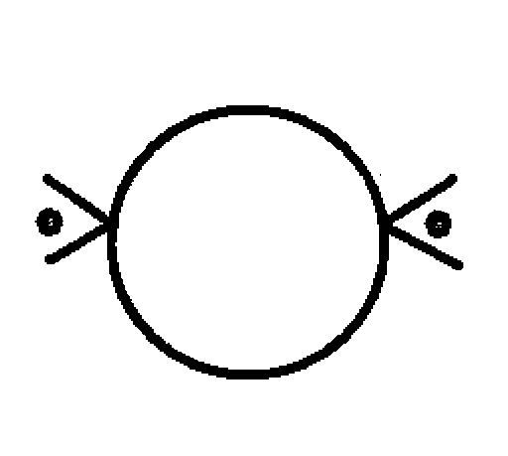
….from compact trees to loops
Compact, on-shell tree Amplitudes
Recursive techniques
Quadruple cuts
On-shell simplification
Powerful computational methods
Impossible by Feynman diagrams
Revolution in doable computations
Key: Compact, simple, symmetric, precise
Integral basis
Rational
polynomials
Development of Automated Programs
Discovery Center Results
Ngluon,
Blackhat
Triple cuts
Automated computation

Slide 13
The measurable scientific output
Activity | #Papers | #Citations (2010-12) | Most cited (2010-12) | Subject
pp ATLAS | 234 | 6649 | 336; 281 | Higgs
QGP ALICE | 68 | 2412 | 243;203 | Elliptic Flow; Jet suppression
CMB Planck | 52 | 1609 | 209; 138 | Fermi map; Planck res.
Theory | 142 | 1827 | 184; 113 | NLO PDF
Total | 496 | 12497
Ph. D. Courses (5), Visitors (>100), Workshops and conferences (?), Youngster symposia, …

Slide 14
Discover the Synergy
Strong and Electroweak interactions, Standard Model and beyond, Higgs, Dark Matter, correlations, Amplitudes
Strong interactions, QCD matter, fluctuations, correlations, flow and thermalization,
heavy quarks,
Color Glass Condensate
ALICE
ATLAS
DISCOVERY
Amplitudes, Parton Distribution functions, Strong and Electroweak interactions , Standard Model and beyond, Cosmology, Gravity
Cosmic Microwave Background, the
Earliest Universe, Dark Matter, fluctuations, flow
THEORY
PLANCK

Slide 15
Synergy A few examples The list should grow!
New and original approach to study the collective aspects and fluctuation in heavy-ion collisions using methods developed for the CMB-sky in cosmology!
Understanding correlations in p-p collisions: a new test of the microscopic QCD physics (the ”underlying event”).
Parton Distributions Functions (PDF) in proton-nucleus collisions:
We will deliver the most accurate predictions!
Improving data sets through recovering signal at zones of detectors faults with strong signal contamination.
New bounds on baryogenesis in the Universe from LHC data!

Slide 16

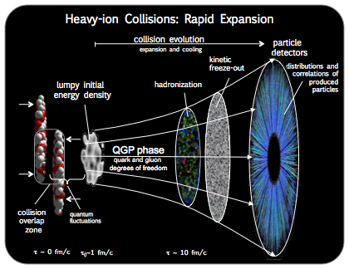
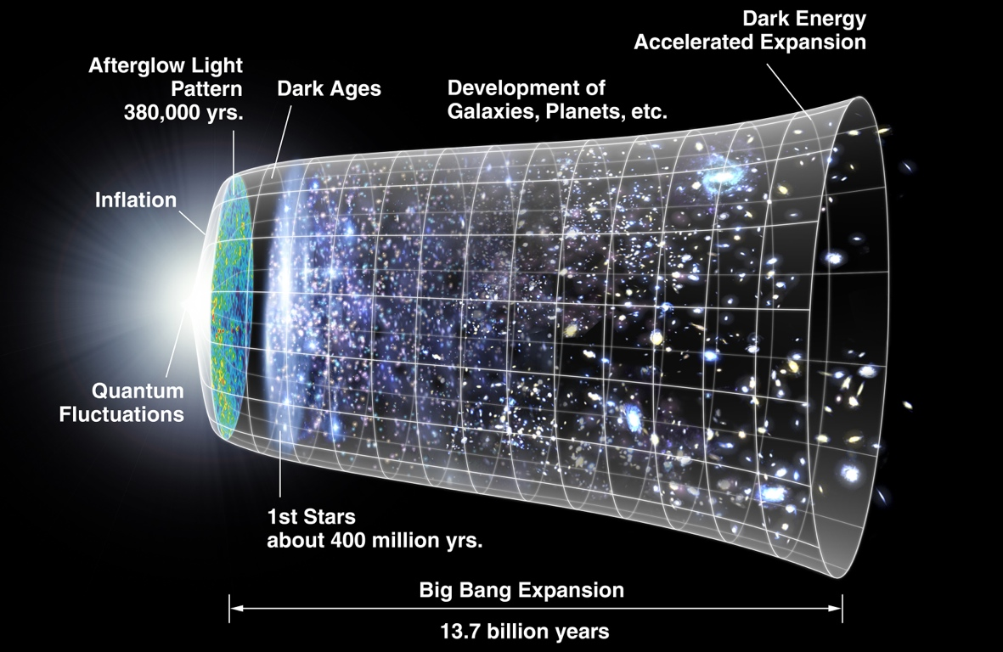
Early Universe vs. Collisions of Heavy Ions
CMB sky
Heavy Ion Collision

Slide 17
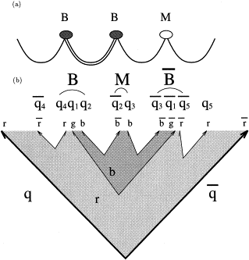
Long Range Rapidity Correlations
QED-field
QCD-field
Backward-Forward correlations
String Fragmentation

Slide 18
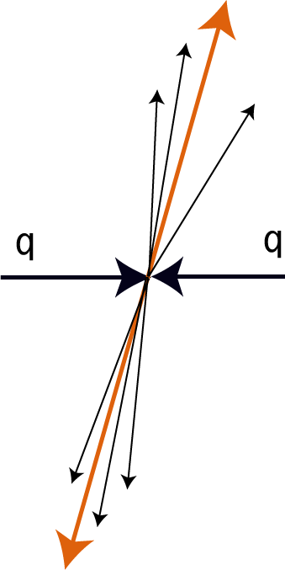
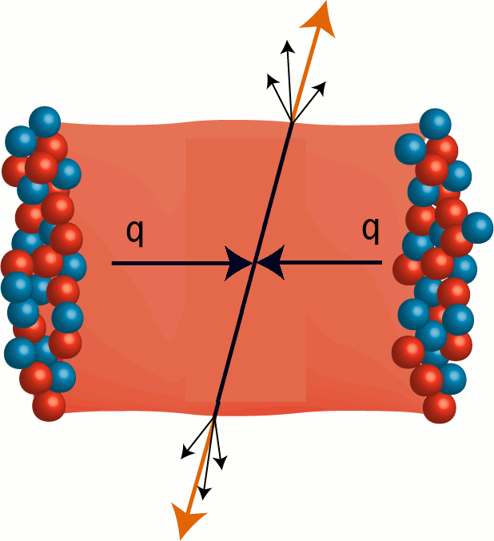
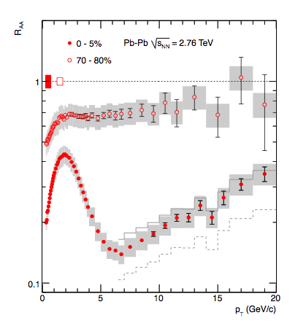

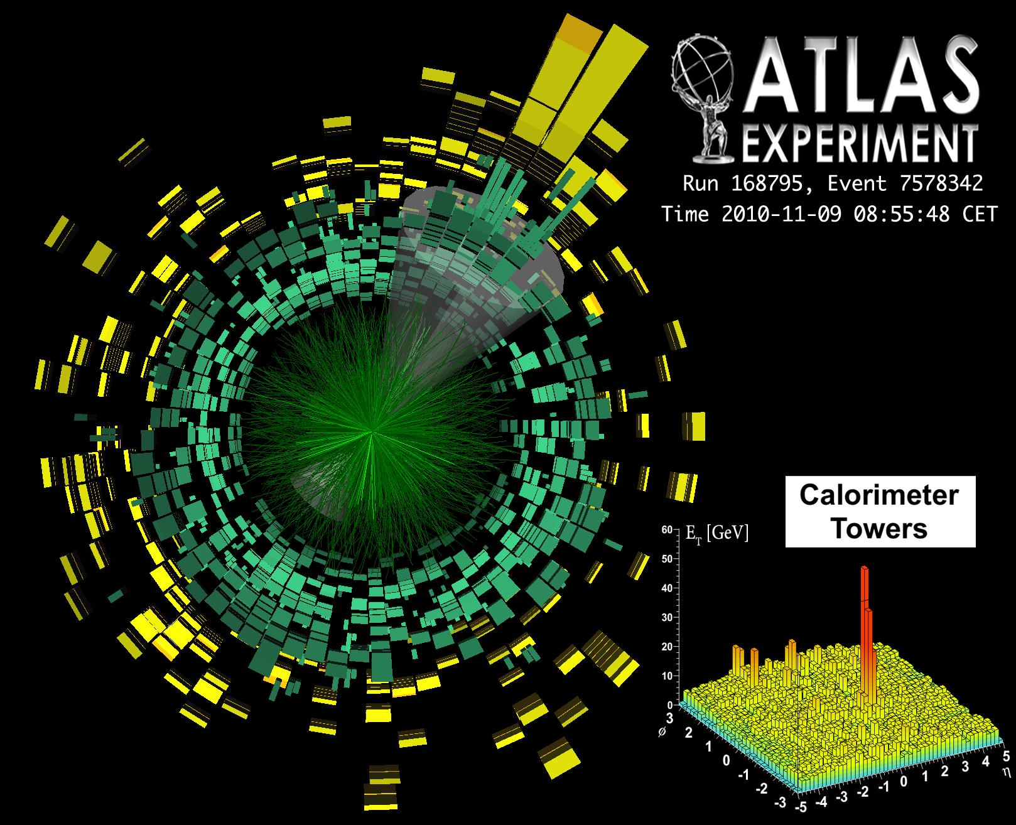
Jet Quenching
x7
Punch through?
ALICE. Phys. Lett. B 696 (2010) 30-39

Slide 19
Summary
The grant from the Danish National Research Foundation has been decisive for bringing outstanding young scientists to the Discovery Center and for initiating new physics across previous borders
The flexibility has been essential for hiring the best at the right time and combining with other grants: a fantastic period of growth
Many diverse activities: A wealth of exciting results already delivered, and much more to come
The Discovery Center is much more than the sum of the parts: a transformation of the high energy research landscape in Denmark

Slide 20
Synergy & added value
Need to work on this
Joint activities.
Added value
… for discussion…

