Slide 1


DISCOVERY II Center of Excellence in Particle Physics AND COSMOLOGY
Notes:
Good morning. I am XX and will present an overview of the Discovery center.

Slide 2
The following slides are meant as a loose sketch to trigger discussion – not in any way a final proposal.
A total of nine broad projects are proposed. Could not make it fewer.
A red thread is dark matter. LHC has ,MAYBE!, confirmed the SM and seen nothing beyond. So the logical step is to increase energy and luminosity to get more statistics at high masses and to raise our sights to cosmic radiation. We know that some new particle must be there. The CMB can narrow it further down and cosmic radiation can give hints.
But at the same time many long standing intertwined issues will be addressed: The CR acceleration, the QGP phase-transitions, the nature of the electro-weak symmetry breakdown, the constitution of protons and nuclei, neutrino masses etc..

Slide 3
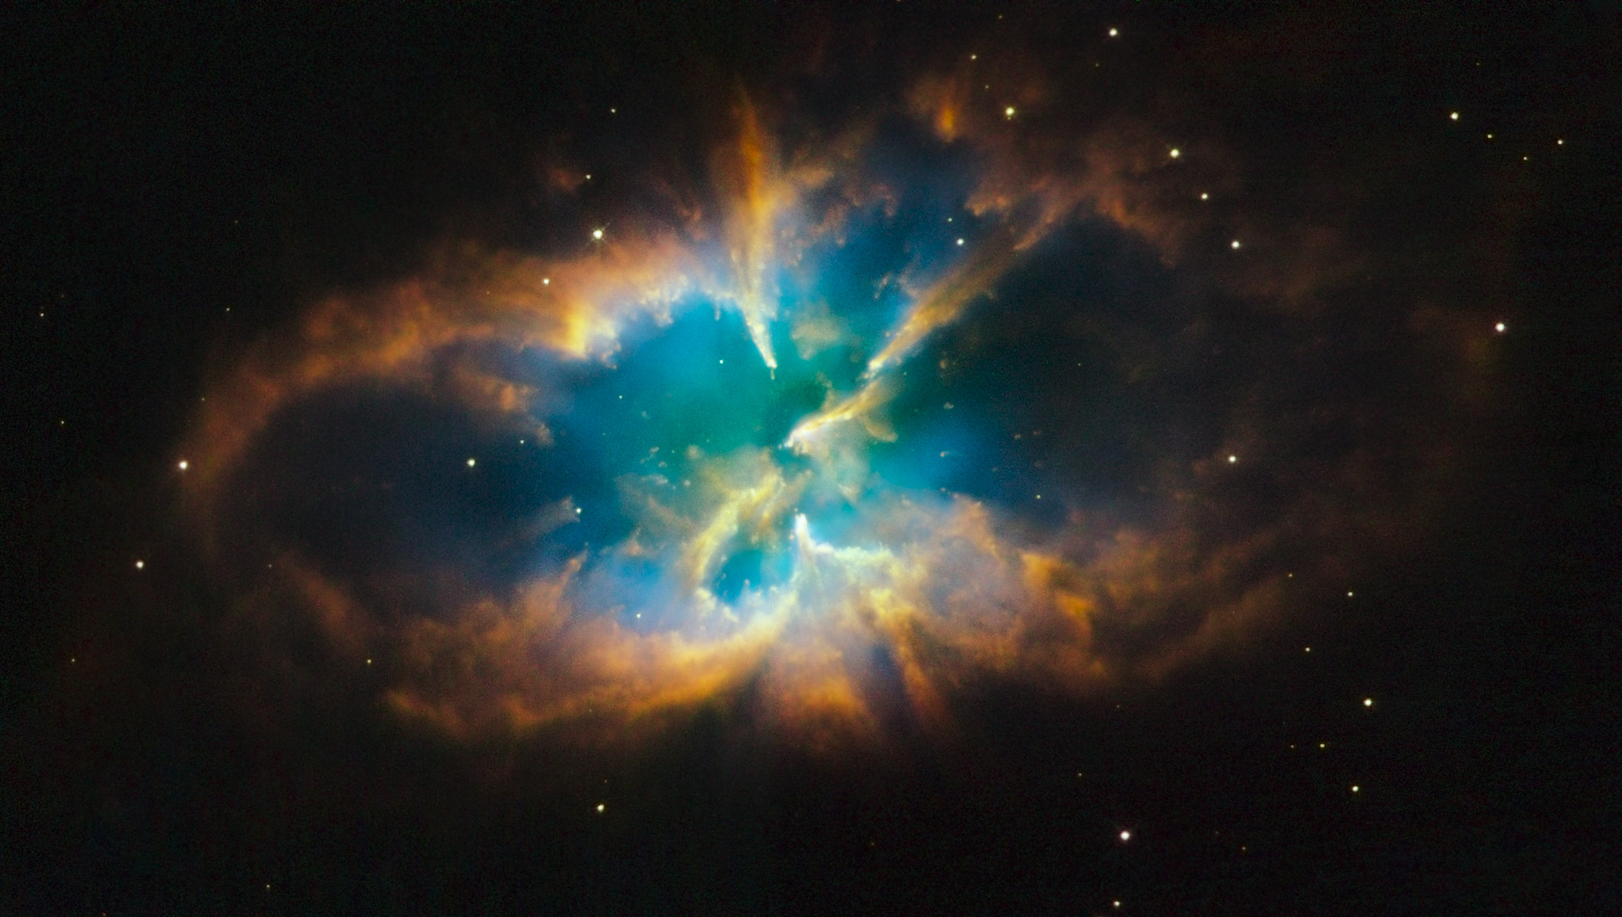

Slide 4
AstroP/cosmology Projects:
Cosmic radiation –New!
With data from ICECUBE, CTA, Herschel, ALMA and PLANCK we can
1a) Determine the acceleration mechanism
1b) Map the magnetic fields for CR tracking
1c) Explore anomalies (PLANCK haze). Perhaps Dark Matter.
1d) Pin down CR point sources
1e) Do fundamental neutrino physics with ICECUBE??
Overlaps from all components of Discovery. And we are good at mirrors in DK.

Slide 5
AstroP/cosmology Projects:
CMB anomalies
With PLANCK it is within our reach to
2a) Explain low multi-pole anomalies (constr. cosmo. principle)
2b) Explain Dark Energy (anisotropies, voids, metric perturbations)
2c) Test models of inflation (B-modes, grav. waves, non-Gauss)
2d) Place constraints on neutrino species and masses
Some overlaps with theory and LHC

Slide 6
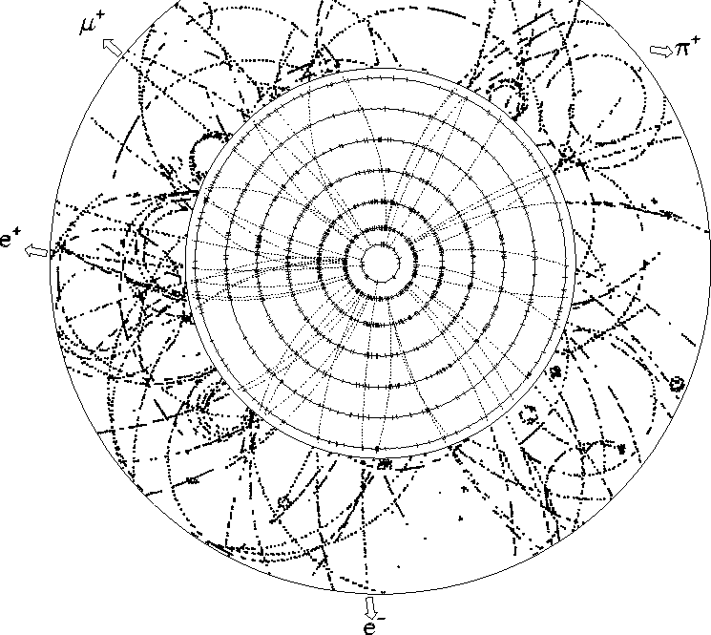
Energy frontier projects
What is this “Higgs-like” new particle ?
Spin, parity, CP from analysis of 4l events?
Is there more than one Higgs-like particle?
Does it couple to bosons and fermions as expected?
Event as seen by the TRT detector. The occupancy is near 100%, rendering reconstructing void!

Slide 7
Energy frontier projects
Coupling strength anomalies ?
Limits on anomalous Triple Gauge Boson Couplings
Significantly better the W mass.
alpha_{S}(Q²) from Z+jets? (would be new)
Sin²(theta_{W}) ?? Forward electrons and Z-> tau polarization
Event as seen by the TRT detector. The occupancy is near 100%, rendering reconstructing void!

Slide 8
Energy frontier projects
Searches
Limits on any new particle decaying into third generation??
WHIMP DM searches via mono-jets?? (would be new)
Long-lived SUSY and monopoles?? Or something else?
Event as seen by the TRT detector. The occupancy is near 100%, rendering reconstructing void!

Slide 9
High Energy Heavy Ion project 1 Theory and ALICE
What is the microscopic nature of the phase transitions?
What are the properties of the QGP state and how does it
influence the development of the early universe?

Slide 10
High Energy Heavy Ion project 2 both ALICE and ATLAS
1) Low-x dynamics. How does gluon saturation work?
2) What are the nuclear structure functions? Hard and soft probes..
3) What are the dynamics of very peripheral collisions?
4) Diffraction and forward physics.
An interesting extension could be
You would have p+A or Pb+A collisions at about Ecms=100GeV, polarized targets, access to x_{F}=-1 and very high luminosity. You address a wide range of unexplored, exciting and surprising QCD phenomena. Participation in some of the studies could be considered.

Slide 11
Hard(ware) choices
Some hardware expenses are coming up in the next 5 years, without any clear funding source:
ATLAS Phase I upgrade. 1.2Mkr 2013-2018
ALICE Upgrade. Similar
Tier 1 pledges 3 Mkr 2013-2018
Discovery 1 had none of this kind.
However, it is unclear whether DFF/Ministry will pay.
There is no Danish participation without….
So should we include things like that?

Slide 12
Theory project 1: SM
Create tools to analyze and understand data in terms of SM reactions, steadily adding more legs, loops and PDF constraints.
Neutrino physics is new.
European collaboration and coordination (MCnet) is increasingly important, because a lot of work is needed making user friendly interfaces, validation, matching, hadronization and HepMC output. A higher emphasis on organized European collaboration would be new and is in a way already happening.

Slide 13
Theory project 2: BSM
Theory will probably be more “experiment-driven” than in the past. “Around the corner” arguments tend to be given up.
Still all crazy ideas should be pursued, as well as any hint from baryogenesis, grand unification, string theory or other beautiful principle to guide searches.

