Slide 1
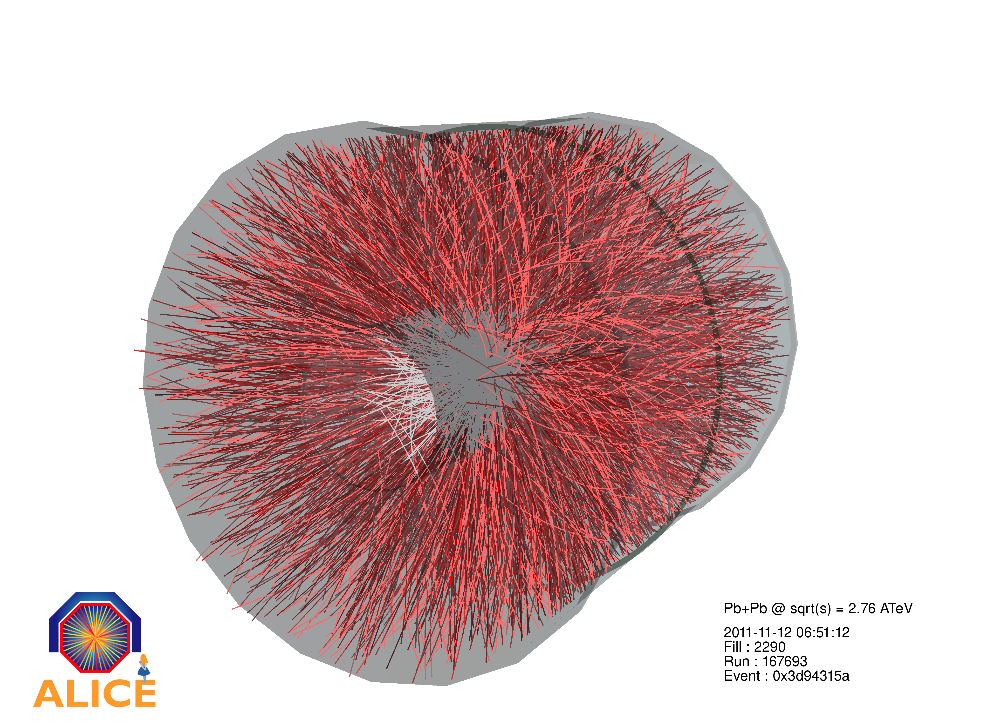
Relativistic Heavy-Ion Collisions @ LHC ++
One central ALICE event for
Pb+Pb @ 2.76 TeV.A
=> E(kin_total)= 574 GeV
0-5% central:
25000 particles

Slide 2
Relativistic AA and eA Collisions
The High Energy Frontier:
Heavy-Ion Collisions at the LHC: ALICE
The Low-x , high Q² Frontier :
Electron-Ion collisions at LHeC
High Baryon Density:
New Facilities and Future Fixed-Target Running
Synergies and complementarities: The Future RHIC Programme

Slide 3
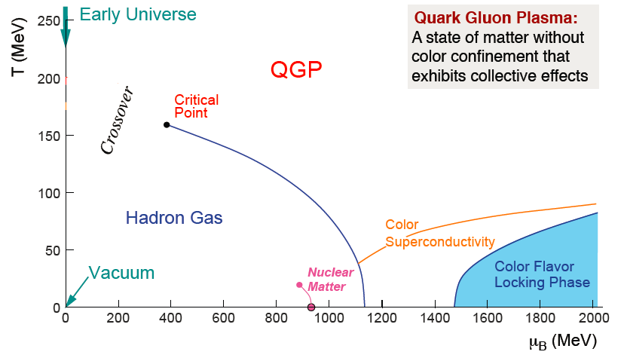
New states of dense matter
„QCD leads to new states of matter, when temperature and densities exceed the values beyond which quarks and gluons are confined inside hadrons.“
„Discussion Document 2006“
deconfinement
chiral symmetry restoration

Slide 4
„Condensed QCD matter physics“
What is the nature of matter at ultra-high temperature and density?
Which are the relevant microscopic degrees of freedom and excitations?
Which are the macroscopic transport properties and equation of state?
How did their properties influence the evolution of the early universe?
What is the relation between strongly coupled QGP and asymptotically free QCD?
Heavy-Ion collisions
Laboratory studies of the bulk properties of non-Abelian matter
...with connections to other fields in physics:
String Theory, Cosmology, Condensed Matter Physics, Ultra-Cold Quantum Gases

Slide 5
The Energy Frontier:
Heavy-Ion Collisions at the LHC
NUPECC-statement:
„ALICE experiment is the highest priority of High Energy Nuclear Physics in Europe“.

Slide 6
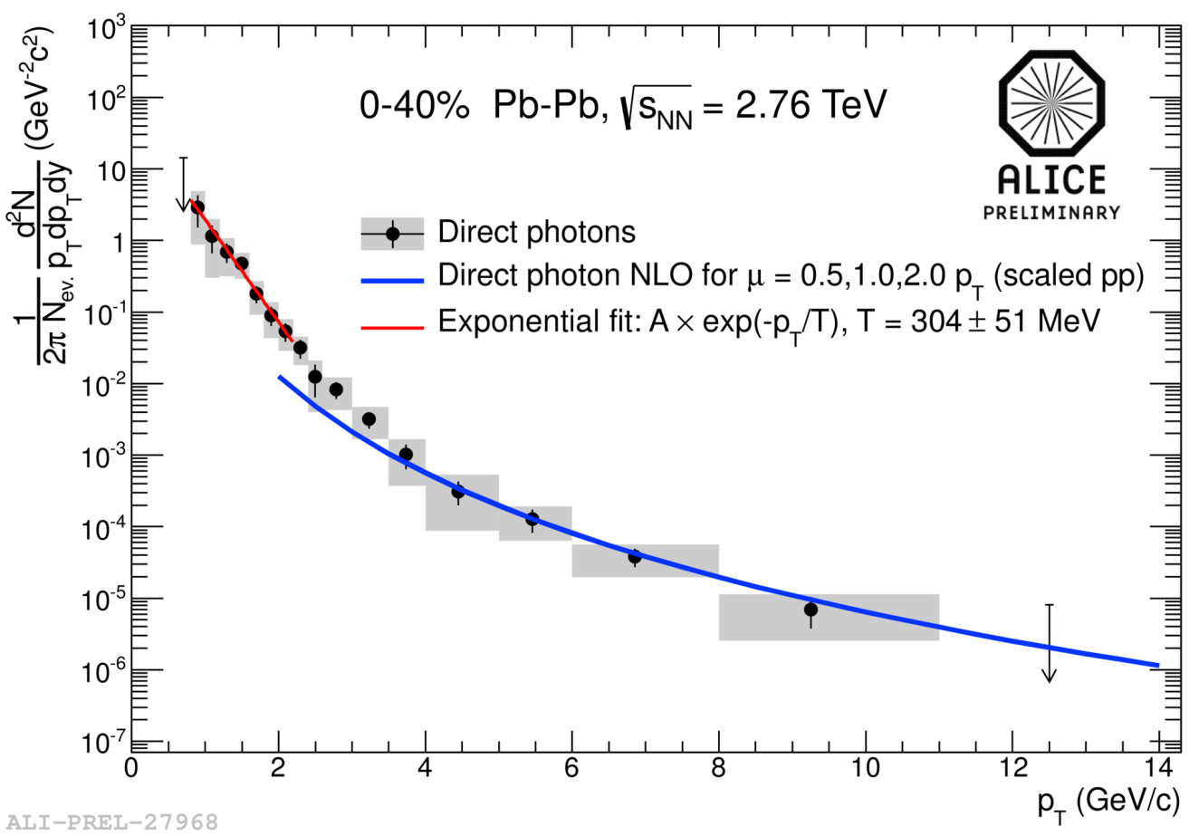
LHC HI-highlights (1) – thermal radiation
Large excess of direct photons pointing to effective temperatures far above T_{c}:
Hottest system (T >300 MeV) ever produced in a human laboratory

Slide 7
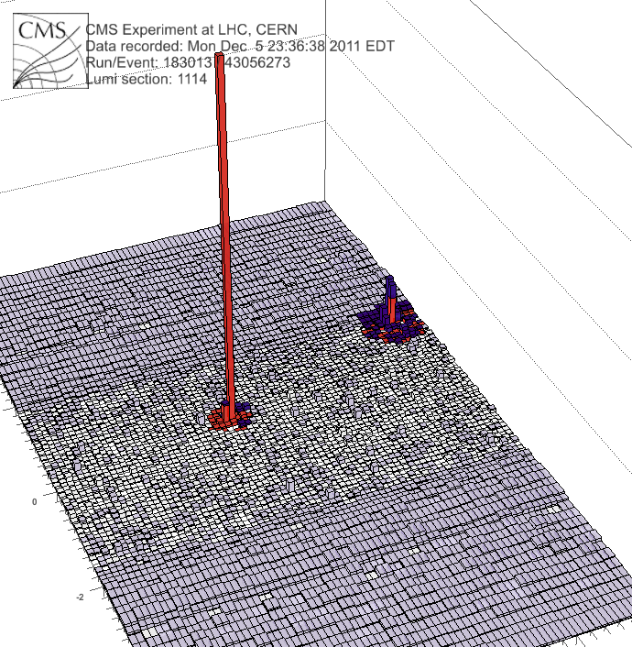
LHC HI-highlights – jet quenching
x_{Jγ}=p_{T,jet}/p_{T,γ}
Direct observation of large partonic energy loss in the QGP via γ-jet imbalance
Photon
(191GeV)
Jet
(98 GeV)

Slide 8
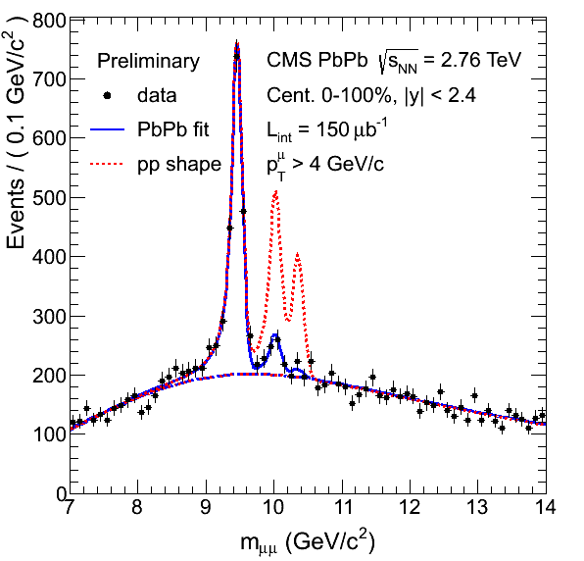
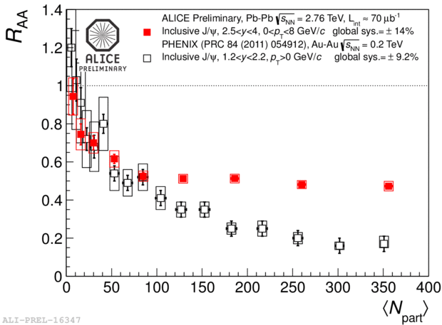
LHC HI-highlights – quarkonia suppression
J/ψ
ϒ
LHC
RHIC
J/ψ suppression pattern at LHC qualitatively different from RHIC: enhancement via regeneration predicted as consequence of deconfinement and large charm cross section
Melting of weakly bound bottonium states indicating strong color screening in the QGP

Slide 9
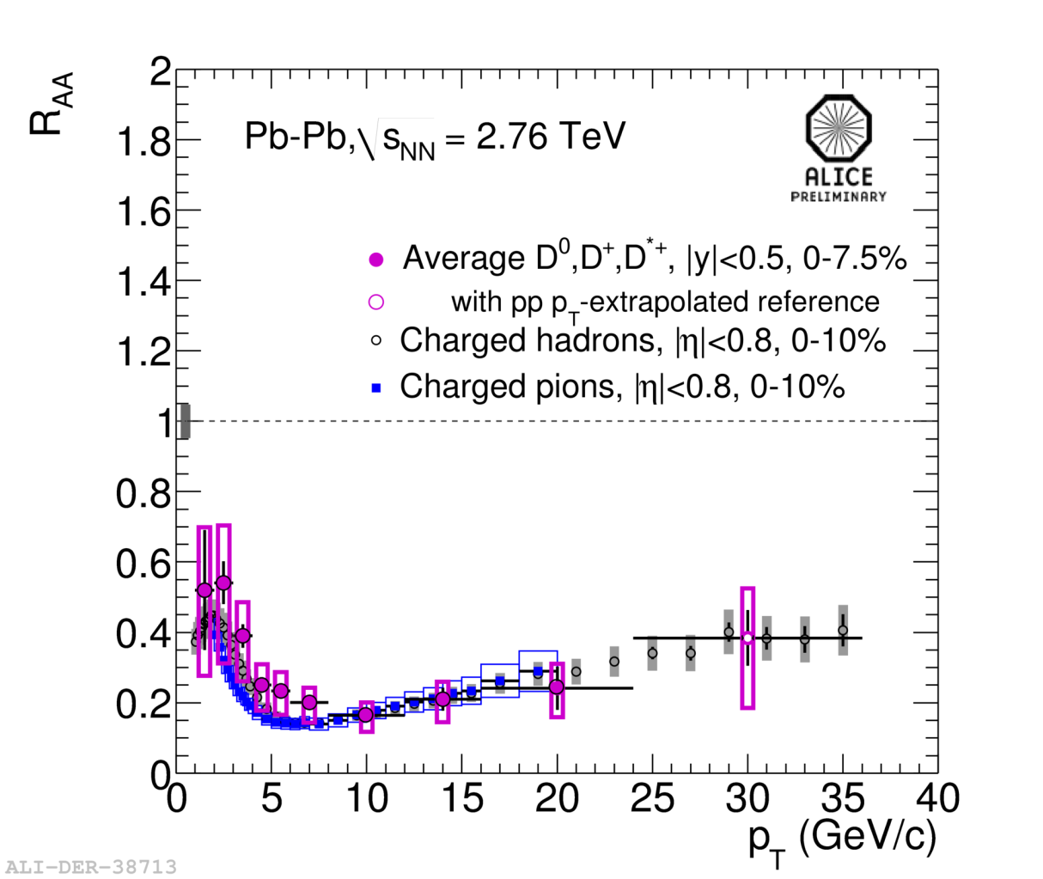
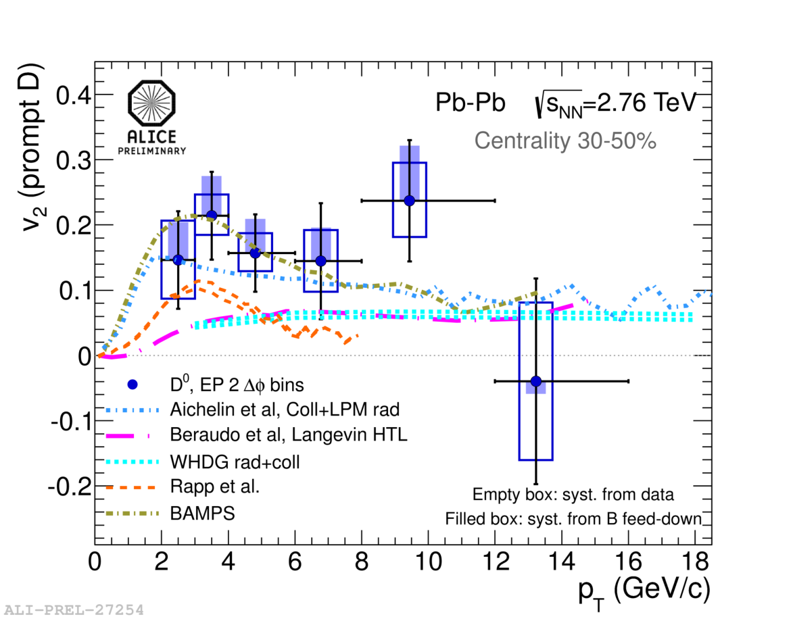
LHC HI-highlights – heavy flavor transport
Large quenching at high p_{T} and pronounced collectivity of heavy-flavor hadrons indicating very strongly coupled system

Slide 10
ALICE: LHC phase 1
after completion of Phase 1 (1 nb⁻¹ Pb-Pb at √s_{NN}=5.5 TeV)
there will be high-precision data available on some of the key
observables
BUT
there are major opportunities at the LHC to be explored with increased Pb-Pb luminosity!

Slide 11



future opportunities at HL-LHC
Jets - precision measurements:
γ-Jet, b-Jet, Z-Jet, multi-Jet,
PID fragmentation functions,
TeV-scale jet quenching
ϒ spectroscopy - 1s, 2s, 3s states, onset-behaviour
Charmonia - low p_{T} J/ψ over wide rapidity range, ψ‘, Χ_{c}
Heavy Flavors - comprehensive measurement of D, D*, D_{s}, Λ_{c}, B, Λ_{b}:
Baryon/Meson ratios down to low p_{T}, R_{AA}, v₂
accurate normalization for quarkonia
EM radiation - low mass dileptons
Exotica - anti- and hypernuclei
→ enter 10 nb⁻¹ regime

Slide 12

ALICE – upgrade strategy
Dedicated heavy-ion experiment
→ upgrades focus on heavy-ion physics
Strengthen the uniqueness of ALICE
→ improve low p_{T} tracking, vertexing, and PID capabilities,
reduce material budget
Many of the key observables, though „rare“, do not allow low-level triggering
→ high rate capability of detectors and readout systems
emphasizes complementarity to ATLAS and CMS
Letter of Intent
approved by LHCC

Slide 13

ALICE – core upgrades
LS2 (2017-18): - Upgrade Inner Tracking System (ITS)
→ improve vertex resolution
and low p_{T} tracking capability,
faster readout, reduced material budget
- Upgrade TPC with GEM-based readout chambers
→ continuous readout at 50 kHz !
- Upgrade of readout electronics and online systems
HLT, DAQ, trigger
→ 1 TB/s into online systems
→ partial event reconstruction (20 GB/s to tape)

Slide 14
ALICE running scenario to 2016.
ALICE plans to run 6 years with upgraded detector, i.e. until 2026
(assuming start in 2019 and 2 years break of LS3)
Possible scenario:
  2019 – Pb–Pb 2.85 nb⁻¹
  2020 – Pb–Pb 2.85 nb⁻¹ (low magnetic field)
  2021 – pp reference run
  2022 – LS3 ?
  2023 – LS3 ?
  2024 – Pb–Pb 2.85 nb⁻¹
  2025 – ½ Pb–Pb 1.42 nb⁻¹ + ½ p–Pb 50 nb⁻¹
  2026 – Pb–Pb 2.85 nb⁻¹
This would not require pp running during high-luminosity runs, only a short time before a heavy-ion run for setting up and commissioning.

Slide 15
LHeC = Large Hadron-electron Collider

Slide 16
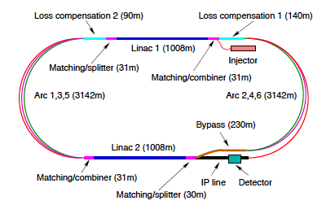
Large Hadron electron Collider (LHeC)
- 60 GeV electron beam
colliding with LHC protons
(ions) from mid-2020s
Simultaneous with pp running
Lumi ~10³³ cm⁻¹s⁻¹ constrained
by 100 MW power consumption,
→ ~100 fb-1 integrated
- `Medium scale LHC upgrade’
IP2
- Mainly QCD & PDF-focused facility at the ep energy frontier,
attacking fundamental questions in QCD and providing a basis for LHC discovery potential near the kinematic limit
Discovery potential, probing eq, eg vertices, excited leptons …
Complementary to LHC in Higgs sensitivity (clean WW, ZZ production, bbbar decay, CP properties …)
Precision electroweak measurements
QCD: Color Glass Condesate: Gluon Saturation

Slide 17
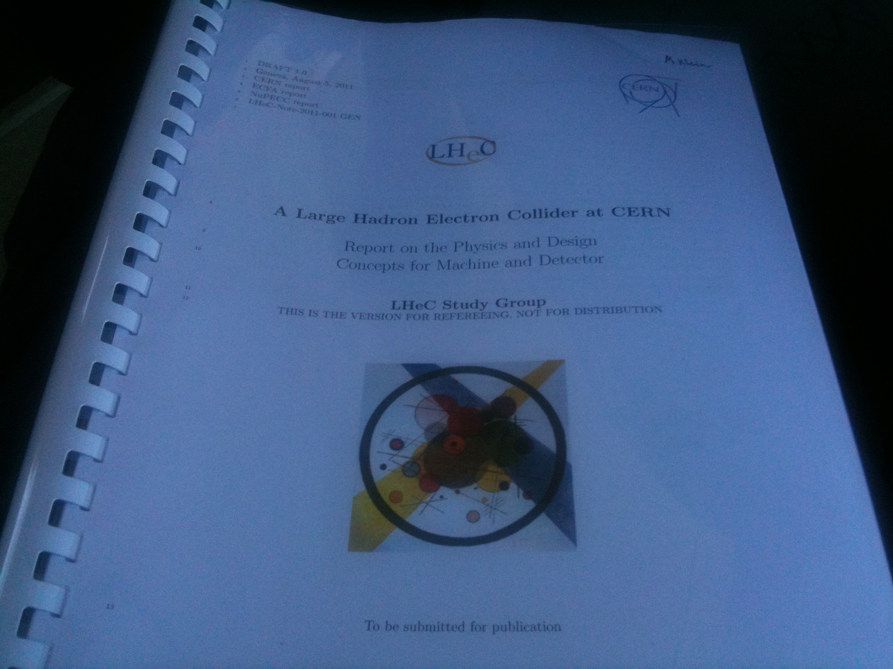

Slide 18
Why an ep/A Experiment at TeV Energies?
For resolving the quark structure of the nucleon with p, d and ion beams
For the development of perturbative QCD
For mapping the gluon field
For searches and the understanding of new physics
For investigating the physics of parton saturation
QPM symmetries, quark distributions (complete set from data!), GPDs, nuclear PDFs ..
N^{k}LO (k≥2) and h.o. eweak, HQs, jets, resummation, factorisation, diffraction
Gluon for ~10⁻⁵ < x <1 , is unitarity violated? J/ψ, F₂^{c}, … unintegrated gluon
GUT (α_{s} to 0.1%), LQs RPV, Higgs (bb, HWW) … PDFs4LHC… instanton, odderon,..?
Non-pQCD (chiral symm breaking, strings), black disc limit, saturation border..
..For providing data which could be of use for future experiments [Proposal for SLAC ep 1967]

Slide 19
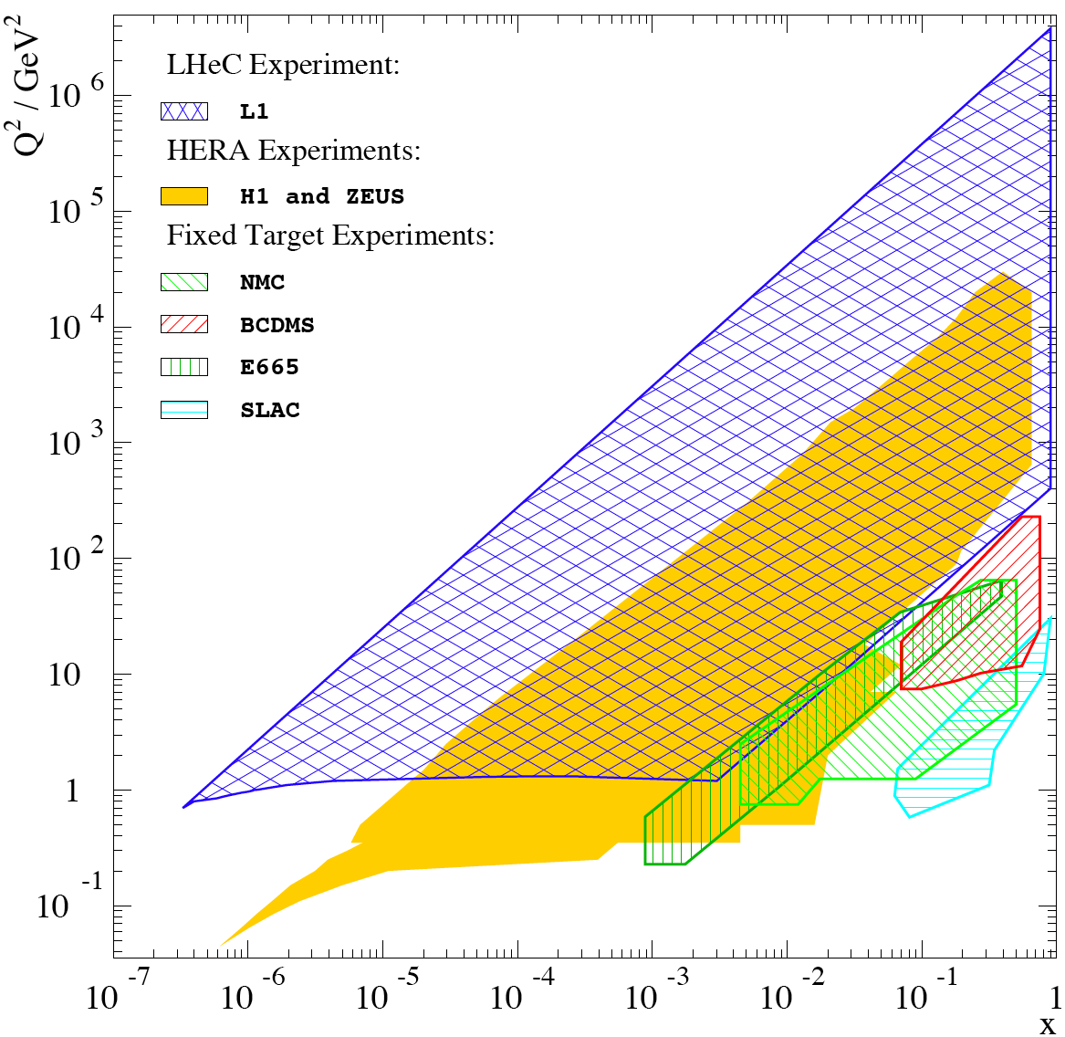
Physics and Range
New Physics
Large x
High precision
partons in plateau
of the LHC
Nuclear
Structure
& dynamics
High Density Matter
Q² = 4momentum transfer² x = Bjorken x: fraction of p’s momentum

Slide 20
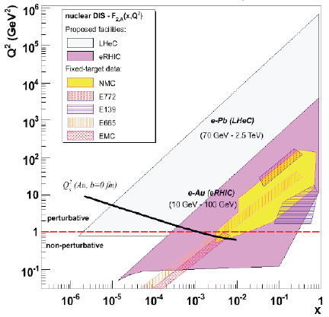
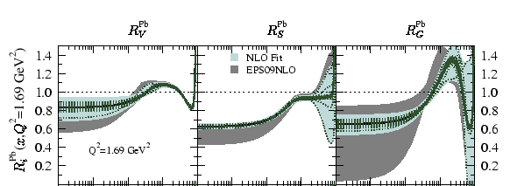
Nuclear PDFs: eA
eA offers access to lower x than
easily achievable in pA at LHC
LHeC (EIC) extends x range by
3-4 (1-2) orders of magnitude
Clean final states / theoretical
control - to (N)NLO in pQCD
New effects anyway likely to be
revealed in tensions between
eA and pA, AA (breakdown of factorisation)
LHeC
Simulation

Slide 21
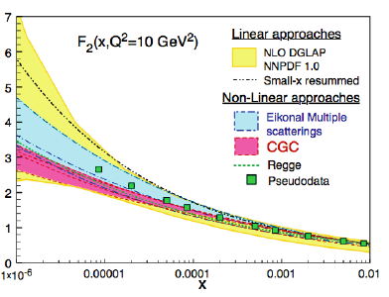
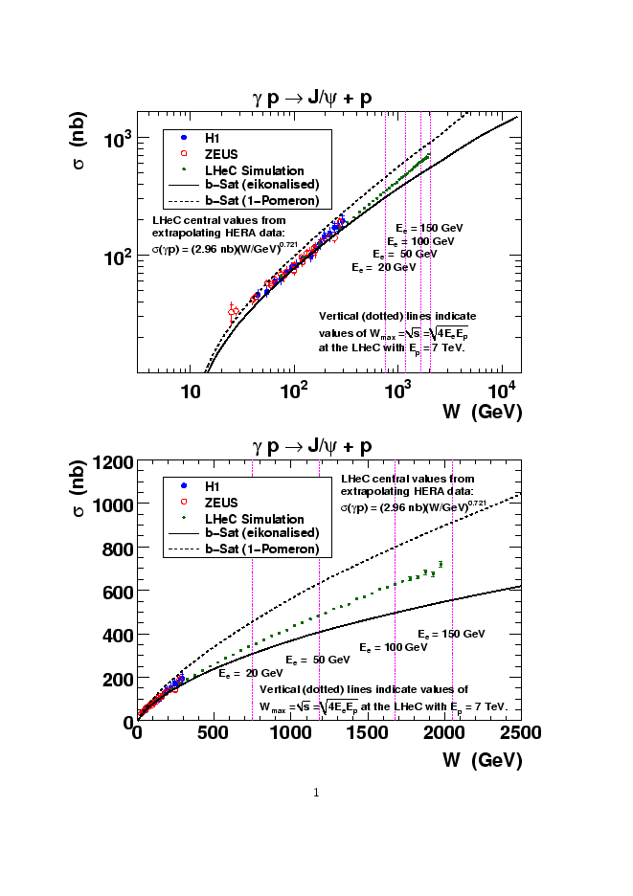
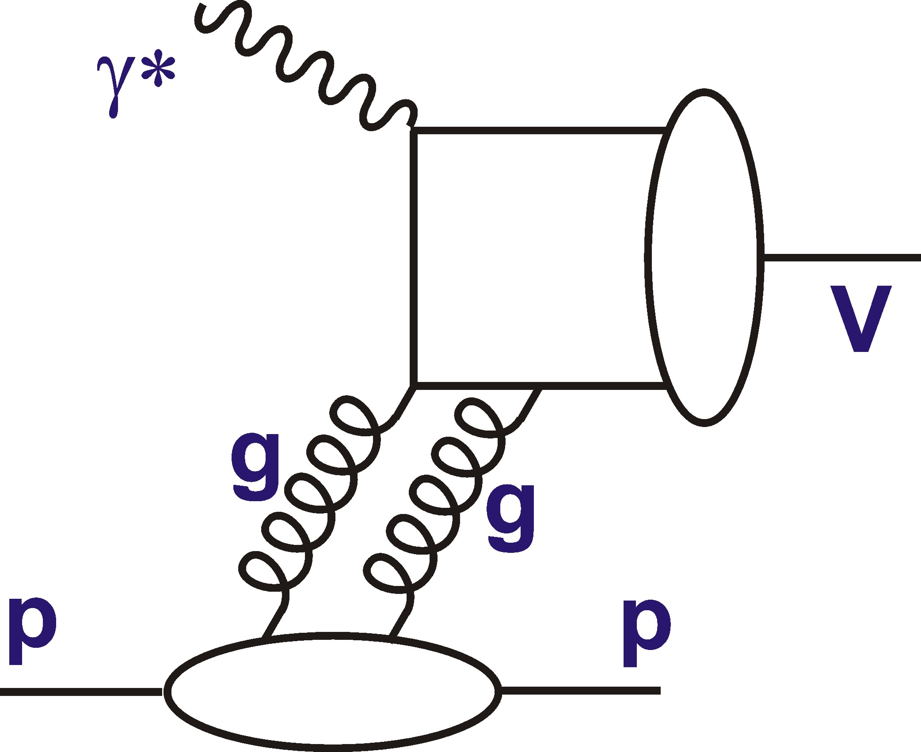
Precision Low x Physics at LHeC
LHeC can distinguish between
different QCD-based models for the
onset of non-linear dynamics
Unambiguous observation of
saturation will be based on tension
between different observables
e.g. F₂ v F_{L} in ep or F₂ in ep v eA
Significant non-linear
effects expected in diffraction
in LHeC kinematic
range, even for
ep → eJ/Ψp –
even more
so in eA …
[2 fb⁻¹]
21

Slide 22
New facilities and future fixed-target running

Slide 23
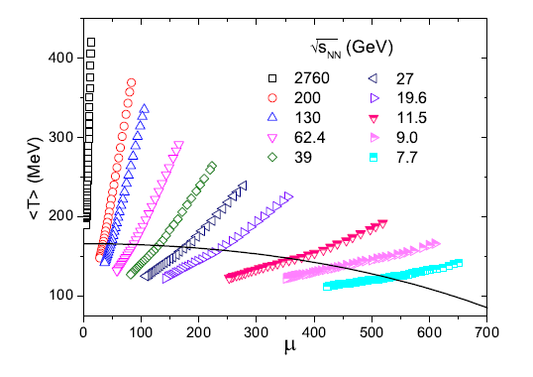
High baryon densities
Quark Gluon Plasma
Temperature [MeV]
system trajectories at different
collision energies (model)
Baryon Chemical Potential [MeV]

Slide 24
Heavy-Ion facilities for high-μ_{B} studies
20??
2019
2017
2015
SIS-300 (FAIR)
planned
running
closed
SIS-100 (FAIR)
NICA (JINR)
Booster (JINR)
Nuclotron-M (JINR)
RHIC (BNL)
SPS (CERN)
AGS (BNL)
SIS-18 (GSI)
2
4
6
8
20
40
60
80
√s_{NN} (GeV) for Au-Au
1
10
10²

Slide 25
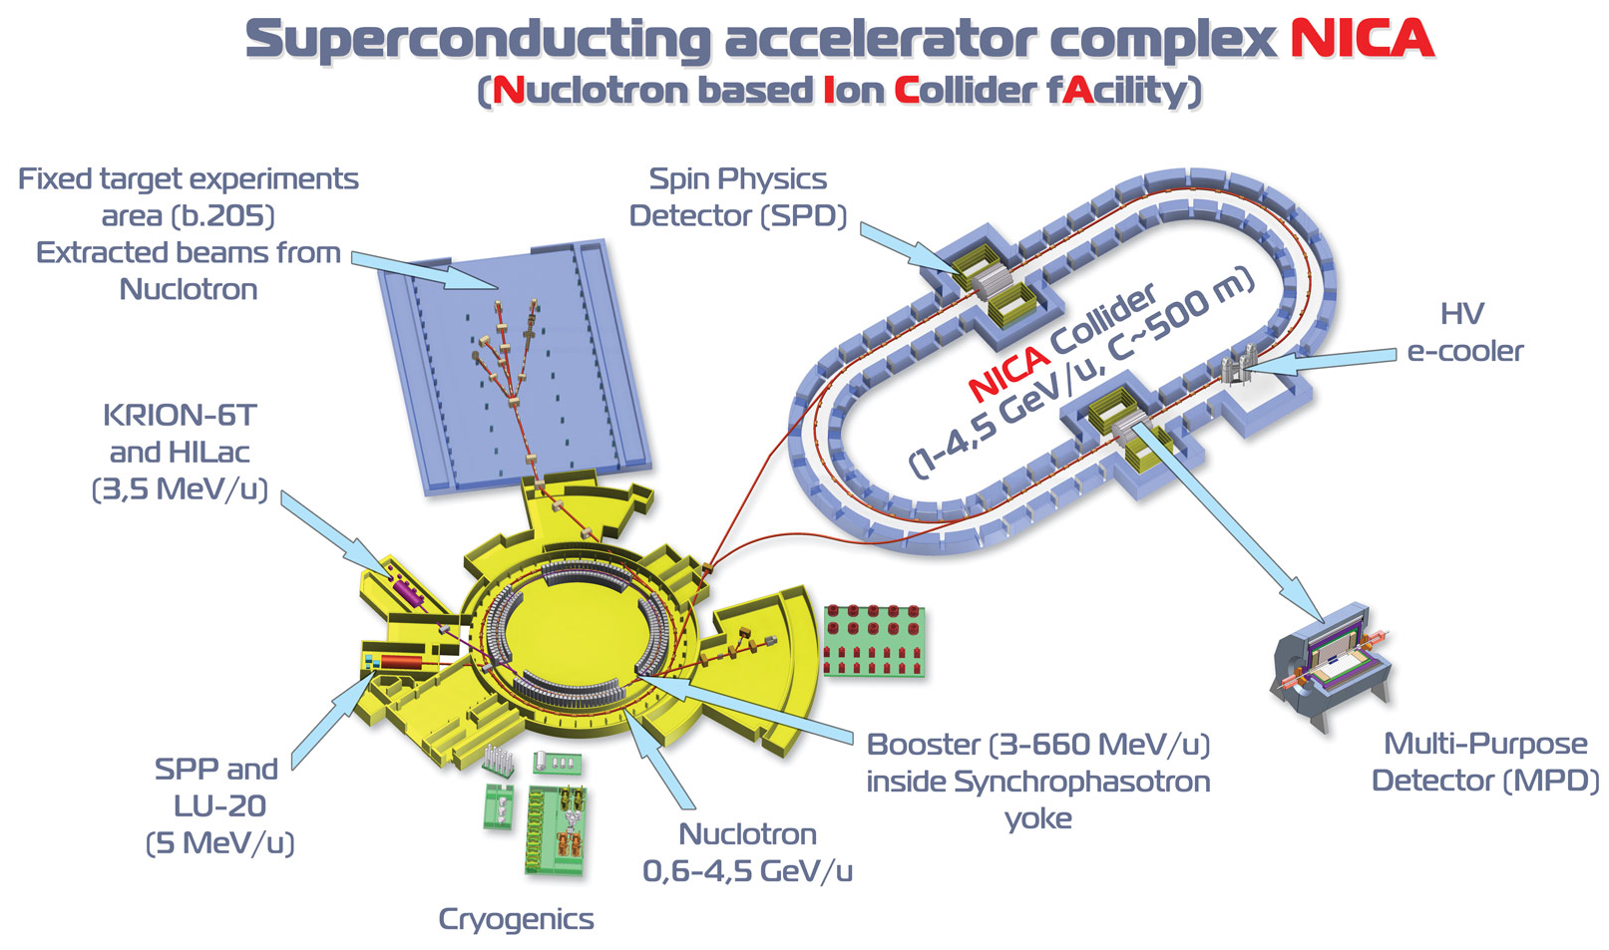
Future facilities – NICA (DUBNA)
NICA:
Based on existing Nuclotron at JINR/Dubna
Heavy-Ion collisions in fixed-target (2015) and collider (2017) mode (√s_{NN}= 4-11 AGeV)
→ Competitive high luminosity collider at the low energy end

Slide 26
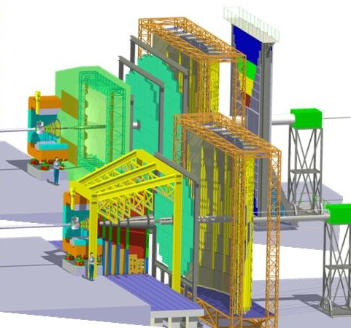
Future facilities – FAIR (GSI)
Compressed-Baryonic-Matter Experiment (CBM) at FAIR/GSI Darmstadt
2019: SIS100 (√s_{NN} = 2-4.5 AGeV)
20??: SIS300 (√s_{NN} = 4.2-9 AGeV)
Fixed-target heavy-ion collisions
at unprecedented rates
(up to 10⁹ ions/s)
Study of rare probes (EM and
charm) at highest baryon densities

Slide 27
Future activities at the SPS
Proposal for NA60-like dimuon spectrometers to measure low-mass dileptons and charm at E_{beam}=20 – 160 AGeV
(√s_{NN}= 6-17 AGeV):
  complementary to NA61: leptons vs hadrons
  high physics potential: onset of deconfinement and critical point
  competitive with RHIC: high luminosity

Slide 28
Synergies and Complementarities:
The Future RHIC Program

Slide 29
Future RHIC operation
RHIC community formulated their
wish to continue operation for
one more decade:
Beam-energy scan (BES) II
Luminosity increase x10,
low cost
Different ion species (U-U, Cu-Au)

Slide 30
RHIC future physics program (examples)
Search for onset of deconfinement and critical point
  → study beam energy scan program
Study of temperature dependence of QGP transport parameters
  → precision measurements of particle spectra and correlations
Transition from strong coupling to asymptotic freedom
  → jet studies
Study origin of initial density fluctuations
  asymmetric ion collisions
  → implies machine and experiment upgrades
  → complementary to LHC programme

Slide 31
(Partial) Summary
At the energy frontier, the LHC allows precision studies of quark-gluon matter at conditions similar to those of the early universe. Full exploitation of the physics potential requires upgrades and heavy-ion running at the LHC until at least 2025.
New accelerator und detector technologies at future facilities NICA and FAIR will enable a comprehensive study of the QGP phase diagram at high baryon densities.
The CERN-SPS will remain an important facility with high potential for specific studies on a competitive time scale.
RHIC envisages a continuation of its heavy-ion programme which offers important complementarities present and future facilities in Europe.
LHeC may be an interesting option for part of the HI and PP communities after the completion of the ALICE measurement program (2026)

Slide 32
backup

Slide 33
detector upgrades - ATLAS
LS1(2013-14): - additional pixel layer (Insertable B-layer, IBL)
→ improve b-tagging
LS2(2017-18): - fast tracking trigger (FTK)
→ improve high-multiplicity tracking
- calorimeter readout and trigger upgrade
→ improve selectivity of photon and electron trigger
- new forward muon detectors
→ improved muon triggers
LS3(2022): - replacement of inner detector (pixel and strips,
reduced material budget)
→ improve tracking and resolution

Slide 34
detector upgrades - CMS
By end of LS2: - new pixel vertex detector
- upgraded trigger
- extension of forward muon system
- refurbishment of hadron calo electronics
- DAQ upgrade
Important for Heavy-ion running at 50 kHz:
- HLT input limitation (3kHz) requires 0.95 rejection at Level 1
(0.5 achieved so far)
→ dedicated R&D effort started on Level 1 upgrade,
largely driven by HI needs and HI community
LS3 (2022): - new inner tracker
- trigger and DAQ
- ...

Slide 35
ALICE ITS upgrade
new ALICE Inner Tracking System:
7 Si-layers (7 pixel or 3 pixel + 4 strip)
low material budget X/X₀= 0.3% per layer
(currently 1.14%)
improve vertex resolution by factor 3
improve low p_{T} tracking efficiency
allow for 50 kHz readout
CERN-LHCC-2012-05 / LHCC-G-159
Parallel 6C: R. Lemmon
Poster: G. Contin

Slide 36
ALICE ITS upgrade
new ALICE Inner Tracking System:
7 Si-layers (7 pixel or 3 pixel + 4 strip)
low material budget X/X₀= 0.3% per layer
(currently 1.14%)
improve vertex resolution by factor 3
improve low p_{T} tracking efficiency
allow for 50 kHz readout
CERN-LHCC-2012-05 / LHCC-G-159
current
ITS
new
ITS
new
ITS
current
ITS
Parallel 6C: R. Lemmon
Poster: G. Contin

Slide 37
ALICE TPC upgrade
GG open
(drift time)
GG closed
(ion coll. time in ROCs)
Limitation of the present system:
Readout rate limited to 3.5 kHz due to Gating Grid closing time
- Needed to prevent ions from drifting back into the drift volume
→ drift distortions from space charge
Solution:
Replace present MWPC-based readout chambers by GEMs
- GEMs have intrinsic property to block back-drifting ions
→ allows continuous operation at 50 kHz
→ preserves the present momentum and dE/dx resolution
inter.
L1a
t0
t0+6.5μs
Int. + 100μs
Int. + 280μs
Parallel 6C: T. Peitzmann
Poster: T. Gunji

Slide 38
ALICE TPC upgrade
Poster: T. Gunji
- new TPC readout chambers with triple GEMs
- required Ion Back Flow (IBF) limit of 0.25% in reach
- prototype tests at PS and in ALICE cavern under
preparation (2012/2013)
- new electronics for continuous readout needed
→ major R&D effort started

Slide 39
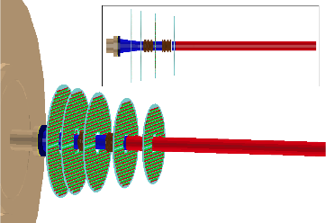
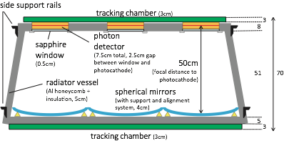
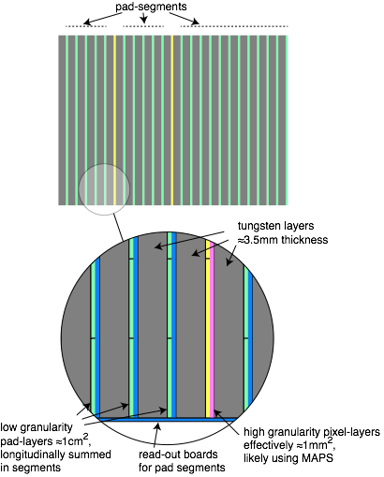
ALICE further upgrade options
Muon Forward Tracker
5 circular Si-pixel planes covering
muon arm acceptance
Improves secondary vertex, background rejection,
mass resolution
VHMPID
- focussing RICH for
high momentum hadron PID
in central barrel
FoCal
- forward SiW calorimeter for low-x physics
Poster: A. Uras
Poster: T. Gunji

Slide 40
QCD phase transitions
Deconfinement
Chiral Symmetry
Lattice QCD predicts:
transition of hadronic matter to deconfined quarks and gluons
  → Quark-Gluon Plasma, most elementary matter in SM
restoration of chiral symmetry

Slide 41
Heavy-Ion collisions at the LHC - conclusions
Conclusions of the Heavy-Ion Town Meeting June 29 2012 at CERN:
http://indico.cern.ch/event/HItownmeeting
Contribution ID 55:
„1. The top priority for future quark matter research in Europe is the
full exploitation of the physics potential of colliding heavy ions in the LHC“
Priority endorsed by NUPECC:
Contribution ID 32:
„Support for R & D to complete a technical design report for the LHeC was also included among the recommendations in the Long Range plan, but with lower priority. From the point of view of the Heavy Ion community, the LHec could thus be seen as an interesting option in the future, if the necessary critical mass of people could be assembled. The recent proposal to use Point 2 (where the ALICE experiment is located) as the interaction region for the LHeC is not supported, if installation were to start before 2025, because it is incompatible with the top priority of the Long Range plan.“

