Slide 1
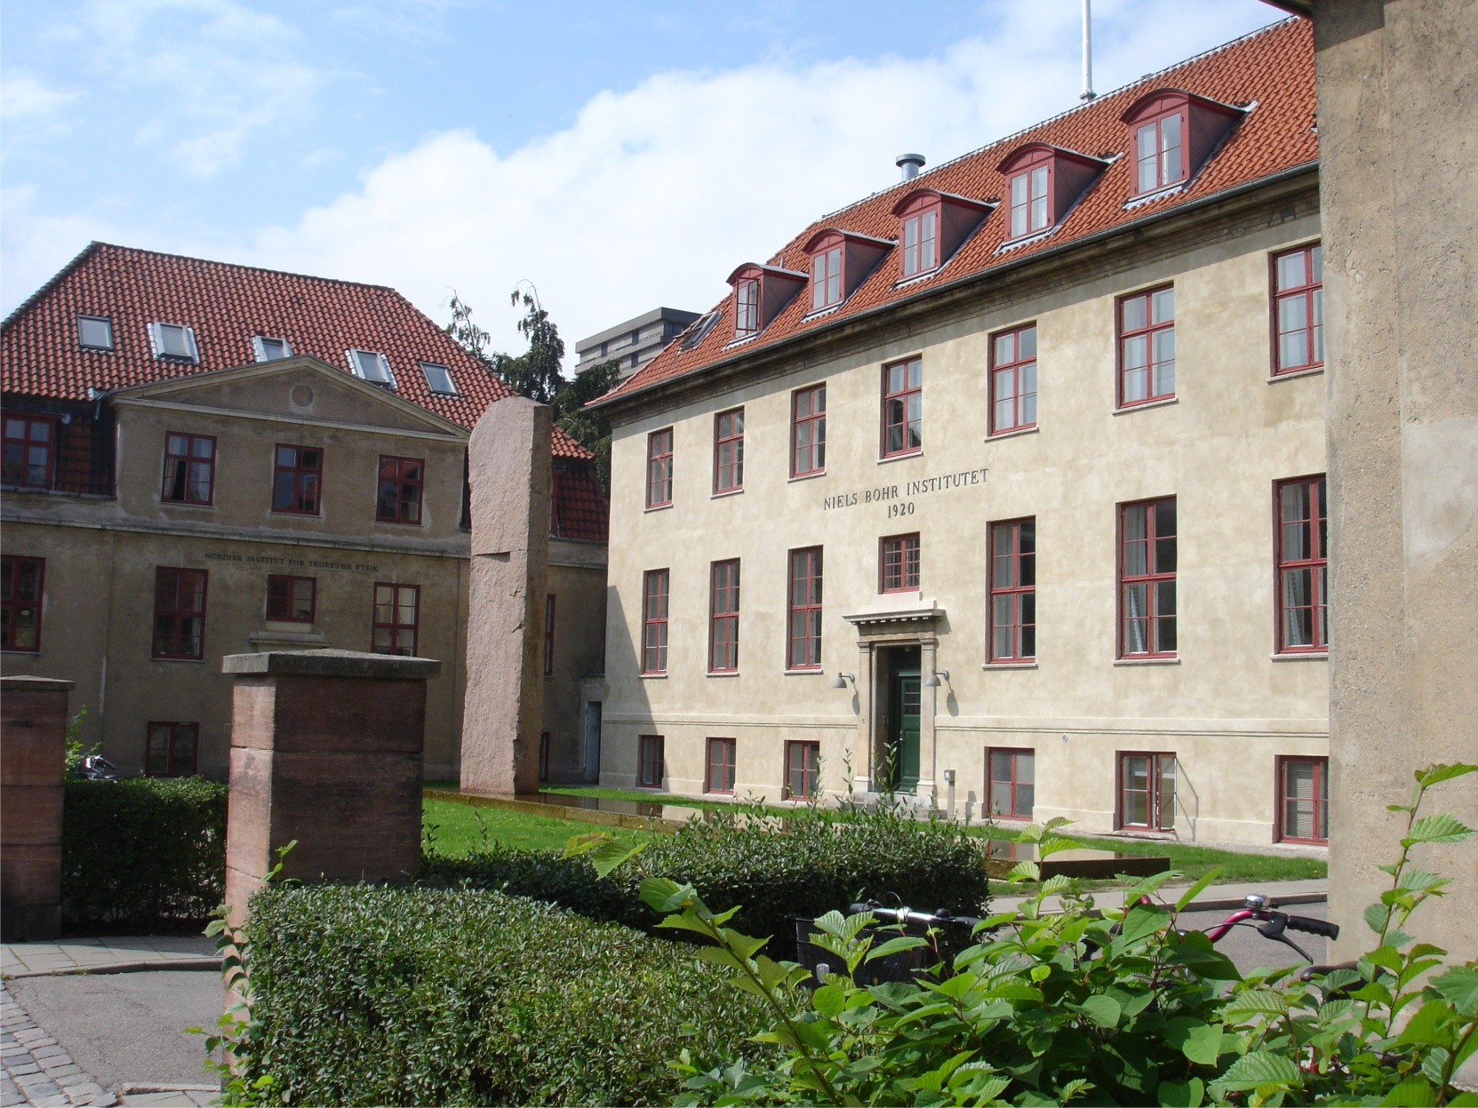
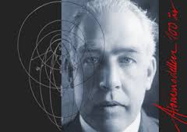
Accelerators and Storage rings for
Life Science and Materials Research.
The Danish Perspective
Robert Feidenhans’l
Niels Bohr Institute
University of Copenhagen
robert@nbi.ku.dk

Slide 2
Why are accelerators important for
Life Science and Materials Research?
Technology output from Particle Physics

Slide 3
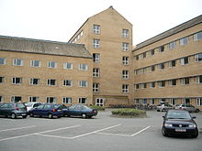
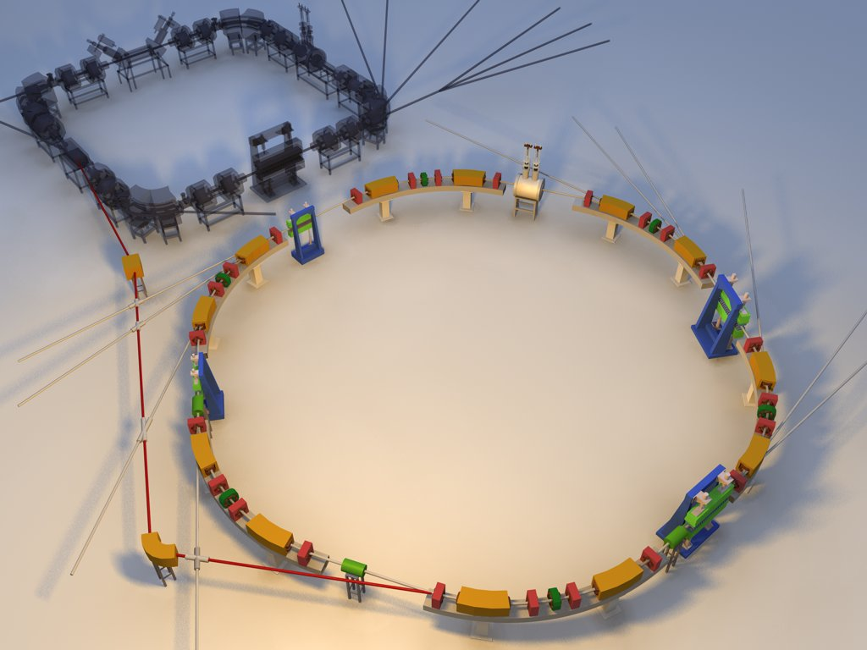
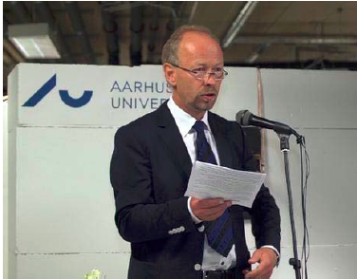
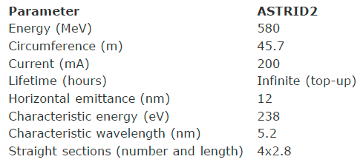
The Danish Synchrotron Radiation Facility:
ASTRID II

Slide 4

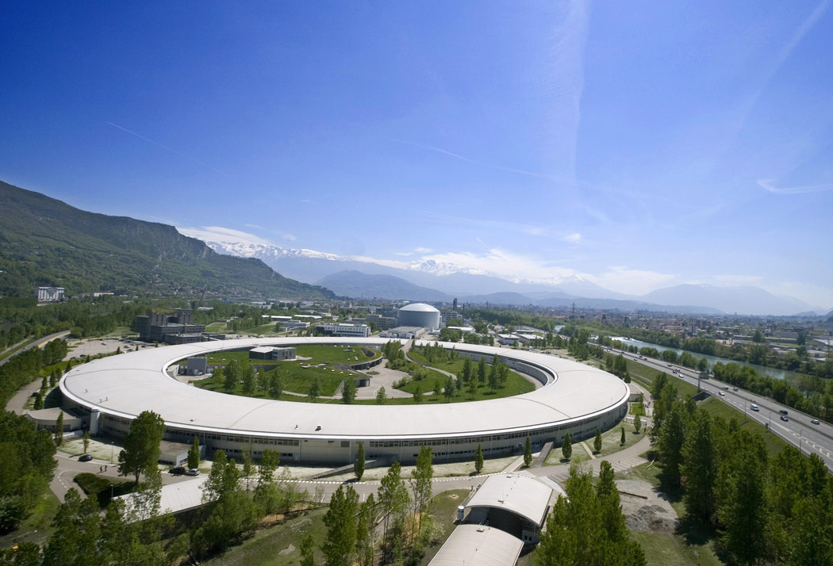

Danish membership of ESRF

Slide 5
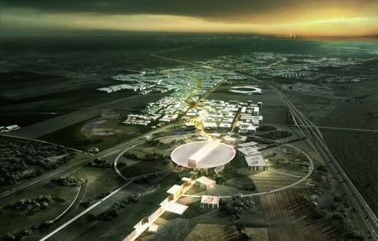
European
Spallation
Source
ESS
Neutrons
For the
Future

Slide 6
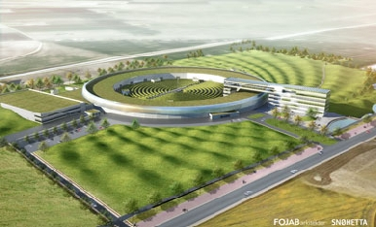
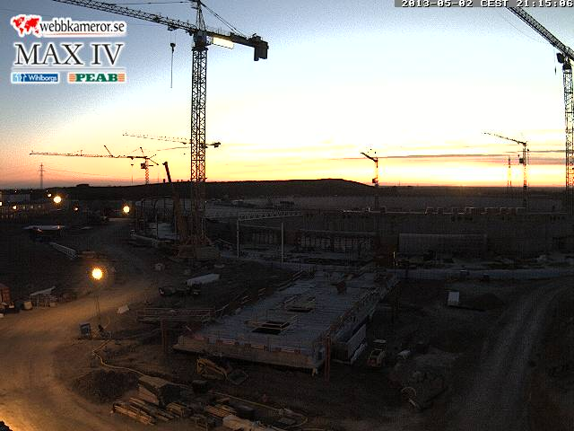
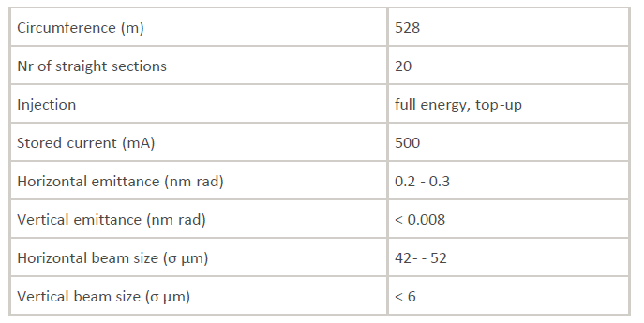
Synchrotron Radiation Facility
MAX IV @ Lund

Slide 7
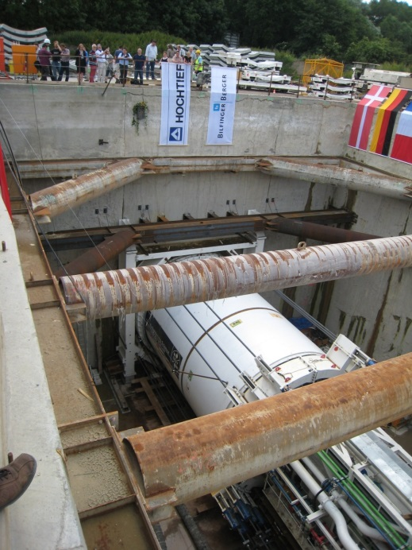
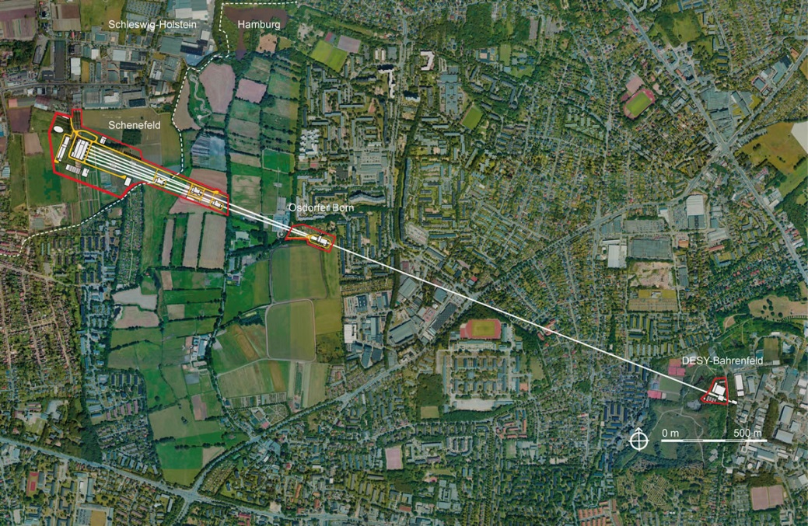
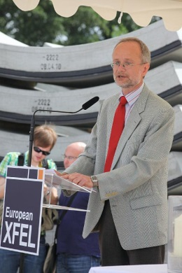

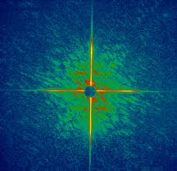
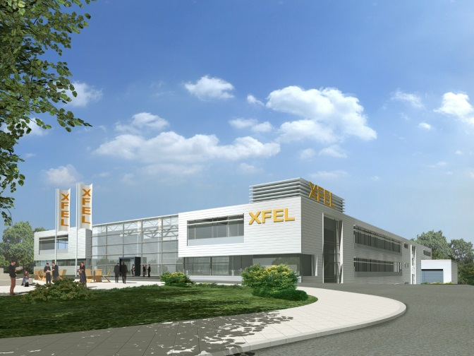
European XFEL Hamburg

Slide 8
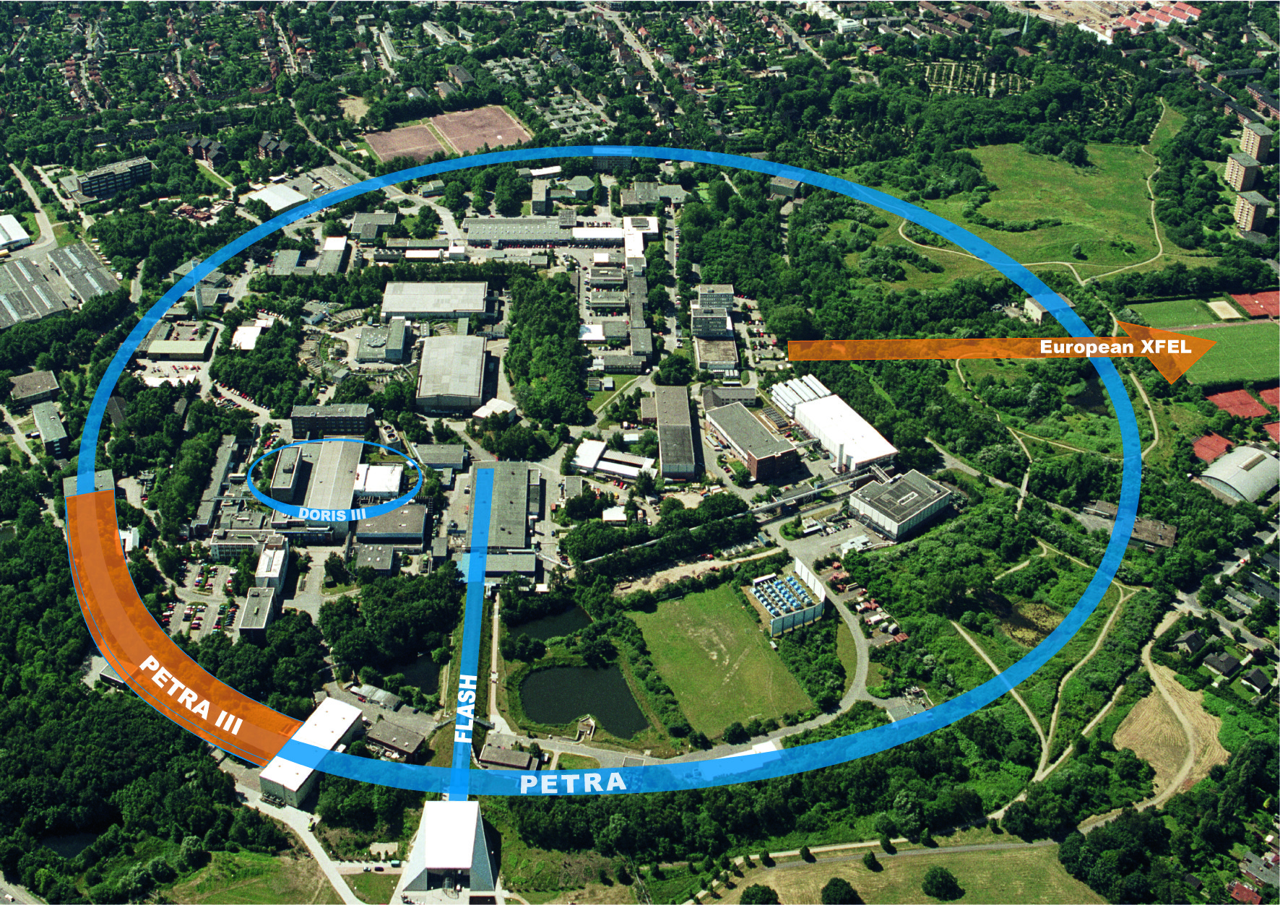
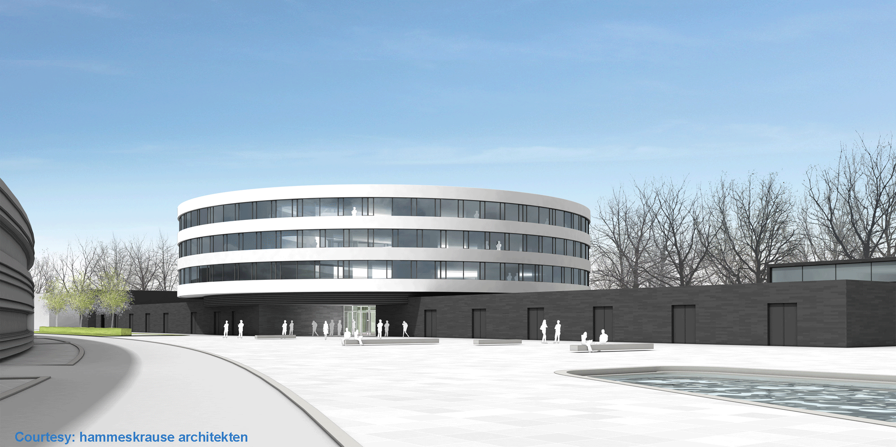
DESY , new center for Photon Science
CFEL
Centre for Free Electron Lasers

Slide 9
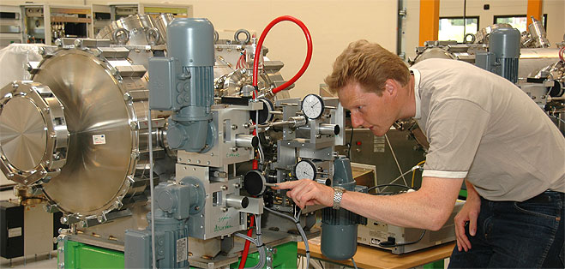
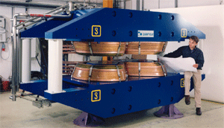


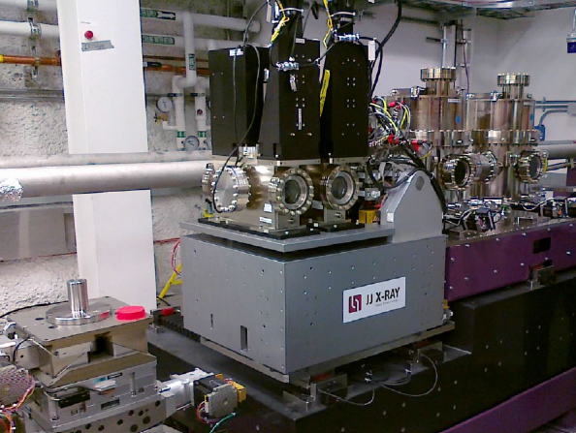

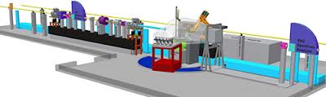
Danish Companies

Slide 10
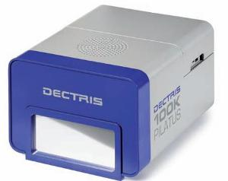
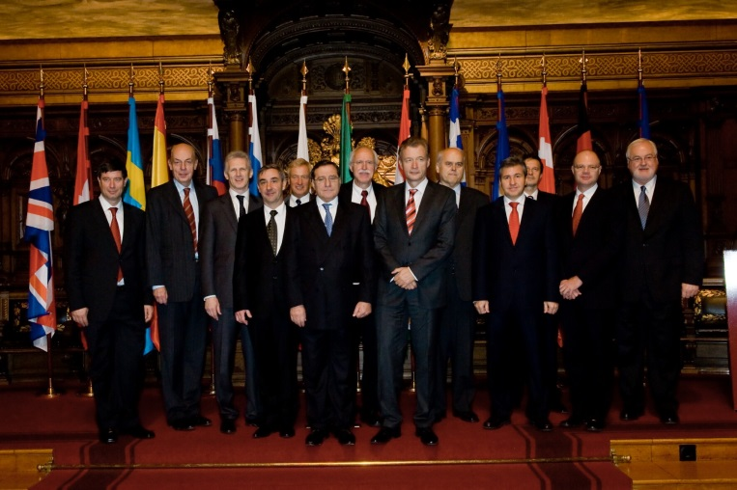
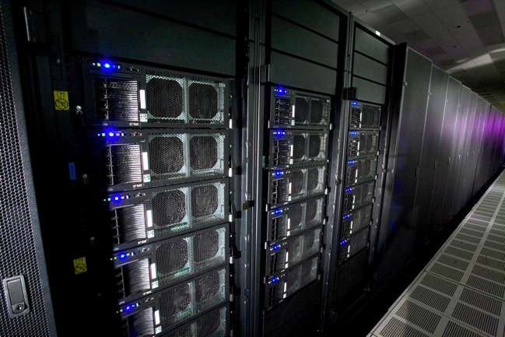
What do we get from CERN and particle physics
Accelerator technology
Detector technology
Data handling
Governance structure
international collaborations

Slide 11

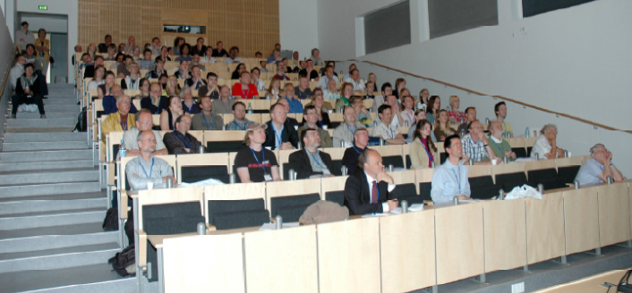

DANSCATT
Danish Centre for the use of
Synchrotron X-ray and Neutron facilities
Funded by the Natural Research Council:
360 scientists incl about 90 Staff, 50 Post docs
140 PhD students and 80 Master/Bachelor students

Slide 12
Main tasks for DANSCATT
support for travel and experiments at international facilities
development for new instrumentation and new scientific directions using synchrotron x-ray radiation and neutron scattering
training of high-quality graduate students and post docs
summer schools and courses, including experimental exercises at international facilities.
stimulating collaboration between groups, yearly meetings, homepage
International relations (ESRF, XFEL, ILL, PSI)
Advisor role for research council and ministry

Slide 13
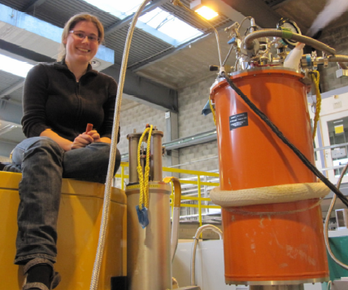
Training
Provide travel support for students (Bachelor+Master+ PhD)
Exercises at MAXlab, Cassiopeia and at PSI, SINQ+SLS
Summerschools

Slide 14
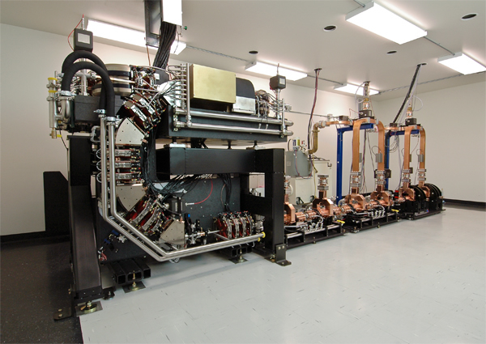
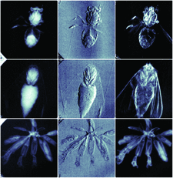
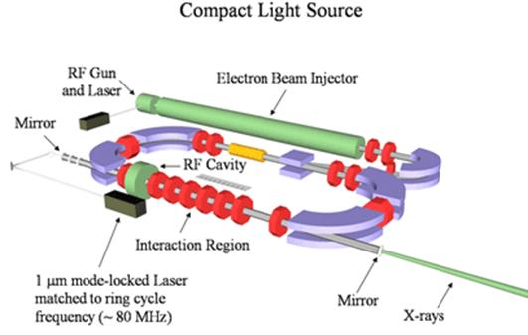
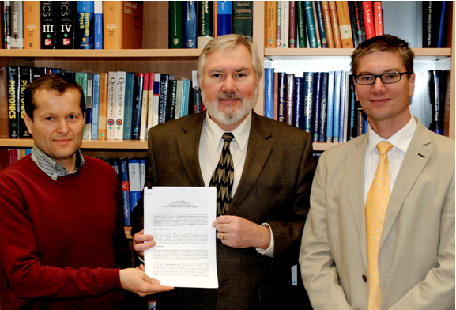
Compact Light Sources – a dream?
First machine in TUM

