Slide 1


ATLAS activities Niels Bohr Institute
S.Xella on behalf of the ATLAS NBI group

Slide 2
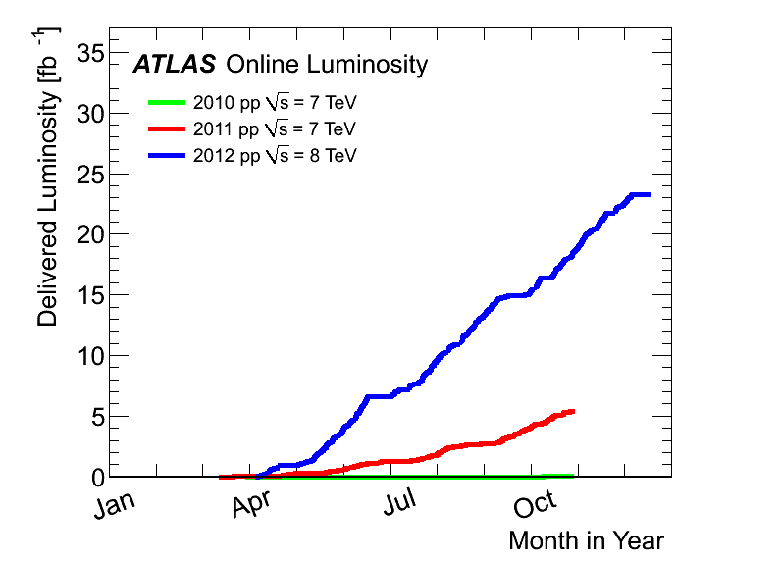
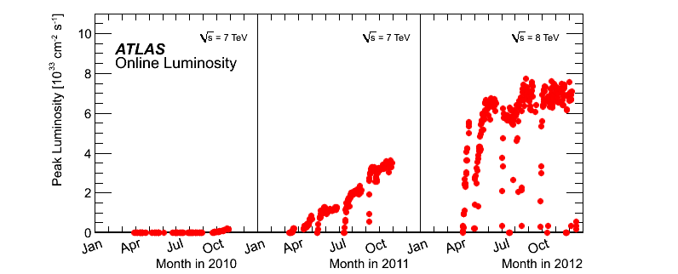
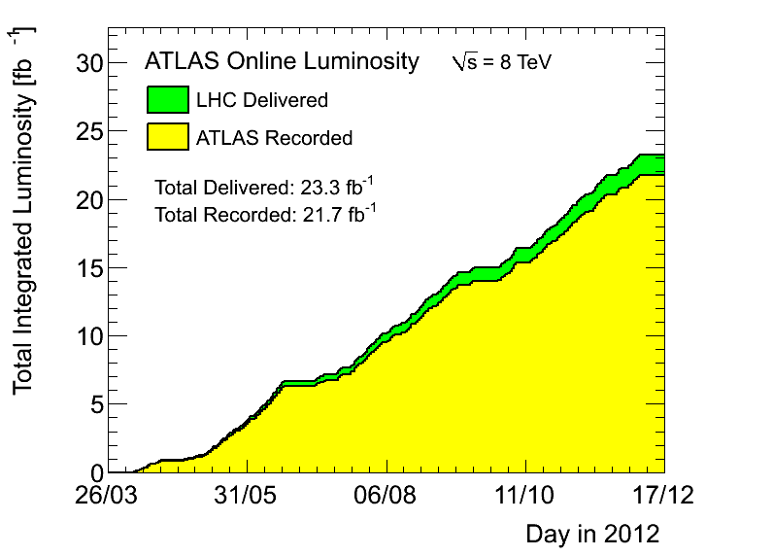
LHC and ATLAS : remarkable operation during Run 1
smaller and smaller beam size σ
more and more bunches (from 368 to up to 1380 , nominal 2808)
bunch spacing reduced from 150 to 50 (nominal 25 ns)
2012
2011
2010
Notes:
20 fb-1 = two times more than what Tevatron has delivered in all his 10++ years of operation

Slide 3
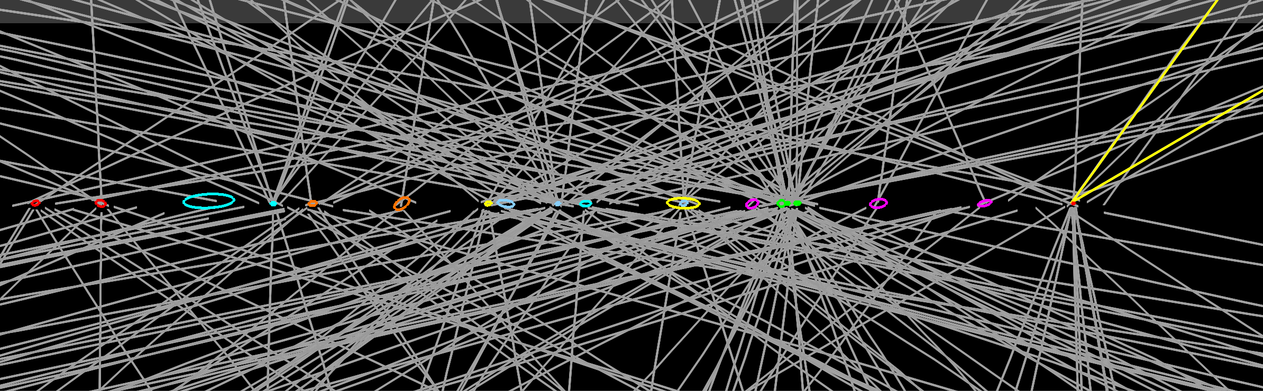
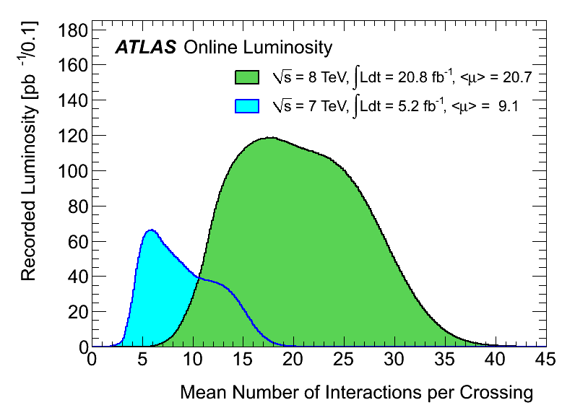
Bring it on !
Example of Z → μμ decay with 20 reconstructed vertices
(shown ± 15 cm, p_{T} (track) > 0.4 GeV )

Slide 4
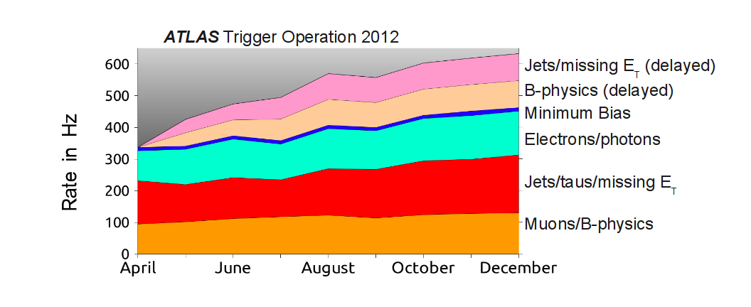
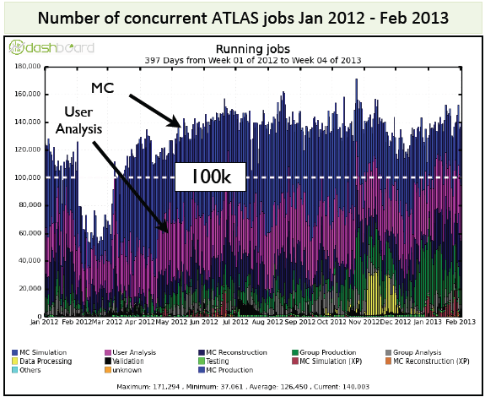
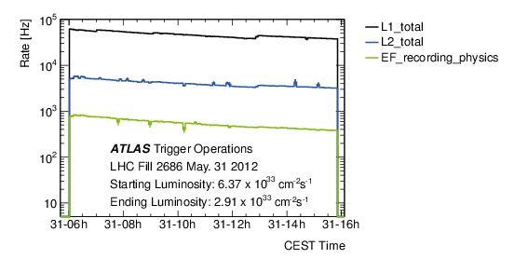
Trigger was exceptional
Way above expectations !

Slide 5
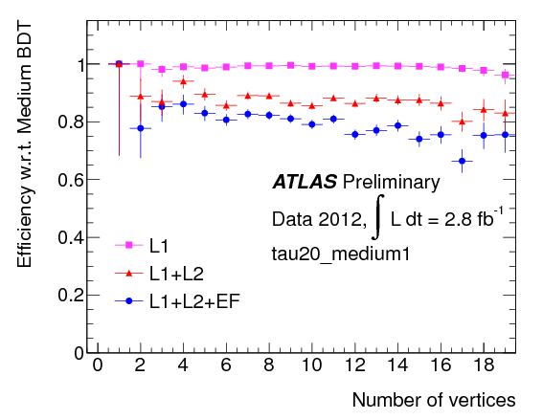
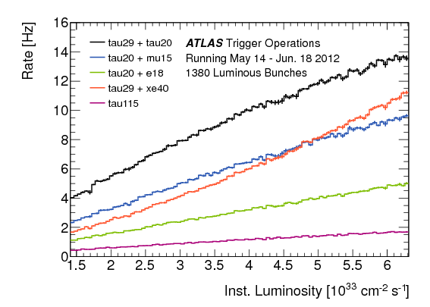
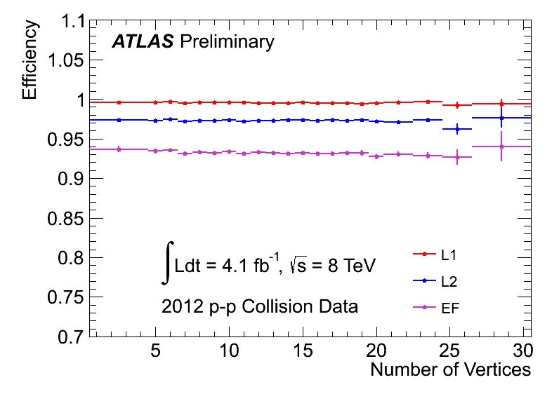
Robust and rich Trigger menu
Trigger |  | Event Filter Thresholds (GeV)
Single e | Iso | 24
Combined e | e+e | 12
 | e+e+e | 18,7,7
 | e+missing ET | 24,35
 | e+mu , tight e | 12,8
Single tau |  | 115
Combined tau | tau+tau, iso tau | 29+20
 | tau+mu | 20,15
 | tau+e , iso tau | 20,18
 | tau+missing ET | 29, 50
~100 primary physics triggers active during a run + support triggers (calibration, background estimations, etc…)
e24vhi_medium1 OR e60_medium1

Slide 6
ATLAS @ NBI
I will now highlight the areas where NBI group provides an important contribution
Run 1:
Basic particle reconstruction performance (trigger and offline reconstruction)
The Standard Model Higgs search
Physics beyond the Standard Model search
Luminosity measurement
Run 2 and beyond : Upgrade contribution
Luminosity measurement
L1 , HLT , L4 trigger

Slide 7





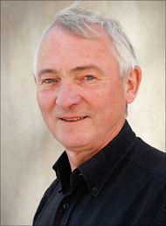
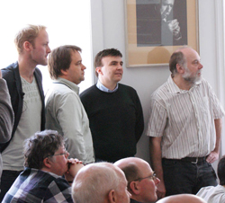





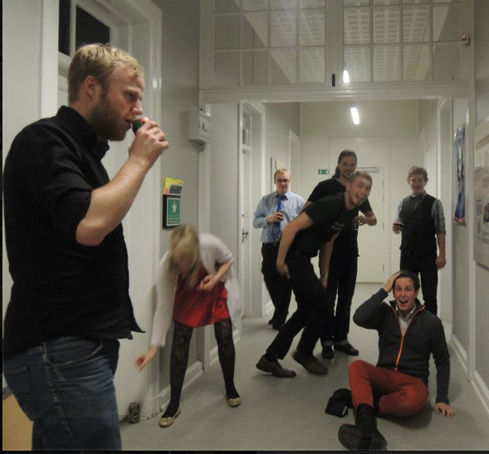



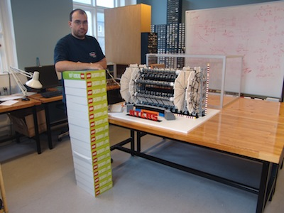

Slide 8
Basic particle reconstruction performance (trigger and offline reconstruction)

Slide 9
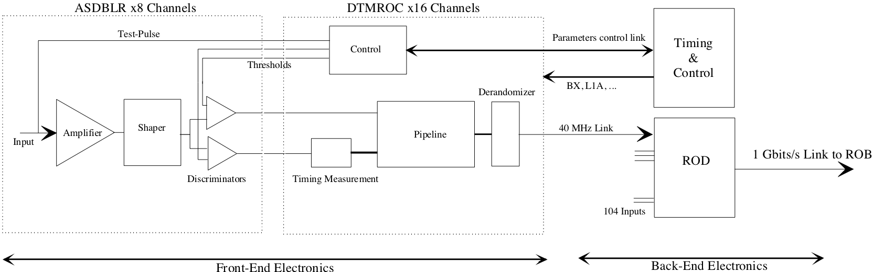
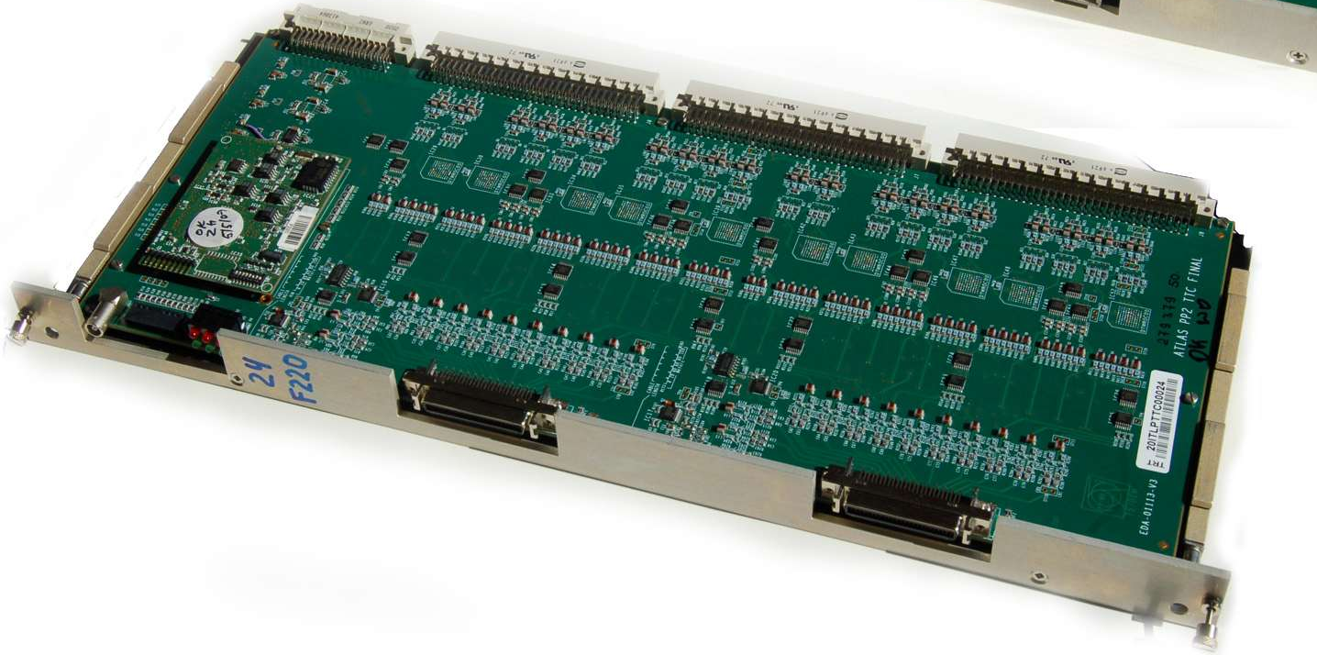
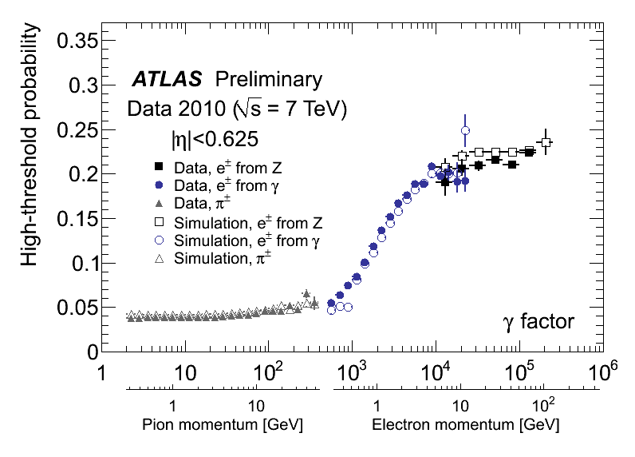
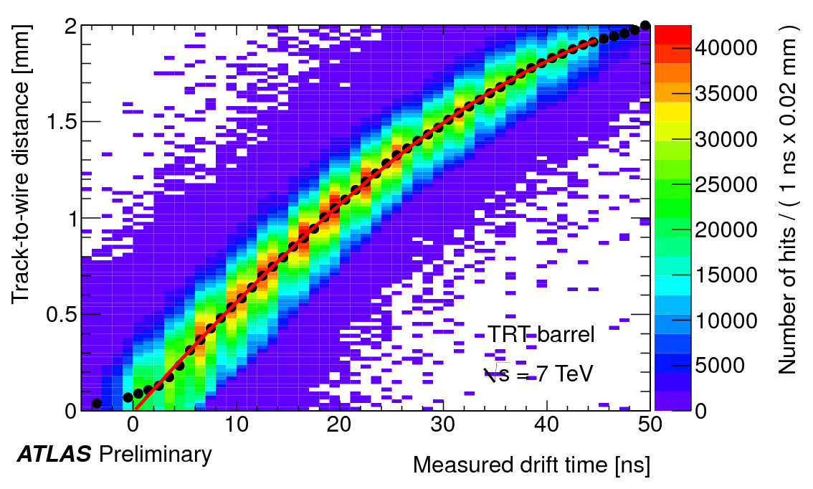
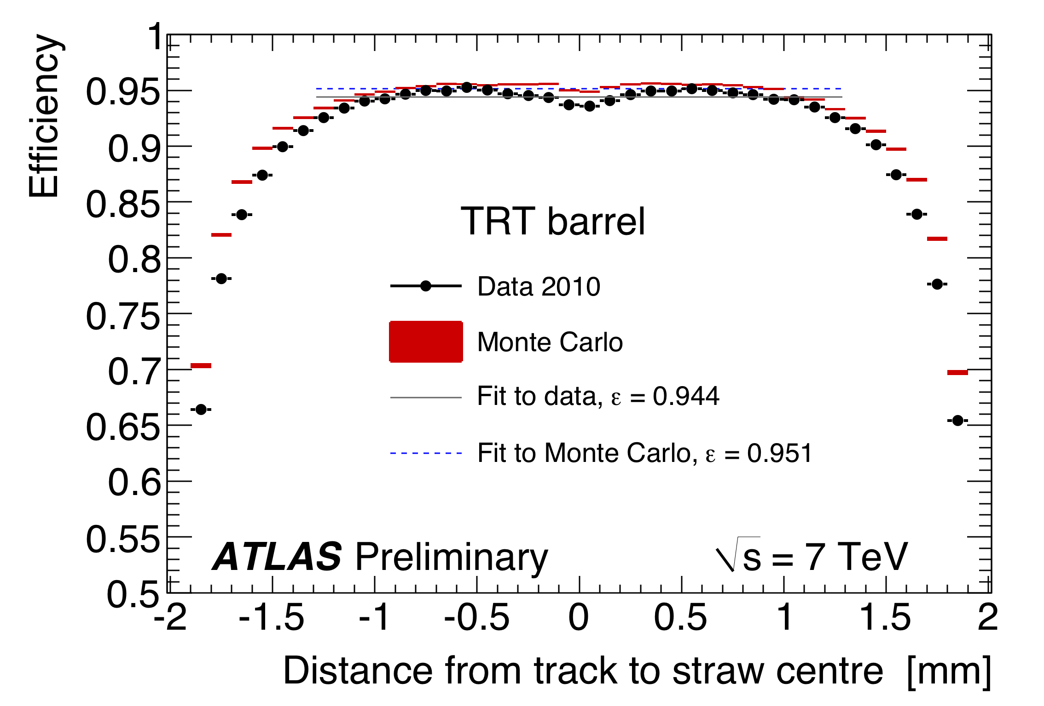
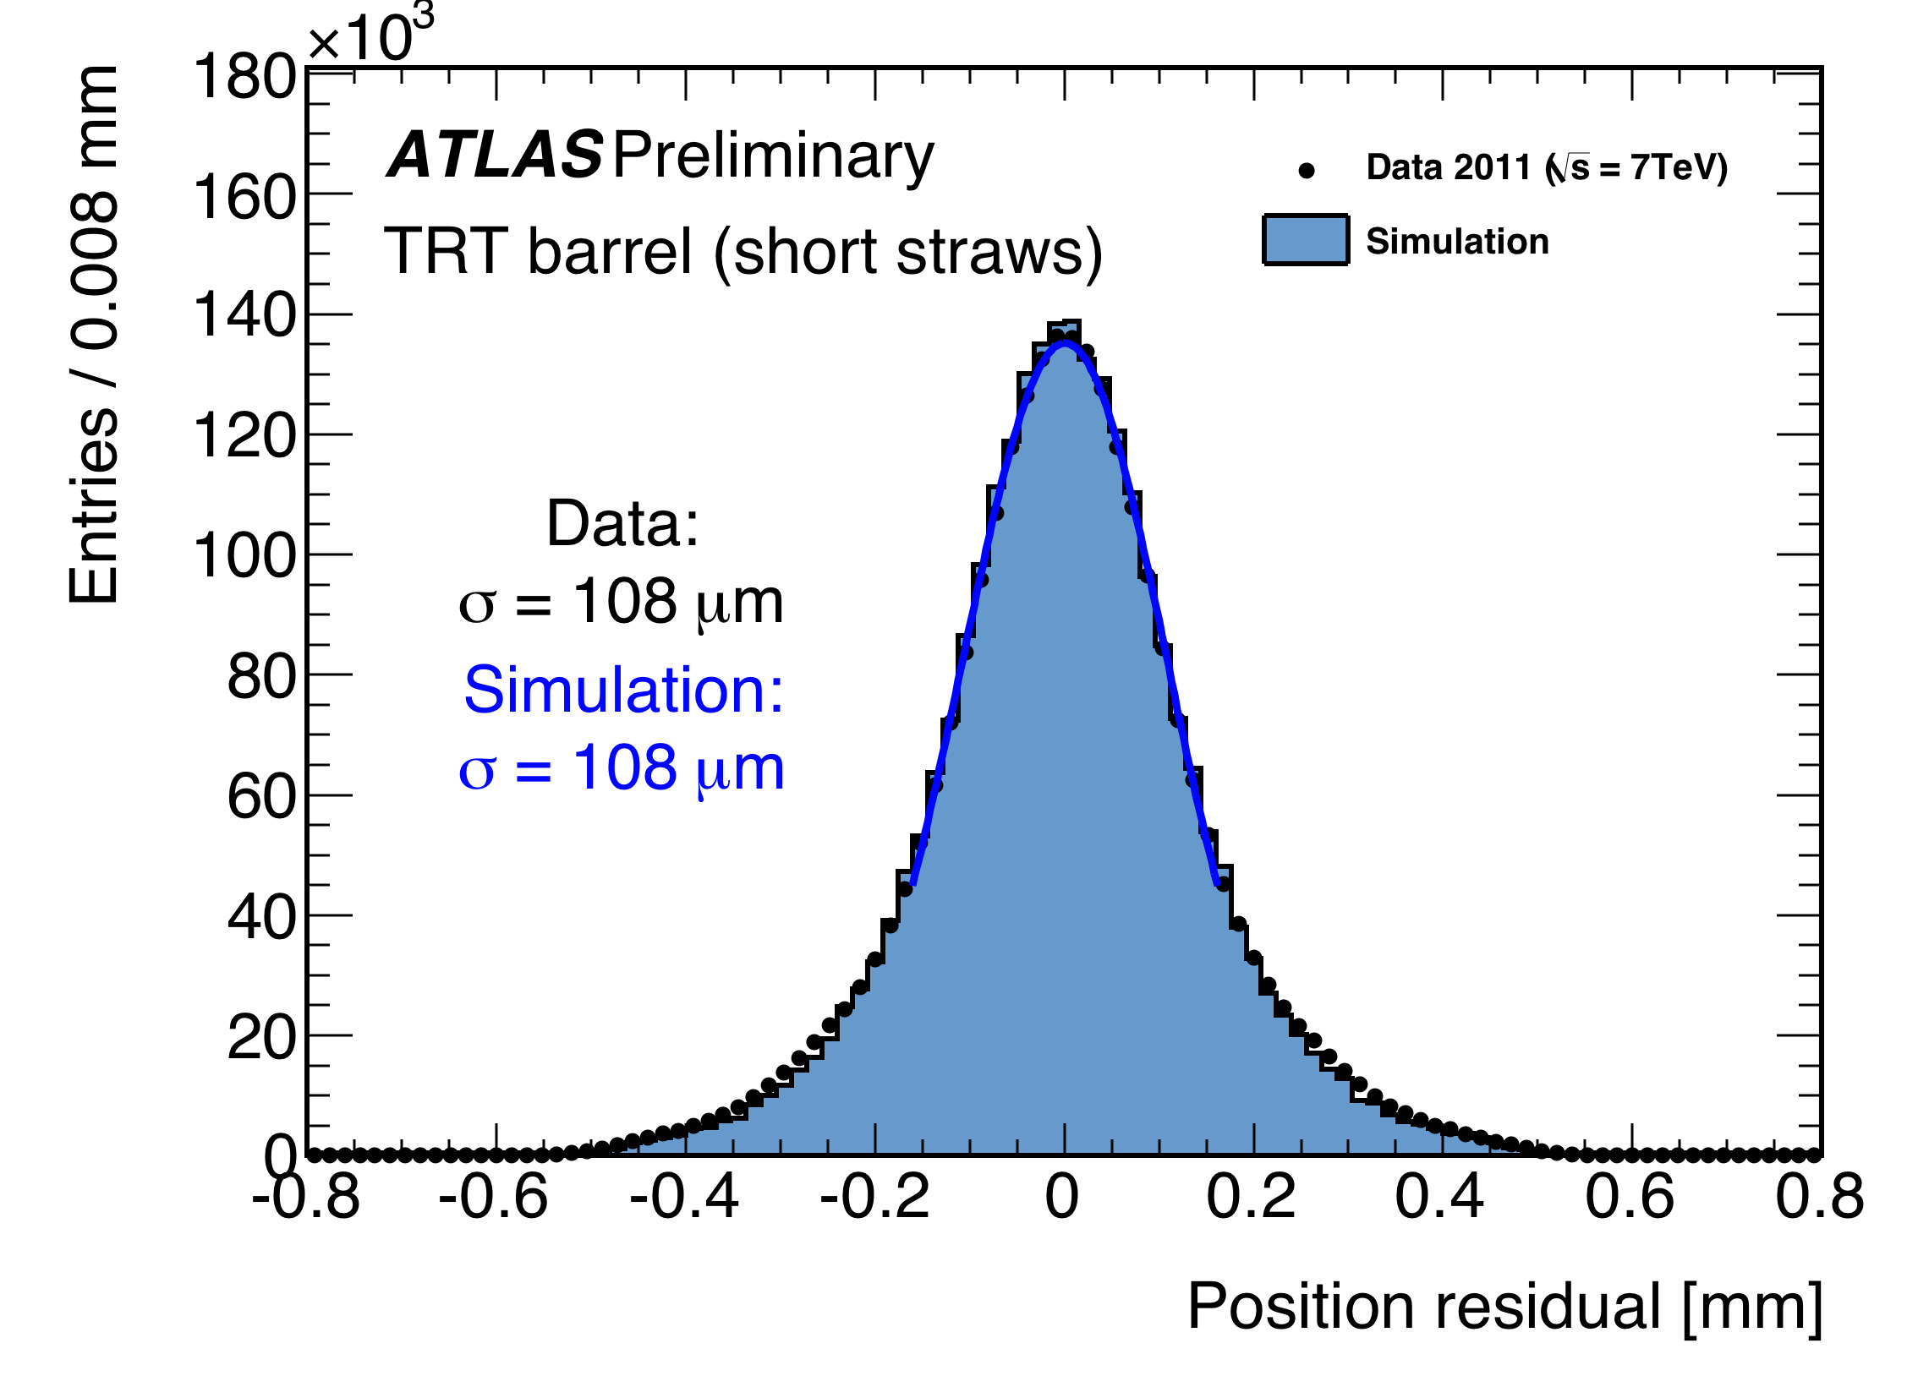
Transition Radiation Tracker
Electronics:
Production of Timing, Trigger Control backend electronics module
Test the front-end electronics
Operation:
Leading role in testbeam campaign
Developing of software for reconstruction and simulation
Electron Identification:
Use Transition radiation to separate electrons from pions
TRT PID capabilities are fundamental at trigger and offline for e.g. H->ZZ
Tracking Calibration:
Method to correct timing changes in the detector
Improving the so-called r-t relation
All data is calibrated automatically to get the best positions residual
Detector Simulation:
Development of simulation and digitization of the TRT
Tuning of the MC to data with very good agreement in the
distributions used in analysis

Slide 10
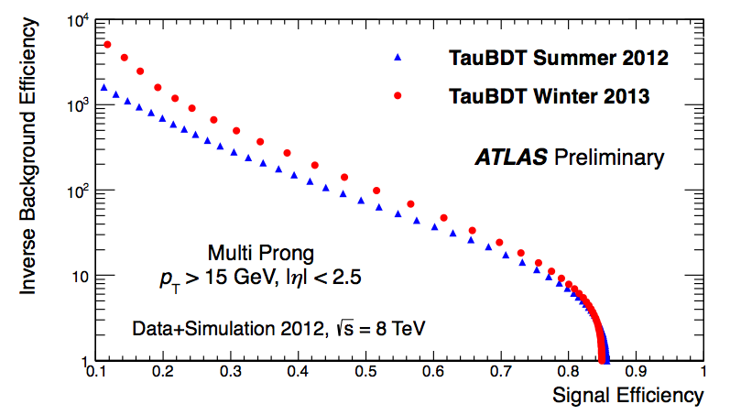
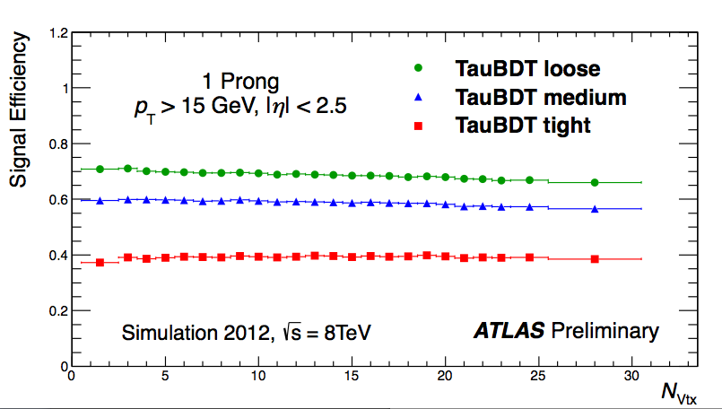
Trigger and tau online/offline identification
Trigger:
Contributed to HLT farm design (experience from Hera-B)
NBI is Member of the TDAQ Institute Board
Tau trigger coordination (2009-2011)
Commissioning tau trigger during 2010-2011 run period + ensure a rich tau+X trigger menu for wide range of tau physics searches
Developing of software for tau reconstruction online and offline
Tau Identification:
Tau offline reconstruction coordination (2011-2013)
Develop tau identification for 2012 run, align trigger algorithm to this, provide robustness to pile-up
Develop tau energy calibration
TRT PID capabilities used for electron veto development
All essential ingredients for H-> ττ search

Slide 11
Higgs search

Slide 12
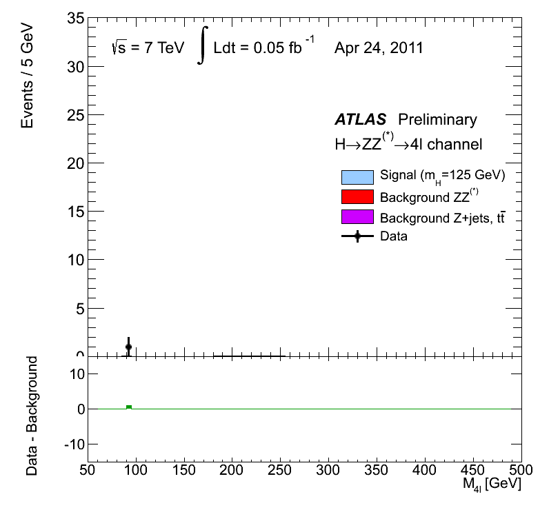
Higgs decay to ZZ

Slide 13
Higgs Properties
After discovery of 126 GeV Higgs-like particle, we want to measure properties
Mass ➔ Compatible between CMS and ATLAS
ATLAS 125.5 ± 0.2 (stat) +0.5 -0.6 (sys) GeV
CMS 125.8 ± 0.4 (stat) ±0.4(sys) GeV
Signal strength ➔ Compatible with SM so far
ATLAS 1.43 ± 0.16 (stat) ± 0.14 (sys)
CMS 0.91 ^{+0.30} _{-0.24}
Coupling to boson and fermions ➔ Compatible with SM so far, but fermions (bb,ττ, …) missing
Spin ➔ most likely 0
Parity ➔ most likely 0+ ➔ SM like !
There is still lots to measure ! We just started !

Slide 14
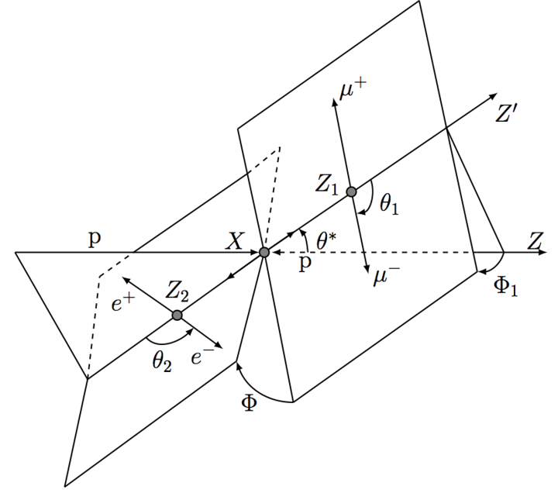
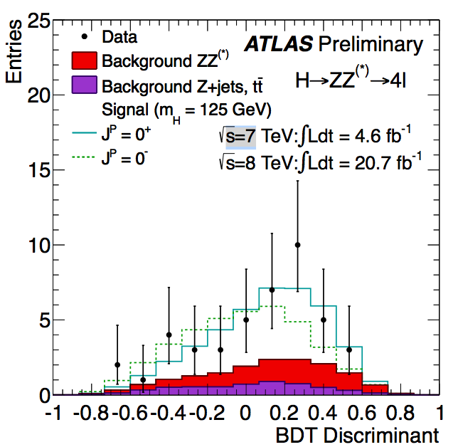
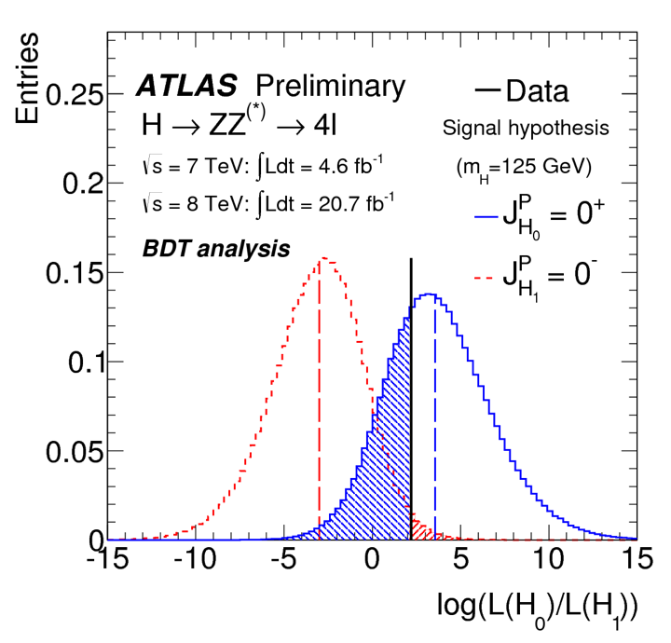
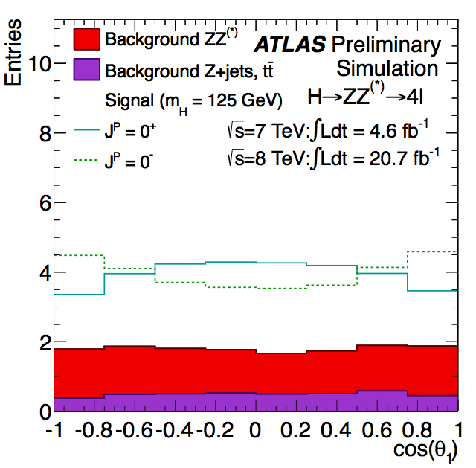
Higgs Spin and Parity
H ➛ ZZ channel dominates the parity determination (H ➛ γγ is “blind” to parity!).
H ➛ ZZ channel has five angles and two invariant masses sensitive to spin and parity.
Combining these in a Boosted Decision Tree (BDT) yields maximum pr. event
separation between 0⁺ and 0_ hypothesis.
p-value for 0_ state 0.015 (excluded at more than 2σ)

Slide 15
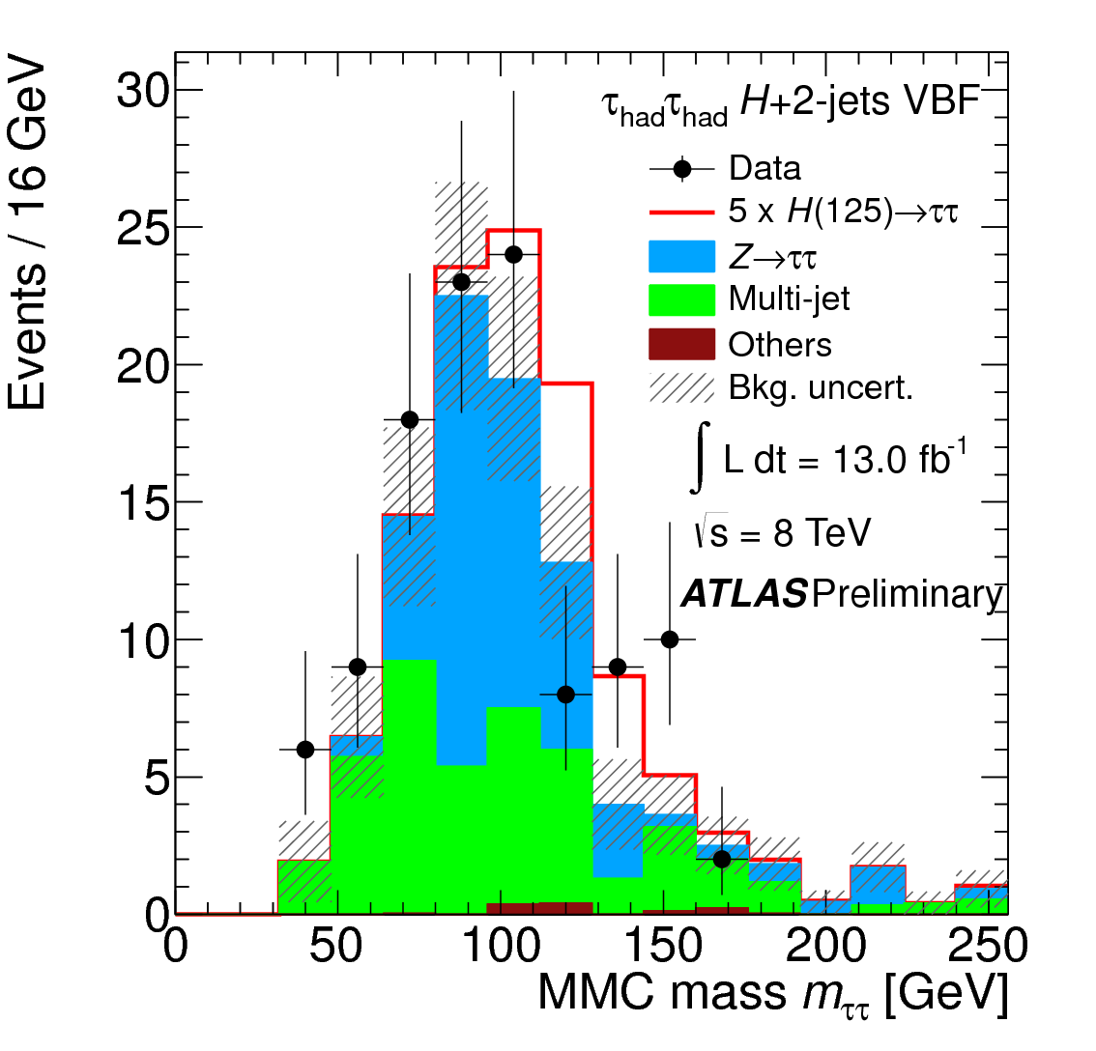
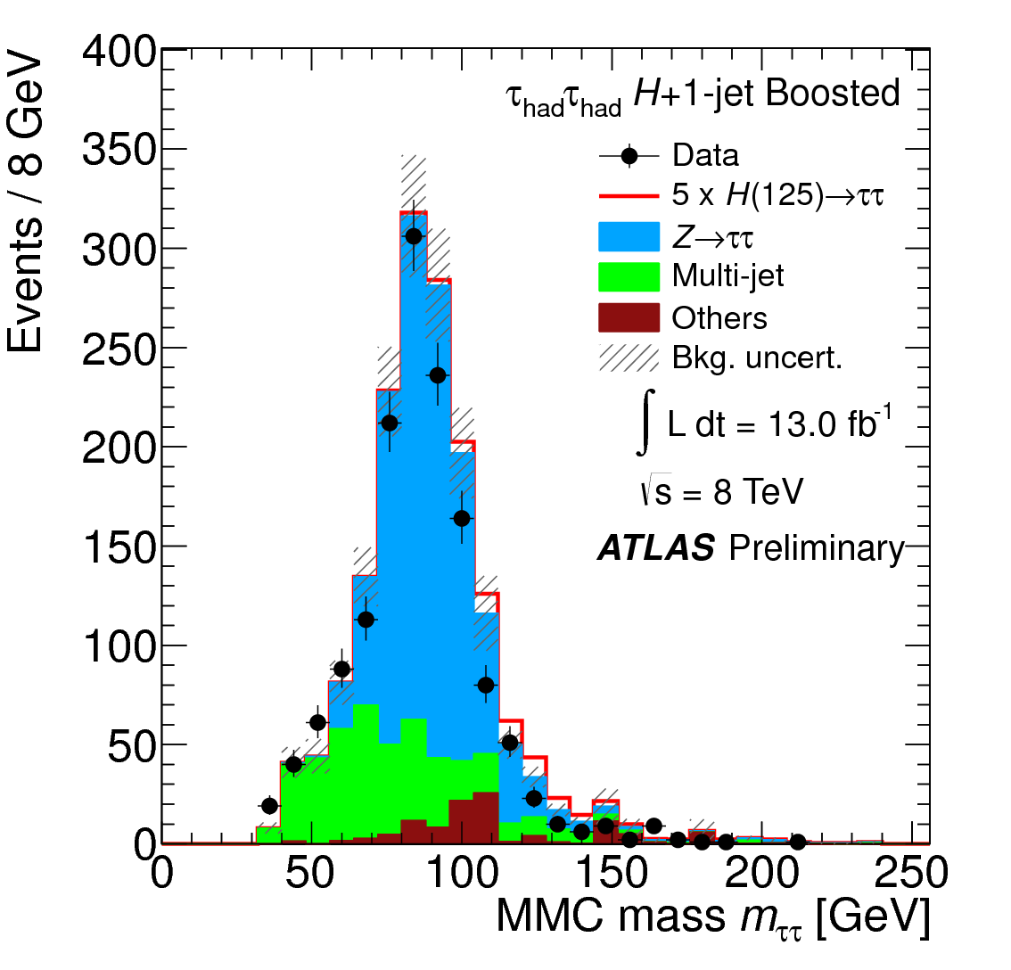
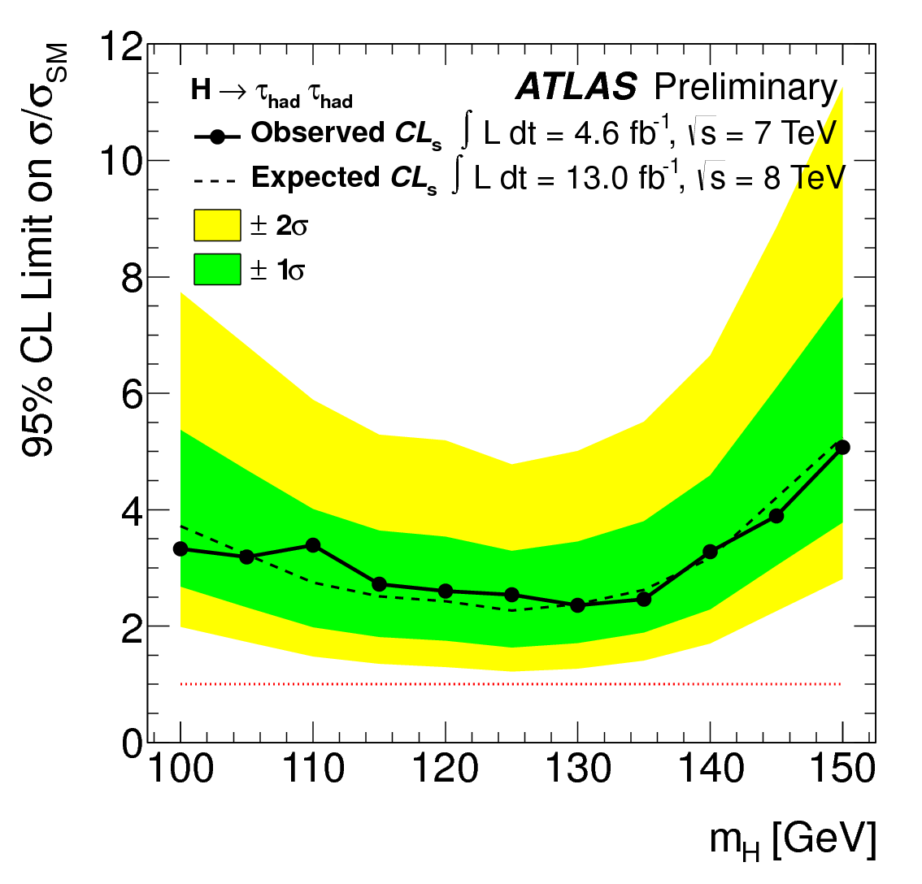
Higgs decay to τ(had)τ(had)
Already in combination with other H->ττ since 2011.
Very important part of the current ATLAS sensitivity to ττ final state (total expected 95% CL is 1, observed 2).
NBI group effort, from beginning of 2009, has made this channel a reality:
- Double hadronic trigger in trigger menu
Tau trigger design and optimization
Tau identification and energy resolution
Robustness to pileup
Analysis
Benefit also the H->ττ -> lep had + neutrinos
Now working on further improvements on energy and identification (using substructure information). And adding VH ->ττ channel. 2015 will be tough (very high pileup).

Slide 16
Search for new physics: - direct or indirect searches - model dependent or general

Slide 17
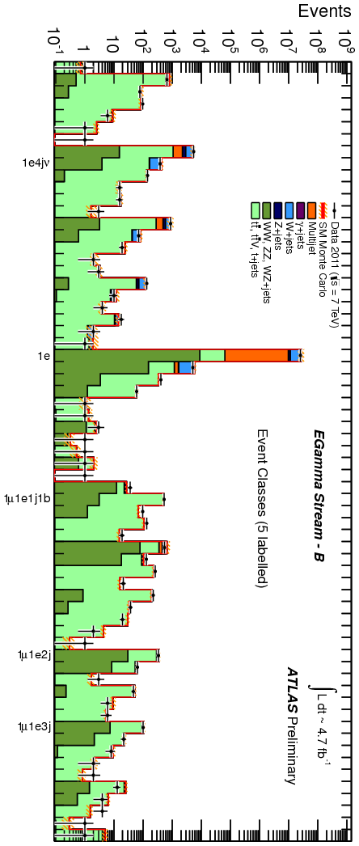
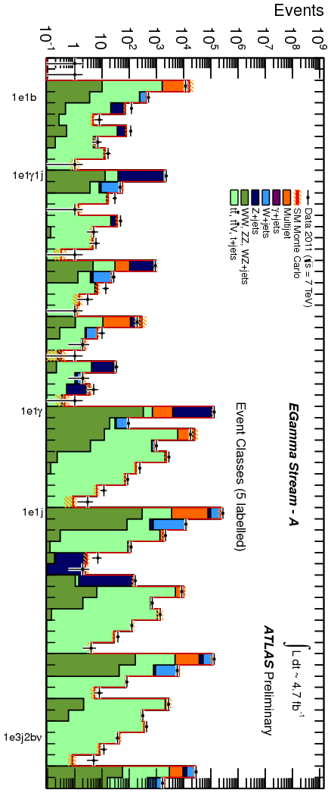
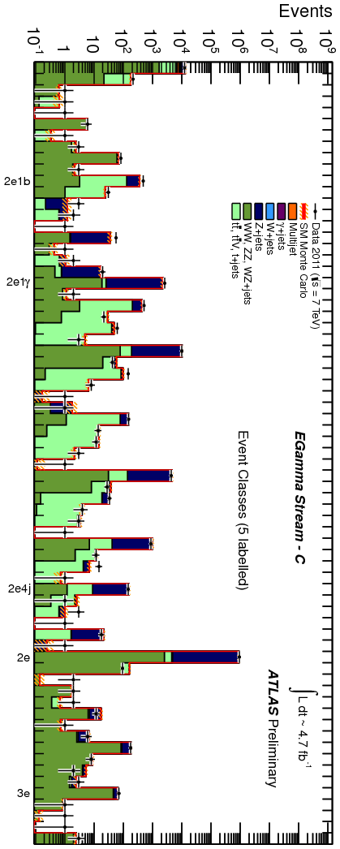
Search for new physics
2011 data
Model independent analysis
of all channels with high pt
electron, muon, jet or MET trigger
in all 7 TeV data
Data found in 655 channels
Scan for deviations
Nothing found !
Question is: is this the best way to do this ?

Slide 18
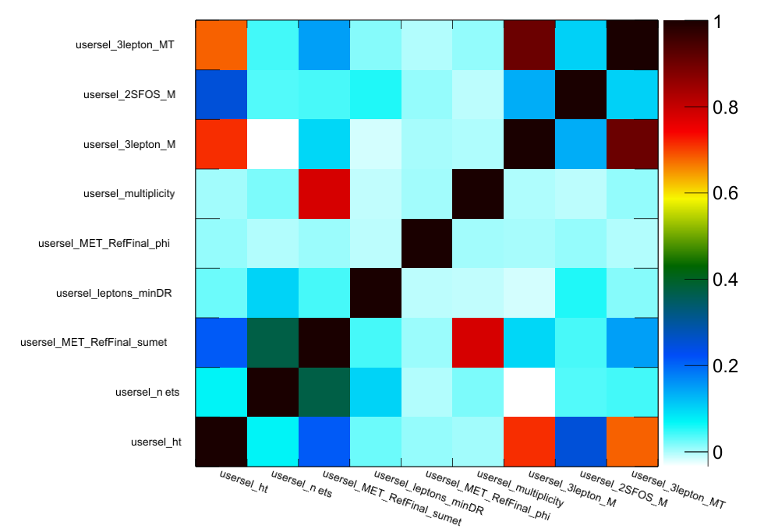
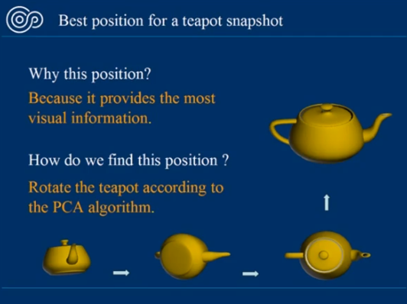
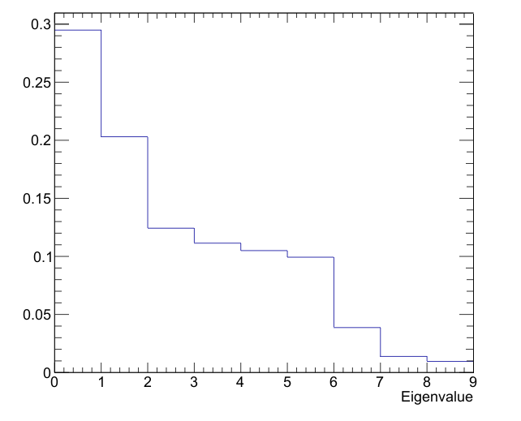
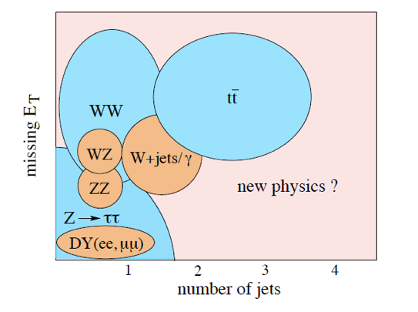
Novel use of statistical methods for general searches in multilepton final states
Using Principal Component Analysis to get uncorrelated observables.
Combining several observables into one simultaneous fit will probe a much larger phase-space, and help seeing deviances from the Standard Model.
To probe a larger phase space a “Principal Component Analysis” (PCA) is performed.
Principal component analysis (PCA) : mathematical procedure that transforms a number of correlated variables into a smaller number of uncorrelated variables called principal components. The first principal component accounts for as much of the variability in the data as possible, and each succeeding component accounts for as much of the remaining variability as possible.
In our initial example we can see
that out of the input 9 variables
only 6 principal components (uncorrelated
variables) really seem to account for the
full variability of the data.

Slide 19
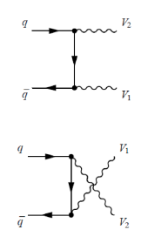
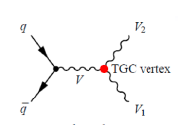
Triple gauge couplings in ZZ production
V1, V2 = Z
Z
SM : sorry
no can’t do
☹
SM ☺
Triple Gauge Coupling studies :
Vector boson self interactions are a fundamental predictions of the SM
gauge symmetry
- they are not yet well measured
- neutral couplings do not exist in SM
➔ sensitive to new physics , eg new heavy particles that couple
to vector bosons, compositness of the bosons

Slide 20


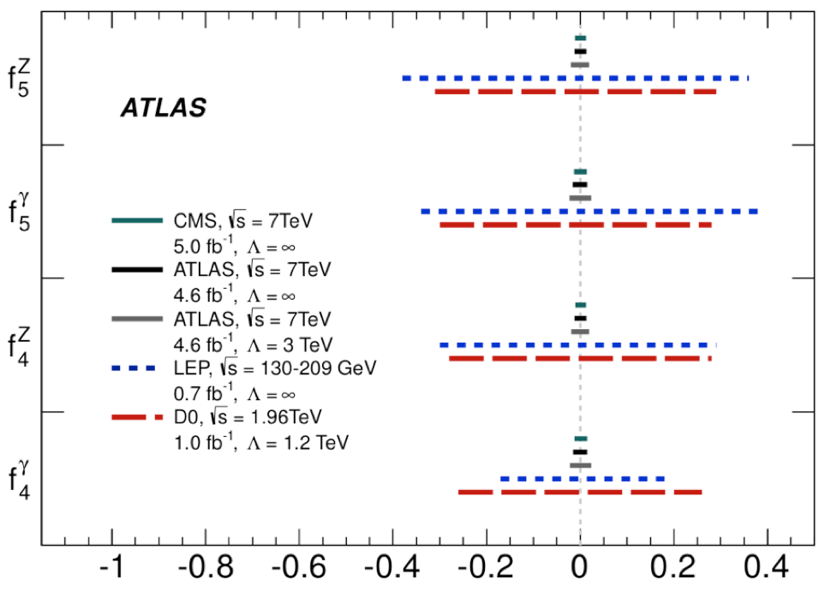
Triple gauge couplings in ZZ production
Model independent parametrisation of new physics operating at a much higher scale : parameters f^{V}_{i} in an effective lagrangian
Z
Z
The signature is an enhanced differential cross section at high center of mass energies
and large scattering angles.
Factor 10
better than
Tevatron/LEP
Factor 10 to go
to reach SM
prediction
h.o. diagrams(10⁻³ )

Slide 21
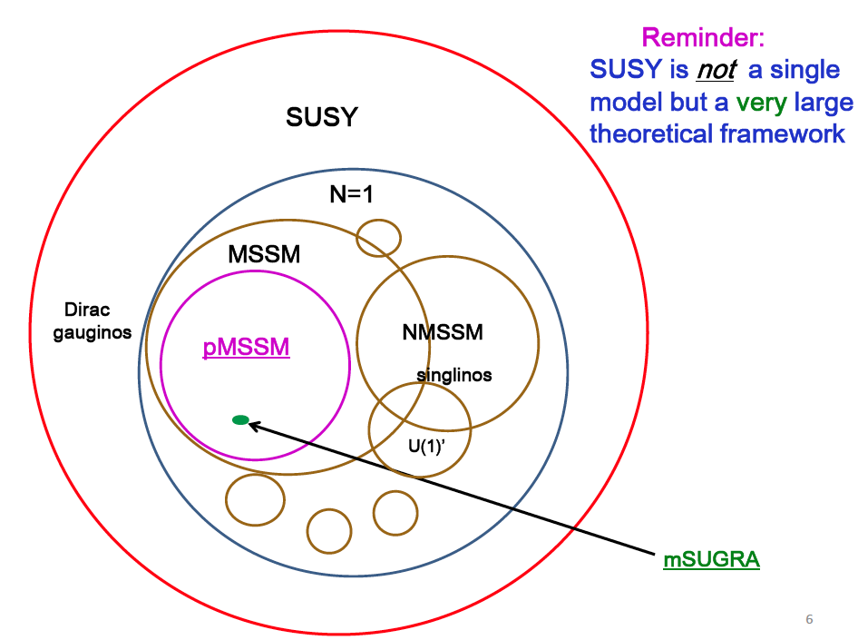
SUSY
19/20 parameters
These are in
trouble now!
T.Rizzo
ATLAS SUSY workshop
April 2013
cMSSM quite similar

Slide 22
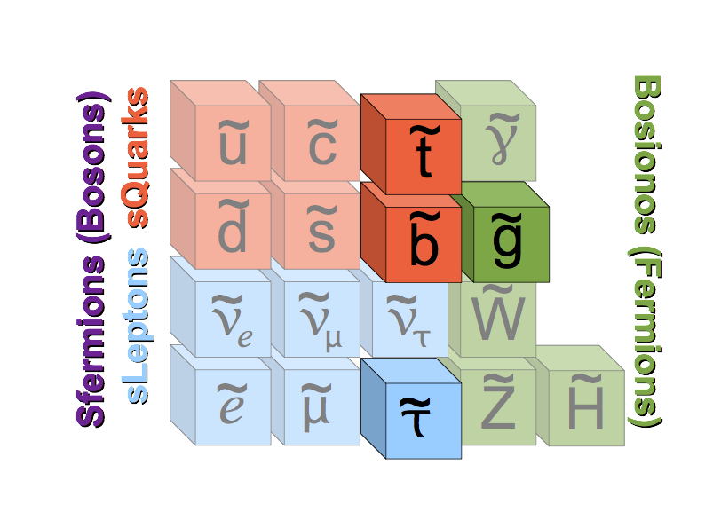
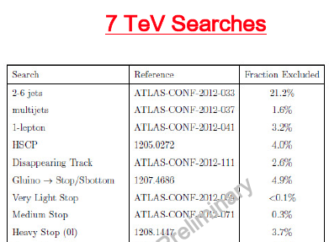

Stable Massive Particles (SMPs)
SMPs are one of the “classical” extentions
for BSM physics. One of the largest loop holes in covering the
(simplified 19 parameter) pMSSM SUSY phase space.
We consider two classes of SMPs:
R-hadrons (gluino, stop & sbottom)
Sleptons (stau)
of pMSSM
Heavy Stable
Charged Particles
(SMPs)

Slide 23
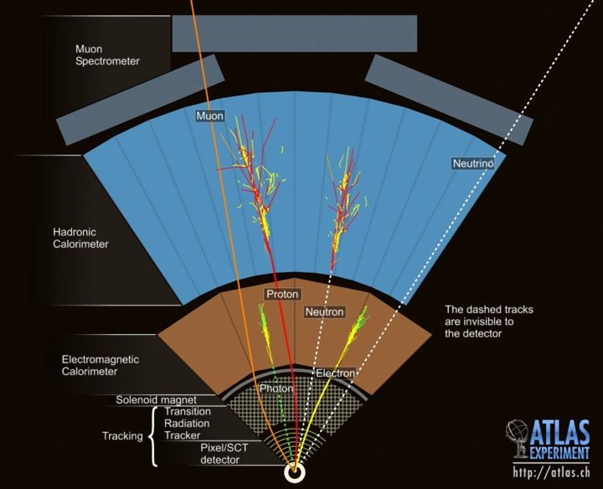
Stable heavy particles in detector
Signatures:
Charged ID+MS
(R-hadrons,
sleptons)
SMP
Charged MS only
(R-hadrons)
Charged ID only
(R-hadrons,
particles with
short lifetimes)
23

Slide 24
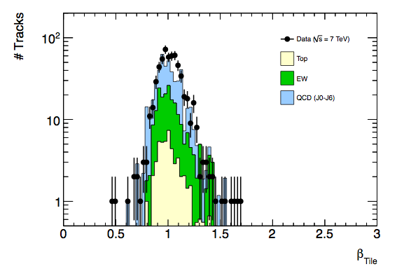
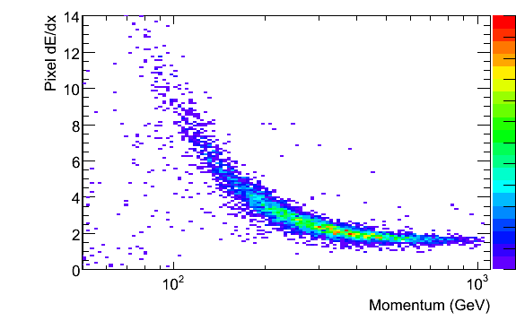
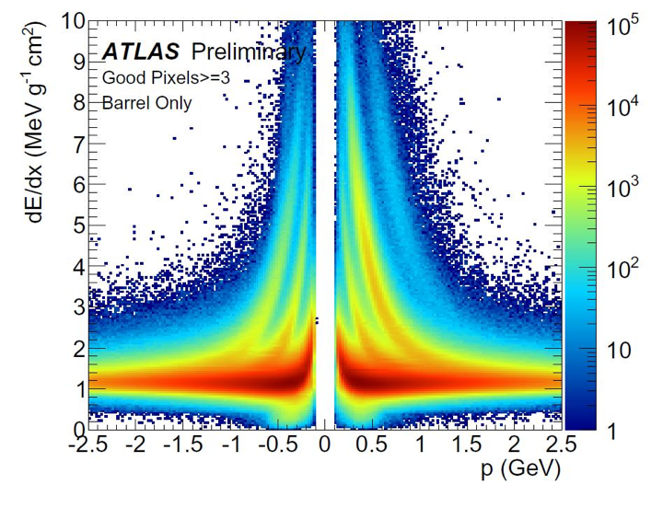
Stable heavy particles in detector
Tile (or LAr):
SMP
Pixel:
24

Slide 25
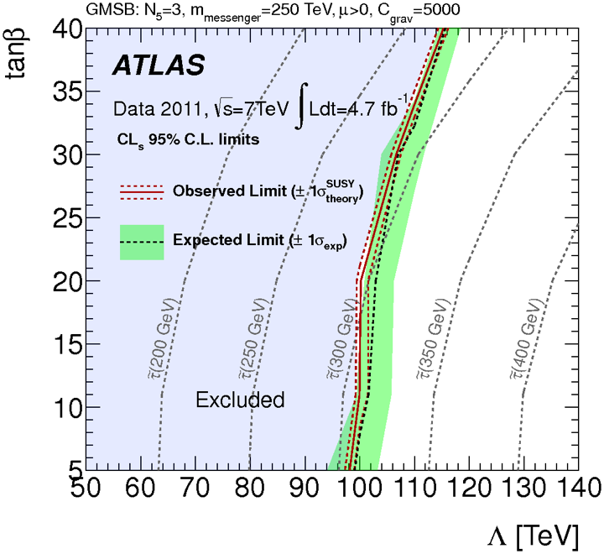
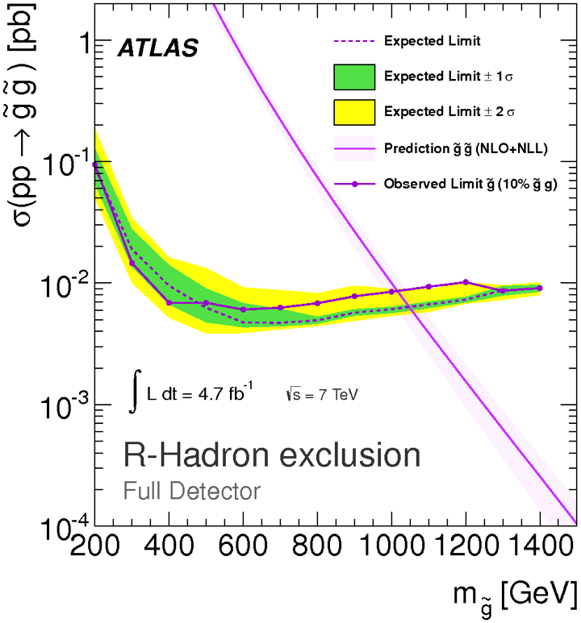
SMPs results
Slepton limits
R-hadron limits
Limits set (95% CL):
R-hadrons (τ ~ ns): 986 (940) GeV
Stops and Sbottoms: 683 and 612 GeV
Sleptons: 278 GeV

Slide 26

Indirect searches for new physics
“The W mass is probably the most powerful indirect probe for new physics”
(T.Petersen)
Current world average is
m(W) = 80385 ± 15 MeV,
dominated by Tevatron results.
Dominating uncertainties:
lepton scale and PDFs, both
improvable at LHC!

Slide 27


W mass
Closure test on MC:
Result on data:
At LHC using Z-peak in new differential methods we can get muon momentum scale uncertainty to 7 MeV using 20% of data.
The LHC use of Z-peak for calibration gives further cancellations in PDF errors through correlations between W & Z (PDF variations moving mW also move mZ!).
ATLAS target m(W) precision: Below 10 MeV
[Eur.Phys.J. C57 (2008) 627-651]

Slide 28

Luminosity
Forward Proton Tagger ALFA : Roman pots with scintillating fiber trackers (30 μm). Trigger & operations joint Copenhagen-CERN project.
Elastic scattering at low t -> inelastic-> luminosity (using Totem the total cross section)
Combine ALFA with ATLAS to study diffraction

Slide 29
Run 2 and beyond

Slide 30

LHC timeline

Slide 31



NBI Plans for Physics searches 14 TeV
TGC : 8->14 TeV x 4
higher lumi x2
Fantastic opportunity to
enlarge the reach for new
physics searches e.g. SMPs
Still need to establish
discovery in tau tau Higgs decay channel.
Access low rate Higgs decays
and measure properties precisely.

Slide 32

NBI contribution to ATLAS upgrade
Long Shutdown 1:
Improve L1 trigger readout rate to 100kHz
Improve speed of calorimeter HLT algorithms, assess need of a L4 trigger
Upgrade the ALFA electronics to run with 2015 ATLAS trigger
Long Shutdown 2 :
New muon small wheels with more trigger granularity and trigger track vector information
Forward physics detection station at 220m for new diffractive physics - AFP (full 3D edgeless and timing detectors)

Slide 33
Summary
2010-2012 have been amazing three years!
Hard work but exciting and satisfying!
In Run1 the ATLAS NBI group has :
contributed significantly to ensuring good physics results could be extracted from the LHC pp data : trigger, tracking, particle identification, luminosity.
Had fun using the data to find the Higgs, look for new physics, and in general try to answer the important open questions in particle physics.
We are now ready to pull up our sleaves and help getting ready for the next exciting step: 2015 Run 2 period.
CERN and ATLAS is the place to be for the next many years ! That’s where we get answers to our fundamental questions about Nature

Slide 34
backup

Slide 35

SMPs results: how is the future?
No significant out-of-time background is seen with this data...

Slide 36


Slide 37



Slide 38
Stable heavy particles in detector
Stable charged
R-hadron,
becoming neutral
in hadronic
interaction!
SMP
38

Slide 39





Three measurements
p, β and βγ
through relation
m = p/βγ
combines to two masses
mβ and mβγ
to our signal region (SR):
SR
39

Slide 40


Higgs Spin and Parity
Result for f(qqbar) = 25%
Results vs. f(qqbar)
Higgs 2⁺ state ruled out with more than 3σ for all production hypothesis.

Slide 41

ATLAS experiment
~3000 physicists
50 countries
200 institutions

