Slide 1
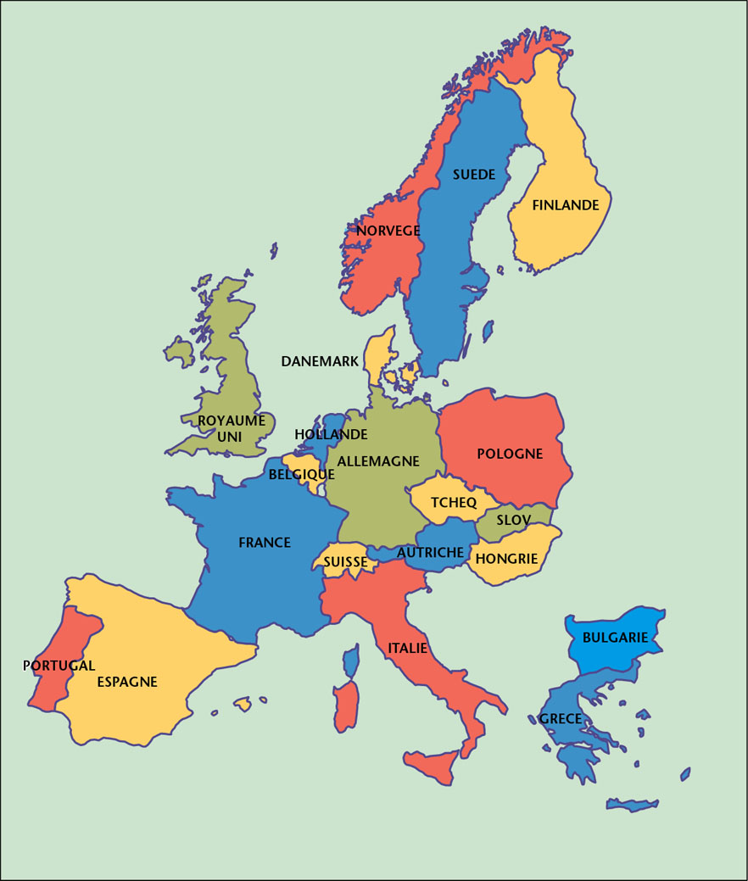
Fact and figures
for Denmark
General & HEP
RECFA visit to DK
May 2013
Ulrik I. Uggerhøj, Department of Physics and Astronomy, Aarhus University
Peter Hansen, Discovery center, Niels Bohr Institute University of Copenhagen

Slide 2
Outline
Economy, education and physics in DK
HEP places and people. DK@CERN.
Funding of HEP. Present and future.

Slide 3

Economy and research
Population: 5.6M
Area: 43,094 km³
No. 15 in OECD by GDP/capita: 35,757 (2005)$.
The world's highest level of income equality.
Frequently ranked as ”happiest people”.
High job frequency: 72.8% (78.7% in 2008!).
R&D expenditure of GDP: 3.1% (1% public).
R&D FTEs: 35200 (private), 20000 (public).
No. 2 in publication frequency (Finland higher)
Universities with physics 6
Notes:
gross domestic product (GDP) at purchasing power parity (PPP)
R&D is right on the Lisbon target

Slide 4
Education
Everybody spends 9-10 years in primary school.
90% attend secondary school or similar.
46% pursue further education. Sharply up from 2007. Females/males=1.22.
1525 got a PhD degree in 2011.
Public education is free of charge and students get a public support of 771€ monthly. PhD students cost 5500€ monthly.
Highest public education expense (7.5% of GDP).
Highest participation in adult learning (31.8%)
Notes:
The increase in people who seek a higher education is partly due to the economic crisis.

Slide 5
Physics
~300 enroll each year, up ~50% from 2008.
~half complete this education.
~100 PhDs/year
doubled since 2007, about half are foreign.
Bachelor+Master 3y+2y. PhD duration 3y.
Zero unemployment among physics graduates.
Physics=cosmo+geo+nano+particle.
Nano is largest by far. Particle physics is about 10%.
Notes:
There is for now no entrance conditions in physics. If you, on the other hand, want to be a midwife, a librarian, a doctor or a psychologist you need very high grades from high school.

Slide 6
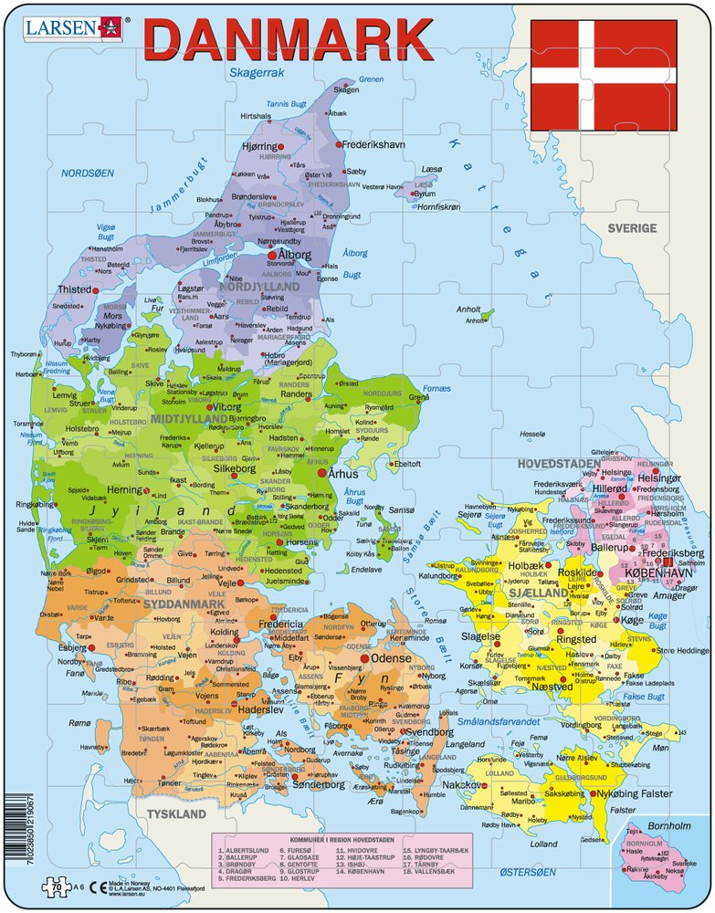
HEP places
KU: Copenhagen
theory,
LHC experiments, Planck
AU: Aarhus
CERN non-LHC experiments,
cosmology
SDU: Odense phenomenology, cosmology
The Technical University (Copenhagen) is now also knocking at the door (OSCAR)
Notes:
We would really like to see the Technical University in the CERN family, but they are not funded yet and not registered as members of any CERN experiment. They were in CLOUD.

Slide 7
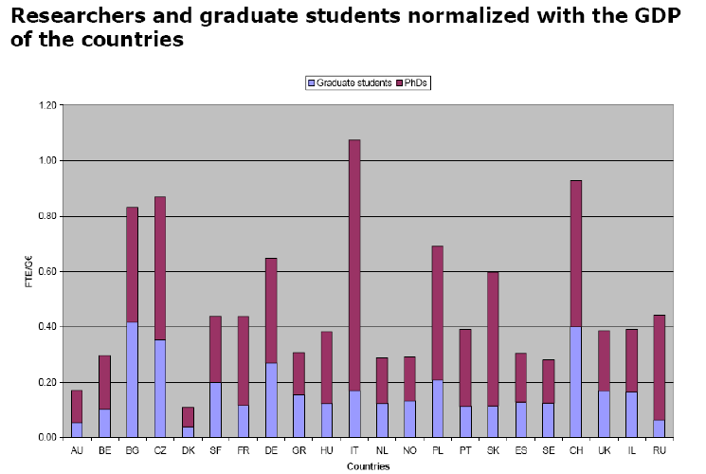
DK HEP people (2005)
Notes:
In the ECFA survey of 2005, which excluded theorists, Denmark was last in the class by far.

Slide 8
DK HEP people (2009)
Notes:
In the 2009 survey theory was added. That helped but Denmark was still last in the class, however in the heals of Norway.

Slide 9
DK HEP people (2013)
Notes:
Great things has happened between 2009 and now. Now Denmark is in the European mainstream, much like an average of Finland and Austria.

Slide 10
HEP people
 | Permanent | Post Doc | PhD | Master
LHC Exp | 8 | 11 | 9 | 9
CERN non-LHC | 8 | 1 | 9 | 5
Theory | 15 | 31 | 23 | 10
Total | 31 | 43 | 41 | 24
Currently, ~4 new positions, in phenomenology and astro-particle
physics, are being filled.
Theory is ~40% phenomenology, ~30% QFT/string and ~30%
astroparticle and cosmology.
Currently, about 3 technician/engineer FTEs are provided by universities
Notes:
The theorist can attract truly excellent people to their post doc positions. These people are in turn asked to apply for their own salary plus additional post docs.
The number of engineers is not a fixed number. If we have a good project with some funding for engineers then the universities will gladly support.

Slide 11
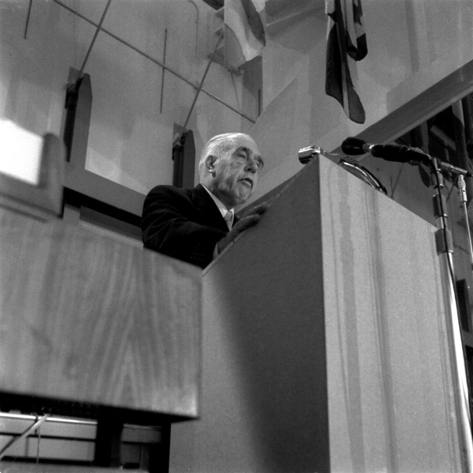
DK @ CERN
Contribution to CERN budget: 1.8% (almost 16M€)
CERN member state since 1954
Using all CERNs accelerators
Numbers (2012):
users 71 – including many theorists
Tech students 3
staff 20 (including 2 non-permanent physicists)
Niels Bohr,
PS inauguration, 5.2.1960

Slide 12
DK in CERN experiments
ATLAS (KU) (TRT, HLT, ALFA, μMEGAS, phys)
ALICE (KU) (FMD, TPC, physics)
ISOLDE (AU) (Nucl. physics and biochemistry)
AD-ALPHA (AU) (anti-hydrogen spectrocopy)
AD-ACE (AU) (antiproton cancer therapy)
AD-ASACUSA (AU) (atomic physics)
NA63 (AU) (QED in strong fields)
CLIC (AU) (beamstrahlung)

Slide 13
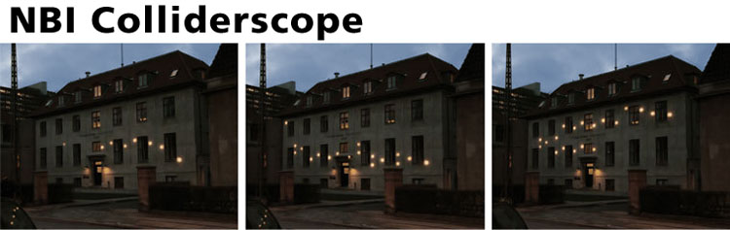
National Collaboration
NICE (National Instrument center for CERN Experiments) coordinates M&O, new equipment, travels, a few Postdoc and PhD salaries, summer students, CERN schools, CERN events, cars at CERN etc.
Cooperation on equipment (ISOLDE), detector R&D (Mimosa), astro-particle research, outreach and education between KU, AU and SDU.
http://colliderscope.nbi.ku.dk/english/video1/

Slide 14
HEP Funding 2013
Foundation | Main beneficiary | Yearly amount
Research Council | NICE (CERN operations) | 1.4 M€
DC Scientific Computing | Tier1 contribution | 0.1 M€
Danish National Research Foundation | CP3-Origins (Odense) Discovery (Copenhagen) Astro-particle (Cph) | 1.1 M€ 1.1 M€ 0.8 M€ (start sept 13)
Research Council/NBIA | Various post doc grants | 1.3 M€
ERC | ALPHA, ISOLDE | 0.7 M€
Sum public funding |  | 6.5M€
Lundbeck | 2 theory, 1 ATLAS (young) | 0.8M€
Villum | 1 theory | 0.2M€
Various | Various post doc grants | 0.3M€
Sum private funding |  | 1.3 M€
All numbers include 44% overhead
Expensive equipment come on top. CERN activities have received about 3.7M€ since 1998.
Notes:
The first item is the backbone covering everything that is directly connected with our CERN membership and memberships of CERN experiments.
The second items is the miracle that has recently happened as I will return to.
The expensive equipment budget is perhaps fast being filled out, even before the structure is in place, by astronomy, ESS and XFEL wishes..

Slide 15
HEP centers
NICE : DK CERN operations (P.H.Hansen, KU). 1.4M€/y (Funded by the Natural Science Research Council. Now this changes).
CP3-Origins: Particle physics phenomenology and cosmology (F. Saninno, SDU). 1.1M€/y (DNRF, 2009-14).
Discovery: Data analysis in ATLAS, ALICE and PLANCK and particle physics phenomenology (P.H.Hansen, KU). 1.1M€/y (DNRF, 2010-14).
Notes:
NICE has always been there in various forms. This is the backbone. The funding of this center is now changing again.
The two DNRF centers represent a new development.

Slide 16
This year strengthened:
Niels Bohr Professor: Astro-particle phenomenology and experiment (IceCube). S. Sarkar, Ox+KU. DNRF 3.9M€. 2013-18.
ERC senior grant: ALPHA experiment, J. Hangst, AU, 2.1M€ plus hardware from Carlsberg 0.5M€.
ERC junior grant: ISOLDE astro-nuclear physics, H. Fynbo, AU, 1.4M€.

Slide 17
Future plans:
The two DNRF centers are presently up for an review for extension into 2015-19. Hope for the best.
Copenhagen will push for full DK membership of IceCube from 2015. This requires extra funding.
The CERN experiments will apply for various upgrades. Already contributing from running budgets.

Slide 18
Times are a-changing:
A cornerstone is the NICE center providing for the basic CERN operations.
The funding of NICE will be taken over by a new committee, NUFI, that is composed by all the universities and research councils. Its charge is to fund all large “Research Infrastructure”.
A second pillar, DCSC(DeIC) providing High Performance Computing, including the Danish contribution to the Nordic Tier1, is about to terminate. Future uncertain.

Slide 19
-and a problem arises:
In a draft budget, the new NUFI will cut the funding of NICE in half of the present budget. To 0.7M€. This follows a downwards slide from 2007 where the budget was 1.9M€ in present value.
Already the slow downslide has precluded any new DK initiatives at CERN. The new cut will reduce current activities to near zero.
Similar cuts hit the activities at ESO, ESRF etc
This is a potential disaster that we have about a week to defuse. May we succeed!

Slide 20
Summary:
Denmark is doing very well in general research and education.
Particle physics has on average been in a positive development since 2009. This includes a first push into experimental astro-particle physics.
Particle physics is threatened by a structural change in CERN experiment funding and is also depending on the outcome of an ongoing review of two phenomenology/analysis centers.

