Slide 1
Physics around ISOLDE
K. Riisager on behalf on Danish ISOLDE users
RECFA meeting, Copenhagen, May 3-4 2013

Slide 2
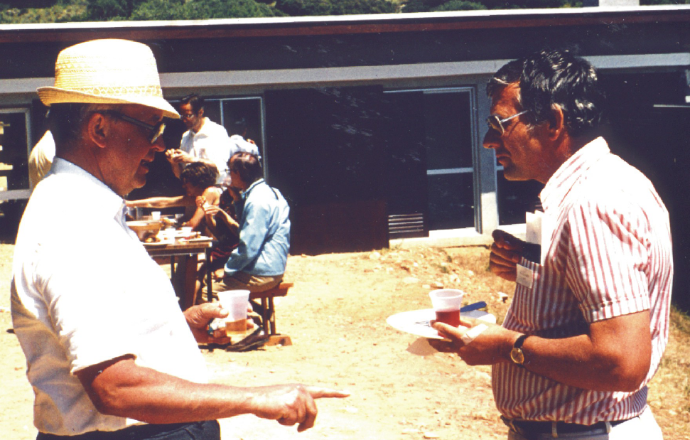
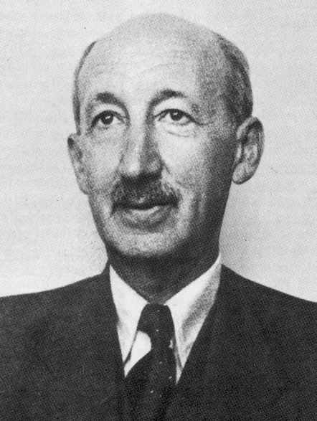
Overview
The ISOLDE facility
Nuclear structure (2 staff, 4 phd-students + theory)
  Decay experiments (ISOLDE)
  Reaction experiments (ISOLDE)
  Nuclear astrophysics (ISOLDE + Aarhus + …)
Condensed matter (1)
Biochemistry and biophysics (2)

Slide 3
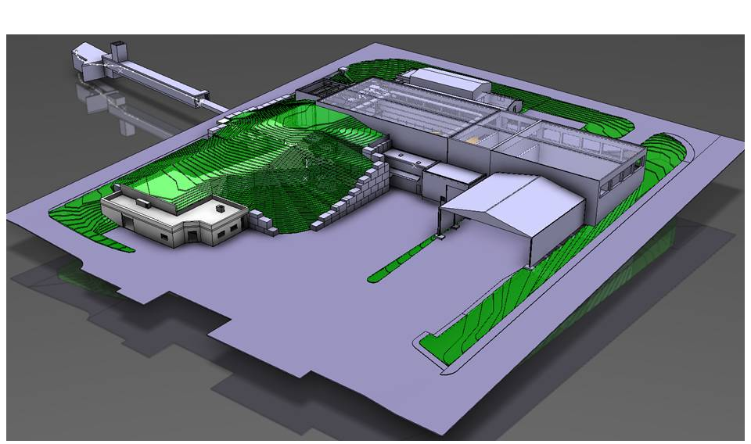
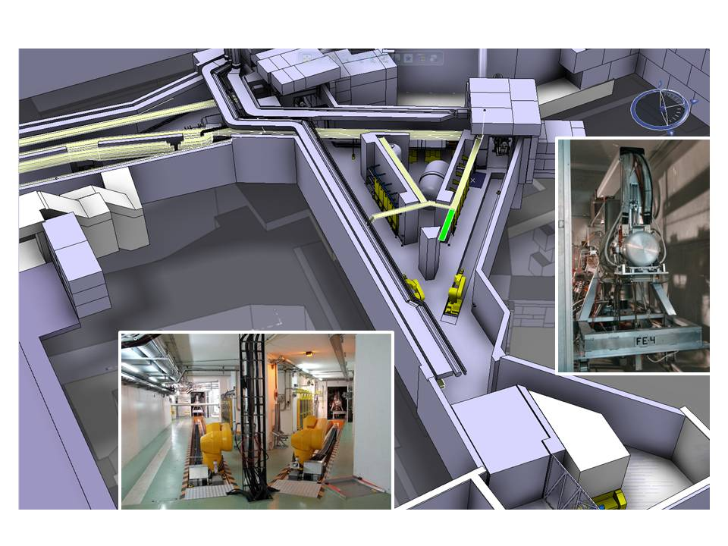
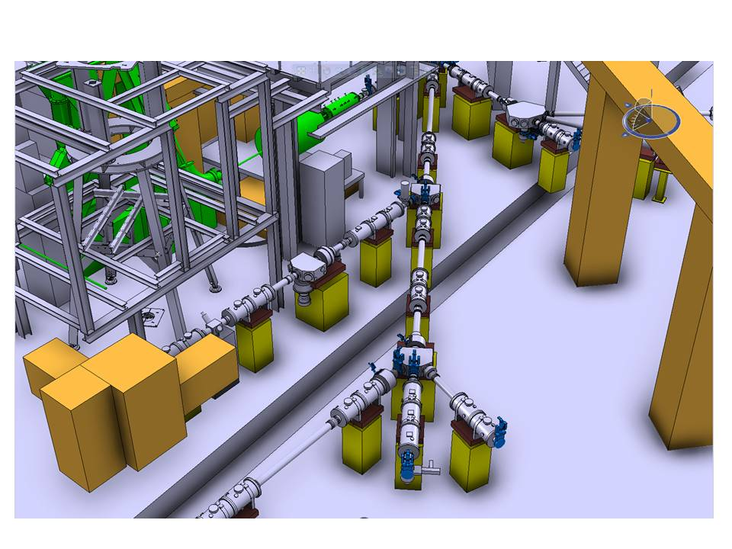
The ISOLDE facility
http://www.scholarpedia.org/article/The_ISOLDE_facility

Slide 4
ISOLDE yields
Energy range 10⁻⁶ eV (10 mK) to 3 MeV/u
Intensity 1 – 10¹⁰ ions/s
Isotope range ⁶He to ²³²Ra
(Z: 2-88, N:4-144)

Slide 5
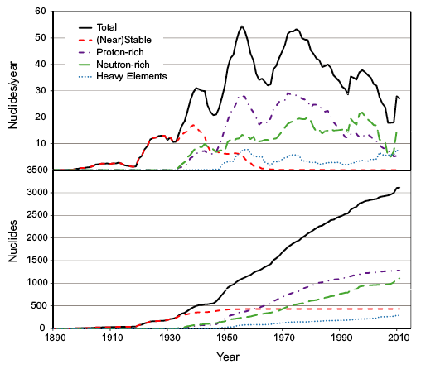
Nuclear Structure Themes
NuPECC Long Range Plan 2010 www.nupecc.org
Many-body system, rapidly changing structure
  Bridge to QCD (light nuclei, EFT)
  Changing magic numbers
  Modifications close to/in continuum
  Limits predictable ? (very n-rich…)
Important “applications”
  Astrophysics, condensed matter, life science
  Medical physics, environment, …

Slide 6
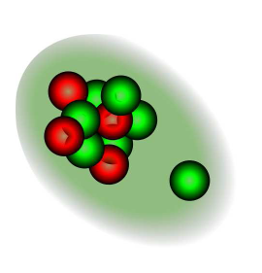
¹¹Be beta-delayed protons ?
One-neutron halo
βp branch O(10⁻⁸)
Direct / sequential decay ??
Collected 10¹² ions + AMS for ¹⁰Be (daughter nucleus)
J. Phys. G40 (2013) 035109

Slide 7
¹¹Be(d,p)¹²Be reaction
How much is N=8 shell broken ?
  Simple picture: ¹⁰Be+n+n (s,p,d)
Exp spec. factor (standard reaction theory)
inconsistent with current structure models
J.G. Johansen, PhD thesis, Aarhus 2012

Slide 8
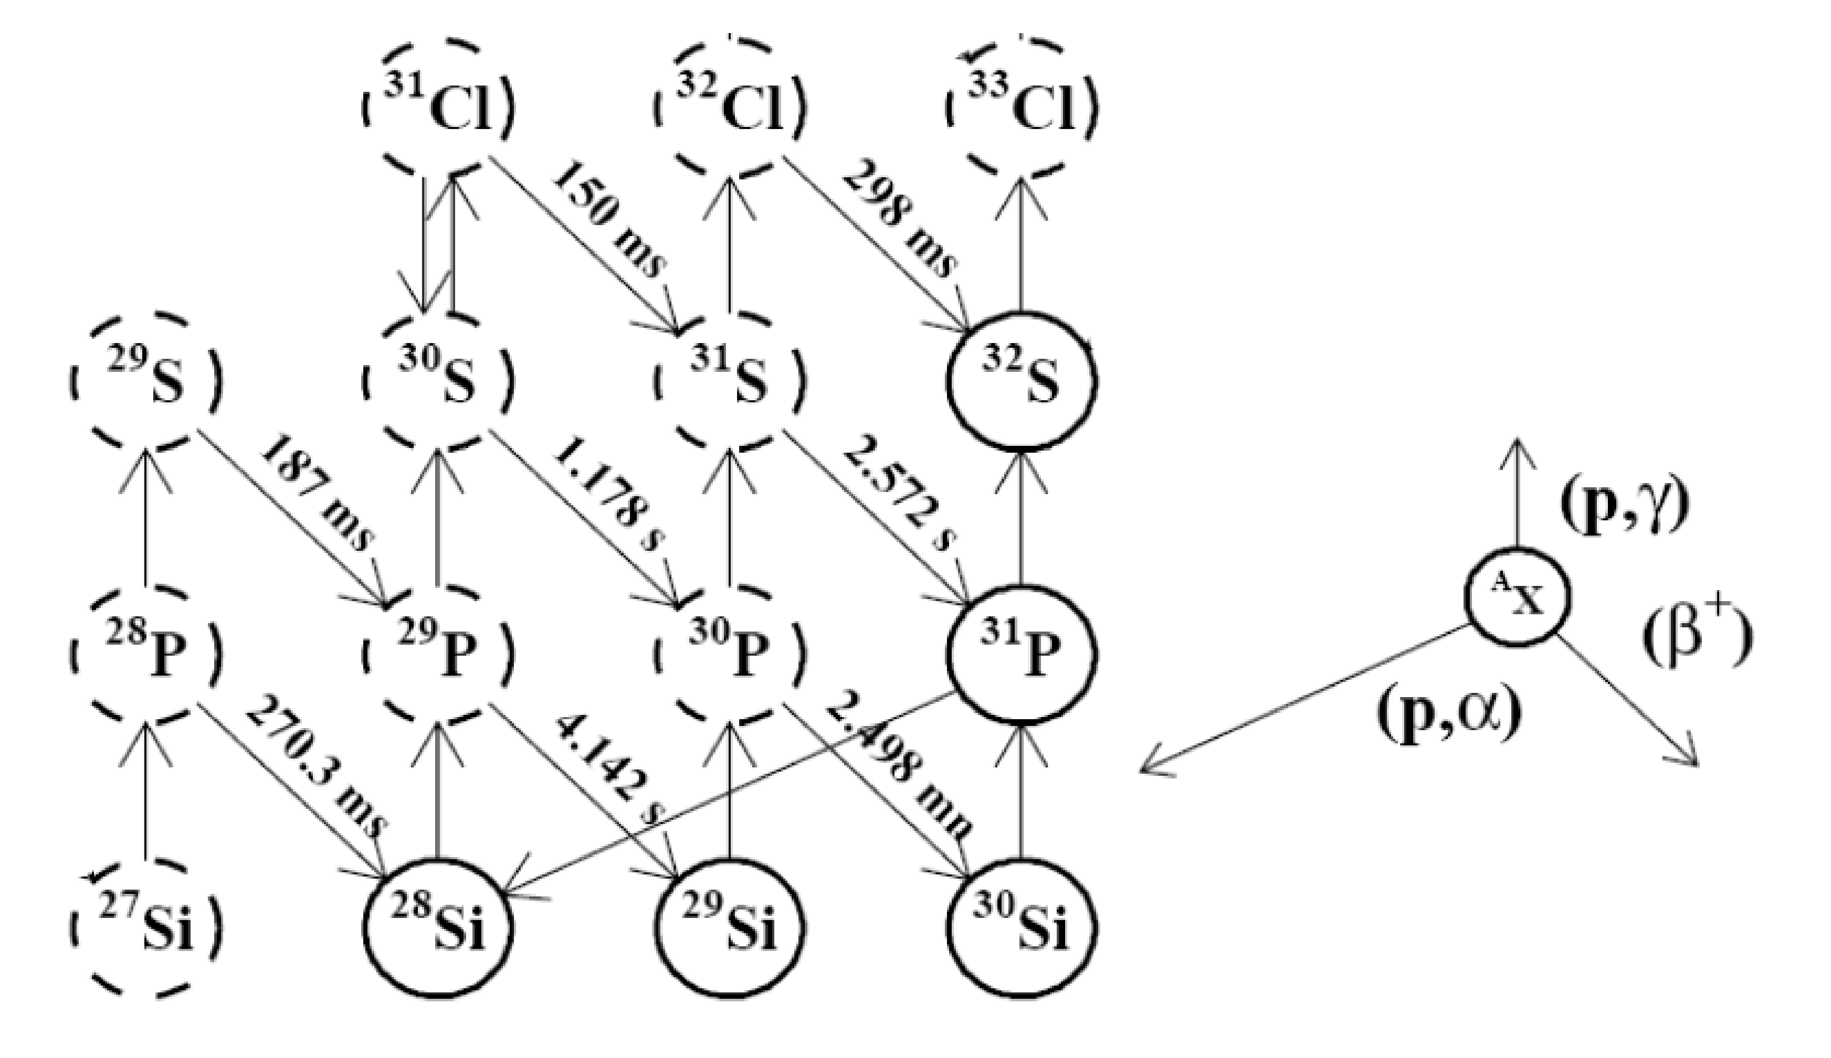
³¹Ar decay
Astrophysical rp-process passes through ³⁰S
³¹Ar
²⁹P
³⁰S
G.T. Koldste et al, Phys. Rev. C in press
Notes:
Novae, Si isotopic abundances in meteorites, x-ray bursts

Slide 9

LOBENA: Long Beam time experiments for Nuclear Astrophysics
β-decay
1⁺
β-decay
2⁻
¹²N
¹⁶N
β-decay
2⁺
0⁺, 1⁺, 2⁺⁻, 3⁻
0⁻, 1⁻, 2⁻, 3⁻
⁸B
2⁺
γ-decay
γ-decay
γ-decay
2⁺
¹²C+α
3α
1⁻
¹²C+α
1⁻
2⁺
3α
0⁺
2α
2⁺
¹²C
0⁺
¹⁶O
0⁺
2α
0⁺
⁸Be
Combination of in-house (VdG), and KVI (NL), JYFL (SF), ANL (US) experiments
Notes:
-C-12. gamma+beta
-O-16. gamma+beta
-Be-8. gamma+beta
-Potential contribution
-Required resources

Slide 10
Collaborators / nuclear structure
Denmark: H.O.U. Fynbo, K. Riisager, G.T. Koldste, K.L. Laursen, M.V. Lund, J. Refsgaard
CERN: M.J.G. Borge, J. Kurcewicz, M. Pfützner
Spain: L. Fraile, O. Tengblad + students
Sweden: B. Jonson, T. Nilsson, G. Nyman, J. Cederkäll + …
Germany: T. Kröll, D. Mücher, J.G. Johansen +
Finland: J. Äystö, A. Jokinen, I. Moore +
UK: C.A. Diget, B. Fulton +
Belgium: R. Raabe +
France: B. Blank +
Austria: O. Forstner +
Canada: O. Kirsebom, R. Krücken

Slide 11
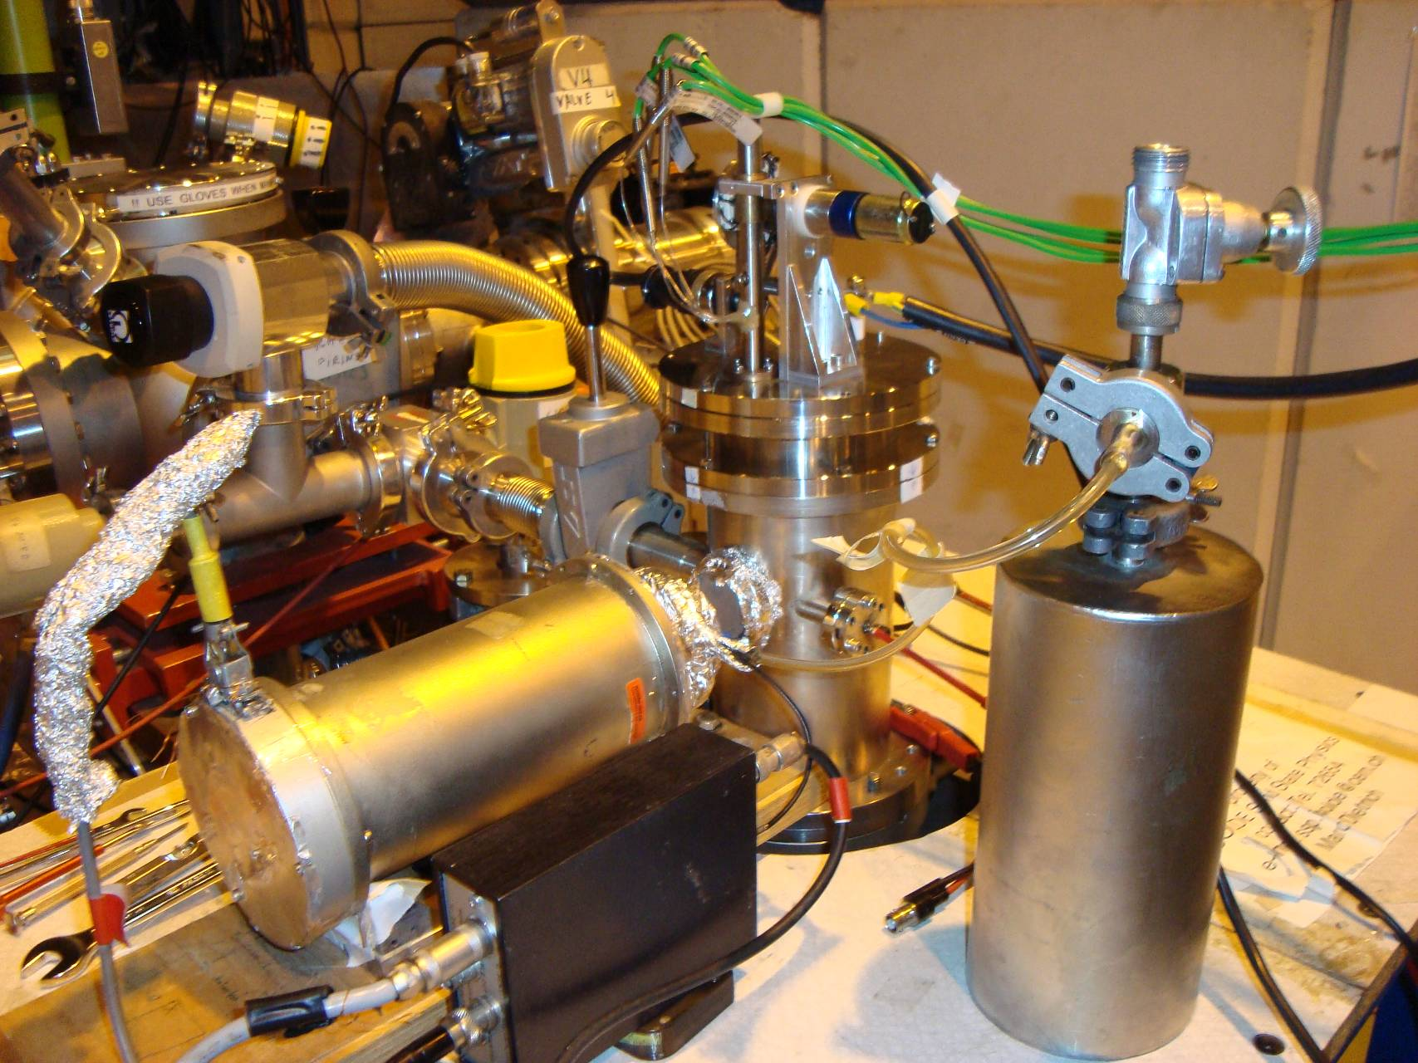
Mössbauer spectroscopy @ ISOLDE
General principle:
Major benefits:
- High dilution ~10⁻⁴ at.%
- High energy resolution ~ neV
- Informations on charge states, symmetry, relaxation, magnetic interactions, binding properties, …
⁵⁷Mn (1.5 min.)
Resonance
detection
Implantation of short lived parent isotopes
γ
⁵⁷Fe
Current isotopes:
⁵⁷Mn, ⁵⁷Co for ⁵⁷Fe MS
¹¹⁹In, ^{119m}Sn, ¹¹⁹Sb for ¹¹⁹Sn MS
Recent highlight:
Absence of magnetic interaction in dilute magnetic semiconductors (3d metal doped ZnO, SnO₂, TiO₂,…) APL 100 (2012) 042109; 97 (2010) 142501

Slide 12





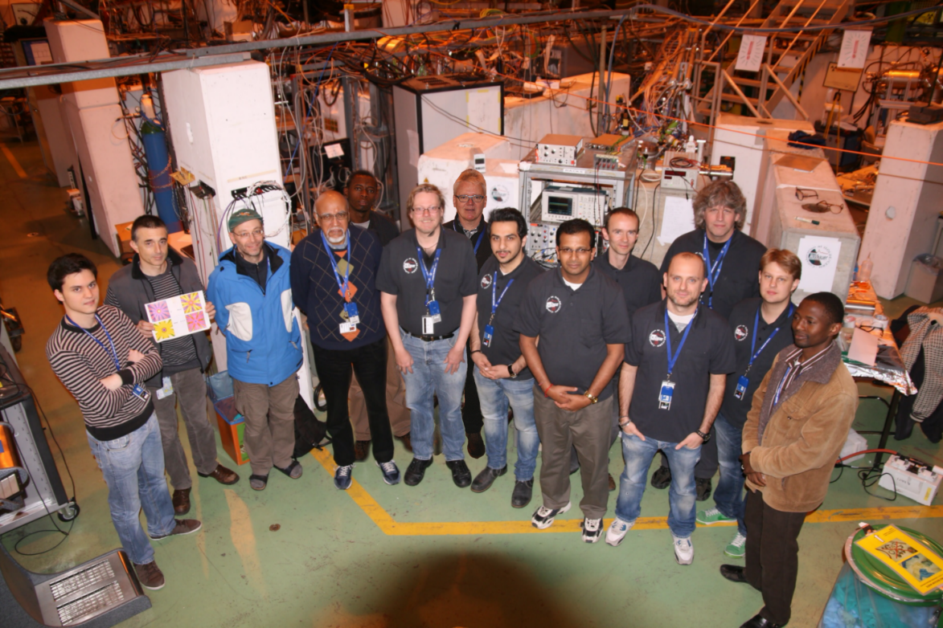





Mössbauer collaboration at ISOLDE/CERN
Denmark: H. P. Gunnlaugsson, G. Weyer, M.B. Madsen
Iceland: T. E. Mølholt, H. P. Gíslason, S. Ólafsson, S. Shayestehaminzadeh
Italy: R. Mantovan, M. Fanciulli
South Africa: D. Naidoo, H. Masenda, K. Bharuth-Ram, M. Ncube
Switzerland: K. Johnston and the ISOLDE collaboration
Germany: R. Sielemann
Belgium: G. Langouche

Slide 13
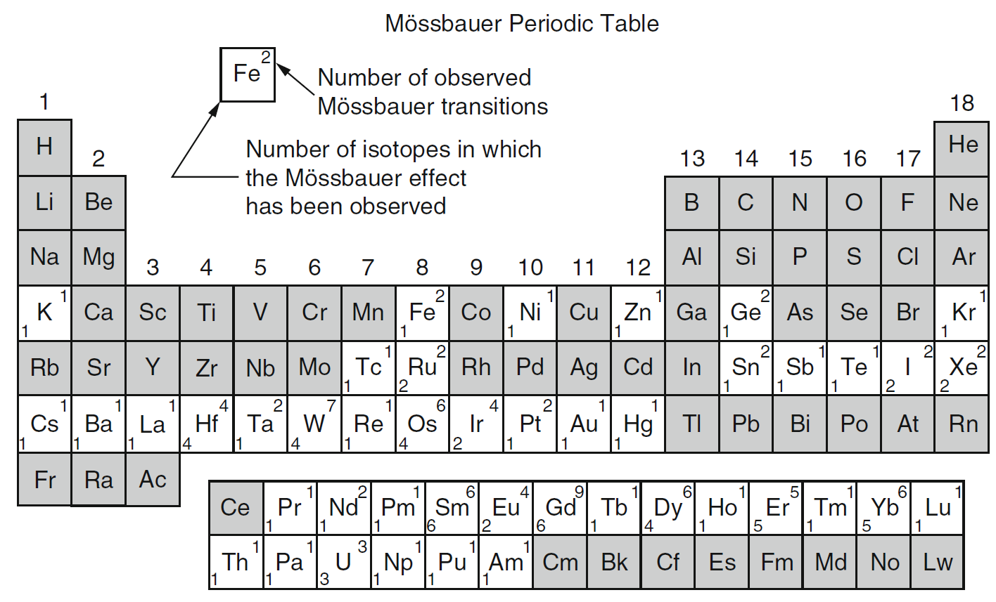
Mössbauer periodic table
Green – reproducible good beam
Red – low quality beam
67 Zn
(62h)
73Ga (5h)
Fe
Sn
181Hf
(42d)

Slide 14
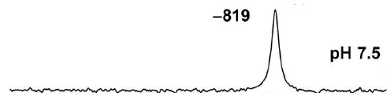
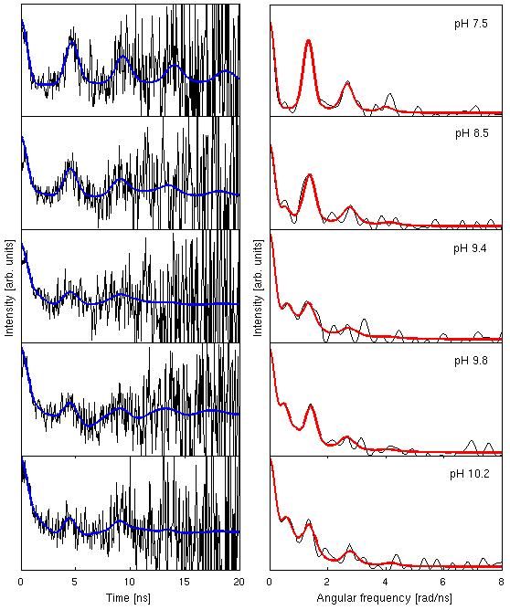
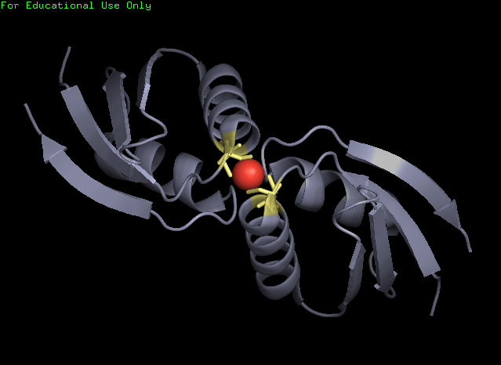
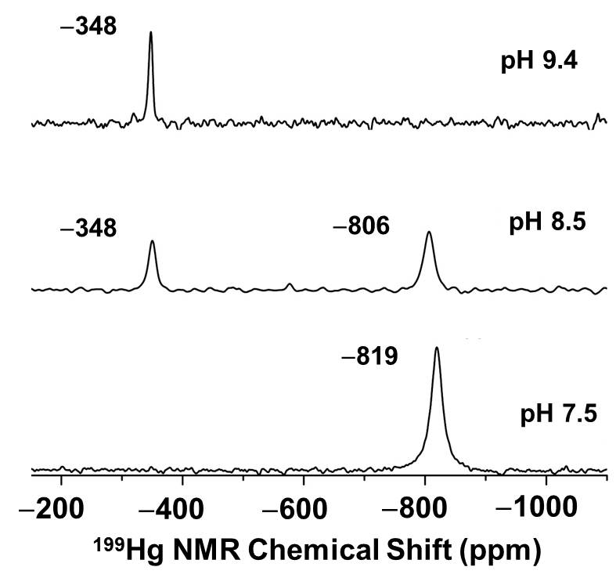
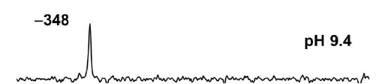
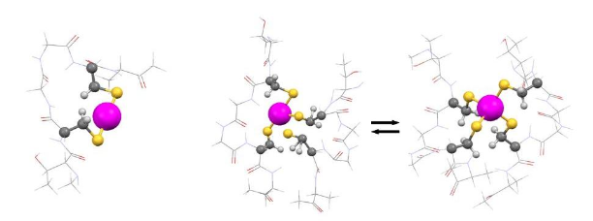
Metal ion transfer between proteins:
The Cu(I) binding protein HAH1
^{199m}Hg PAC
^{pH 7.5}
^{pH 8.5}
^{pH 9.4}
^{pH 9.8}
μs to ns exchange dynamics
^{pH 10.2}
^{pH 7.5}
^{pH 9.4}
0 2 4 6 8
Angular frequency (rad/ns)
Luczkowski , Zeider, Hinz, Stachura, Chakraborty, Hemmimgsen, Huffmann, Pecoraro,
accepted Eur. J. Chem.
Notes:
- We identified structures which are (presumably) intermediates the in metal ion transfer process, as well as put limits on the rates of conversion between the different structures:
At pH 7.5 HgS2 structure corresponding to a protein monomer, at pH 8.5 HgS2 and HgS3/HgS4 co-exist (HgS3/HgS4 can only be tealizde in a protein-metal-protein complex) – exchange between HgS2 (monomer) and HgS3/HgS4 (ternary complex) is slow (>ms), at pH 9.4 HgS3/HgS4 with exchange dynamics on the us-ns time scale (corresponding to individual sulphur ligands rchanging in the ternary complex).
- Hg(II) as model of Cu(I) chemistry

Slide 15
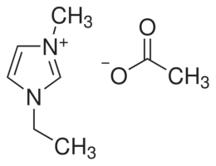
β-NMR applied to soft condensed matter
³¹Mg⁺ implanted into an ionic liquid
(1-ethyl-3-methylimidazolium acetate):
Pressure (mbar)
Alexander Gottberg, CSIC, Madrid, Monika Stachura*, University of Copenhagen; Magdalena Kowalska, CERN, Geneva, Klaus Blaum, Max Planck Institute for Nuclear Physics, Heidelberg; Gerda Neyens, Leuven University, (Leuven); Rainer Neugart, Mainz University, (Mainz); Deyan Yordanov, Max Planck Institute for Nuclear Physics, Heidelberg; Mark Bissell, Leuven University, (Leuven); Kim Kreim, Max Planck Institute for Nuclear Physics, Heidelberg, Lars Hemmingsen*, University of Copenhagen
Notes:
First beta-NMR measurement on liquid sample – Perspective: A novel technique in chemistry/biochemistry NOT PUBLISHED
Mg(I) -> Mg(II) rapidly we assume
First beta-nmr on soft condensed matter
two resonances; interpretation n progress
asymmetry larger in IL than in MgO, because of longer relaxation time (presumably)
asymmetry persists up to ~0.2 mbar only ~30 times below the vapor pressure of water at 0 C; can be gained by further design of differential pumping system with pin holes

Slide 16
Immediate future
Exploit new opportunities at HIE-ISOLDE
Develop nuclear astrophysics research “at home”
Seek funding for expanding biochemistry at CERN

Slide 18

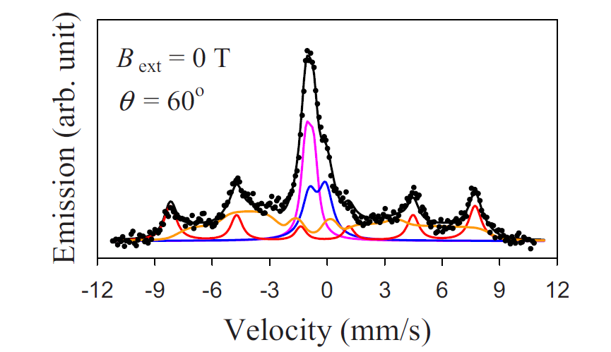
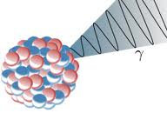
Fe: ZnO a ferromagnetic semiconductor?
(nope!)
ZnO C axis
6 fold spectrum: characteristic of magnetic structure (at room temperature!!!).
Results in an external magnetic field show that the spectrum shown to be a slowly relaxing paramagnetic system .
Gunnlaugsson et al (APL 97 142501 2010)
B
After high-dose implantations, precipitates of Fe-III are formed. These form clusters yielding misleading information about the nature of magnetism in ZnO (as reported by many groups over the last number of years).
B
Gunnlaugsson et al APL 100 042109 2012

