Slide 1
DISCOVERY-HEHI Group @ NBI Working on ALICE
Kristjan Gulbrandsen

Slide 2
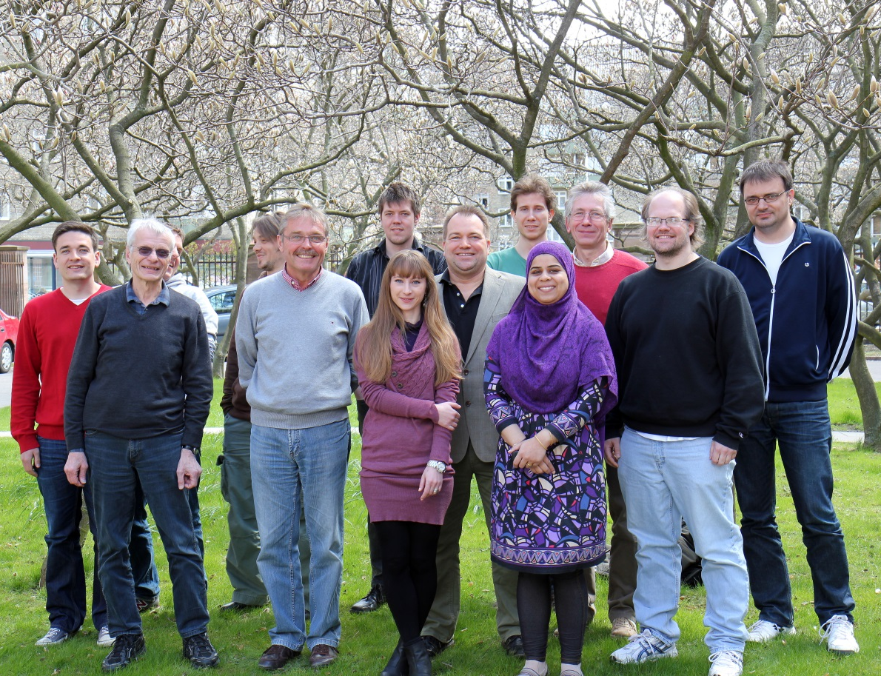
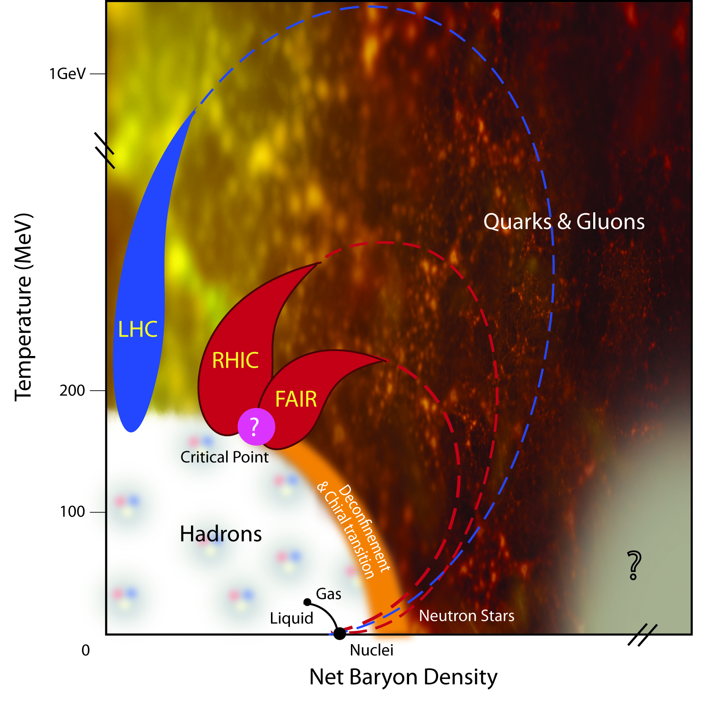
HEHI Group
Perm. Staff:
Ian Bearden
Hans Bøggild (Emeritus)
Jens Jørgen Gaardhøje
Børge Svane Nielsen
Temp. Staff:
Christian Holm Christensen
Kristjan Gulbrandsen
PostDocs:
Ante Bilandzic
Marek Chojnacki
Hajrah Tabassam
Ph. D. students:
Alexander Hansen
Valentina Zaccolo
Undergraduate students:
Lasse Albæk
Peter Jochumzsen
Bastian Poulsen
Thomas Schwanberger
Techn.& Eng.:
Henrik Bertelsen
Aksel Boiesen
Jimmy K. Hansen
Funded By:
-Danish Natural Science
Research Council(FNU)
-Danish Basic Research
Foundation (GF)
-Carlsberg Foundation

Slide 3
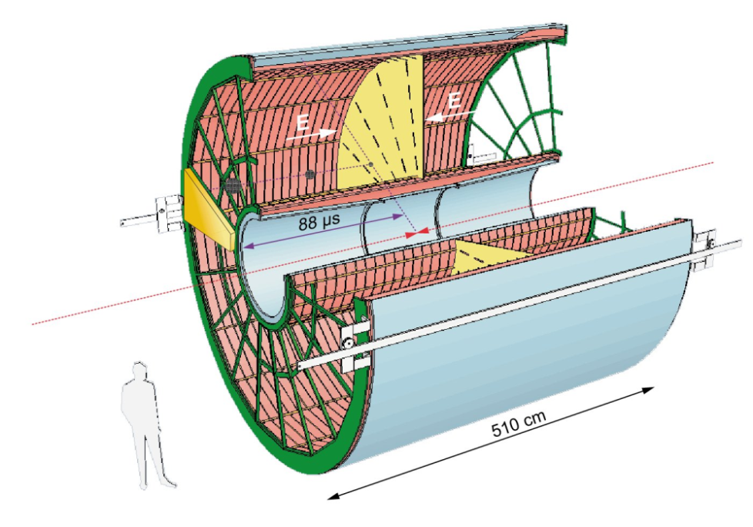
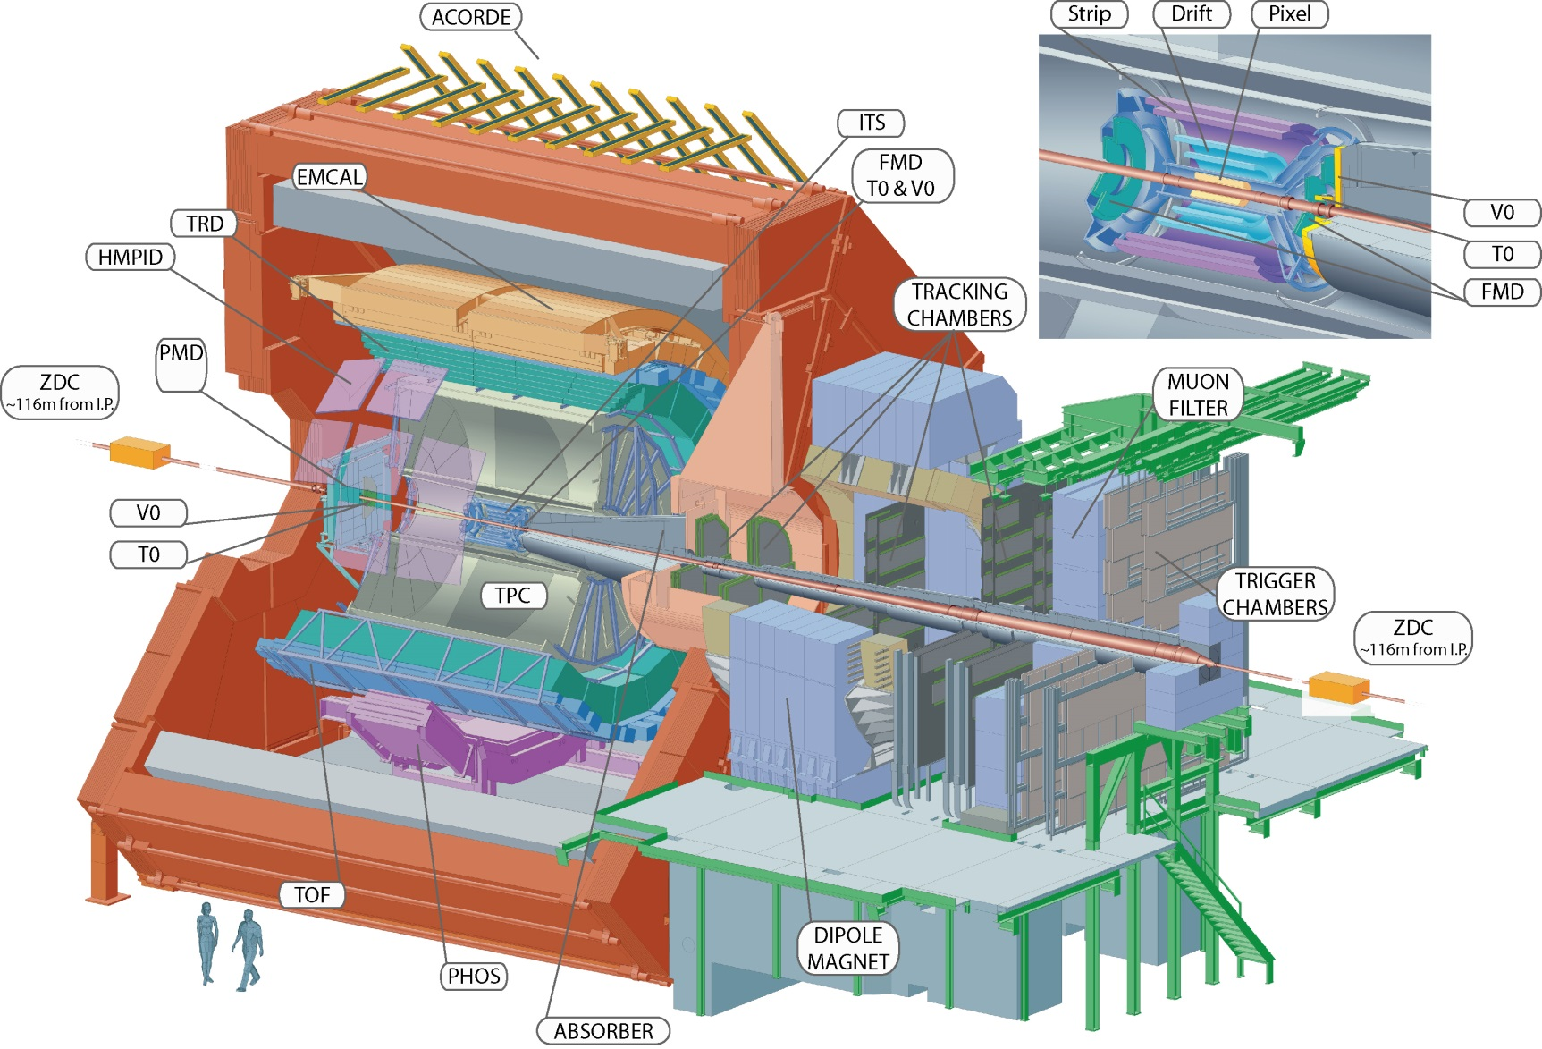
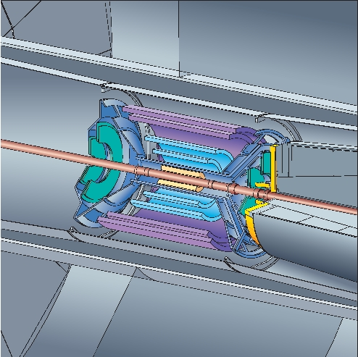
A Large Ion Collider Experiment
Time Projection Chamber (TPC)
Forward
Multiplicity
Detector
(FMD)

Slide 4



Official Posts
Ian Bearden
Editorial Board member
Jens Jørgen Gaardhøje
CERN council
ALICE Management Board
FMD project leader
Kristjan Gulbrandsen
Physics Analysis Group convenor
Børge Svane Nielsen
TPC Laser subproject leader

Slide 5
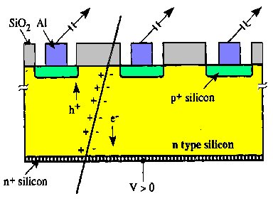

Further ALICE Responsibilities
TPC Laser
Børge Svane Nielsen
Control systems/trigger/upgrades
Forward Multiplicity Detector (FMD)
Børge Svane Nielsen
System run coordinator (shift organization)
Note: Shifters (from NBI) must be at CERN
Kristjan Gulbrandsen
Detector control system
Data acquisition
Christian Holm Christensen
Trigger interface
Core software development/maintenance/upgrades
Calibrations
Data quality assurance
Hardware and Maintenance
Technicians required for frequent trips to CERN

Slide 6
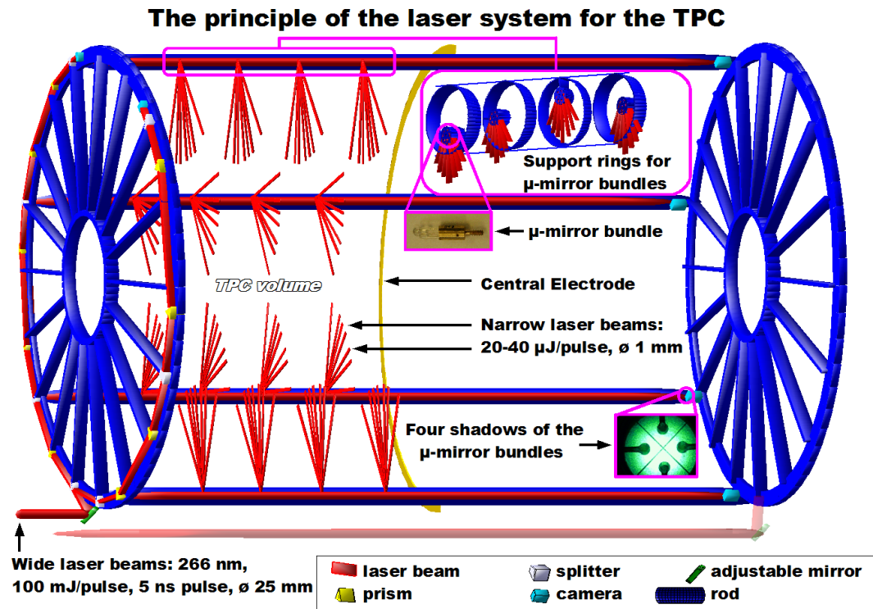
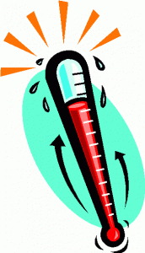

Time Projection Chamber (TPC)
Measure position and momentum
Requires knowledge of drift time
Temperature dependent
Laser installed
Required fabrication and installation of large amount of optics

Slide 7
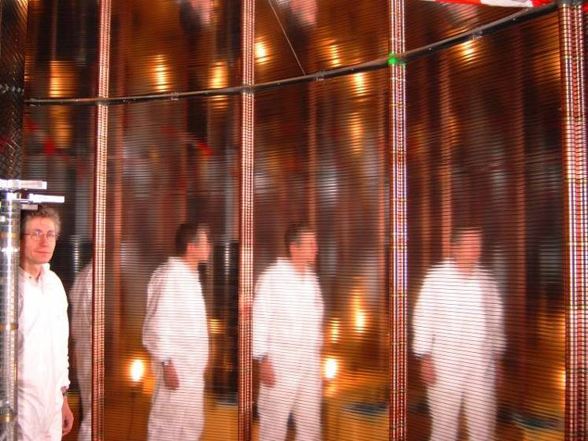
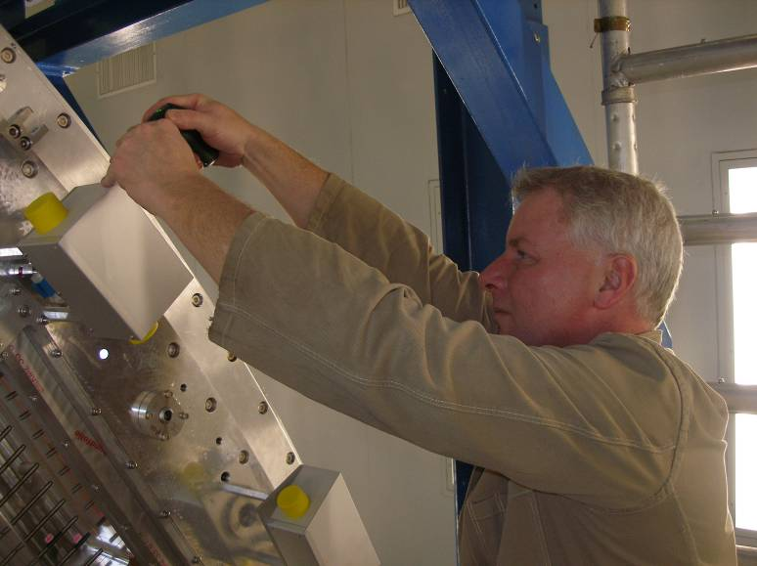
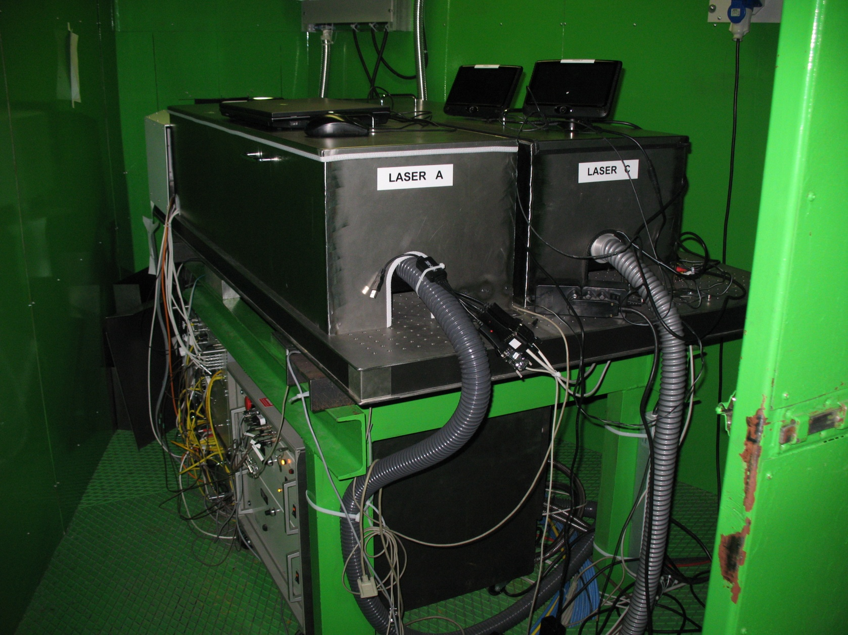
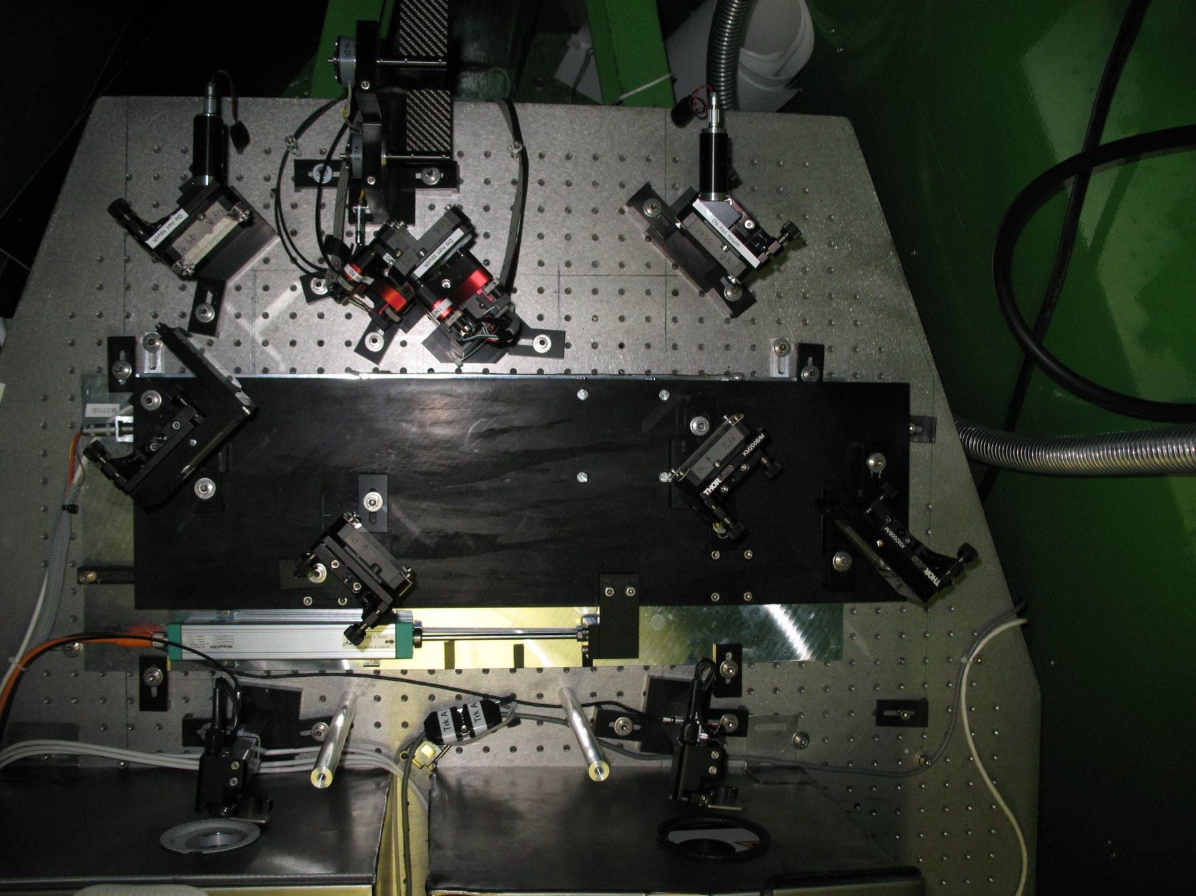
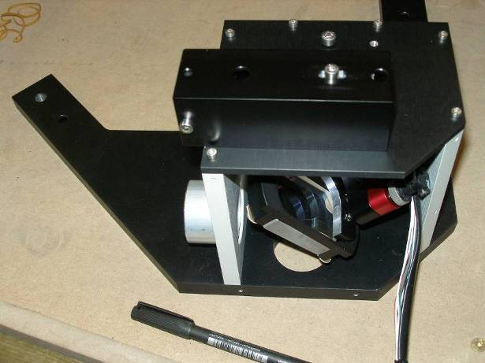
Laser System Construction
Notes:
Design, installation, optics, interface to trigger

Slide 8
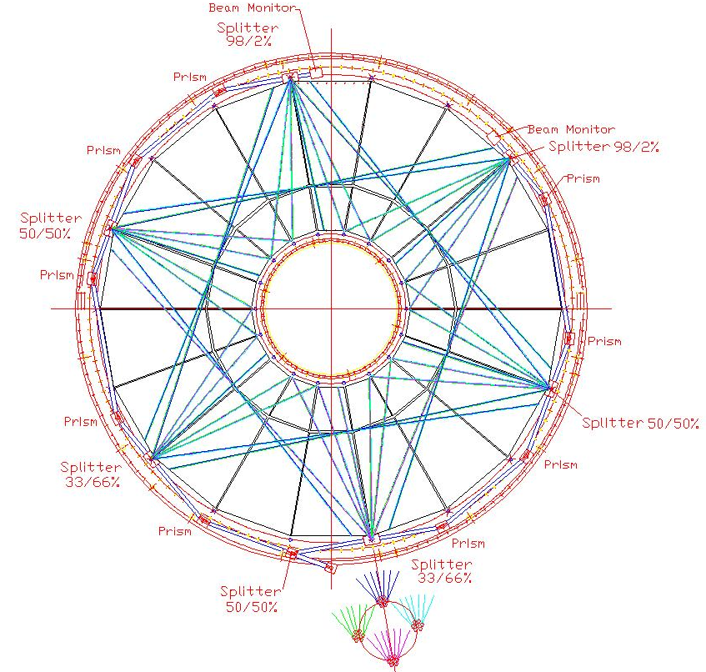
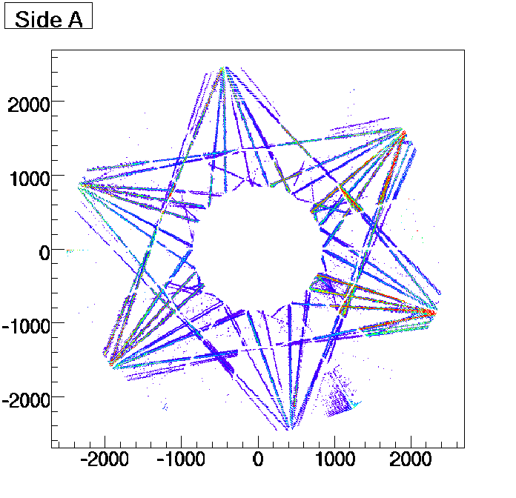
TPC Laser Data
Beam split into 336 laser tracks
Unaffected by magnetic field
Crucial for knowledge of drift time
Exact positions known

Slide 9
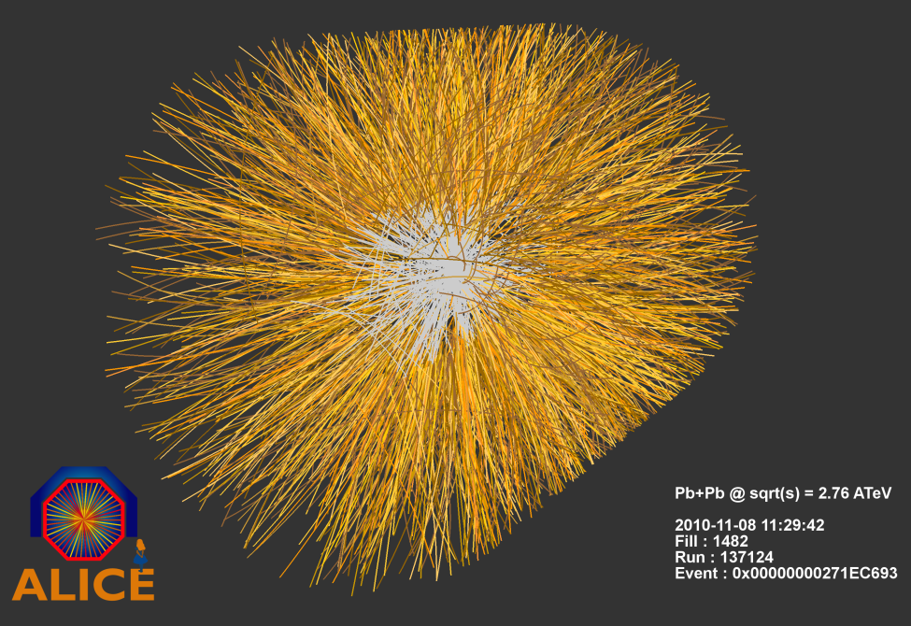
TPC PbPb Event
Laser is run at beginning of every run and each hour during the run.

Slide 10
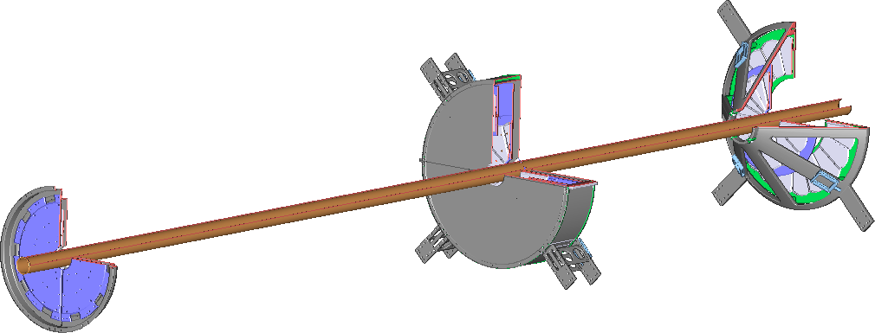
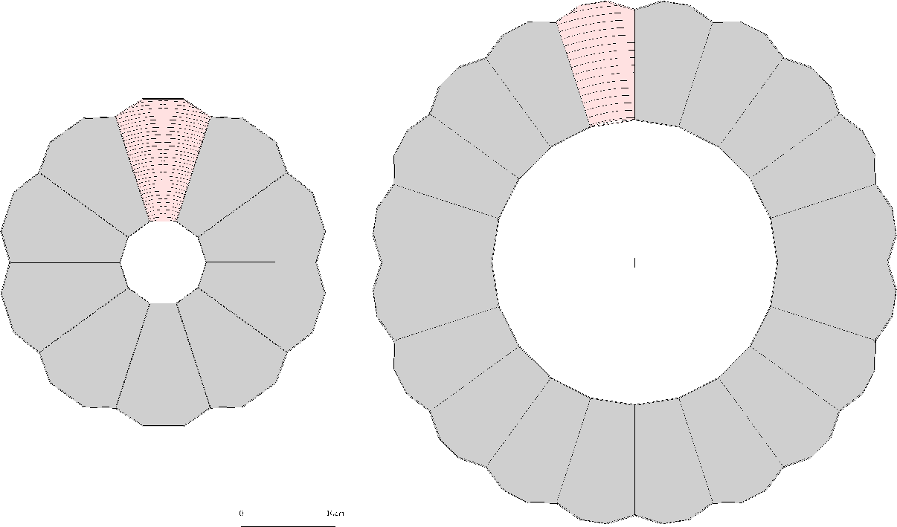
Forward Multiplicity Detector
Interaction Point
Only detector in ALICE with high segmentation at forward η (-3.4 < η < -1.7 and 1.7 < η < 5.0)
51200 silicon strips - radial and azimuthal segmentation
Position and energy information
Hit information can be used in p+p for particles detection
Energy information used in Pb+Pb (high occupancy)

Slide 11
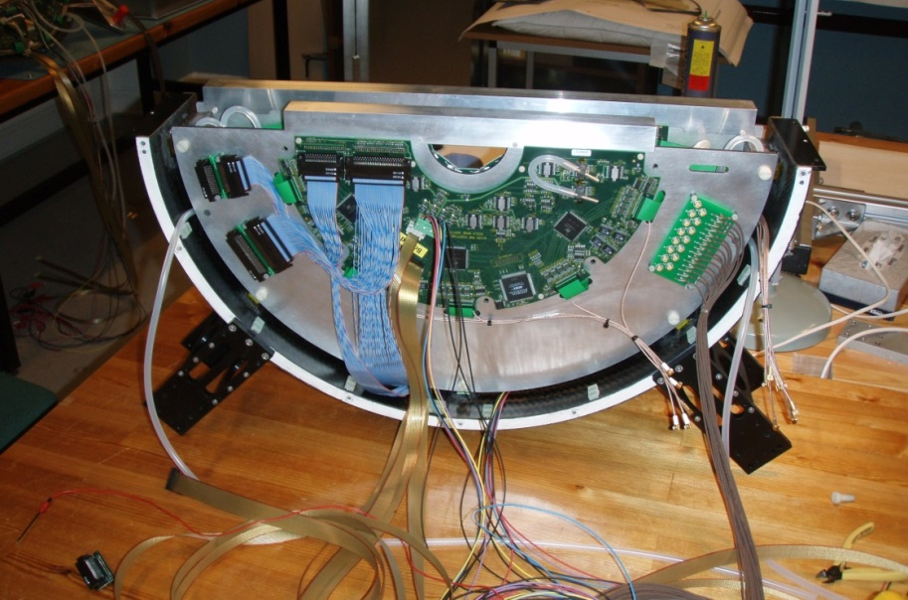
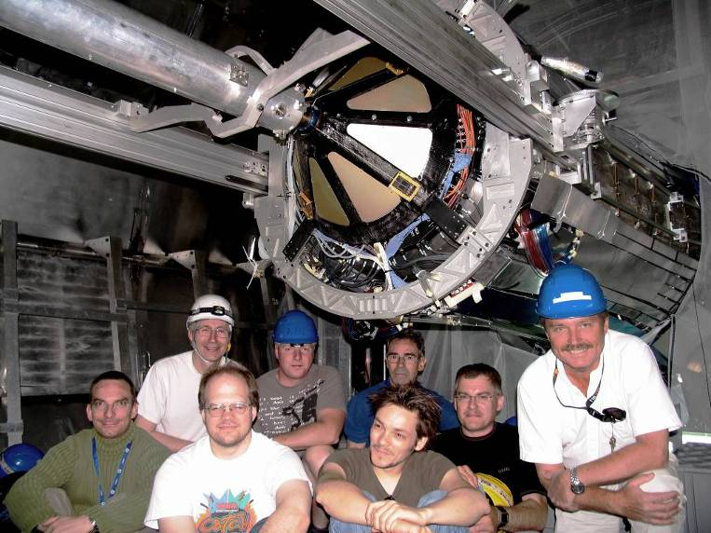
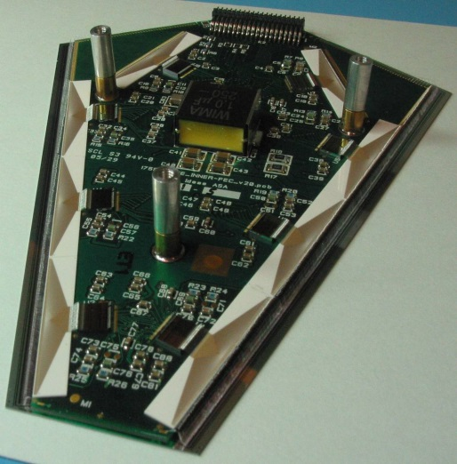
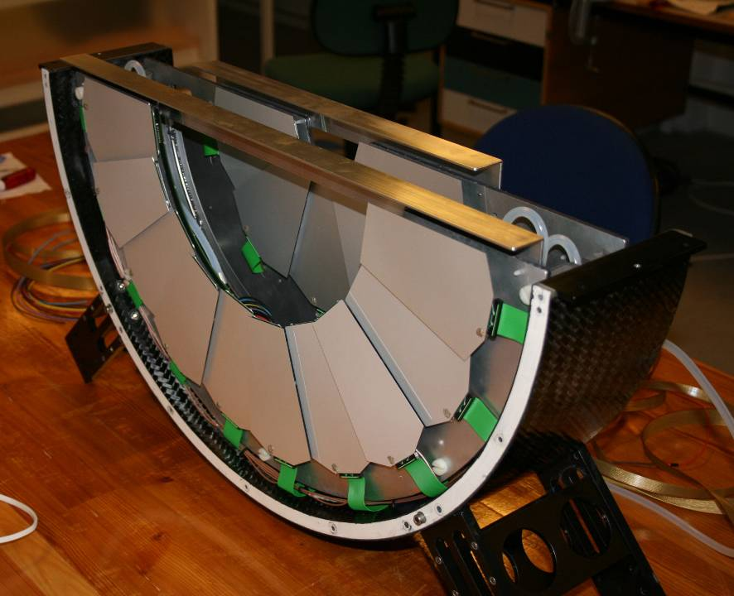
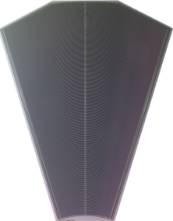
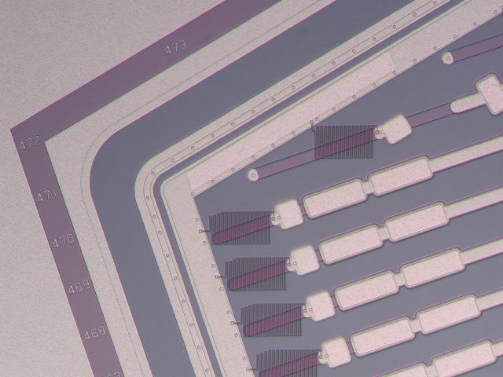
FMD Construction
Notes:
Design, construction, installation, control systems

Slide 12
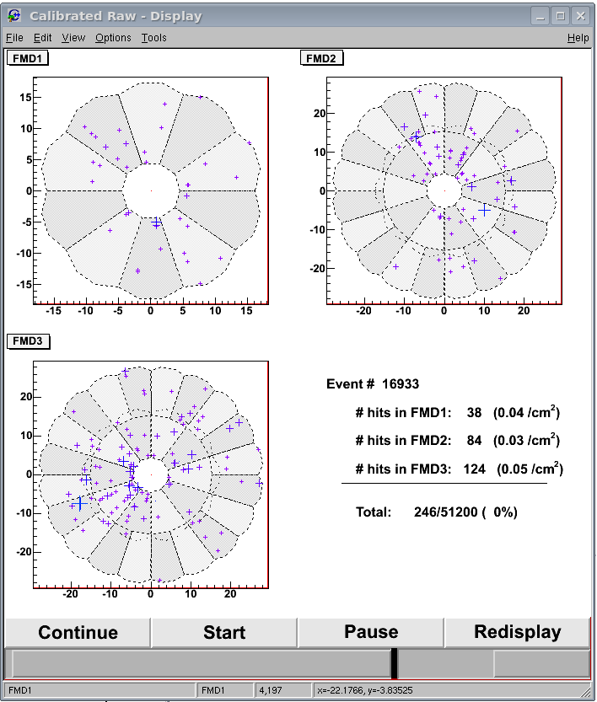
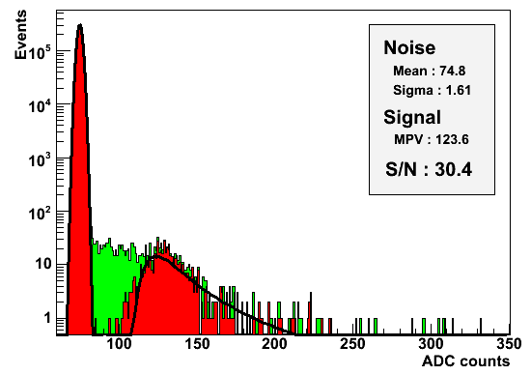
FMD Data

Slide 13
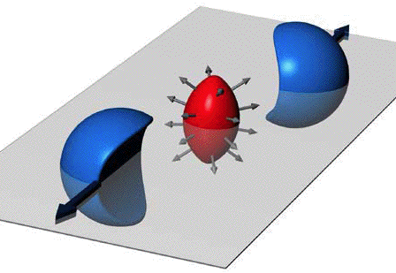
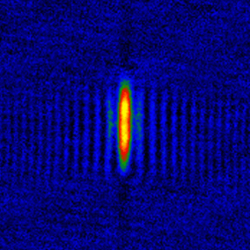
Strong Hydrodynamics
Asymmetry in region of interaction
Produces asymmetric azimuthal distribution of particles from pressure gradient
Can measure this final asymmetry
v₂ - second moment of Fourier expansion
Related to viscosity of the medium
North Carolina State University – JETLab – Cold Atoms
http://www.physics.ncsu.edu/jet/news/index.html

Slide 14
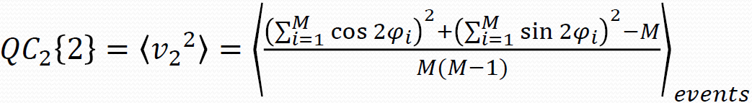
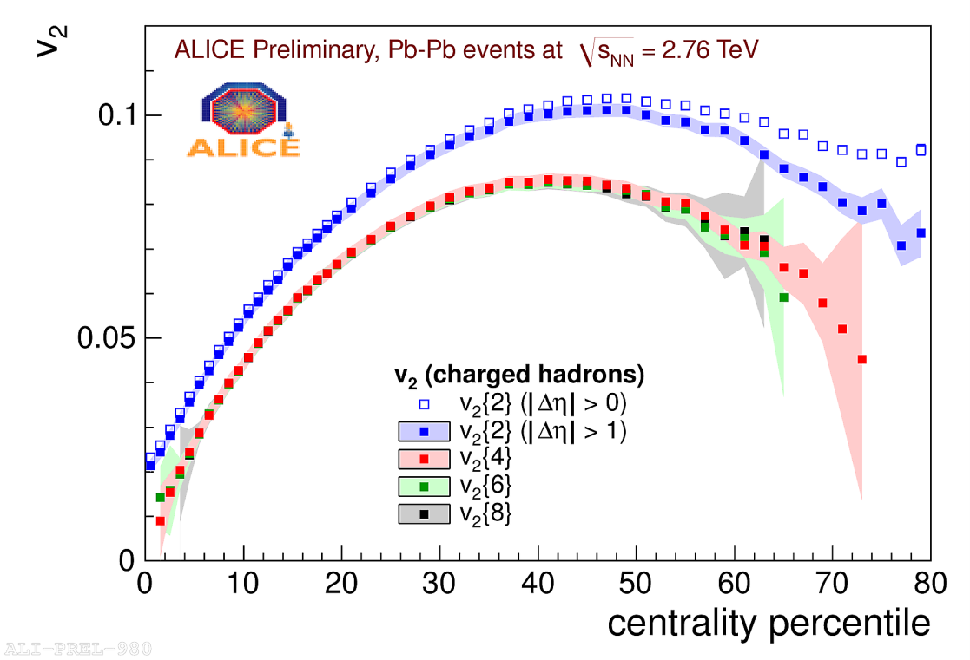
Elliptic Flow
Q-Cumulant (correlation) method used
Does not require measuring symmetry plane
Higher order correlations can be computed
Less sensitive to non-collective effects
Higher order correlations agree

Slide 15
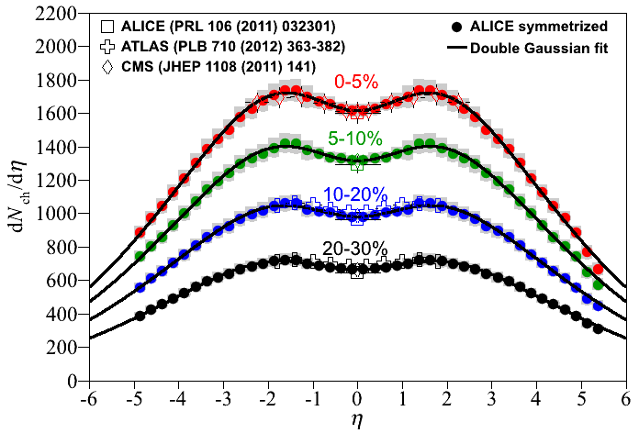
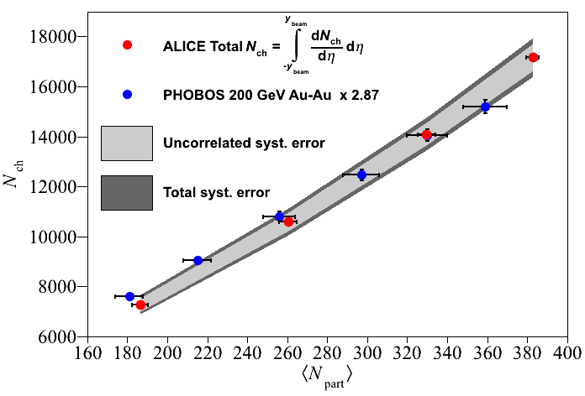
Particle Production
Can measure distribution of produced particles
Most energy goes into production of particles at midrapidity
~ 17000 particles produced in central collision
Energy density greater than 15 GeV/fm³
arXiv:1304.0347

Slide 16
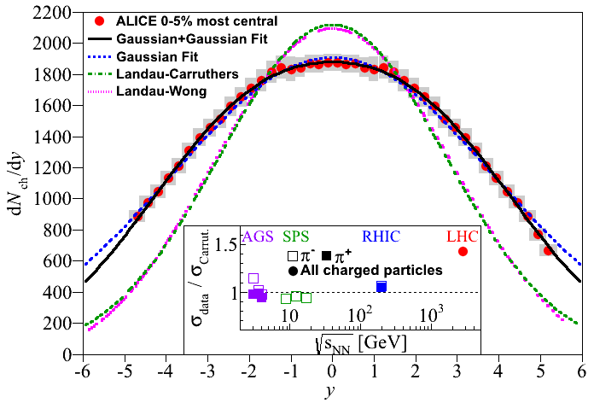
Hydrodynamics
Simple assumptions used to transform from pseudorapidity to rapidity
Gaussian distribution found
Wider than predicted by Landau hydrodynamics
Deviation from Landau hydrodynamics new at LHC
arXiv:1304.0347

Slide 17
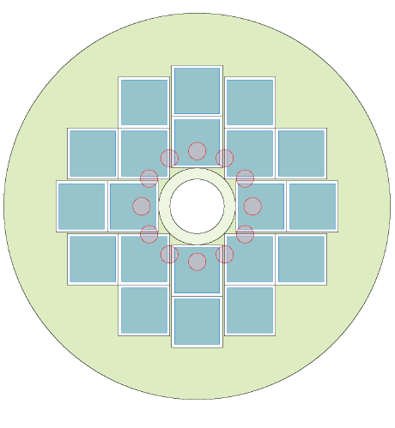
Future Plans
LHC will have a major shutdown in 2018 for a luminosity upgrade
Forward Centrality Trigger
New trigger detector needed for ALICE
Combine 3 separate subdetectors (V0, T0, FMD)
New Micro-Channel Plate detector proposed (Cerenkov radiator)
Upgraded laser
Higher luminosity will produce space-charge effects in TPC
Upgrade current laser to allow for more continuous calibration
Along with many more interesting analyses of the ALICE data!

