Slide 1
CERN NA63 and accelerator + detector R&D
Ulrik I. Uggerhøj
(Spokesman, CERN NA63 and SLAC E-212)
Department of Physics and Astronomy
Aarhus University
Denmark
Notes:
25 MINUTTER! **********************************************

Slide 2



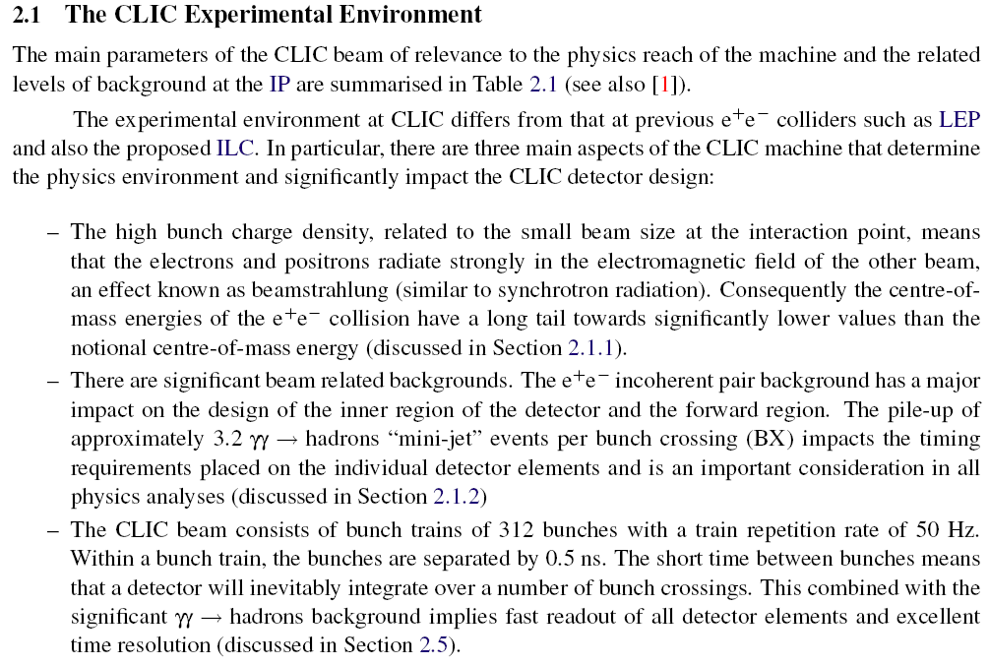

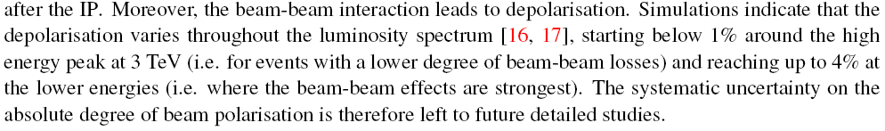
p.
&
Strong field effects
Real and virtual photon interactions
Tertiary photons as fast luminosity monitor
Spin-flip interactions
CLIC is part of ‘délibérations’ of:

Slide 3
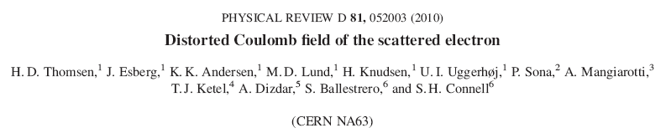
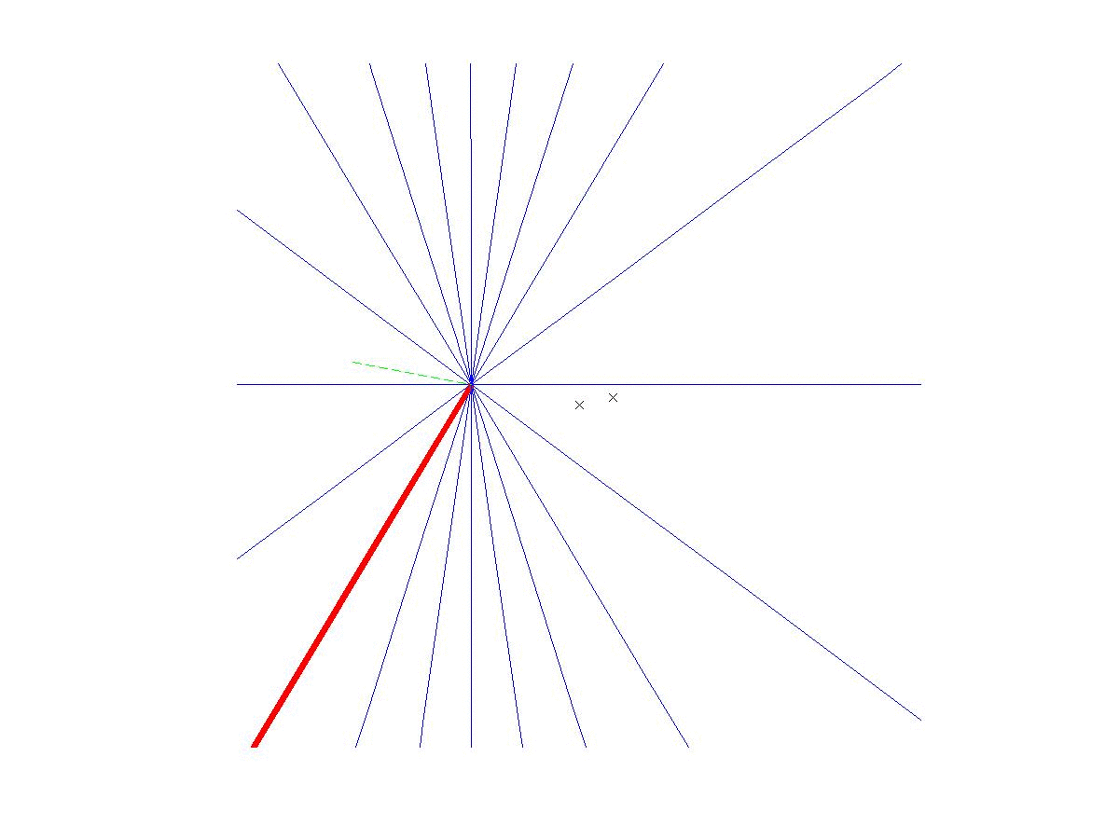
CERN
NA63

Slide 4




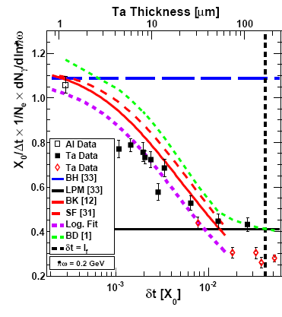
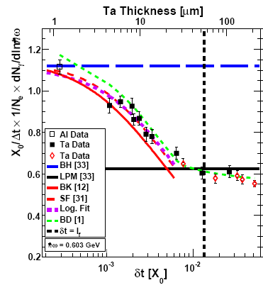
Logarithmic t dependence
Transition between Bethe-Heitler and LPM regimes:
’Radiation per interaction as a function of number of scatterings’

Slide 5
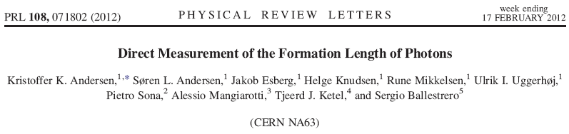
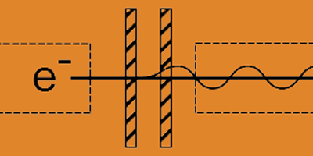
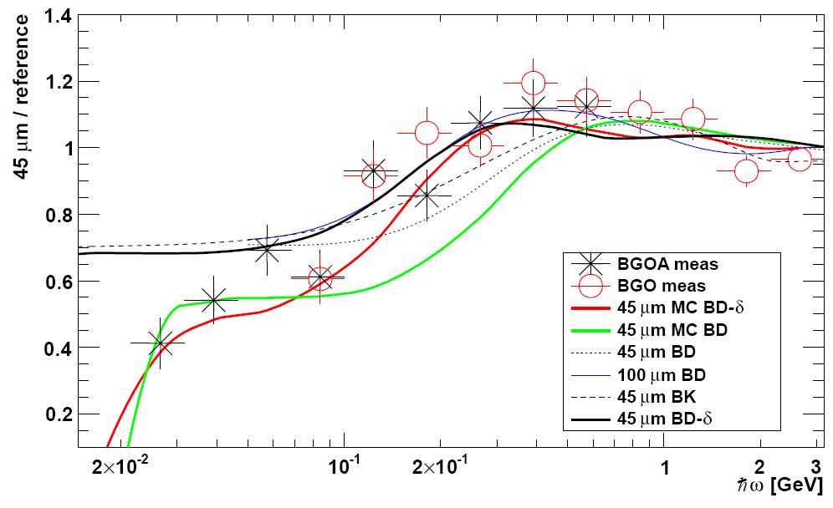
Measuring the formation length with a micrometer screw....
Synopsis: Going the Distance
Discrepancy reported at SPSC Oct 2011 was a theory problem!

Slide 6

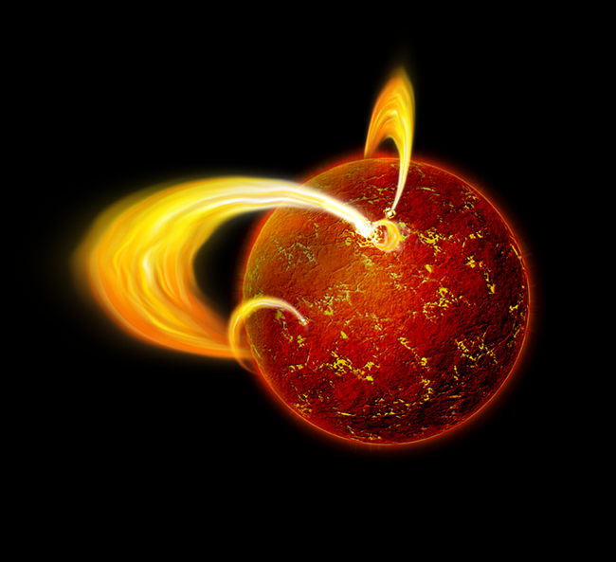



Strong fields
Strong – compared to what?
The critical field:
Exists at the surface of some neutron stars (magnetars)
Relativistic invariant:

Slide 7
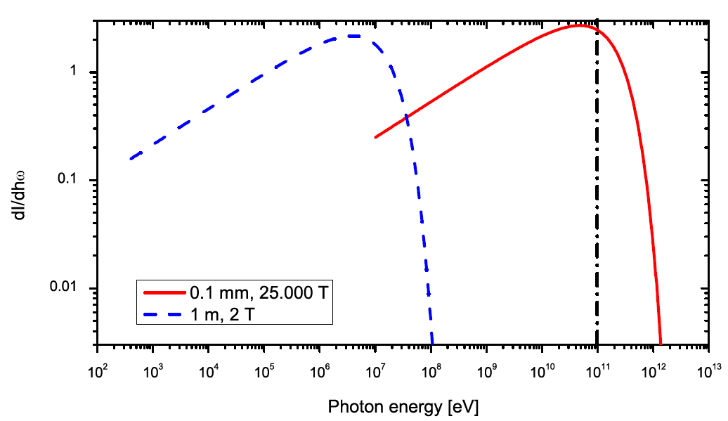
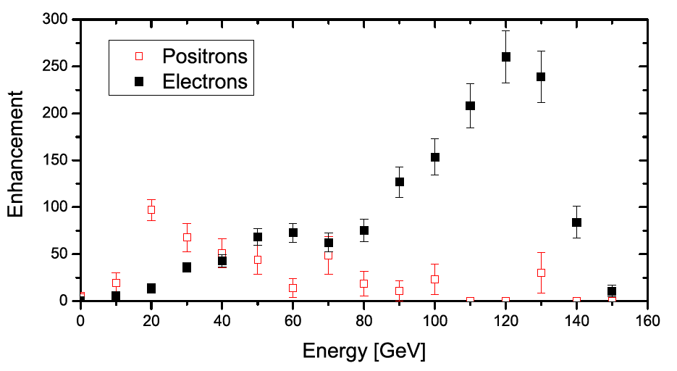
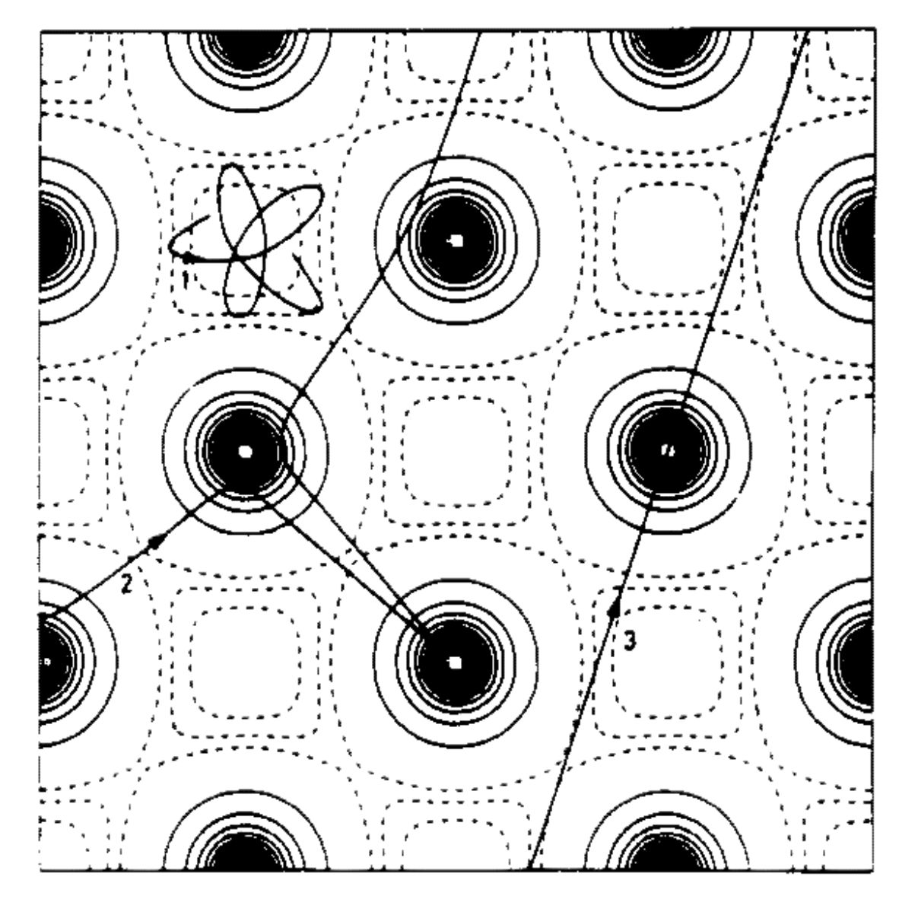
Radiation emission

Slide 8

Beamstrahlung – synchr.rad.
Classical: -> 0 => C_{b} -> infty

Slide 9



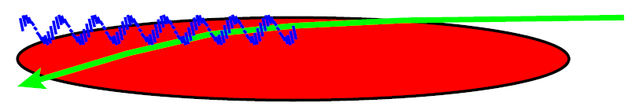
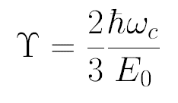
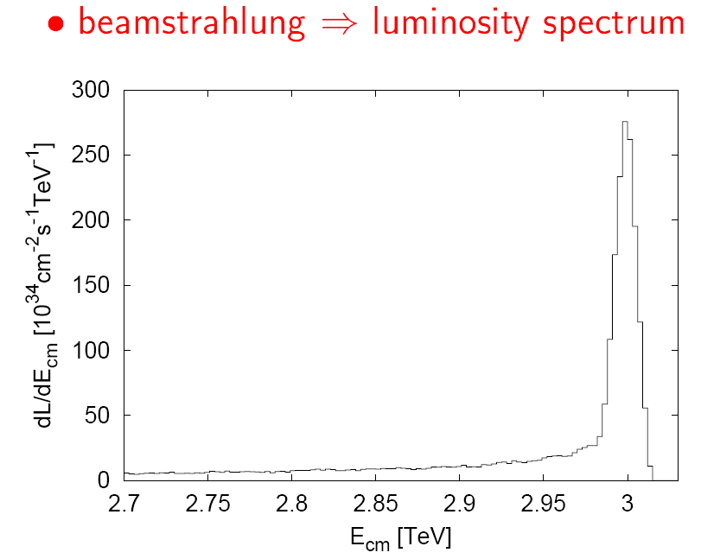
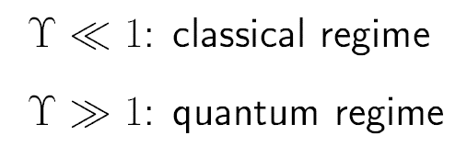

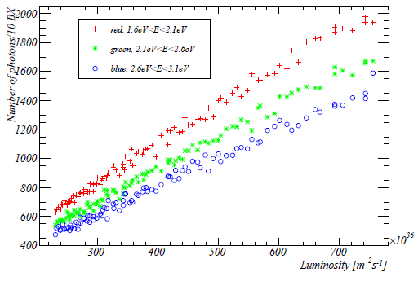


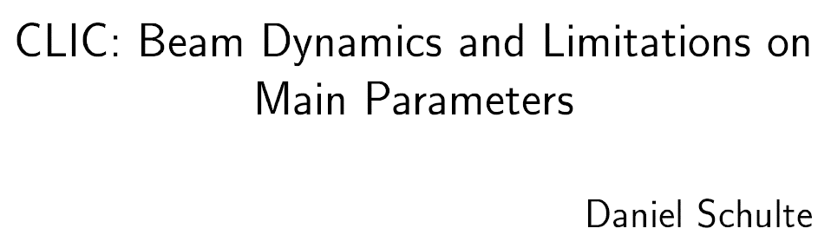
Quantum suppression
Factor ≈ 5 more than classical theory would say
From:
J. Esberg (NA63) – CTF3, GUINEA-PIG implementation
optical tertiary photons as a fast (ns) luminosity signal for CLIC

Slide 10
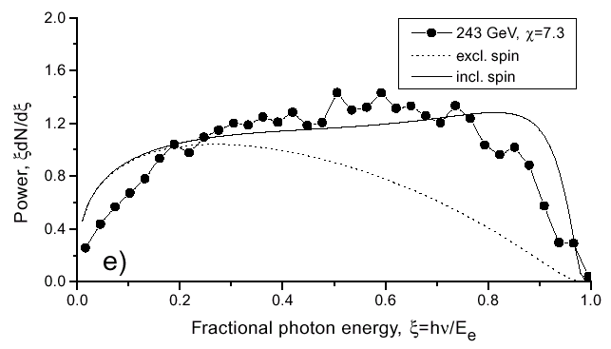
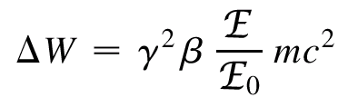

Spin-flip
100 GeV
χ=1
cτ_{sf} = 10 μm
τ_{sf} = 32 fs
1 GeV
B=1 T
cτ_{sf}= 7.3 A.U.
τ_{sf} = 61 min.
’Polarization time/length’

Slide 11
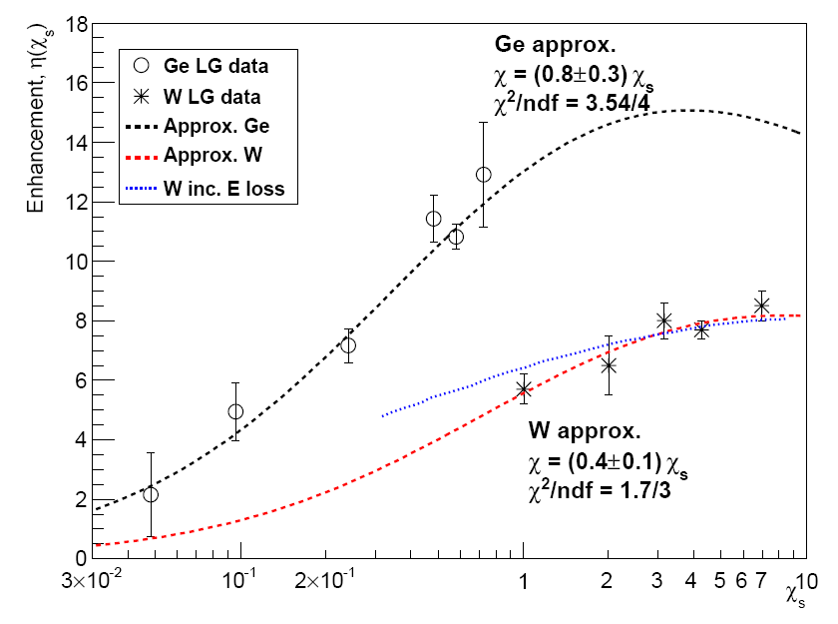
Classical -> Quantum synchrotron
Plotted as:
CERN NA63
K.K. Andersen et al.
Phys.Rev. D 86, 072001, 2012
CLIC
ILC
GUINEA-PIG (D. Schulte, CERN) simulations of beamstrahlung are now ‘experimentally verified’

Slide 12
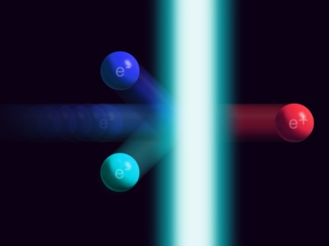
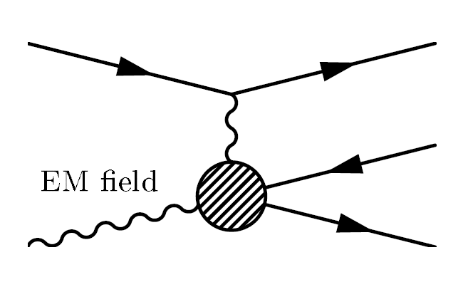
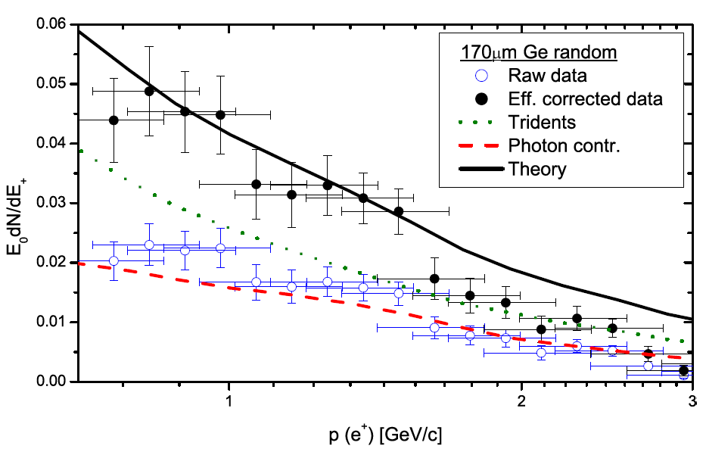
Trident production

Slide 13
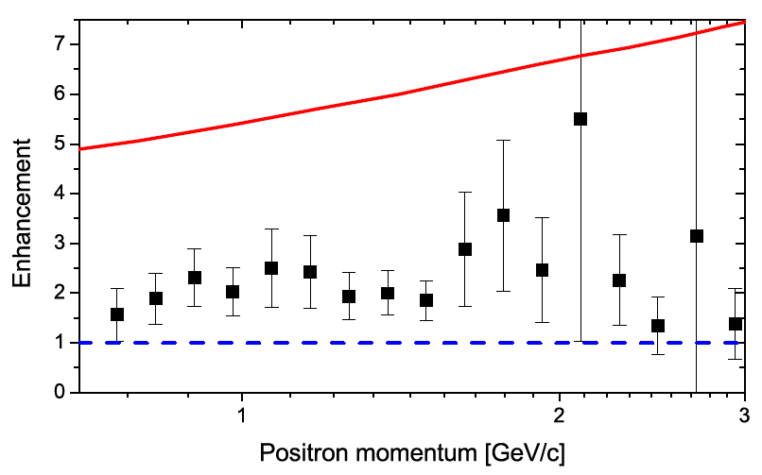
Trident enhancement in strong field
Theory (BKS)

Slide 14




Plasma wakefields
Transverse focusing forces:
Lead to values
for realistic parameters:
AWAKE - Proton Driven Plasma Wakefield Facility at CERN
SPSC-I-240

Slide 15
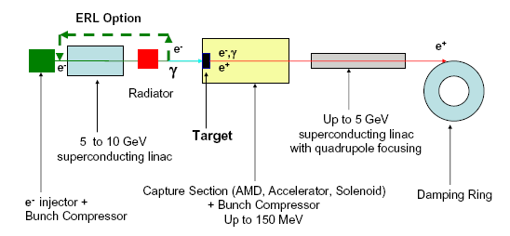
Positron production
…studies with aligned crystals – to be used for e.g. CLIC, LHeC previous studies with tungsten
High multiplicity and ’low’ energies (10 MeV e⁺)

Slide 16
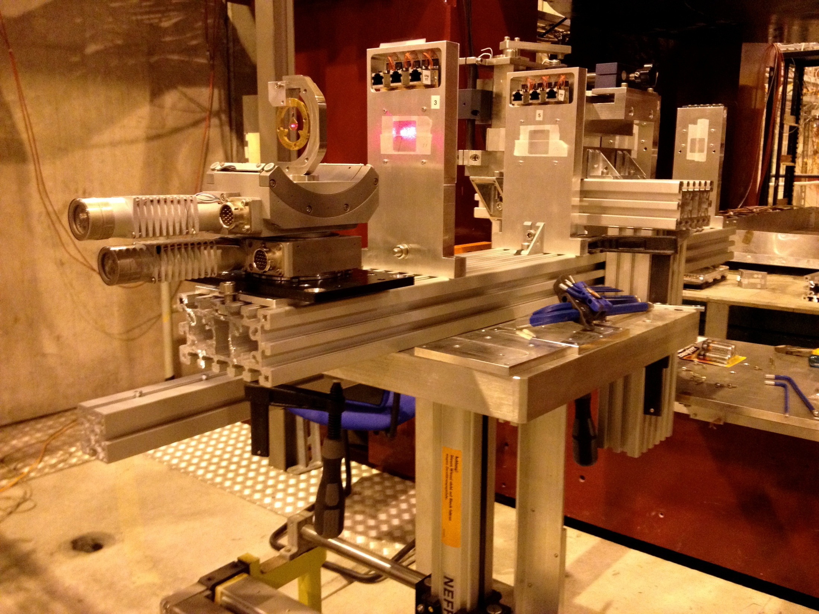
Spectrometer magnet
Aligned diamond <100> crystal
MIMOSA detectors

Slide 17
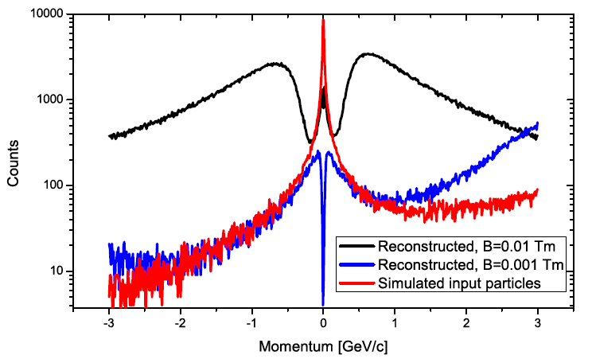
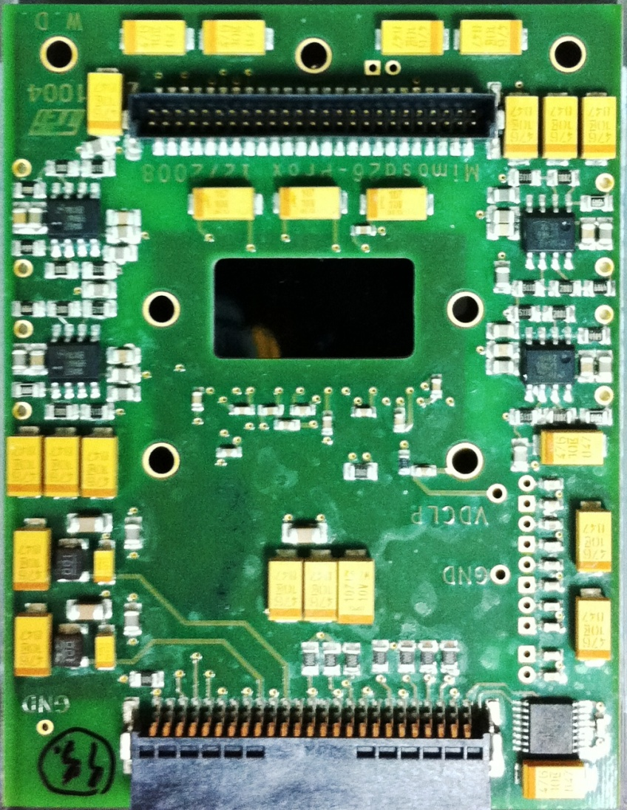




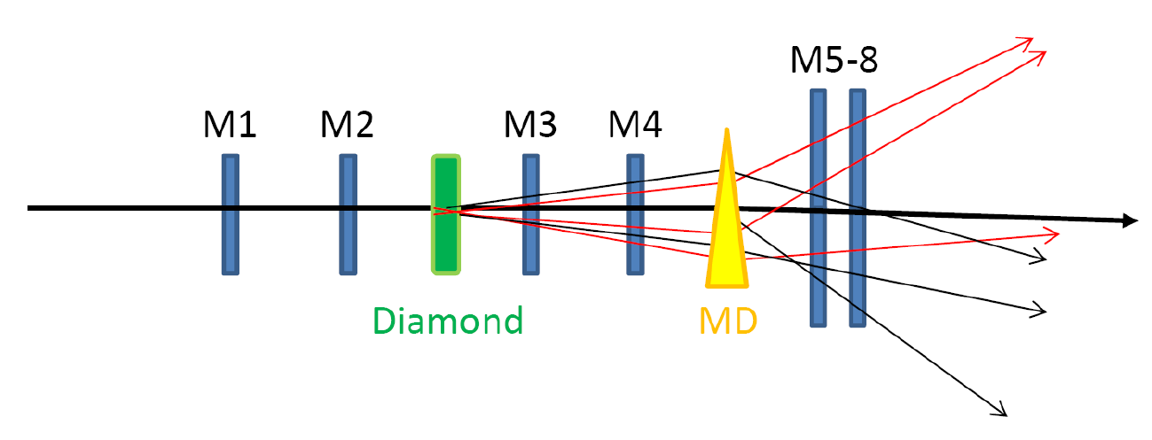
Positron production
MIMOSA detectors (M. Winter, Strasbourg)
  Vertex detectors for CLIC (?)
Detector R&D

Slide 18

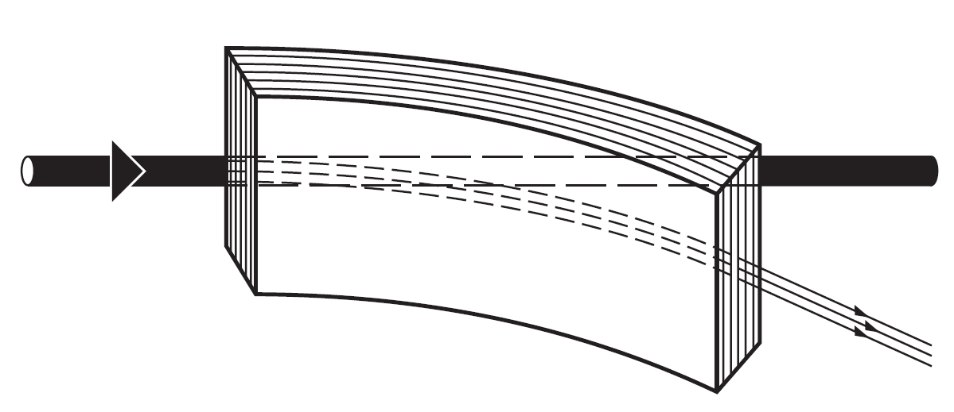
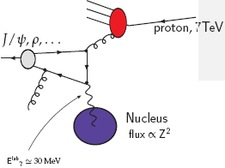
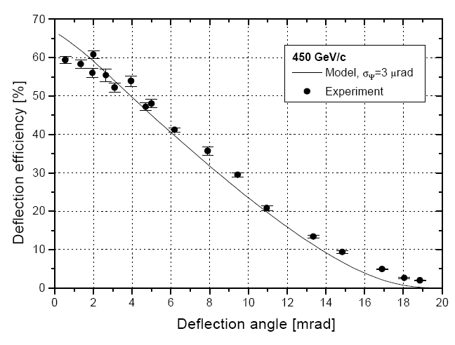
J.P. Lansberg, V. Chambert, J.P. Didelez, B. Genolini, C. Hadjidakis, P. Rosier, R. Arnaldi, E. Scomparin, S.J. Brodsky, E.G. Ferreiro, F. Fleuret, A. Rakotozafindrabe, U.I. Uggerhøj
(Ultra)Peripheral collision
Extraction of 7 TeV LHC protons for ‘fixed-target’ physics: AFTER@LHC

Slide 19
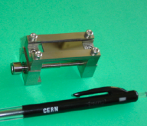
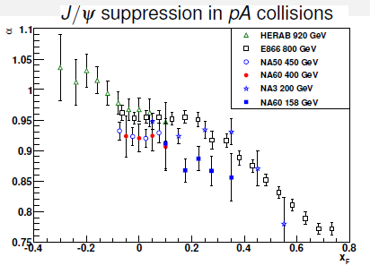
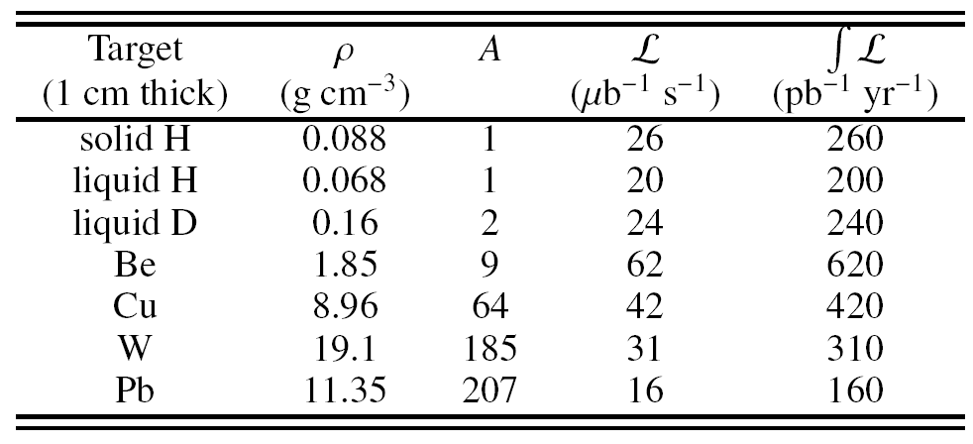
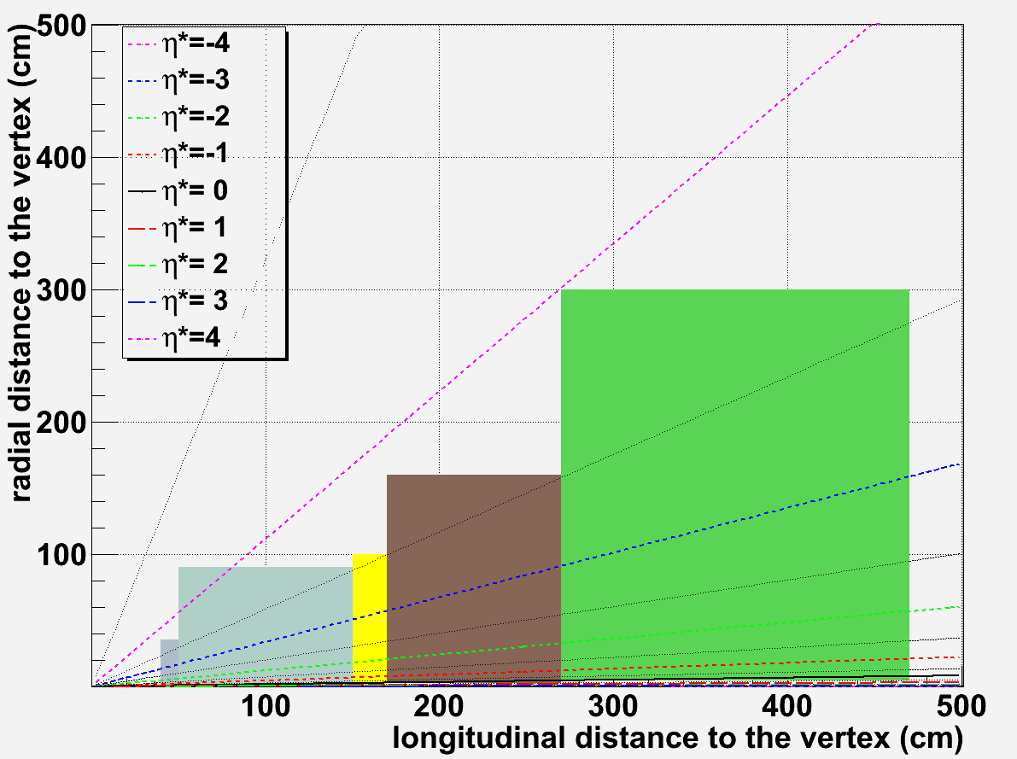
Luminosity at LHC
Extraction by a bent crystal
Access to target rapidity region (x_{F} -> -1)
η*=-4
η*=0
Reach few fb⁻¹ with 10cm liq H/D target

Slide 20
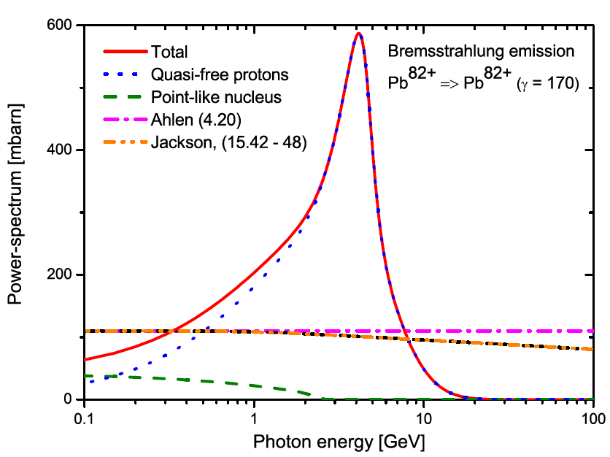
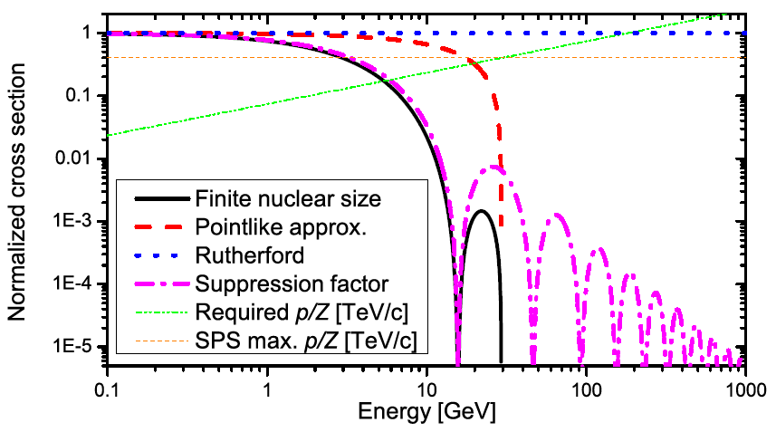
Heavy ion bremsstrahlung
Delta-electron emission
Finite nuclear size
Photon emission
Nuclear charge distribution for short-lived species
(Aarhus-CERN-Berkeley collab.)

Slide 21
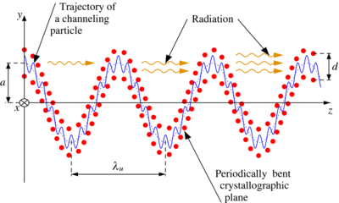
Undulator Radiation from Positron Channeling in a Single Crystal
A. Solov’yov, A. Korol, W. Greiner et al.
MAMI, Mainz

Slide 22
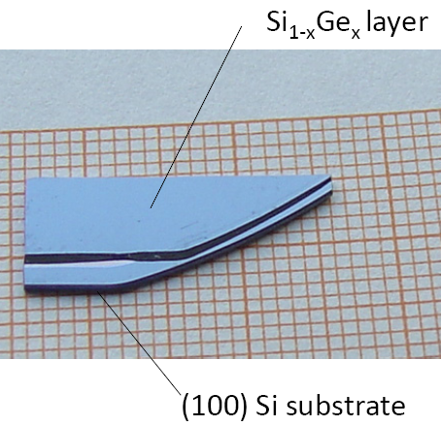
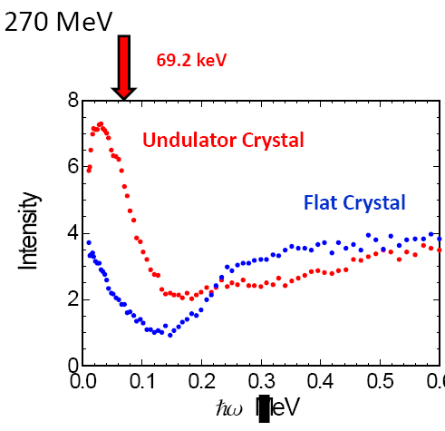
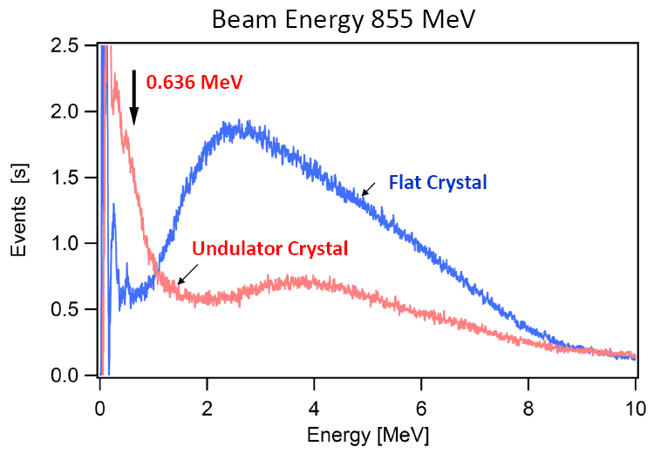
Crystalline undulator radiation
Electrons

Slide 23
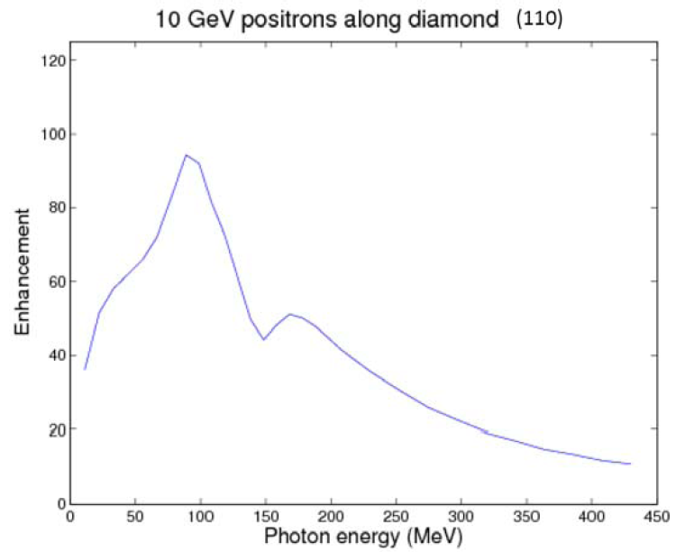
Undulator Radiation from Positron Channeling in a Single Crystal
SLAC E-212
Stimulated emission in (nearly) harmonic potential
Facility for Advanced Accelerator Experimental Tests
A possible route to a gamma-ray laser?

Slide 24
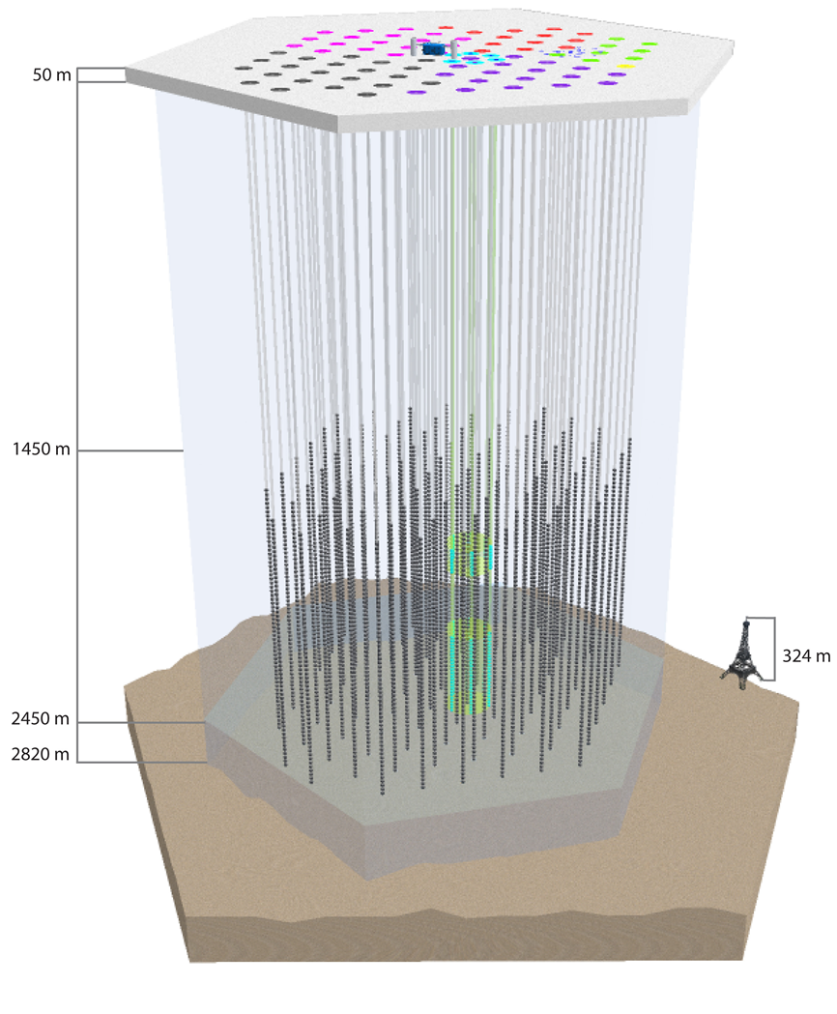

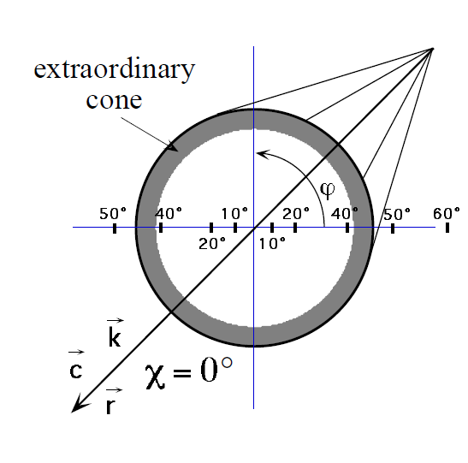
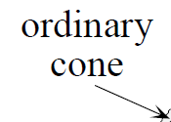
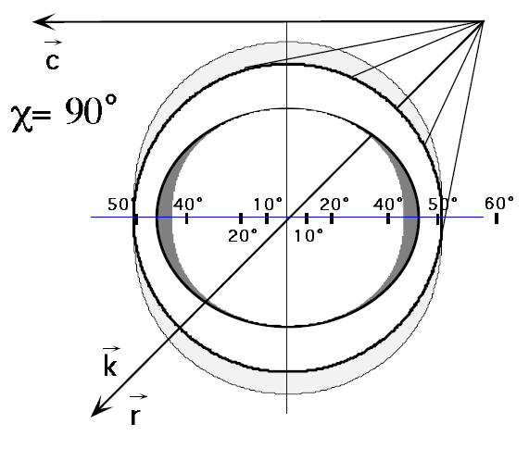
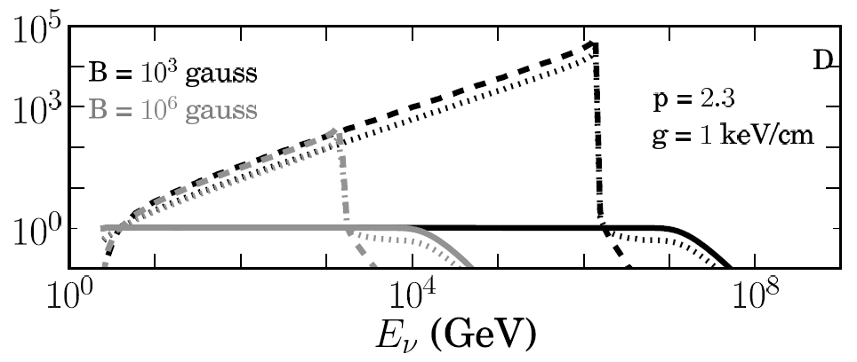
IceCube (-related)
Subm. ApJ Lett.
Does Čerenkov emission depend on direction in a birefringent crystal (hexagonal ice)?
”Using the IceCube high energy diffuse neutrino flux limits, we […] put strong constraints on different models of particle acceleration, particularly those based on plasma wakefield acceleration, and limit models for sources like Gamma-Ray Bursts and magnetars.”
Experiment underway (week 20)
… and S. Klein, X. Artru

Slide 25
CERN NA63
Summary
Incoherent bremsstrahlung (formation time)
Strong fields
  Radiation, quantum suppression
  Spin-flip
  Plasma wake-fields
  Positron production
  Tridents
  Beamstrahlung, luminosity measurement
AFTER@LHC – extract 7 TeV for FT QCD
Heavy ion bremsstrahlung
Crystalline undulator, E-212 (stimulated emission?)
IceCube-related studies

Slide 26
Backup slides

Slide 27


Slide 28

Crystals

Slide 29

Crystals
Extremely strong
electric fields
10¹⁰-10¹¹ V/cm
50 V / 0.1 Å
=
5·10¹⁰ V/cm

Slide 30


Spin contr. to beamstrahlung
Tungsten
Germanium
Blankenbecler and Drell, ”Quantum treatment of beamstrahlung”, PRD 36, 277 (1987)

Slide 31


A fixed-target experiment using the LHC beam(s):
AFTER@LHC (LOI in prep.)

Slide 32




W. Scandale et al.

Slide 33
Luminosity at LHC
Intensity: expect 5.10⁸ protons.s⁻¹
  Beam: 2808 bunches of 1.15x10¹¹ protons = 3.2x10¹⁴ protons
  Bunch: Each bunch passes IP: 3.10⁵km.s⁻¹/27 km ~ 11 kHz
  Instantaneous extraction: IP sees 2808 x 11000~3.10⁷ bunches passing every second ➔ extract 5.10⁸/3.10⁷ ~ extract 16 protons in each bunch at each pass
  Integrated extraction: Over a 10h run: extract 5.10⁸p x 3600s.h⁻¹ x 10h=1.810¹³p.run⁻¹ ➔ extract 1.8 x 10¹³/(3.2 x 10¹⁴)~5.6% of the protons stored in the beam
Instantaneous Luminosity
  L = N_{beam} x N_{Target} =
  N_{beam} x (ρ x e x N_{A})/A
  N_{beam}=5 x 10⁸ p⁺/s
  e (target thickness) = 1 cm
Integrated luminosity
  9 months running/year
  ➔ 1year ~ 10⁷ s
  ➔ ∫_{year}L = L_{inst}x10⁷
From F. Fleuret
Reach few fb⁻¹ with 10cm liq H/D target

Slide 34


Pseudo-rapidity
η* = η – y_{CMS}
forward region: η*>0
backward region: η*<0
Very high boost:
  With 7 TeV beam : γ = 61.1
  With 2.75 TeV beam: γ = 38.3
Very well placed to access backward physics
Forward physics difficult to access
η*=-4.5
7 TeV
y_{CMS}= 4.8
η*=-4.8
η*=-4
η*=0
At 0.9 degrees
2.75 TeV
y_{CMS}= 4.3
η*=-4.3
η*=-4
η*=-3.5
η*=0

Slide 35
Tentative design transverse magnetic field detector
~0.1 m
~0.2 m
Typical detector: -3.5 < y* < 0
  Multipurpose detector:
    Vertex
    Tracking
    Calorimetry
    Muons
  Compact detector
    Because of the high boost, the detector must be as compact as possible
Dimensions
  Vertex: z=40 / R_{min}=0.5 / R_{max}=35 cm
  Tracker: z=50 / R_{min}=0.8 / R_{max}=90 cm
  EMCal: z=150 / R_{min}=2 / R_{max}=100 cm
  Hcal: z=170 / R_{min}=2.5 / R_{max}=160 cm
  Muons: z = 270 / R_{min}=4 / R_{max}=300 cm
~1 m
~1 m
~2 m
MuID
EMcal
Hcal
η*=-4
η*=-3.5
η*=0

