Slide 1
NBIA School on
Computational Astrophysics
Beyond MHD:
Particle-in-Cell (PIC) Simulations
23-aug-2013

Slide 2
Plans for today
Beyond MHD: Charged Particle Dynamics
Particle-in-Cell (PIC) simulations
  The coupled Maxwell and Newton equations
  Scaling to/from non-dimensional units
Applications to the Solar Corona
The PP-code
  Today exercises

Slide 3
Books …
“Principles of Magnetohydrodynamics”, Goedbloed & Poedts
  Amazon (or library)
“Plasma Physics via Computer Simulation”, Birdsall & Langdon
  Amazon (or library)

Slide 4
Central issue
Magneto-hydrodynamics (MHD)
  Assumptions, break-down
Charged particle motion in given E & B
  .. including how to treat this numerically
Plasma (collective) behavior
  Collisionless
  With collisions

Slide 5
Topics this is crucial for in astrophysics
Solar physics
  The Sun as an astrophysics laboratory
  The solar corona
    plasma heating
    particle acceleration
Gamma Ray Bursts
  Collisionless shocks
    particle acceleration
    radiation diagnostics

Slide 6
Many other applications
Magnetospheric physics
  Aurorae
Fusions research
  Tokamaks (e.g. ITER)

Slide 7
Single particle motion
in electro-magnetic fields

Slide 8
Charged particle motion
In constant E & B fields:
  circular (cyclotron) motion
  drift
  acceleration

Slide 9
Motion and drift
Cyclotron motion
  gyro- (cyclotron-) frequency Ω = q B / m
  gyro- (cyclotron-) radius R = v / Ω
  E x B drift v_{d} = E x B / B²
In the books
  G & B: Chapter 1, Chapter 2
  B & L: Chapter 4, especially Section 4.4

Slide 10
[from “Principles of MHD”, lecture notes by Goedbloed, Poedts & Keppens]

Slide 11
[from “Principles of MHD”, lecture notes by Goedbloed, Poedts & Keppens]

Slide 12
[from “Principles of MHD”, lecture notes by Goedbloed, Poedts & Keppens]

Slide 13
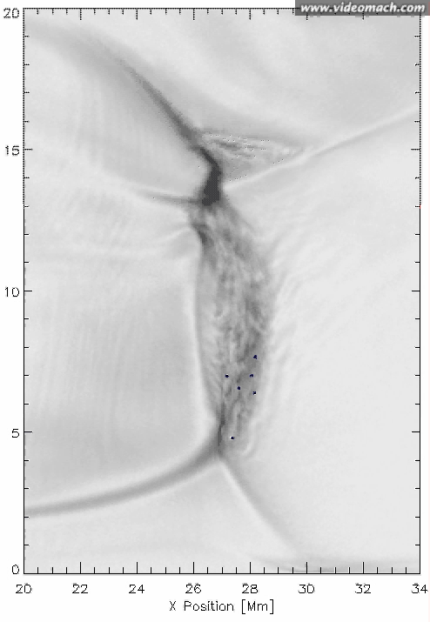
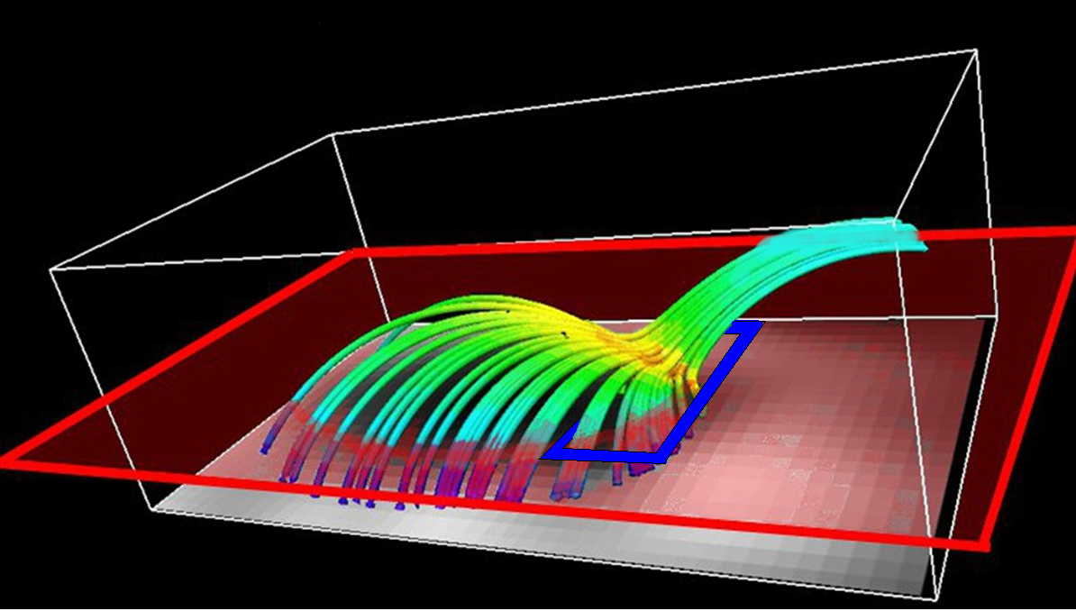
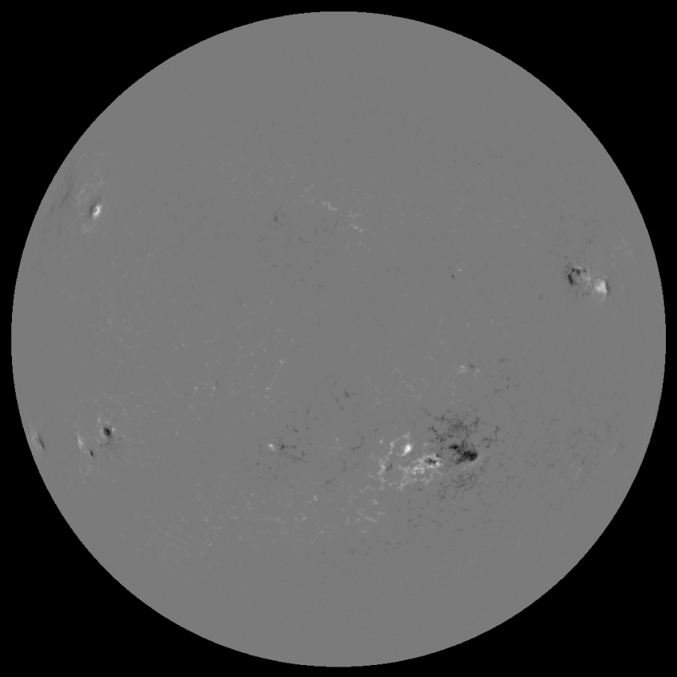
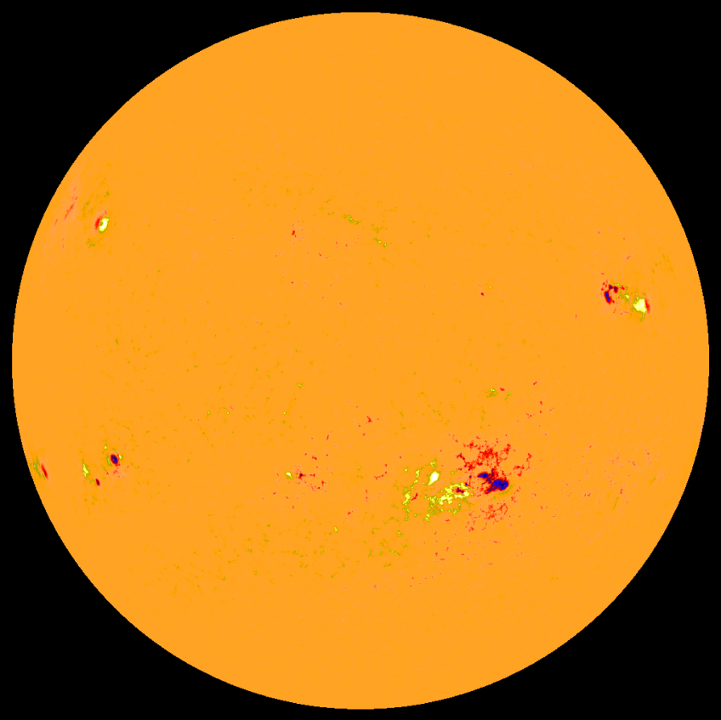
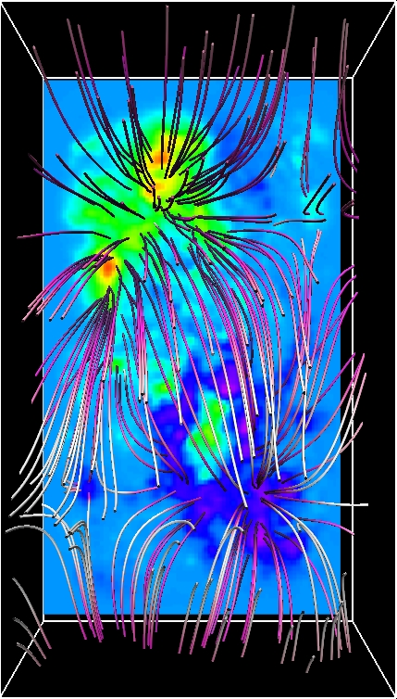
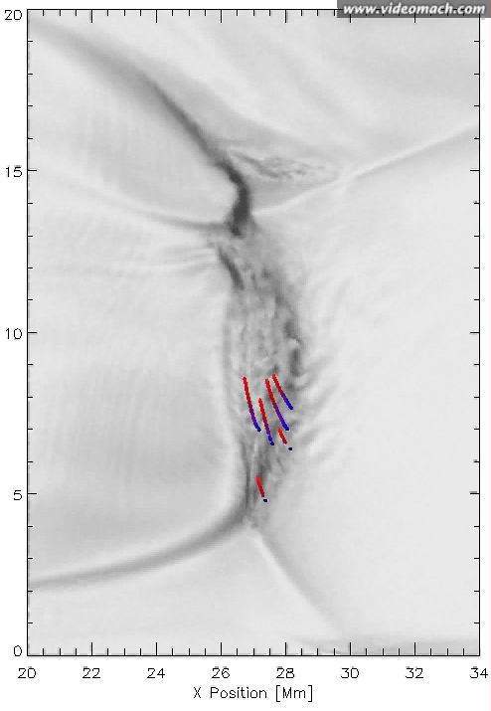
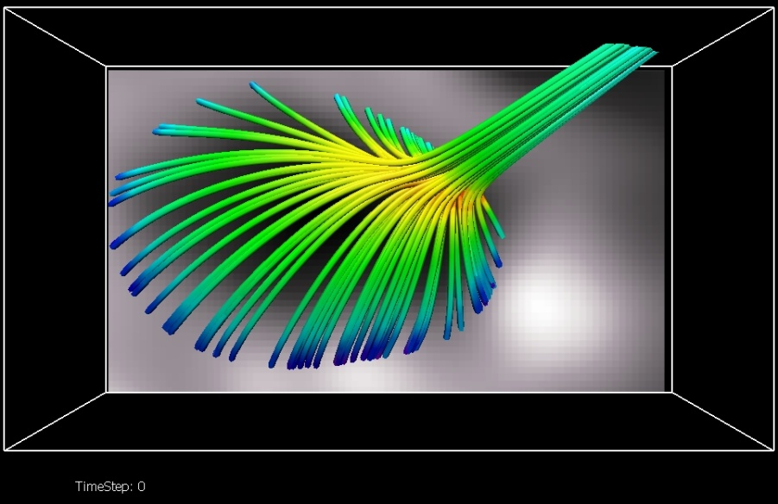
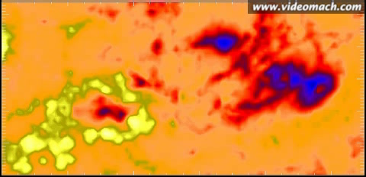
Record Breaking: 135 billion particles
Solar storms:
electron acceleration
in the solar
corona
Ab initio: Fundamental physics in ⇒ realistic models out
Ran 36h on 2¹⁸ = 262 144 cores on JUGENE (PRACE @ Forschungs-Zentrum Jülich)

Slide 14
Solar Chromosphere & Corona Conditions:
Which of the MHD approximations are valid?
  Enough charged particles to make a plasma?
    Certainly! Typical Debye lengths are a few mm!
  Slow enough motions relative to the speed of light?
    Well ”yes, most of the time!”
  Frequent enough collisions for thermal behavior?
    No!! Mean-free-paths similar to structure size!
    Coulomb collisions dominate
      Have interesting run-away behavior!

Slide 15
The one most important macro-scale kinetic effect:
Particle acceleration!
  Might be a recursive accerelation (ping-pong) effect
  But more likely it is a direct acceleration effect!
Mean free path comparable to structure scales
  Coulomb cross sections decrease with energy!
  Minority population can have run-away
Need particle-in-cell codes to investigate!

Slide 16
Computational Costs
MHD codes, cost per cell
  On Intel Nehalem, IBM Power-6, and similar CPUs
  Costs of the order 2-10 microseconds per cell-update
    Depending on equation-of-state, radiative transfer, …
Particle-in-cell (PIC) codes
  On similar CPUs
  Costs of the order 1 microsecond per particle-update
  Need 10-50 particles per cell
Naïve bottom line: only about 5-10 times slower
  However...; physical scales!!

Slide 17

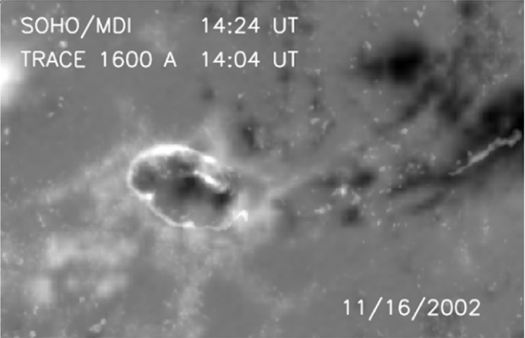
From observations to PIC
Masson et al. 2009
06:27 UT
MHD simulation
Flare ribbon
PIC simulation
?

Slide 18
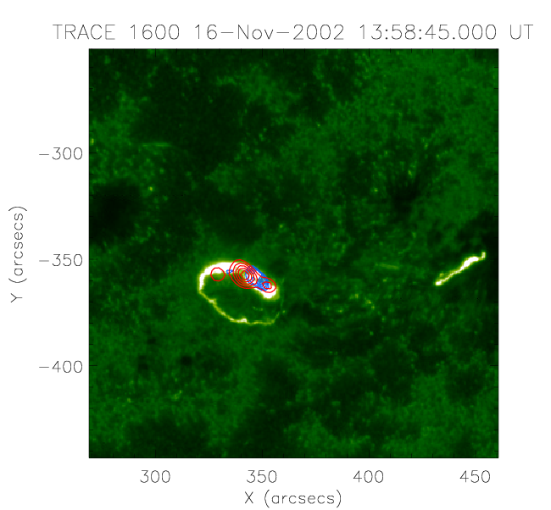
TRACE and RHESSI observations
12-25 keV (>50%)
25-100 keV (>50%)
A dense electrons beam is accelerated by the E-field in the reconnection region and travels along the fan magnetic field lines. The impact on the photosphere creates X-rays and UV emission.
Image: H. Reid
Notes:
Let’s have a look at the comparison with the RHESSI observations of this particular 3D reconnection event.
The entire circular ribbon brightens simultaneously. The ribbon is located where the footpoints of the fan are.
The peaks of the EUV (aligned picture from TRACE at 1600 Angstrom) for each area are co-temporal with the two peaks of the hard X-ray (>25keV) emission, which is co-spatial with the fan footpoints.
(click) If we compare the hard X-ray emission location (red contour lines) with the motion of the particles from the power-law tail, we see, that the particles are accelerated towards the northen part of the ribbon into the area of the hard X-ray emission. We can conclude, that the electrons are accelerated along the magnetic field lines by the electric field, which is created in the reconnection process taken place around the nullpoint. The to a lower energy related UV emission can be seen all along the fan footpoints, presumably coming from less accelerated particles travelling all the way from the reconnection region down the fan plane to its footpoints.
It is of course not exact, because the representation of the driving motion on the lower boundary is not exact, as we have seen in an earlier slide.

Slide 19
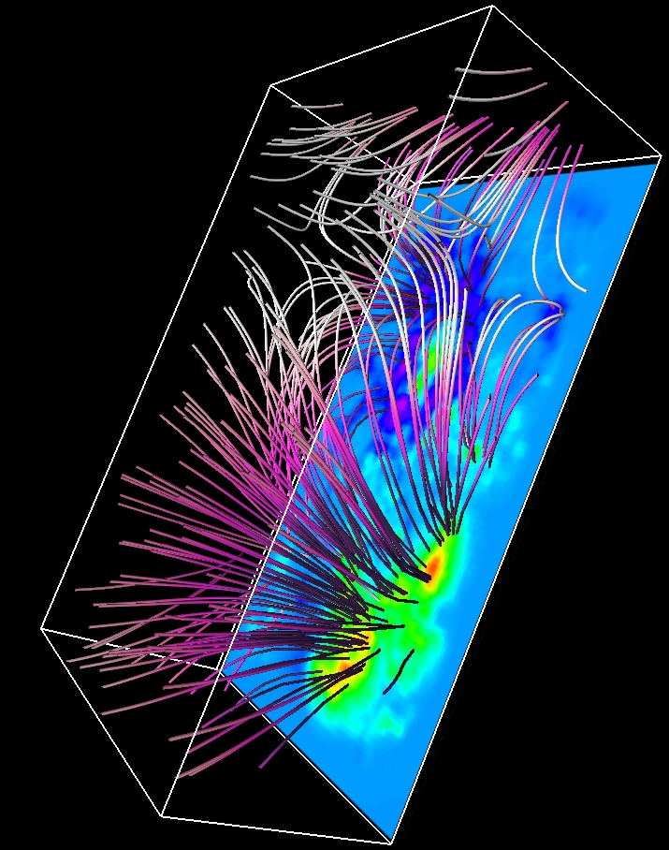
Initial extrapolated B-field

Slide 20
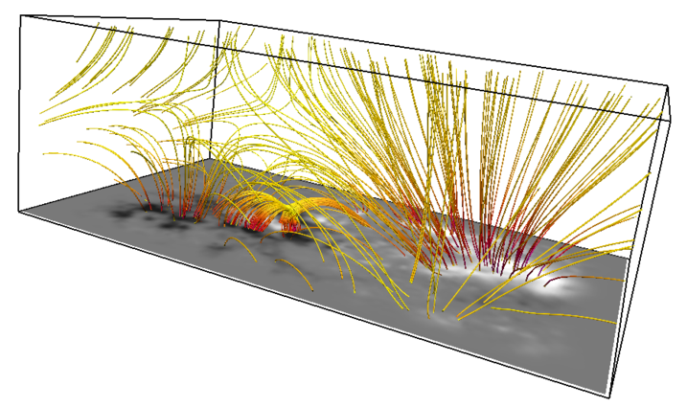
Potential extrapolation, side view

Slide 21
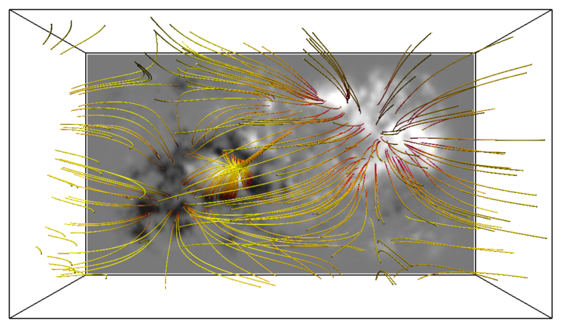
Potential extrapolation, top view

Slide 22
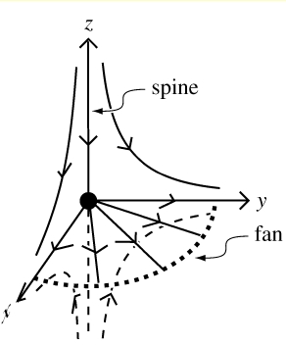
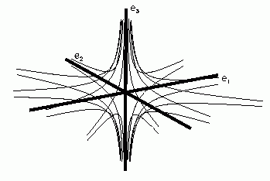
3D nullpoint reconnection
magnetic field lines
nullpoint

Slide 23
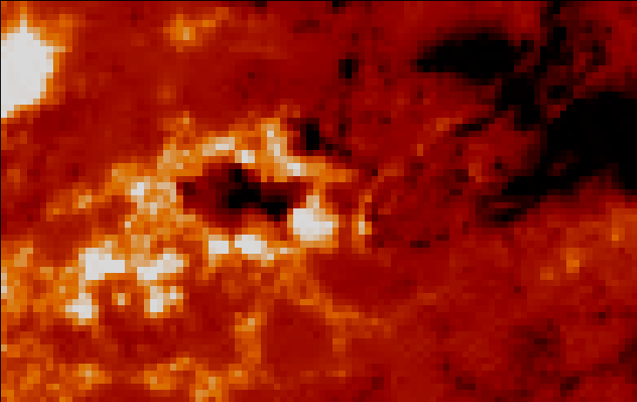
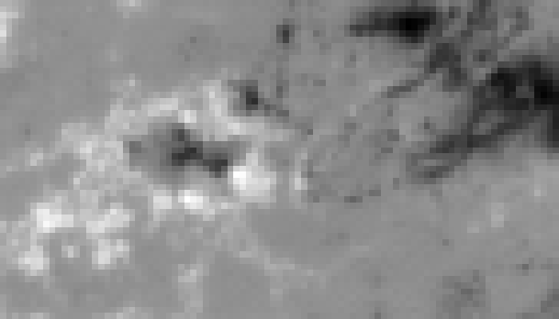
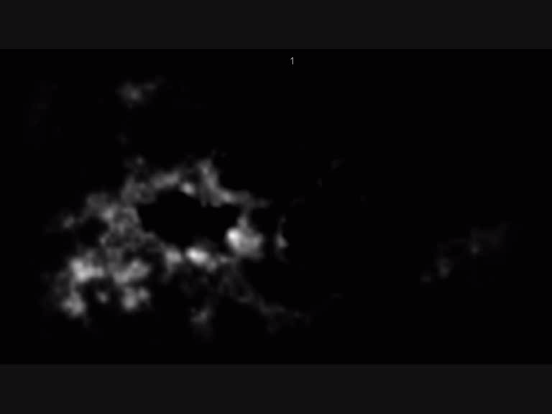
Applied driver
Flux emergence on 16th Nov ‘02
The elliptical driver applies a sub-Alfvénic velocity of about 20 km/s to the lower boundary after about 150 sec of relaxation time.

Slide 24
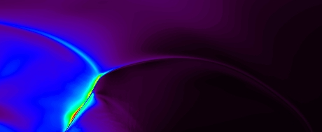
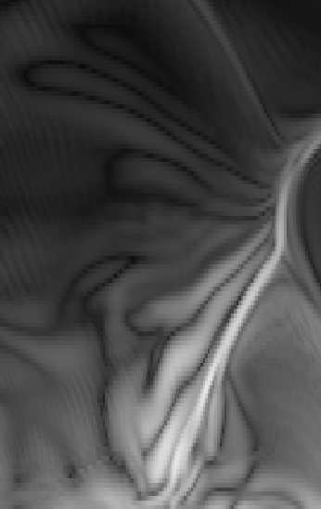
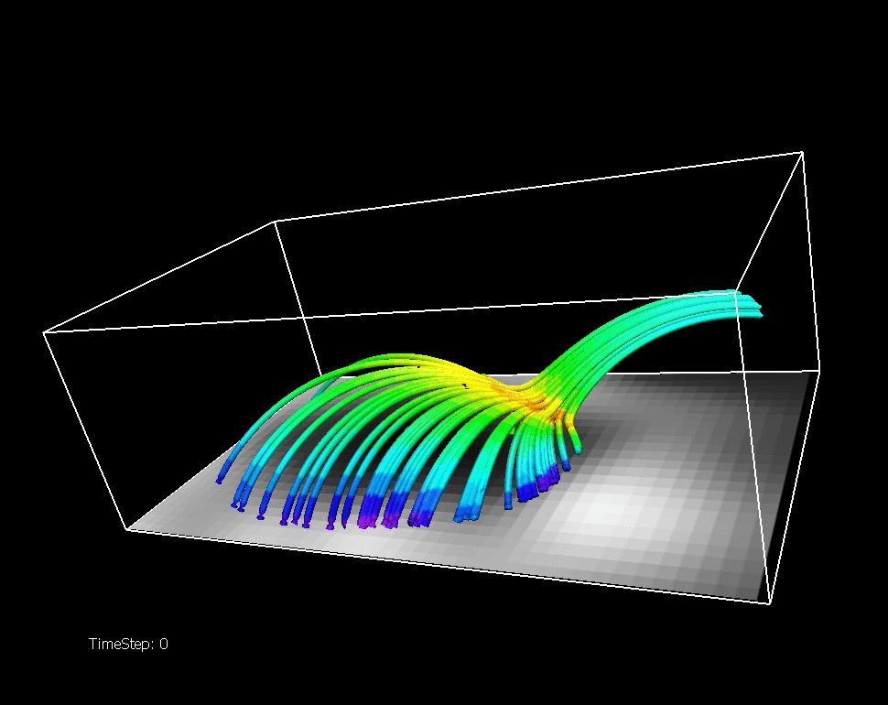
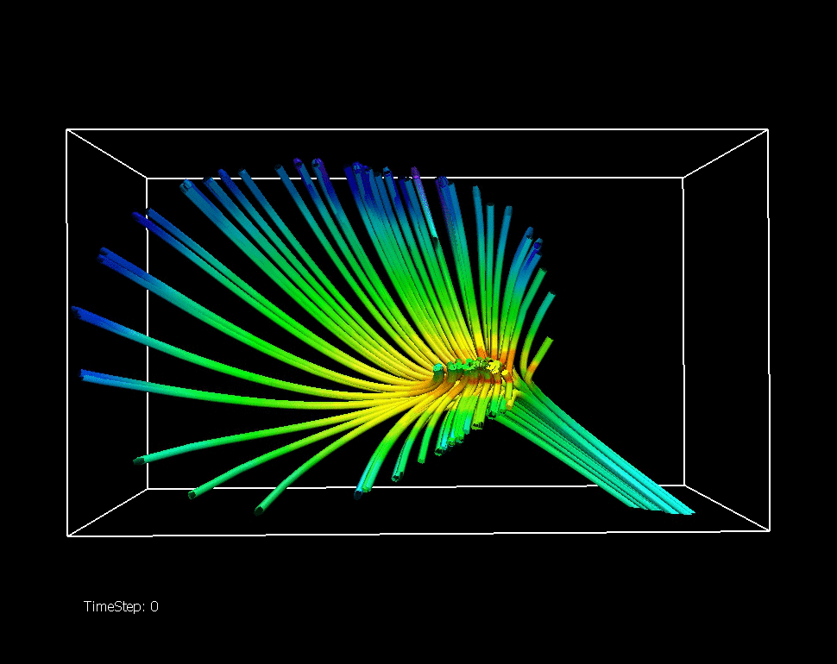
Spine/fan motion and j//b
About 5h 30min. real time

Slide 25
Resistive MHD Simulation
Code: Stagger MHD code
  (6th order space, 3th order in time)
Computational box size: 62 x 175 x 100 [Mm]
Stretched mesh, max. resolution: 80 [km]
Boundaries: closed

Slide 26
Spine/fan motion and j//b
About 5h 30min. real time
Notes:
The movie shows in solar time: about 11min., but since we drive with a 40x higher speed, it is about 5h 30min. (if the first 170sec are taken without driving - not taking into account that the driver starts slowly)
The lower plane shows the bx (black is negative, white positive bx), the magn field lines are colored according to their magn field strength and the purple cloud appearing is the j//b component.
The left movie is taken from below.

Slide 27
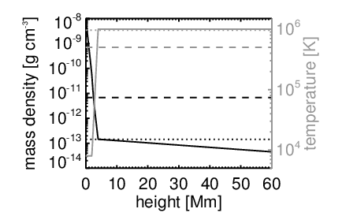
Initial, average vertical structure

Slide 28
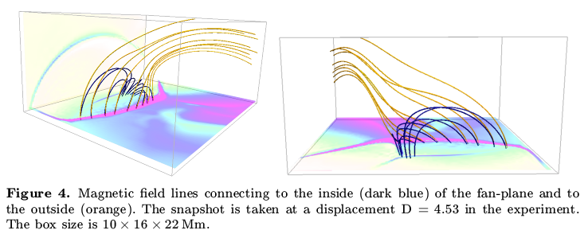
Magnetic field line connectivity

Slide 29
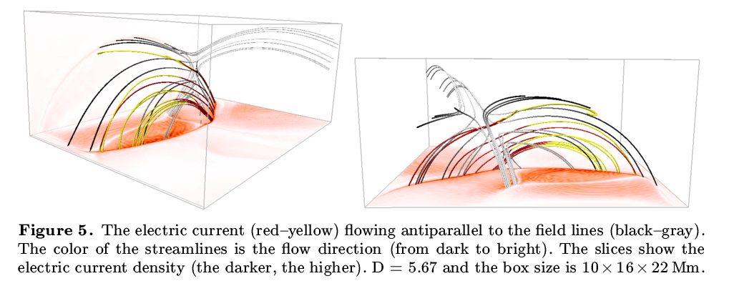
Electric currents in the current sheet

Slide 30
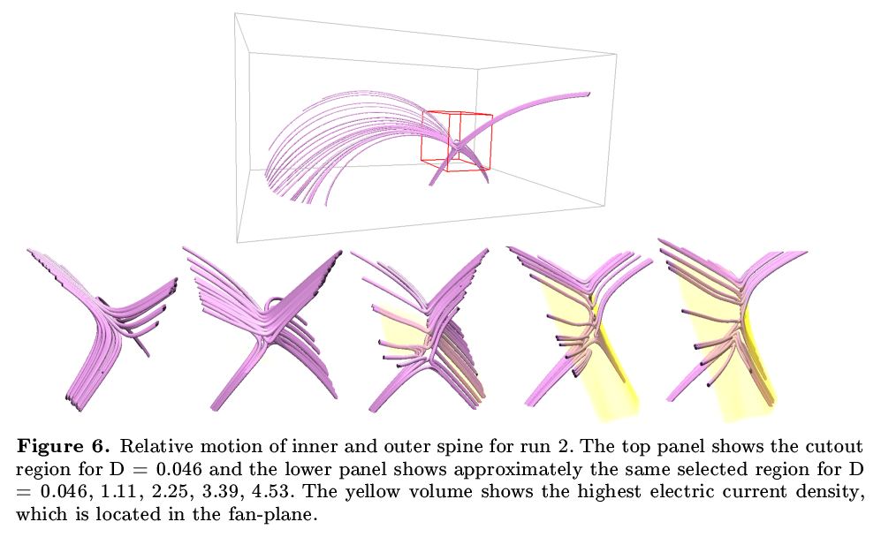
Relative displacement of the spines

Slide 31
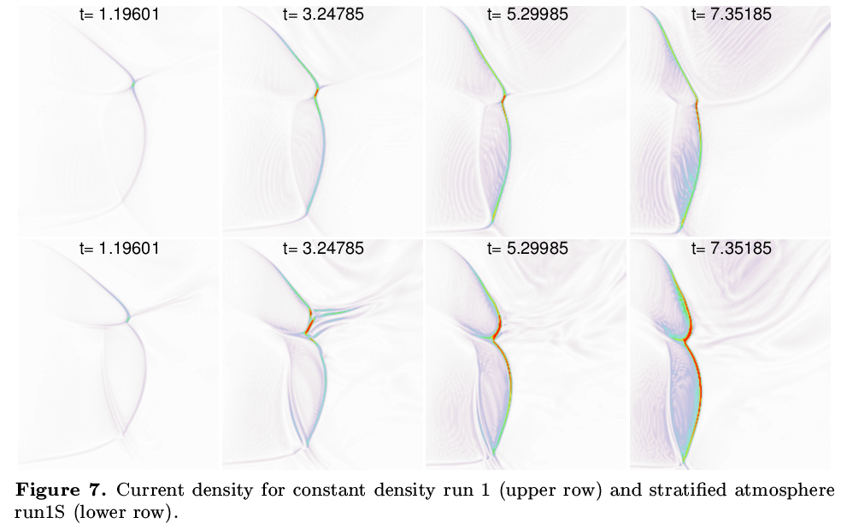
Current density in the fan plane

Slide 32
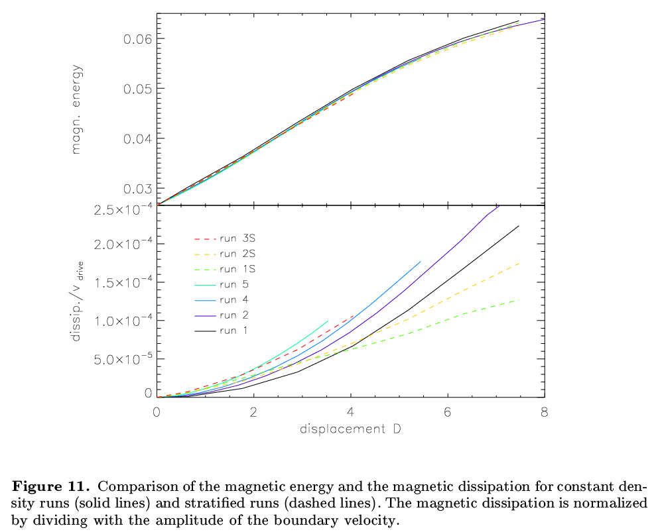
Evolution with time of magnetic energy and magnetic dissipation

Slide 33
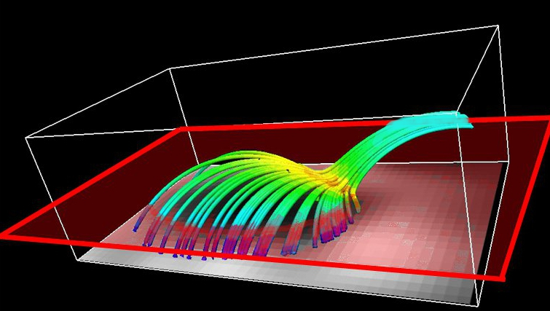
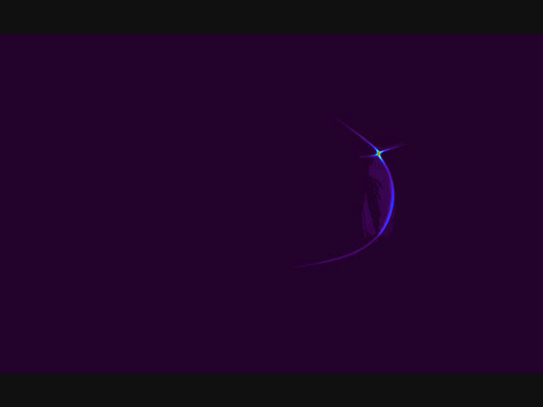
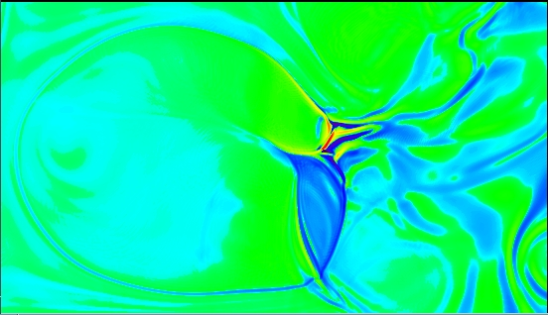
Results MHD
Current parallel B
Current density in horizontal slice
Notes:
On the right: Visualization of current density.
On the left:
(The pictures are from MHD snapshots at an evolved stage – where currents have built up)

Slide 34
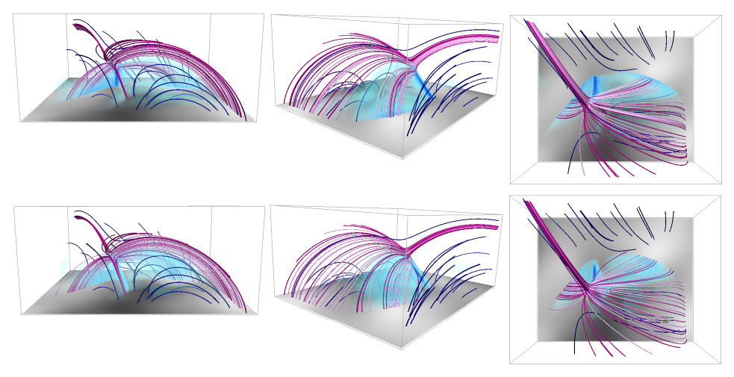
Magnetic dissipation (blue surface) and magnetic field lines near the null

Slide 35
MHD experiment coupled to
PIC (Particle-in-Cell) experiment
MHD snapshot provides
  A cut-out of the ”dome” with uniform mesh
  Initial conditions (including electric currents)
  Boundary conditions (vector B-field at boundaries)
PIC setup
  Box size covers the ”dome” structure
    Stops about 1.3 Mm above the solar surface
  Mesh size 70, 35, and 17.5 (!) km
    The 17.5 resolution case has more mesh points (~ 3 billion) than any MHD model so far

Slide 36
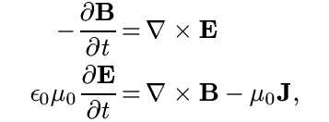

Particle-in-cell simulations
Field equations (Maxwell):
Equations of motion (Newton):

Slide 37
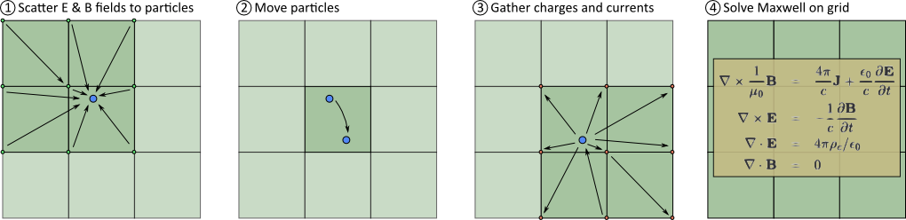
Large scale PIC-simulations
Copenhagen PhotonPlasma Code
  MPI-parallelized PIC code
    Includes particle-interactions
      Most relevant in the corona: Coulomb scattering
      Modular: also Compton scattering, pair creation & annihilation, ...
      Could also do collisional, time dependent ionization this way!
    Scales to thousands of CPUs / cores
      Pleiades (NASA/Ames); ~47.000 cores, tested up to 4096 cores
      Uses about 1 core-microseconds per particle-update
        (95% efficiency from 8 to 4096 cores)

Slide 38
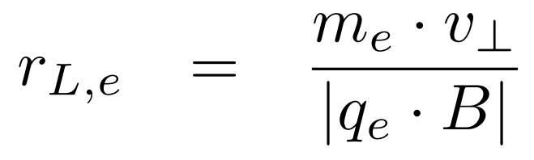
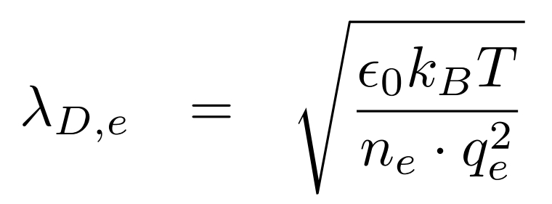
PIC Scaling
Gyroradius:
Debye length:
Notes:
The approach we used was to enlarge the gyroradius by changing the electron charge and the electron mass (gyroradius = mv_{perp}/(|q|B)), and further on we changed the permitivity in order to increase the Debye length, which decreases speed of light together with the permeability by a factor of 1.3e-2 (c = 1/sqrt(μ₀ε₀)).
Scaling factors (scaling_aake, version F):
Number density 128
Length scale 0.01
Electron mass 100 (so the ratio between proton and electron mass becomes 18.36)
Electron charge 1.25E-07
vacuum permeability 5
vacuum permittivity 1200
speed of light 0.0129099
This then changes:
Alfven speed 1000 1580
electron drift speed 0.05 93
electron gyro radius 5.00E-03 40
Electron skin depth 1.54E-03 530

Slide 39
PIC Scaling
L_Debye ~ 0.5 dx
L_skin ~ 6 - 8 dx > L_Debye
v_drift < v_thermal_ion ~ v_sound < v_Alfven < v_thermal_electron < c
100 Mm
175 Mm

Slide 40
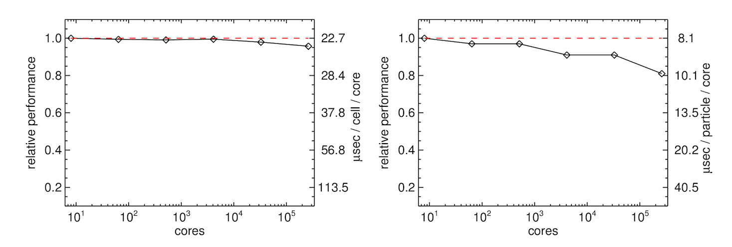
Code Scaling on JUGENE
Both the MHD code and the PIC code scale to the full size of the machine (2¹⁸ cores) !

Slide 41
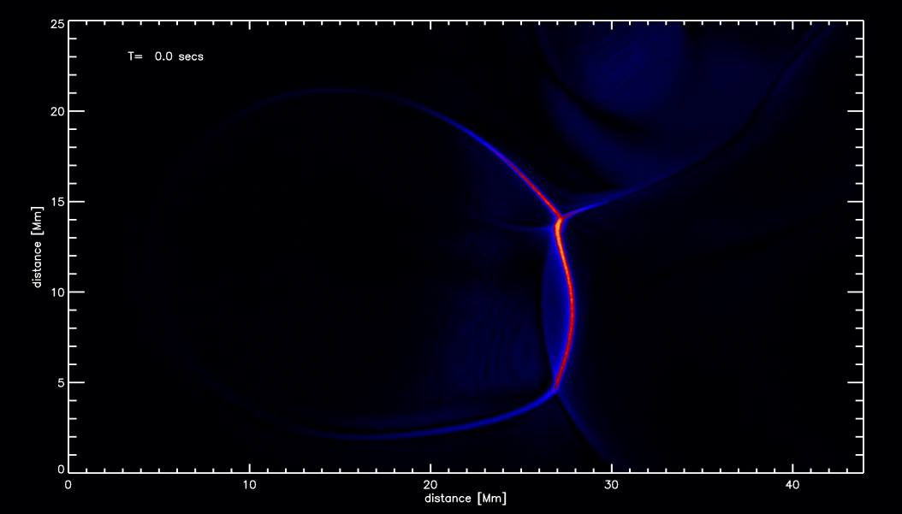
Vertical Projection

Slide 42
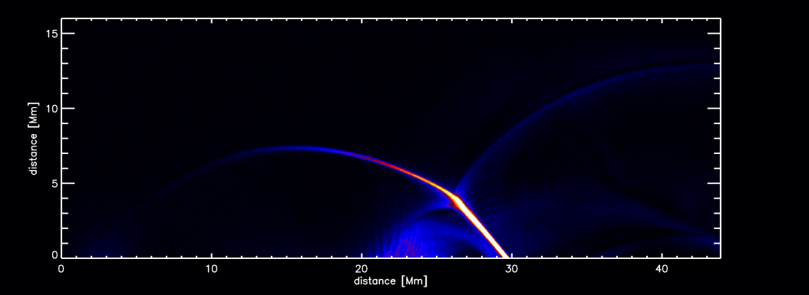
Horizontal Projection

Slide 43
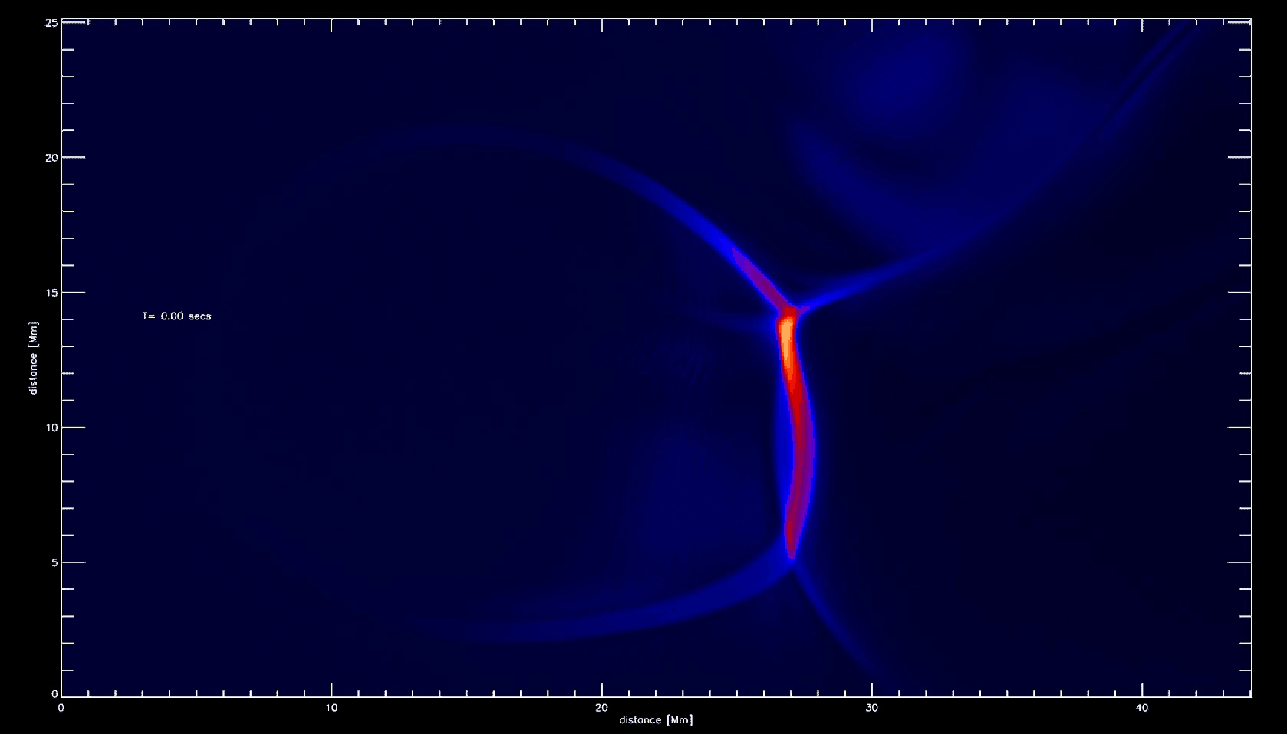

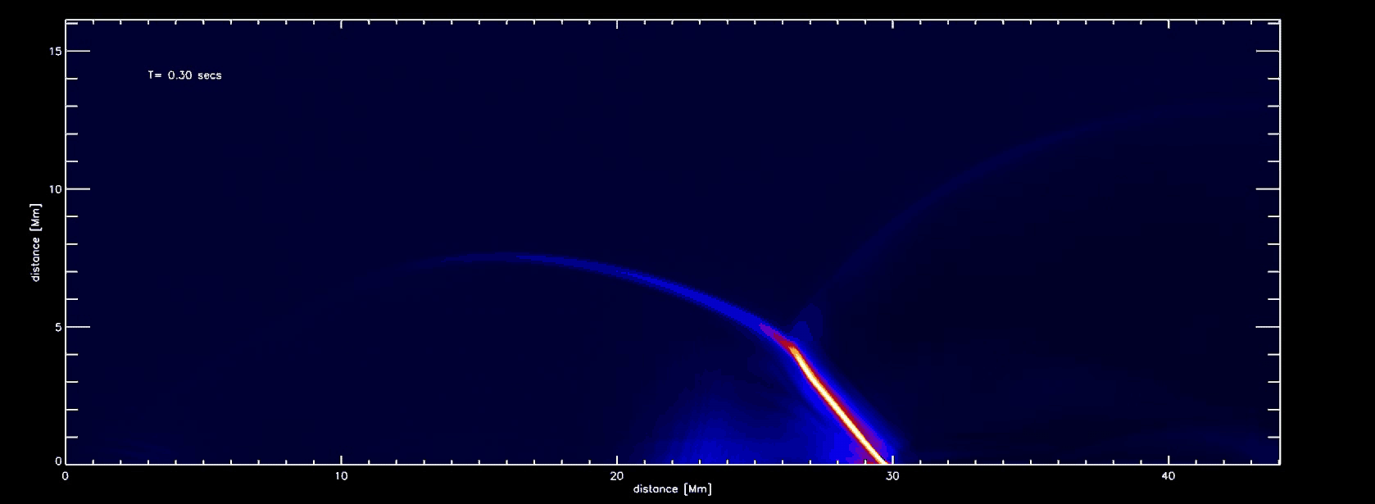
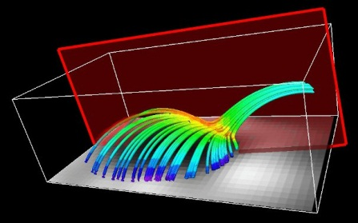
Current density in the null planes
Notes:
Currents flow mainly along magnetic field lines. The main point to make in that slide is to point to where the current density is largest; this is just “below” the null (i.e., in the current sheet at lower y-values than the null.
Instability is unclear up to now. But it also is unimportant for studying the acceleration mechanism of the particle.

Slide 44
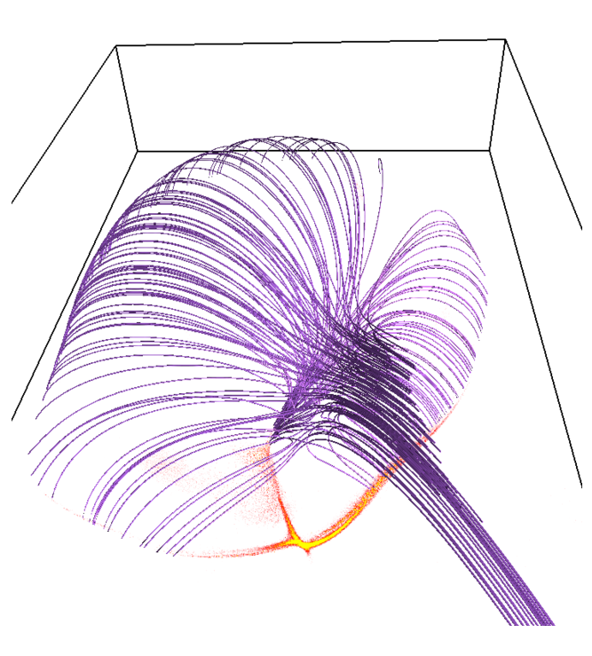
Impact area of electrons

Slide 45
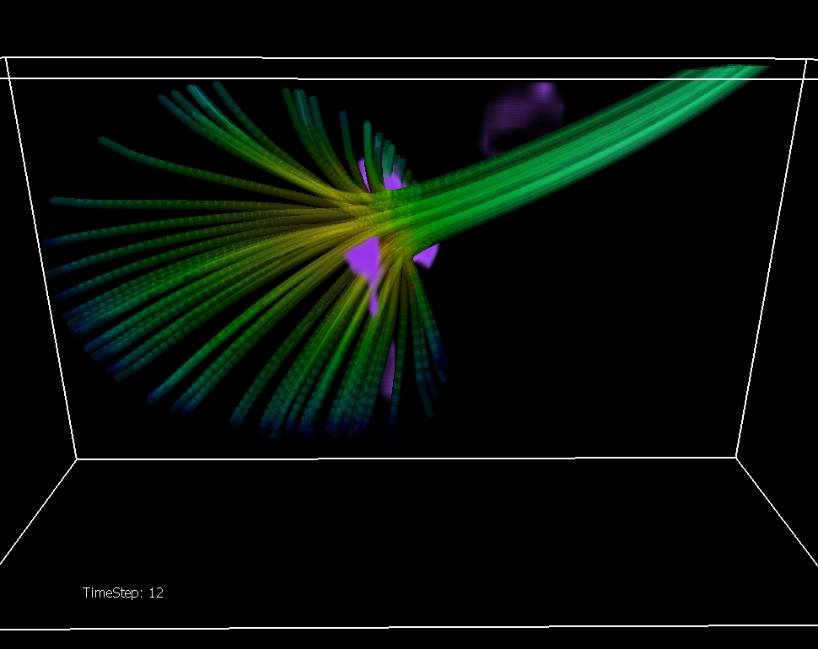
Comparison with TRACE and RHESSI observations
12-25 keV (>50%)
25-100 keV (>50%)
A dense electrons beam is accelerated by E//B in the reconnection region and travels down the inner spine and along the fan magnetic field lines. The impact on the photosphere creates X-rays and UV emission.
J//B maximum
Image: H.Reid

Slide 46
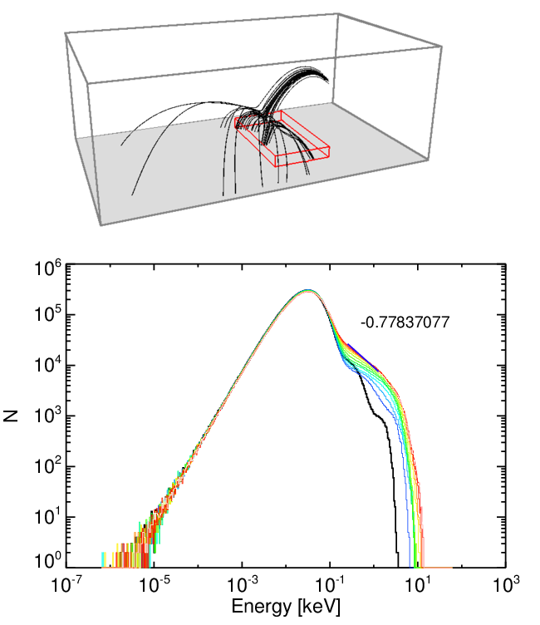
Energy distribution

Slide 47
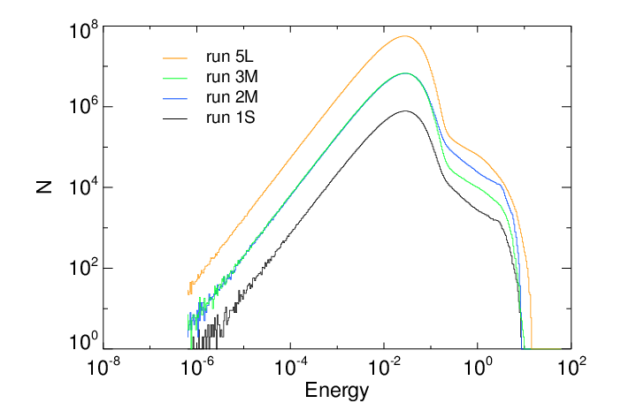
Different simulations

Slide 48
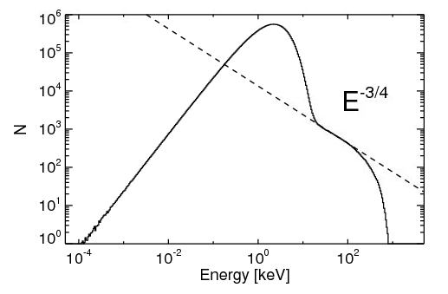
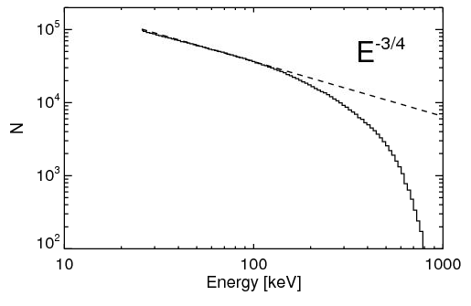
Energy histogram, sampled from N_{tot}=1.35 10¹¹
The histograms here show dN/dlnE = E dN/dE, so the dN/dE distribution index is steeper by one unit; i.e. has slope approximately -1.75
The dN/dE power-law index of -1.75 Implies that the electric current is mainly carried by the low energy electrons, while energy is mainly carried by the high energy ones.

Slide 49
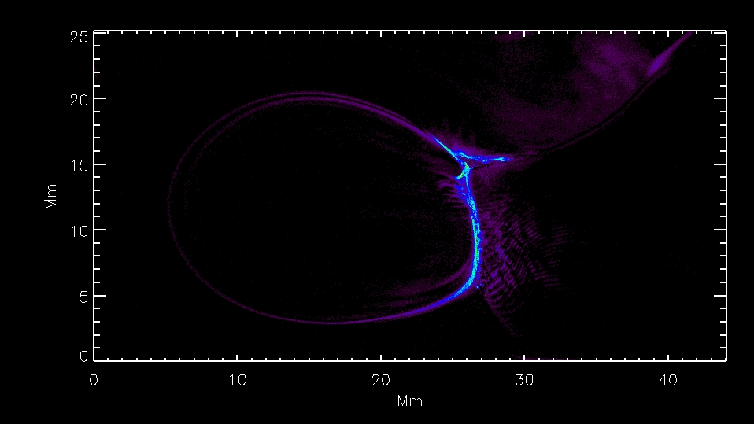
Particle positions in the power-law tail

Slide 50
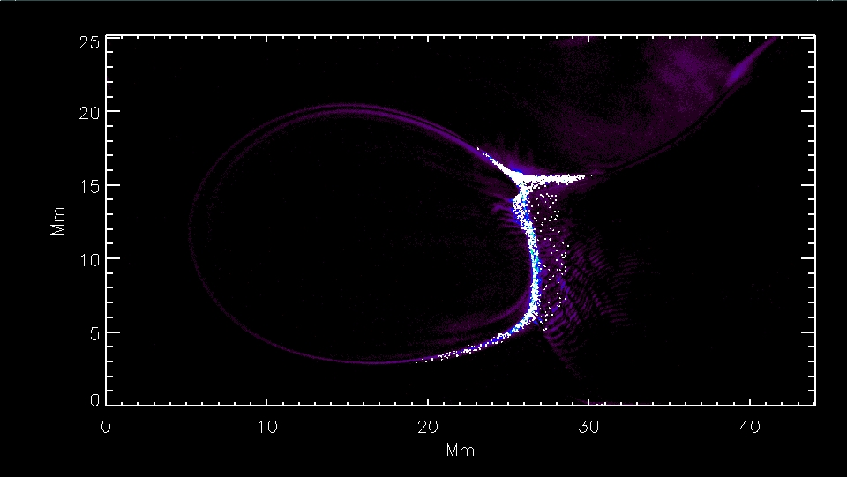
Particle positions in the power-law tail

Slide 51

Location of accelerated particles
Outer spine
Fan plane
Inner spine

Slide 52

Trace of accelerated particles

Slide 53

Losers, in low energy part of tail

Slide 54



Tracing particles in the power-law tail...
X - Y Plane
X - Z Plane

Slide 56

Notes:
Look at their electric field parallel to the velocity!

Slide 57


Slide 58


Slide 59


Slide 60


Slide 61




Lower energy power law particles occur in essentially the same region
Notes:
This visualized the power-law: Only very little particles have very high energies. But they contribute significantly to the total energy
Many of the accelerated particles “fail” = get deflected, and hence are lost from carrying current. These particles from the power-law tail follow rather short paths, which are not systematically parallel. Only a very few particles are so lucky to manage to stay right in the middle of the current sheet, and get accelerated. But these particles are NOT the ones which significantly contribute to the bulk current! (-> hence no polarization electric field builds up, which would act against them)

Slide 62

Total Current Density
Total electric current density in slices through the null point neighborhood
Notes:
These slices have maximum values of the order of 150. The position of the slices are marked. The image is J^0.4, to reduce contrast – otherwise the weaker H.E. current is not visible!

Slide 63

Parallel (accelerating) electric field
stabilizes
in a few
seconds
Note the scale!

Slide 64
Summary
Need to consider kinetic effects in context!
  micro-scales; modified dissipation details
  meso-scales; dissipation hierarchy
  macro-scales; particle acceleration!
Tool: Particle-In-Cell (PIC) simulations
  can now handle resolutions ~ MHD a few years ago
  careful scalings need to be applied
  radiation can be included (Monte Carlo RT)
  time dependent ionization is possible
  synthetic observations over a broad range (gamma ray, X-ray, visual, radio, ...) possible ..

Slide 65
The PhotonPlasma Code
PPcode (at BitBucket.org)

Slide 66


Maxwell’s Equations
(Gauss)

Slide 67
Large scale PIC-simulations
The PhotonPlasma Code
  MPI-parallelized PIC code
    Includes particle-interactions
      Most relevant in the corona: Coulomb scattering
      Modular: also Compton scattering, pair creation & annihilation, ...
      Could also do collisional, time dependent ionization this way!
    Scales to thousands of CPUs / cores
      Pleiades (NASA/Ames); ~47.000 cores, tested up to 4096 cores
      Uses about 1 core-microseconds per particle-update
        (95% efficiency from 8 to 4096 cores)

Slide 68

Time and space arrangement

Slide 69

Main program

Slide 70

Downloading and running the PPcode

Slide 71

The input.nml file

Slide 72
Plasma Oscillations

Slide 73

Plasma Oscillations

Slide 74

Plasma Oscillations

Slide 75
Step-by-step:
Causal loop of effects
Particle conservation
  convergence of motion ⇒ increasing density
Electrostatic field
  electron density excess ⇒ converging E-field
Equation of motion
  E-field ⇒ acceleration ⇒ motion

Slide 76

Plasma Frequency

