Slide 1
Lecture 3 :Particle candidates for dark matter
Dan Hooper - Fermilab/University of Chicago
Supersymmetry or not, what is the evidence?Copenhagen
October, 2013

Slide 2
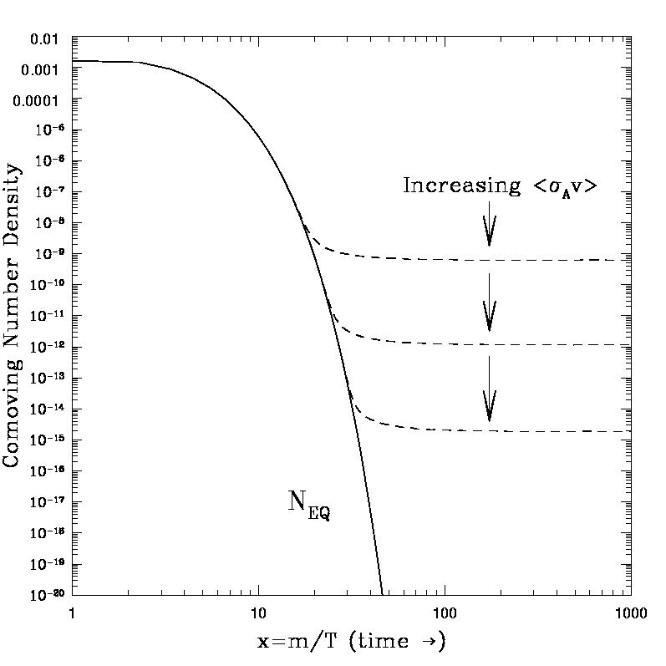




The Thermal Abundance of a WIMP
T>>M_{X}, WIMPs are in thermal equilibrium
T<M_{X}, number density becomes exponentially suppressed
Including the effects of expansion pulls the density away from its equilibrium value:
Numerically, this yields an abundance of:
In comparison,
A generic stable, weakly interacting particle is predicted to be produced in the early universe with an abundance similar to the observed dark matter density.
-Numerical coincidence?
-WIMP Miracle?
Dan Hooper – Dark Matter in the Discovery Age

Slide 3
WIMP Model Building
With the WIMP Miracle in mind, many particle physicist have proposed dark matter candidates within many weak-scale extensions of the Standard Model
While these models vary in many ways, many contain a number of common features
To better appreciate this, consider supersymmetric models as a starting point

Slide 4
Supersymmetric Dark Matter
Supersymmetry, when manifest at or around the electroweak-scale, helps to resolve a number of issues
1) The Hierarchy Problem – exactly cancels quadratic divergences
2) Unification of Standard Model forces at a common scale
3) Provides a WIMP candidate
And while string theorists might argue that supersymmetry could appear at almost any scale (M_{Planck} is as good as M_{weak}), these three problems are only addressed if the superpartners are not much heavier than a couple of TeV
Dark matter candidates appearing in supersymmetric theories include WIMPs (neutralinos, sneutrinos), and even more feebly interacting particles (gravitinos, axinos) – and while not actually WIMPs, gravitinos and axinos can indirectly take advantage of the WIMP Miracle through decays of other sparticles

Slide 5
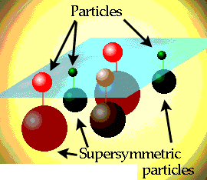
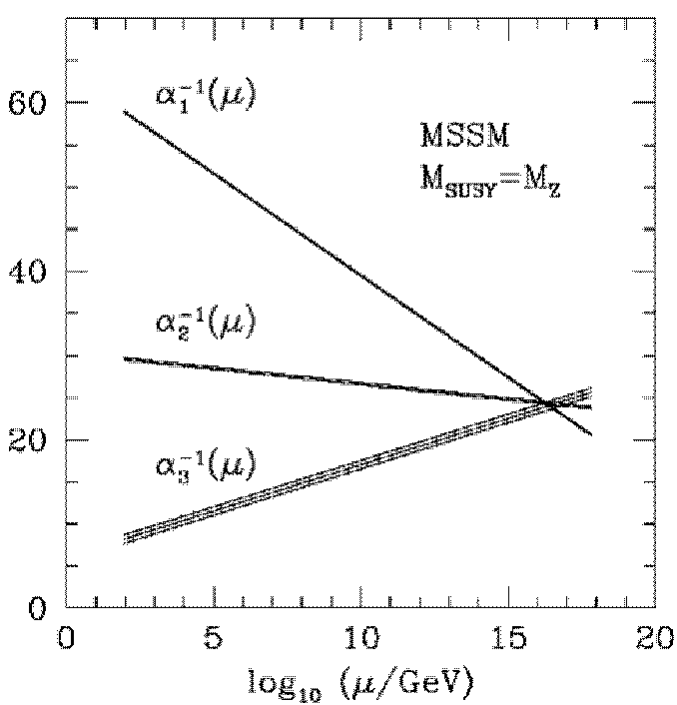
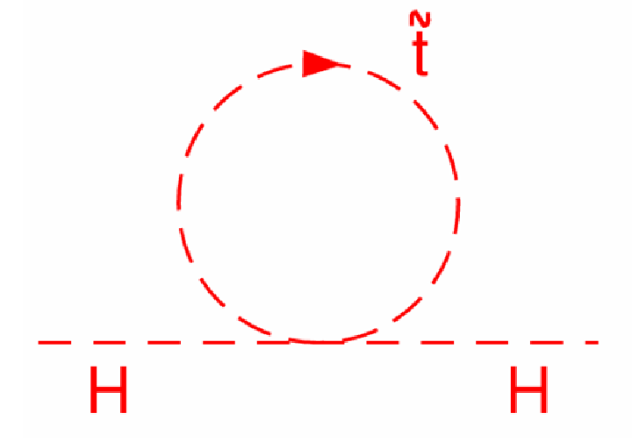
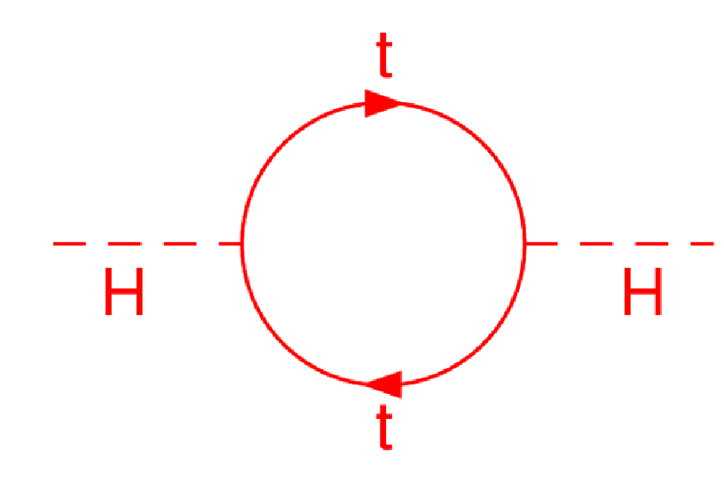
Supersymmetry
Perhaps the most theoretically appealing (certainly the most well studied) extension of the Standard Model
Natural solution to hierarchy problem (stabilizes quadradic divergences to Higgs mass)
Restores unification of couplings
Vital ingredient of string theory
Naturally provides a compelling candidate for dark matter

Slide 6
Supersymmetric Dark Matter
R-parity must be introduced in supersymmetry to prevent rapid proton decay
Another consequence of R-parity is that superpartners can only be created and destroyed in pairs, making the lightest supersymmetric particle (LSP) stable
Possible WIMP candidates from supersymmetry include:
~
~ ~ ~
γ
, Z, h, H
4 Neutralinos
~
3 Sneutrinos
ν

Slide 7
Supersymmetric Dark Matter
R-parity must be introduced in supersymmetry to prevent rapid proton decay
Another consequence of R-parity is that superpartners can only be created and destroyed in pairs, making the lightest supersymmetric particle (LSP) stable
Possible WIMP candidates from supersymmetry include:
~
~ ~ ~
γ
, Z, h, H
4 Neutralinos
~
3 Sneutrinos
ν
Excluded by direct detection

Slide 8
Supersymmetry and Friends
SUSY Specific:
General Feature:
-Presence of weak-scale sparticles cancel quadratic divergences
-R-parity allows for consistency with electroweak precision tests, and ensures the stability of the lightest sparticle
2
-The lightest neutralino is an especially attractive dark matter candidate – although relic abundance only works in specific regions of parameter space
-Neutralinos are Majorana fermions – annihilate to heavy fermions and scatter elastically via Higgs
-New colored particles near the weak-scale reduce/remove fine tuning in higgs sector
-Some discrete symmetry allows for consistency with electroweak precision tests, and insures the stability of at least one new particle
-Cosmologically, this stable state cannot be charged or colored, and if ever in equilibrium, it must annihilate enough to avoid over production – favors a WIMP
-WIMP could be a scalar, Majorana fermion, Dirac fermion, vector, etc. – many of our SUSY-specific rules of thumb do not apply

Slide 9
“We emphasize that the solution to the naturalness (fine-tuning) problem necessarily predicts that new physical phenomena must exist at a scale of m_{W}/g ~ 1 TeV or below. In the case of supersymmetry, this new physics consists of a spectrum of new supersymmetric particles (partners of the ordinary particles) which have masses no greater than about 1 TeV and in some cases may be substantially lighter.”
Howie Haber and Gordy Kane, Physics Reports 117, 75 (1985)

Slide 10
Non-WIMP Dark Matter Candidates I: Axions
Motivated by observation that the neutron’s electric dipole moment is small (consistent with zero)
In other words, although the SM violates parity and charge-parity, QCD does not – requires that θ_{QCD} < 10⁻⁹
In 1977, Peccei and Quinn proposed a dynamical solution to this “strong CP problem”, a new broken U(1) – drives θ_{QCD} to zero
Shortly thereafter, Wilczek and Weinberg pointed out that this solution also predicts the existence of a new extremely weakly interacting pseudoscalar, the axion

Slide 11
Non-WIMP Dark Matter Candidates I: Axions
For masses in the micro- to milli-eV range, axions can make up the dark matter (via misalignment production in the early universe) without violating astrophysical or laboratory constraints
Interactions of such axions are suppressed by a Peccei-Quinn scale of ~10⁹-10¹² GeV
Two photon couplings can be probed, however, via the Primakov mechanism
ADMX is the experiment best positioned to test (much of) the allowed parameter space
By the end of the decade, ADMX will be able to test a sizeable fraction of axion dark matter models

Slide 12
Non-WIMP Dark Matter Candidates II: Sterile Neutrinos
-Sterile neutrinos, produced via mixing with SM neutrinos, can also provide a viable and well motivated class of dark matter candidates
-Constraints include:
Phase space in dwarf spheroidals (ie. Tremaine-Gunn bound)
The lack of x-ray lines
Dark matter abundance
Lyman-α constraints, which require the dark matter to not be too hot; translates to M > 8 keV

Slide 13
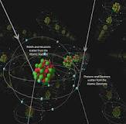
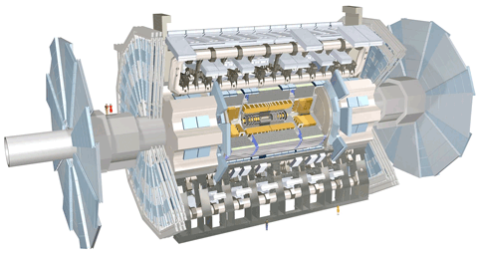
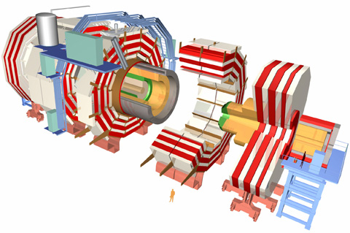
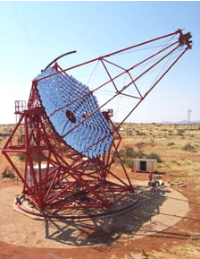
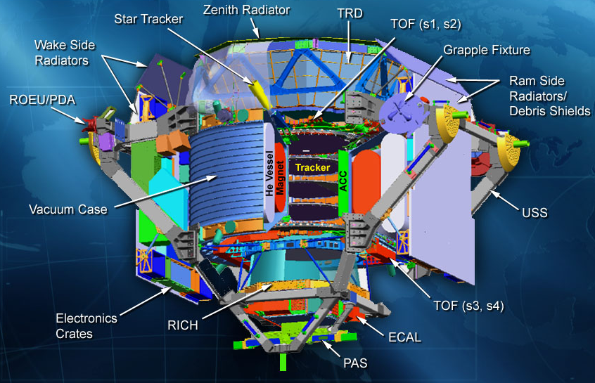
Putting the WIMP Hypothesis to the Test

Slide 14
Lecture 4: Direct Detection
Dan Hooper - Fermilab/University of Chicago
Supersymmetry or not, what is the evidence?Copenhagen
October, 2013

Slide 15
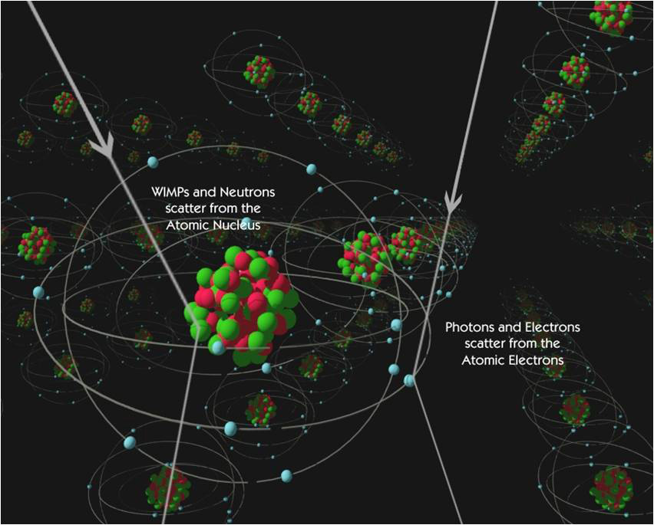
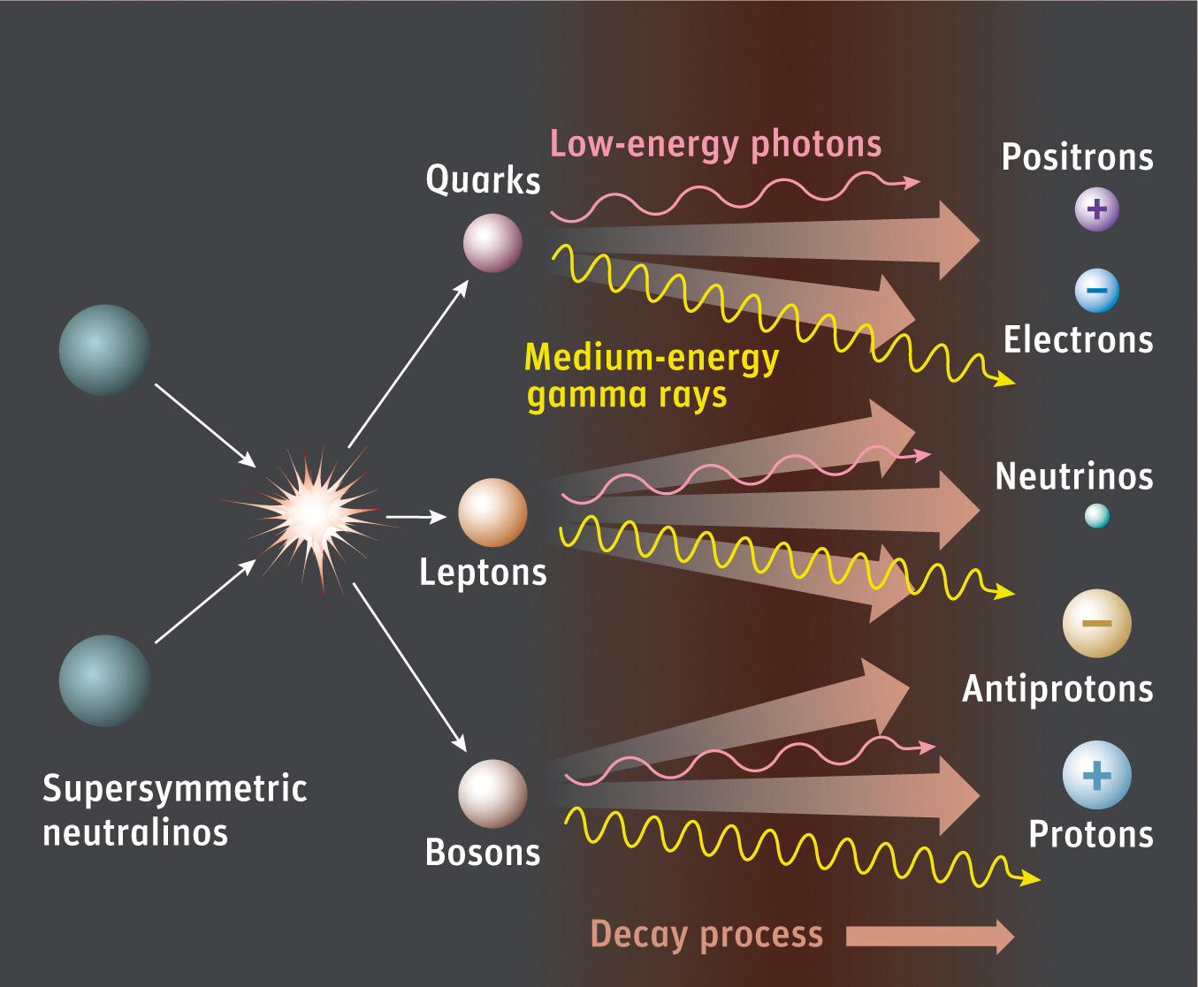

The Trinity of Dark Matter Searches

Slide 16
Direct Detection
A GeV-TeV particle moving a typical halo velocities (~300 km/s) striking a nucleus imparts a recoil of ~1-100 keV
Numerous technologies have been developed and deployed in an effort to observe these collisions – scintillation, ionization, phonons

Slide 17


Direct Detection
A GeV-TeV particle moving a typical halo velocities (~300 km/s) striking a nucleus imparts a recoil of ~1-100 keV
Numerous technologies have been developed and deployed in an effort to observe these collisions – scintillation, ionization, phonons
For m_{X} >> M_{nucleus} and v~300 km/s, this corresponds to E_{recoil}~1-100 keV
The rate of WIMP-nucleus scattering is given by:
f(v)=DM velocity distribution

Slide 18


Direct Detection
In the non-relativistic limit, all interaction forms can be described as spin-independent (coherent) scattering or spin-dependent scattering
For spin-independent scattering:
where

Slide 19
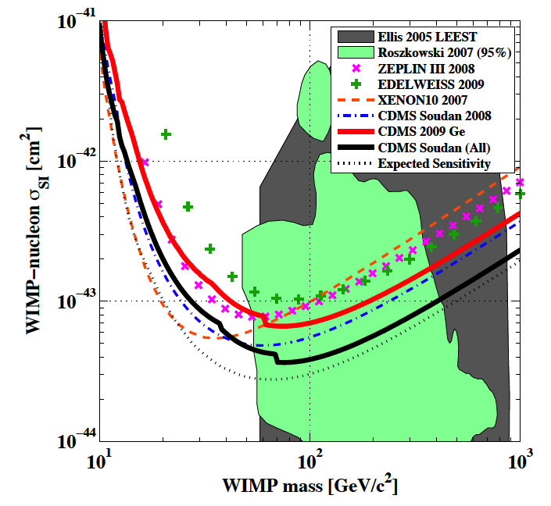
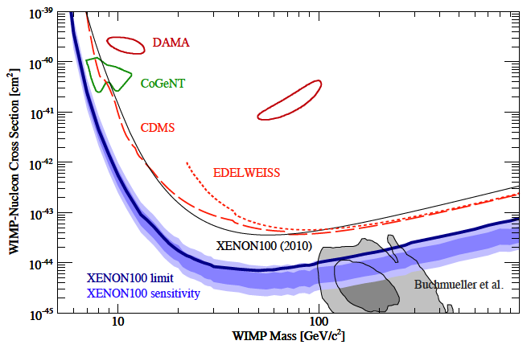
Direct Detection
A GeV-TeV particle moving a typical halo velocities (~300 km/s) striking a nucleus imparts a recoil of ~1-100 keV
Numerous technologies have been developed and deployed in an effort to observe these collisions – scintillation, ionization, phonons
Current state-of-the-art experiments make use of 10-300 kg heavy nuclei targets (Ge, Xe), instrumented and located deep underground to minimize backgrounds
CDMS
XENON100

Slide 20
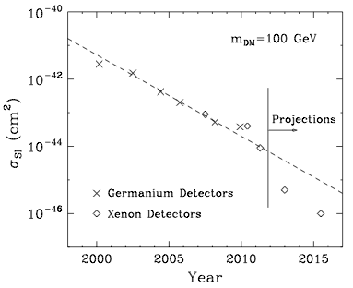
Direct Detection
Over the past dozen years, constraints from direct detection experiments have improved with a Moore’s-law like behavior (a factor of 2 every 15 months)

Slide 21
WIMP Annihilation and Elastic Scattering
From the observed density of dark matter, we can estimate the couplings of the WIMP (in lieu of resonances, coannihilations, etc.)
Annihilation rate to quarks can be used to estimate the elastic scattering cross section with nuclei
WIMP
q
WIMP
WIMP
WIMP
q
q
q

Slide 22
WIMP Annihilation and Elastic Scattering
Case Example: Dirac Fermion or Scalar WIMP with vector-like interactions (such as a heavy 4th generation neutrino, or a sneutrino)
ν
ν
ν
q
Z
Z
ν
q
q
q

Slide 23
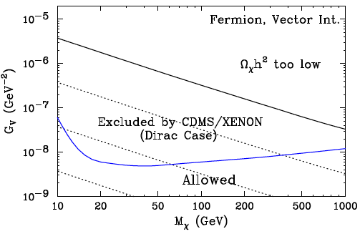
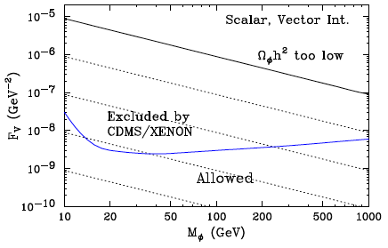
WIMP Annihilation and Elastic Scattering
Case Example: Dirac Fermion or Scalar WIMP with vector-like interactions (such as a heavy 4th generation neutrino, or a sneutrino)
Coupling Needed To Acquire Measured Abundance
ν
ν
ν
q
Z
Z
ν
q
q
q
This candidate and many others are already excluded by the null results of CDMS and XENON
Beltran, Hooper, Kolb, Krusberg, arXiv:0808.3384

Slide 24
WIMP Annihilation and Elastic Scattering
Another Case Example: Majorana Fermion WIMP (such as a neutralino)
Neutralino elastic scattering is suppressed by the fact that they annihilate to heavy quarks (and leptons) and gauge/higgs bosons, none of which are present in nuclei
Elastic scattering is further suppressed if coannihilations or resonances play an important role in the early universe
χ
Q,W,Z,H
χ
χ
χ
Q, W,Z, H
q
q

Slide 25
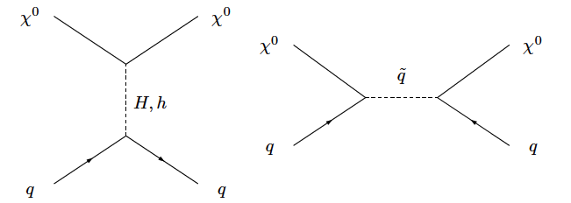
The Direct Detection of Neutralino Dark Matter
Neutralinos can coherently scatter with nuclei through scalar higgs and squark exchange
Benchmark examples:
1) Dominated by relatively light “heavy” higgs:
m_{H}~200 GeV, μ~200 GeV ⇒ σ_{χp}~ 10⁻⁴¹ to 10⁻⁴³ cm²
m_{H}~200 GeV, μ~1 TeV ⇒ σ_{χp}~ 10⁻⁴³ to 10⁻⁴⁵ cm²
2) Dominated by light (SM-like) higgs:
m_{H}>500 GeV, μ~200 GeV (1 TeV) ⇒ σ_{χp}~ 10⁻⁴⁴ (10⁻⁴⁶) cm²
3) Dominated by light (sub-TeV) squarks:
Potentially competitive with contributions from higgs exchange
~

Slide 26
The Direct Detection of Neutralino Dark Matter
Neutralinos can coherently scatter with nuclei through scalar higgs and squark exchange
Benchmark examples:
1) Dominated by relatively light “heavy” higgs:
m_{H}~200 GeV, μ~200 GeV ⇒ σ_{χp}~ 10⁻⁴¹ to 10⁻⁴³ cm²
m_{H}~200 GeV, μ~1 TeV ⇒ σ_{χp}~ 10⁻⁴³ to 10⁻⁴⁵ cm²
2) Dominated by light (SM-like) higgs:
m_{H}>500 GeV, μ~200 GeV (1 TeV) ⇒ σ_{χp}~ 10⁻⁴⁴ (10⁻⁴⁶) cm²
3) Dominated by light (sub-TeV) squarks:
Potentially competitive with contributions from higgs exchange
~0.1-10 events per kg-day (Ge,Xe)
~0.1 events per ton-day (Ge,Xe)
~

Slide 27
Direct Detection
Z-mediated scattering (sneutrinos, heavy neutrinos)
Over the past dozen years, constraints from direct detection experiments have improved with a Moore’s-law like behavior (a factor of 2 every 15 months)
Some important benchmarks exist along this line:
  Mid-late 90s: Experiments (Heidelberg-Moscow, etc.) excluded the cross sections predicted for a WIMP which scatters and annihilates through Z-exchange
  Now!: Current experiments are beginning to test WIMPs which interact through Higgs exchange (including many SUSY models)
Higgs-mediated scattering (A-funnel, focus point neutralinos)
DM
SM
DM
DM
DM
SM
SM
SM

Slide 28
Direct Detection
If this rate of progress continues without an observation for another ~5 years, the surviving dark matter models will be severely constrained
In order for a WIMP to evade detection over this time frame, one must consider one or more of the following:
  WIMPs which couple almost entirely to leptons or gauge bosons, rather than to quarks
  WIMPs which annihilate in the early universe through a finely tuned resonance, or through a highly degenerate coannihilation
  WIMPs which are light enough to fall below experimental energy thresholds (m_{X}<10 GeV)
  Non-standard cosmology (ie. low reheating)
It is starting to become difficult to hide our best motivated dark matter models from direct detection expts.
-5-10 years from now, very few WIMP models will remain out of reach

Slide 29
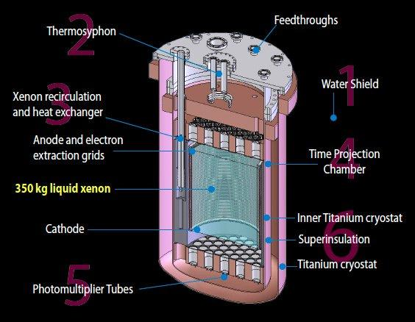

Slide 30
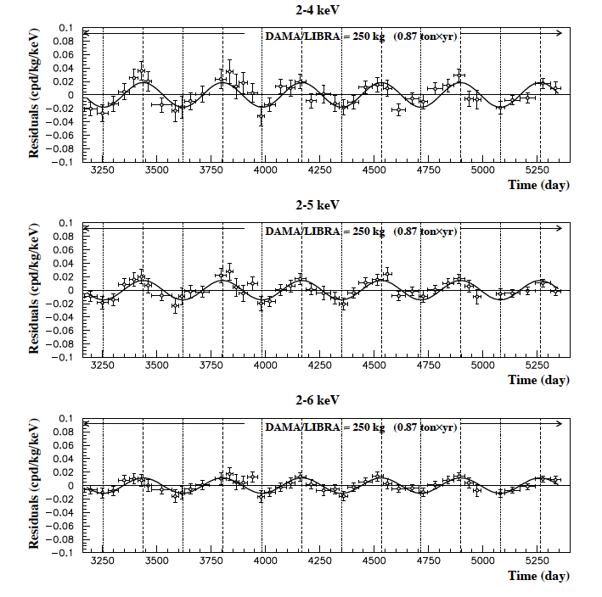
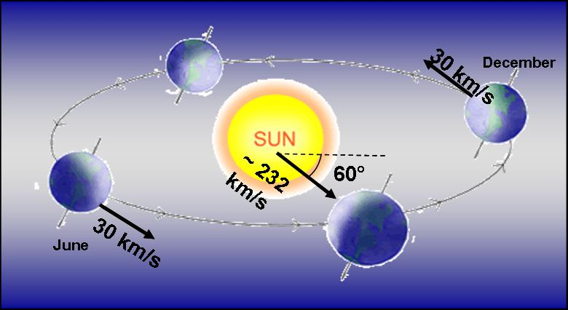
Possible Signals from Direct Detection Experiments
DAMA/LIBRA
Over the course of a year, the motion of the Earth around the Solar System is predicted to induce a modulation in the dark matter scattering rate
The DAMA collaboration reports a modulation with a phase consistent with dark matter scattering, and with high significance (8.9σ)

Slide 31
Possible Signals of Low Mass WIMPs?
CoGeNT
For the past three years, the CoGeNT collaboration has reported an excess of low energy events
As they have collected more data, the CoGeNT collaboration has refined their ability to separate bulk events (nuclear recoil candidates) from surface event backgrounds
CoGeNT’s most recent analysis favors ~7-10 GeV dark matter particles with an elastic scattering cross section of ~3x10⁻⁴¹ cm²
Hints of an annual modulation have been reported, although with only modest statistical significance
Dan Hooper – Dark Matter in the Discovery Age
CoGeNT Collaboration, arXiv:1208.5737

Slide 32
Possible Signals of Low Mass WIMPs?
CDMS Silicon
Last month, the CDMS collaboration announced the observation of 3 nuclear recoil-like events in their silicon detectors
Likelihood analysis favors a dark matter interpretation over their background model at the 99.81% confidence level (about 3σ)
Although 3 events is not enough to tightly constrain the dark matter parameter space, the best fit is found for a mass of ~8.6 GeV and a cross section of ~1.9x10⁻⁴¹ cm²
Dan Hooper – Dark Matter in the Discovery Age
CDMS Collaboration, arXiv:1304.4279

Slide 33
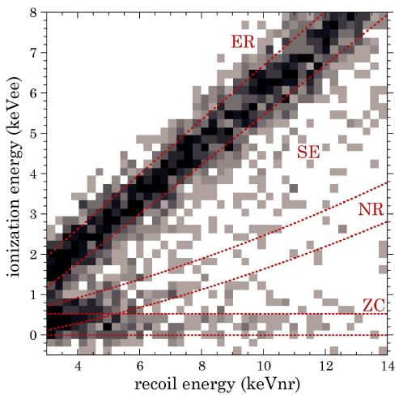
Possible Signals of Low Mass WIMPs?
CDMS Germanium (Collar & Fields)
CDMS separates events into nuclear recoils, electron recoils, surface events, and zero-charge events by using a combination of ionization and photon energies (as well as timing information), but have not (publicly) applied this technique to their low energy events – they instead only derive conservative upper limits, assuming that all low energy events could be WIMPs
Last year, Collar and Fields performed their own likelihood analysis of this data, trying to address the question of whether CDMS’s low energy and low ionization events are mostly zero-charge events (as originally suggested by CDMS) or might include WIMP recoils?
At 5.7σ preference for a population of nuclear recoil events was found
Dan Hooper – Dark Matter in the Discovery Age
J. Collar, N. Fields, arXiv:1204.3559

Slide 34
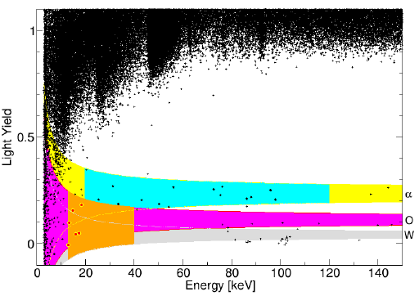
Possible Signals from Direct Detection Experiments
CRESST-II
Last fall, the CRESST-II collaboration reported the results of an analysis which identified 67 WIMP candidate events
Likelihood analysis prefers dark matter interpretation over known backgrounds (neutrons, gammas, alphas, Pb) at 4.7σ
WIMP Candidate Region
(1 of 8 detectors)
Dan Hooper – Dark Matter in the Discovery Age

Slide 35
Possible Signals of Low Mass WIMPs?
These three signals each point to essentially the same region of dark matter parameter space (m~7-10 GeV, σ~3x10⁻⁴¹ cm²) (also not very far from regions suggested by CRESST and DAMA, although those signals are, in my opinion, more difficult to interpret)
Dan Hooper – Dark Matter in the Discovery Age

Slide 36
Possible Signals of Low Mass WIMPs?
These three signals each point to essentially the same region of dark matter parameter space (m~7-10 GeV, σ~3x10⁻⁴¹ cm²) (also not very far from regions suggested by CRESST and DAMA, although those signals are, in my opinion, more difficult to interpret)
This region is consistent with constraints from CDMS, and within reasonable uncertainties of XENON10’s constraint (see Frandsen, et al, arXiv:1304.6066, and XENON10 erratum, arXiv:1104.3088)
XENON100’s constraint appears to be in some degree of tension, but could be reconciled if the relative scintillation efficiency (at ~2-4 keVnr) is lower than assumed in their analysis
If these signals are from WIMPs, LUX, SuperCDMS, and COUPP-lite should each have clear signals to report by the end of this year
Dan Hooper – Dark Matter in the Discovery Age

Slide 37
Possible Signals from Direct Detection Experiments
DAMA/LIBRA
Over the course of a year, the motion of the Earth around the Solar System is predicted to induce a modulation in the dark matter scattering rate
The DAMA collaboration reports a modulation with a phase consistent with dark matter scattering, and with high significance (8.9σ)
Dan Hooper – Dark Matter in the Discovery Age

Slide 38
Indirect Detection
Dan Hooper – Dark Matter in the Discovery Age

Slide 39
The Indirect Detection of Dark Matter
WIMP Annihilation Typical final states include heavy fermions, gauge or Higgs bosons
Fragmentation/Decay Annihilation products decay and/or fragment into combinations of electrons, protons, deuterium, neutrinos and gamma-rays
Synchrotron and Inverse Compton Relativistic electrons up-scatter starlight/CMB to MeV-GeV energies, and emit synchrotron photons via interactions with magnetic fields
χ
χ
W⁻
q
W⁺
q
ν
e⁺
π⁰
p
γ
γ
γ
e⁺

Slide 40
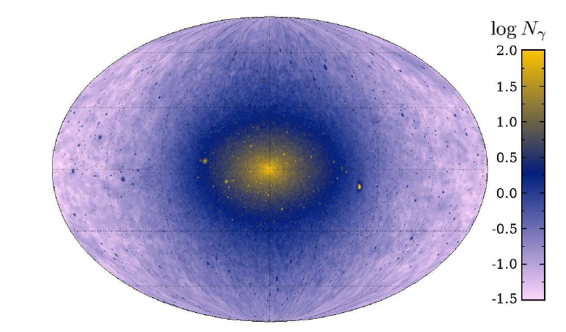
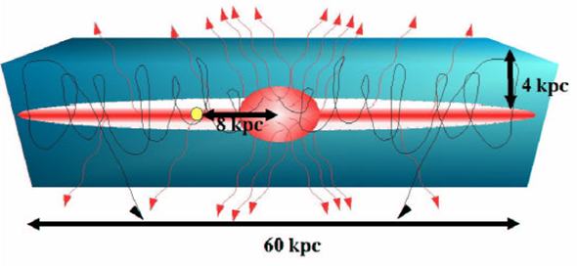
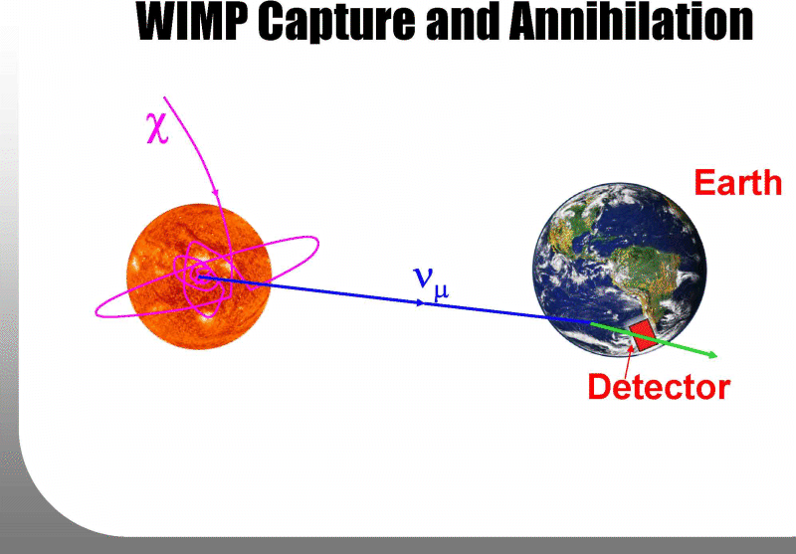
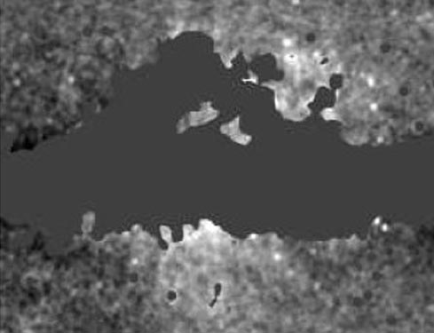
Indirect Detection
Gamma Rays From annihilations in the Galactic Halo, near the Galactic Center, in dwarf galaxies, etc.
Positrons/Antiprotons From annihilations throughout the galactic halo
Neutrinos From annihilations in the core of the Sun
Radio and Microwave Synchrotron From electron/positron interactions with the magnetic field of the Milky Way

Slide 41
Dark Matter Searches With Charged Cosmic Rays
WIMP annihilations are generally predicted to produce equal amounts of matter and antimatter
Charged particles lose energy as they propagate under the influence of the Galactic Magnetic Field, erasing directional and spectral information
A large positron/antiproton content in the cosmic ray spectrum could be an indication of dark matter annihilation
Dan Hooper - Closing In On Dark Matter

Slide 42
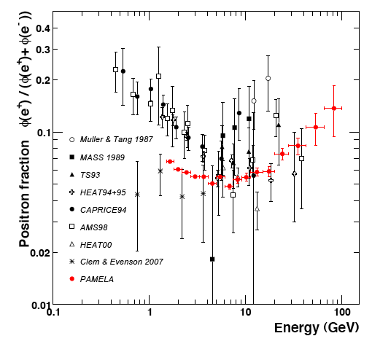
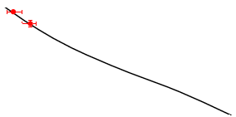
Pamela’s Positron Measurement
Rapid climb above 10 GeV indicates the presence of a primary source of highly energetic cosmic ray positrons!
Astrophysical expectation (secondary production)
Dan Hooper - Closing In On Dark Matter
Pamela Collaboration, arXiv:0810.4995

Slide 43
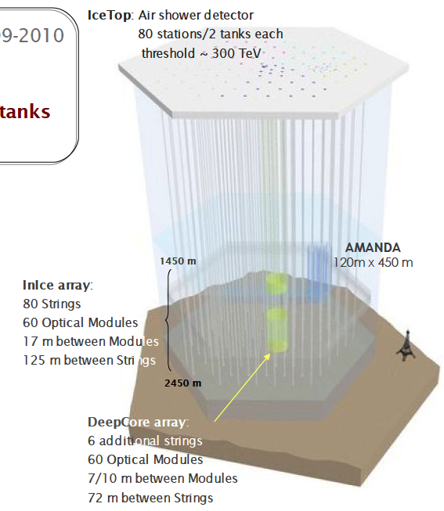
Dark Matter on Ice
WIMPs can elastically scattering with nuclei in the Sun, leading them to become gravitationally captured
After millions/billions of years, the annihilation rate is (in many models) predicted to reach equilibrium with the capture rate
Neutrino telescopes such as IceCube are sensitive to neutrinos from WIMP annihilations in the Sun

Slide 44
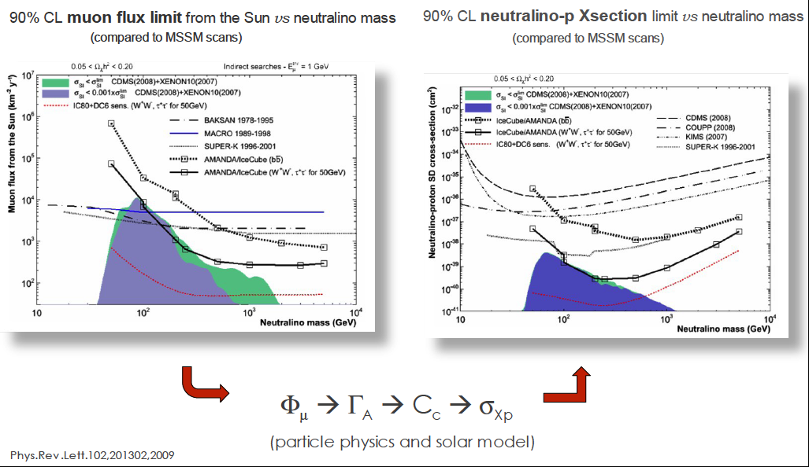
Dark Matter on Ice
IceCube has placed constraints on the neutrino-induced muon flux from the Sun, and interpreted this in terms of a limit on the WIMP’s spin-dependent elastic scattering cross section with protons
These limits are competitive with or stronger than those from current direct detection experiments

Slide 45
Indirect Detection With Neutrinos
Neutralinos elastically scatter with nuclei in the Sun, becoming gravitationally bound
As neutralinos accumulate in the Sun’s core, they annihilate at an increasing rate
After ~Gyr, annihilation rate typically reaches equilibrium with capture rate, generating a potentially observable flux of high-energy neutrinos

Slide 46
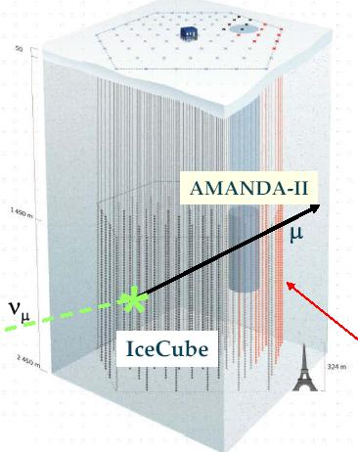
Indirect Detection With Neutrinos
Muon neutrinos from the Sun interacting via charged current produce energetic muons
Kilometer-scale neutrino telescope IceCube currently under construction at South Pole

Slide 47
Indirect Detection With Neutrinos
Rate observed at IceCube depends primarily on the neutralino capture rate in the Sun (the elastic scattering cross section)
The reach of neutrino telescopes is, therefore, expected to be tied to that of direct detection experiments

Slide 48
Indirect Detection With Positrons
Positrons produced through a range of dark matter annihilation channels (decays of heavy quarks, gauge bosons, heavy leptons, etc.)
Move as a random walk through galactic magnetic fields
Energy losses through inverse compton and synchotron scattering with starlight, CMB

Slide 49
Indirect Detection
The key benchmark of indirect searches:
Recall that to be produced with the observed dark matter abundance, a thermal relic must have an annihilation (at freeze-out) of σv≈3x10⁻²⁶ cm³/s
Although many model-dependent factors can cause the dark matter to possess a somewhat lower annihilation cross section today (velocity dependence, co-annihilations, resonances), most models predict current annihilation rates that are within an order of magnitude or so this estimate
Indirect detection experiments which are sensitive to dark matter annihilating at approximately this rate will be able to test a majority of WIMP models
Dan Hooper – Dark Matter in the Discovery Age

Slide 50
Some Highlights in Indirect Detection
EGRET, Super Kamiokande
HEAT
INTEGRAL (511 keV)
2000
WMAP Haze
2003
PAMELA (including rising e⁺ fraction)
2006
IceCube Construction Completed
2009
First Science Results from AMS-02
2011
First Cosmology Results from PLANCK
FERMI
2014
ACTs – HESS, VERITAS, MAGIC, CTA…
2017

Slide 51
Some Highlights in Indirect Detection
Many major experiments are soon to have new results – AMS, Planck, IceCube, more from Fermi, etc.
EGRET, Super Kamiokande
HEAT
INTEGRAL (511 keV)
2000
WMAP Haze
2003
PAMELA (including rising e⁺ fraction)
2006
IceCube Construction Completed
2009
First Science Results from AMS-02
2011
First Cosmology Results from PLANCK
FERMI
2014
ACTs – HESS, VERITAS, MAGIC, CTA…
2017

Slide 52
Some Highlights in Indirect Detection
Many major experiments are soon to have new results – AMS, Planck, IceCube, more from Fermi, etc.
For the first time, we are sensitive to WIMPs with an annihilation cross section near the value expected for a simple thermal relic (~10⁻²⁶ cm³/s)
EGRET, Super Kamiokande
HEAT
INTEGRAL (511 keV)
2000
WMAP Haze
2003
PAMELA (including rising e⁺ fraction)
2006
IceCube Construction Completed
2009
First Science Results from AMS-02
2011
First Cosmology Results from PLANCK
FERMI
2014
ACTs – HESS, VERITAS, MAGIC, CTA…
2017

Slide 53
Indirect Detection With Fermi
No indirect detection experiment has more potential to constrain or discover dark matter than the Fermi Gamma Ray Space Telescope (FGST)
Fermi’s Large Area Telescope (LAT) offers far more effective area (~8000 cm²), better angular resolution (sub-degree), and energy resolution (~10%) that its predecessor, EGRET
Unlike ground based telescopes, Fermi observes the entire sky and can study gamma rays down to ~100 MeV (ACTs are limited to ~100 GeV and up)
Dan Hooper – Dark Matter in the Discovery Age

Slide 54
Where to look for Dark Matter with Fermi?
The Galactic Center
-Brightest spot in the sky
-Considerable astrophysical
backgrounds
The Galactic Halo
-High statistics
-Requires detailed model
of galactic backgrounds
Isotropic Background
-High statistics
-potentially difficult to identify
Dwarf Galaxies
-Less signal
-Low backgrounds
Dan Hooper – Dark Matter in the Discovery Age

Slide 55
Ground-Based Gamma Ray Searches For Dark Matter
Fermi has several years of data taking ahead of it, but no post-Fermi space-based gamma ray mission is being seriously planned at this time (as far as I know)
In parallel to space-based missions, , ground based gamma ray telescopes (HESS, VERITAS, MAGIC) have continued to improve in sensitivity, approaching that likely to be required to observe thermal WIMPs with masses in the ~TeV range
CTA – with a low-threshold (~30 GeV) design – could improve dark matter sensitivity by a factor of 10-20 over existing telescopes
Sensitivity to TeV WIMPs is complementary to Fermi (and to the LHC)

Slide 56
Ground-Based Gamma Ray Searches For Dark Matter

Slide 57
Dark Matter with Antimatter
WIMP annihilations are generally predicted to produce equal quantities of matter and antimatter
A large flux of antimatter in the cosmic ray spectrum could be indicative of a contribution from dark matter
The PAMELA Collaboration’s measurement of the cosmic ray positron fraction got many of us very excited for this reason
Excess positrons now appear likely to originate from astrophysical sources (pulsars?), although TeV-scale dark force models remain a viable possibility (Arkani-Hamed, Finkbeiner, Slayter, Weiner, PRD, arXiv:0810.0713)
Dan Hooper – Dark Matter in the Discovery Age

Slide 58
Dark Matter with Antimatter
AMS-02 was deployed on the International Space Station last year
With ~10² times greater acceptance than PAMELA, and significantly better ability to distinguish between electrons, positrons, protons, antiprotons and various species of nuclei, AMS represents a major leap forward
Anti-proton channel expected to be sensitive to WIMPs up to several hundred GeV (assuming the naïve thermal cross section) – similar reach to Fermi
Dan Hooper – Dark Matter in the Discovery Age

Slide 59
AMS’ Great Leap Forward
AMS-02 has been deployed on the International Space Station since May 2011, and recently announced their first science results
With ~10² times greater acceptance than PAMELA, and significantly greater ability to distinguish between electrons, positrons, protons, antiprotons, and various species of nuclei, AMS represents a major leap forward

Slide 60
AMS’ First New Result!

Slide 61
What We Can Learn From AMS
1) Hopefully settle the question of why the cosmic ray positron fraction climbs so rapidly with energy (as observed by both PAMELA and Fermi) – pulsars? TeV WIMPs with light force carriers?

Slide 62
What We Can Learn From AMS
1) Hopefully settle the question of why the cosmic ray positron fraction climbs so rapidly with energy (as observed by both PAMELA and Fermi) – pulsars? TeV WIMPs with light force carriers?
2) Search for excess high energy anti-protons – sensitive to WIMPs with thermal cross section and masses up to a few hundred GeV
I. Cholis, arXiv:1007.1160

Slide 63
What We Can Learn From AMS
1) Hopefully settle the question of why the cosmic ray positron fraction climbs so rapidly with energy (as observed by both PAMELA and Fermi) – pulsars? TeV WIMPs with light force carriers?
2) Search for excess high energy anti-protons – sensitive to WIMPs with thermal cross section and masses up to a few hundred GeV
3) Nail down cosmic ray propagation model – help strengthen dark matter limits derived from antiproton, positron channels
I. Cholis, arXiv:1007.1160

Slide 64
Dark Matter with Neutrinos
Neutrinos from WIMP annihilations provide a complementary indirect probe, sensitive to the proton-WIMP scattering cross section (instead of the annihilation cross section)
IceCube, supplemented with DeepCore, currently provides (spin-dependent) constraints competitive with the best direct detection limits
Large volume and low threshold extensions, such as PINGU are a very promising possibility
Dan Hooper – Dark Matter in the Discovery Age

Slide 65
Indirect Detection With Fermi
In my opinion, no single indirect detection experiment has more potential to constrain or discover dark matter than the Fermi Gamma Ray Space Telescope (FGST)
Fermi’s Large Area Telescope (LAT) offers far more effective area (~8000 cm²), better angular resolution (sub-degree), and energy resolution (~10%) than any other space-based gamma-ray telescope
Unlike ground-based telescopes, Fermi observes the entire sky and can study gamma rays down to ~100 MeV (ACTs are limited to ~100 GeV and up)

Slide 66
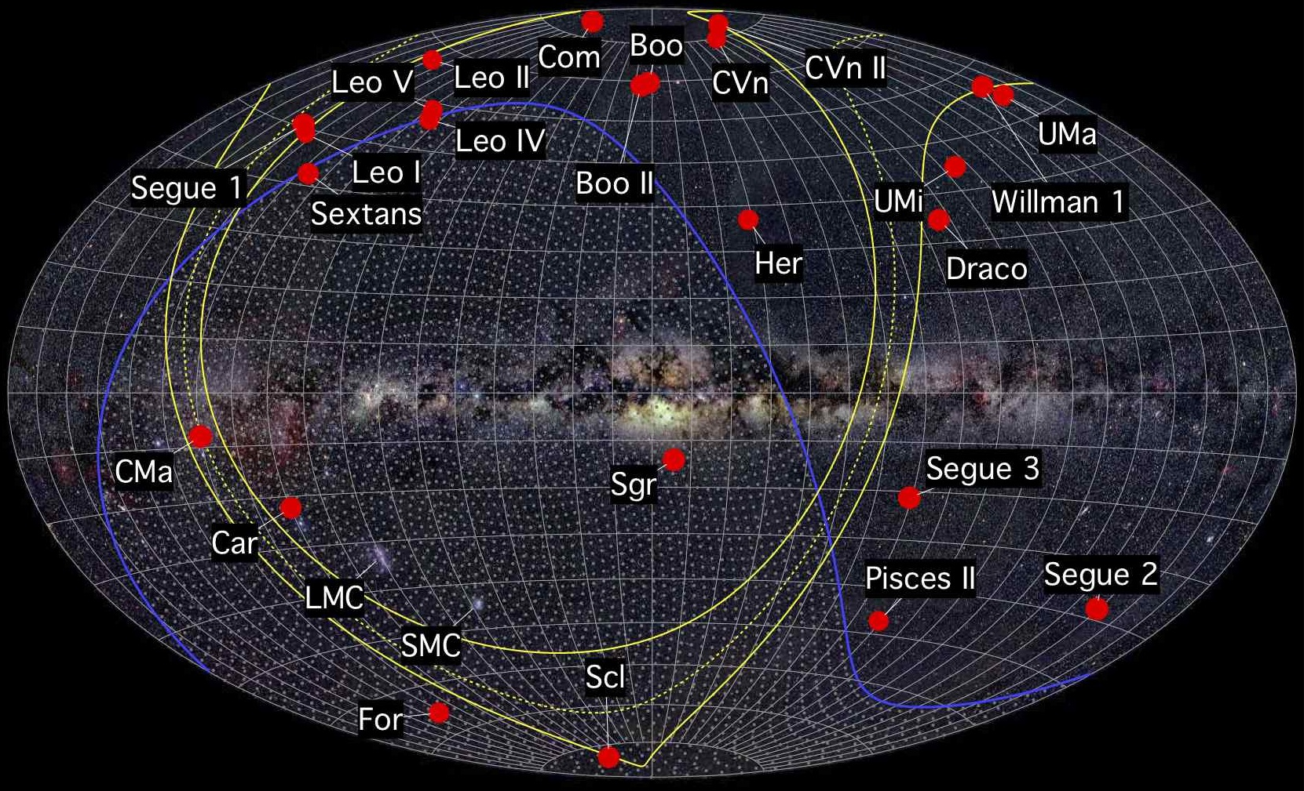
Dark Matter in Dwarf Galaxies
The halo of the Milky Way contains numerous smaller halos, the largest of which are dwarf galaxies
Dwarf galaxies are the most dark matter dominated known systems, with mass-to-light ratios as high as ~10³
These objects represent potentially bright sources of gamma rays from dark matter annihilations, with little astrophysical backgrounds

Slide 67
Dark Matter in Dwarf Galaxies
In the summer of 2011, the results of two analyses of Fermi dwarfs were released (one by Geringer-Sameth & Koushiappas, and another by the Fermi Collaboration)
Although no excess was reported, the lack of observed gamma rays was used to derive a stringent constraint on the dark matter’s annihilation cross section
For the first time, Fermi began to rule out dark matter models with a cross section equal to the naïve estimate for a simple thermal relic (σv~3x10⁻²⁶ cm³/s) – reaching masses up to ~30-50 GeV

Slide 68
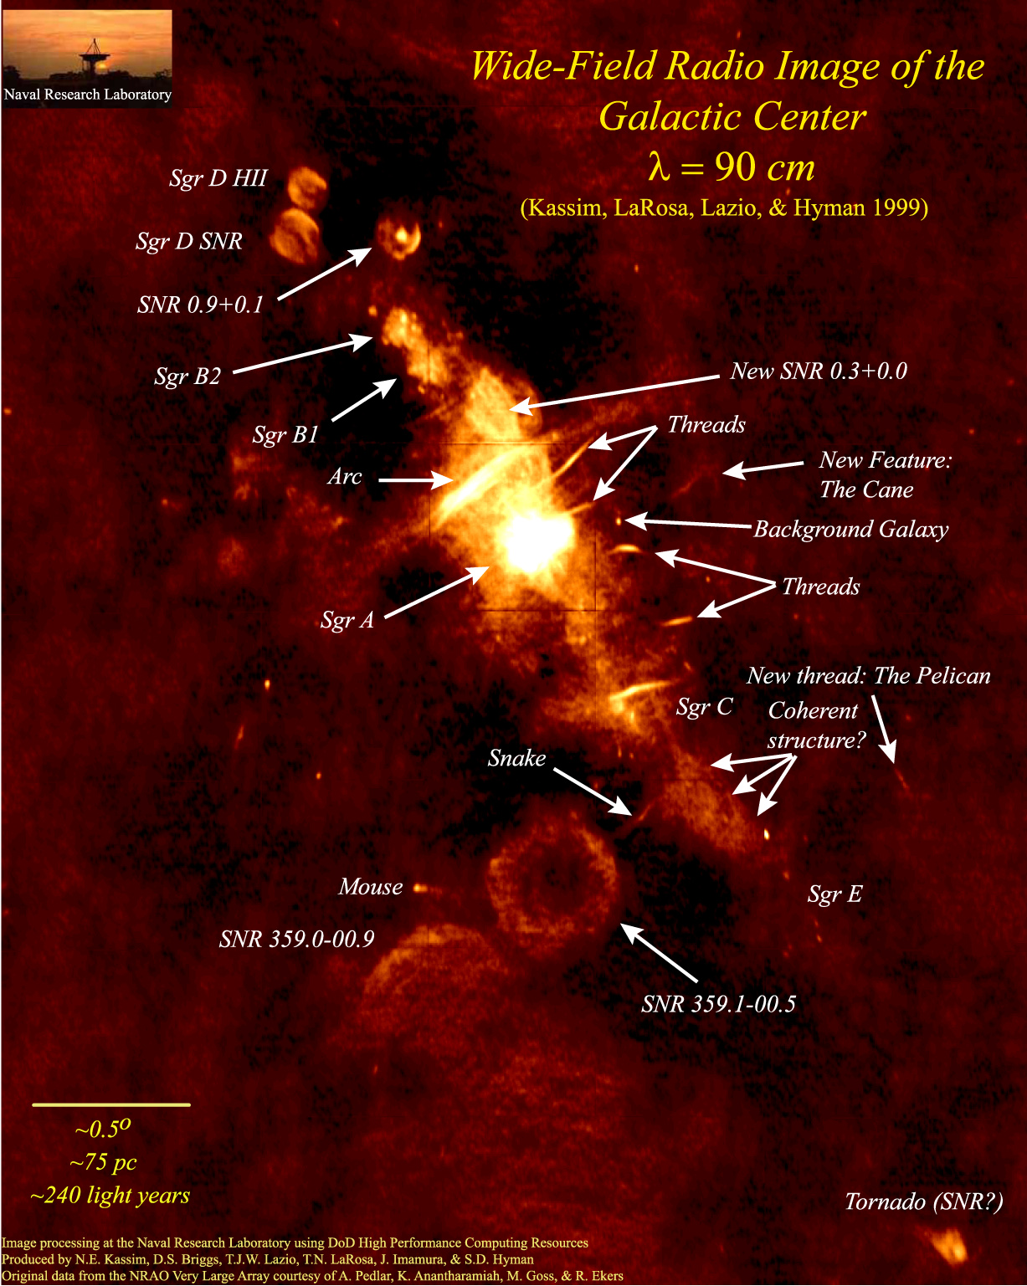
Dark Matter in The Galactic Center
The volume surrounding the Galactic Center is complex; backgrounds present are not necessarily well understood
This does not, however, make searches for dark matter region intractable
The flux of gamma rays predicted from dark matter annihilations around the Galactic Center is very large – tens of thousands of times brighter than that predicted from the brightest dwarf galaxies
But to separate dark matter annihilation products from astrophysical backgrounds, one must take advantage of the distinct observational features of these components

Slide 69
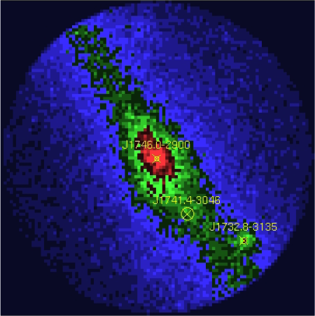

Dark Matter in The Galactic Center
The gamma ray signal from dark matter annihilations is described by:
1) Distinctive “bump-like” spectral feature
2) Signal highly concentrated around the Galactic Center (but not entirely point-like); precise morphology determined by the dark matter distribution

Slide 70
A Simple (but effective) Approach to the Galactic Center
1) Start with a raw map (smoothed out over 0.5° circles)
Hooper and Linden, PRD,
arXiv:1110.0006

Slide 71
A Simple (but effective) Approach to the Galactic Center
1) Start with a raw map (smoothed out over 0.5° circles)
2) Subtract known point sources (Fermi 2nd source catalog)
Hooper and Linden, PRD,
arXiv:1110.0006

Slide 72
A Simple (but effective) Approach to the Galactic Center
1) Start with a raw map (smoothed out over 0.5° circles)
2) Subtract known point sources (Fermi 2nd source catalog)
3) Subtract line-of-sight gas density template (empirical, good match to 21-cm)
Hooper and Linden, PRD,
arXiv:1110.0006

Slide 73
A Simple (but effective) Approach to the Galactic Center
This method removes ~90% of the emission in the inner galaxy (outside of the innermost few degrees)
Typical residuals are ~5% or less as bright as the inner residual – spatial variations in backgrounds are of only modest importance
Clearly isolates the emission associated with the inner source or sources (supermassive black hole? Dark matter? Pulsars?), along with a subdominant component of “ridge” emission
Hooper and Linden, PRD,
arXiv:1110.0006

Slide 74
Characteristics of the Observed Gamma Ray Residual
1) The spectrum peaks between ~300 MeV and ~10 GeV
Hooper and Linden, PRD,
arXiv:1110.0006

Slide 75
Characteristics of the Observed Gamma Ray Residual
1) The spectrum peaks between ~300 MeV and ~10 GeV
2) Clear spatial extension – only a small fraction of the emission above ~300 MeV is point-like
Hooper and Linden, PRD,
arXiv:1110.0006

Slide 76
Characteristics of the Observed Gamma Ray Residual
1) The spectrum peaks between ~300 MeV and ~10 GeV
2) Clear spatial extension – only a small fraction of the emission above ~300 MeV is point-like
3) Good agreement is found between our analysis and those of other groups (see the recent analysis by Abazajian and Kaplinghat, for example)
Hooper and Linden, PRD,
arXiv:1110.0006

Slide 77
The Dark Matter Interpretation
The extended emission can be explained by annihilating dark matter with the following characteristics:
The spectral shape of the residual is well fit by a dark matter particle with a mass in the range of 7 to 12 GeV (similar to that suggested by CoGeNT, DAMA, and CRESST), annihilating primarily to τ⁺τ⁻ (possibly among other leptons), or with a mass of 22 to 45 GeV annihilating to quarks
The angular distribution of the signal is well fit by a halo profile with an inner slope of γ~1.25 to 1.4 (in agreement with expectations from simulations)
The normalization of the signal requires a low-velocity annihilation cross section of σv ~ 10⁻²⁶ -10⁻²⁷ cm³/s (up to uncertainties in the profile normalization, etc.); similar to expectations for a thermal relic
Hooper and Linden, PRD, arXiv:1110.0006

Slide 78
Three Common Perspectives, Circa 2012
The Dark Matter Enthusiast – These arguments look compelling; the extended GeV gamma ray excess from the Galactic Center probably comes from dark matter annihilations
The Pulsar Enthusiast – The signal is there and requires an explanation, but (millisecond) pulsars are at least as likely as dark matter
The Galactic Center Pessimist – The Galactic Center is so complicated from an astrophysical perspective that it would be almost impossible to identify a dark matter signal from that direction of the sky

Slide 79
Three Common Perspectives, Circa 2012
The Dark Matter Enthusiast – These arguments look compelling; the extended GeV gamma ray excess from the Galactic Center probably comes from dark matter annihilations
The Pulsar Enthusiast – The signal is there and requires an explanation, but (millisecond) pulsars are at least as likely as dark matter
The Galactic Center Pessimist – The Galactic Center is so complicated from an astrophysical perspective that it would be almost impossible to identify a dark matter signal from that direction of the sky
-To convince those in the second and third groups, it appears that additional observations will be required, ideally from a direction well away from the Galactic Center

Slide 80
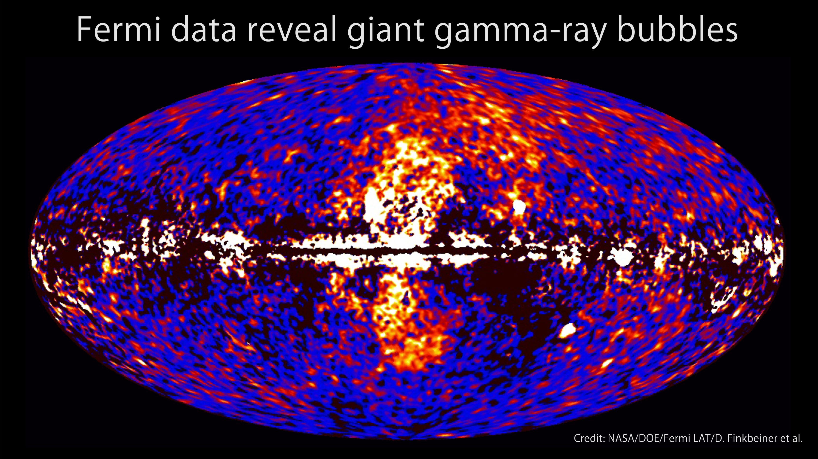
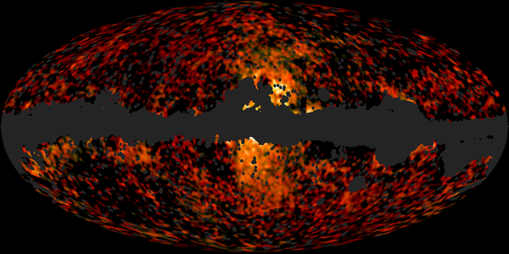
The Fermi Bubbles and Synchrotron Haze
In 2010, Su, Slatyer, and Finkbeiner discovered two giant bubble-like gamma ray features in the Fermi data, extending ~50° north and south of the Galactic Center
In 2012, the Planck collaboration reported that the synchrotron emission previously known as the “WMAP haze” is real, and is highly spatially correlated with the bubbles, supporting a common origin (inverse Compton/synchrotron from the same cosmic ray electron population)
Many questions remain: Powered by star formation? Past activity of central black hole? Other mechanism?

Slide 81
Annihilation Products in the Fermi Bubbles?
If dark matter annihilation products are responsible for the extended gamma-ray signal seen around the Galactic Center, then gamma-rays should also be discernable at higher Galactic Latitudes as well – this flux should be comparable in brightness to the Fermi Bubbles, for example
This provides an important test that can be used to discriminate between dark matter and pulsar interpretations of the extended Galactic Center signal (and also address the “the Galactic Center is too complicated” critique)
Is this high latitude emission present?
If so, can we see it?

Slide 82
Spectral Analysis of the Fermi Bubbles
We employ a template analysis to the Fermi data – the same approach as was previously used to discover the bubbles
In previous template analyses of the bubbles, only one template was used for the bubbles (this essentially assumes that the spectrum from the bubbles does not vary much with latitude, longitude)
To see if the spectrum of the bubbles emission varies with Galactic Latitude, we break up the bubbles into five templates – if dark matter annihilation products are present, they should be prominent at low latitudes, and largely absent at high latitudes

Slide 83
Spectral Analysis of the Fermi Bubbles
Very strong spectral variation (with Galactic Latitude) is observed in the Fermi bubbles
Fairly flat at high latitudes, and much more peaked close to the Galactic Center
Hooper and Slatyer, arXiv:1302.6589

Slide 84
The Bubbles At High Latitudes
At high latitudes (|b|>30°), the observed gamma ray emission is very consistent with inverse Compton scattering of an power-law spectrum of electrons (dN_{e}/dE_{e} ~ E⁻³)
Hooper and Slatyer, arXiv:1302.6589

Slide 85
The Bubbles At High Latitudes
At high latitudes (|b|>30°), the observed gamma ray emission is very consistent with inverse Compton scattering of an power-law spectrum of electrons (dN_{e}/dE_{e} ~ E⁻³)
Furthermore, the same electrons can also easily account for the observed synchrotron haze (for B ~ 0.1-1 μG)
A very simple, plausible, and compelling explanation for both observations
Hooper and Slatyer, arXiv:1302.6589

Slide 86
The Bubbles At Low Latitudes
At low latitudes (|b|<20°), however, the observed emission is inconsistent with the inverse Compton scattering of any realistic spectrum of electrons
The best fits are found for electron spectra that are highly (unrealistically) peaked near ~16 GeV; and even then fails to generate the observed spectrum
An additional spectral component is clearly present, concentrated at low galactic latitudes, and peaking at ~2-3 GeV
Hooper and Slatyer, arXiv:1302.6589

Slide 87
Annihilation Products in the Fermi Bubbles?
If we (not unreasonably) assume that the shape of the electron spectrum does not vary significantly throughout the volume of the bubbles, we can subtract the inverse Compton contribution from the observed spectrum
The residuals shown display a spectrum and morphology that is very similar to that observed from the Galactic Center region
The dashed lines are the predictions for a 10 GeV WIMP annihilating to τ⁺τ⁻, with an NFW-like profile of inner slope 1.2 (which provides a good fit the Galactic Center, see Hooper/Linden, Abazajian/Kaplinghat)
Hooper and Slatyer, arXiv:1302.6589

Slide 88
Annihilation Products in the Fermi Bubbles?
If we (not unreasonably) assume that the shape of the electron spectrum does not vary significantly throughout the volume of the bubbles, we can subtract the inverse Compton contribution from the observed spectrum
The residuals shown display a spectrum and morphology that is very similar to that observed from the Galactic Center region
The dashed lines are the predictions for a 10 GeV WIMP annihilating to τ⁺τ⁻, with an NFW-like profile of inner slope 1.2 (which provides a good fit the Galactic Center, see Hooper/Linden, Abazajian/Kaplinghat)
Key Point: The signal previously observed from the Galactic Center is not confined to the inner few hundred parsecs, but extends to at least ~3-4 kpc from the Inner Galaxy
Hooper and Slatyer, arXiv:1302.6589

Slide 89
Three Common Perspectives, Circa 2012
The Dark Matter Enthusiast – These arguments look compelling; the extended GeV gamma ray excess from the Galactic Center probably comes from dark matter annihilations
The Pulsar Enthusiast – The signal is there and requires an explanation, but (millisecond) pulsars are at least as likely as dark matter
The Galactic Center Pessimist – The Galactic Center is so complicated from an astrophysical perspective that it would be almost impossible to identify a dark matter signal from that direction of the sky

Slide 90
Three Common Perspectives, Circa 2012
The Dark Matter Enthusiast – These arguments look compelling; the extended GeV gamma ray excess from the Galactic Center probably comes from dark matter annihilations
The Pulsar Enthusiast – The signal is there and requires an explanation, but (millisecond) pulsars are at least as likely as dark matter
The Galactic Center Pessimist – The Galactic Center is so complicated from an astrophysical perspective that it would be almost impossible to identify a dark matter signal from that direction of the sky
-We now know that this emission is not confined to the Galactic Center, but extends at least ~3-4 kpc, well beyond the extent that “Galactic Center Pessimist” type arguments might reasonably apply

Slide 91
Three Common Perspectives, Circa 2012
The Dark Matter Enthusiast – These arguments look compelling; the extended GeV gamma ray excess from the Galactic Center probably comes from dark matter annihilations
The Pulsar Enthusiast – The signal is there and requires an explanation, but (millisecond) pulsars are at least as likely as dark matter
The Galactic Center Pessimist – The Galactic Center is so complicated from an astrophysical perspective that it would be almost impossible to identify a dark matter signal from that direction of the sky
-We now know that this emission is not confined to the Galactic Center, but extends at least ~3-4 kpc, well beyond the extent that “Galactic Center Pessimist” type arguments might reasonably apply
-But what about pulsars?

Slide 92
Pulsars In The Fermi Bubbles?
There are two independent and compelling arguments against pulsars (millisecond and otherwise) as the source of this gamma ray emission:

Slide 93
Pulsars In The Fermi Bubbles?
There are two independent and compelling arguments against pulsars (millisecond and otherwise) as the source of this gamma ray emission:
1) The Spectrum – As in the case of the Galactic Center signal, the signal from the low-latitude regions of the bubbles exhibits a much harder spectrum than is observed from pulsars

Slide 94
Pulsars In The Fermi Bubbles?
There are two independent and compelling arguments against pulsars (millisecond and otherwise) as the source of this gamma ray emission:
1) The Spectrum – As in the case of the Galactic Center signal, the signal from the low-latitude regions of the bubbles exhibits a much harder spectrum than is observed from pulsars
2) The lack of pulsar-like point sources – To account for this signal, there must exist a significant population of unresolved MSPs well above/below the Galactic Plane; but Fermi does not see nearly enough point sources to account for this population
MSP population models which are consistent with the observed source distribution are capable of producing no more than ~1-10% of the observed excess emission

Slide 95
Summary
Weakly interacting massive particles provide a natural class of candidates for dark matter, with a simple and compelling explanation for the observed dark matter abundance
Direct and indirect searches for dark matter (as well as searches at the LHC), are each approaching the sensitivity expected to be required to detect dark matter non-gravitationally
A number of reported signals can be interpreted as possible detections of dark matter (especially from Fermi – Galactic Center and Inner Halo)

Slide 96
Indirect Detection
The key benchmark of indirect searches:
Recall that to be produced with the observed dark matter abundance, a thermal relic must have an annihilation (at freeze-out) of σv~3x10⁻²⁶ cm³/s
Although many model-dependent factors can cause the dark matter to possess a somewhat lower annihilation cross section today (velocity dependence, co-annihilations, resonances), most models predict current annihilation rates that are within an order of magnitude or so this estimate
Indirect detection experiments which are sensitive to dark matter annihilating at approximately this rate will be able to test the majority of WIMP models

Slide 97
Indirect Detection With Fermi
No indirect detection experiment has more potential to constrain or discover dark matter than the Fermi Gamma Ray Space Telescope (FGST)
Fermi’s Large Area Telescope (LAT) offers far more effective area (~8000 cm²), better angular resolution (sub-degree), and energy resolution (~10%) that its predecessor, EGRET
Unlike ground based telescopes, Fermi observes the entire sky and can study gamma rays down to ~100 MeV (ACTs are limited to ~100 GeV and up)

Slide 98
A Gamma-Ray Line at 130 GeV?!
Recently, evidence for a monoenergetic (up to resolution) gamma-ray line from the Inner Galaxy has been identified within Fermi’s data (at 3.3σ, after LEE)
Such a single has long been considered a “smoking gun” of dark matter annihilations, provided through loop-level diagrams
Morphology of the signal is well fit to a that predicted from a cusped dark matter distribution, with a cross section of σv ~ 2 x 10⁻²⁷ cm³/s
C. Weniger, arXiv:1204.2797

Slide 99
This is a Real Dark Matter Line?
Pros
Cons

Slide 100
This is a Real Dark Matter Line?
Pros
Appears most bright near the Galactic Center; overall structure looks consistent to that expected from dark matter annihilations
Cons
Peak brightness is about 200 pc (~1.5°) from Galactic Center (with fairly high significance)

Slide 101
This is a Real Dark Matter Line?
Pros
Appears most bright near the Galactic Center; overall structure looks consistent to that expected from dark matter annihilations
Very difficult to explain with known astrophysics (attempts such as broken power law backgrounds, and pulsar wind nebulae have significant challenges)
Cons
Peak brightness is about 200 pc (~1.5°) from Galactic Center (with fairly high significance)
Very difficult to explain with particle physics – need a very large cross section to the photon line, while also suppressing annihilations to other final states

Slide 102
This is a Real Dark Matter Line?
Pros
Appears most bright near the Galactic Center; overall structure looks consistent to that expected from dark matter annihilations
Very difficult to explain with known astrophysics (attempts such as broken power law backgrounds, and pulsar wind nebulae have significant challenges)
Hints present from Galaxy Clusters
Cons
Peak brightness is about 200 pc (~1.5°) from Galactic Center (with fairly high significance)
Very difficult to explain with particle physics – need a very large cross section to the photon line, while also suppressing annihilations to other final states

Slide 103
This is a Real Dark Matter Line?
Pros
Appears most bright near the Galactic Center; overall structure looks consistent to that expected from dark matter annihilations
Very difficult to explain with known astrophysics (attempts such as broken power law backgrounds, and pulsar wind nebulae have significant challenges)
Hints present from Galaxy Clusters
Cons
Peak brightness is about 200 pc (~1.5°) from Galactic Center (with fairly high significance)
Very difficult to explain with particle physics – need a very large cross section to the photon line, while also suppressing annihilations to other final states
Signs of a similar line appear in events associated with the Earth’s albedo (“limb” photons) – signs of a systematic error in energy reconstruction?
➔ HESS-II should be able to settle

Slide 104
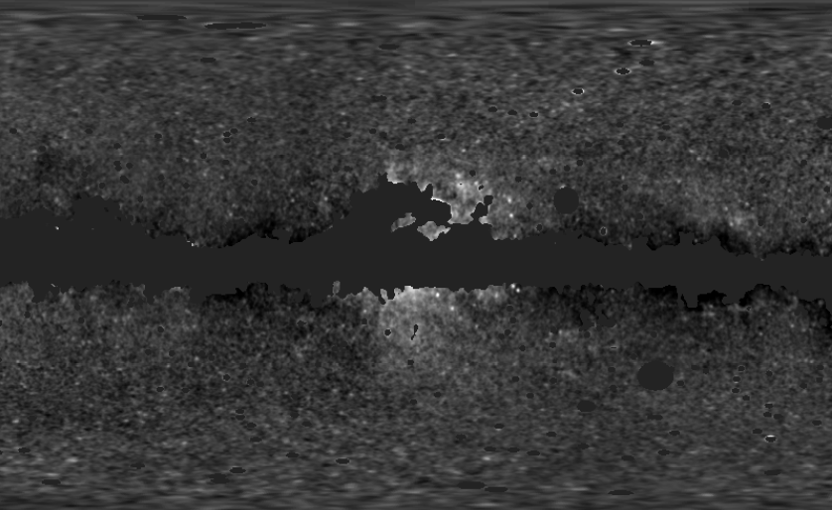
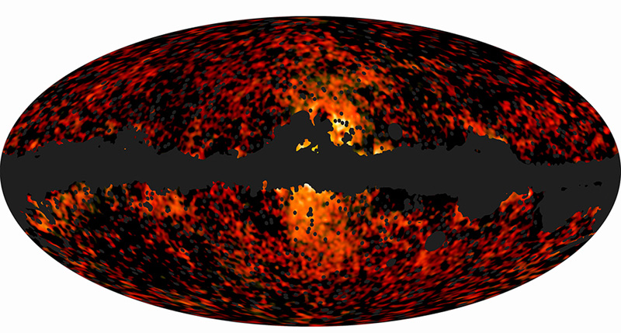
Dark Matter with Microwave and Radio Telescopes
Electrons/positrons produced in dark matter annihilations lose energy via synchrotron emission, producing signals at radio/microwave wavelengths
In 2004, Doug Finkbeiner discovered an excess of hard synchrotron emission around the Inner Galaxy in WMAP data
Very recently, the Planck collaboration has “unambiguously” confirmed the presence of this synchrotron haze
WMAP (22 GHz)
Planck (30 and 44 GHz)
Finkbeiner, astro-ph/0409027;
Hooper, Finkbeiner, Dobler, PRD (2007); Dobler, Finkbeiner, ApJ (2008)

Slide 105
Dark Matter with Antimatter
WIMP annihilations are generally predicted to produce equal quantities of matter and antimatter
A large flux of antimatter in the cosmic ray spectrum could be indicative of a contribution from dark matter
The PAMELA Collaboration’s measurement of the cosmic ray positron fraction got many of us very excited for this reason
Excess positrons now appear likely to originate from astrophysical sources (pulsars?), although TeV-scale dark force models remain a viable possibility (Arkani-Hamed, Finkbeiner, Slayter, Weiner, PRD, arXiv:0810.0713)
–

Slide 106
Dark Matter with Antimatter
AMS-02 was deployed on the International Space Station last year
With ~10² times greater acceptance than PAMELA, and significantly better ability to distinguish between electrons, positrons, protons, antiprotons and various species of nuclei, AMS represents a major leap forward
Anti-proton channel expected to be sensitive to WIMPs up to ~500 GeV (assuming the naïve thermal cross section) – similar reach to Fermi
–

Slide 107
Dark Matter with Antimatter
WIMP annihilations are generally predicted to produce equal quantities of matter and antimatter
A large flux of antimatter in the cosmic ray spectrum could be indicative of a contribution from dark matter
The PAMELA Collaboration’s measurement of the cosmic ray positron fraction got many of us very excited for this reason
Excess positrons now appear likely to originate from astrophysical sources (pulsars?), although TeV-scale dark force models remain a viable possibility (Arkani-Hamed, Finkbeiner, Slayter, Weiner, PRD, arXiv:0810.0713)
Dan Hooper – Dark Matter in the Discovery Age

Slide 108
Dark Matter with Antimatter
AMS-02 was deployed on the International Space Station last year
With ~10² times greater acceptance than PAMELA, and significantly better ability to distinguish between electrons, positrons, protons, antiprotons and various species of nuclei, AMS represents a major leap forward
Anti-proton channel expected to be sensitive to WIMPs up to ~500 GeV (assuming the naïve thermal cross section) – similar reach to Fermi
Dan Hooper – Dark Matter in the Discovery Age

Slide 109
Dark Matter with Microwave and Radio Telescopes
Electrons/positrons produced in dark matter annihilations lose energy via synchrotron emission, producing signals at radio/microwave wavelengths
In 2004, Doug Finkbeiner discovered an excess of hard synchrotron emission around the Inner Galaxy in WMAP data
Very recently, the Planck collaboration “unambiguously” confirmed the presence of this synchrotron haze
WMAP (22 GHz)
Planck (30 and 44 GHz)
Finkbeiner, astro-ph/0409027;
Hooper, Finkbeiner, Dobler, PRD (2007); Dobler, Finkbeiner, ApJ (2008)
Dan Hooper – Dark Matter in the Discovery Age

Slide 110
Dark Matter with Microwave and Radio Telescopes
Roger et al.
A number of observations at radio frequencies, including those of the ARCADE 2 collaboration, have revealed an isotropic background with a power-law spectrum, ~E^{-2.6}
Estimates of the contribution from unresolved radio sources fall short of this flux by a factor of ~5-6
Could synchrotron emission from cosmological dark matter annihilations provide a significant contribution?
- Yes, possibly, but requires light masses and leptonic annihilation channels
Maeda et al.
Haslam et al.
ARCADE 2
CMB
Reich & Reich
Dan Hooper – Dark Matter in the Discovery Age

Slide 111
The Trinity of Dark Matter Searches
Dan Hooper – Dark Matter in the Gamma-Ray Sky

Slide 112
Indirect Detection
The key benchmark of indirect searches:
Recall that to be produced with the observed dark matter abundance, a thermal relic must have an annihilation (at freeze-out) of σv~3x10⁻²⁶ cm³/s
Although many model-dependent factors can cause the dark matter to possess a somewhat lower annihilation cross section today (velocity dependence, co-annihilations, resonances), most models predict current annihilation rates that are within an order of magnitude or so of this estimate
Indirect detection experiments which are sensitive to dark matter annihilating at approximately this rate will be able to test the majority of WIMP models
Dan Hooper – Dark Matter in the Gamma-Ray Sky

Slide 113
Indirect Detection With Fermi
In my opinion, no single indirect detection experiment has more potential to constrain or discover dark matter than the Fermi Gamma-Ray Space Telescope (FGST)
Fermi’s Large Area Telescope (LAT) offers far more effective area (~8000 cm²), better angular resolution (sub-degree), and energy resolution (~10%) than any other space-based gamma-ray telescope
Unlike ground-based telescopes, Fermi observes the entire sky and can study gamma rays down to ~100 MeV (ACTs are limited to ~100 GeV and up)
Dan Hooper – Dark Matter in the Gamma-Ray Sky

Slide 114
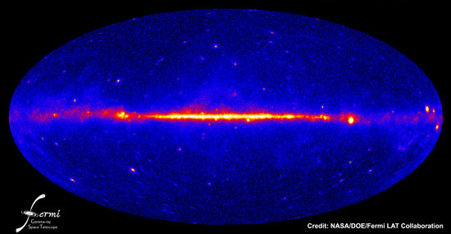
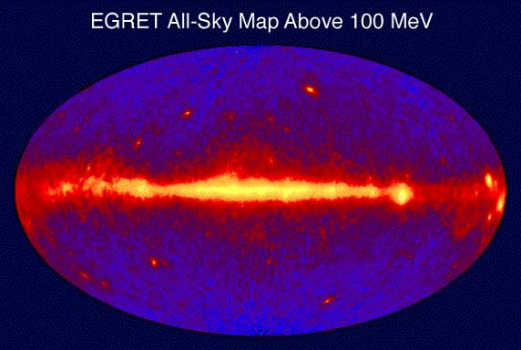
Dan Hooper – Dark Matter in the Gamma-Ray Sky

Slide 115
Dan Hooper – Dark Matter in the Gamma-Ray Sky

Slide 116
Where to look for Dark Matter with Fermi?
The Galactic Center
-Brightest spot in the sky
-Considerable astrophysical
backgrounds
The Galactic Halo
-High statistics
-Requires detailed model
of galactic backgrounds
Isotropic Background
-High statistics
-potentially difficult to identify
Dwarf Galaxies
-Less signal
-Low backgrounds
Dan Hooper – Dark Matter in the Gamma-Ray Sky

Slide 117
The Signal:
Gamma Rays from Dark Matter Annihilations
The gamma-ray signal from dark matter annihilations is described by:

Slide 118
The Signal:
Gamma Rays from Dark Matter Annihilations
The gamma-ray signal from dark matter annihilations is described by:
1) Distinctive “bump-like” spectrum
bb
ττ
ZZ
WW
μμ

Slide 119
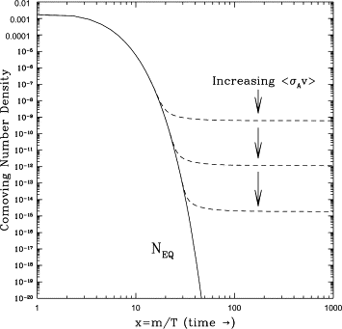
The Signal:
Gamma Rays from Dark Matter Annihilations
The gamma-ray signal from dark matter annihilations is described by:
1) Distinctive “bump-like” spectrum
2) Normalization of the signal is set by the dark matter’s mass and annihilation cross section (in the low-velocity limit)
-To be produced with the observed dark matter abundance, a thermal relic must annihilate at a rate equivalent to σv~3x10⁻²⁶ cm³/s (at freeze-out)
-Although many model-dependent factors can lead to a somewhat lower annihilation cross section today (velocity dependence, co-annihilations, resonances), most models predict current annihilation rates that are within an order of magnitude or so of ~10⁻²⁶ cm³/s

Slide 120
The Signal:
Gamma Rays from Dark Matter Annihilations
The gamma-ray signal from dark matter annihilations is described by:
1) Distinctive “bump-like” spectrum
2) Normalization of the signal is set by the dark matter’s mass and annihilation cross section (in the low-velocity limit)
3) Signal highly concentrated around the Galactic Center (but not point-like); precise morphology is determined by the dark matter distribution
M. Kuhlen et al.

Slide 121
The Distribution of Dark Matter in the Inner Milky Way
Dark matter only simulations (Via Lactea, Aquarius, etc.) produce halos that possess inner profiles of ρ α r ^{-γ} where γ=1.0 to 1.2
The inner volume (~10 kpc) of the Milky Way is dominated by baryons, not dark matter – significant departures from results of dark matter-only simulations may be expected
For years, an active debate has taken place in the literature over the question of how the baryons alter the profiles of dark matter halos
Existing microlensing and dynamical data are not capable of determining the inner slope, although γ~1.3 provides the best fit
γ
Iocco, Pato, Bertone, Jetzer, arXiv:1107.5810

Slide 122
The Distribution of Dark Matter in the Inner Milky Way
Many state-of-the-art hydro-dynamical simulations (carried out by several different groups and running different codes), have begun to converge in favor of a moderate degree of contraction in Milky Way-like halos, typically exhibiting a steepening of the inner slope (γ) from ~1.0 to ~1.2-1.5
Other groups find that cusps may be somewhat flattened (γ < 1) if baryonic feedback processes are assumed to be very efficient
We keep an open mind and adopt a generalized NFW profile with an inner slope, γ
D. Nagai (2006)
Gottloeber et al. (2010)
(Gnedin, et al. arXiv:1108.5736)
Levine et al. (2008)

Slide 123
The Backgrounds:
Astrophysical Sources of Gamma Rays
Gamma-Ray Point Sources:
Galactic sources include pulsars, pulsar wind nebulae, supernova remnants, globular clusters, nova, and high mass binaries
Extragalactic sources include active galactic nuclei, and galaxies (especially starburst and radio galaxies)

Slide 124
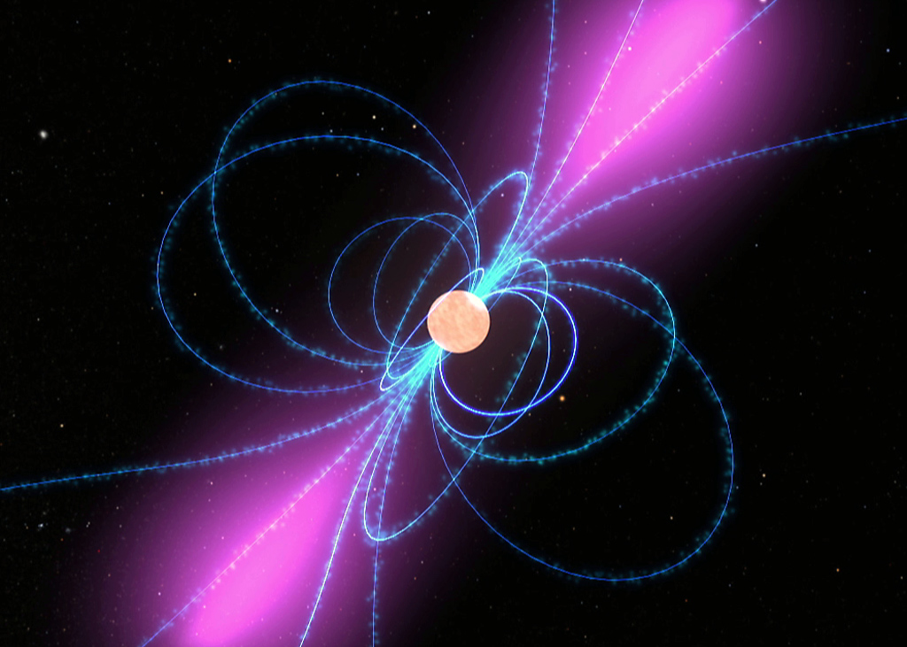
The Backgrounds:
Astrophysical Sources of Gamma Rays
Gamma-Ray Point Sources:
Galactic sources include pulsars, pulsar wind nebulae, supernova remnants, globular clusters, nova, and high mass binaries
Extragalactic sources include active galactic nuclei, and galaxies (especially starburst and radio galaxies)
Gamma-rays from unresolved extragalactic sources are (nearly) isotropic – not a problem for dark matter searches in the inner galaxy

Slide 125
The Backgrounds:
Astrophysical Sources of Gamma Rays
Gamma-Ray Point Sources:
Galactic sources include pulsars, pulsar wind nebulae, supernova remnants, globular clusters, nova, and high mass binaries
Extragalactic sources include active galactic nuclei, and galaxies (especially starburst and radio galaxies)
Gamma-rays from unresolved extragalactic sources are (nearly) isotropic – not a problem for dark matter searches in the inner galaxy
Most gamma-ray point sources do not exhibit a “bump-like” spectrum which could be confused with dark matter annihilation products
The exception to this are gamma-ray pulsars (and possibly globular clusters, which contain many pulsars); pulsar spectra peak mildly at energies around ~1-2 GeV
-I will return to the subject of pulsars later in this talk

Slide 126
The Backgrounds:
Astrophysical Sources of Gamma Rays
Processes to Generate Diffuse Gamma-Ray Emission:
Pion production (cosmic ray collisions with gas)
Inverse Compton emission (cosmic ray electrons up-scattering starlight, CMB, or other radiation)
Bremsstrahlung (electron energy losses from interactions with nuclei)

Slide 127
The Backgrounds:
Astrophysical Sources of Gamma Rays
Processes to Generate Diffuse Gamma-Ray Emission:
Pion production (cosmic ray collisions with gas)
Inverse Compton emission (cosmic ray electrons up-scattering starlight, CMB, or other radiation)
Bremsstrahlung (electron energy losses from interactions with nuclei)
The spectra and morphology of these backgrounds are determined by the spatial and spectral distribution of cosmic rays, gas, and radiation in the Milky Way
Inverse Compton and Bremsstrahlung gamma-rays do not exhibit “bump-like” spectra; at least for realistic cosmic ray electron spectra
Gamma-rays from pion decay do typically peak at GeV energies; similar to the spectra observed from pulsars
GALPROP defaults, inner galaxy

Slide 128
Our Simple (but effective) Approach to the Galactic Center
1) Start with a raw map (smoothed out over 0.5° circles)
Hooper and Linden, PRD,
arXiv:1110.0006

Slide 129
Our Simple (but effective) Approach to the Galactic Center
1) Start with a raw map (smoothed out over 0.5° circles)
2) Subtract known point sources (Fermi 2nd source catalog)
Hooper and Linden, PRD,
arXiv:1110.0006

Slide 130
Our Simple (but effective) Approach to the Galactic Center
1) Start with a raw map (smoothed out over 0.5° circles)
2) Subtract known point sources (Fermi 2nd source catalog)
3) Subtract disk template (constant with longitude, empirical fit with latitude, good match to 21-cm)
Hooper and Linden, PRD,
arXiv:1110.0006

Slide 131
Our Simple (but effective) Approach to the Galactic Center
This method removes ~90% of the emission in the inner galaxy (outside of the innermost few degrees)
Typical residuals are ~5% or less as bright as the inner residual – spatial variations in backgrounds are of only modest importance
Clearly isolates the emission associated with the inner source or sources (supermassive black hole? Dark matter? Pulsars?), along with a subdominant component of “ridge” emission
Hooper and Linden, PRD,
arXiv:1110.0006

Slide 132
Characteristics of the Observed Gamma-Ray Residual
1) The spectrum peaks between ~300 MeV and ~10 GeV
Hooper and Linden, PRD,
arXiv:1110.0006

Slide 133
Characteristics of the Observed Gamma-Ray Residual
1) The spectrum peaks between ~300 MeV and ~10 GeV
2) Clear spatial extension – only a small fraction of the emission above ~300 MeV is point-like
Hooper and Linden, PRD,
arXiv:1110.0006

Slide 134
Characteristics of the Observed Gamma-Ray Residual
1) The spectrum peaks between ~300 MeV and ~10 GeV
2) Clear spatial extension – only a small fraction of the emission above ~300 MeV is point-like
3) Good agreement is found between our analysis and those of other groups (see the analyses by Abazajian and Kaplinghat, or Gordon and Macas, for example)
Hooper and Linden, PRD,
arXiv:1110.0006

Slide 135
The Dark Matter Interpretation
The extended emission residual can be explained by annihilating dark matter with the following characteristics:
The spectral shape of the residual is well fit by a dark matter particle with a mass in the range of ~7-12 GeV, annihilating primarily to τ⁺τ⁻ (possibly among other leptons), or with a mass of ~25-45 GeV annihilating to quarks
The angular distribution of the signal is well fit by a halo profile with an inner slope of γ~1.2 to 1.4 (in agreement with expectations from simulations)
The normalization of the signal requires a low-velocity annihilation cross section of σv ~ 10⁻²⁶ -10⁻²⁷ cm³/s (up to uncertainties in the profile normalization, etc.); similar to expectations for a thermal relic
Hooper and Linden, PRD, arXiv:1110.0006

Slide 136
Astrophysical Interpretations
Pion Decay Gamma Rays From Cosmic Rays?
The observed emission (above ~0.3 GeV) is spatially extended, and does not originate directly from the supermassive black hole; but protons accelerated by or nearby the SMBH could plausibly propagate outward, leading to an extended signal
The spectrum of the extended emission, however, rises rapidly between 0.1-1 GeV; much more so than the spectrum from proton collisions (for any proton spectrum)
Changes to point source spectra can reduce this tension (Abazajian and Kaplinghat), but not with 2FGL spectra
Boyarsky et al., arXiv:1012.5839
Dan Hooper – Dark Matter in the Gamma-Ray Sky

Slide 137
Astrophysical Interpretations
Pion Decay Gamma Rays From Cosmic Rays?
Furthermore, the morphology of the gamma-ray signal is largely determined by the distribution of gas, and will be dominated by the circum-nuclear ring that is known to be present within ~1-3 pc of the Galactic Center
To Fermi, this emission should appear point-like (3 pc is equivalent to ~0.02°)
The observed morphology of the gamma-ray emission is extended over a region of at least 50-100 pc; this is inconsistent with the known distribution of gas
Linden, Lovegrove, Profumo, arXiv:1203.3539;
See also Linden and Profumo, arXiv:1206.4308
Dan Hooper – Dark Matter in the Gamma-Ray Sky

Slide 138
Astrophysical Interpretations
A Collection of Unresolved Pulsars
Perhaps a large population of unresolved points sources distributed throughout the inner tens of parsecs of the Milky Way could produce the observed signal; a collection of ~10³ millisecond pulsars, for example

Slide 139
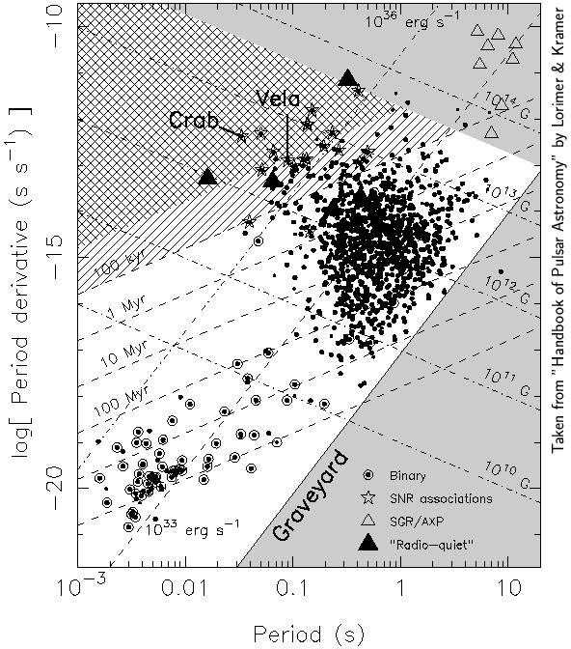
Pulsar Basics
Ordinary Pulsars
Pulsars are rapidly spinning neutron stars, which gradually convert their rotational kinetic energy into radio and gamma-ray emission

Slide 140
Pulsar Basics
Ordinary Pulsars
Pulsars are rapidly spinning neutron stars, which gradually convert their rotational kinetic energy into radio and gamma-ray emission
Typical pulsars exhibit periods on the order of ~1 second and slow down at a rate that implies the presence ~10¹² Gauss magnetic fields

Slide 141
Pulsar Basics
Ordinary Pulsars
Pulsars are rapidly spinning neutron stars, which gradually convert their rotational kinetic energy into radio and gamma-ray emission
Typical pulsars exhibit periods on the order of ~1 second and slow down at a rate that implies the presence ~10¹² Gauss magnetic fields
Over ~10⁶ -10⁸ years, pulsars lose most of their rotational energy and become faint

Slide 142
Pulsar Basics
Ordinary Pulsars
Pulsars are rapidly spinning neutron stars, which gradually convert their rotational kinetic energy into radio and gamma-ray emission
Typical pulsars exhibit periods on the order of ~1 second and slow down at a rate that implies the presence ~10¹² Gauss magnetic fields
Over ~10⁶ -10⁸ years, pulsars lose most of their rotational energy and become faint
Millisecond Pulsars (aka Recycled Pulsars)
Some pulsars have binary companions (although most are lost from velocity kicks)
If a companion of a pulsar evolves into a red giant, accretion can “spin-up” the pulsar’s period to as short as ~1.5 msec, and with much lower magnetic fields (~10⁸-10⁹ G) and much slower spin-down timescales than are found among ordinary pulsars – can remain bright for >10⁹ years

Slide 143
Millisecond Pulsars as the Source of the Galactic Center Signal?
Millisecond Pulsars (MSPs) are better suited to account for the Galactic Center gamma rays for two reasons:

Slide 144
Millisecond Pulsars as the Source of the Galactic Center Signal?
Millisecond Pulsars (MSPs) are better suited to account for the Galactic Center gamma rays for two reasons:
1) MSPs remain bright for billions of years, and thus ancient periods of rapid star formation might have produced a large number of such objects in the Galactic Center; there should not be enough ordinary pulsars in the Galactic Center to account for the signal

Slide 145
Millisecond Pulsars as the Source of the Galactic Center Signal?
Millisecond Pulsars (MSPs) are better suited to account for the Galactic Center gamma rays for two reasons:
1) MSPs remain bright for billions of years, and thus ancient periods of rapid star formation might have produced a large number of such objects in the Galactic Center; there should not be enough ordinary pulsars in the Galactic Center to account for the signal
2) When pulsars are formed, they typically obtain “kicks” of several hundred km/s as a result of asymmetric collapse – sufficient to expel the vast majority of pulsars from the gravitational potential of the Galactic Center
But MSPs retained their binary companion, and thus must have had exceptionally weak kicks; and those kicks were also weighed down by the mass of their companion – this is why so many MSPs are found in globular clusters (130 known)

Slide 146
Gamma-Ray Observations of Millisecond Pulsars
The Fermi Collaboration has identified 47 pulsars with millisecond-scale periods; 37 of which have spectra reported in the 2-year Fermi source catalog (2FGL)
The combined spectrum of these 37 sources is well described by a power-law index of 1.3-1.4 with an exponential cutoff at 2.5-3.0 GeV (further supported by observations of globular clusters, whose gamma-ray emission is believed to be dominated by MSPs)
This is considerably less sharply peaked than is observed from the Galactic Center (spectral index of ~0.5 instead of ~1.35); perhaps systematics (over-subtracting point sources) could make compatible?
MSPs
10 GeV DM, τ⁺τ⁻

Slide 147
Gamma-Ray Observations of Millisecond Pulsars
The Fermi Collaboration has identified 47 pulsars with millisecond-scale periods; 37 of which have spectra reported in the 2-year Fermi source catalog (2FGL)
The combined spectrum of these 37 sources is well described by a power-law index of 1.3-1.4 with an exponential cutoff at 2.5-3.0 GeV (further supported by observations of globular clusters, whose gamma-ray emission is believed to be dominated by MSPs)
This is considerably less sharply peaked than is observed from the Galactic Center (spectral index of ~0.5 instead of ~1.35); perhaps systematics (over-subtracting point sources) could make compatible?
The observed morphology of the gamma-ray signal requires a spatial distribution of pulsars that is much more concentrated than the observed distributions of stars, requiring n_{pulsar}~r ^{-2.5}, whereas n_{star}~ r ^{-1.25}
Perhaps OK if MSPs are formed as a result of star-star interactions?
MSPs
10 GeV DM, τ⁺τ⁻

Slide 148
Three Common Perspectives, Circa 2012
Dan Hooper – Dark Matter in the Gamma-Ray Sky

Slide 149
Three Common Perspectives, Circa 2012
The Dark Matter Enthusiast – These arguments look compelling; the extended GeV gamma-ray excess from the Galactic Center probably comes from dark matter annihilations
The Pulsar Enthusiast – The signal is there and requires an explanation, but (millisecond) pulsars are at least as likely as dark matter
The Galactic Center Pessimist – The Galactic Center is so complicated from an astrophysical perspective that it would be almost impossible to identify a dark matter signal from that direction of the sky
Dan Hooper – Dark Matter in the Gamma-Ray Sky

Slide 150
Three Common Perspectives, Circa 2012
The Dark Matter Enthusiast – These arguments look compelling; the extended GeV gamma-ray excess from the Galactic Center probably comes from dark matter annihilations
The Pulsar Enthusiast – The signal is there and requires an explanation, but (millisecond) pulsars are at least as likely as dark matter
The Galactic Center Pessimist – The Galactic Center is so complicated from an astrophysical perspective that it would be almost impossible to identify a dark matter signal from that direction of the sky
-To address the concerns of the second and third groups, additional observations are required, ideally from a direction well away from the Galactic Center
Dan Hooper – Dark Matter in the Gamma-Ray Sky

Slide 151
The Fermi Bubbles and Synchrotron Haze
In 2010, Su, Slatyer, and Finkbeiner discovered two giant bubble-like gamma ray features in the Fermi data, extending ~50° north and south of the Galactic Center
In 2012, the Planck collaboration reported that the synchrotron emission previously known as the “WMAP haze” (also discovered by Finkbeiner) is real, and is highly spatially correlated with the bubbles, supporting a common origin (inverse Compton/synchrotron from the same cosmic ray electron population)
Many questions remain: Powered by star formation? Past activity of central black hole? Another mechanism?

Slide 152
Annihilation Products in the Fermi Bubbles?
If dark matter annihilation products are responsible for the extended gamma-ray signal seen around the Galactic Center, then gamma-rays should be discernable at higher Galactic Latitudes as well – this flux should be comparable in brightness to the Fermi Bubbles, for example
This provides an important test that can be used to discriminate between dark matter and pulsar interpretations of the extended Galactic Center signal (and also address the “the Galactic Center is too complicated” critique)
Is this high latitude emission present?
If so, can we see it?

Slide 153
Spectral Analysis of the Fermi Bubbles
We employ a template analysis to the Fermi data – the same approach as was previously used to discover the bubbles
Although we used three different sets of templates in our analysis (as a check of systematics), in this talk I will show results for our “diffuse model” template set:
  An isotropic template, or uniform offset (to absorb cosmic ray contamination)
  The Fermi diffuse model template (derived by the Fermi Collaboration using dust and gas maps to model pion emission and GALPROP to model inverse Compton emission; we use version P6V11, which was the last version that did not explicitly include emission from the bubbles)
  Templates associated with the bubbles
For each energy energy bin, we vary the coefficients of each template to find the best-fit and the errors around those values
Hooper and Slatyer, Phys. Dark Univ., arXiv:1302.6589

Slide 154
Spectral Analysis of the Fermi Bubbles
In previous template analyses of the bubbles, only one template was used for the bubbles (this essentially assumes that the spectrum from the bubbles does not vary much with latitude, longitude)
To see if the spectrum of the bubbles emission varies with Galactic Latitude, we break up the bubbles into five templates – if dark matter annihilation products are present, they should be prominent at low latitudes, and largely absent at high latitudes
Hooper and Slatyer, Phys. Dark Univ., arXiv:1302.6589

Slide 155
Spectral Analysis of the Fermi Bubbles
Very strong spectral variation with Galactic Latitude is observed in the Fermi bubbles
Fairly flat at high latitudes; much more peaked close to the Galactic Center
Hooper and Slatyer, arXiv:1302.6589

Slide 156
The Bubbles At High Latitudes
At high latitudes (|b|=30-50°), the observed gamma-ray emission is consistent with inverse Compton scattering of an power-law spectrum of electrons (dN_{e}/dE_{e} ~ E⁻³)
Hooper and Slatyer, arXiv:1302.6589

Slide 157
The Bubbles At High Latitudes
At high latitudes (|b|=30-50°), the observed gamma-ray emission is consistent with inverse Compton scattering of an power-law spectrum of electrons (dN_{e}/dE_{e} ~ E⁻³)
Furthermore, the same electrons can also easily account for the observed synchrotron haze (for B ~ 0.1-1 μG)
A very simple, plausible, and compelling explanation for both observations
Hooper and Slatyer, arXiv:1302.6589

Slide 158
The Bubbles At Low Latitudes
At low latitudes (|b|<20-30°), however, the observed emission is inconsistent with the inverse Compton scattering of any realistic spectrum of electrons
The best fits are found for electron spectra that are highly (unrealistically; basically a delta function) peaked near ~16 GeV
An additional spectral component is clearly present, concentrated at low galactic latitudes, and peaking at ~2-3 GeV
Hooper and Slatyer, Phys. Dark Univ., arXiv:1302.6589

Slide 159
The Non-Inverse Compton Component
After subtracting emission from inverse Compton Scattering (responsible the observed bubbles’ emission at high latitudes, and the synchrotron haze), we find the spectra shown
This spectrum and morphology is very similar to that observed from the Galactic Center – and a direct comparison can be made!
Hooper and Slatyer, Phys. Dark Univ., arXiv:1302.6589

Slide 160
The Non-Inverse Compton Component
After subtracting emission from inverse Compton Scattering (responsible the observed bubbles’ emission at high latitudes, and the synchrotron haze), we find the spectra shown
This spectrum and morphology is very similar to that observed from the Galactic Center
The dotted lines is the prediction for a 10 GeV WIMP annihilating to τ⁺τ⁻, with an NFW-like profile of inner slope 1.2, chosen to provide a good fit to the Galactic Center (Hooper/Linden, Abazajian/Kaplinghat) – No free parameters!
Key Point: The signal previously observed from the Galactic Center is not confined to the inner few hundred parsecs, but extends out to at least ~3-4 kpc from the Inner Galaxy
Hooper and Slatyer, Phys. Dark Univ., arXiv:1302.6589

Slide 161
Cross-Checks, Tests, and Questions
Our rather long paper (26 pages, including 20 figures and 5 appendices) includes many cross-checks and tests of our results; we are confident this signal is present, and that its spectrum and morphology are broadly similar to those described in our paper (although in some details we are less confident, such as in the spectrum from regions within ~5° the plane)
Although I direct you to our paper (or invite you to talk with me) if you are interested in these cross-checks, I’ll describe here some of the key tests we have performed
Hooper and Slatyer, Phys. Dark Univ., arXiv:1302.6589

Slide 162
Cross-Checks, Tests, and Questions
Testing the quality of our template model
The main weakness of the template method is that it only produces reliable results when the templates collectively describe the data reasonably well
Because we are using crude, large scale templates, no sum of these templates should be expected to provide a formal fit to the Fermi data set that is “good”
Hooper and Slatyer, Phys. Dark Univ., arXiv:1302.6589

Slide 163
Cross-Checks, Tests, and Questions
Testing the quality of our template model
The main weakness of the template method is that it only produces reliable results when the templates collectively describe the data reasonably well
Because we are using crude, large scale templates, no sum of these templates should be expected to provide a formal fit to the Fermi data set that is “good”
  In order for us to be confident that a signal identified using this technique is real, two criteria must be met:
  1) The quality of the fit must significantly improve when additional templates are added For example, when we replace the model with only one bubble template with a model with five bubble (latitude-divided) templates, the formal fit improves by 16σ

Slide 164
Cross-Checks, Tests, and Questions
Testing the quality of our template model
The main weakness of the template method is that it only produces reliable results when the templates collectively describe the data reasonably well
Because we are using crude, large scale templates, no sum of these templates should be expected to provide a formal fit to the Fermi data set that is “good”
  In order for us to be confident that a signal identified using this technique is real, two criteria must be met:
  1) The quality of the fit must significantly improve when additional templates are added For example, when we replace the model with only one bubble template with a model with five bubble (latitude-divided) templates, the formal fit improves by 16σ
  2) The residuals maps (data-model) must not be much larger than the magnitude of the signal being extracted
Hooper and Slatyer, Phys. Dark Univ., arXiv:1302.6589

Slide 165
Residuals
1-10 GeV, longitude ±5° region
Hooper and Slatyer, Phys. Dark Univ., arXiv:1302.6589

Slide 166
Residuals
1-10 GeV, longitude ±5° region
-With the exception of near the Galactic Plane (where the bubble templates vanish) residuals are small, a few percent of the total emission, fluctuating around zero
Total Emission
Residual (|data-model|)
Hooper and Slatyer, Phys. Dark Univ., arXiv:1302.6589

Slide 167
Residuals
Residual+Bubbles
(data-model+bubbles)
1-10 GeV, longitude ±5° region
-With the exception of near the Galactic Plane (where the bubble templates vanish) residuals are small, a few percent of the total emission, fluctuating around zero
-The best fit bubbles emission is a factor of a few brighter than the residuals
Except for in the region near the Galactic Plane, our model can reliably extract the latitude-dependent spectrum of the bubbles
Total Emission
Residual (|data-model|)
Hooper and Slatyer, Phys. Dark Univ., arXiv:1302.6589

Slide 168
Cross-Checks, Tests, and Questions
But Can We Find A Better Model?
So far, we have restricted our additional spectral component to the region of the bubbles – but if this is really from dark matter annihilation, it should be distributed with approximately spherical symmetry around the Galactic Center
Where the dark matter annihilations are brightest but outside of the bubbles, the disk is nearby -- perhaps difficult to discern from backgrounds?
But nonetheless, we can ask whether a NFW-like template might work better to extract this signal
Hooper and Slatyer, Phys. Dark Univ., arXiv:1302.6589

Slide 169
Cross-Checks, Tests, and Questions
Model With 5 Bubble Templates and an NFW Template (γ = 1.2)
The question this exercise can answer is whether the GeV, bump-like signal prefers to be absorbed by the templates confined to the bubbles, or by the dark matter template
Hooper and Slatyer, Phys. Dark Univ., arXiv:1302.6589

Slide 170
Cross-Checks, Tests, and Questions
Model With 5 Bubble Templates and an NFW Template (γ = 1.2)
The question this exercise can answer is whether the GeV, bump-like signal prefers to be absorbed by the templates confined to the bubbles, or by the dark matter template
We find that there is no discernable bump in the spectra of any of the bubbles templates; Instead, the GeV bump gets almost entirely absorbed by the dark matter template; this is especially clear when we mask within 5° of the plane, and take steps to limit the impact of emission associated with loop 1
Adding this template (chosen to match GC) improves the fit by an additional 12σ
Hooper and Slatyer, Phys. Dark Univ., arXiv:1302.6589

Slide 171
Cross-Checks, Tests, and Questions
The NFW-like template absorbs a fair amount of emission below 1 GeV -- much more than we found when considering only the bubble templates
In our paper, we argued that this was likely due to leakage from the Galactic Plane (the brightest parts of the NFW squared distribution are near the plane)
We tried various things to control this, with a limited degree of success
Hooper and Slatyer, Phys. Dark Univ., arXiv:1302.6589

Slide 172
Cross-Checks, Tests, and Questions
If we restrict our analysis to events with a good value of the CTBCORE parameter (those events with the best point spread function), the leakage from the plane can be much reduced
After applying such a cut, the spectrum absorbed by the NFW template is much more robust to choice of the region considered, and looks very much like dark matter annihilations!
Highly
Preliminary!
All Ultraclean Events Top 25% of Ultraclean Events
Slatyer, Hooper, Finkbeiner, Portillo, et al., In preparation

Slide 173
Three Common Perspectives, Circa 2012
The Dark Matter Enthusiast – These arguments look compelling; the extended GeV gamma-ray excess from the Galactic Center probably comes from dark matter annihilations
The Pulsar Enthusiast – The signal is there and requires an explanation, but (millisecond) pulsars are at least as likely as dark matter
The Galactic Center Pessimist – The Galactic Center is so complicated from an astrophysical perspective that it would be almost impossible to identify a dark matter signal from that direction of the sky

Slide 174
Three Common Perspectives, Circa 2012
The Dark Matter Enthusiast – These arguments look compelling; the extended GeV gamma-ray excess from the Galactic Center probably comes from dark matter annihilations
The Pulsar Enthusiast – The signal is there and requires an explanation, but (millisecond) pulsars are at least as likely as dark matter
The Galactic Center Pessimist – The Galactic Center is so complicated from an astrophysical perspective that it would be almost impossible to identify a dark matter signal from that direction of the sky
-We now know that this emission is not confined to the Galactic Center, but extends at least ~3-4 kpc, well beyond the extent that “Galactic Center Pessimist” type arguments might reasonably apply

Slide 175
Three Common Perspectives, Circa 2012
The Dark Matter Enthusiast – These arguments look compelling; the extended GeV gamma-ray excess from the Galactic Center probably comes from dark matter annihilations
The Pulsar Enthusiast – The signal is there and requires an explanation, but (millisecond) pulsars are at least as likely as dark matter
The Galactic Center Pessimist – The Galactic Center is so complicated from an astrophysical perspective that it would be almost impossible to identify a dark matter signal from that direction of the sky
-We now know that this emission is not confined to the Galactic Center, but extends at least ~3-4 kpc, well beyond the extent that “Galactic Center Pessimist” type arguments might reasonably apply
-But what about pulsars?

Slide 176
Is the Inner Galaxy’s GeV Excess From Millisecond Pulsars?
There are two independent and compelling arguments against pulsars (millisecond and otherwise) as the source of this gamma-ray emission:
1) The Spectrum – As in the case of the Galactic Center signal, the signal from the low-latitude regions of the bubbles exhibits a much harder spectrum than is observed from pulsars
Hooper, Cholis, Linden, Siegal-Gaskins, Slatyer,
PRD, arXiv:1305.0830

Slide 177
Is the Inner Galaxy’s GeV Excess From Millisecond Pulsars?
There are two independent and compelling arguments against pulsars (millisecond and otherwise) as the source of this gamma-ray emission:
1) The Spectrum – As in the case of the Galactic Center signal, the signal from the low-latitude regions of the bubbles exhibits a much harder spectrum than is observed from pulsars
2) The lack of pulsar-like point sources – To account for this signal, there must exist a significant population of MSPs well above/below the Galactic Plane; but Fermi does not see nearly enough point sources to account for this population
MSP population models which are consistent with the observed source distribution are capable of producing no more than ~5-10% of the observed excess emission
Hooper, Cholis, Linden, Siegal-Gaskins, Slatyer,
PRD, arXiv:1305.0830

Slide 178
What Next?

Slide 179
What Next?
Although the Galactic Center is almost certainly the brightest source of dark matter annihilation products in the sky, a dark matter candidate able to generate the observed signal would also be expected to be potentially observable in other Fermi analyses as well (although probably marginally)

Slide 180
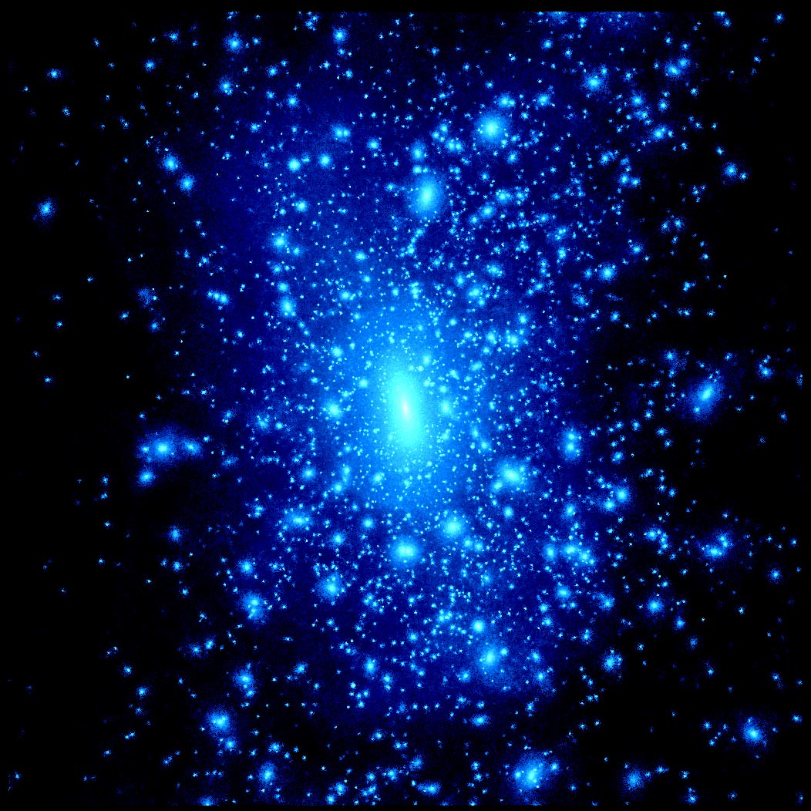
Dwarf Spheroidal Galaxies
Dark matter halos contain large numbers of smaller subhalos – the halo of the Milky Way is no exception
The most massive of these subhalos contain stars, and are known as dwarf galaxies – the most highly dark matter dominated systems known (mass-to-light up to ~10³)

Slide 181
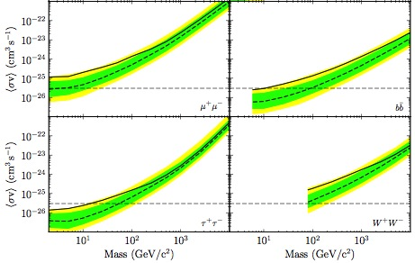
Dwarf Spheroidal Galaxies
The Fermi Collaboration has recently presented their analysis of 25 dwarf spheroidal galaxies, using 4 years of data
They find a modest (local) excess, ~2σ
If interpreted as a signal of dark matter, would imply a mass, channel, and cross section very similar to that required of the Galactic Center/Inner Galaxy signals
It is also interesting to note that the excess originates almost entirely from the three dwarfs with the largest predicted signals (J-factors): Segue 1,
Willman 1, Ursa Major II
With more data from Fermi, this hint could potentially become statistically significant
Fermi Collaboration, arXiv:1310.0828

Slide 182
Galactic Subhalos
The vast majority of the Milky Way’s dark matter subhalos are expected to be too small to retain gas and form stars, leading to a population of invisible dark matter clumps
The most massive and nearby of these objects could be detectable as gamma-ray sources, without observable emission at other wavelengths
This this source population in mind, one can scour the catalog of unidentified Fermi sources for dark matter subhalos candidates
By comparing the distribution of candidates sources with the predictions of N-body simulations (Aquarius, Via Lactea), one can place constraints on the dark matter annihilation cross section

Slide 183
Galactic Subhalos
At present, there are 82 unidentified, high-latitude (|b|>30°), non-variable Fermi sources
Most of these gamma-ray sources, however, do not have a spectral shape compatible with dark matter annihilation
For each mass and channel, we determine which sources fit the spectrum and place upper limits on the cross section
Caution: Limits do not account for any uncertainties involved in mapping Aquarius to the Milky Way
A. Berlin, DH, arXiv:1309.0525

Slide 184
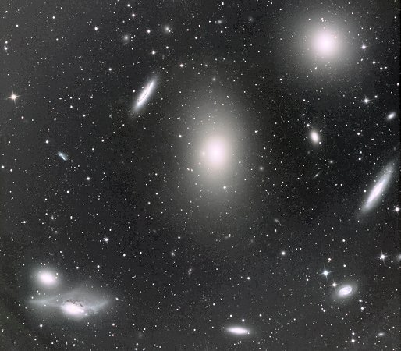
Galaxy Clusters
Galaxy clusters are also promising targets of indirect dark matter searches, competitive with (if not superior to) dwarfs galaxies
The table suggests that clusters should be an order of magnitude more sensitive to dark matter annihilation than dwarfs, but this conclusion relies on large “boost factors” from substructure, and thus on extrapolations to low mass clumps well below the resolution of current simulations
My view is that we should expect dark matter to be annihilating in clusters at a rate similar to that predicted by (extrapolated) simulations, but not be too surprised if the actual rate is as much as ~3-5 times lower
Gao, Frenk, Jenkins, Springel, White, MNRAS, arXiv:1107.1916

Slide 185
Galaxy Clusters
Last year, Han, et al. published the results of a search for gamma-rays from the Virgo, Coma, and Fornax clusters, reporting a ~3σ excess from Virgo
This (modest) excess was confirmed in a later study by Macias-Ramirez, et al.
The results of these analyses, however, depend critically on the treatment of point sources and diffuse cosmic ray induced emission – it is difficult to know how seriously one should take this result
If it arises from dark matter annihilation, such an excess suggests a similar mass and cross section as is needed to accommodate the observed emission from the Galactic Center
bb
Han, et al., arXiv:1207.6749; Macias-Ramirez, Gordon, Brown and Adams, arXiv:1207.6257

Slide 186
Searching for dark matter in the Discovery Age – Lecture 5
Dan Hooper - Fermilab/University of Chicago
Supersymmetry or not, what is the evidence?Copenhagen
October, 2013

Slide 187
Dark Matter at The LHC
Machines such as the Large Hadron Collider (LHC) may be able to produce and observe dark matter particles
The LHC collected data at a staggering rate last year, and is preparing to begin its 8 TeV run this spring
Evidence for a 125 GeV Higgs boson from ATLAS and CMS, (and CDF, D0) has been accumulating
A wide range of TeV-scale physics scenarios beyond the Standard Model are in the process of being put to the test by the LHC… including the WIMP hypothesis
ATLAS
CMS
Dan Hooper – Dark Matter in the Discovery Age

Slide 188
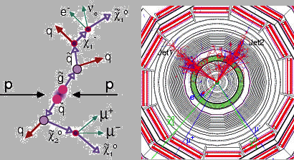
Dark Matter at The LHC
Two strategies for dark matter hunting at Hadron Colliders:
Strategy A (SUSY-like case): Produce strongly interacting particles which, although not dark matter themselves, produce dark matter particles in their decays (study distributions of events with various combinations of jets, leptons, and missing energy)
Strength: Potentially large production cross sections and rates
Weakness: Not very model independent (what if there are no strongly interacting states!?)
Dan Hooper – Dark Matter in the Discovery Age

Slide 189
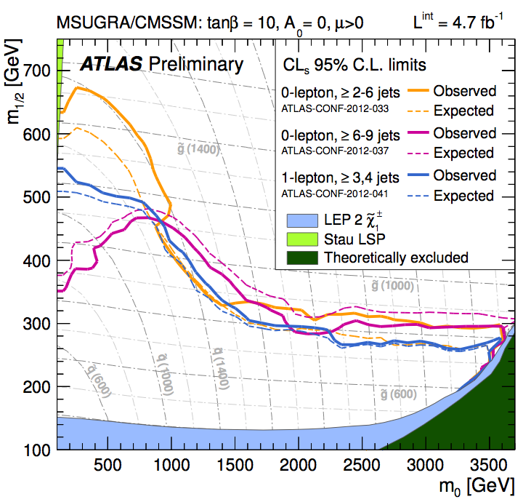
Dark Matter at The LHC
Numerous searches for supersymmetry are being carried out by the ATLAS and CMS collaborations
For typical patterns of superpartner masses, these results constrain squarks/gluinos to be lighter than 1400/900 GeV (for comparison, the Tevatron probed up to ~400 GeV)
Ultimately, the LHC will test models with squarks/gluinos as heavy as several TeV
Broadly speaking, models capable of addressing the electroweak hierarch problem (SUSY or otherwise) are likely to fall within the reach of the LHC
Dan Hooper – Dark Matter in the Discovery Age

Slide 190
Dark Matter at The LHC
Two strategies for dark matter hunting at Hadron Colliders:
Strategy B (Direct Production): Produce the dark matter directly (in association with a jet or photon), leading to more model independent constraints
Test effective operators (integrating out the details of other particles involved)
(2011)
Mediator mass/coupling
Scalar interactions, coupled to down-quarks
Strength: Constrains the mass/coupling of any WIMP – highly model independent
Weakness: Modest rates, limited reach – LHC (14 TeV) is only sensitive to dark matter lighter than ~200 GeV and with a heavy mediator (based on couplings needed for relic density)
Dan Hooper – Dark Matter in the Discovery Age
Rajaraman, Shephard, Tait, Wijangco, arXiv:1108.1196

Slide 191
The Status:
Dan Hooper – Dark Matter in the Discovery Age

Slide 192
The Status:
Z-mediated scattering (sneutrinos, heavy neutrinos)
1) Direct Detection:
Ruled out Z-mediated interactions more than a decade ago
Are currently at roughly the sensitivity needed to test Higgs-mediated scattering
5-10 years from now, only very fine tuned and/or baroque models will remain beyond the reach of direct detection experiments
Higgs-mediated scattering (A-funnel, focus point neutralinos)
DM
SM
DM
DM
Dan Hooper – Dark Matter in the Discovery Age
DM
SM
SM
SM

Slide 193
The Status:
2) Indirect Detection:
Gamma ray constraints are beginning to test the naïve thermal estimate for low mass WIMPs (up to ~30 GeV, for specific channels)
Several indirect experiments, including Fermi and AMS-02, will ultimately be sensitive to dark matter with masses up to several hundred GeV
Heavier WIMPs, and WIMPs with suppressed annihilation cross sections (at low velocity) will remain beyond reach of current and planned experiments
At Freeze-Out At Low Velocity
DM
SM
DM
SM
Dan Hooper – Dark Matter in the Discovery Age
DM
SM
DM
SM

Slide 194
The Status:
3) The LHC:
The LHC will be sensitive to strongly coupled particles up to several TeV, but to isolated WIMPs only up to hundreds of GeV
Worst case scenario: Isolated WIMPs interacting through light and very weakly coupled particles
The prospects for discovering dark matter at the LHC depend very strongly on the rest of the broader particle physics framework, and less on the properties of the WIMP itself
ATLAS
CMS
DM
SM
SM
DM
Dan Hooper – Dark Matter in the Discovery Age
DM
SM
SM
DM

Slide 195
The Status:
All three of these search strategies are poised to tell us very interesting things about dark matter very soon
For the first time, we should expect positive detections of WIMPs in the near future, and in multiple search techniques
If no WIMPs are observed in the next several years, the entire paradigm of WIMP dark matter will be challenged, lending favor to axions and other classes of non-WIMP dark matter candidates
Dan Hooper – Dark Matter in the Discovery Age

Slide 196
The Future:
Steady progress toward scalable and very large (ton and multi-ton) and low-threshold (DAMIC) direct detection experiments
Expand upon the progress made by Fermi with a large array of ground based gamma ray telescopes, such as CTA (low threshold is essential – tens, not hundreds, of GeV)
We should also start thinking now about future space-based gamma ray and/or cosmic ray missions, as well as large, low-threshold neutrino telescopes (PINGU)
Dan Hooper – Dark Matter in the Discovery Age

Slide 197
Putting This All Together
Various dark matter search strategies offer different advantages and disadvantages, and are potentially able to measure different quantities
Direct Detection Experiments:
Measure the rate and energy spectrum of recoil events, ideally using multiple targets
➔Mass (modulo uncertainties in velocity distribution)
➔(Spin-independent/dependent scattering cross section with protons/neutrons) x (local density)
Unanswered questions:
Does this particle make up most/all of the dark matter?
What is it?
Dan Hooper – Dark Matter in the Discovery Age

Slide 198
Putting This All Together
Various dark matter search strategies offer different advantages and disadvantages, and are potentially able to measure different quantities
Indirect Detection Experiments:
Measure the flux and spectrum of a variety of types of annihilation products, from a variety of regions ➔Dominant annihilation channels (in low velocity limit)
➔Mass
➔Low velocity annihilation cross section (assuming only one dark matter component and modulo uncertainties in the dark matter distribution)
Unanswered questions:
Does this particle make up most/all of the dark matter?
(although σv~3x10⁻²⁶ cm³/s would be suggestive)
What is it?

Slide 199
Putting This All Together
Various dark matter search strategies offer different advantages and disadvantages, and are potentially able to measure different quantities
The Large Hadron Collider:
Measure distributions of events with missing energy
➔Mass
★Discover other particles which may inform us as to the interactions and other properties of the WIMP
Unanswered questions:
Does this particle make up most/all/some of the dark matter? (Is it even stable!?)
What is it?
Dan Hooper – Dark Matter in the Discovery Age

Slide 200
Putting This All Together
None of these experiments are going to solve the mystery of dark matter’s identity alone
Only with information from multiple (all three?) search strategies, will it be possible to determine the particle nature of dark matter
Dan Hooper – Dark Matter in the Discovery Age

Slide 201
Experimental Sensitivity
WIMP Models
2000
2012
2020

Slide 202
Dark Matter at The LHC
Machines such as the Large Hadron Collider (LHC) may be able to produce and observe dark matter particles
The LHC collected data at a staggering rate last year, and is preparing to begin its 8 TeV run this spring
The discovery of the/a Higgs boson with a mass of 125 GeV represents a major accomplishment for both ATLAS and CMS (and CDF, D0)
A wide range of TeV-scale physics scenarios beyond the Standard Model are in the process of being put to the test by the LHC… including the WIMP hypothesis
ATLAS
CMS

Slide 203
Dark Matter at The LHC
Two strategies for dark matter hunting at Hadron Colliders:
Strategy A (SUSY-like case): Produce strongly interacting particles which, although not dark matter themselves, produce dark matter particles in their decays (study distributions of events with various combinations of jets, leptons, and missing energy)
Strength: Potentially large production cross sections and rates
Weakness: Not very model independent (what if there are no strongly interacting states!?)

Slide 204
Dark Matter at The LHC
Numerous searches for supersymmetry are being carried out by the ATLAS and CMS collaborations
For typical patterns of superpartner masses, these results constrain squarks/gluinos to be heavier than ~1400/900 GeV (for comparison, the Tevatron probed up to ~450 GeV)
Ultimately, the LHC will test models with squarks/gluinos as heavy as a few TeV
Broadly speaking, models capable of addressing the electroweak hierarch problem (SUSY or otherwise) are likely to fall within the LHC’s reach

Slide 205
Dark Matter at The LHC
Two strategies for dark matter hunting at Hadron Colliders:
Strategy B (Direct Production): Produce the dark matter directly (in association with a jet or photon), leading to more model independent constraints
Test effective operators (integrating out the details of other particles involved)
Mediator mass and coupling
(Scalar interactions, coupled to down-quarks)
Strength: Constrains the mass and effective coupling of any WIMP – highly model independent
Weakness: Modest rates, limited reach – LHC (14 TeV) is only sensitive to dark matter lighter than ~200 GeV (based on couplings needed for relic density)
Rajaraman, Shephard, Tait, Wijangco, arXiv:1108.1196

Slide 206
The Status:
Z-mediated scattering (sneutrinos, heavy neutrinos)
1) Direct Detection:
Ruled out Z-mediated interactions more than a decade ago
Are currently at roughly the sensitivity needed to test Higgs-mediated scattering
5-10 years from now, only very fine tuned and/or baroque WIMP models will remain beyond the reach of direct detection experiments
Higgs-mediated scattering (A-funnel, focus point neutralinos)
DM
SM
DM
DM
DM
SM
SM
SM

Slide 207
The Status:
2) Indirect Detection:
Gamma ray constraints are beginning to test the naïve thermal estimate for low mass WIMPs (up to ~30 GeV)
Several indirect experiments, including Fermi and AMS-02, will ultimately be sensitive to dark matter with masses up to several hundred GeV
Heavier WIMPs, and WIMPs with suppressed annihilation cross sections (at low velocity) will remain beyond reach of current and planned experiments
At Freeze-Out At Low Velocity
DM
SM
DM
SM
DM
SM
DM
SM

Slide 208
The Status:
3) The LHC:
The LHC will be sensitive to strongly coupled particles up to several TeV, but to isolated WIMPs only up to hundreds of GeV
Worst case scenario: Isolated WIMPs interacting through light and very weakly coupled particles
The prospects for discovering dark matter at the LHC depend very strongly on the rest of the broader particle physics framework, and less on the properties of the WIMP itself
ATLAS
CMS
DM
SM
SM
DM
DM
SM
SM
DM

Slide 209
The Status:
All three of these search strategies are poised to tell us very interesting things about dark matter very soon
For the first time, we should expect positive detections of WIMPs in the near future, and in multiple search techniques
If no WIMPs are observed in the next several years, the entire paradigm of WIMP dark matter will be challenged, lending favor to axions and other classes of non-WIMP dark matter candidates

Slide 210
Putting This All Together
Various dark matter search strategies offer different advantages and disadvantages, and are potentially able to measure different quantities
Direct detection experiments measure a distribution of events connected to the WIMP’s mass and elastic scattering cross section, along with the dark matter’s velocity distribution and local density
Indirect detection experiments measure a spectrum of annihilation products (gamma-rays, cosmic rays, etc.) determined by the WIMP’s mass, annihilation cross section, and annihilation final states, along with the dark matter distribution
The LHC measures a distribution of events with missing energy, but is the state stable? Or cosmologically relevant?

Slide 211
Summary
Weakly interacting massive particles provide a natural class of candidates for dark matter, with a simple and compelling explanation for the observed dark matter abundance
Searches for dark matter a the LHC, as well as direct and indirect astrophysical searches, are each approaching the sensitivity expected to be required to detect dark matter non-gravitationally
A number of reported signals can be interpreted as possible detections of dark matter (DAMA, CoGeNT, CRESST… Fermi, Haze…)

Slide 212
Putting This All Together
Various dark matter search strategies offer different advantages and disadvantages, and are potentially able to measure different quantities
Direct Detection Experiments:
Measure the rate and energy spectrum of recoil events, ideally using multiple targets
➔Mass – modulo uncertainties in velocity distribution
➔(Spin-independent/dependent scattering cross section with protons/neutrons) x (local density)
Unanswered questions:
Does this particle make up most/all of the dark matter?
What is it?

Slide 213
Putting This All Together
Various dark matter search strategies offer different advantages and disadvantages, and are potentially able to measure different quantities
Indirect Detection Experiments:
Measure the flux and spectrum of a variety of types of annihilation products, from a variety of regions ➔Dominant annihilation channels (in low velocity limit)
➔Mass
➔(Low velocity annihilation cross section) x (fraction of dark matter)²
– modulo uncertainties in the DM distribution
Unanswered questions:
Does this particle make up most/all of the dark matter?
(although σv~3x10⁻²⁶ cm³/s would be suggestive)
What is it?

Slide 214
Putting This All Together
Various dark matter search strategies offer different advantages and disadvantages, and are potentially able to measure different quantities
The Large Hadron Collider:
Measure distributions of events with missing energy
➔Mass
★Discover other particles which may inform us as to the interactions and other properties of the WIMP
Unanswered questions:
Does this particle make up most/all/some of the dark matter? (Is it even stable!?)
What is it?

Slide 215
Putting This All Together
None of these experiments are going to solve the mystery of dark matter’s identity alone
Only with information from multiple (all three?) search strategies, will it be possible to determine the particle nature of dark matter

Slide 216
Dark Matter at The LHC
Machines such as the Large Hadron Collider (LHC) may be able to produce and observe dark matter particles
The LHC collected data at a staggering rate last year, and is preparing to begin its 8 TeV run this spring
Evidence for a 125 GeV Higgs boson from ATLAS and CMS, (and CDF, D0) has been accumulating
A wide range of TeV-scale physics scenarios beyond the Standard Model are in the process of being put to the test by the LHC… including the WIMP hypothesis
ATLAS
CMS
Dan Hooper – Dark Matter in the Discovery Age

Slide 217
Dark Matter at The LHC
Two strategies for dark matter hunting at Hadron Colliders:
Strategy A (SUSY-like case): Produce strongly interacting particles which, although not dark matter themselves, produce dark matter particles in their decays (study distributions of events with various combinations of jets, leptons, and missing energy)
Strength: Potentially large production cross sections and rates
Weakness: Not very model independent (what if there are no strongly interacting states!?)
Dan Hooper – Dark Matter in the Discovery Age

Slide 218
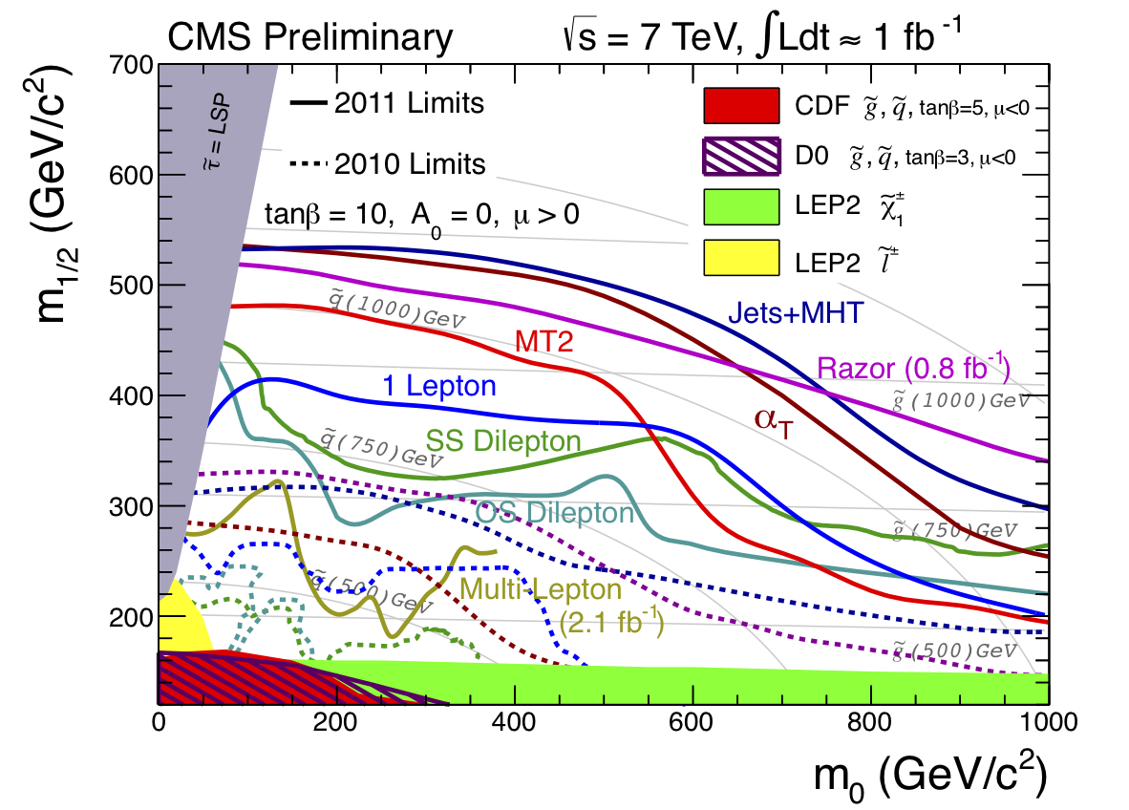
Dark Matter at The LHC
Numerous searches for supersymmetry are being carried out by the ATLAS and CMS collaborations
For typical patterns of superpartner masses, these results constrain squarks and gluinos to be lighter than ~600-800 GeV (for comparison, the Tevatron probed up to ~450 GeV)
Ultimately, the LHC will test models with squarks/gluinos as heavy as several TeV
Broadly speaking, models capable of addressing the electroweak hierarch problem (SUSY or otherwise) are likely to fall within the reach of the LHC
Dan Hooper – Dark Matter in the Discovery Age

Slide 219
Dark Matter at The LHC
Two strategies for dark matter hunting at Hadron Colliders:
Strategy B (Direct Production): Produce the dark matter directly (in association with a jet or photon), leading to more model independent constraints
Test effective operators (integrating out the details of other particles involved)
Mediator mass/coupling
Scalar interactions, coupled to down-quarks
Strength: Constrains the mass/coupling of any WIMP – highly model independent
Weakness: Modest rates, limited reach – LHC (14 TeV) is only sensitive to dark matter lighter than ~200 GeV (based on couplings needed for relic density)
Dan Hooper – Dark Matter in the Discovery Age
Rajaraman, Shephard, Tait, Wijangco, arXiv:1108.1196

Slide 220
The Status:
Dan Hooper – Dark Matter in the Discovery Age

Slide 221
The Status:
Z-mediated scattering (sneutrinos, heavy neutrinos)
1) Direct Detection:
Ruled out Z-mediated interactions more than a decade ago
Are currently at roughly the sensitivity needed to test Higgs-mediated scattering
5-10 years from now, only very fine tuned and/or baroque models will remain beyond the reach of direct detection experiments
Higgs-mediated scattering (A-funnel, focus point neutralinos)
DM
SM
DM
DM
Dan Hooper – Dark Matter in the Discovery Age
DM
SM
SM
SM

Slide 222
The Status:
2) Indirect Detection:
Gamma ray constraints are beginning to test the naïve thermal estimate for low mass WIMPs (up to ~30 GeV)
Several indirect experiments, including Fermi and AMS-02, will ultimately be sensitive to dark matter with masses up to several hundred GeV
Heavier WIMPs, and WIMPs with suppressed annihilation cross sections (at low velocity) will remain beyond reach of current and planned experiments
At Freeze-Out At Low Velocity
DM
SM
DM
SM
Dan Hooper – Dark Matter in the Discovery Age
DM
SM
DM
SM

Slide 223
The Status:
3) The LHC:
The LHC will be sensitive to strongly coupled particles up to several TeV, but to isolated WIMPs only up to hundreds of GeV
Worst case scenario: Isolated WIMPs interacting through light and very weakly coupled particles
The prospects for discovering dark matter at the LHC depend very strongly on the rest of the broader particle physics framework, and less on the properties of the WIMP itself
ATLAS
CMS
DM
SM
SM
DM
Dan Hooper – Dark Matter in the Discovery Age
DM
SM
SM
DM

Slide 224
The Status:
All three of these search strategies are poised to tell us very interesting things about dark matter very soon
For the first time, we should expect positive detections of WIMPs in the near future, and in multiple search techniques
If no WIMPs are observed in the next several years, the entire paradigm of WIMP dark matter will be challenged, lending favor to axions and other classes of non-WIMP dark matter candidates
Dan Hooper – Dark Matter in the Discovery Age

Slide 225
Putting This All Together
Various dark matter search strategies offer different advantages and disadvantages, and are potentially able to measure different quantities
Direct Detection Experiments:
Measure the rate and energy spectrum of recoil events, ideally using multiple targets
➔Mass (modulo uncertainties in velocity distribution)
➔(Spin-independent/dependent scattering cross section with protons/neutrons) x (local density)
Unanswered questions:
Does this particle make up most/all of the dark matter?
What is it?
Dan Hooper – Dark Matter in the Discovery Age

Slide 226
Putting This All Together
Various dark matter search strategies offer different advantages and disadvantages, and are potentially able to measure different quantities
Indirect Detection Experiments:
Measure the flux and spectrum of a variety of types of annihilation products, from a variety of regions ➔Dominant annihilation channels (in low velocity limit)
➔Mass
➔(Low velocity annihilation cross section) x (fraction of dark matter)², modulo uncertainties in the dark matter distribution)
Unanswered questions:
Does this particle make up most/all of the dark matter?
(although σv~3x10⁻²⁶ cm³/s would be suggestive)
What is it?
Dan Hooper – Dark Matter in the Discovery Age

Slide 227
Putting This All Together
Various dark matter search strategies offer different advantages and disadvantages, and are potentially able to measure different quantities
The Large Hadron Collider:
Measure distributions of events with missing energy
➔Mass
★Discover other particles which may inform us as to the interactions and other properties of the WIMP
Unanswered questions:
Does this particle make up most/all/some of the dark matter? (Is it even stable!?)
What is it?
Dan Hooper – Dark Matter in the Discovery Age

Slide 228
Putting This All Together
None of these experiments are going to solve the mystery of dark matter’s identity alone
Only with information from multiple (all three?) search strategies, will it be possible to determine the particle nature of dark matter
Dan Hooper – Dark Matter in the Discovery Age

Slide 229
Summary
Weakly interacting massive particles provide a natural class of candidates for dark matter, with a simple and compelling explanation for the observed dark matter abundance
Searches for dark matter a the LHC, as well as direct and indirect astrophysical searches, are each approaching the sensitivity expected to be required to detect dark matter non-gravitationally
A number of reported signals can be interpreted as possible detections of dark matter (DAMA, CoGeNT, CRESST… Fermi, Haze…)

Slide 230
Experimental Sensitivity
WIMP Models
2000
2012
2020

Slide 231

Supersymmetry at the Tevatron
Most promising channel is through neutralino-chargino production
For example:
Currently sensitive to charginos as heavy as ~140 GeV
Tevatron searches for light squarks and gluinos are also very interesting
For the case of light m_{A} and large tanβ, heavy MSSM higgs bosons (A/H) may be observable

Slide 232


Supersymmetry at the LHC
Squarks and gluinos produced prolifically at the LHC
Subsequent decays result in distinctive combinations of leptons, jets and missing energy
T. Plehn, Prospino 2.0
Squarks and gluinos up to 1 TeV can be discovered with 1% of the first year design luminosity
Ultimately, LHC can probe squarks and gluinos up to ~3 TeV

Slide 233

Supersymmetry at the LHC
What Can We Learn About Supersymmetry At The LHC?
Kinematics of squark/gluino decays can reveal masses of squarks, gluinos, sleptons and neutralinos involved
If many superpartners are light (bulk region), much of the sparticle spectrum could be reconstructed at the LHC
E. Baltz, et al, hep-ph/0602187

Slide 234
Supersymmetry at the LHC
What Can We Learn About Supersymmetry At The LHC?
Kinematics of squark/gluino decays can reveal masses of squarks, gluinos, sleptons and neutralinos involved
If many superpartners are light (bulk region), most/much of the sparticle spectrum could be reconstructed at the LHC
But we might not be so lucky!
E. Baltz, et al, hep-ph/0602187

Slide 235

Supersymmetry at the LHC
What Can We Learn About Supersymmetry At The LHC?
For moderate and heavy SUSY models, the LHC will reveal far fewer superpartners
It is not at all unlikely that the LHC could uncover a spectrum of squarks, gluinos and one neutralino
Other than one mass, this would tell us next to nothing about the neutralino sector
E. Baltz, et al, hep-ph/0602187

Slide 236


Studying Supersymmetry With Neutralino Dark Matter
Unless several of the neutralinos are light enough to be discovered at the LHC, we will learn very little about the composition and couplings of the lightest neutralino
Astrophysical dark matter experiments provide another way to probe these couplings
Potentially enable us to constrain/measure parameters appearing in the neutralino mass matrix: μ, M₁, M₂, tanβ

Slide 237



Putting It All Together
Direct Detection
Neutrino Telescopes
γ-Rays + e⁺

Slide 238

Putting It All Together

Slide 239
Studying SUSY with the LHC and Astrophysics
Benchmark model IM3:
SUSY Inputs: M₂=673 GeV, μ=619 GeV, m_{A}=397 GeV, tanβ=51, 2130 GeV squarks
Measured by the LHC: m_{χ}= 236 ± 10%, m_{squark}=2130 ± 30%, tanβ=51 ± 15%, m_{A}=397 ± 1% (no sleptons, charginos, or heavy neutralinos)
Measured by astrophysical experiments: σ_{χN}=9.6 10⁻⁹ pb x/÷ 2, R_{ν} < 10 yr⁻¹, σ_{γγ+γZ} / σ_{tot} < 10⁻⁵

Slide 240

Studying SUSY with the LHC and Astrophysics
Benchmark model IM3:
Actual Value
LHC+Relic Density
+Astro
Hooper and A. Taylor, hep-ph/0607086

Slide 241
Studying SUSY with the LHC and Astrophysics
Benchmark model IM1:
SUSY Inputs: M₂=551 GeV, μ=1318 GeV, m_{A}=580 GeV, tanβ=6.8, 2240 GeV squarks
Measured by the LHC: m_{χ}= 276 ± 10%, m_{squark}=2240 ± 30%, (no sleptons, charginos, heavy neutralinos, heavy Higgs bosons or tanβ)
Measured by astrophysical experiments: σ_{χN} < 10⁻¹⁰ pb, R_{ν} < 10 yr⁻¹, σ_{γγ+γZ} / σ_{tot} < 10⁻⁴ to 10⁻⁶

Slide 242

Studying SUSY with the LHC and Astrophysics
Benchmark model IM1:
Actual Value
LHC+Relic Density
Hooper and A. Taylor, hep-ph/0607086

Slide 243
Studying SUSY with the LHC and Astrophysics
Benchmark model IM1:
Actual Value
LHC+Relic Density
+Astro
Hooper and A. Taylor, hep-ph/0607086

Slide 244

Studying SUSY with the LHC and Astrophysics
Benchmark model IM1:
Actual Value
LHC+Relic Density
+Astro
Hooper and A. Taylor, hep-ph/0607086

Slide 245
Is It SUSY?
Thus far, we have assumed that the new particles seen at the Tevatron/LHC and in dark matter experiments are superpartners of SM particles
Several alternatives to supersymmetry have been proposed which may effectively mimic the signatures of supersymmetry at the LHC

Slide 246

Is It SUSY?
Universal Extra Dimensions (UED)
All SM particles allowed to travel around extra dimension(s) with size ~TeV⁻¹
Particles moving around extra dimensions appear as heavy versions of SM particles (Kaluza-Klein modes)
The lightest Kaluza-Klein particle can be stable, weakly interacting and a suitable candidate for dark matter
Can we distinguish Kaluza-Klein modes from superpartners?

Slide 247
Is It SUSY?
Discriminating Supersymmetry and UED at the LHC
Squarks and gluinos or KK quarks and KK gluons cascade to combinations of jets, leptons and missing energy; mass measurements possible, but are they sparticles or KK states? ⇒ Spin-determination crucial

Slide 248
Is It SUSY?
Discriminating Supersymmetry and UED at the LHC
Recent literature on SUSY/UED discrimination: (see Cheng, Matchev, Schmaltz; Datta, Kong, Matchev; Datta, Kane, Toharia; Alves, Eboli, Plehn; Athanasiou, Lester, Smilie, Webber)
In the case of somewhat heavy masses or quasi-degenerate spectra, spin determination becomes very challenging/impossible
The observation of 2nd level KK modes would bolster case for UED, but could be confused with a Z prime, for example

Slide 249
Is It SUSY?
Discriminating Supersymmetry and UED with Dark Matter
Kalzua-Klein dark matter (KK ‘photon’, B⁽¹⁾) annihilates primarily to charged leptons pairs (20-25% to each of e⁺e⁻, μ⁺μ⁻ and τ⁺τ⁻)
Neutarlino annihilations to light fermions, in contrast, are chirality suppressed (σv α [m_{f}/m_{χ}]²)
This difference can lead to very distinctive signatures in indirect dark matter experiments

Slide 250

Is It SUSY?
The Gamma-Ray Annihilation Spectrum
Neutralino annihilations to gauge/Higgs bosons and heavy quarks produce rather soft gamma-ray spectrum

Slide 251


Is It SUSY?
The Gamma-Ray Annihilation Spectrum
Kaluza-Klein dark matter particles produce harder spectrum due to 20-25% annihilation to tau pairs, and final state radiation
Total, including τ’s and FSR
Quark fragmentation alone (SUSY-like)
Including τ’s

Slide 252

Is It SUSY?
The Cosmic Positron Spectrum
Annihilations to e⁺e⁻ ( and μ⁺μ⁻, τ⁺τ⁻) generate distinctive hard spectrum with edge
UED Case
Gauge Bosons, Heavy Quarks
background
(m_{DM}=300 GeV, BF=5, moderate propagation)

Slide 253


Is It SUSY?
Pamela
The Cosmic Positron Spectrum
Clearly identifiable by future experiments (Pamela, AMS-02) for light/moderate masses
UED Case
Gauge Bosons, Heavy Quarks
background
(m_{DM}=300 GeV, BF=5, moderate propagation)

Slide 254

Supersymmetry in the ILC Era
Combined with LHC data, likely able to measure much/most/all of the sparticle and Higgs masses
With such knowledge of the particle spectrum, it may become possible to accurately calculate the expected relic abundance of neutralinos, and compare this to the observed dark matter density

Slide 255
Supersymmetry in the ILC Era
Combined with LHC data, likely able to measure much/most/all of the sparticle and Higgs masses
With such knowledge of the particle spectrum, it may become possible to accurately calculate the expected relic abundance of neutralinos, and compare this to the observed dark matter density
⇒ Confirmation that neutralinos make up the dark matter of our universe!
But what if they don’t match?

Slide 256
Supersymmetry in the ILC Era
What if the calculated abundance doesn’t match astrophysical observations?
SuperWIMP Scenario: neutralinos freeze-out, and later decay to gravitinos
Non-WIMP dark matter generated through WIMP-like freeze-out process
No signal for direct or indirect detection
χ
g
~

Slide 257
Supersymmetry in the ILC Era
What if the calculated abundance doesn’t match astrophysical observations?
Relic abundance calculation assumes standard cosmological picture
Non-standard cosmology/expansion history can lead to very different relic abundance (see Lykken and Barenboim, last week)

Slide 258


Slide 259
Current Observations

Slide 260
The ILC Is A Window Into The Early Universe!
Terascale Observations
Current Observations

Slide 261

Summary
If (low-scale) supersymmetry exists in nature, then the LHC is exceedingly likely to discover superpartners
The sparticle spectrum measured by the LHC will be very incomplete unless most of the sparticles are very light
To learn more about the SUSY spectrum with colliders, we may have to wait for the ILC

Slide 262
Summary
If (low-scale) supersymmetry exists in nature, then the LHC is exceedingly likely to discover superpartners
The sparticle spectrum measured by the LHC will be very incomplete unless most of the sparticles are very light
To learn more about the SUSY spectrum with colliders, we may have to wait for the ILC
(but I’m not that patient!)

Slide 263

Summary
Direct and indirect detection of dark matter can provide additional information on the couplings/composition of the lightest neutralino and masses of exchanged particles
In many cases, dark matter measurements can break degeneracies between bulk/funnel/coannihilation regions of parameter space
For models in the A-funnel region of parameter space, m_{A} can often be determined by astrophysical measurements
Astrophysical probes of neutralino dark matter can fill in some of the gaps in our post-LHC/pre-ILC understanding of supersymmetry

Slide 264

ANTA
CMS
DZERO
ZEPLIN
A T L S
RES
H E S
I C E C U B E
D M S
CDF
VERITAS
M A G I C
GLAST
A
I C E
P
M E L A
M S
Let’s use all of the tools we have to solve the puzzles of the terascale!

Slide 265
Weakly Interacting Massive Particles (WIMPs)
As a result of the thermal freeze-out process, a relic density of WIMPs is left behind:
Ω h² ~ x_{F} / <σv>
For a particle with a GeV-TeV mass, to obtain a thermal abundance equal to the observed dark matter density, we need an annihilation cross section of <σv> ~ pb
Generic weak interaction yields:
<σv> ~ α² (100 GeV)⁻² ~ pb

Slide 266
Weakly Interacting Massive Particles (WIMPs)
As a result of the thermal freeze-out process, a relic density of WIMPs is left behind:
Ω h² ~ x_{F} / <σv>
For a particle with a GeV-TeV mass, to obtain a thermal abundance equal to the observed dark matter density, we need an annihilation cross section of <σv> ~ pb
Generic weak interaction yields:
<σv> ~ α² (100 GeV)⁻² ~ pb
Numerical coincidence? Or an indication that dark matter originates from EW physics?

Slide 267
Supersymmetry
Perhaps the most theoretically appealing (certainly the most well studied) extension of the Standard Model
Natural solution to hierarchy problem (stabilizes quadradic divergences to Higgs mass)
Restores unification of couplings
Vital ingredient of string theory
Naturally provides a compelling candidate for dark matter

Slide 268
Supersymmetric Dark Matter
R-parity must be introduced in supersymmetry to prevent rapid proton decay
Another consequence of R-parity is that superpartners can only be created and destroyed in pairs, making the lightest supersymmetric particle (LSP) stable
Possible WIMP candidates from supersymmetry include:
~
~ ~ ~
γ
, Z, h, H
4 Neutralinos
~
3 Sneutrinos
ν

Slide 269
Supersymmetric Dark Matter
R-parity must be introduced in supersymmetry to prevent rapid proton decay
Another consequence of R-parity is that superpartners can only be created and destroyed in pairs, making the lightest supersymmetric particle (LSP) stable
Possible WIMP candidates from supersymmetry include:
~
~ ~ ~
γ
, Z, h, H
4 Neutralinos
~
3 Sneutrinos
ν
Excluded by direct detection

Slide 270
Supersymmetry at the Tevatron
Most promising channel is through neutralino-chargino production
For example:
Currently sensitive to charginos as heavy as ~140 GeV
Tevatron searches for light squarks and gluinos are also very interesting
For the case of light m_{A} and large tanβ, heavy MSSM higgs bosons (A/H) may be observable

Slide 271
Supersymmetry at the LHC
Squarks and gluinos produced prolifically at the LHC
Subsequent decays result in distinctive combinations of leptons, jets and missing energy
T. Plehn, Prospino 2.0
Squarks and gluinos up to 1 TeV can be discovered with 1% of the first year design luminosity
Ultimately, LHC can probe squarks and gluinos up to ~3 TeV

Slide 272
Indirect Detection With Neutrinos
Neutralinos elastically scatter with nuclei in the Sun, becoming gravitationally bound
As neutralinos accumulate in the Sun’s core, they annihilate at an increasing rate
After ~Gyr, annihilation rate typically reaches equilibrium with capture rate, generating a potentially observable flux of high-energy neutrinos

Slide 273
Indirect Detection With Neutrinos
Muon neutrinos from the Sun interacting via charged current produce energetic muons
Kilometer-scale neutrino telescope IceCube currently under construction at South Pole

Slide 274
Indirect Detection With Neutrinos
Rate observed at IceCube depends primarily on the neutralino capture rate in the Sun (the elastic scattering cross section)
The reach of neutrino telescopes is, therefore, expected to be tied to that of direct detection experiments

Slide 275


Indirect Detection With Neutrinos
Important Caveat: WIMPs scatter with nuclei in the Sun through both spin-independent and spin-dependent scattering
Sensitivity of direct detection to spin-dependent scattering is currently very weak
Spin-Independent
Spin-Dependent
F. Halzen and Hooper, PRD, hep-ph/0510048

Slide 276

Indirect Detection With Neutrinos
What kind of neutralino has large spin-dependent couplings?
χ
Z
q
q
q
q
α [ |f_{H1}|² - |f_{H2}|² ]²
Always Small
Substantial Higgsino Component Needed

Slide 277
Is It SUSY?
Thus far, we have assumed that the new particles seen at the Tevatron/LHC and in dark matter experiments are superpartners of SM particles
Several alternatives to supersymmetry have been proposed which may effectively mimic the signatures of supersymmetry at the LHC

Slide 278
Is It SUSY?
Universal Extra Dimensions (UED)
All SM particles allowed to travel around extra dimension(s) with size ~TeV⁻¹
Particles moving around extra dimensions appear as heavy versions of SM particles (Kaluza-Klein modes)
The lightest Kaluza-Klein particle can be stable, weakly interacting and a suitable candidate for dark matter
Can we distinguish Kaluza-Klein modes from superpartners?
(See, Tait and Servant, NJP, hep-ph/0206071)

Slide 279
Is It SUSY?
Discriminating Supersymmetry and UED at the LHC
Squarks and gluinos or KK quarks and KK gluons cascade to combinations of jets, leptons and missing energy; mass measurements possible, but are they sparticles or KK states? ⇒ Spin-determination crucial

Slide 280
Is It SUSY?
Discriminating Supersymmetry and UED at the LHC
Recent literature on SUSY/UED discrimination: (see Cheng, Matchev, Schmaltz; Datta, Kong, Matchev; Datta, Kane, Toharia; Alves, Eboli, Plehn; Athanasiou, Lester, Smilie, Webber)
In the case of somewhat heavy masses or quasi-degenerate spectra, spin determination becomes very challenging/impossible
The observation of 2nd level KK modes would bolster case for UED, but could be confused with a Z prime, for example

Slide 281
Is It SUSY?
Discriminating Supersymmetry and UED with Dark Matter
Kalzua-Klein dark matter (KK ‘photon’, B⁽¹⁾) annihilates primarily to charged leptons pairs (20-25% to each of e⁺e⁻, μ⁺μ⁻ and τ⁺τ⁻)
Neutralino annihilations to light fermions, in contrast, are chirality suppressed (σv α [m_{f}/m_{χ}]²)
This difference can lead to very distinctive signatures in indirect dark matter experiments

Slide 282
Is It SUSY?
The Gamma-Ray Annihilation Spectrum
Neutralino annihilations to gauge/Higgs bosons and heavy quarks produce rather soft gamma-ray spectrum

Slide 283
Is It SUSY?
The Gamma-Ray Annihilation Spectrum
Kaluza-Klein dark matter particles produce harder spectrum due to 20-25% annihilation to tau pairs, and final state radiation
Total, including τ’s and FSR
Quark fragmentation alone (SUSY-like)
Including τ’s
Bergstrom et al, PRL, hep-ph/0410359

Slide 284
Is It SUSY?
The Cosmic Positron Spectrum
Annihilations to e⁺e⁻ ( and μ⁺μ⁻, τ⁺τ⁻) generate distinctive hard spectrum with edge
UED Case
Gauge Bosons, Heavy Quarks
background
(m_{DM}=300 GeV, BF=5, moderate propagation)
Hooper and G. Zaharijas, hep-ph/0612137

Slide 285
Is It SUSY?
Pamela
The Cosmic Positron Spectrum
Clearly identifiable by future experiments (Pamela, AMS-02) for light/moderate masses
UED Case
Gauge Bosons, Heavy Quarks
background
(m_{DM}=300 GeV, BF=5, moderate propagation)
Hooper and G. Zaharijas, hep-ph/0612137

Slide 286
Supersymmetry in the ILC Era
Combined with LHC data, likely able to measure much/most/all of the sparticle and Higgs masses
With such knowledge of the particle spectrum, it may become possible to accurately calculate the expected relic abundance of neutralinos, and compare this to the observed dark matter density

Slide 287
Supersymmetry in the ILC Era
Combined with LHC data, likely able to measure much/most/all of the sparticle and Higgs masses
With such knowledge of the particle spectrum, it may become possible to accurately calculate the expected relic abundance of neutralinos, and compare this to the observed dark matter density
⇒ Confirmation that neutralinos make up the dark matter of our universe!

Slide 288
Supersymmetry in the ILC Era
Combined with LHC data, likely able to measure much/most/all of the sparticle and Higgs masses
With such knowledge of the particle spectrum, it may become possible to accurately calculate the expected relic abundance of neutralinos, and compare this to the observed dark matter density
⇒ Confirmation that neutralinos make up the dark matter of our universe!
But what if they don’t match?

Slide 289
Supersymmetry in the ILC Era
What if the calculated abundance doesn’t match astrophysical observations?
SuperWIMP Scenario: neutralinos freeze-out, and later decay to gravitinos
Non-WIMP dark matter generated through WIMP-like freeze-out process
No signal for direct or indirect detection
χ
g
~

Slide 290
Supersymmetry in the ILC Era
What if the calculated abundance doesn’t match astrophysical observations?
Relic abundance calculation assumes standard cosmological picture
Non-standard cosmology/expansion history can lead to very different relic abundance

Slide 292
Current Observations

Slide 293
The ILC Is A Window Into The Early Universe!
Terascale Observations
Current Observations

Slide 294
Summary
Searches for supersymmetry at colliders, direct and indirect dark matter experiments are each very exciting
(but I’m not that patient!)

Slide 295
Summary
CDMS and other direct detection experiments have already ruled out many SUSY models, and continue to push farther, testing more of the parameter space
(but I’m not that patient!)

Slide 296
Summary
SUSY searches at the Tevatron are testing models with light charginos, neutralinos and other sparticles
(but I’m not that patient!)

Slide 297
Summary
IceCube continues to grow, soon able to test mixed higgsino-gaugino neutralinos
(but I’m not that patient!)

Slide 298
Summary
HEAT may have already seen hints of dark matter in the positron spectrum. PAMELA and AMS-02 will increase the sensitivity considerably
(but I’m not that patient!)

Slide 299
Summary
If low energy supersymmetry exists in nature, the LHC is almost certain to discover it!
(but I’m not that patient!)

Slide 300
Summary
Searches for supersymmetry at colliders, direct and indirect dark matter experiments are each very exciting
A few years from now, our understanding of dark matter will almost certainly be very different – either a discovery is on the way, or very new ideas will be needed
(but I’m not that patient!)

Slide 301
ANTA
CMS
DZERO
ZEPLIN
A T L S
RES
H E S
I C E C U B E
D M S
CDF
VERITAS
M A G I C
GLAST
P
M E L A
M S
Let’s use all of the tools we have to solve the puzzles of the terascale!

Slide 302
Dark Matter At Particle Colliders
ATLAS
Machines such as the Large Hadron Collider (LHC) and the Tevatron may be able to produce and observe dark matter particles
The LHC is currently collecting data at a rapidly accelerating rate - progress over the past year has been staggering
Within the next year or so, a substantial fraction of weak-scale extensions of the Standard Model will become within the reach of the LHC - Expect new discoveries in 2012 conferences
CMS

Slide 303
Dark Matter At Particle Colliders
Two strategies for dark matter hunting at colliders:
Produce strongly interacting particles which although not dark matter themselves, produce dark matter particles in their decays (study distributions of events with various combinations of jets, leptons and missing energy)
Produce the dark matter directly (in association with a jet or photon),
leading to more model independent constraints
Dan Hooper - Closing In On Dark Matter

Slide 304


Summary
Big Bang cosmology has been incredibly successful in explaining a wide range of observed phenomena
Yet some aspects of our universe’s history and composition remain poorly understood - dark matter, dark energy, inflation
Weakly interacting massive particles provide a natural candidate for the dark matter, with a simple and compelling explanation for the observed dark matter abundance
In addition to searches for dark matter at the LHC, both direct and indirect astrophysical searches are approaching the sensitivities thought to be required to observe dark matter non-gravitationally

Slide 305
How to search for WIMPs?
1) Go deep underground and wait for WIMPs to hit your detector
The Soudan Mine

Slide 306

How to search for WIMPs?
2) Use “telescopes” to look for energetic particles that are produced when dark matter particles annihilate

Slide 307
How to search for WIMPs?
3) Create it using a particle accelerator
The Large Hadron Collider (LHC)
The Fermilab Tevatron

Slide 308
Direct Detection
But what does direct detection tell us?
Neutralino is dark matter (μsec vs. cosmological time scales)
Models with large cross sections are dominated by Higgs exchange, couplings to b, s quarks
Squark exchange contribution substantial only below ~10⁻⁸ pb
Leads to correlation between neutralino composition, tanβ, m_{A} and the elastic scattering rate
Hooper and A. Taylor, hep-ph/0607086

Slide 309

Possible Signals from Direct Detection Experiments
1) The DAMA/LIBRA collaboration reports a modulation with a phase consistent with dark matter scattering, and at high significance (8.9σ)
2) The CoGeNT collaboration reports an overall excess of low-energy events, and a DAMA-like modulation – albeit with only ~2σ significance
3) CRESST-II reports a 4.2σ excess of low-energy events
Evidence of light WIMPs?
Or evidence that low energy backgrounds are more complicated than anticipated?
Dan Hooper – Dark Matter in the Discovery Age

Slide 310
Possible Signals from Direct Detection Experiments
DAMA/LIBRA
Over the course of a year, the motion of the Earth around the Solar System is predicted to induce a modulation in the dark matter scattering rate
The DAMA collaboration reports a modulation with a phase consistent with dark matter scattering, and with high significance (8.9σ)
Dan Hooper – Dark Matter in the Discovery Age

Slide 311
CoGeNT, CDMS, and CRESST…
Several other experiments report possible signals of dark matter scattering at low energies (light WIMP masses)
While none of these signals are conclusive, taken together, they are fairly suggestive
If these signals are really from dark matter, near future experiments should see very many events and be able to settle this once and for all!
WIMP Candidate Region
(1 of 8 detectors)
See also: Fox, Kopp, Lisanti, Weiner, PRD, arXiv:1107.0717; Kelso, Hooper, PRD, arXiv:1106.1066

Slide 312
And CoGeNT and CRESST…
CoGeNT
CoGeNT reports an excess very low energy events, inconsistent with known backgrounds
Also, a DAMA-like modulation, although with a very modest statistical significance (~2σ) – and preliminary reports suggest less modulation in more recent data
CRESST-II
More recently, the CRESST-II collaboration reported the results of an analysis which identified 67 WIMP candidate events
Likelihood analysis prefers dark matter interpretation over known backgrounds (neutrons, gammas, alphas, Pb) at 4.7σ
WIMP Candidate Region
(1 of 8 detectors)
See also: Fox, Kopp, Lisanti, Weiner, PRD, arXiv:1107.0717; Kelso, Hooper, PRD, arXiv:1106.1066

Slide 313
A Consistent Picture?
DAMA, CoGeNT and CRESST-II
The spectrum of events reported by CoGeNT and CRESST are mutually compatible – favor a ~10-15 GeV mass and a ~10⁻⁴¹ cm² cross section
Kelso, Hooper, Buckley,
PRD, arXiv:1110.5338

Slide 314
A Consistent Picture?
DAMA, CoGeNT and CRESST-II
The spectrum of events reported by CoGeNT and CRESST are mutually compatible – favor a ~10-15 GeV mass and a ~10⁻⁴¹ cm² cross section
The modulation amplitudes reported by CoGeNT and DAMA also appear to be compatible with one another (if interpreted as dark matter with m~10 GeV and elastic scattering with σ~A²)
Kelso, Hooper, Buckley, arXiv:1110.5338; Fox, Liu, Weiner, PRD, arXiv:1107.0717

Slide 315
A Consistent Picture?
DAMA, CoGeNT and CRESST-II
The spectrum of events reported by CoGeNT and CRESST are mutually compatible – favor a ~10-15 GeV mass and a ~10⁻⁴¹ cm² cross section
The modulation amplitudes reported by CoGeNT and DAMA also appear to be compatible with one another (if interpreted as dark matter with m~10 GeV and elastic scattering with σ~A²)
Some tension with XENON – solved if significant fractions of low energy recoil energy goes to photons/heat
Kelso, Hooper, Buckley, arXiv:1110.5338; Fox, Liu, Weiner, PRD, arXiv:1107.0717

Slide 316
No Tension (and maybe a signal) from CDMS
CDMS separates events into nuclear recoils, electron recoils, surface events, and zero-charge events by using a combination of ionization and photon energies, but have not (publicly) applied this technique to their low energy events
CDMS has only placed conservative upper limits, assuming that all low energy events could be WIMPs
Recently, Collar and Fields digitized the CDMS data and performed their own likelihood analysis – are the low energy/low ionization events zero-charge events (as suggested by CDMS) or WIMP recoils?
Collar and Fields, arXiv:1204:3559

Slide 317

No Tension (and maybe a signal) from CDMS
At 5.7σ significance, Collar and Fields found a preference for a population of nuclear recoil events (blue spectrum)
If interpreted as WIMP scattering, this implies a mass and cross section that is compatible with CoGeNT, and consistent with CDMS’s published limits
CDMS’s modulation constraint would not be sensitive to this scenario
Collar and Fields, arXiv:1204:3559

Slide 318

A Consistent Picture?
DAMA, CoGeNT and CRESST-II
The modulation amplitude reported by DAMA is larger than expected based on the spectrum observed by CoGeNT, CRESST, (and CDMS?), assuming a simple velocity-independent scattering cross section and an isotropic, Maxwellian velocity distribution
Solutions?
-Sagittarius stream or other highly non-isotropic velocity structures?
-Inelastic or other velocity-dependent dark matter scattering?
-Ratio of proton-to-neutron couplings enhance scattering with sodium?

