Slide 1
Lecture 1: the Evidence For dark matter
Dan Hooper - Fermilab/University of Chicago
Supersymmetry or Not, What is the Evidence?Copenhagen
October, 2013

Slide 2
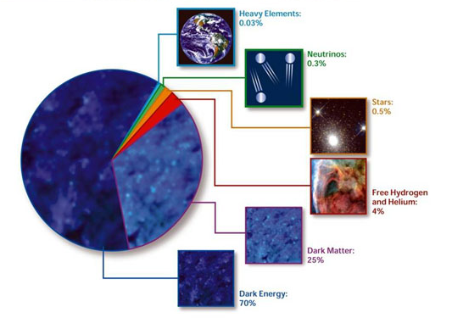

Slide 3
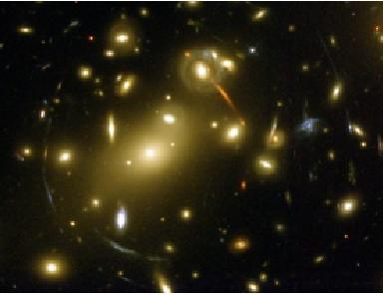
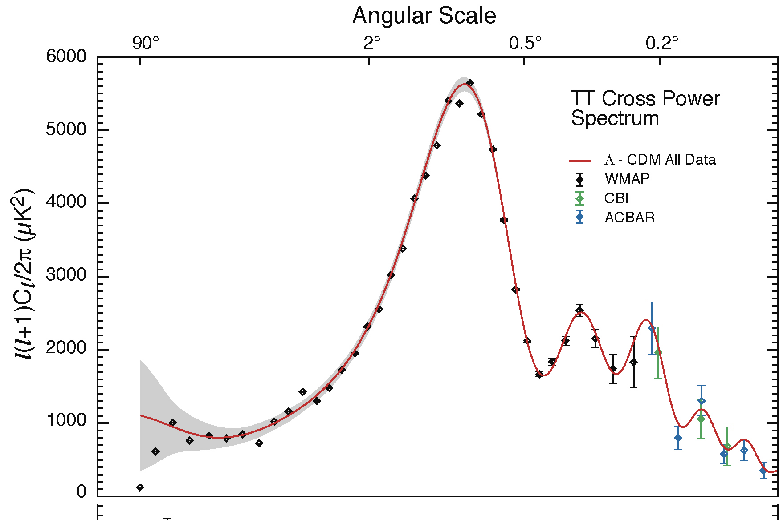
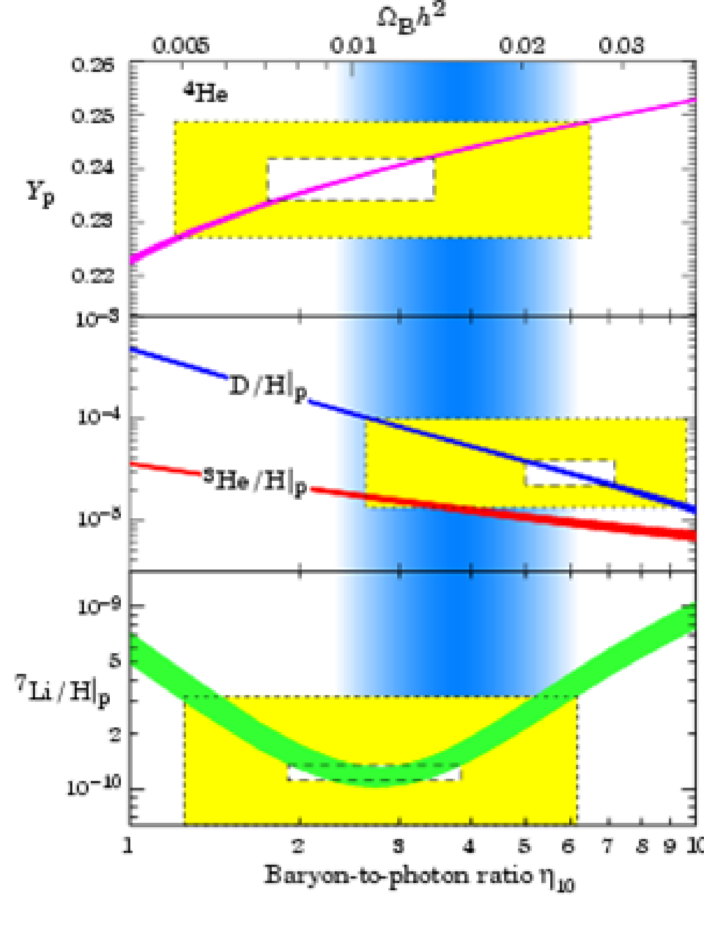
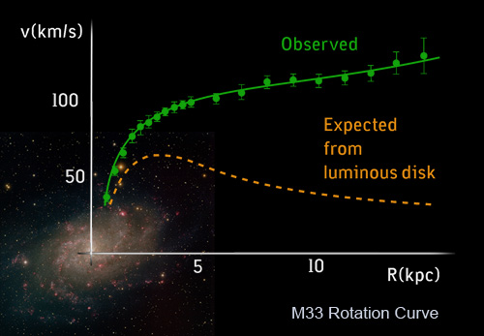
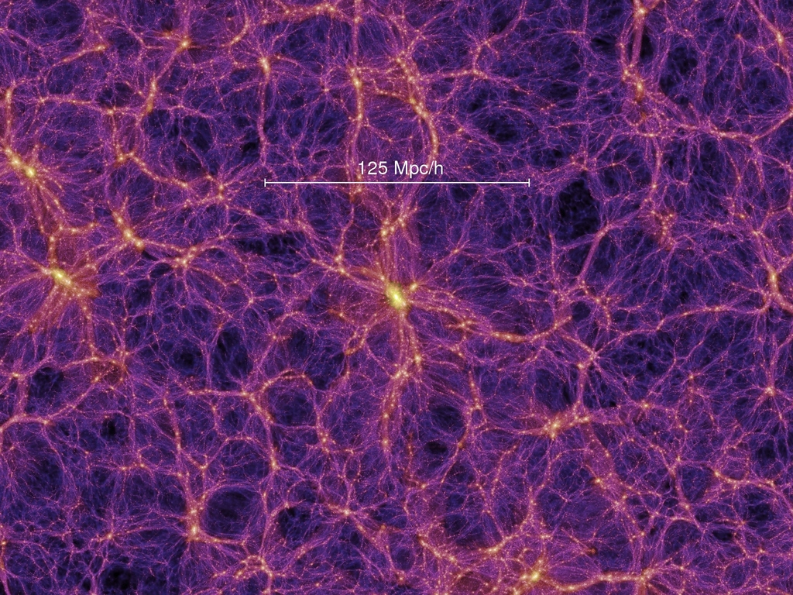
Evidence for Dark Matter
Galactic rotation curves
Gravitational lensing
Light element abundances
Cosmic microwave
background anisotropies
Large scale structure

Slide 4
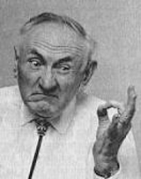
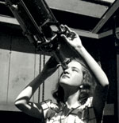
Fritz Zwicky
Vera Rubin

Slide 5
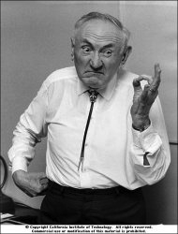
Fritz Zwicky
Swiss astronomer (emigrated to the US in 1925)
Major accomplishments include:
-First to realize that supernovae were the result of a star transitioning into a neutron star (coined the term supernova in 1934)
-Proposed using supernovae as standard candles to measure cosmological distances
-Proposed the use of galaxy clusters as gravitational lenses
-Identified the presence of missing matter (dark matter) in the Coma cluster

Slide 6
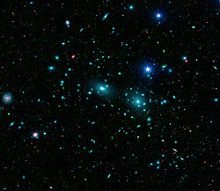
The Coma Cluster
Cluster of at least ~1000 galaxies
About 100 Mpc (325,000,000 light years) distant
In 1933, Zwicky studied the motions of these galaxies (using the virial theorem) to determine the average mass of the galaxies within the cluster

Slide 7

The Coma Cluster
Cluster of at least ~1000 galaxies
About 100 Mpc (325,000,000 light years) distant
In 1933, Zwicky studied the motions of these galaxies (using the virial theorem) to determine the average mass of the galaxies within the cluster:
which, he pointed out, was…
⇒ Mass-to-light ratio of ~500
(per mass, 1/500th as luminous as the sun)

Slide 8
The Coma Cluster
How might this be explained?
1) Stars are different (less luminous) in the Coma cluster than in our galaxy
2) Coma cluster is not in equilibrium (galaxies are in the process of flying apart)
3) The laws of physics are different in the Coma cluster than in our galaxy
4) The vast majority of the Coma cluster’s mass is in non-luminous material (dark matter)
To discriminate between these various possibilities, it would be necessary to study other clusters and see if they too had large mass-to-light ratios (Sinclair Smith, in 1936, found similar results for the Virgo cluster)
Over time, options 1, 2 and 3 would become increasingly untenable

Slide 9
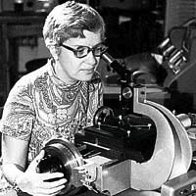
Vera Rubin
American astronomer
Between roughly 1950 and 1980, carried out many of the most detailed and influential studies of the dynamics of stars in galaxies
In particular, she published a key paper in 1970 (with W.K. Ford) on the motions of stars in the Andromeda galaxy, revealing a large mass-to-light ratio
By 1980 or so, the conclusion that galaxies and clusters of galaxies were much more massive than their luminosities would suggest had become broadly accepted among astronomers

Slide 10
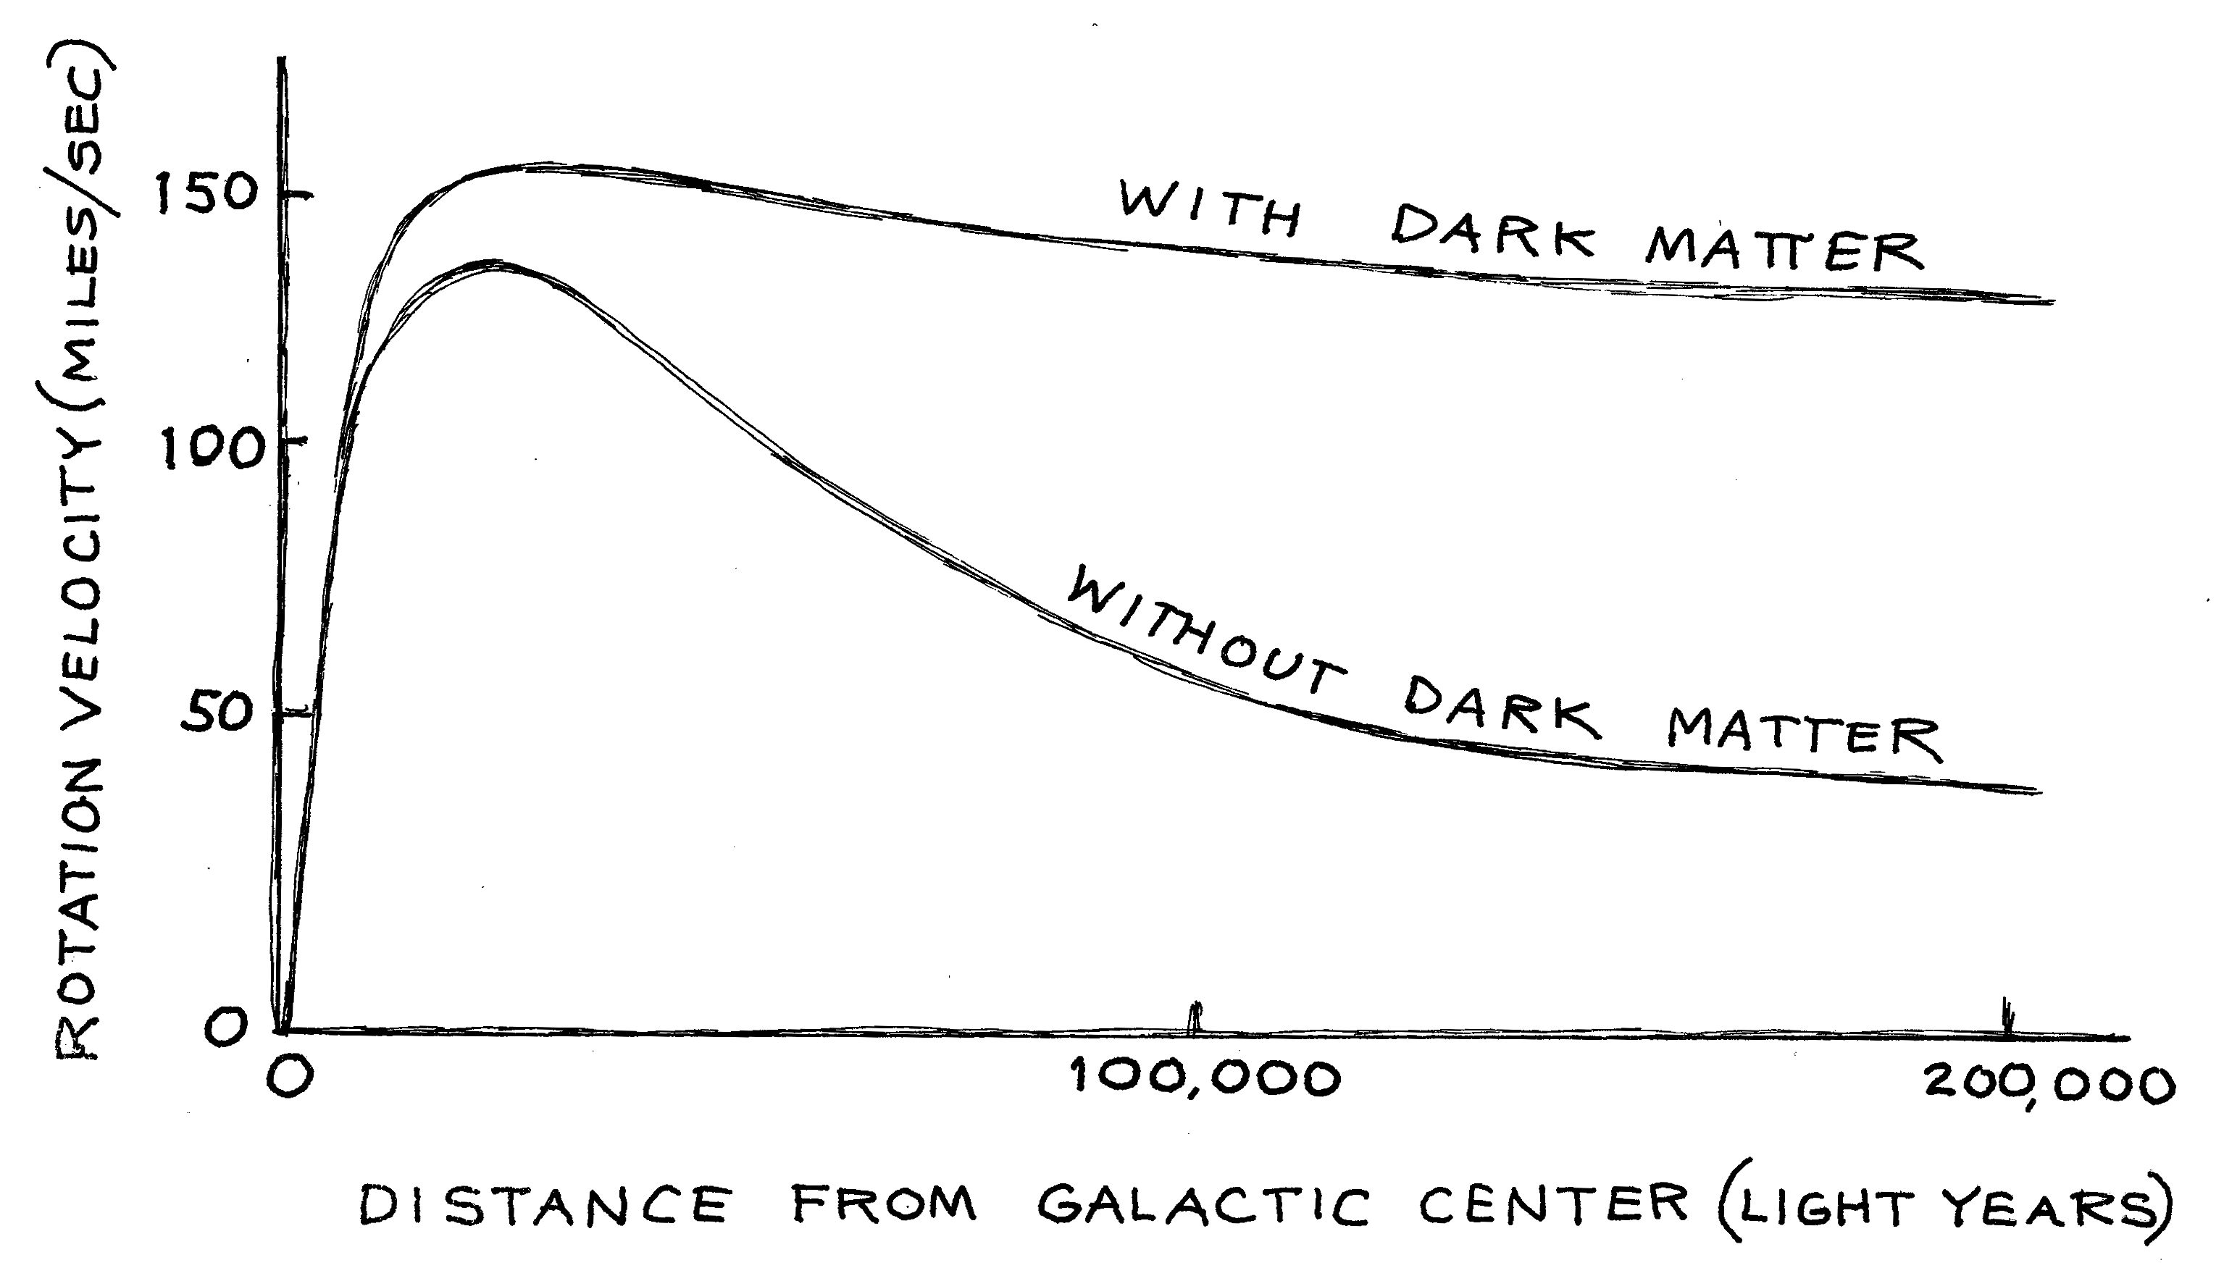

Slide 12
Most of the mass is invisible

Slide 13
v² G M_{Sun}
R R²
m_{pl}
m_{pl}
=
R
v
Centrifugal Force
Gravitational Force
Measure the speed at which planets orbit around the Sun
The Sun’s Mass

Slide 14
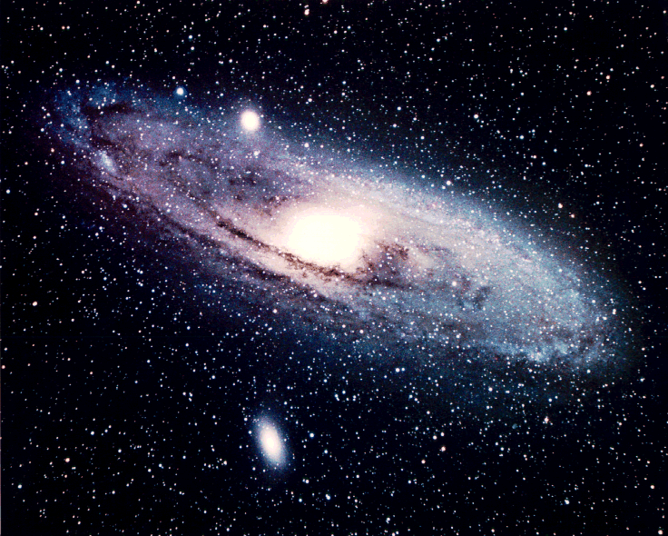
ANDROMEDA
GALAXY

Slide 15
v² G M_{Sun}
R R²
=
R
v
v² G M_{GALAXY} (<R)
R R²
=
Measure the speeds ⇒ Determine the mass of stars of their galaxy

Slide 16
Three Possibilities
1) Galaxies are mostly made up of very non-luminous objects (black holes, neutron stars, white dwarf stars, large planets, etc.)

Slide 17
Three Possibilities
1) Galaxies are mostly made up of very non-luminous objects (black holes, neutron stars, white dwarf stars, large planets, etc.)
2) Gravity does not work in galaxies and clusters the way it does on Earth or in our Solar System

Slide 18
Three Possibilities
1) Galaxies are mostly made up of very non-luminous objects (black holes, neutron stars, white dwarf stars, large planets, etc.)
2) Gravity does not work in galaxies and clusters the way it does on Earth or in our Solar System
3) The missing mass consists of some other form of matter

Slide 19
What Is Dark Matter?
MACHOs
Massive Compact Halo Objects
Faint stars or planets (or rocks, baseballs, automobiles…)
As most of the visible matter in our universe is made up of baryons (protons and neutrons), a first good guess is non-luminous or faint baryonic objects
WIMPs
Weakly Interacting Massive Particles
A gas of subatomic particles, interacting only through the weak force and gravity

Slide 20
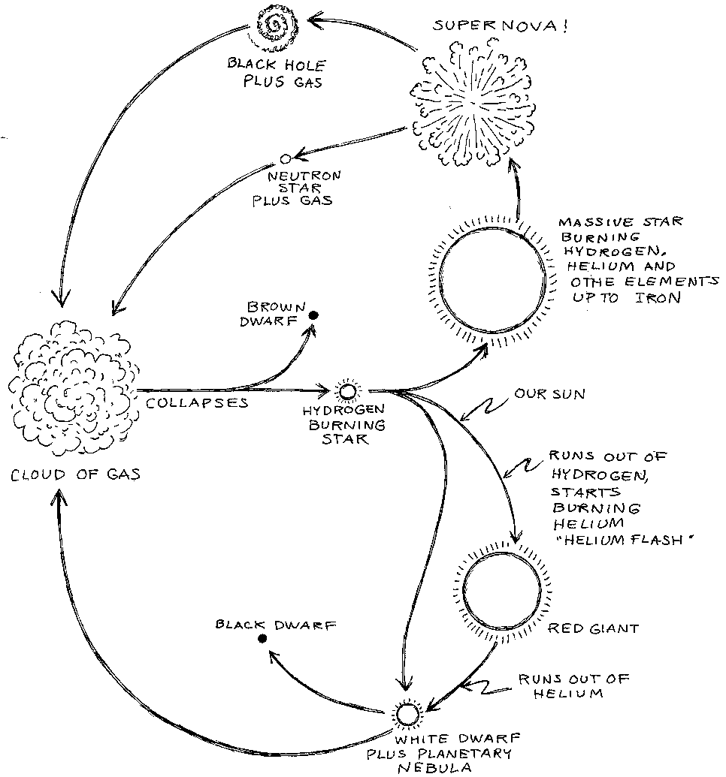

Slide 22
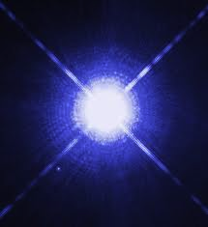
Faint Stars
When most (~97%, including the Sun) stars run out of nuclear fuel, they compress into objects about the size of the Earth - white dwarfs
White dwarfs become fainter as they age; most are 20% to 0.03% as luminous as the Sun
When massive stars (~3%) run out of fuel, they explode as supernovae, leaving behind either a neutron star or a black hole
Neutron stars are objects made up almost entirely of neutrons (few protons, electrons); they consist of a solar mass worth of material within a radius of ~10 kilometers
Black holes are remnants of stars so massive that they collapse to a single point of space, with infinite density; nothing (including light) can escape their gravitational pull

Slide 23
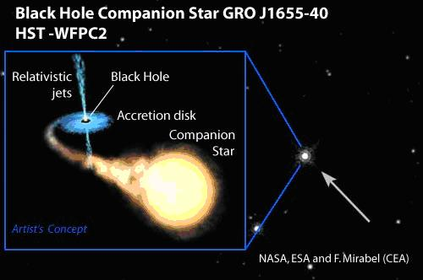
“Seeing” Black Holes

Slide 24
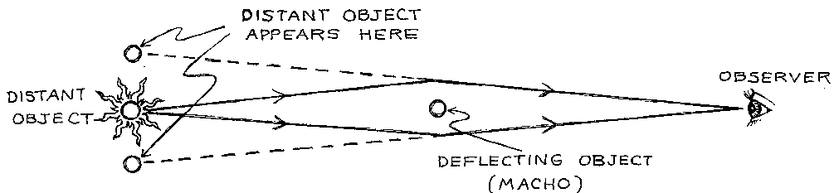
“Seeing” Black Holes
Massive objects can be detected as gravitational lenses, even if they are themselves non-luminous

Slide 25
Caused by a black hole six times more massive than the Sun

Slide 26
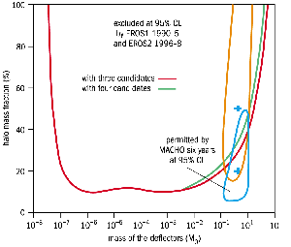
Searches For Dark Matter With Gravitational Microlensing
Although microlensing searches have found some faint and compact objects, they seem to be far too rare to make up much of the missing matter
Whatever the dark matter is, it does not consist of objects with masses between about 10⁻⁸ and 100 solar masses
Maximum Fraction of Halo Mass (%)
Mass of Deflectors (Solar Masses)

Slide 27
Evidence for Dark Matter
Galactic rotation curves
Gravitational lensing
Light element abundances
Cosmic microwave
background anisotropies
Large scale structure
-Dynamical evidence (galaxies, clusters) is only a small fraction of the case for dark matter
-To understand the rest of the evidence, we need to understand cosmology

Slide 28
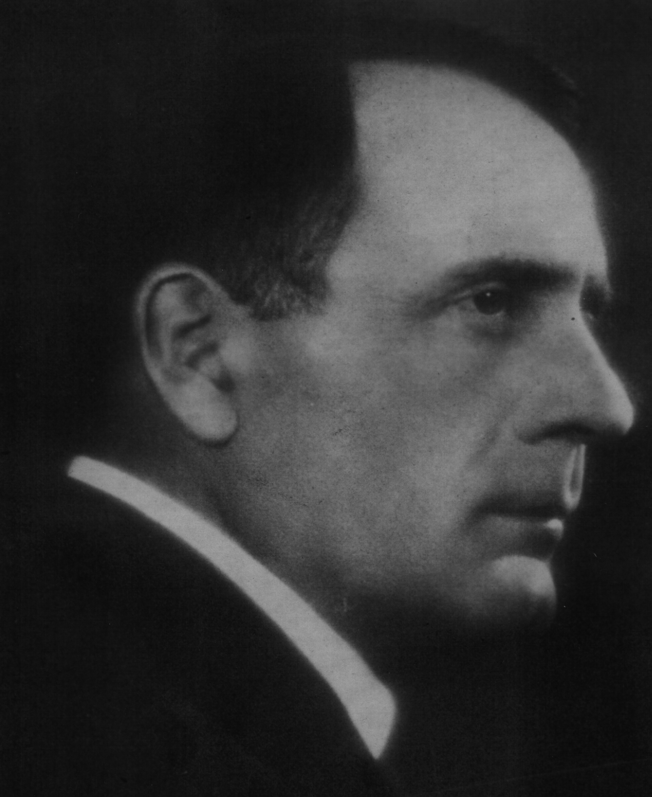
The Pillars Of Physical Cosmology
Hubble Expansion

Slide 29
The Pillars Of Physical Cosmology
Hubble Expansion
Depending on the amount of energy and mass present, Space itself is predicted to expand or contract!
Curvature of space Density of mass and energy

Slide 30
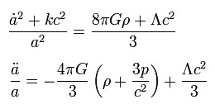
The Pillars Of Physical Cosmology
Hubble Expansion
assuming a homogeneous and isotropic universe, we can derive the friedmann equations, which describe the expansion history

Slide 31
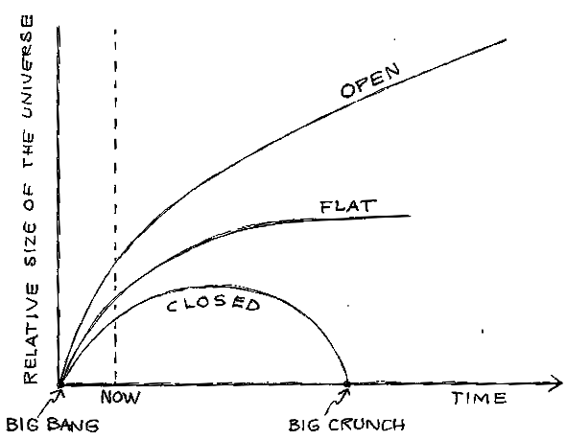
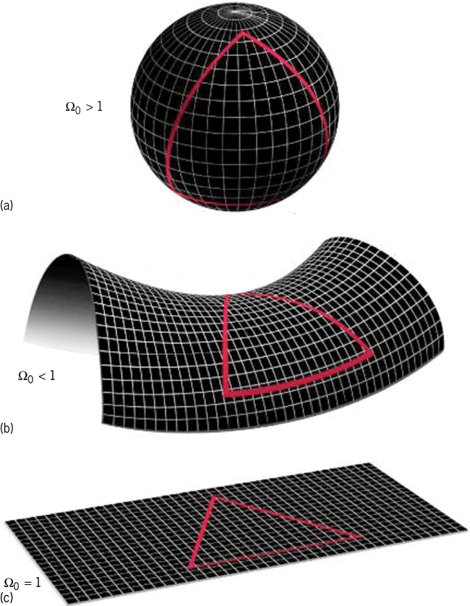
Expanding, Λ=0 Solution

Slide 32
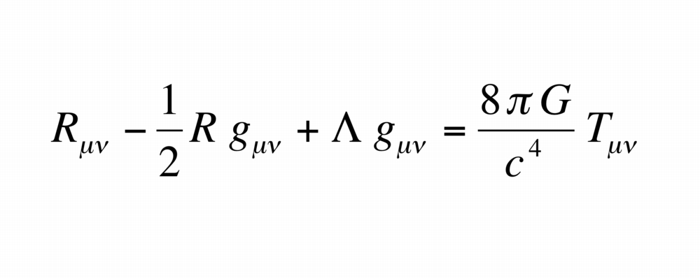

Slide 33
Solution with a “Cosmological Constant”
Einstein found that for the choice of Λ=4πGρ/c², a static solution (with positive curvature, k=1) resulted
But this solution was unstable

Slide 34
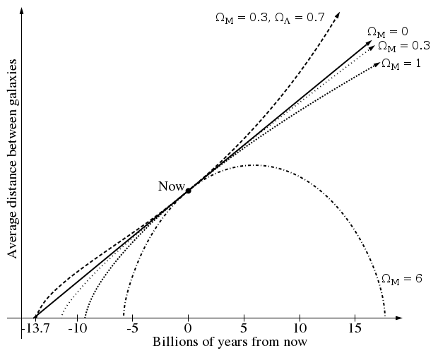
The Pillars Of Physical Cosmology
Hubble Expansion

Slide 35
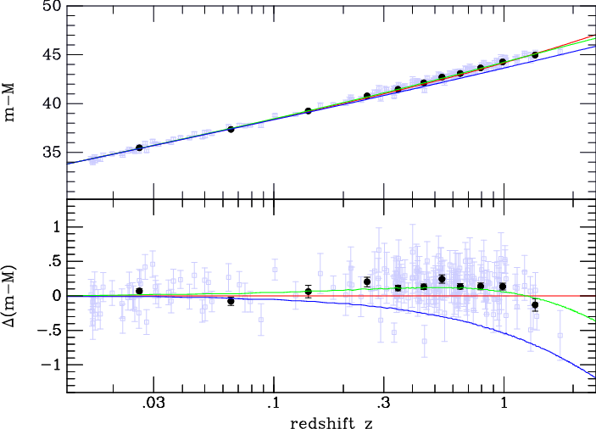
The Pillars Of Physical Cosmology
Hubble Expansion
Red= empty universe (Milne)
Blue=Einstein-de Sitter (matter dom, flat)
Green=70% cosmological constant

Slide 36
Accelerating Expansion Rate

Slide 37
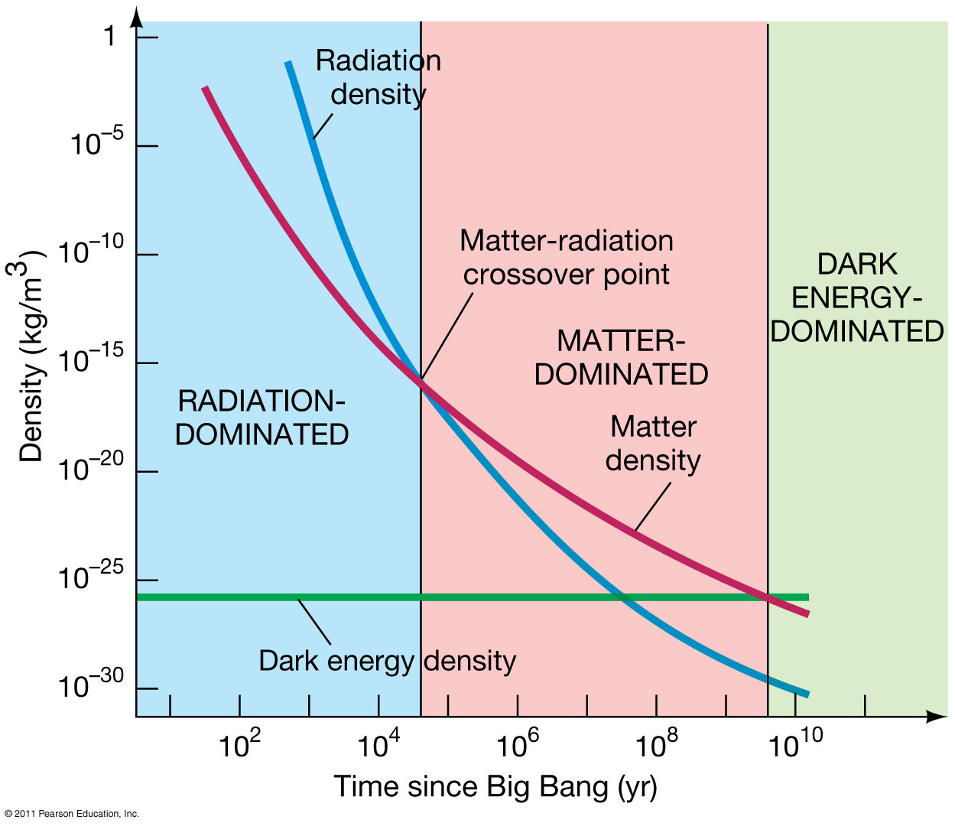

Slide 39
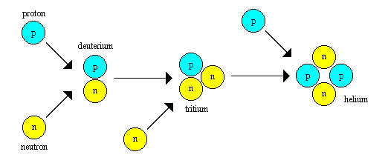
The Pillars Of Physical Cosmology
Hubble Expansion
The Light Element Abundances

Slide 40
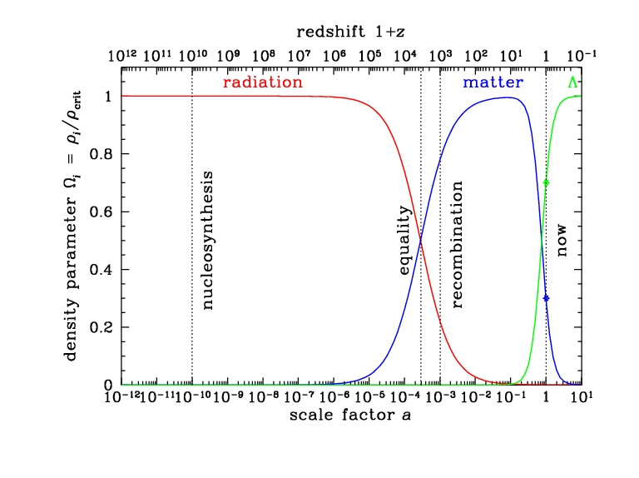

Slide 41
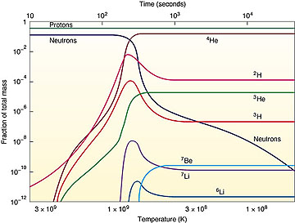

Slide 43
The Pillars Of Physical Cosmology
Hubble Expansion
The Light Element Abundances
The Cosmic Microwave Background

Slide 44
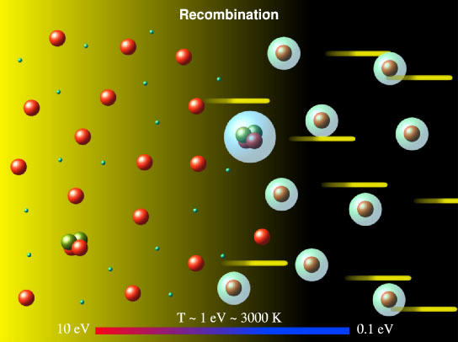

Slide 45
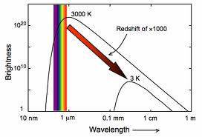

Slide 46
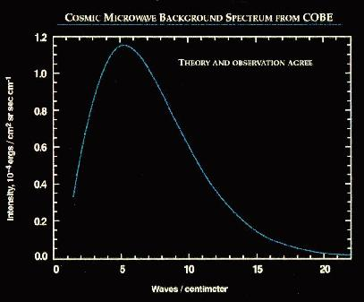
Notes:
WITH ERROR BARS!, 2.726 K

Slide 47


Slide 48
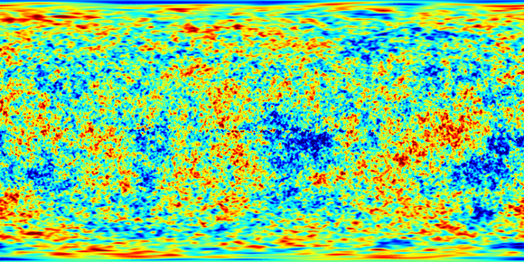

Slide 49
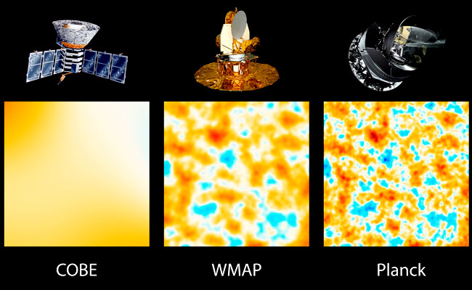

Slide 50
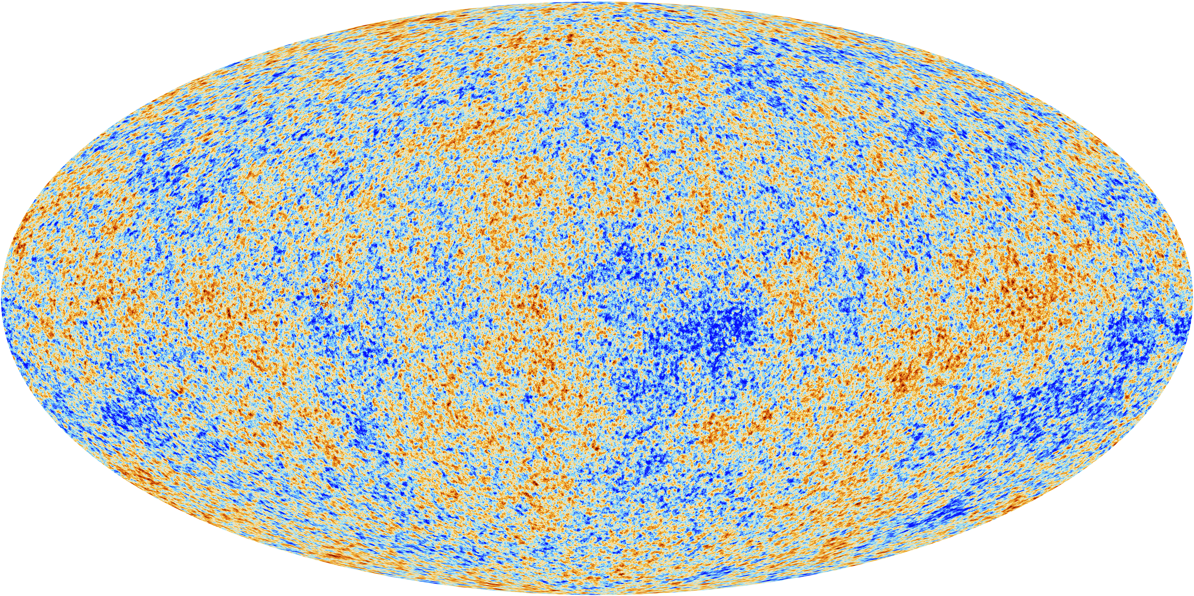

Slide 51
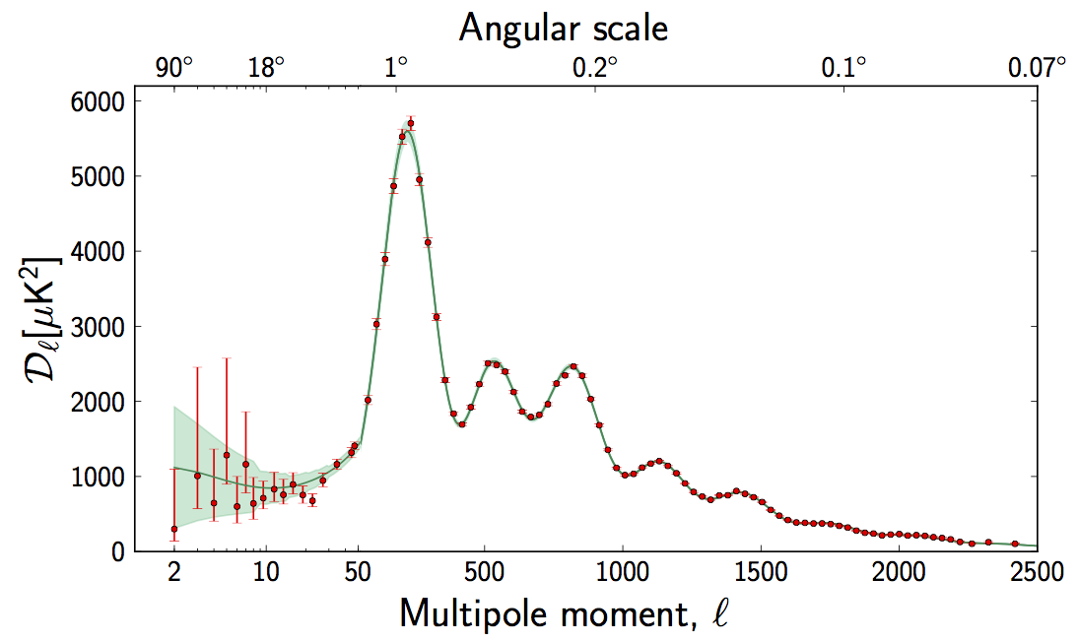

Slide 52
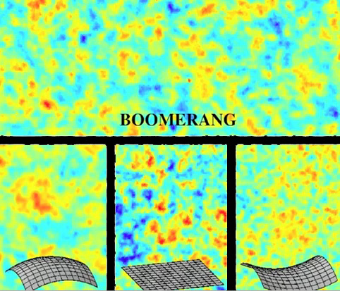

Slide 54
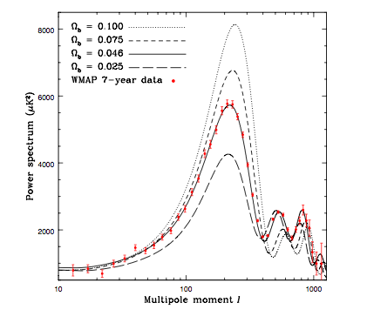

Slide 55
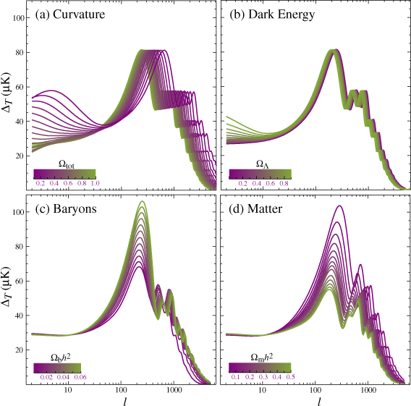

Slide 56
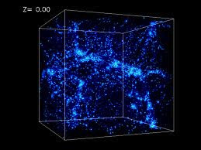
The Pillars Of Physical Cosmology
Hubble Expansion
The Light Element Abundances
The Cosmic Microwave Background
Large Scale Structure

Slide 57
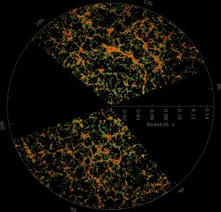

Slide 58
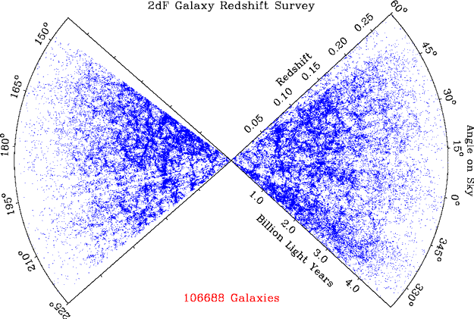

Slide 59
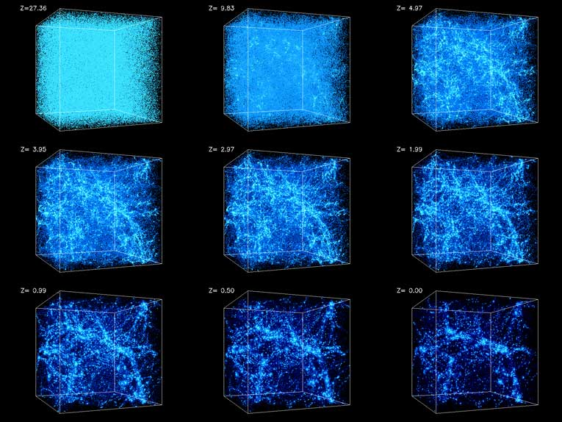

Slide 60
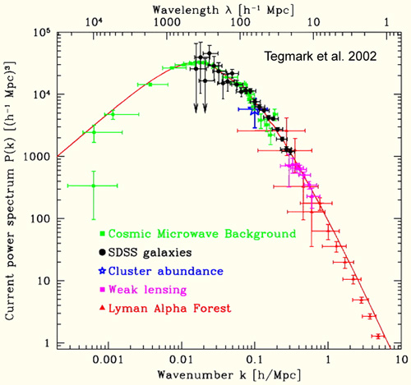

Slide 61
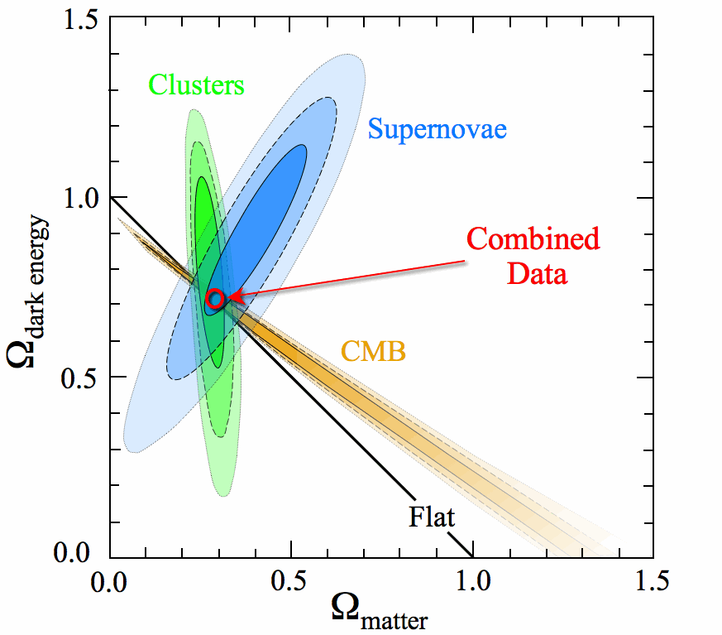

Slide 62
The Pillars Of Physical Cosmology
Hubble Expansion
The Light Element Abundances
The Cosmic Microwave Background
Large Scale Structure
The Big Bang Theory, although remarkably successful, requires us to introduce:
1) something that drives accelerated expansion in the early universe (inflation)
2) dark matter
3) something that drives accelerated expansion in the current era (dark energy)

Slide 64
The First Problem With MACHOs
Of the key predictions (and successes) of Big Bang Cosmology is the prediction of the relative abundances of the light elements (H, D, He, Li)
Big Bang Nucleosynthesis yields Ω_{B}h² ~ 0.02
Total matter density is much larger, Ω_{M}h² ~ 0.13
Most of the matter in our universe is non-baryonic!

Slide 65
The Other Problem With MACHOs
It is possible to detect MACHOs through their gravitational lensing of bright objects
A catalog of MACHO candidates exists from lensing surveys
Not nearly enough to constitute most of our Galaxy’s dark matter halo!

Slide 66
And Yet Another Problem With MACHOs!

Slide 67
And Yet Another Problem With MACHOs!

Slide 68
Three Possibilities
1) Galaxies are mostly made up of very non-luminous objects (black holes, neutron stars, white dwarf stars, large planets, etc.)
2) Gravity does not work in galaxies and clusters the way in does on Earth or in our Solar System
3) The missing mass consists of some other form of matter

Slide 69
Evidence for Dark Matter
Galactic rotation curves
Gravitational lensing
Light element abundances
Cosmic microwave
background anisotropies
Large scale structure

Slide 70
Evidence for Dark Matter
There is a wide variety of evidence indicating that dark matter exists
Each of these observations infer dark matter’s presence uniquely through its gravitational influence
To-date, no (non-controversial) observations have been made of dark matter’s electroweak or other non-gravitational interactions

Slide 71
Evidence for Dark Matter
There is a wide variety of evidence indicating that dark matter exists
Each of these observations infer dark matter’s presence uniquely through its gravitational influence
To-date, no (non-controversial) observations have been made of dark matter’s electroweak or other non-gravitational interactions
Instead of dark matter, might we not understand gravity?

Slide 72



Modified Newtonian Dynamics (MOND)
Begin by modifying Newtonian dynamics as follows:
where μ≈1, except for small at acceleration, at which μ=a/a₀
For a circular orbit,
which in the low-acceleration limit yields
Rotational velocity independent of galactic radius (flat rotation curve)

Slide 73
Modified Newtonian Dynamics (MOND)
MOND has been quite successful in explaining the dynamics of galaxies, and provides an explanation for the Tully-Fisher relationship
Galaxy clusters are not well described by MOND
MOND cannot be applied to most questions of cosmology (toy theory – modifies Newton, not Einstein)
Dark matter suppresses the impact of baryon acoustic oscillations, explaining the observed matter power spectrum – MOND does not
S. Dodelson, arXiv:1112.1320

Slide 74
MONDs and Dark Matters In History
Case 1: Astronomical tables of Uranus’ orbit were found to deviate from observations. It suggested that either another planet was perturbing its orbit (dark matter) or that Newton’s laws had broken down

Slide 75
MONDs and Dark Matters In History
Case 1: Astronomical tables of Uranus’ orbit were found to deviate from observations. It suggested that either another planet was perturbing its orbit (dark matter) or that Newton’s laws had broken down
-One point for dark matter

Slide 76
MONDs and Dark Matters In History
Case 1: Astronomical tables of Uranus’ orbit were found to deviate from observations. It suggested that either another planet was perturbing its orbit (dark matter) or that Newton’s laws had broken down
Case 2: The precession of the perihelion of Mercury did not match the prediction of Newtonian gravity. Another planet (Vulcan) was proposed. Einstein solved with general relativity.
-One point for dark matter

Slide 77
MONDs and Dark Matters In History
Case 1: Astronomical tables of Uranus’ orbit were found to deviate from observations. It suggested that either another planet was perturbing its orbit (dark matter) or that Newton’s laws had broken down
Case 2: The precession of the perihelion of Mercury did not match the prediction of Newtonian gravity. Another planet (Vulcan) was proposed. Einstein solved with general relativity.
-One point for dark matter
-One point for MOND

Slide 78
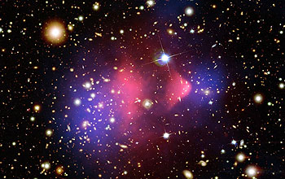
NASA/Chandra Press Release, August 21, 2006

Slide 79
Baryonic Matter (hot gas)
NASA/Chandra Press Release, August 21, 2006

Slide 80
Baryonic Matter (hot gas)
Total Mass
NASA/Chandra Press Release, August 21, 2006

Slide 81
The End Of MOND
NASA/Chandra Press Release, August 21, 2006

Slide 82
Three Possibilities
1) Galaxies are mostly made up of very non-luminous objects (black holes, neutron stars, white dwarf stars, large planets, etc.)
2) Gravity does not work in galaxies and clusters the way in does on Earth or in our Solar System
3) The missing mass consists of some other form of matter

Slide 83
And Further Confirmation From Large Scale Structure

Slide 84
And Further Confirmation From Large Scale Structure

Slide 85
And Further Confirmation From Large Scale Structure

Slide 86
Dark Matter In The 21st Century

Slide 87
Dark Matter In The 21st Century
Dark matter’s nature remains a mystery

Slide 88
Dark Matter In The 21st Century
Dark matter’s nature remains a mystery
Astrophysicists see its imprint in many different ways:
-Gravitation lensing of clusters

Slide 89
Dark Matter In The 21st Century
Dark matter’s nature remains a mystery
Astrophysicists see its imprint in many different ways:
-Gravitation lensing of clusters
-The cosmic microwave background radiation

Slide 90
Dark Matter In The 21st Century
Dark matter’s nature remains a mystery
Astrophysicists see its imprint in many different ways:
-Gravitation lensing of clusters
-The cosmic microwave background radiation
-The large scale structure of our universe

Slide 91
Dark Matter In The 21st Century
Dark matter’s nature remains a mystery
Astrophysicists see its imprint in many different ways
The WIMP-paradigm for dark matter has held up to much scrutiny, but what WIMPs actually are remains to be discovered

Slide 92
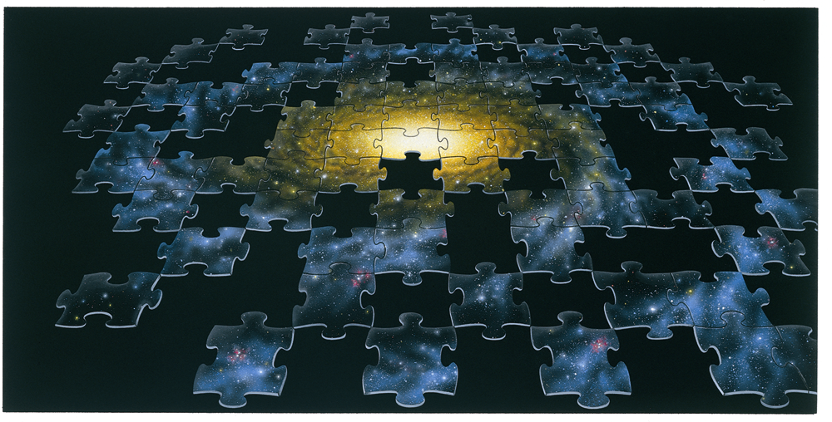

Slide 93
Lecture 2 :Particle candidates for dark matter
Dan Hooper - Fermilab/University of Chicago
Supersymmetry or not, what is the evidence?Copenhagen
October, 2013

Slide 94
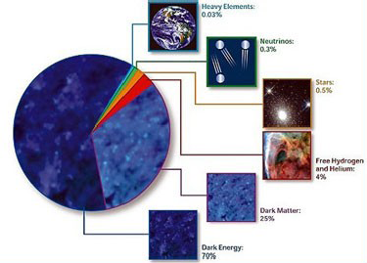
“The world is full of things which nobody by any chance ever observes.”
- Sherlock Holmes

Slide 95


Slide 96
Properties of Dark Matter
1) Not made of baryons (protons, neutrons)
2) Comes in “small” pieces (relative to stars, planets)
3) Does not significantly emit, reflect, or absorb light (electrically neutral)
4) Stable (or at least cosmologically long-lived)
5) Massive

Slide 98
Cosmic Background Neutrinos
Much like WIMPs, neutrinos undergo decoupling and survive as a thermal relic in the early universe
Thermal decoupling and annihilation freeze-out happens at approximately the same time/temperature (t~2 sec, T~MeV)
Assuming stability, this should lead to a cosmic background of neutrinos with a similar density and temperature as the CMB (1.95 K vs 2.73 K)
Indirect evidence of this background is observed in the anisotropies CMB – in fact, current data from Planck, WMAP, SPT and ACT appear to favor ~3.5 neutrinos instead of 3!

Slide 99
Could Neutrinos Be The Dark Matter?
The only weakly interacting massive particles in the Standard Model are neutrinos – might they make up the dark matter?
Neutrinos decouple at ~MeV temperatures, and were thus relativistic when gravity began to bind dark matter into large scale structure
Neutrinos therefore act as “hot” dark matter

Slide 100
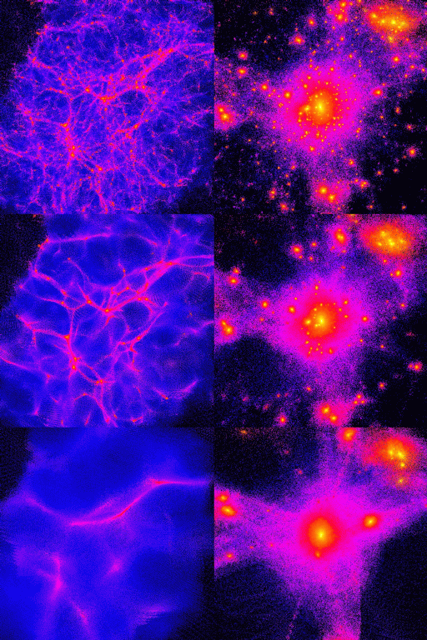
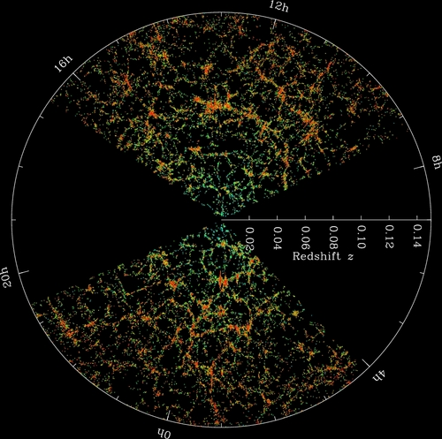

Hot and Cold Dark Matter
Cosmologists use N-body simulations to predict how dark matter will form structures under gravity
The hotter the dark matter is, the less small scale structure forms, and the more “puffy” halos are
When compared to observations (such as those from SDSS, shown), it is clear that dark matter is not hot – dark matter is not neutrinos
HOT COLD

Slide 101
The Dark Matter Candidate Zoo
Neutralinos (higgsino, bins, winos, singlinos)
Axinos
Gravitinos
Sneutrinos
Axions
Sterile neutrinos
4th generation neutrinos
Kaluza-Klein photons
Kaluza-Klein gravitons
Brane world dark matter/D-matter
Little higgs dark matter
Light scalars
Superheavy states (ie. “WIMPzillas”)
Self-interacting dark matter
Super-WIMPs
Asymmetric dark matter
Q-balls (and other topological states)
CHAMPs (charged massive particles)
Cryptons, mirror matter, and many, many, many others…

Slide 102





The Thermal Abundance of a WIMP
T>>M_{X}, WIMPs are in thermal equilibrium
T<M_{X}, number density becomes exponentially suppressed
Including the effects of expansion pulls the density away from its equilibrium value:
Numerically, this yields an abundance of:
In comparison,
Dan Hooper – Dark Matter in the Discovery Age

Slide 103
The Thermal Abundance of a WIMP
T>>M_{X}, WIMPs are in thermal equilibrium
T<M_{X}, number density becomes exponentially suppressed
Including the effects of expansion pulls the density away from its equilibrium value:
Numerically, this yields an abundance of:
In comparison,
A generic stable, weakly interacting particle is predicted to be produced in the early universe with an abundance similar to the observed dark matter density.
-Numerical coincidence?
-WIMP Miracle?
Dan Hooper – Dark Matter in the Discovery Age

Slide 104
WIMP Model Building
With the WIMP Miracle in mind, many particle physicist have proposed dark matter candidates within many weak-scale extensions of the Standard Model
While these models vary in many ways, many contain a number of common features
To better appreciate this, consider supersymmetric models as a starting point

Slide 105
Supersymmetric Dark Matter
Supersymmetry, when manifest at or around the electroweak-scale, helps to resolve a number of issues
1) The Hierarchy Problem – exactly cancels quadratic divergences
2) Unification of Standard Model forces at a common scale
3) Provides a WIMP candidate
And while string theorists might argue that supersymmetry could appear at almost any scale (M_{Planck} is as good as M_{weak}), these three problems are only addressed if the superpartners are not much heavier than a couple of TeV
Dark matter candidates appearing in supersymmetric theories include WIMPs (neutralinos, sneutrinos), and even more feebly interacting particles (gravitinos, axinos) – and while not actually WIMPs, gravitinos and axinos can indirectly take advantage of the WIMP Miracle through decays of other sparticles

Slide 106




Supersymmetry
Perhaps the most theoretically appealing (certainly the most well studied) extension of the Standard Model
Natural solution to hierarchy problem (stabilizes quadradic divergences to Higgs mass)
Restores unification of couplings
Vital ingredient of string theory
Naturally provides a compelling candidate for dark matter

Slide 107
Supersymmetric Dark Matter
R-parity must be introduced in supersymmetry to prevent rapid proton decay
Another consequence of R-parity is that superpartners can only be created and destroyed in pairs, making the lightest supersymmetric particle (LSP) stable
Possible WIMP candidates from supersymmetry include:
~
~ ~ ~
γ
, Z, h, H
4 Neutralinos
~
3 Sneutrinos
ν

Slide 108
Supersymmetric Dark Matter
R-parity must be introduced in supersymmetry to prevent rapid proton decay
Another consequence of R-parity is that superpartners can only be created and destroyed in pairs, making the lightest supersymmetric particle (LSP) stable
Possible WIMP candidates from supersymmetry include:
~
~ ~ ~
γ
, Z, h, H
4 Neutralinos
~
3 Sneutrinos
ν
Excluded by direct detection

Slide 109
Supersymmetry and Friends
SUSY Specific:
General Feature:
-Presence of weak-scale sparticles cancel quadratic divergences
-R-parity allows for consistency with electroweak precision tests, and ensures the stability of the lightest sparticle
2
-The lightest neutralino is an especially attractive dark matter candidate – although relic abundance only works in specific regions of parameter space
-Neutralinos are Majorana fermions – annihilate to heavy fermions and scatter elastically via Higgs
-New colored particles near the weak-scale reduce/remove fine tuning in higgs sector
-Some discrete symmetry allows for consistency with electroweak precision tests, and insures the stability of at least one new particle
-Cosmologically, this stable state cannot be charged or colored, and if ever in equilibrium, it must annihilate enough to avoid over production – favors a WIMP
-WIMP could be a scalar, Majorana fermion, Dirac fermion, vector, etc. – many of our SUSY-specific rules of thumb do not apply

Slide 110
“We emphasize that the solution to the naturalness (fine-tuning) problem necessarily predicts that new physical phenomena must exist at a scale of m_{W}/g ~ 1 TeV or below. In the case of supersymmetry, this new physics consists of a spectrum of new supersymmetric particles (partners of the ordinary particles) which have masses no greater than about 1 TeV and in some cases may be substantially lighter.”
Howie Haber and Gordy Kane, Physics Reports 117, 75 (1985)

Slide 111
Non-WIMP Dark Matter Candidates I: Axions
Motivated by observation that the neutron’s electric dipole moment is small (consistent with zero)
In other words, although the SM violates parity and charge-parity, QCD does not – requires that θ_{QCD} < 10⁻⁹
In 1977, Peccei and Quinn proposed a dynamical solution to this “strong CP problem”, a new broken U(1) – drives θ_{QCD} to zero
Shortly thereafter, Wilczek and Weinberg pointed out that this solution also predicts the existence of a new extremely weakly interacting pseudoscalar, the axion

Slide 112
Non-WIMP Dark Matter Candidates I: Axions
For masses in the micro- to milli-eV range, axions can make up the dark matter (via misalignment production in the early universe) without violating astrophysical or laboratory constraints
Interactions of such axions are suppressed by a Peccei-Quinn scale of ~10⁹-10¹² GeV
Two photon couplings can be probed, however, via the Primakov mechanism
ADMX is the experiment best positioned to test (much of) the allowed parameter space
By the end of the decade, ADMX will be able to test a sizeable fraction of axion dark matter models

Slide 113
Non-WIMP Dark Matter Candidates II: Sterile Neutrinos
-Sterile neutrinos, produced via mixing with SM neutrinos, can also provide a viable and well motivated class of dark matter candidates
-Constraints include:
Phase space in dwarf spheroidals (ie. Tremaine-Gunn bound)
The lack of x-ray lines
Dark matter abundance
Lyman-α constraints, which require the dark matter to not be too hot; translates to M > 8 keV

Slide 114





Putting the WIMP Hypothesis to the Test

