Slide 1
Current Status of EUMETSAT Operational winds
Ken Holmlund, R. Borde, M. Carranza, and O. Hautecoeur

Slide 2
Content
Geostationary Satellite status
MTP/MSG Planning
Major evolutions impacting AMVs since last IWWS
Upcoming Changes
Low earth Orbiting Systems status
Metop planning
AVHRR Winds
ASCAT Status
Oceansat-2 status
Reprocessing

Slide 3
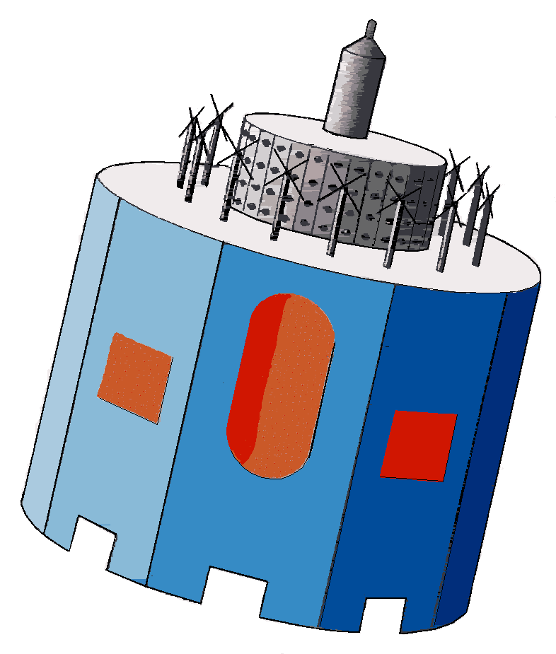
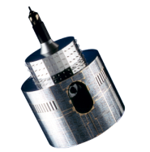
MSG space segment configuration
MSG space segment configuration is stable since the end of re-locations and services swaps in early 2013.
Met-10
Met-8
Met-9
Met-7
MSG-4
IOS position
3.4°W
0°
3.5°E
9.5°E
57.5°E
Rapid Scan Service
IODC
Launched 5-7-12
Full Earth Scan
Launched 28-8-2002
Back up Met-10
Back up Met-9 RSS
RSS gap filling until 2015

Slide 4
Meteosat Long Term Planning Reference Scenario
2011
2012
2013
2014
2015
2016
2017
2018
N
D
J
F
M
A
M
J
J
A
S
O
N
D
J
F
M
A
M
J
J
A
S
O
N
D
J
F
M
A
M
J
J
A
S
O
N
D
J
F
M
A
M
J
J
A
S
O
N
D
J
F
M
A
M
J
J
A
S
O
N
D
J
F
M
A
M
J
J
A
S
O
N
D
J
F
M
A
M
MSG-3 Commissioning
MSG-4 Commissioning
Met-11 IOS (Duration TBD)
MTG-I1 Commissioning
3.4ºW
Met-10 drift start
Met-11 drift start
MSG-3 Launch
MSG-4 Launch
MTG-I1 Launch
Met-9
0º
Met-10 drift start
Met-9 drift start
Met-11 drift stop
Met-11
Met-10 drift stop
3.5ºE
Met-8
Met-8 at 3° inclination
Met-9
9.5ºE
Met-10
Met-9 RSS stop/Drift start
Met-10 drift stop/RSS start
57.5ºE
Met-7
Met-7
Met-8
Met-8 takes over IODC (if agreed by Council)
63ºE
Met-8 RSS stop/Drift start
Met-8 at 5° NS inclination
67.5ºE
Met-9 drift stop/RSS start
Met-7 disposal
N
D
J
F
M
A
M
J
J
A
S
O
N
D
J
F
M
A
M
J
J
A
S
O
N
D
J
F
M
A
M
J
J
A
S
O
N
D
J
F
M
A
M
J
J
A
S
O
N
D
J
F
M
A
M
J
J
A
S
O
N
D
J
F
M
A
M
J
J
A
S
O
N
D
J
F
M
A
M
2011
2012
2013
2014
2015
2016
2017
2018
MSG operations for IODC is TBD by Council
Duration of MSG-4 in orbit storage is TBD by Council

Slide 5
Meteosat AMVs change since IWW11
Release 1.5.3 ; September 2012.
Introduction of CCC to set AMV HA
→ Statistics of AMVs improved at high and mid levels, degraded at low levels
Patch low levels, February 2013
→ Statistics of AMVs slightly better at low levels.
Release 1.5.4 September 2013
AMVs extracted at low levels in WV channels set to a poor QI
Introduction of the Best-fit calculation
Introduction of OCA product (2 layers, hourly), but not used for AMVs

Slide 6
Meteosat AMVs upcoming changes
MFG
Introduction of CCC to set AMV HA, Dec 2015
Divergence product, Dec 2015
MSG
Use OCA to set AMV HA, asap, depends on OCA availability every 15 min.
Change WV AMV HA in clear sky conditions, Dec 2015
Continue investigation on nested tracking scheme
MTG
MTG FCI: prototyping activities using proxy data.
MTG IRS: Revisit the potential of optical flow methods applied to humidity fields (IASI data and/or proxy data), External study should start in 2014

Slide 7
SAF – EUM Workshop: update of MTG Status
Satellites
  Satellites Status: MTG-I
    MTG-I schedule is quite stable schedule with a FAR in July 2018.
    PDR of the LI is on-going.
  Satellites Status: MTG-S
    Realistic date for the MTG-S FAR is now January 2021,
    Closure of the MTG-S PDR : October 2013,
    Closure of the S-4 PDR : November 2013.

Slide 8
SAF – EUM Workshop: update of MTG Status
Major MTG-I milestones:
Milestones | Current | Comment
GS facility PDRs | 2014/2015
GS facility CDRs | 2015
System Implementation Review | Late 2015 | Implementation of MTG-S. MTG-I System Status before the System CDR-I
SVT-0 | Nov 2016 | SatSim and MOF aligned. Fix date
CDR MTG-I1 | Sept 2016
GS MTG-I CDR | 2016
CDR System | Early 2017 | After the satellite and GS CDR.
MTG-I FAR | Mid 2018
Launch | End 2018 | early 2019 in the Budget assumptions

Slide 9
SAF – EUM Workshop: update of MTG Status
Major MTG-S milestones :
    FAR announced with high probability to be delayed by about 6 months, leading to launch in 2021.
Milestones | Current | Comment
System Implementation Review | Late 2015
CDR MTG-S1 | Dec 2016
GS facility ΔPDRs | 2017/2018
GS facility ΔCDRs | 2018
GS MTG-S CDR | 2018
CDR System | 2018
MTG-S1 FAR | Early 2021 | Impacts to be analysed
Launch | Mid 2021

Slide 10
EPS-Metop Lifetime Review
Lifetime Review in Sept. 2013 confirmed Metop-A lifetime extension remains feasible (77th Council) and Metop-B expected operational lifetime is same as for Metop-A (12 years).

Slide 11
Metop-B Status
Data Acquisition:
Primary Operational
ADA Dumps (most, but not all passes);
HRPT Full Coverage.
Status:
HIRS F/W problem – channels out of spec caused no real impact as yet;
ADCS ARGOS 2 Only (CRA Antenna);
SARR/SARP also impacted to lesser extent.

Slide 12
Metop-A Status
Data Acquisition: Secondary Operational
No ADA Dumps
HRPT Limited Coverage
Status:
HRPT B-side, SSPA switching since 16/05/13
AMSUA1 H7 failed, H3 & H8 out of spec/worsening
MHS H3 & H4 worsening, LO-B;
GOME UV Throughput still falling slightly.

Slide 13
Metop AVHRR polar wind change since IWW11
Validation METOP B winds and Version v2.1.3 ; March 2013.
Several minor changes
Validation Version v2.2 ; May 2013
Tropopause determination
Temperature inversion determination.
Coverage extended from 55° to 50° latitude
The IASI CTH is only used if the barycentre of the CCC method is contained in the IASI pixel. In this version, the collocation distance threshold is set to 5 km.
Version 2.4 that extracts both single Metop polar winds and global dual Metop winds, May 2014.
Change in quality (more good quality winds, smaller bias, smaller RMS)

Slide 14
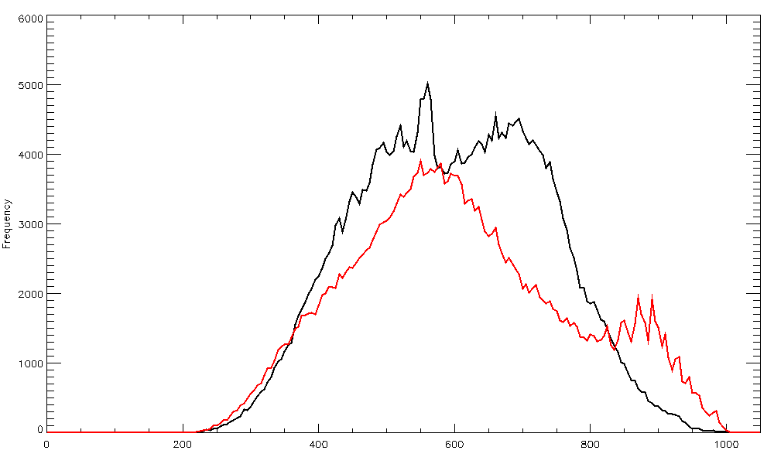
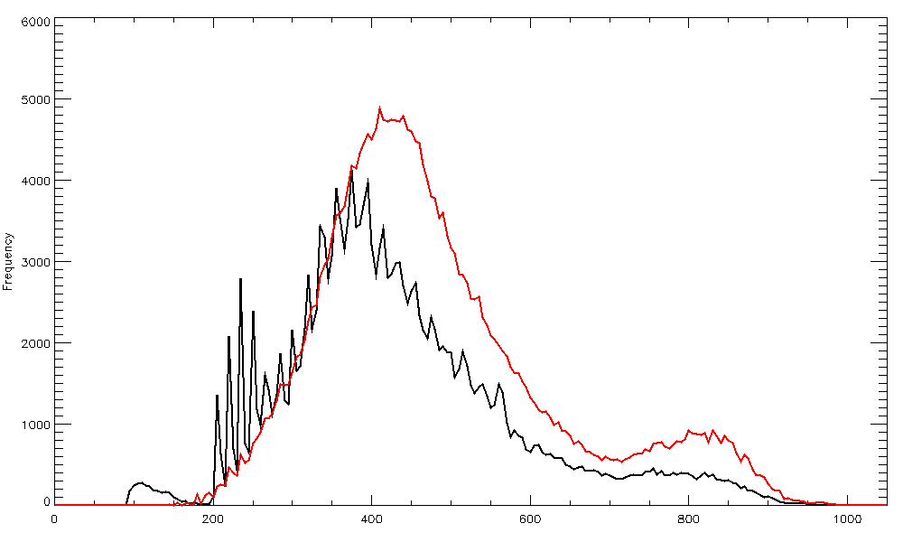
Validation Version v2.2 ; Histogram Pressure
Period: 24th May - 4th June 2013
North Pole
South Pole
Histogram of AMV pressures obtained on GS‑1 (black) and on GS‑2 (red) for Metop A between 24th May 2013 and 4th June 2013. QI larger than 60 %.

Slide 15
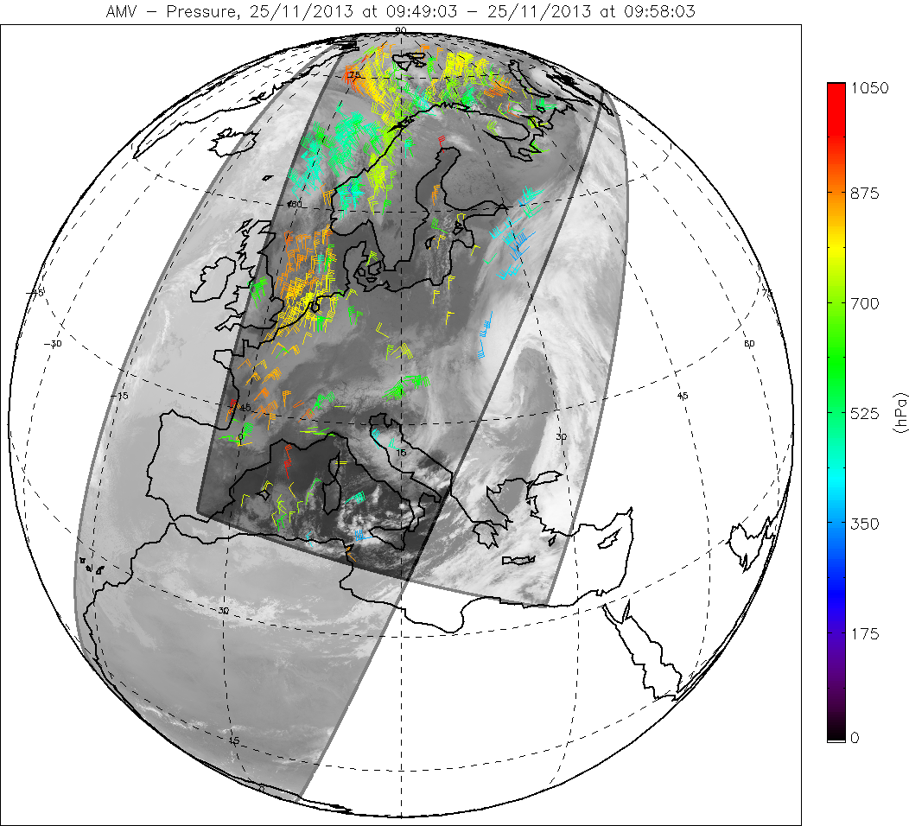
Global Dual Metop AVHRR wind
Version 2.4 that extracts both single Metop polar winds and global dual Metop winds, May 2014.
Two complementary products: Metop A/Metop B and Metop B / Metop A
Global coverage
Help filling 50-70 deg latitude band
Trial dissemination foreseen in July
Validation study against other wind observation. (TROPOS, Leipzig)

Slide 16
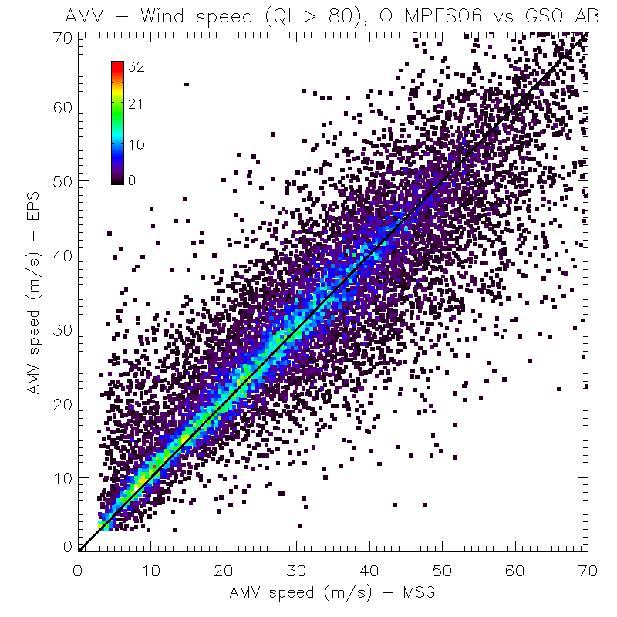
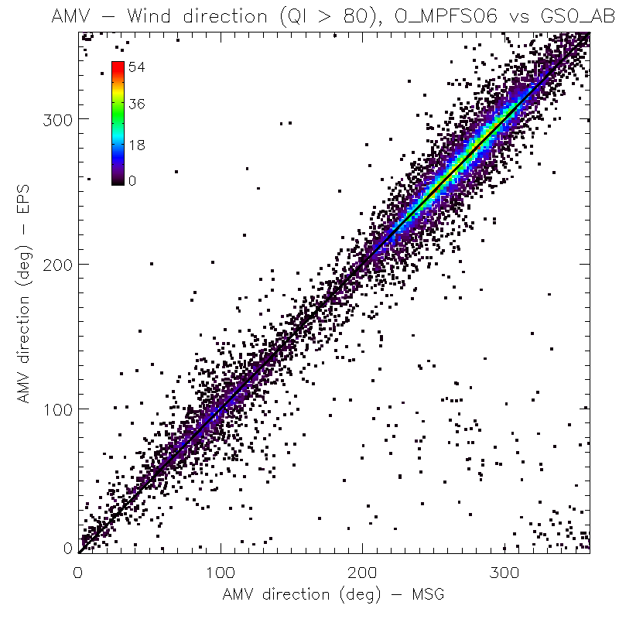
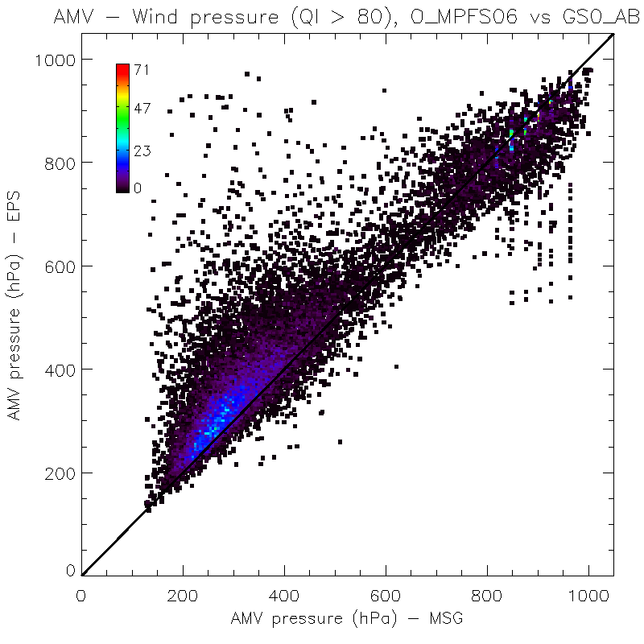
EUMETSAT dual Metop winds
Comparisons dual Metop winds / MSG
Comparison criteria:
1st Oct 2013
– 31st Jan 2014
QI > 80
45 minutes max difference
0.25 deg lat/lon grid box
For more details, see:
Olivier’s talk
Akos’ poster for validation

Slide 17
Metop AVHRR AMVs upcoming changes
Polar winds
Introduction of triplet mode over polar areas, Dec 2014
Preparation of AMV METImage ATBD
Dual winds
Development and updates according to users feedbacks.

Slide 18
Scatterometer constellation
Source: CEOS Ocean Surface Winds Virtual Constellation
Launch
10
11
12
13
14
15
16
17
18
19
20
21
22
23
24
10/06
METOP-A Europe
METOP-C Europe
C-band
METOP-B Europe
Post EPS Europe
06/99
QSCAT USA
03/04
Oceansat-2 India
Oceansat-3 India
SCATSAT India
HY-2A China
HY-2B China
HY-2C China
CFOSAT China/France
Ku-band
RapidSCAT USA
Meteor-M N3 Russia
Meteor-MP 3 Russia
Combined C- and Ku-band
GCOM-W2 Japan/India/USA
GCOM-W3 Japan/India/USA
FY-3E China
FY-3G China
Scatt operational series India
Design Life
Extended Life
Design Life
Extended Life
Proposed
Operating
Approved
May2014

Slide 19
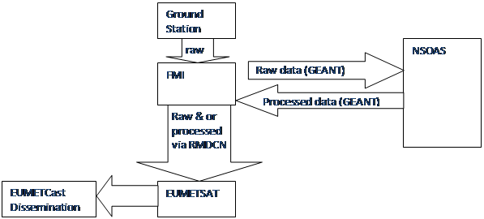
Update on HY-2/NSOAS data access
Technical bilateral with NSOAS 21 May in Guangzhou, China
NRT data distribution discussions ongoing
Use of a Nordic reception station (Sodankylä, TBC), would enable NRT timeliness for 75% of the data initially (limitations due to Ground Station conflicts with other missions
Preparations for tests ongoing, however limited by EUMETSAT’s DVB-S2 migration activities
Final commitment on dump strategy pending decision by China’s State Oceanic Administration
A Potential redistribution scenario:

Slide 20
Scatterometer data from ISRO’s missions
Oceansat-2 scatterometer failed 20 February 2014
At the 42 CGMS in Guangzhou, China, ISRO reconfirmed it’s commitment to CGMS:
  Requested to become full member
  Committed to provide NRT access in a similar fashion to Oceansat-2 from future missions
Next step is to prepare for SCATSAT to be launched in 2015

Slide 21
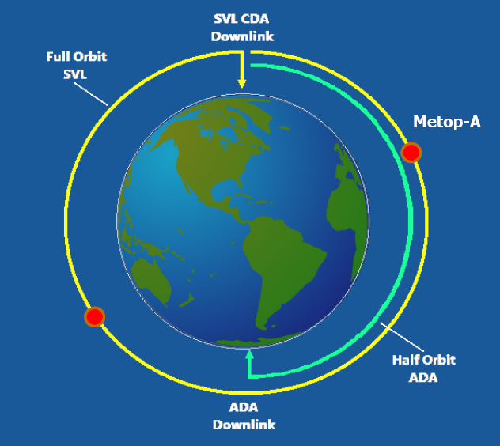
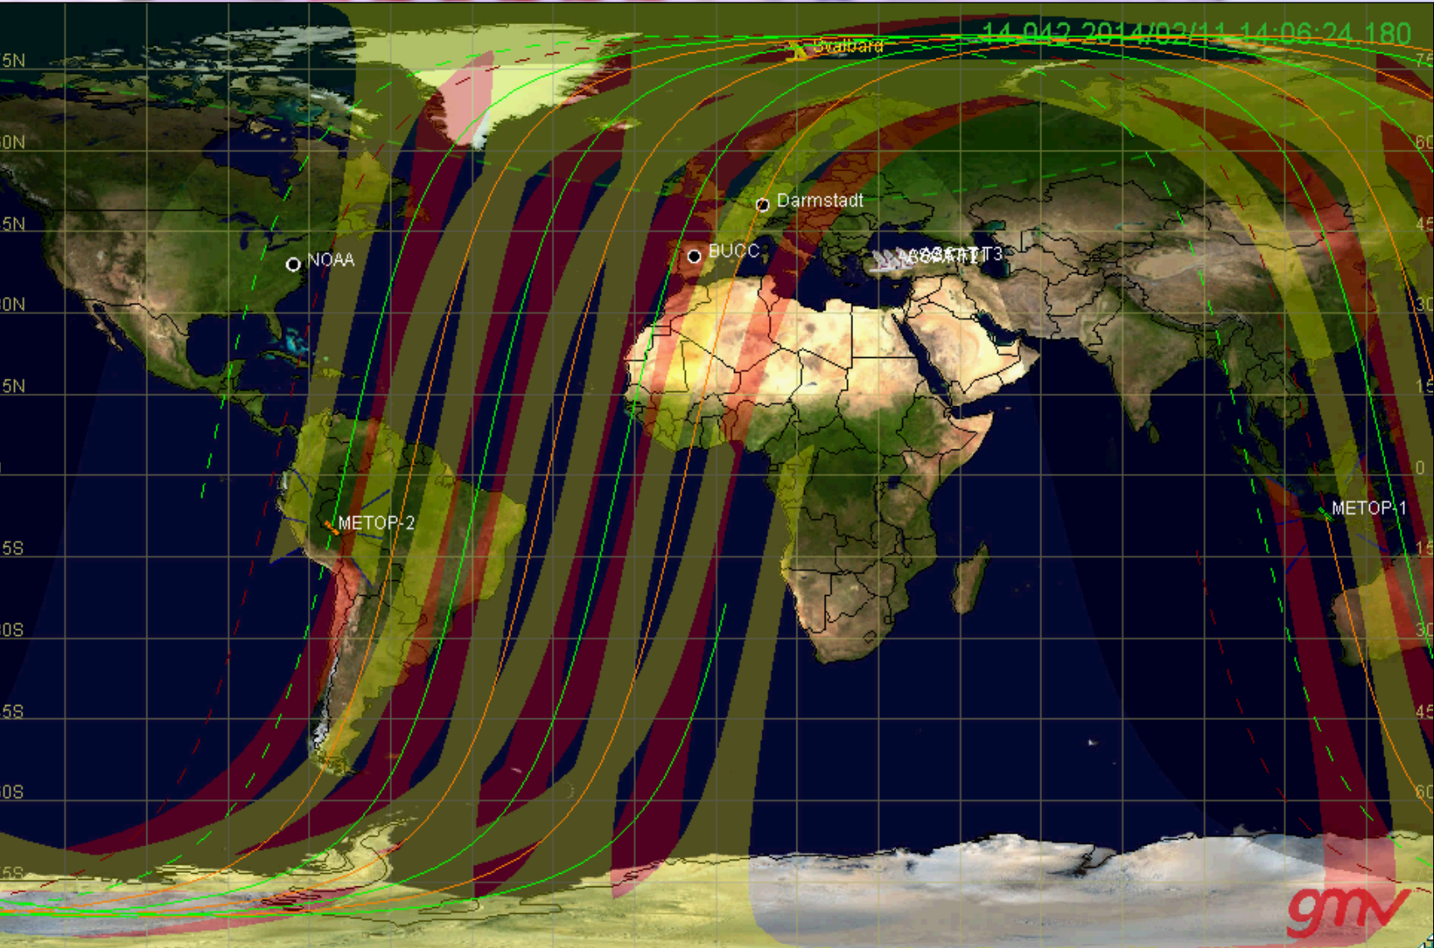
Scatterometer winds MetOp
Instruments: ASCAT on Metop-A and Metop-B in Dual (tandem) operations:
Good coverage and revisit time at mid to high latitudes (50/100 min, and almost full daily coverage)
In tropics/Equator, overlap swaths from consecutive orbits provide measurements with 50 min time interval – convection at the surface
Services: Global and EARS/Fast extraction service
EUMETSAT provides NRCS and OSI SAF (KKNMI) provides winds
Timeliness global: ASCAT-B ~ 80 min (primary mission) / ASCAT-A ~ 120 min
Timeliness EARS/FES: 30 min
Since may 2013, dissemination of full-resolution NRCS in NRT
Ongoing activities: consolidation of services (integration) by Q2 2015 and optimization of spatial re-sampling and resolution, as well as coastal processing
Products
ASCAT-A NRCS record (2017-2013) re-processed – validation it shows a very stable instrument, able to detect long term surface wind trends over 0.1 m/s over 5 years
See Ad’s presentation on Wednesday for more on winds products
Current coverage

Slide 22
Wind reprocessing activities
(mainly in the framework of ERACLIM project)
LEO
METOP AVHRR AMVs were reprocessed over the period 2004 – 2012 using two algorithms (CIMSS / EUMETSAT) .
-> End of 2014, reprocessing with the new EUMETSAT algorithm
GEO
MSG AMVs have been reprocessed (2004-2011). 2012 will be done by the end of the summer.
Meteosat First Generation AMVs reprocessing with an MSG-like algorithm by the end of 2016.

Slide 23
Thanks
Special thanks to M. Doutriaux-Boucher, J. Figa, R. Stuhlmann and F. Montagner for their inputs.

