Slide 1
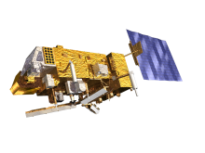
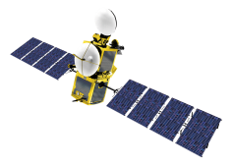
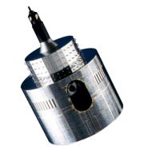
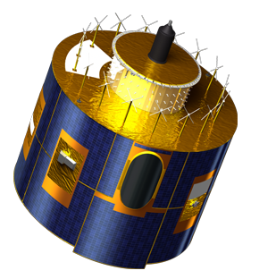
Introducing recommendations from CGMS 42 to the 12th International Winds Workshop
Johannes Schmetz
EUMETSAT
CGMS Rapporteur for IWWG
with co-chairs of IWWG
Mary Forsythe and Jaime Daniels
Notes:
EUM/STG-SWG/36/14/VWG/15

Slide 2
Content of Talk
Thanks to Mary Forsythe, Jaime Daniels and Regis Borde for leadership and excellent cooperation
Recalling actions and recommendations from CGMS-41
New actions and recommendations from CGMS-42
Topic for discussion => I suggest that re-processed AMVs:
Are of scientific interest per se, over and above their importance in re-analyses’ => notably in ops4MIPs (Observations for Model Intercomparison Projects)
Have potential to improve the understanding of processes in the climate system (e.g. circulation patterns)

Slide 3
Now five International Working Groups under CGMS (2)
ITWG: The International TOVS Working Group is also convened as a sub-group of the Radiation Commission of the International Association of Meteorology and Atmospheric Sciences (IAMAS). ITWG continues to organize International TOVS Study Conferences (ITSCs) which have met every 18-24 months since 1983.
IWWG: The International Winds Working Group was established in 1991 and became a Working Group of CGMS in 1994.
IPWG: The International Precipitation Working Group was established as a permanent Working Group of the Coordination Group for Meteorological Satellites (CGMS) in June 2001.
IROWG: The International Radio Occultation Working Group was established as a permanent Working Group of CGMS at the 37th meeting in October 2009.
NEW: ICWG: The International Cloud Working Group was established as a permanent Working Group of CGMS at the 42nd meeting in May 2014.

Slide 4
Actions from CGMS - 41
CGMS-A41.24. Co-chairs of IWWG to provide a summary paper and lessons learnt to CGMS-42 from the second AMV derivation inter-comparison project.
=> discussed at IWW12 and to be reported to CGMS-43
CGMS-A41.25. IWWG co-chairs to i) organise a dedicated session at IWW12 on research, operational applications and benefits of high resolution AMVs and ii) to provide a corresponding report to the next CGMS meeting
discussed at IWW12 and to be reported to CGMS-43
CGMS-A41.28. NOAA to ensure that CIMSS/SSEC AMV reprocessing activity should be embedded into SCOPE-CM AMV project by a communication to the SCOPE-CM Secretariat
(this was not specifically addressed at CGMS-42)

Slide 5
Recalling Recommendations from CGMS- 41
CGMS-R41.06: IWW12 is requested to discuss progress on spatially enhanced AMV products using combinations of data from polar orbiting satellites (including sounders)
=> special session at IWW12
CGMS-R41.09: IWWG to support SCOPE-CM towards the possible development of a unified algorithm for consistent reprocessing of AMVs from geostationary meteorological satellites
=> there is a new recommendation from CGMS-42
CGMS-R41.08: NOAA is invited to consider sustained support to future reprocessing work on GOES and polar AMVs for the benefit of future reanalyses
=> work conducted at CIMSS
CGMS-R41.07: NASA is requested to provide a summary paper to CGMS-42 on cloud motion winds from MISR. The paper should include the potential of the product for NRT application in NWP and also describe efforts to provide the product for reanalyses.
=> Paper presented at CGMS-42

Slide 6
From CGMS - 42
Recommendation WG II CGMS 42.xx:
CGMS recommends to CGMS members performing a reprocessing of AMVs, to pursue future AMV reprocessing with their own algorithm and in addition with a common algorithm. IWW12 is invited to discuss the implications and derive guidance on the practical implementations.

Slide 7
Action from CGMS Plenary
Action CGMS 42.xx:
IWW12 and IPWGx (next session) to respond to the updated HLPP* and to provide feedback to the CGMS Secretariat within 3 months after the working group meeting.
*HLPP = High-level priority plan of CGMS

Slide 8
Relevant topics in HLPP (1)
From Chapter 3:
ENHANCE THE QUALITY OF SATELLITE-DERIVED DATA AND PRODUCTS
3.2 Establish commonality in the derivation of satellite products for global users where appropriate (e.g. through sharing of prototype algorithms);
3.2.1 Infer guidance from the ongoing intercomparison of AMV products for the future developments towards consistent AMV products. Consider in the guidance the future perspective of having the geostationary ring populated with 16-channel imagers.
How should we read this?
Note: The ongoing intercomparison is confined to geostationary AMVs.
It is the 2nd intercomparison and will be presented at IWW12. Guidance means to strive toward more commonality .
The last sentence points at the fact that soon most geostationary imagers will have similar capabilities like MSG or better (16 channels). This means for height assignment one can all adopt similar approaches (i.e. software realisations) based on the same science.

Slide 9
Relevant topics in HLPP (2)
3.5 Develop, and start implementing, methods to describe the error characteristics of satellite data and products;
3.5.1 Address the error characteristics of wind products at the next International Winds Workshop in 2014 and provide a set of guidelines to be considered at the operational centres.
Recent pertinent discussion on HLPP => There is need to improve the methodology; errors should be traceable to standards whenever possible; scale and flow dependent errors?

Slide 10
Topic for discussion ‘and food for thought’
Re-processed AMVs:
Are of scientific interest per se, further to their importance in re-analyses’ => notably in ops4MIPs (Observations for Model Intercomparison Projects)
have potential to improve the understanding of processes in the climate system (circulation patterns at different scales and their impact, e.g. on clouds or vice versa)
Two examples:
Strength of Somali jet and Indian monsoon => direct monitoring from re-processed AMVs
Divergence derived from AMVs tracking marine boundary layer clouds => marine Sc/St plays an important role in the climate system (albedo effect) => study link between dynamics/subsidence and cloud characteristics?

Slide 11
Onset of Somali jet and monsoon rainfall (Goa) (Halpern and Woiceshyn, 2001)
Study features of Somali Jet with long-term record of low-level AMVs
Do climate models replicate the observed variability and details/processes?

Slide 12
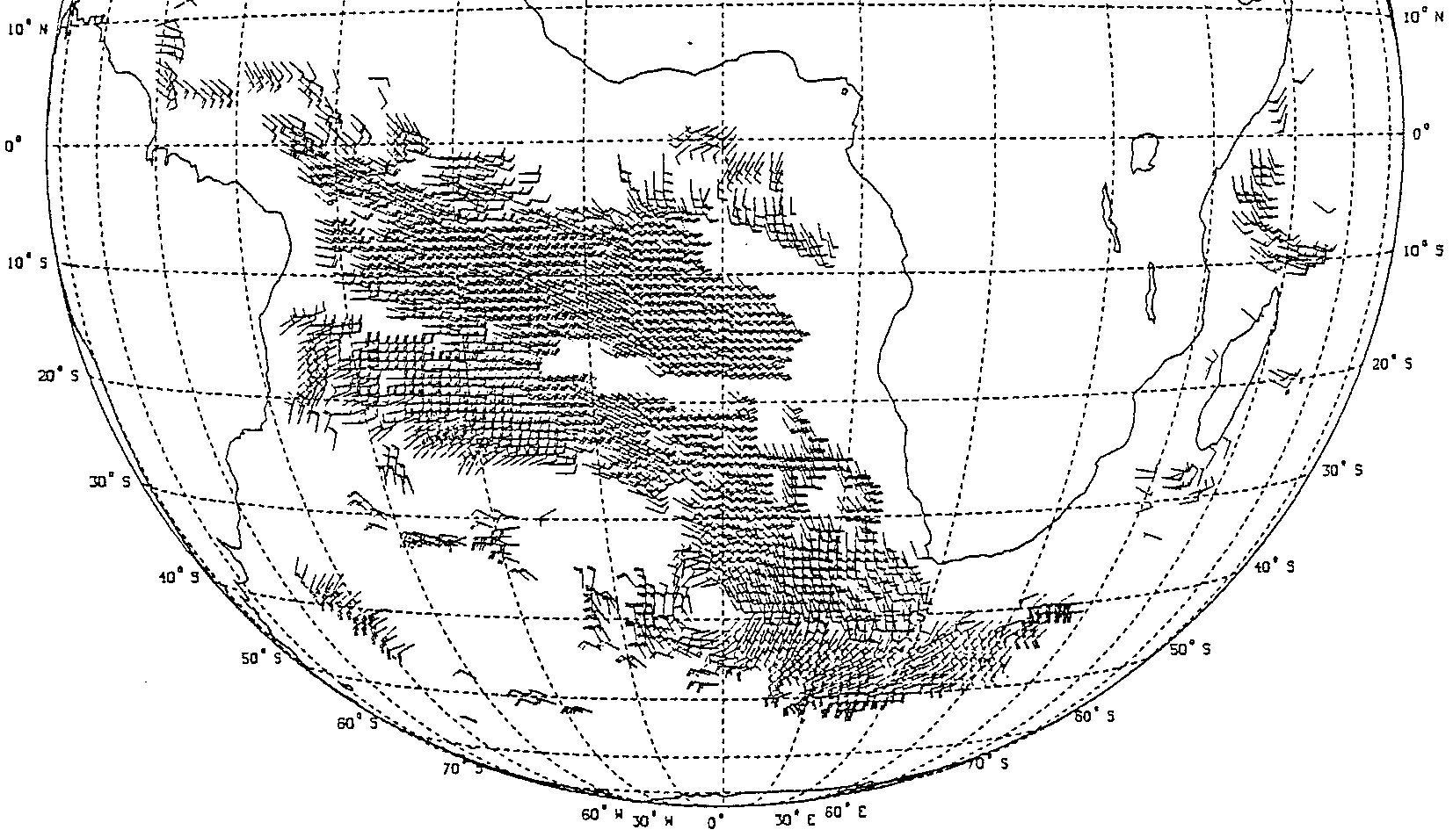
Divergence/subsidence over subtropical oceans from AMVs tracked over marine boundary layer clouds
Regis Borde, personal communication,
‘... an early attempt ... over the South Atlantic’
Note: ‘The highly reflective marine boundary layer clouds are crucial to the cloud-climate feedback’
=> highlighted in IPPC AR5
Some science questions for IWWG:
Is there a link between the observed circulation, i.e. subsidence, and characteristics of marine boundary layer cloud ? Use satellite cloud products with AMV fields.
Do models replicate the observations?
Ottenbacher et al., 1997)

