Slide 1
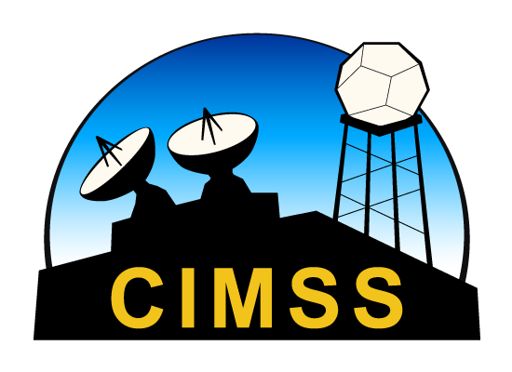
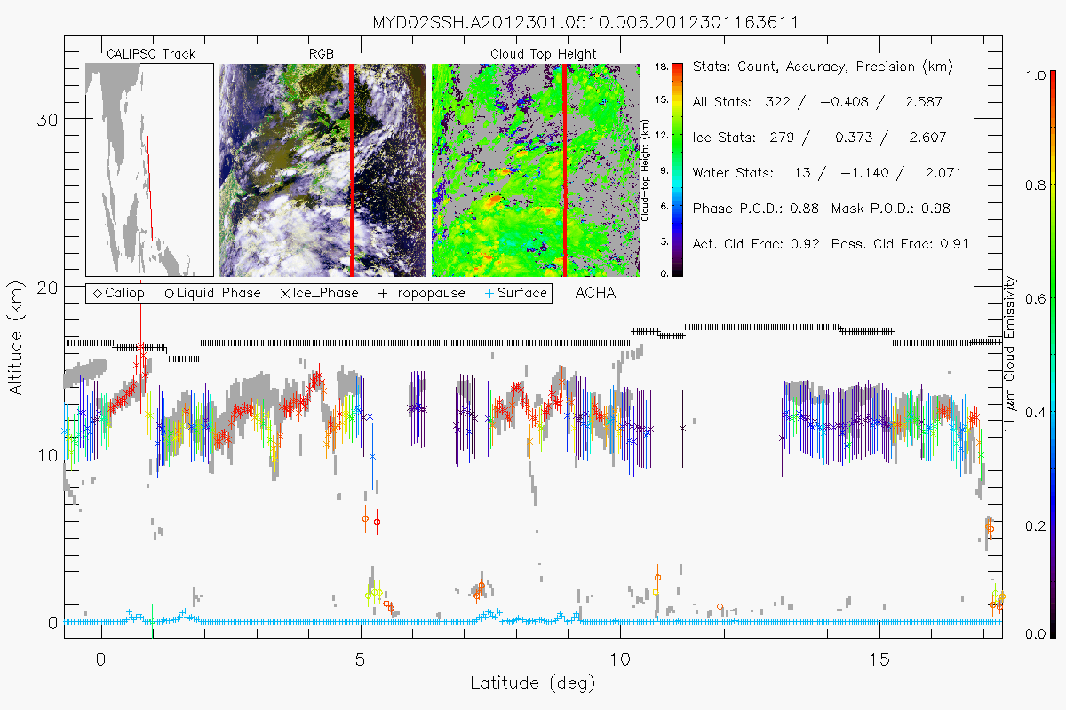
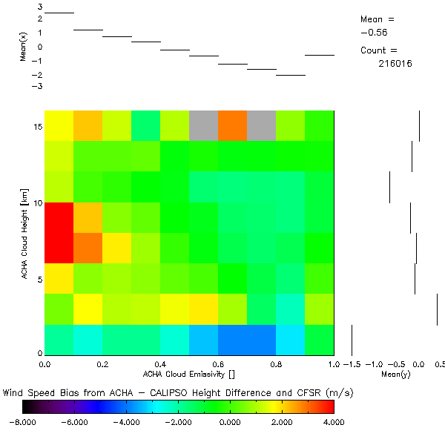
NOAA GOES-R AWG Cloud Height Algorithm (ACHA)
Andrew Heidinger (NOAA), Steve Wanzong and Yue Li (CIMSS)
ACHA was developed by NOAA for GOES-R. Similar to EUMESAT’s OCA, it is an optimal estimation but only uses longwave IR (6.7 – 13.3 μm). Operational now on GOES, AVHRR and S-NPP/VIIRS.
It is a two layer approach and derives optical depth, particle size and the “true” top and base heights.
Since the GOES-R effort, ACHA was modified to be an “enterprise” algorithm to support AVHRR, MODIS, VIIRS, GOES-IM, GOES-NOP, MTSAT, SEVIRI, COMS and GOES-Sounder.
Global Distribution of Wind Speed Bias due to Cloud Height Bias using NCEP NWP
ACHA using 6.7, 11 and 13.3 μm from MODIS versus CALIPSO

