Slide 1
Impact Studies Of Ascat Winds in the ECMWF 4D-var Assimilation System
Giovanna De Chiara,
Peter Janssen, Jean Bidlot, Stephen English
Acknowledgement
Thanks to EUMETSAT for supporting the activity through the project EUM/CO/12/4600001149/JF

Slide 2
ASCAT impact study
Monitoring and assessment of the impact of ASCAT wind observations on the Global Observing System (GOS).
Evaluate the impact of ASCAT winds on the Global Observing System
Better characterize the impact on analysis and forecasts of severe events i.e. tropical cyclones
Improve the Assimilation Strategy
Observing System Experiments in different GOS configuration
Full System:
copy of the Operational System
Starved System:
Full System without
Geostationary Satellites
MW Imagers (AMSR-E/TMI/SSMIS)
AMVs
Starved+ System:
Starved System without AMSU-A
Experiments set-up
T511 (~ 40km)
CY38R1
17 Dec 2012 – 28 Feb 2013
Use of Ocean Currents (Mercator)
Label | ASCAT-A | ASCAT-B | OSCAT
ALL in | Y | Y | Y
A-O | Y | N | Y
B-O | N | Y | Y
O | N | N | Y
Den | N | N | N

Slide 3
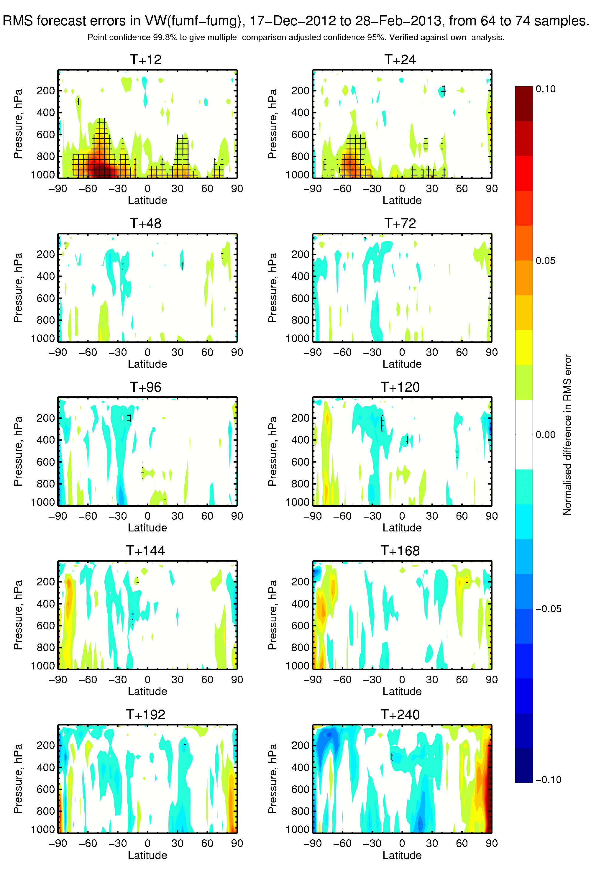
Forecast Verification – Full System
ALL in (A/B/O) - A/O
Vector Wind RMS forecast error
Verified against own analysis

Slide 4
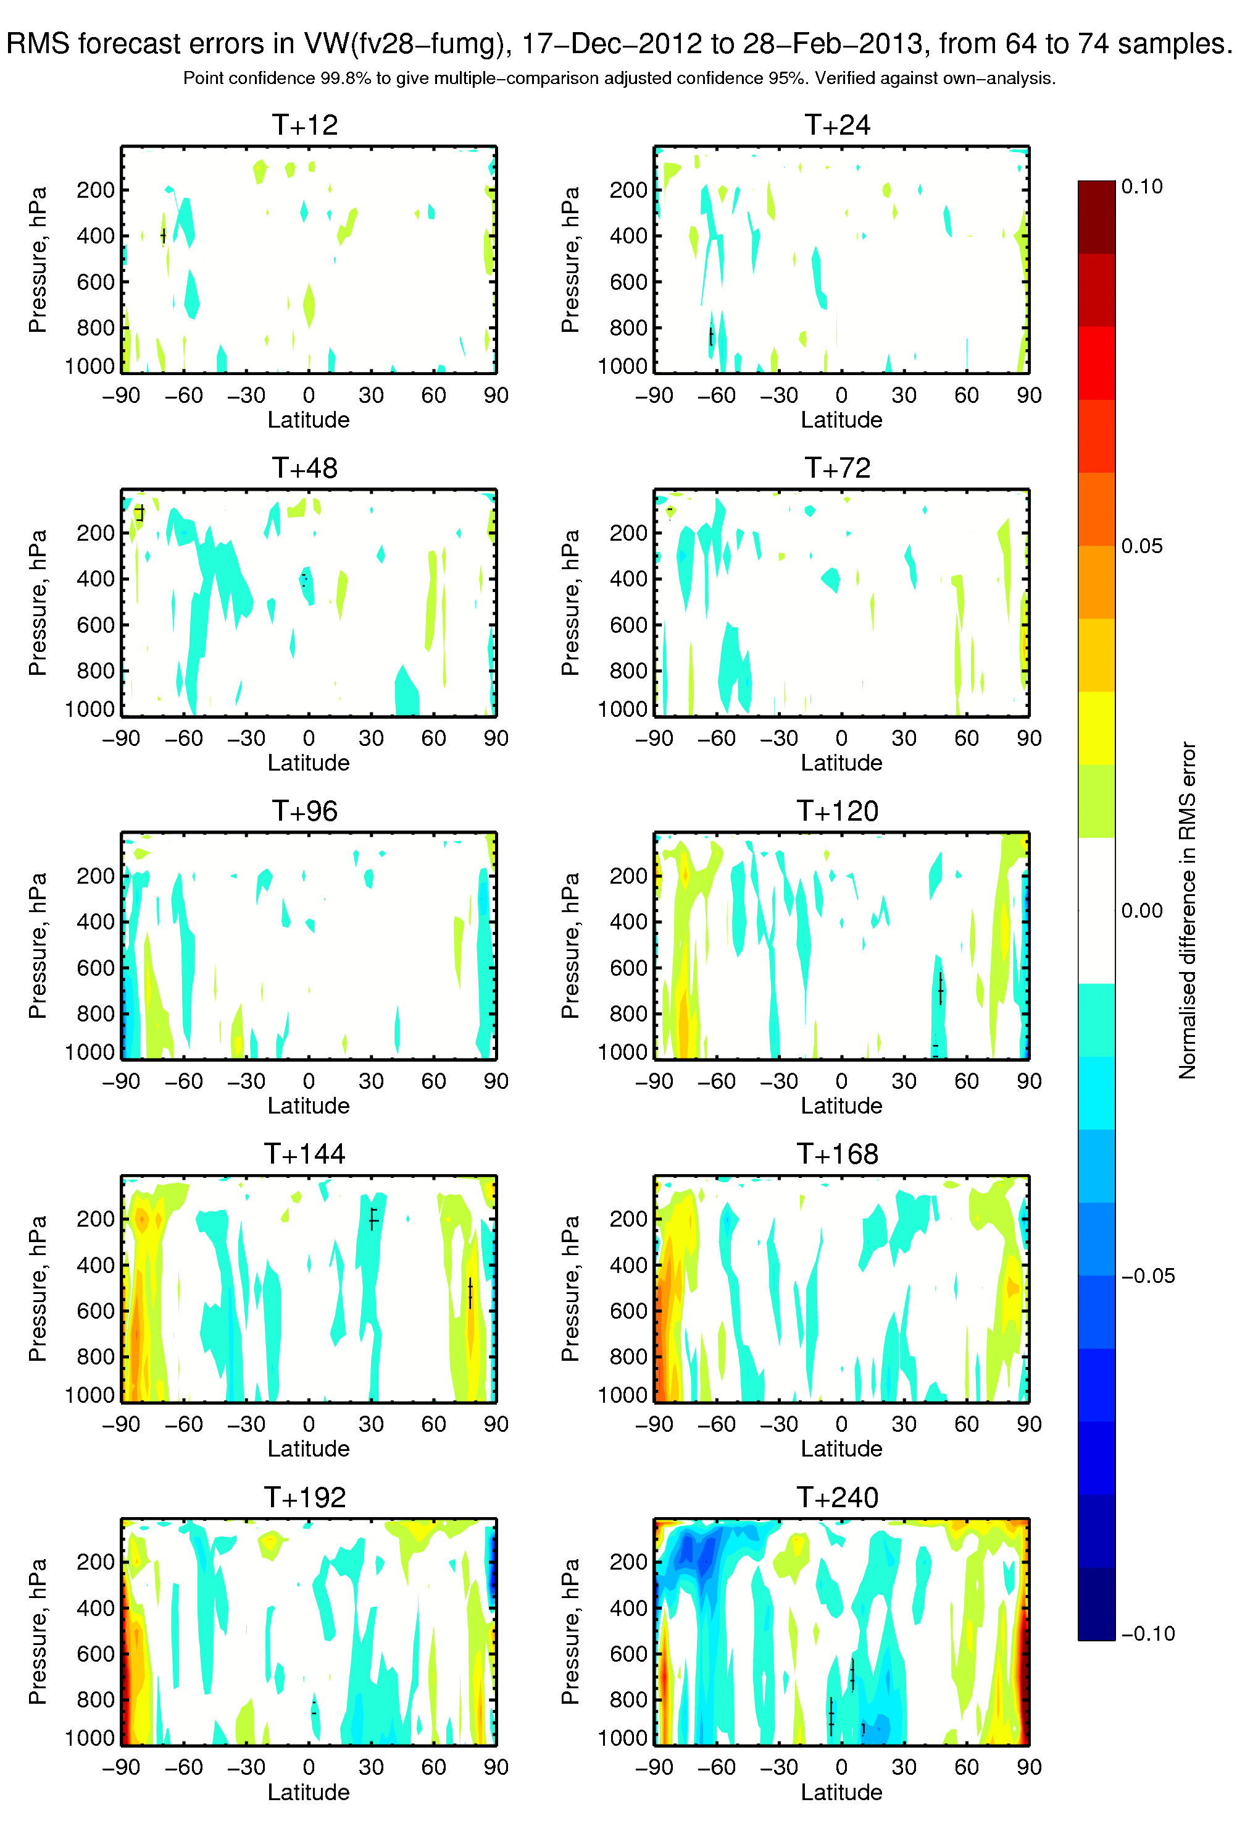
Forecast Verification – Full System
B/O - A/O
Vector Wind RMS forecast error
Verified against own analysis

Slide 5
Verification vs Altimeter winds (JASON-1) – Full System
Tropics
ALL IN A/O B/O O Denial

Slide 6
Verification vs Altimeter winds (JASON-1) – Starved+ System
Tropics
ALL IN A/O B/O O Denial

Slide 7
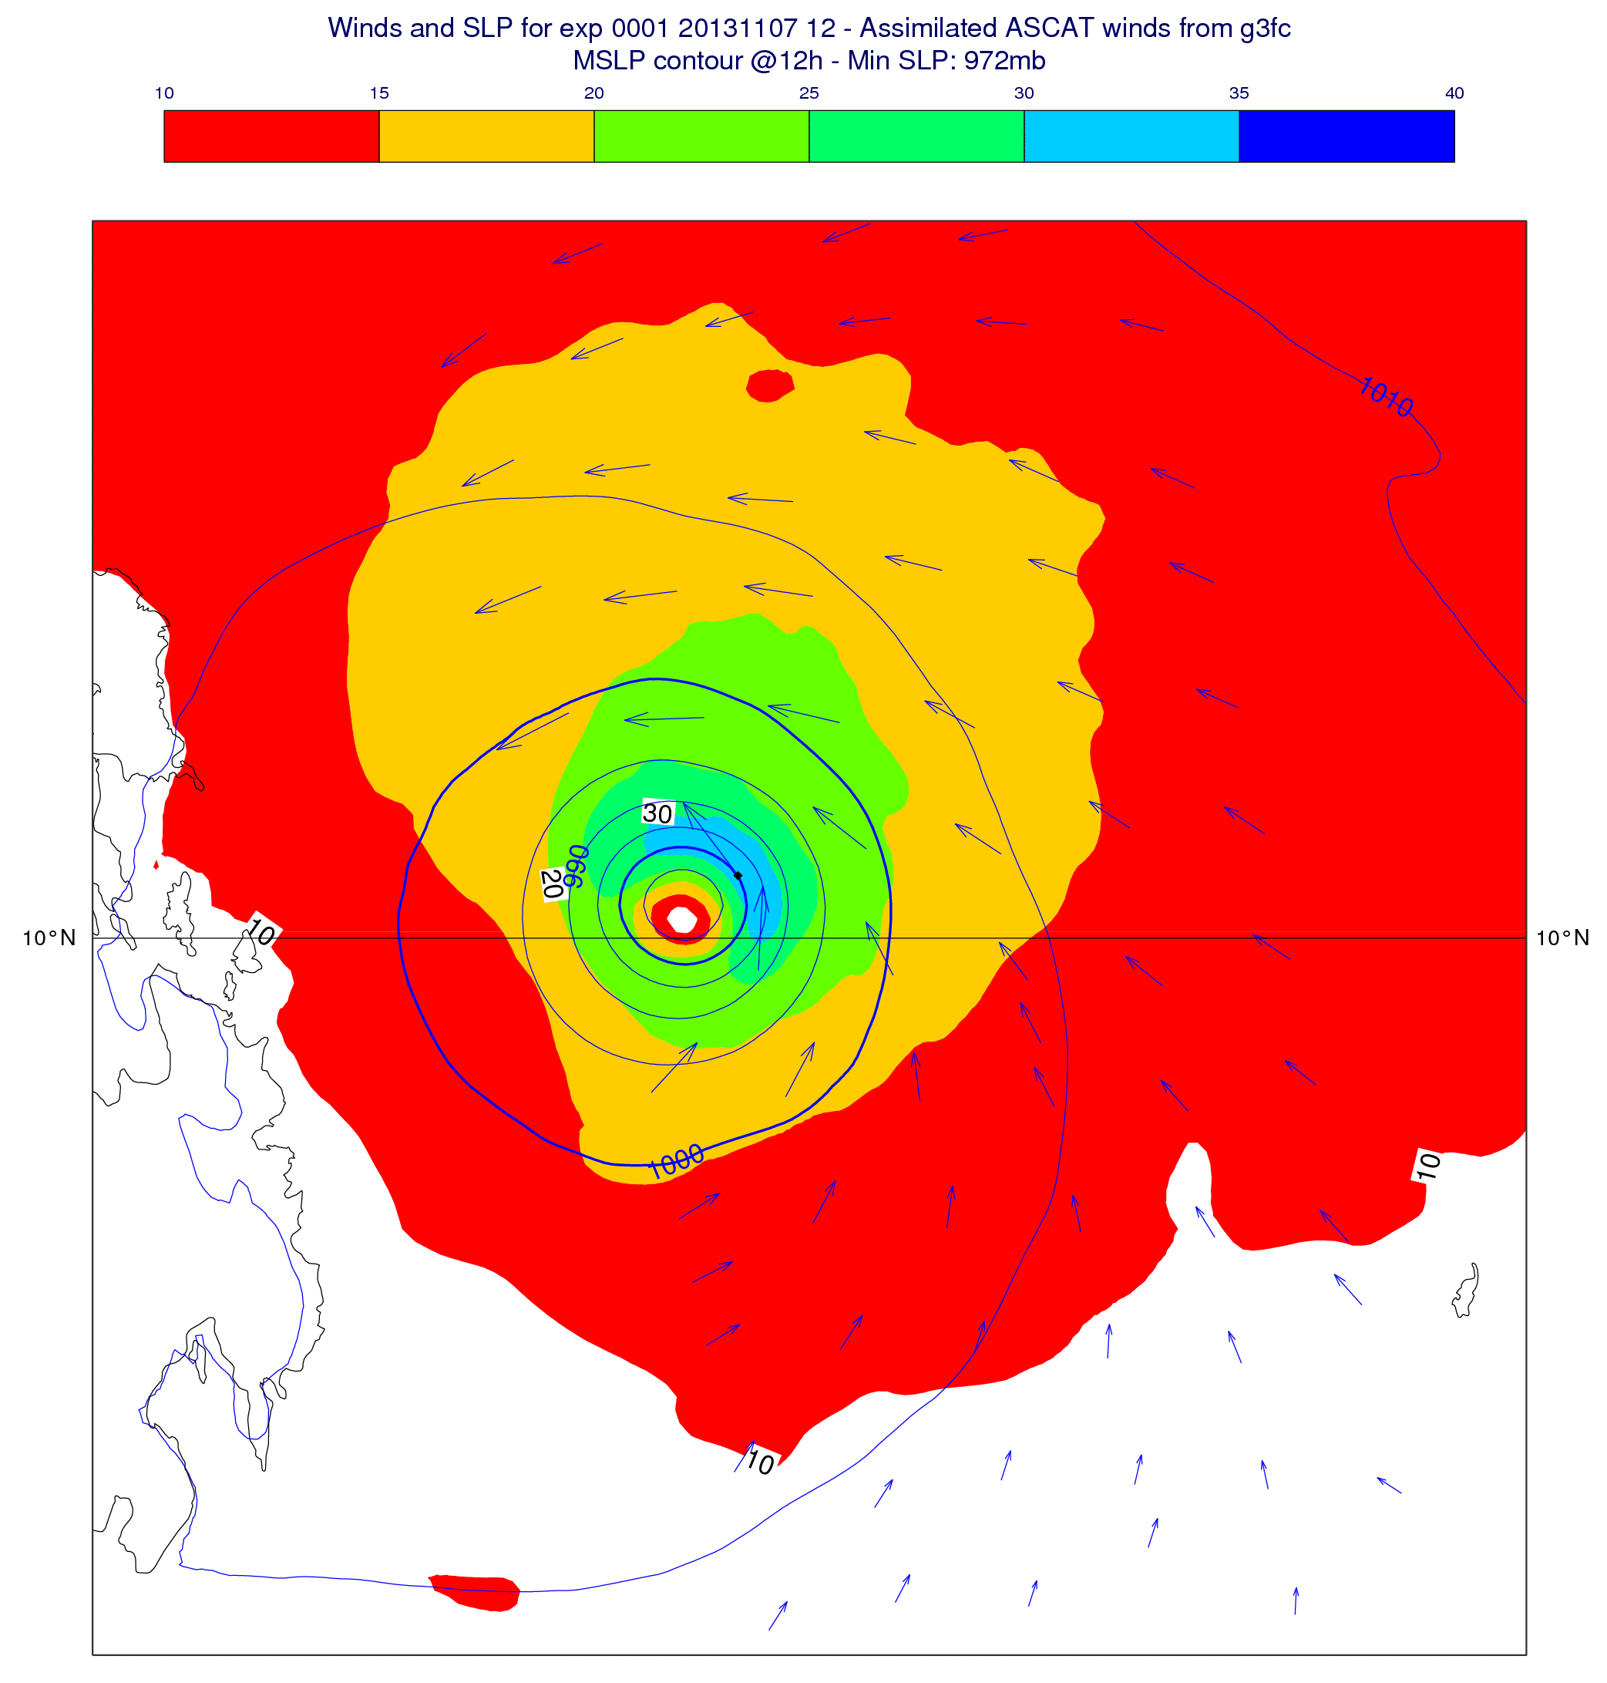
Single Observation Experiments (1 ASCAT-A)
TC Haiyan – CY40R1 2013110712 [Assimilation Window 9 - 21]
1 ASCAT-A obs @ 1pm

Slide 8
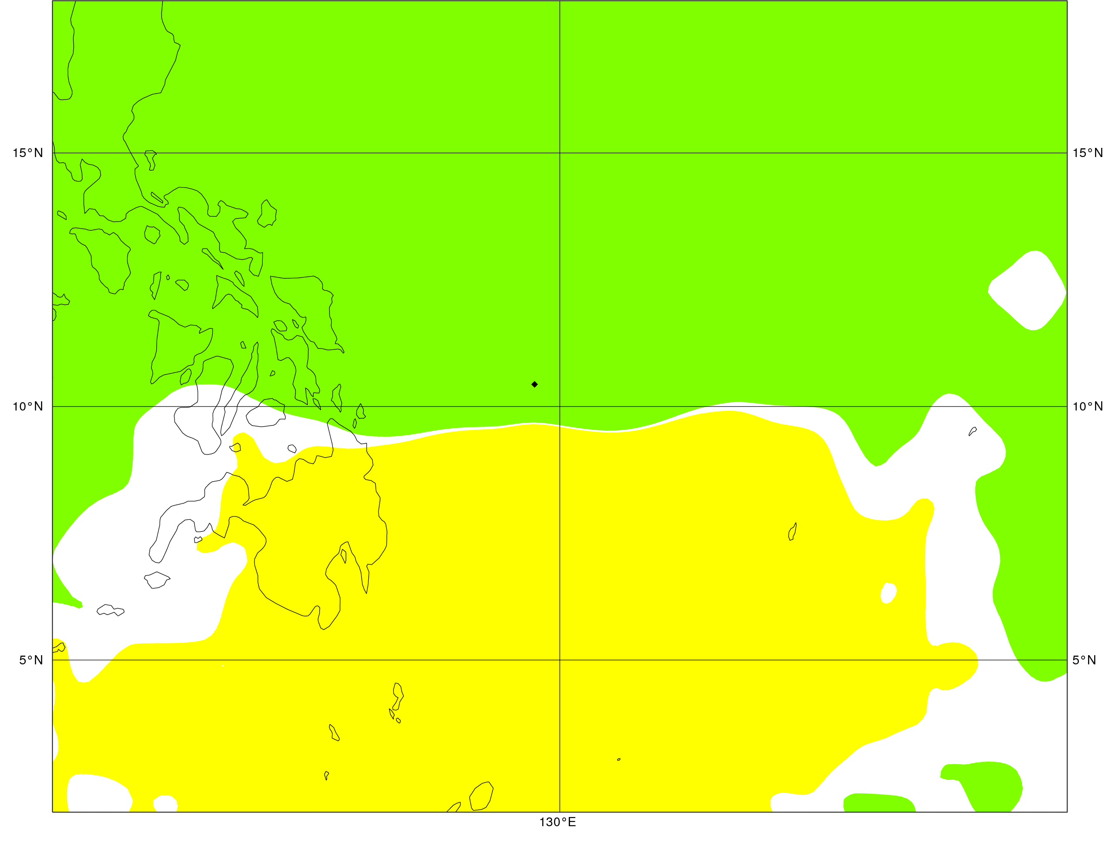
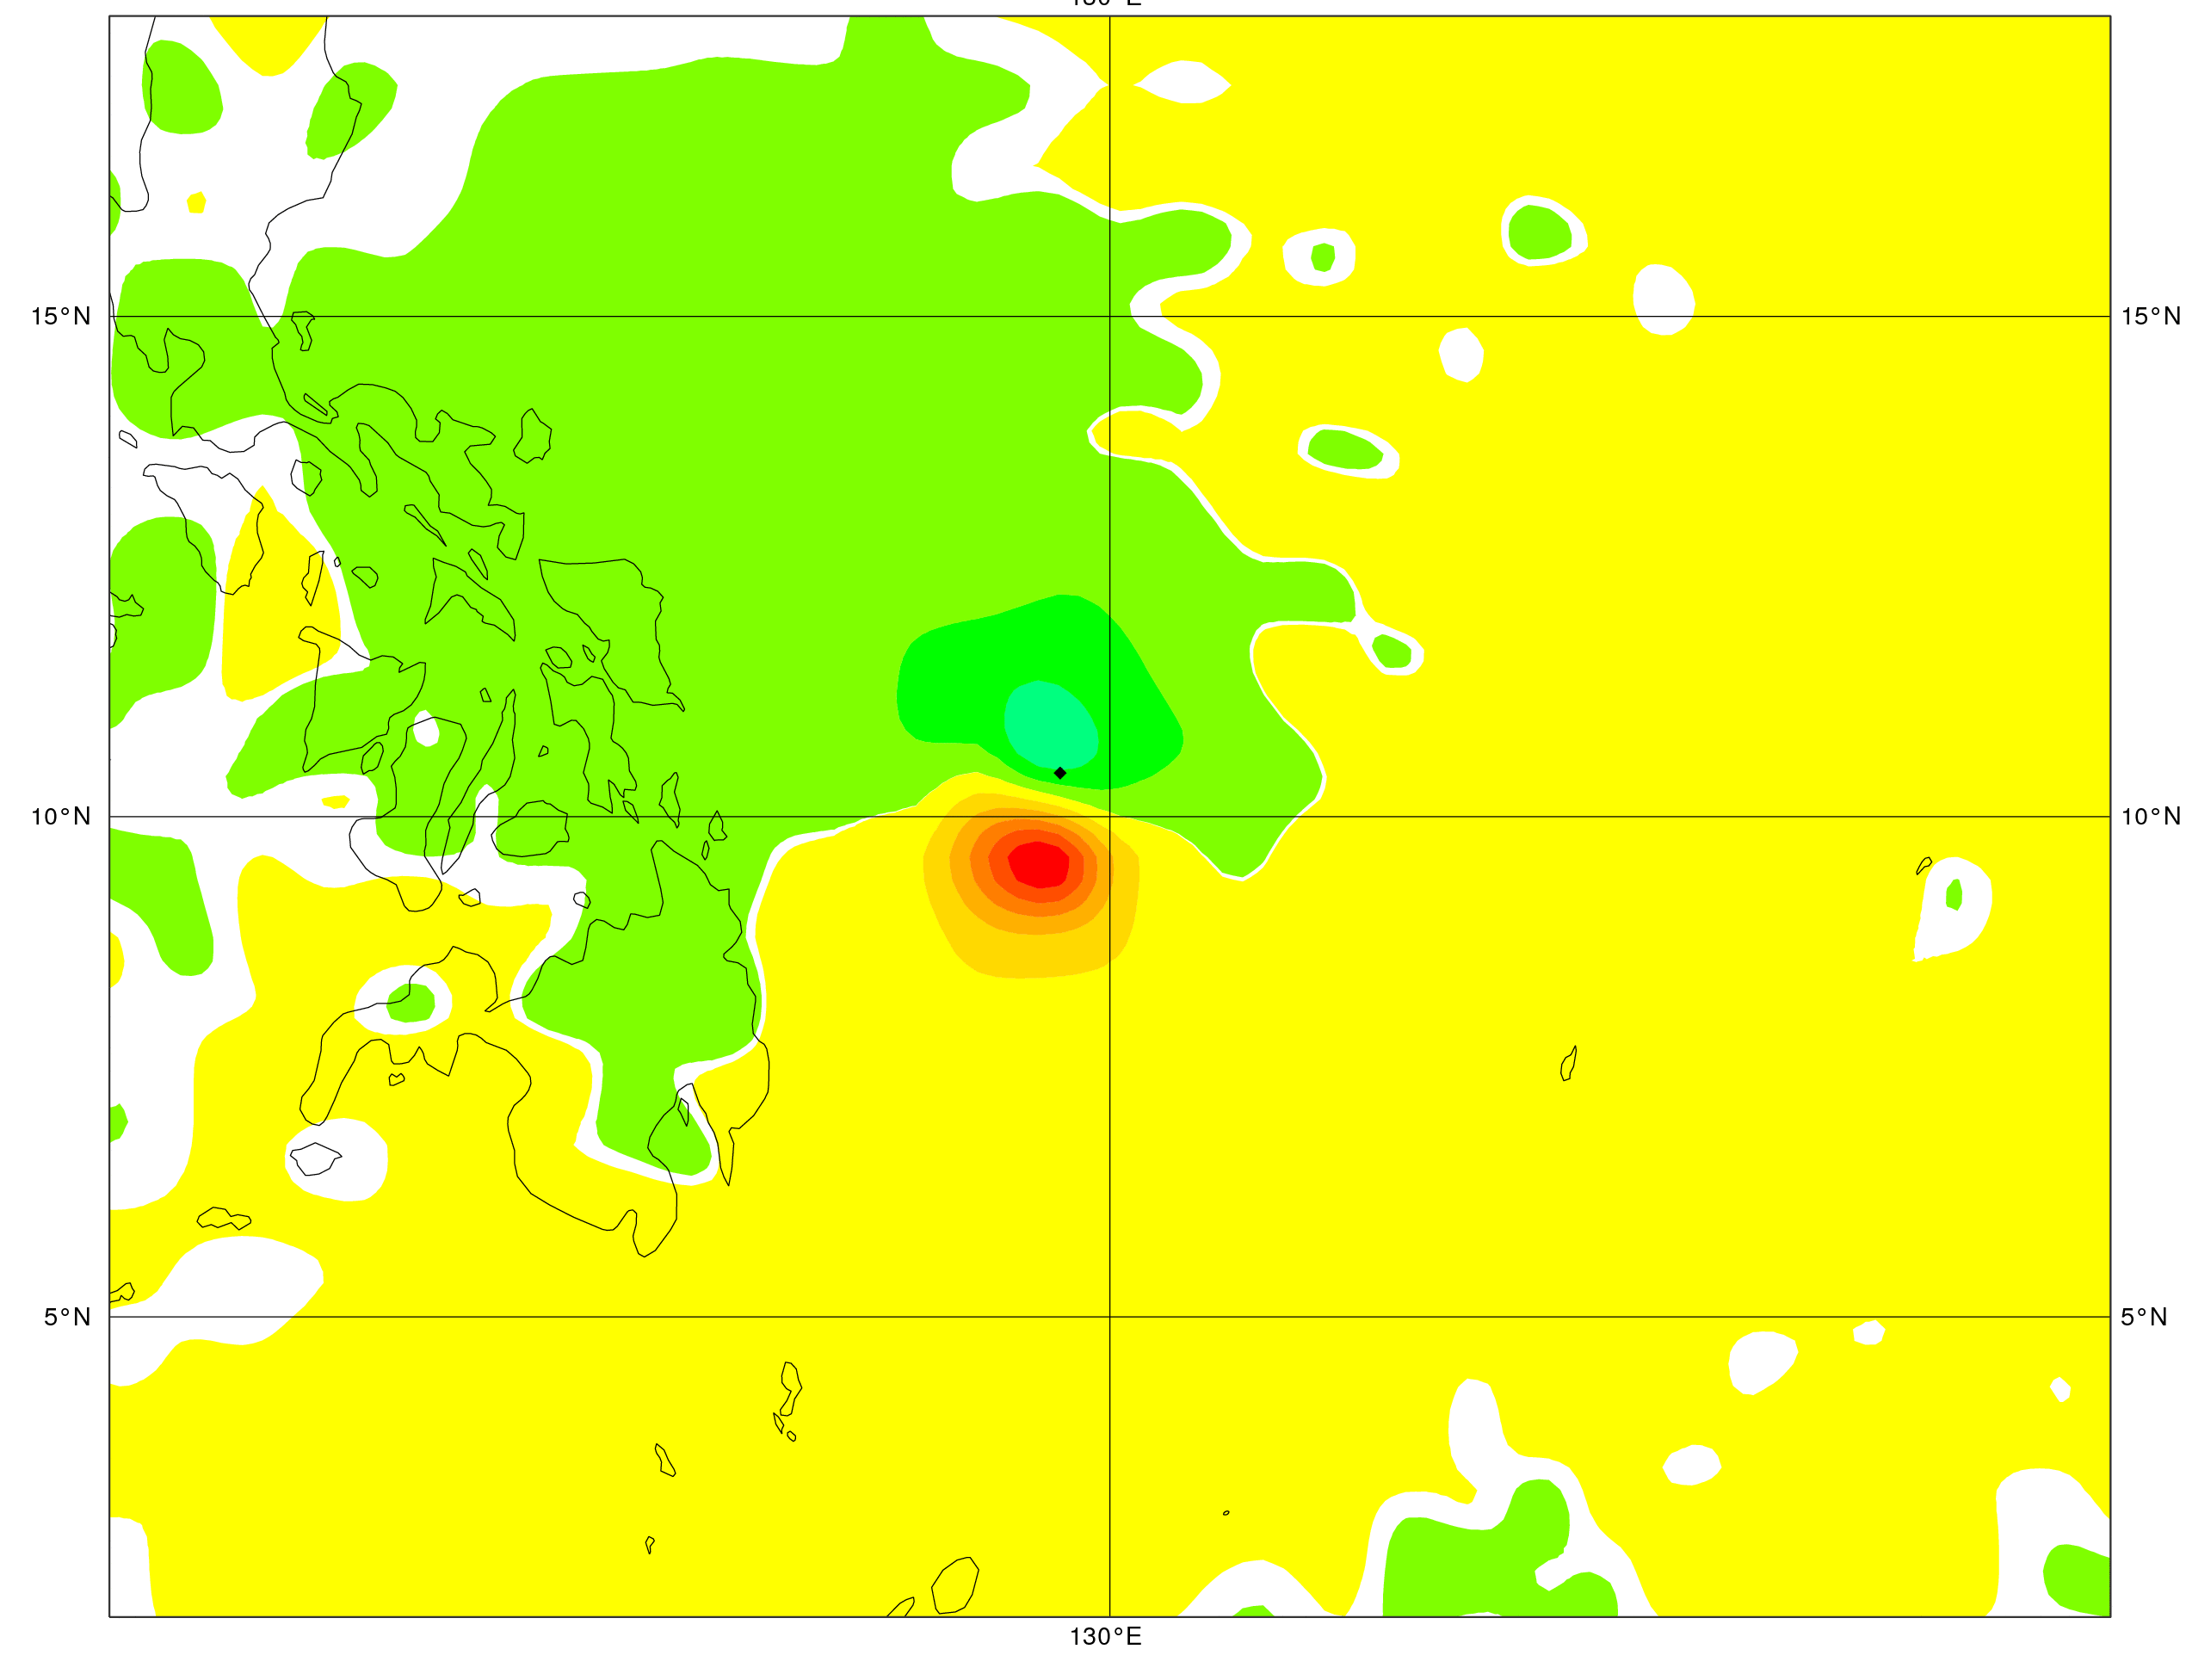
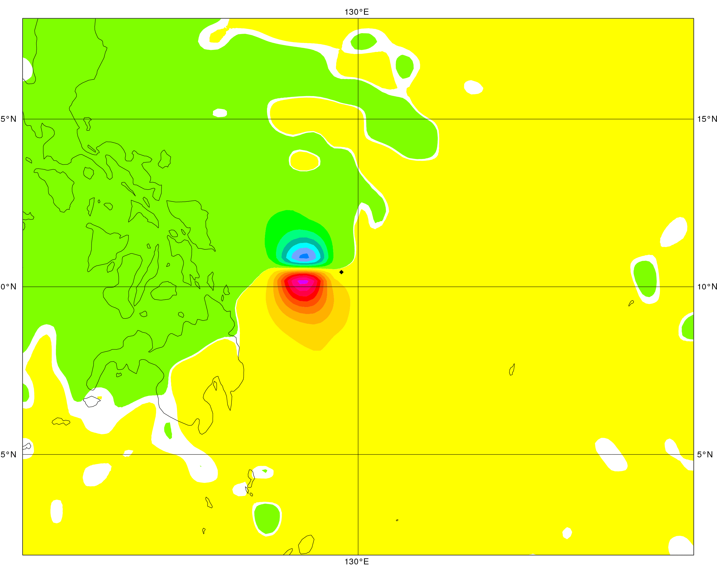
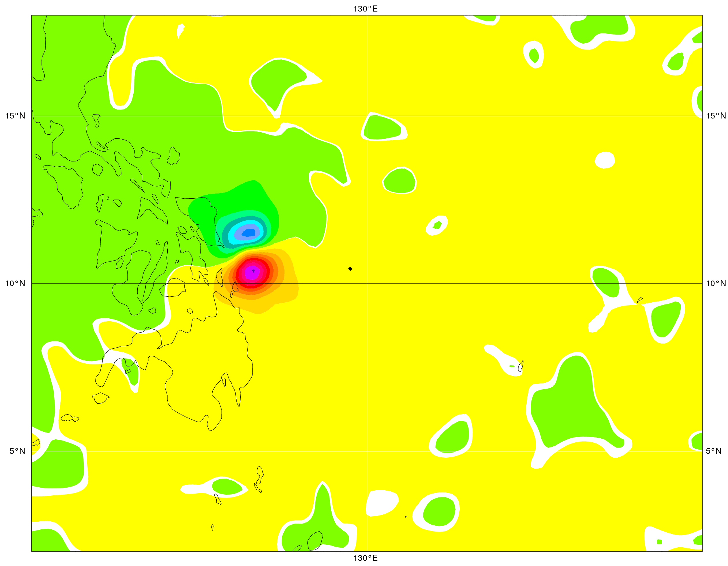
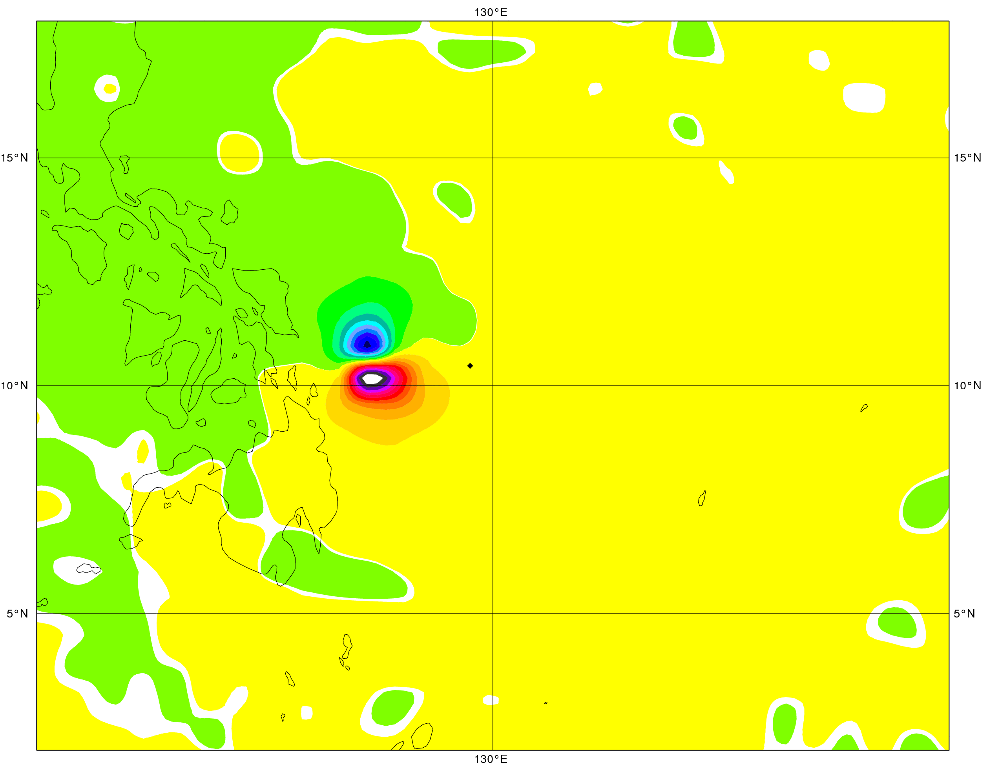
Single Observation Experiments (1 ASCAT-A)
00 [09h]
03 [12h]
T1279
06 [15h]
12 [21h]
09 [18h]

Slide 9
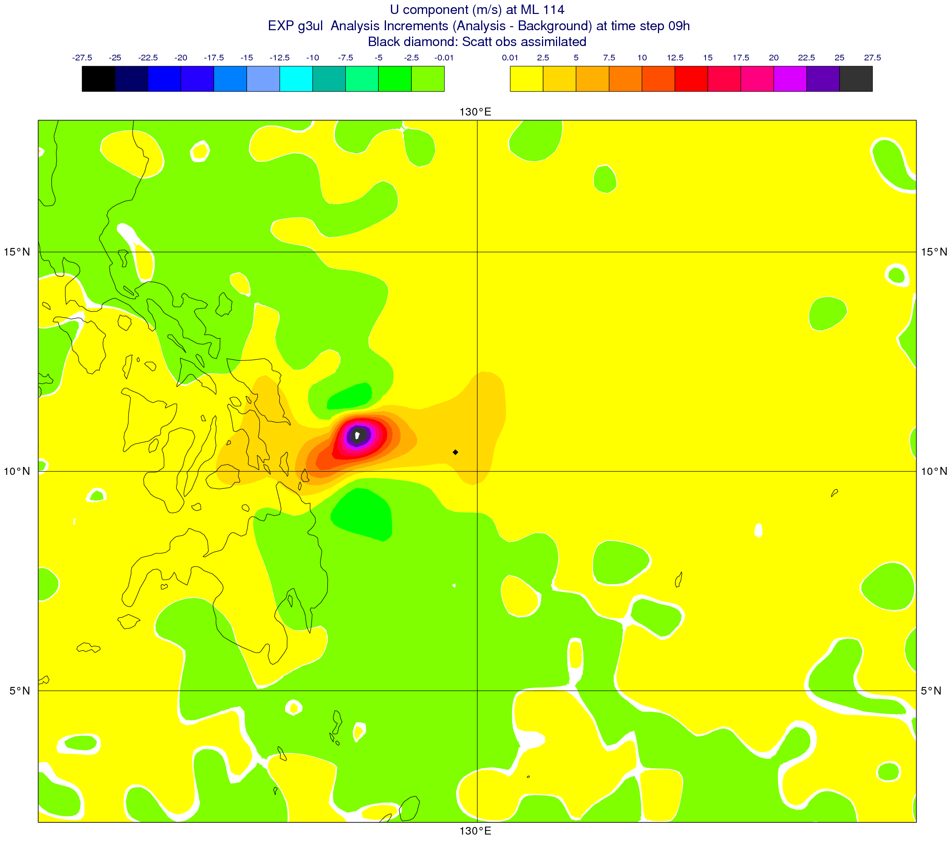
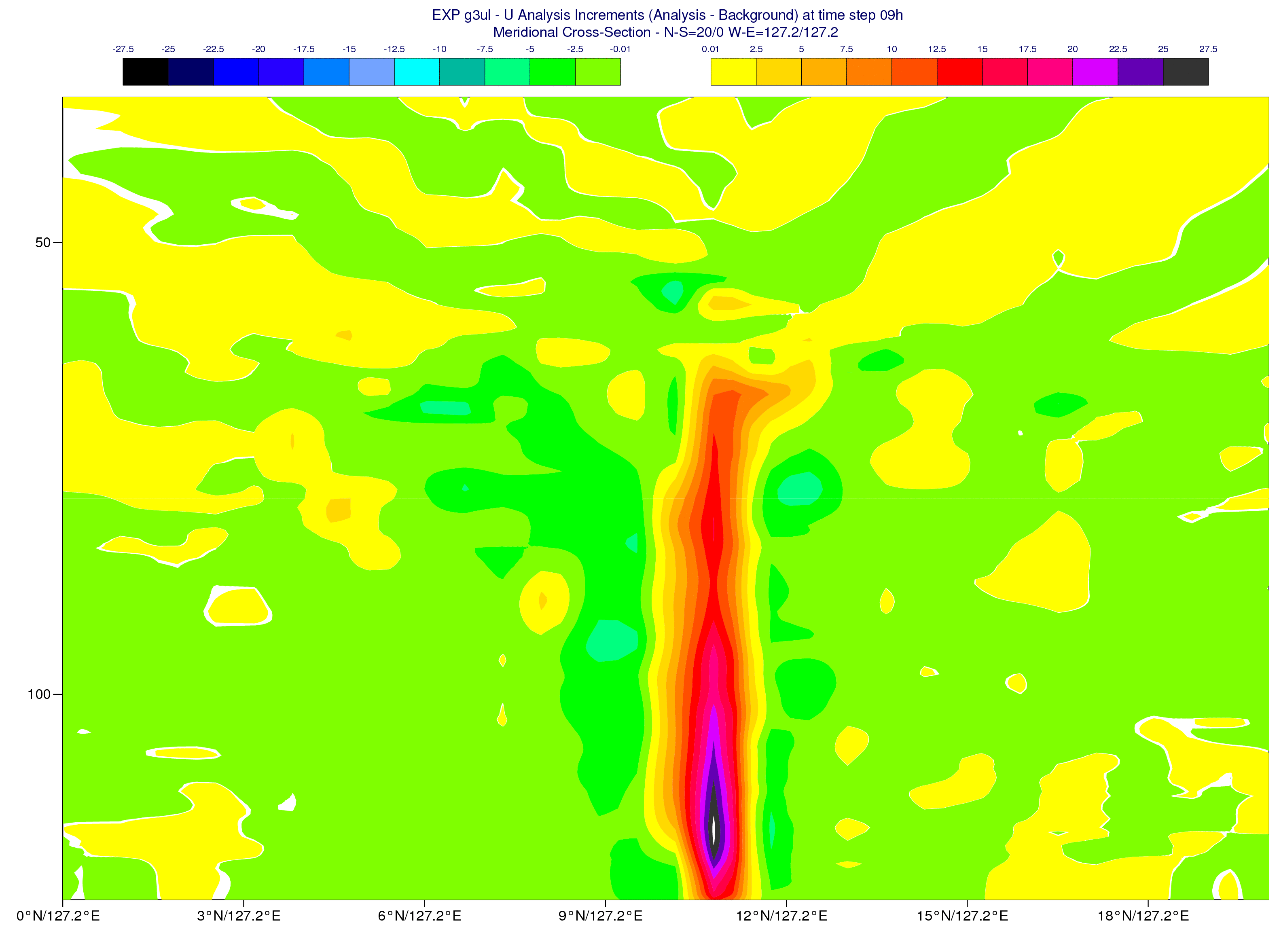
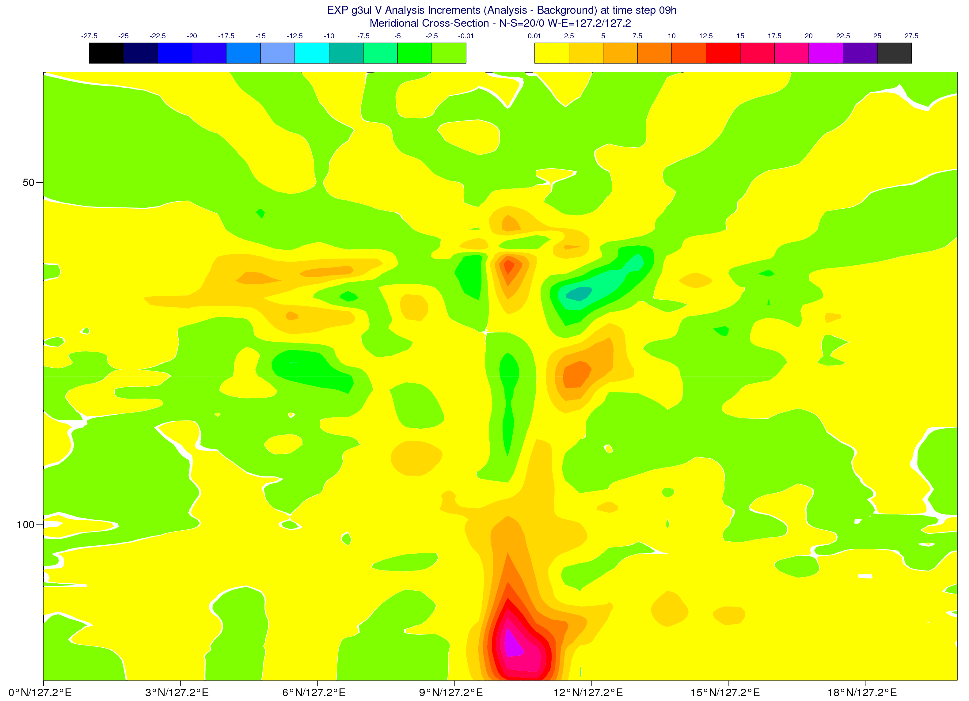
Single Observation Experiments (1 ASCAT-A)
T1279
U An Incr @ 18h
ML 114
ML PL(hPa)
137 ~ 1013
114 ~ 850
96 ~ 500
79 ~ 250
60 ~ 100
U An Incr @ 18h
V An Incr @ 18h
50
50
Model Levels
100
100
S
N
S
N
137
137

Slide 10
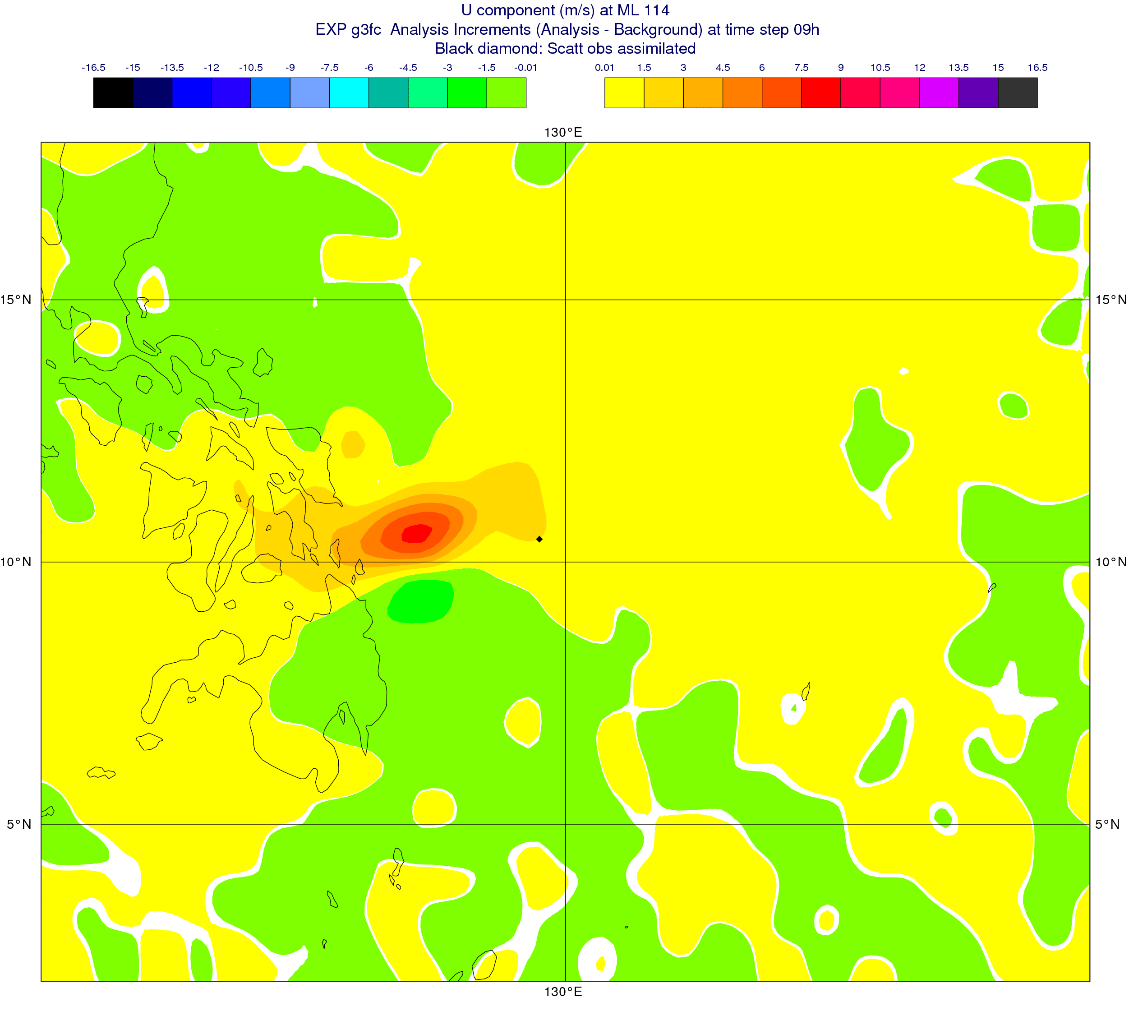
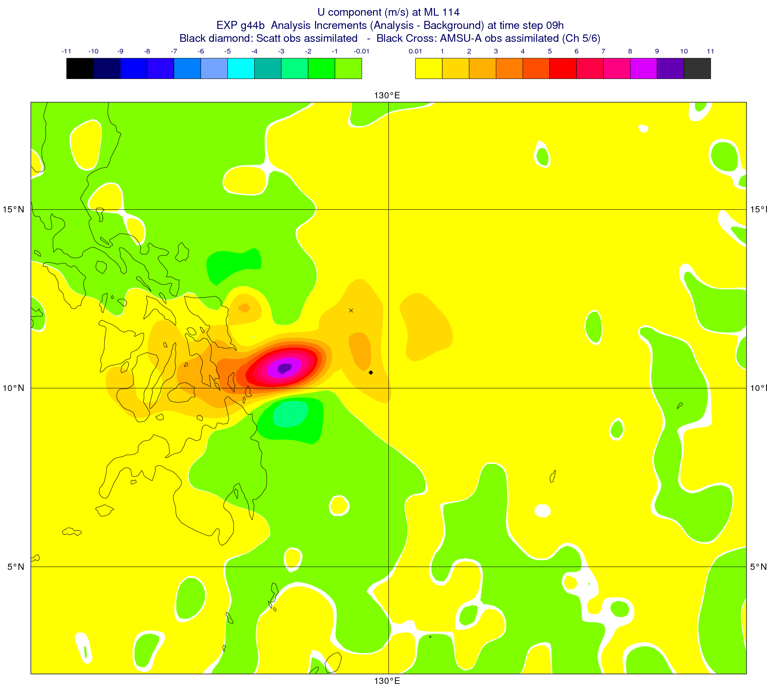
Single Observation Experiments (1 ASCAT-A + 1 AMSU-A)
1 ASCAT-A Obs + 1 AMSU-A (METOP-A):
ch5 (600 hPa / ml 100)
ch5/ch6 (600/400 hPa – ml 100/90)
ch9 (100 hPa – ml 60)
ch9/ch10 (100/50 hPa - ml 60/50)
CY40R1
T511 - An Incr 09 [18h]
ASCAT-A + AMSU-A (Ch5&6)
ASCAT-A
U - ML 114
U - ML 114

Slide 11
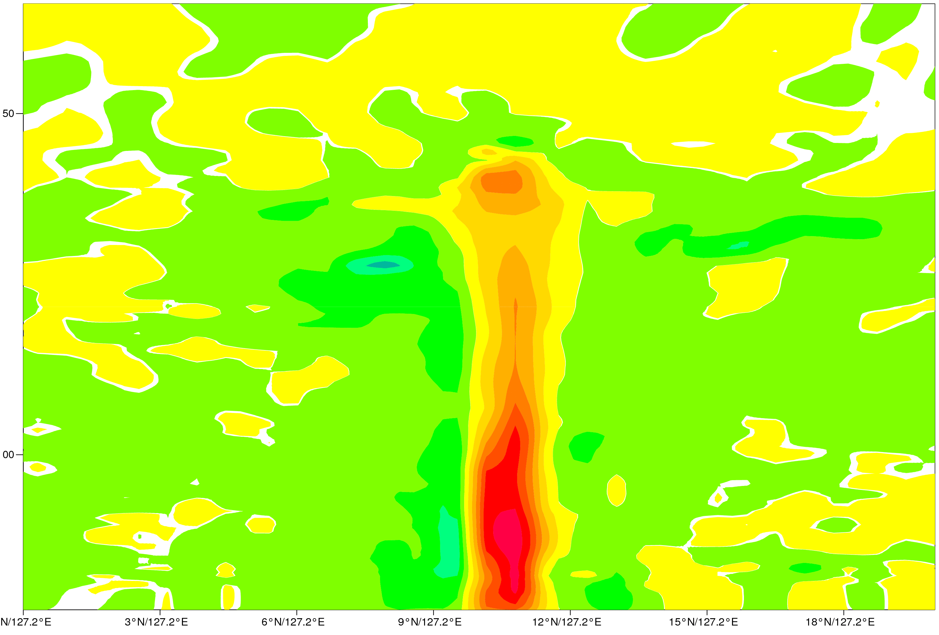
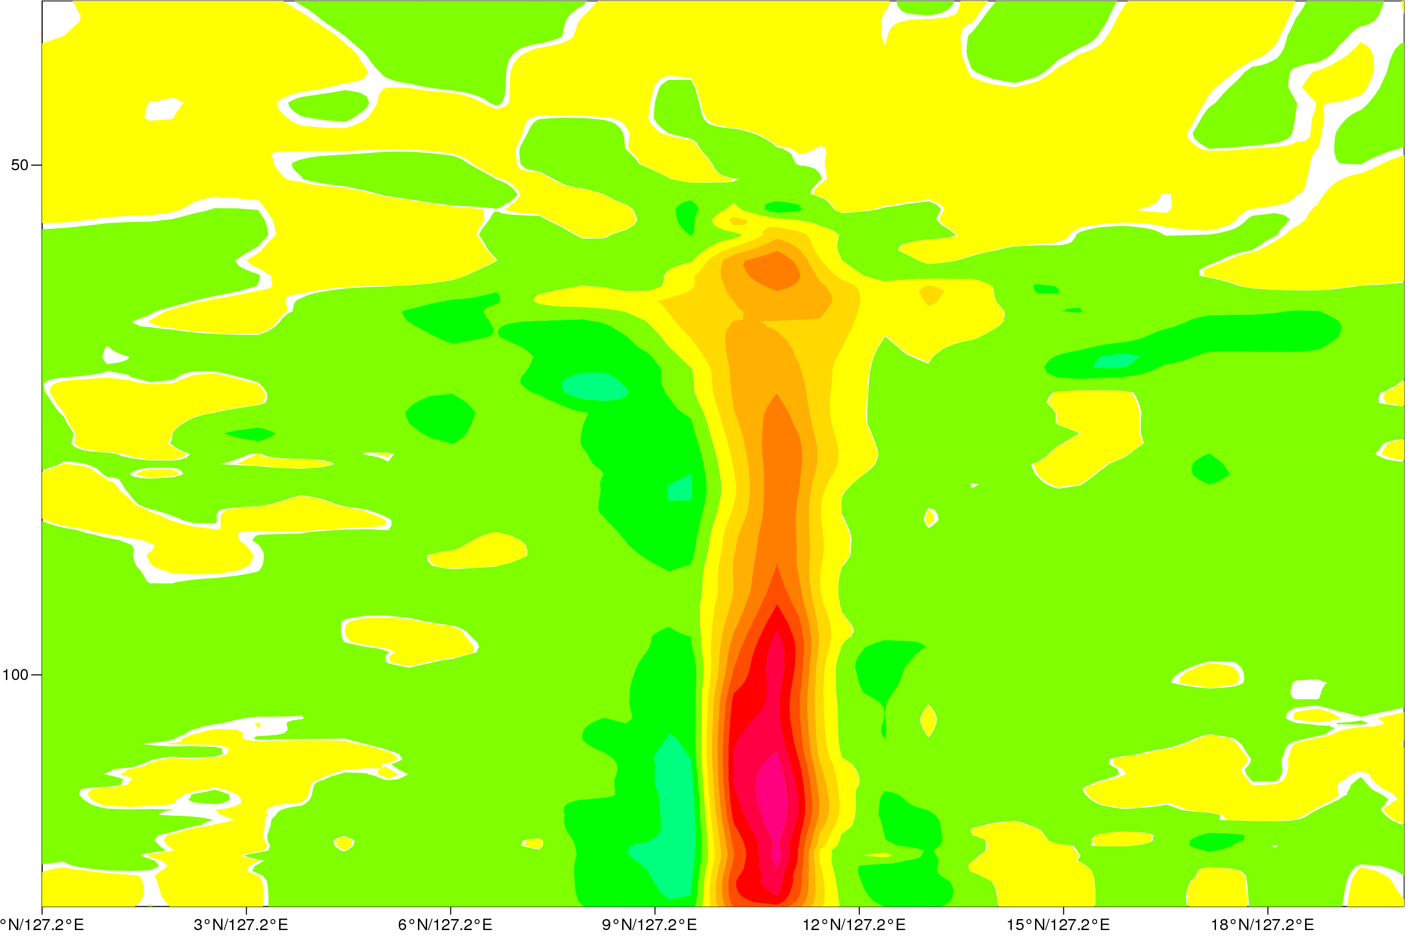
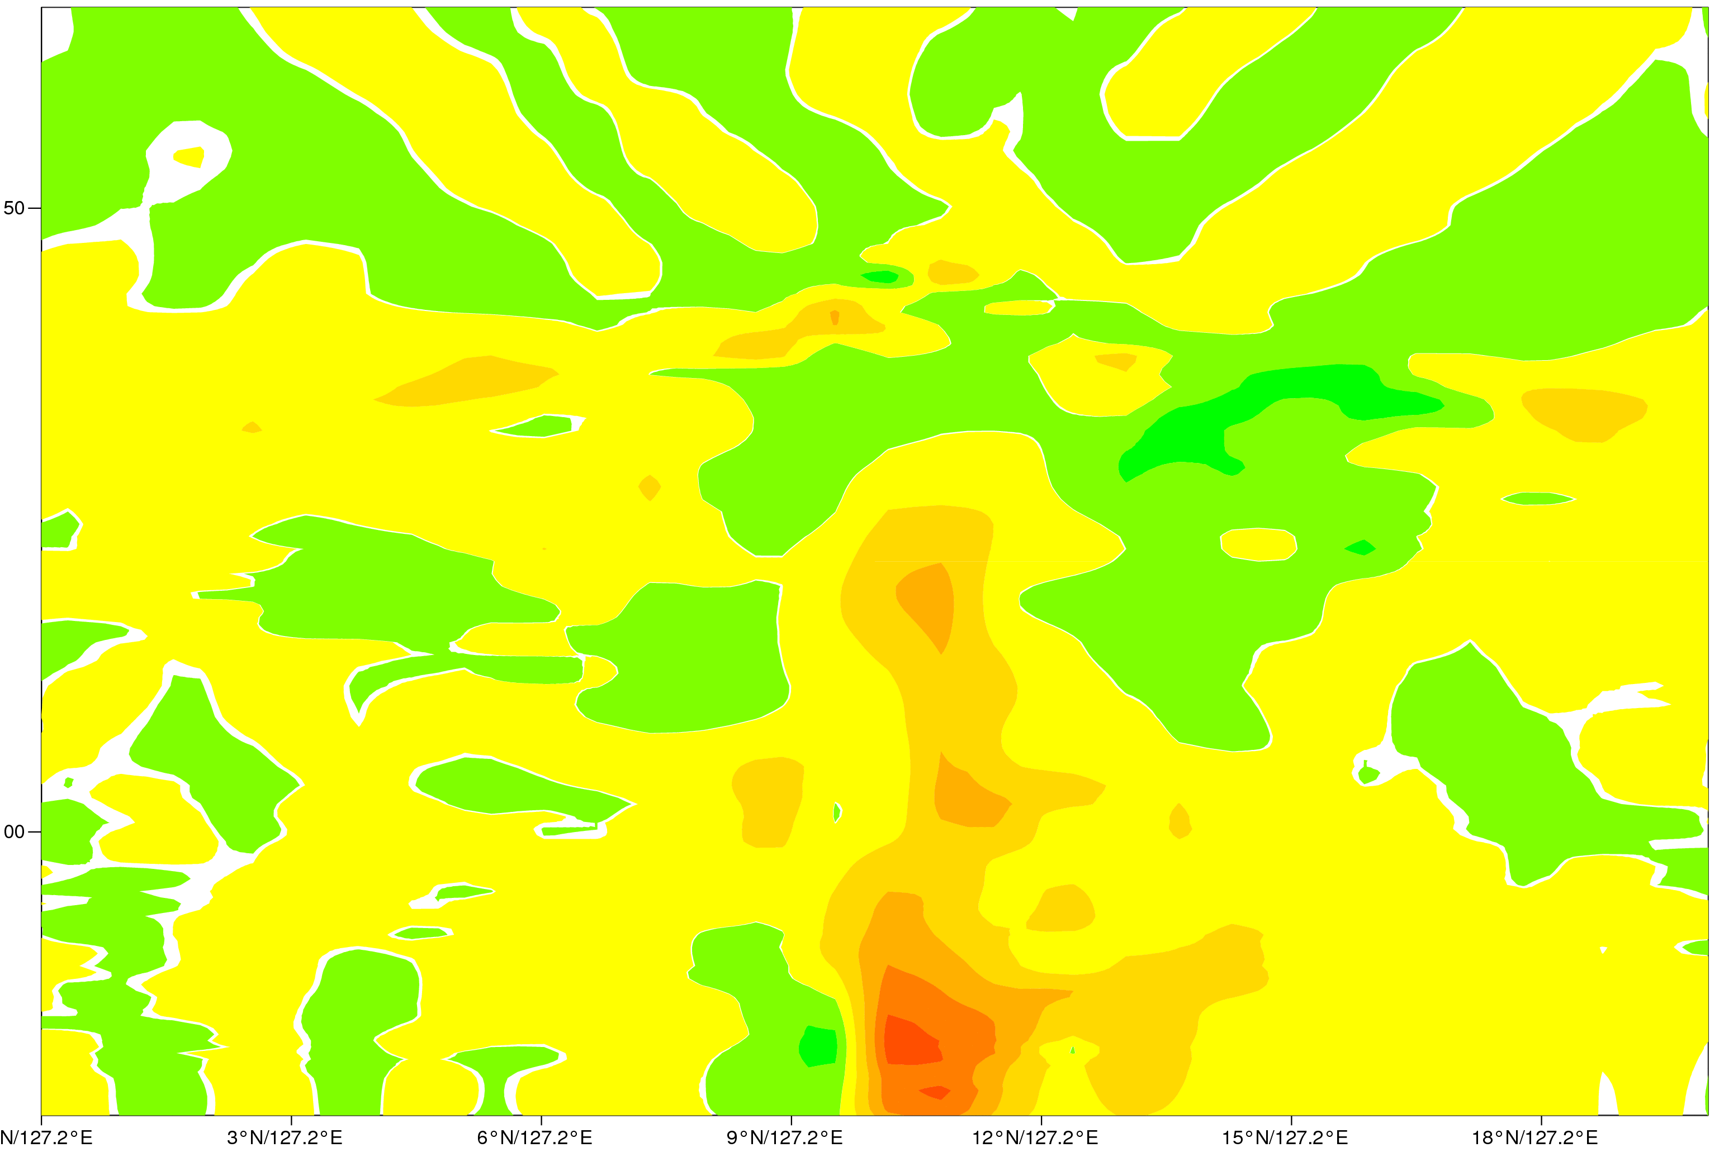
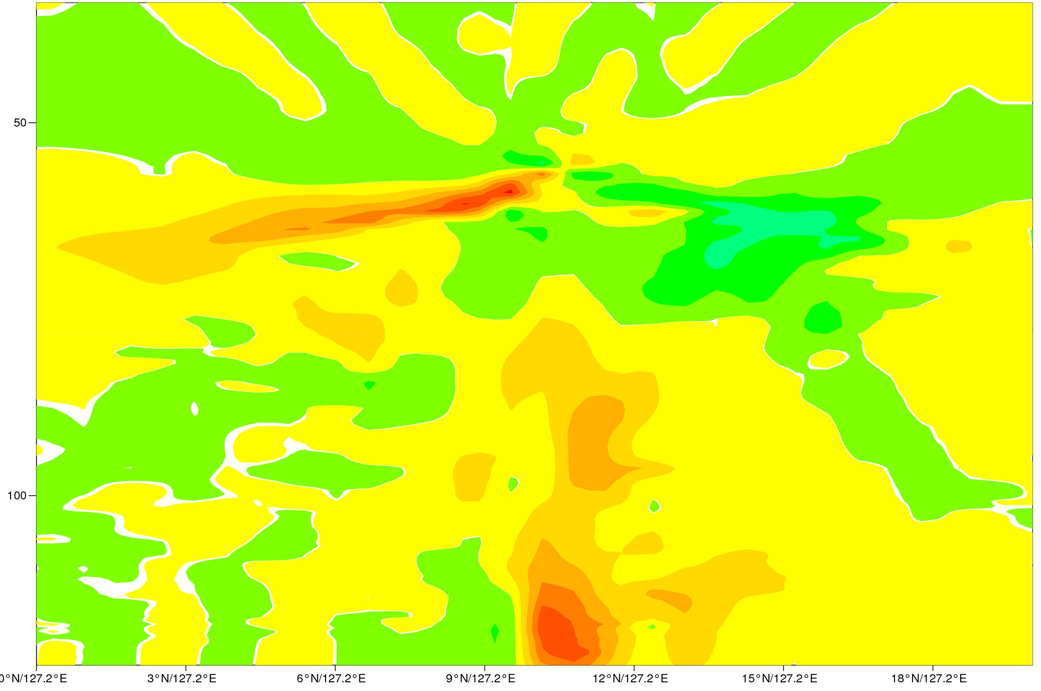
Single Observation Experiments (1 ASCAT-A + AMSU-A)
U Scatt
U Scatt + AMSUA (CH5&6)
V Scatt
V Scatt + AMSUA (Ch9&10)

Slide 12
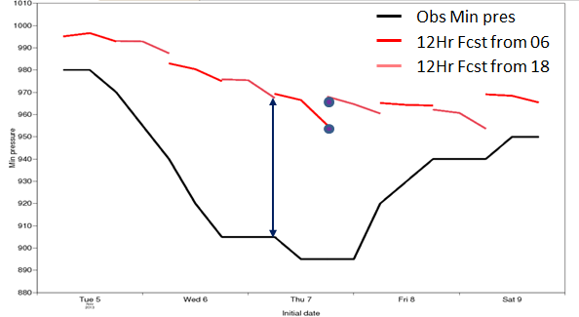
Case study: Typhoon Haiyan
Typhon Haiyan hit the Philippines on the 8 November 2013 with winds of about 315 km/h.
ECMWF forecast well the storm trajectory but the storm lacked in intensity and strength both in the analysis and forecasts.
Reported central pressure was 895 hPa at 00 UTC on 8 November (uncertainty on the observation)
ECMWF analysis was 966 hPa
The difference in the minimum pressure was partially due to the model resolution

Slide 13
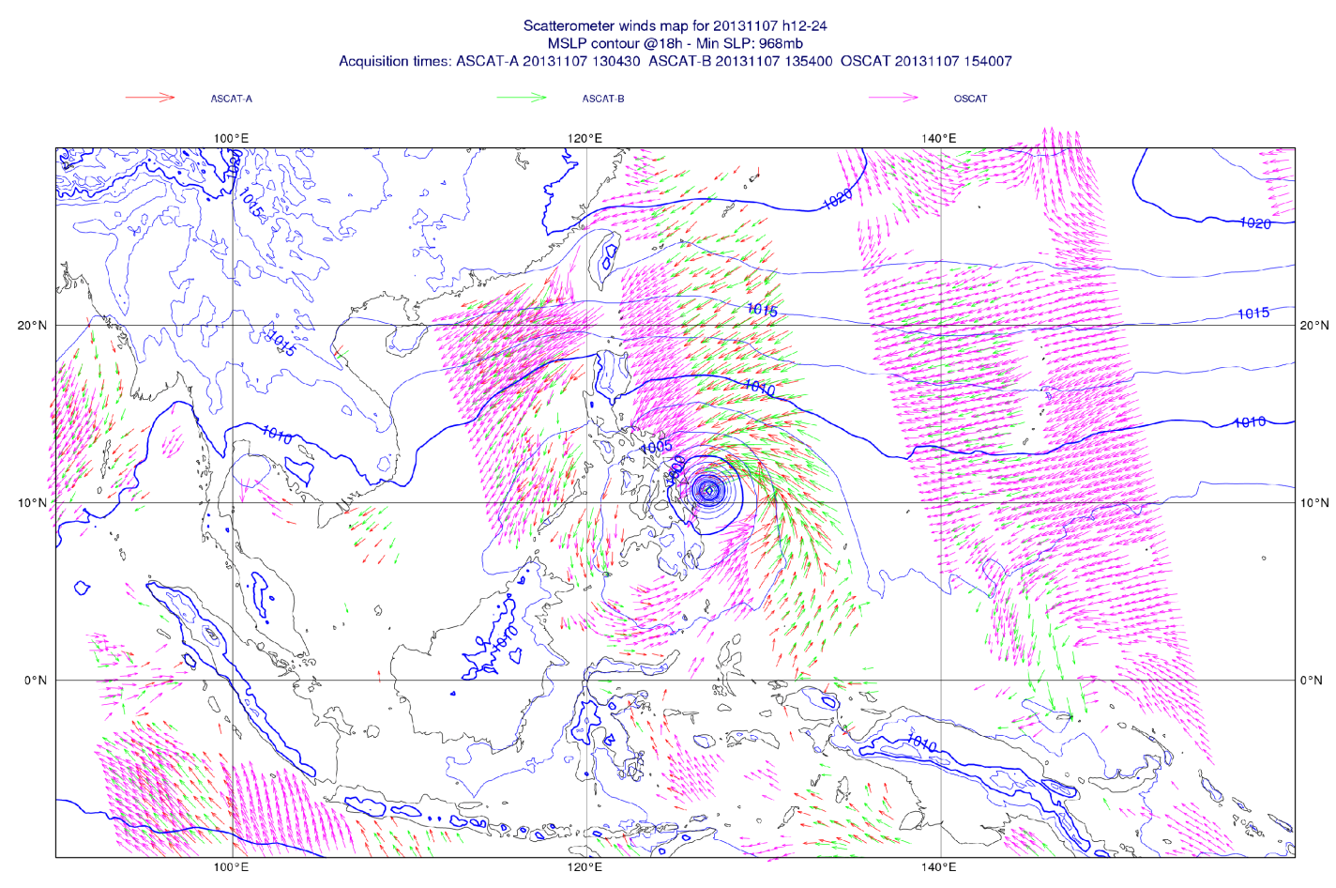
Typhoon Haiyan

Slide 14
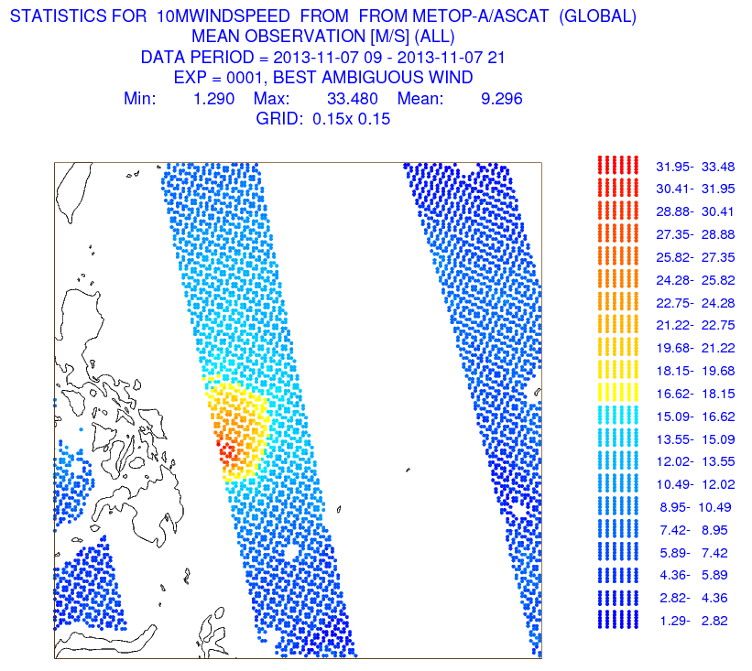
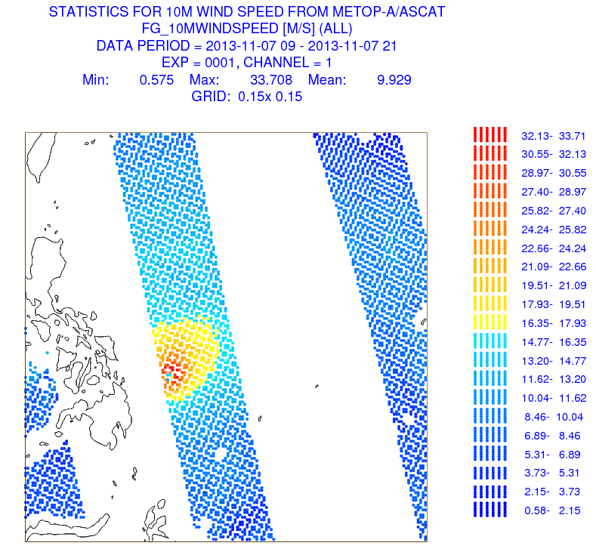
Typhoon Haiyan
All observations (active and passive)
10m ASCAT-A wind speed
10m FG wind speed

Slide 15
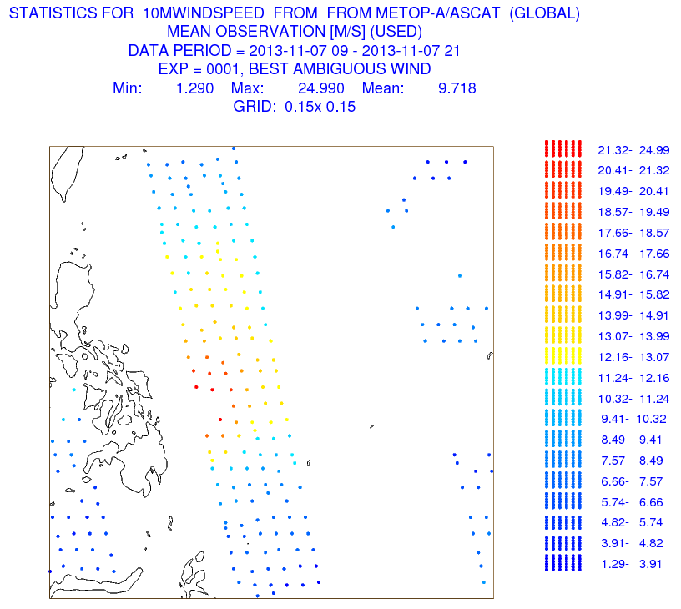
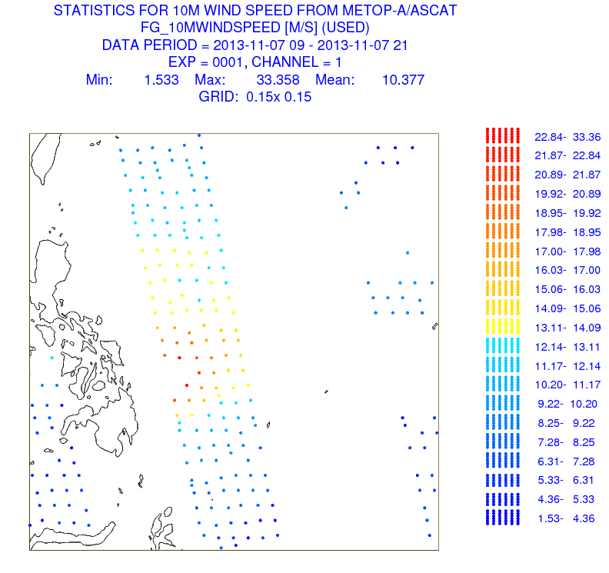
Typhoon Haiyan
Used observations
10m ASCAT-A wind speed
10m FG wind speed

Slide 16
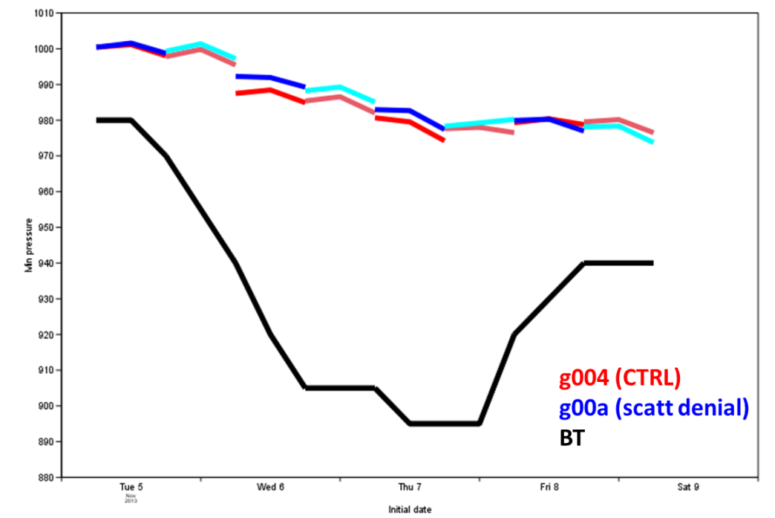
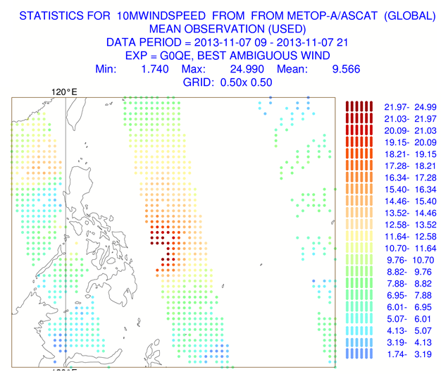
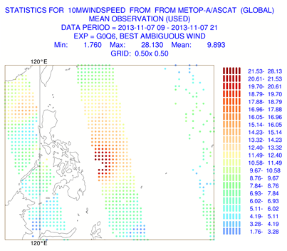
Typhoon Haiyan
Experiments Configuration
T511 (~ 40km) - CY38R1
g004: CTRL
g00a: Scatterometer Denial
g0qe: Thinning=2 (~50 km) & obs weight 1/4
g0q6: No Thinning & obs weight 1/16
Thinning =2
No Thinning

Slide 17
Conclusions
Summary
ASCAT-A and ASCAT-B are consistent and have the same impact on the system.
Verification against independent observations shows that the assimilation of scatterometer winds is beneficial on the analysis, largest impact coming from ASCAT:
Main impact is in the Tropics
A positive impact on the short range forecast is seen in the starved systems
Single observation experiments showed that:
the impact of Scatterometer winds can be propagated up to the tropopause
ASCAT and AMSU-A do not work one against each other
A Typhoon Haiyan showed that for small scale events the QC and the thinning may prevent the strongest wind to be used in the analysis:
Tests on several thinning configurations are under examination on a global scale and for TC
Different VarQC settings are under testing
The QC will be revisited by testing the Huber Norm

Slide 19
ASCAT & OSCAT assimilation strategy
ASCAT (25km)
Wind inversion is performed in-house using the CMOD5.N GMF
Assimilated as 10m equivalent neutral winds
Calibration and Quality control:
Sigma nought bias correction before the wind inversion
Wind speed bias correction after wind inversion
Screening: Sea Ice check based on SST and Sea Ice model
Thinning: 100 km
Threshold: 35 m/s
Observation error: 1.5 m/s
OCEANSAT-2 (50km)
Use of L2 wind products from OSI-SAF (KNMI)
Wind speed bias correction (WVC and WS dependent)
Quality control:
- Screening: Sea Ice check on SST and Sea Ice model
- No thinning; weight in the assimilation 0.25
Observation error: 2 m/s
Threshold: 25 m/s

Slide 20
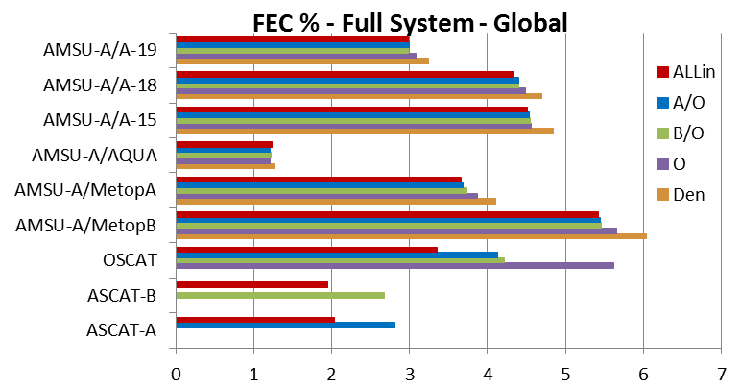
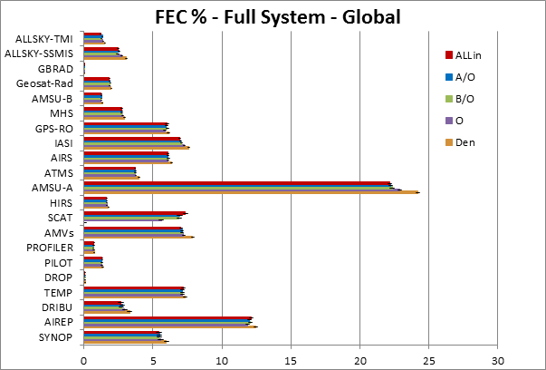
Forecast Sensitivity to Observations – Full System
Regional statistics show that the larger impact is in the SH.

Slide 21
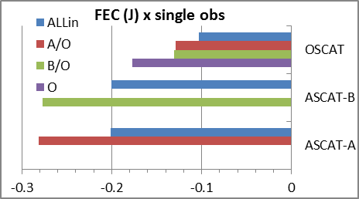
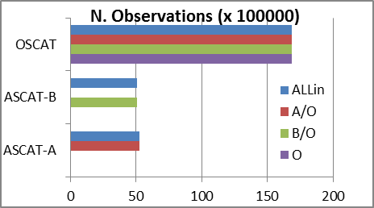
Forecast Sensitivity to Observations – Full System

Slide 22
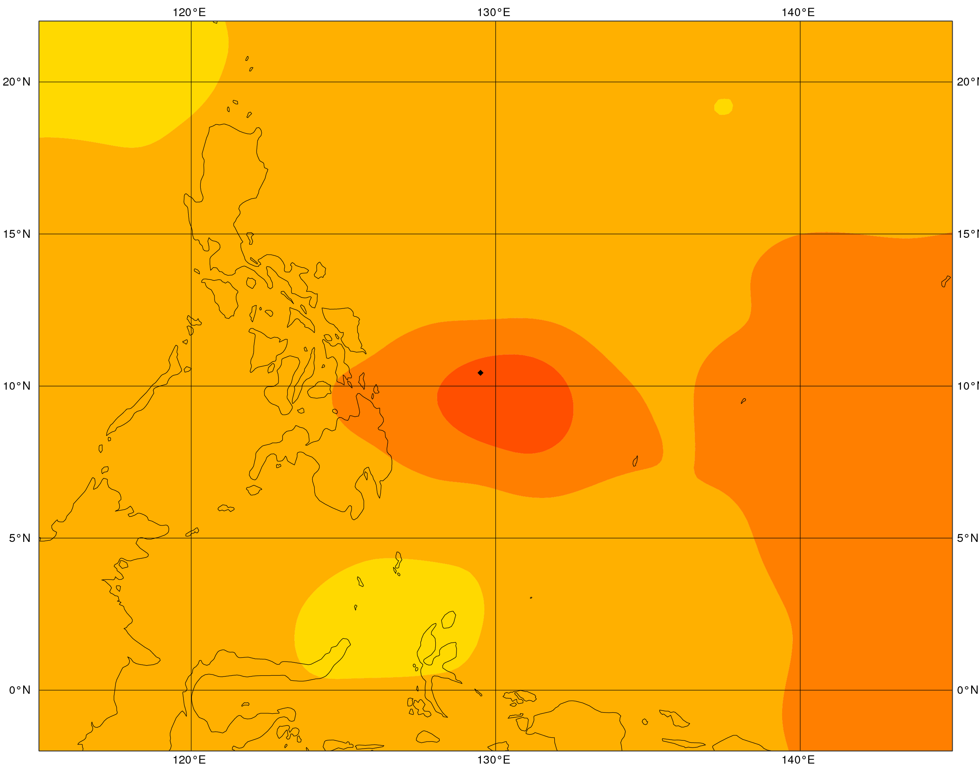
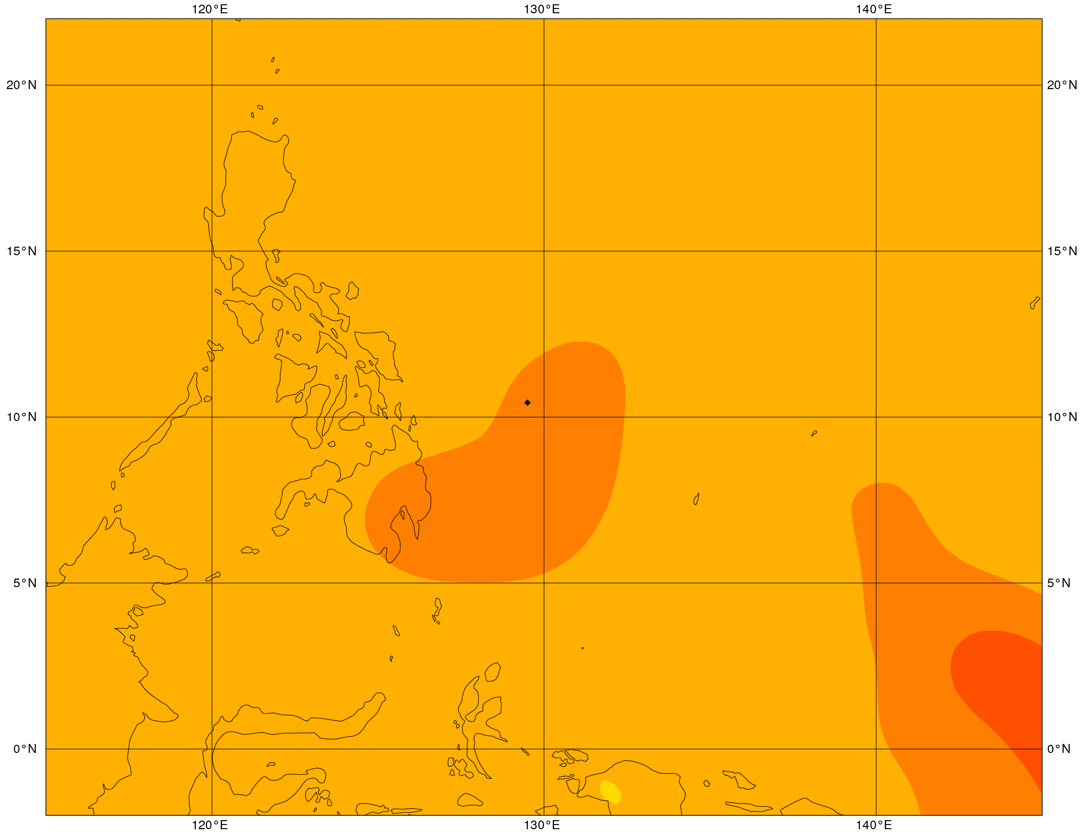
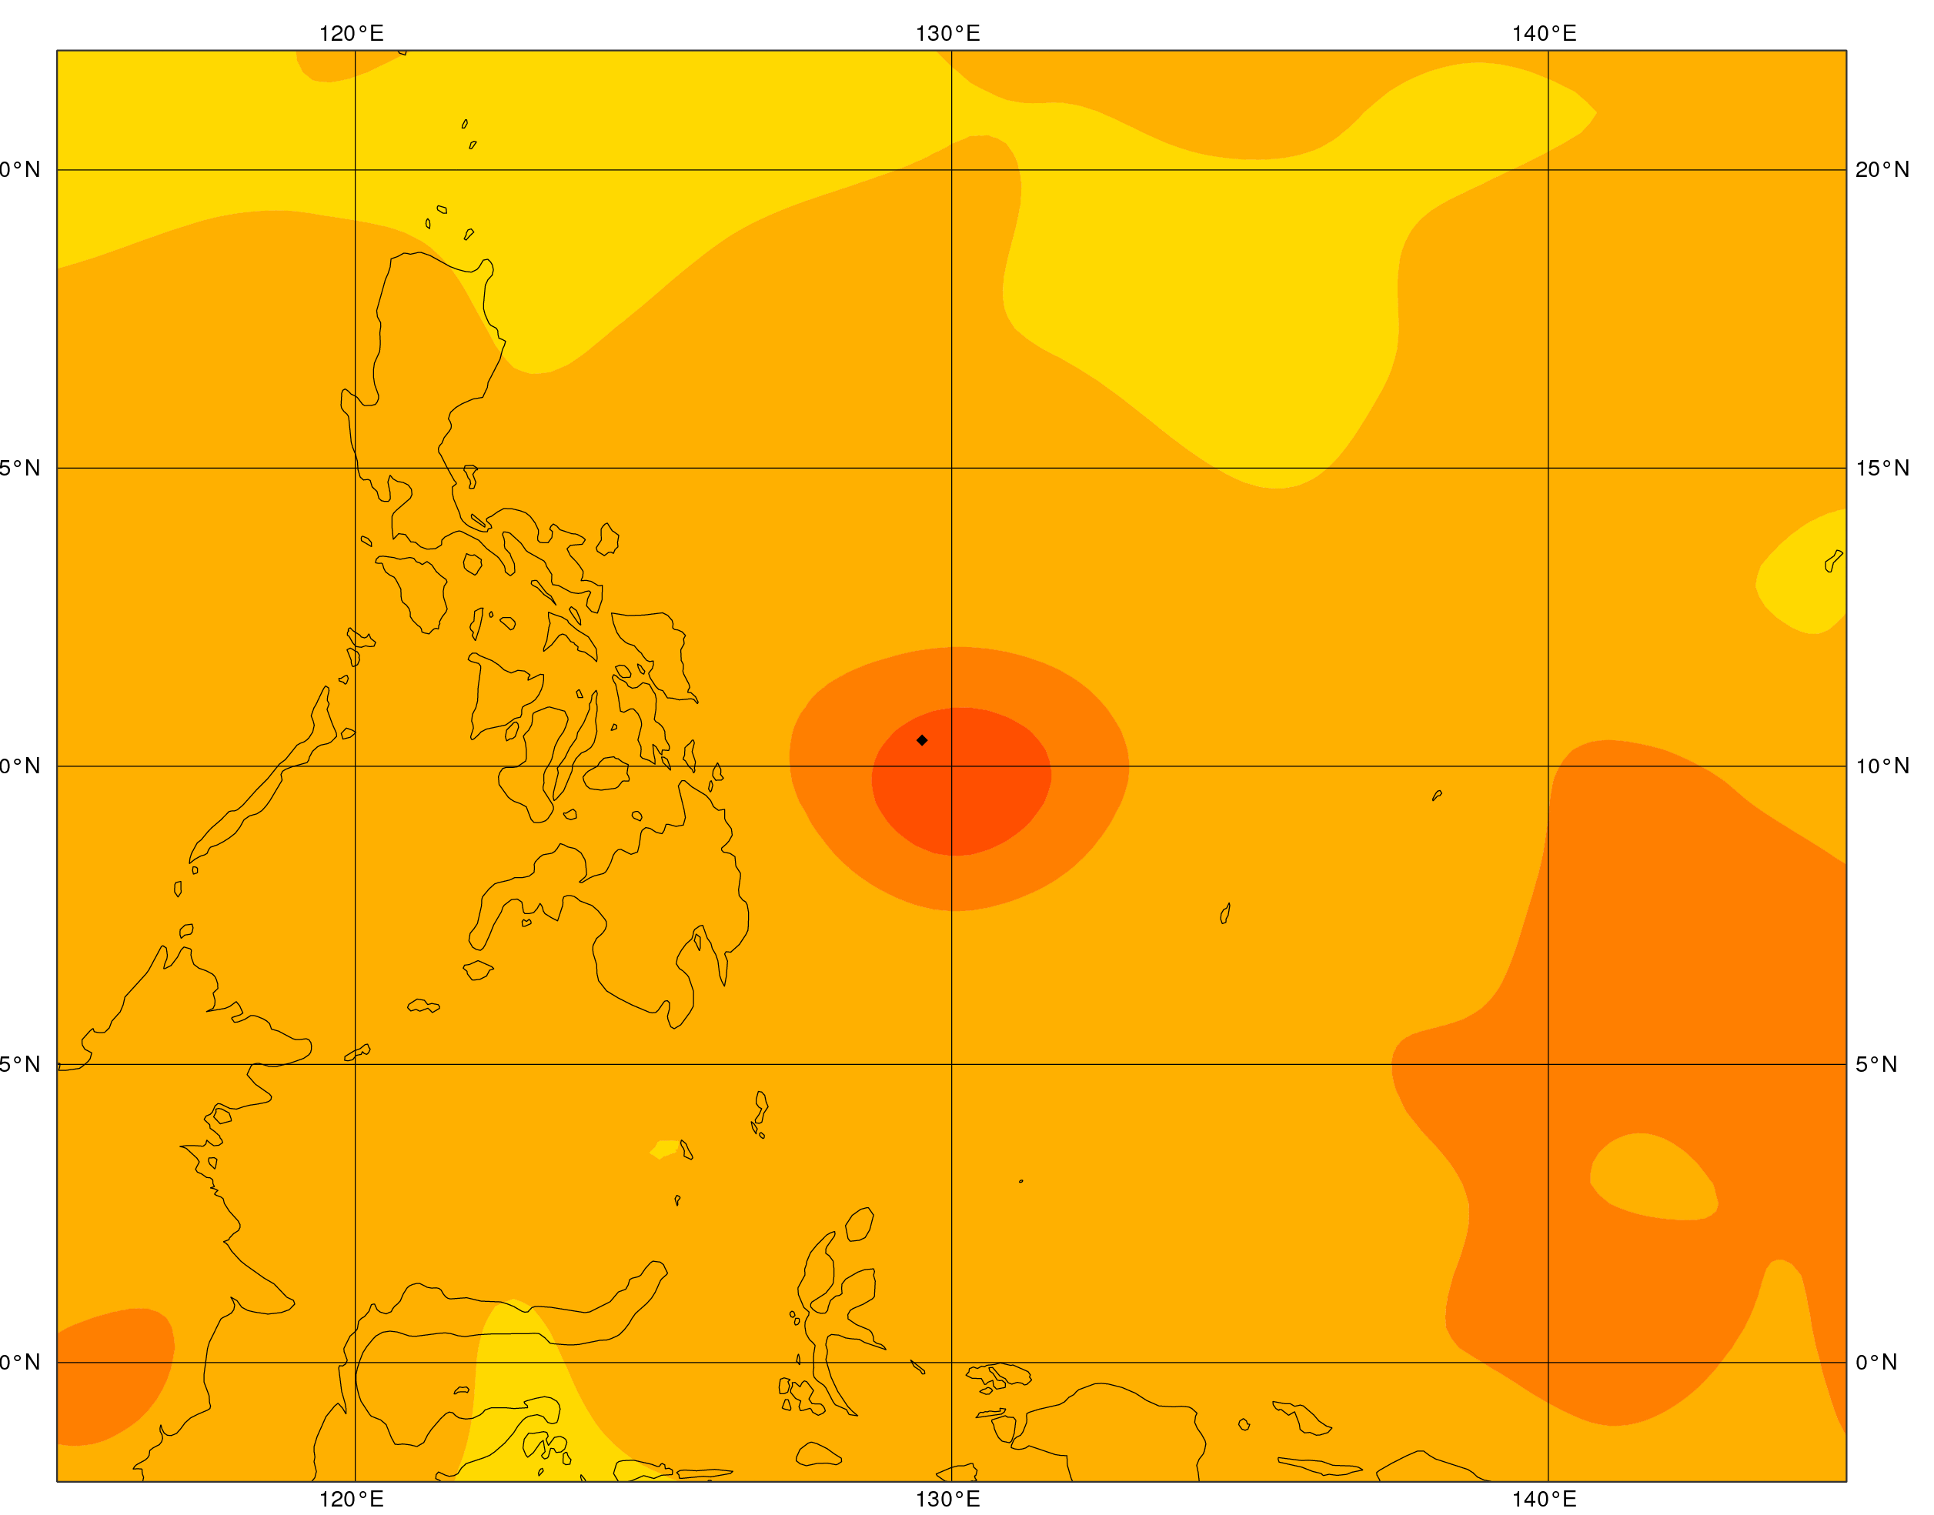
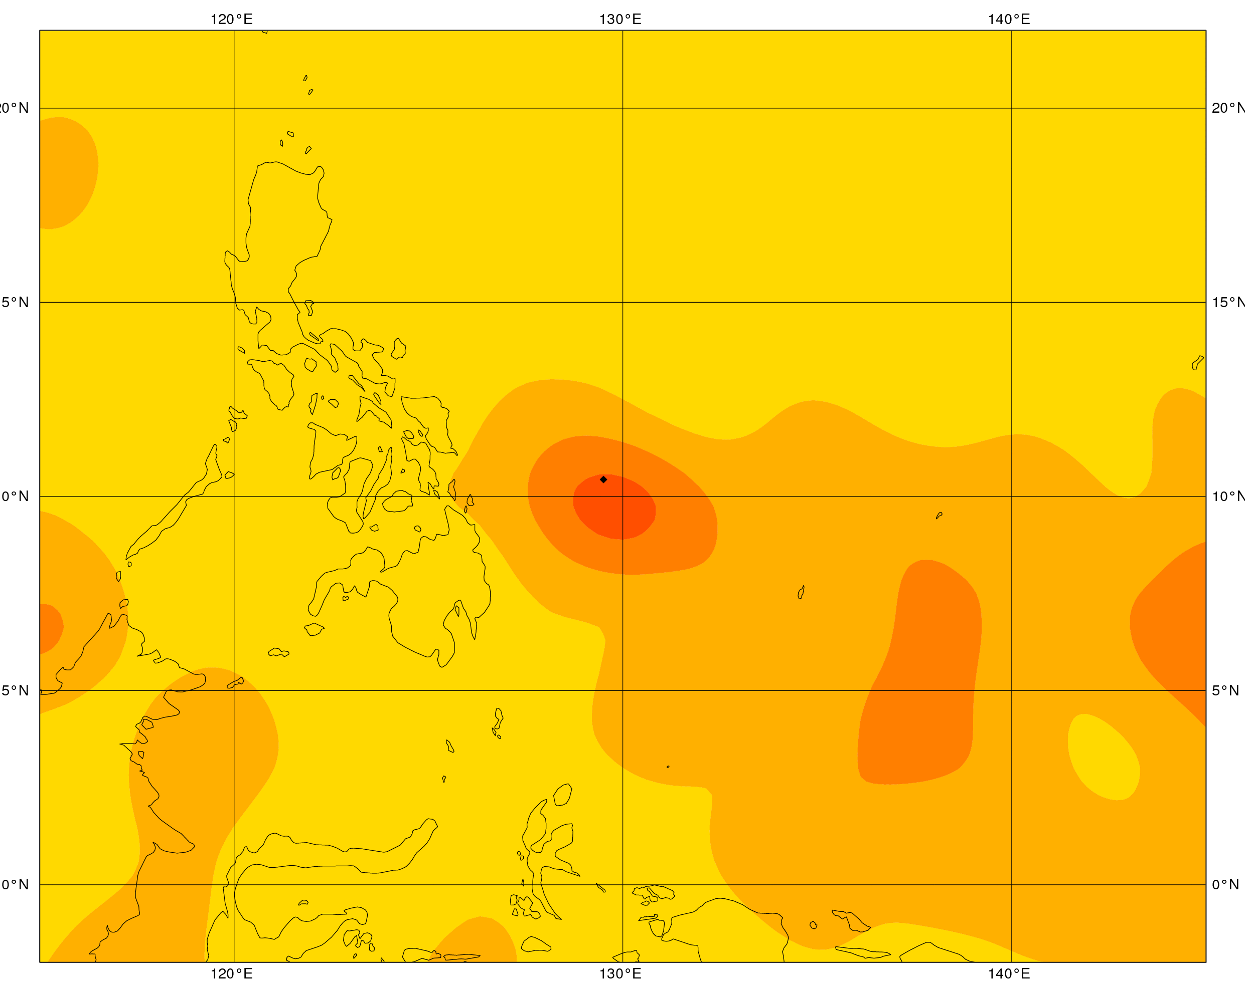
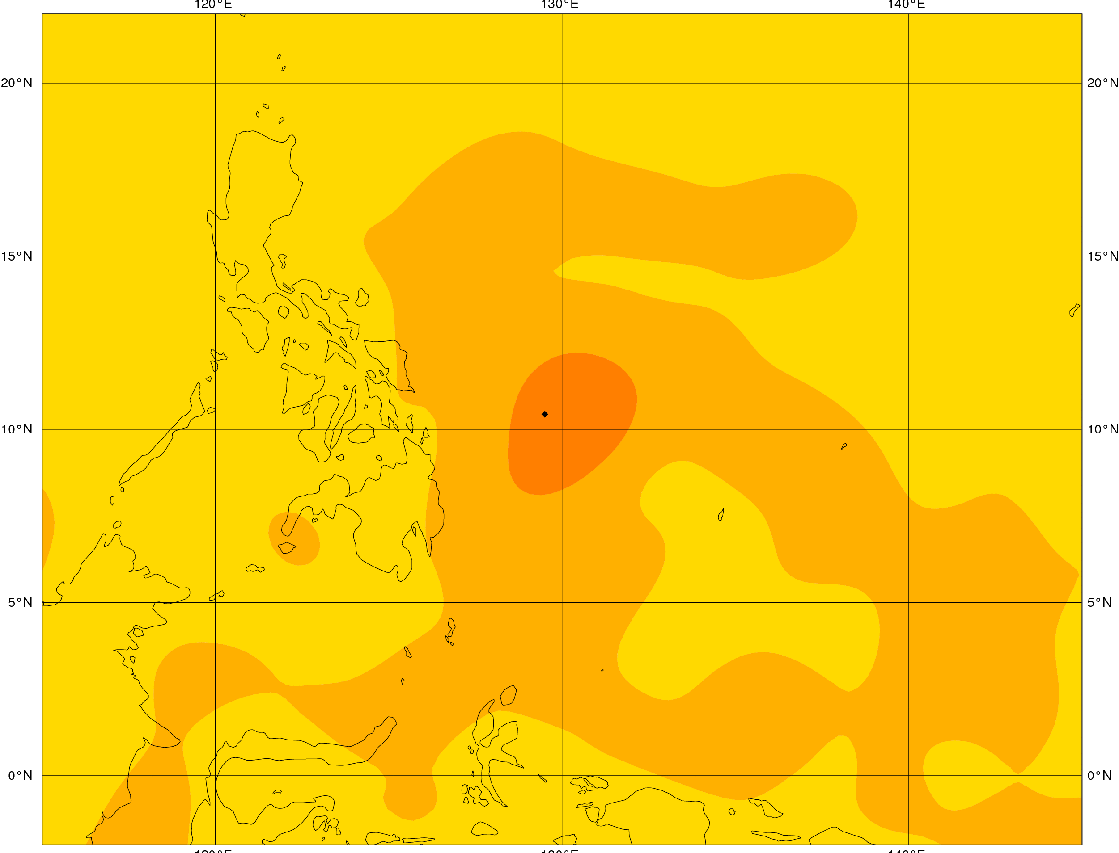
Single Observation Experiments (1 ASCAT-A)
U-comp EDA Background Error V-comp
ML 96
ML 96
ML 114
ML 114
ML 137
ML 137

