Slide 1
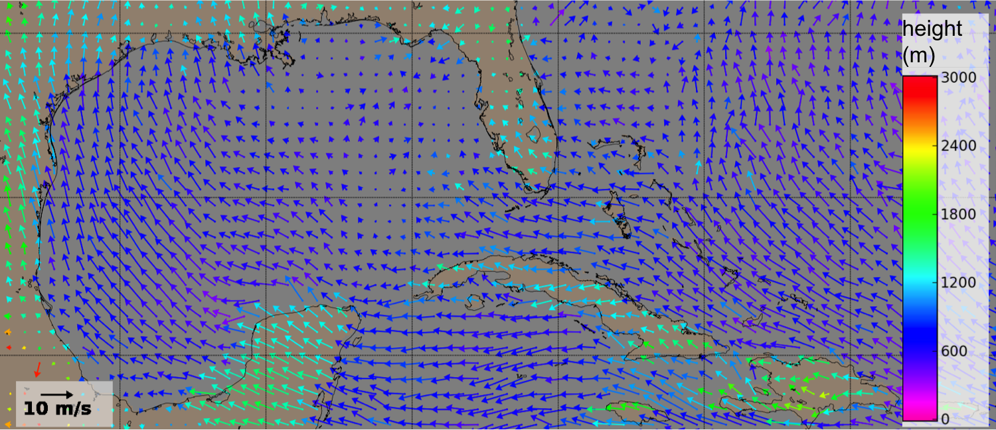
The MISR NRT CMV product: MISR cloud motion vectors within 3 hour latency
Kevin Mueller¹, Steve Protack², Nancy Baker³, Brian Rheingans¹, Veljko Jovanovic¹, Sebastian Val¹
¹Jet Propulsion Laboratory, California Institute of Technology
² SSAI NASA Langley Resarch Center
³ Naval Research Laboratory, Monterey
June. 17, 2014
Mean MISR summer 2007 Cloud Motion Vectors of height < 3 km
© California Institute of Technology

Slide 2
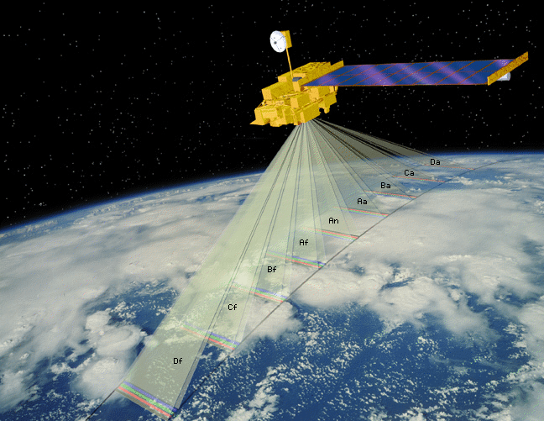
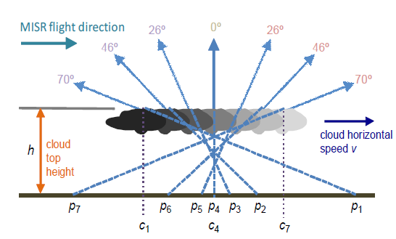
Multi-Angle Imaging SpectroRadiometer (MISR) Wind Products
MISR instrument
Mission Lifetime
1999 -> 2018+
Swath Width ~ 380 km
9 Camera View Angles
0º (Nadir)
±26.1º, ± 45.6º
±60.0º, ± 70.5º
7 minute overpass
B, G, R, & NIR Bands
Spatial Resolution
275 m for Nadir and Red Band
1100 m all else
Up
Cross-track
Along-track
∆t ~ 7 minutes
Cross-track
Along-track
MISR Wind Products
Height-resolved Cloud Motion Vectors (CMV)
Geometric height obtained from parallax
Retrieved from redundant forward and aft camera triplets
Time interval ∆t = 200 seconds
Gridded resolution ∆x = 17.6 km
Height-resolved cross-track cloud motions:
Geometric height obtained from parallax
Retrieved from redundant forward and aft camera pairs
Time interval ∆t = 46 seconds
Gridded resolution ∆x = 1.1 km

Slide 3
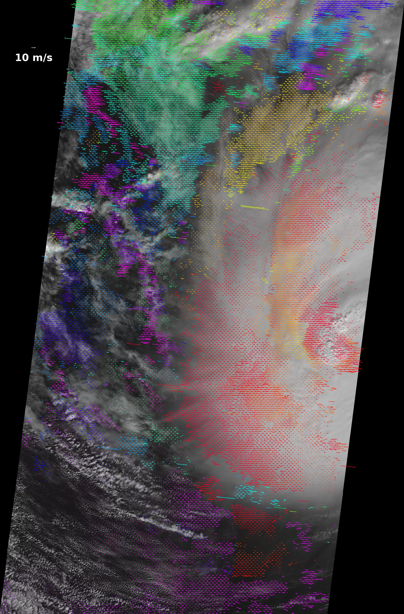
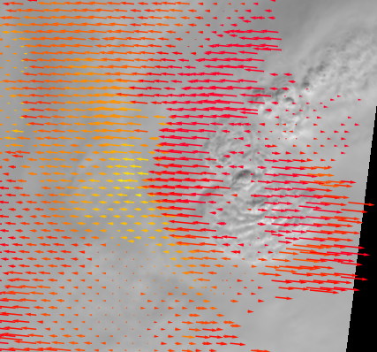
Example MISR Wind Product Retrievals
Height resolved cross-track cloud motion (1.1 km resolution)
(Hurricane Ida)
Height resolved cloud motion vectors (17.6 km resolution)
(Hurricane Francis)
Height (meters)

Slide 4
Revisiting IWW-11 NWP WG Recommendations
Recommendation | Progress
“NWP centres to evaluate MISR winds in offline assimilation tests” | Naval Research Lab (NRL) obtained significant positive forecast impact with study continuing. Study led by N. Baker Japan Meteorological Agency (JMA) obtained mixed, but overall positive forecast impact. Study led by K. Yamashita German Weather Service (DWD) obtained mixed, but mostly positive forecast impact. Study led by A. Cress. JPL study under way with support from NASA Global Modeling and Assimilation Office (GMAO) using GEOS-5 DAS
“JPL to provide MISR winds with improved latency (~5hr)” | Near Real Time (NRT) MISR wind product to enter production by August 2014 Currently in final end-to-end testing at NASA Langley Research Center MISR NRT wind product to have well under 3 hour latency
“Agencies to provide data in BUFR format” | MISR NRT wind product will be offered in BUFR and HDF-EOS4 format

Slide 5
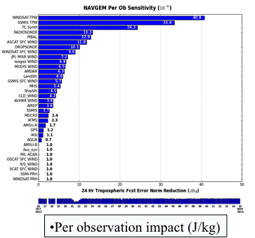
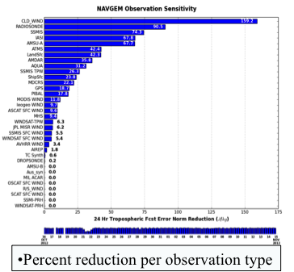
NRL obtains good overall forecast impact
NRL conclusion: Good overall impact from MISR winds
Low level MISR winds appear to fill data gap
details in poster...
MODIS WIND (11.8)
MISR (6.2)
WINDSAT SFC (5.4)
WINDSAT SFC (9.0)
MISR (7.2)
MODIS WIND (6.5)

Slide 6
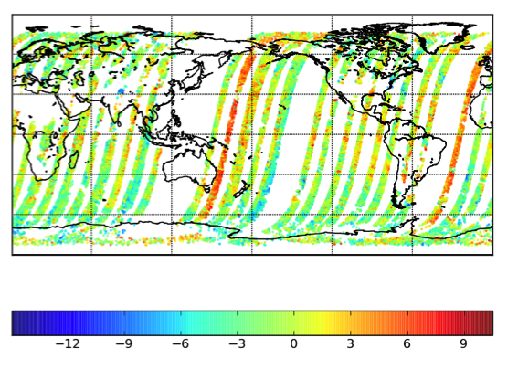
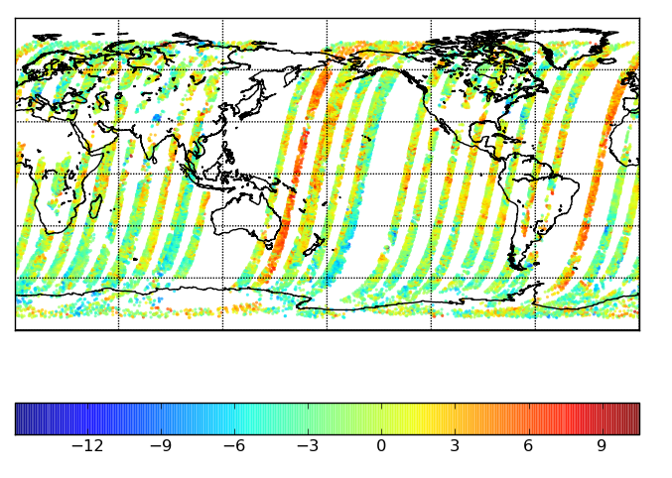
NRL expecting improved impact with fine-tuning
NRL opportunities to improve MISR impact
Revisit quality control and assimilation procedures
Make use of MISR QI along with observation
Find optimum observation density
Screen per retrieval and per orbit to identify MISR orbits with suspect georegistration
MISR v-wind innovation
Screening observations per orbit as well as per retrieval will benefit MISR
impact

Slide 7
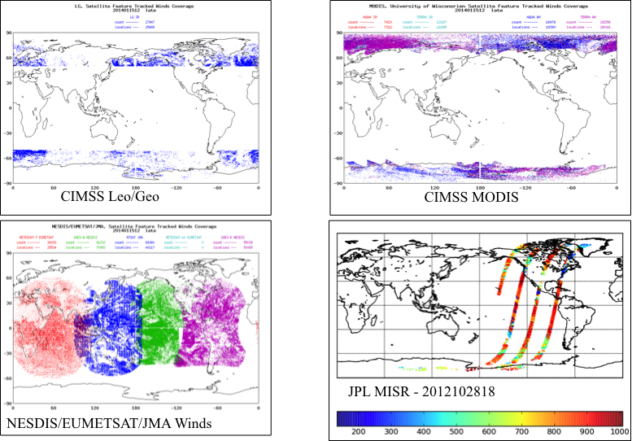
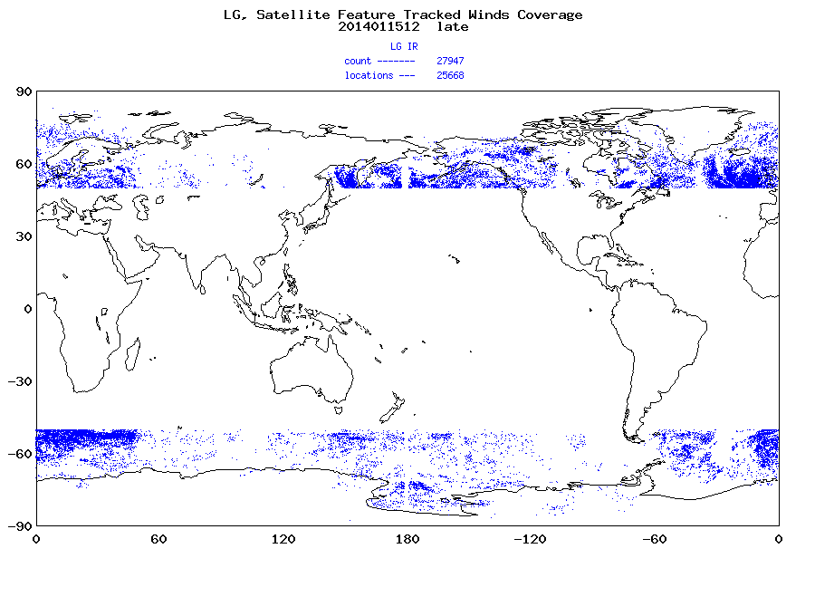
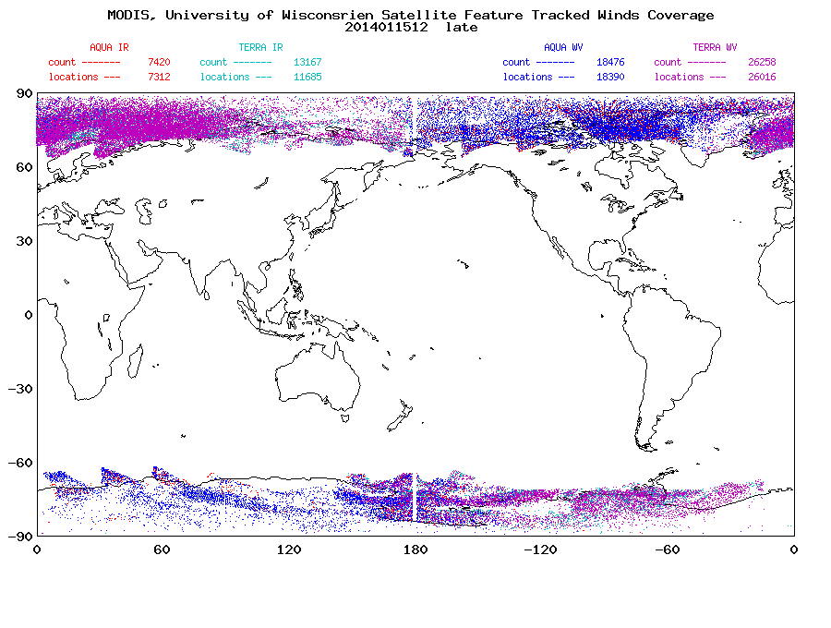
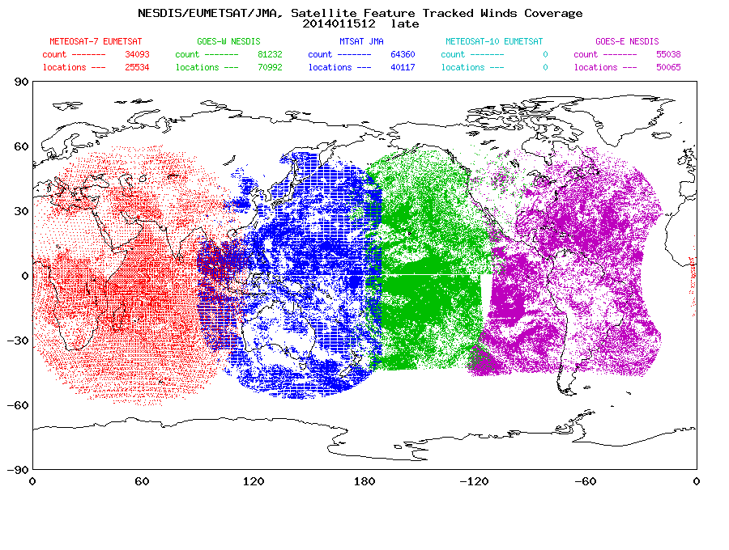
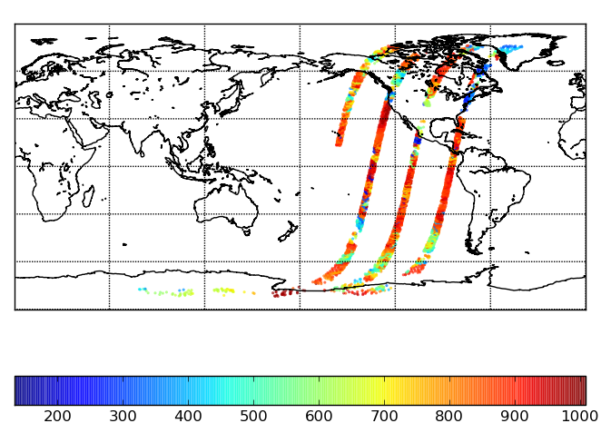
MISR horizontal coverage is pole-to-pole, potentially filling observational data gaps
Figures courtesy N. Baker
CIMSS Leo/Geo
CIMSS MODIS
CIMSS Leo/Geo
CIMSS MODIS
CIMSS Leo/Geo
CIMSS MODIS
JPL MISR - 2012102818
JPL MISR - 2012102818
JPL MISR - 2012102818
NESDIS/EUMETSAT/JMA Winds
NESDIS/EUMETSAT/JMA Winds
NESDIS/EUMETSAT/JMA Winds

Slide 8
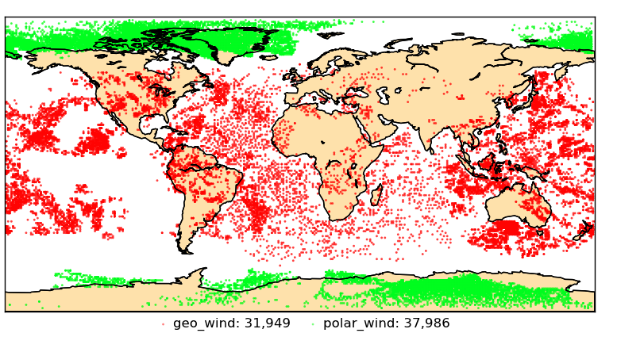
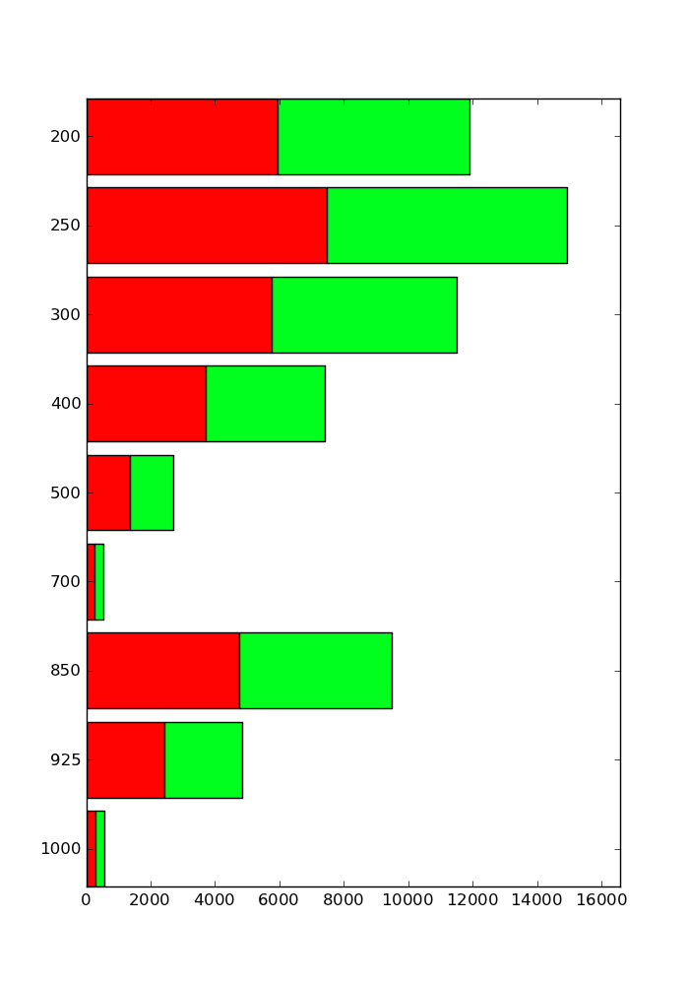
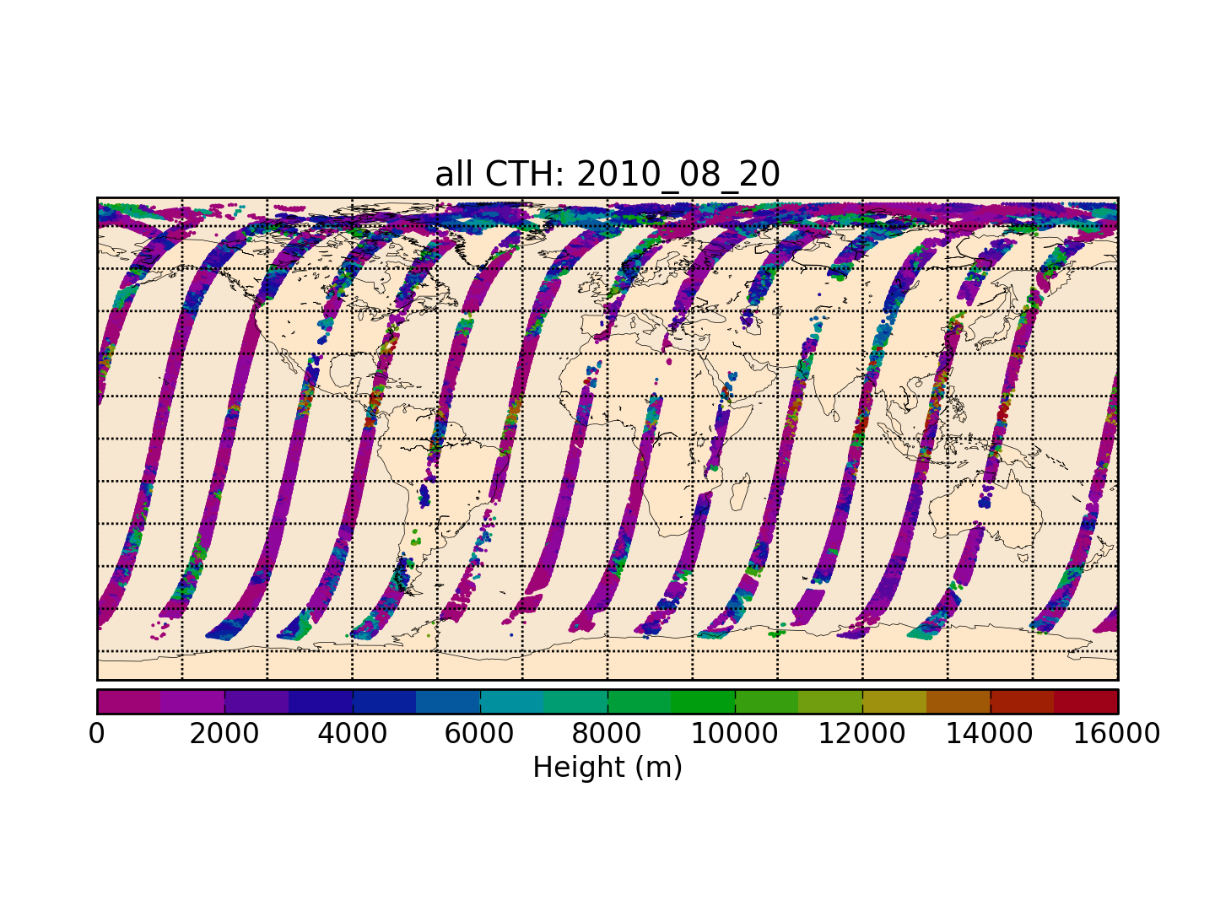
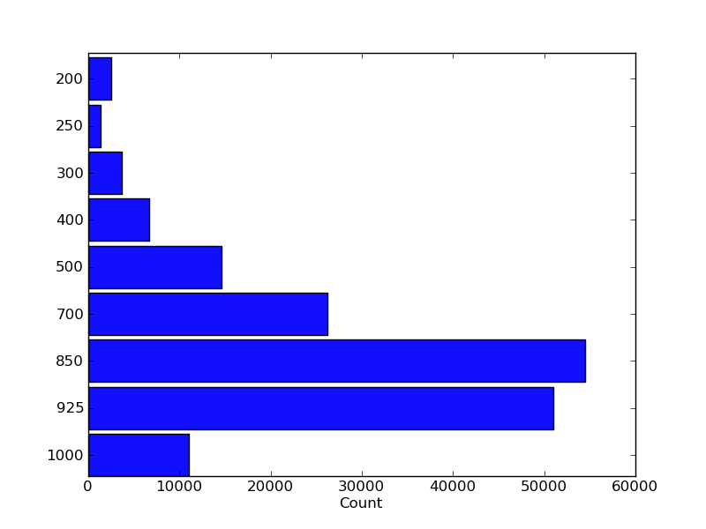
MISR has potential niche in excellent boundary layer sampling
Quantity of MISR CMV at low level comparable to quantity currently assimilated by GEOS-5 DAS
MISR produces winds in GOES view where winds from GOES ought to have been assimilated but were not
Above: Atmospheric Motion Vectors assimilated in GEOS-5 DAS at 00Z, August 20, 2010
Green: polar orbiting instruments
Red: geostationary instruments
Below: MISR Cloud Motion Vectors available that day
GEOS-5 AMV used
200
250
300
400
Pressure (hPa)
500
700
850
925
1000
Motion vectors per pressure level
MISR CMV available
200
250
300
Pressure (hPa)
400
500
700
850
925
1000
Upper figures from Merkova & Gelaro

Slide 9
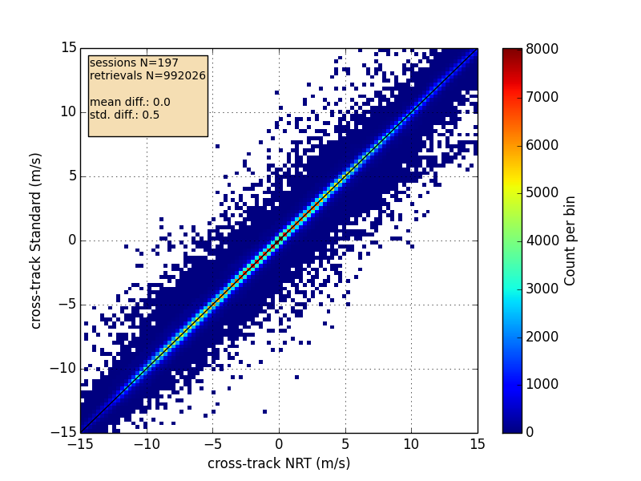
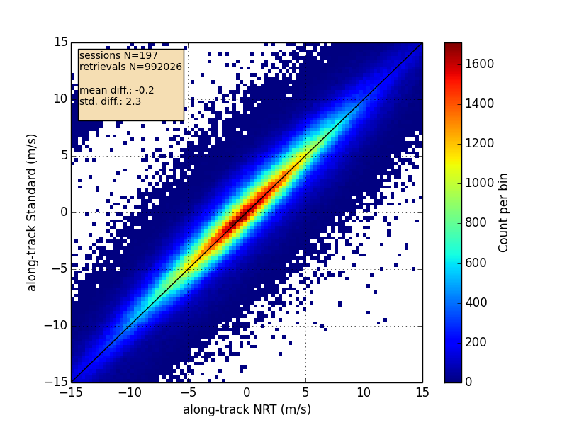
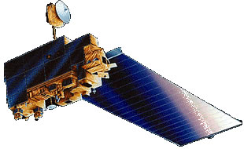
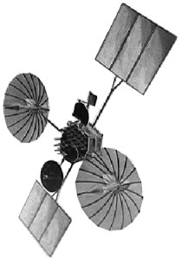
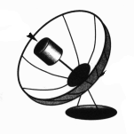
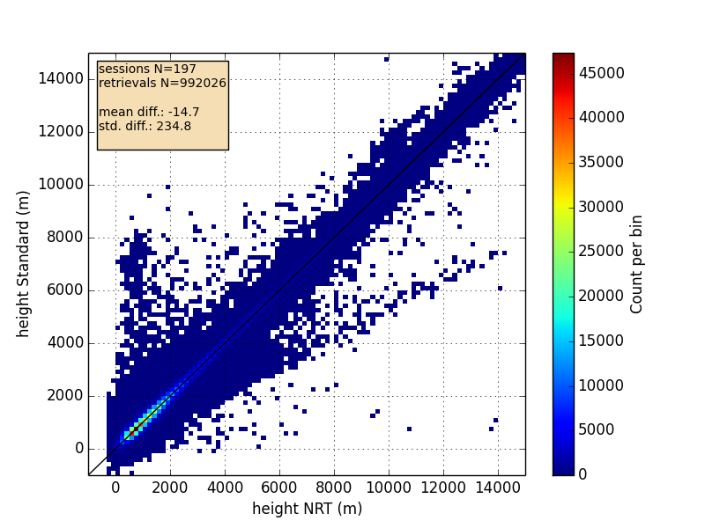
Upcoming NRT MISR CMV leverages existing heritage
Standard vs. NRT CMV Regressions
NRT MISR CMV
Planned release by August 2014
In end-to-end testing at Langley Research Center
NRT MISR CMV functionally equivalent to CMV produced in standard production
Std. Deviation between them is σ=0.5 ms⁻¹ cross-track wind, 2.3 ms⁻¹ along-track wind, 235 m height
Same algorithms; minor differences in upstream L1 workflow
Takes advantage of well understood heritage
Horvath, 2013; Mueller et al., 2013; Lonitz & Horvath, 2011; Hinkelman et al., 2009; … Horvath & Davies, 2001
Latency: 90% data in 2.5 h
Available in BUFR and HDF-EOS4 format
MISR software pipeline at LaRC to produce CMV products
raw data
MISR / Terra sensors
TDRSS / GSFC
downlink
MISR L0
session
Steps skipped in NRT production
Per orbit L0 consolidation
MISR L0
orbit
ATT/EPH
session
MISR L1 Processing
MISR L1B2
orbit
MISR CMV Processing
Per two-hour
ATT/EPH
consolidation
ATT/EPH
refinement
two-hour
ATT/EPH
refined
ATT/EPH

Slide 10
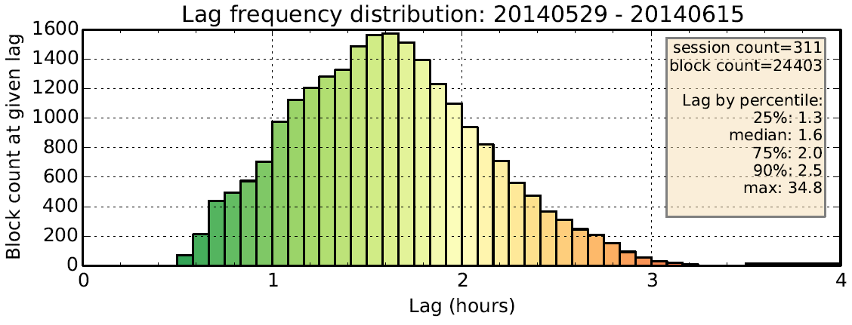
90% of MISR NRT CMV data within 2.5 h
Figure below shows lag between observation and product availability

Slide 11
Summary of Status Update
The MISR NRT Winds product will be in production by August 2014
Will be functionally equivalent to monthly MISR CMV product
90 % of MISR CMV data offered within 2.5 hours
Accuracy will be roughly comparable to MISR CMV product
NRL has obtained positive forecast impact from MISR winds
Studies continue
Thought to be benefitting from MISR low level winds
Additional investigations under way
NRL, DWD, JMA, JPL are investigating MISR winds
What further steps might the MISR team take to move forward?
Complete production of NRT MISR winds
Push NRT MISR winds via GTS distribution
Assess possible weak QI correlation with true wind quality?
11

Slide 16
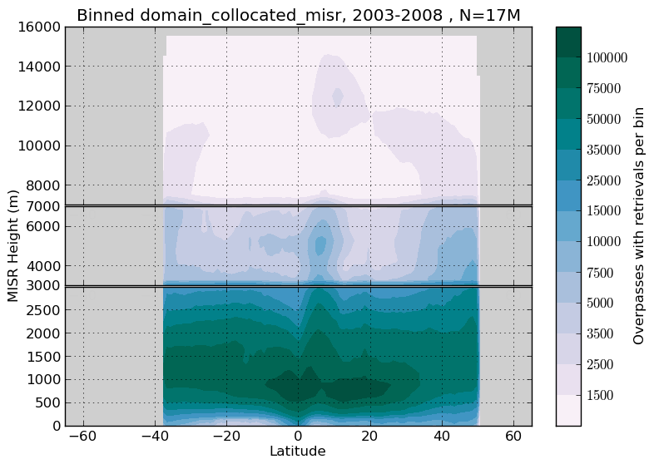
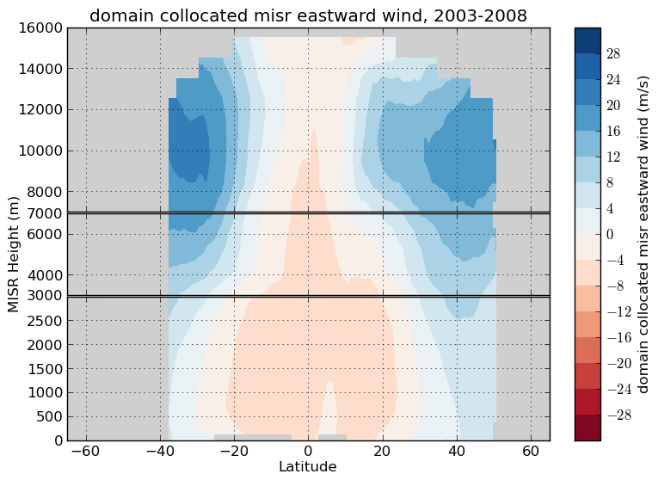
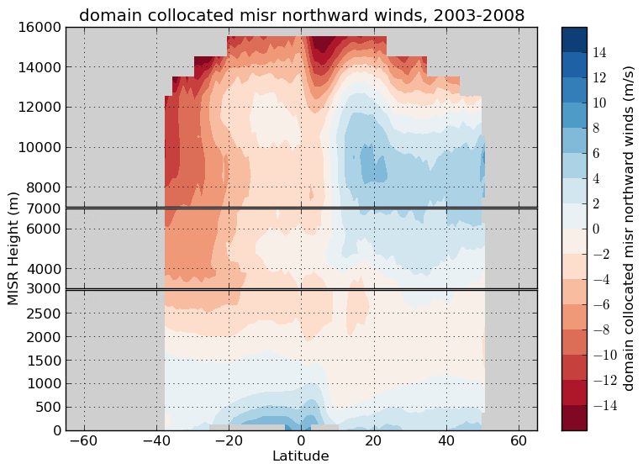
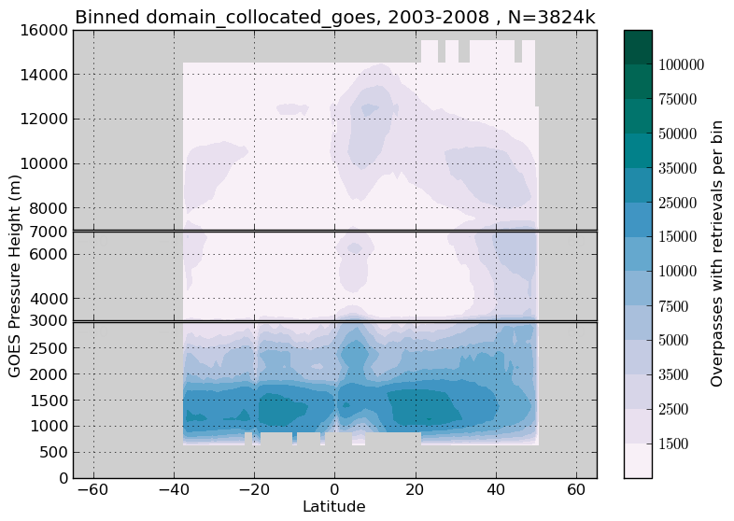
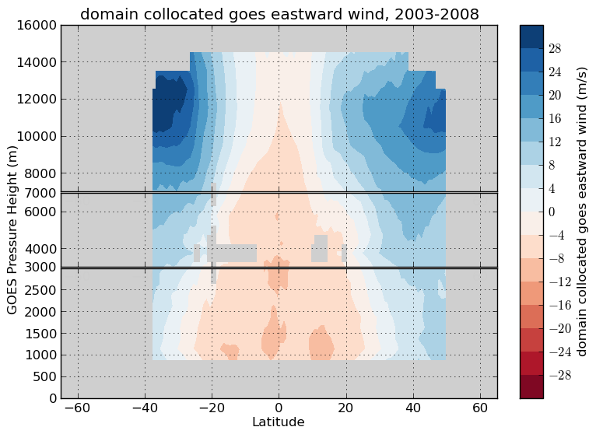
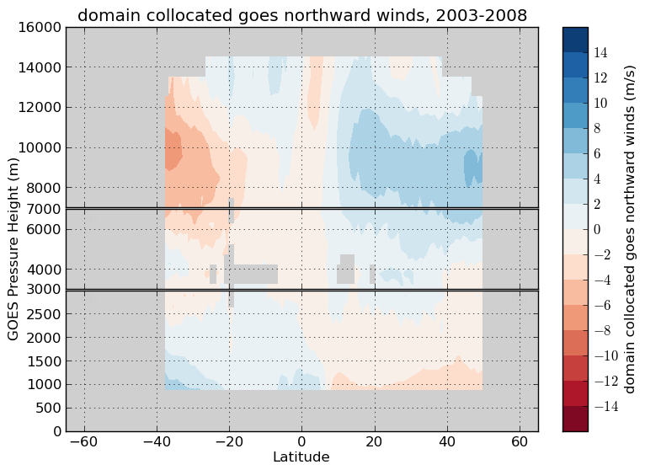
Low level MISR winds have more dense and consistent coverage than coincident GOES IR
MISR winds coverage relative to GOES IR observations captured within MISR swath at same time and projected into same coordinate grid (2003-2008)
Below 3 km, MISR coverage 4-fold that of GOES
MISR has stronger tendency to track low level clouds
MISR may be losing sampling of high speed winds, indicated by a weaker mean jet
Samples per bin
u wind
v wind
MISR CMV
GOES IR

Slide 17
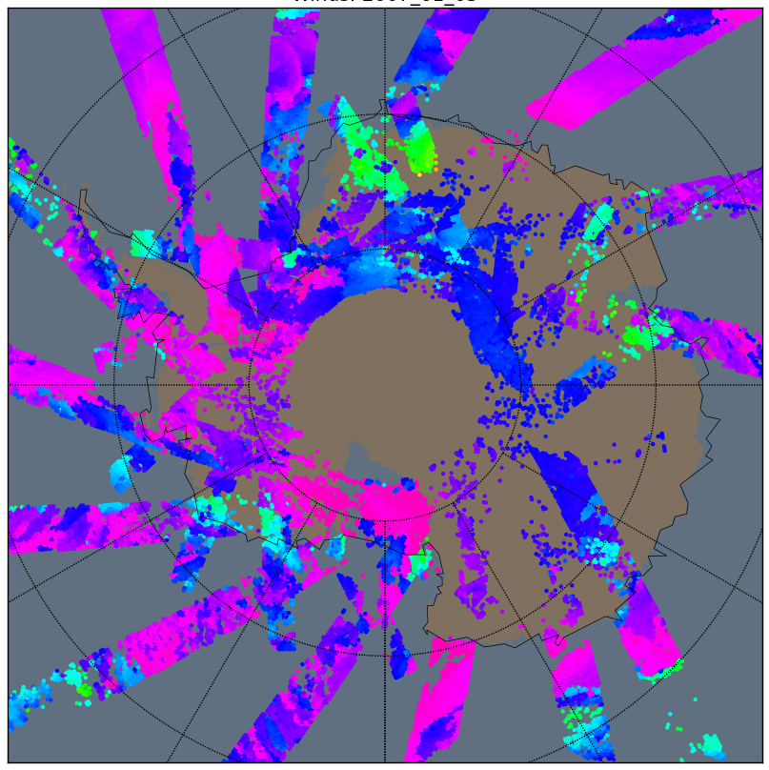
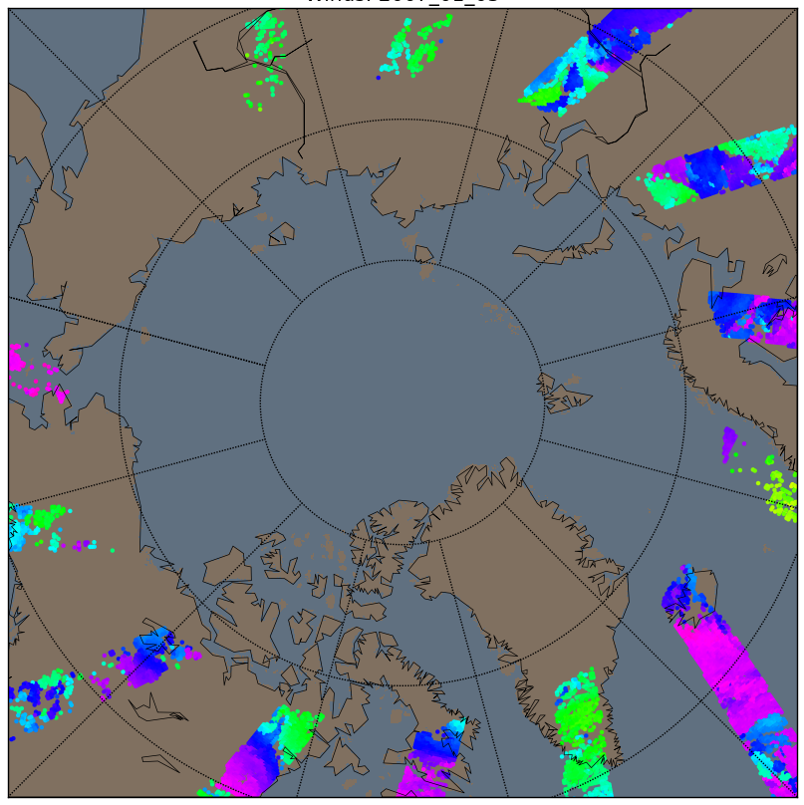
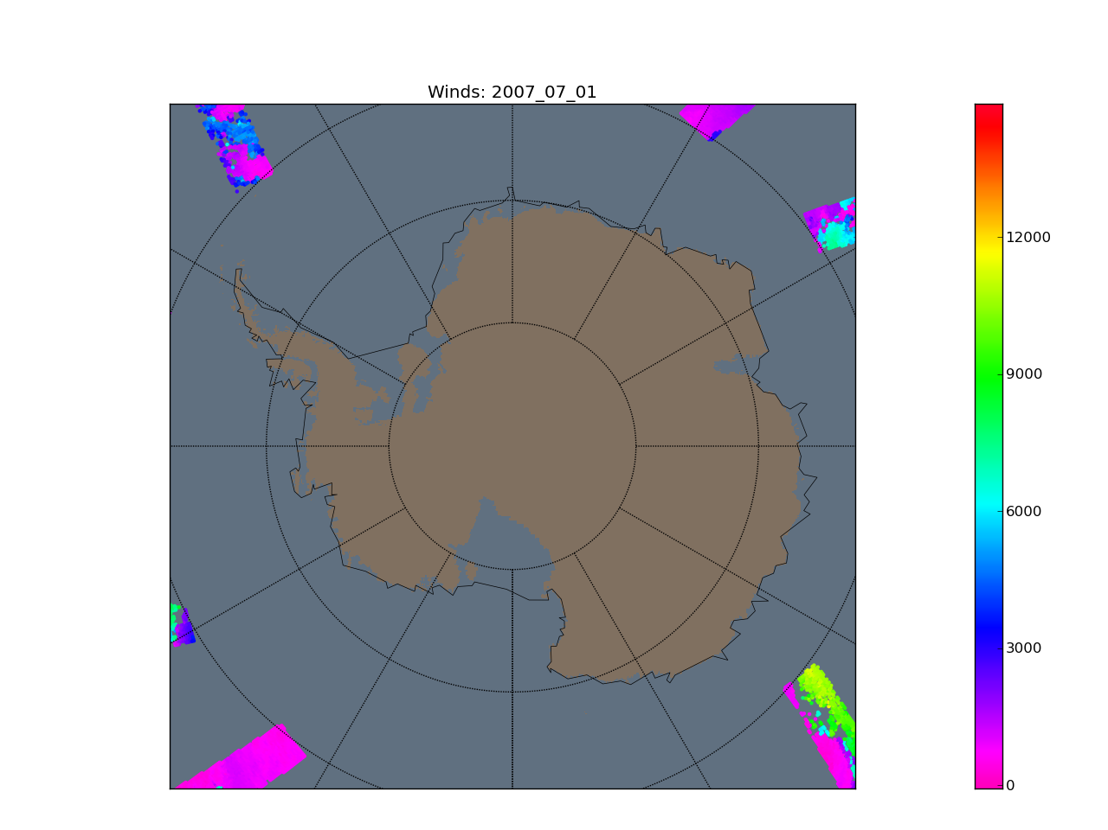
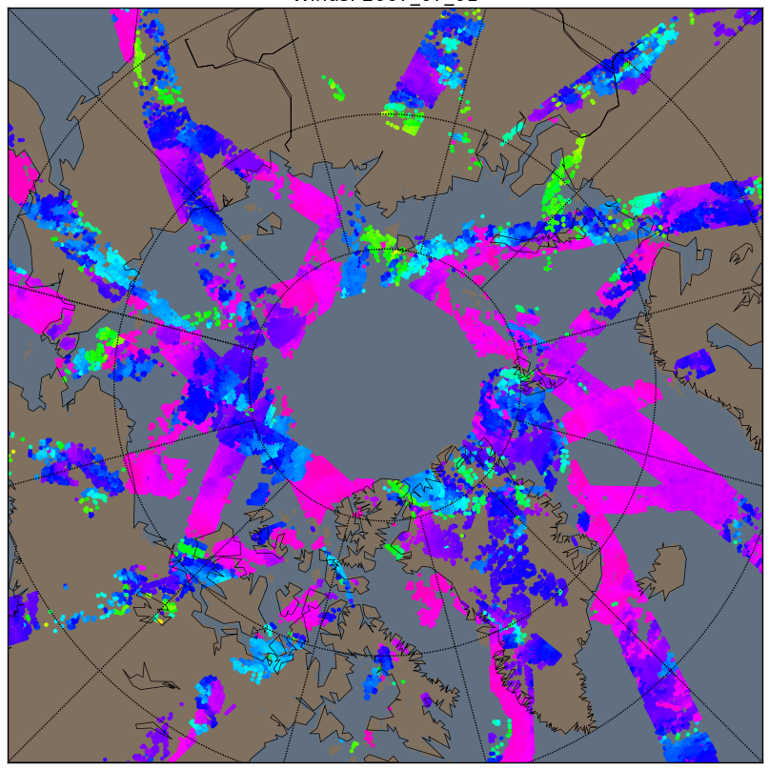
Daily pole-to-pole MISR winds coverage
January 1, 2007
Antarctic coverage ~ twice a day
Tropical coverage ~ once per 9 days
July 1, 2007
Arctic coverage ~ twice a day
Tropical coverage ~ once per 9 days
CTH (m)

Slide 18
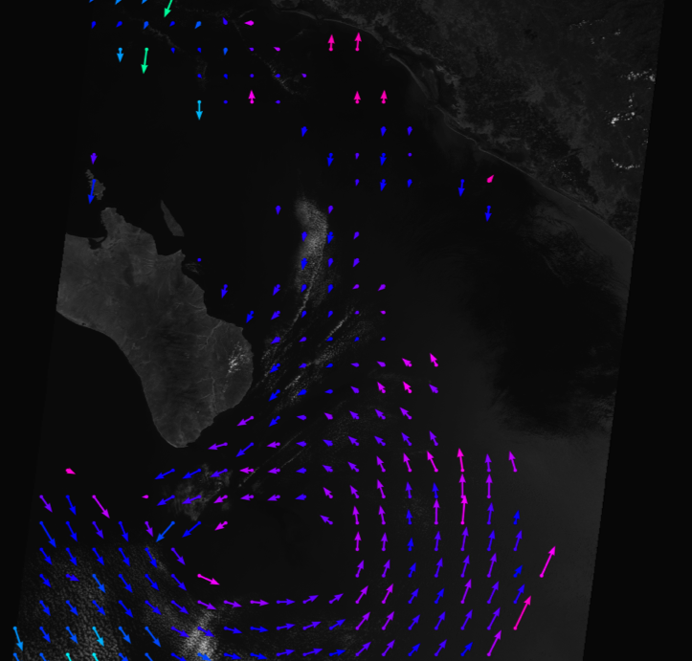
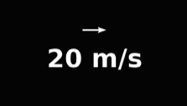
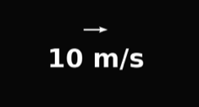
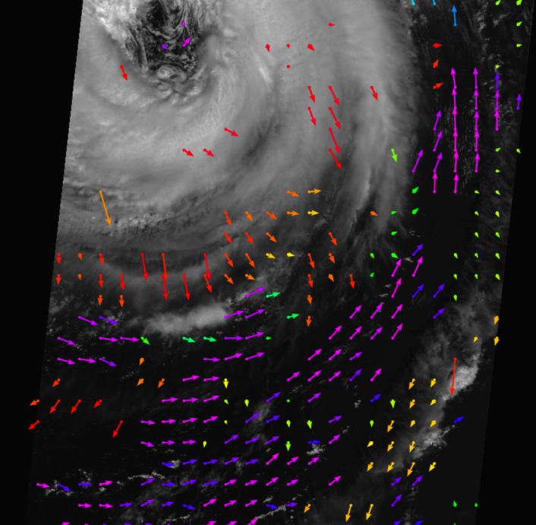
MISR Cloud Motion Vectors (CMV) characteristics
Capture rapidly evolving scenes (eye of hurricane)
Capture subtle small scale changes in cloud heights
Handles multi-layer scenes
Baja peninsula
Hurricane Alberto
Height (m)
Height (m)

Slide 20
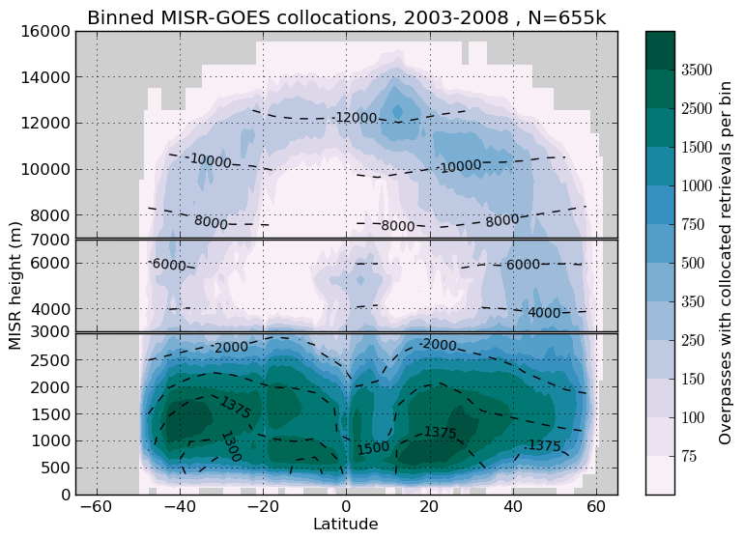
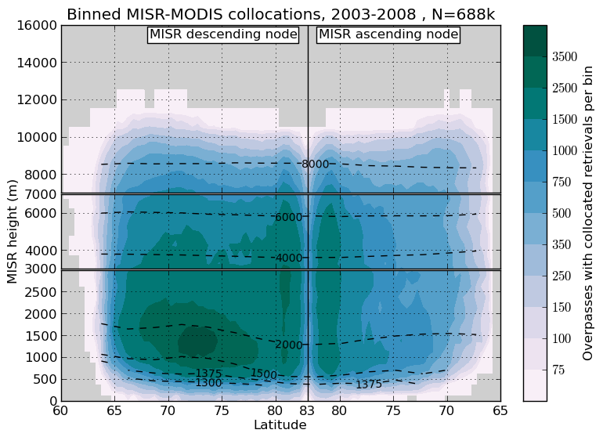
This slide is a placeholder for results I don’t want to present, but want at the ready

Slide 21
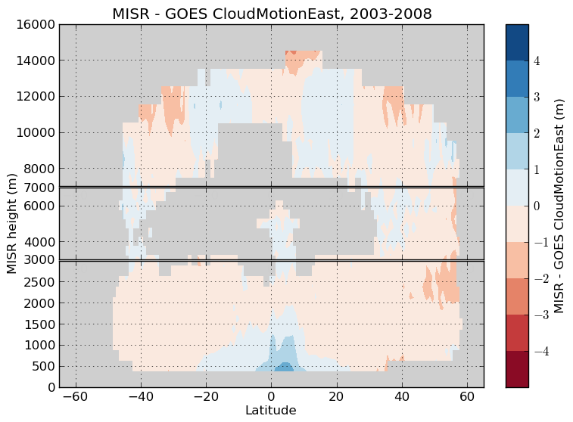
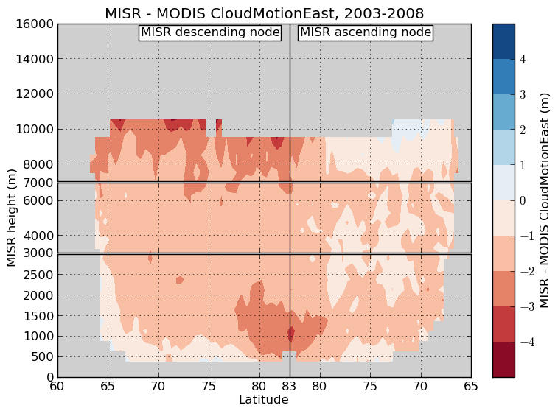
This slide is a placeholder for results I don’t want to present, but want at the ready

Slide 22
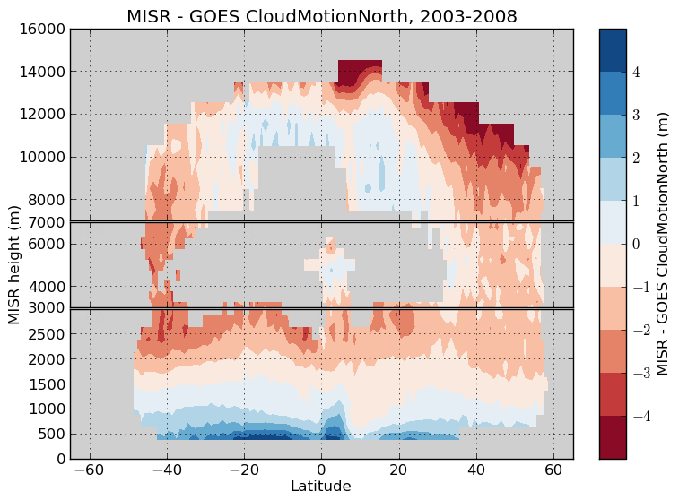
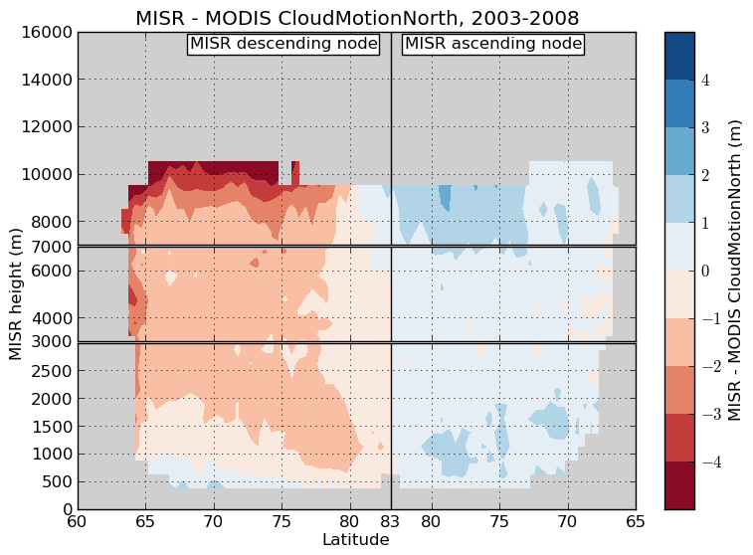
This slide is a placeholder for results I don’t want to present, but want at the ready

Slide 23
This slide is a placeholder for results I don’t want to present, but want at the ready
Objective
Assess how WindQA diagnostics have performed throughout mission
Relevant to ongoing assessment of NRT diagnostics
Provide context for 2013 increased frequency of L0 flagged orbits
Technical Details
Block range limited to 41-140 to lessen seasonal effects
Raw
Orbits that do not have L1 “QA” flag set
Retrievals with comparable forward and aft values
Height of wind difference < 2500 m
Wind vector difference < 15 m/s
Final
Orbits that do not have L2 “QA Winds” flag set
Retrievals with QualityIndicator > 50
Time series statistics show monthly mean and monthly standard deviation of per orbit mean forward-aft differences
Per SOM path statistics show per path mission (2001-2013) mean and standard deviation of per orbit mean forward-aft differences
At first I limited the analysis to low clouds only, but including all wind heights did not appear to affect statistics
Results
Global georegistration precision appears to maintain “final” forward-aft variance < 2 m/s and 200 m
Per path georegistration precision appears to maintain “final” forward-aft variance < 3 m/s
Particular paths with worse precision than 3 m/s
Off United States west coast
Over Panama Canal
Over Tibet
Loss of L0 sampling in 2013
More significant L0 flagging than any time after 2004
Not coincident with any apparent loss of quality in raw or final winds (need to look at sampling, though)
Shift in steady state of forward-aft height differences
Steady state height difference 2002-2008 is 0 m
Steady state height difference 2009-2013 is -100 m
Shift is also somewhat apparent in forward-aft along-track differences
The change coincides with an incident at end of 2008 causing spike in flagging of orbits by L2
Future work
Better assessment of sampling removed by forward-aft checks.
Identify specific problematic SOM paths, and characterize as simple text data enabling users to handle per-path quality variability (in e.g. assimilation schemes)
Put this information into TC_CLOUD Quality Statement

Slide 24
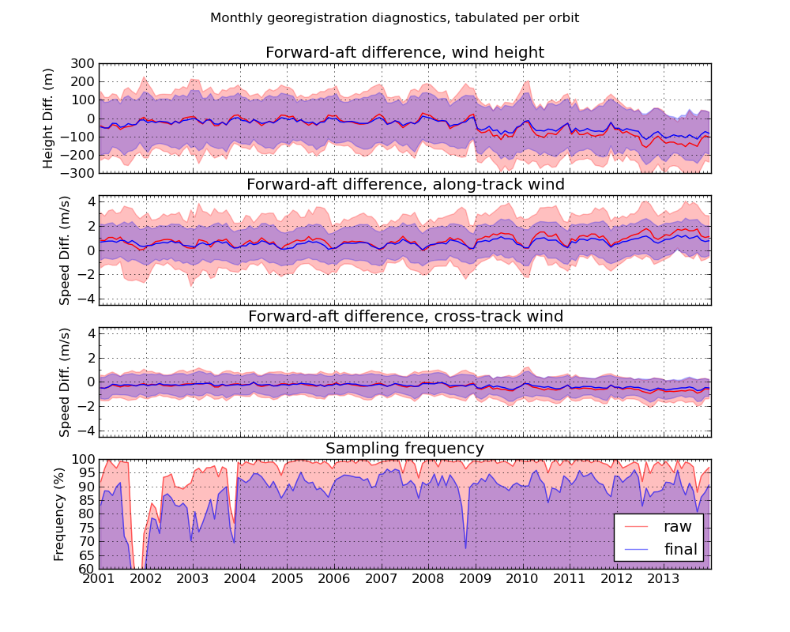
This slide is a placeholder for results I don’t want to present, but want at the ready
shading shows variance

Slide 25
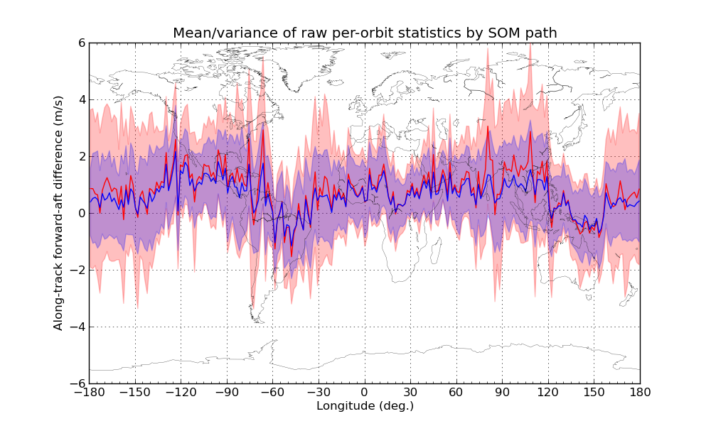
This slide is a placeholder for results I don’t want to present, but want at the ready

