Slide 1
Status of operational AMVs from FY-2 satellites since the 11th winds workshop
Zhang Xiaohu, Xu Jianmin, Zhang Qisong
National Satellite Meteorological Center (NSMC)
China Meteorological Administration (CMA)
Notes:
I will talk about the Status of operational AMVs from FY-2 satellites since last winds workshop.

Slide 2
Content of talk:
Current FY-2 satellites status and planned configurations
Current status of CMA winds
Changes in operational system since last winds workshop
Historical dataset reprocessing plan
Notes:
My talk has four part:
The first is Current FY-2 satellites status and planned configurations

Slide 3
FY-2 Satellite Operations
Since the 11th wind workshop, FY-2E, FY-2D and FY-2F are both in operation.
FY-2E at 105˚E → Prime mission.
FY-2D at 86.5˚E → Prime mission.
FY-2F at 112˚E → Backup to FY-2E and rapid scan .
Product | Satellite | Nadir longitude | Product times
Infrared and Water Vapour Winds | FY-2E | 105˚E | Every 6h 00:00,06:00,12:00,18:00(UTC)
Infrared and Water Vapour Winds | FY-2D | 86.5˚E | Every 6h 03:00,09:00,15:00,21:00(UTC)
Infrared and Water Vapour Winds | FY-2F | 112˚E | Every 6h (not continuous) 03:00,09:00,15:00,21:00(UTC)
Notes:
Fengyun Satellite Operations
Since the 11th wind workshop, FY-2E, FY-2D and FY-2F are both in operation.
FY-2E operated at one hundred five east and FY-2D operated at eighty six dot five east.
These two are prime mission position.
FY-2F is backup to FY2E at one hundred twelve east and do rapid scan as required.

Slide 4
FY-2 Satellite Operations Planning
FY-2G will be launched in Dec. 2014 and operate at 105˚E.
FY-2E will replace FY-2D at 86.5˚E .
FY-2F will drift to 123.5˚E in Aug. 2014.
Notes:
Fengyun Satellite Operations Planning
FY-2G is planed to launch in December this year and will operate at one hundred five east instead of FY-2E.
FY-2E will drift to eighty six dot five east and replace FY-2D.
FY-2F will drift to one hundred twenty three dot five in August this year for the monitoring of typhoon.

Slide 5
Content of talk:
Current FY-2 satellites status and planned configurations
Current status of CMA winds
Changes in operational system since last winds workshop
Historical dataset reprocessing plan
Notes:
The second is to talk about Current status of CMA winds.

Slide 6
Current status of CMA winds
Since the 11th wind workshop, infrared (IR) and water vapor (WV) channel AMVs derivations are performed for both FY-2E and FY-2D.
FY-2E and FY-2D AMVs passed quality control are transmitted through GTS in BURF code.
FY-2F AMVs are derived except in RSS and did not distribute through GTS.
Product | Satellite | Nadir longitude | Product times
Infrared and Water Vapour Winds | FY-2E | 105˚E | Every 6h 00:00,06:00,12:00,18:00(UTC)
Infrared and Water Vapour Winds | FY-2D | 86.5˚E | Every 6h 03:00,09:00,15:00,21:00(UTC)
Infrared and Water Vapour Winds | FY-2F | 112˚E | Every 6h (not continuous) 03:00,09:00,15:00,21:00(UTC)
Notes:
Since the 11th wind workshop, infrared and water vapor channel AMVs derivations are performed for both FY-2E, FY-2D and FY-2F.
FY-2E and FY-2D AMVs are continuous every six hours, and the AMVs passed quality control are transmitted through GTS in BURF code.
FY-2F AMVs are not continuous.
It derived except in rapid scan time and did not distribute through GTS.

Slide 7
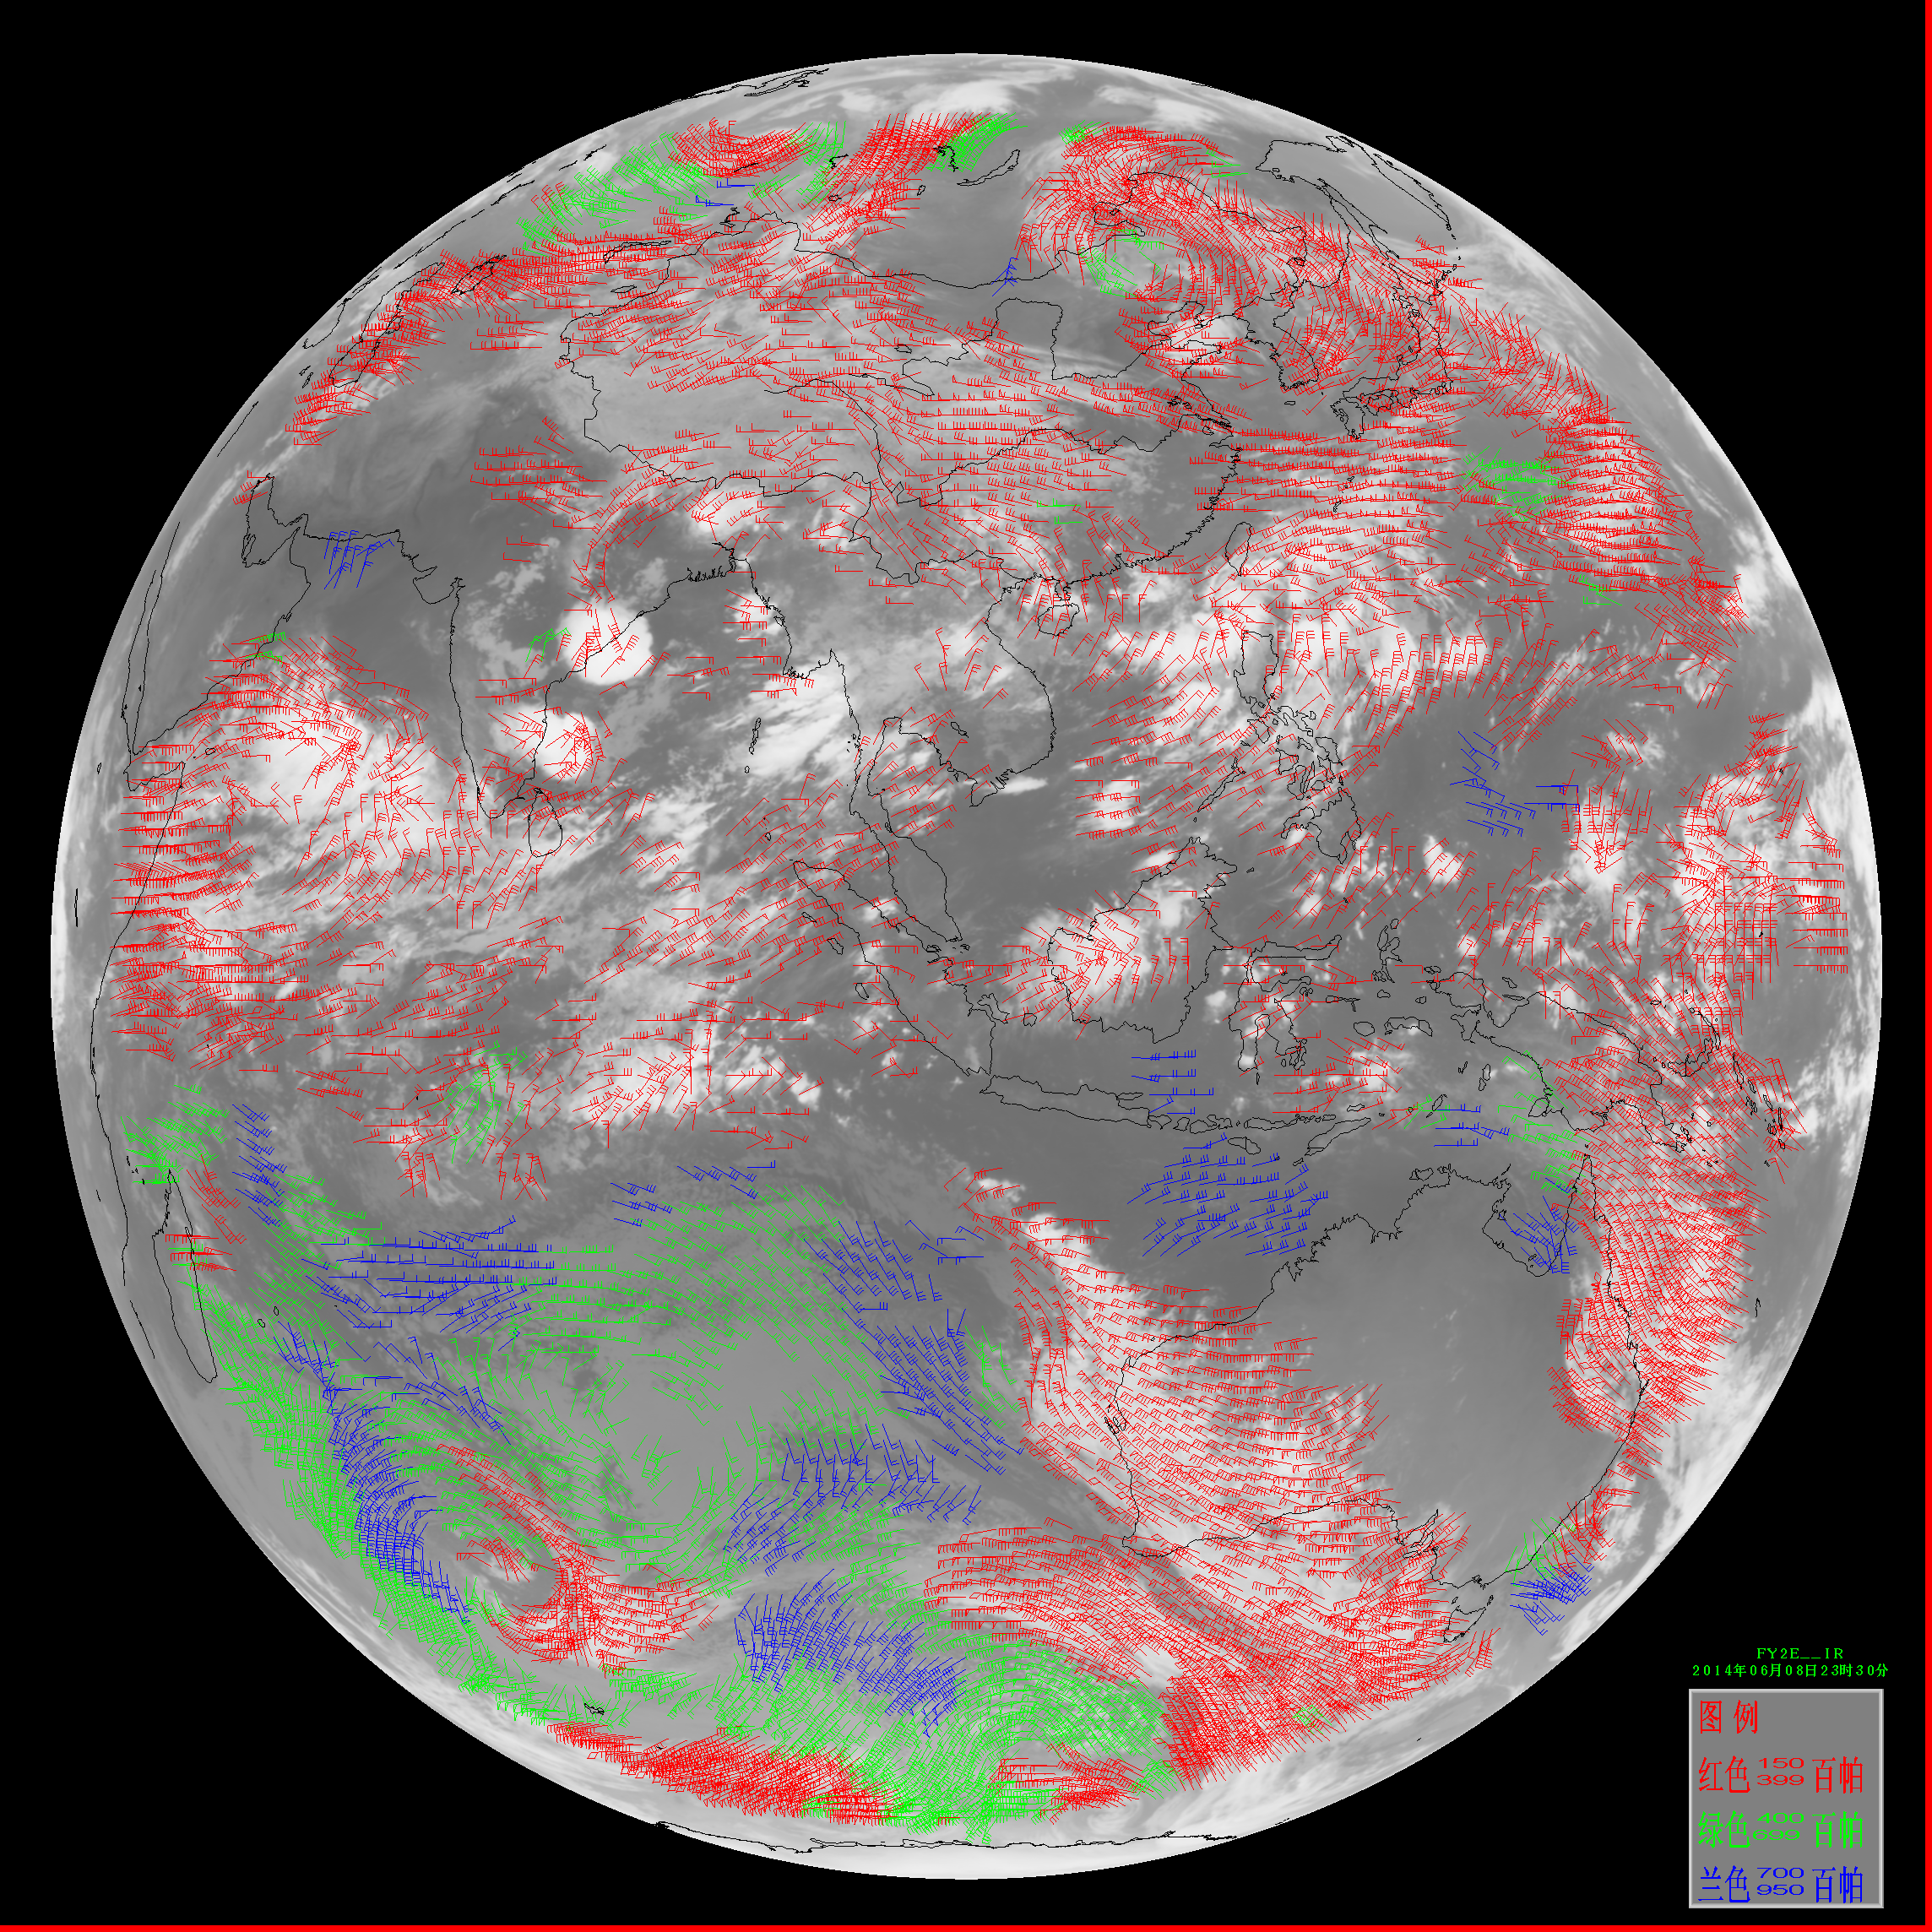
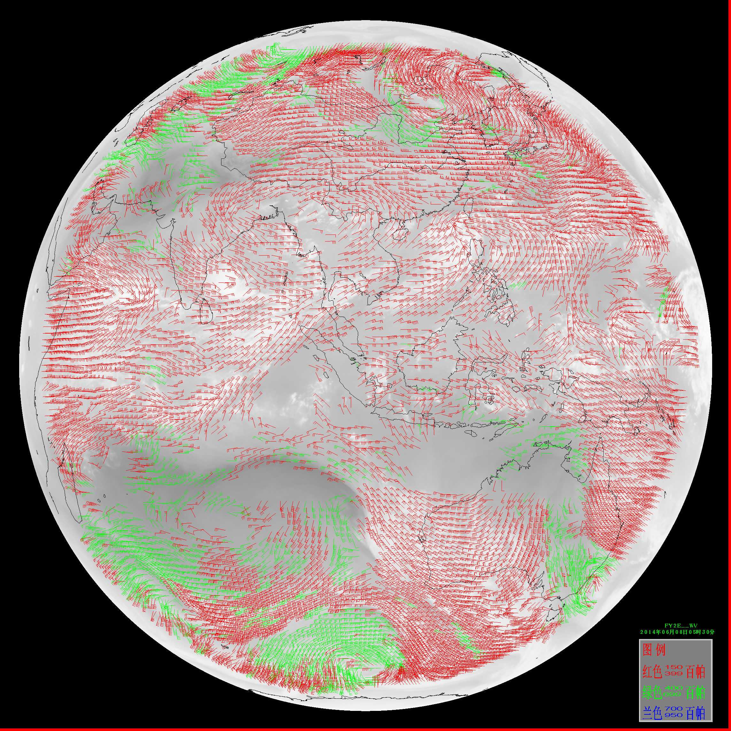
Example of FY-2E AMVs
06UTC on 8 June 2014
High-, middle- and low-level IR AMVs
High- and middle-level WV AMVs
Notes:
These are the example of FY-2E AMVs, infrared and water vapor channel AMVs.

Slide 8
Current status of CMA winds
Mean of departures from FY2-E IR wind speed and those of analysis (QI>0.8)
 | High level winds (Above 400hPa) |  | Middle level winds (between 400-700hPa) |  | Low level winds (below 700hPa)
 | 2012 | 2013 | 2012 | 2013 | 2012 | 2013
Jan | -2.12423 | -1.94587 | -3.50365 | -3.9023 | -0.56508 | -0.58041
Feb | -1.93563 | -1.94897 | -3.35226 | -3.06902 | -0.39329 | -0.31534
Mar | -2.04533 | -2.21874 | -3.15719 | -2.69138 | -0.39004 | -0.36816
Apr | -2.18449 | -2.7657 | -3.02689 | -3.17522 | -0.4454 | -0.32753
May | -2.43691 | -2.61128 | -2.76822 | -2.6329 | -0.35193 | -0.08515
Jun | -2.47499 | -2.7072 | -2.57676 | -2.50116 | -0.44933 | -0.17935
Jul | -2.22251 | -2.92635 | -2.38746 | -2.74717 | -0.34463 | -0.26356
Aug | -2.41222 | -2.8553 | -2.91576 | -3.28757 | -0.43861 | -0.26695
Sep | -2.15256 | -2.90911 | -2.8914 | -3.10136 | -0.34482 | -0.19641
Oct | -2.07584 | -2.46678 | -3.08267 | -2.67326 | -0.32728 | -0.3544
Nov | -2.27077 | -2.26952 | -3.47111 | -3.54425 | -0.38728 | -0.22208
Dec | -2.09586 | -2.08142 | -3.97566 | -3.86096 | -0.51668 | -0.31554
Notes:
This is the bias of FY-2E infrared channel AMVs winds speed of last two years. Quality index is larger than zero dot eight.
From the data ,we can see FY-2E infrared channel AMVs FY-2E have negative deviation.

Slide 9
Current status of CMA winds
Standard deviation of departures from FY-2E IR wind speed and those of analysis (QI>0.8)
 | High level winds (Above 400hPa) |  | Middle level winds (between 400-700hPa) |  | Low level winds (below 700hPa)
 | 2012 | 2013 | 2012 | 2013 | 2012 | 2013
Jan | 4.892085 | 4.64946 | 6.179803 | 6.048372 | 3.320474 | 3.028624
Feb | 4.583046 | 4.721529 | 6.082641 | 6.010609 | 2.934222 | 3.125594
Mar | 4.809744 | 4.814942 | 5.896808 | 5.813749 | 2.737408 | 2.747139
Apr | 4.889798 | 4.91965 | 5.926031 | 5.793845 | 2.594708 | 2.705312
May | 4.759254 | 4.887551 | 5.48489 | 5.657166 | 2.594291 | 2.66821
Jun | 5.071055 | 4.940804 | 5.364794 | 5.404209 | 2.542841 | 2.53057
Jul | 4.855787 | 5.063397 | 5.460641 | 5.505674 | 2.508121 | 2.808593
Aug | 4.820954 | 5.030996 | 5.336308 | 5.524529 | 2.537602 | 2.799735
Sep | 4.530054 | 4.967143 | 5.299152 | 5.623036 | 2.662271 | 2.885943
Oct | 4.561009 | 4.850967 | 5.562412 | 5.711941 | 2.932993 | 2.839276
Nov | 4.508193 | 4.501802 | 5.990277 | 5.61666 | 2.834245 | 2.752524
Dec | 4.549424 | 4.506401 | 6.05042 | 5.962793 | 3.160056 | 3.117601
Notes:
This is the standard deviation of FY-2E infrared channel AMVs winds speed of last two years. Quality index is larger than zero dot eight.
From the data ,we can see the standard deviations are between two and six.

Slide 10
Current status of CMA winds
Mean of departures and standard deviation of departures from FY-2E WV wind speed and those of analysis (QI>0.8)
 | Bias |  | STD
 | 2012 | 2013 | 2012 | 2013
Jan | -0.50399 | -0.38239 | 4.391838 | 4.26404
Feb | -0.47929 | -0.41272 | 4.0707 | 4.286302
Mar | -0.48913 | -0.44487 | 4.136906 | 3.907031
Apr | -0.5062 | -0.66317 | 4.125719 | 3.95154
May | -0.54818 | -0.68822 | 4.08815 | 3.956886
Jun | -0.50877 | -0.61573 | 4.428806 | 4.252967
Jul | -0.29856 | -0.62436 | 4.338072 | 4.628991
Aug | -0.26134 | -0.49397 | 4.250763 | 4.178475
Sep | -0.28748 | -0.54414 | 3.999249 | 4.053517
Oct | -0.33508 | -0.36832 | 3.838787 | 3.90512
Nov | -0.46192 | -0.43004 | 3.866909 | 3.715909
Dec | -0.5712 | -0.42291 | 4.656152 | 4.170294
Notes:
This is the bias and standard deviation of FY-2E water vapor channel AMVs of last two years. Quality index is larger than zero dot eight.
From the data ,we can see FY-2E water vapor channel AMVs have negative deviation and the standard deviations are between three and five.

Slide 11
High-level (above 400hPa) IR AMVs
STD and wind speed bias
Notes:
This chart illustrates bias and standard deviations of FY-2E High-level infrared AMVs in different zonal area .
From this chart, we can see the amvs in tropics have small bias and standard deviations.
In north hemisphere, amvs have large bias and and standard deviations.

Slide 12
High-level (above 400hPa) WV AMVs
STD and wind speed bias
Notes:
This chart illustrates bias and standard deviations of FY-2E High-level water vapor AMVs in different zonal area .
They have the same appearance as infrared AMVs.

Slide 13
In earth shadow period
FY-2E earth shadow period:
February 24 ---- April 12
August 22 ---- October 16
In midnight of earth shadow period, FY-2E doesn’t receive image (1600, 1700, 1730, 1800UTC ) and AMVs of 1800UTC are not derived.
Earth shadow period
Earth shadow period
Earth shadow period
Earth shadow period
Notes:
This chart shows the influence of earth shadow.
FY-2E earth shadow period is from February twenty four to April twelve and August twenty two to October sixteen every year.
In that period, FY-2E doesn’t receive image (1600, 1700, 1730, 1800UTC ) and AMVs of 1800UTC are not derived.
So amvs in March and September have low number.

Slide 14
Content of talk:
Current FY-2 satellites status and planned configurations
Current status of CMA winds
Changes in operational system since last winds workshop
  A new calibration system was updated to operational system
  Eliminate the influence of abnormal satellite image (upcoming)
  Remove noise in the satellite image (upcoming)
  Second tracking algorithm (upcoming)
  Height assignment in inversion layer (upcoming)
  Height assignment in target box full of cloud (upcoming)
Historical dataset reprocessing plan
Notes:
The third is to talk about Changes in operational system since last IWW
It has six changes, the one is already updated to operational system and the other is upcoming to update.

Slide 15


A new calibration system was updated to operational system
Calibration of Inner Blackbody corrected by Lunar Emission (CIBLE)
+
CIBLE
Lunar Obs. in TIR band
=
Inner Blackbody
CIBLE has been in operation for FY-2F satellite since 21 July, 2012
CILBE has been in operation for FY-2E satellite since 27 March, 2013
CILBE has been in operation for FY-2D satellite since 21 May, 2013
→ see Guo Qiang’s talk
Notes:
First changes,
A new calibration system called CIBLE was updated to AMVs operational system in last two years.
The details about CIBLE, please see Guo Qiang’s talk.

Slide 16
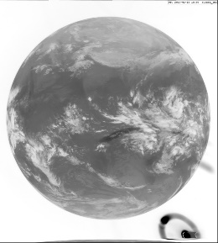
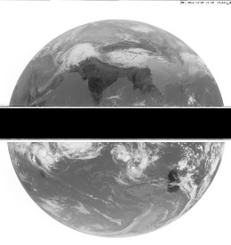
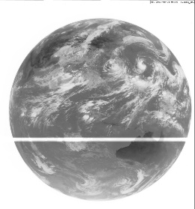
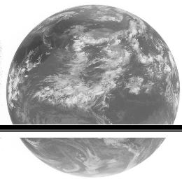
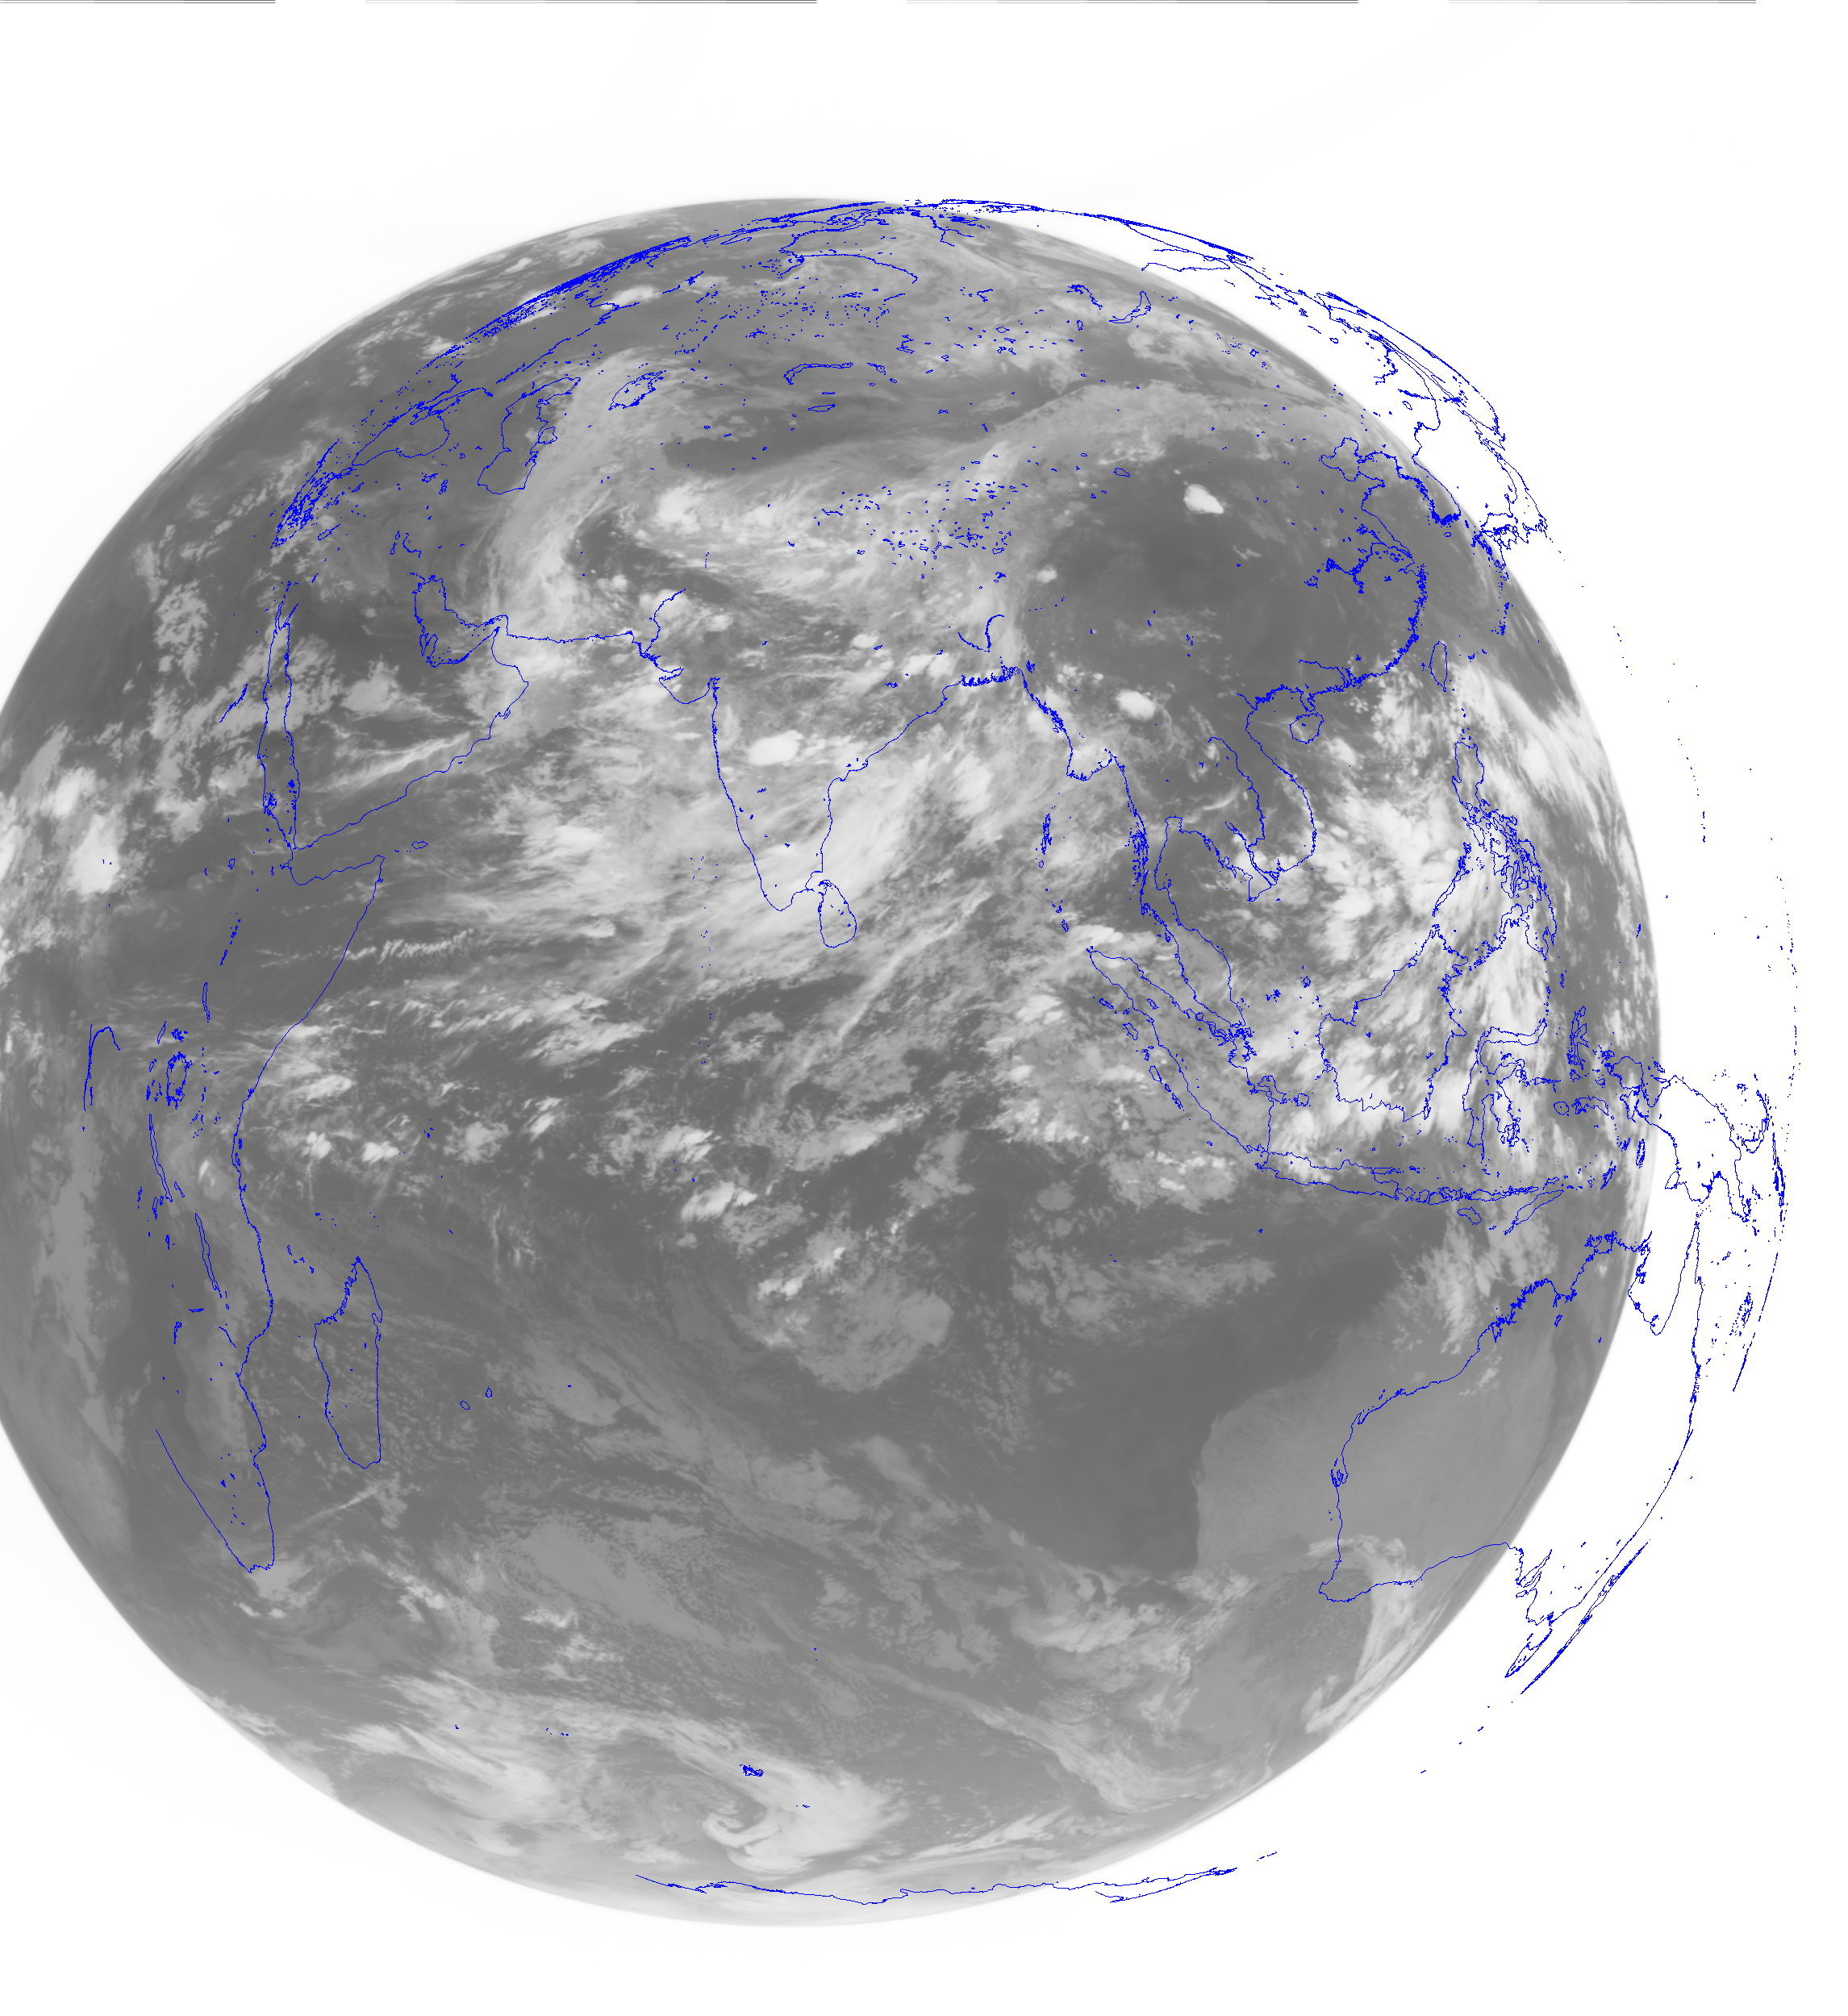
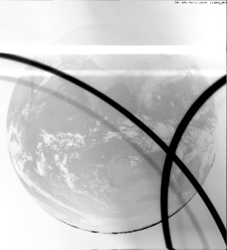
Eliminate the influence of abnormal satellite image (upcoming)
-- influences of abnormal images
Image navigation influences AMVs derivation greatly.
Image navigation is a major part of the FY-2 observation process and is based on a mathematical model. The model uses time series of satellite positions and observation vectors toward earth center as input.
FY-2 image navigation quality is good. But some abnormal satellite image will affect the navigation and AMVs quality .
Image of sun
Sun Outage
Moon influence
Error line data
Spin synchronization error
Radiation of imager bracket
Abnormal images
Notes:
Second change:
The algorithm for Eliminating the influence of abnormal satellite image.
In some special period, FY-2 has some abnormal images.
The examples of abnormal images are follows: image of sun, sun outage, moon influence and so on.
influences of abnormal images is the image navigation quality.
As we know, Image navigation influences AMVs derivation greatly.
Image navigation is a major part of the FY-2 observation process and is based on a mathematical model. The model uses time series of satellite positions and observation vectors toward earth center as input.
FY-2 image navigation quality is good. But some abnormal satellite image will affect the navigation and AMVs quality .

Slide 17
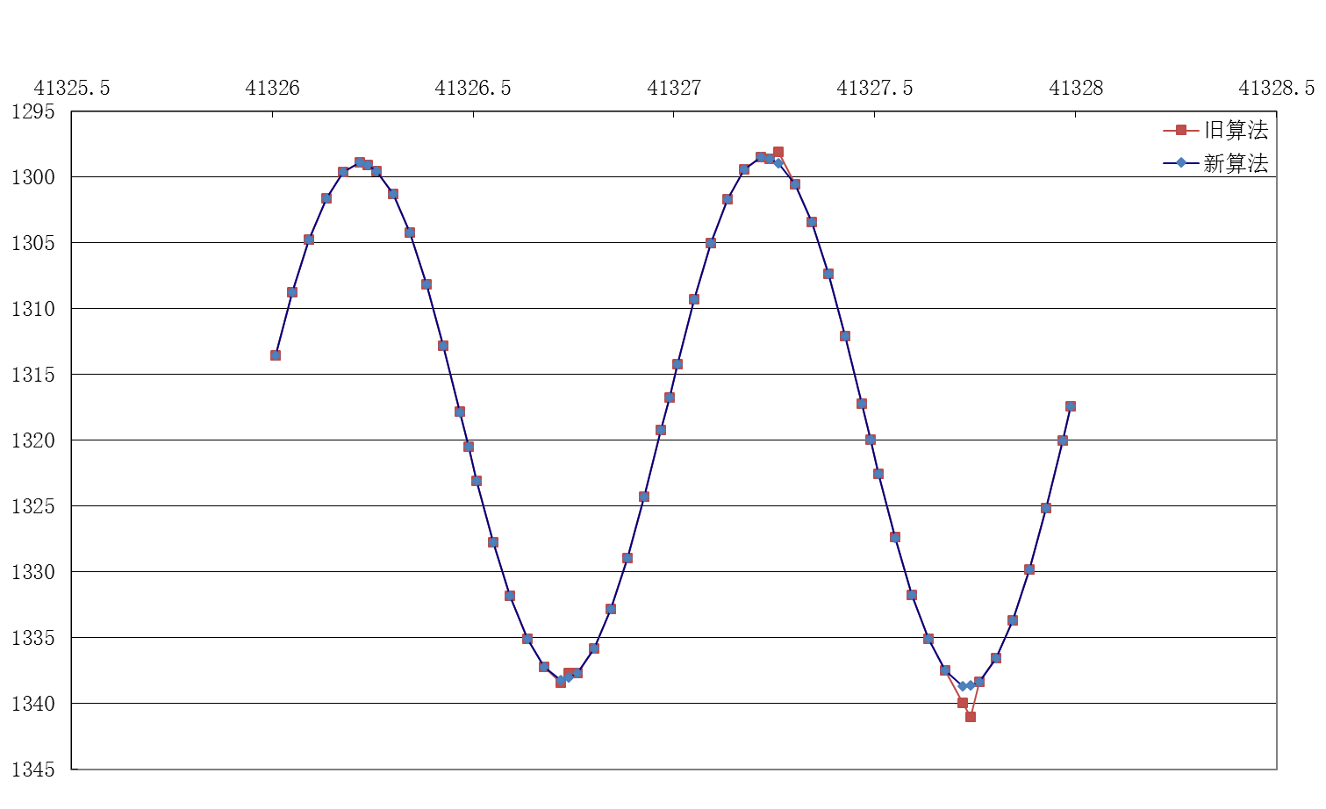
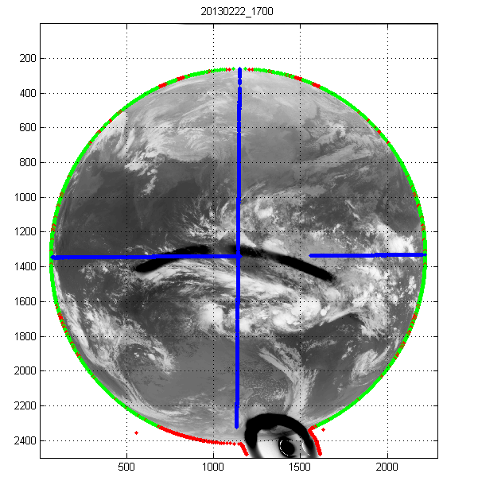
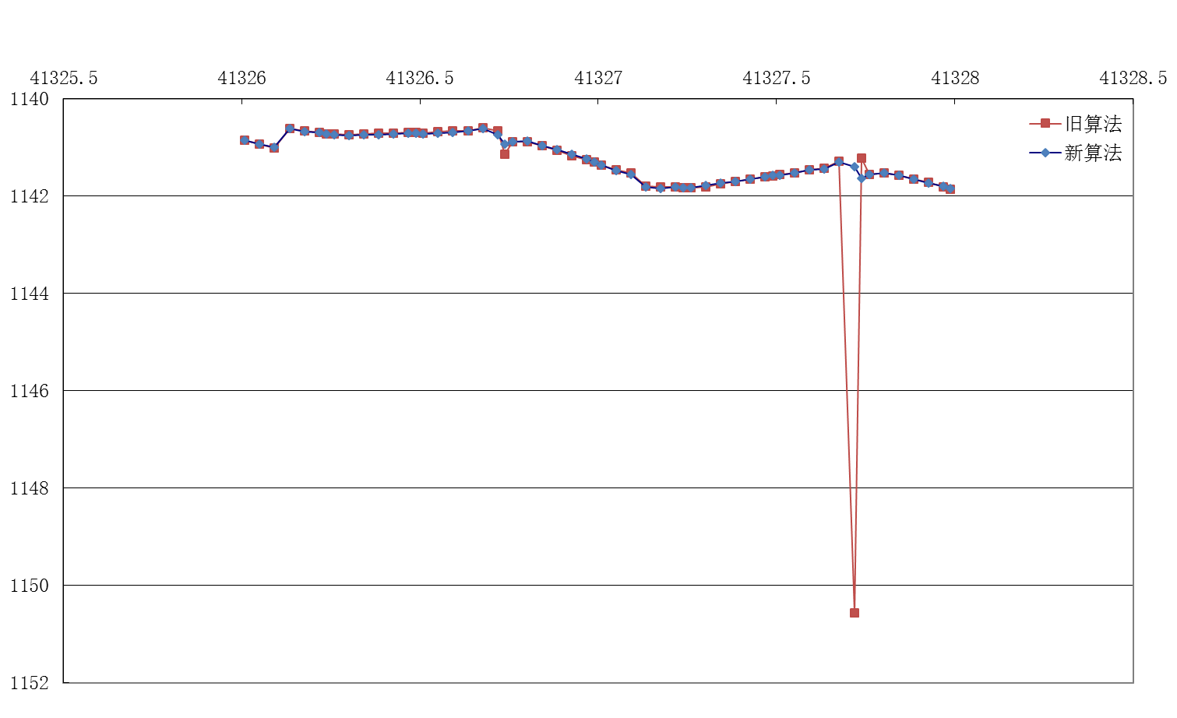
Eliminate the influence of abnormal satellite image (upcoming)
-- a new quality control algorithm performed
  The abnormal satellite image can break up the time series of observation vectors toward earth center and will cause bad navigation quality.
  A quality control algorithm is performed to catch right observation vectors toward earth center, then eliminate the influence of abnormal satellite image.
Notes:
The abnormal satellite image can break up the time series of observation vectors toward earth center and will cause bad navigation quality.
The left figure is the abnormal image, the right figure shows that the time series in red line are not continuous .
A quality control algorithm is performed to catch right observation vectors toward earth center, then eliminate the influence of abnormal satellite image. the right figure shows that the time series in blue line are continuous .

Slide 18
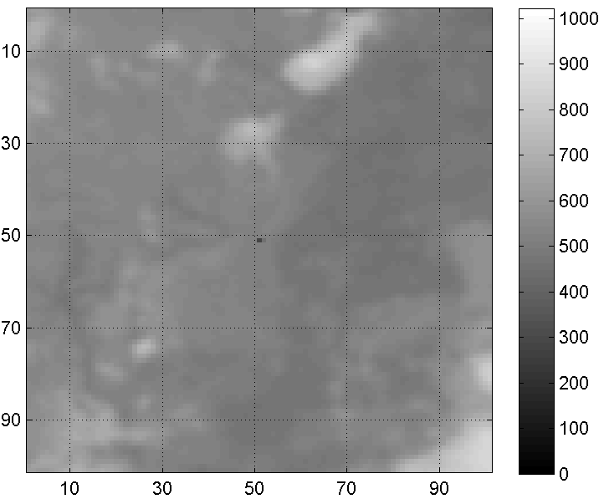
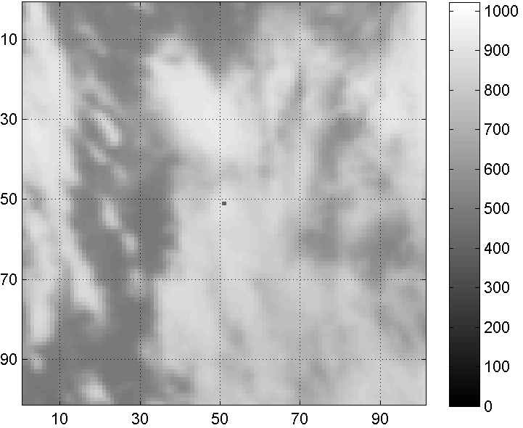
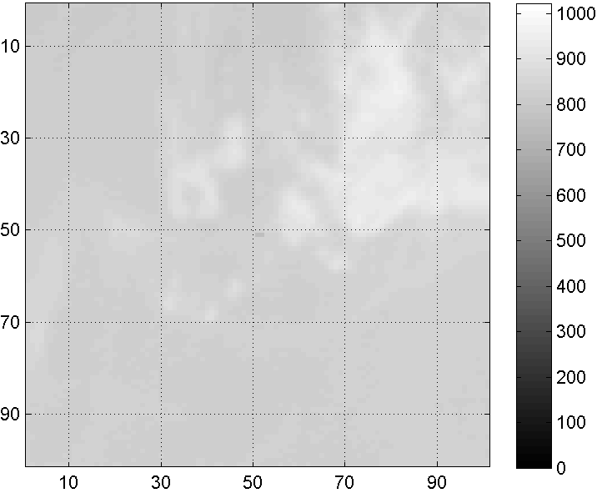
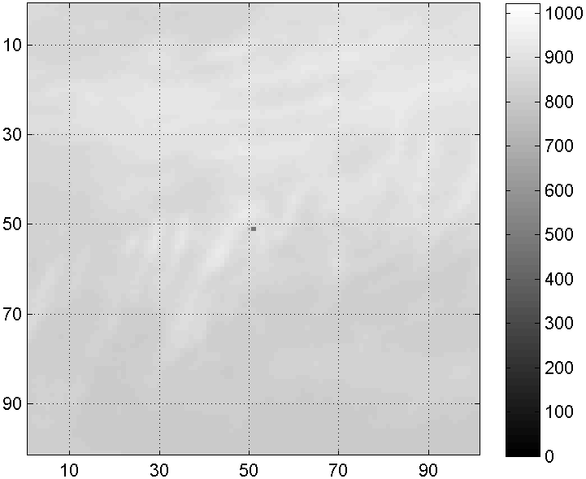
Remove noise in the satellite image(upcoming)
There are some noise data in the satellite image.
The noise data will influence the quality of AMVs and must be eliminated before the derivation of AMVs.
Noise data in both infrared channel and water vapour channel
Infrared channel
Infrared channel
Water vapour channel
Water vapour channel
Notes:
Third change:
An algorithm Remove noise.
There are some noise data in the satellite image.
The noise data will influence the quality of AMVs and must be eliminated before the derivation of AMVs.
Noise data in both infrared channel and water vapour channel

Slide 19
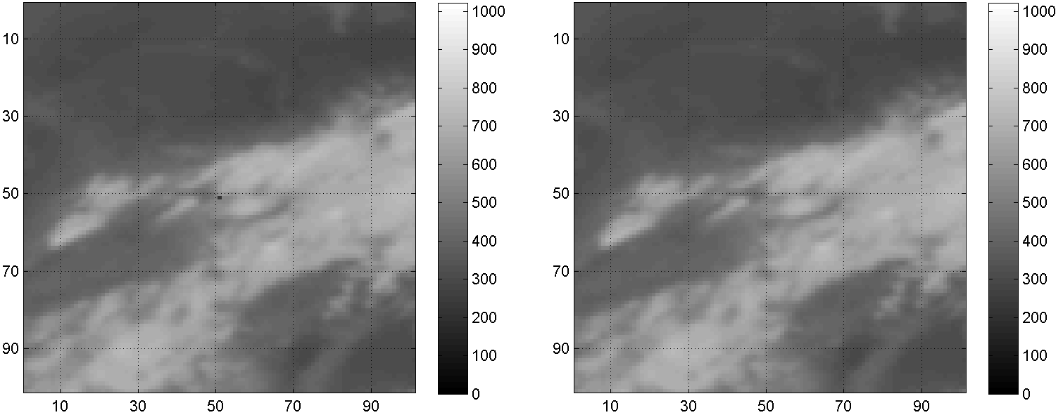
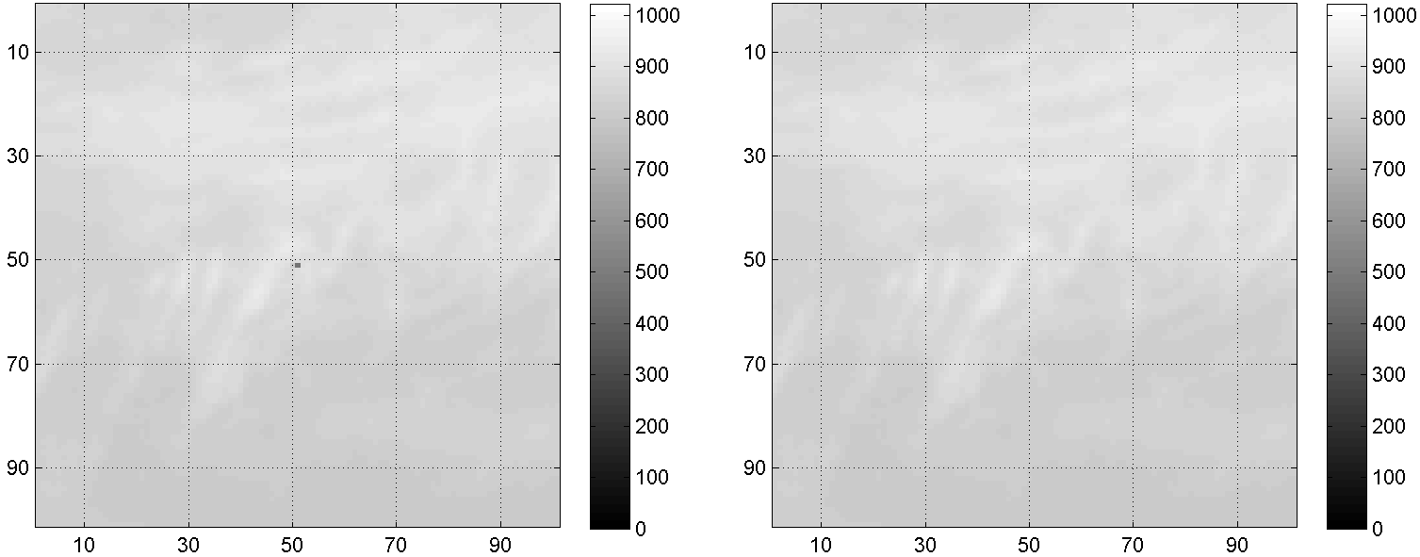
Remove noise in the satellite image(upcoming)
--Identify and eliminate the noise
An algorithm based on median filter will perform to identify and eliminate the noise.
The algorithm do not change the value except the noise.
befor
after
befor
after
Notes:
An algorithm based on median filter will perform to identify and eliminate the noise.
The algorithm do not change the value except the noise.
The left figure has noise, after performing the algorithm, there is no noise in the right figure.

Slide 20
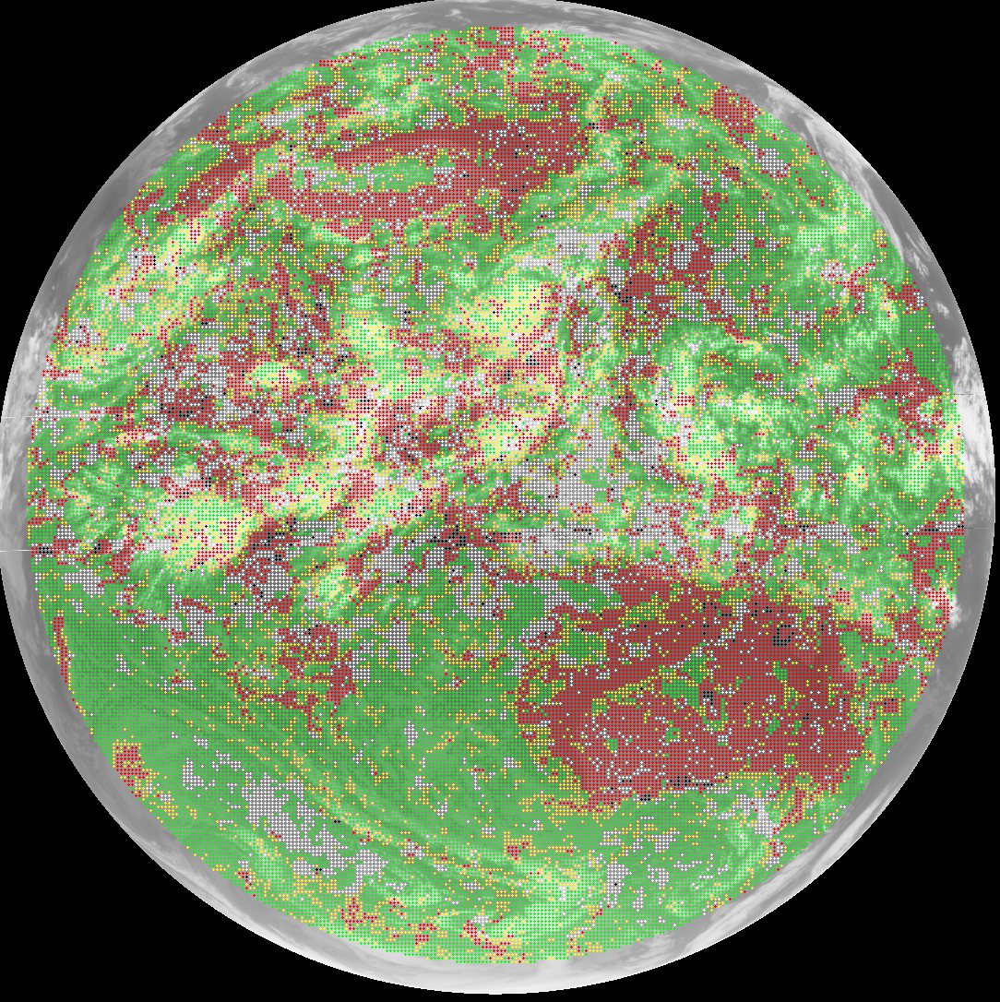
Second tracking algorithm (upcoming)
If the correlation coefficent of first tracking is larger than 0.8, second tracking will be performed.
The first tracking box is 32 X 32, and the second tracking box is 16 X 16.
In left image:
  Green: Second tracking succeeded.
  Mean speed of First tracking: 11.01 m/s
  Mean speed of Second tracking: 13.70 m/s
Notes:
Fourth change:
Second tracking algorithm
If the correlation coefficent of first tracking is larger than 0.8, second tracking will be performed.
The first tracking box is 32 X 32, and the second tracking box is 16 X 16.
In left image:
Green: Second tracking succeeded.
Mean speed of First tracking: 11.01 m/s (eleven meters per second)
Mean speed of Second tracking: 13.70 m/s (thirteen meters per second)
the correlation coefficent of first tracking is larger than 0.8 Two-thirds of First tracking winds are succeed in second tracking.

Slide 21
Height assignment in inversion layer
Low-level inversions layers can produce height assignment errors for winds.
In IR/WV relationship chart, the temperature of points in inversions layers is higher than the surface. Those points must not be used to determine the clear sky point.
Notes:
Fifth change:
Height assignment in inversion layer
In height assignment with IR/WV relationship,
Low-level inversions layers in the left figure, will cause the temperature of points in inversions layers higher than the surface in IR/WV relationship chart,
That cause to find wrong clear sky point, and produce height assignment errors for winds.
So those points in inversions layers must not be used to determine the clear sky point.

Slide 22
Height assignment in target box full of cloud
When the target box full of cloud, the clear sky point is difficult to be find.
The clear sky point can be found in the expand box approximatively.
Clear sky point
Notes:
Sixth change:
Height assignment in target box full of cloud
In height assignment with IR/WV relationship,
When the target box full of cloud, the clear sky point is difficult to be find.
The clear sky point can be found in the expand box approximatively.

Slide 23
Content of talk:
Current FY-2 satellites status and planned configurations
Current status of CMA winds
Changes in operational system since last winds workshop
Historical dataset reprocessing plan
Notes:
The fourth is to talk about Historical dataset reprocessing plan

Slide 24
Historical dataset reprocessing plan
CMA already started an project to reprocess the historical AMVs dataset in 2013, and will be finished in end of 2015.
Reprocess all historical AMVs data with latest AMVs algorithm(CMA Version 2014)
DATE | CONTENT
2013.1 --- 2013.12 | Prepare historical data ( FY-2 satellite data, NWP data, etc. )
2013.1 --- 2014.6 | Improve AMVs algorithm
2014.7 --- 2015.9 | Reprocess historical AMVs data with latest AMVs algorithm
2015.10 --- 2015.12 | Check quality of the reprocessed AMVs data, and archive
Notes:
CMA already started an project to reprocess the historical AMVs dataset in two thousand thirteen, and will be finished in end of two thousand fifteen.
In this plan, we will reprocess all historical AMVs data with latest AMVs algorithm(CMA Version two thousand fourteen).
The reprocessing work schedule is:
In two thousand thirteen, to prepare historical data, including FY satellite image data, NWP data, and so on.
In last year and this year, to improve AMVs algorithm, including calibration, navigation, height assignment, and so on.
After AMVs algorithm improving, to reprocess historical AMVs data with latest AMVs algorithm.
Finally, we will check quality of the reprocessed AMVs data, and archive them.

Slide 25
Historical dataset reprocessing plan
--historical AMVs data information
CMA AMV’s operation begin from January 2006
Infrared (IR) and water vapor (WV) channel AMVs derivations were performed for three FY-2 satellites
SATELLITE | NADIR LONGITUDE | DATE | AMVs TIME (UTC)
FY-2C | 105º | Jan 1st, 2006 – Nov 24th, 2009 | 00/06/12/18
FY-2D | 86.5º | Feb 14th, 2007 – Dec 31st, 2013 | 03/09/15/21
FY-2E | 105º | Nov 23rd, 2009 – Dec 31st, 2013 | 00/06/12/18
Notes:
Let see the historical AMVs data information
CMA AMV’s operation begin from January thousand six with FY-2C.
Infrared (IR) and water vapor (WV) channel AMVs derivations were performed for three FY satellites
The FY-2C operated at one hundred five east, it has about four years data;
The FY-2D operated at eighty six dot five east, it has about seven years data;
The FY-2E operated at one hundred five east, it has about four years data;

Slide 26
Historical dataset reprocessing plan
--Main work
Re-calibration of historical satellite data
  FY-2 On-orbit Operational Calibration Approach(CIBLE)
Re-navigation of historical satellite data
  Latest re-navigation algorithm is performed to eliminate the influence of abnormal satellite image
Eliminate the noise point of infrared and water vapor channel
Review and improve AMVs algorithm
  Second tracking algorithm
  Height assignment in inversion layer
  Height assignment in target box full of cloud
  ……
Notes:
Historical dataset reprocessing plan has the following works
Re-calibration
Re-navigation
Eliminate the noise point of infrared and water vapor channel
Review and improve AMVs algorithm
Second tracking algorithm
Height assignment in inversion layer
Height assignment in target box full of cloud

Slide 27
Thank you !

