Slide 1
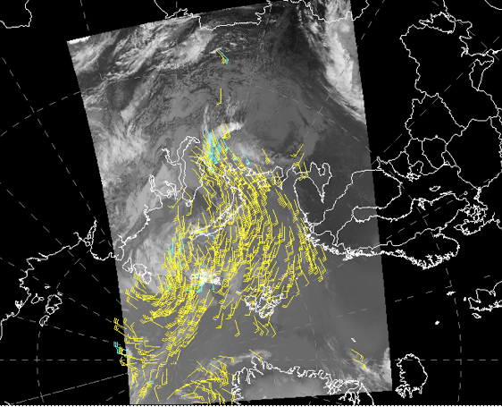
Polar Winds from VIIRS
Jeff Key*, Jaime Daniels#, Steve Wanzong⁺, Andrew Bailey@, Hongming Qi^,
Wayne Bresky@, Dave Santek⁺, Chris Velden⁺, Walter Wolf#
*NOAA/National Environmental Satellite, Data, and Information Service, Madison, WI
+ Cooperative Institute for Meteorological Satellite Studies, University of Wisconsin-Madison
#NOAA/National Environmental Satellite, Data, and Information Service, Camp Springs, MD
^NOAA/National Environmental Satellite, Data, and Information Service, Camp Springs, MD
@I.M. Systems Group (IMSG), Rockville, MD USA
12th International Winds Workshop, Copenhagen, 16-20 June 2014

Slide 2
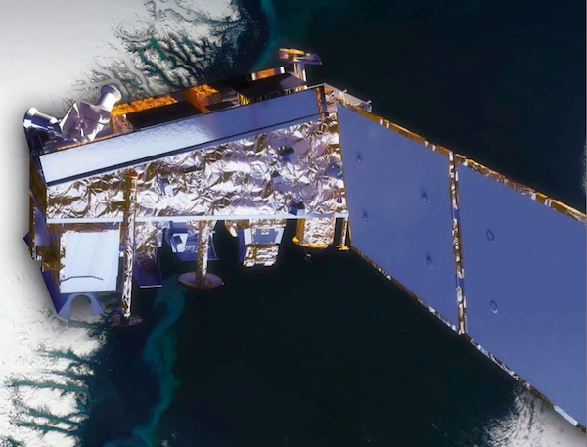
Unique Characteristics of VIIRS
The Visible Infrared Imaging Radiometer Suite (VIIRS) on the Suomi National Polar-orbiting Partnership (S-NPP) satellite was launched 28 October 2011.
VIIRS will be on the JPSS series of satellites, replacing AVHRR as NOAA’s operational polar-orbiting imager.
VIIRS’ unique characteristics relevant to a polar winds product include:
Higher spatial resolution (750 m for most bands; 375 m for some)
Wider swath than MODIS
Constrained pixel growth: better resolution at edge of swath
Day-night band (DNB)
Disadvantage: No thermal water vapor band so no clear-sky WV winds
The VIIRS polar winds processing utilizes the GOES-R AMV algorithm.

Slide 3
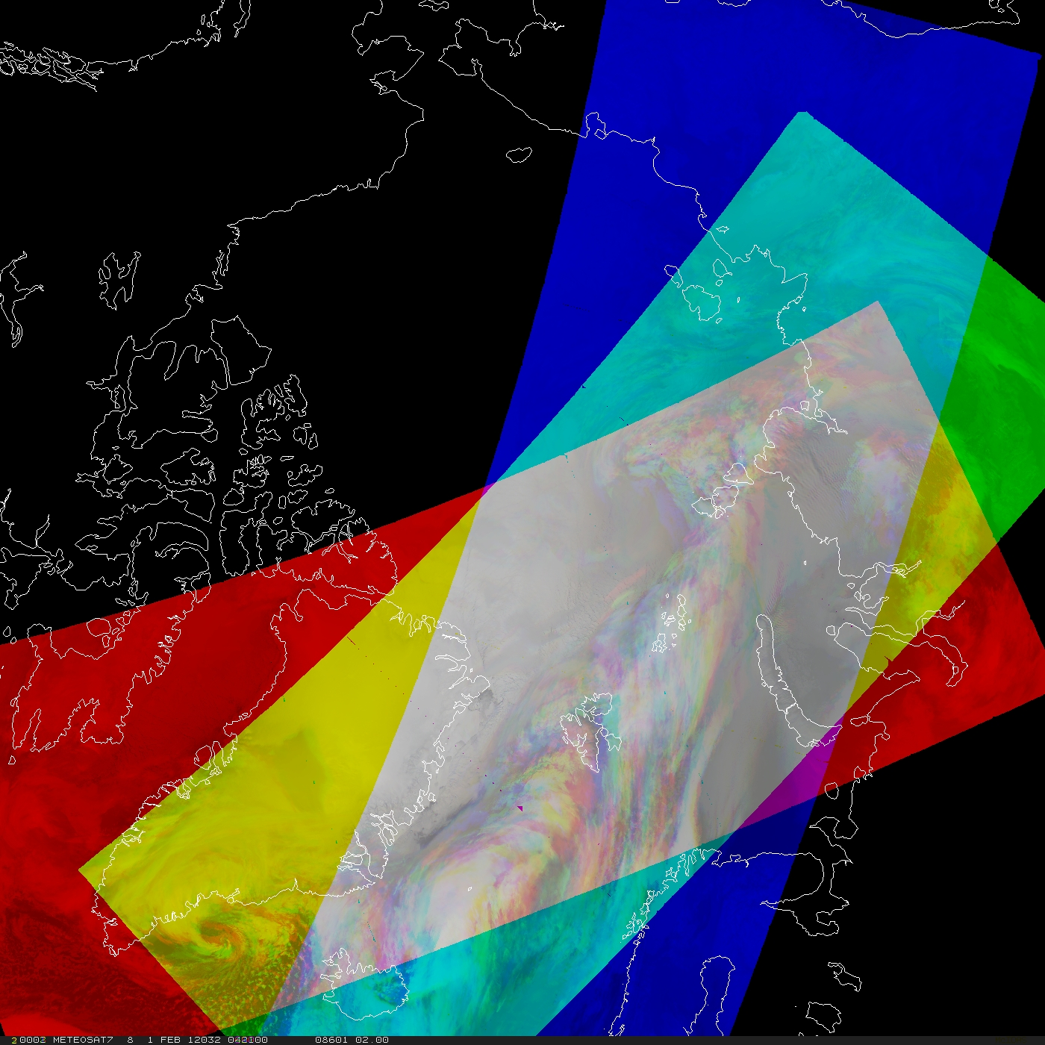
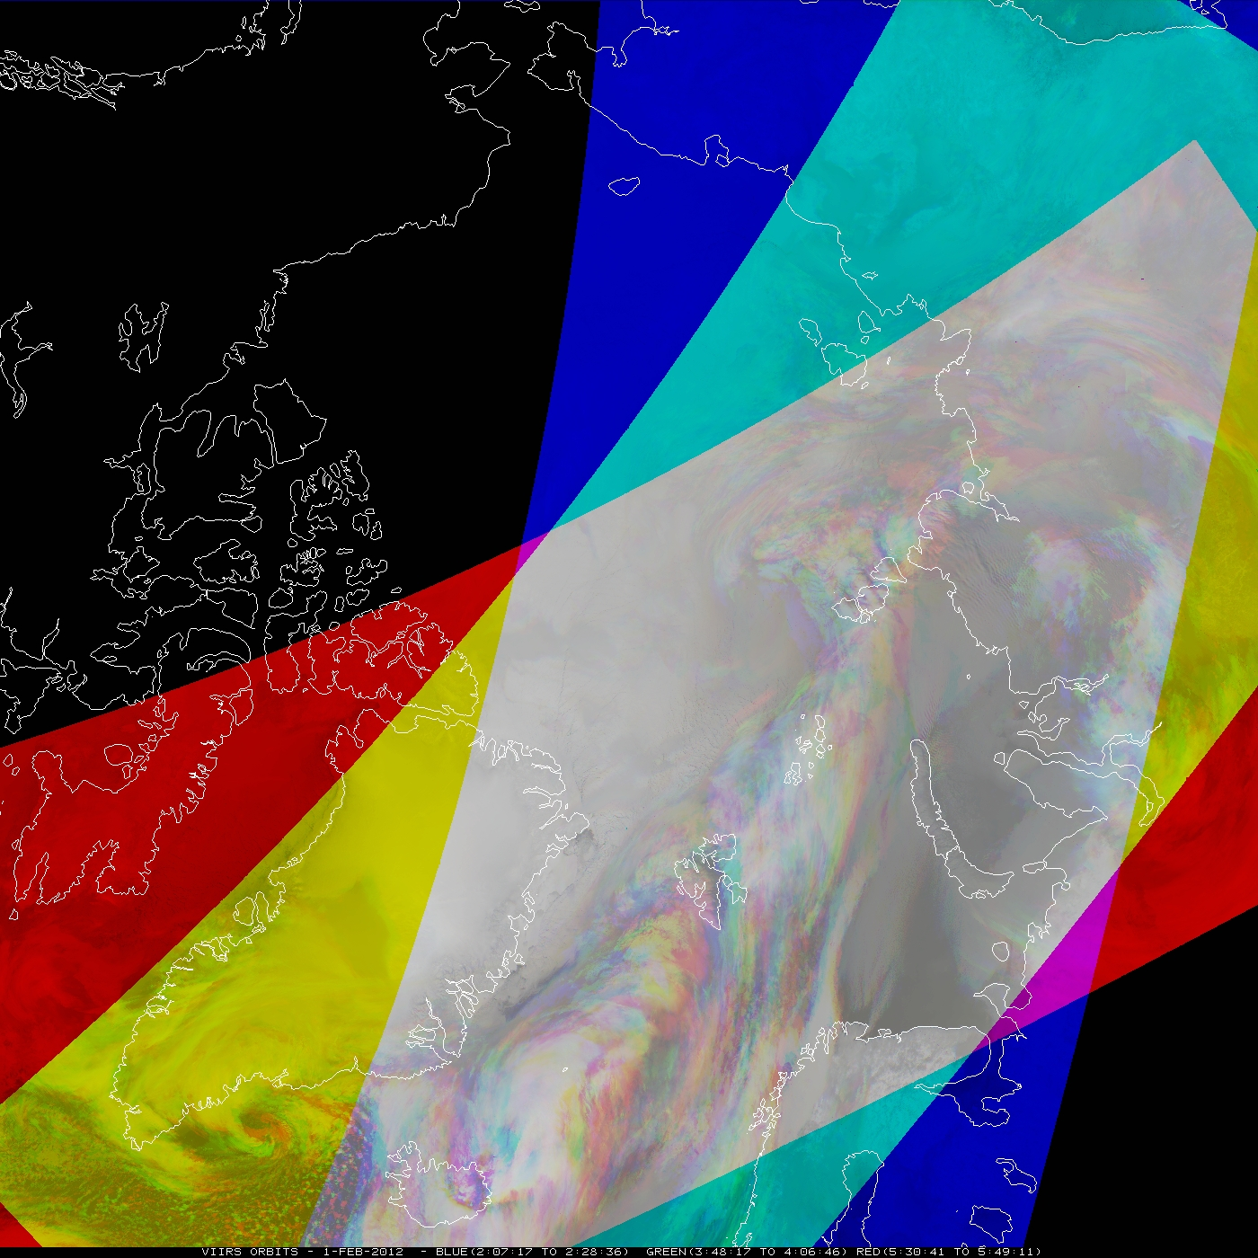
VIIRS Coverage: Wider Swath
VIIRS has a wider swath (3000 km) than MODIS (2320 km), so the coverage will be better and will extend further south.
MODIS
VIIRS
A wider swath means more winds with each orbit.

Slide 4
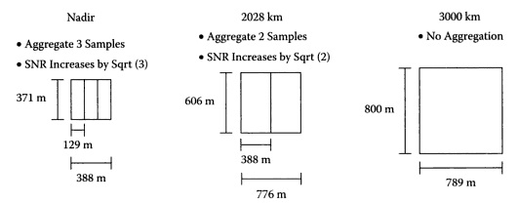
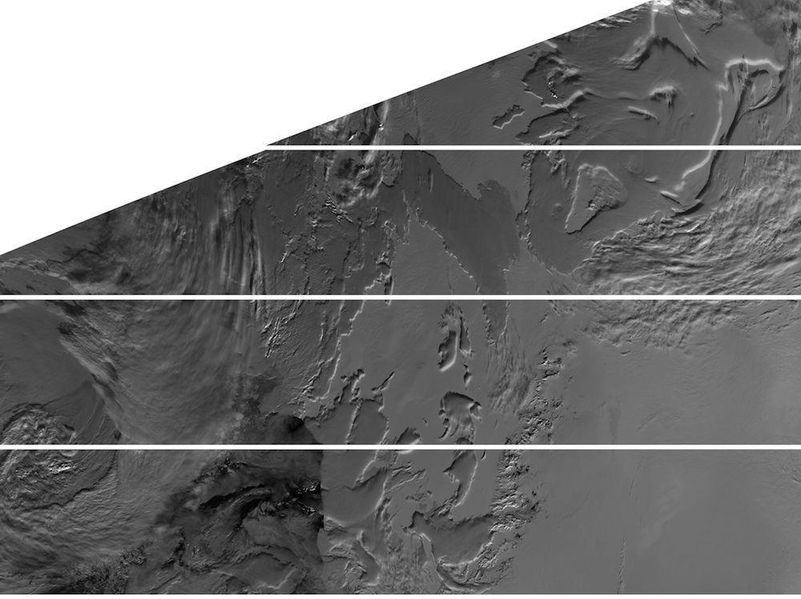
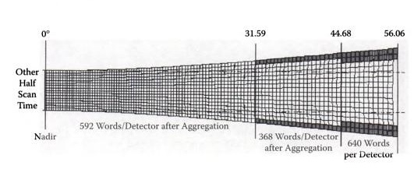
Improved Resolution at Edge of Swath
VIIRS method of aggregating detectors and deleting portions of the scans near the swath edge results in smaller pixels at large scan angles.
For thermal bands, VIIRS is 0.56 km² (0.75 x 0.75 km) at nadir and 2.25 km² at the edge of the swath (0.37 -> 0.8 km for imager bands; 0.74 -> 0.74 km for DNB)
In contrast, AVHRR and MODIS are 1 km² at nadir and 9.7 km² at edge of swath.
Additionally, VIIRS scan processing reduces the bow-tie effect.

Slide 5
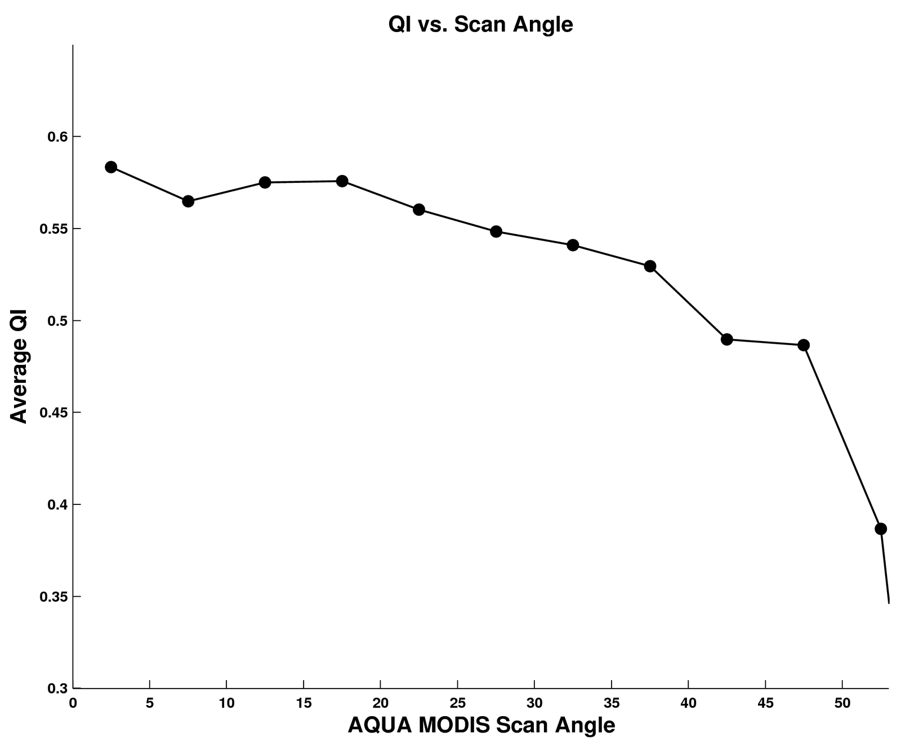
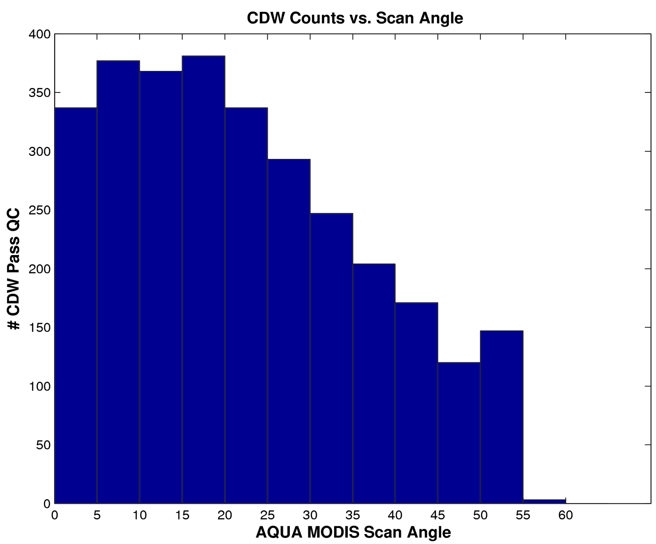
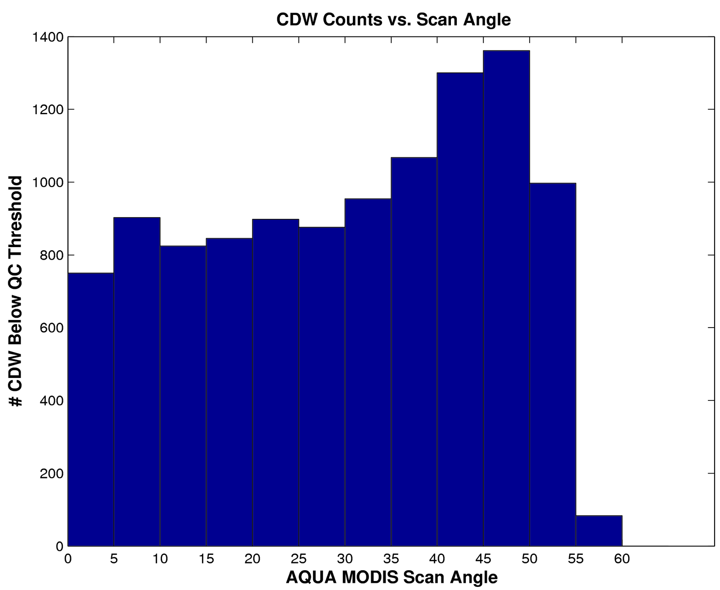
Effects of Scan Angle on Winds
Does the improved resolution away from nadir matter for wind retrieval?
Good MODIS Winds (QI > 0.6)
Not-so-good MODIS Winds (QI < 0.6)
Nadir
Nadir
So it is clear that many of the winds toward the swath edges are filtered out by QC.

Slide 6
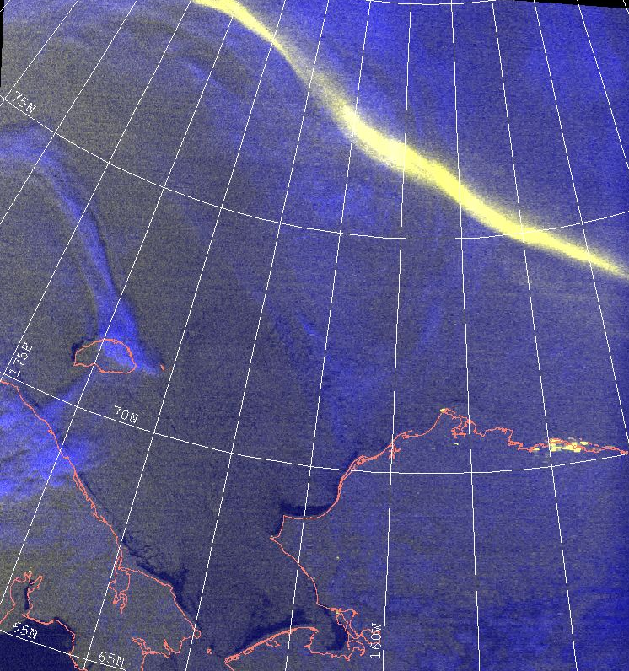
VIIRS Day-Night Band (DNB)
Satellite-based low light detection was pioneered by the Operational Linescan System (OLS), which has flown continuously on the Defense Meteorological Satellite Program (DMSP) since 1967.
VIIRS has a “Day/Night Band” (DNB), which offers marked advances over the heritage DMSP/OLS.
We are not yet using this band for AMVs.
DMSP F-16 1/12/2011 0516UTC
Aurora Borealis
Sea Ice
Barrow
Open Water Channels
(Courtesy of Steve Miller, CIRA)
Notes:
To fly on NPP (25 Oct 2011 launch) as part of the Visible/Infrared Imager/Radiometers Suite (VIIRS), 1330 LTAN orbtit.
740 m resolution (constant across the full 3000 km swath).
Calibrated radiance across 7 orders of magnitude radiance range, using 3 stages of dynamically selected gain, sensitive down to ~10⁻⁵ W/m²-sr-µm.
14-bit quantization (vs. 6-bit for the OLS).
Minimal stray light (solar glare) effects compared to OLS.
First opportunity to combine low-light visible with numerous near-IR and thermal-IR bands for multi-spectral applications.
* Lee, T. F., S. D. Miller, F. J. Turk, C. Schueler, R. Julian, S. Deyo, P. Dills, and S. Wang, 2006: The NPOESS/VIIRS day/night visible sensor, Bull. Amer. Meteor. Soc., 87(2), 191-199.

Slide 7
GOES-R ABI and VIIRS Algorithm
Unique features of the ABI wind retrieval methodology:
Feature Tracking: The Sum-of-Squared Differences (SS) method is used in conjunction with the “nested tracking” algorithm that is very effective at capturing the dominant motion in each target scene being tracked to track the feature backward and forward in time.
Target Height Assignment: Externally-generated cloud heights are used. This approach offers the best opportunity to assign the most representative heights to targets being tracked in time and contains diagnostic performance metrics.

Slide 8
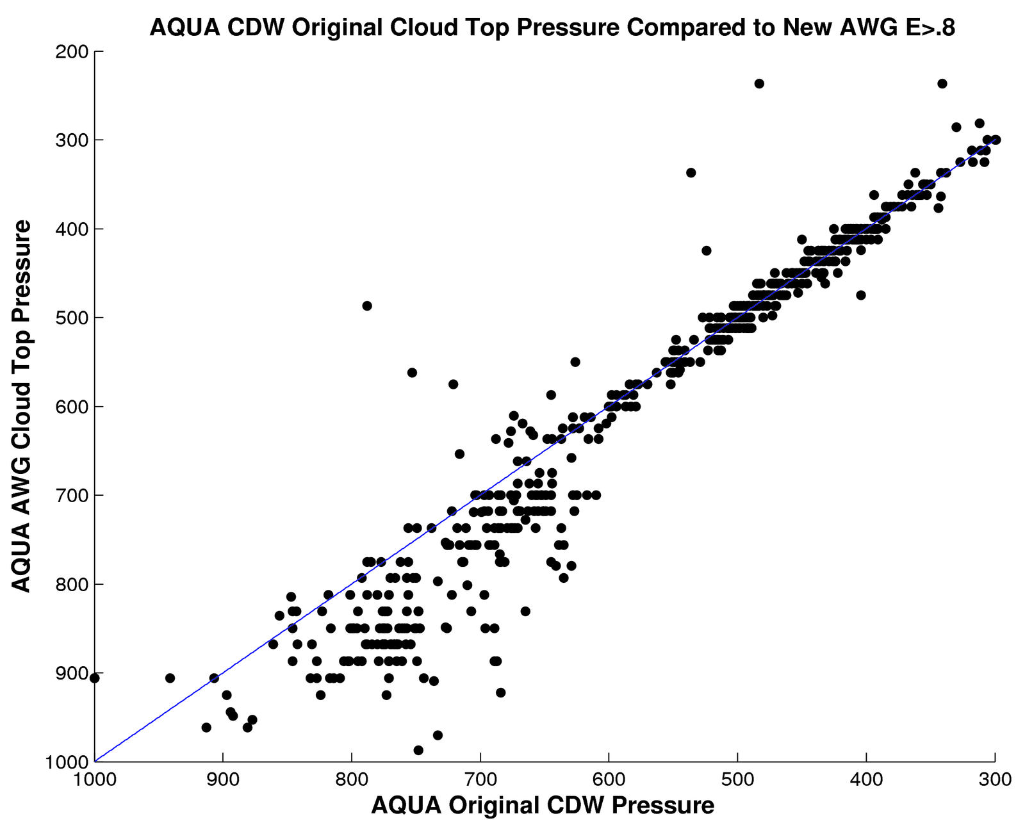
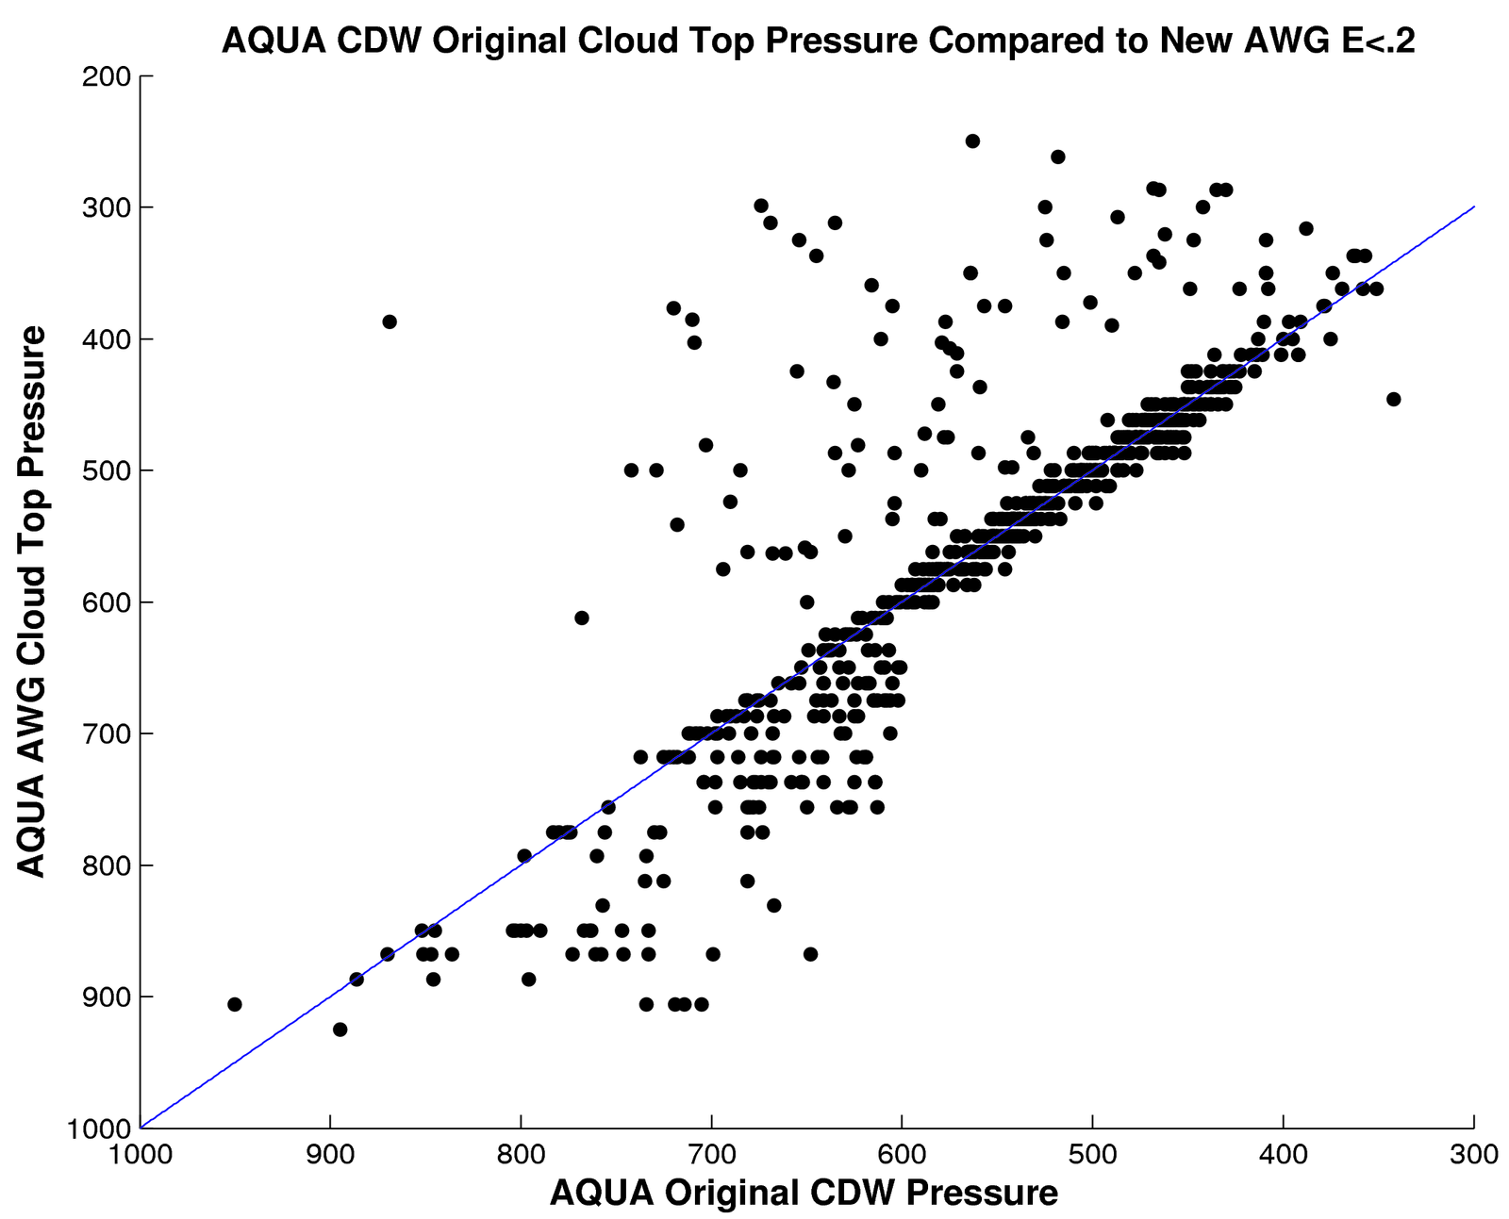
Clouds Heights: Externally-Generated vs Windco
Windco quality control eliminates many of the cases where heights are significantly different, but biases remain:
Thick Clouds, QI > 0.6
Thin Clouds, QI > 0.6

Slide 9
Orbits
Satellite | Equator Crossing Time
NOAA-15 | 07:30
NOAA-16 | 14:00 (decommissioned 06/2014)
NOAA-17 | 10:00 (decommissioned 04/2013)
NOAA-18 | 14:00
NOAA-19 | 13:30
Metop-A | 09:30
Metop-B | 09:30
Terra | 10:30
Aqua | 13:30
S-NPP | 13:30
VIIRS provides similar time coverage as Aqua, NOAA-19, and NOAA-18.
Animation of Terra, Aqua, NPP and others (not NOAA-xx) at https://www.youtube.com/watch?v=WT-WhWHPyk4.
Notes:
http://www.noaasis.noaa.gov/NOAASIS/ml/life_expectancy.html
NPP and Aqua fly in tandem for only a few orbits every three days.

Slide 10
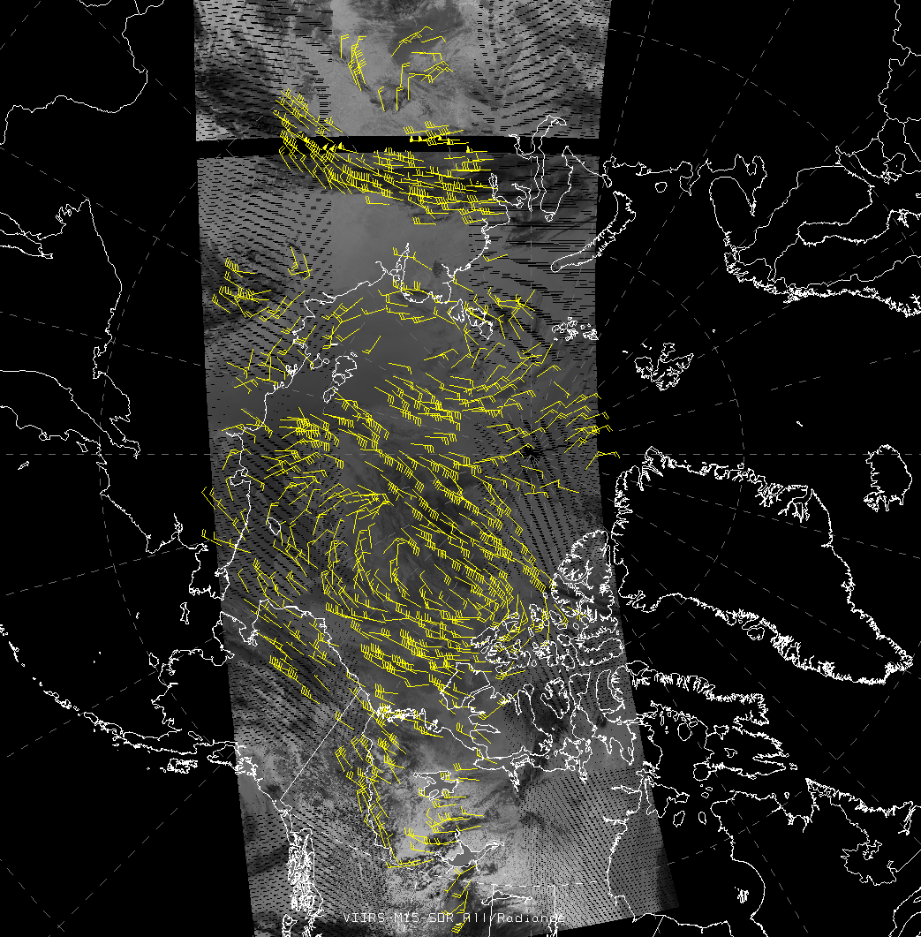
VIIRS Polar Winds Status
The VIIRS polar winds product became operational in NESDIS on 8 May 2014.
Many changes to the processing have been made, including the conversion of VIIRS data to a polar stereographic projection, conversion to AREA files, and integration into GEOCAT, all without McIDAS.
This is the first GOES-R algorithm to become operational.

Slide 11
Validation: Radiosondes September, 2013 – January, 2014
All Levels (100-1000 hPa) | VIIRS Polar Wind vs. Radiosonde Winds (m/s)
 | NHEM | SHEM
Accuracy | 5.67 | 5.71
Precision | 3.41 | 3.25
Speed bias | 0.38 | -0.04
Speed | 17.61 | 14.22
Sample | 9650 | 866
High Level (100-400 hPa) | NHEM | SHEM
Accuracy | 6.21 | 6.81
Precision | 3.55 | 3.36
Speed bias | -0.06 | -0.23
Speed | 23.62 | 18.05
Sample | 3054 | 301
Mid Level (400-700 hPa) | NHEM | SHEM
Accuracy | 5.65 | 5.24
Precision | 3.40 | 3.12
Speed bias | 0.56 | 0.07
Speed | 16.69 | 12.51
Sample | 4468 | 471
Low Level (700-1000 hPa) | NHEM | SHEM
Accuracy | 4.95 | 4.55
Precision | 3.08 | 2.39
Speed bias | 0.64 | 0.04
Speed | 10.91 | 10.52
Sample | 2128 | 94
Requirements:
Measurement Accuracy | 7.5m/s
Measurement Precision | 4.2m/s
Statistics are similar for comparisons with aircraft winds.

Slide 12
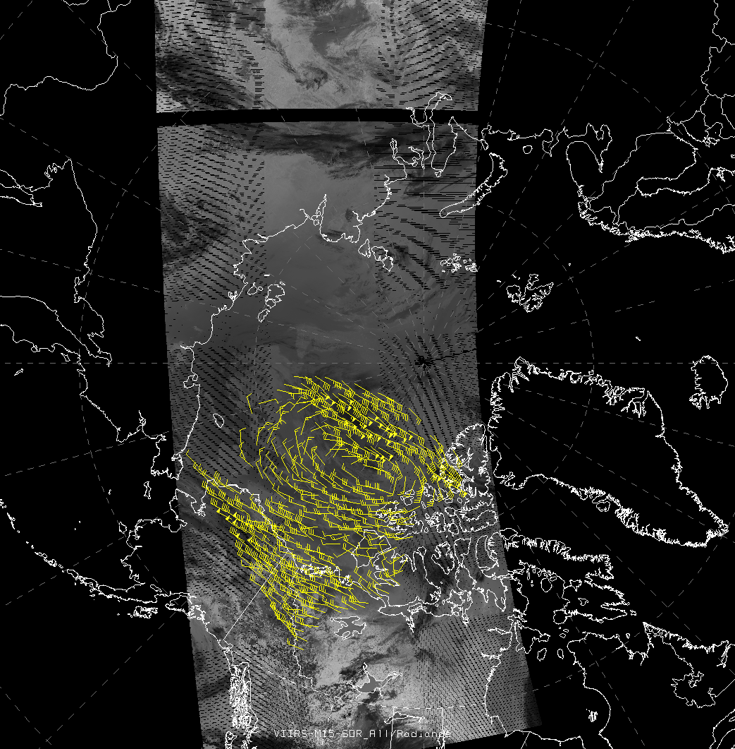
Direct Broadcast VIIRS Polar Winds
DB winds generated at Fairbanks, Alaska (the only site so far).
Uses the heritage algorithm (“windco”), not nested tracking.
DB
NESDIS
ops
Graphical comparison of DB (left) and operational (right) VIIRS winds

Slide 13
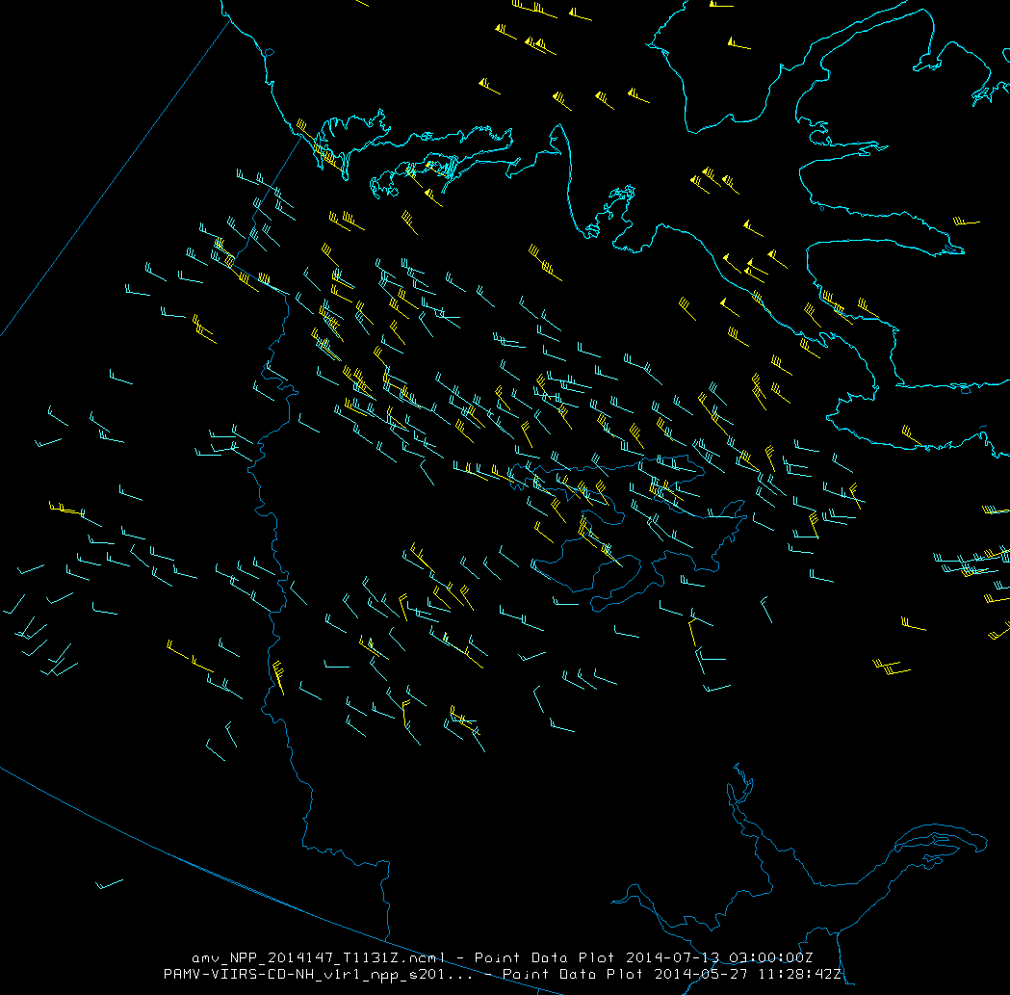
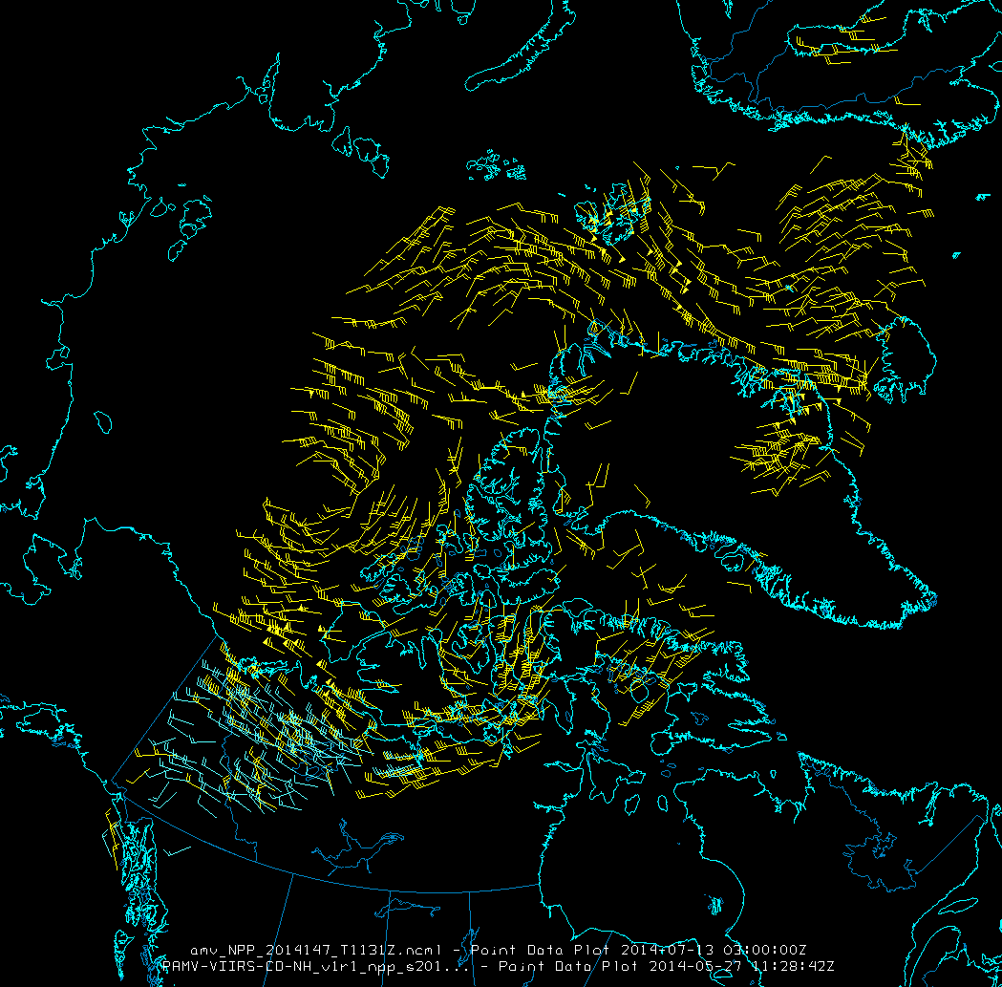
Direct Broadcast VIIRS Polar Winds
Graphical comparison of DB (cyan) and operational (yellow) VIIRS winds together.
DB (cyan)
NESDIS ops (yellow)
DB (cyan)
NESDIS ops (yellow)

Slide 14
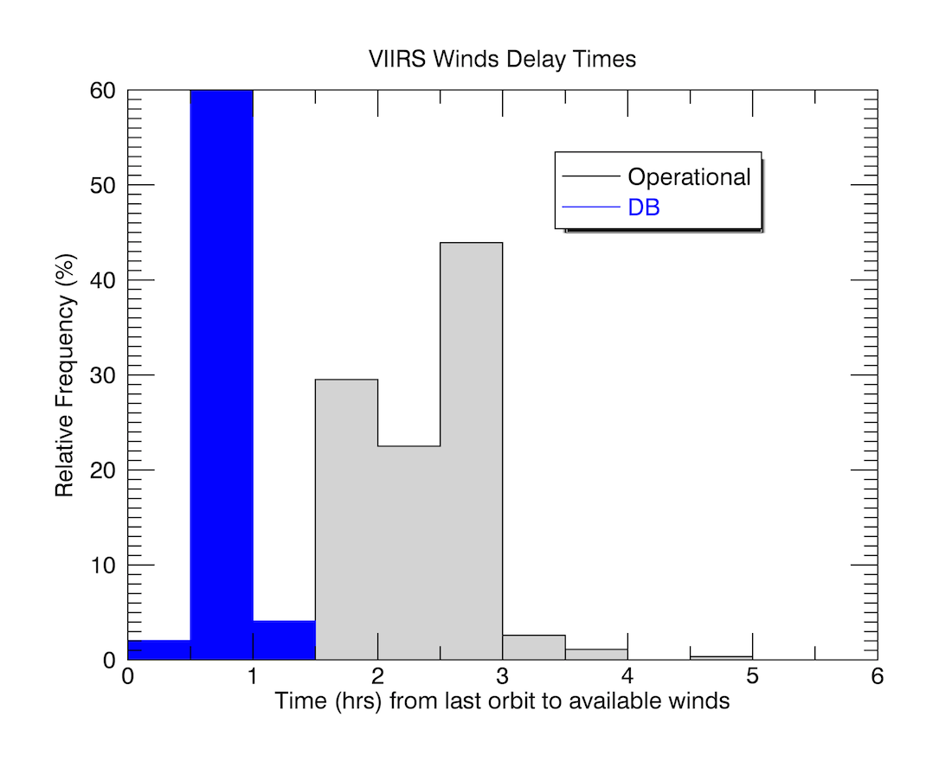
Latency
The time it takes to generate winds after the time of the last image in an orbit triplet is, on average, approximately 0.8 hrs for DB winds and 2.0-2.5 hrs for the operational winds.
100 minutes (1.7 hrs) must be added to these numbers to obtain the actual latency of the wind observation because its time is that of the middle image/orbit.

Slide 15
All Polar Winds Products: History
10-day MODIS winds case study made available
Real-time AVHRR winds
MODIS DB winds at Fairbanks
LEO-GEO winds
Real-time Terra and Aqua MODIS winds
MODIS DB winds at McMurdo
Mixed-satellite MODIS winds
VIIRS DB winds at Fairbanks
AVHRR historical winds (v2)
Metop AVHRR winds
2001
2002
2003
2004
2005
2006
2007
2008
2009
2010
2011
2012
2013
2014
2015
Daily AVHRR winds
AVHRR HRPT winds from Rothera
NESDIS MODIS winds on GTS
MODIS DB winds at Tromsø
VIIRS winds
MODIS DB winds at Sodankylä
ECMWF and NASA DAO demonstrate positive impact
MODIS, AVHRR winds with nested tracking algorithm
Terra MODIS winds in ECMWF operational system
DB winds distributed via EUMETCast
AVHRR HRPT winds from Barrow

Slide 16
The Polar Wind Product Suite
MODIS
Aqua and Terra separately
Aqua and Terra combined
Direct broadcast (DB) at
McMurdo, Antarctica (Terra, Aqua)
Tromsø, Norway (Terra)
Sodankylä, Finland (Terra)
Fairbanks, Alaska (MODIS discontinued)
EW
AVHRR
Global Area Coverage (GAC) for NOAA-15, -16, -17, -18, -19
Metop-A, -B
HRPT (High Resolution Picture Transmission = direct readout) at
Barrow, Alaska, NOAA-18, -19
Rothera, Antarctica, NOAA-18, -19
Historical GAC winds, 1982-2012. Two satellites throughout most of the time series.
LEO-GEO
Combination of may geostationary and polar-orbiting imagers
Fills the 60-70 degree latitude gap
EW
VIIRS
S-NPP (GOES-R algorithm)
Direct broadcast at Fairbanks (heritage algorithm)
Notes:
NOAA-17 was decommissioned on 10 April 2013. AVHRR unusable since March 2010.
NOAA-16 was decommissioned on 9 June 2014.
Operational
Operational
Operational
Operational

Slide 17
Operational NWP Users of Polar Winds
13 NWP centers in 9 countries:
European Centre for Medium-Range Weather Forecasts (ECMWF) - since Jan 2003.
NASA Global Modeling and Assimilation Office (GMAO) - since early 2003.
Deutscher Wetterdienst (DWD) – MODIS since Nov 2003. DB and AVHRR.
Japan Meteorological Agency (JMA), Arctic only - since May 2004.
Canadian Meteorological Centre (CMC) – since Sep 2004. DB winds since Mar 2009.
US Navy, Naval Research Lab, Fleet Numerical Meteorology and Oceanography Center (FNMOC) –since Oct 2004. DB winds since Apr 2006. AVHRR GAC, Metop since Nov 2007.
Met Office – MODIS since Feb 2005. DB since Feb 2009. AVHRR GAC since May 2008.
National Centers for Environmental Prediction (NCEP) and the Joint Center for Satellite Data Assimilation - since Nov 2005.
Météo-France - since Jun 2006.
National Center for Atmospheric Research (NCAR), Antarctic Mesoscale Model (AMPS) - since Oct 2006.
Australian Bureau of Meteorology – since late 2007
China Meteorological Administration (CMA) – since mid-2009
HydroMeteorological Center of Russia (Hydrometcenter) – since 2010

Slide 18
Polar Winds User Survey (May 2014)
Respondents:
European Centre for Medium-Range Weather Forecasts (ECMWF)
NASA Global Modeling and Assimilation Office (GMAO)
Deutscher Wetterdienst (DWD)
Japan Meteorological Agency (JMA)
Meteorological Services of Canada (MSC)
Naval Research Lab/FNMOC (two survey entries)
Met Office
National Centers for Environmental Prediction (NCEP) and the Joint Center for Satellite Data Assimilation
Météo-France
HydroMeteorological Center of Russia (Hydrometcenter) – since 2010

Slide 19
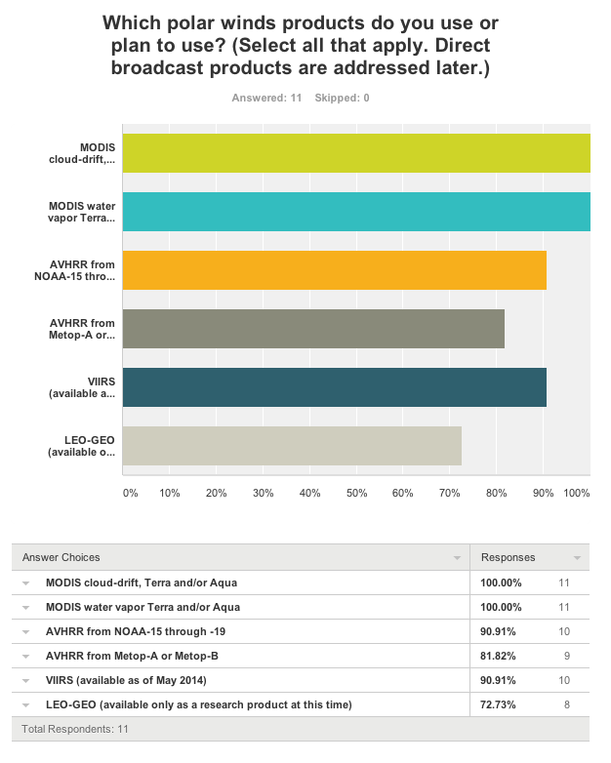

Slide 20
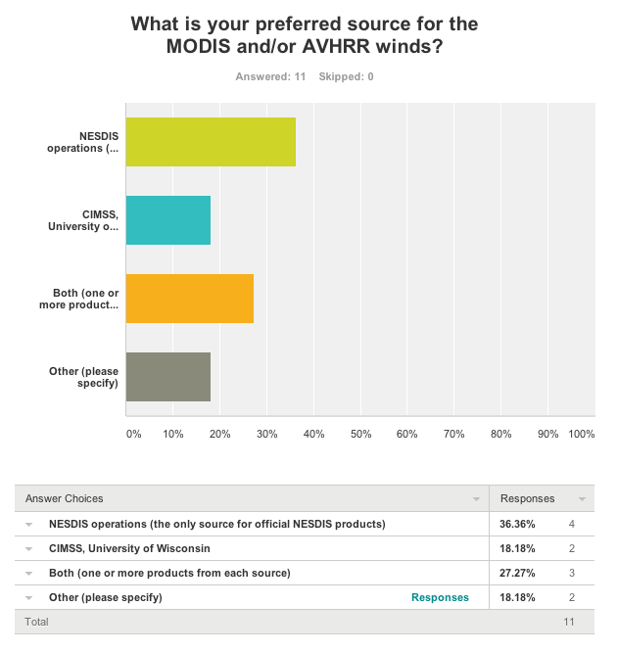
(“NESDIS and EUMETSAT”)

Slide 21
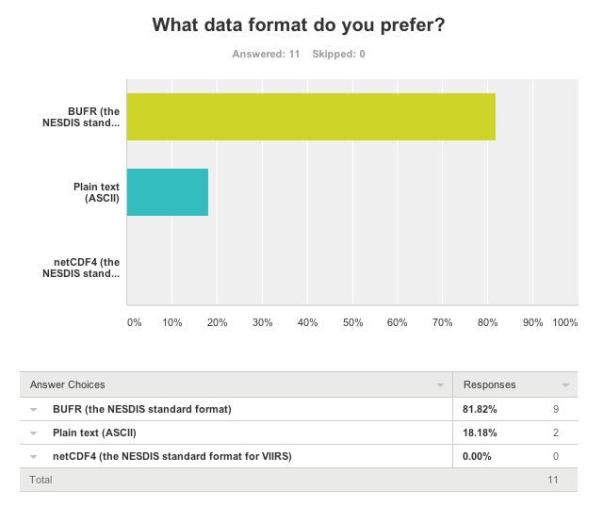

Slide 22
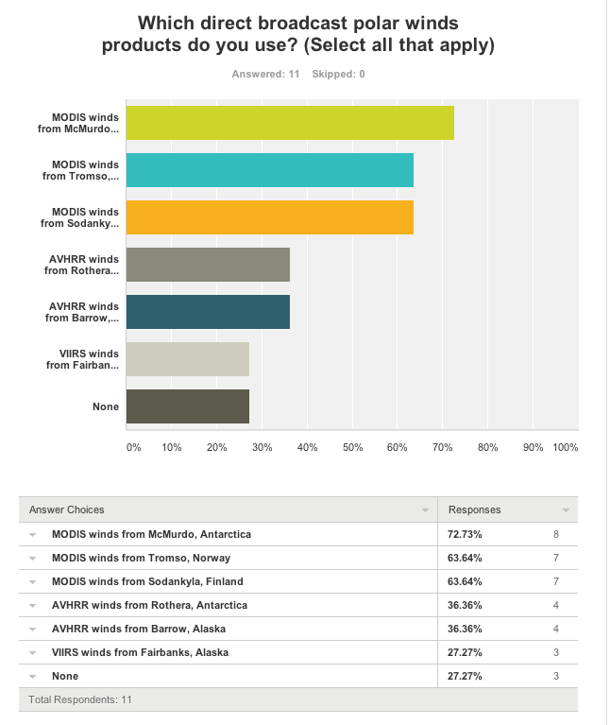

Slide 23
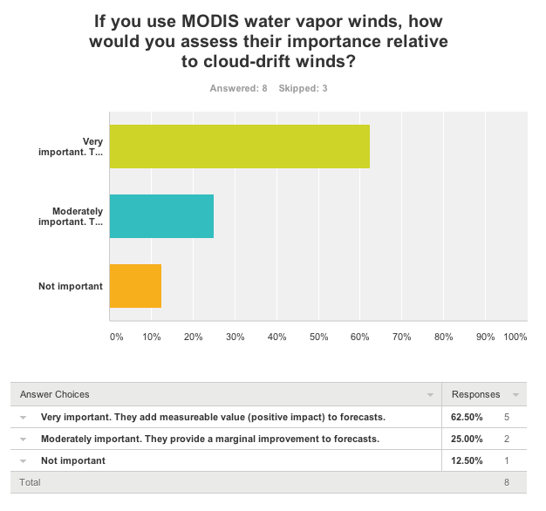

Slide 24
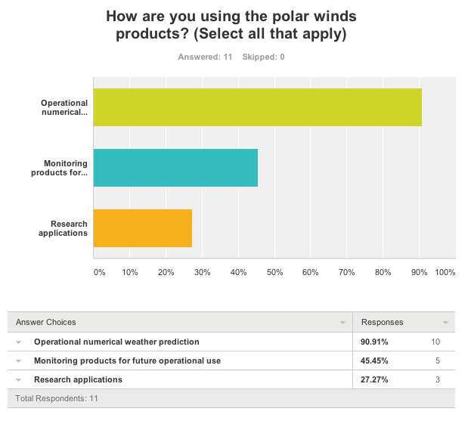

Slide 25
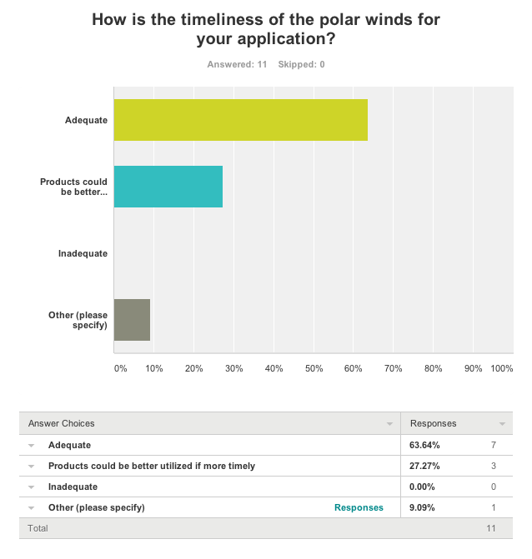

Slide 26
Survey Comments:
1) MODIS AMVs are in operations, AVHRR are under investigation (work by D.Santek) and soon to be added to ops, VIIRS are currently being added to the BUFR data stream. 3) Ascii and NETCDF formats are fine for research purposes only 5) MODIS WV winds are about 90% in terms of counts of the all number of MODIS winds (WV+CloudDrift)
Currently, we are using data in ASCII. Transition to BUFR will be needed soon for operational reasons. To accomplish this transition, we will need a BUFR reader and a period of parallel ASCII and BUFR data transmission. Thanks for your data, we like them!
AVHRR winds and VIIRS winds of Q4 is not used in the JMA operational NWP system. JMA has a plan for use these winds.
In our operational run we use polar winds that are used in NCEP, since we share and get data that are used in their GFS/GDAS run. We are using extra AVHRR polar winds for our next reanalysis (MERRA2).
Thanks for your work pioneering these products.
Polar winds will become increasingly vital as commercial and DOD entities ramp up their operations within this domain as sea ice retreat provides new opportunities.
We are currently monitoring the direct broadcast MODIS winds but do not assimilate them.

Slide 27
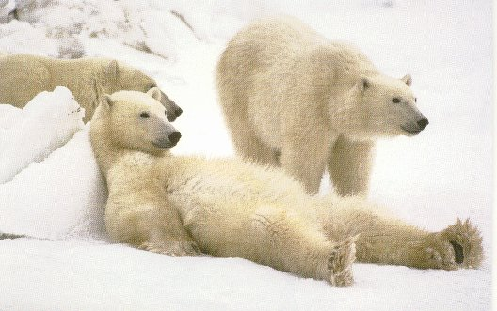
Summary
Several unique characteristics of VIIRS are expected to influence the quality of the polar winds product: wider swath, higher spatial resolution across the swath. We have not expoited the day-night band (DNB) yet.
VIIRS polar winds became operational in May 2014. It uses the GOES-R AMV algorithm.
Validation statistics are good, being similar to MODIS winds.
Direct broadcast VIIRS winds are generated on-site at Fairbanks, Alaska.
The recent survey indicates that all polar winds products are utilized in NWP operations, though not all are used by every center.
Future work: MODIS and (maybe) AVHRR products will be converted to the nested-tracking (GOES-R) algorithm.

