Slide 1
Operational use of NWC SAF AMV package in the Met Office mesoscale forecasting system
Graeme Kelly, Peter Lean, Crispian Batstone,
and James Cotton.

Slide 2
OVERVIEW
Satellite derived Atmospheric Motion Vectors (AMVs) have given positive benefit to the Global and Regional NWP forecasts for many years, however their use in Nowcasting and mesoscale forecasting systems has been limited due large AMV tracking boxes and timeliness.
This NWCSAF package allows AMVs to be produced with smaller tracking boxes producing AMVs that are more suitable. In addition the NWCSAF package can be run locally over a small region to provide AMVs within a few minutes of the satellite image reception.

Slide 3
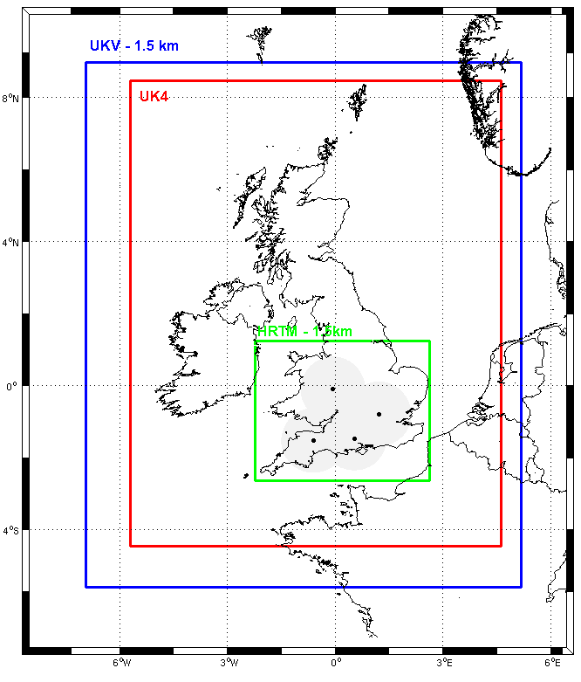
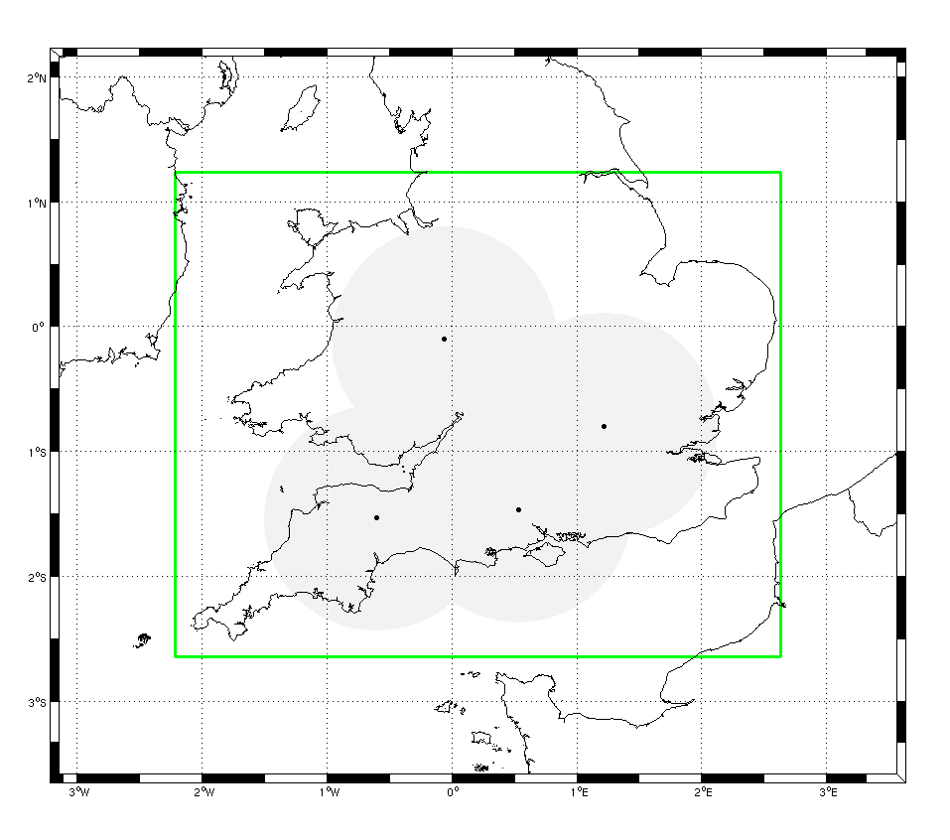
UKV,UK4 & Nowcasting Model Domains
Model | Resolution | VAR | Time Window | Cycling | Forecast Length
UKV | 4 km / 1.5km | 3D-Var /3km | 3 hr | 3 hr | T+36
South UK Fixed | 1.5 km | 4D-Var 1.5/3km | 1 hr | 1 hr | T+6 or T+12
© Crown copyright Met Office
Notes:
3
3
The Nowcasting model domain at present can be nested (1-way) in either one of 2 operational limited area models.
This means that the Lateral Boundary Conditions (LBCs) are given by either
UK4 model (4 km) or
UKV model (1.5 km variable resolution with grid stretched from 1.5 to 4 km at the boundary)

Slide 4
UKV 1.5km DA cycling
8 three-hour cycles per day
Data times for long (t+36) forecasts 03, 09, 15, 21 UTC
Observation cut-off hh+ 30min
Lateral boundaries from Global model
Intermediate cycles at 00, 06, 12, 18 UTC
Observation cut-off hh+ 2hr 40min
Lateral boundaries from hh Global run
Notes:
4

Slide 5
New web monitoring

Slide 6
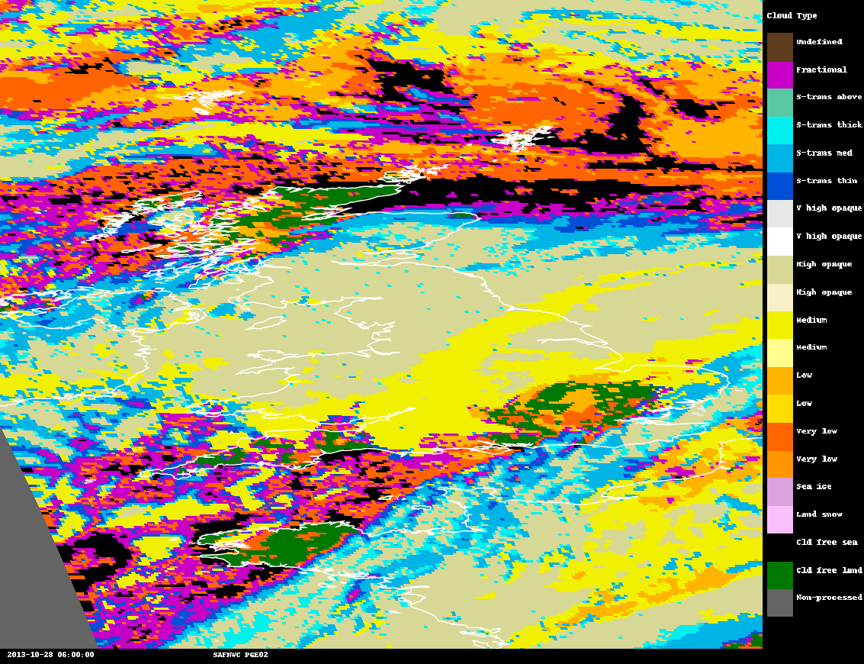
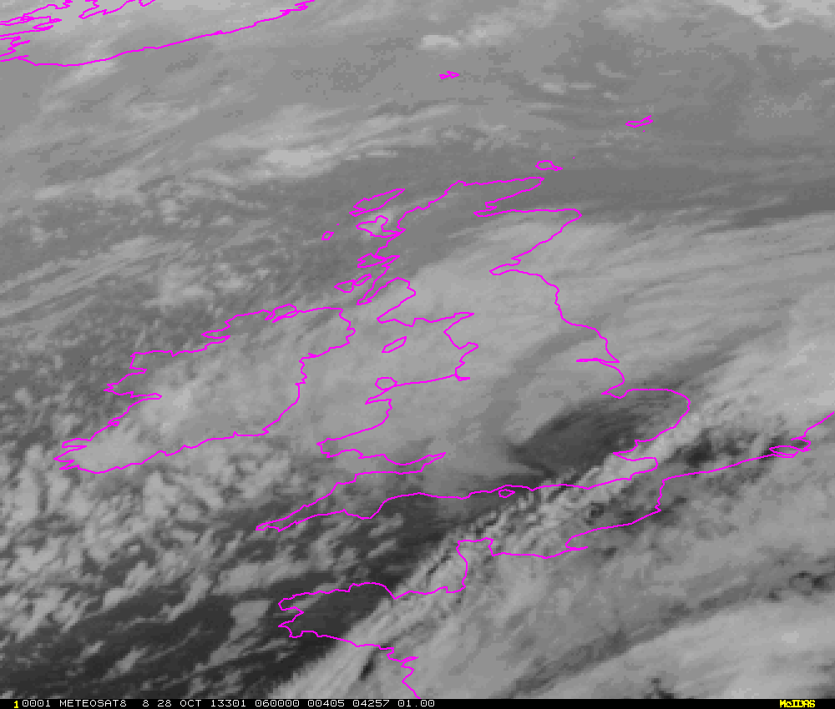
NWCSAF CLOUD PRODUCT St Jude day storm
Meteosat 8 cloud type 06z 28 OCT Meteosat 8 channel 9 06z 28 OCT

Slide 7
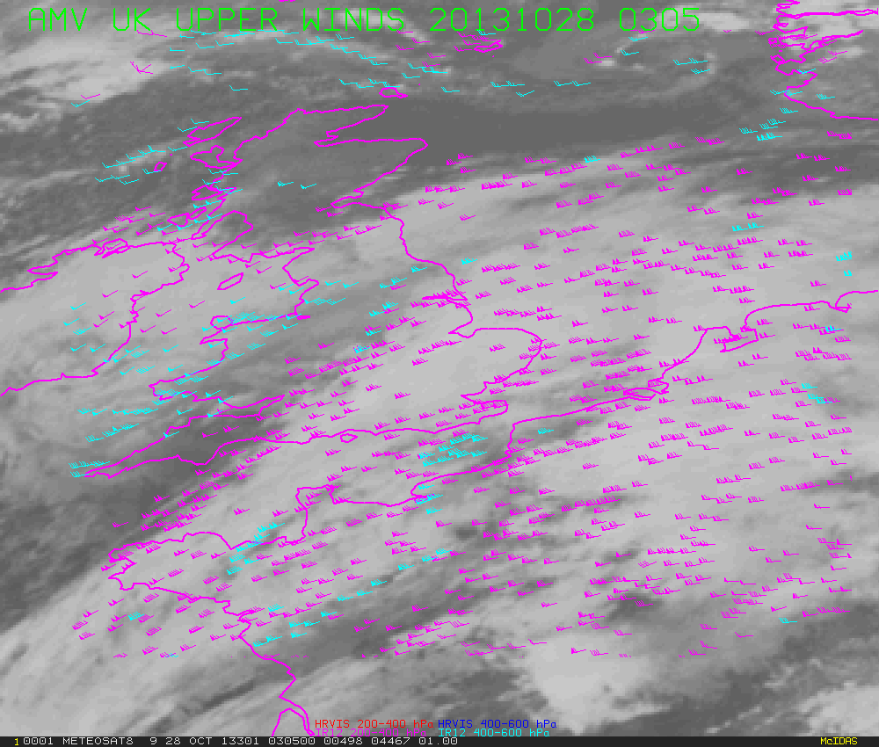
RAPID SCAN
M8 5 MINUTE UKAMVs
During the passage of the
St JUDE day storm
2013 OCT 2013
0305-0855
All UKAMVs
Blue 0-30kts
Yellow 31-60kts
Green 61-90kts
Red 91-120kts
Navy 121-150kts

Slide 8
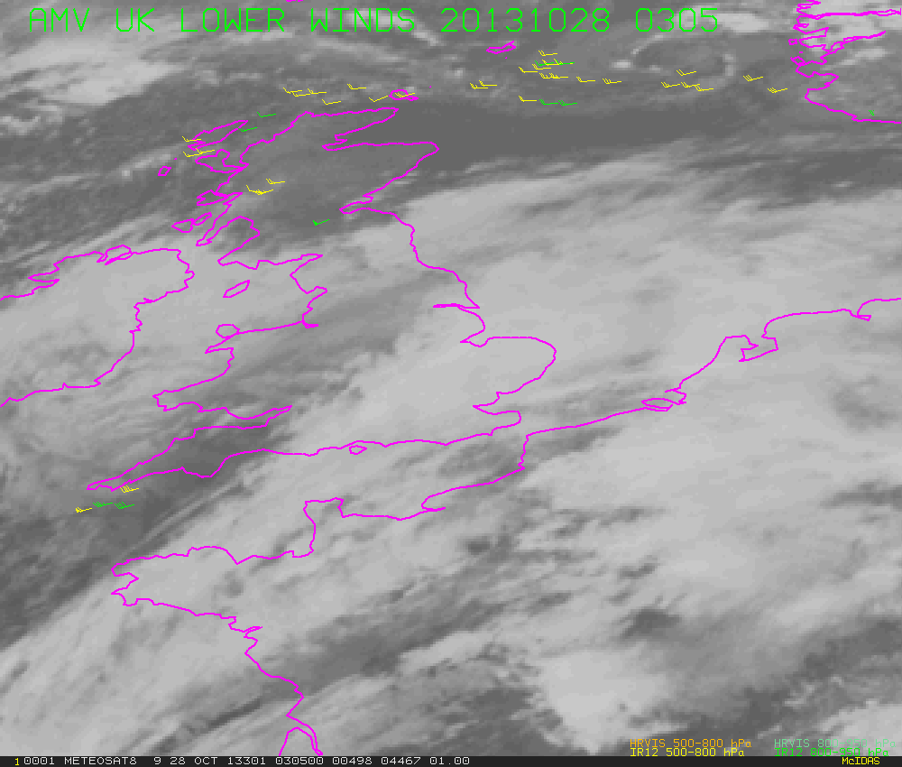
RAPID SCAN
M8 5 MINUTE UKAMVs
During the passage of the
St JUDE day storm
2013 OCT 2013
0305-0855
All UKAMVs
Blue 0-30kts
Yellow 31-60kts
Green 61-90kts
Red 91-120kts
Navy 121-150kts

Slide 9
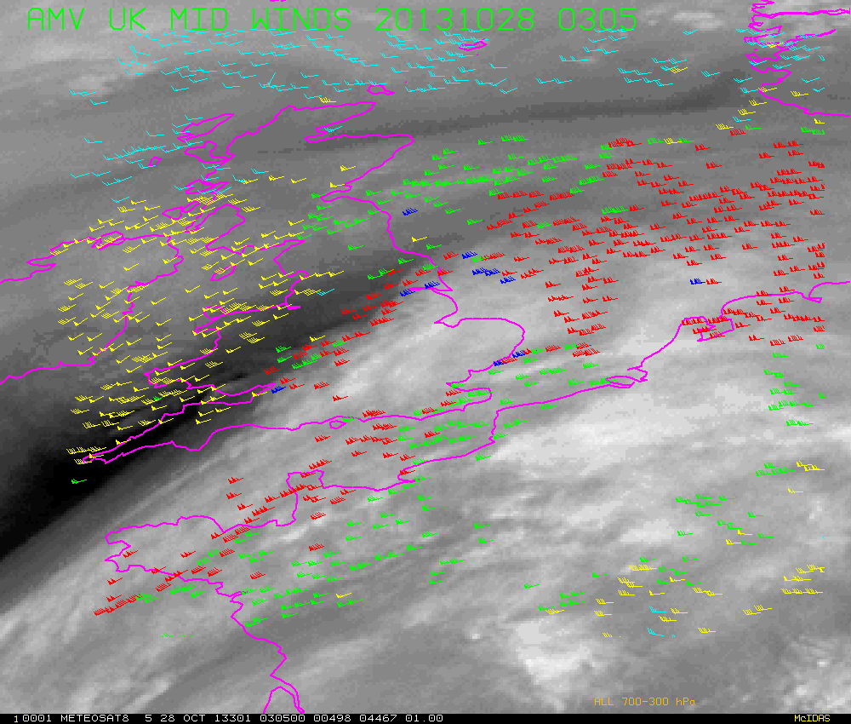
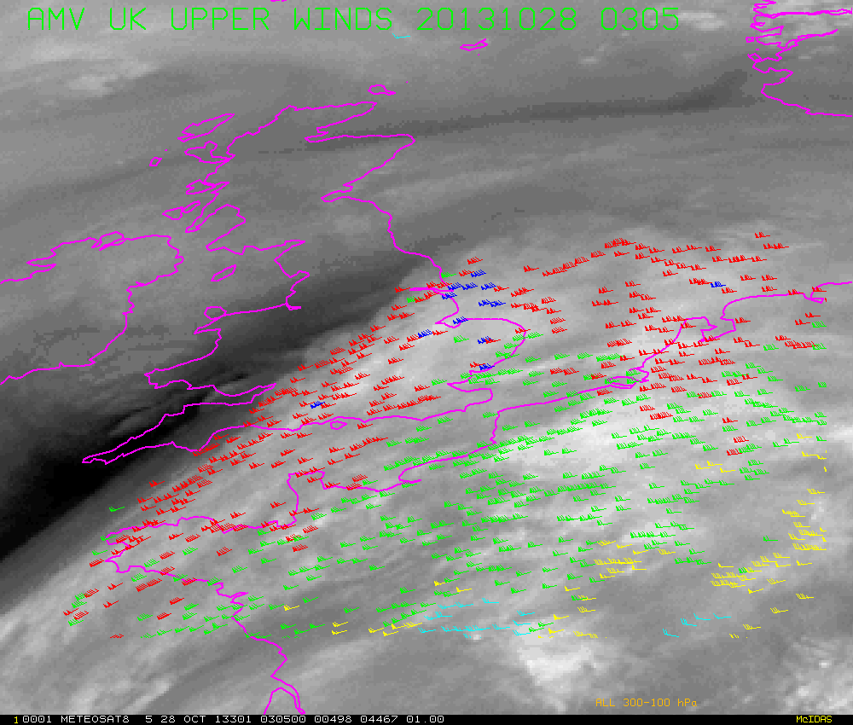
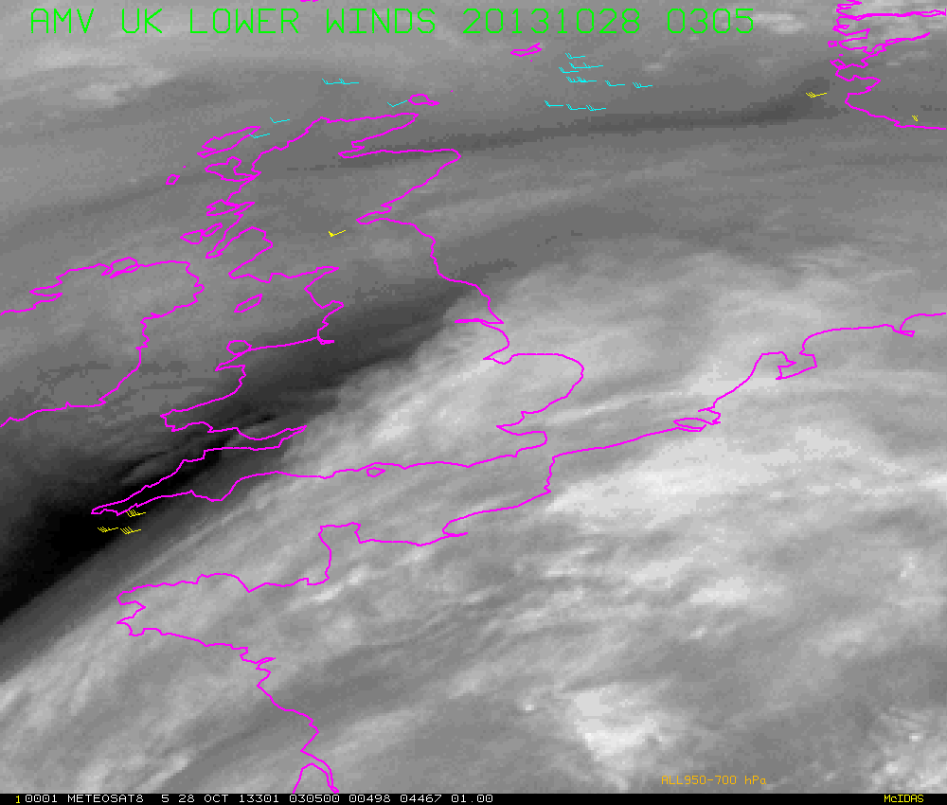
RAPID SCAN
M8 5 MINUTE UKAMVs
During the passage of the
St JUDE day storm
2013 OCT 2013
0305-0855
All UKAMVs increasing speed
Blue 0-30kts
Yellow 31-60kts
Green 61-90kts
Red 91-120kts
Navy 121-150kts

Slide 10
Forecast impact
The NWCSAF AMV package (v2011) was initially setup in research mode and some NWP trials were run 28 days.
The results were essentially neutral using the current AMV setup for EUMETSAT AMVs. A number of 7 day trials were run with various settings of the time and space thinning parameters.
The results appeared to degrade if the thinning was reduced below 20km and the time window was larger than one hour. In addition the sensitivity to various setting of AMV QI were tested.

Slide 11
Forecast impact
A 28day NDP 4DVAR was run with the rapid scan MSG imagery producing AMVs from every second image. AMVs were sent to Met Office data base and available for all times slots for 4DVAR with 45min data cut-off.
Given the small region of the NDP over southern England it was not surprising that there was no significant impact of AMVs but this experiment useful to check feasibility of the setup and check AMV could be processed quickly enough to meet the data cut off time.
The UKV data assimilation is in the of process of being upgraded to 4DVAR.

Slide 12
UK Index Metric for forecast verification
ETS Equitable Threat Score
RMS root mean square
Weighted Basket of Indices
6 elements
Combo of ETS & RMS scores
UK4 Impact trials verified to T+24 at 00, 06, 12, 18 UTC
Element | ETS Threshold
1.5m Visibility | 200m, 1000m, 5000m
6 hour ppn accumulation | 0.5mm, 1.0mm, 4.0mm
Cloud Cover | 0.3, 0.6, 0.8
Cloud Base Height | 100m, 500m, 1000m
1.5m Temperature | 1-RMS² RMS²(pst)
10m wind | 1-RMS² RMS²(pst)

Slide 13
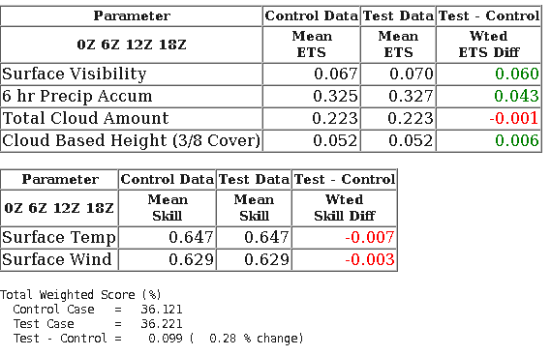
UKV 15 Nov 2012 to 31 Dec 2012

Slide 14
Forecast impact
Following the installation of the NWCSAF package (v2012) AMVs could now be calculated from addition MSG channels including water vapour.
A series of three 40day trials were run with the new package to testing thinning (20km and 10km) and temporal thinning (30min and 60min) with the UKV suite.
The best UKV trial ( 20km and 30min thinning) it trial was then extended to 47 days.
A further 30 day trial run with an updated version of NWCSAF package.

Slide 15
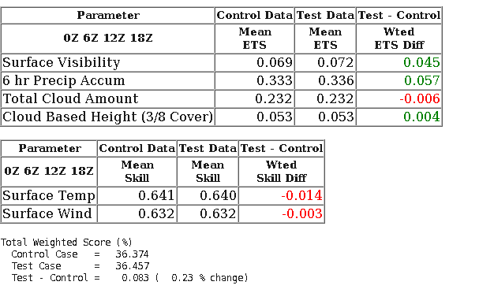
The best of three UKV 40 day trials extended to 47 days

Slide 16
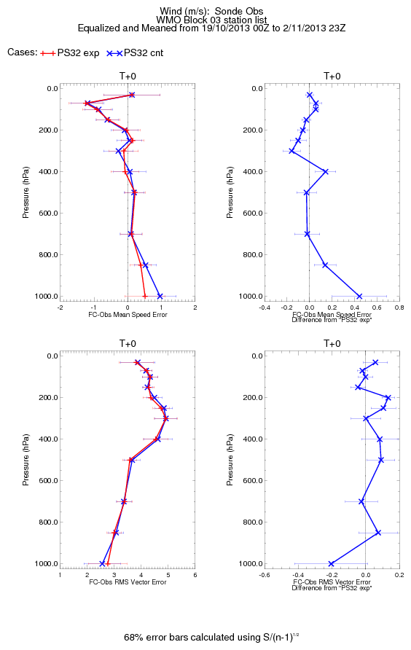
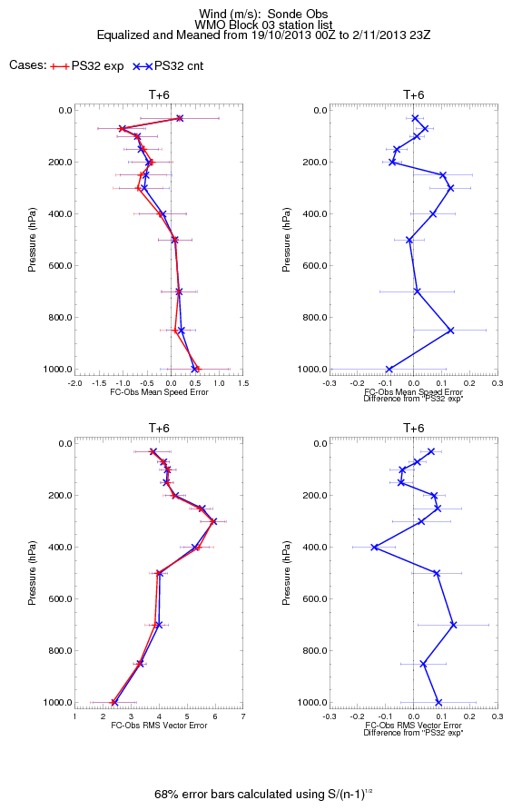
NWP assimilation trials using a lower assigned height
Results demonstrated that lowering assigned height by around 40hPa gives an improved fit to the model background.
Easy-win : no changes required to observation operator
NWP assimilation trial setup:
2 weeks Nov 2013.
UKV 3d VAR, 3 hour cycling.
Lowered all assigned heights by 40hPa
+ve impact on tropospheric winds during t+0 – t+12h
broadly neutral for other variables.

Slide 17
Table of monthly stats in UKV region. Height bias (40 hPa) lower was introduced to UK AMVs after March 2014
 |  | 2013 DEC | 2014 JAN | 2014 FEB | 2014 MAR | 2014 APR | 2014 MAY
UK BIAS |  | -3.38 | -2.99 | -2.68 | -1.31 | -1.31 | -0.42
EUM BIAS |  | -3.93 | -3.61 | -3.23 | -3.04 | -2 | -2.33
UK STD |  | 5.34 | 5.39 | 5.1 | 4.36 | 4.37 | 4.08
EUM STD |  | 6.86 | 6.59 | 6.13 | 6.97 | 4.70 | 5.01
UK NUM |  | 807017 | 64456 | 553310 | 533615 | 728237 | 574661
EUM NUM |  | 19323 | 12030 | 12546 | 14059 | 15502 | 14932
Note: from March clear improvement in BIAS and STD for UK AMVs
after the reduction of 40 hPa

Slide 18
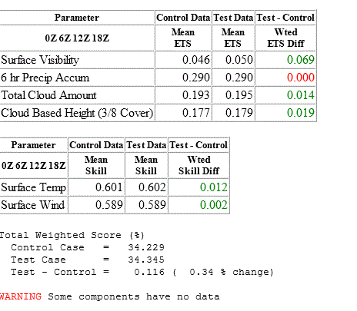
Adjusted AMV lowering AMV heights by 40 hPa 28 Sept 2013 to 28 Oct 2013 AMV’s usage above 400hPa

Slide 19
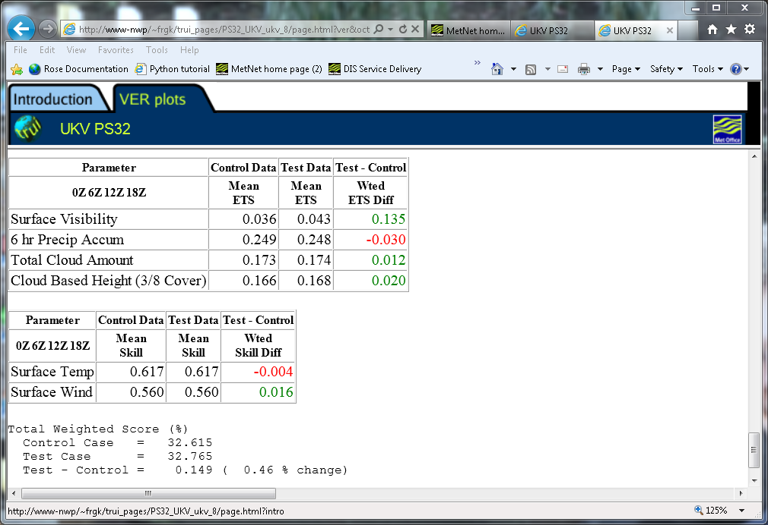
Forecast impact of adding extra AMV’s (900-401) hPa over sea. (28 Sept 2013 to 28 Oct 2013) AMV’s usage above 400hPa (forecast control use amv’s > 400hpa adjusted heights by 40 hPa)

Slide 20
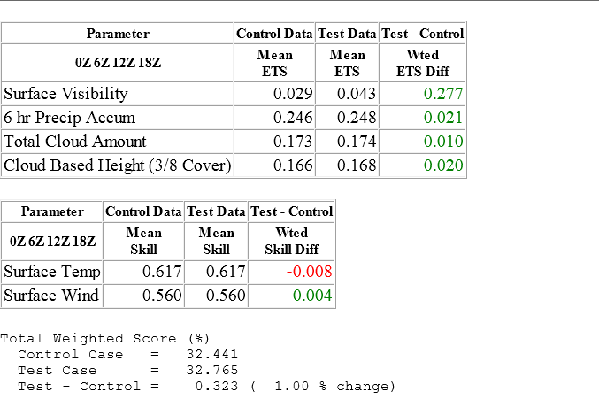
Forecast impact of adding extra AMV’s (900-401) hPa over sea and adjusted AMV’s above 400 hPa (28 Sept 2013 to 28 Oct 2013) AMV’s usage above 400hPa (forecast control use amv’s > 400hpa adjusted heights by 40 hPa)

Slide 21
Final comments
In January 2014 the locally produced AMVs, using the NWCSAF package, replaced the EUMETSAT AMVs in the operational UKV data assimilation.
In March 2014 the UK AMVs > 400 hPa assigned heights were reduced by 40 hPa .
The use of UK AMVs over sea >900 hPa has been successfully tested and has been introduced to the operational UKV data assimilation.
Testing of UK AMVs will begin in the near future using 4DVAR.

