Slide 1
AN OVERVIEW OF 10 YEARS OF RESEARCH ACTIVITIES ON AMVs AT EUMETSAT
R. Borde
and
J. Schmetz, K. Holmlund, A. Arriaga, A. De Smet, G. Dew, J.B. Gustafson, M. Doutriaux-Boucher, M. Carranza, O. Hautecoeur, Ph. Watts, H.J. Lutz, R. Huckle from EUMETSAT
P. Dubuisson (LOA), G. Seze (LMD), R. Oyama (JMA) E.H. Sohn (KMA), J. Garcia-Pereda (AEMET), N. Bormann (ECMWF), A. Hernandez (AEMET), A. Horvath (TROPOS), R.G. Negri (INPE)...etc.

Slide 2
AN OVERVIEW OF MORE THAN 10 YEARS OF RESEARCH ACTIVITIES ON AMVs AT EUMETSAT
MSG 1 was just launched
People were really excited about the new capabilities of SEVIRI
HA problem expected to be solved/understood very quickly

Slide 3
Many AMV height assignment methods computed Too many... ???
EBBT method : chan at 10.8 μm,
2 STC config. : chan 10.8 and 6.2 μm; channels 10.8 and 7.3 μm
2 IRW config. : chan 10.8 and 6.2 μm; channels 10.8 and 7.3 μm
3 CO2 slicing method config. : chan at 10.8 and 13.4 μm, chan at 12.0 and 13.4 μm, chan at 10.8, 12 and 13.4 μm.
Inversion method at low levels
Cloud Base Height Method at low levels
-…
No ‘magic’ keys or combinations of methods have been found.
Something crucial was missing in our strategy:
We did not know the truth !!

Slide 4
How to know the correct altitude ?
Two important studies initiated:
Test the sensitivity of the semi-transparent correction methods using simulated MSG radiances
→ Collaboration with P. Dubuisson (LOA), 2005
Compare the AMV HA against collocated A-train observations
→ External study, G. Sèze and J. Pelon (LMD), 2006

Slide 5
Borde, R. and Ph. Dubuisson, ‘Sensitivity of Atmospheric Motion Vectors Height Assignment methods to semi-transparent cloud properties using simulated Meteosat-8 radiances’,2010, J. Appl. Meteor. Climatol.49:6, 1205-1218.
Main Conclusions
STC and CO2 methods retrieve correct pressure within few hPa in ideal thick case
Methods are very sensitive to several atmospheric parameters, and performances are really poor for thin clouds.
STC generally more accurate and more robust for grey clouds, but more sensitive to natural noise coming from geophysical data.
CO2 slicing depends on the cloud microphysics
Multilayer situations can not be treated using such methods.
Cloud top
too low
Cloud top
too high
Cloud top
too high
ΔP = P(retrieved) – P(simulation)

Slide 6
Sèze, G., S. Marchand, J. Pelon and R. Borde, (2008), A comparison of AMV cloud top pressure derived from MSG with space-based Lidar observations’, Ninth Int. Winds Workshop, Annapolis, USA.
Main Conclusions
SIGNIFICANT DIFFERENCES BETWEEN AMV AND CALIOP PRESSURE LEVELS FOR HIGH CLOUDS WITH CO2 METHOD
Good agreement for upper layer (100hPa), degraded to about 100 hPa at 300 hPa
BETTER RESULTS WITH IR/WV METHODS BUT LIDAR MAY BIAS TOWARDS UPPER ALTITUDE (ONLY CLOUD ALTITUDE USED)
MIDDLE CLOUDS : POOR AGREEMENT
LOW CLOUDS :
Inversion correction methods give good agreement between AMVs and CALIOP lowest cloud top
Results from cloud base assignment methods (2 and 5) are closer to CALIOP cloud base observations
Cloud top
too high

Slide 7
Then...
I was then convinced of the following:
We must use the most accurate CTH method available
→ Test and use the ‘new’ OCA pixel based product.
We must select carefully the pixels used for HA
→ Investigate link between tracking and HA. CCC method
Borde R., and R. Oyama, (2008), ‘A Direct Link between Feature Tracking and Height Assignment of Operational Atmospheric Motion Vectors’, Ninth Int. Winds Workshop, Annapolis, USA

Slide 8
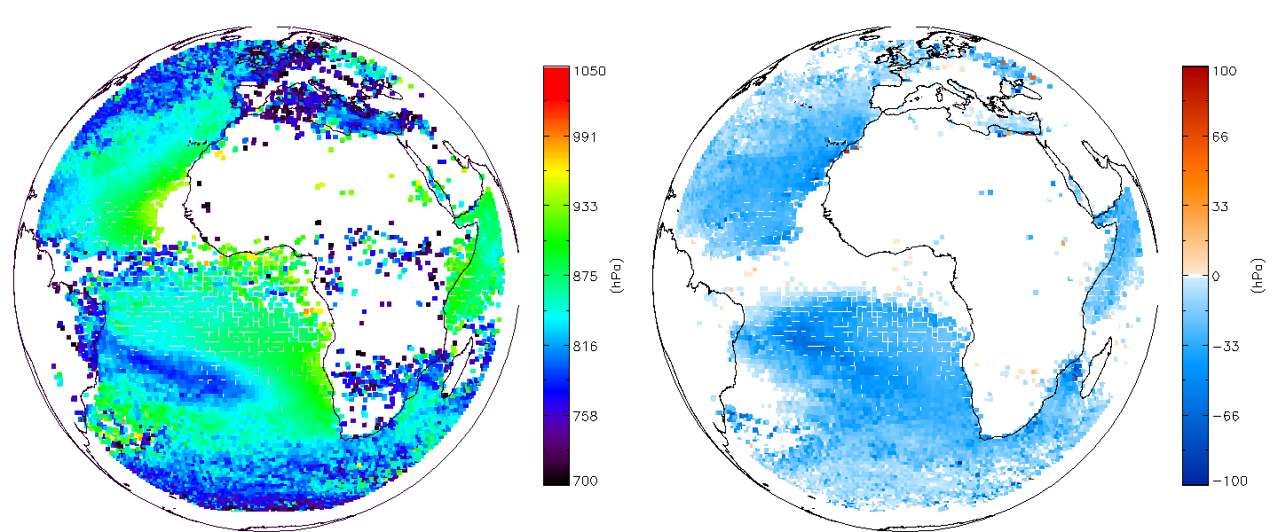
CCC method
Implemented at EUMETSAT in september 2012
Borde, R., M. Doutriaux-Boucher, G. Dew, M. Carranza, 2014: A Direct Link between Feature Tracking and Height Assignment of Operational EUMETSAT Atmospheric Motion Vectors. J. Atmos. Oceanic Technol., 31, 33–46.
Consequences:
Improvement at high and mid-levels
Degradation at low levels,
→ Patch implemented in March 2013
See Manuel’s talk
Implemented in NWCSAF HRW software in 2011
J. García-Pereda, R. Borde, and R. Randriamampianina, ‘Latest developments in NWC SAF Resolution Winds (HRW) product’, Eleventh Int. Winds Workshop, Auckland, New-Zealand, 2012.
AMV height (hPa) QI > 0.85, period: 08-26 February 2013

Slide 9
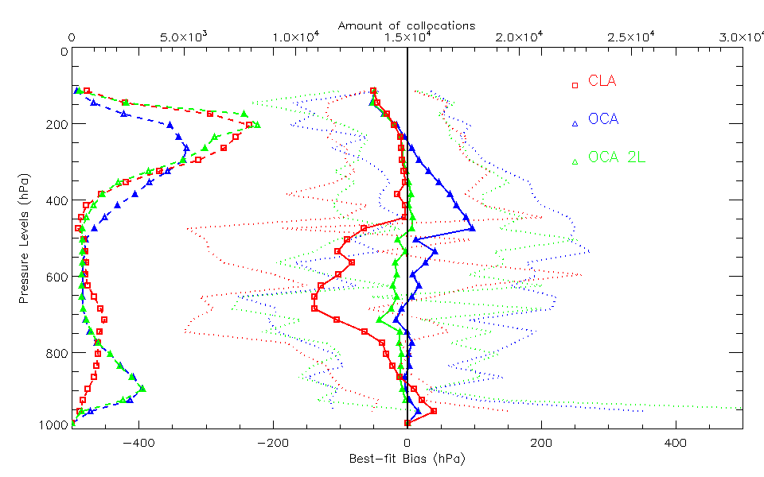
Use of OCA 2 layers
Tested at EUMETSAT using prototype software
Borde, R. and, P. Watts, ‘Potential of the two layer OCA product to improve the AMV heights’, Proc. EUMETSAT User Conference, Sopot, Poland, 2012
Results:
Results better using OCA 2L
But slow speed bias larger at HL with OCA 2L than with OCA ???
It appeared really difficult to improve best-fit and speed bias at HL in same time.
→ What does it mean ?

Slide 10

Possible explanation...
Nearly the same shape…
…but not the same wind speed within the cloud...
So the speed AT the cloud top may be different to the speed OF the cloud top.
Cirrus uncinus
(Heymsfield, 1975)
t
t+dt
t

Slide 11
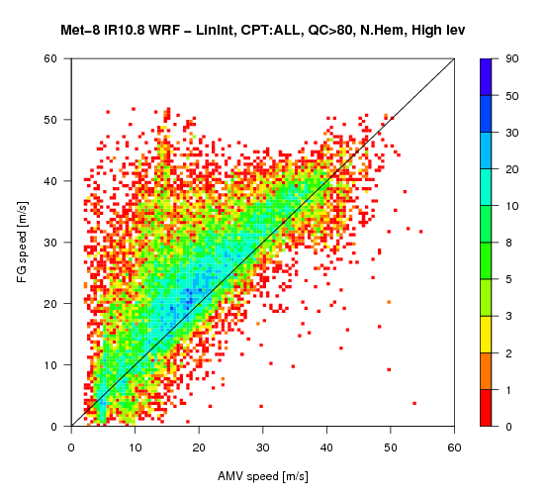
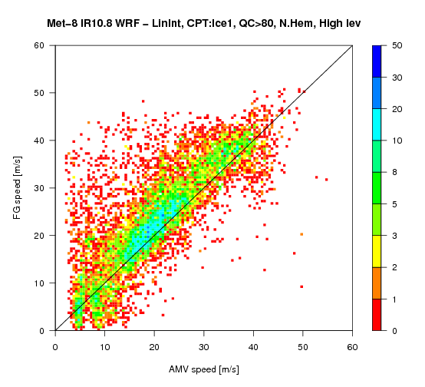
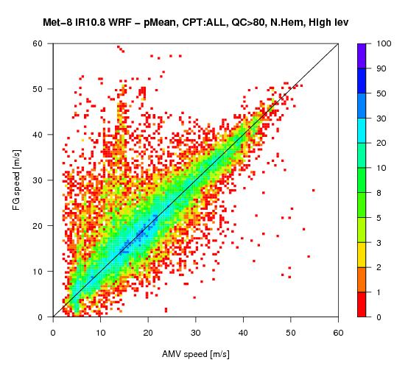
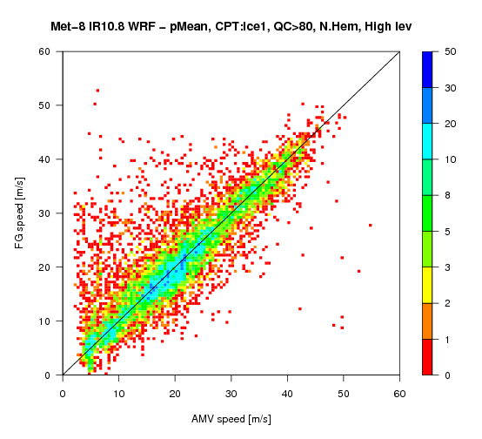
Use of simulated images, 2010
External study, ECMWF, See Angeles’s talk.
Collaboration between EUMETSAT, ECMWF and CIMSS
Bormann et al., 2014: Atmospheric Motion Vectors from Model Simulations. Part I: Methods and Characterization as Single-Level Estimates of Wind. J. Appl. Meteor. Climatol., 53, 47–64
Hernandez-Carrascal and Bormann, 2014: Atmospheric Motion Vectors from Model Simulations. Part II: Interpretation as Spatial and Vertical Averages of Wind and Role of Clouds. J. Appl. Meteor. Climatol., 53, 65–82.
IR10.8, with a model-independent QI > 80%
Some interesting results:
Better agreement doing averaging, but quite small.
Large improvement re-assigning AMVs to lower heights.
At High Levels, AMVs more representative at a level within the cloud.
At Low Levels, AMVs more representative of a wind average over the layer.
...Etc.
→ CTH probably not the best parameter !!
AMV pressure
AMV pressure, ICE
averaged over the top
averaged over the top
ICE

Slide 12
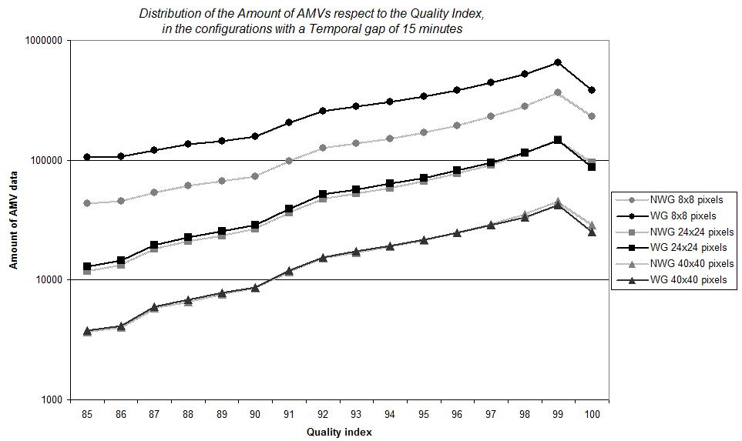
Use of NWCSAF HRW for testing, 2011
AEMET, external study, see Javier’s talk
Test the impact of the use of ‘wind guess’ on AMV tracking
Borde, R., J. García-Pereda, 2014: Impact of Wind Guess on the Tracking of Atmospheric Motion Vectors. J. Atmos. Oceanic Technol., 31, 458–467.
Use of wind guess impacts AMVs extraction.
Very large impact when using small target boxes.
NBias and NRMS smaller without using the guess.
Better to limit the use of the FC model in AMV extraction.

Slide 13
Use of NWCSAF HRW for testing, 2011
AEMET, external study, see Javier’s talk
Test the impact of target box sizes and temporal gap on AMV; following the work by Sohn and Borde, 2008
J. Garcia-Perreda and Borde R., 2014, ‘The impact of the Tracer size and the Temporal gap between images in the extraction of Atmospheric Motion Vectors, To be published into J.
Close relationships between target box, temporal gap, size/lifetime of feature tracked, and quality of the tracking.
Very difficult to define optimized configuration that improve all the parameters.

Slide 14
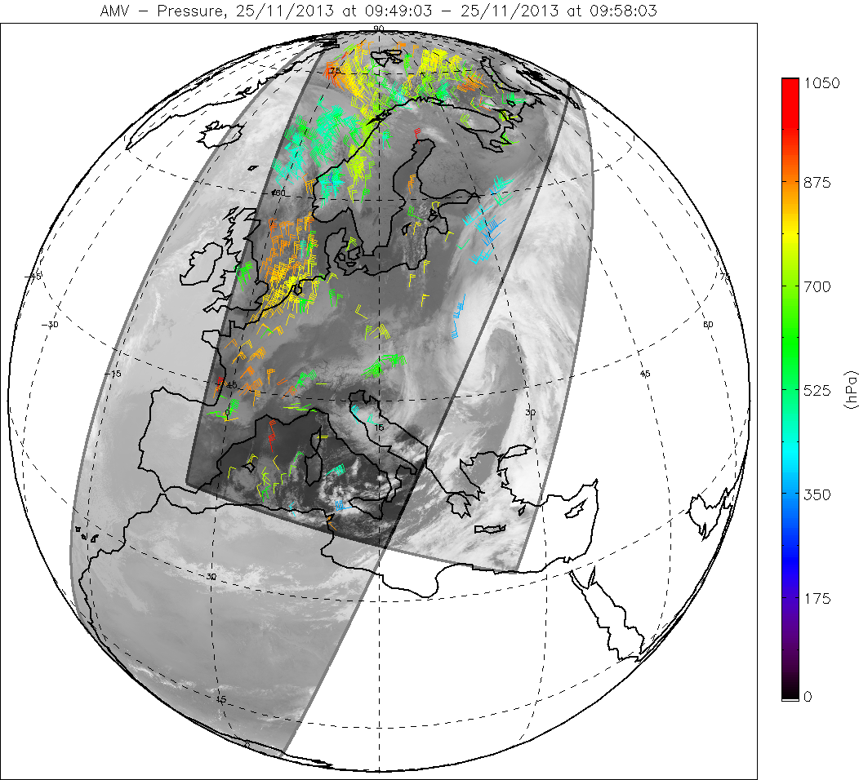
AVHRR winds
Single Metop polar winds, 2010
Use image pairs to increase the coverage area.
Last version in May 2014
→ Quality has improved, planned to be assimilated at ECMWF
See Kirsti’s talk,
Dual Metop winds, 2014
Global coverage area.
Operational July 2014
See Olivier’s talk, this session
See Akos Horvath poster

Slide 15

AVHRR winds
Some interesting questions for the future…
Possibility to derive ‘correct’ information using only image pairs
Good agreement with other wind observations.
Strange feature of QI estimation observed between single and dual Metop winds
Use of vector consistency like:
If dt is divided by 2., dV is artificially multiplied by 2. !!!
→ This feature probably impacts also RSS AMVs.
→ Needs to revisit the QI estimation.

Slide 16
Main general lessons learned
Do the right thing to do the things rights !
Consider sounded scientific principles and methods
Stop comfort fine tuning
Limited to very short term improvements
Nearly impossible to improve then
CTH probably not always the most appropriate parameter for AMVs
Avoid the use of the model reference in the algorithms when possible.

Slide 17
Some prospectives for futur investigations at EUMETSAT
Set HA using microphysics info. See Manuel’s talk
Investigate how to account the scaling properties of the natural wind fields:
In the tracking (nested tracking ?)
for comparisons/validation against other wind Obs.
Revisit the QI definition, what is a good quality AMV ?
Revisit the use of optical flow methods for MTG IRS humidity fields.

Slide 18
Thanks

