Slide 1
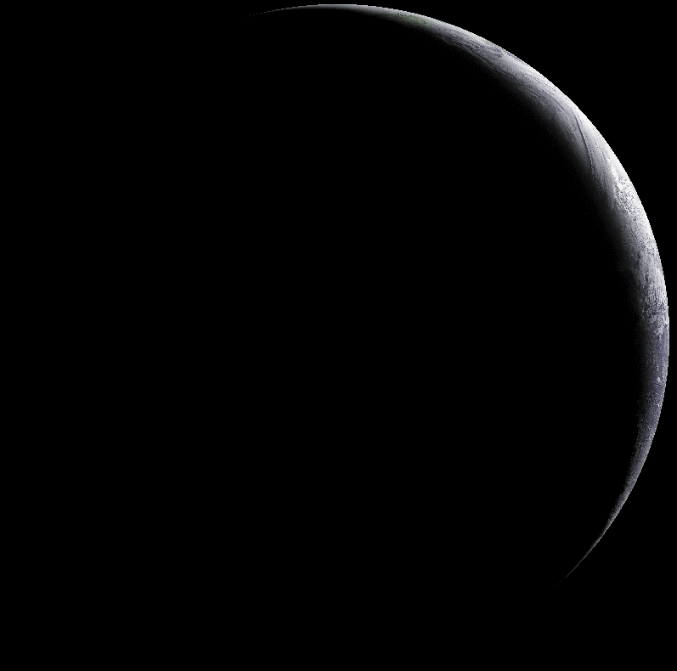
Characterising AMV height Characterising AMV height assignment errors in a simulation study
Peter Lean^{1*}
Stefano Migliorini¹ and Graeme Kelly²
* EUMETSAT Research Fellow, ¹ University of Reading, UK
² Met Office, UK
Notes:
Recent results: thought might be of interest here. A work in progress… no firm conclusions yet.

Slide 2
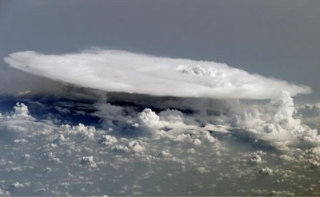
Background: Atmospheric Motion Vectors (AMVs)
Wind retrievals from satellite imagery
actually observations of apparent cloud motion
Method:
Feature detection and tracking between consecutive images
Height Assignment performed (usually assume AMV represents winds at estimated cloud top height)
Vertical representivity:
Much discussion about whether AMVs are representative of winds at cloud top or in fact representative of winds within cloud.
Current NWP observation operators assume AMV represents wind at single height.
Simulation studies:
Several previous studies: is this technique capable of providing useful insights into AMV representivity which give real world improvements?

Slide 3
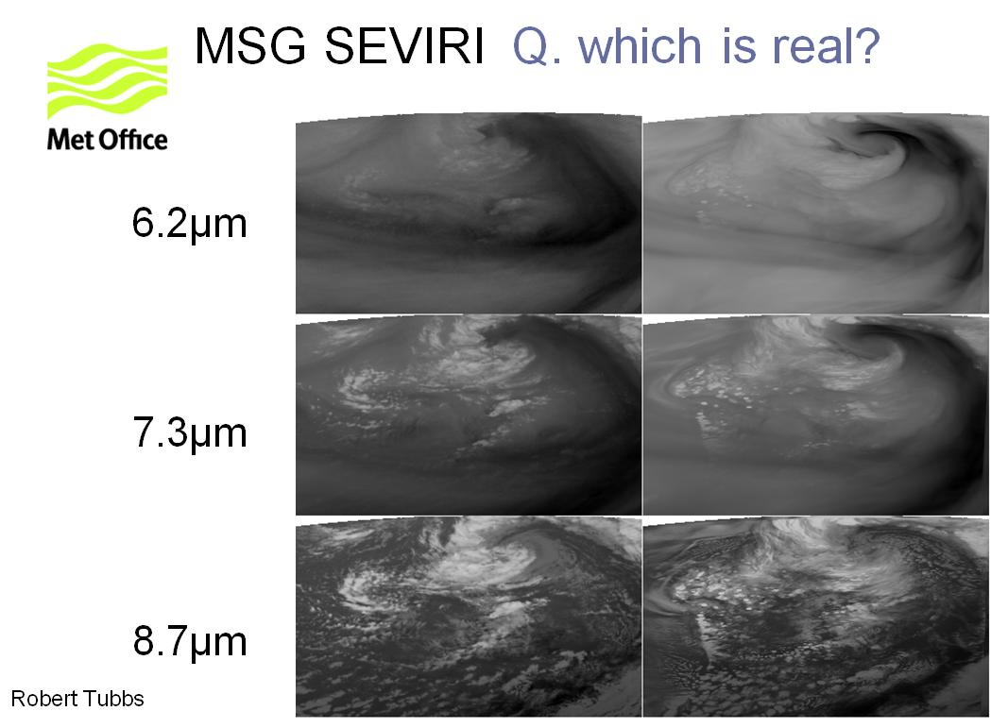
Motivation: Latest generation of NWP models have very realistic representation of cloud features

Slide 4
Aims:
Understand vertical representivity of AMVs to help design an improved observation operator for assimilation in NWP models.
Compare and contrast simulation study results against standard O-B stats to understand how useful this technique is.
Determine if AMV error characteristics depend on cloud type.
Apply results to current UK AMV processing.

Slide 5
Talk outline:
AMV error budget
Experiment setup
How realistic are the experiments?
AMV error characteristics
Testing different vertical representivity assumptions
NWP assimilation trial
Conclusions

Slide 6
AMV error budget

Slide 7
AMV error budget
Misfit between AMVs and model background:
Innovations d = y − H (x_{f} , p_{assign} )
AMV vector
obs operator
Background forecast
Misfit O - B
Assigned height (estimated cloud top height)
d = f (ε_{y} , ε_{H} , ε_{xf} , ε_{passign} )
ε_{passign} = g (ε_{instrument} , ε_{xf} , ε_{technique} )
ε_{y} - tracking error
ε_{H} - observation operator error
= error in assumptions of vertical representivity
ε_{xf} - background forecast error
ε_{passign} - error in estimated cloud top

Slide 8
Synthetic AMV error budget
Misfit between synthetic AMVs and model truth:
Errors ε = y − H (x_{t} , p_{assign} )
Forecast errors removed
Instrument errors removed
ε = f (ε_{y} , ε_{H} , ε_{xt} , ε_{passign} )
Height assignment errors changed
ε_{passign} = g (ε_{instrument} , ε_{xt} , ε_{technique} )
ε_{passign} = g (ε_{RTTOV} , ε_{xt} , ε_{technique} )
For simulation study to be useful:
ε < d
i.e. AMVs should be closer fit to model truth than in O-B (which includes forecast and instrument errors).
Cloud top height estimation techniques are very sensitive to cloud properties:
error characteristics from simulated radiances from model clouds may be different from those for real clouds

Slide 9
Experiment set up

Slide 10
Simulation framework
Building upon previous AMV simulation studies:
Wanzong et al (2006)
von Bremen et al (2008)
Stewart and Eyre (2012)
Hernandez-Carrascal et al (2012)
Met Office UKV model
1.5km grid length NWP model
RTTOV 11 radiative transfer
produces simulated brightness temperatures from model prognostic fields using parameterized treatment of cloud scattering.
Nowcasting SAF (NWCSAF) cloud and AMV products
produces AMVs from the simulated satellite imagery.

Slide 11
NWCSAF AMV workflow
Standard setup
NWP
background
SEVIRI
observations
Cloud Products
Feature detection
Feature tracking
(which previous
features persist?)
Cloud Type
Cloud Mask
Height Assignment
Cloud Top Height

Slide 12
NWCSAF AMV workflow
4 week suite: Feb 5th – March 5th 2013
UKV ran daily from 03z to t+22h (PS32 components)
RTTOV11 run on model data at 23:45, 00:00 and 00:15 each day
NWP
background
SEVIRI
observations
Simulated
Radiances
RTTOV
Cloud Products
Feature detection
Feature tracking
(which previous
features persist?)
Cloud Type
Cloud Mask
Height Assignment
Cloud Top Height

Slide 13
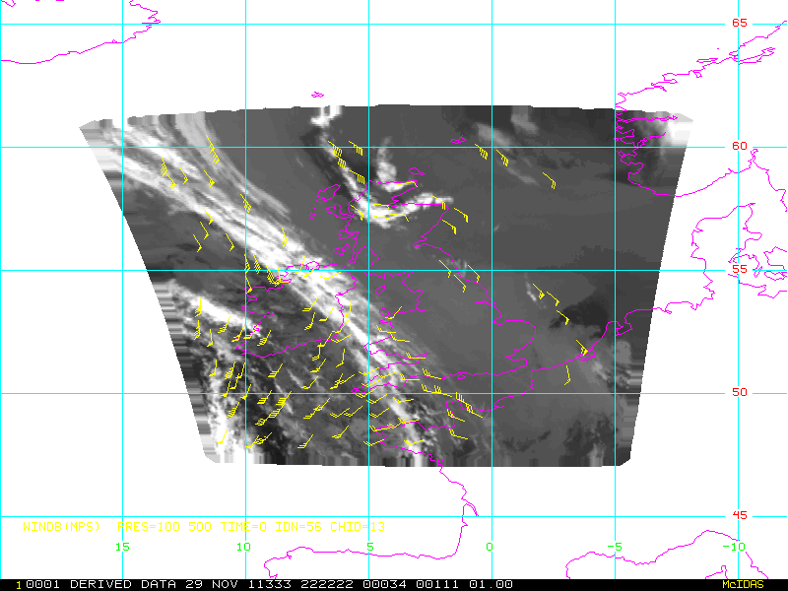
EUMETSAT AMV product

Slide 14
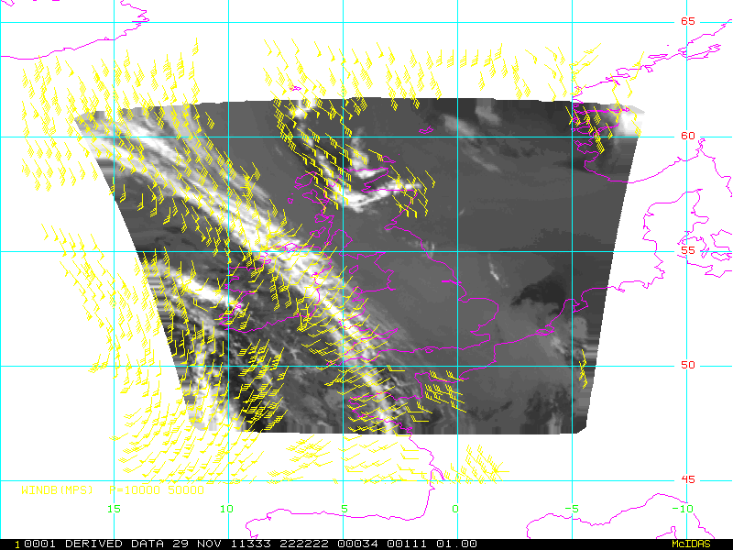
NWCSAF mesoscale AMV product (AEMET)

Slide 15
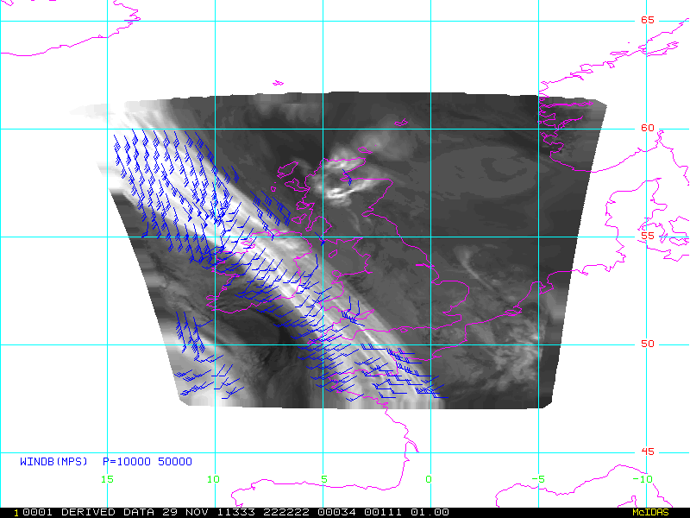
Synthetic high resolution AMVs
24x24 pixel tracking box size

Slide 16
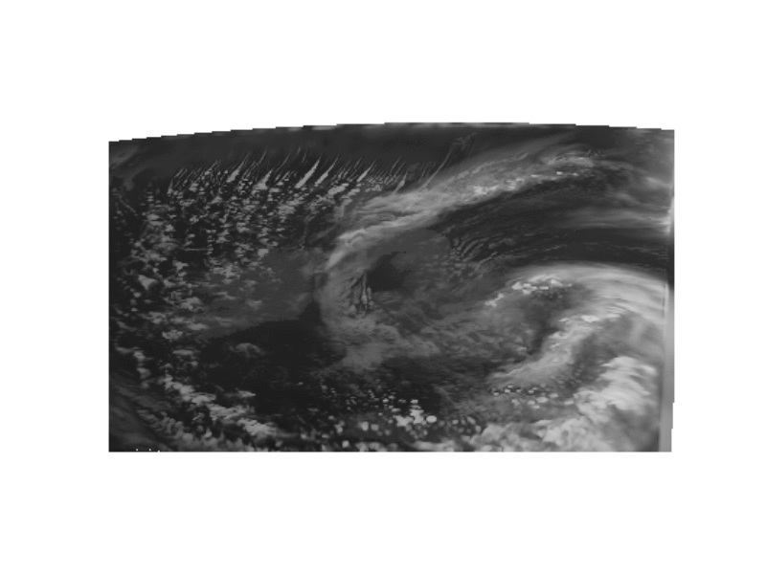
Trial period: simulated brightness temperatures
Wide range of meteorological situations sampled:
-maritime convection, frontal cloud, thin cirrus, stratocumulus over inversion etc
-6 weeks: long period of study compensates for relatively small domain

Slide 17
How realistic are the simulations?

Slide 18
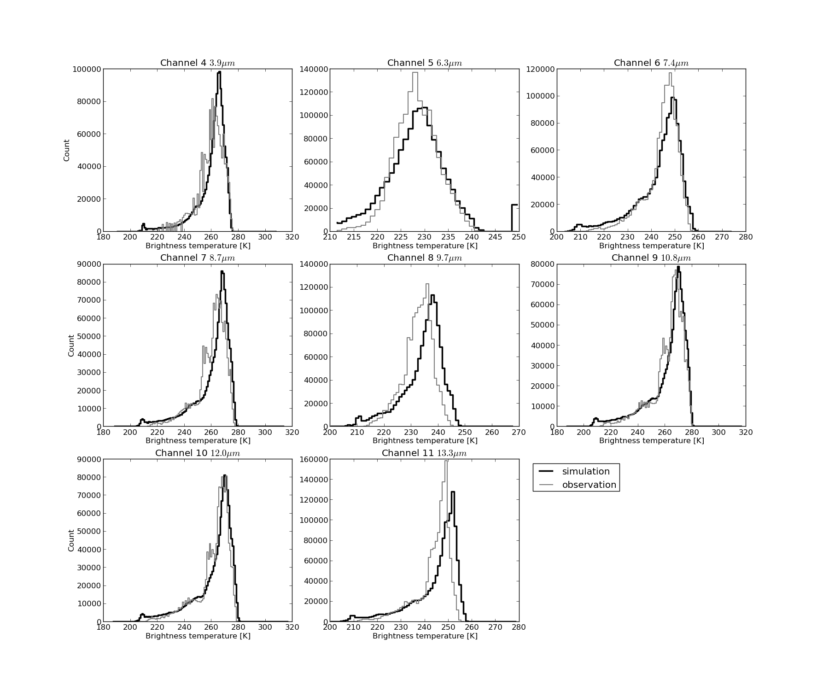
Realism of simulated brightness temperatures
Tendency for more cold pixels in simulations
(cirrus)
1 month of data:
Feb 5th – March 5th, 2013

Slide 19
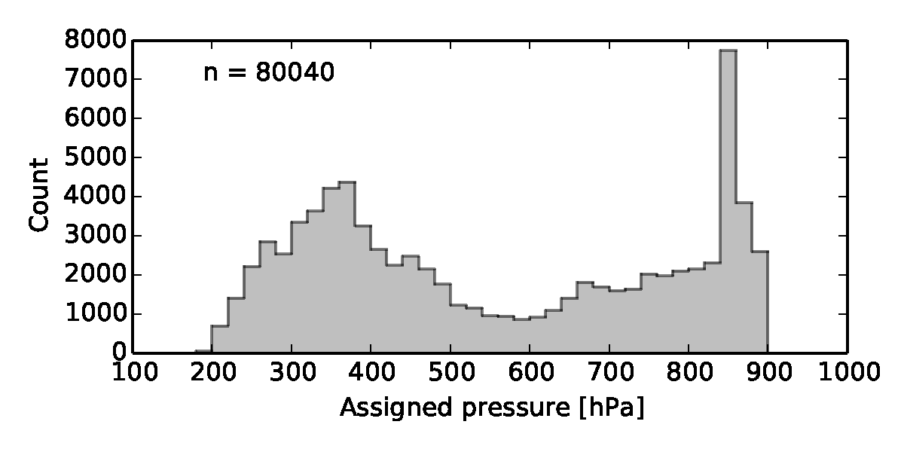
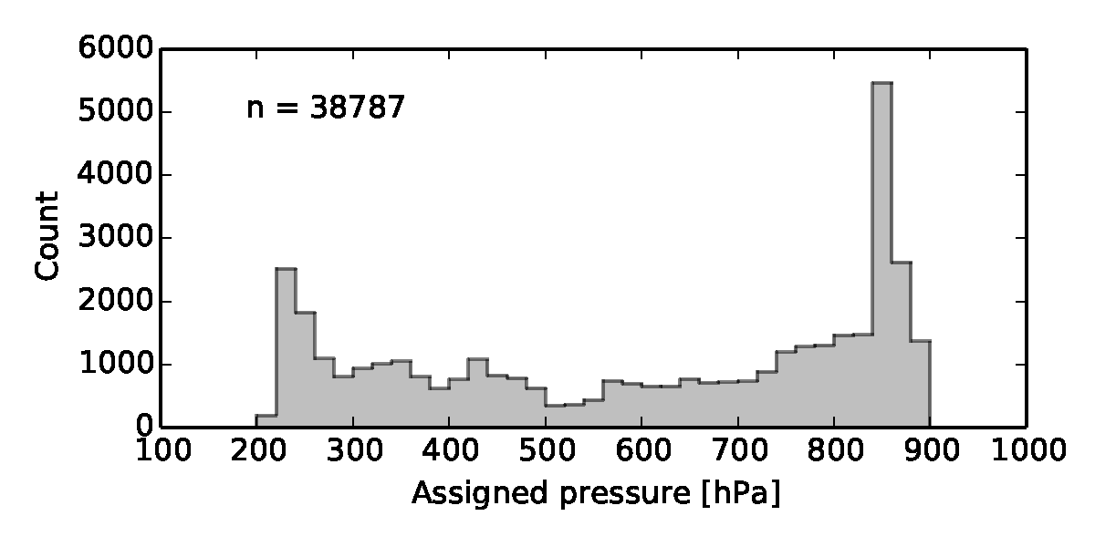
Realism of simulated AMVs: distribution of assigned heights
Real AMVs
Not as many AMVs from upper level clouds in simulations
Cirrus peak too high
Synthetic AMVs

Slide 20
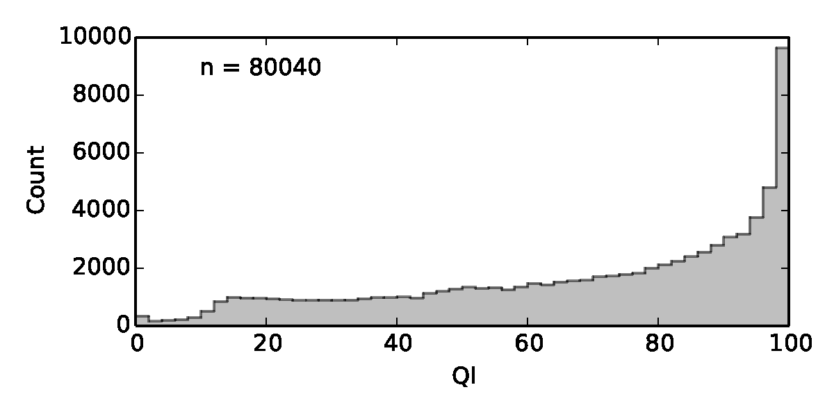
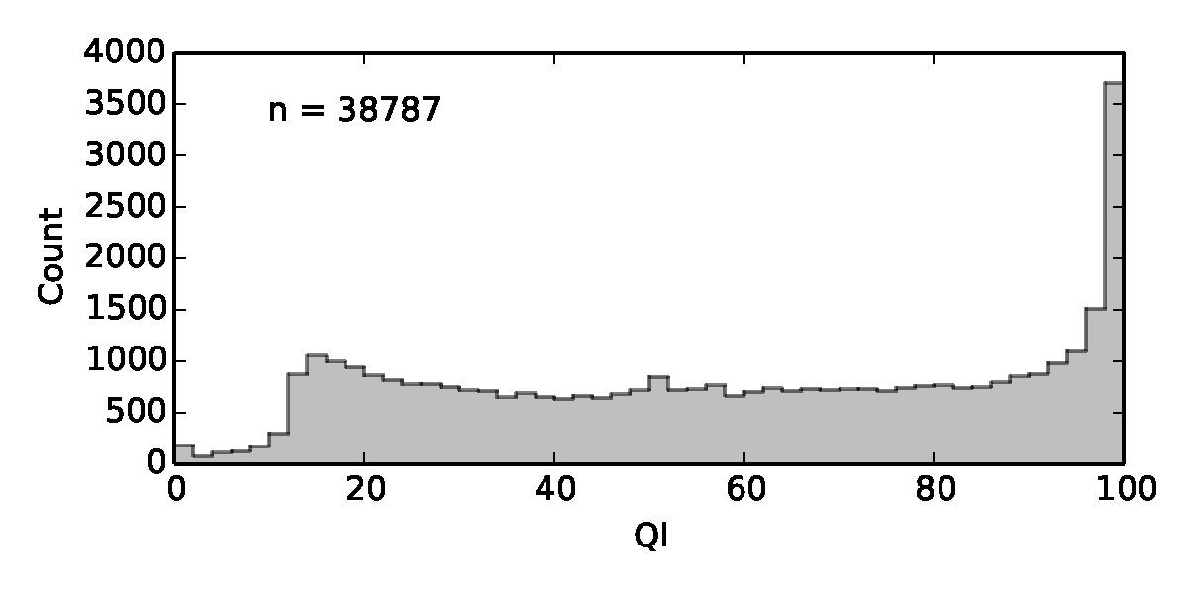
Realism of simulated AMVs: distribution of QI values
Used QI without model background consistency check
Real AMVs
More AMVs with low QI values in simulated dataset
= increased tracking errors?
Synthetic AMVs

Slide 21
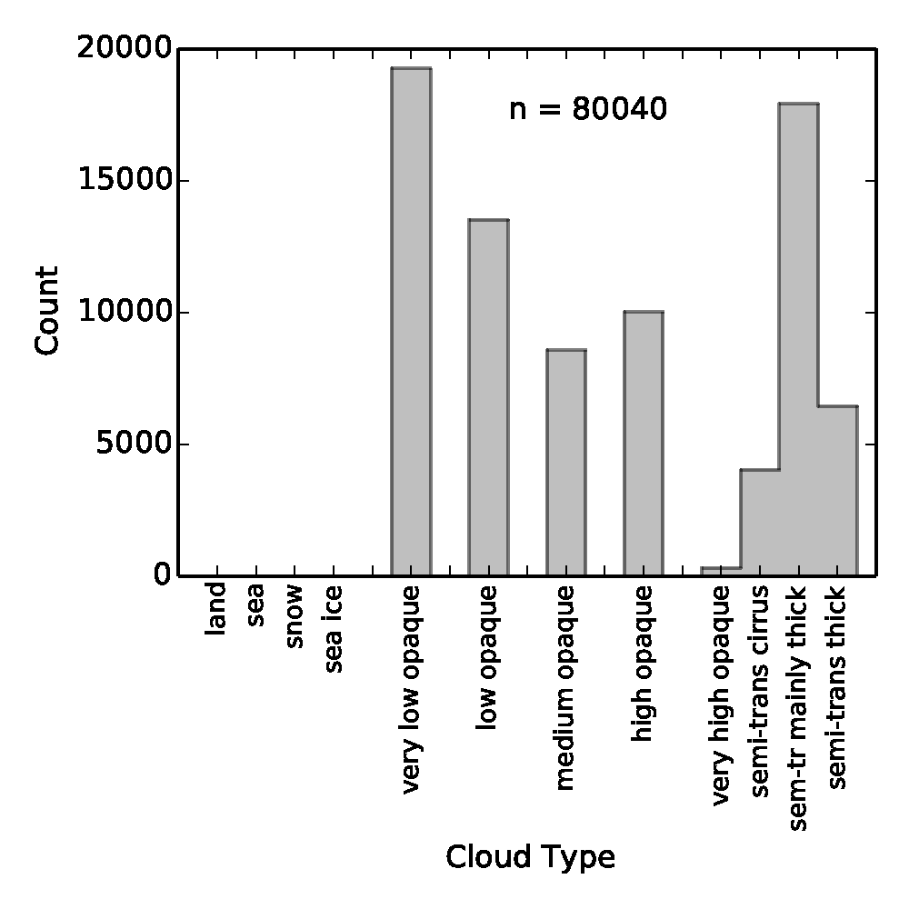
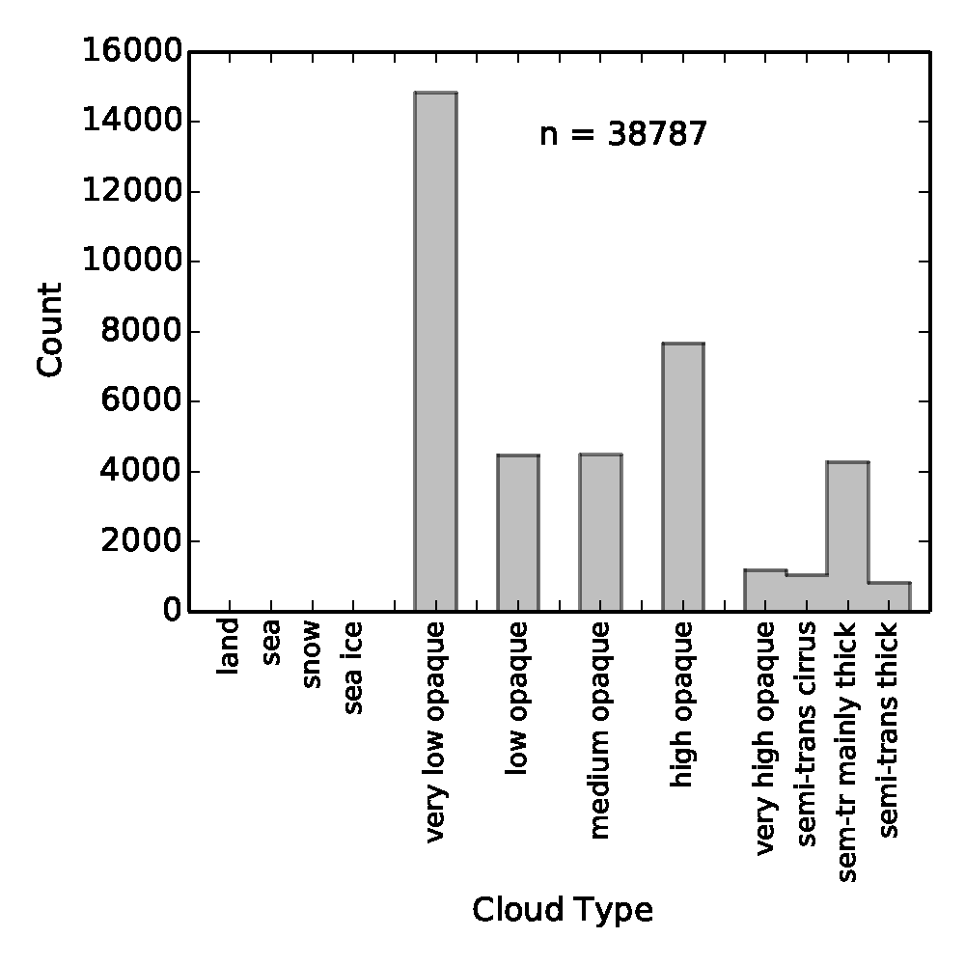
Realism of simulated AMVs: distribution of cloud types
Real AMVs
Synthetic AMVs
Fewer AMVs in simulated dataset, particularly from thin cirrus clouds.
-fewer trackable features

Slide 22
Error characteristics of AMVs: real v simulations

Slide 23
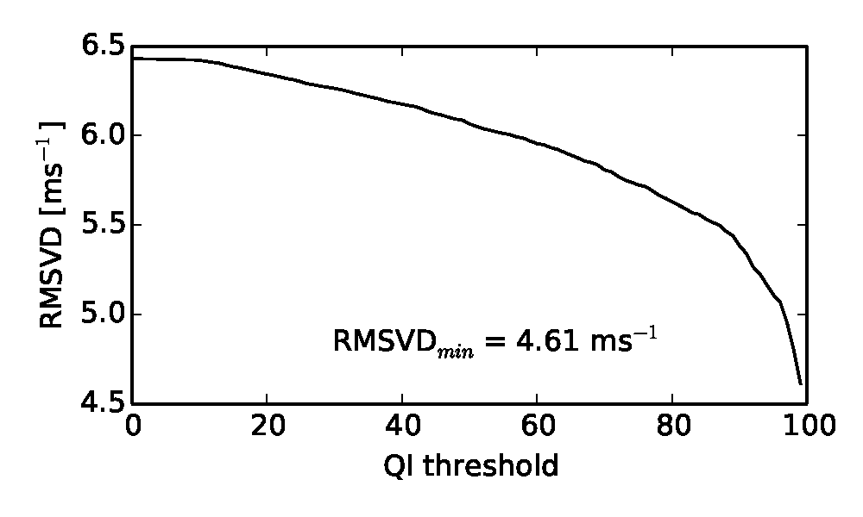
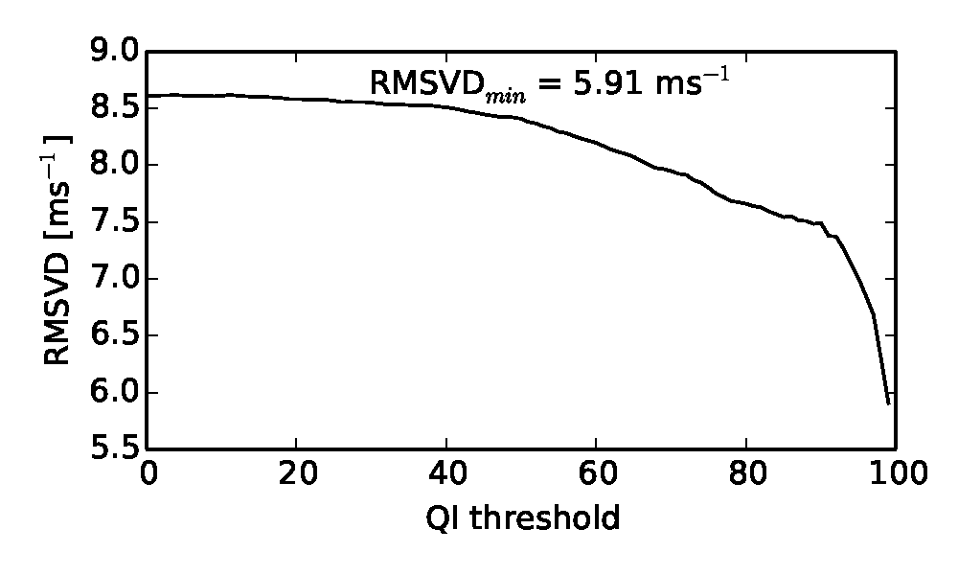
Error as function of QI threshold
Used QI without model background consistency term
Real AMVs
QI is a provides a good estimate of AMV errors.
Synthetic AMVs

Slide 24
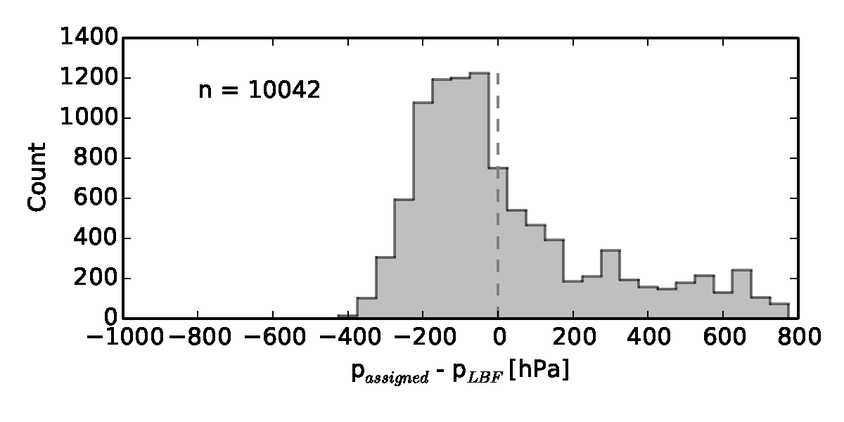
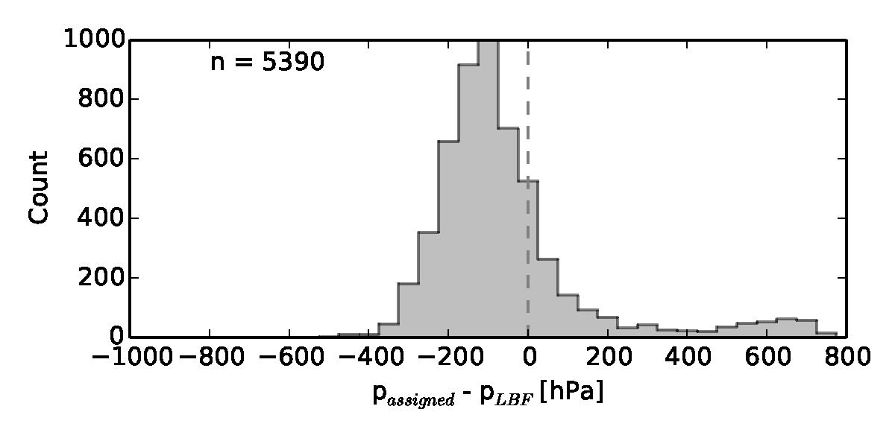
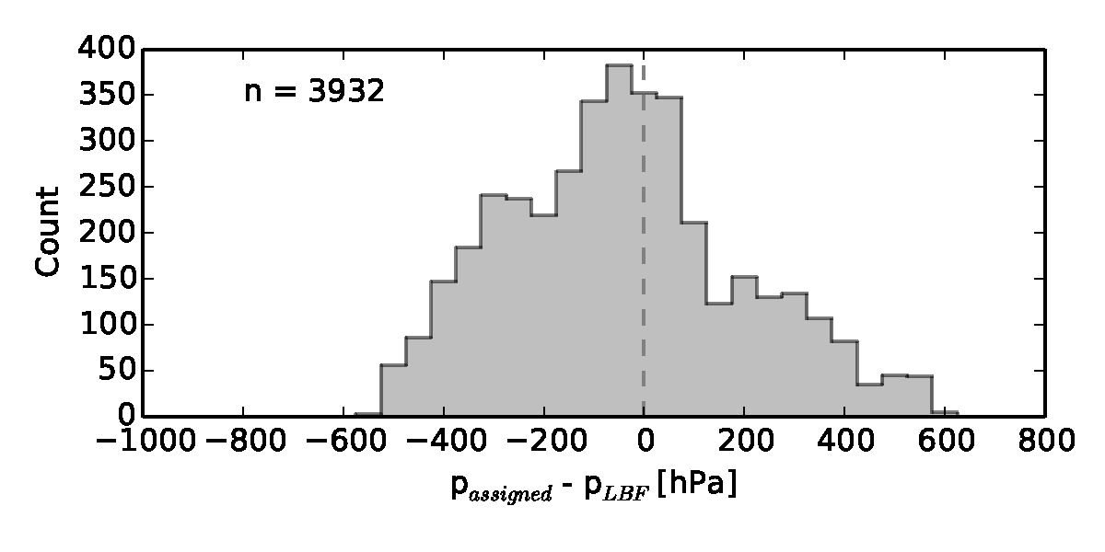
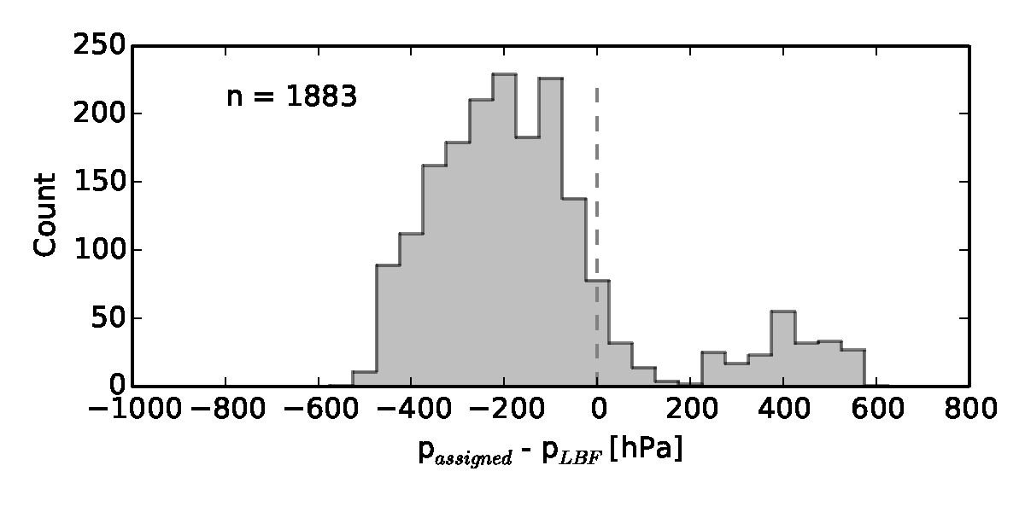
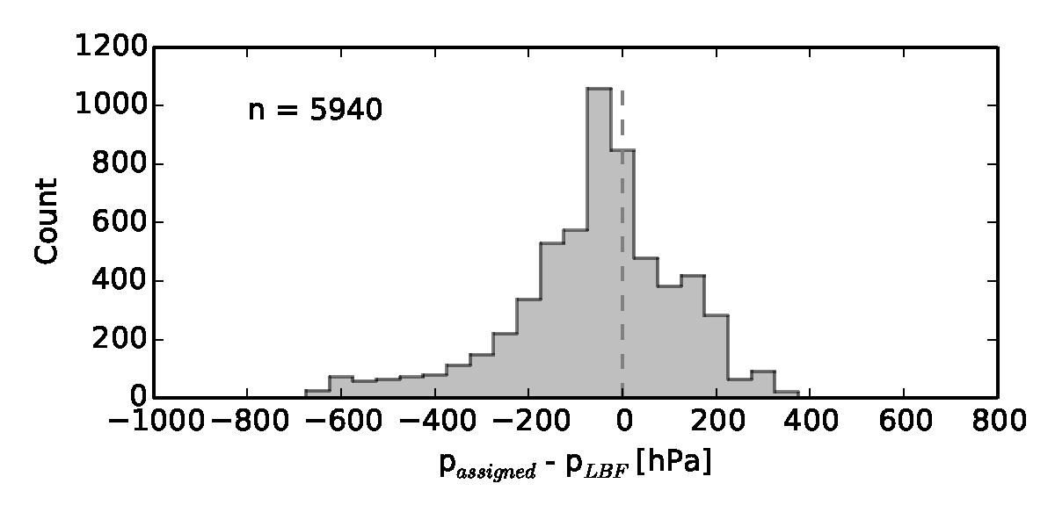
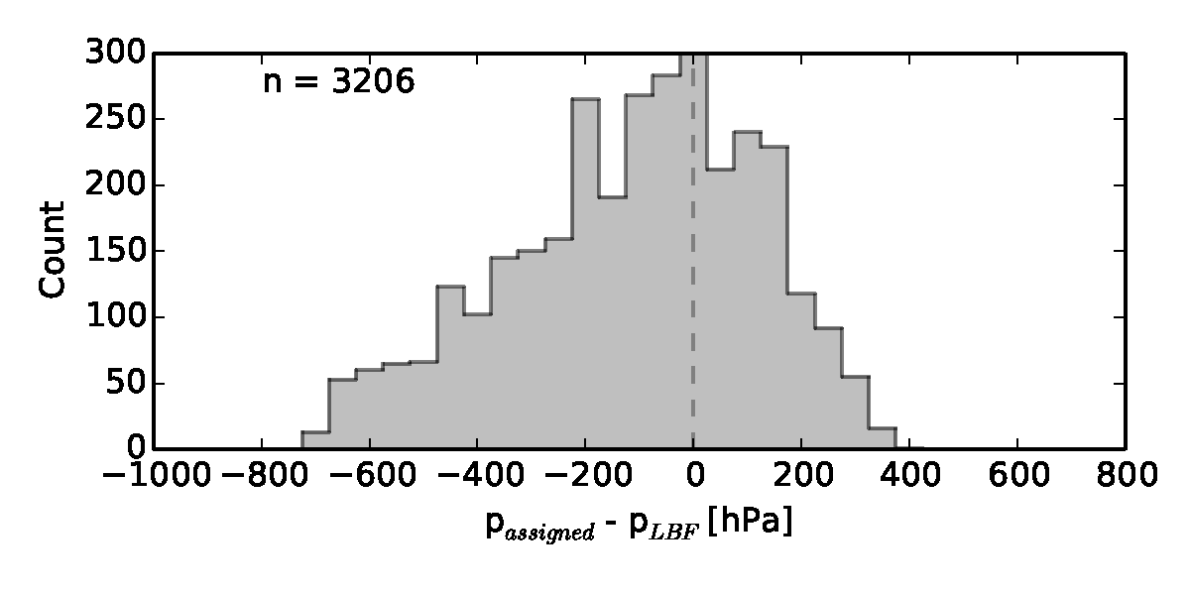
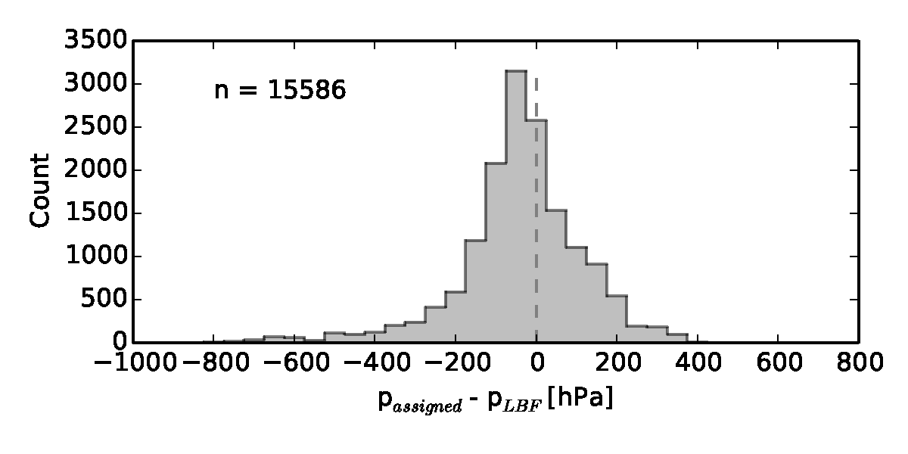
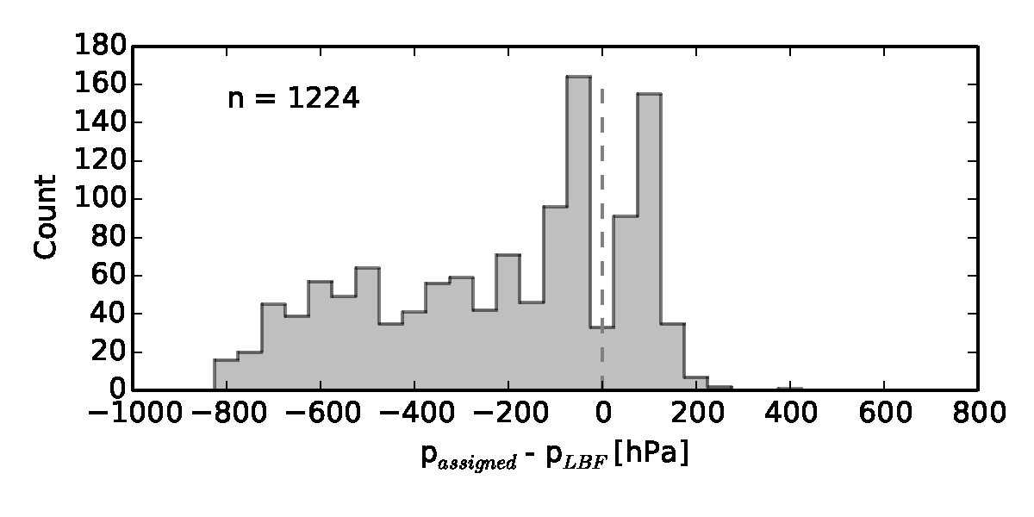
Level of best fit stats: real v simulated
low
medium
high
semi-transparent

Slide 25
Misfit between AMV and model: simulated v O-B
QI>80
 | Simulated |  | Real
Cloud category | RSMVD [ms⁻¹] | Bias [ms⁻¹] | RMSVD [ms⁻¹] | Bias [ms⁻¹]
Low opaque | 3.97 | -1.66 | 4.69 | -0.56
Medium opaque | 5.67 | -2.94 | 5.34 | -1.08
High opaque | 9.95 | -3.73 | 6.54 | -2.50
High semi-transparent | 13.53 | -7.64 | 5.88 | -1.27
includes forecast error and instrument error
Q. Why are the simulated errors so large?
Due to increased height assignment errors or tracking errors?

Slide 26
Misfit between AMV and model at level of best fit
QI>80
Errors at level of best fit:
 | Simulated |  | Real
Cloud category | RSMVD [ms⁻¹] | Bias [ms⁻¹] | RMSVD [ms⁻¹] | Bias [ms⁻¹]
Low opaque | 1.37 | -0.19 | 1.55 | -0.05
Medium opaque | 1.41 | -0.15 | 1.63 | -0.06
High opaque | 2.43 | 0.07 | 2.12 | 0.04
High semi-transparent | 1.98 | -0.16 | 2.19 | 0.20
Strongly suggests that height assignment errors are increased for simulated high clouds.
If increased error in simulated AMVs was due to increased tracking error: wouldn’t expect to find a good fit at any level.
If increased error in simulated AMVs was due to increased height assignment error: expect there would be some height which gives a good fit.

Slide 27
Synthetic AMV error budget
Real ‘O-B’
Simulated ‘Obs-Truth’
d = y − H (x_{f} , p_{assign} )
ε = y − H (x_{t} , p_{assign} )
d = f (ε_{y} , ε_{H} , ε_{xf} , ε_{passign} )
ε = f (ε_{y} , ε_{H} , ε_{passign} )
ε_{passign} = g (ε_{instrument} , ε_{xf} , ε_{technique} )
ε_{passign} = g (ε_{RTTOV} , ε_{technique} )
For simulation study to be useful:
ε < d
We have shown:
ε < d for low clouds: simulation study is useful.
ε > d for high clouds:
primarily due to increased ε_{passign}, most likely from ε_{technique}
simulation study results for these clouds not useful.

Slide 28
Vertical representivity assumptions ε_{H}

Slide 29
Synthetic AMV error budget
Real ‘O-B’
Simulated ‘Obs-Truth’
d = y − H (x_{f} , p_{assign} )
ε = y − H (x_{t} , p_{assign} )
d = f (ε_{y} , ε_{H} , ε_{xf} , ε_{passign} )
ε = f (ε_{y} , ε_{H} , ε_{passign} )
ε_{passign} = g (ε_{instrument} , ε_{xf} , ε_{technique} )
ε_{passign} = g (ε_{RTTOV} , ε_{technique} )
Observation operator, H:
Maps model state into quantity equivalent to AMV observation.
Requires you to make an assumption about what an AMV represents
e.g. assumption A: AMV represents wind at cloud top height.
assumption B: AMV represents mean wind in 100hPa layer beneath cloud top.
Helps understand vertical representivity of AMVs:
- change H, and see how d and ε change.
- indicates if error in observation operator, ε_{H} is increased or decreased.

Slide 30
Vertical representivity of AMVs
All AMV observation operators used in NWP data assimilation assume AMVs are representative of winds at cloud top height.
Several studies have shown that AMVs are more representative of winds within a layer beneath the cloud top.
Hernandez-Carascal and Bormann (2014) showed that much of the benefit of the layer averaging could be gained by simply lowering the assigned height.
Here, we compare 3 vertical representivity assumptions:
AMVs representative of winds at cloud top height (control)
AMVs representative of winds at single height beneath cloud top.
AMVs representative of winds in layer beneath cloud top.
1)
2)
3)
offset
thickness

Slide 31
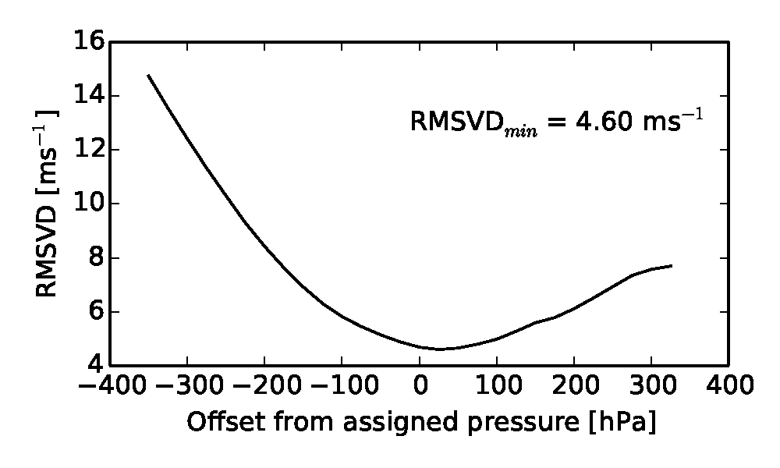
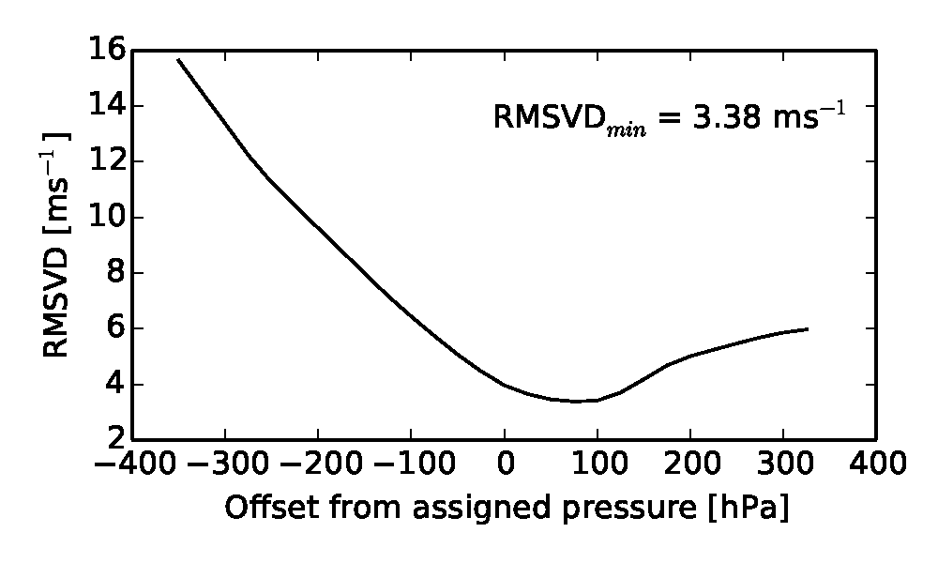
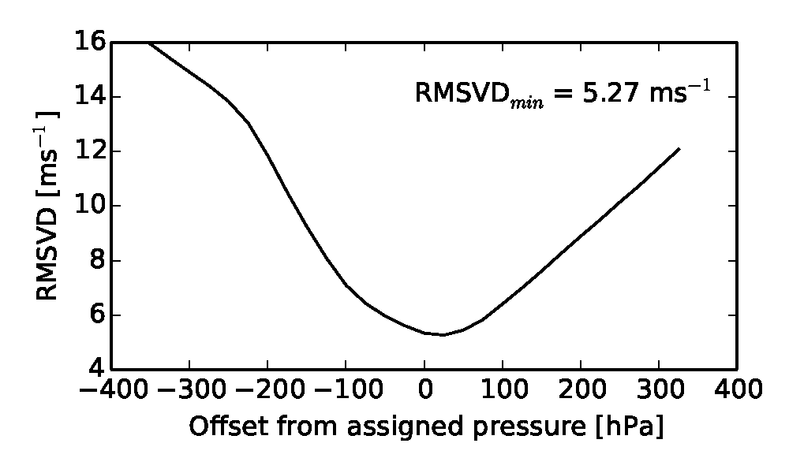
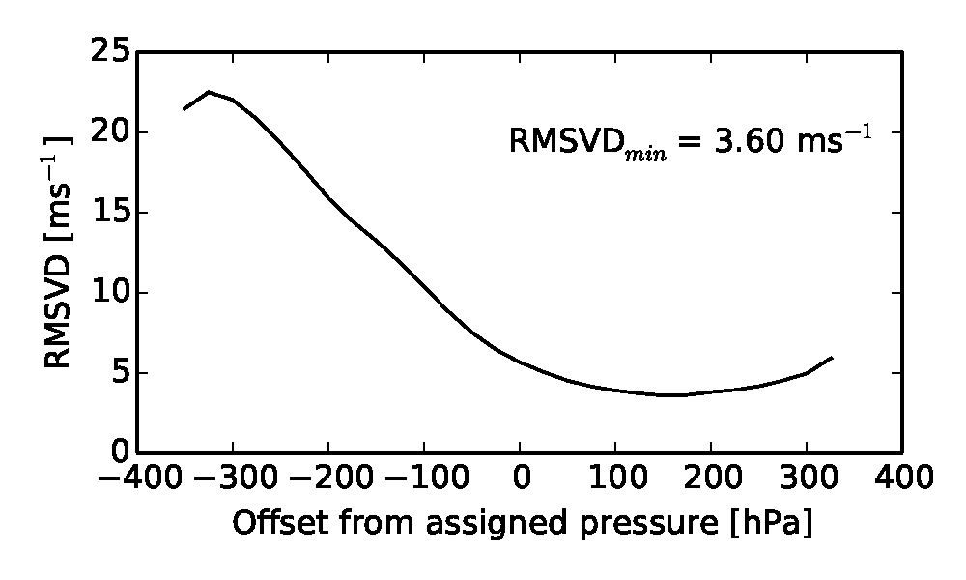
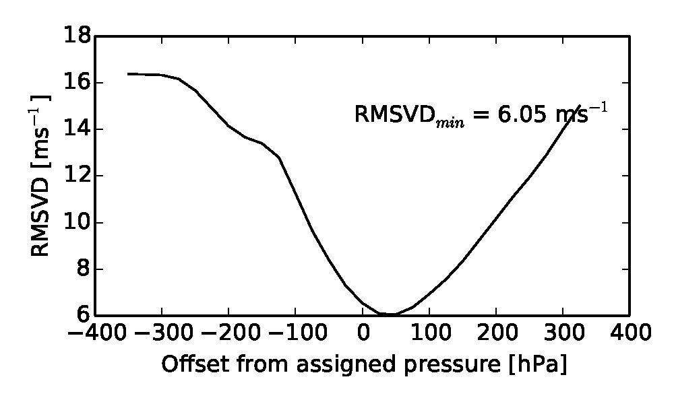
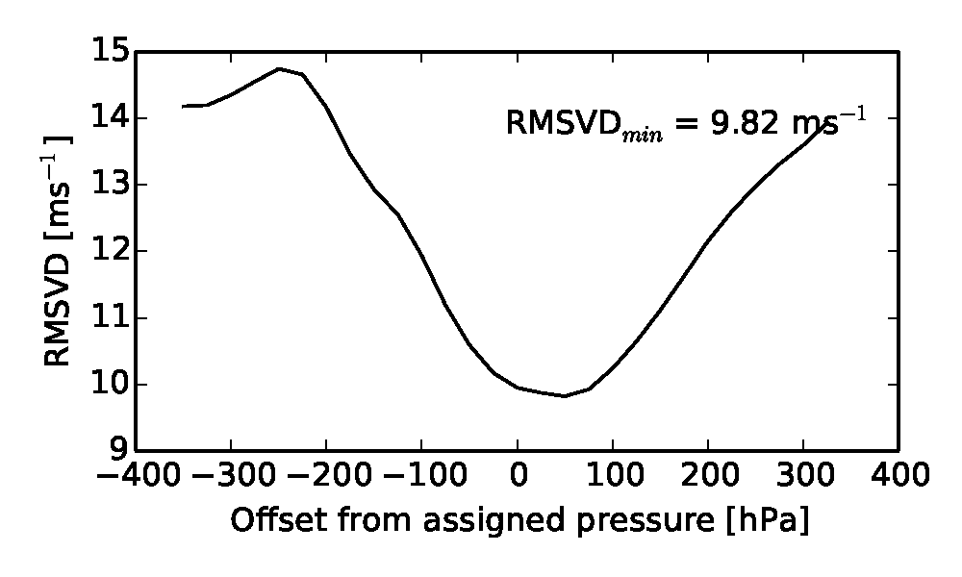
Vertical representivity: single level beneath assigned height real v simulated
Finding optimal offset for lower assigned height
Low opaque
Medium opaque
High opaque

Slide 32
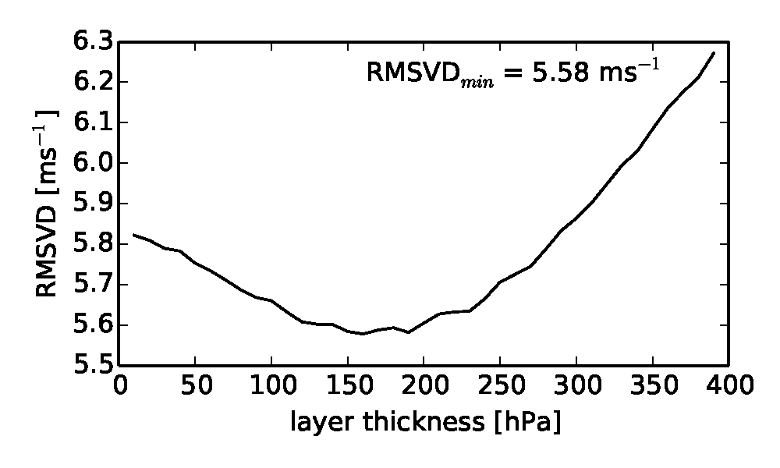
Vertical representivity: layer mean beneath assigned height
Vary layer thickness and find which thickness gives minimum RMSVD
Semi-transparent high clouds
For layer centre 30hPa below assigned height.

Slide 33
Vertical representivity: layer mean beneath assigned height real v simulated
Optimal offset and layer thickness found from Feb 5th – Mar 5th 2013 real data
Cloud category | Offset [hPa] | Layer thickness [hPa]
Low | 40 | 450
Medium | 10 | 275
High opaque | 40 | 250
High semi-transparent | 30 | 150
i.e. layer centred beneath cloud top gives optimal fit to AMVs.

Slide 34
Improved fit using new vertical representivity assumptions
QI>80
Results from Feb 5th – Mar 5th, 2013 (real data) :
 | At assigned |  | Lower assigned |  | Optimal layer
Cloud category | RSMVD [ms⁻¹] | Bias [ms⁻¹] | RMSVD [ms⁻¹] | Bias [ms⁻¹] | RMSVD [ms⁻¹] | Bias [ms⁻¹]
Low opaque | 4.69 | -0.56 | 4.62 (1.5%) | -0.30 | 4.27 (9.0%) | 0.13
Medium opaque | 5.34 | -1.08 | 5.29 (0.9%) | -0.85 | 5.14 (3.7%) | -0.98
High opaque | 6.54 | -2.50 | 6.03 (7.8%) | -0.40 | 5.54 (15.3%) | -0.38
High semi-transparent | 5.88 | -1.27 | 5.69 (3.2%) | -0.17 | 5.40 (8.2%) | 0.08
Optimal layer gives best fit for all categories.
Slow bias in upper level AMVs is almost completely removed

Slide 35
Improved fit using new vertical representivity assumptions
Results from Oct 14th – Nov 2nd, 2013 (real data):
Independent trial period using same optimal offset, thickness paramaters derived from previous case study.
QI>80
 | At assigned |  | Lower assigned |  | Optimal layer
Cloud category | RSMVD [ms⁻¹] | Bias [ms⁻¹] | RMSVD [ms⁻¹] | Bias [ms⁻¹] | RMSVD [ms⁻¹] | Bias [ms⁻¹]
Low opaque | 4.29 | -1.41 | 4.18 (2.6%) | -0.99 | 3.67 (14.5%) | -0.33
Medium opaque | 6.86 | -1.23 | 6.77 (1.3%) | -0.89 | 6.09 (11.2%) | -1.42
High opaque | 8.85 | -2.95 | 7.66 (13.4%) | -0.13 | 6.96 (21.4%) | -0.12
High semi-transparent | 8.57 | -3.02 | 7.45 (13.1%) | -1.41 | 7.05 (17.7%) | -1.04
Results indicate that improvement from using layer mean is robust.
Slow bias still significantly reduced in independent trial period.

Slide 36
Removal of slow bias
NWCSAF AMVs
(re- assigned height)
NWCSAF AMVs
(standard assigned height)

Slide 37
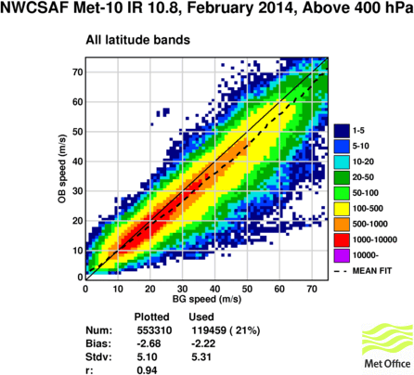
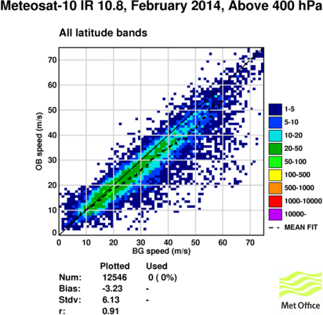
Slow bias
NWCSAF AMVs
(standard assigned height)
EUMETSAT AMVs
(only within NWCSAF domain)

Slide 38
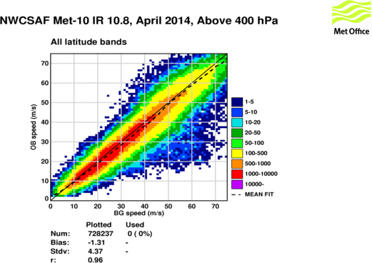
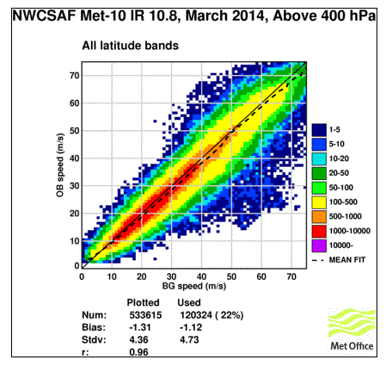
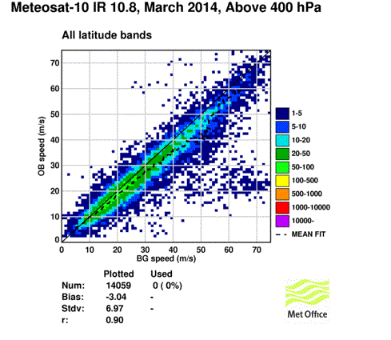
March stats

Slide 39
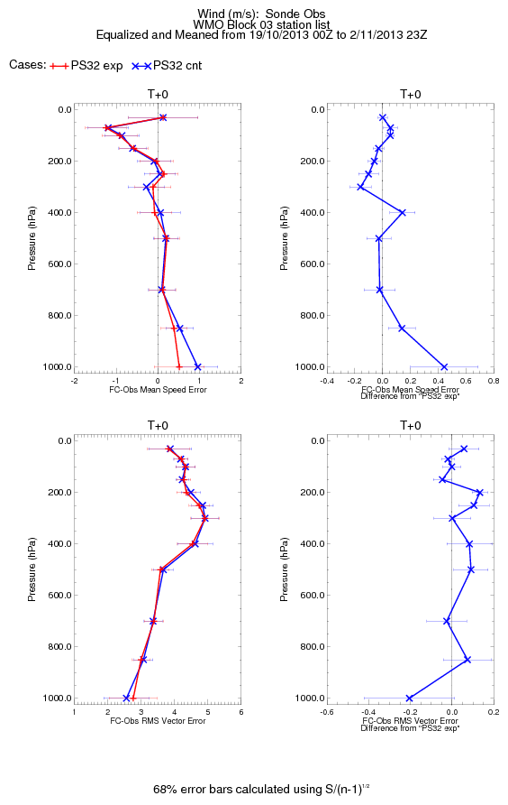
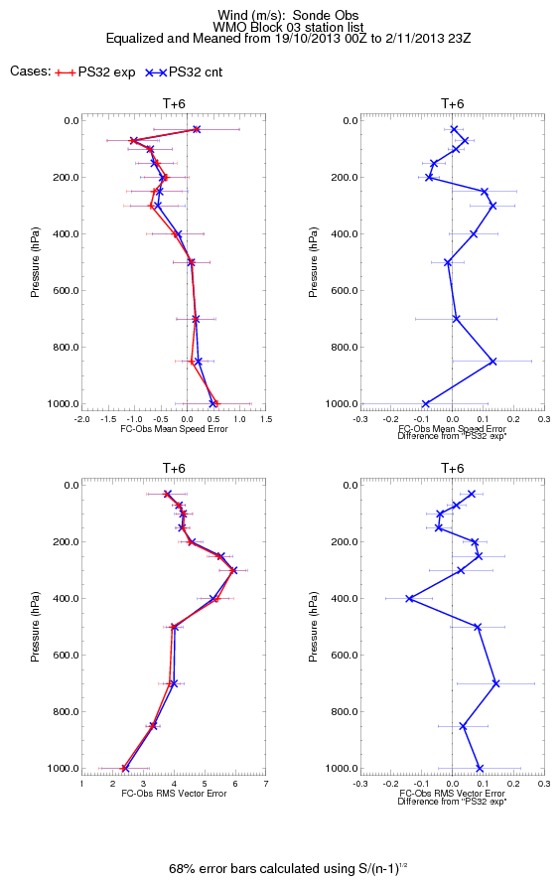
NWP assimilation trials using a lower assigned height
Results demonstrated that lowering assigned height by around 40hPa gives an improved fit to the model background.
NWP assimilation trial setup:
2 weeks Nov 2013.
UKV 3d VAR, 3 hour cycling.
Lowered all assigned heights by 40hPa
+ve impact on tropospheric winds during t+0 – t+12h
broadly neutral for other variables.

Slide 40
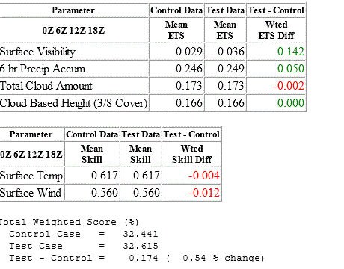
UKV trials with 40 hPa height adjustment

Slide 41
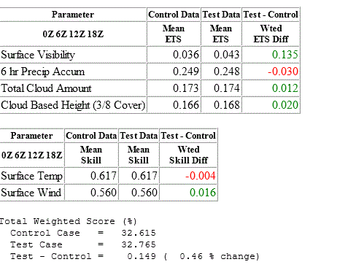
UKV trials data over sea

Slide 42
NWCSAF AMVs
Met Office now produces mesoscale AMVs operationally using NWCSAF AMV package.
NWCSAF AMVs operationally assimilated into UKV model (>400hPa only) with adjusted heights.
NWCSAF lower AMVs have been tested over sea and ready to be included with monthly blacklist change
Plans:
to start testing a layer average observation operator.
retune observation errors in assimilation based on cloud top height and cloud type.
new O-B stats monitoring package developed during this fellowship to be run in real time at Met Office.

Slide 43
Conclusions
On vertical representivity of AMVs:
Presented further evidence that AMVs representative of layer mean wind with layer centre slightly below cloud top.
Slow bias in upper level AMVs almost completely removed by either lowering assigned height or by comparing against optimal layer mean wind.
Demonstrated improved usage of AMVs:
Lower assigned height ~40hPa: easy win
significantly reduced slow bias
Layer mean wind:
gives closest fit between AMVs and model.
Robust results confirmed in independent trial period.
Cloud type dependence of AMV error stats: evidence that cloud type is a predictor of AMV error characteristics
On utility of simulation study technique:
Model simulations are getting more and more realistic.
Synthetic AMVs from low and medium height clouds had similar error characteristics to real AMVs
Simulations of clouds are still imperfect:
Synthetic AMVs from high cloud suffered from large height assignment errors: results not representative of real AMVs
In this study of cloudy AMVs, the simulation technique did not yield any more useful results that could not be found from standard O-B stats.
Simulation studies still very useful for simulating future observing systems.
Need to be aware of limitations of technique when drawing conclusions from results.

