Slide 1
FY-2 On-orbit Operational Calibration Approach (CIBLE) and its Benefit to FY-2D/E AMV Products
12th International Winds Workshop (IWW12)
Calibration of Inner Blackbody corrected by Lunar Emission (CIBLE)
Qiang Guo*, Boyang Chen, Xuan Feng, Changjun Yang, Xin Wang, Xiuzhen Han
(Working Group of Operational Calibration, WGOC for FY-2 Satellite)
guoqiang@cma.gov.cn
National Satellite Meteorological Center (NSMC), CMA
Copenhagen, Denmark, June 16, 2014

Slide 2
Outline
Current Status & Challenge for FY-2 Calibration
Brief Introduction to CIBLE
Basic Principles & Key Technologies
Overview the Working Performance of CIBLE
Bias Evaluation & Primary Application
CIBLE’s Benefit to FY-2D/E AMV Products
Conclusion

Slide 3
Current Status & Challenge for FY-2 Calibration

Slide 4
Satellite | Launch Time | Application and Main Merits
FY-2A | 1997.06.10 | Subseries 1st , Experimental Satellite: Validation of main detecting functions and some key technologies of the whole system are completed.
FY-2B | 2000.06.25
FY-2C | 2004.10.19 | Subseries 2nd , Operational Satellite: ▪ Operational Stabilized Systems for both space and ground segments ▪ INR technique has been conquered ▪ Inter-calibration and main products have been in operation
FY-2D | 2006.12.08
FY-2E | 2008.12.23
FY-2F | 2012.01.13 | Subseries 3rd , Operational Satellite: Quantitative applications are willing to be improved in an overall scale, where the increase of calibration accuracy is one of the most important factors!

Slide 5
Main features of current calibration methods for FY-2 satellite
Types | Methods | Merit | Shortcoming
Before Launch | In-lab Cal. | High calibration accuracy, mainly used for sensitivity and amplification parameter determination | A few conditions cannot represent fully the on-orbit environment. Application for onboard payload is limited
After Launch | Inter-Calibration (AVHRR/HIRS) | Calibration performance of AVHRR is stable with long-term observation serials, and its spatial resolution is at the same order (Km) as FY-2 VISSR | Wide-band sensor, the performance of spectral response matching is limited and finally influence the calibration accuracy.
 | Inter-Calibration (GSICS) | Calibration performance of IASI/AIRS is stable. Spectral response matching can be solved with these high spectral resolution sensors | Lower spatial resolution at 10¹ Km order (12/13.5), spatial matching depends on targets, especially for non-window band, e.g. water-vapor
 | In situ Calibration | In situ target and atmospheric feature can be measured directly. Generally used for validation with high accuracy | Limited number of in situ targets with a relative narrower dynamic range for calibration
 | Sea buoy Calibration | Calibration with uniform water body, whose radiometric feature is quite stable | Temperature measured by sea buoy differs from the surface one observed by onboard sensor. The range focus on high segment (>270K)

Slide 6
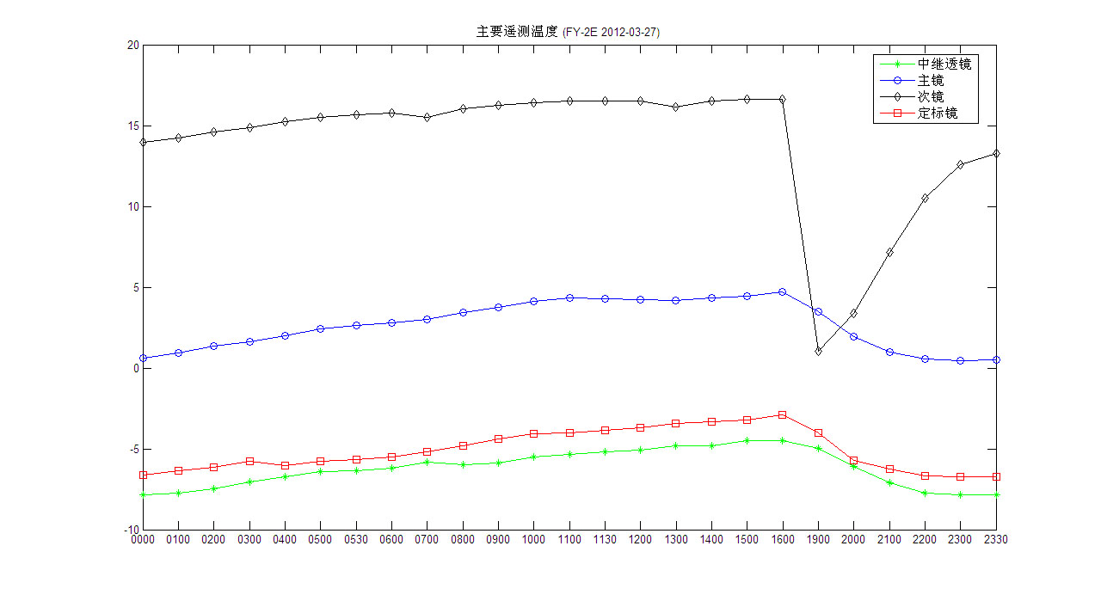
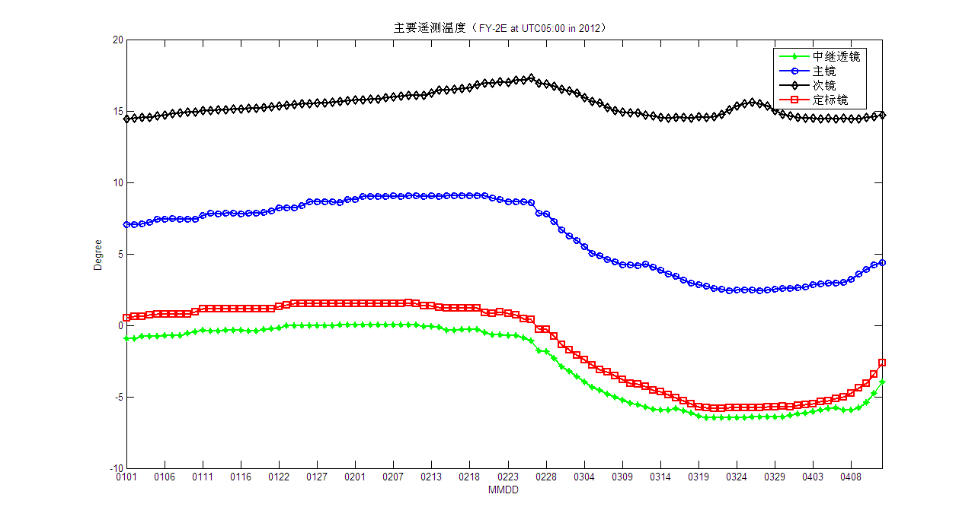
diurnal variations
Main optical component temperature variation of FY-2E satellite
annual variations
Thermal environment of FY-2 is continuously changing, which requires some new calibration source with high frequency and accuracy

Slide 7
Brief Introduction to CIBLE

Slide 8
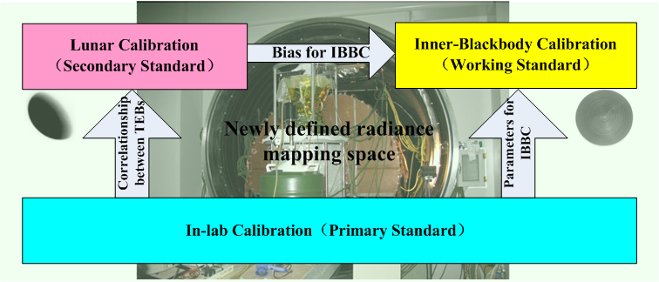
Basic Principles of CIBLE
Based on the in-lab radiometric calibration with high accuracy, the on-orbit lunar calibration as well as the inner-blackbody one are proposed, and the CIBLE has been finally realized by radiation transformation between different reference standards.

Slide 9
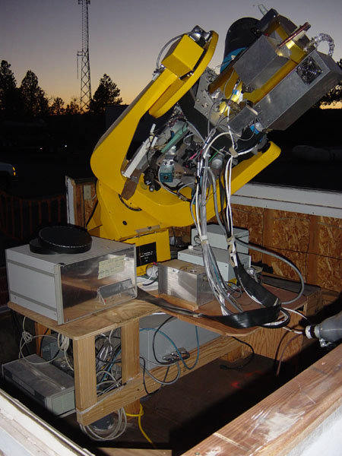
Key Technique of CIBLE: Lunar Calibration (LC) in TEB
Feasibility of TEB Lunar Calibration:
The Moon’s photometric stability is as perfect as 10⁻⁹ per year and it is surrounded by a black field in both reflective and emissive bands.
(J. Atmos. Oceanic Technol., Vol.13, pp.360-374)
▪ No significant emission or absorption feature;
▪ Surface temperature peak at infrared wavelength;
▪ Thermal emission spectra can be modeled as a function of illumination and viewing geometry.
(ICARUS, Vol.92, pp.80-93)
For full moon with zero phase angle
(Opt. Eng., Vol.38, No.10, pp1763-1764)
At present, lunar calibration is mainly applied in RSBs, for example MODIS, SeaWiFs and GOES imager. In 2010, Xiong et al. used on-orbit lunar observations to evaluate the calibration performance of MODIS’s MIR band.
Lunar Obs. on ground: RObotic Lunar Observatory (ROLO) Project

Slide 10
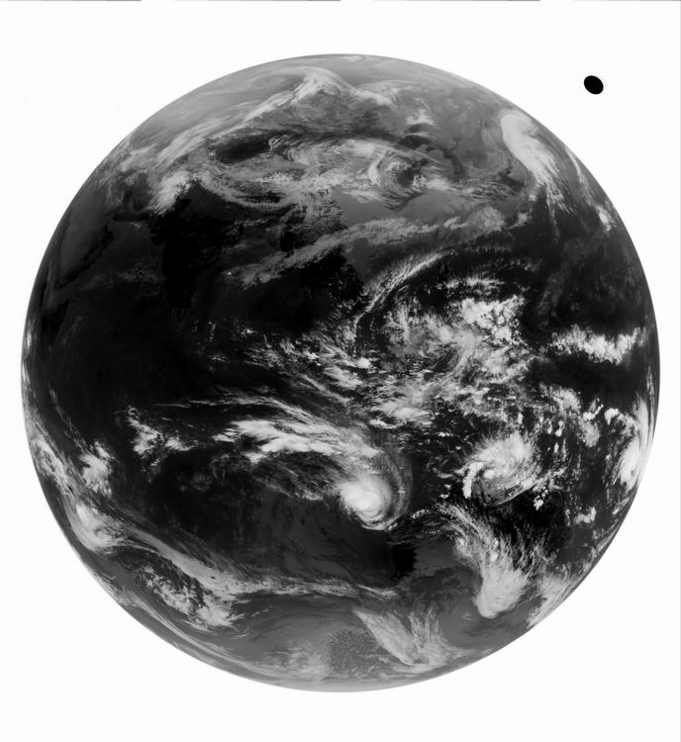
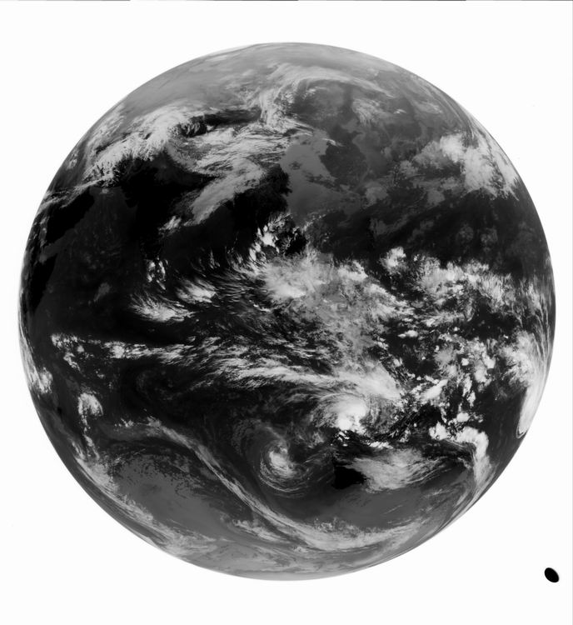
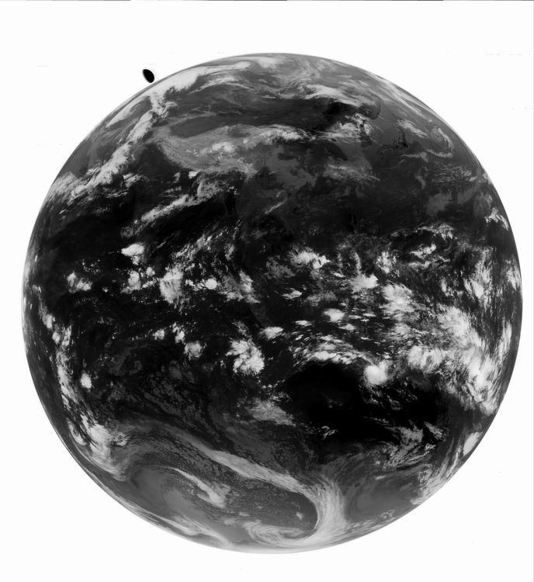
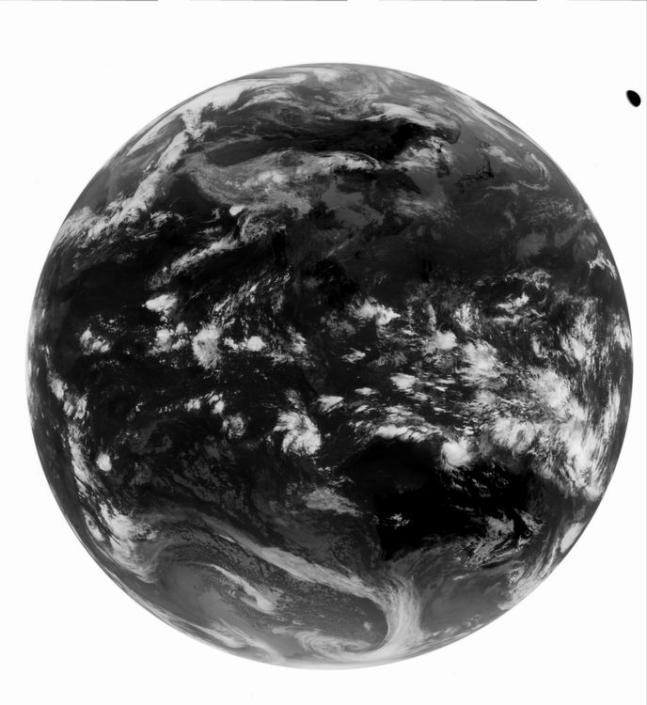
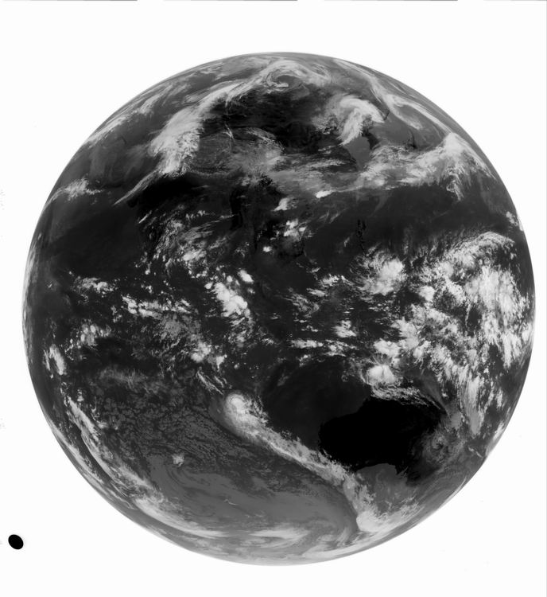
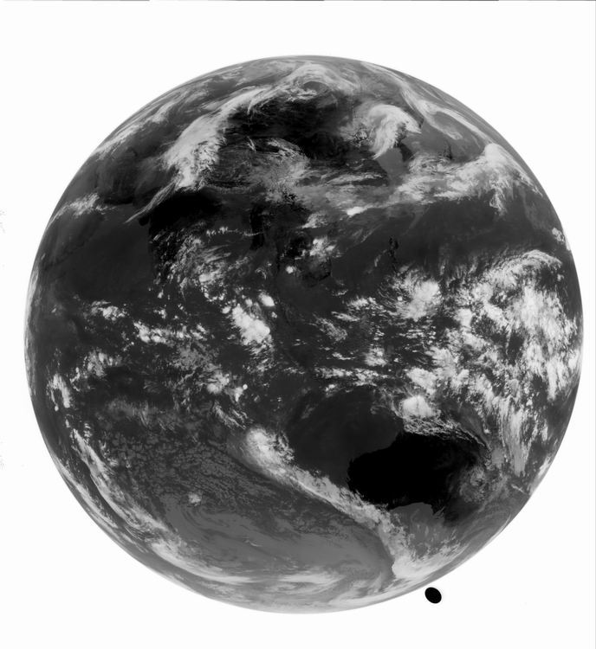
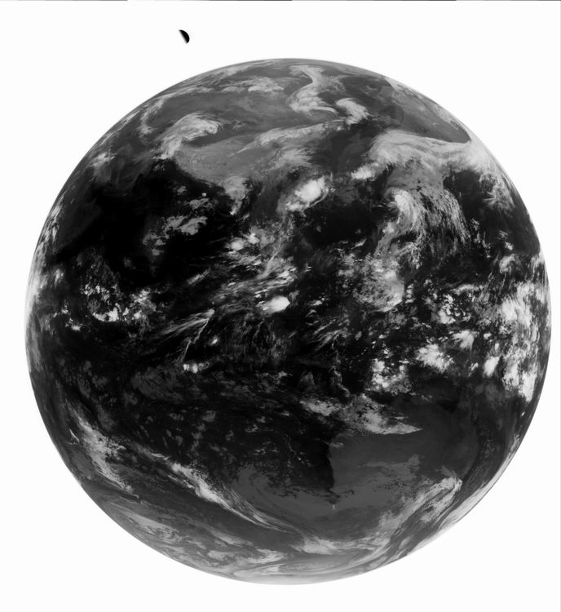
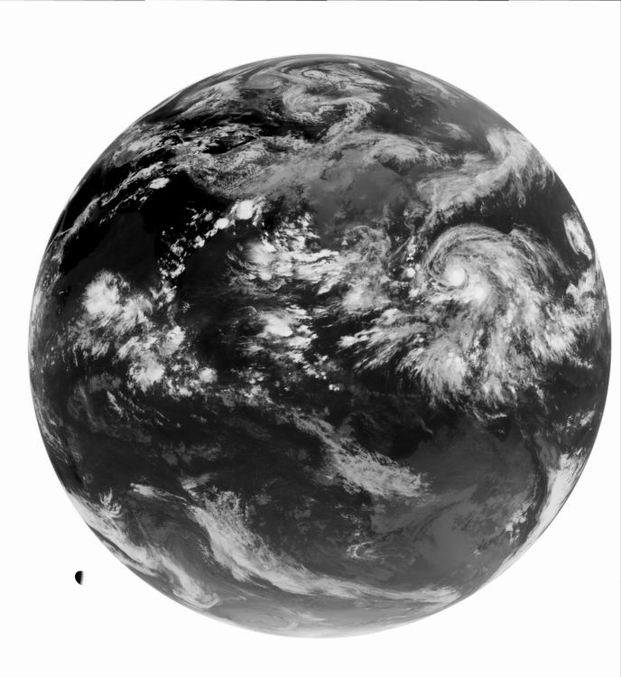
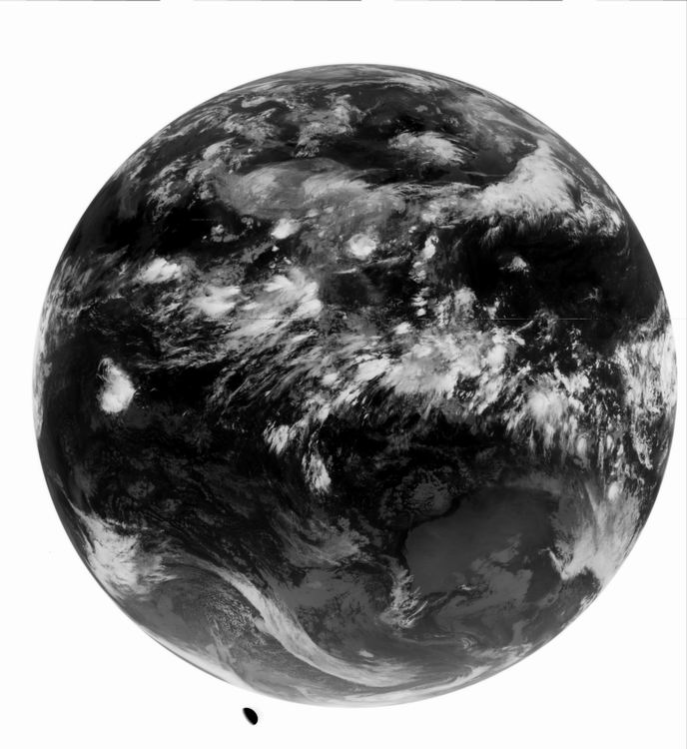
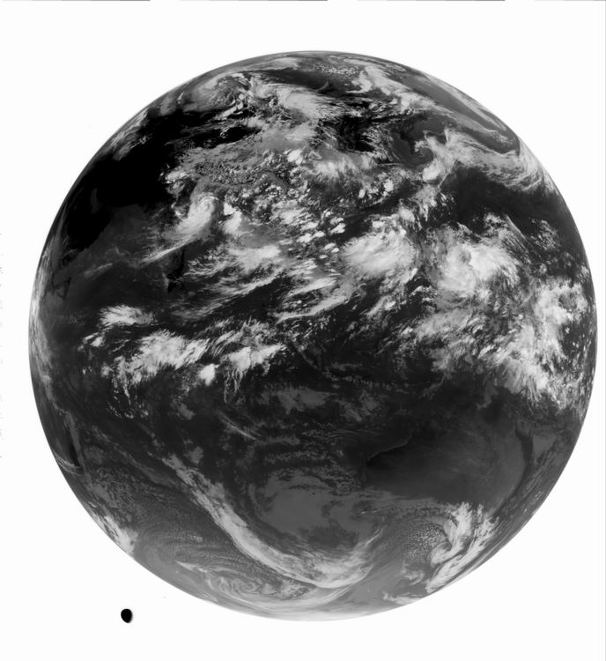
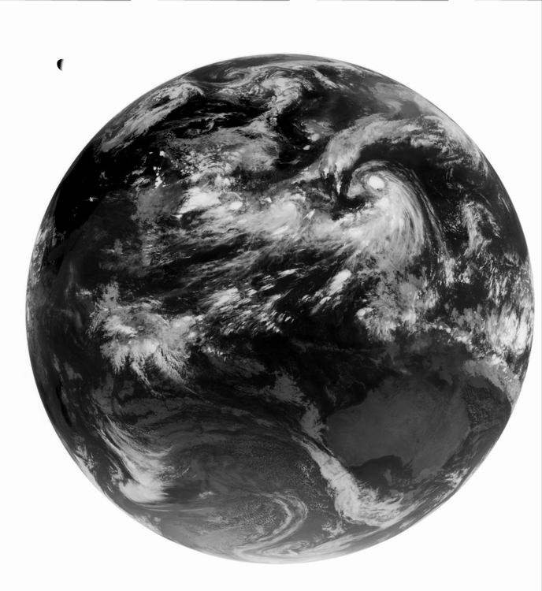
Moon’s position distribution for LC in TEBs (Examples as for FY-2E)

Slide 11
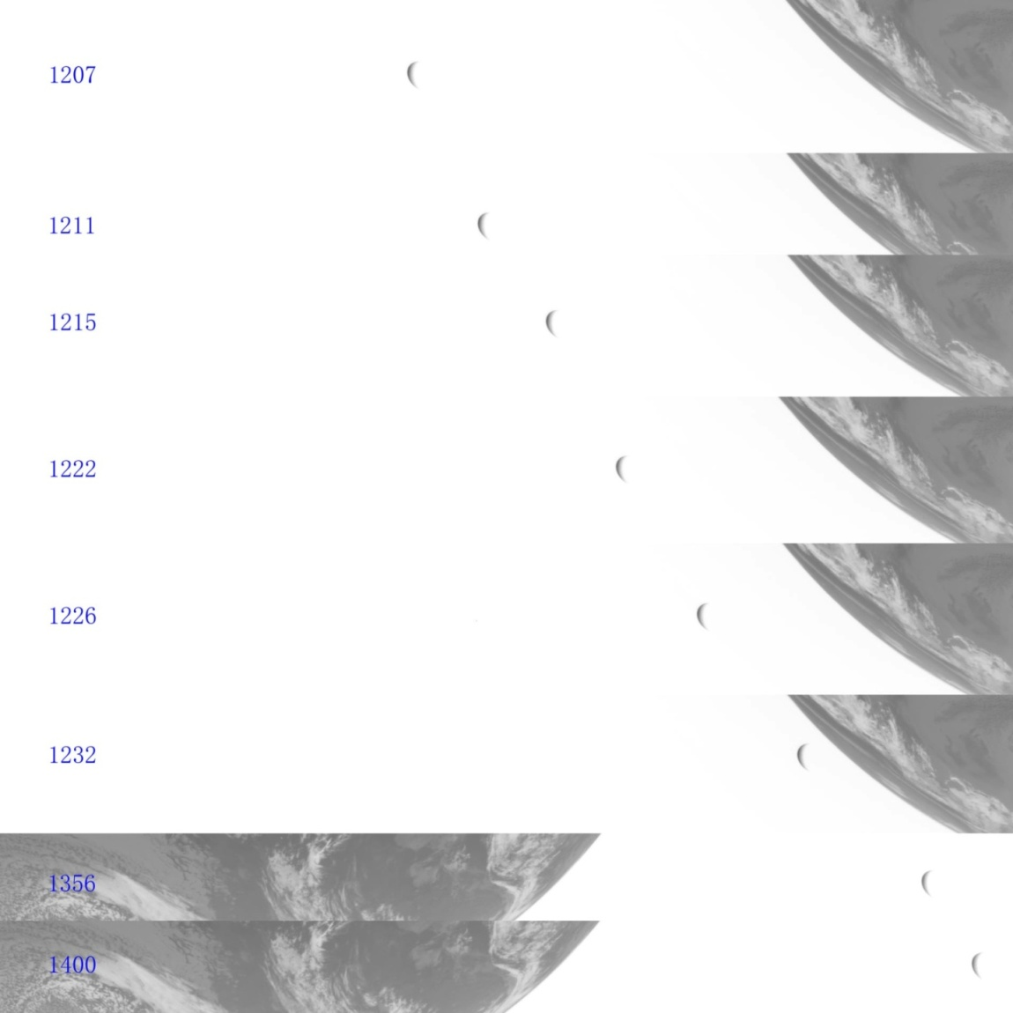
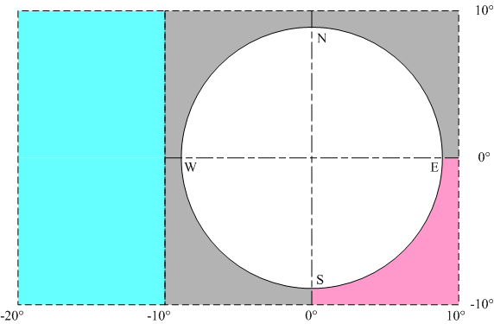
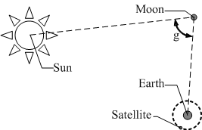
Continuous Moon Observations with area-scanning mode of FY-2F in Apr. 16, 2012
g is Moon’s phase and satisfied with:
Aft. Cps. 5:1, VIS
Aft. Cps.1:1
Aft. Cps. 5:1, IR1
Aft. Cps.1:1
VIS
IR1

Slide 12
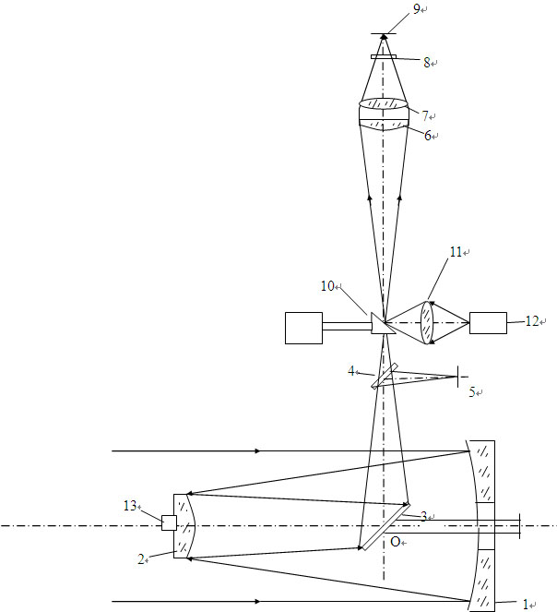
Inner-Blackbody Calibration (IBBC) for FY-2 Satellite TEBs
Main Optical Components
1: Primary Mirror
2: Secondary Mirror
6/7: Relay lens
10: Mirror for Cal.
12: Inner-Blackbody
Sketch Map of FY-2 Optics
Main Challengers for IBBC of FY-2 satellite
▪ The radiometric contribution of front-optics, including primary and secondary mirrors, has different effects on IBBC as well as space-view.
▪ The thermal environment of aft-optics for FY-2 cannot be controlled perfectly.

Slide 13
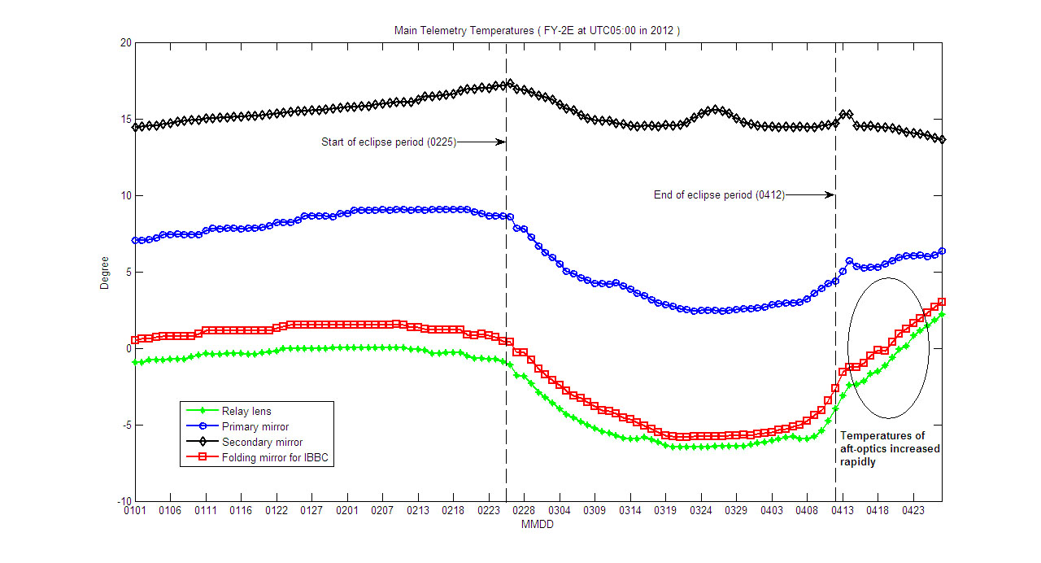
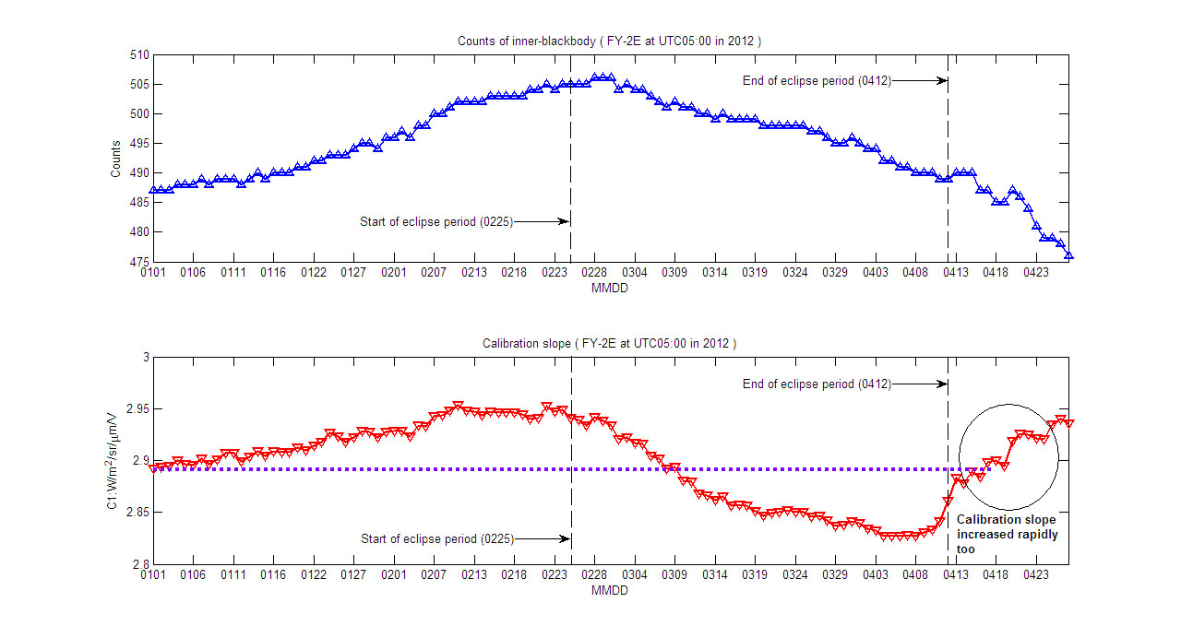
IBBC results for FY-2E between January 1 and April 27, 2012

Slide 14
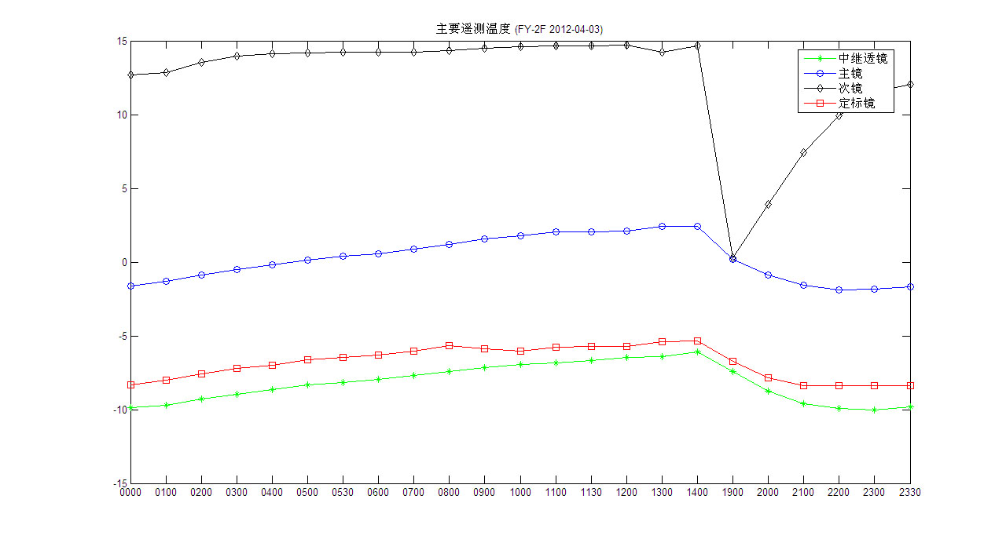
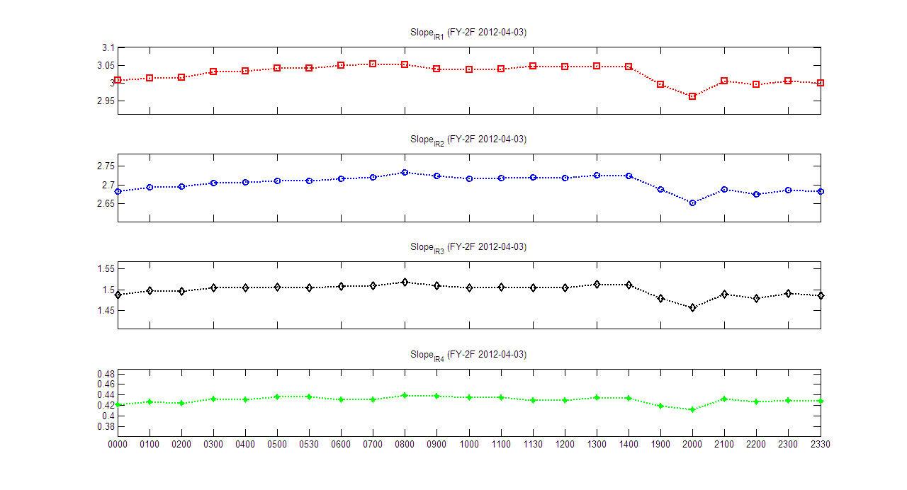
Calibration slope’s diurnal variation for FY-2F during satellite eclipse period
Maximal Relative Variation: 3%

Slide 15
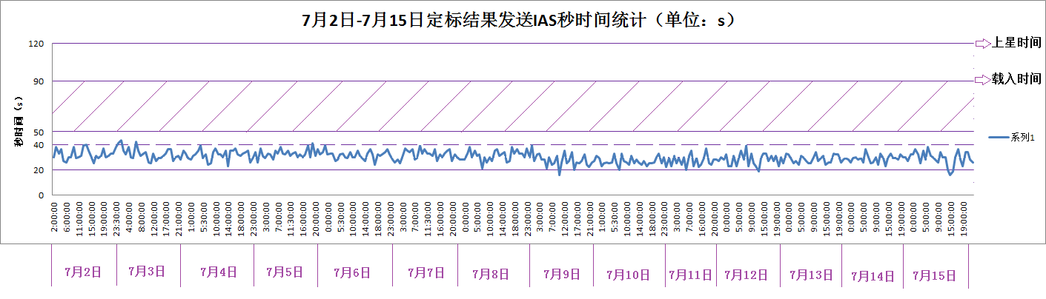
Timeliness analysis for CIBLE in FY-2 satellites
transmit
load
Time (s)
Jul. 2
Jul. 3
Jul. 4
Jul. 5
Jul. 6
Jul. 7
Jul. 8
Jul. 9
Jul. 10
Jul. 11
Jul. 12
Jul. 13
Jul. 14
Jul. 15
2012
ΔT(Processing time for CIBLE): Min=16s, Max=43s
The latest calibration results of CIBLE will be added in S-VISSR stream at the beginning of No.201 scanning line. (about 2 minutes later)
FY-2F CIBLE
2012/07/21
FY-2E CIBLE
2013/03/27
FY-2D CIBLE
2013/05/21
Important Milestones for CIBLE

Slide 16
Overview the Working Performance of CIBLE

Slide 17
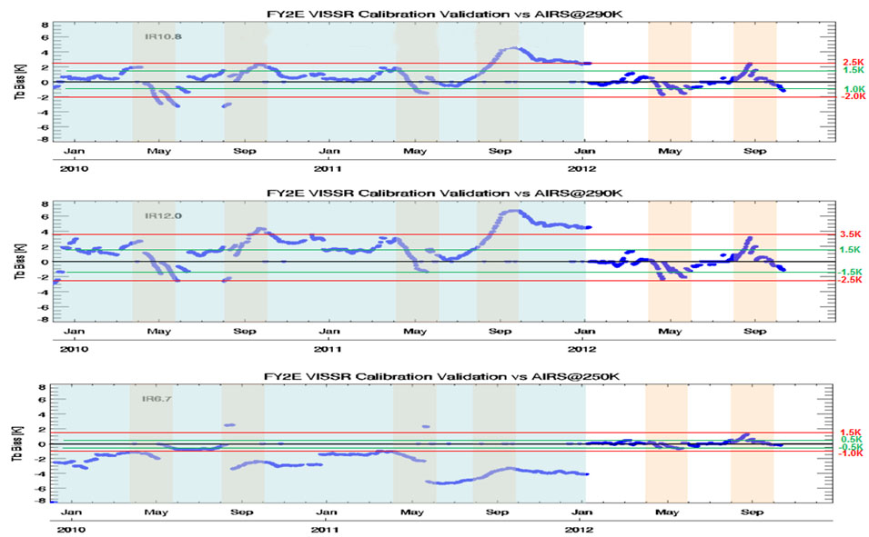
FY-2E Satellite Operational Calibration Accuracy Monitoring
Cross-Calibration with AVHRR/HIRS
Cross-Calibration with IASI
Recommended by GSICS

Slide 18
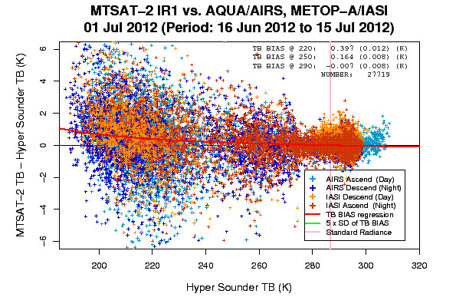
Slope
Time
Calibration slope comparison between CIBLE and O.C. in IR1 band during 2012
0.42K
Bias@220K
Time
Analysis of CIBLE’s accuracy in IR1 band during 2012 for FY-2E
0.39K

Slide 19
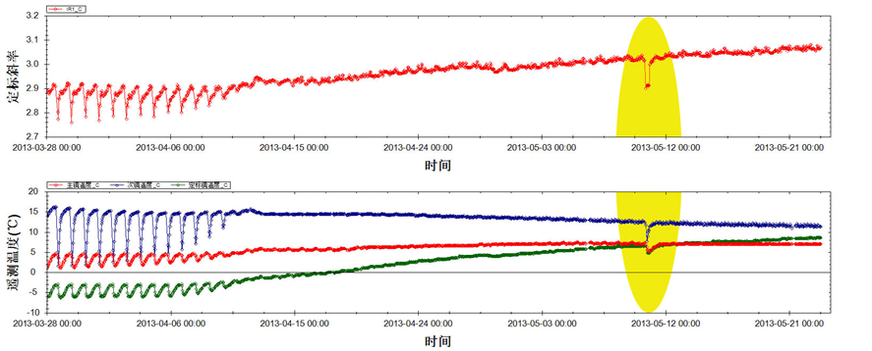
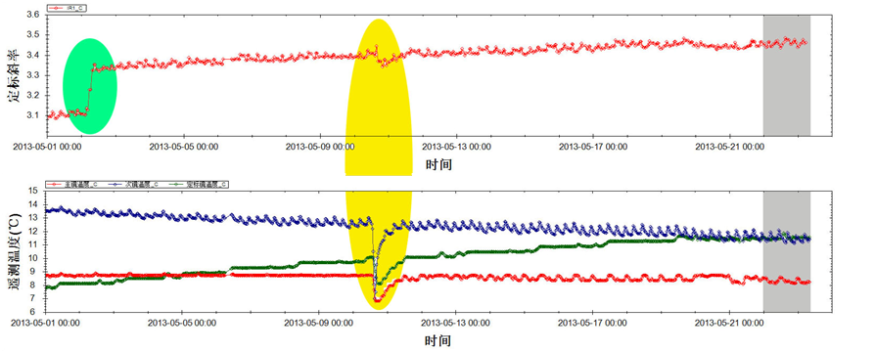
FY-2E
Slope
Shielded by
the Moon
Time
Temperature
Time
FY-2D
Slope
Radiant Cooler Switched
(93K→100K)
operation
Shielded by
the Moon
Time
Temperature
Time

Slide 20
FY-2E Thermal Environment
Operational Working since March 27, 2013
Satellite Eclipses
FY-2E Slope_{IR1}
FY-2D Thermal Environment
FY-2D Slope_{IR1}
Operational Working since May 21, 2013

Slide 21
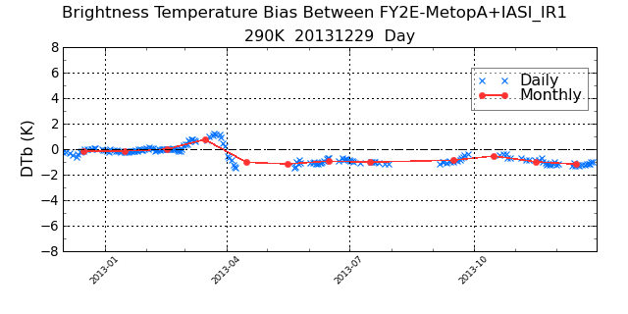
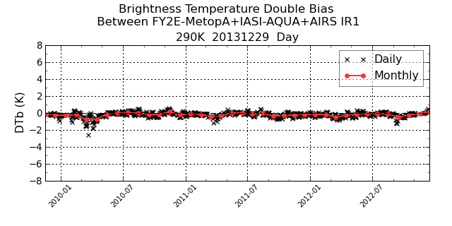
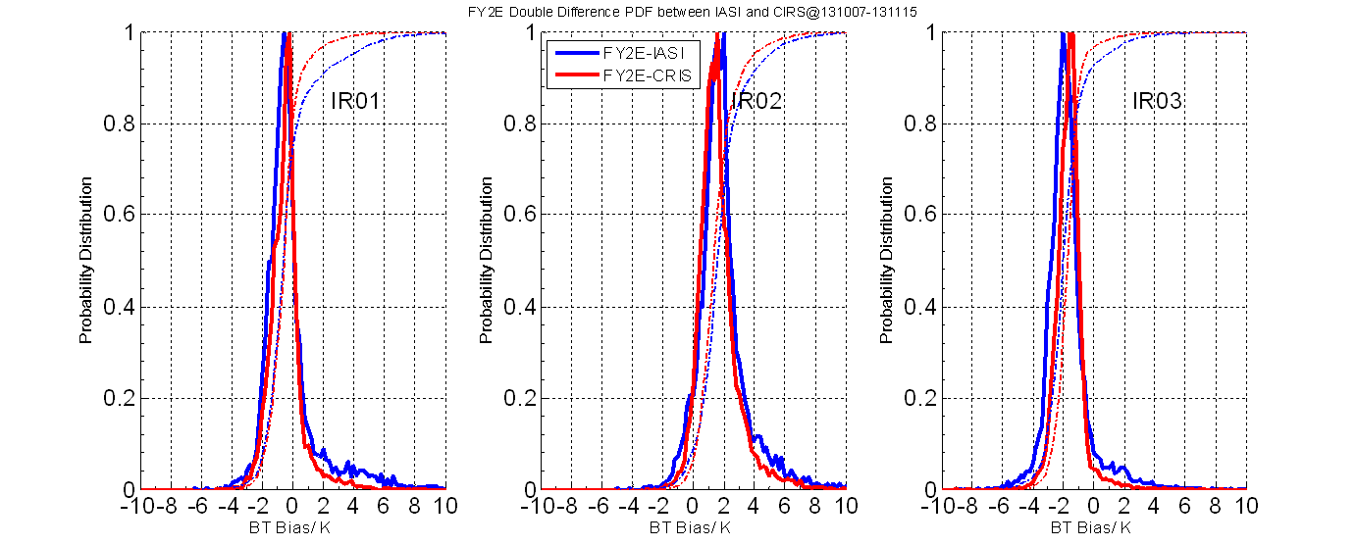
http://gsics.nsmc.cma.gov.cn
CrIS as reference, IR1:-0.5K@290K

Slide 22
CIBLE’s Benefit to FY-2D/E AMV Products

Slide 23
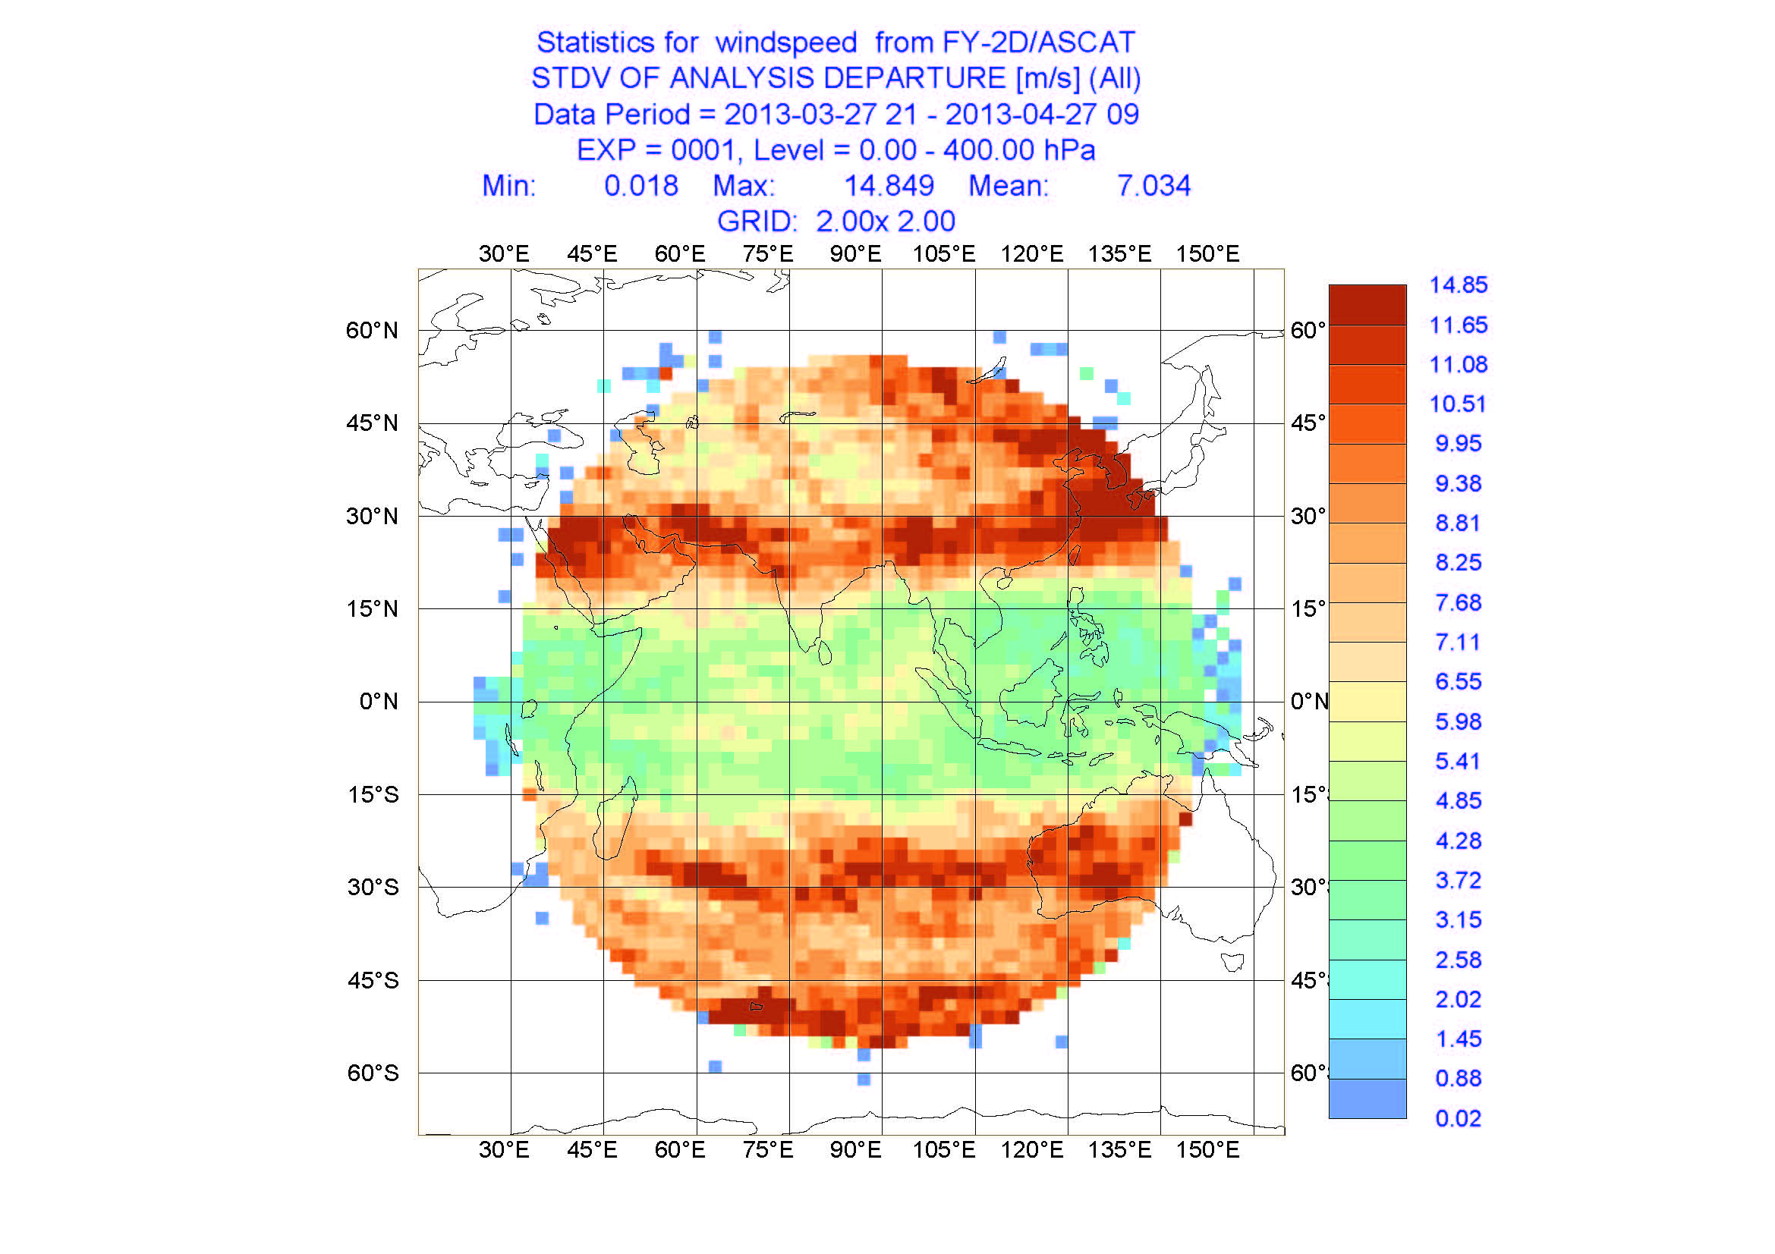
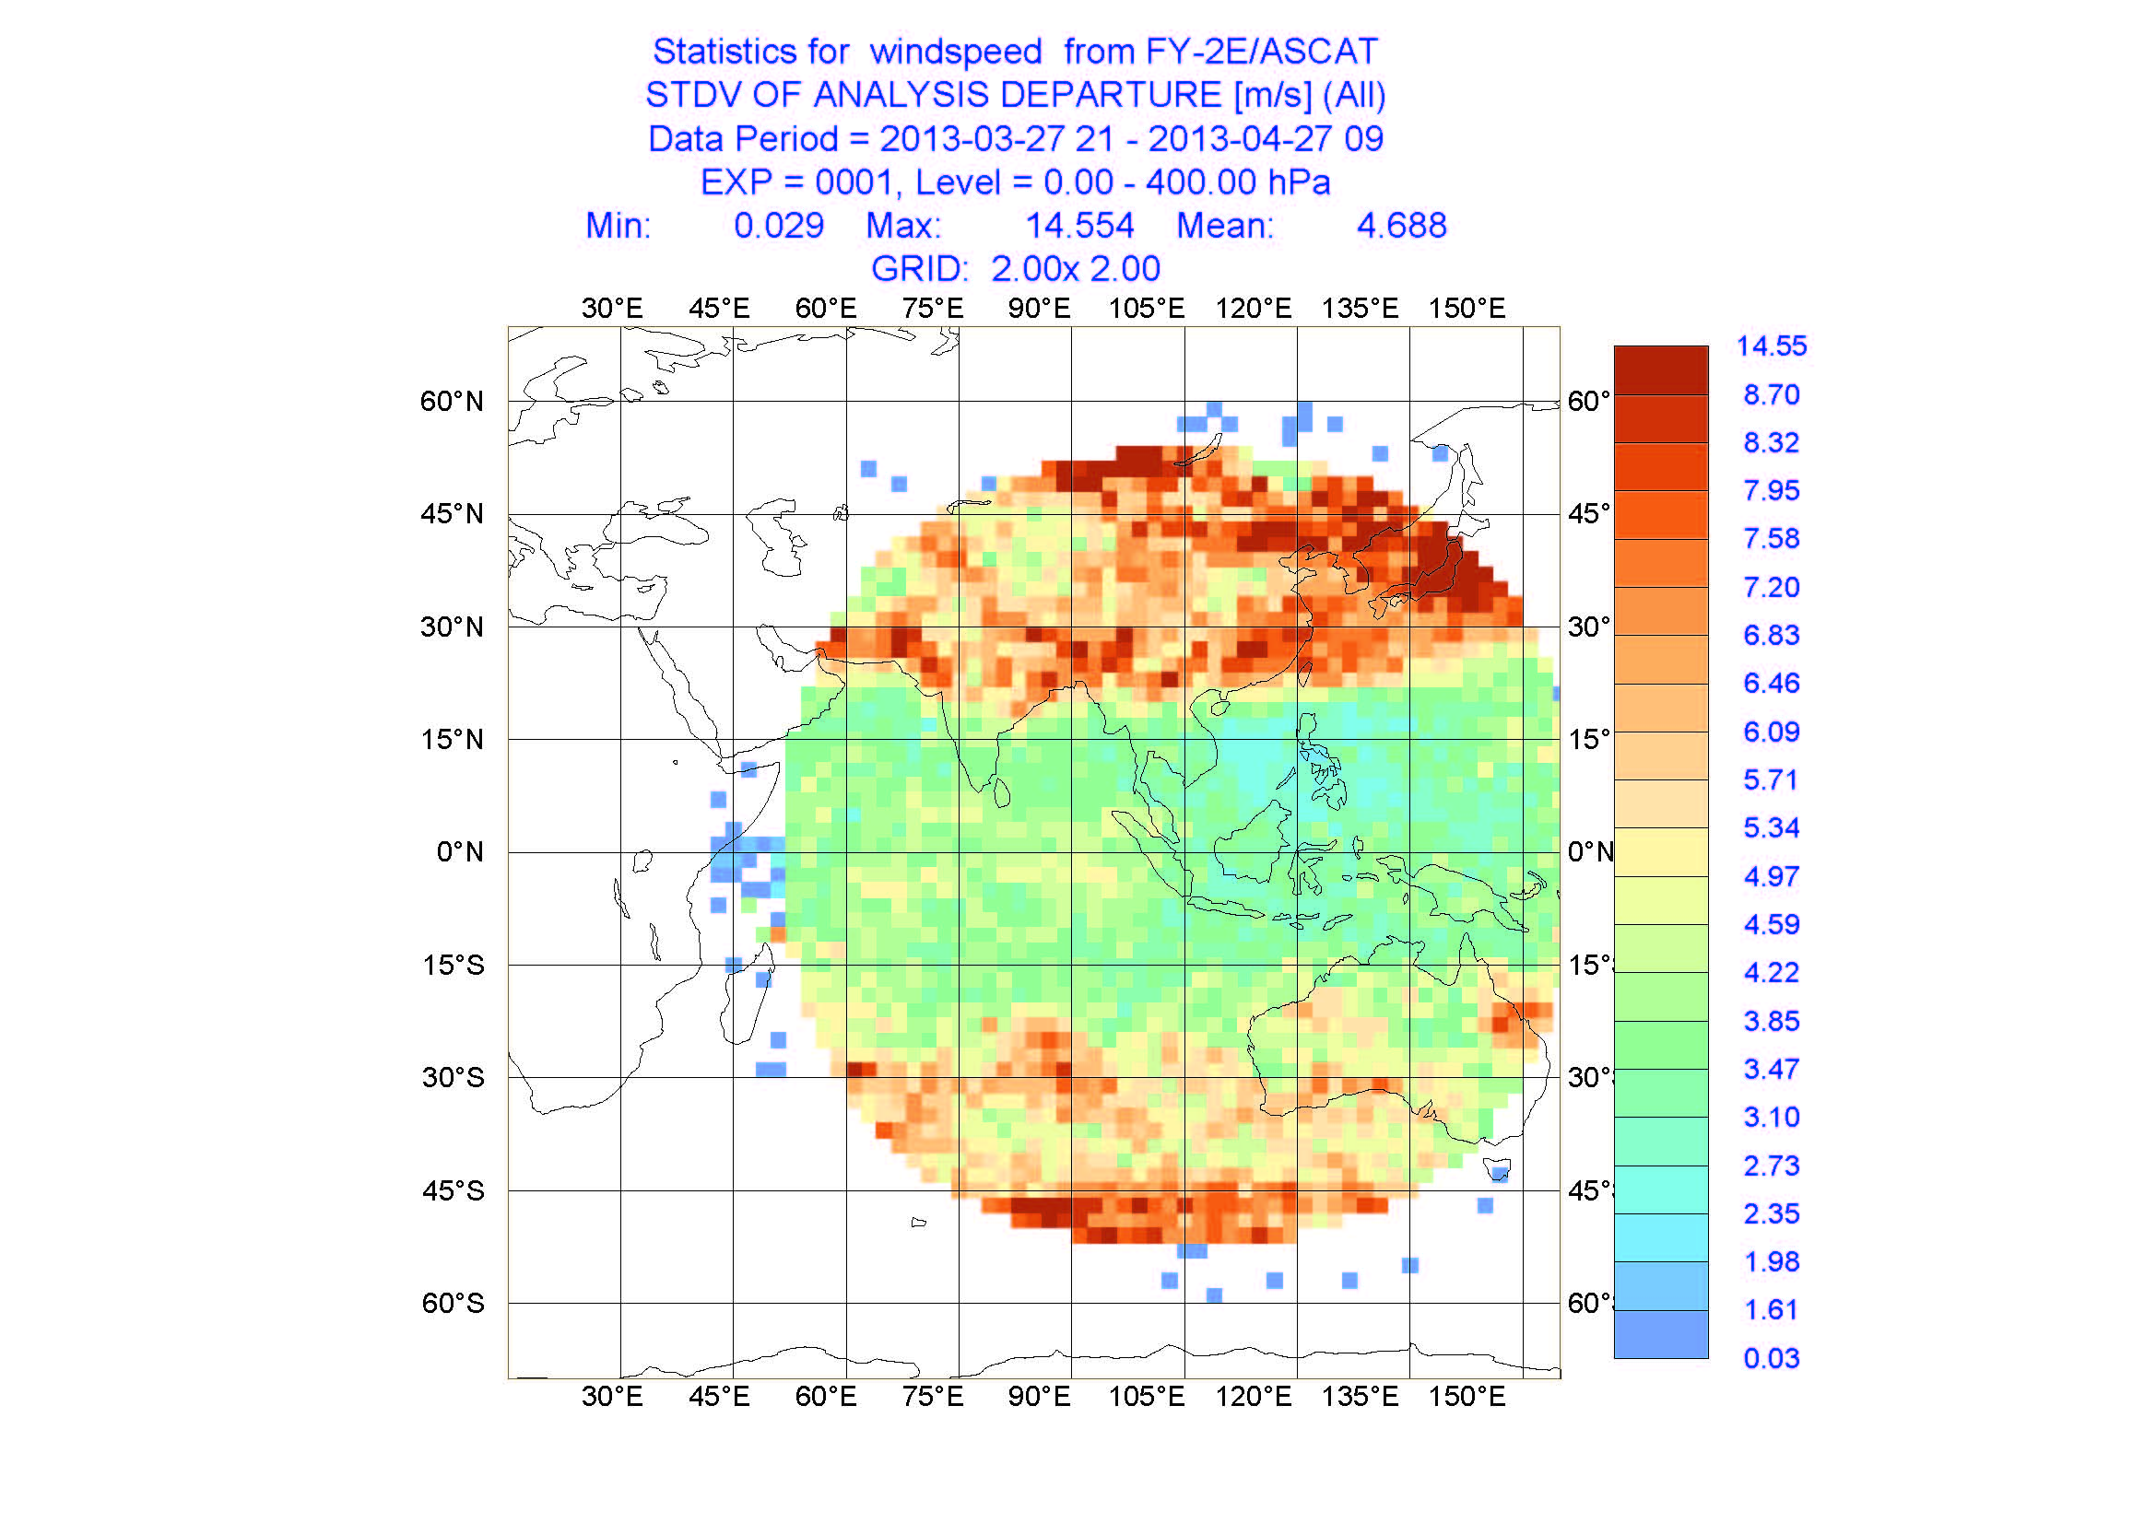
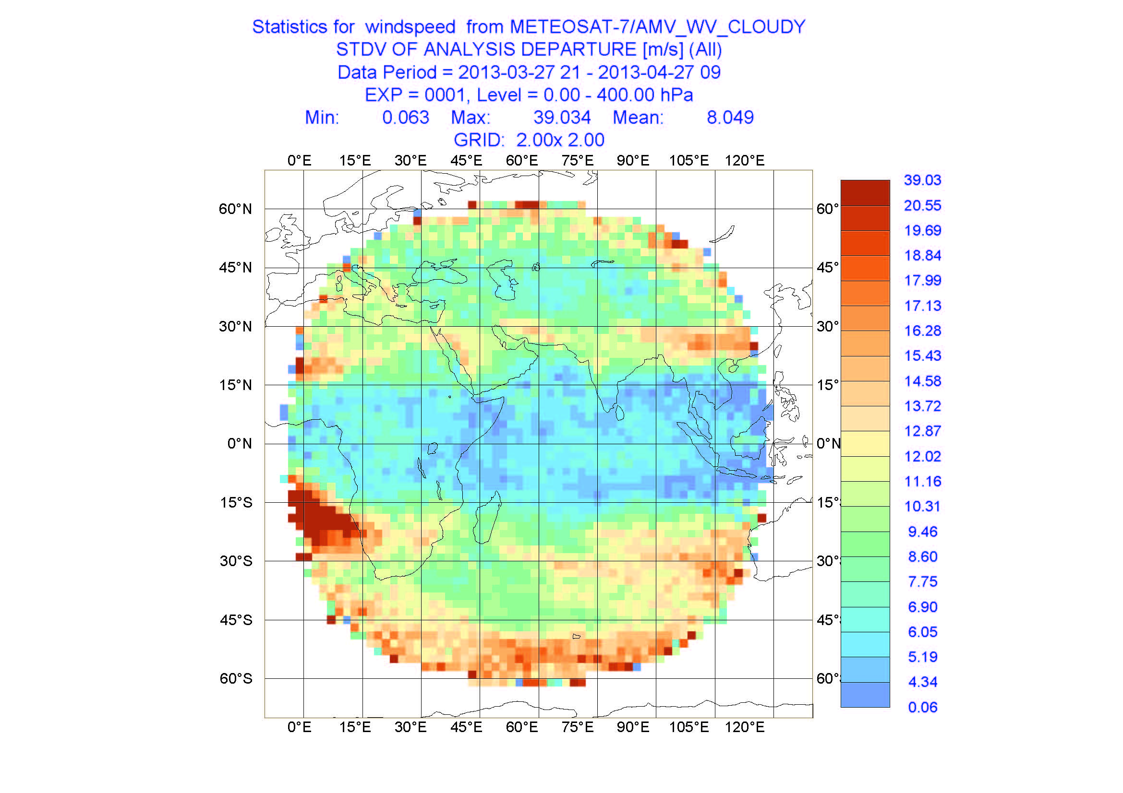
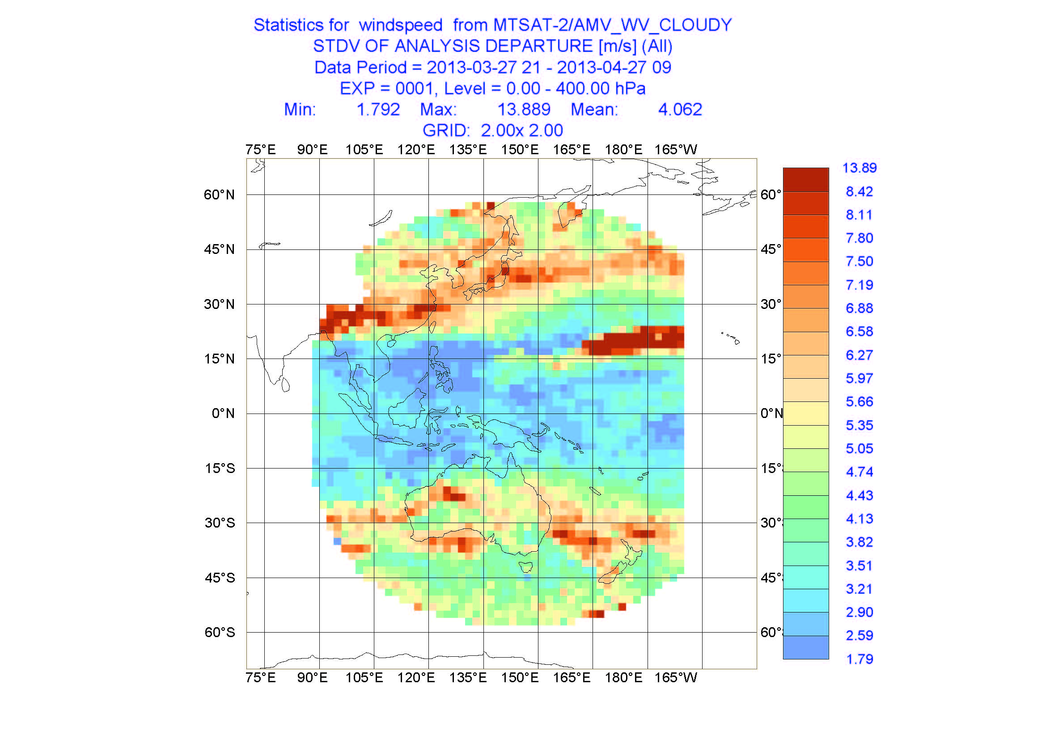
STDV(AMV) analysis for Water-Vapor band between Mar. 27 and Apr. 27 in 2013
FY-2D
7.034m/s
(GSICS)
FY-2E
4.688m/s
(CIBLE)
MET7
8.049m/s
MTS2
4.062m/s
http://www.ecmwf.int/products/forecasts/d/charts/monitoring/satellite/amv/windspeed/

Slide 24
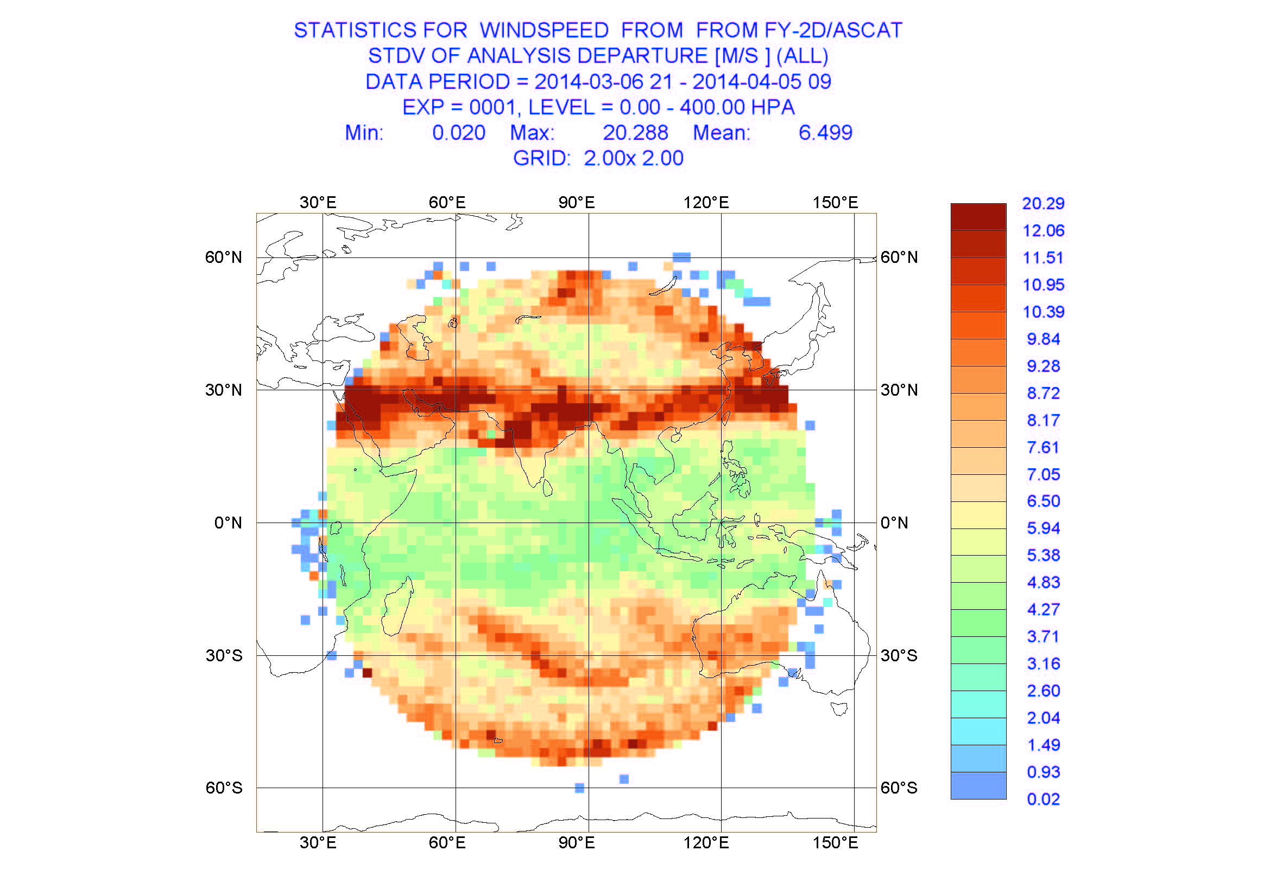
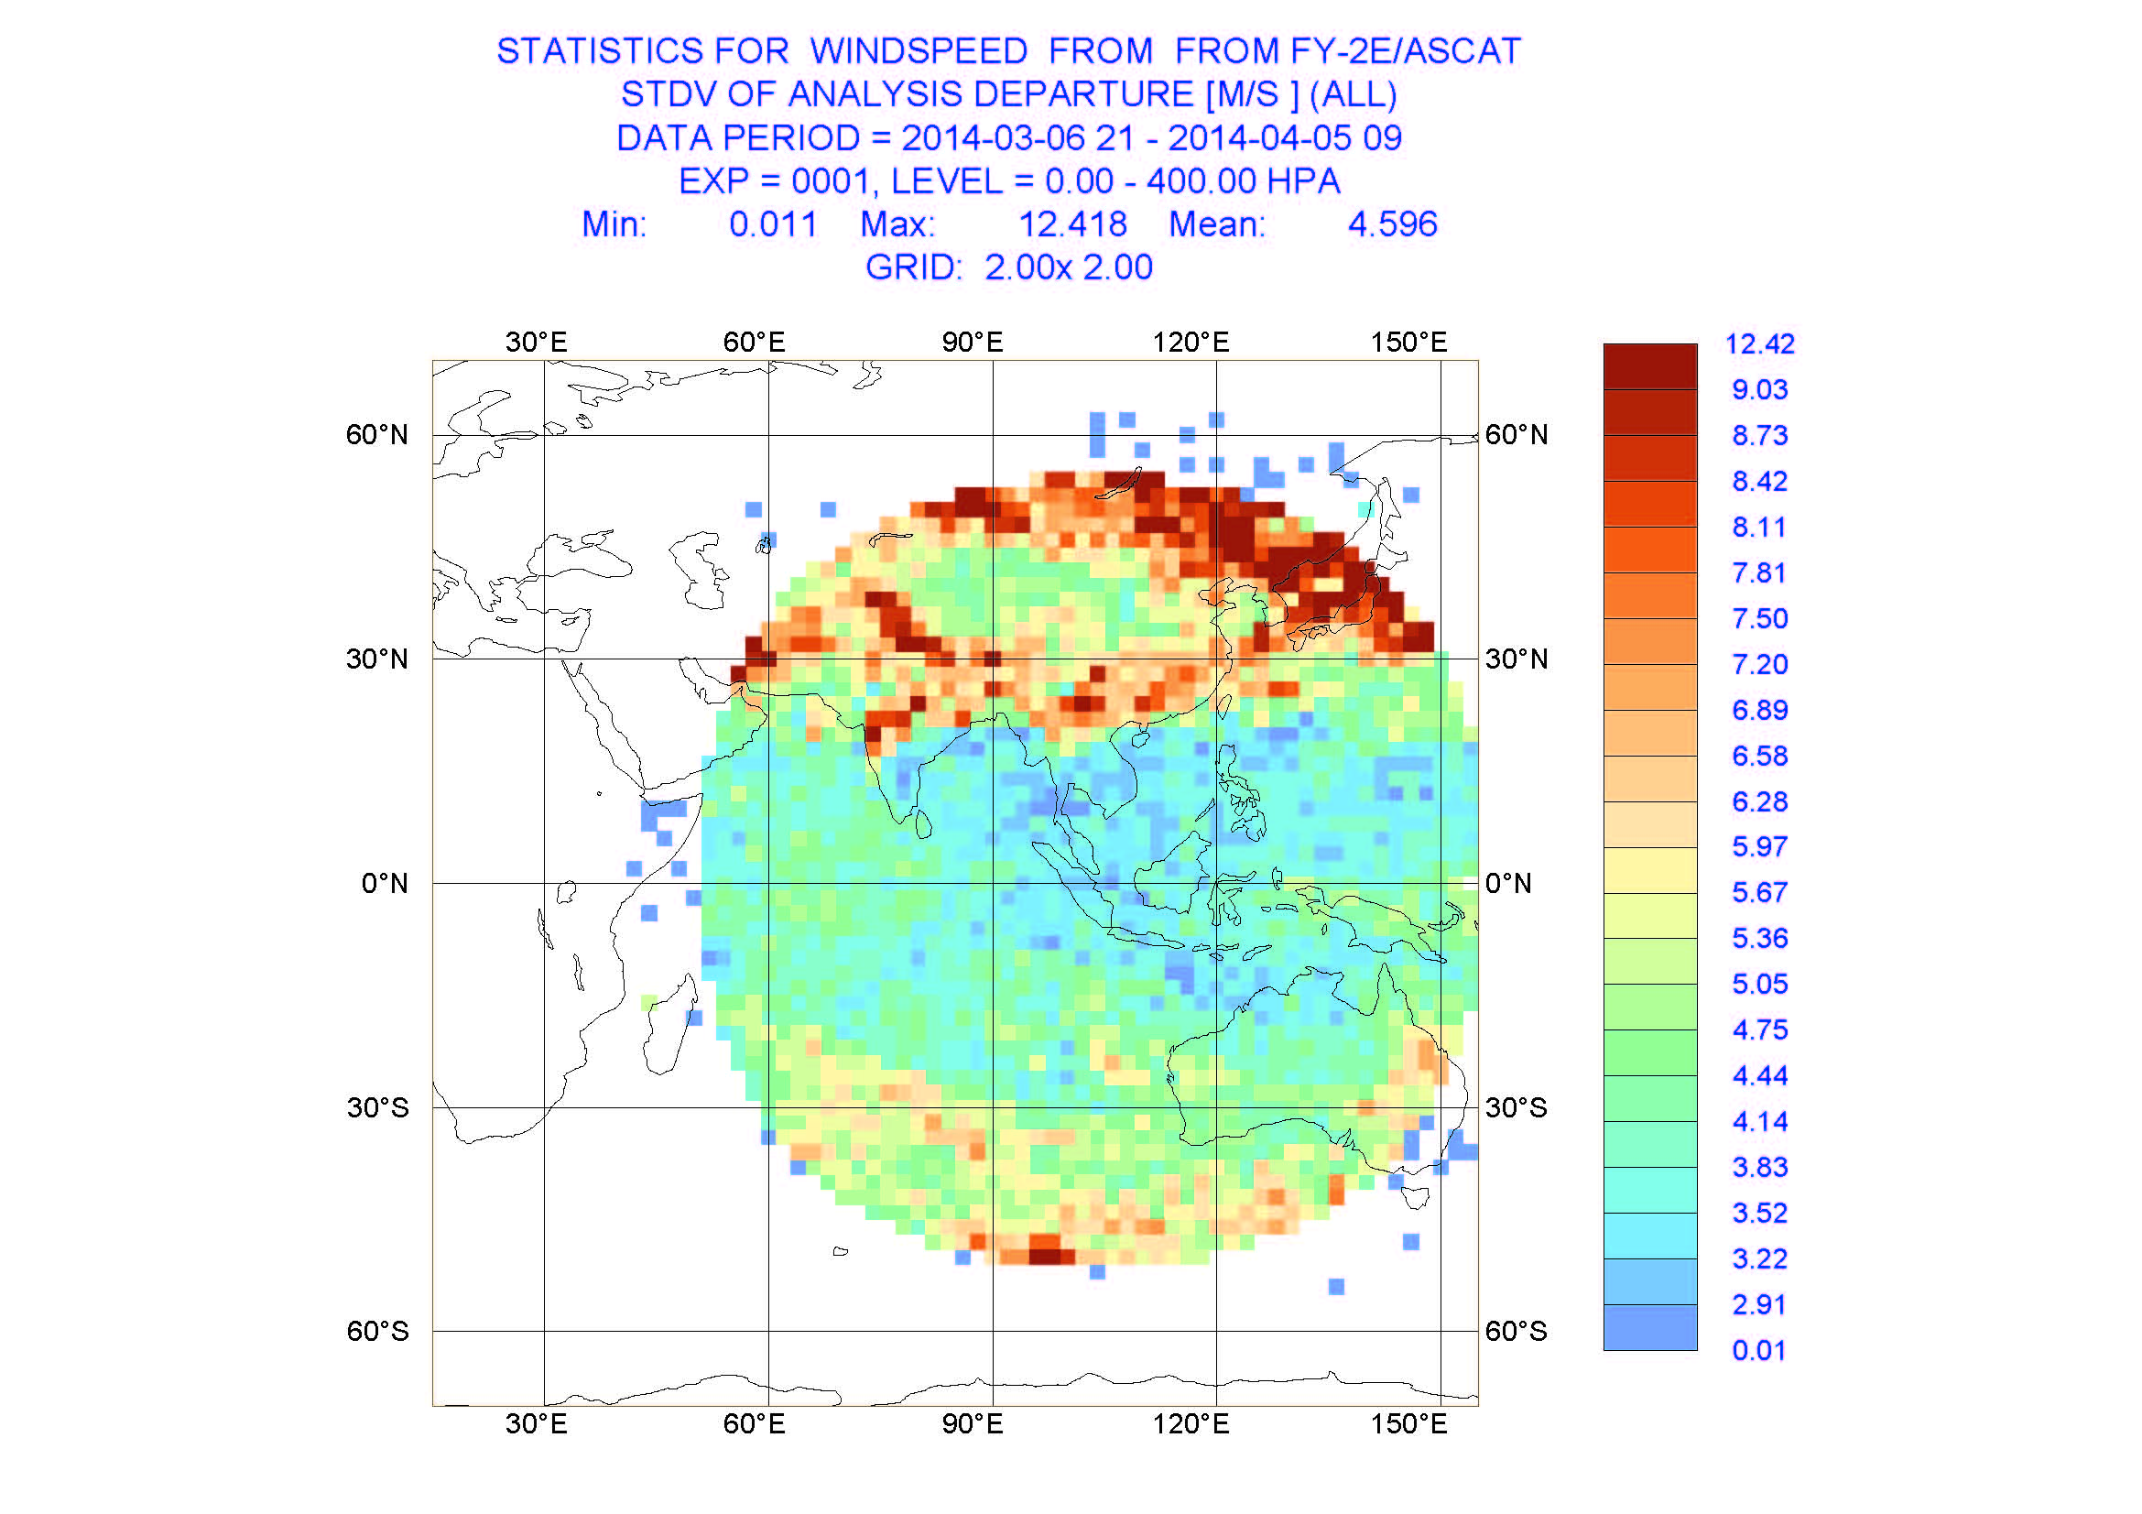
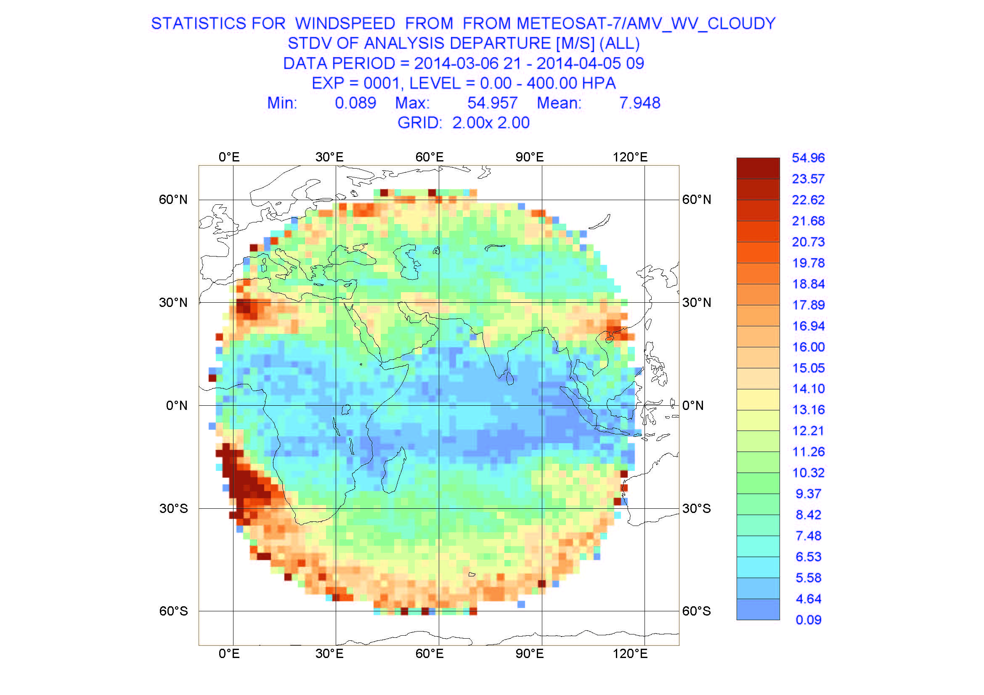
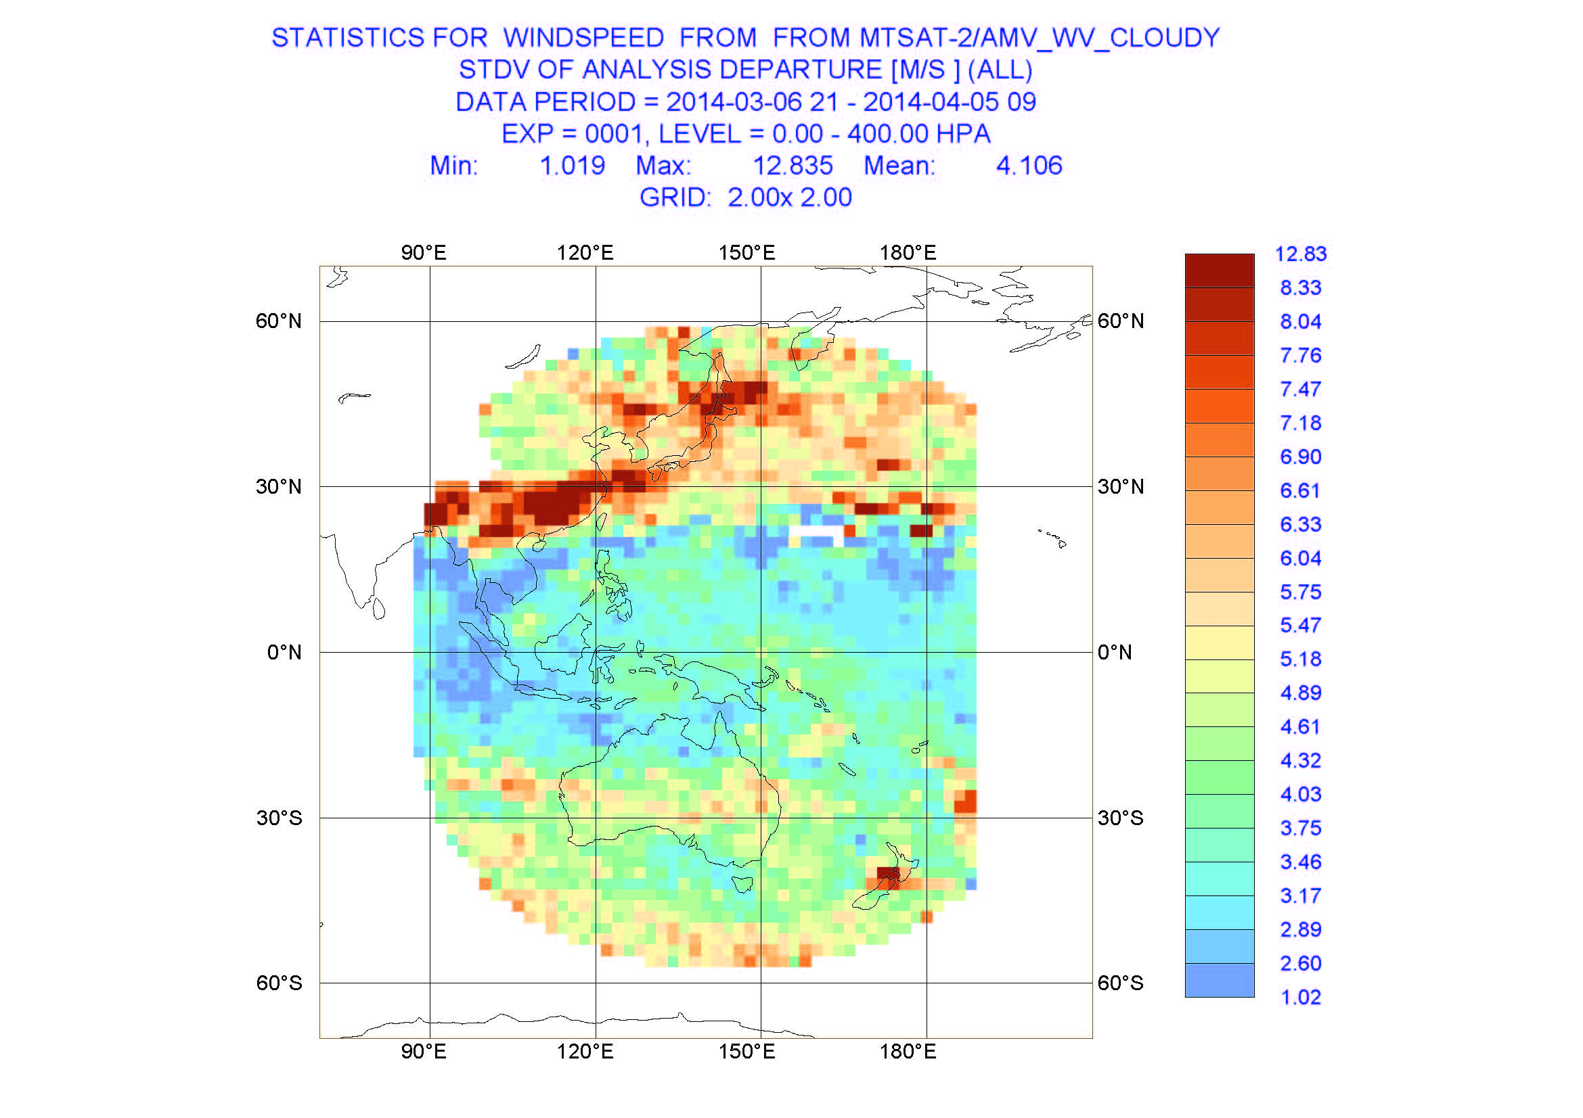
STDV(AMV) analysis for Water-Vapor band between March 6 and April 5 in 2014
FY-2D
6.499m/s
(CIBLE)
FY-2E
4.596m/s
(CIBLE)
MET7
7.048m/s
MTS2
4.106m/s
http://www.ecmwf.int/products/forecasts/d/charts/monitoring/satellite/amv/windspeed/

Slide 25
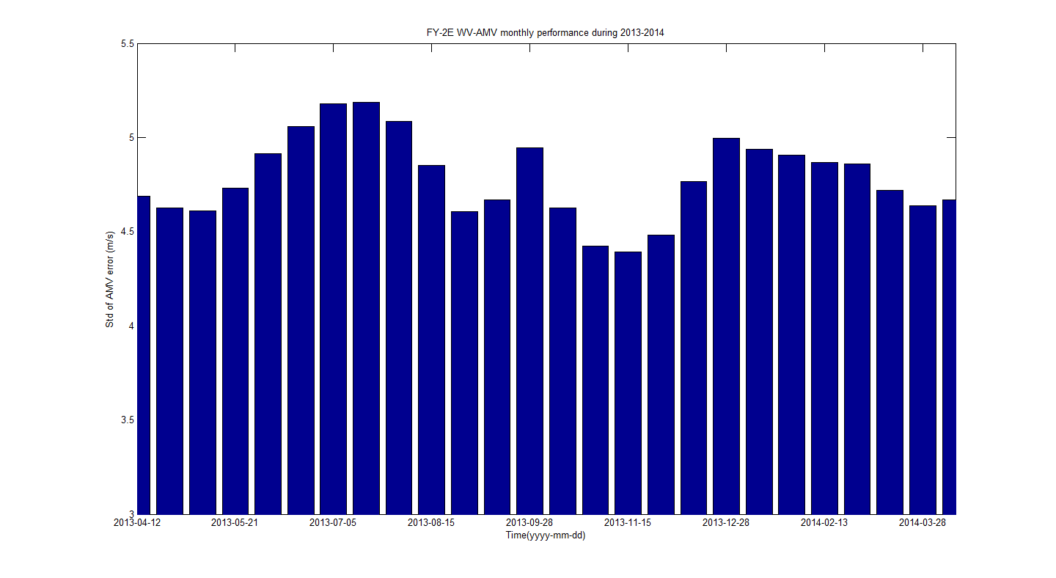
FY-2E Thermal Environment Variation
This delay is
about 10-15 days
FY-2E/WV Calibration-Slope
FY-2E/WV-AMV Monthly Performance During 2013-2014 (between 4.4m/s and 5.2m/s)
http://www.ecmwf.int/products/forecasts/d/charts/monitoring/satellite/amv/windspeed/

Slide 26
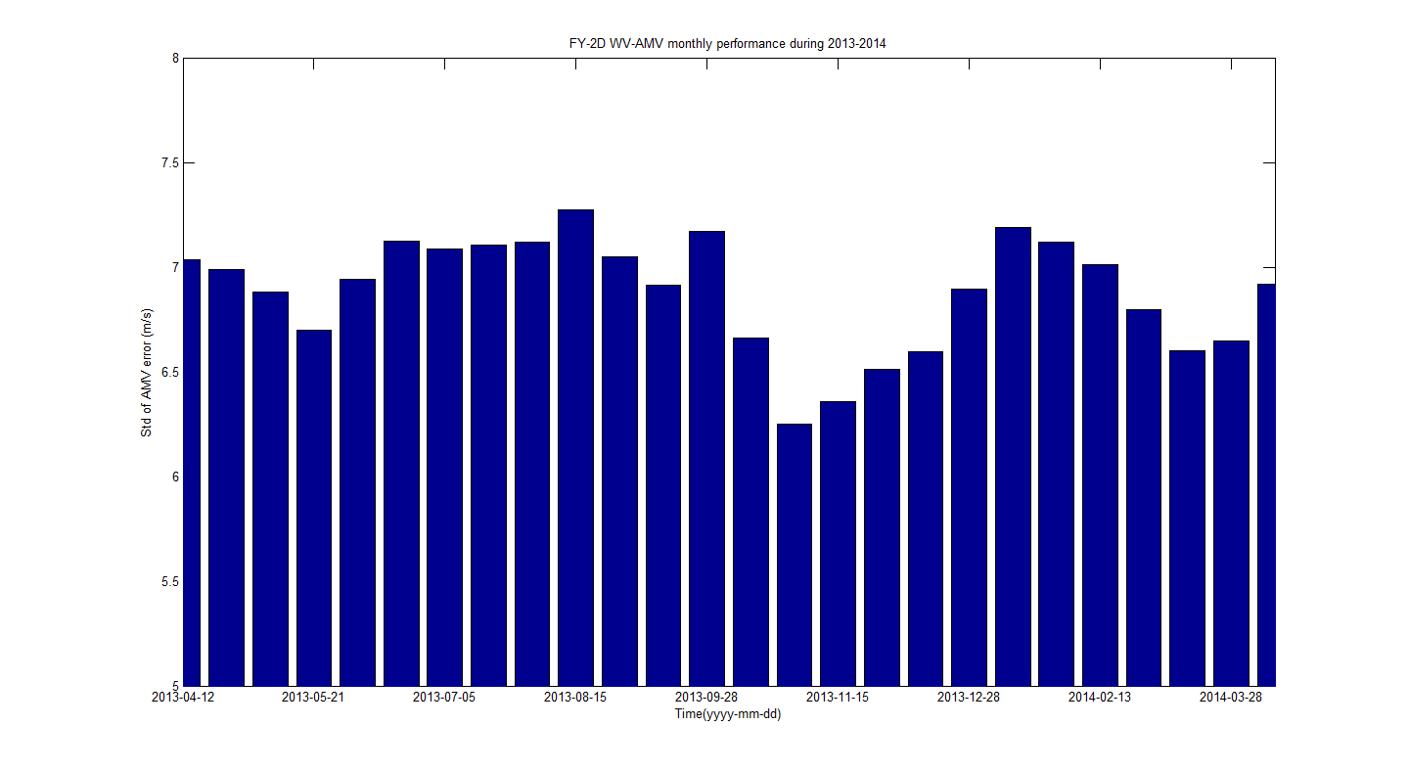
FY-2D Thermal Environment Variation
Cooler: 100K
FY-2D/WV Calibration-Slope
05-27
08-02
FY-2D/WV-AMV Monthly Performance During 2013-2014 (between 6.3m/s and 7.2m/s)
Jun.20 – Jul.20
Jun.30 – Aug.3
Jun.6 – Jul.6
Jul.13 – Aug.17
http://www.ecmwf.int/products/forecasts/d/charts/monitoring/satellite/amv/windspeed/

Slide 27
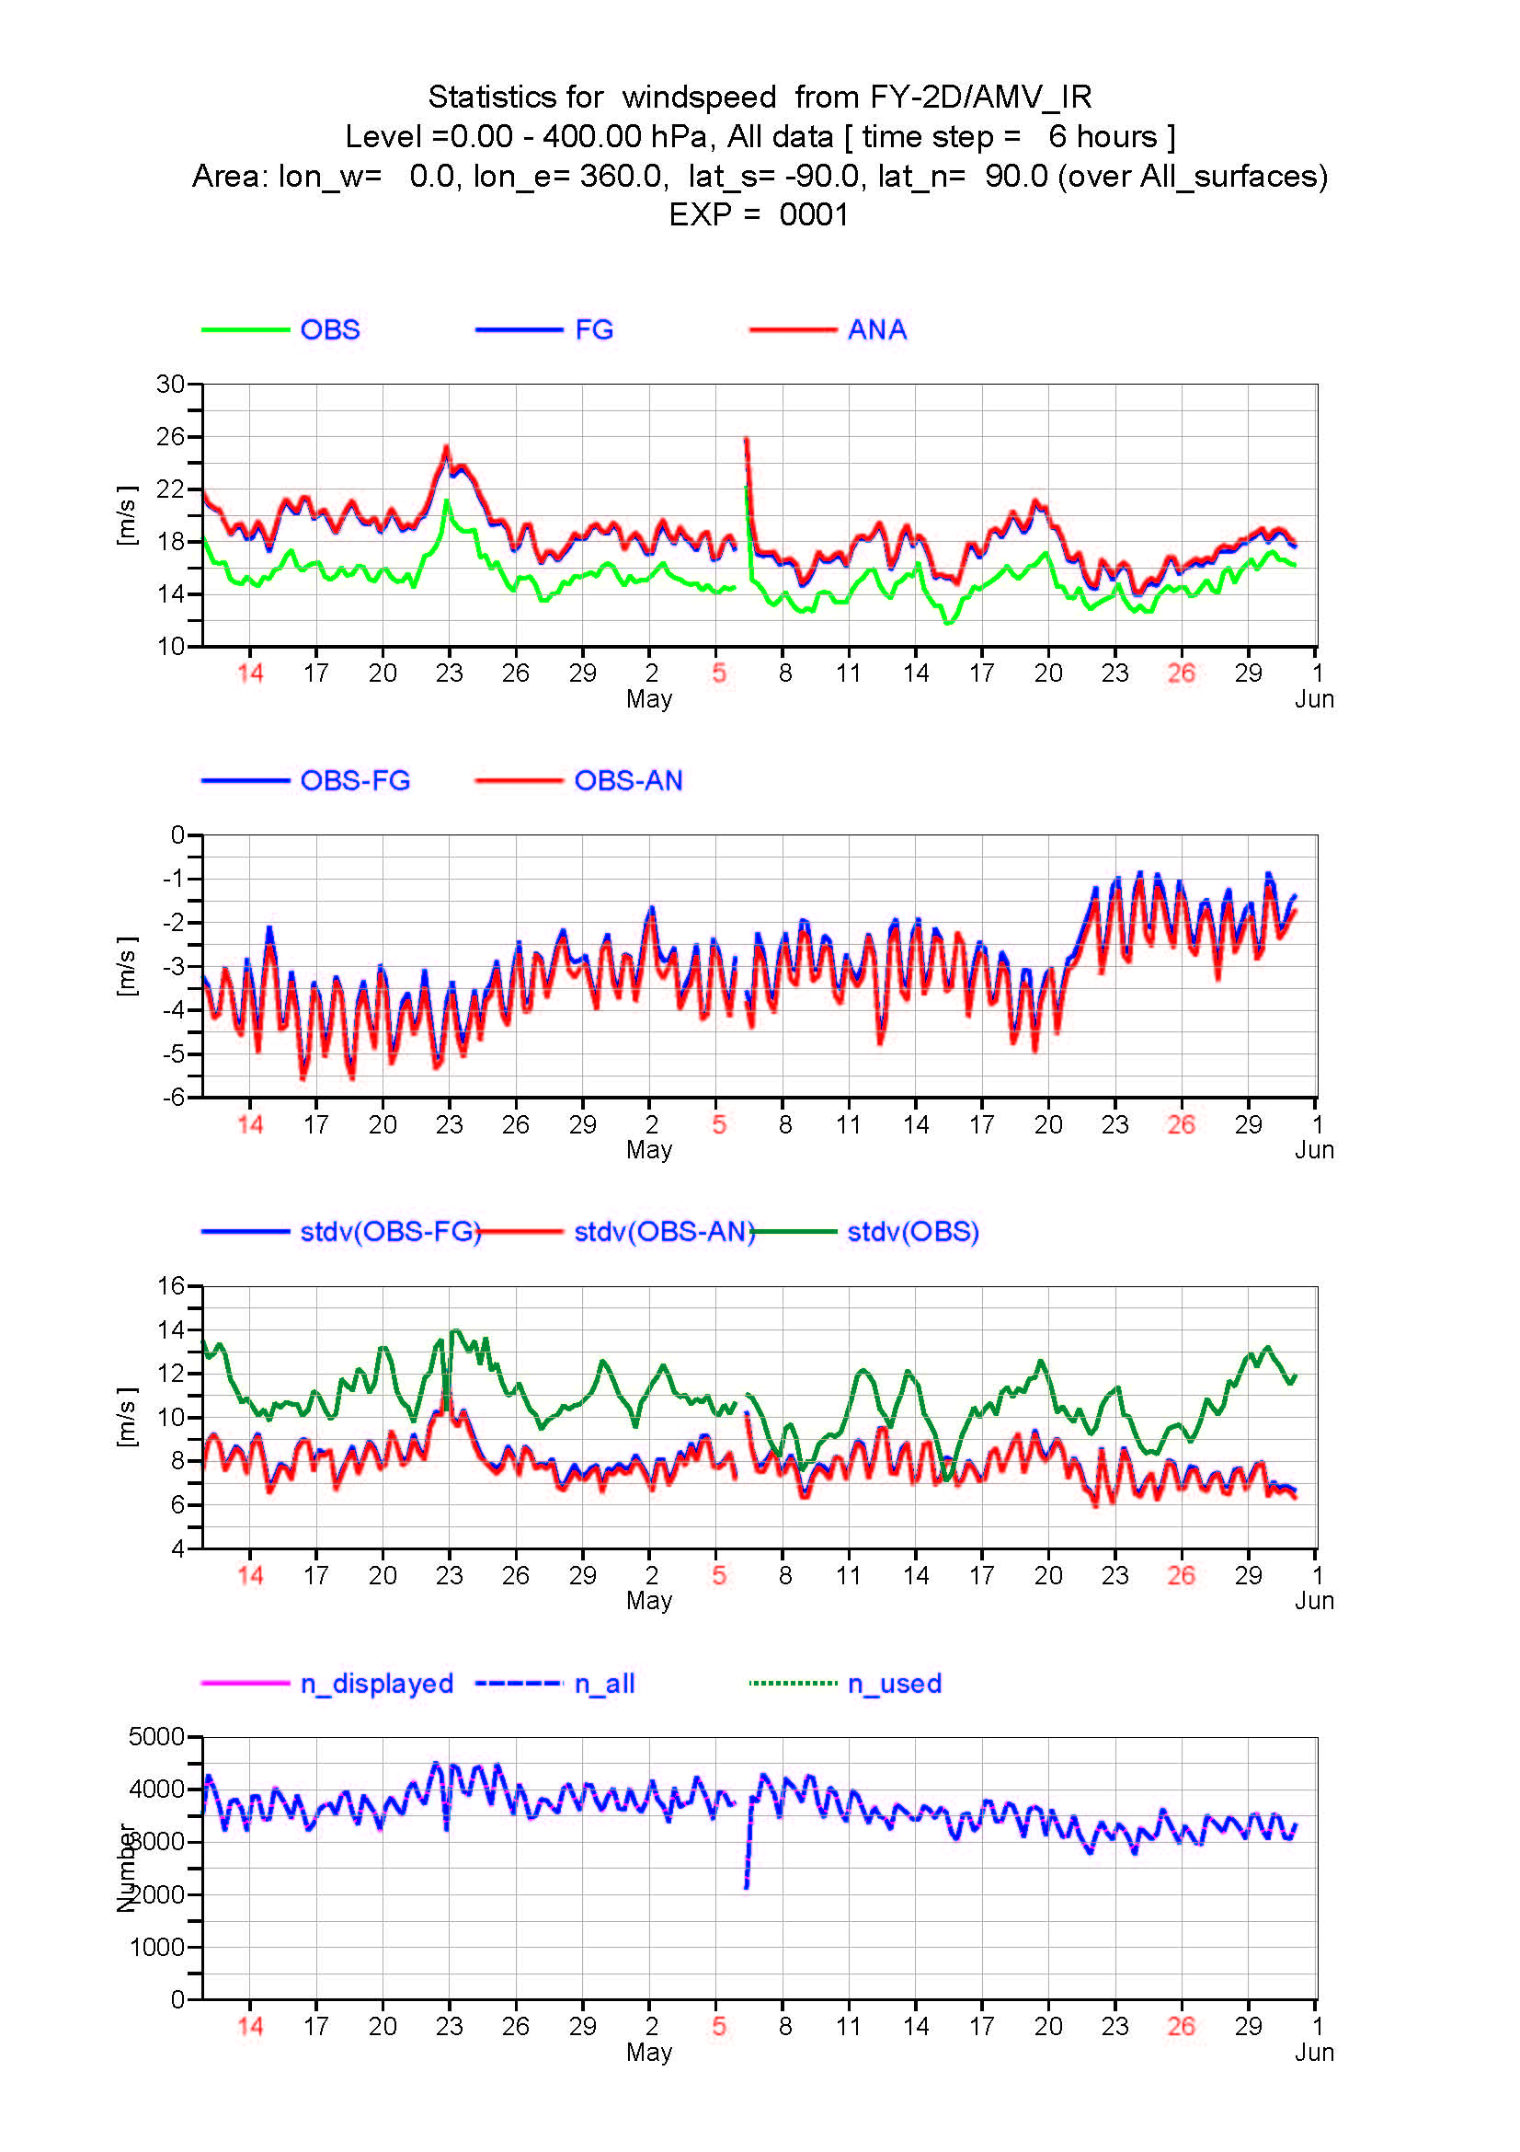
AMV analysis for Infrared band between before vs. after CIBLE switch of FY-2D
May 21,2013
Bias(↓):1.5m/s
RMS(↓):1.0m/s
http://www.ecmwf.int/products/forecasts/d/charts/monitoring/satellite/amv/windspeed/

Slide 28
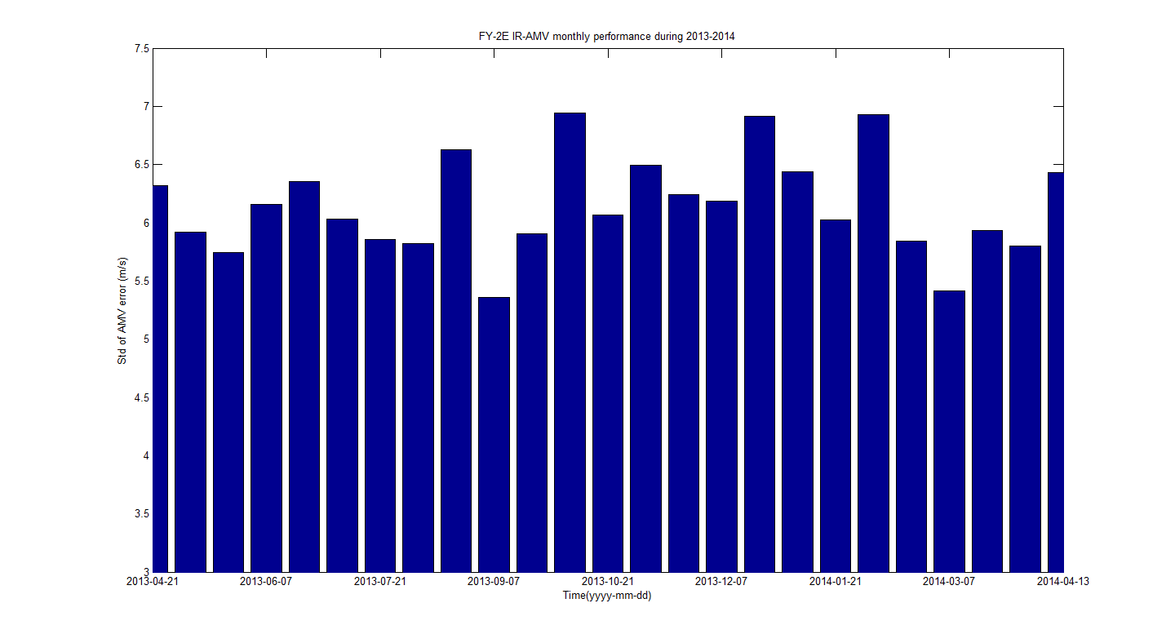
FY-2E Thermal Environment Variation
During the Summer Solstice Period
Cooler > 93.5K
FY-2E/IR Calibration-Slope
FY-2E/IR-AMV Monthly Performance During 2013-2014 (between 5.4m/s and 6.9m/s)
Mixed
Mixed
Distri. Abnor. In Dec.24
Mixed
http://www.ecmwf.int/products/forecasts/d/charts/monitoring/satellite/amv/windspeed/

Slide 29
Conclusion

Slide 30
The CIBLE method has been independently developed by using both lunar calibration (LC) and inner-blackbody calibration (IBBC) for TEBs, which is widely considered to be a prominent progress in terms of operational calibration for FY-2 satellite .
The CIBLE software has been operational working in ground segments of FY-2F, FY-2E and FY-2D satellites since July 21, 2012, March 27 and May 21, 2013 respectively, whose calibration accuracies are evaluated to be superior to 1K@300K. At the same time, the difficulty of calibration with high accuracy for the radiometric response, which varies rapidly with VISSR’s thermal environment, has been conquered successfully.
By using the latest CIBLE outcomes, the performances of AMV has also been greatly improved. Particularly, it is validated by ECMWF that the RMSE of WV-AMV for FY-2E satellite remains 4-5 m/s and the bias of IR-AMV for FY-2D satellite has been decreased by about 1.5 m/s after using CIBLE approaches.

Slide 31
Thanks for your attention!

