Slide 1
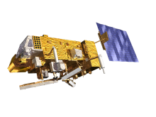
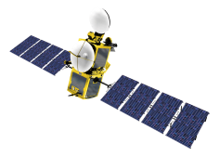
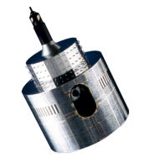
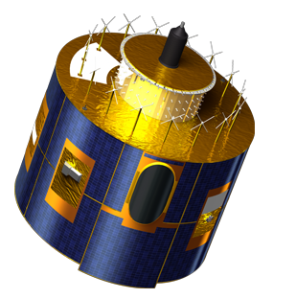
EUMETSAT operational dual-Metop wind products
O. Hautecoeur
R. Borde
M. Doutriaux-Boucher
M. Carranza

Slide 2
Content
New AMVs processor version (v2.4)
New dual-Metop global winds product
Dual vs Single Metop winds product over Polar Regions

Slide 3
EUMETSAT AVHRR/Metop winds New processor version 2.4
Changes since v2.0:
NWP temperature profile review :
Tropopause determination → upper limit for height determination
Temperature inversion identification → consider the inversion if necessary
Wind vector computed from centres of reference and matched target windows (parallax correction applied)
Search window size depends on the time difference, and roughly on the error expected on the speed
IASI data use is restricted
Bugs fixed

Slide 4
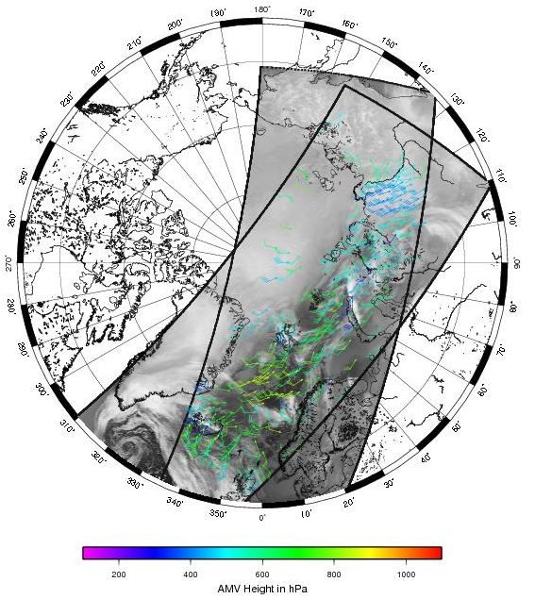
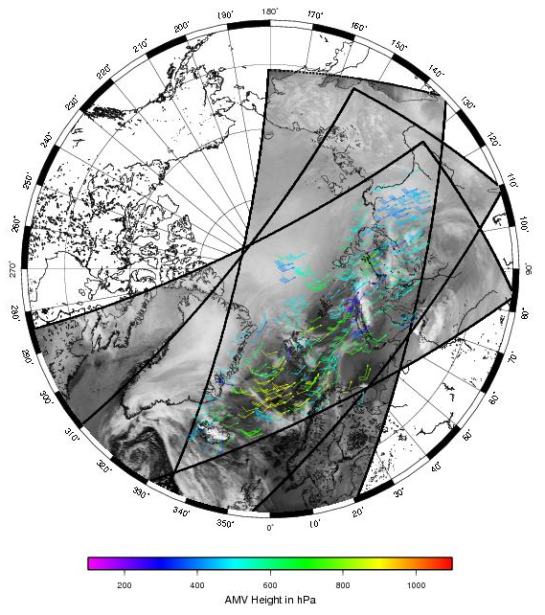
EUMETSAT AVHRR/Metop winds Operational since 2010
2 images
used at
EUMETSAT
~100 min
3 images
used at
CIMSS
~200 min
Problems of view angles, parallax and varying pixels sizes
Small areas to track features
No cloudy product to set altitude (AVHRR), basic cloud mask
Polar region specificities like ground colder to air above

Slide 5
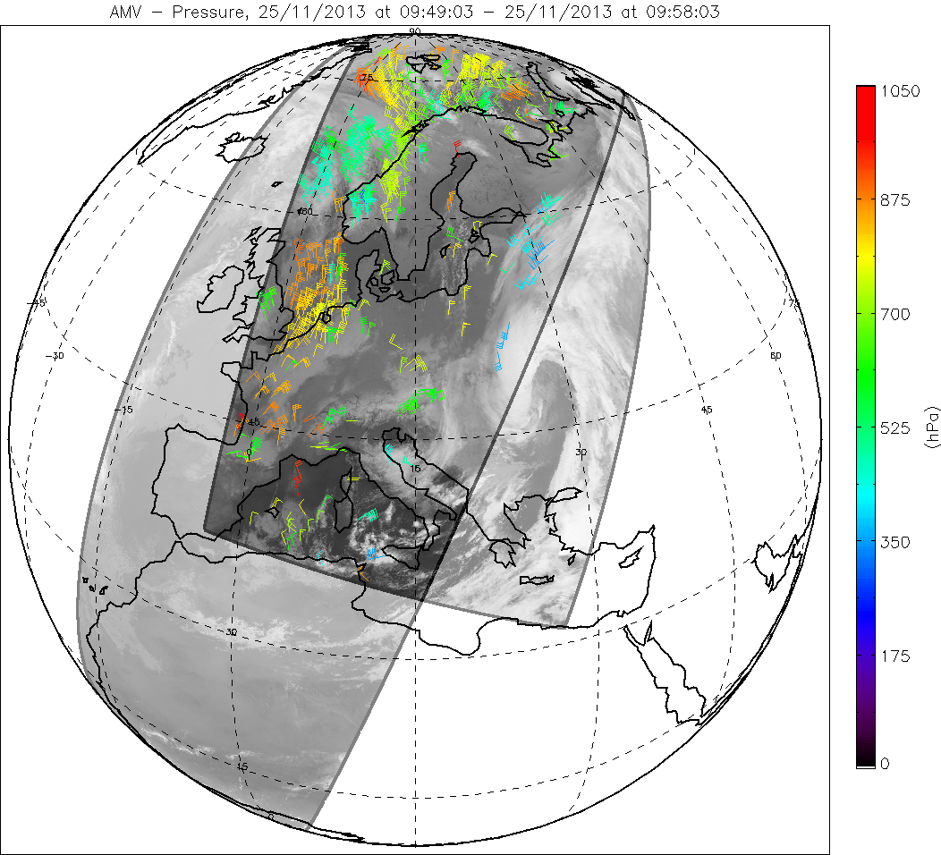
EUMETSAT dual Metop winds The tandem Metop configuration
The tandem configuration with two satellites on the same orbital plane provides an interesting opportunity to create global AMVs from satellites with a significant overlap in imagery data
The same algorithm is used for dual Metop winds and for single Metop winds extraction.
It uses image pairs from the two different Metop satellites.
2 complementary products:
Metop-A / Metop-B, ~46 min temporal gap
Metop-B / Metop-A, ~55 min temporal gap

Slide 6
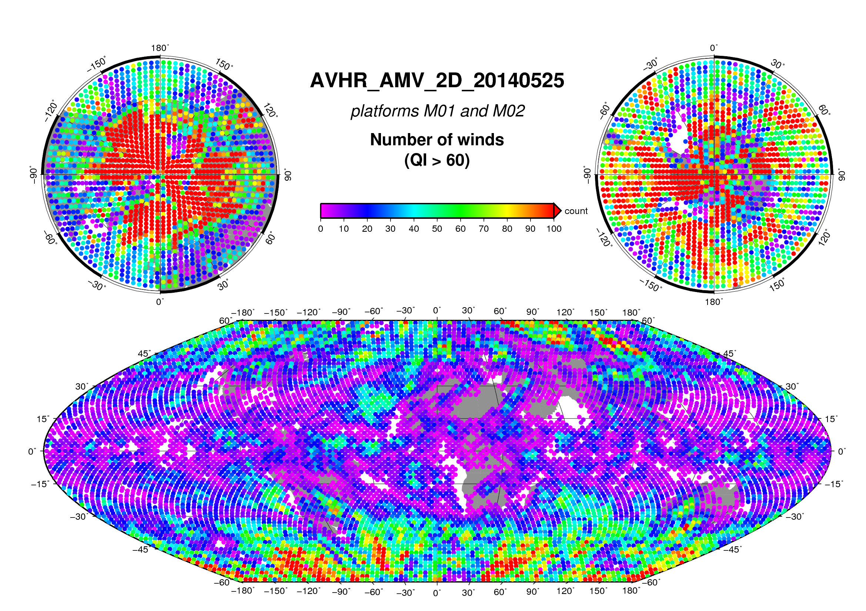
EUMETSAT dual Metop winds Global coverage
Accumulated number of dual Metop winds, Equal Area spots (~3 square degrees)
M01/M02 and M02/M01 products

Slide 7
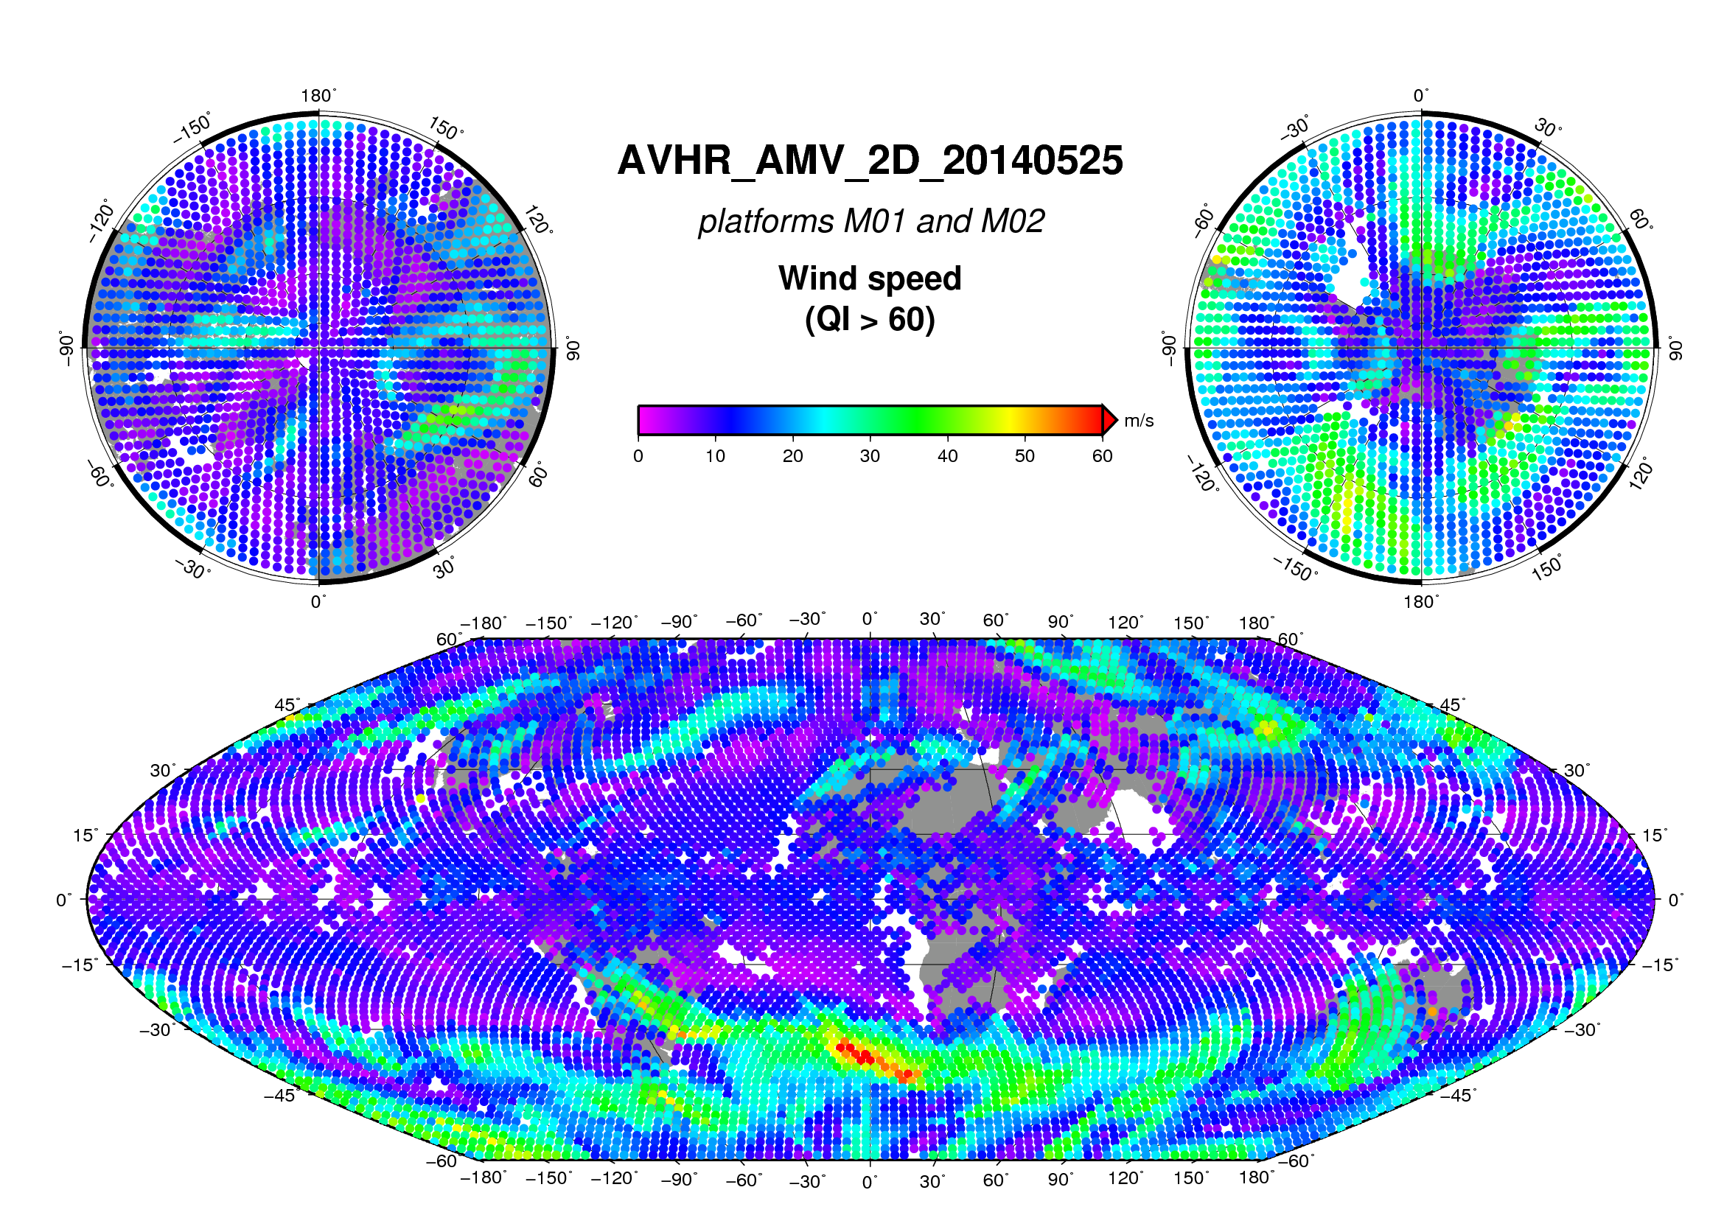
EUMETSAT dual Metop winds Global and homogeneous product
Averaged speed of dual Metop winds, Equal Area spots (~3 square degrees)
M01/M02 and M02/M01 products

Slide 8
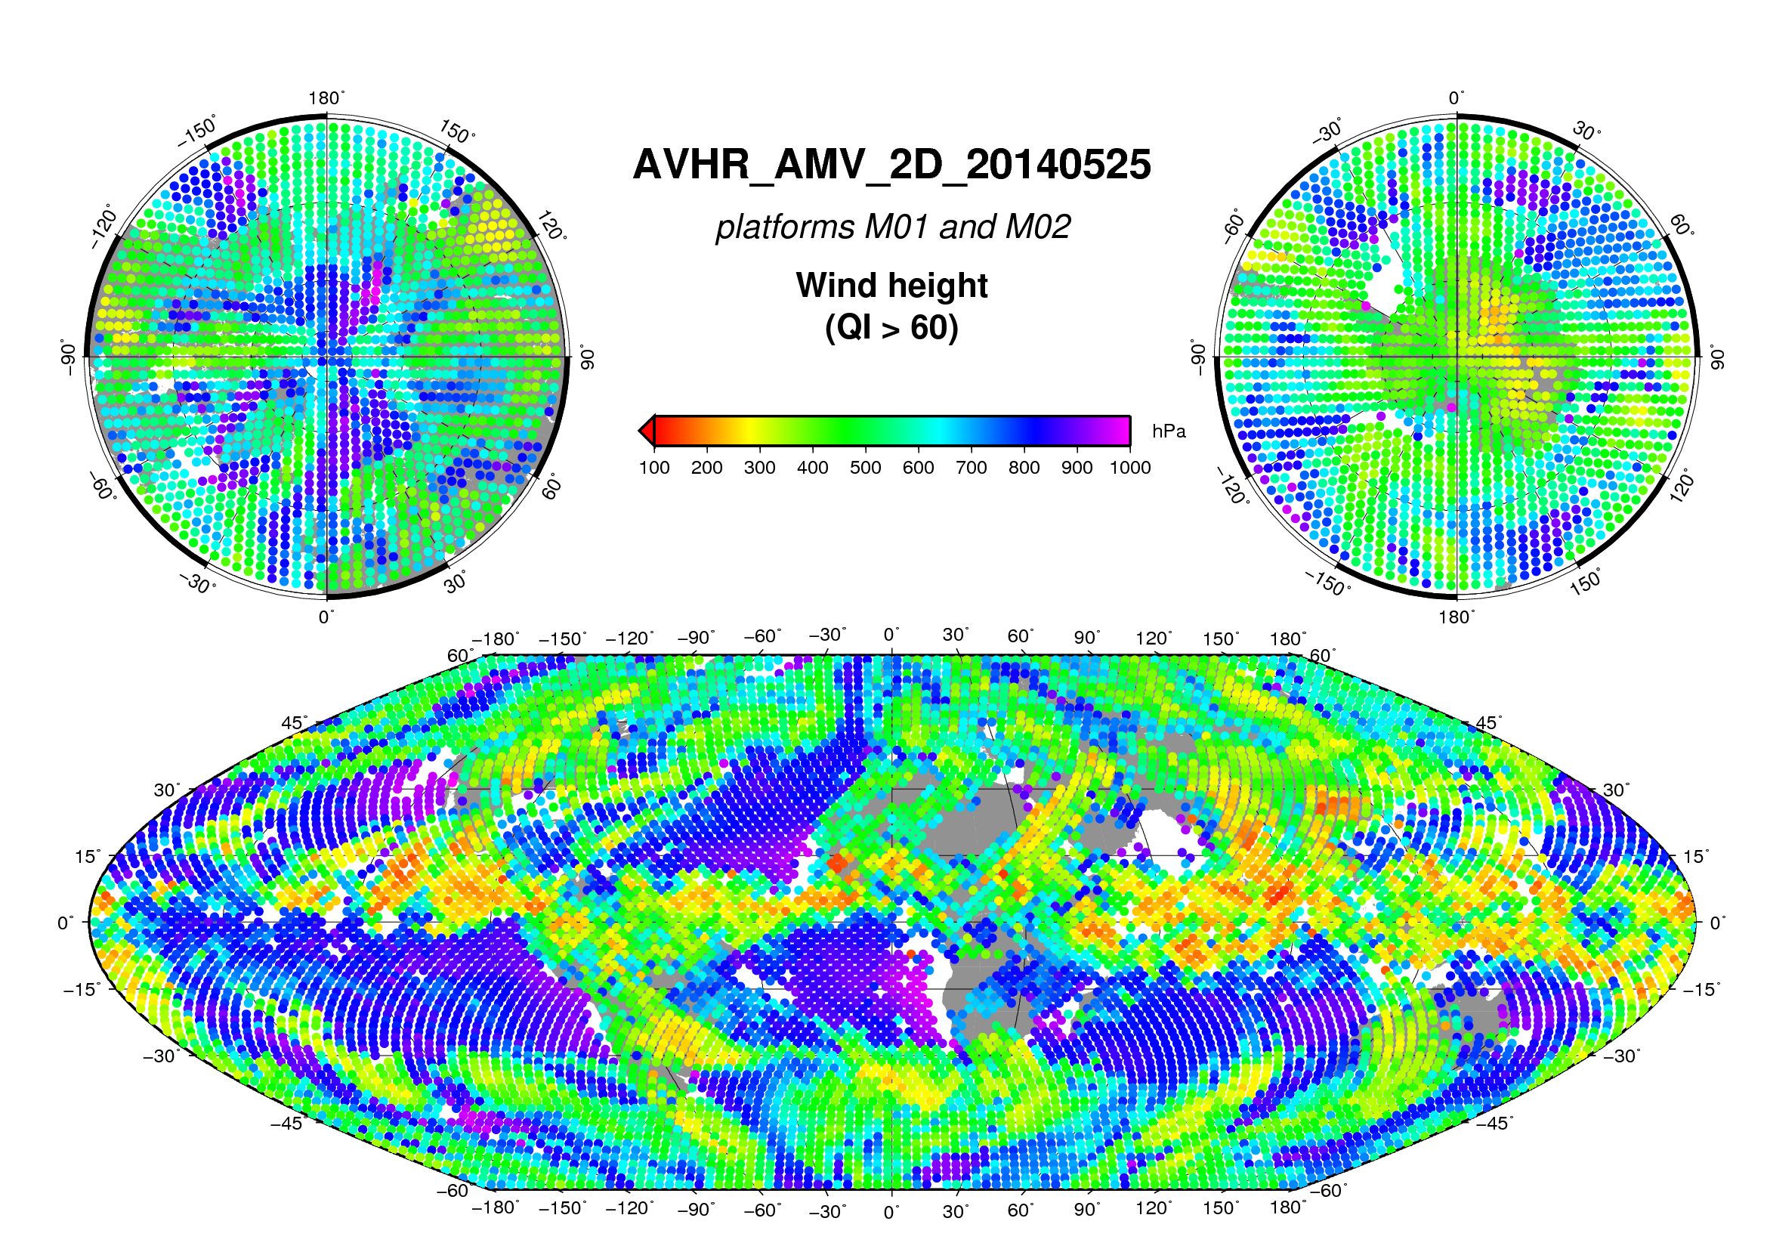
EUMETSAT dual Metop winds Global and homogeneous product
Averaged pressure of dual Metop winds, Equal Area spots (~3 square degrees)
M01/M02 and M02/M01 products

Slide 9
EUMETSAT dual Metop winds Comparison versus forecast (December 2013, Processor v2.3)
QI > 80, including forecast check
Dual Metop Winds against FC | Amount | Speed (m/s) |  | Direction (deg) |  | Vector difference RMS (m/s) | Mean fc wind speed (m/s) | NRMS | NRMS (without fc)
 |  | Bias | RMS | Bias | RMS
All levels | 801 037 | 0.05 | 4.47 | -11.11 | 40.20 | 5.90 | 16.54 | 0.36 | 0.60
High levels | 301688 | -0.17 | 5.11 | -5.68 | 22.31 | 7.09 | 27.04 | 0.26 | 0.39
Mid levels | 408 439 | 0.45 | 4.95 | -14.29 | 44.80 | 6.45 | 16.99 | 0.38 | 0.65
Low levels | 90910 | 0.03 | 2.93 | -12.94 | 35.23 | 3.88 | 10.18 | 0.38 | 0.76
General statistics look quite good but lots of disparities exist as function of the geographical areas. Large fast bias is especially found in tropics, probably due to a very poor height assignment.
Statistics should be better with the last PPF v2.4

Slide 10
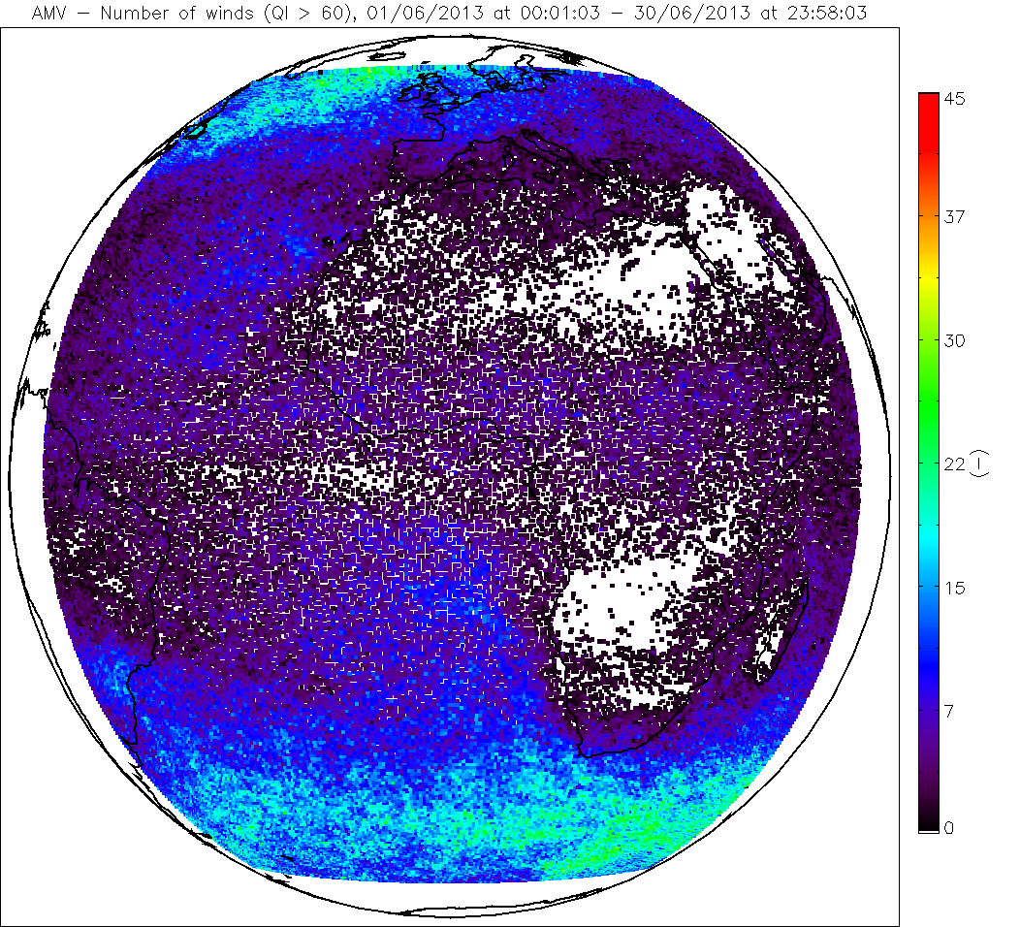
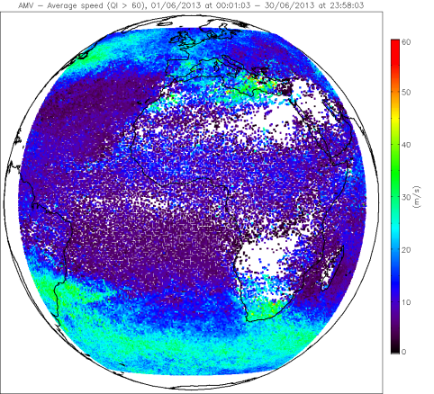
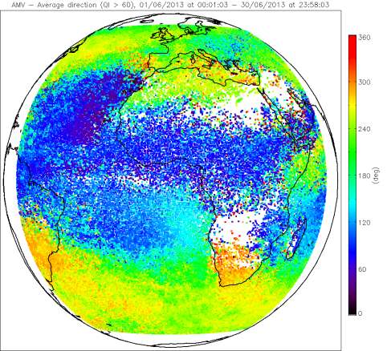
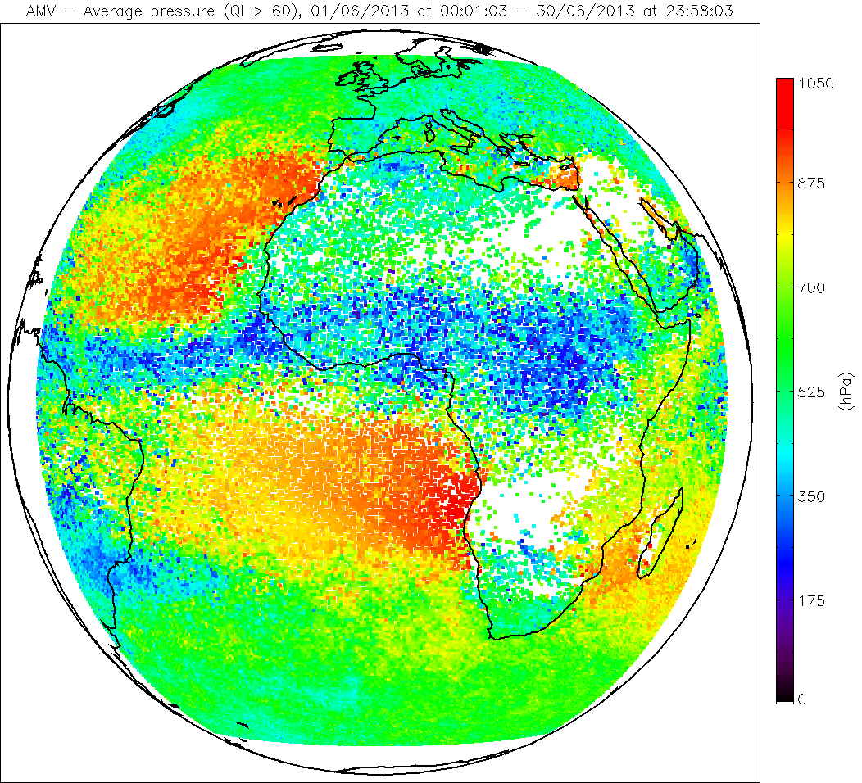
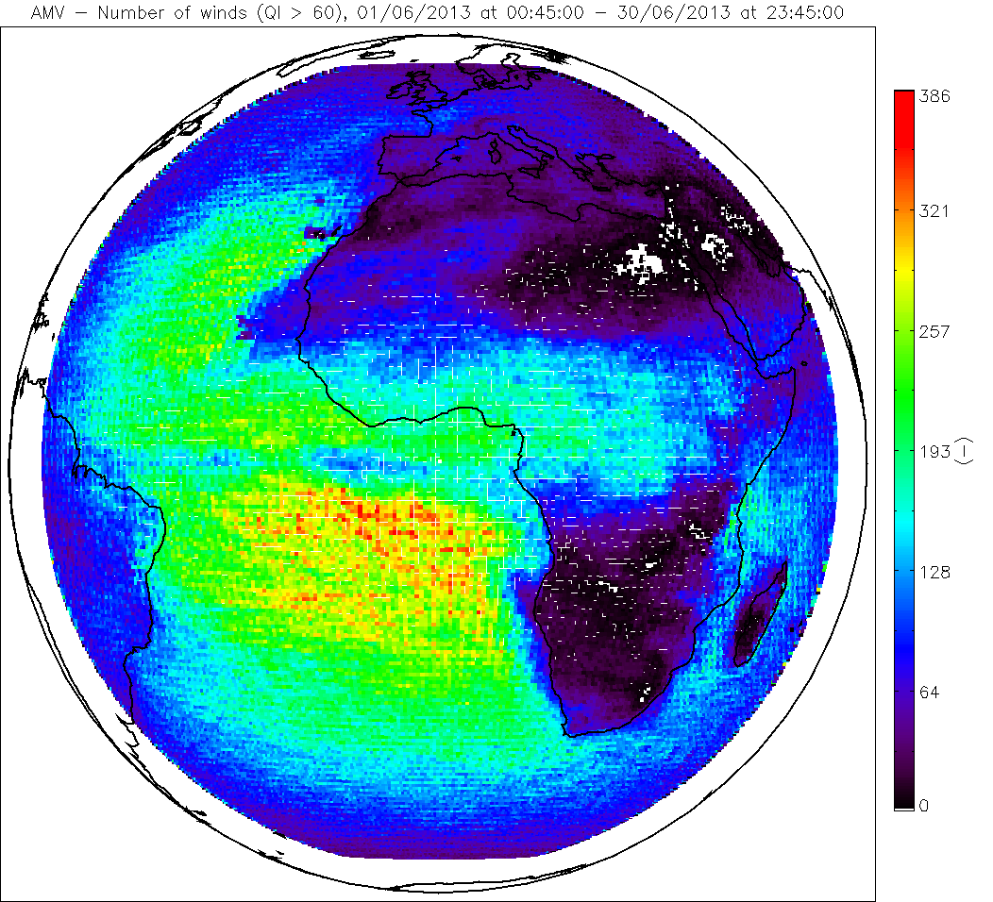
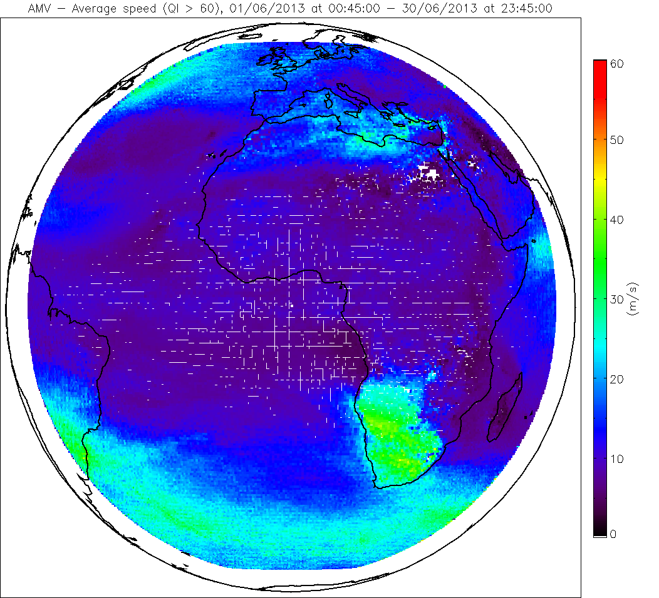
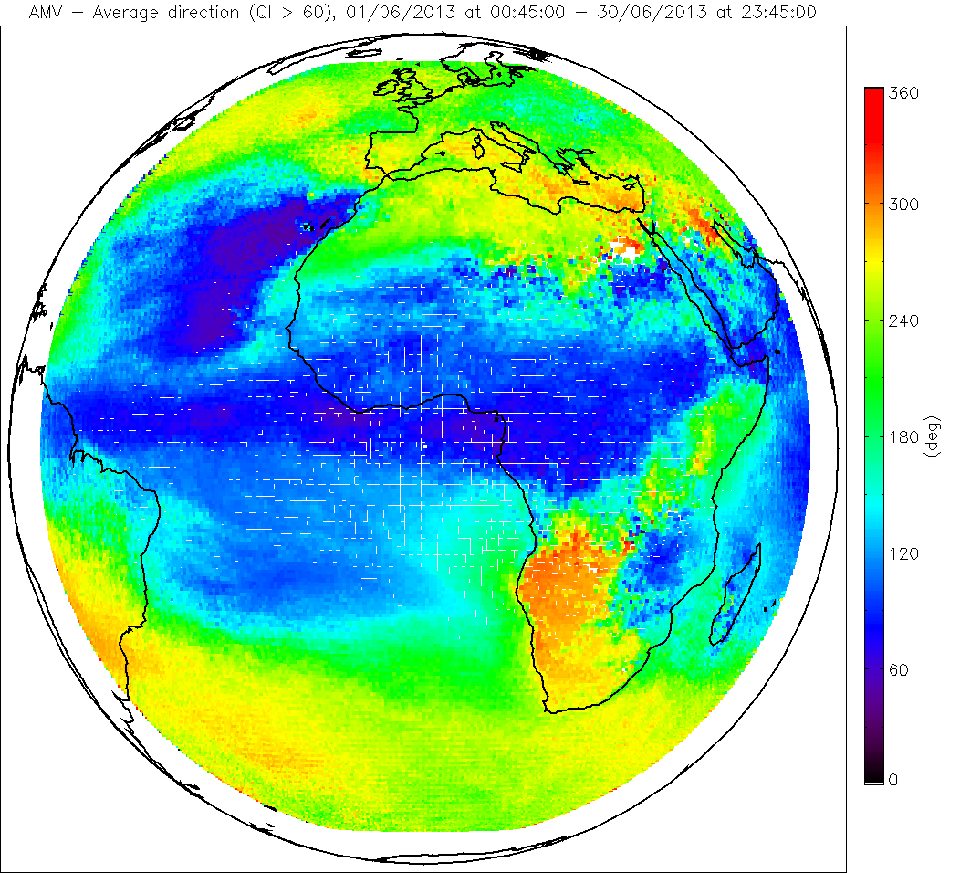
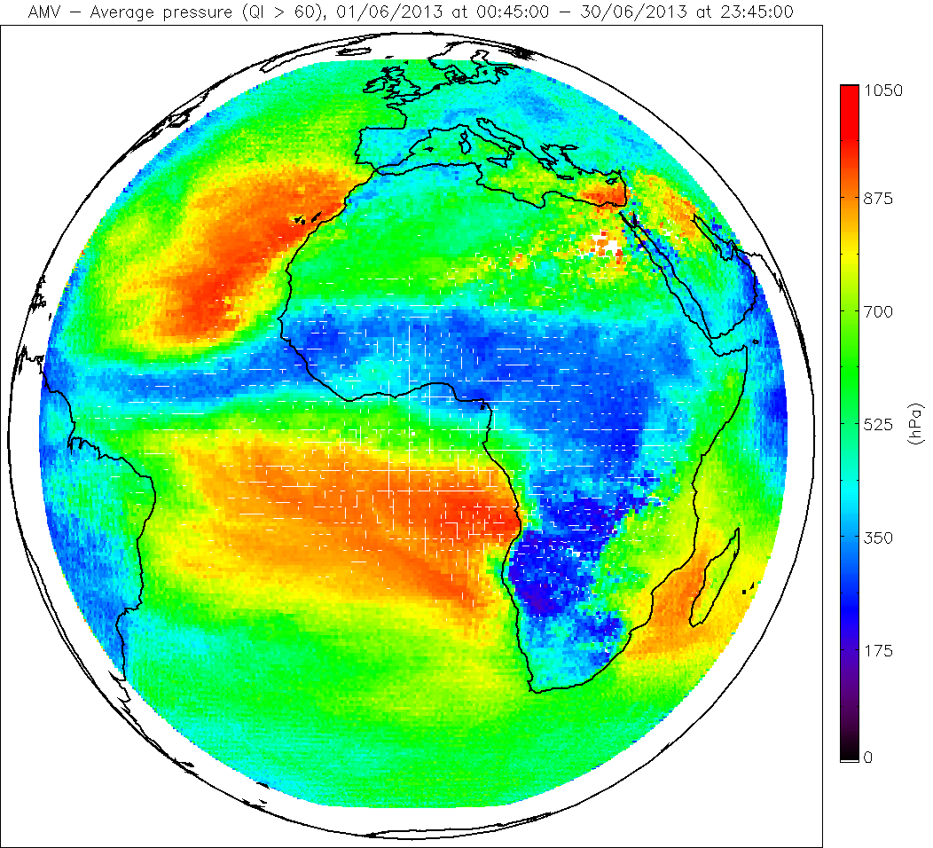
EUMETSAT dual Metop winds Comparison versus SEVIRI/MSG (June 2013, Processor v2.3)
Amount
Speed
Direction
Pressure
Dual Metop
QI>60
MSG
QI>60

Slide 11
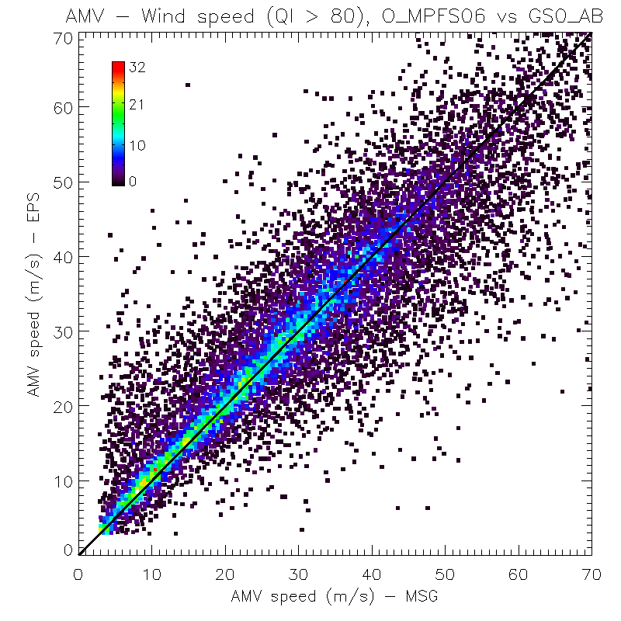
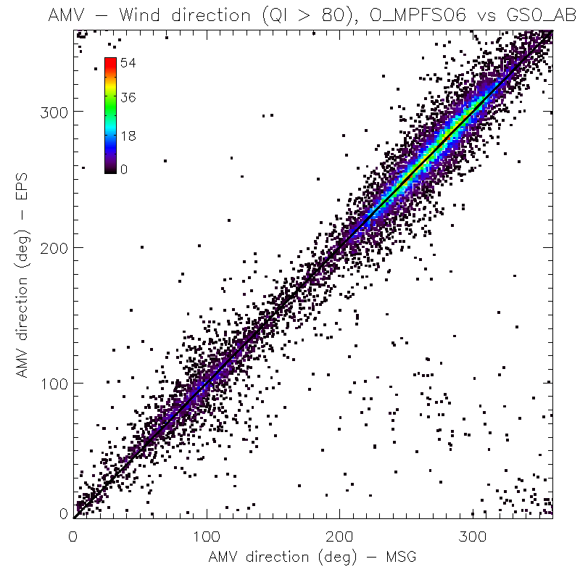
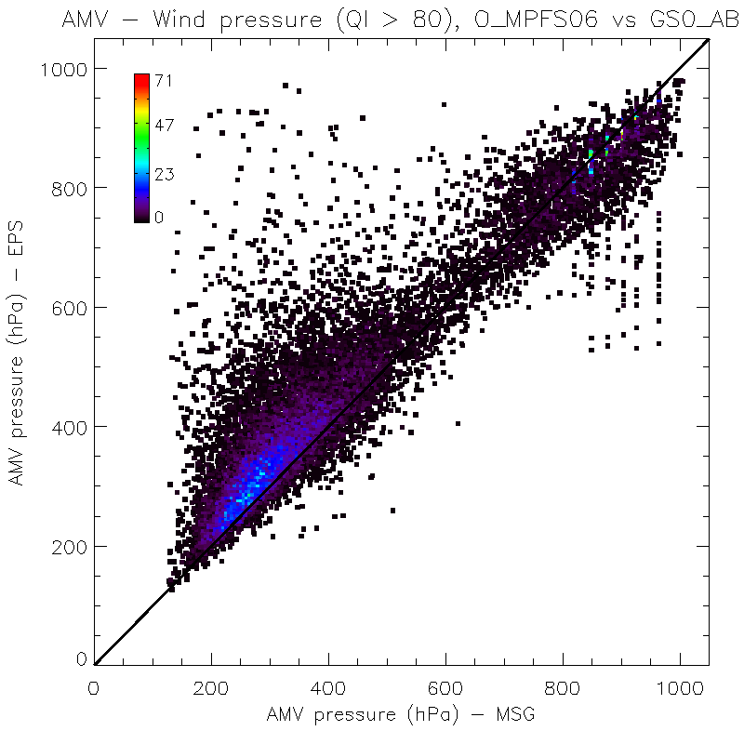
EUMETSAT dual Metop winds Comparison versus SEVIRI/MSG (Processor v2.3)
Comparison criteria:
1st Oct 2013
– 31st Jan 2014
QI > 80
45 minutes max difference
0.25 deg lat/lon grid box

Slide 12
EUMETSAT dual Metop winds Comparison versus GOES-15 (Oct 13 – Jan 14, Processor v2.3)
QI > 60
…and comparison with MTSAT-2, MET07, MET10, Modis/TERRA, MISR/TERRA
First externe validation study made by TROPOS
QI > 80
Notes:
Max distance < 150 km, max time diff. < 90 min, max direction diff. < 60 deg. Time period: 20 October – 02 November 2013.

Slide 13
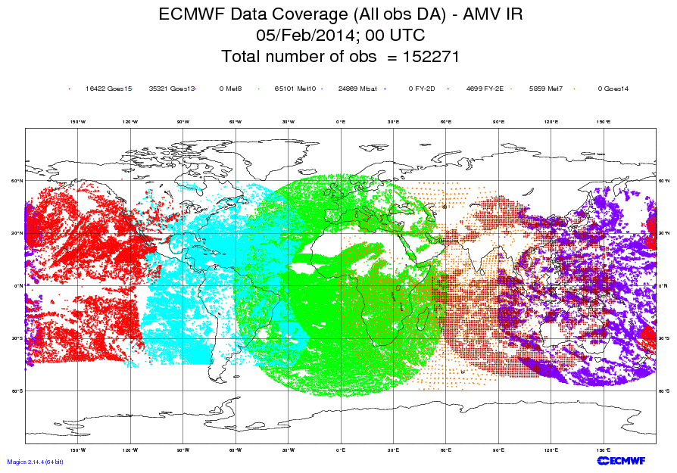
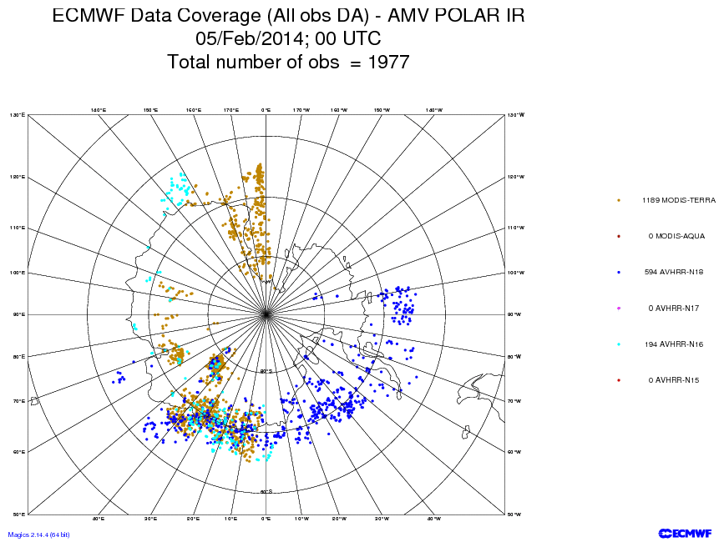
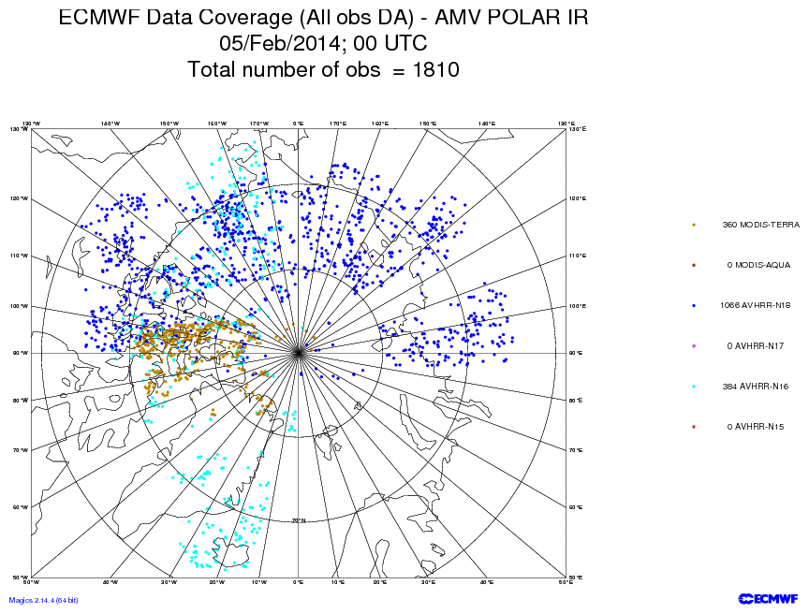
EUMETSAT dual Metop winds for Polar Regions Why do we care?
For best results, NWP models require information on both the mass field and the wind field.
AMVs are the only observation type to provide good coverage of upper tropospheric wind data over oceans and at high latitudes.
Different AMV extraction schemes are used, no homogeneous product
Polar winds are extracted, but it remains a lack of observations between 50 to 70 deg latitude
AMVs

Slide 14
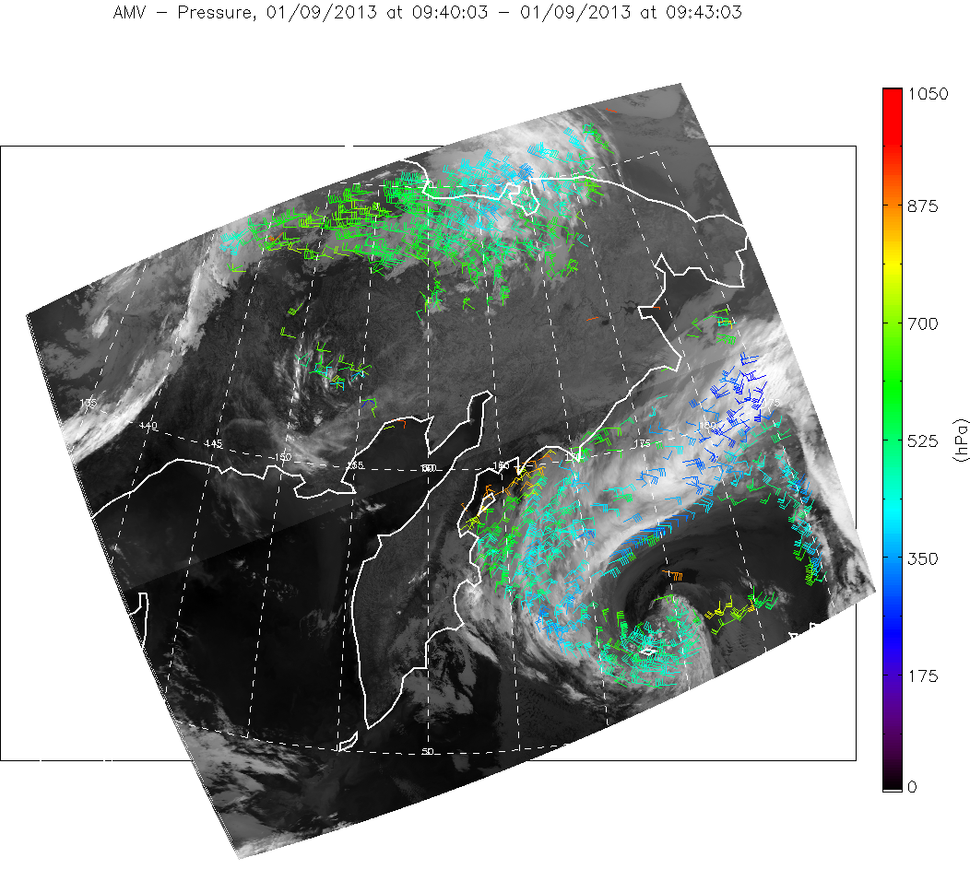
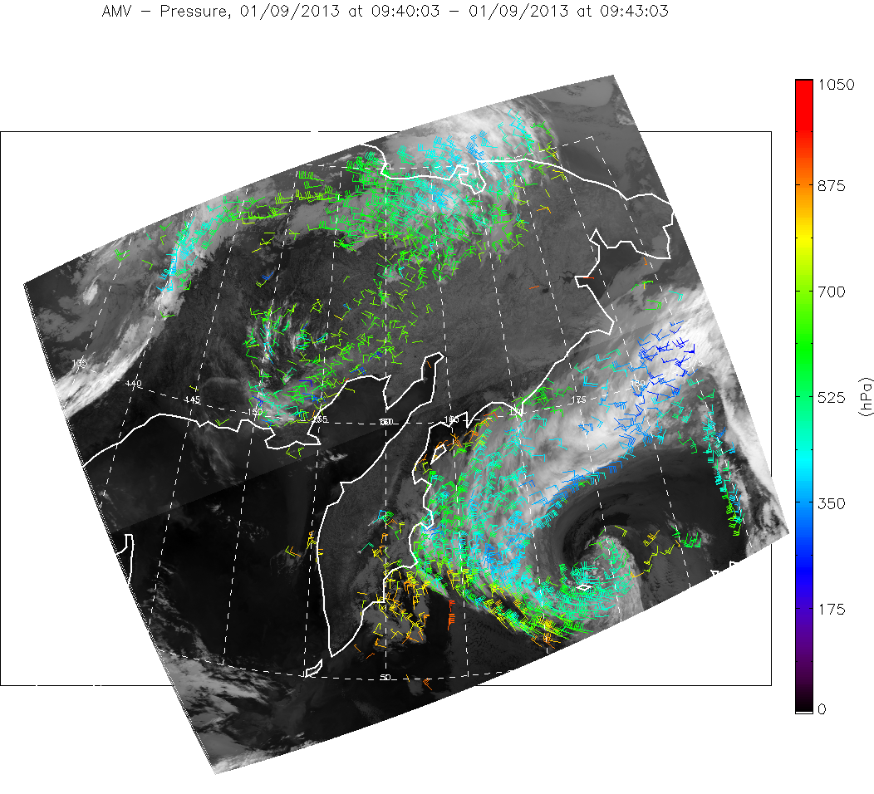
EUMETSAT AVHRR/Metop winds Increase the coverage on Polar Regions & Reduce the temporal gap
More winds are
extracted by dual
Metop algo.
Single Metop; all winds
(~100 min gap)
Dual Metop; all winds
(~50 min gap)

Slide 15
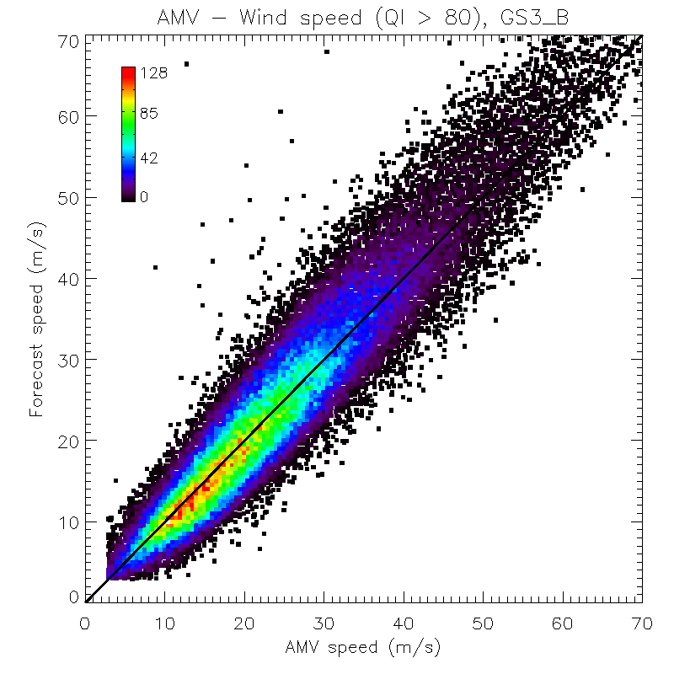
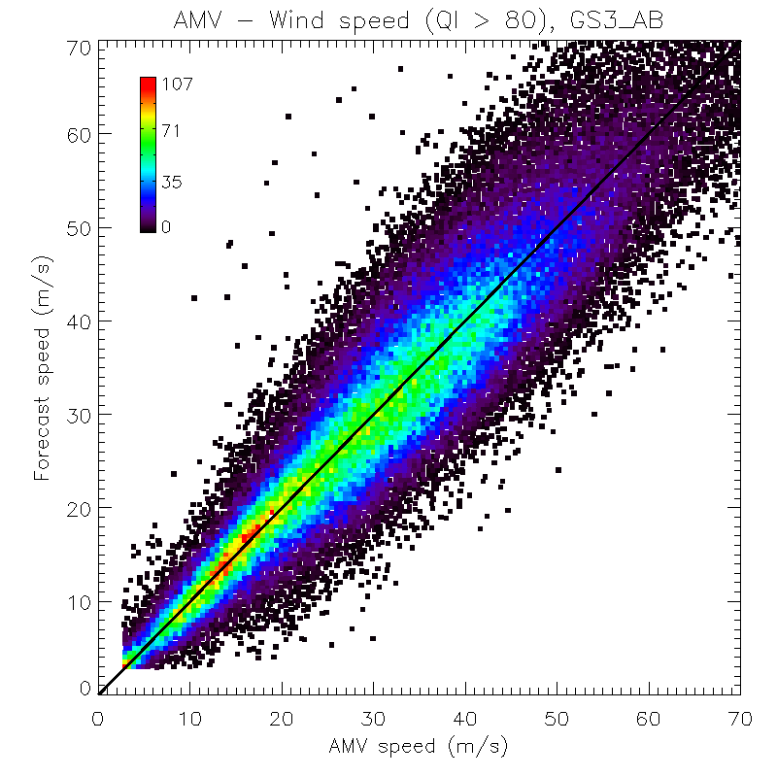
EUMETSAT AVHRR/Metop winds Comparison single vs dual over South Pole, 22 Jan – 5 Feb 2014
More fast winds detected with dual algorithm
Single Metop; QI>80
Dual Metop; QI>80

Slide 16
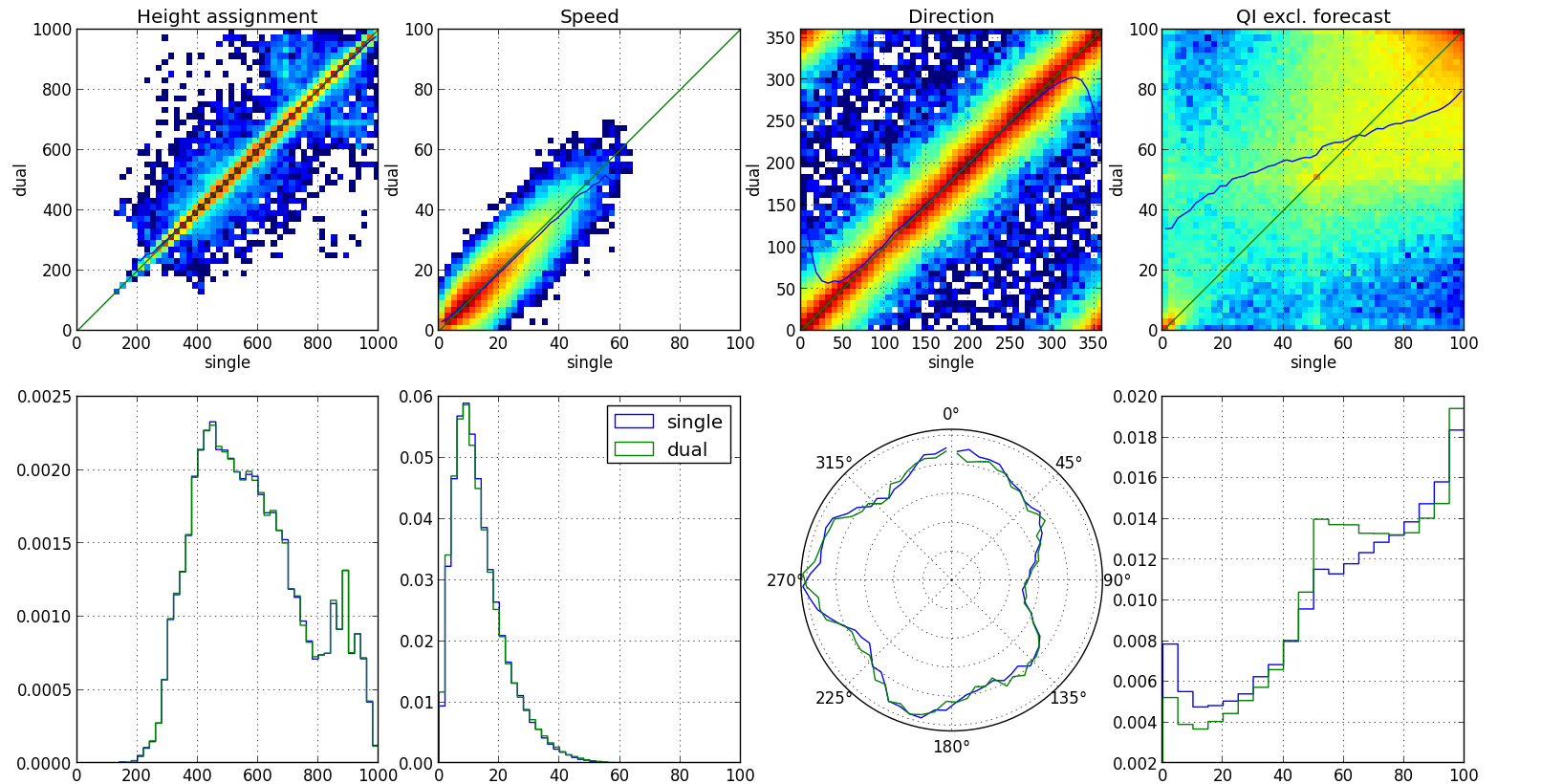
EUMETSAT single vs. dual Metop winds Collocated AMVs (version 2.4)
Collocated single and dual AMVs M01 on 20140525
Filter = QIx >0

Slide 17
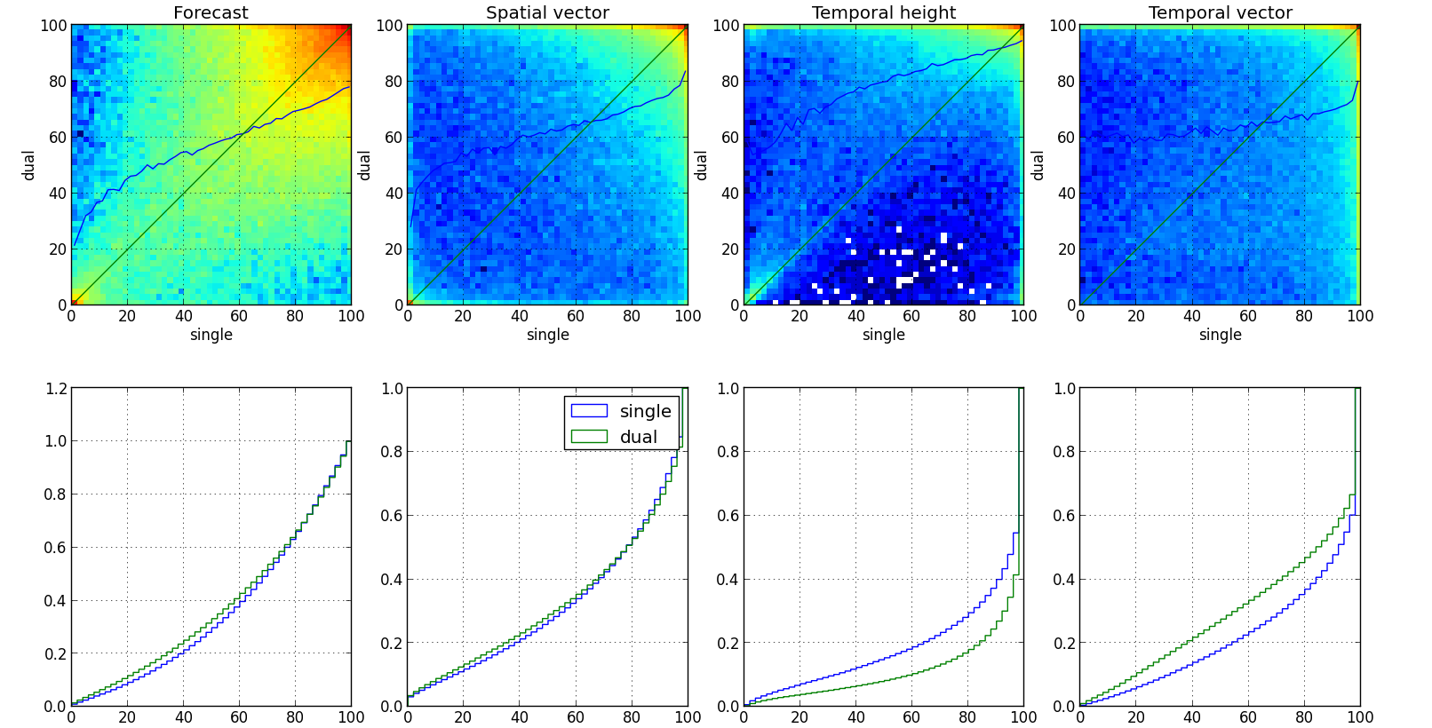
EUMETSAT single vs. dual Metop winds Collocated AMVs (version 2.4)
Collocated single and dual AMVs M01 on 20140525
Filter = QIx >0

Slide 18
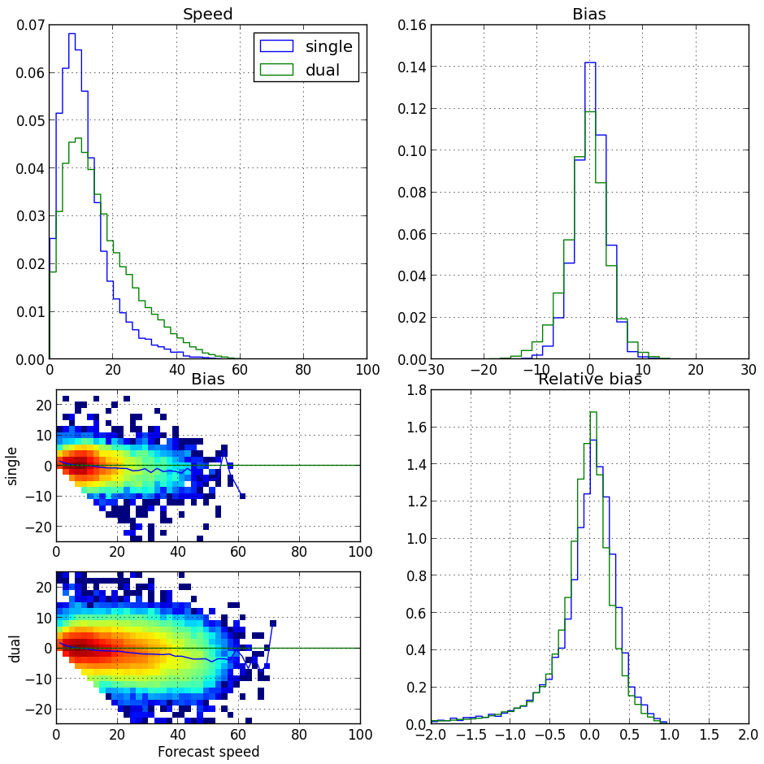
EUMETSAT single vs. dual Metop winds Collocated AMVs (version 2.4)
AMV count | Single | Dual
Single | 19526 | 146580
Dual | 146580 | 90416
Comparison based on the same set of PDUs processed:
166106 single winds
236996 dual winds
Count +40%
Possibility too track faster winds

Slide 19
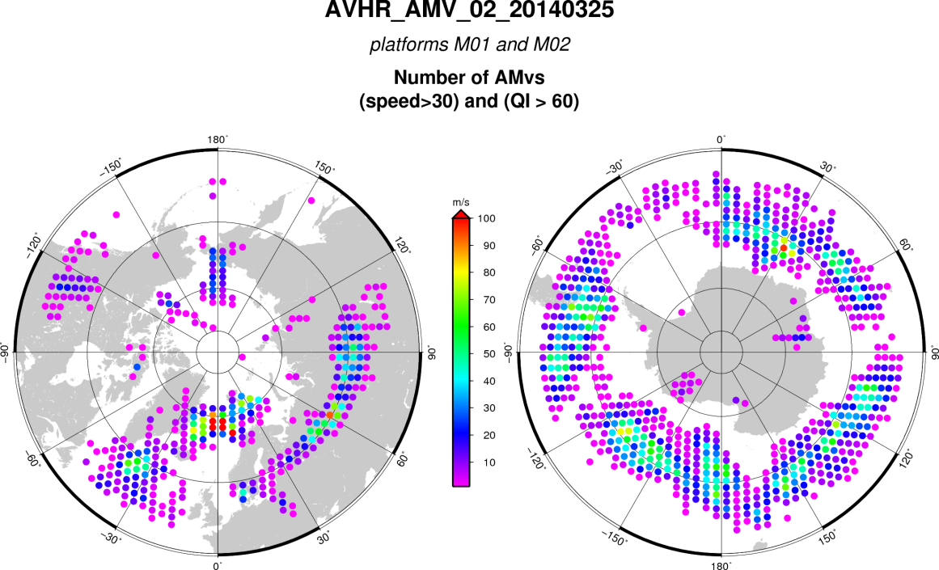
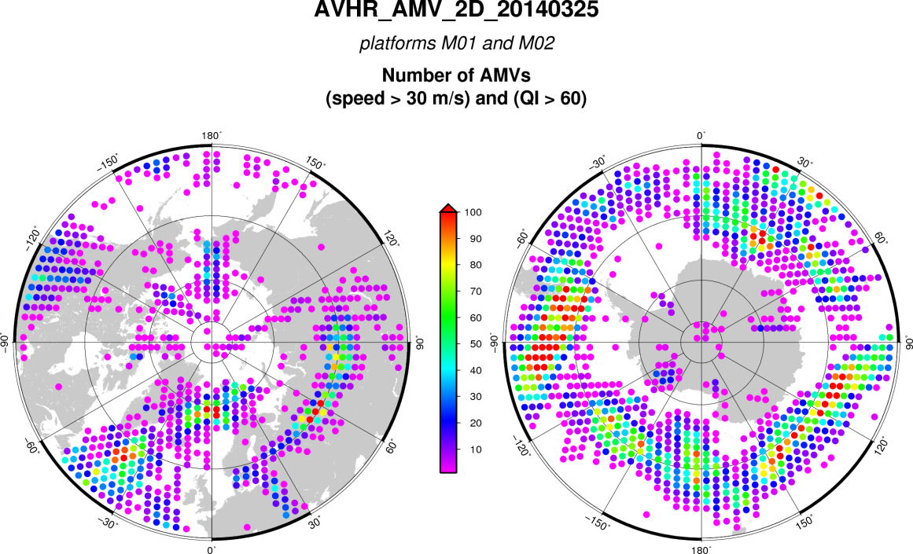
EUMETSAT AVHRR/Metop winds Better detection of Polar jets
The fast winds extracted with dual Metop algorithm are located in the polar jets.
They are also extracted at lower latitudes
Single Metop; QI>60
Speed > 30 m/s
Dual Metop; QI>60
Speed > 30 m/s

Slide 20
EUMETSAT dual Metop winds Summary
Global coverage homogeneous product, allow comparison against geo AMVs
Validation study (external study, TROPOS, Leipzig) based on test data (v2.3)
Comparisons against geo AMVs (GOES, Meteosat and MTSAT), MODIS winds and MISR winds
Larger coverage over polar areas, reduction of the temporal gap
Help to filling the 50-70 deg latitude gap, better detection of polar jets
Operationally processed on Eumetsat ground segment (v2.4 since end of May)
Trial dissemination comming soon

Slide 21
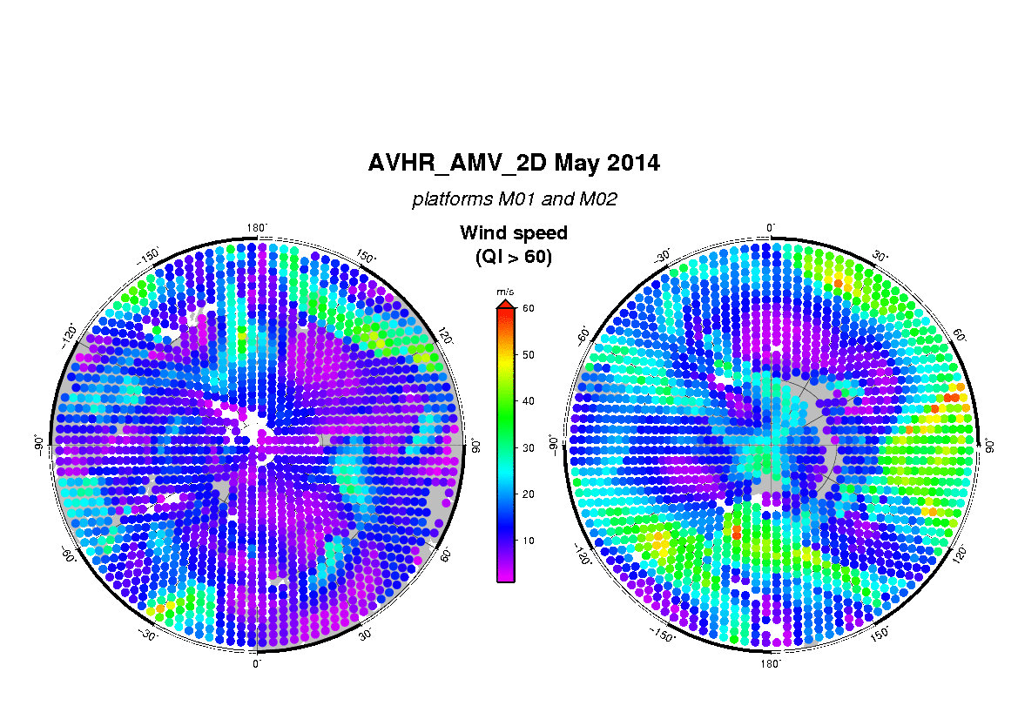
One month of data over Polar Regions

Slide 22
Coming next…
Further validation / characterisation of actual products
Version 3
Projection of all data on a grid
All pixels same size
Allows to track features outside of the reference image
Review of the tracking algorithm
Reconsider how to use IASI data
Revise the quality assessment process
Introduce the triplet mode
New BUFR wind sequence

Slide 23
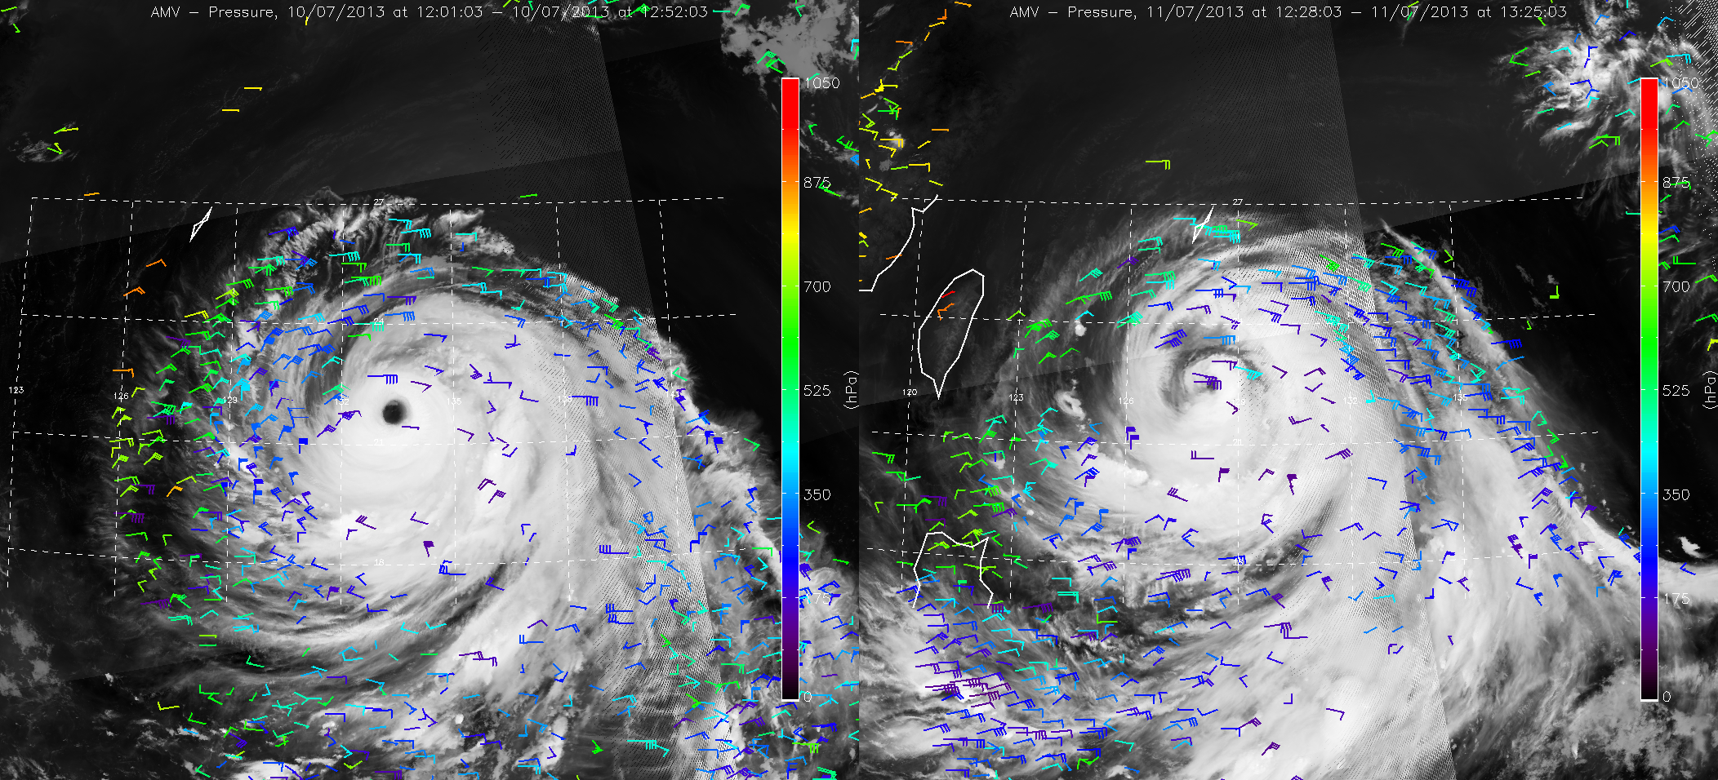
THANKS
Olivier.Hautecoeur@eumetsat.int
Dual Metop, Typhoon Soulik/Huaning over the Pacific, 10th and 11th July 2013

