Slide 1
Scatterometer Ocean Surface Vector Wind Products at NOAA Paul Chang, Zorana Jelenak, Joseph Sienkiewicz – NOAA and CEOS OSVW Virtual Constellation Update Co-leads Paul Chang (NOAA), Julia Figa-Saldana (EUMETSAT), BS Gohil(ISRO)
IWWG Meeting
Copenhagen, Denmark
June 16-20 , 2014

Slide 2
Primary Utilization
Scatterometer Ocean Surface Vector Wind (OSVW) Products
Use in NWP models
Use directly by human forecasters
Observational data of current conditions directly supports marine warnings and forecasts
Real-time NWP model verification

Slide 3
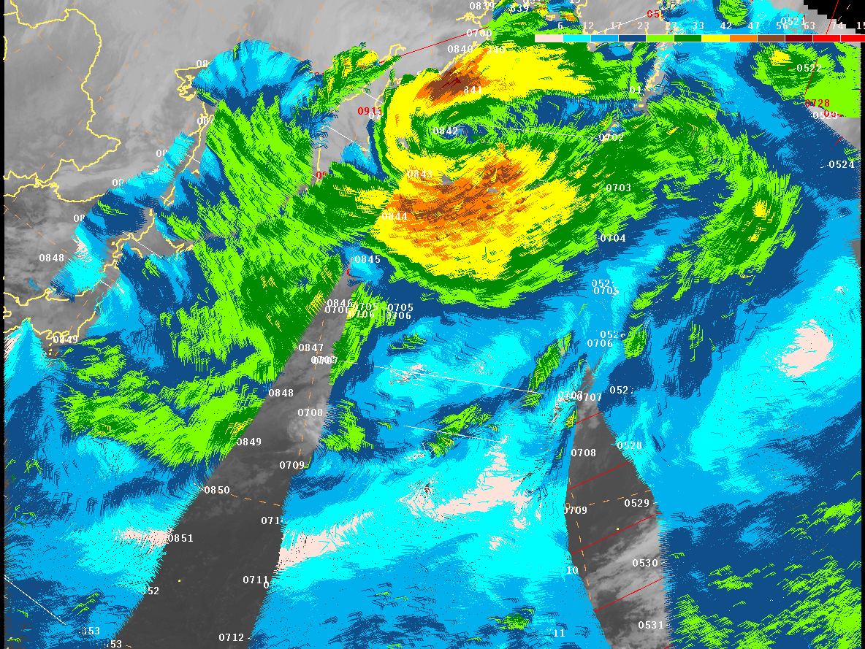


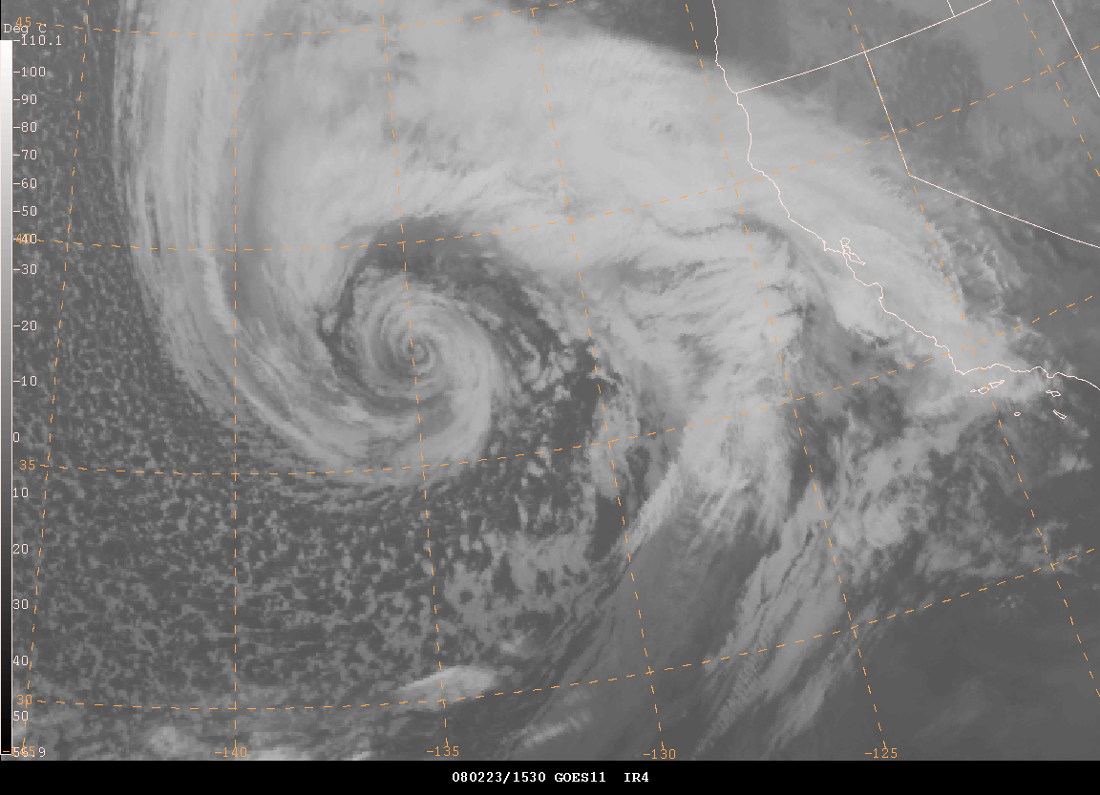
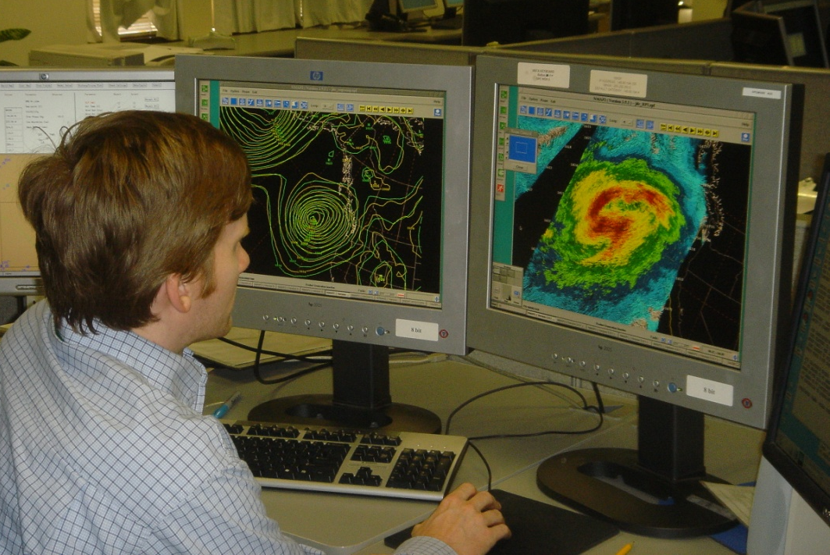
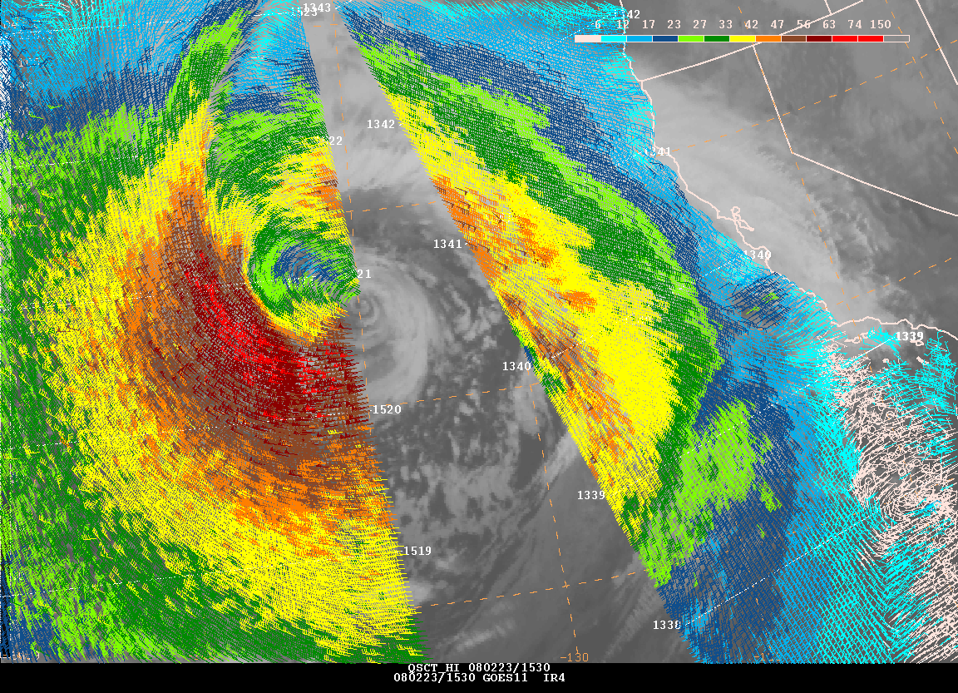
Use of Ocean Wind Vector Data at NWS Marine Weather Forecasting Offices and Centers
QuikSCAT
Marine wind warnings
Issue, continue, terminate
Identify weather features
Lows, highs, fronts
Intensity
Trends
Short term marine forecasts
Aerial coverage of winds
Real-time Verification
Comparison to NWP analyses
Feature intensity
OSVW of particular interest for extratropical cyclone (ETC) forecasting and warnings
Resulted in the introduction of the HF wind warning category for extratropical cyclones

Slide 4
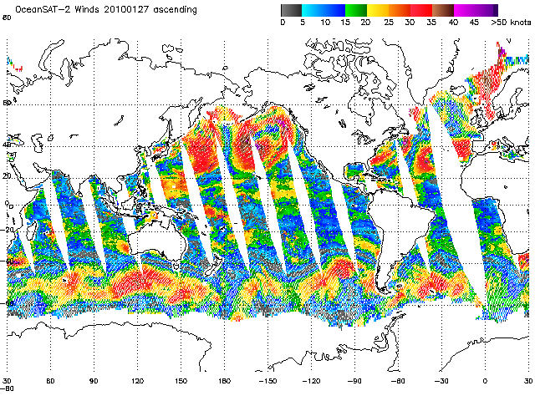
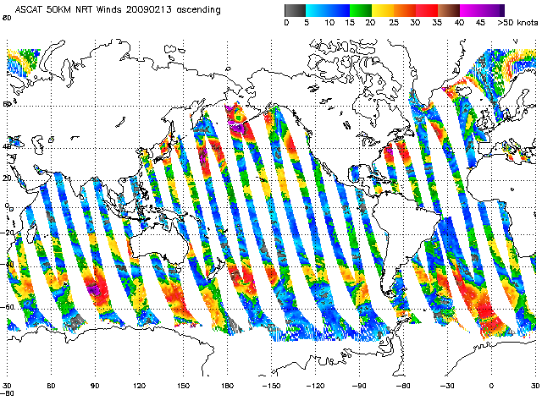
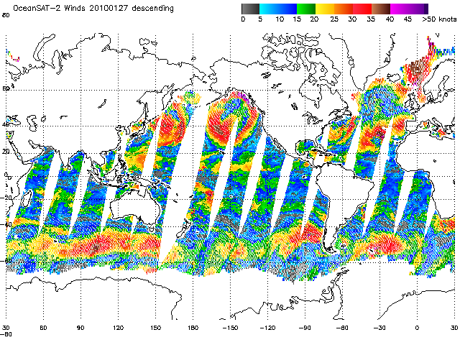
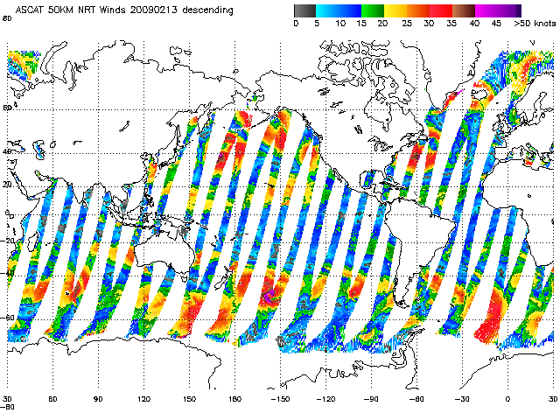
Current Scatterometer Missions
ASCAT(A&B)– Operational mission by EUMETSAT (data flow support operations)
OSCAT – Research mission by ISRO- ceased data flow in March 2014 after unrecoverable anomaly
OSCAT (daily coverage)‏
ASCAT (daily coverage)‏

Slide 5
ASCAT Wind Product in NOAA Operations
ASCAT Coastal 12.5km product with high wind GMF fully integrated

Slide 6
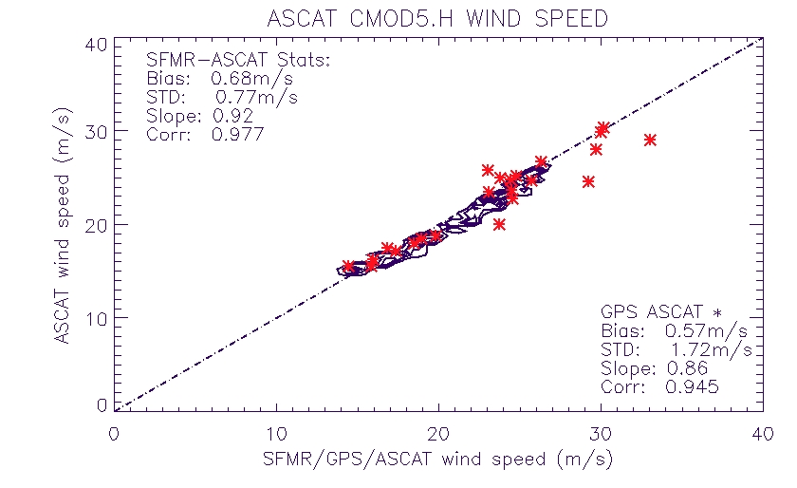
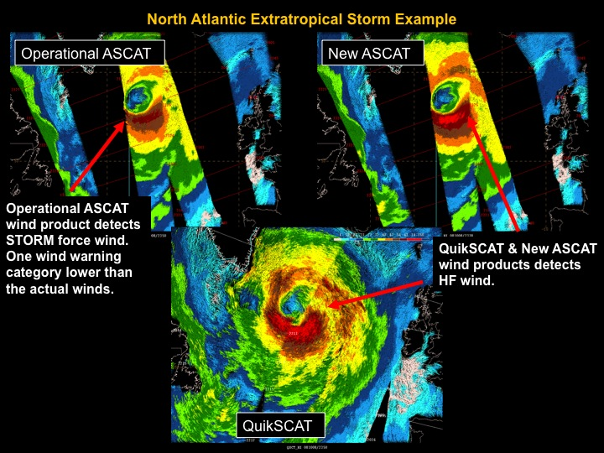
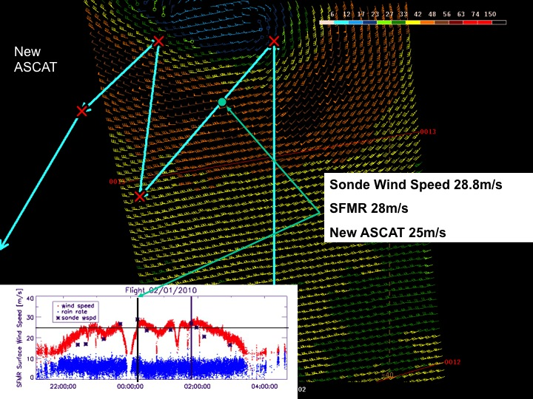
ASCAT High Wind Speed Retrieval Improvement
ASCAT high wind speed improvements developed utilizing aircraft and satellite data
New ASCAT winds versus SFMR and GPS dropsonde winds
Hurricane force wind observations with NOAA’s QuikSCAT and original and new ASCAT wind products
Flight track overlaid on ASCAT swath

Slide 7
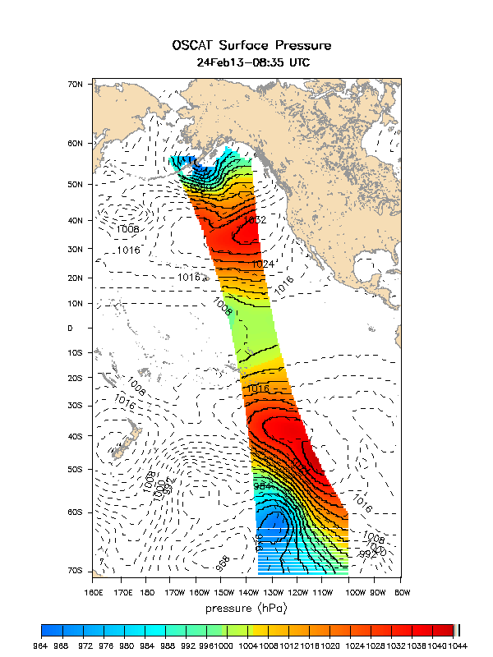
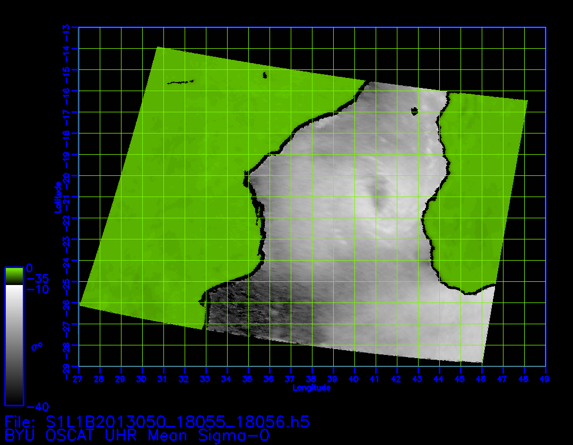
Enhanced Resolution Products implemented at NOAA (Successful transition of International Ocean Vector Wind Science Team [IOVWST] research efforts into operations)
SLP courtesy of Jerome Patoux
(University of Washington)
Enhanced resolution processing courtesy of David Long (BYU)
http://manati.star.nesdis.noaa.gov/datasets/ASCATData.php
Notes:
NOAA/NESDIS/STAR Ocean Winds Science team transitioned these applications to operations by working closely with the respective science team members
These are two products that we transitioned from efforts into near real-time operations to support NOAA’s mission. These were developed by members of the International Ocean Vector Wind Science Team. This is a prime example of the transitioning of research to operations and highlights the importance of remaining engaged with the external science community.
The panel on the left shows sea level pressure field derived from the OSCAT winds. Winds and surface pressure are very closely related. This panel is another way of looking at scatterometer wind retrievals. Assimilating these sea level pressure data versus vector winds into weather models may provide improved utilization of data in the models.
The panel on the right is an enhanced resolution radar cross-section product of a tropical cyclone between Madagascar and Africa.

Slide 8
Gridded ASCAT-GFS Wind Difference Fields

Slide 9
Use of ASCAT @ NHC

Slide 10
In search of wind fetch
NOAA/NWS - increasing focus on coastal effects: near shore waves, rip currents, water level, inundation
GOAL – objective method to estimate the magnitude of fetch for favored wave generation areas relative to specific coastal sites
Applicable to both NWP and gridded OSVW products
Use as a diagnostic by comparing remotely sensed and NWP sources
Give forecasters an early indication of potential threat, validity of NWP wind and wave predictions

Slide 11
In search of wind fetch
Thoughts
Forecasters rely very heavily on NWP sources for wave forecasts (weakness is NWP winds)
Present methods
subjective, limited scope (local)
inconsistent between offices/forecasters
Observing network (buoys) focused on nearshore and coastal areas (limits warning time for U.S.; other areas - no warning)
Opportunity to:
Optimize use of OSVW
Extend awareness of wave generation and threat potential seaward
Provide objective and consistent methodology to understand and estimate wind/wave system

Slide 12
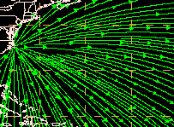
Approach
Develop a function in GEMPAK to calculate unit vectors of great circle paths emanating from a given Lat, Lon point (Great Circle Rays)
Terminate rays when strike land (GEMPAK function)
Apply unit vector field to gridded sources of wind (NWP and/or remotely sensed OSVW) to determine wind component opposing GC ray (site specific fetch) (negative values of dot product)
SGCr=GCr.Vqscat
Vqscat
GCr
Cape
Hatteras
SGCr
If SGCr < 0

Slide 13
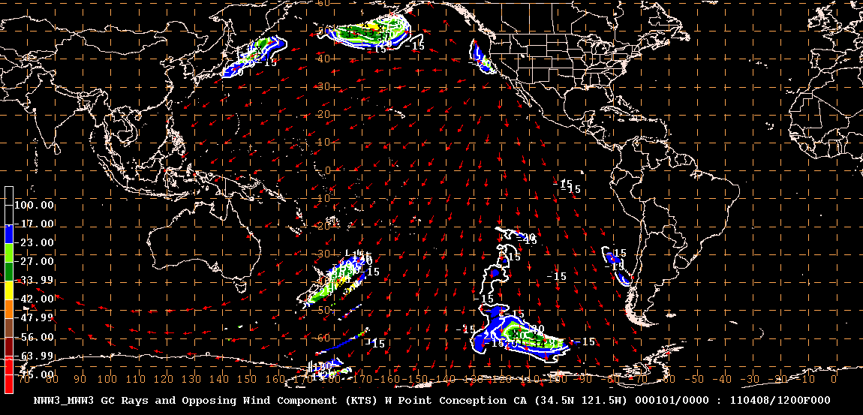

Slide 14
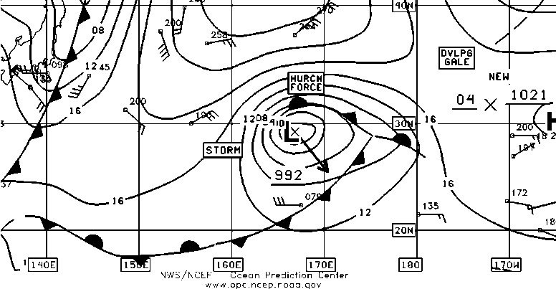
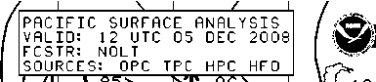
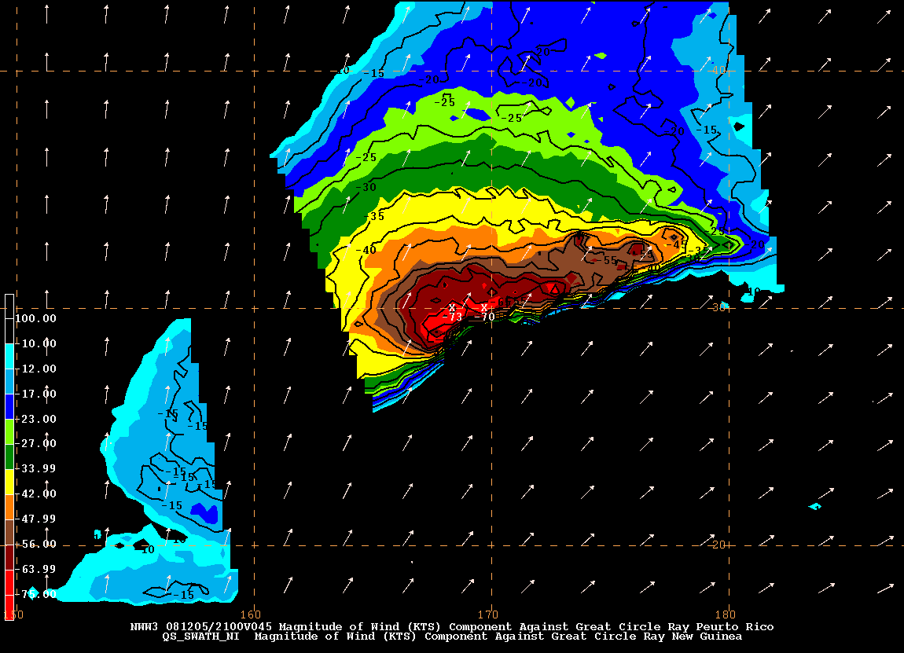
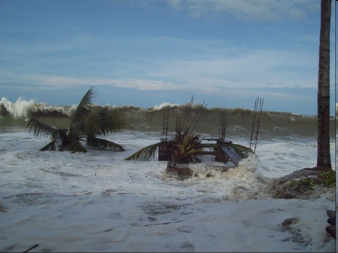
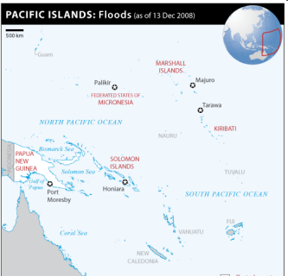
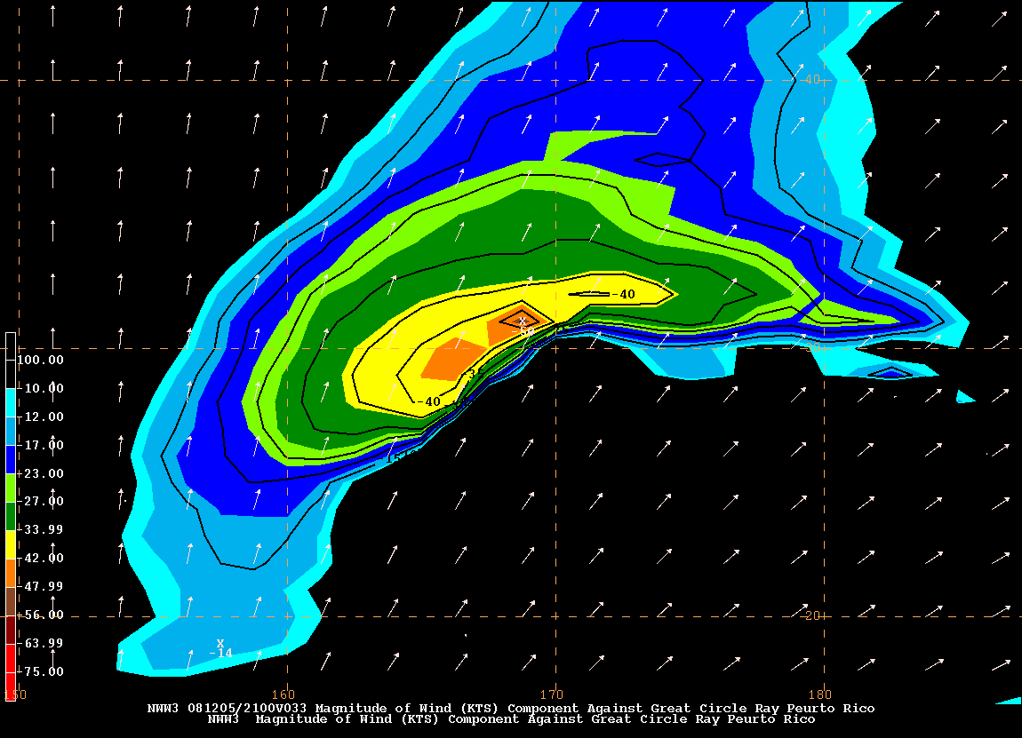
Wind is the destructive force
North Pacific Storm – the Source
4 days later
New Guinea – Wave Inundation
QuikSCAT wind component – long fetch
of Hurricane Force Winds
GFS wind component – fetch of Gale
Force Winds

Slide 15
Committee on Earth Observation Satellites (CEOS)
Strategic Implementation Team (SIT)
Ocean Surface Vector Winds – Virtual Constellation

Slide 16
CEOS Ocean Vector Surface Winds Virtual Constellation (OSVW-VC)
Status of activities
Sustained operations assessment (advocate for timely and open data access)
ASCAT on METOP-A and METOP-B operating nominally
HSCAT on HY2-A operating nominally, no NRT data access
OSCAT on OceanSat-2 discontinued operations
ISRO already has a gap filler OSVW mission (ScatSat) approved and scheduled for a late 2015 launch
NASA RapidScat mission on the International Space Station scheduled for an early August 2014 launch
Optimization of the OSVW constellation (coordination of orbits)
Analysis of the overall local time coverage from the constellation for different applications
Bridging with the International Ocean Vector Winds Science Team
IOVWST 2014 annual meeting in June 2014, planning an OSVW-VC side meeting
Specific working groups will be kicked-off on Climate wind CDRs, Data Standards and Coastal Applications
Outreach and training (focused on end users)
Satellite winds and waves marine forecaster training workshop conducted in December 2013 with the South African Weather Service as part of the outreach and training effort

Slide 17
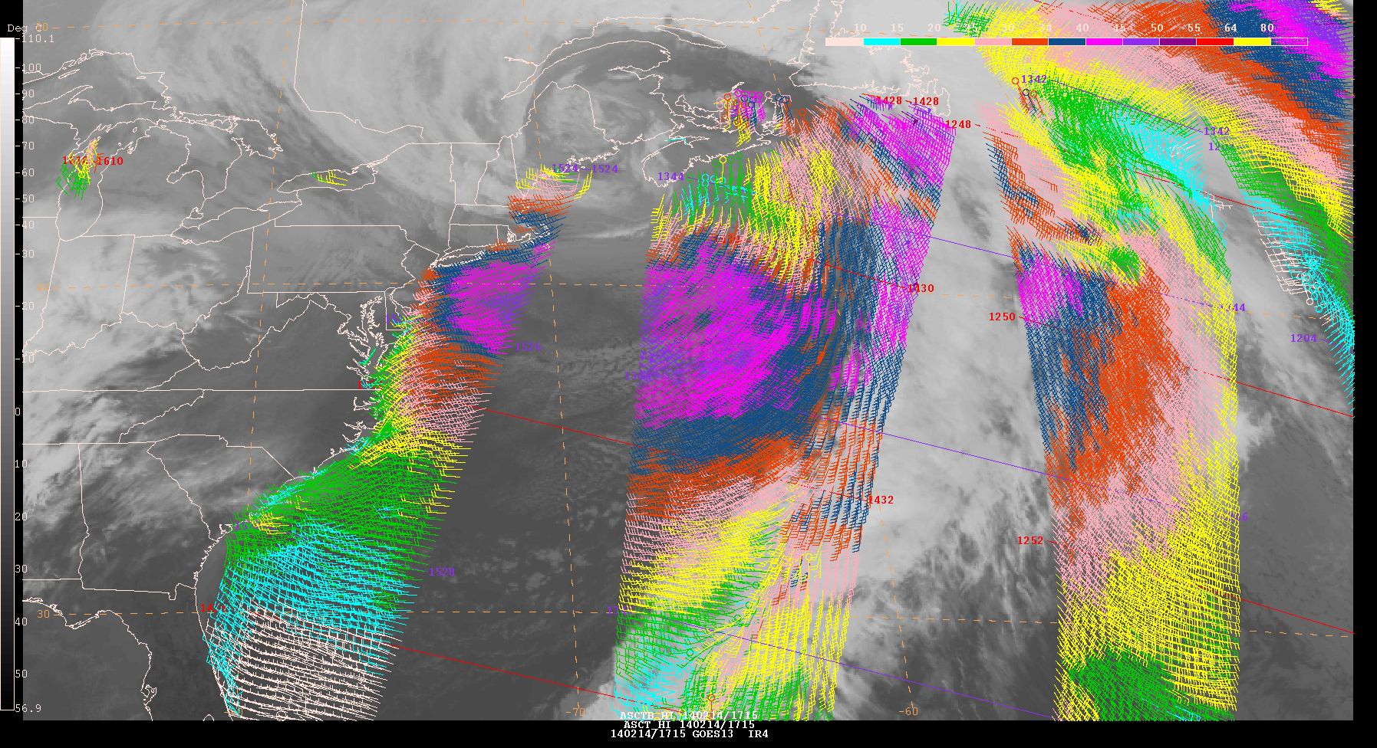
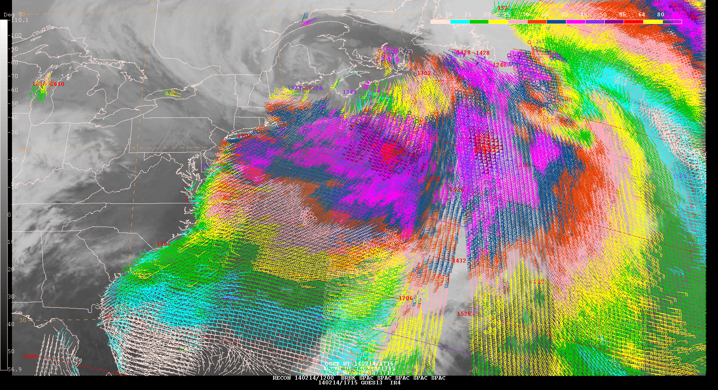

CEOS Ocean Vector Surface Winds Virtual Constellation (OSVW-VC)
The impact of OSCAT in marine forecast and warnings
(scale in knots)

Slide 18
CEOS Ocean Vector Surface Winds Virtual Constellation (OSVW-VC)
Current status and outlook – NRT data access
Launch
10
11
12
13
14
15
16
17
18
19
20
21
22
23
24
10/06
METOP-A Europe
METOP-C Europe
C-band
METOP-B Europe
Post EPS Europe
06/99
QSCAT USA
03/04
Oceansat-2 India
Oceansat-3 India
SCATSAT India
HY-2A China
HY-2B China
HY-2C China
No NRT data access committed
CFOSAT China/France
Ku-band
RapidSCAT USA
Meteor-M N3 Russia
Meteor-MP 3 Russia
Combined C- and Ku-band
GCOM-W2 Japan/India/USA
GCOM-W3 Japan/India/USA
FY-3E China
FY-3G China
Scatt operational series India
Design Life
Extended Life
Design Life
Extended Life
Proposed
Operating
Approved

Slide 19
Summary
Scatterometer OSVW products have a significant impact on operational weather forecasting and warning
Need to keep pushing for timely and open data access
Build/maintain robustness of constellation
Orbit selection needs to be coordinated to the extent possible to optimize coverage

