Slide 1
Historical GOES AMV Reprocessing
Steve Wanzong¹, David Santek¹, Christopher Velden¹, Jaime Daniels², Dave Stettner¹, Wayne Bresky³, and Andrew Bailey³
¹ University of Wisconsin - Madison/SSEC/CIMSS, Madison, Wisconsin
² NOAA/NESDIS/STAR, College Park, Maryland
³ I.M. Systems Group (IMSG), Inc., Rockville, Maryland
12th International Winds Workshop
The University of Copenhagen
Copenhagen, Denmark
June 16 – 20, 2014

Slide 2
Outline
Motivation For Reprocessing
Historical Processing Details
Example Results and Quality Control
Summary and Potential Future Plans

Slide 3
Motivation
Following the recommendations from the 9th and 10th International Winds Workshops and the Coordination Group for Meteorological Satellites (CGMS)
Complements the AMV reprocessing efforts from JMA and EUMETSAT
Provides a baseline for future AMV reprocessing with the next generation (GOES-R) algorithms
New NWP reanalysis efforts are planned (ECMWF, JMA, NASA-GMAO)
Reprocessed GOES AMVs will be an important data resource for research studies

Slide 4
Motivation
ECMWF: “keen interest by ECMWF in the proposed effort”… “…we are encouraged by this proposal and strongly support it as a contribution to filling the gap.”
The Global Climate Observing System leadership: “we can only express the very strongest support of the GCOS programme for your proposed reprocessing, which would meet a longstanding and off-stated need.”
JMA: “The reprocessing of historical GOES AMVs data will surely bring benefits to, and will be appreciated by, the NWP and climate communities. In this context, I wish to express my heartfelt appreciation to your efforts and my cordial welcome for your proposal.”
UW-Madison/SSEC-CIMSS: Has a long history in AMV development going back to FGGE reprocessing in the late 1970’s. The SSEC directors sensed the importance of this latest reprocessing effort and provided the funding for the first phase.

Slide 5
Processing Details (Data)
Period: GOES GVAR Era ->1995 to mid 2013
Background NWP guess: Interpolated 6-hour analyses from the ERA Interim dataset
Hourly, near-full-disk datasets using most frequent image triplets available (except no rapid-scans)
GOES East (1995 – mid 2013)
Includes GOES-8/10/12/13/14
GOES West (1996 – mid 2013)
Includes GOES-9/10/11/15
Entire data archive on-line at UW-SSEC

Slide 6
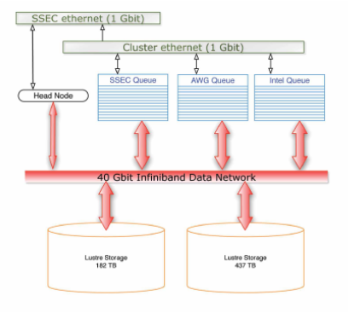
Processing -- Computing Cluster
400 compute cores
1 TB RAM
3.8 PB Storage
Infiniband Interconnect
Simple parallel or MPI Jobs

Slide 7
Computational AMV Software
Current Operational NESDIS/CIMSS Software
Calibration and navigation of GOES data
Post-processing: Recursive Filtering (RF) and Quality Indicator (QI) values are calculated
Check RF and QI values, and any vectors that surpass threshold are accepted
Calculate local brightness temperature gradients and find targets
Acceleration check on sub-vectors of triplets
Final manual check for unusual dataset numbers or low-quality flag ratios
Create search box and find highest correlated point between target and search box
Determine height of target dependent on spectral channels
ASCII file output

Slide 8
AMV ASCII Output Fields
type | sat | day | hms | lat | lon | pre | spd | dir | rff | qiwf | qinf | zen | ch
WV | GOES12 | 20031026 | 2351 | 55.25 | 64.98 | 230 | 50.3 | 249 | 58.82 | 0.92 | 0.96 | 61 | CO2
WVCS | GOES12 | 20031026 | 2347 | 51.51 | 70.91 | 262 | 77.0 | 227 | 50.00 | 0.90 | 0.96 | 59 | HIST
IR | GOES12 | 20031026 | 2333 | 48.35 | 75.82 | 587 | 14.6 | 242 | 77.94 | 0.84 | 0.88 | 56 | H2O
VIS | GOES12 | 20031026 | 2335 | 26.62 | 98.52 | 812 | 5.9 | 308 | 80.22 | 0.65 | 0.59 | 48 | BASE
SWIR | GOES12 | 20031026 | 2335 | 55.96 | 74.25 | 737 | 6.6 | 255 | 81.52 | 0.99 | 0.99 | 64 | WIN
Time (HMS) is satellite scan line time
Longitude (LON) is positive west
Height assignment pressure (PRE) is in hPa
Speed (SPD) is in m/s
RFF is the Recursive Filter quality Flag
QIWF is the Quality Indicator With Forecast
QINF is the Quality Indicator No Forecast
ZEN is the local satellite zenith angle
CH is the height assignment method

Slide 9
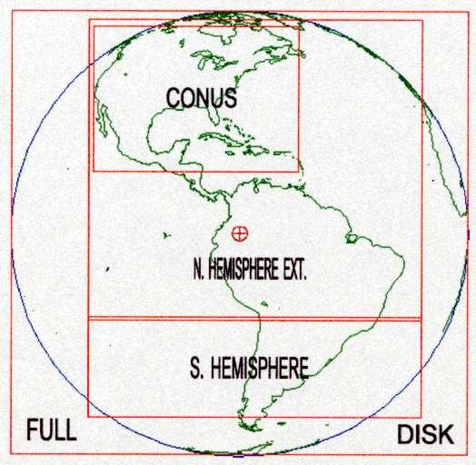
GOES East Scanning Metrics
NHEM AMVs:
15-minute time steps over CONUS; 30- minute time steps elsewhere.
SHEM AMVs:
30-minute time steps; NHEM+FD [0 – 20S]; FD+SHEM [20S – 50S]
NO RSO OR SRSO used

Slide 10
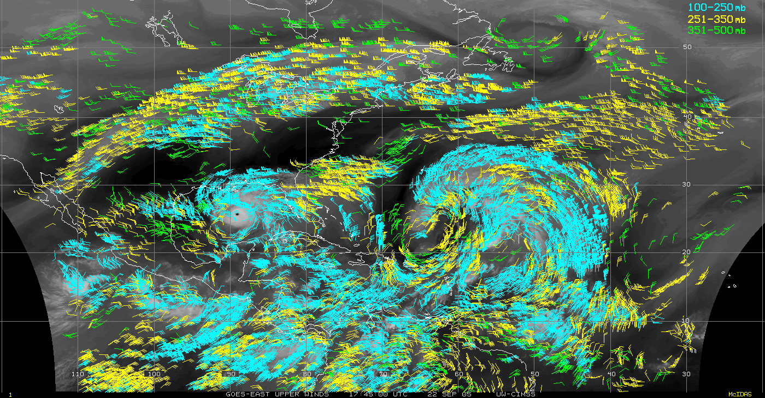
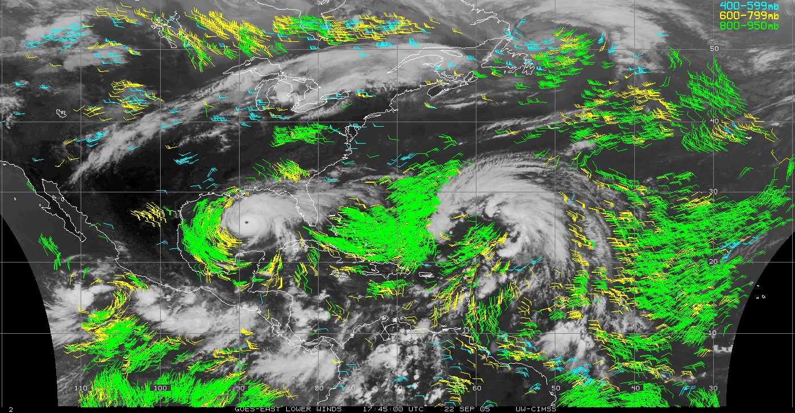
GOES East NHEM Example AMVs

Slide 11
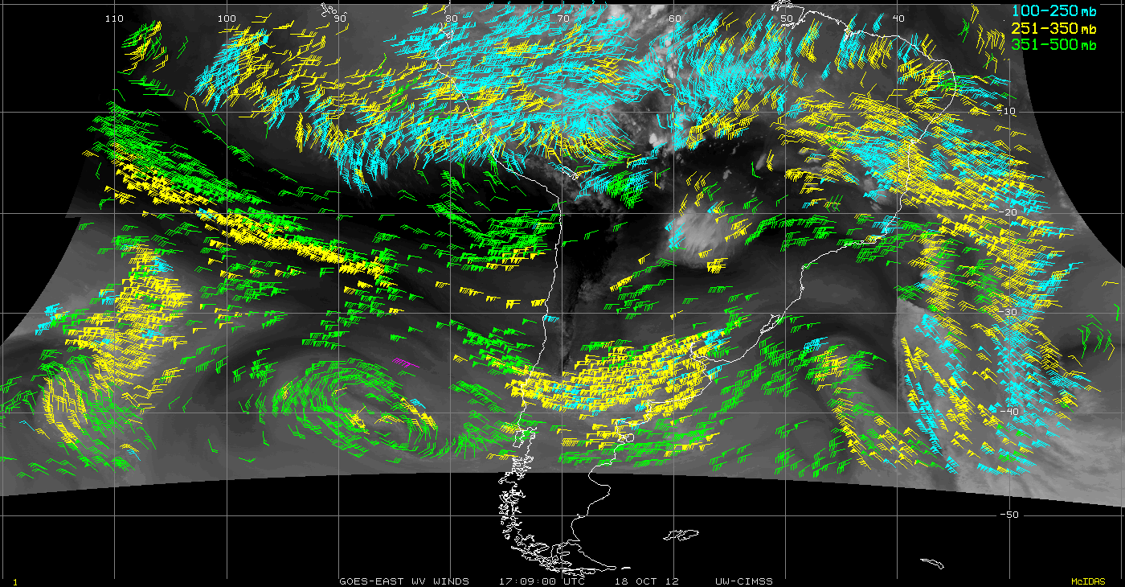
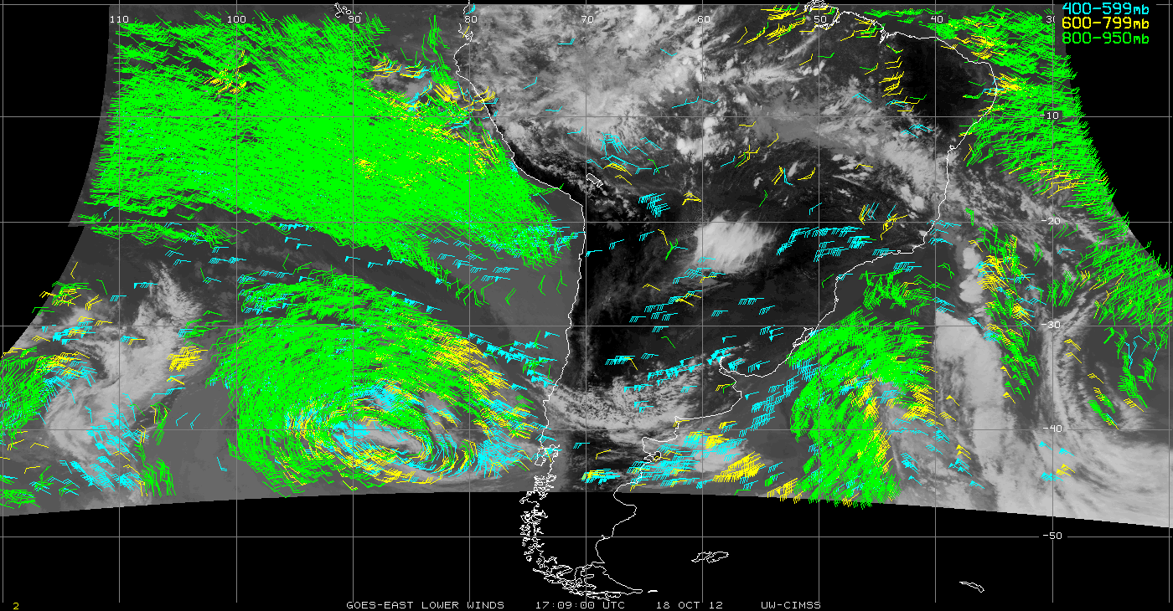
GOES East SHEM Example AMVs

Slide 12
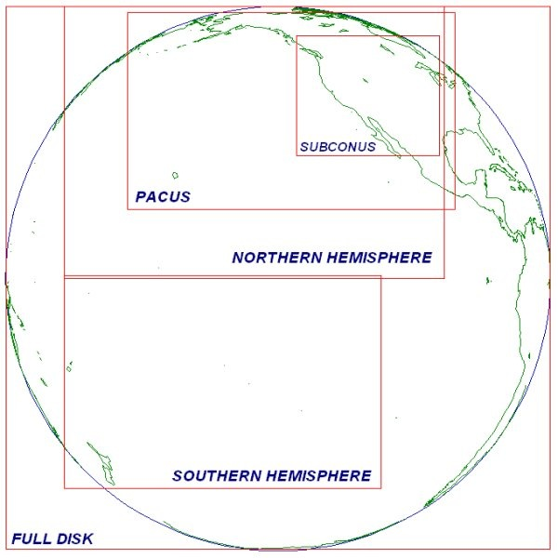
GOES West Scanning Metrics
NHEM AMVs:
15-minute time steps over PACUS;
30-minute time steps elsewhere.
SHEM AMVs:
30-minute time steps over SHEM sector.
No RSO or SRSO used

Slide 13
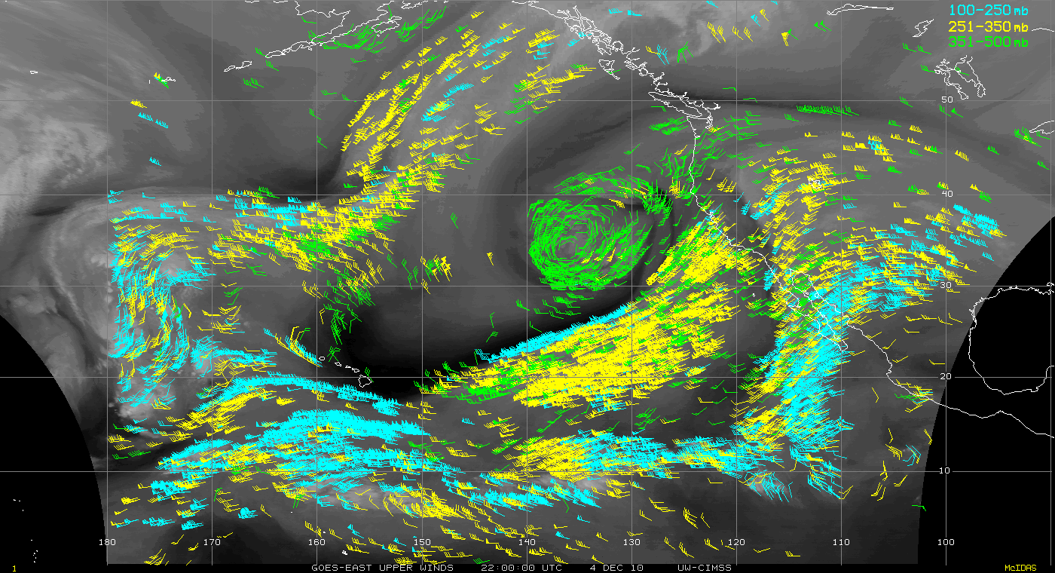
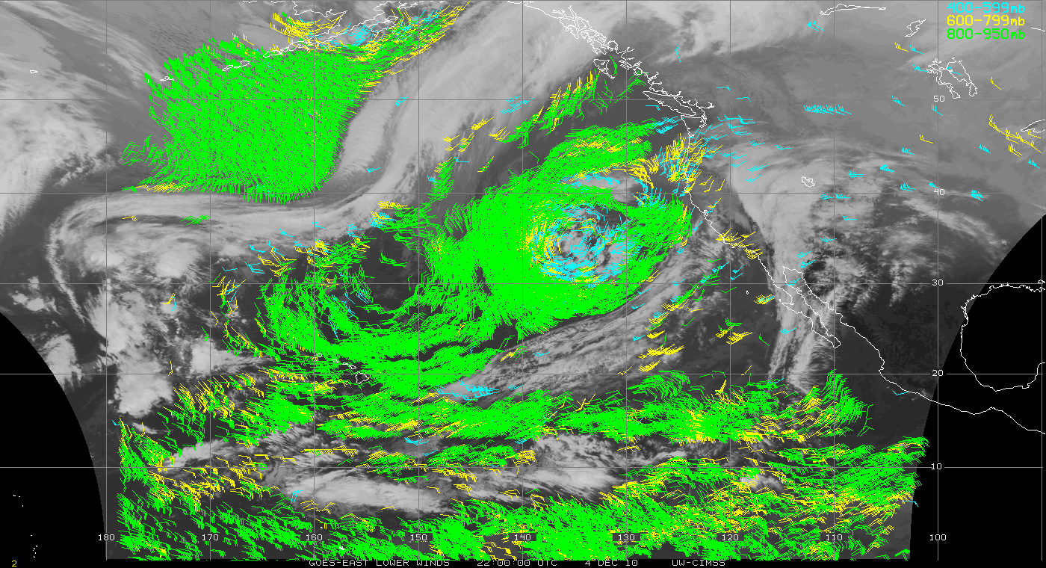
GOES West NHEM Example AMVs

Slide 14
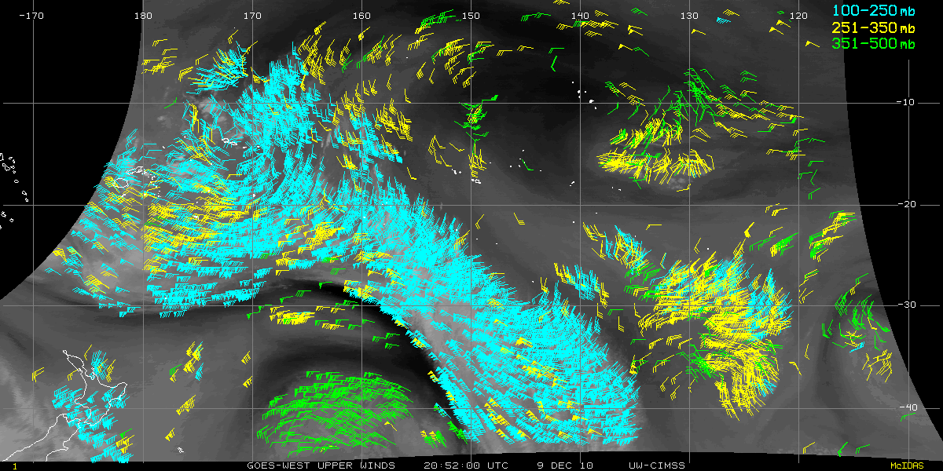
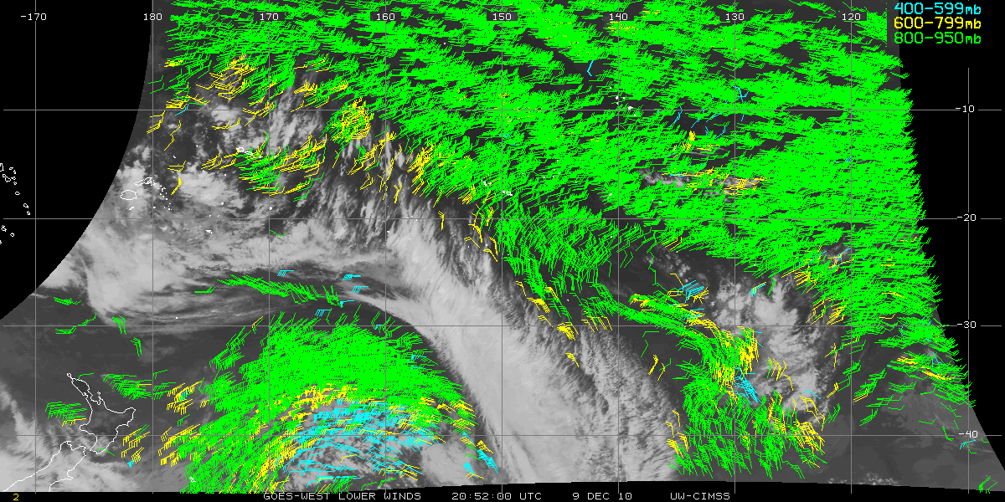
GOES West SHEM Example AMVs

Slide 15
Project Quality Control Challenge
539,047 hourly AMV datasets
7,802,592,221 individual AMVs
No way to manually inspect all of the datasets

Slide 16
Rawinsonde Collocations Look for anomalous signals Not much help in GOES-WEST SH datasets

Slide 17
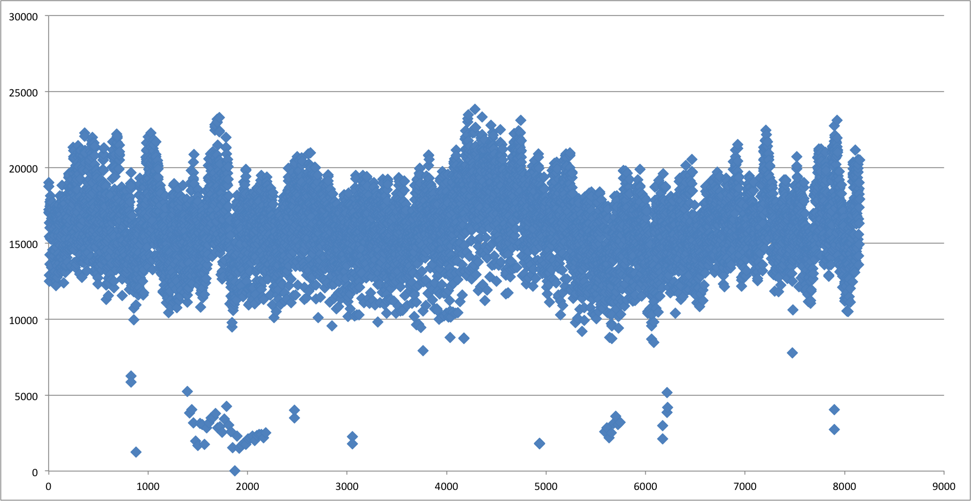
Dataset Analysis Look for datasets with low counts
GOES East NHEM – 2011

Slide 18
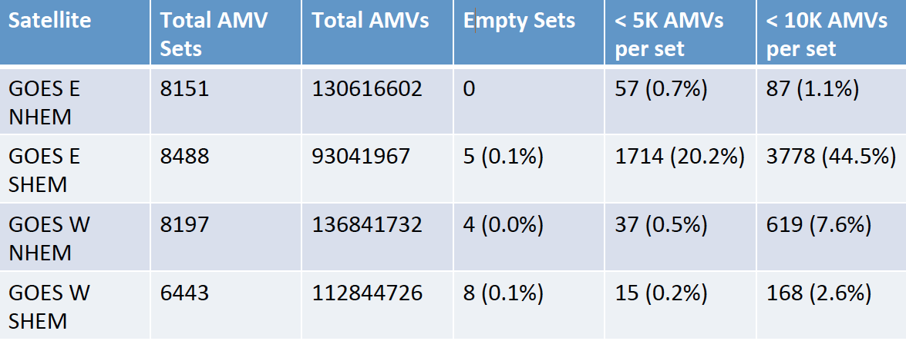
Dataset Analysis
2011 All Basins
A lot of rapid scans called in 2011; curtails GOES-E SHEM coverage

Slide 19
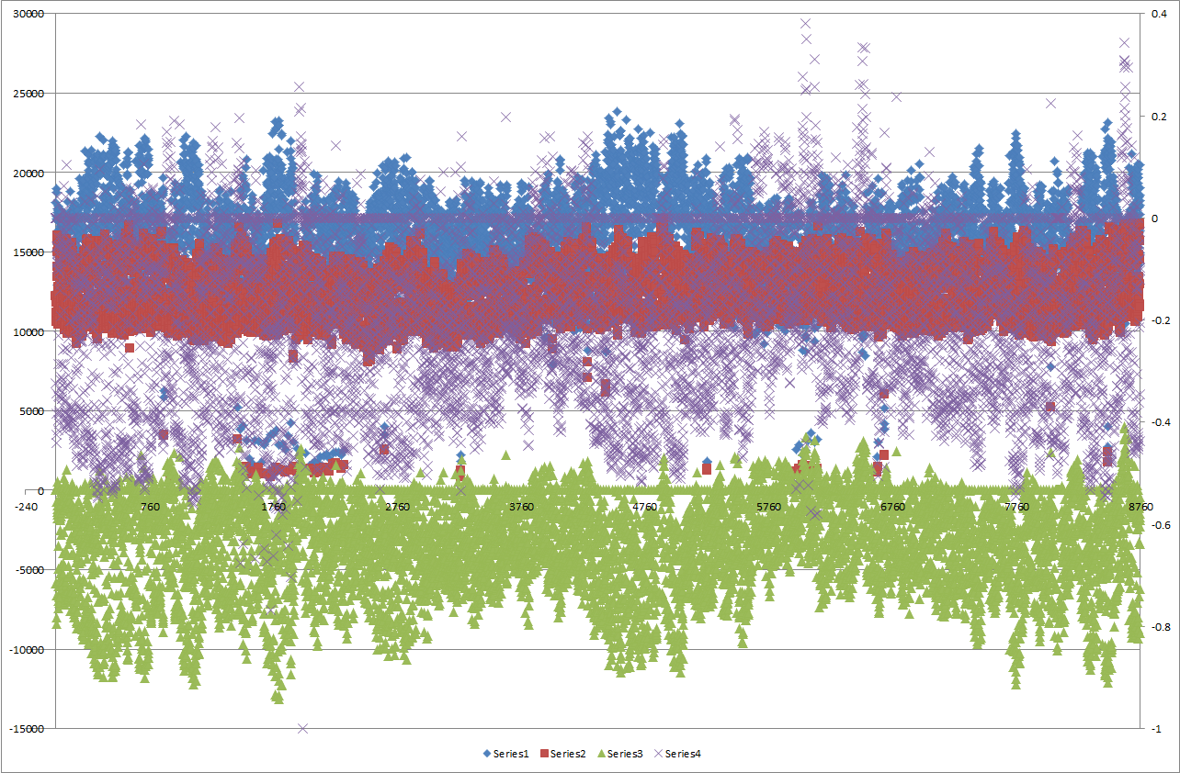
Final Dataset Filtering
Counts
Ratio
<Time>
Blue: Good AMVs (passed QC)
Red: AMVs that failed QC
Green: Failed minus Good
Purple: (Failed QC – Good AMV)/Good AMV
Distribution Rule: Ratio (purple) below 0.3
and with more than 500 AMVs in a set

Slide 20
Processing Summary
Continuous, hourly AMV datasets have been re-processed for GOES East/West from 1995 to mid-2013 using the current NESDIS operational algorithm
6-month project just completed (May 2014) by UW-SSEC
539,047 AMV datasets generated.
Output ASCII text files now available for community access
Phase 1a complete!
Future GOES AMV reprocessing plans (???>$$$)
Phase 1b: Reprocess GVAR dataset using the latest methods being developed for GOES-R (tracking and cloud height algorithms)
Phase 2: Extend the reprocessing to earlier U.S. satellites (1978 – 1994)
Will involve more efforts to correct sensor calibration and geolocation
Need to develop the cloud height products for the pre-GVAR era

Slide 21
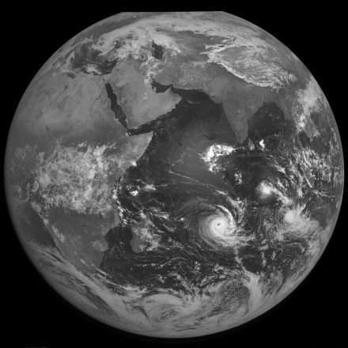
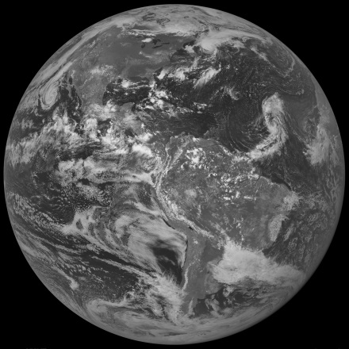
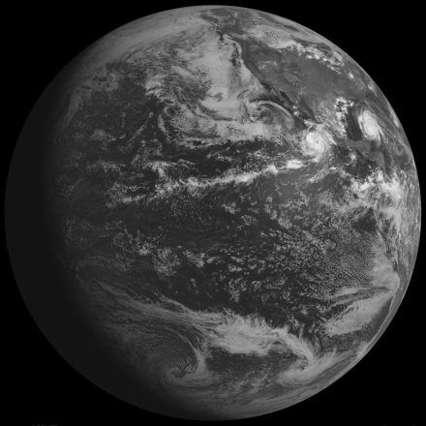
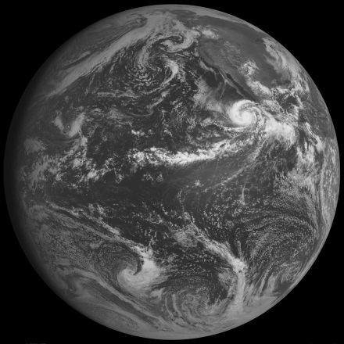
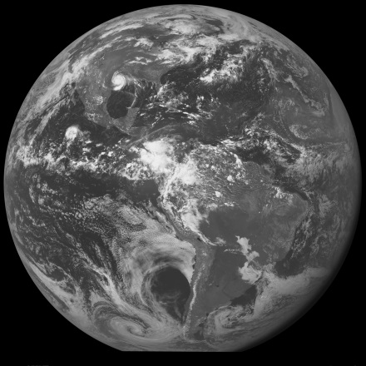
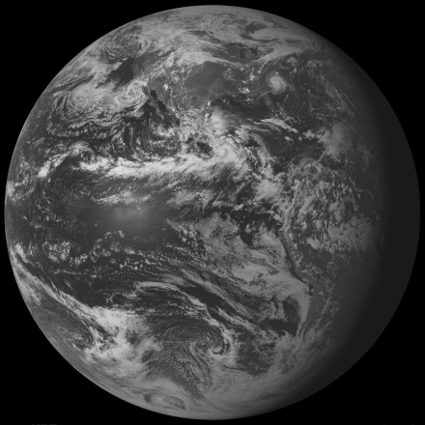
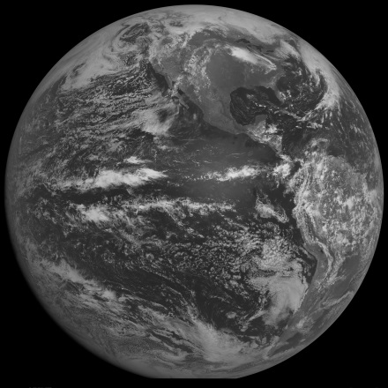
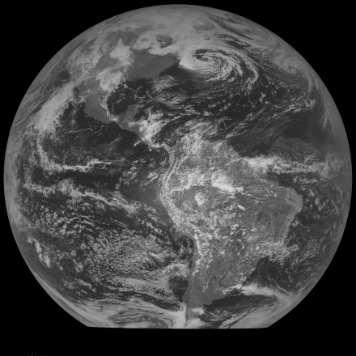
Future AMV Re-Processing? All on archive at UW-SSEC
GOES-1
GOES-2
GOES-3
GOES-4
GOES-5
GOES-6
GOES-7
SMS 1/2

Slide 22
Questions?
The tar/gzip'd file packages in:
http://tropic.ssec.wisc.edu/archive/data/goes_reprocess/wind_files

Slide 23
Backup Slides

Slide 24
Historical GOES East (Data)
Satellite | Years of Service
GOES-08 | 1 January 1995 – 1 April 2003
GOES-10 | 5 December 2007 – 17 December 2007
GOES-12 | 1 April 2003 – 4 December 2007 18 December 2007 – 14 December 2008 5 January 2009 – 14 April 2010
GOES-13 | 15 December 2008 – 4 January 2009 14 April 2010 – 23 September 2012 18 October 2012 – 22 May 2013 10 June 2013 - present
GOES-14 | 24 September 2012 – 17 October 2012 23 May 2013 – 10 June 2013
Launched April 13, 1994
Launched April 25, 1997
Launched July 23, 2001
Launched May 24, 2006
Launched June 27, 2009

Slide 25
Historical GOES West (Data)
Satellite | Years of Service
GOES-09 | 1 January 1996 – 21 July 1998
GOES-10 | 21 July 1998 – 21 June 2006
GOES-11 | 21 June 2006 – 6 December 2011
GOES-15 | 6 December 2011 - present
Launched May 23, 1995
Launched April 25, 1997
Launched May 3, 2000
Launched March 4, 2010

Slide 26
AMV Data Location
The tar/gzip'd file packages in:
http://tropic.ssec.wisc.edu/archive/data/goes_reprocess/wind_files
The file names are formatted [YYYYMM]-GOES-[E or W]-[NH or SH].tar.gz, where YYYY is the year, MM is the two digit month. For "E “or “W” use E for GOES-East or W for GOES-West. For "NH” or “SH" use NH for northern hemisphere or SH for southern hemisphere.
Use wget or curl for access. Future anonymous FTP?
wget http://tropic.ssec.wisc.edu/archive/data/goes_reprocess/wind_files/199501-GOES-E-NH.tar.gz
curl http://tropic.ssec.wisc.edu/archive/data/goes_reprocess/wind_files/199501-GOES-E-NH.tar.gz -O

Slide 27
Pre GVAR Data
Satellite | Potential Archive
GOES-01 [WestPac] | 2 December 1978 – 1 December 1979 29 November 1982 – 31 May 1983 30 April 1984 – 3 February 1985
GOES-02 [EastUSA] | 18 February 1978 – 26 January 1979
GOES-03 [WestUSA] | 20 December 1978 – 4 March 1981
GOES-04 [WestUSA] | 5 January 1981 – 25 November 1982
GOES-05 [EastUSA] | 6 August 1981 – 29 July 1985
GOES-06 [WestUSA and PrimeUSA] | 1 June 1983 – 2 April 1987 20 October 1987 – 21 January 1989
GOES-07 [East USA and PrimeUSA] | 25 March 1987 – 9 January 1996
SMS I [EastUSA] | 27 January 1979 – 19 April 1979
SMS II [EastUSA] | 20 April 1979 – 5 August 1981

Slide 28
Assimilation of AMVs
AMVs provided by CIMSS will use the features in place for the operational ECMWF NWP system (see talk by Niels Bormann for latest updates)
Notable differences
AMV data reprocessed by CIMSS are ingested from text format (OPS: BUFR)
Then converted into ODB2 and archived on the Observation Feedback Archive (OFA), an ERA-CLIM development of ECMWF MARS (Archive)
Then retrieved from the OFA during reanalysis production and merged with other AMV data for assimilation
Equivalent AMV data from same instrument already available in the ECMWF archive will be blacklisted (to avoid using data with two different processing's)
Blacklist of the reprocessed AMV data can benefit from a prior look at the whole time-series of observations (from the OFA) to spot potentially problematic time periods
Slide courtesy of Paul Poli

Slide 29
GOES East NHEM Images
GOES-E NH/CONUS triplets:
00:15, 00:45, 01:15 - 00:45, 01:02, 01:15
01:15, 01:45, 02:15 - 01:45, 02:02, 02:15
02:15, 02:45, 03:15 - 02:15, 02:32, 03:45
03:15, 03:45, 04:15 - 03:45, 04:02, 04:15
04:15, 04:45, 05:15 - 04:45, 05:02, 05:15
05:15, 05:45, 06:15 - 05:15, 05:32, 05:45
06:15, 06:45, 07:15 - 06:45, 07:02, 07:15
07:15, 07:45, 08:15 - 07:45, 08:02, 08:15
08:15, 08:45, 09:15 - 08:15, 08:32, 08:45
09:15, 09:45, 10:15 - 09:45, 10:02, 10:15
10:15, 10:45, 11:15 - 10:45, 11:02, 11:15
11:15, 11:45, 12:15 - 11:15, 11:32, 11:45
12:15, 12:45, 13:15 - 12:45, 13:02, 13:15
13:15, 13:45, 14:15 - 13:45, 14:02, 14:15
14:15, 14:45, 15:15 - 14:15, 14:32, 14:45
15:15, 15:45, 16:15 - 15:45, 16:02, 16:15
16:15, 16:45, 17:15 - 16:45, 17:02, 17:15
17:15, 17:45, 18:15 - 17:15, 17:32, 17:45
18:15, 18:45, 19:15 - 18:45, 19:02, 19:15
19:15, 19:45, 20:15 - 19:45, 20:02, 20:15
20:15, 20:45, 21:15 - 20:15, 20:32, 20:45
21:15, 21:45, 22:15 - 21:45, 22:02, 22:15
22:15, 22:45, 23:15 - 22:45, 23:02, 23:15
23:15, 23:45, 00:15 - 23:15, 23:32, 23:45

Slide 30
GOES East SHEM Images
GOES-E SH (0-20S/20S-50S) triplets:
00:15, 00:45, 01:15 - 00:39(G-13 only), 01:09, 01:39
01:15, 01:45, 02:15 - 01:39, 02:09, 02:39
02:15, 02:45, 03:15 - 02:39, 02:45, 03:39
03:15, 03:45, 04:15 - 03:39, 04:09, 04:39
04:15, 04:45, 05:15 - 04:39, 05:09, 05:39
05:15, 05:45, 06:15 - 05:39, 05:45, 06:39(G-12/13, G-8 2001 only)
06:15, 06:45, 07:15 - 06:39(G-12/13, G-8 2001 only), 07:09, 07:39
07:15, 07:45, 08:15 - 07:39, 08:09, 08:39
08:15, 08:45, 09:15 - 08:39, 08:45, 09:39
09:15, 09:45, 10:15 - 09:39, 10:09, 10:39
10:15, 10:45, 11:15 - 10:39, 11:09, 11:39
11:15, 11:45, 12:15 - 11:39, 11:45, 12:39(G-13 only)
12:15, 12:45, 13:15 - 12:39(G-13 only), 13:09, 13:39
13:15, 13:45, 14:15 - 13:39, 14:09, 14:39
14:15, 14:45, 15:15 - 14:39, 14:45, 15:39(not G-13)
15:15, 15:45, 16:15 - 15:39(not G-13), 16:09, 16:39
16:15, 16:45, 17:15 - 16:39, 17:09, 17:39
17:15, 17:45, 18:15 - 17:39, 17:45, 18:39(G-13 only)
18:15, 18:45, 19:15 - 18:39(G-13 only), 19:09, 19:39
19:15, 19:45, 20:15 - 19:39, 20:09, 20:39
20:15, 20:45, 21:15 - 20:39, 20:45, 21:39
21:15, 21:45, 22:15 - 21:39, 22:09, 22:39
22:15, 22:45, 23:15 - 22:39, 23:09, 23:39
23:15, 23:45, 00:15 - 23:39, 23:45, 00:39(G-13 only)

Slide 31
GOES West NHEM Images
GOES-W NH/CONUS triplets GOES-15 (GOES-9/10/11):
23:30, 00:00, 00:30 - 23:30, 23:45, 00:00
00:30, 01:00, 01:30 - 01:00, 01:15, 01:30 (00:45, 01:00, 01:15 could use for GOES-9/10/11)
01:30, 02:00, 02:30 - 01:45, 02:00, 02:15 (02:00, 02:15, 02:30 must use for GOES-9)
02:30, 03:00, 03:30 - 02:30, 02:45, 03:00
03:30, 04:00, 04:30 - 03:45, 04:00, 04:15 (04:00, 04:15, 04:30 must use for GOES-9/10/11)
04:30, 05:00, 05:30 - 04:45, 05:00, 05:15
05:30, 06:00, 06:30 - 05:30. 05:45, 06:00
06:30, 07:00, 07:30 - 06:45, 07:00, 07:15
07:30, 08:00, 08:30 - 07:45, 08:00, 08:15 (08:00, 08:15, 08:30 must use for GOES-9)
08:30, 09:00, 09:30 - 08:30, 08:45, 09:00
09:30, 10:00, 10:30 - 09:45, 10:00, 10:15 (10:00, 10:15, 10:30 GOES-9)
10:30, 11:00, 11:30 - 10:45, 11:00, 11:15
11:30, 12:00, 12:30 - 11:30, 11:45, 12:00
12:30, 13:00, 13:30 - 12:45, 13:00, 13:15
13:30, 14:00, 14:30 - 13:45, 14:00, 14:15 (14:00, 14:15, 14:30 must use for GOES-9)
14:30, 15:00, 15:30 - 14:30, 14:45, 15:00
15:30, 16:00, 16:30 - 15:45, 16:00, 16:15 (16:00, 16:15, 16:30 must use for GOES-9/10/11)
16:30, 17:00, 17:30 - 17:00. 17:15, 17:30 (16:45, 17:00, 17:15 could use for GOES-9/10/11)
17:30, 18:00, 18:30 - 17:30, 17:45, 18:00
18:30, 19:00, 19:30 - 18:45, 19:00, 19:15
19:30, 20:00, 20:30 - 19:45, 20:00, 20:15 (20:00, 20:15, 20:30 must use for GOES-9)
20:30, 21:00, 21:30 - None (20:30, 20:45, 21:00 must use for GOES-9/10/11)
21:30, 22:00, 22:30 - 21:45, 22:00, 22:15 (22:00, 22:15, 22:30 must use for GOES-9/10/11)
22:30, 23:00, 23:30 - 22:45, 23:00, 23:15

Slide 32
GOES West SHEM Images
GOES-W SH triplets GOES-W:
23:22, 23:52, 00:00
00:00, 00:52, 01:22
01:22, 01:52, 02:22 (unavailable for GOES-9)
02:22, 02:52, 03:00
03:00, 03:52, 04:22 (unavailable for GOES-10/11)
04:22, 04:52, 05:22
05:22, 05:52, 06:00
06:00, 06:52, 07:22
07:22, 07:52, 08:22 (unavailable for GOES-9)
08:22, 08:52, 09:00
09:00, 09:52, 10:22
10:22, 10:52, 11:22
11:22, 11:52, 12:00
12:00, 12:52, 13:22
13:22, 13:52, 14:22 (unavailable for GOES-9)
14:22, 14:53, 15:00
15:00, 15:52, 16:22 (unavailable for GOES-10/11)
16:22, 16:52, 17:22
17:22, 17:52, 18:00
18:00, 18:52, 19:22
19:22, 19:52, 20:22 (unavailable for GOEs-9)
20:22, 20:52, 21:00 (unavailable for GOES-15)
21:00, 21:52, 22:22 (unavailable for GOES-10/11)
22:22, 22:52, 23:22
Vis t<9 or t>15
Swir t> 3 and t<18

