Slide 1
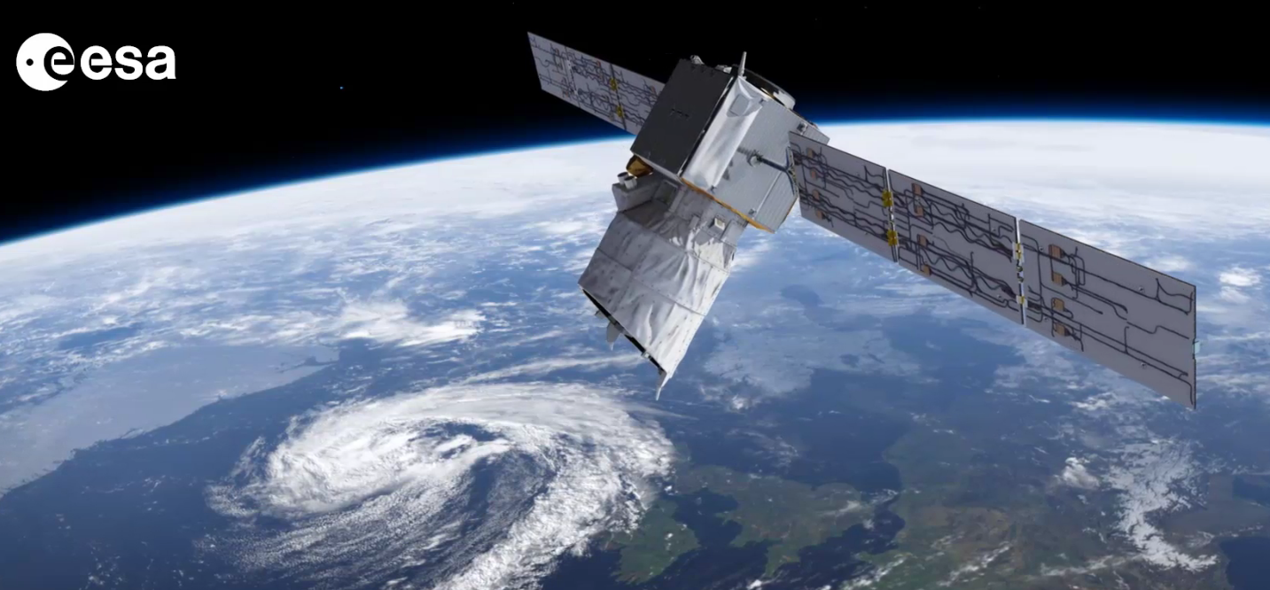
Aeolus preparations and indications of NWP impact by Michael Rennie, Andras Horanyi and Lars Isaksen Twelfth International Winds Workshop Acknowledgements: KNMI: Jos de Kloe, Ad Stoffelen, Gert-Jan Marseille; ECMWF: David Tan; DLR: Oliver Reitebuch; DoRIT: Dorit Huber; ESA/ESTEC: Anne Grete Straume, Frank de Bruin; Météo-France: Alain Dabas, Christophe Payan. Plus many other people who have contributed to the L2B/C processing over the years. The activities are supported by ESA contracts: 18555/04/NL/MM and 104080

Slide 2
Outline
Aeolus L2B wind product
Simulations of Aeolus
Impact of HLOS winds at ECMWF

Slide 3
1. What is Aeolus measuring?
Counting electrons (photons); output from spectrometers
Counts calibrated against frequency
Frequency shifts (Doppler effect) occur due to relative motion of emitter
Atmospheric molecules/particles are the emitter – average motion is the wind
At UV:
Rayleigh scattering: clear atmosphere
Mie scattering: top of dense clouds/aerosols; within/below partially transparent clouds/aerosols
Still optimistic for good NWP impact
Horizontal line-of-sight (HLOS) wind profiles – still lacking in GOS
Getting ready for a launch in late 2015

Slide 4
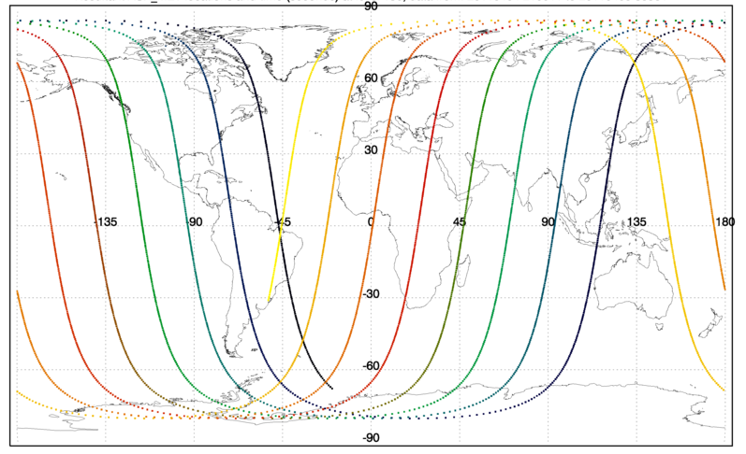
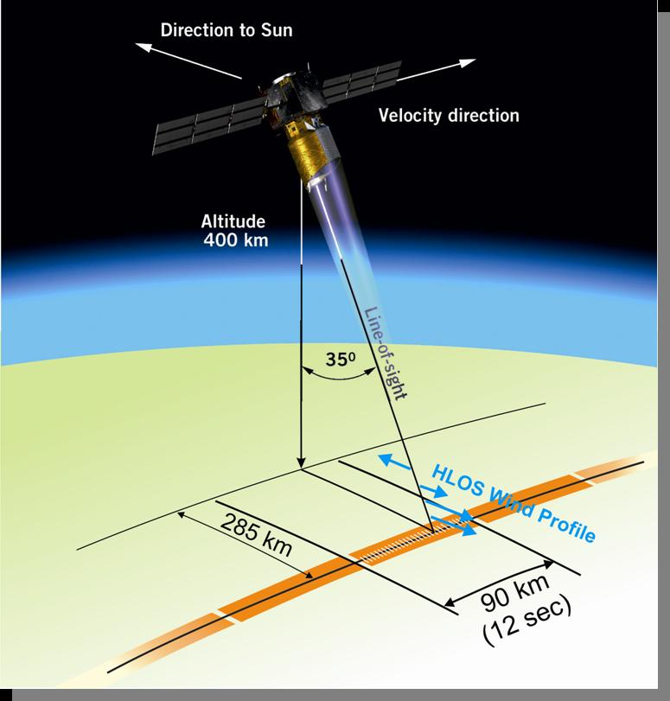
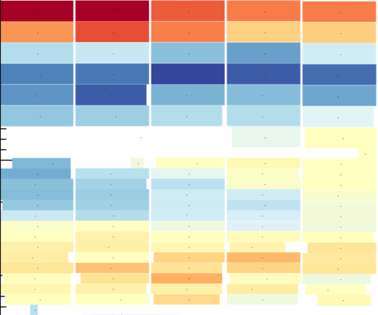
Sampling
12 hrs coverage, ~92K winds
Example of Aeolus vertical sampling
30 km ~10 hPa
16 km
16 km
Mie
Rayleigh
BRC
0 km
0 km
WGS84

Slide 5
Winds for NWP: Level-2B product
Level-2B processor provides
HLOS winds
Geolocated – geometric height, lat, lon, azimuth angle, time
Error estimates for each wind, quality flags
Flexible classification into wind types – cloudy or clear (currently)
Flexible horizontal averaging of spectrometer counts
Some control of noise and representativity of observations
Rayleigh winds corrected for temperature, pressure and Mie cross-talk
In future: estimates of optical properties (KNMI)
Many processing options controllable from settings file
Research mission; encourage users to play with L2B processor
Notes:
20 shots per measurement

Slide 6
L2B processor software package:
Available to download (e.g. for use by NWP centres):
http://www.ecmwf.int/en/research/projects/aeolus
Code, documentation, test data
Highly portable (mostly Fortran)
New version (2.10) available soon with:
L2B EE-to-BUFR converter
Much improved speed; bug fixes
Notes:
L2Bp developed by ECMWF, KNMI, DLR and Météo-France since 2006
CM=continuous mode, BM=burst mode
Documentation and source code available, e.g. for NWP centres and researchers
Shown to be highly portable by testing in many different linux/unix environments and with many different compilers
Grouping algorithm allows control over which measurements (how many) go on to be processed to a wind observation. I.e. control of error levels, representative scales of observations

Slide 7
Aeolus at ECMWF
http://www.ecmwf.int/en/research/projects/aeolus
Develop L2B processor (with KNMI)
Operational L2B processing:
During mission lifetime;
products sent to ESA
Linked to data assimilation cycles for a priori T, p
Advanced monitoring of Aeolus data
Involved in CAL/VAL during Commissioning Phase
Assimilate if proven positive impact
Notes:
L2Bp can be integrated at the Fortran subroutine level into NWP systems also.

Slide 8
2. Simulating Aeolus winds
Preparing processors with simulations:
Indications of Aeolus observation quality
CALIPSO/ECMWF optical data
Atmospheric database
Aeolus simulation
Aeolus raw data
L0/L1A/L1B processing
ECMWF data: T, p, HLOS
L1B products
Verification statistics
Verification tool
L2B products
L2B processing
Notes:
The processsing of the simulated raw Aeolus measurements is done with the to be opertaional processors, i.e. the L1B followed by L2B processors.

Slide 9
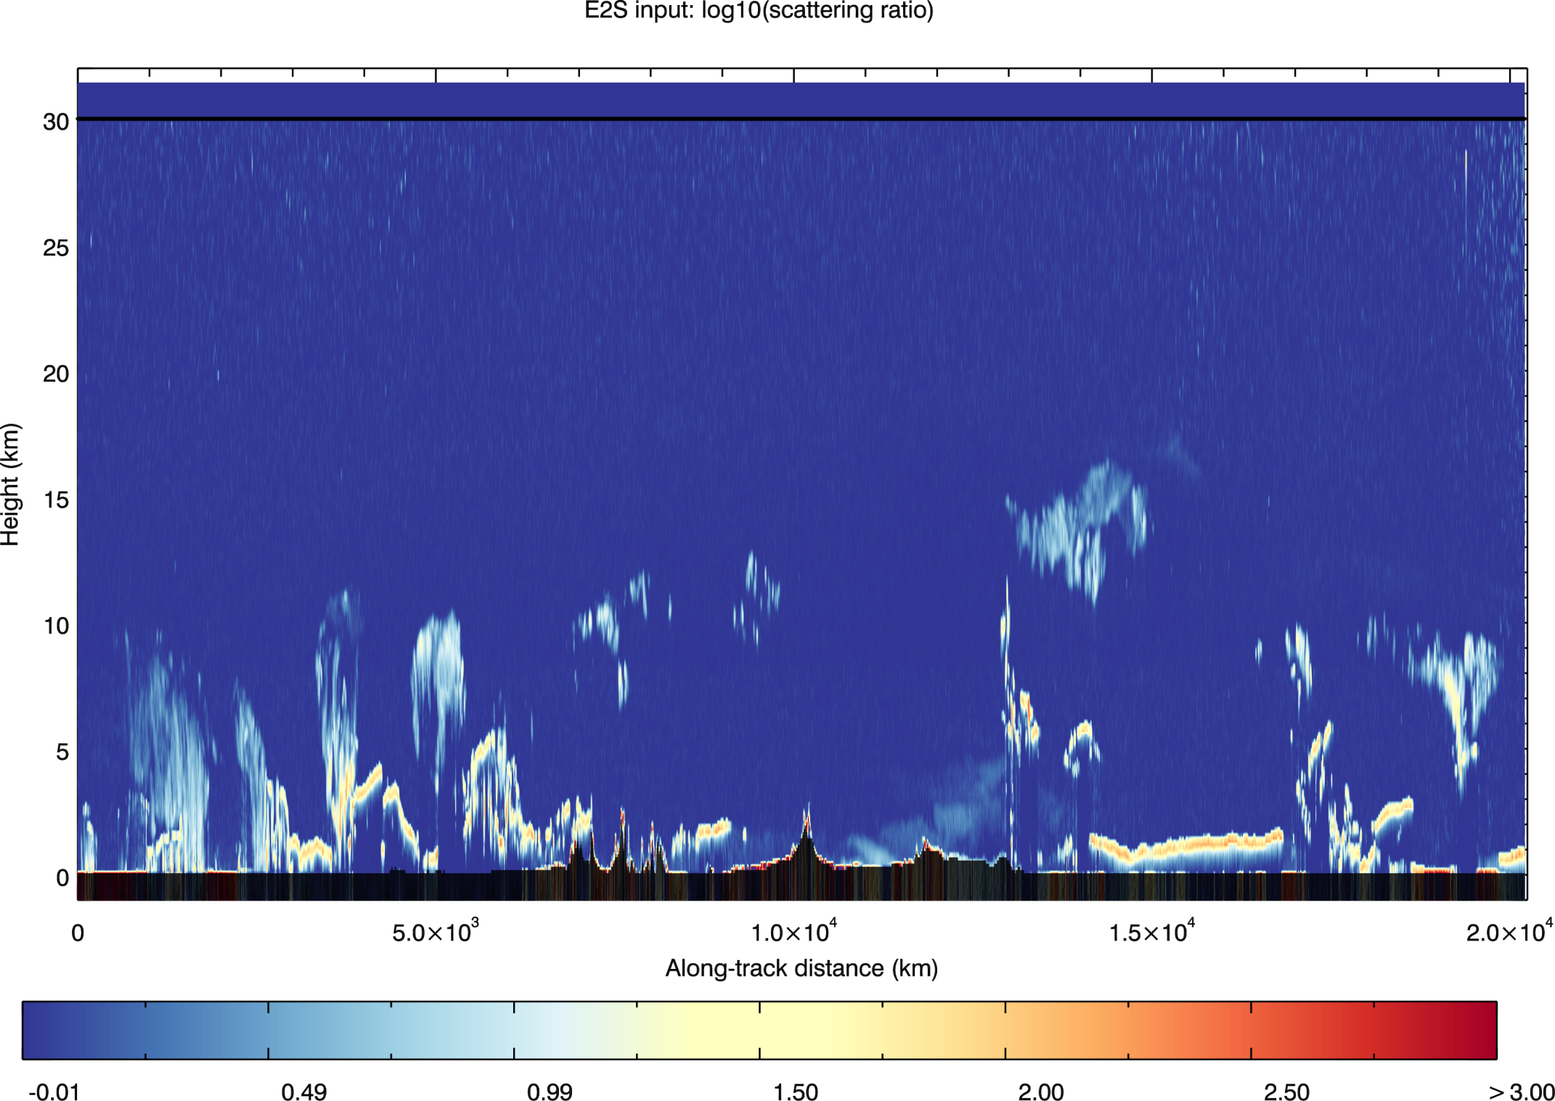
Example simulator input Derived CALIPSO log₁₀(scattering ratio) 355 nm (KNMI)
Ice cloud:tropical cirrus
Saharan dust
Frontal system cloud
Ice cloud:cirrus

Slide 10
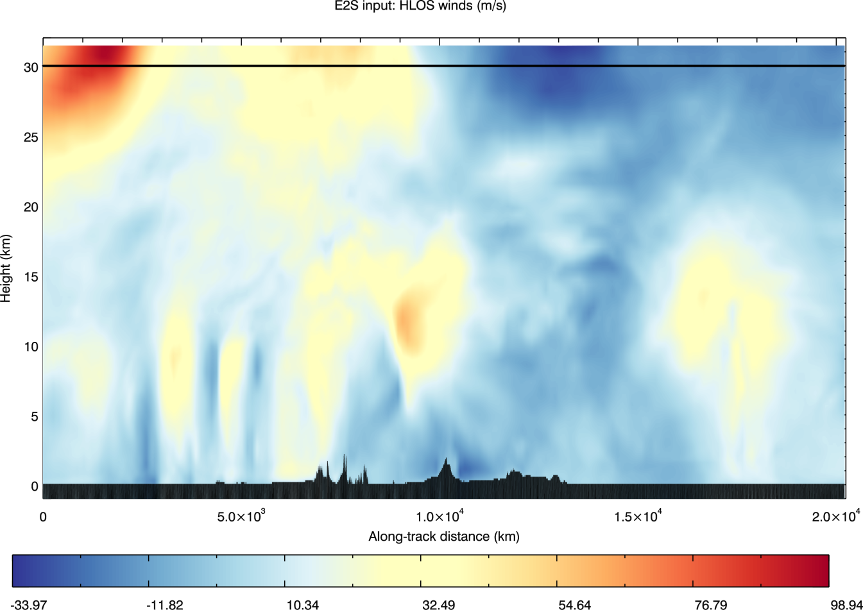
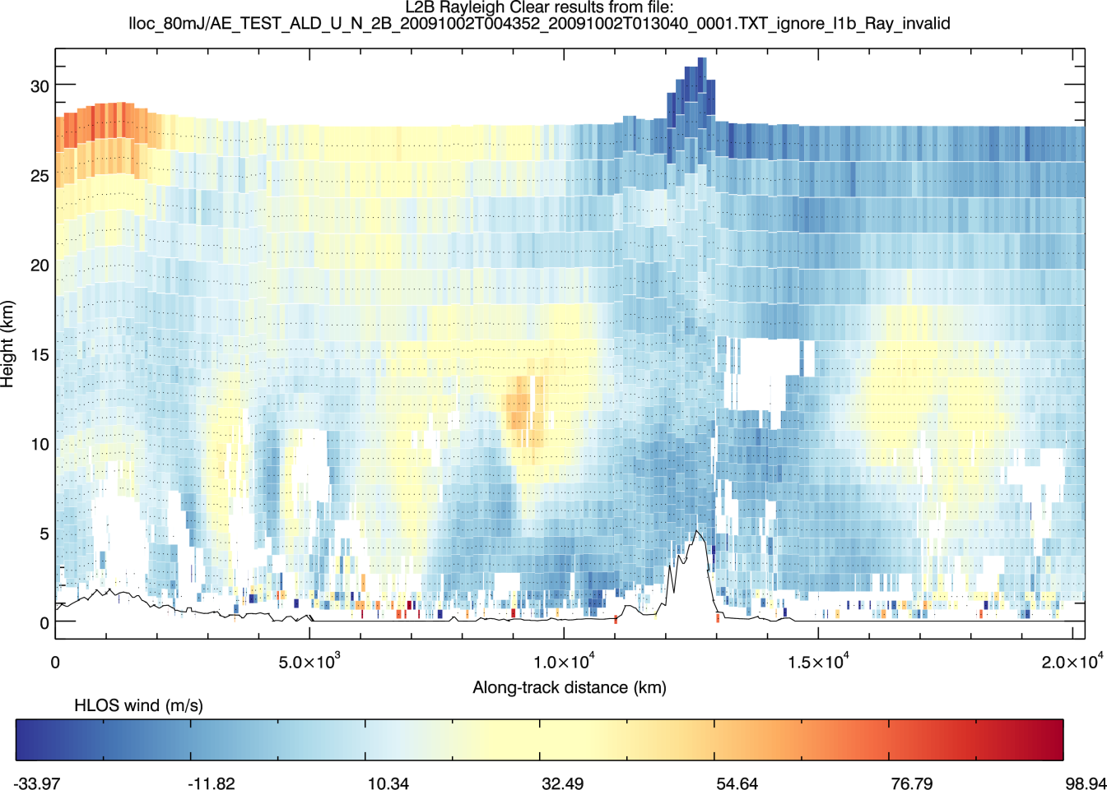
Simulator input: “True” HLOS wind (ECMWF)
Output: L2B “clear-Rayleigh” HLOS wind
Notes:
Polar jet stream partially obscured by cloud
Extensive coverage along the “curtain” of the orbital ground-track

Slide 11
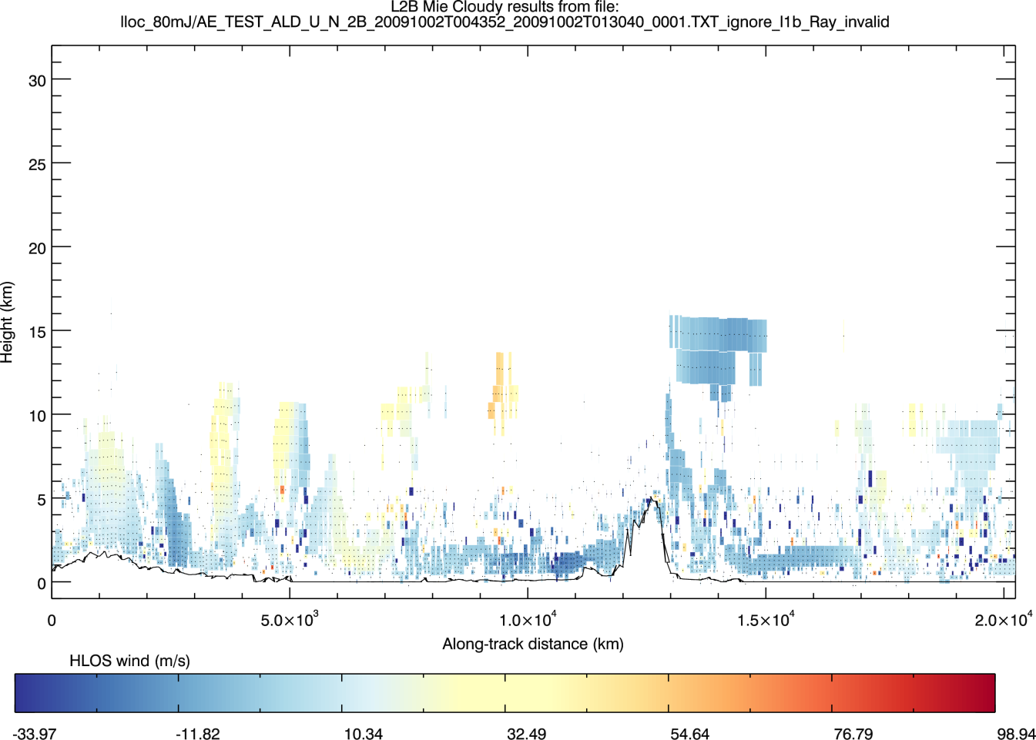
Simulator input: “True” HLOS wind (ECMWF)
Output: L2B “cloudy-Mie” HLOS wind
Notes:
Polar jet stream partially obscured by cloud
Extensive coverage along the “curtain” of the orbital ground-track

Slide 12
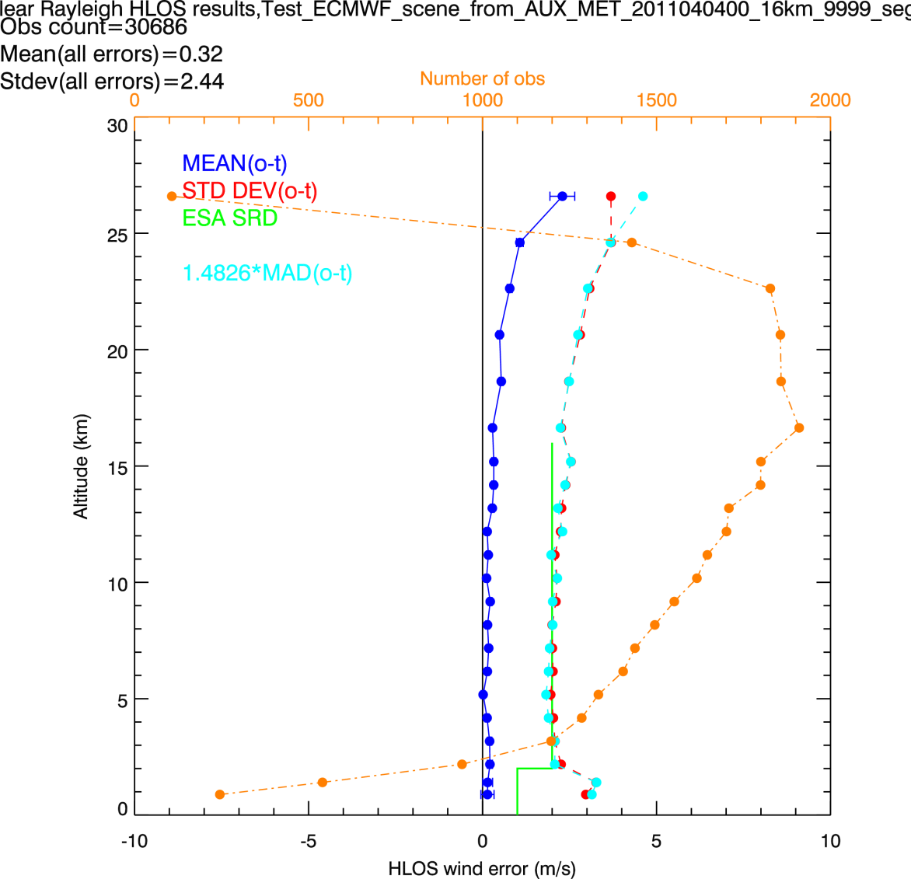
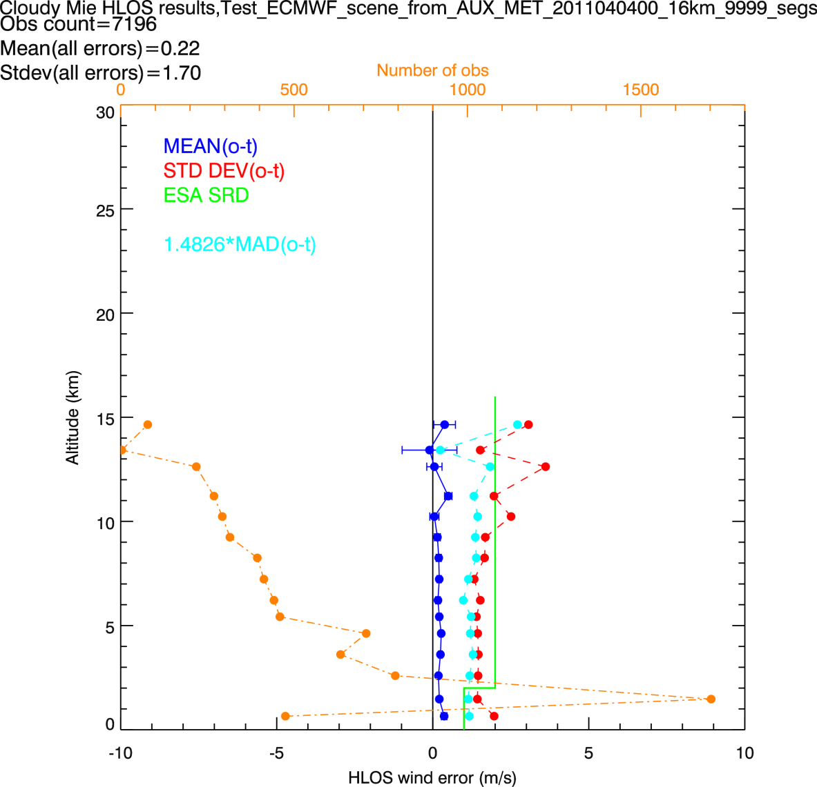
Example L2B HLOS error statistics
Rayleigh-clear
Mie-cloudy
Notes:
Based on 4 orbits. Using ECMWF cloud properties for cloud backscatter
80 mJ laser
1 BRC horizontal averaging
Stats are sensitive to QC; QC applied:
reject > 5 m/s error estimates on Rayleigh
Reject > 3 m/s error estimates on Mie

Slide 13
Simulated Aeolus L2B wind quality
Random errors:
1.5-3 m/s standard deviation
Systematic errors:
Some surprises; larger than hoped for
One source of Rayleigh bias will be corrected soon
Mie biases: wind shear/thick range bins/thin particle layers
Caveat:
Simulations!
Real data will probably be different
Worth it?
Have fixed many bugs with this process

Slide 14
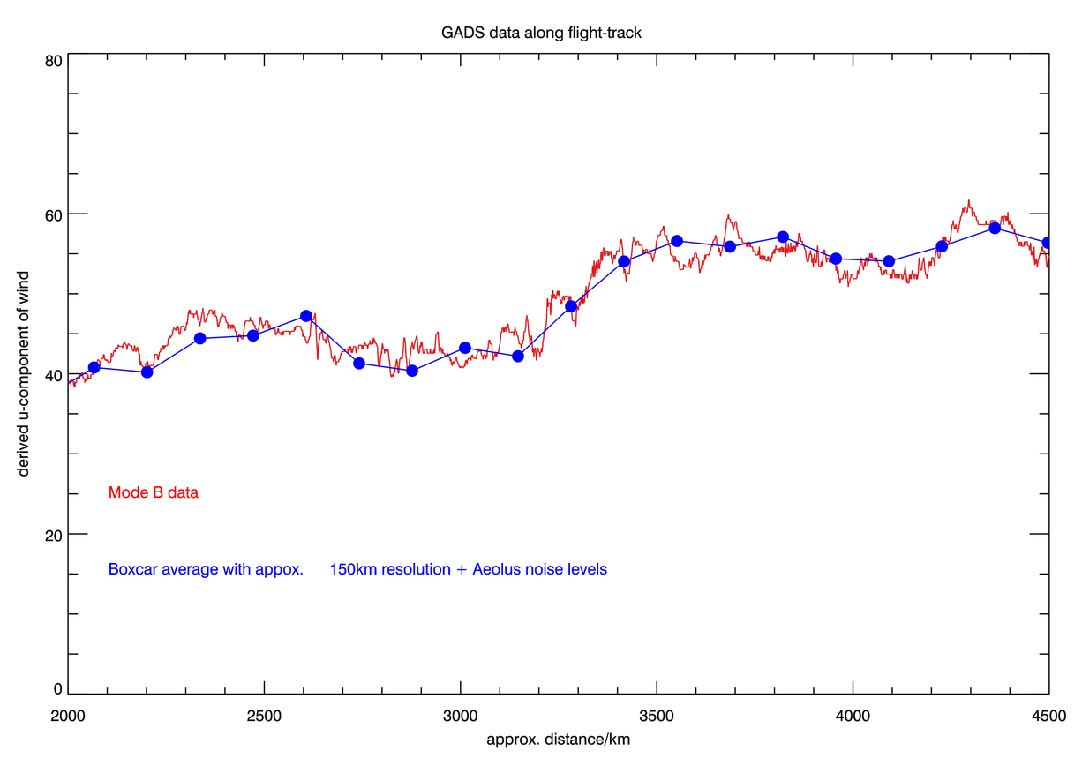
u-component of wind; Aeolus-like averaging (150 km) + 1.6 m/s noise (~Rayleigh channel)
m/s
100 km
1 km horiz. res. aircraft winds

Slide 15
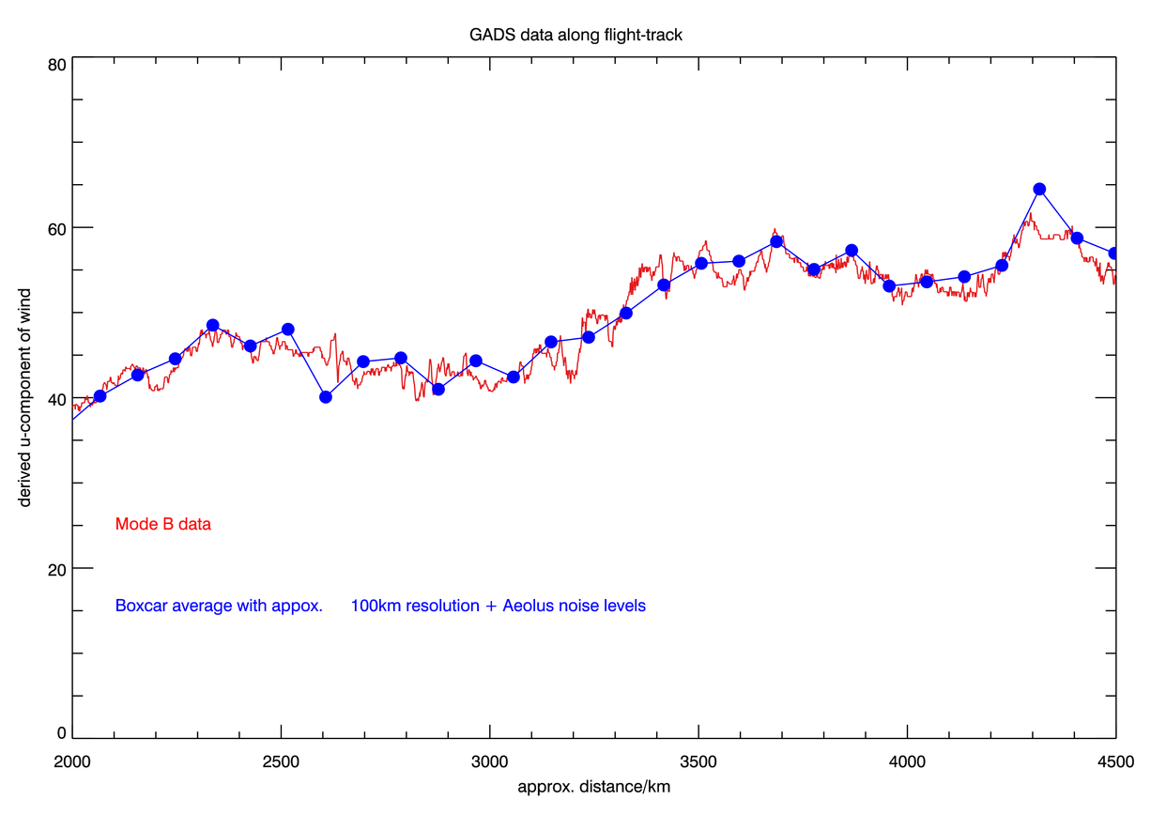
100 km averaging + appropriate noise (2 m/s)
100 km
Notes:
Random sample of Aeolus noise. 2 m/s when averaging to 100 km.

Slide 16
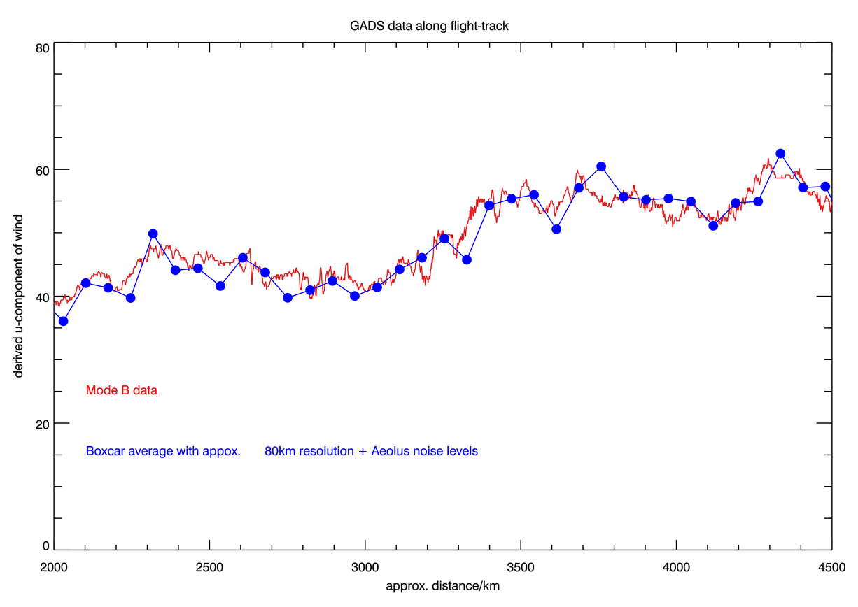
80 km averaging + appropriate noise (2.2 m/s)
100 km

Slide 17
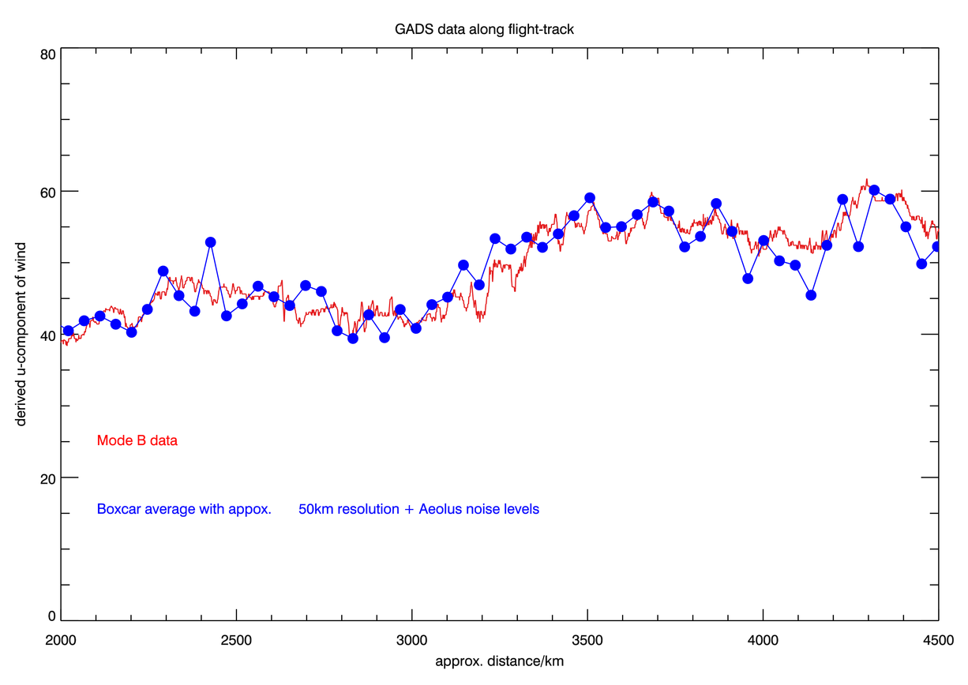
50 km averaging + appropriate noise (2.8 m/s)
100 km

Slide 18
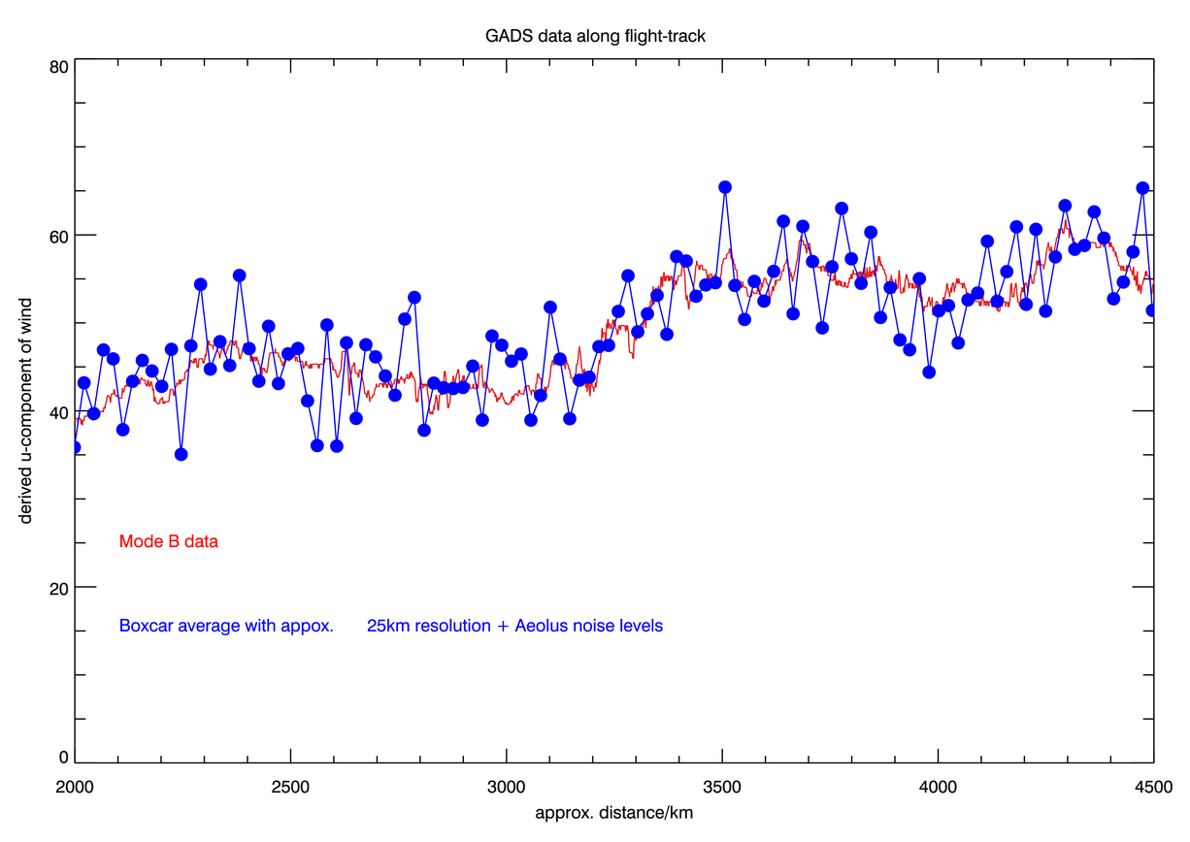
25 km averaging + appropriate noise (4 m/s)
100 km
Small-scale structure would be lost in Aeolus instrument noise

Slide 19
3. Wind impact investigation at ECMWF work by A. Horanyi , C. Cardinali, M. Rennie and L. Isaksen
1 month OSEs using in situ observations:
aircraft; radiosondes; PILOT and wind profilers
Assessed impact of:
Different combinations of wind and mass obs (u, v, T and q)
which gives most impact relative to current OS?
Assimilation of HLOS winds
convert (u, v) → HLOS
can real single-component wind give useful impact?
Increasing HLOS random and systematic error
what reduction in accuracy can we tolerate?
indications for Aeolus

Slide 20
OSE results: comparison of different experiments
Reference = no upper-air in situ obs
Impact HLOS ~0.7 (vector wind)
Impact wind obs > twiceT,q
Increasing random noise on HLOS leads to relatively small degradation
Adding bias > 1 m/s is very damaging to the impact
u gives more impact than v
Vertically integrated total energy

Slide 21
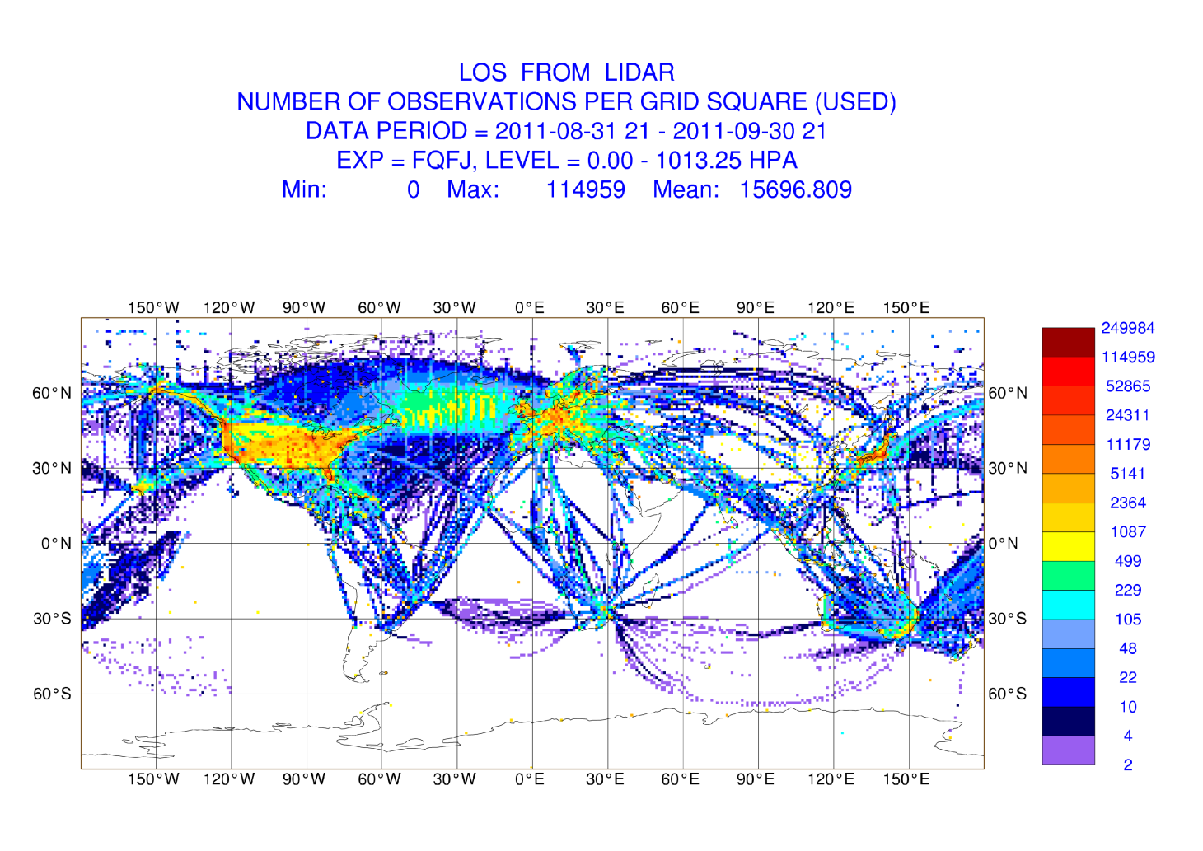
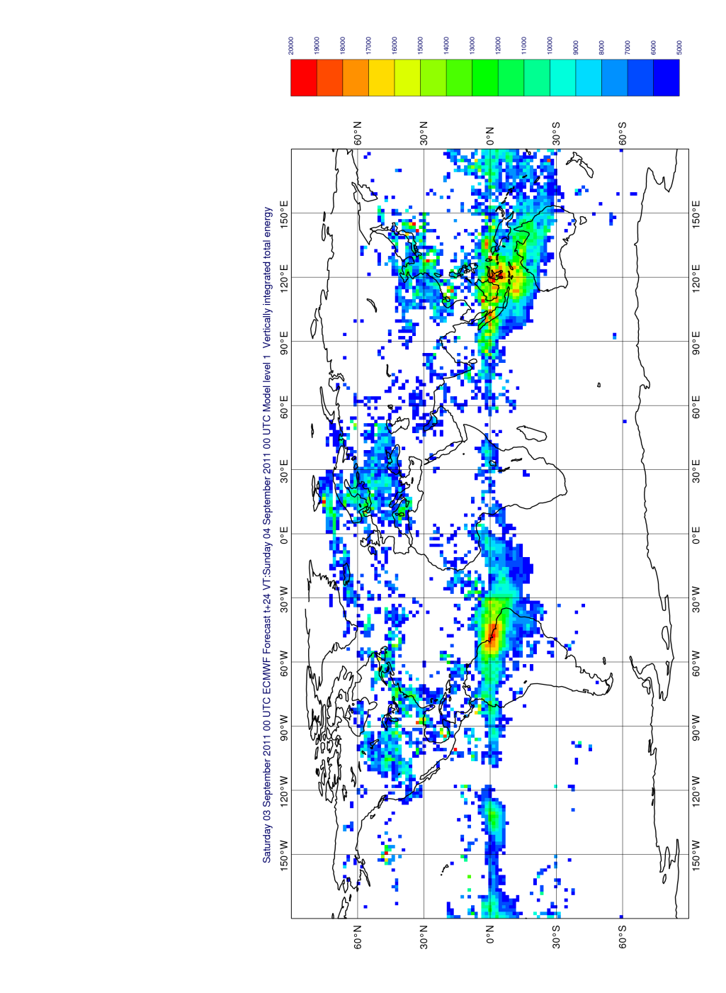
Distribution of observations
mostly aircraft at 100-400 hPa
OSE results: Impact of zonal HLOS
largest in tropical regions
Impact also larger in data-rich areas
Metric: reduction of vertically integrated total energy error for 24 hr FC
Notes:
Aeolus will of course sample the SH very well, so potential for good impacts there.

Slide 22
Summary of impact experiments
Wind and mass comparison:
wind more beneficial than mass when added on top of the full satellite observing system
particularly in Tropics
HLOS assimilation:
HLOS gives large fraction of vector wind impact – promising for Aeolus
Zonal component impact a bit larger than meridional
Larger random errors not too damaging
2 m/s bias: large negative impact – therefore critical to minimise Aeolus “unknown” biases
study has limitations for assessing Aeolus potential impact
Paper submitted to QJRMS
Notes:
The assimilation of horizontal line-of-sight wind information into the ECMWF data assimilation and forecasting system

Slide 23
Thanks for listening. Any questions?
Aeolus L2B processing software available to download:
http://www.ecmwf.int/en/research/projects/aeolus

Slide 24
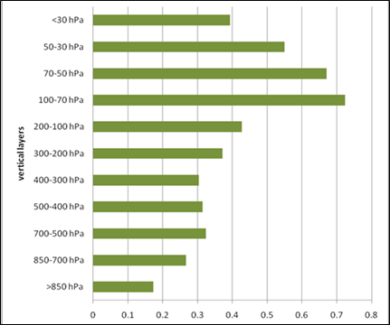
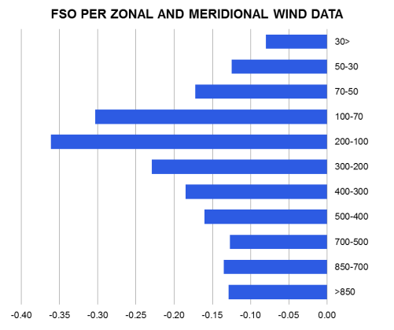
Wind vector impact per ob; dependence on height
DFS per ob
Forecast error contribution per ob
70-200 hPa winds provide most impact per ob. Therefore can expect new obs to be most beneficial here – Aeolus should provides lot of Rayleigh and Mie winds here
Notes:
Particularly Rayleigh winds, or Mie in tropical cirrus

Slide 25
L2Bp inputs
ESA provide:
L1B data (typically 1 file per orbit)
Measurement level spectrometer counts
Geolcation information
Uncorrected Rayleigh winds
Mie calibration information
Zero wind correction
AUX_RBC_L2: Rayleigh calibration taking account of T and p dependence (uncertain, but perhaps once per week)
Users provide:
AUX_MET; profiles of T, p along Aeolus orbit
AUX_PAR_2B; processor settings file

