Slide 1
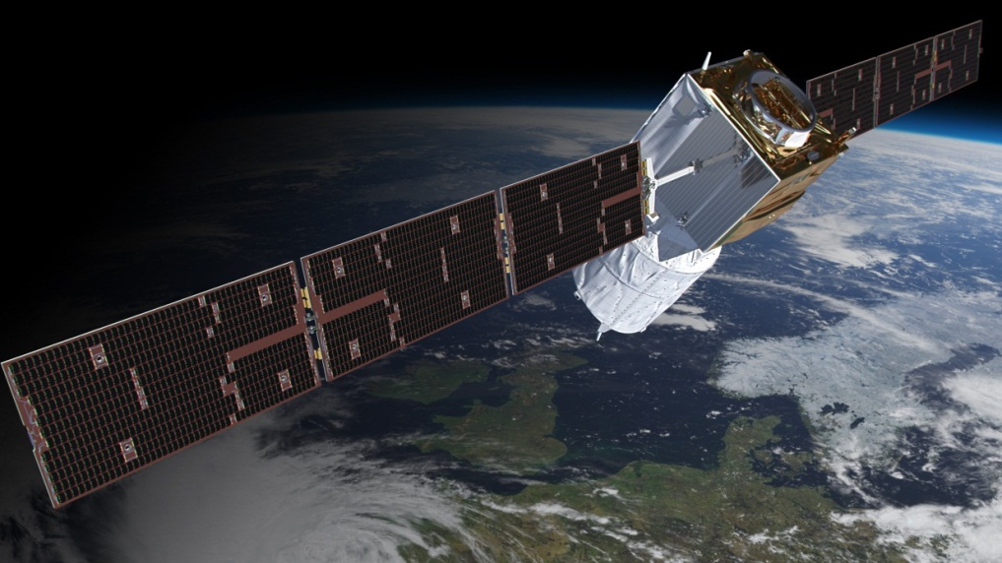
Status of the ADM-Aeolus wind lidar mission
A.G. Straume¹, A. Elfving¹, F. de Bruin¹, A. Culoma¹, T. Kanitz¹, G. Labruyere¹ , L. Mondin¹, D. Wernham¹, D. Schuettemeyer¹, F. Buscaglione², A. Dehn², S. Casadio², W. Lengert²
¹ESA-ESTEC, The Netherlands, ²ESA-ESRIN, Italy
http://www.esa.int/esaLP/LPadmaeolus.html

Slide 2
Aeolus teams
The Aeolus Mission Advisory Group
Angela Benedetti / ECMWF
Alain Dabas / MeteoFrance
Pierre Flamant / IPSL
Mary Forsythe / MetOffice
Erland Källén / ECMWF
Heiner Körnich / MISU
Harald Schyberg / met.no
Ad Stoffelen / KNMI
Oliver Reitebuch / DLR
Michael Vaughan / Lidar & Optics Associates
The Aeolus L1b, L2a and L2b algorithm development teams (DLR, ECMWF, IPSL, KNMI, MétéoFrance)
ESA Aeolus project and support teams (ESTEC, ESRIN, ESOC)
Airbus Defence and Space, and subcontractors

Slide 3
Outline
ESA’s Earth Observation programme
Scientific motivation for ESA’s Doppler wind lidar mission
Instrument and measurement principle
Mission products and their envisaged use
Campaigns and CAL/VAL
Programmatic status
Conclusions

Slide 4
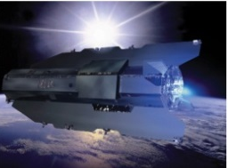
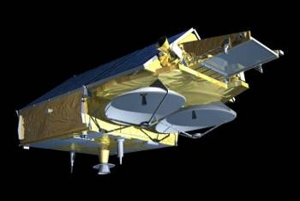
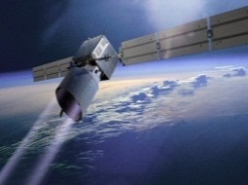
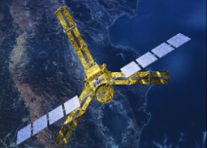
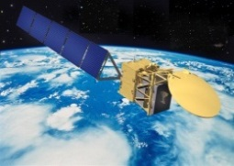
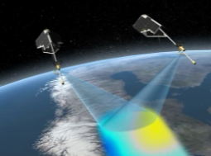
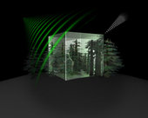
ESA’s Earth Observation Programme
ERS1
ERS2
Envisat
Meteosat
Earth Explorers
Research driven
Earth Watch
Service driven
Core Missions
Opportunity Missions
Operational Meteorology
COPERNICUS
GOCE
2009
CryoSat 2
2010
MSG
MTG
Metop
Metop SG
Sentinel 1
Sentinel 2
Sentinel 3
ADM-Aeolus
2015
SMOS
2009
Sentinel 4
Sentinel 5/5p
EarthCARE
2016
Swarm
2013
www.esa.int/livingplanet
BIOMASS
2020
?
2 candidates
CarbonSat, FLEX
EE8
2022

Slide 5
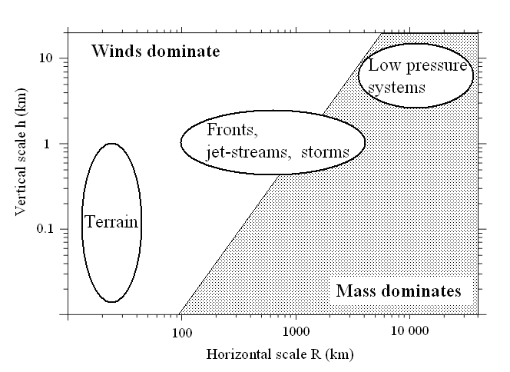
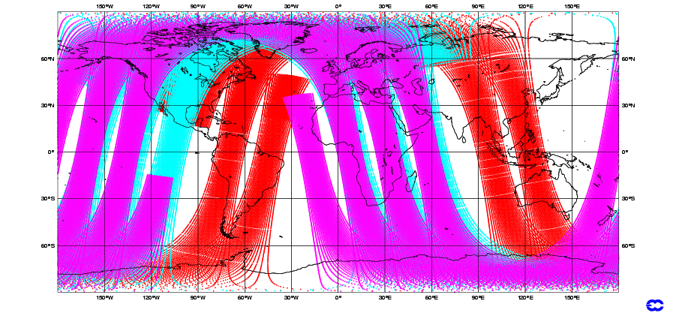
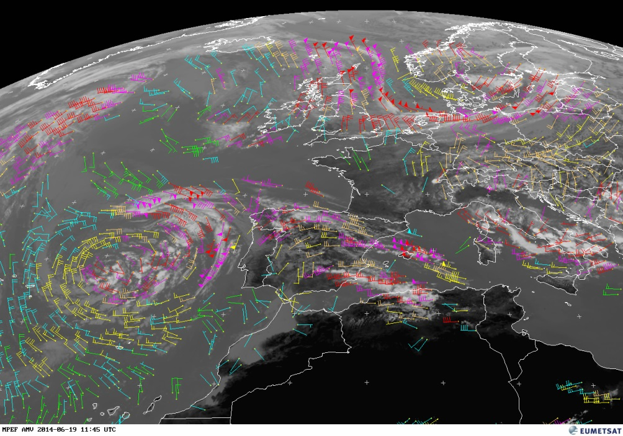
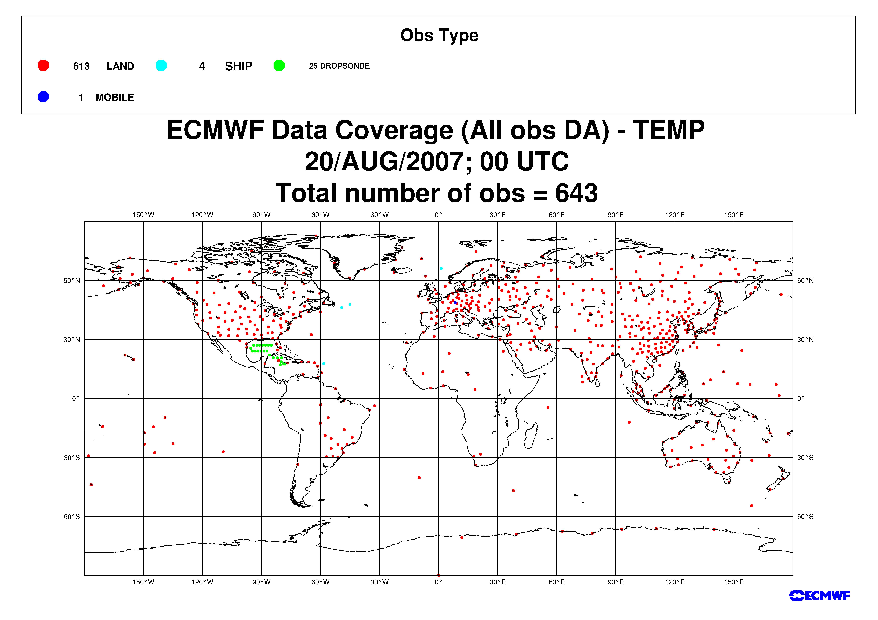
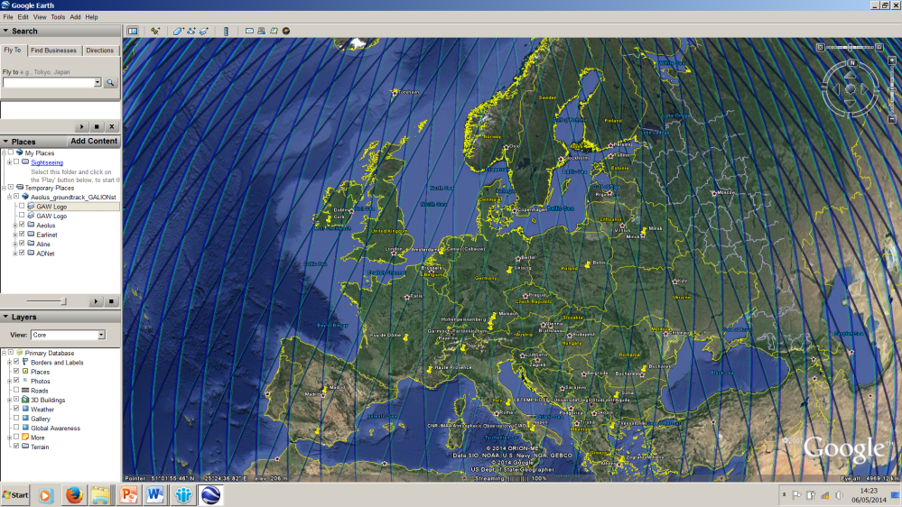
The importance of direct wind observations
Global temperature soundings
ROSSBY RADIUS OF DEFORMATION
Direct wind observations are important at smaller scales
Direct wind profile soundings (radiosondes)
g: gravitational acceleration, h: altitude, ω: angular
velocity of Earth’s rotation, φ: latitude (here 45°)
Aeolus sampling in 1 week

Slide 6
Aeolus objectives
What are the scientific requirements?
Improve our understanding and predictability of
Atmospheric dynamics and global atmospheric transport
Global cycling of energy, water, aerosols, chemicals
How are they achieved?
Improved atmospheric analysis fields through use of Aeolus winds, in particular:
Tropics: Wind fields governs dynamics
Mid-latitudes: Intense storm developments and mesoscale circulation
What are the benefits?
Better initial conditions for weather forecasting
Improved parameterisation and modelling of atmospheric processes in climate and forecast models
Demonstrate the capabilities of space-based Doppler Wind LIDARs (DWLs) for global wind profiling and its potential for operational use

Slide 7
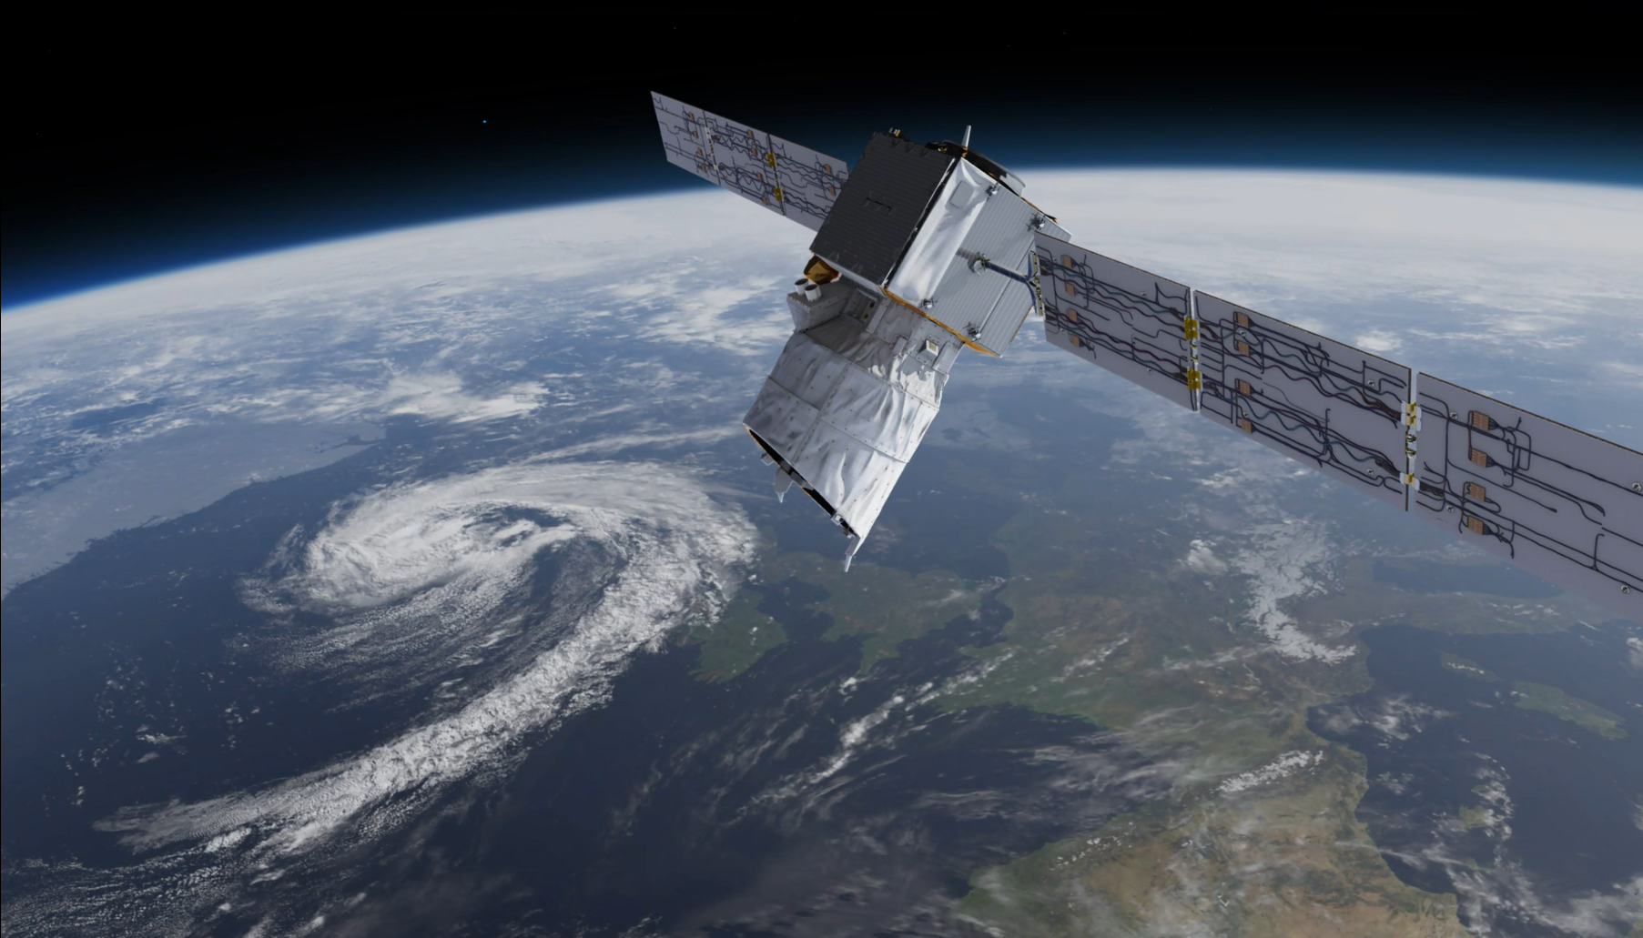
Aeolus Mission
Doppler Wind Lidar
Direct Detection System
High Spectral Resolution
355 nm

Slide 8
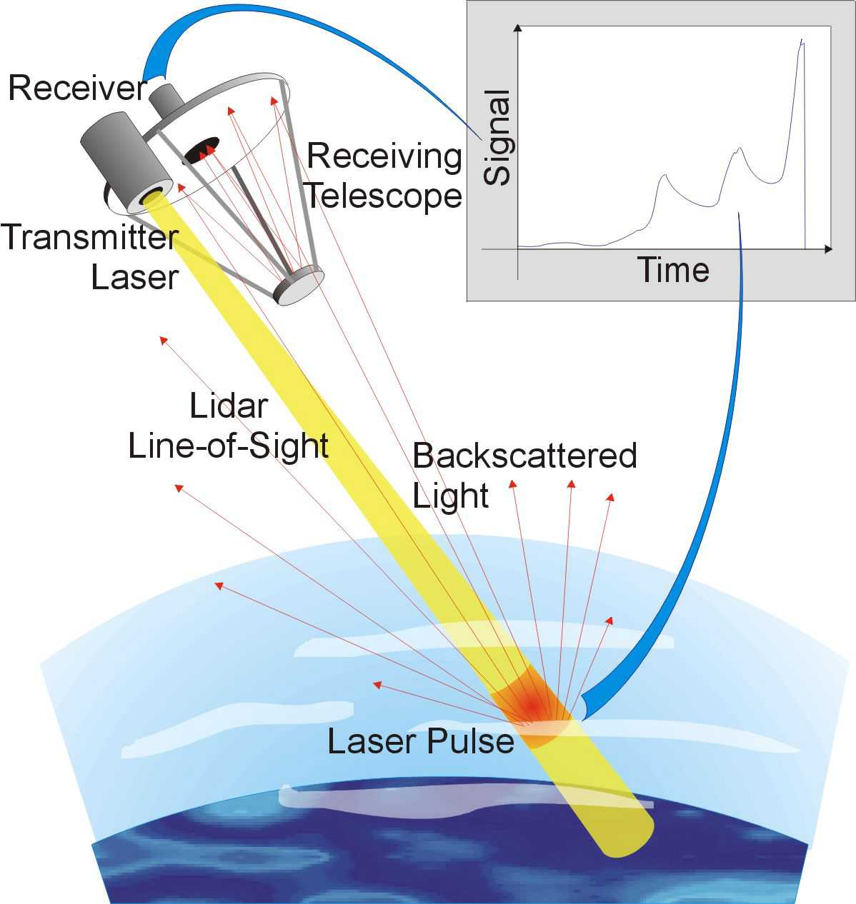
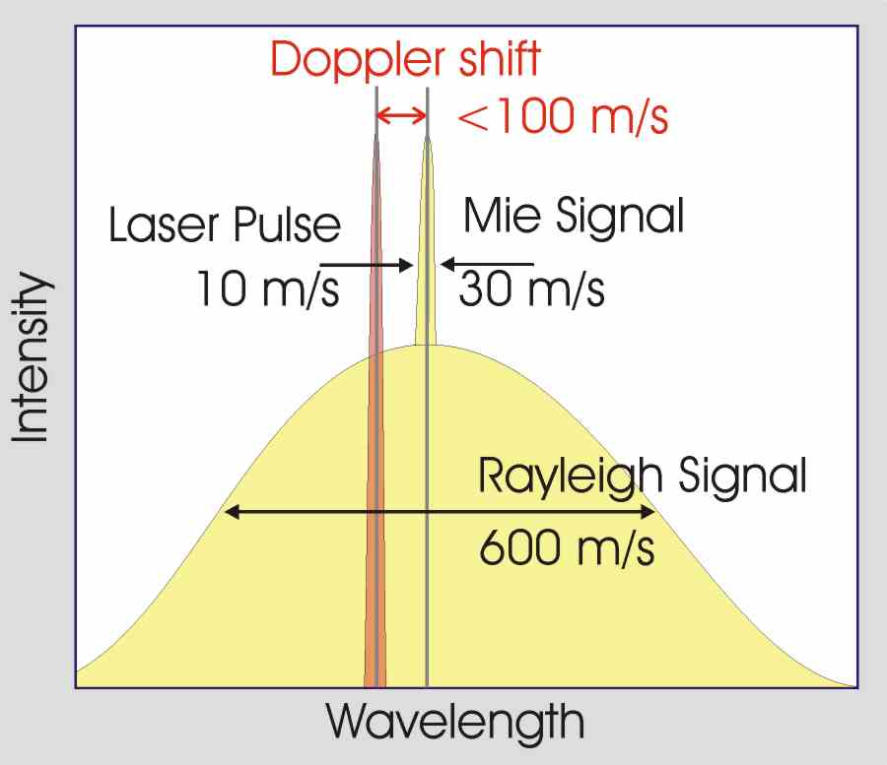
Aeolus measurement concept
Monostatic emit-receive path
(shown skewed)
(= height)
(ALADIN)
80 mJ, 50 Hz
Wind and atmospheric optical properties profile measurements are derived from the Doppler shifted signals that are back-scattered along the lidar line-of-sight (LOS)

Slide 9
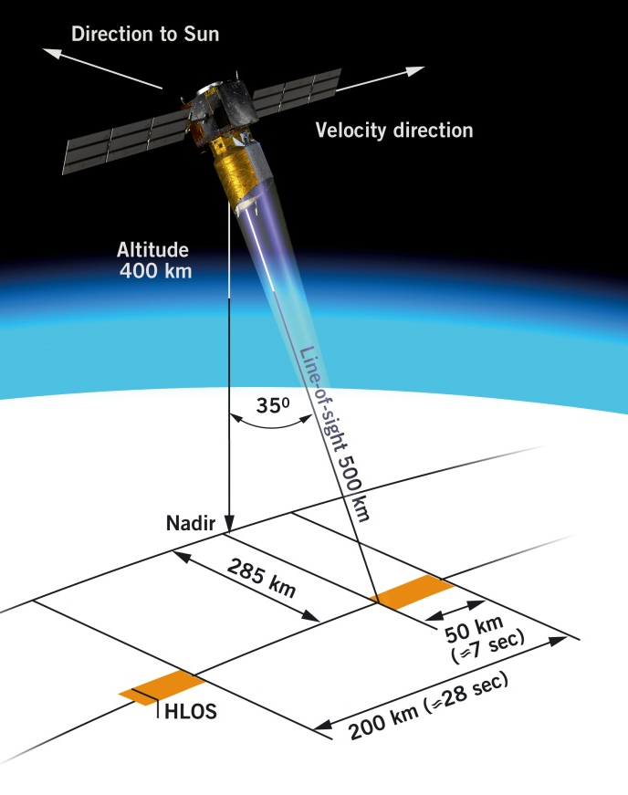
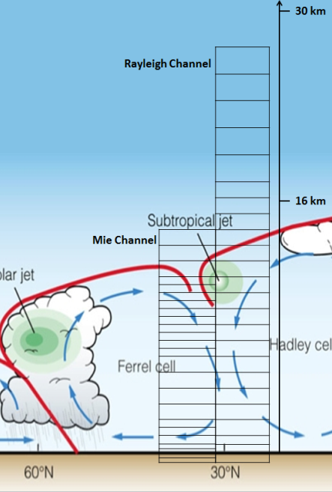
Measurement baseline
Old measurement baseline
High Spectral Resolution: Separate molecular and a particle backscatter receivers
UV (355 nm , circularly polarized)
Cross-linear polarized light detected in polarizing scenes
Ground calibration (nadir and off-nadir)
Adjustable vertical sampling of atmospheric layers
Δz: 0.25–2 km
z: 0-30 km
Example of ADM-Aeolus vertical sampling

Slide 10
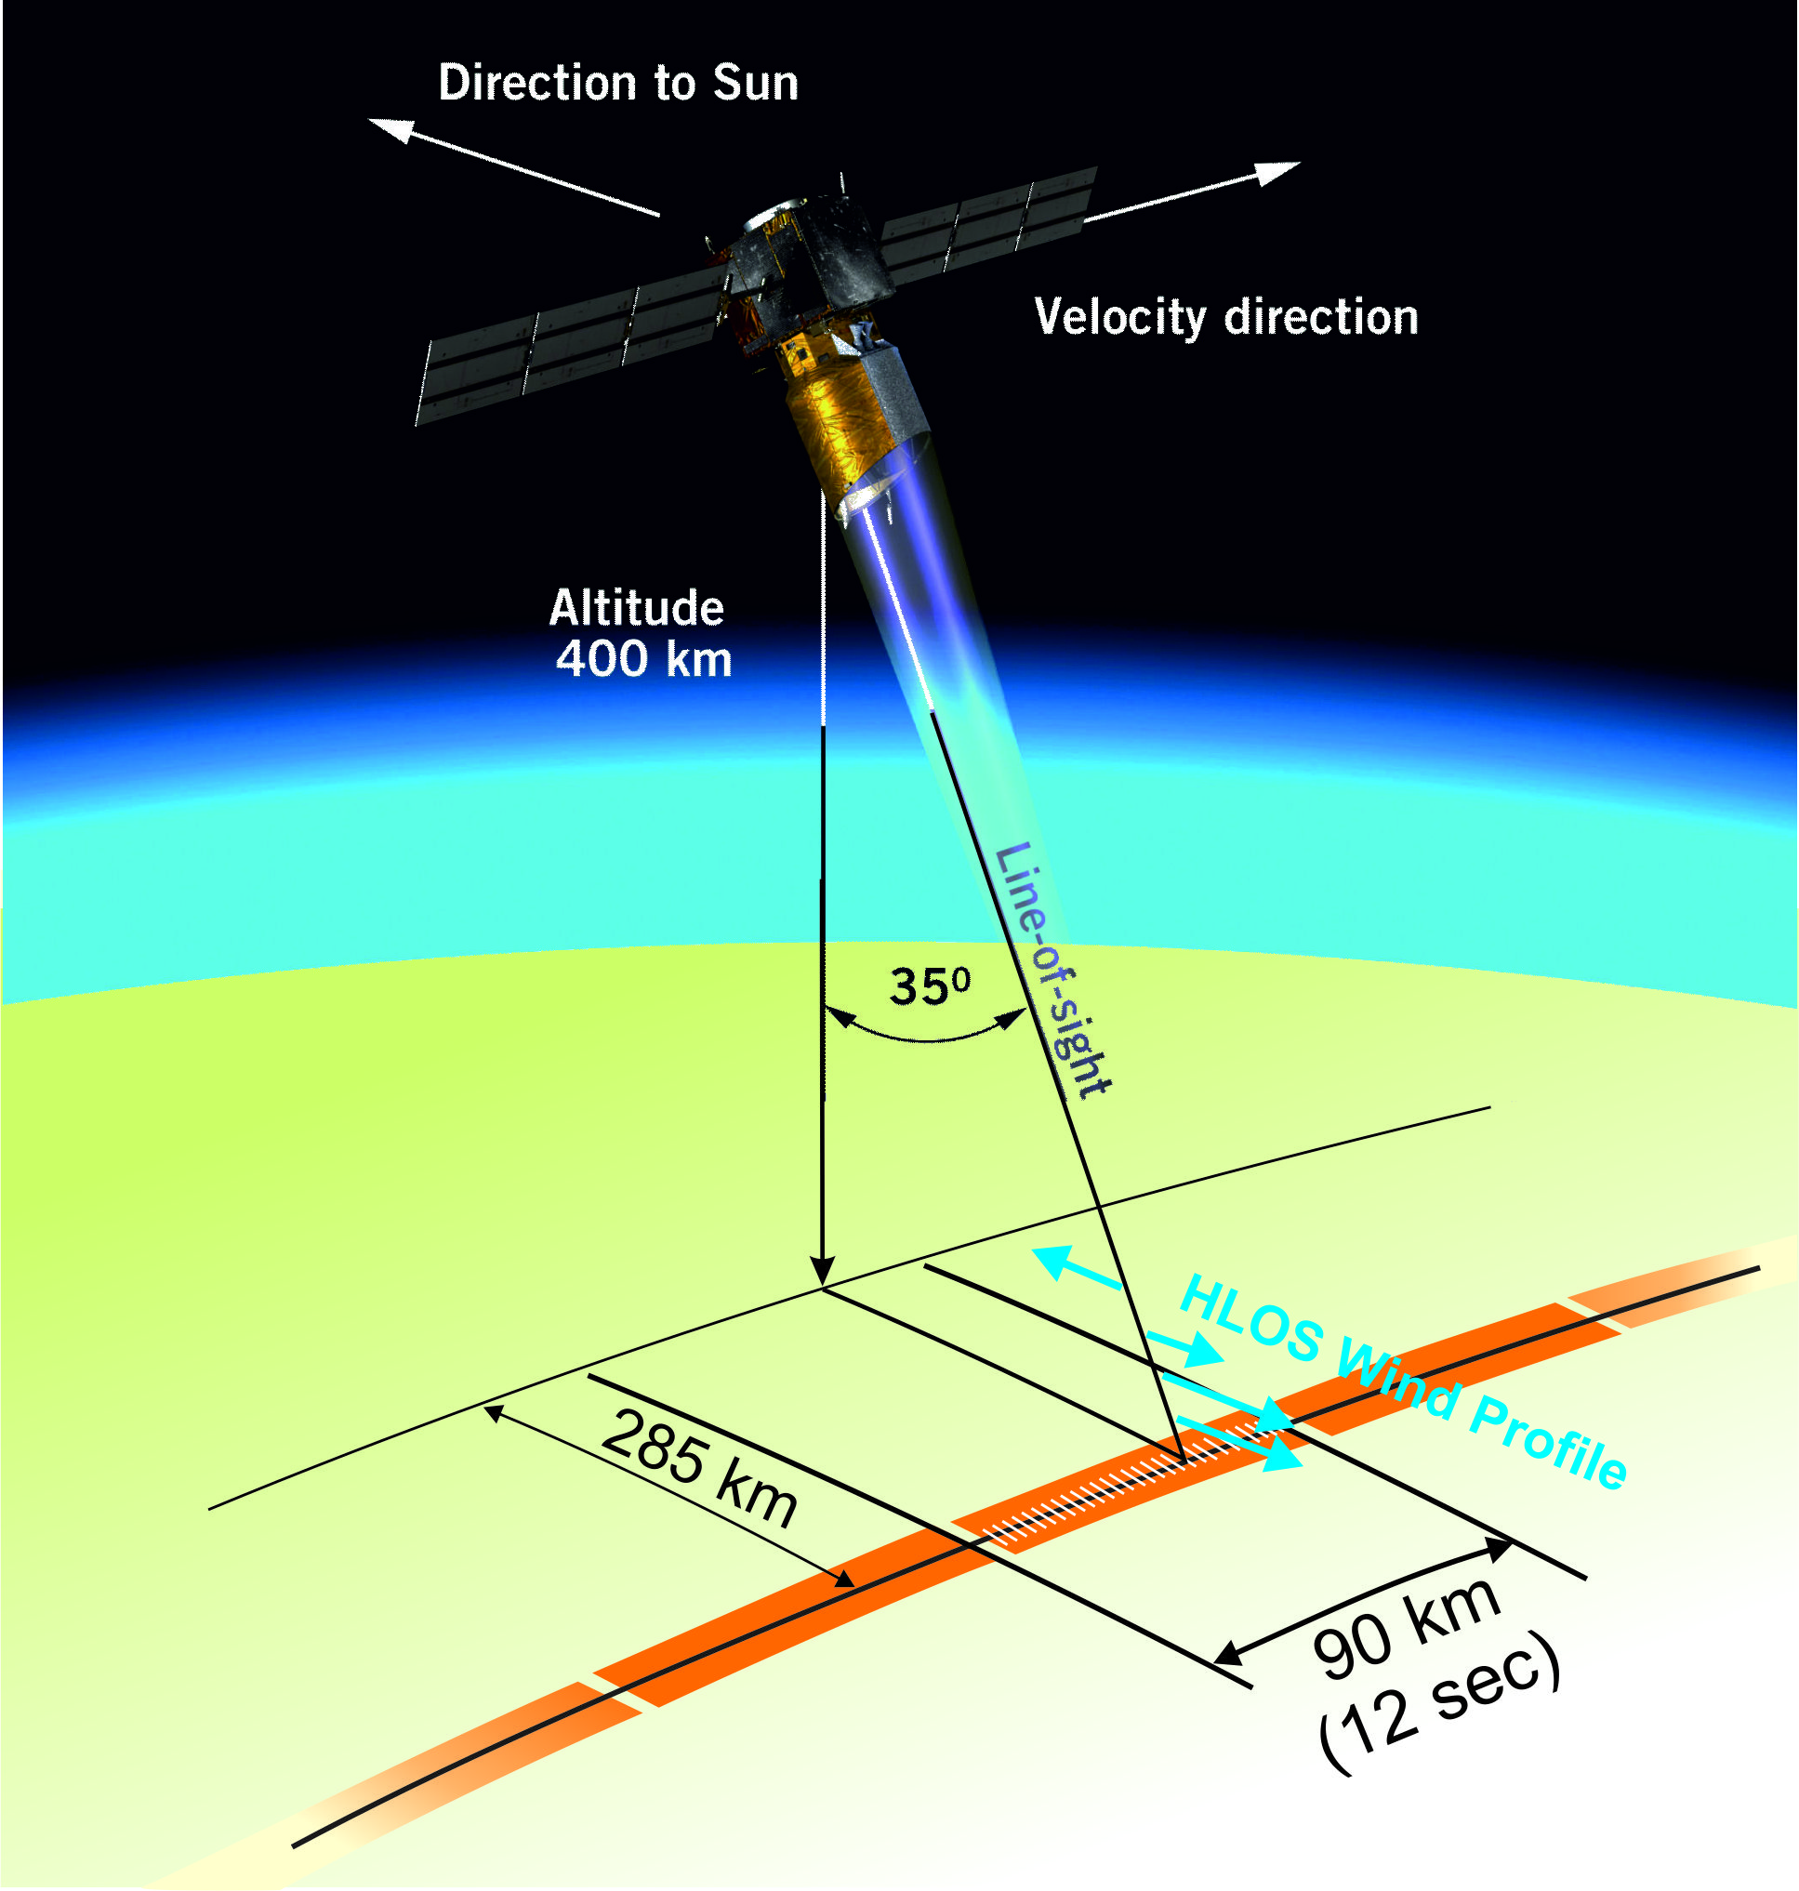
Measurement baseline
New measurement baseline
Old measurement baseline
High Spectral Resolution: Separate molecular and a particle backscatter receivers
UV (355 nm , circularly polarized)
Cross-linear polarized light detected in polarizing scenes
Ground calibration (nadir and off-nadir)
Adjustable vertical sampling of atmospheric layers
Δz: 0.25–2 km
z: 0-30 km
Example of ADM-Aeolus vertical sampling

Slide 11
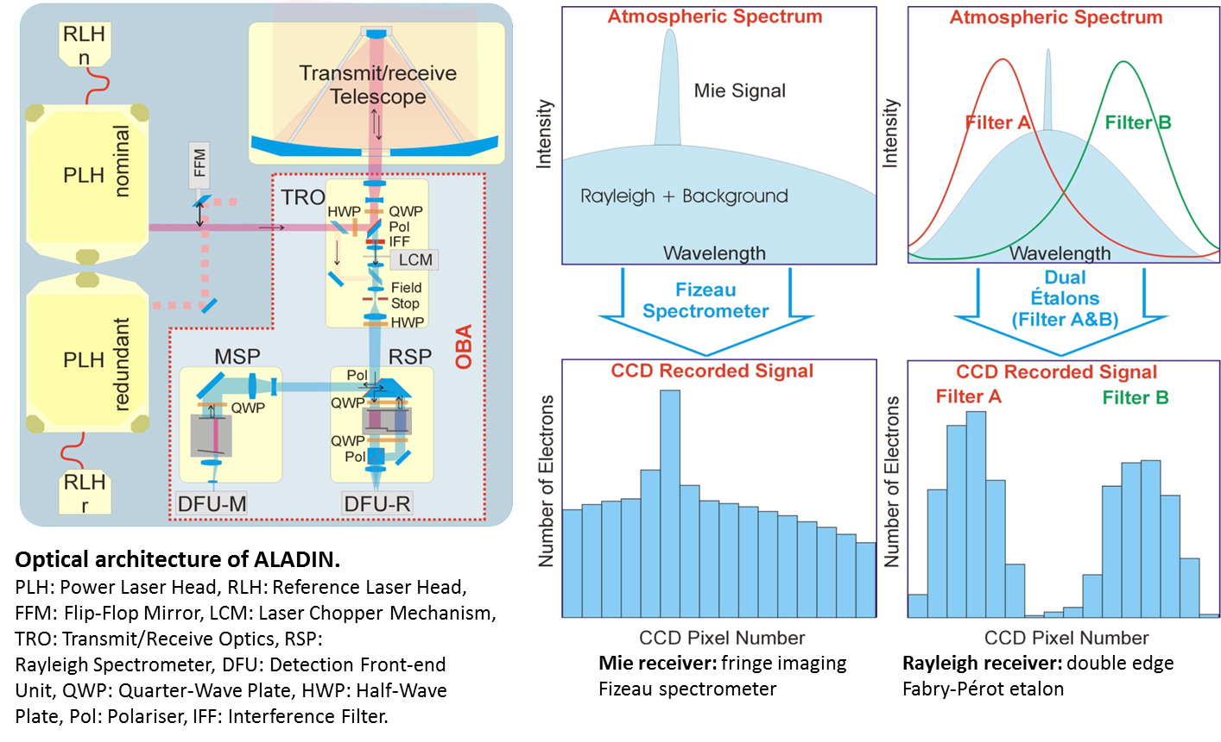
Aladin design

Slide 12
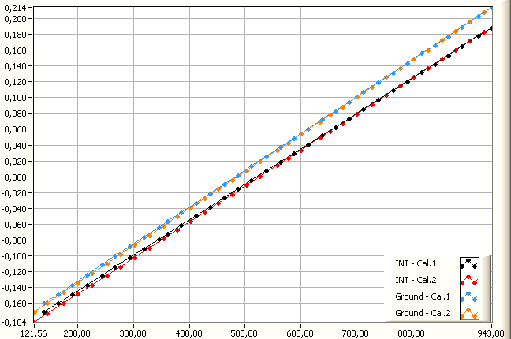
Aeolus wind speed determination
$$\hat{R}=\frac{{\hat{N}}_{A}−{\hat{N}}_{B}}{{\hat{N}}_{A}+{\hat{N}}_{B}} \underset{→}{\text{inversion}} {\hat{v}}_{r}$$
R: Rayleigh response
Important to accurately determine the instrument responses to retrieve accurate wind speed.
Dedicated calibration modes for this.
Use NWP T and p when retrieveing Dopplershift
Challenge to determine wind altitude representativeness within a layer in cases with strong wind shear
Response
Frequency (pixel #)

Slide 13
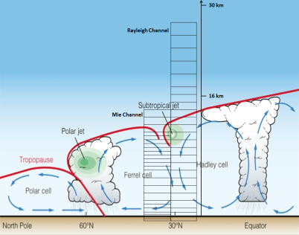
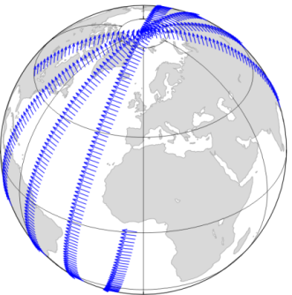
Aeolus atmospheric products
Primary (L2b) product:
Horizontally projected LOS (HLOS) wind profiles
Approximately zonal at dawn/dusk (6 am/pm)
3 km-averaged measurements and ~85 km observation averages – scene classified
From surface to ~30 km in 24 vertical layers
Random errors: 1-2(PBL), 2(Trop), 3-5(Strat) m/s
Bias requirements: 0.5 m/s
Spin-off (L2a) products:
Optical properties profiles
β, σ, OD, scattering ratio
Cloud/aerosol cover/stratification
Cloud/aerosol top heights
Cloud/aerosol base height (optically thin)
Aerosol typing (limited)
3 km averaged measurements and <85 km observation averages – scene classified
Powerful space-borne lidar with separate
molecular and particle backscatter detection
Near Real Time delivery of L1b data + L2b processor serves
* numerical weather prediction (NWP)
* potential for aerosol assimilation in
forecast and climate models
Flight direction
Courtesy
N. Žagar
Dusk/dawn orbit

Slide 14
Aeolus atmospheric products
Primary (L2b) product:
Horizontally projected LOS (HLOS) wind profiles
Approximately zonal at dawn/dusk (6 am/pm)
3 km-averaged measurements and ~85 km observation averages – scene classified
From surface to ~30 km in 24 vertical layers
Random errors: 1-2(PBL), 2(Trop), 3-5(Strat) m/s
Bias requirements: 0.5 m/s
Spin-off (L2a) products:
Optical properties profiles
β, σ, OD, scattering ratio
Cloud/aerosol cover/stratification
Cloud/aerosol top heights
Cloud/aerosol base height (optically thin)
Aerosol typing (limited)
3 km averaged measurements and <85 km observation averages – scene classified
Powerful space-borne lidar with separate
molecular and particle backscatter detection
Near Real Time delivery of L1b data + L2b processor serves
* numerical weather prediction (NWP)
* potential for aerosol assimilation in
forecast and climate models
Flight direction
Courtesy
N. Žagar
Dusk/dawn orbit

Slide 15
L2A processor (P. Flamant, A. Dabas, V. Levert, P. Martinet)
Aims at reterieving the optical properties of the aerosols detected by the lidar: backscatter coefficient, extinction coefficient, backscatter to extinction ratio
ALADIN = first lidar in space able to discriminate particle from molecular backscatter
In principle, backscatter and extinction coefficients can be determined independently, there is no need for a priori values of the backscatter to extinction ratio
This opens the way to qualitative estimations of the type of aerosols, despite the lack of wavelength-dependent and polarization dependent information

Slide 16
The lidar equation
Strength (in Watts) of a lidar signal as a function of the altitude z:
with
K is a calibration constant.
R(z) is the range from the lidar to the altitude z.
β(z) is the backscatter coefficient (in m⁻¹) of the atmosphere. It measures the capacity of the atmosphere to “reflect” the circularly polarized laser light.
T²(z) (no unit, less than 1, decreasing function of range) is the transmission factor (measures photon loss ).
α (in m⁻¹) is the extinction coefficient of the atmosphere.
z_{sat}
R(z)
z
The strength of the signal received by the lidar is a function of two optical, altitude dependant, parameters of the atmosphere, the backscatter β(z) and extinction coefficients α(z) of the atmosphere. Backscatter depend on scene polarization

Slide 17
Aeolus - HSRL
For each observation, ADM provides to signals, one Rayleigh, one Mie, related to the optical parameters of the atmosphere via the equations:
where C₁, C₂, C₃, C₄, K_{ray} and K_{mie} are characterized calibration constants.
In principle, it is possible to determine α_{aer}(z) and β_{aer}(z) from the
equations above.
In practise, difficulties are encountered due to:
The lidar cannot distinguish absorption and scattering when detecting extinction
Large thickness of the height bin (vertical inhomogeneities give ambiguous results when solving the lidar equation)
Dependence on a priori T and p information
Only way to discriminate aerosol versus cloud particles: use β/α (non-trivial) or co-located cloud observations (not available at present)

Slide 18
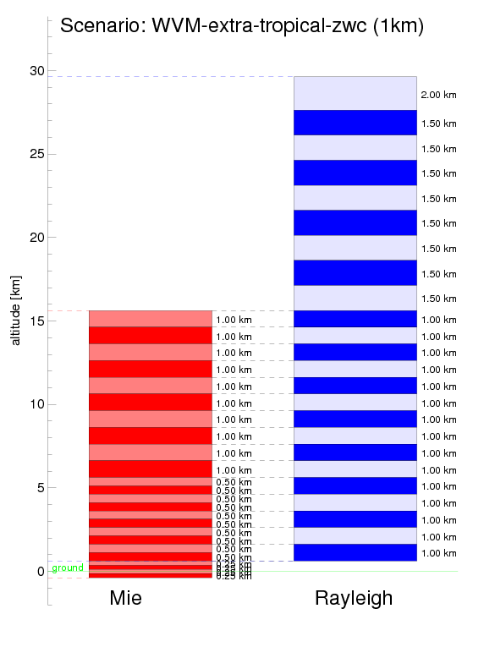
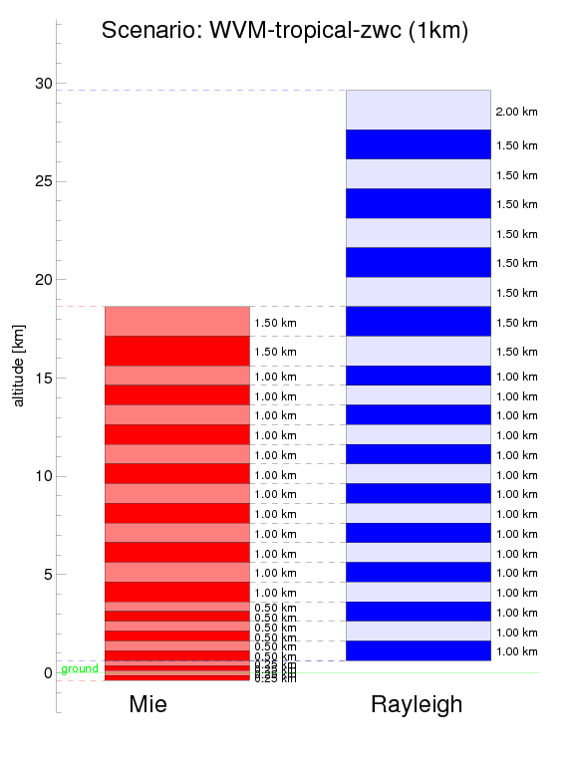
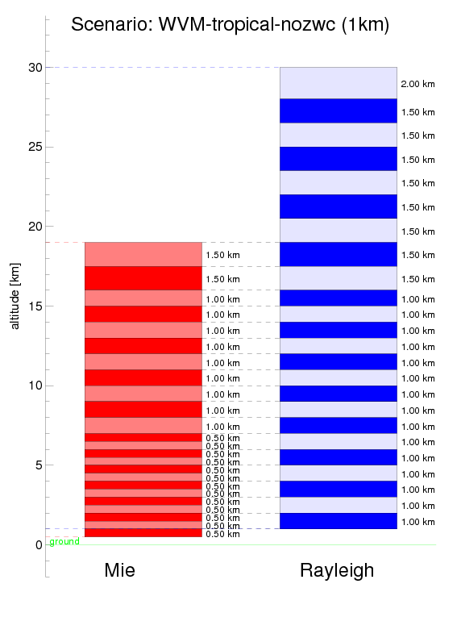
Variation of Aeolus sampling along the orbit
Extra-tropical scenario
Tropical scenario
Tropical scenario – no calibration
Segment 2
Segment 3
Courtesy G.J. Marseille
Obs. 5
Obs. 8
Terrain-
Following
model
Segment 1
Obs. 7
Obs. 4
Obs. 6
Obs. 9
Obs. 3
Obs. 2
Obs. 1
LUT
values
Ellipsoid
Co-location of Mie and Rayleigh channel sampling within an observation is essential

Slide 19
Science related activities in support of the mission
Phase 0
investigating data impact on NWP and atmospheric modelling
Phase A
elaborating on system and data processing requirements (performance and end-to-end simulation tools), user requirements (impact studies), ground-based validation campaigns
-> Lead to the scientific and technical mission concept which was evaluated and recommended at the Granada UCM in 1999
Phase B
OSSE impact experiment, data assimilation, wind and cloud/aerosol statistics, signal processing, random and systematic errors and quality control
-> Leading to the 2001 Mission Requirements Document (MRD) and SRD
Phase C/D
Wind and spin-off product processing, campaigns, product optimisation, further impact verification following baseline changes

Slide 20
Mission Baseline changes resulting from hardware qualification
Change from Burst Mode (BM) to Continuous Mode (CM) operation in 2010 to ensure the necessary stable laser operation
Relaxation of the planned laser output power operation at the start of the mission from 110 to 80 mJ in 2012
ADM-Aeolus MAG:
Is the mission still meeting the MRD, i.e. will the mission still provide beneficial atmospheric modelling and NWP impact?
How to optimize the data processing?
Two parallel scientific Impact Study activities were launched to provide a consolidated answer using different tools and methods:
KNMI, met.no, MISU/SMHI: Theoretical and Ensemble Data Assimilation impact experiment using simulated observations
ECMWF: Impact of real observations adapted to the ADM-Aeolus sampling / properties in an Observing System Experiment (OSE)
Results will be shown in presentations
by M. Rennie and A. Stoffelen

Slide 21
Aeolus campaigns
Objective:
Validation of the predicted instrument radiometric and wind measurement performance using the Aladin Airborne Demonstrator (A2D)
Establishing a dataset of atmospheric measurements obtained with an Aeolus type Lidar to improve algorithm development
2006 – 2009 A2D Campaigns:
Two ground-based (2006, 2007) and three airborne (2007, 2008 and 2009)
So far, on the order of 100 recommendations for the Aeolus mission (instrument and algorithm development and testing)
First atmospheric measurements worldwide with a Fizeau and Double Fabry-Perot UV lidar system
A further pre-launch campaign in spring 2015 in order to:
extend Rayleigh and Mie observations in highly heterogeneous conditions (vert./hor.)
extend dataset on nadir response calibrations over ice and land
rehearsal and preparation for CAL/VAL activities
Preliminary comparisons of A2D and DLR 2μm wind lidar measurements on-board the Falcon, near Greenland, 2009.
Courtesy: U. Marksteiner, DLR

Slide 22
Aeolus CAL/VAL AO delta-call 2014
Aeolus CAL/VAL AO call, 2007:
Draft Phase E1 (and E) CAL/VAL plan and requirements established
Call open to experts/scientists worldwide
16 (joint) proposals received and reviewed
15 proposals were selected but now uncertain/no longer valid due to launch delays
DELTA AO CAL/VAL CALL NEEDED
Aeolus AO delta-call Objectives:
Allow for confirmation/update of current proposals
Attract new proposals
CAL/VAL Schedule:
Delta-call release: 1 May 2014, http://earth.esa.int/aos/AeolusCalVal
Phase E1 preparatory CAL/VAL Workshop end 2014 / early 2015:
Refinement of CAL/VAL plan and compile implementation plan
Campaigns planning and coordination amongst AO proposals and external campaigns
Launch (End 2015)
Phase E1 CAL/VAL Workshop/meeting (date TBC)
Phase E CAL/VAL monitoring and Workshops (coordinated by Mission Manager)

Slide 23
Aeolus sampling and CAL/VAL requirements
Reference orbit: Equat. cros. time ascend node: 18:00 LT
Repeat cycle: 7 days
Track spacing in 1 week: ~300 km at mid lat
Example weekly coverage - one repeat cycle:
ADM-Aeolus: Scientific Cal. and Val. Requirements
Detail Aeolus specifics concerning its wind and aerosol products and areas for special CAL/VAL attention:
Available at http://earth.esa.int/aos/AeolusCalVal
T. Kanitz

Slide 24
Why support our “BYO” CAL/VAL?
Early access to data (commissioning phase, first 3 months)
Access to data quality information, facilitating a good understanding of product quality and product use
Forum of exchange in learning how to work with the data from processing to visualization
Access to CAL/VAL data and results from other validation groups from ground-based to airborne and model assimilation experiments
Access to national funding sources and early preparation of your centre to assimilate Aeolus data

Slide 25
Aeolus Project status
The platform was completed in 2009, has been regularly health checked and delta-tested, and is being prepared for satellite integration early 2015
In-situ Cleaning System is being implemented
Satellite tests with VEGA to determine shock levels showed compliance
Satellite characterization w.r.t. microvibrations by the reaction wheels: very low disturbance accelerations were measured at the laser position thanks to wheel dampers;
The transmitter laser is the most challenging for the qualification
The 1st flight laser transmitter operated for 5 weeks (August->September 2013) in vacuum: 150Mshots at 100-110 mJ output energy with ~7MHz frequency stability!
Transmitter successfully passed full environmental qualification in autumn 2013
Transmitter delivered to Airbus Defence & Space (Toulouse) for Aladin instrument integration and performance tests
2nd and 3rd flight laser transmitters undergoing acceptance testing
Aladin instrument delivery early 2015
Flight Acceptance Review: November 2015

Slide 26
Conclusions
The Aeolus wind lidar mission will deliver wind (suitable for data assimilation) and atmospheric optical properties products (could become suitable for NWP assimilation after R&D)
Aeolus L1b wind profiles (not corrected for temperature and pressure effects and no scene classification) will be delivered NRT together with a stand-alone processor
Impact studies has shown that recent measurement baseline updates will still allow for significant mission impact
CAL/VAL AO delta-call release: 1 May 2014, deadline 15 July
The Aeolus off-line L2a optical properties products will be made available to users off-line (now every 12 hours) but could in the future become available every 4 hours or more often
Aeolus laser qualification has recently been successfully completed, instrument integration and testing has started
Launch: End 2015

Slide 27
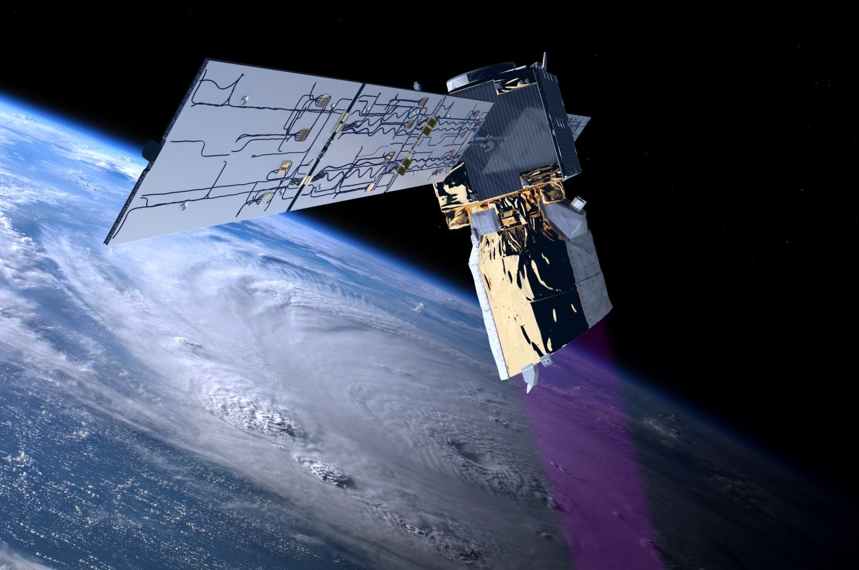
An artist’s view of Aeolus in-flight
http://www.esa.int/esaLP/LPadmaeolus.html

Slide 28
Spare slides

Slide 29
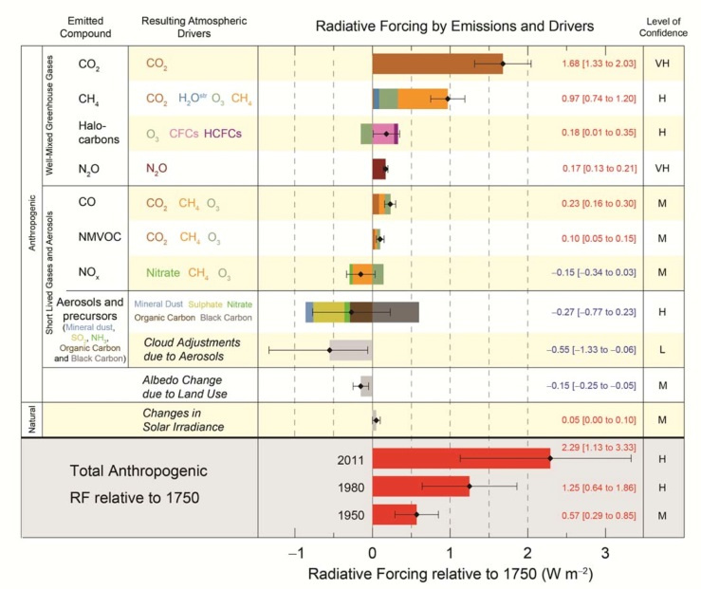
Areas of concern to weather forecasting and climate modelling
Lack of homogeneous global coverage of direct wind profile measurements in the current Global Observing System (GOS)
Large uncertainties in the estimated contribution of aerosols and clouds to the global radiative forcing
Radiosonde network
Aeolus mainly addresses the first
and provides spin-off products in support of the latter

Slide 30
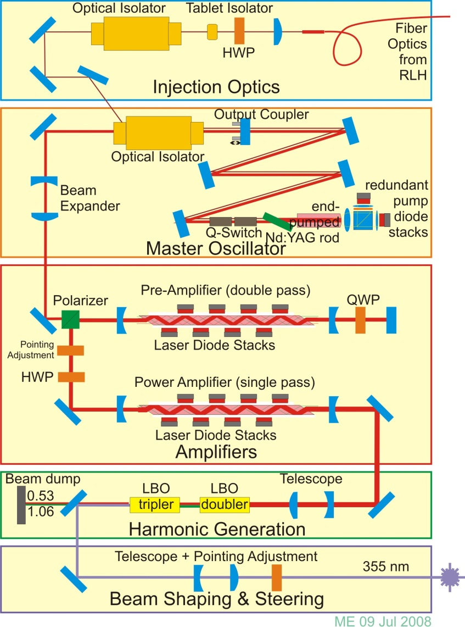
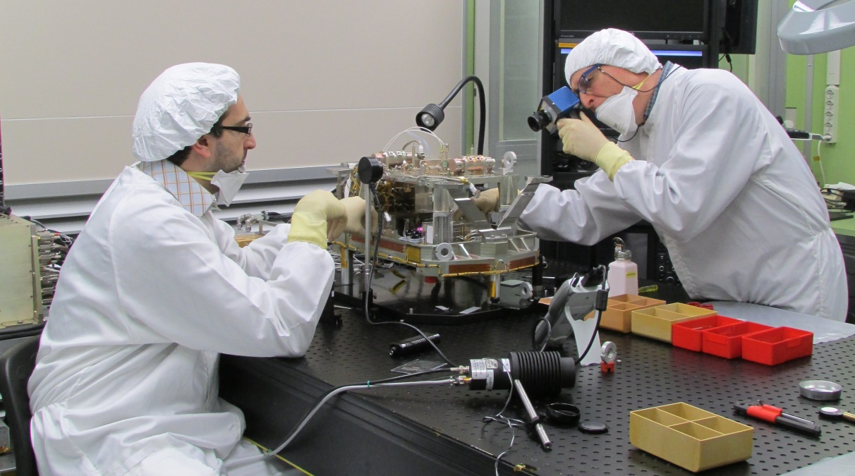
Aeolus: ALADIN Laser Transmitter
The Master Oscillator is a stable resonator with an end-pumped rod. A crystal q-switch is used. Pulses of about 5 mJ energy at 1.06 um are generated.
Two diode pumped slab amplifiers generate about 350 mJ at 50 Hz pulse repetition frequency.
These IR pulses are frequency tripled to the UV (355 nm) in two harmonic generator crystals with ~35% efficiency.
UV optics to shape and steer the output beam for compatibility with ALADIN transmit optics.
laser transmitter in final integration

Slide 31
AUX_CAL
Calibration coefficients defined by
$$S_{Ray}\left(z\right)=K_{Ray}\left[C_{1}β_{mol}\left(z\right)+C_{2}β_{part}\left(z\right)\right]\frac{T_{mol}^{2}\left(z\right)T_{part}^{2}\left(z\right)}{R^{2}\left(z\right)}$$
$$S_{Mie}\left(z\right)=K_{Mie}\left[C_{4}β_{mol}\left(z\right)+C_{3}β_{part}\left(z\right)\right]\frac{T_{mol}^{2}\left(z\right)T_{part}^{2}\left(z\right)}{R^{2}\left(z\right)}$$
where
$K_{Ray}$, $K_{Mie}$, $C_{1}$, $C_{2}$, $C_{3}$ and $C_{4}$ are calibration constants,
$β_{mol}$ and $β_{part}$ are the molecular and particle backscatter,
$R(z)$ is the range from the satellite to the point at altitude z on the line-of-sight,
$T_{mol}$ and $T_{part}$ the molecular and particle transmission factors
$$T_{mol,part}\left(z\right)=\exp\left(−\int_{z}^{z_{sat}}{α\left(z\right)dR\left(z\right)}\right)$$
N.B.: $S_{Ray}(z)$ is the sum of the number of photons counted in channels A and B of the Rayleigh reciever (« useful » signals).

Slide 32
AUX_CAL
If the calibration constant are known, the molecular and particle contributions to the signals can be separated:
$$\underset{=X_{part}(z)}{\underbrace{\frac{C_{1}}{C_{1}C_{3}−C_{2}C_{4}}\frac{R^{2}\left(z\right)S_{Mie}\left(z\right)}{K_{Mie}}−\frac{C_{4}}{C_{1}C_{3}−C_{2}C_{4}}\frac{R^{2}\left(z\right)S_{Ray}\left(z\right)}{K_{Ray}}}}=β_{part}\left(z\right)T_{mol}^{2}\left(z\right)T_{part}^{2}(z)$$
$$\underset{=X_{mol}(z)}{\underbrace{−\frac{C_{2}}{C_{1}C_{3}−C_{2}C_{4}}\frac{R^{2}\left(z\right)S_{Mie}\left(z\right)}{K_{Mie}}+\frac{C_{2}}{C_{1}C_{3}−C_{2}C_{4}}\frac{R^{2}\left(z\right)S_{Ray}\left(z\right)}{K_{Ray}}}}=β_{mol}\left(z\right)T_{mol}^{2}\left(z\right)T_{part}^{2}(z)$$
From which it follows that
$$\frac{β_{part}\left(z\right)}{β_{mol}\left(z\right)}=\frac{X_{part}\left(z\right)}{X_{mol}\left(z\right)}$$
(Basis of the L2A processor)

Slide 33
AUX_CAL
Coefficients $C_{1}$ to $C_{4}$ are computed from $T_{A}^{CSR}\left(f\right)$, $T_{B}^{CSR}\left(f\right)$ and $T_{FIZ}\left(f\right)$ (transmission of the Fiseau determined from an ISR)
$$C_{1}\left(ν,P,T\right)∝\int{I_{RB}\left(f−ν,P,T\right)\left(T_{A}^{CSR}\left(f\right)+T_{B}^{CSR}\left(f\right)\right)df}$$
$$C_{4}\left(ν,P,T\right)∝\int{I_{RB}\left(f−ν,P,T\right)T_{Fiz}\left(f\right)df}$$
$$C_{2}\left(ν\right)∝T_{A}^{CSR}\left(ν\right)+T_{B}^{CSR}\left(ν\right) C_{3}\left(ν\right)∝T_{Fiz}(ν)$$
And $K_{Ray}$ and $K_{Mie}$ are estimated in a way similar to the generation of the AUX_CSR: useful signals of an IRC are predicted and compared to the real ones, and $K_{Ray}$ and $K_{Mie}$ are determined so that both match.

Slide 34
Scientific Cal/Val Requirements
Understanding of the products and product properties
Consult product requirements (Mission Requirements Document)
Areas of special attention:
Atmospheric sampling by the space-borne and validation instrumentation
Horizontal (scene dependent)
Vertical (scene and commanding dependent)
Variable along the orbit
Space-borne and validation product quality as function of
measurement and retrieval technique
atmospheric scene (clear and cloudy products, use of apriori)
Complimentarity of different validation techniques
Validation over different spatial and temporal scales
Different information content
Co-location criteria
…

Slide 35
L2A: Overarching view
Auxiliary data:
Synthetic molecular signal
- meteorology,
- calibration,
- climatology.
L1B data
L2A
BRC Analysis
Group Analysis
First analysis at BRC level
In second step, identical features in the BRC scene are tentatively detected and processed independently.
L2A products
Synthetic molecular signals = prediction of the Mie and Rayleigh signals the lidar should detect is there were no aerosols in the atmosphere (pure molecular signals). The signature of the aerosols is determined by comparing the signals actually detected by the lidar to these synthetic signals.

Slide 36
L2A: Observation analysis
Molecular data
Auxiliary data:
- meteorology,
- calibration,
- climatology.
L1B data
BRC packing
SCA takes advantage of the presence of the two receivers. Needs Mie and Rayleigh bins are matching.
MCA
Matching Bin Finder
Crosstalk correction
MCA similar to Klett inversion. Requires the a priori knowledge of the BER.
SCA
ICA
L2A products

Slide 37
L2A: Group analysis
Molecular data
Auxiliary data:
- meteorology,
- calibration.
L1B data
Feature Finder
Group packing
Crosstalk correction
SCA
Scene Classification
L2A products

Slide 38
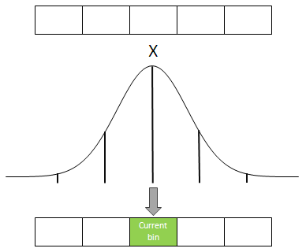
Feature Finder’s rationale
Based on the particle backscatter coefficient of the group
Horizontal Gaussian filter
Peak detection: group seeds
Parallel sprouting: aggregation of neighbour bins
Criteria based on the group’s
4. Eviction of dubious groups (high relative error on )

Slide 39
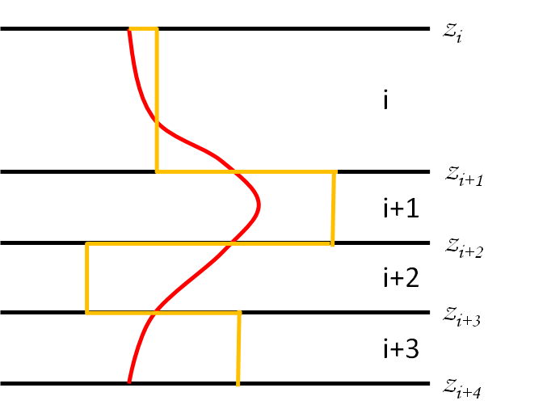
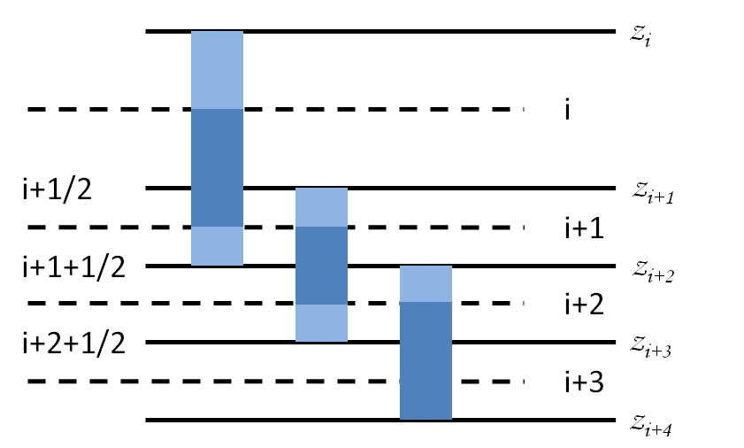
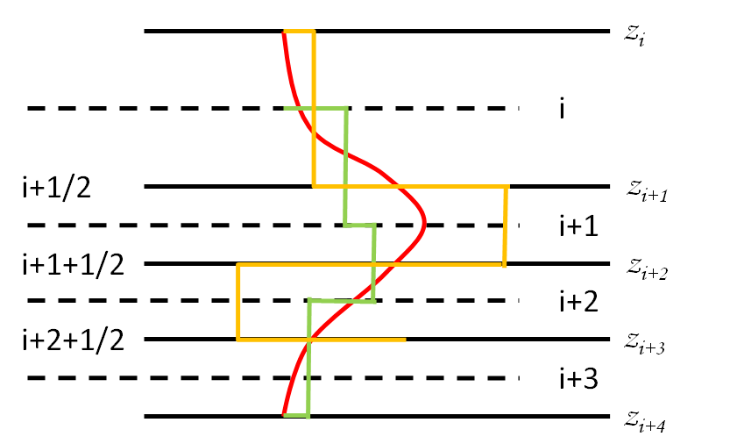
SCA on groups
2-bin periodic oscillations on
Need for averaging
Averaging with neighbours:
Creation of intermediate bins
1-bin-wide resolution kept in the sphere of influence of the averages

Slide 40
Scene classification
Cloud-aerosol discrimination for each group, including averages centred on its upper and lower boundary:
A 16-classes flag:
2 BERs : ≈ 0.05 sr⁻¹ => Water cloud
1 SR : > 2.5 => Water cloud
NWP’s RH : > 94% => Water cloud
Consolidated by a 12-classes flag:
NWP’s CLWC & CIWC : 4 domains (only vapour, liquid, mixed-phase, ice),
NWP’s temperature , 2 boundaries 233.15 K and 273.15 K : 3 domains.

Slide 41
L2A Conclusion
The L2A processor is now complete.
Fine tuning of settings still necessary, but the possible output products are there.
Full use of the possibilities offered by the High-Spectral-Resolution of the lidar requires matching Mie and Rayleigh bins (→ constraint on the mission).
From now on, major refinements will come from real observations.

