Slide 1
Provision of atmospheric motion vectors (AMVs) for the use in Numerical Weather Prediction (NWP) model-based reanalysis in the framework of SCOPE-CM (Sustained and coordinated processing of Environmental Satellite data for Climate Monitoring)
Toshiyuki KURINO (presented by Kazuki Shmoji)
Data Processing Department
Meteorological Satellite Center (MSC)
Japan Meteorological Agency (JMA)

Slide 2
Objective
The major objective of this project is to provide Atmospheric Motion Vectors (AMV), Clear Sky Radiances (CSR) and All Sky Radiances (ASR) for the use in global and potentially regional Numerical Weather Prediction (NWP) model-based reanalysis.
Furthermore, AMV data provided on regular grids may also be utilised in the analysis of dynamical systems in relation to water vapour transport or monsoon studies.
(e.g. SCM-04: Utility of Satellite derived winds for Monsoon and Cyclone studies over Indian region)

Slide 3
Satellite Sensor Record for geostationary imagers
Satellite System | Position Longitude | Period | Image rate for AMV derivation | Comments
GOES-E | 75° W | 1980 – today | Variable
GOES-W | 135° W | 1980 – today | Variable
Meteosat (2 - 10) | 0° | 1982 – 2004 2004 - today | 30 min 15 min
Meteosat (5 and 7) | 63° E 57° E | 1997 – 2005 2005 - today | 30 min 30 min | Called Indian Ocean Data Coverage (IODC)
Meteosat 3 | 70° W 75° W | 1991 – 1993 1993 – 1995 | 30 min 30 min | Called Atlantic Data Coverage (ADC) Called eXtended ADC (XADC)
GMS (GOES-9) | 140° E 155° E | 1978 – 2003 2003 – 2005 | 30 min 30 min | GOES-9 was put at the Western Pacific Region
MTSAT | 140° E 145° E | 2005 – 2010 2010 – today | 15 min, 30 min, 60 min

Slide 4
Satellite Sensor Record for polar orbiting imagers
AMVs can also be derived from instruments on board polar orbiting satellites providing measurements in infrared window and water vapour absorption channels. Instruments utilised by NOAA, CIMSS and EUMETSAT are AVHHR (IR-window) and MODIS (IR window and water vapour). AVHRR data coverage reaches back to 1979 and MODIS data coverage starts in 2000.
http://noaasis.noaa.gov/NOAASIS/ml/avhrr.html (NOAA/NESDIS)
http://www.eumetsat.int/Home/Main/Satellites/Metop/Instruments/SP_2010053153142514 (EUMETSAT)
http://modis.gsfc.nasa.gov/ (NASA)

Slide 5
Algorithms and Processing chains (1/3)
The overarching objective would be an AMV processing system that could be applicable to all historical geostationary satellites.
The existing processing systems at EUMETSAT and JMA do not have this capability, but could be extended.
The CIMSS AMV derivation algorithm is capable of reprocessing all historical MODIS, AVHRR, GOES, Meteosat and GMS/MTSAT images.
The existing algorithms differ between AMV processing agencies, and a first step towards a more unified algorithm would be the analysis of the differences.

Slide 6
Algorithms and Processing chains (2/3)
The project would seek close interaction with the CGMS International Winds Working Group (IWWG) to benefit from ongoing comparison activities that might need to be enhanced to cover the temporal dimension of the AMVs long term records.
The project would also seek close interaction with SCOPE-CM sub-project, SCM-06: Inter-calibration of imager observations from time-series of geostationary satellites (IOGEO) through the experience from Global Space-based Inter-calibration System (GSICS) for reprocessing AMVs and CSRs/ASRs long term records.
GSICS provides bias corrections through the inter-calibration of satellite sensors with respect to selected references that can be applied to generate reprocessed CSR and ASR products as Fundamental Climate Data Records (FCDRs) and related Thematic Climate Data Records (TCDRs).

Slide 7
Algorithms and Processing chains (3/3)
The reprocessing of AMV requires the background fields of NWP, which are crucial for its height assignment. The periods of the exsisting reanalyses fully cover the operation periods of historical meteorological satellites. Thus, the updated reanalysis fields are expected to be used in the AMV reprocessing with the quality information of the reanalysis fields.
The project would exchange information with reanalysis communities on their calculation plans and the quality. The best forum identified for discussion of data issues is the WCRP Data Advisory Council that has representation from reanalysis centres.
The project will encourage reanalysis centres to give feedback and support AMV, CSR and ASR validation exercises by involving observation feedback archives and associated tools such as developed at ECMWF.

Slide 8
Historical overview of related reanalysis activities (1/2)
The first reanalysis was the 15-year ECMWF Reanalysis (ERA-15). ERA-15 collected and used historical AMV data generated operationally. Such reanalysis activity was extended to other NWP centres such as NCEP/NWS/NOAA, JMA and NASA, and some of them performed reanalysis calculation repeatedly extending period and upgrading NWP and data assimilation system.
As the extension of reanalysis, accurate observation data were requested. To meet the requirement, EUMETSAT reprocessed AMVs for past Meteosat satellites. It reprocessed Meteosat-2 to 7 AMVs and provided them to ECMWF for ERA-40 and ERA-Interim.
The first reprocessing by JMA was performed to provide reprocessed GMS-3 to -5 AMVs to the Japanese 25-year Reanalysis (JRA-25).

Slide 9
Historical overview of related reanalysis activities (2/2)
Currently, EUMETSAT is performing the reprocessing of AMVs, CSRs and ASRs for Meteosat-8 and 9 data within the ERA-CLIM project. This activity will continue in ERA-CLIM2 and also include METEOSAT-2 to 7.
JMA/MSC has completed the reprocessing of AMVs for GMS-1,3,4,5, GOES-9 and MTSAT-1R data within the JRA-55 project. JMA/MSC also has completed CSRs reprocessing for GMS-5, GOES-9 and MTSAT-1R .
University of Wisconsin/CIMSS has completed the re-processing of 18-19 years of GOES AMVs.

Slide 10
ERA-CLIM
ERA-CLIM: 2011 – 2013
CSR and ASR from MSG for 2004 – 2011 (ongoing)
AMV from MSG for 2004 – 2011 (ongoing)
AMV from METOP-A for 2007 – 2012 (completed for two algorithms (EUMETSAT & CIMSS))
ERA-CLIM2: 2014 – 2016
AVHRR AMVs from 1982 to present
AMV from MFG and MSG 1982 to present

Slide 11
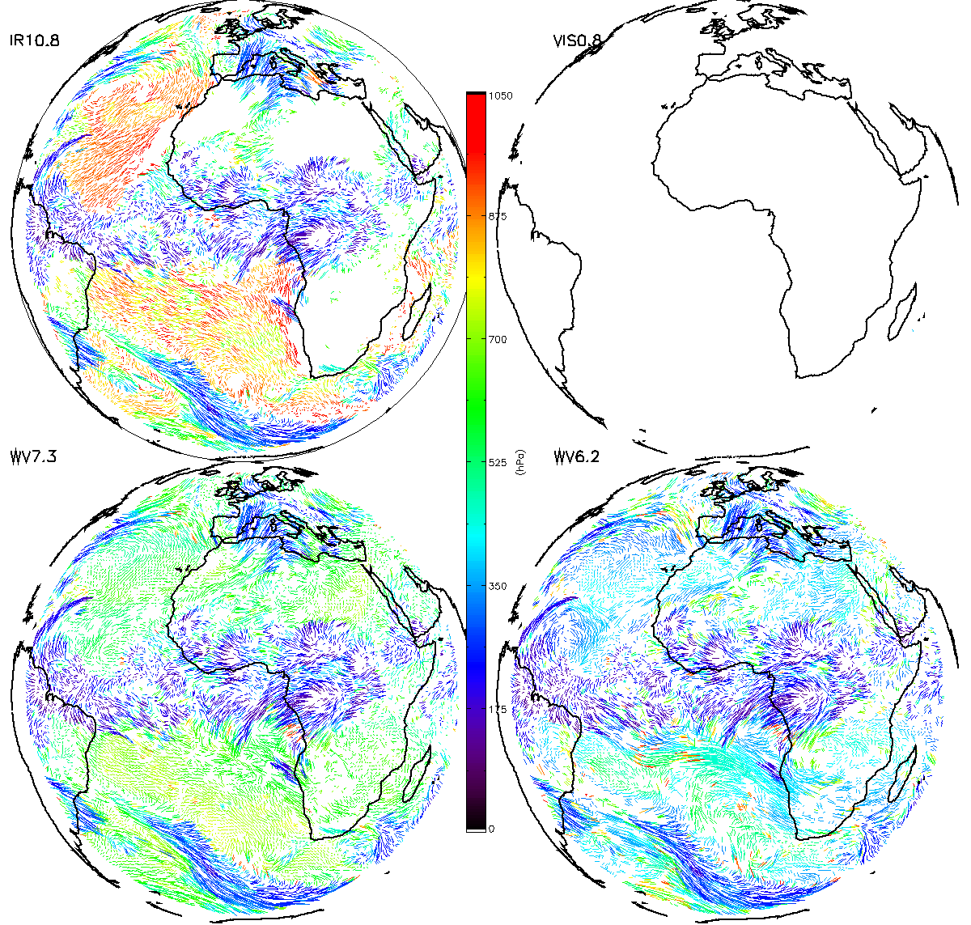
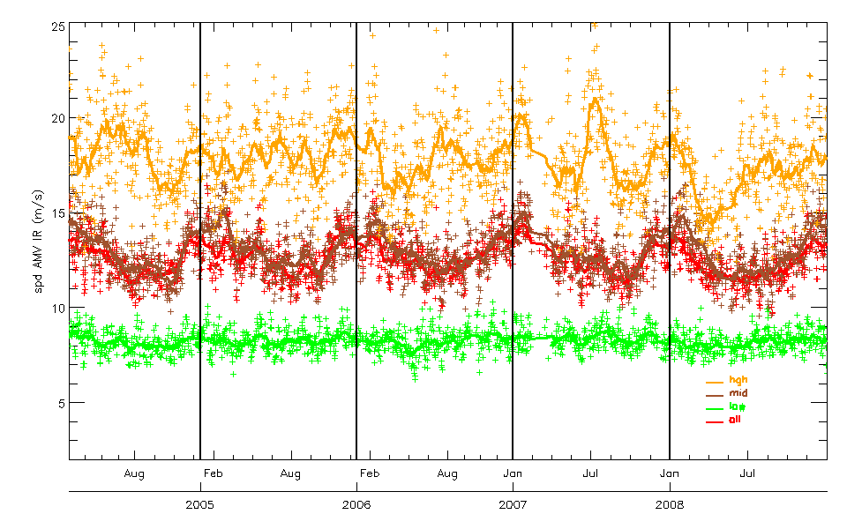
Atmospheric Motion Vectors (AMVs) from GEO
MSG 2004 – 2011
3-hourly winds
IR 10.8 µm
VIS 0.8 µm
WV 7.3 µm & 6.2 µm
Speed AMV IR, all, high, mid, low altitudes

Slide 12
Summary of proposed project
The major points to work on to reach the goal of this project are:
- Analysis of differences in AMV, CSR and ASR product definition, algorithms and processing chains for instruments in geostationary and polar orbit;
- Development of a plan for a more coherent product suite for all instruments;
- Enhancement of AMV algorithms with a quantitative uncertainty estimate;
- Establishment of a validation framework for AMVs by agreeing on a metric, certain quality analysed non-satellite observations and by utilising means from reanalysis centres;
- Enhancement of the documentation towards a coherent description of the products

Slide 13
Current and targeted Maturity Level
The software used to create AMVs, CSRs and ASRs products is in operational use and can be considered mature. However, as one objective of this project is to present the products in a more coherent way by potentially using a common software.
 | Software Readiness | Meta Data | Documentation | Validation | Public Access | Utility
Current Maturity level | 3 | 3 | 3 | 2 | 4 | 5
Targeted Maturity level | 5 | 5 | 5 | 5 | 5 | 6

Slide 14
Duration of the project and schedule (5 years from 1 Jan 2014)
Review on the use of AMV and CSR in past reanalysis; Analyze requirement for future reanalysis; Analyze the differences in AMV product definition, algorithms and processing chains and develop a plan for a globally coherent product; Perform feasibility analysis of GOES AMV processing with respect to satellite observation schedule and forward analysis result to reanalysis centres Encourage other space agencies operating geostationary /polar orbital instruments to join the project; Open a project portal site | 2014 | All All JMA, EUM, NOAA, NOAA JMA, EUM JMA
Build common validation framework following agreed metric involving radiosonde observations and tools provided by reanalysis centres; Perform processing of geostationary products; | 2015 | EUM, JMA, NOAA EUM, JMA, NOAA
Perform processing of polar orbit data; Perform processing of geostationary products (continue); Validate products from geostationary satellites; Analyze feedback on early phase products from reanalysis centers | 2016 | EUM EUM, JMA, NOAA All
Update the documentation of all products in coherent style; Validate products from polar orbiting satellites; | 2017 | EUM , JMA, NOAA
Analyze feedback on products from reanalysis centres and other applications and develop a plan for SCOPE-CM phase 3 | 2018 | All

Slide 15
Status and Progress
GOES AMV Reprocessing (Point 4)
AMV workshop at ECMWF (Point 3)
Project Portal Site (Point 6)

Slide 16
Status of GOES AMV Reprocessing C. Velden, D. Santek, D. Stettner, S. Wanzong Cooperative Institute for Meteorological Satellite Studies (CIMSS) University of Wisconsin-Madison U.S.A 20 February 2014

Slide 17
GOES AMV Reprocessing: Phase 1a
Derive hourly AMV datasets from each of the two GOES operational satellites (East and West) from 1995 to present.
GVAR satellite series (GOES-8 to -15); entire data archive on-line at UW-SSEC
Mostly stable calibration and geolocation throughout time period
Utilize full-resolution image triplets from longwave IR (window), shortwave IR, and water vapor channels, and the visible channel at ½ spatial resolution
Only GOES Imager, no Sounder data used
Divide processing into two sectors per satellite: Northern and Southern Hemisphere
Employ the current NOAA operational AMV processing algorithm
ERA-Interim analyses used for first guess and in AMV height determination
AMV datasets processed on a cluster computer system to reduce reprocessing time -- about a 3-month (dedicated) effort

Slide 18
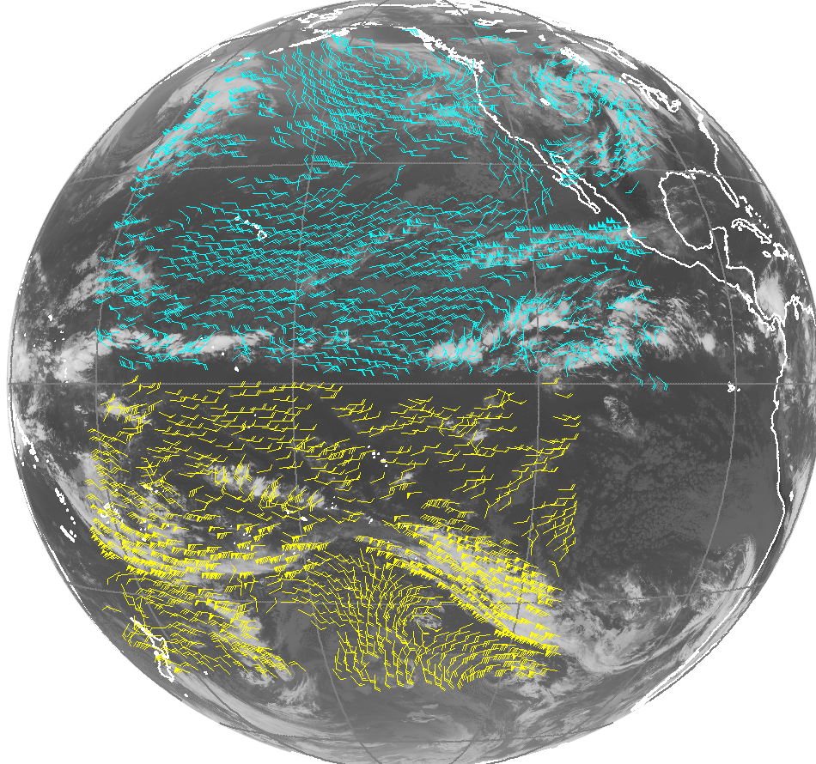
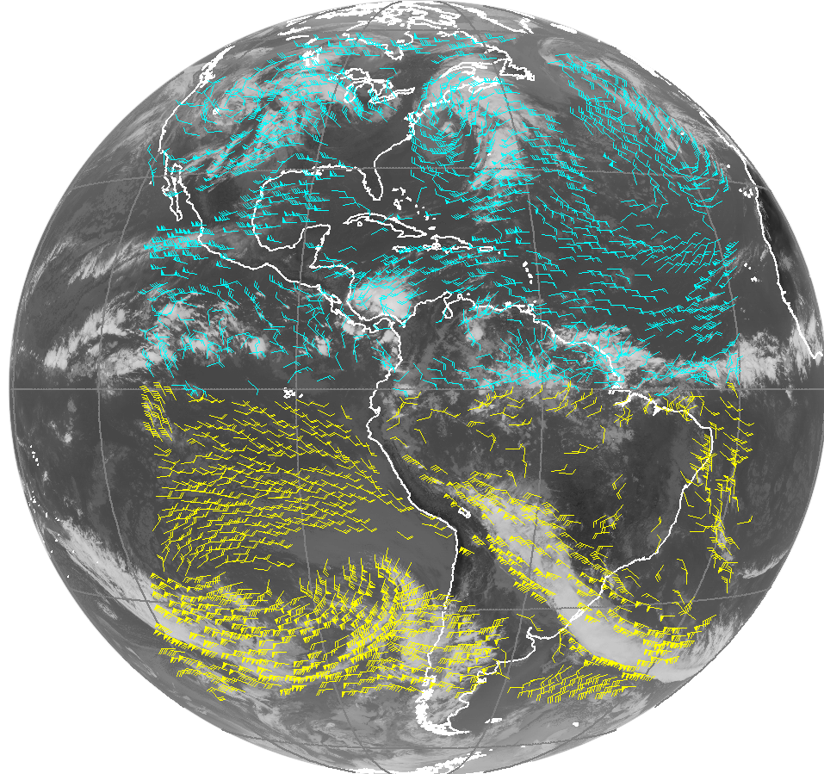
GOES AMV Reprocessing: Coverage
Blue: Northern Hemisphere coverage
Yellow: Southern Hemishpere coverage
GOES-West
07 May 2005
1500 UTC
GOES-East
07 May 2005
1500 UTC

Slide 19
GOES AMV Reprocessing: Status
Continuous, hourly AMV datasets have been re-processed for the two GOES operational satellites from 1995 to mid-2013.
~600,000 AMV datasets generated
Quality control of the AMVs is underway, both automated and visual
Output text files will be prepared for community access (April release expected)
This will complete Phase 1a of the reprocessing effort
Future GOES AMV reprocessing plans (currently unfunded):
Phase 1b: Reprocess the same dataset, but using the GOES-R cluster tracking algorithm (J. Daniels, NOAA/NESDIS) and cloud height algorithm (A. Heidinger, NOAA/NESDIS), both under development
Phase 2: Extend the reprocessing to earlier U.S. satellites (from 1978 onward), which will require a more substantial effort to:
Correct sensor calibration and geolocation
Produce cloud products (heights) for the pre-GVAR satellites

Slide 20
AMV workshop at ECMWF together with EUMETSAT and CIMSS
In 2013 a workshop including EUMETSAT and CIMSS was held at ECMWF.
The differences between the EUMETSAT and CIMSS algorithms were analysed.
Usability of AMV products at ECMWF discussed.
Results forwarded to JMA and IWWG.

Slide 21
Contents for Project Portal Site
Reprocessing Projects
JMA’s website for reprocessing of Satellite Products for Climate
http://mscweb.kishou.go.jp/product/reprocess/
EUMETSAT’s website on Climate Data Records:
http://www.eumetsat.int/website/home/Data/Products/Climate/index.html
Reanalysis Projects
JRA-55 website:
http://jra.kishou.go.jp/JRA-55/index_en.html
ERA-CLIM website: http://era-clim.eu/

Slide 22
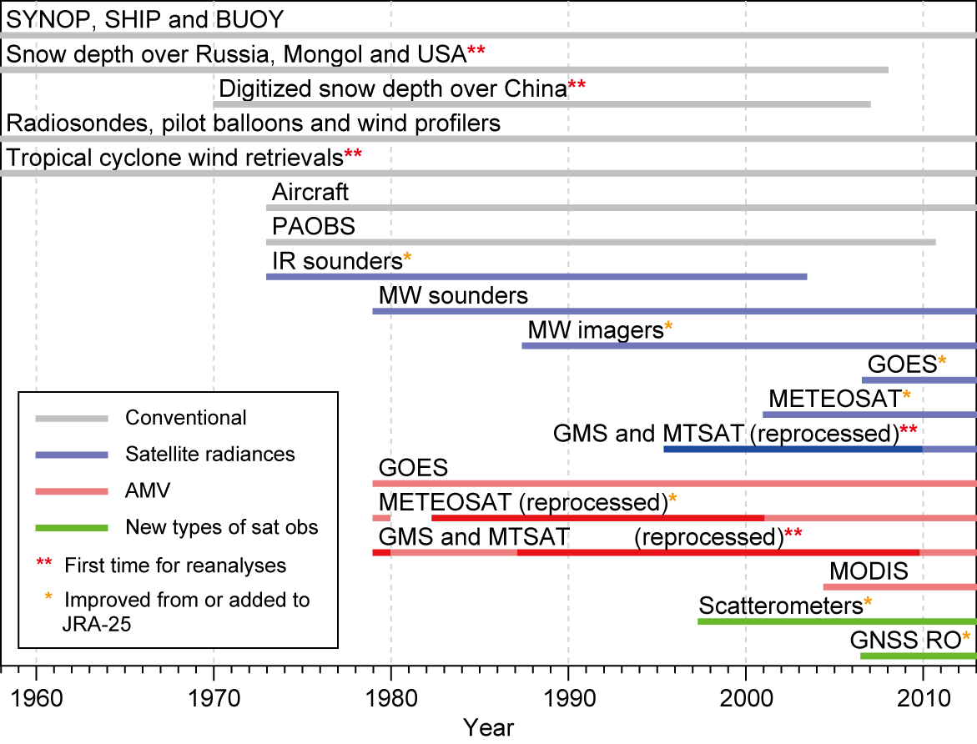
Observational Data available for JRA-55
GNSS: Global Navigation Satellite System

Slide 23
Appendix
Summary of reprocessing efforts for GOES, METEOSAT, Himawari, and AVHRR, mostly AMVs
(report from AMV workshop at ECMWF with the addition of JMA’s status for Himawari)
as of Sep, 2013
(need to be updated)

Slide 24
Summary of reprocessing efforts for GOES, METEOSAT, Himawari, and AVHRR, mostly AMVs as of Sep, 2013 (1/10)
(1) Programmatic
 | CIMSS | EUMETSAT | JMA/MSC
Current data holdings | GOES, SMS-1, -2, MODIS, KALPANA, POES AVHRR, COMS, GMS, METEOSAT-3 onwards, MTSAT, FY- 2C/D/E | METEOSAT, METOP and POES AVHRR (starting with NOAA-18) | GMS, (GOES-9), MTSAT
Already reprocessed | AMV from POES AVHRR (NOAA-7 to – 18) | 1) AMV and CSR from METEOSAT-2 to -7 up to end of 2000 2) AMV from AVHRR METOP-A up to end of 2012 (using two algorithms, EUMETSAT operational and CIMSS) | AMVs from GMS-1 to MTSAT, CSRs from GMS-5 to MTSAT
Current production | GOES GVAR -8 to -15 (1995-present): AMV. Expected to be available by 2014. Includes processing of 30- minute images, 15-minute images, and 7-minute rapid scan images (producing possibly 1 wind product every 7 minutes, though limited to extreme weather situations) | AMV, CSR, ASR, THU, CTH, NDVI, CLM, Cloud type, cloud top pressure, cloud top temperature, from METEOSAT-8 and -9. Expected to be available by 2014 | AMVs and CSRs

Slide 25
Summary of reprocessing efforts for GOES, METEOSAT, Himawari, and AVHRR, mostly AMVs as of Sep, 2013 (2/10)
 | CIMSS | EUMETSAT | JMA/MSC
Funding for current production | SSEC grant | EU FP7 ERA-CLIM and EUMETSAT own resources | JMA/MSC own resources
Committed reprocessing |  | 1) AMV, CSR, ASR from Meteosat-7 for years 2001-2004 for zero degree, and for years from 2001 and up to real time for Indian Ocean Data Coverage. Expected to be available by 2014. 2) AMV from AVHRR POES and AVHRR METOP-A and -B reprocessed by 2015. 3) AMV, CSR, ASR from METEOSAT-2 to -9 based on inter-satellite calibrated IR radiances and updated algorithm. Expected to be available by 2016.
Funding for committed reprocessing |  | EU FP7 ERA-CLIM2 and EUMETSAT own resources

Slide 26
Summary of reprocessing efforts for GOES, METEOSAT, Himawari, and AVHRR, mostly AMVs as of Sep, 2013 (3/10)
 | CIMSS | EUMETSAT | JMA/MSC
Considered reprocessing | POES AVHRR using updated code and input and more metadata in output MODIS from EOS-Aqua and Terra Repeat current GVAR reprocessing but with latest algorithm (NESDIS GOES-R tracking), and extend reprocessing to older GOES satellites, pre-GVAR. | After ERA-CLIM2 updated codes may arrive from SCOPE-CM and can be used for increasing the consistency of geostationary AMV products. Also planned Meteosat First Generation image reprocessing and inter-satellite calibration lead to new reprocessing of the same data
Of value, but unfunded | - KALPANA - GOES-1 to -7 (1978-1995) - SMS-1 and SMS-2 (1979-1981) - ATS (1974) | - Routine METEOSAT-8 and -9 rapid scan images (since May 2008) at 5-minute intervals, producing possibly 1 wind product every 20 minutes, limited to 15N-70N - METEOSAT-8 and -9 high resolution visible channel images

Slide 27
Summary of reprocessing efforts for GOES, METEOSAT, Himawari, and AVHRR, mostly AMVs as of Sep, 2013 (4/10)
 | CIMSS | EUMETSAT | JMA/MSC
Problems preventing reprocessing of earlier data | - GOES-1 to -7 cannot be reprocessed until navigation and calibration have been corrected - Upcoming (GOES-R) winds algorithm cannot be applied to reprocessing prior to GOES-8; requires development to cloud analysis | - Current CCC algorithm cannot be applied to METEOSAT-2 to -7 on the current EUMETSAT reprocessing system; requires development to cloud analysis product - For Meteosat First Generation a reprocessing of the Image data including improvements in navigation and image resampling as well as anomaly detection is planned but the resources are tight and time of realisation is uncertain. | VIS AMV of GMS-1 not processed due to stripe noise
Input data preservation | All original tapes transferred to digital (online) at SSEC Data Centre | Funded and committed archive preservation (EUMETSAT Data Centre) | Some original digital data was lost in early date for GMS period; IR image before March 1981, VIS image before March 1987 excepting 1979

Slide 28
Summary of reprocessing efforts for GOES, METEOSAT, Himawari, and AVHRR, mostly AMVs as of Sep, 2013 (5/10)
 | CIMSS | EUMETSAT | JMA/MSC
Input data backup (disaster recovery) | - NOAA NCDC holds the official GOES archive - SSEC has additionally processed the original GOES archive and has rescued more data and produced data of higher quality than current NCDC holdings. | - EUMETSAT Data Centre - Third copy back-up off-site | - JMA/MSC Data Archives - Third copy back-up in distributed universities and research institutes (no systematic preservation)
(2) Reprocessing methods, including input and output interfaces
 | CIMSS | EUMETSAT | JMA/MSC
Input sensor data | GVAR level 1b AVHRR POES level 1b and regridded | METEOSAT level 1.5 MVIRI and SEVIRI AVHRR METOP level 1b (and IASI METOP level 1c) | VISSR, SVISSR for GMS HIRID and HRIT for MTSAT

Slide 29
Summary of reprocessing efforts for GOES, METEOSAT, Himawari, and AVHRR, mostly AMVs as of Sep, 2013 (6/10)
 | CIMSS | EUMETSAT | JMA/MSC
Input channels | - AVHRR: IR 10.8 micron - GOES: WV 6.7 micron, IR 10.7 micron, SWIR 3.9 micron, and VIS 0.63 micron | - AVHRR: IR 10.8 micron - METEOSAT-8 and -9: IR 10.8 micron, WV 6.2 and 7.3 micron, VIS 0.8 micron Note: VIS 0.6 micron not used for AMV METEOSAT-2 to -7: IR [10.5-12.5 micron], WV [5.7-7.1 micron], VIS [0.5-0.9 micron] | GMS-5,GOES-9 and MTSAT (IR,WV,VIS) GMS-(1-5) (IR, VIS)
Input background | - GOES: ERA-Interim reanalysis analyses Pressure levels 1x1 degree2 grid 6-hourly - AVHRR: NCEP/NCAR reanalysis analyses Pressure levels 1x1 degree2 grid 6-hourly | ERA-Interim 6-hourly forecasts (+6h and +12h steps) 60 model levels for AVHRR, 31 model levels for METEOSAT-8 and -9, 16 model levels for METEOSAT-2 to - 7 0.5x0.5 degree2 grid for AVHRR, 1x1 degree2 grid for METEOSAT-8 and -9, 1.5x1.5 degree2 grid for METEOSAT-2 to -7 6-hourly | JRA-25 reanalysis data (Grid:1.25 degree 23 Layers)
Background time interpolation | Linear in time | Linear in time | Linear in time

Slide 30
Summary of reprocessing efforts for GOES, METEOSAT, Himawari, and AVHRR, mostly AMVs as of Sep, 2013 (7/10)
 | CIMSS | EUMETSAT | JMA/MSC
Background used for | - Height assignment for AVHRR and GOES - First-guess to tracking solution for AVHRR and GOES - Quality control for GOES and AVHRR in recursive filter editing system | - Height assignment for AVHRR and METEOSAT (no best fit applied, EBBT only) - First-guess to tracking solution for AVHRR | Cloud height assignment for AMV, Sea Surface Temperature for CSR
Tracking | Compute 2 vectors from 3 consecutive images, spaced by 30 minutes for GOES and 100 minutes for AVHRR, using first-guess tracking solution from background, and then average the two individual vectors to produce final solution Lp norm for GOES Cross-correlation for AVHRR | METEOSAT: Compute 3 vectors from 4 consecutive images, spaced by 30 minutes for METEOSAT-2 to -7, and 15 minutes for METEOSAT-8 and -9 AVHRR: Compute 1 vector from 2 consecutive images spaced by 100 minutes, using first-guess tracking solution from background | Cross Correlation method, Compute 2 vectors from 3 consecutive imagery
Height assignment | GOES: EBBT for VIS, IR, and WV H2O-intercept for IR and cloudy WV, only upper levels CO2-slicing for IR and cloudy WV, only upper levels Cloud base for VIS and IR, only low levels Height assignment based on the above (decision tree) POES AVHRR: Same as above, but no H2O-intercept and CO2-slicing | METEOSAT: EBBT for VIS, IR, and WV and H2O-intercept for IR and WV from METEOSAT-2 to -7, Cloud analysis product’s output for METEOSAT-8 and -9 (CCC method) Final assignment for METEOSAT based on 3 intermediate products (average) METOP AVHRR: EBBT (and IASI) | EBBT : from GMS-1 to GMS-4 EBBT and IR-WV intercept : GMS-5, GOES-9, MTSAT

Slide 31
Summary of reprocessing efforts for GOES, METEOSAT, Himawari, and AVHRR, mostly AMVs as of Sep, 2013 (8/10)
 | CIMSS | EUMETSAT | JMA/MSC
Height assignment future method | 1DVAR for GOES and AVHRR | Optimal estimation using the OCA output for METEOSAT-8 and -9
Quality indicator | EUMETSAT quality indicators (QIs), with and without background (forecast) check RFF quality indicator using height reassignment and potential speed bias adjustment | EUMETSAT quality indicators (QIs), with and without background (forecast) check | EUMETSAT QI
Quality control (yes/no) | QI has to exceed 60 Visual inspection of time-series of validation metrics w.r.t RAOB | QI has to exceed 30 | QI has to exceed 60
Native output format | McIDAS MD format (binary) | METEOSAT-native EPS format for AVHRR | "JMA Vector File"
Delivery format | Text (space-separated) | BUFR | BUFR

Slide 32
Summary of reprocessing efforts for GOES, METEOSAT, Himawari, and AVHRR, mostly AMVs as of Sep, 2013 (9/10)
 | CIMSS | EUMETSAT | JMA/MSC
Processing system: input data acquisition | Satellite data online | Satellite data retrieved from EUMETSAT Data Centre | Satellite data retrieved from JMA/MSC Data Centre
Processing system: hardware | Linux cluster, can run ~50 simultaneous streams | Legacy RMPEF (32-bit SUN environment) for METEOSAT R-EPS (IBM AIX Power6) for AVHRR Can run 3 simultaneous streams for METEOSAT, and 24 for AVHRR | Linux
Hardware resource | In-kind contribution from SSEC | Funded by EUMETSAT | Funded by JMA/MSC
Processing system: main software | For GOES, NOAA/NESDIS operational For AVHRR, CIMSS code | EUMETSAT operational ground segment software, adapted for reprocessing purposes | JMA AMV derivation software
Reprocessing speed | 3900 days/day for AVHRR (using regridded input) Estimated 440 days/day for GOES | 50 days/day for AVHRR (including radiance mapping) 9 days/day for METEOSAT | MTSAT : 10days/1day OTHERS : 45days/1day

Slide 33
Thank you for your attention

