Slide 1
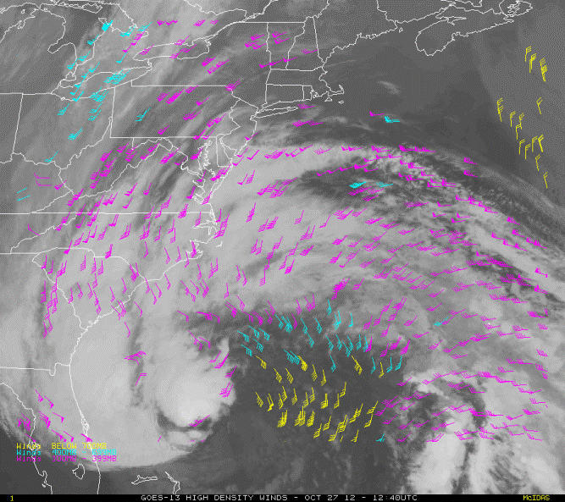
NESDIS’ Atmospheric Motion Vector (AMV) Nested Tracking Algorithm: Exploring its Performance
Jaime Daniels
NOAA/NESDIS, Center for Satellite Applications and Research
Wayne Bresky & Andrew Bailey
IM Systems Group (IMSG)
Steve Wanzong & Chris Velden
Cooperative Institute for Meteorological Satellite Studies (CIMSS)

Slide 2
Topics
Some GOES-R Information
Review of Nested Tracking Approach
Some Examples: Application to an Assortment of Imagers
Using Available ABI Proxy Data…
Performance
Overall, individual cases, experimentation with new ideas
Ongoing Activities and Plans
Summary

Slide 3
Topics
Some GOES-R Information
Review of Nested Tracking Approach
Some Examples: Application to an Assortment of Imagers
Using Available ABI Proxy Data…
Performance
Overall, individual cases, experimentation with new ideas
Ongoing Activities and Plans
Summary

Slide 4
Continuity of GOES Mission
GOES-R Launch Date: No later than March 31, 2016
Notes:
GOES-R moved from October 2015 Launch Commitment Date to 2Q FY2016 and GOES-S shifted to 3Q FY17. GOES-T and U LCD remain unchanged.

Slide 5
The Advanced Baseline Imager
ABI Current GOES Imager
Spectral Coverage 16 bands 5 bands
Spatial resolution
0.64 μm Visible 0.5 km Approx. 1 km
Other Visible/near-IR 1.0 km n/a
Bands (>2 μm) 2 km Approx. 4 km
Spatial coverage
Full disk 4 per hour 12 per hour Scheduled (3 hrly)
CONUS 12 per hour ~4 per hour
Mesoscale Every 30 sec n/a
Visible (reflective bands)
On-orbit calibration Yes No
Scan Mode 3 Scan Mode 4
June 16-20, 2014
5

Slide 6
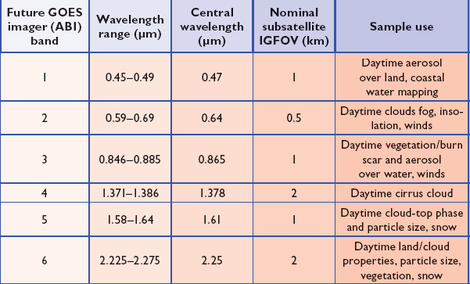
ABI Visible/Near-IR Bands
Schmit, T. J., M. M. Gunshor, W. P. Menzel, J. J. Gurka, J. Li, and A. S. Bachmeier, 2005: Introducing the next-generation Advanced Baseline Imager on GOES-R. Bull. Amer. Meteor. Soc., 86, 1079-1096.
June 16-20, 2014
IWW12 Copenhagen, Denmark
Schml, 2005
Notes:
Schmit, T. J., M. M. Gunshor, W. P. Menzel, J. J. Gurka, J. Li, and A. S. Bachmeier, 2005: Introducing the next-generation Advanced Baseline Imager on GOES-R. Bull. Amer. Meteor. Soc., 86, 1079-1096.

Slide 7
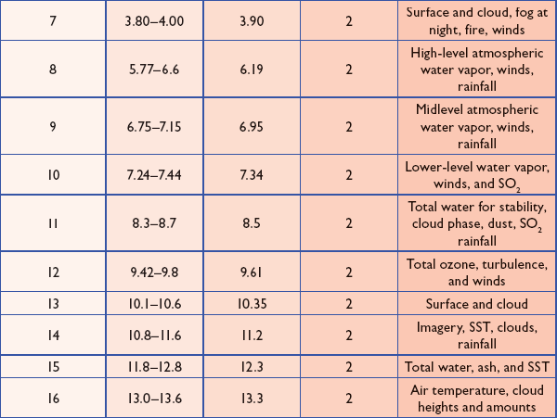
ABI IR Bands
Notes:
Schmit, T. J., M. M. Gunshor, W. P. Menzel, J. J. Gurka, J. Li, and A. S. Bachmeier, 2005: Introducing the next-generation Advanced Baseline Imager on GOES-R. Bull. Amer. Meteor. Soc., 86, 1079-1096.

Slide 8
Topics
Some GOES-R Information
Review of Nested Tracking Approach
Some Examples: Application to an Assortment of Imagers
Using Available ABI Proxy Data…
Performance
Overall, individual cases, experimentation with new ideas
Ongoing Activities and Plans
Summary

Slide 9
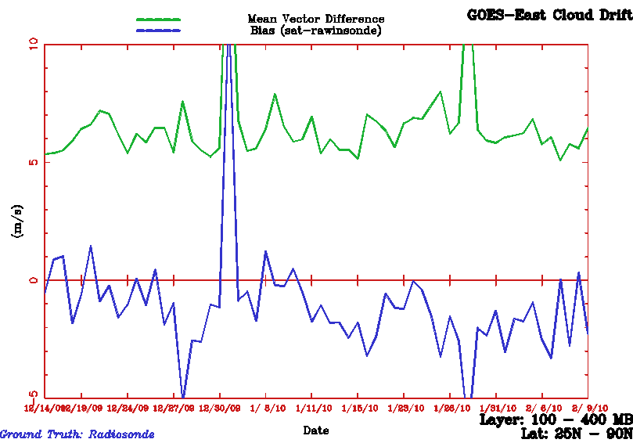
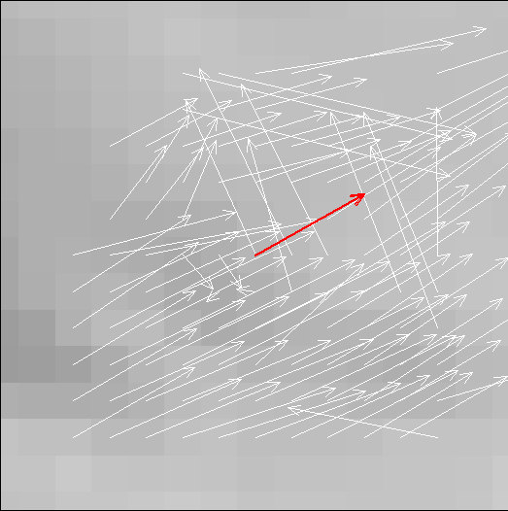
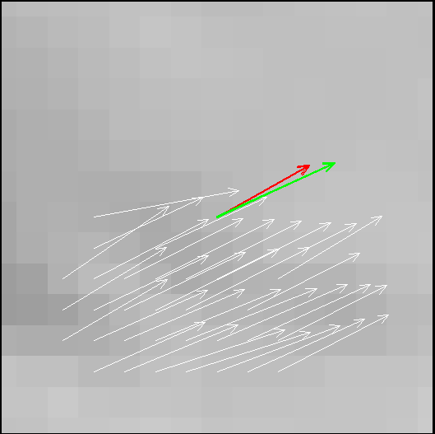
Nested Tracking Approach
Designed to minimize observed slow speed bias of satellite winds; a long standing concern of the NWP community
Computes local motions (nested) within a larger target scene, together with a clustering algorithm, to arrive at a motion solution(s)
Potential for determination of motion at different levels and/or different scales
Cloud heights at pixels belonging to the largest cluster are used to assign a representative height to the derived motion wind
GOES-12 Satwinds vs. Rawinsonde (100-400 hPa)
10
Mean Vector Difference
5
m/s
0
Speed Bias
-5
Date
Motion of entire box
SPD: 22.3 m/s
Average of largest cluster
SPD: 27.6 m/s
Before clustering
After clustering

Slide 10
Nested Tracking Approach*
Use local motion vectors to extract dominant motion(s)
Perform cluster analysis of line and element displacements
Use a density-based cluster analysis scheme (DBSCAN**)
Link pixels driving tracking solution(s) to final height assignment
Use the median of pixel level cloud heights associated with each cluster.
* Bresky, W., J. Daniels, A. Bailey, and S. Wanzong, 2012: New Methods Towards Minimizing the Slow Speed Bias Associated With Atmospheric Motion Vectors (AMVs). J. Appl. Meteor. Climatol., 51, 2137-2151
** Ester, M., H.-P. Kriegel, J. Sander and X. Xu (1996): A Density-Based Algorithm for Discovering Clusters in Large Spatial Databases with Noise. In Proceedings of 2nd International Conference on Knowledge Discovery and Data Mining (KDD-96), Portland, Oregon, USA, 226-231

Slide 11
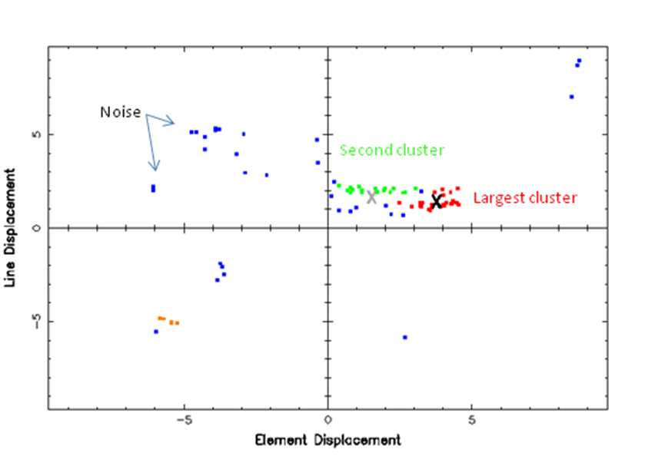
Nested Tracking Approach
Clustering is done on displacements in line/element space:
X – Average displacement of points in cluster
X – Displacement from tracking the entire 15x15 target scene
Notes:
DBSCAN output for the cloud scene pictured in Slide 9. The two largest clusters are shown by the red and green dots. The average displacement of the points in the largest cluster is shown by the black “X” while the motion derived from tracking the entire scene is shown by the gray “X.”

Slide 12
Nested Tracking & Clustering Details
Size of outer target scene is 19x19 pixels
2-pixel offset is used that yields a maximum of 225 possible local motion estimates derived from nested 5x5 target scenes
An initial sample of local motion vectors is filtered by imposing a 0.8 correlation threshold
Clustering (via DBSCAN)
Specification of two parameters to start
Minimum number of points in a cluster (4)
Radius about each point to search for neighboring points (1/2 pixel)
Each point (ie., displacement) is processed and given a classification based on nearby points
“Core” cluster point: Has at least 4 points in neighborhood (radius)
“Boundary” point: Has fewer than 4 neighbors, but connected to neighborhood by at least one other point
“Noise”: Point does not belong to any cluster

Slide 13
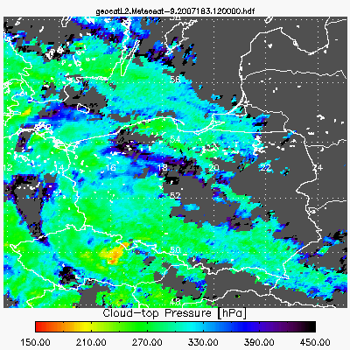
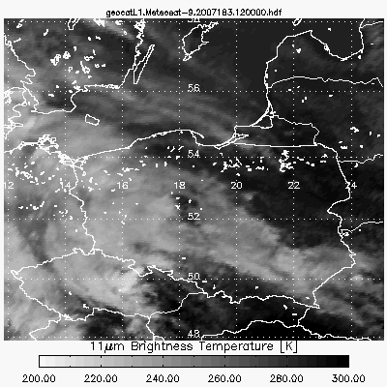
Cloud-Top Pressure Product
Cloud Height Algorithm Highlights
Algorithm uses the 11, 12 and 13.3mm channels to retrieve cloud temperature, cloud emissivity and a cloud microphysics.
Algorithm uses an optimal estimation approach (Rogers, 1976) that provides error estimates (T_{c}).
NWP forecast temperature profiles used to compute cloud-top pressure and height.
For pixels typed as containing multi-layer clouds, a multi-layer solution is performed.
Special processing occurs in the presence of low level temperature inversions.
References
Heidinger, A., 2010: GOES-R Advanced Baseline Imager (ABI) Algorithm Theoretical Basis Document For Cloud Mask, GOES-R Program Office, www.goes-r.gov.
Rodgers, C.D., 1976: Retrieval of atmospheric temperature and composition from remote measurements of thermal radiation. Rev. Geophys. Space Phys., 60, 609-624.
Please visit Andy Heidinger (NOAA/NESDIS) at his poster to learn more about this cloud height algorithm!!
Notes:
IR-only technique
This cloud height algorithm has been applied to a number of sensors (AVHRR and GOES 8-11; 11,12um); GOES-12,13,14,15 (11, 13.3um); VIIRS (8.5, 11, 12um); and will be for the future GOES-R ABI (11,12, 13.3um)
While channels and results performances vary, all algorithms share the same physical basis and coding framework
IR approaches found to be superior to other methods and provide consistent day-night results
Approach provides information on cloud microphysics which gives more insight into cloud evolution

Slide 14
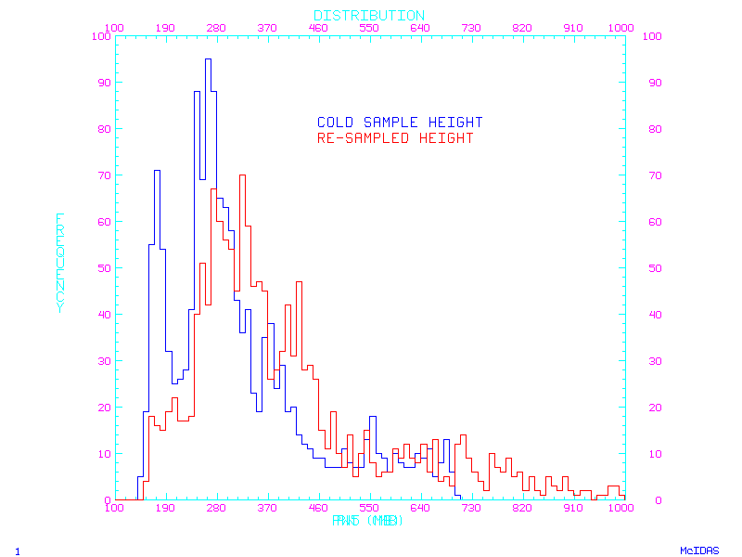
Nested Tracking Approach
Linking Tracking to Height Assignment…
Heritage Approach:
Coldest 20% of pixels in target box used to compute AMV height assignment
Nested Tracking Approach:
Median of cloud-top pressure of points in largest cluster is assigned AMV height assignment
Frequency
Pressure
Impact is to push AMV height assignments lower in the atmosphere

Slide 15
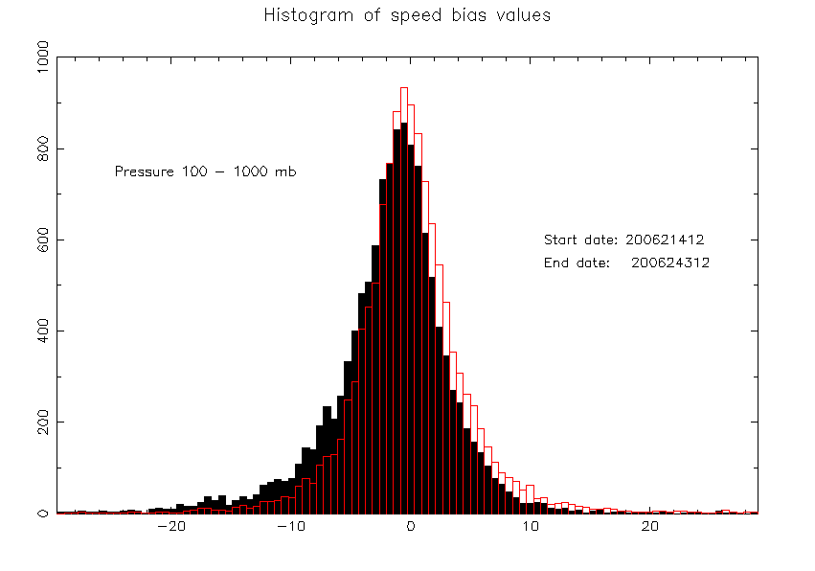
Nested Tracking Approach Impact on Speed Bias…
Nested tracking reduces slow speed bias of AMVs when compared to radiosonde winds!
Expect this to be beneficial to NWP…
Black histogram shows conventional tracking
Red histogram shows nested tracking
August 2006
Meteosat-8, Band 9
Test distribution shifted right
- Due to faster AMVs and/or lower heights
Speed bias (AMV – RAOB) (m/s)

Slide 16
Nested Tracking Output
Standard deviation of displacements (in pixels) in largest cluster
Sample 1 (reverse vector), Sample 2 (forward vector)
Standard deviation of displacements divided by magnitude of average displacement
Sample 1 (reverse vector), Sample 2 (forward vector)
Size of largest cluster
Sample 1 (reverse vector), Sample 2 (forward vector)
Median, Minimum, and Maximum cloud-top pressure (hPa) in largest cluster
Median, Minimum , and Maximum cloud-top temperature (K) in largest cluster
Median, Minimum , and Maximum cloud optical depth in largest cluster
Dominant cloud phase of target scene
Dominant cloud type of target scene
Standard deviation of cloud top pressure values in target scene (hPa)
Sharon will talk about the parameters she tested with and found useful.
These variables are part of the new proposed winds BUFR sequence
Notes:
Quality Control settings: QIFN > 80 NEE < 0.9 IR AMVs 0.04< PCT1 < 0.5

Slide 17
Topics
Some GOES-R Information
Review of Nested Tracking Approach
Some Examples: Application to an Assortment of Imagers
Using Available ABI Proxy Data…
Performance
Overall, individual cases, experimentation with new ideas
Ongoing Activities and Plans
Summary

Slide 18
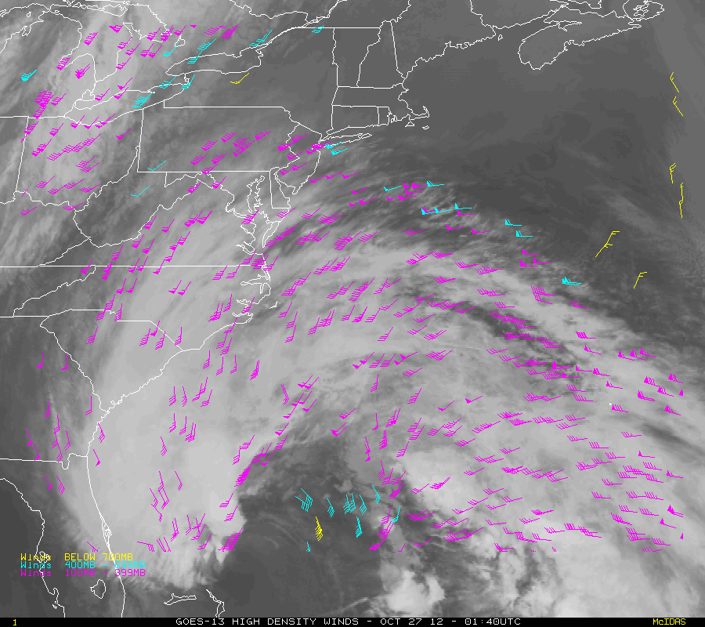
Application to Current GOES
Cloud-drift winds derived from 15-min GOES-13 imagery over Hurricane Sandy (4-day loop)
High-Level 100-400 mb
Mid-Level 400-700 mb
Low-Level >700 mb
The GOES-R Winds Team continues to routinely generate and validate ABI proxy winds from GOES-13, GOES-15, Meteosat-10/SEVIRI, and NPP/VIIRS using the GOES-R winds algorithm.
Notes:
22 UTC April 24 – 08 UTC April 25, 2012

Slide 19
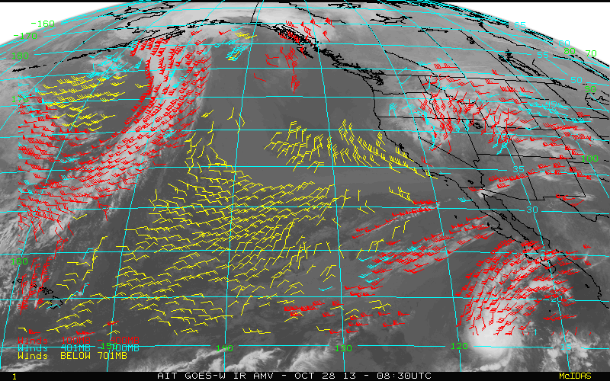
Application to Current GOES
Cloud-drift winds derived from 15-min GOES-15 imagery over the East Pacific
High-Level 100-400 mb
Mid-Level 400-700 mb
Low-Level >700 mb
Notes:
22 UTC April 24 – 08 UTC April 25, 2012

Slide 20
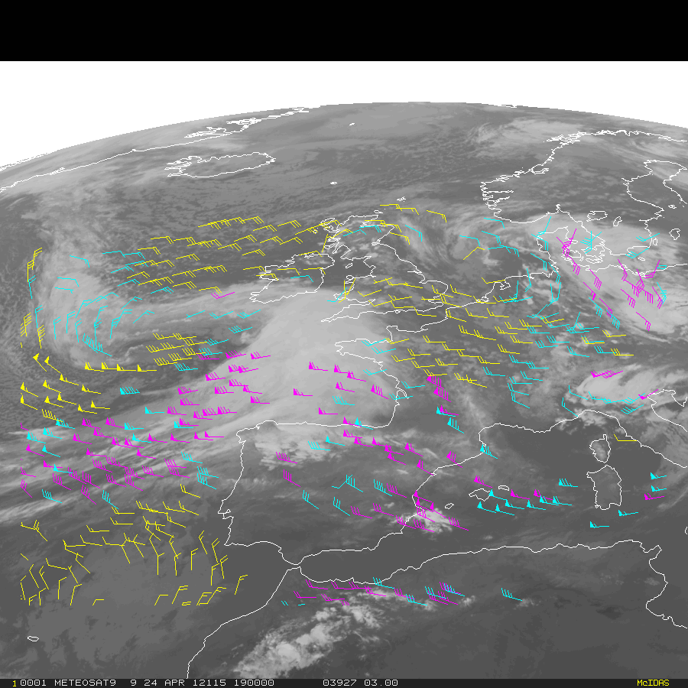
Using SEVIRI as a Proxy for the Future GOES-R ABI
Application to Meteosat/SEVIRI
Loop of winds derived from hourly Full Disk Meteosat-9 SEVERI 10.8 µm imagery (22 UTC Apr 24 – 08 UTC Apr 25, 2012
High-Level 100-400 mb
Mid-Level 400-700 mb
Low-Level >700 mb
Notes:
22 UTC April 24 – 08 UTC April 25, 2012

Slide 21
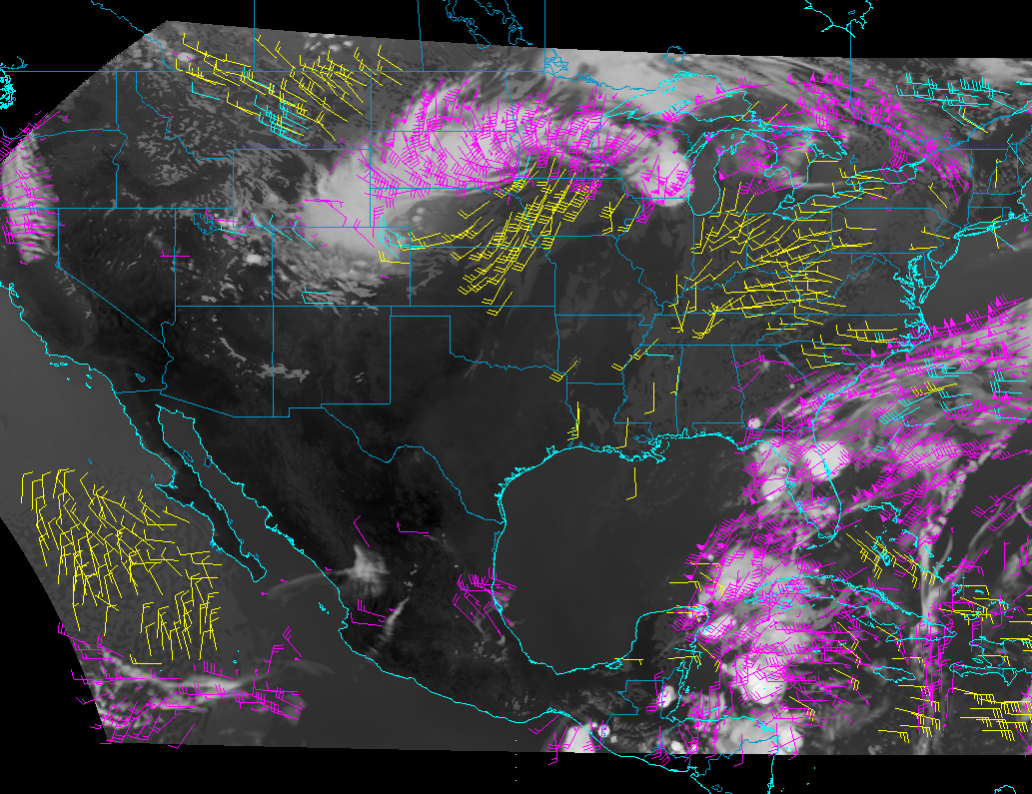
Application to Simulated ABI Imagery
High-Level 100-400 mb
Mid-Level 400-700 mb
Low-Level >700 mb
Notes:
WRF-CHEM Simulated ABI Imagery routinely produced every hour by the GOES-R ABI proxy team.
Initial Capability/Demonstration by AWG proxy team at CIMSS
WRF-Chem model met/aerosol forecasts (8km) over CONUS using the Community Radiative Transfer Model (CRTM) to simulated all 16 ABI bands.
NCEP/GFS model 3 hr forecast (T574L64, an effective grid point spacing of ~27 km) outputs used, together with CRTM (v2.1), to produce ABI simulated radiances (all bands) at 3hr intervals over FD
Generate simulated ABI radiances at 1hr intervals via interpolation of 3hr GFS forecast output and running CRTM every hour
Simulated data (all bands) are remapped from WRF-chem & GFS grids to the GOES-R ABI fixed grid at their expected resolutions and converted to GRB format

Slide 22
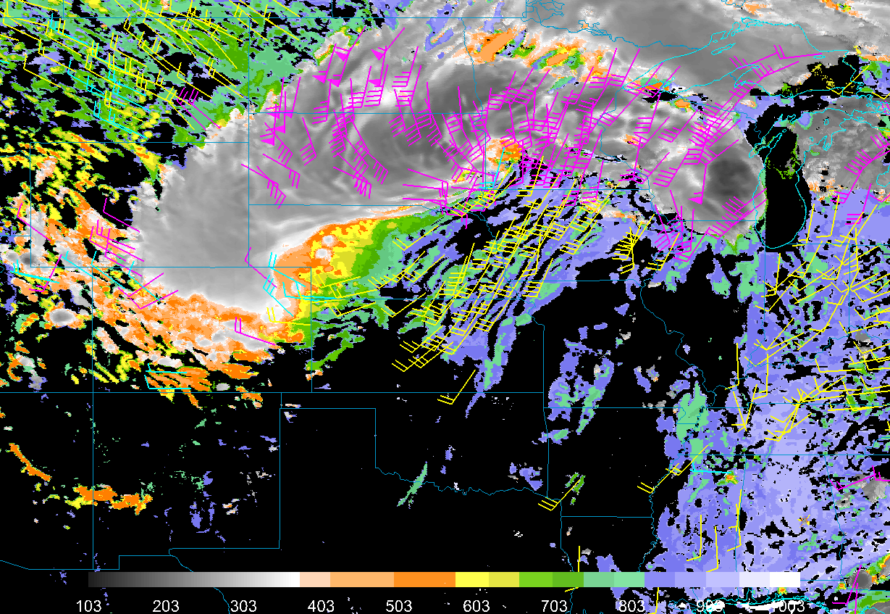
Application to Simulated ABI Imagery
High-Level 100-400 mb
Mid-Level 400-700 mb
Low-Level >700 mb
Notes:
Simulated datasets have been used by a number of the GOES-R ABI algorithm teams to generate Level-2 products
Simulated datasets will support a number of tests for different elements of the GOES-R ground system segment

Slide 23
Topics
Some GOES-R Information
Review of Nested Tracking Approach
Some Examples: Application to an Assortment of Imagers
Using Available ABI Proxy Data…
Performance
Overall, individual cases, experimentation with new ideas
Ongoing Activities and Plans
Summary

Slide 24
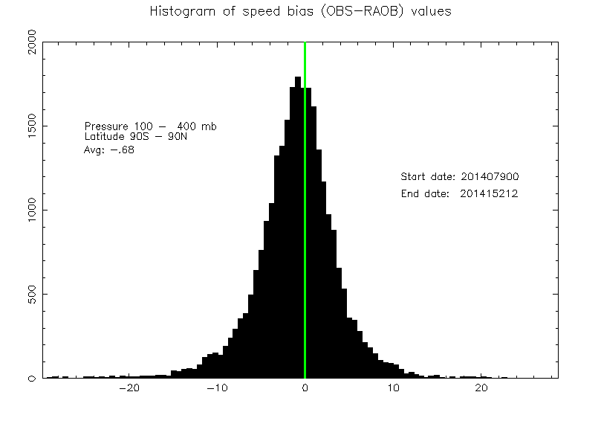
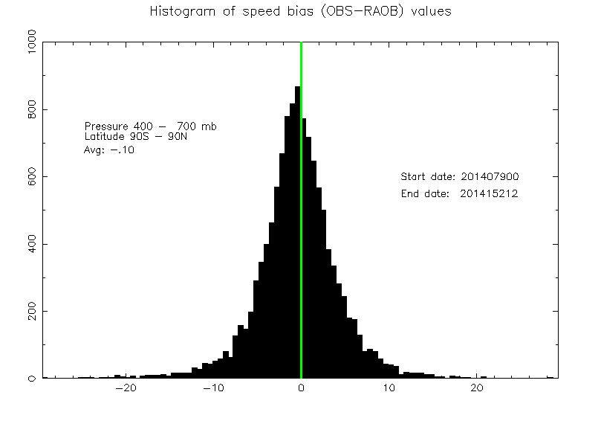
Validation Speed Bias…
Pressure 100–400 hPa
Latitude 90S – 90N
Speed Bias: -0.68
100-400 hPa
Pressure 400–700 hPa
Latitude 90S – 90N
Speed Bias: -0.10
400-700 hPa
AMV – Raob (m/s)
AMV – Raob (m/s)
Meteosat-10/SEVIRI (10.8um) AMVs (March 20 - June 2, 2014)

Slide 25
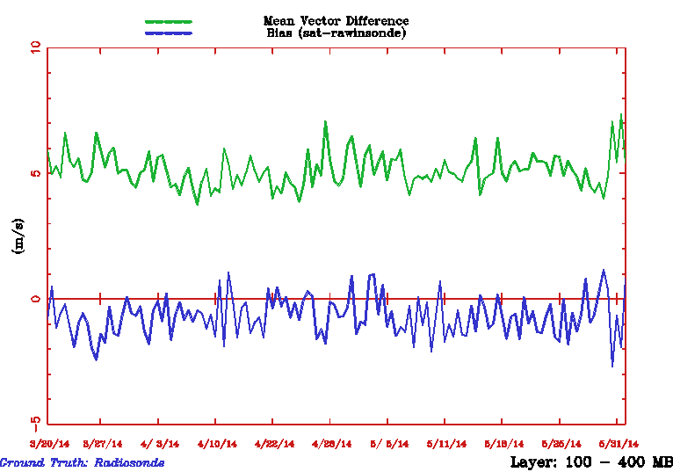
Meteosat-10/SEVIRI Winds (10.8um) vs Radiosondes
100-400 mb
QI > 80;
PCT1, PCT2 = 0.05 – 0.50
Nested Tracking Used
MVD
Overall Stats for Period:
MVD = 4.84 m/s
NRMS = 0.37
Speed Bias = -0.72 m/s
Avg Speed = 16.12 m/s
N = 23,400
Speed Bias

Slide 26
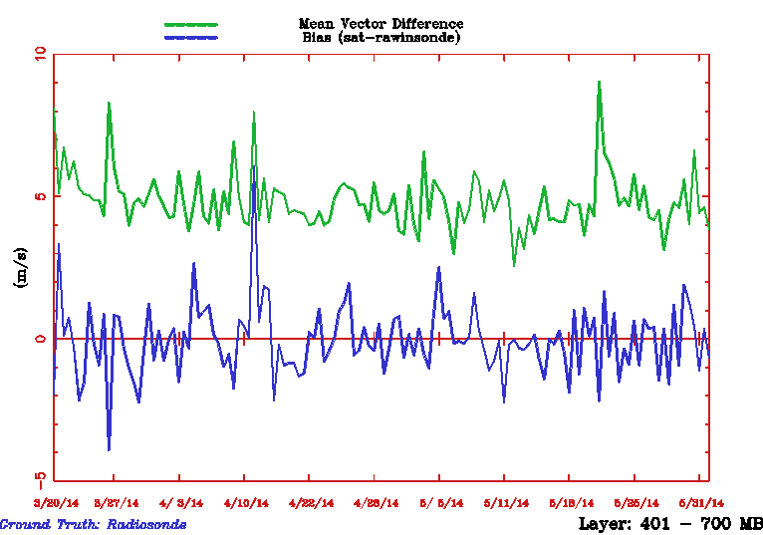
Meteosat-10/SEVIRI Winds (10.8um) vs Radiosondes
400-700 mb
QI > 80;
PCT1, PCT2 = 0.05 – 0.50
Nested Tracking Used
MVD
Overall Stats for Period:
MVD = 4.62 m/s
NRMS = 0.19
Speed Bias = -0.19 m/s
Avg Speed = 13.31 m/s
N = 10,573
Speed Bias

Slide 27
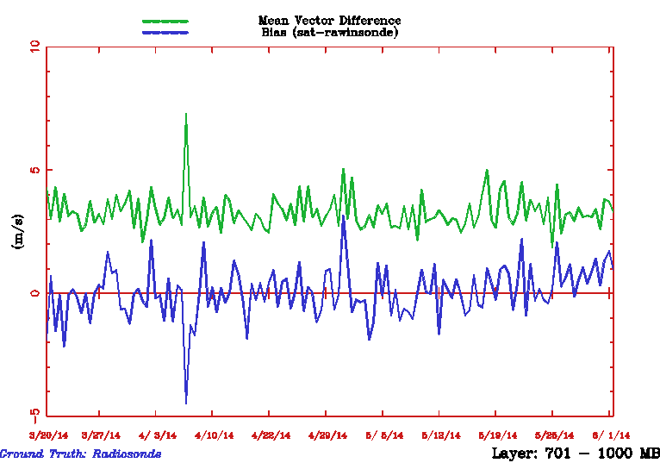
Meteosat-10/SEVIRI Winds (10.8um) vs Radiosondes
P > 700 mb
QI > 80;
PCT1, PCT2 = 0.05 – 0.50
Nested Tracking Used
MVD
Overall Stats for Period:
MVD = 2.94 m/s
NRMS = 0.40
Speed Bias = -0.04 m/s
Avg Speed = 8.68 m/s
N = 9349
Speed Bias

Slide 28
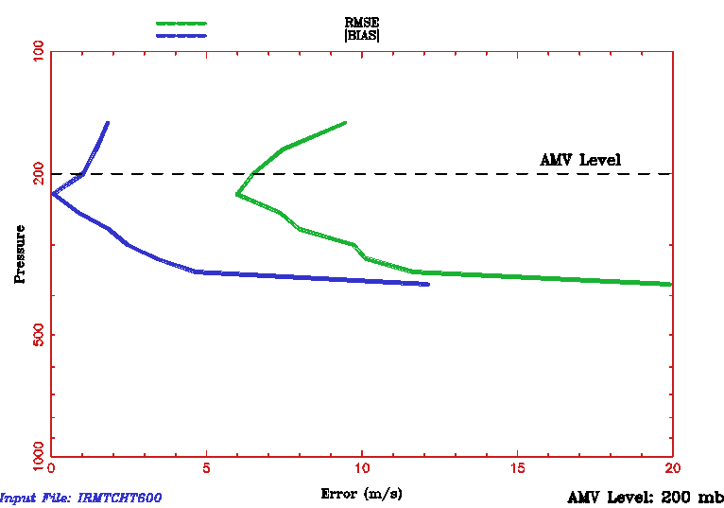
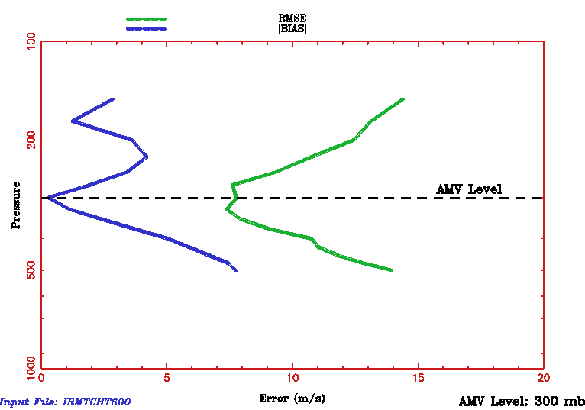
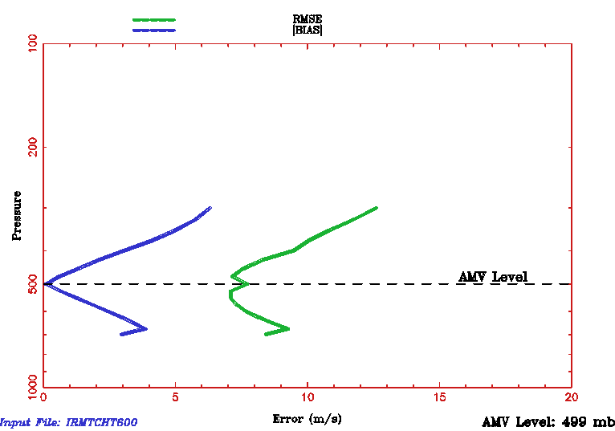
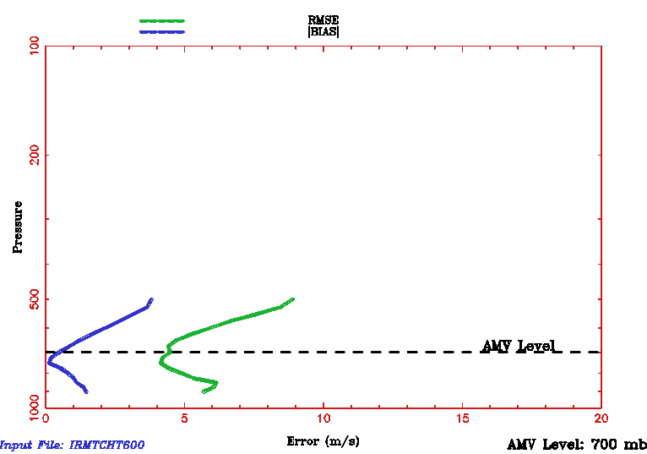
Validation Height Assignment (Level-of-Best-Fit)…
Meteosat-10/SEVIRI (10.8um) AMVs (22 March 2014 – 02 June 2014)
Speed Bias, RMSE
Speed Bias, RMSE
AMVs at 200 mb
AMVs at 300 mb
Speed Bias, RMSE
Speed Bias, RMSE
AMVs at 500 mb
AMVs at 700 mb
Notes:
Met-10/SEVIRI 10.8um AMVs (via nested tracking algorithm)
Date range is: 22 March 2014 – 2 June 2014
Radiosonde wind profiles used to derive Level-of-Best-Fit Curves
Minimums of Level-of-Best-Fit (RMSE and Bias) curves match AMV heights very well at all levels
Good to see that mininums in RMSE and speed bias curves agree

Slide 29
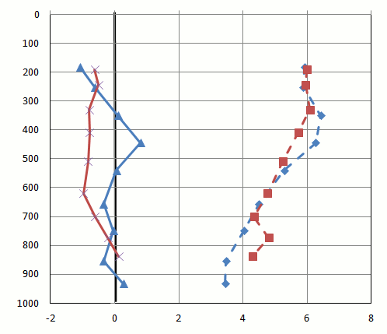
New vs. Heritage AMV Algorithm
Comparing Performance…
Meteosat-8, 11 um
Aug 2006 and Feb 2007
Speed Bias
RMSE
Nested Tracking
Heritage
643
3673
4079
3085
1499
1125
1533
2511
1573
AMV – Radiosonde (m/s)
Notes:
Meteosat-8, 11 um
Aug 2006 and Feb 2007
QI=80 100 (without forecast)
PCT1=5 50
643 3673 4079 3085 1499 1125 1533 2511 1573

Slide 30
Testing EUMETSAT’s CC_{ij} Approach
Meteosat-8 11 micron winds Feb 1-28, 2007 100–400 hPa | Comparisons to Radiosondes (QI > 80)
 | Nested tracking 23x23 box Median pressure of largest motion cluster | Traditional tracking 23x23 box CC_{ij} height assignment
Vector RMSE (m/s) | 7.76 | 8.15
Speed Bias (m/s) | -1.37 | -2.74
Mean speed (m/s) | 22.85 | 22.44
Mean AMV Height (hPa) | 277 | 267
Sample Size | 3268 | 3268
CC_{ij} approach tested in GOES-R AMV algorithm for 1 month (Feb 2007)
Result: Higher heights and slightly slower winds; increased slow bias

Slide 31
Testing EUMETSAT’s CC_{ij} Approach
Meteosat-8 11 micron winds Feb 1-28, 2007 400–650 hPa | Comparisons to Radiosondes (QI > 80)
 | Nested tracking 23x23 box Median pressure of largest motion cluster | Traditional tracking 23x23 box CC_{ij} height assignment
Vector RMSE (m/s) | 7.02 | 7.97
Speed Bias (m/s) | 0.12 | -2.46
Mean speed (m/s) | 18.30 | 18.01
Mean AMV Height (hPa) | 480 | 418
Sample Size | 951 | 951
CC_{ij} approach tested in GOES-R AMV algorithm for 1 month (Feb 2007)
Result: Higher heights and slightly slower winds; increased slow bias

Slide 32
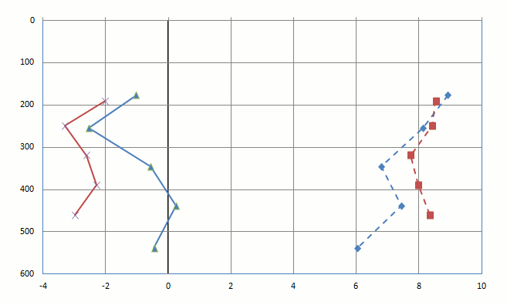
Testing EUMETSAT’s CC_{ij} Approach
Meteosat-8, 11 um
Feb 2007
QI > 80
Nested Tracking
CC_{ij}
Speed Bias
RMSE
680
1159
1429
639
232
AMV – Radiosonde (m/s)
CC_{ij} approach tested in GOES-R AMV algorithm for 1 month (Feb 2007)
Result: Higher heights and slightly slower winds; increased slow bias
Notes:
CC_{ij} approach integrated within our software. We generated two sets of AMVs; one set using nested tracking, the other with CC_{ij}
680 1159 1429 639 232

Slide 33
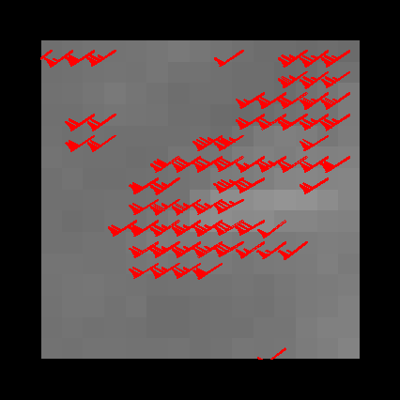
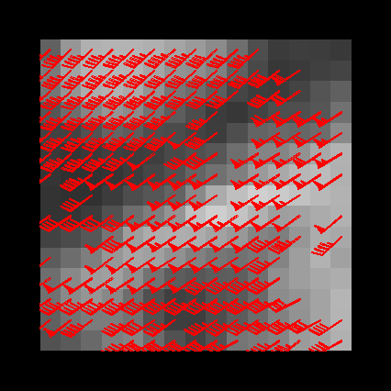
Feature Tracking WV band vs. LWIR Window…
Tracking Clouds with the 6.2um band
Tracking Clouds with the 10.8um band
Avg speed: 32 m/s
Avg speed: 24 m/s
WVCT wind (6.2um) almost always faster than IR (10.8um) cloud-drift wind
LWIR channel tracking features over greater depth of the atmosphere
Greater shear evident leading to more smoothing and slower wind estimate
Notes:
Meteosat-8
12 UTC Feb 1, 2007

Slide 34
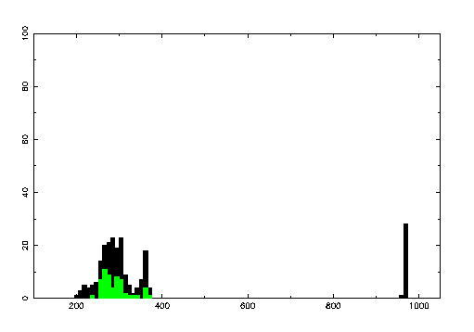
Height Assignment WV band vs. LWIR Window…
Histograms of cloud top pressure
6.2um band
10.8um band
Median PW = 283 hPa
Median PW = 293 hPa
Black histogram is for entire scene, green histogram is largest motion cluster
10.8um channel tracking more points over greater depth of the atmosphere
Note the interesting fact that for this case we have two AMVs within 10 hPa of each other, but with very different speeds. Which AMV is more correct?
Notes:
Meteosat-8
12 UTC Feb 1, 2007
Look at colocated radiosonde wind profile to answer the question: “Which AMV is more correct?”

Slide 35
Testing the Idea of Combining the Displacements of Each Time Step
Compute sub-vector for the Reverse Time Step
This is our current implementation
Sub-vector 1
Before clustering
After clustering
Average
sub-vectors
Final
Vector
Compute sub-vector for the Forward Time Step
Sub-vector 2
Before clustering
After clustering
Notes:
Meteosat-8/SEVIRI 11um LWIR (11um) Cloud drift winds
Feb-07
QINF=80 100
No acceleration or gross error checks performed
2D neighborhood radius used in DBSCAN
We see a 5-6% increase in good wind counts when combining the displacements before clustering. The reverse time step is plotted in red and the forward time step is plotted in white.

Slide 36
Testing the Idea of Combining the Displacements of Each Time Step
Reverse Time Step
Before clustering
Apply clustering
to local displacements from both time steps
After clustering
Final
Vector
Forward Time Step
Before clustering
After clustering
Notes:
Meteosat-8/SEVIRI 11um LWIR (11um) Cloud drift winds
Feb-07
QINF=80 100
No acceleration or gross error checks performed
2D neighborhood radius used in DBSCAN
We see a 5-6% increase in good wind counts when combining the displacements before clustering. The reverse time step is plotted in red and the forward time step is plotted in white.

Slide 37
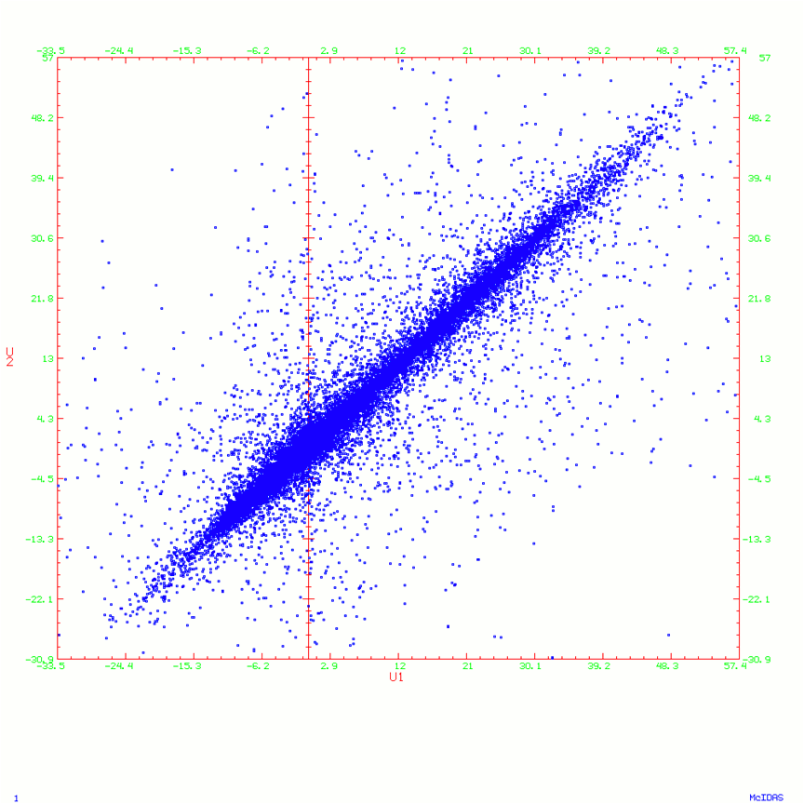
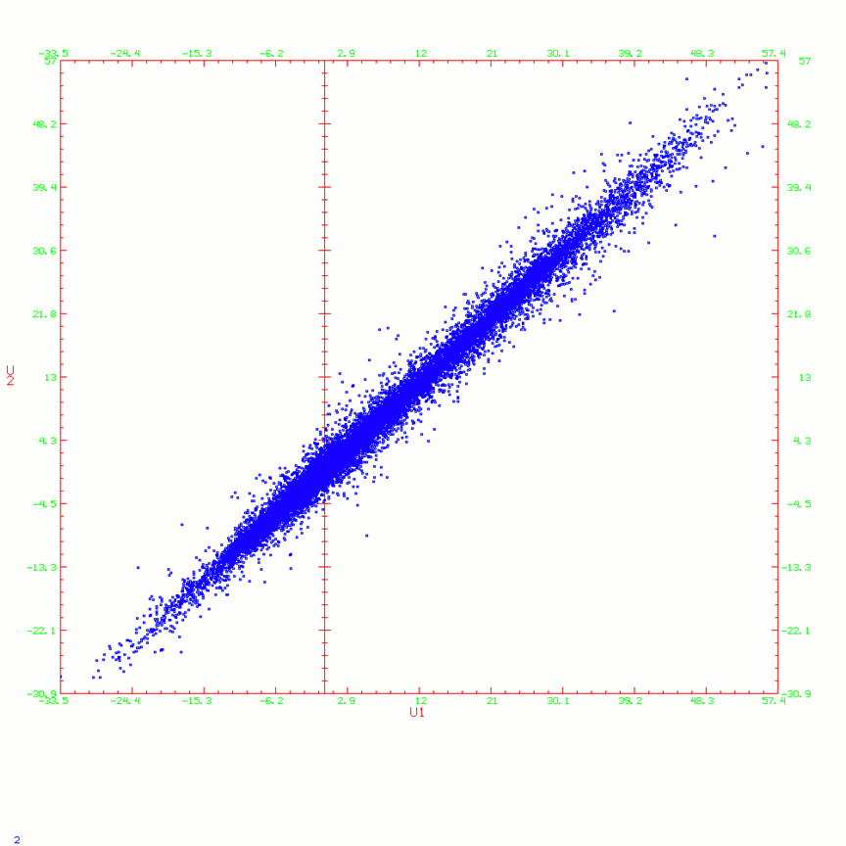
Testing the Idea of Combining the Displacements of Each Time Step
U1 vs U2
U2
U2
U1
U1
Points from both time steps when analyzed together;
Points from each time step when analyzed separately
Notes:
Meteosat-8/SEVIRI 11um LWIR (11um) Cloud drift winds
Feb-07
QINF=80 100
No acceleration or gross error checks performed
2D neighborhood radius used in DBSCAN
We see a 5-6% increase in good wind counts when combining the displacements before clustering. The reverse time step is plotted in red and the forward time step is plotted in white.

Slide 38
Testing the Idea of Combined Displacements
RMSE - Cluster analysis of displacements from each time step
RMSE - Cluster analysis of combined displacements from time steps
Small, but consistent
improvement in vector RMSE
No real change in mean
speeds, so no change in speed
bias
5-6% increase in good
wind counts when combining
the displacements before
clustering.
m/s
Notes:
Meteosat-8/SEVIRI 11um LWIR (11um) Cloud drift winds
Feb-07
QINF=80 100
No acceleration or gross error checks performed
2D neighborhood radius used in DBSCAN
We see a 5-6% increase in good wind counts when combining the displacements before clustering. The reverse time step is plotted in red and the forward time step is plotted in white.

Slide 39
Topics
Some GOES-R Information
Review of Nested Tracking Approach
Some Examples: Application to an Assortment of Imagers
Using Available ABI Proxy Data…
Performance
Overall, individual cases, experimentation with new ideas
Ongoing Activities and Plans
Summary

Slide 40
Ongoing Activities and Plans
Supporting industry’s implementation of GOES-R Winds algorithm into the GOES-R core ground system
Continuing our Validation Related Activities Using Available ABI Proxy Data
Meteosat-9/10/SEVIRI imagery, GOES-13/15, NPP/VIIRS, and Himawari-8
Case studies: Search for outliers, analyze, and understand
Develop, test, and validate algorithm adjustments
Validation tool development
Supporting development of a new BUFR sequence for satellite winds (Thurs morning discussion)
Our routine (ie., hourly) experimental GOES-13/15 winds (all types) are placed in latest version of this new BUFR sequence and made available on our ftp server.
Assessing Impact of Nested Tracking Winds in the NCEP GFS Data Assimilation System
Meteosat/SEVIRI (Sharon Nebuda will talk more about this Tues afternoon)
GOES-13/15 (Iliana Genkova is working on this at NCEP)
Latest information on transition of nested tracking algorithm into NESDIS operations:
NPP/VIIRS: Operational as of May 8, 2014 (Jeff Key will talk more about this later today)
GOES-13/15: September 2014 – running in operations in parallel with existing GOES winds for a 9 month period to help ensure a smooth transition for NWP users
MODIS: November 2015
AVHRR: November 2015
GOES-R/ABI: Late 2016/Early 2017

Slide 41
Topics
Some GOES-R Information
Review of Nested Tracking Approach
Some Examples: Application to an Assortment of Imagers
Using Available ABI Proxy Data…
Performance
Overall, individual cases, experimentation with new ideas
Ongoing Activities and Plans
Summary

Slide 42
Summary
Developed, tested, and validated nested tracking approach using a variety of available ABI proxy data (Meteosat/SEVIRI, GOES-13/15, NPP/VIIRS, and Himawari-8, when available)
Nested tracking approach effectively minimizes the slow speed bias
Most speed “adjustments” are small, but some can exceed 10 m/s
Smaller bias a result of lower heights and faster winds
Improvement over heritage approach
Expected to benefit NWP
Opportunities with the nested tracking approach
Additional clusters may contain useful wind information in the target scene
Clustering output enables new quality control to be employed in NWP data assimilation
Nested tracking being implemented in NESDIS operations:
GOES-13/15 (soon), VIIRS (now), Terra/Aqua/MODIS (soon), AVHRR (soon), and GOES-R/ABI
Impact testing of nested tracking winds in NCEP’s GFS System in progress

Slide 43
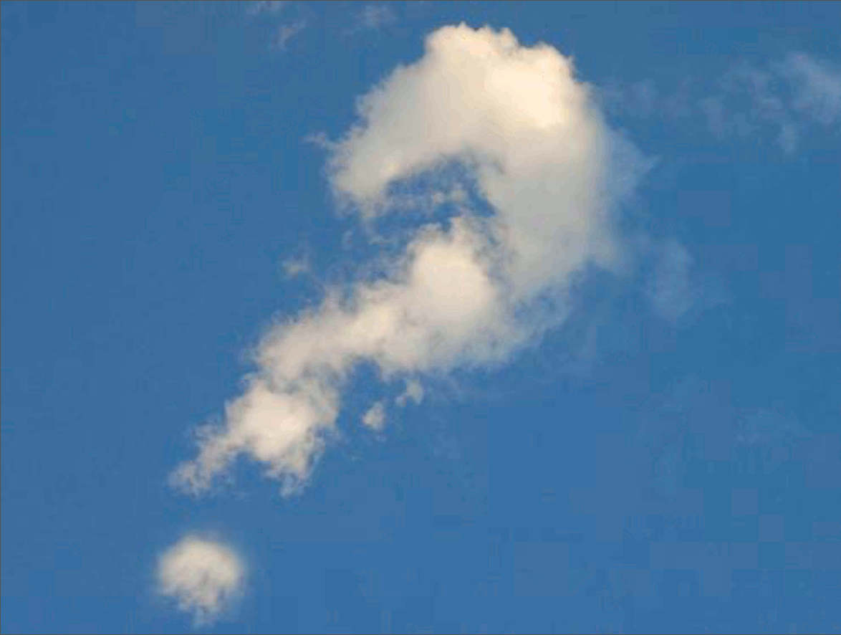
Questions

Slide 44
Backup Slides

Slide 45
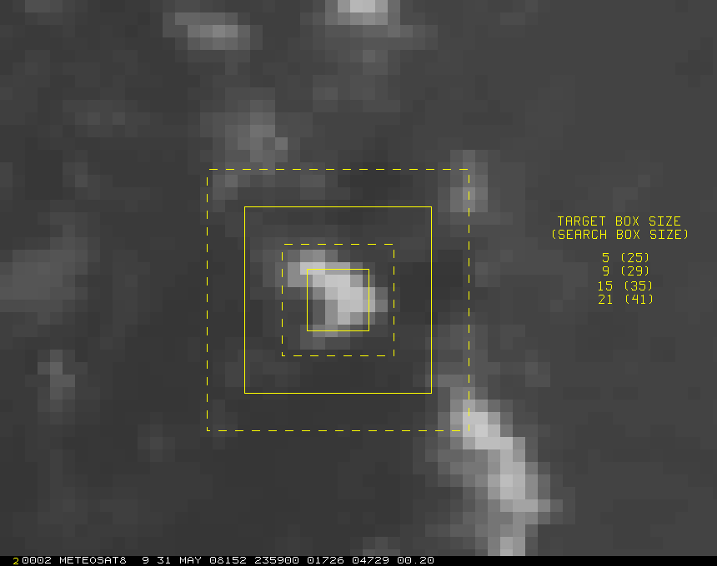
Impact of Box Size and Time Interval
on Magnitude of Speed Bias
Setup of Study
Winds were generated using Meteosat-8 rapid scan imagery for the period June 1 – 8, 2008.
Target locations were fixed while box size and time interval varied.
Target Box Sizes:
- 5x5, 9x9, 15x15, 21x21
Time Intervals:
- 5, 10, 15, 30 minutes
21
15
9
5
21
15
9
5

Slide 46
Impact of Box Size and Time Interval on Magnitude of the Speed Bias
Results – relative to control run (15x15 box, 15-minute loop interval)
Meteosat-8, Band 9
A larger box yields a larger slow bias – consistent with Sohn and Borde (2008)
Argues for using a small target box to reduce speed bias
Larger time interval also reduces slow bias
Believed to be resolution related

Slide 47
Impact of Box Size and Time Interval on the RMS
Results – relative to control run (15x15 box, 15-minute loop interval)
Meteosat-8, Band 9
A larger box reduces the RMS – largest box tested was 21x21 pixels
Argues against using a small box

