Slide 1
Globally Distributed Time Series of the enhanced Cloud Motion Vector Product
Roger Davies and Kevin Mueller

Slide 2
MISR winds: First Generation
Previously (10th and 11th Workshops) showed general agreement between average MISR first generation winds and reanalysis winds over the ocean
  better agreement over the Northern Hemisphere where the reanalysis had access to more data
  differences in meridional wind component due to higher spatial resolution of MISR
  differences in average low-level winds over the Southern Oceans due to lack of data in the reanalysis winds (they are too fast)
Also showed similar 10-year trends in low level wind speed
  increased wind speed over the Southern Oceans ≈1 m/s/decade
  decreases elsewhere ≈0-1 m/s/decade
  more spatial detail, and slightly larger values for MISR
Notes:
Albedos led to heights and winds and the need for operational stereo.

Slide 3
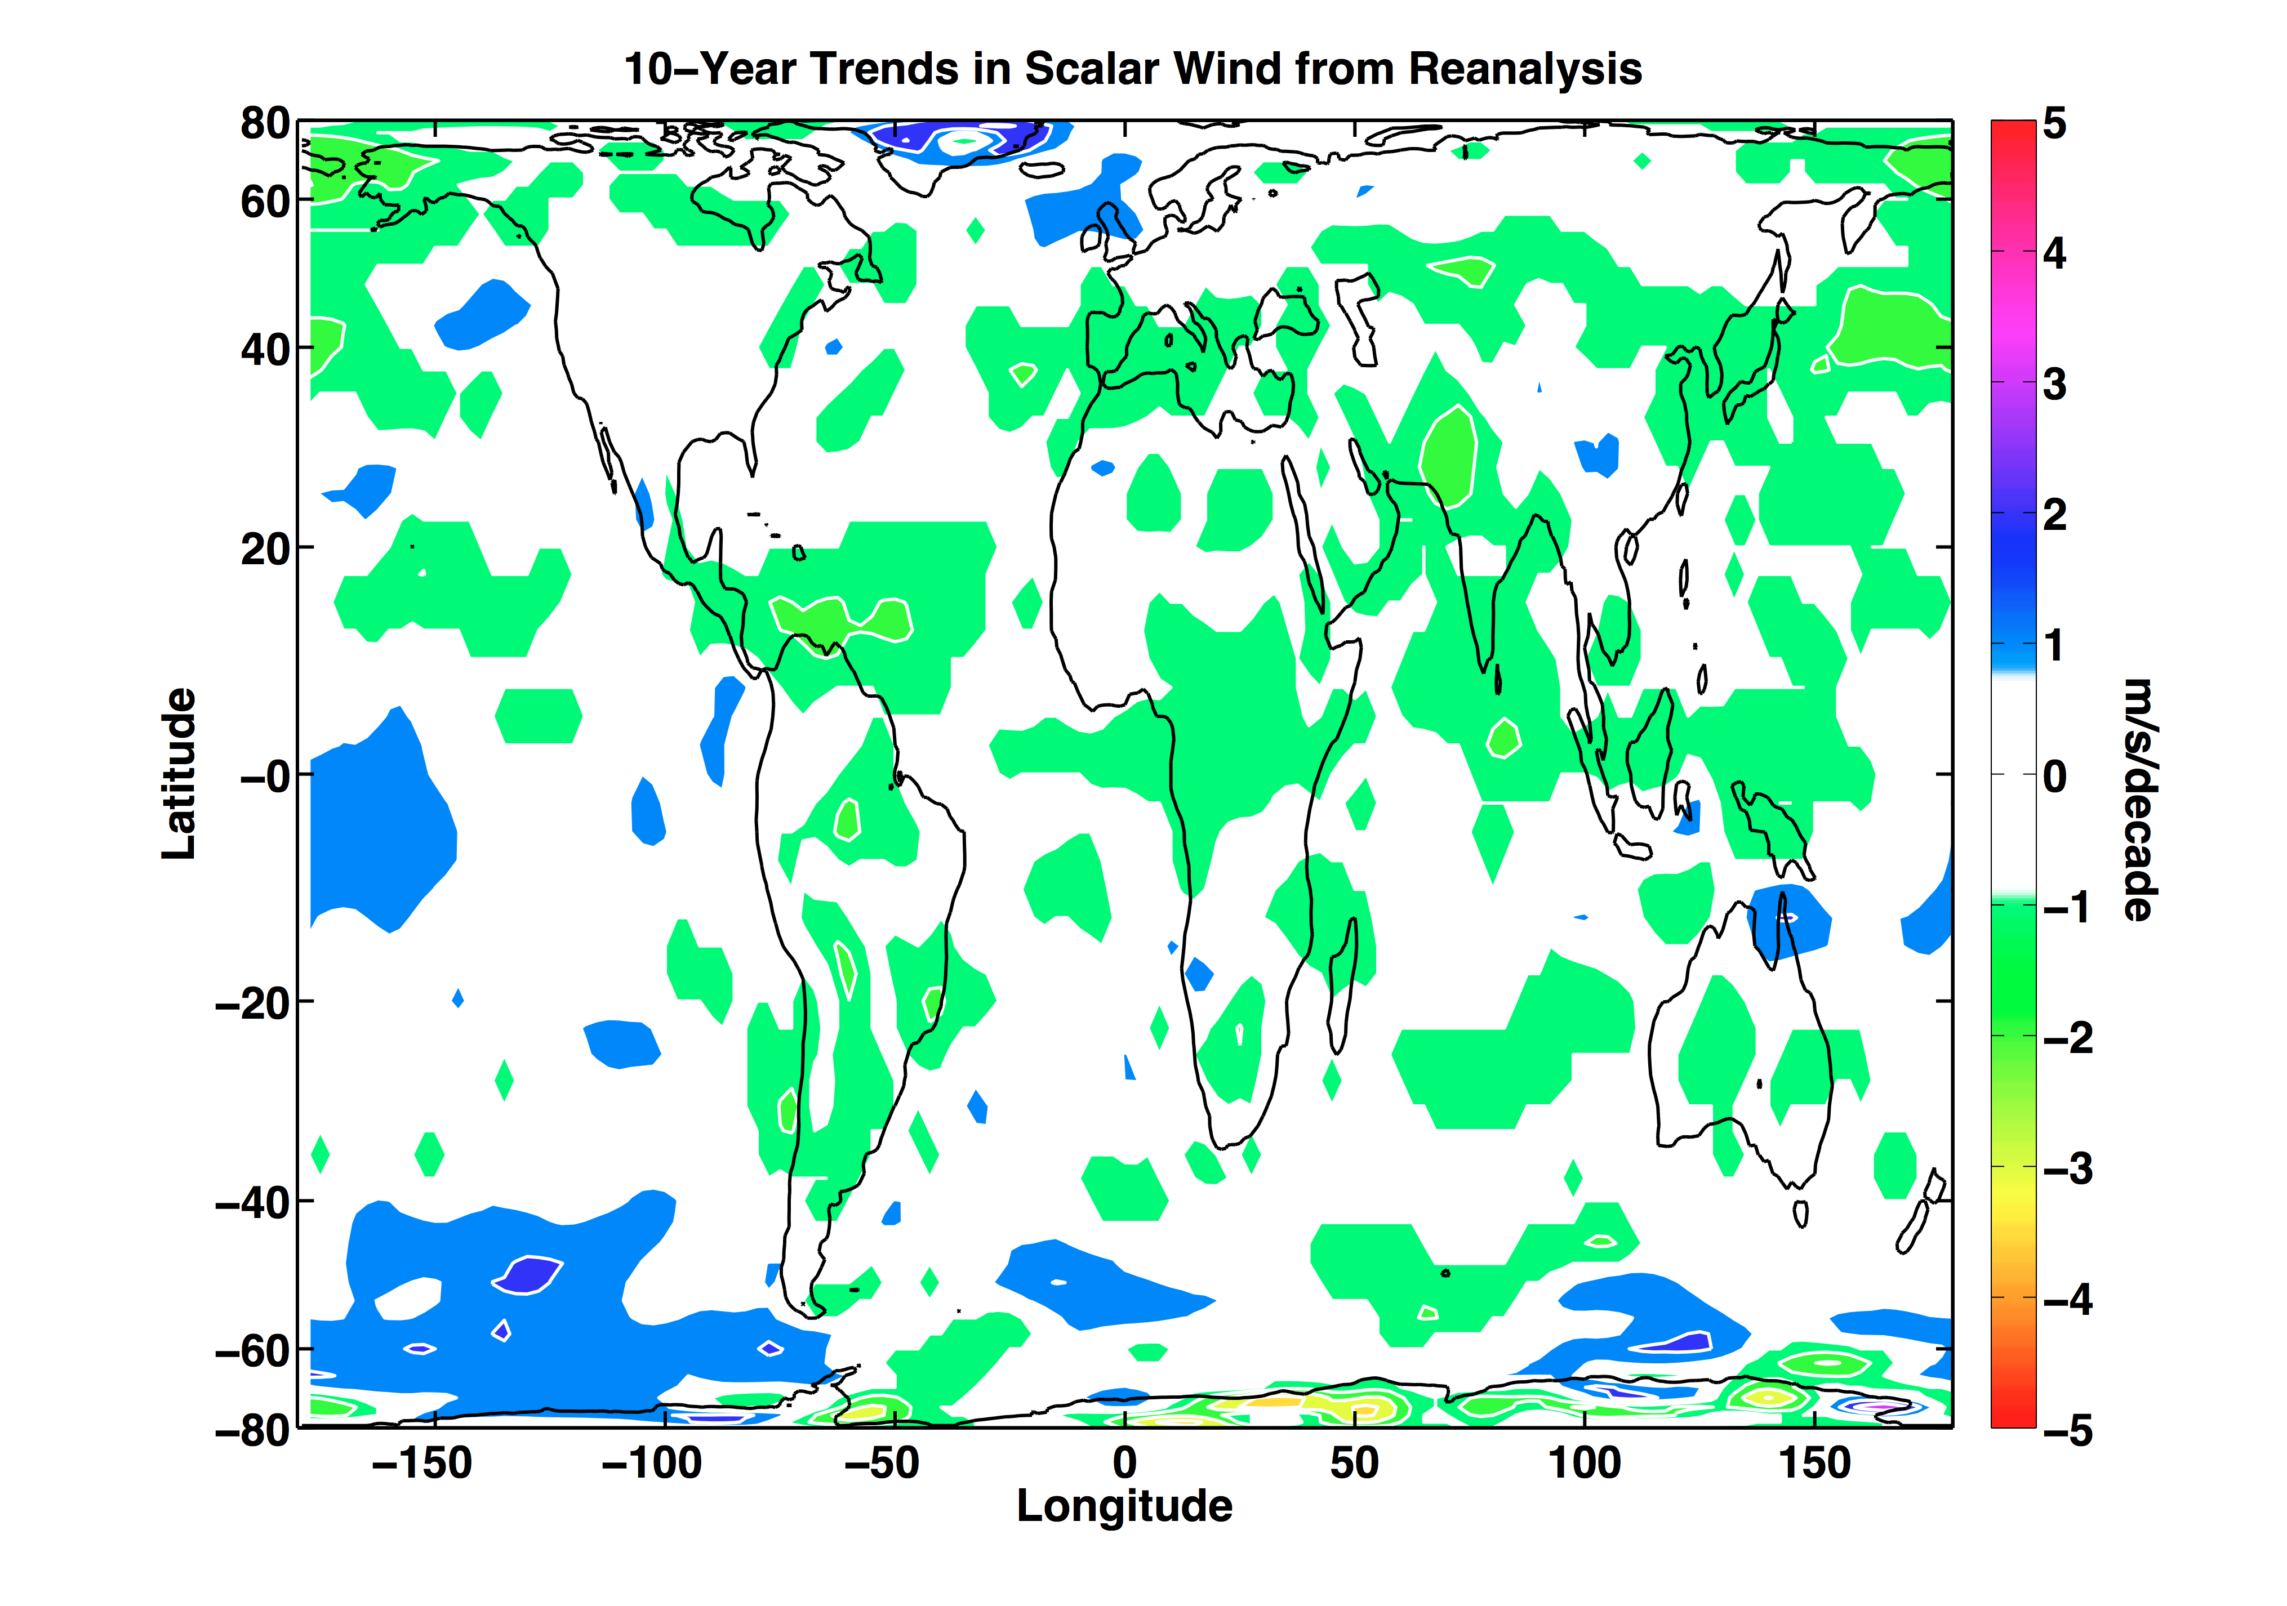

Slide 4
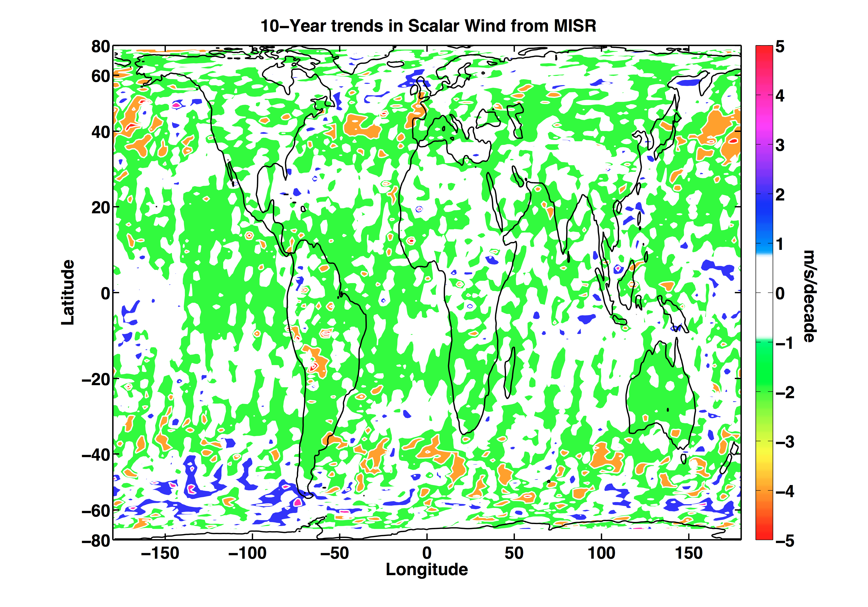

Slide 5
MISR winds: Second Generation
Improved stereo algorithm for simultaneous wind and height retrieval
  higher spatial resolution (17.6 km)
  both fore and aft triplets to improve quality assurance
Now have reprocessed the second generation winds for entire mission.
  these give 14-years, pole-pole, geometrically height-resolved, cloud motion vectors
Here are some preliminary results: 3/00–2/14
  ocean only (land shows the expected slow bias that decreases with height, but simpler to exclude altogether)
  average over ocean basin (Pacific, Atlantic, Indian, Southern Ocean–poleward of 45°S)
  low level (<1.5 km) and high level (9–11 km)

Slide 6


Slide 15
Summary of Low Level Winds
Southern Ocean (max effect at 55°S)
  increased wind speed ≈0.5 m/s/decade
  due to increasing westerlies
Southern Ocean (max effect at 45°S)
  Narrow band of decreased westerlies reduces speed ≈0.6 m/s/decade at 45°S
North Pacific
  Narrow band of increased winds 1 m/s/decade at 4°N (probably a shift in the ITCZ), stronger easterlies by 1.5 m/s/decade
North Atlantic
  Slight decrease at 13°N of 0.4 m/s/decade, due to both ITCZ and decreasing easterlies

Slide 24
Upper level winds
Climatology looks reasonable
  stronger meridional components than for reanalysis, especially over S. Oceans
Trends over last 14 years are fairly weak in general
  increases of ≈3 m/s/decade in a few places

Slide 25
Work in Progress
need to compare regions in more detail against reanalysis
error analysis is still incomplete
are there implications for circulation changes affecting high clouds?
what is going on around the ITCZ?
last 14 years has not been representative of climate change

