Slide 1
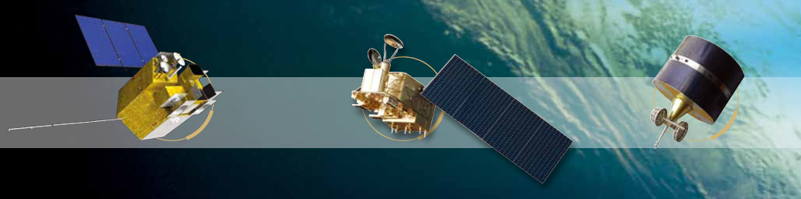



Visible channel CMV from FengYun Geo. Stereo view – simulation and bias analysis
Feng Lu, Jianmin Xu
Office of System Development,
National Satellite Meteorological Center/CMA
Twelfth International Winds Workshop (IWW12), 16-20 June 2014, Copenhagen, Denmark
Notes:
Dual GEO

Slide 2
Outline
1)Background
2)FengYun Geo. satellite settings
3)FengYun DUAL-GEO CMV Bias analysis
4)Future work

Slide 3
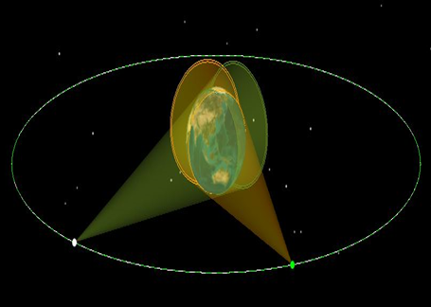
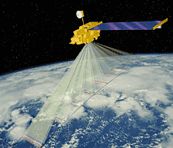
Parallax*
Apparent displacement, or difference in the apparent position, of an object, caused by actual change (or difference) of position of the point of observation; spec. the angular amount of such displacement or difference of position, being the angle contained between the two straight lines drawn to the object from the two different points of view, and constituting a measure of the distance of the object."
DUAL-GEO
LEO MISR
*Oxford English Dictionary (Second Edition ed.). 1989.
Notes:
To create stereo image pair

Slide 4
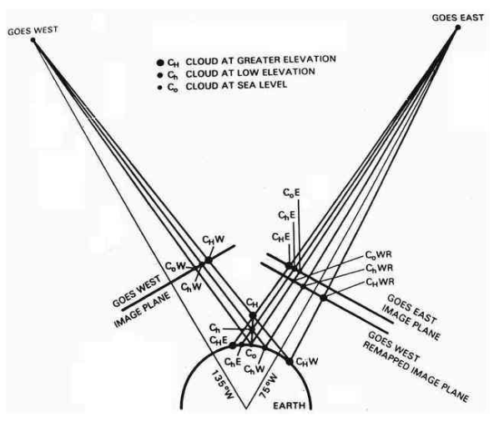

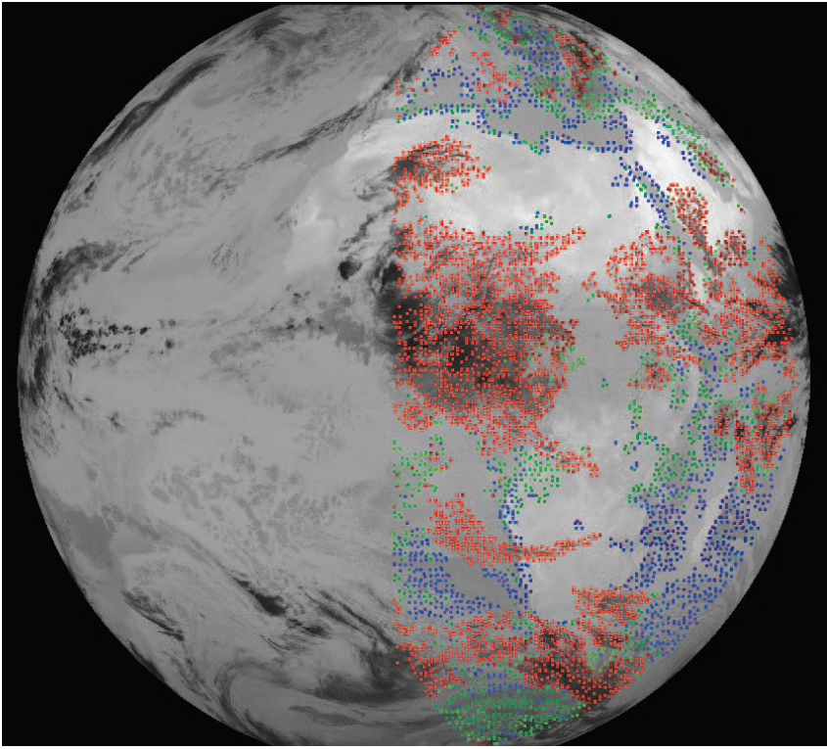
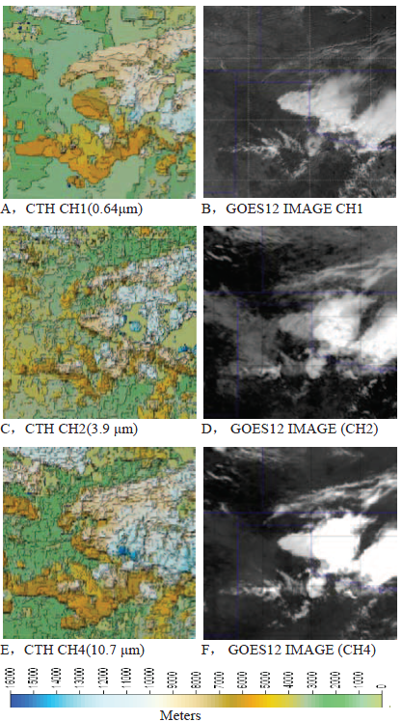
H: cloud top height
P10: parallax while cloud height is 10Km
P: parallax offset observed in image pair
Fujita T.T., 1982: Principle of stereographic height computations and their and their applications to stratospheric cirrus over severe thunderstorms. J. Meteor.Soc. of Japan, 60, 355-368.
Automatic analysis of stereoscopic satellite image pairs for determination of cloud-top height structure (1991)
by A F Hasler, J Strong, R H Woodward, H Pierce, Journal of Applied Meteorology
Wylie, D. P. Santek, D. Starr, D. O. Cloud-top heights from GOES-8 and GOES-9 stereoscopic imagery, Journal of Applied Meteorology,1998
VOL37,4,p405-413
Geometric cloud heights from Meteosat，
G.G. G. CAMPBELL，K. HOLMLUND，INT. J. REMOTE SENSING, 10 NOVEMBER, 2004，VOL. 25, NO. 21, 4505–4519
Feng Lu,Jianmin Xu,W. Paul Menzel,Christopher S. Velden, Geometric cloud top height assignment by geosychronous meteorological satellite images,2009,
2009 IEEE International Geoscience & Remote Sensing Symposium
Notes:
In 1980s, Prof. Fujita first bring up the concept of stereographic height. This is a simplified equation .
1990s Hasler give the idea of Automatic stereoscopic height assignment.
from then on , many attempts are applied to GOES and meteosat height assignment,
The three picture at the bottom are part of these works , the left one is from Dr,wylie, and dave santek , they make some efforts using visble channel to assign the cloud height.
The middle one is from Dr.campel and ken, they try infrared channels
The right one is my work in 2009, which using all the goes I_M CHANNELS, from VIS to infrared.

Slide 5
Benefits of Dual-Geo. In Visible CMV Retrieval
Not rely on NWP data for height assignment.
Good accuracy in cloud height assignment, especially for low level cloud.
Good temporal resolution.
Good spatial coverage.

Slide 6
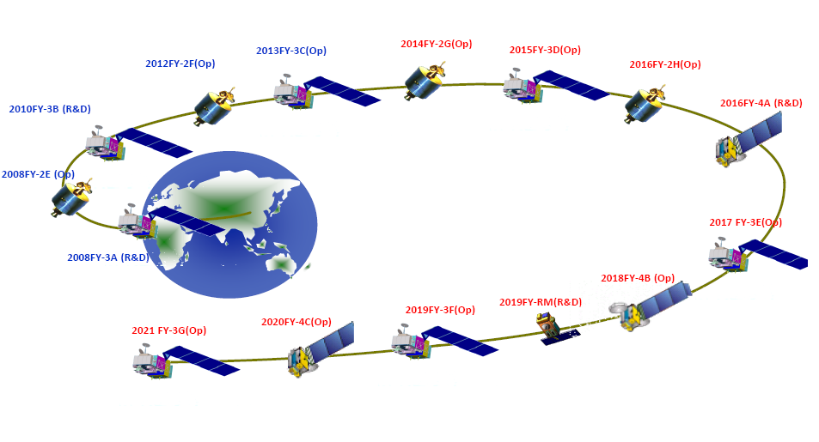
Planning of CMA satellite systems by 2020.
Notes:
From now on,

Slide 7
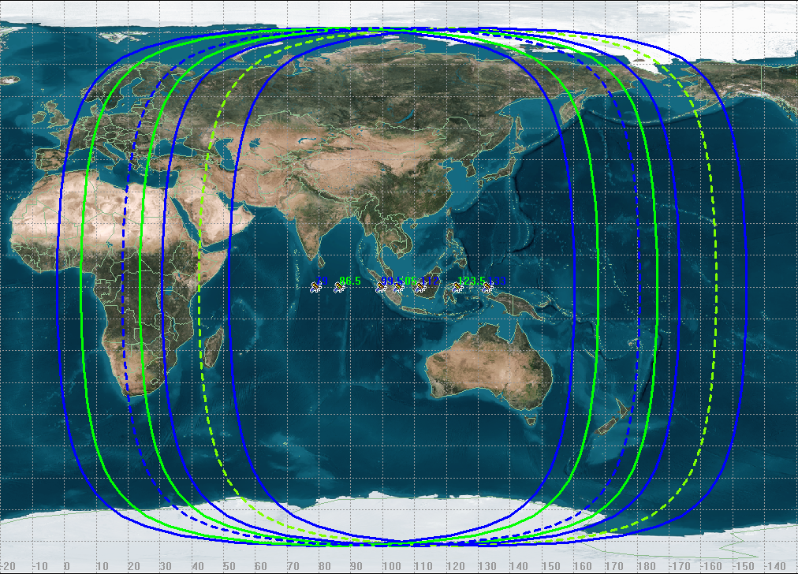
Orbital positions for FengYun Geo.
Heritage positions from FY-2 86.5E,105E and 123.5E
New positions to apply 79E,99.5E,112E and 133E

Slide 8
FY-4A AGRI
Channel Setting of FengYun Geo.
FY-2 VISSR
Channel | FY-2 C/D/E | FY-2 F/G/H | Spatial Resolution (Km) | Detection Sensitivity | Main Application
Visible | 0.55～0.9 | 0.55～0.75 | 1.25 |  | Fog Cloud Environment
Mid-wave Infrared | 3.5-4.0 | 3.5-4.0 | 5 | NEΔT≤0.7K(300K) | Fire, Cloud
Water Vapor | 6.9～7.3 | 6.9～7.3 | 5 | NEΔT≤0.3K(260K) | WV
Long-wave Infrared | 10.3～11.3 | 10.3～11.3 | 5 | NEΔT=0.2K(300K) | WV,Cloud SST
 | 11.5～12.5 | 11.5～12.5 | 5 | NEΔT=0.2K(300K) | SST Cloud,WV
Channel | Band (μm) | Spatial Resolution (Km) | Detection Sensitivity |  | Main Application
Visible & Near-Infrared | 0.45～0.49 | 1 | S/N≥ | 70(ρ=100%) | Aerosol
 | 0.55～0.75 | 0.5～1 |  | 200(ρ=100%),5(ρ=1%)@0.5Km | Fog,Clound
 | 0.75～0.90 | 1 |  |  | Vegetation
Short-wave Infrared | 1.36～1.39 | 2 | S/N≥ | 200 (ρ=100%) 5 (ρ=1%) | Cirrus
 | 1.58～1.64 | 2 |  |  | Cloud,Snow
 | 2.1～2.35 | 2～4 |  |  | Cirrus,Aerosol
Mid-wave Infrared | 3.5～4.0(high) | 2 | NEΔT≤0.7K(300K) |  | Fire
 | 3.5～4.0(low) | 4 | NEΔT≤0.2K(300K) |  | Land surface
Water Vapor | 5.8～6.7 | 4 | NEΔT≤0.3K(260K) |  | WV
 | 6.9～7.3 | 4 | NEΔT≤0.3K(260K) |  | WV
Long-wave Infrared | 8.0～9.0 | 4 | NEΔT=0.2K(300K) |  | WV,Cloud
 | 10.3～11.3 | 4 | NEΔT=0.2K(300K) |  | SST
 | 11.5～12.5 | 4 | NEΔT=0.2K(300K) |  | SST
 | 13.2～13.8 | 4 | NEΔT=0.5K(300K) |  | Cloud,WV

Slide 9
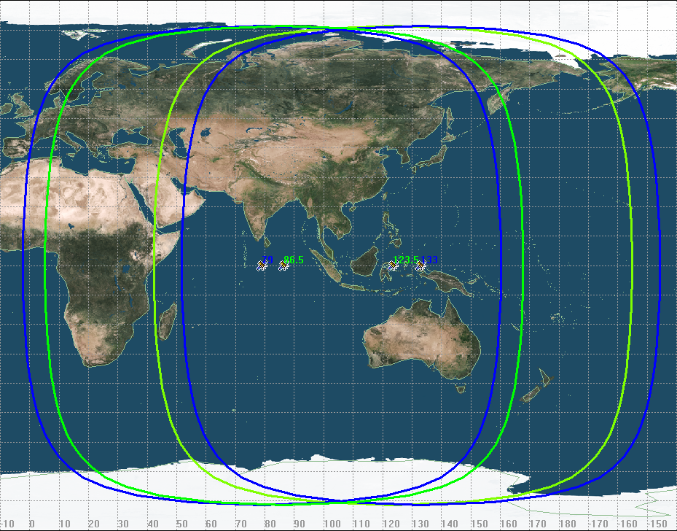
FengYun Geo. Overlap
Operational Setting (86.5+123.5) Vs Potential Setting(79+133)
Notes:
Lets discuss the current FY-2 dual-geo and some other possible settings.

Slide 10
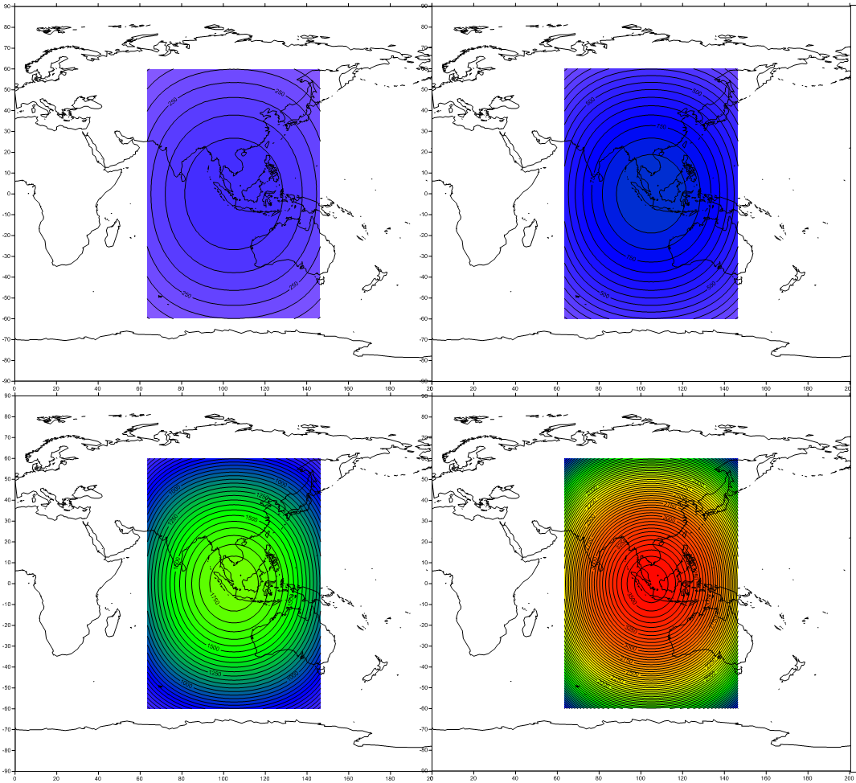
Parallax Corresponding CTH Analysis: FY-2 Dual-GEO Operational Setting
0.5 Pixel 1.0 Pixel
2.0 Pixel 4.0 Pixel
One FY-2 Visible Pixel =1.25Km SSP

Slide 11
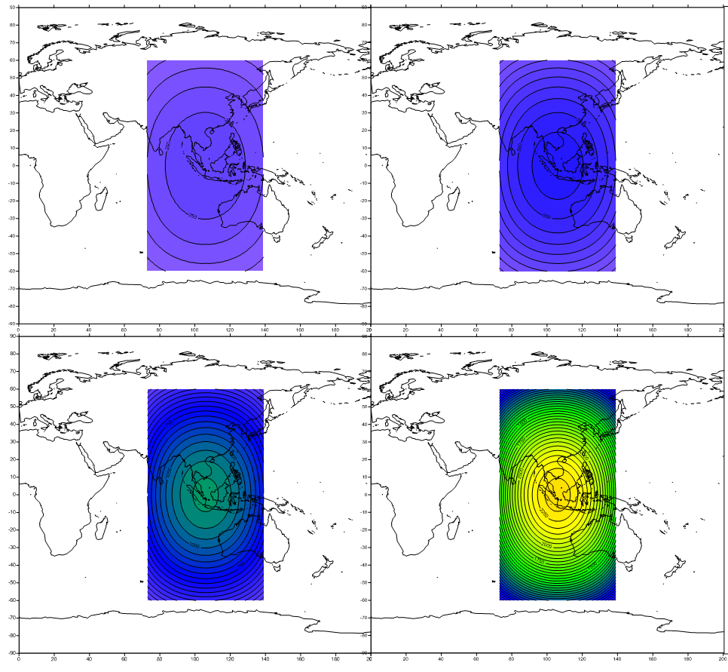
Parallax Corresponding CTH Analysis: FY-2 Dual-GEO Potential Setting
0.5 Pixel 1.0 Pixel
2.0 Pixel 4.0 Pixel
One FY-2 Visible Pixel =1.25Km SSP

Slide 12
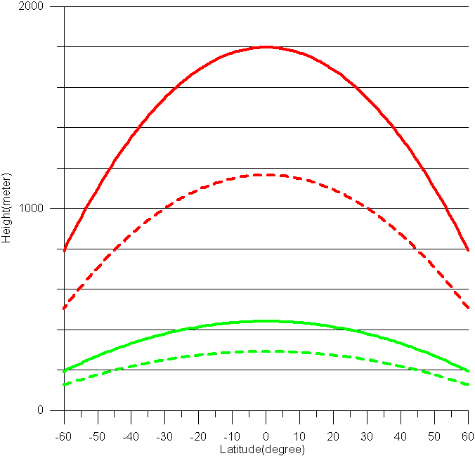
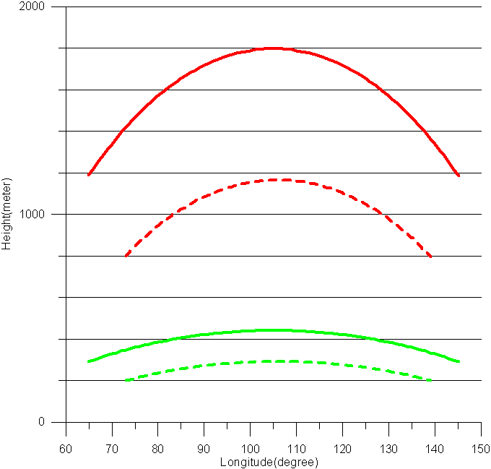
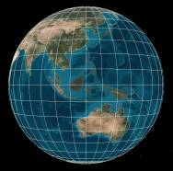

Parallax Corresponding CTH Analysis: FY-2 Dual-GEO
East-West Slicing
North South Slicing
86.5+123.5 Half IR pixels
*Half pixels in FY-2 IR channel =2.5Km
*Half pixels in FY-2 Vis channel =0.625Km
79+133 Half IR pixels
86.5+123.5 Half Vis pixel
79+133 Half Vis pixel

Slide 13
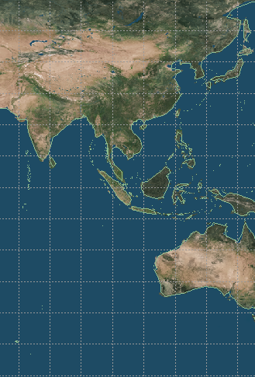
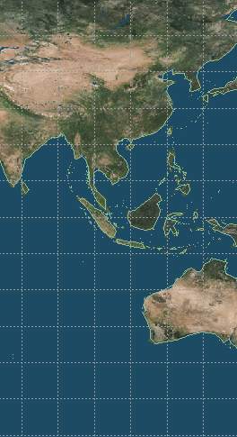
86.5E+123.5E Dual-Geo
1) FY-2 Dual-Geo CTH Capability
For FY-2 Vis channel,
86.5+123.5 dual-geo could recognize CTH >500 meters
79.0+133.0 dual-geo could recognize CTH >400 meters.
For FY-2 Ir channel,
86.5+123.5 dual-geo could recognize CTH >1800 meters
79.0+133.0 dual-geo could recognize CTH >1200 meters.
2) Coverage
86.5+123.5 dual-geo covers China and most of Asian-Pacific region
3)Operational Possibility
CMA have approved the 2014 FY-2 Maneuver plan,
FY-2F it will provide rapid scan on 123.5E from Q3 2014.
It could cooperate with current FY-2(86.5E) for Dual-Geo.
Observations.
60N-60S
63.5E-146.5E
79E+133E Dual-Geo
60N-60S
73E-139E
Operational Setting (86.5+123.5)
Potential Setting(79+133)
Notes:
Based on above analysis, we can get some preliminary conclusions.
For the operational setting , in Vis channel using stereo view ,we can recognize CTH above 500 Meters, for the IR channel we can recongize CTH above 1800 meters.
The potential setting have some advantage in accuracy but its not very significant.
For the spatial coverage , we can see the operational setting is much better than potential setting.
So the operational setting could satisfy for the requirement of DUAL-GEO VIS CMV applications.

Slide 14
FengYun DUAL-Geo. CMV
Image Pair Offset = INR Bias +Parallax (T0) +Cloud motion(dT)
！The two FengYun Geo. satellite make observation asynchronous
Notes:
This is schematic diagram of DUAL-GEO stereo view

Slide 15
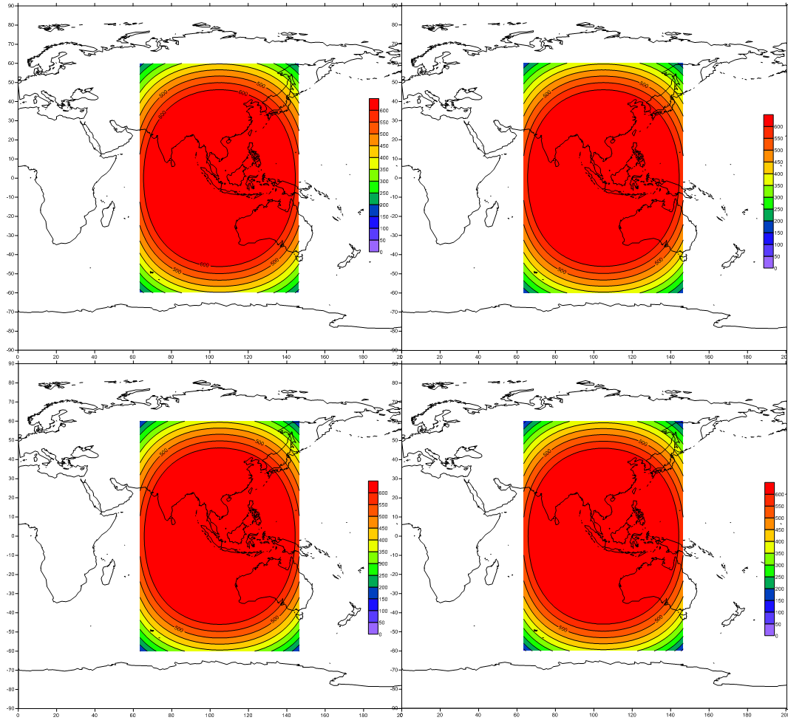
CTH errors related to INR bias
CTH 5Km CTH 10Km
CTH 15Km CTH 20Km
dINR=1pixels (FY-2 Vis)
FY-2 Dual-GEO 86.5E+123.5E

Slide 16
1）How does INR bias effect CTH,
does it change with height?
2）How does cloud Motion effect on CTH,
Is it a big error source?

Slide 17
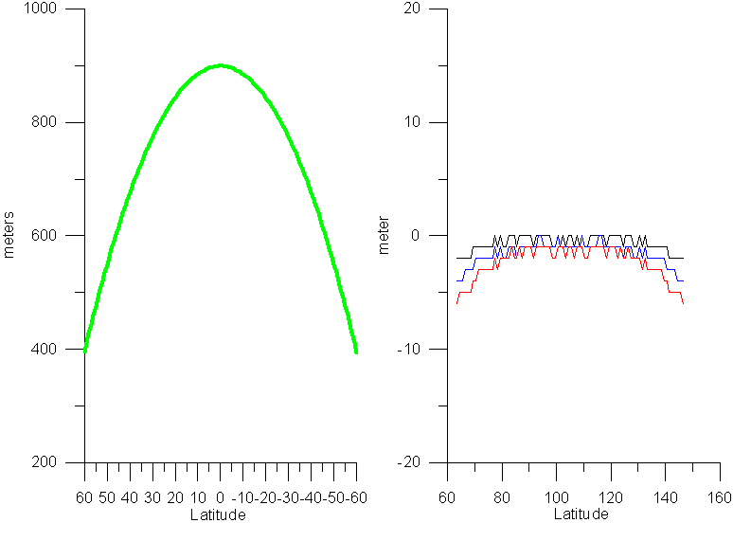
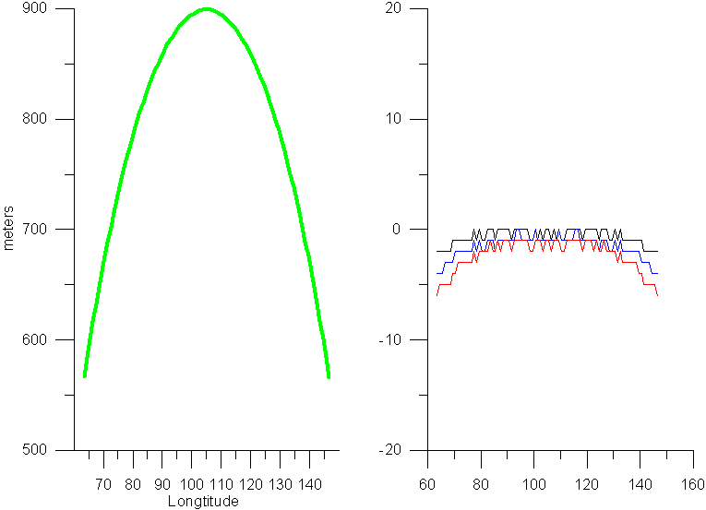
dCTH=CTH(with 1Pixel INR bias)-CTH
CTH errors related to INR bias varies only several meters in troposphere, this variation could be ignored for Dual-Geo AMV
dCTH₁₀-dCTH₅
dCTH₁₅-dCTH₅
dCTH₂₀-dCTH₅
dCTH₅
dCTH₁₀-dCTH₅
dCTH₁₅-dCTH₅
dCTH₂₀-dCTH₅
dCTH₅

Slide 18
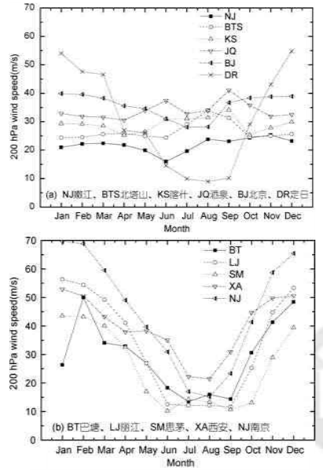
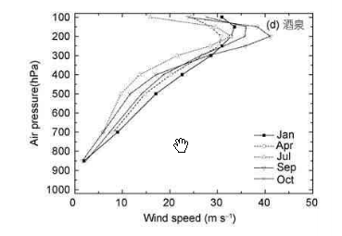
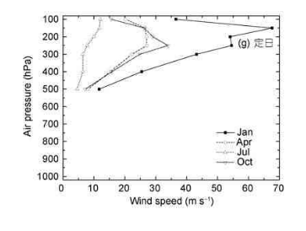

Tropospheric Wind Speed Over China
NJ
KS
JQ
XA
DR
NJ
LJ
*Research of upper-level wind for astronomical site survey. Zhang Yonhjing ,Yao YongQiang ,Qian Xuan. DOI:10.1360/132011-348,Scientia SINICA Physica,Mechanica&Astronomica Vol.42 No.2 199-209,2012 Based on 1951-2008 upper-air station in China

Slide 19
Basic consideration on time asynchronous
FY-2 Full disk scan: 25 minutes
Time Different of Dual-Geo view =30 seconds
1）Middle level: 5.5km（500hPa） 20m/s
2）High Level: 12km（200hPa） 80m/s
Cloud movement
30 seconds on 12Km height: 2400m
30 seconds on 5500m height: 600m

Slide 20
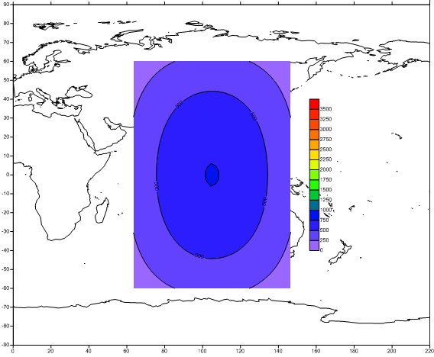
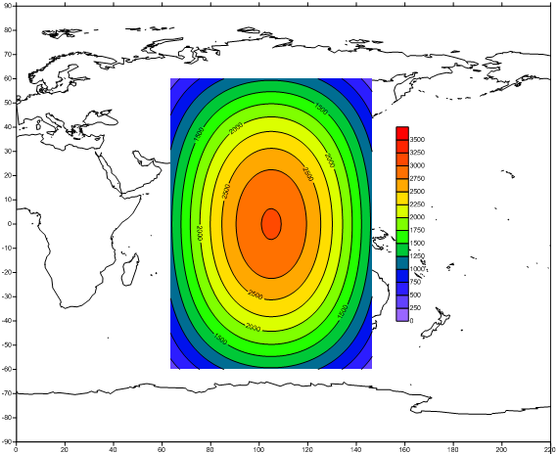
Time asynchronous effect on CTH
Middle Level: 5500m（500hPa） 80m/s
Time asynchronous :30 Second
High Level: 12km（200hPa） 80m/s
Time asynchronous :30 Second

Slide 21
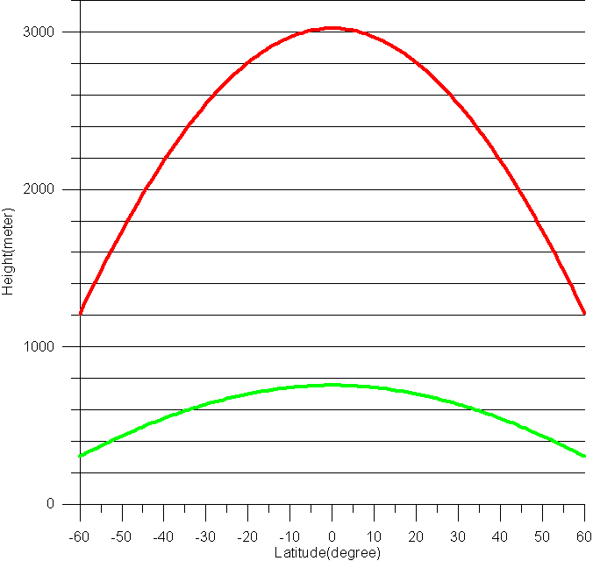
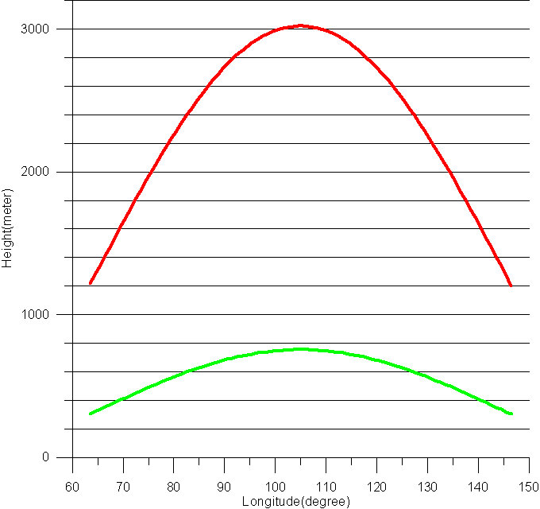
Time asynchronous
->Cloud Motion
->CTH Error
Observation time asynchronous is big error source for Stereo CMW.
Middle Level: 5500m（500hPa） 80m/s
High Level: 12km（200hPa） 80m/s
Time asynchronous :30 Second
Notes:
Observation time asynchronous is big error source for Stereo CMW. It need special treatment on data peocessing.

Slide 22
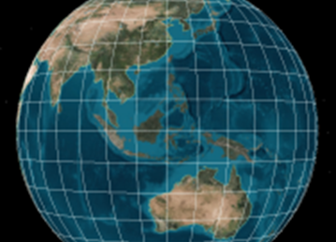
Diagram of FengYun Dual-Geo CMV
WestSat
EastSat
（time synchronous）
EastSat
Dual-Geo Image pair offset
One Geo Image Time series Offset
CTH First Guess
CMV First Guess
（Speed，Height，Direction）
*
*INR correction
*Cloud movement correction
*CTH correction
*Iteration Based On Satellite Orbit and Attitude
Dual-Geo CMV（Speed，Height，Direction）

Slide 23
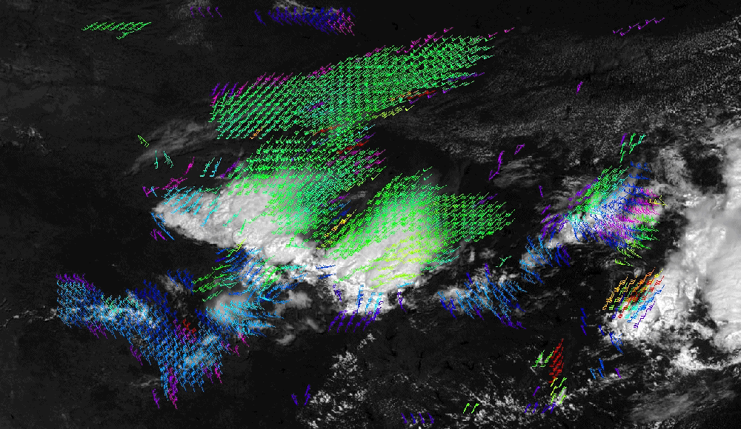
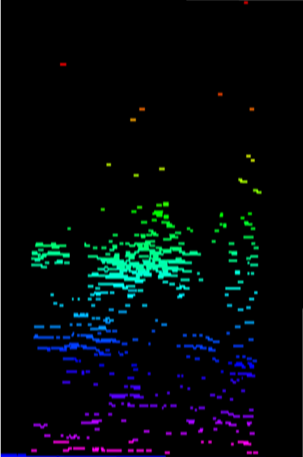
Prototype Algorithms have been finished

Slide 24
Future Work
FY-2F will move to 123.5 in Q3,2014 for Rapid Scan service, Combine FY-2(86.5E) and FY-2(123.5E) for FengYun Dual-Geo Vis CMV.
Build up FY-2 DUAL-GEO Vis CMV system.
CMV Validation
Extending the Dual-GEO observations.

Slide 25

Thank you for your attention
Lufeng@cma.gov.cn

