Slide 1
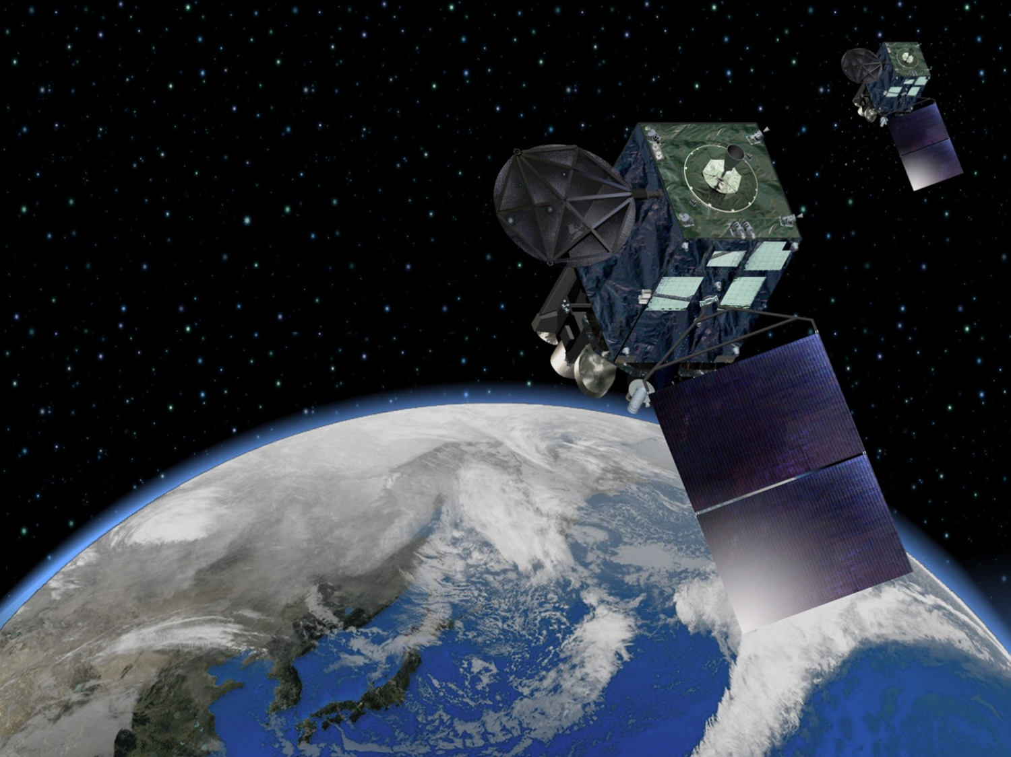
Current status and plans of JMA operational wind product
Kazuki Shimoji
Meteorological Satellite Center
Japan Meteorological Agency

Slide 2

Contents
Planning of JMA satellite systems
Statistics of MTSAT-1R/2 AMV
Plan for switching over from MTSAT to Himawari-8
Overview of Himawari-8 AMV
Summary

Slide 3
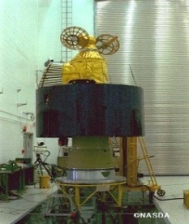
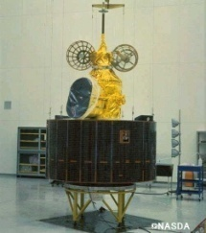
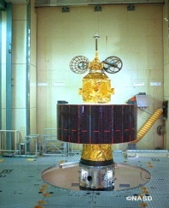
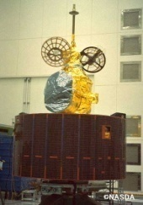
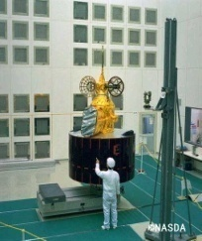
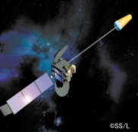
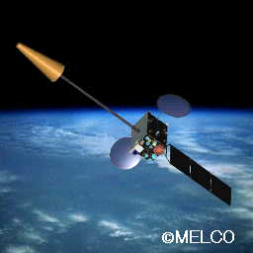

Overview - Planning of JMA satellite systems (Himawari-series)
GMS (Geostationary Meteorological Satellite)
GMS
GMS-2
GMS-3
GMS-4
GMS-5
(GOES-9)
(Himawari)
(Himawari-2)
(Himawari-3)
(Himawari-4)
(Himawari-5)
Back-up operation of
GMS-5 with GOES-9 by
NOAA/NESDIS
from May 22, 2003
to June 28, 2005
ⒸNASDA
ⒸNASDA
ⒸNASDA
ⒸNASDA
ⒸNASDA
Jul 1977
Aug 1981
Aug 1984
Sep 1989
Mar 1995
Satellite | Observation period
GMS | 1978 – 1981
GMS-2 | 1981 – 1984
GMS-3 | 1984 – 1989
GMS-4 | 1989 – 1995
GMS-5 | 1995 – 2003
GOES-9 | 2003 – 2005
MTSAT-1R | 2005 – 2010
MTSAT-2 | 2010 – 2015
Himawari-8 | 2015 – 2022
Himawari-9 | 2022 – 2029
MTSAT (Multi-functional Transport SATellite )
MTSAT-1R
MTSAT-2
(Himawari-6)
(Himawari-7)
Himawari-8
Himawari-9
Himawari
2014
2016
ⒸSS/L
ⒸMELCO
Feb 2005
Feb 2006

Slide 4
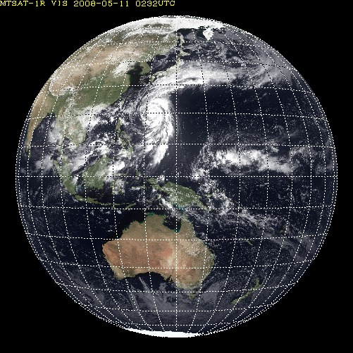
    Specification of Advanced Himawari Imager (AHI)
HIMAWARI-8/9
Full disk
(every 10 minutes)
Band | Central Wavelength [μｍ] | Spatial Resolution
1 | 0.43 - 0.48 | 1Km
2 | 0.50 - 0.52 | 1Km
3 | 0.63 - 0.66 | 0.5Km
4 | 0.85 - 0.87 | 1Km
5 | 1.60 - 1.62 | 2Km
6 | 2.25 - 2.27 | 2Km
7 | 3.74 - 3.96 | 2Km
8 | 6.06 - 6.43 | 2Km
9 | 6.89 - 7.01 | 2Km
10 | 7.26 - 7.43 | 2Km
11 | 8.44 - 8.76 | 2Km
12 | 9.54 - 9.72 | 2Km
13 | 10.3 - 10.6 | 2Km
14 | 11.1- 11.3 | 2Km
15 | 12.2 - 12.5 | 2Km
16 | 13.2 - 13.4 | 2Km
RGB
rapidscan（every 2.5min）
Band | Central Wavelength [μｍ] | Spatial Resolution
1 | 0.55 – 0.90 | 1Km
2 | 3.50 – 4.00 | 4Km
3 | 6.50- 7.00 | 4Km
4 | 10.3 – 11.3 | 4Km
5 | 11.5 – 12.5 | 4Km
MTSAT-1R/2
Notes:
This is a introduce of himawari-8 specification.
As you can see, number of bands will be increased from 5 to 16.
Spatial and time resolution will be 2 km and 10minutes.

Slide 5



Schedule for switching over from MTSAT to Himawari-8
 | 2005 | 2006 | 2007 | 2008 | 2009 | 2010 | 2011 | 2012 | 2013 | 2014 | 2015 | 2016 | 2017 | 2018 | 2019 | 2020 | 2021 | 2022 | 2023 | 2024 | 2025 | 2026 | 2027 | 2028 | 2029
MTSAT-1R Meteorological Mission MTSAT-2 Meteorological Mission
Himawari-8 Himawari-9
Operational
In-orbit standby
In-orbit standby
Operational
In-orbit standby
Launch
Operational
In-orbit standby
Manufacturing
In-orbit standby
Operational
Launch
JMA plans to launch Himawari-8 in 2014 and begin its operation in 2015. Around early July, JMA will announce the launch date of Himawari-8.
The launch of Himawari-9 for in-orbit standby is scheduled in 2016.
Himawari-8/9 will be in operation at 140 degrees East covering the East Asia and Western Pacific regions for 15 years.

Slide 6
Contents
Planning of JMA satellite systems
Statistics of MTSAT-1R/2 AMV
Plan for switching over from MTSAT to Himawari-8
Overview of Himawari-8 AMV
Summary

Slide 7

Production and Dissemination of MTSAT-operational AMV
IR1
WV
VIS
IR4
MTSAT-1R
RS
Standby
RS
Standby
RS
Standby
MTSAT-2
Operational
2015
2012
2013
2014
Himawari-8
launched
Switchover
MTSAT-2 to
Himawari-8
RS AMV is computed for internal use only

Slide 8
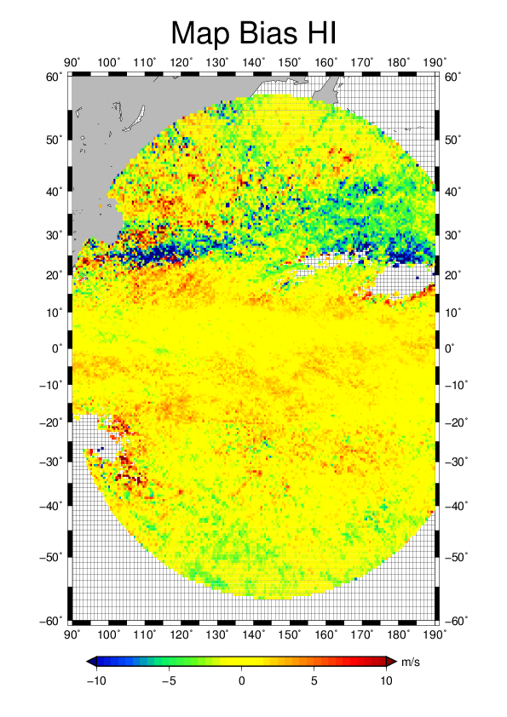
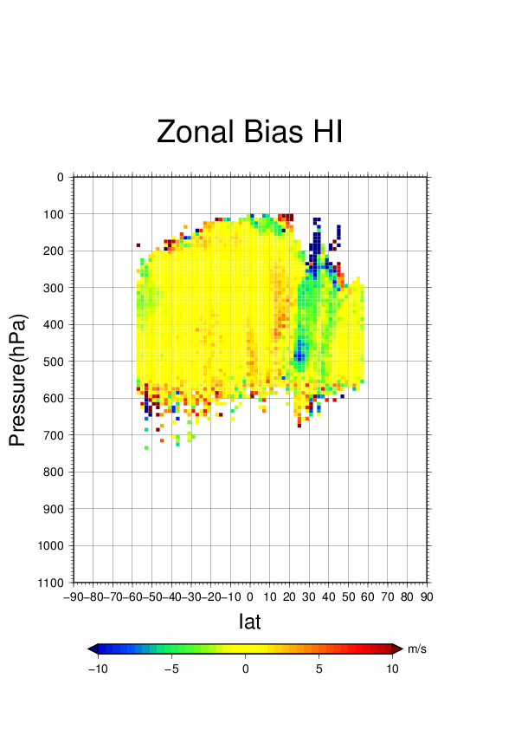
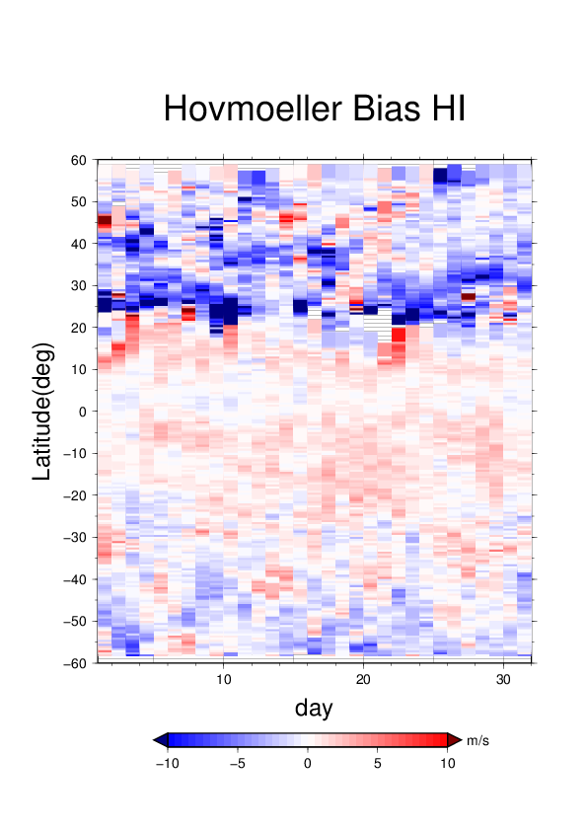
Historical statistic for Upper Level MTSAT AMV
MTSAT-1R
MTSAT-2
O-B statistic for Jan. 2013
Negative wind speed BIAS was significantly improved by CCC and other method, but Negative BIAS still can be confirmed around jet in winter season

Slide 9
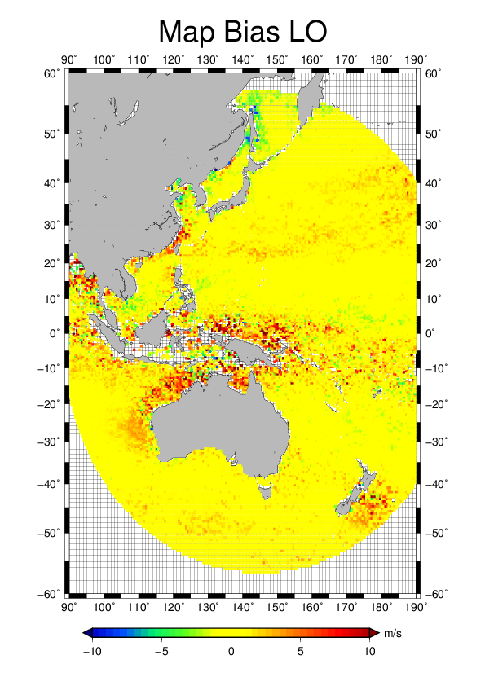
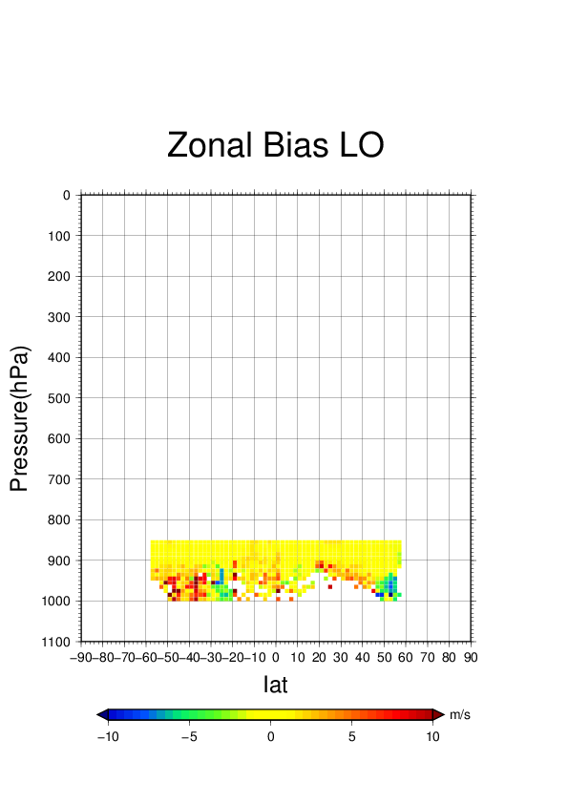
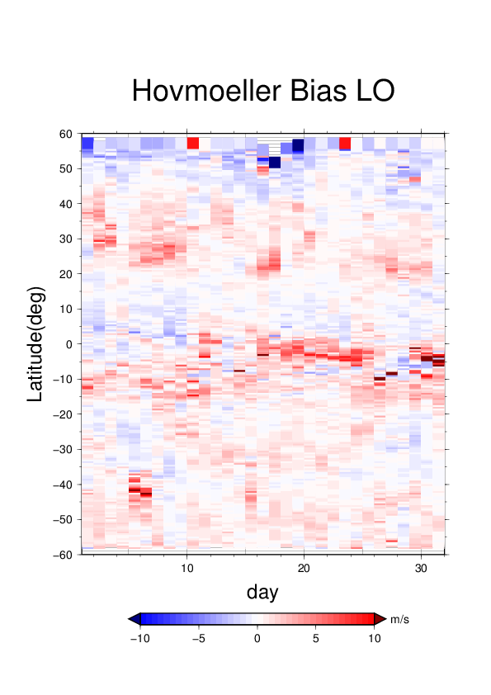
Historical statistic for Lower Level MTSAT AMV
MTSAT-1R
MTSAT-2
O-B statistic for Jan. 2013
Positive wind speed BIAS significantly debase quality of lower level AMV over tropical area

Slide 10
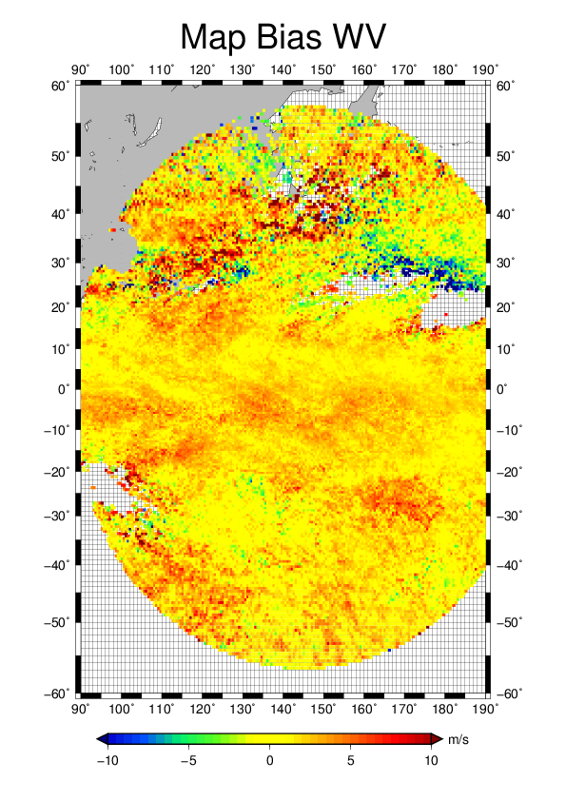
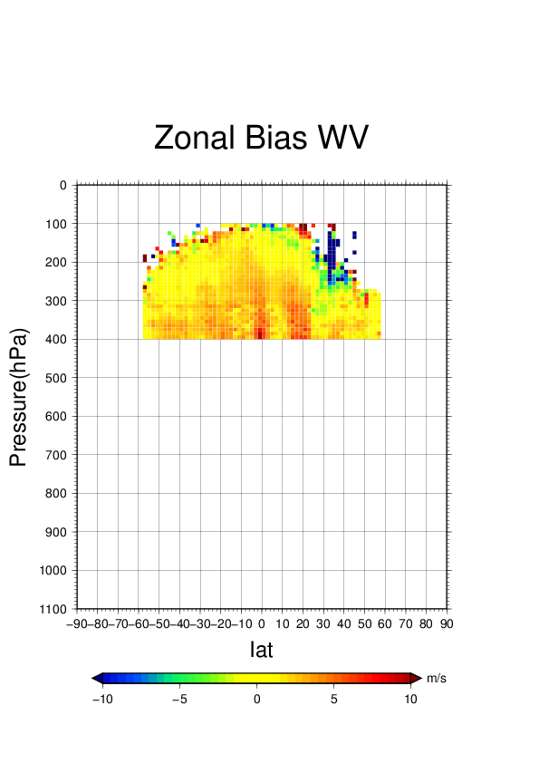
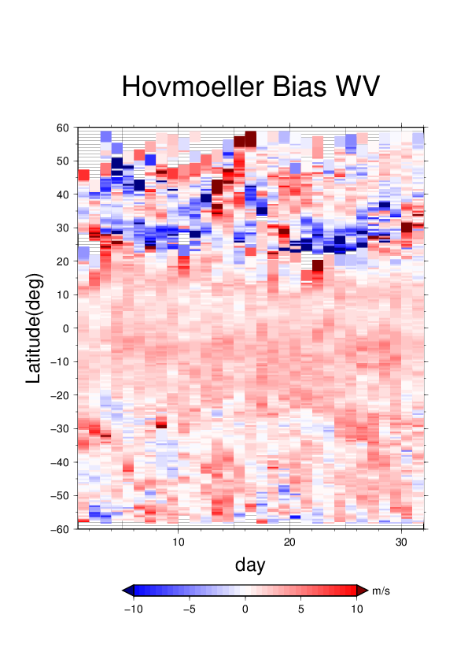
Historical statistic for WV MTSAT AMV (cloudy)
MTSAT-1R
MTSAT-2
positive wind speed BIAS in all season globally
negative wind speed BIAS around jet in winter season
O-B statistic for Jan. 2013

Slide 11
Contents
Planning of JMA satellite systems
Statistics of MTSAT-1R/2 AMV
Plan for switching over from MTSAT to Himawari-8
Overview of Himawari-8 AMV
Summary

Slide 12
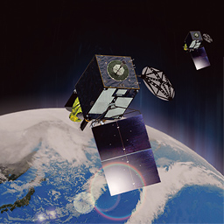
dissemination schedule for Himawari-8 AMV
parallel dissemination via JMA FTP server
Himawari-8 AMV
for evaluation
MTSAT AMV
for backup
Test
Tuning
Operational MTSAT AMV
Operational Himawari-8 AMV
operational AMV via GTS
launch
summer 2014
April 2015
parallel dissemination
July 2015
Switchover to Himawari-8
October 2015
MTSAT
Himawari-8 ANV
Produced wind
VIS, IR and WV
Dissemination frequency
hourly
Data format
BUFR EDITION 4
Produced wind
VIS(0.64), WV(6.2,7.0,7.3) and 10.4
Dissemination frequency
hourly
Data format
BUFR EDITION 4

Slide 13
algorithm changes for Himawari-8 AMV
simultaneous utilization of information
wind vector and height are retrieved by maximizing likelihood function
 | target selection | tracking | height assignment | quality control
MTSAT AMV | cloud analysis module for MTSAT AMV | cross-correlation method | IR-WV intercept and EBBT methods | EUMETSAT QI
Himawari-8 AMV | Himawari-8 cloud mask product based on NWCSAF and goes-R algorithm | Maximum Likelihood Estimation method using multiple cross-correlation surface | Maximum Likelihood Estimation | EUMETSAT QI

Slide 14
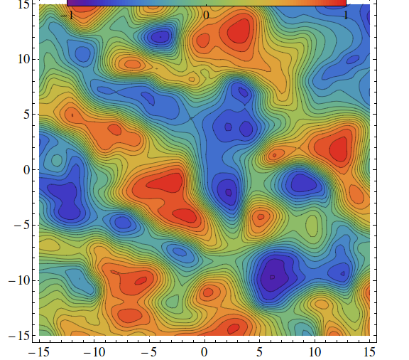
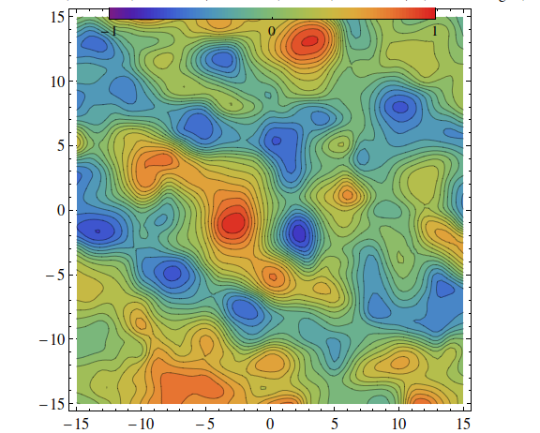
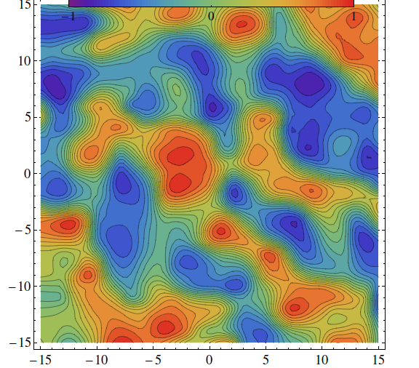
improvement to tracking accuracy
set of potential motion vector
set of
probable motion vectors
in forward matching
set of
probable motion vectors
in backward matching
prior information
correlation surface from forward matching
auxiliary information
correlation surface from backward matching
posterior information
averaged correlation surfaces

Slide 15
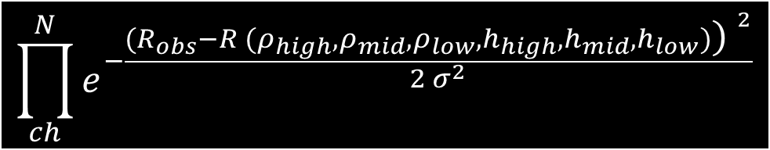



optimal estimation for cloud height assignment
To formulate forward model which gives a relationship between latent variable and observables
Conversion from the forward model to likelihood functions
maximizing sum of log likelihood functions
$$R (ρ_{high},ρ_{mid},ρ_{low},h_{high},h_{mid},h_{low})=$$
$$ρ_{high} ε_{high}\left(ch\right)Rad\left(h_{high}\right)+$$
$$ρ_{mid} ε_{mid}\left(ch\right)Rad\left(h_{mid}\right)+$$
$$ρ_{low} ε_{low}\left(ch\right)Rad\left(h_{low}\right)+$$
$\left(1−(ρ_{high}+ρ_{mid}+ρ_{low})\right)ε_{ground}\left(ch\right)Rad(ground)$
$$\prod_{ch}^{N}{e^{−\frac{{(R_{obs}−R (ρ_{high},ρ_{mid},ρ_{low},h_{high},h_{mid},h_{low})\text{)} }^{2}}{2 σ^{2}}}}$$
ground

Slide 16
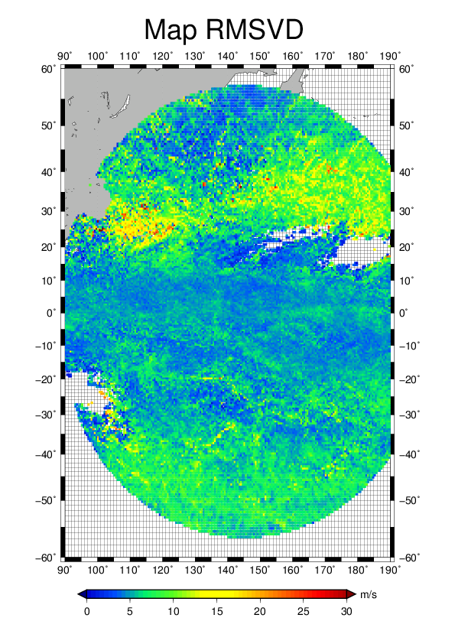
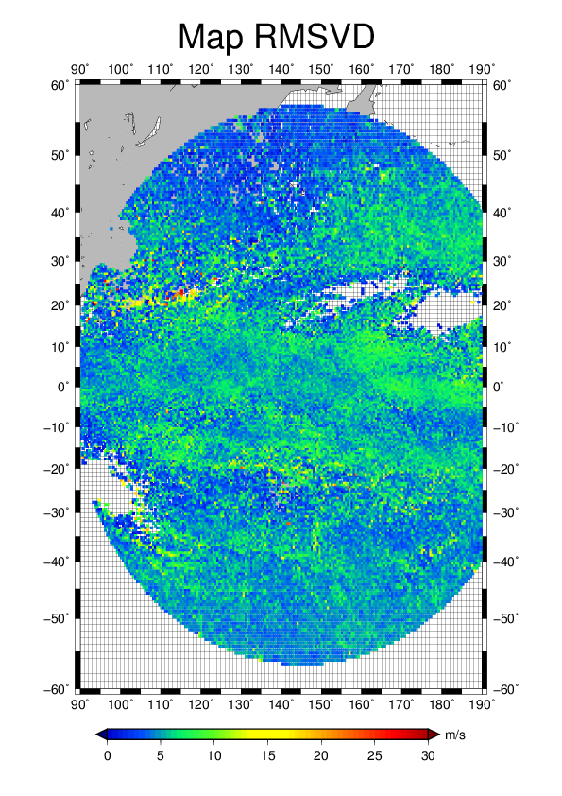
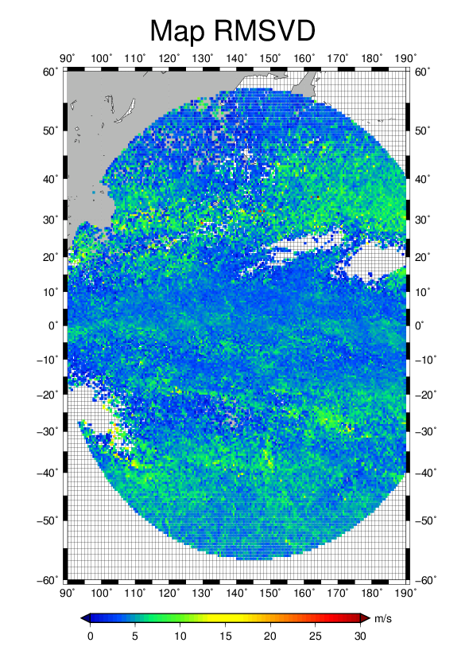
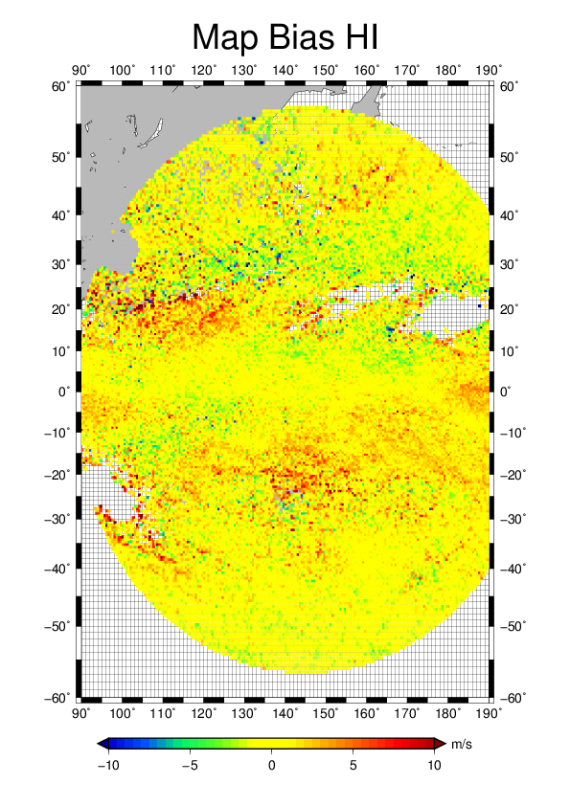
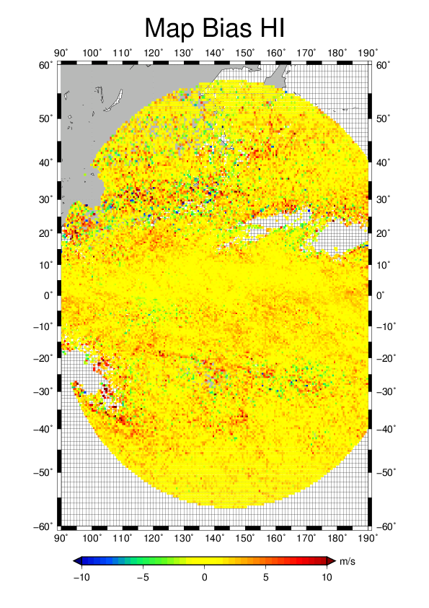
Comparison of MTSAT and Himawari-8 algorithm
IR upper level AMV on Jan. 2013
MTSAT algorithm
H8 algorithm #1
H8 algorithm #2

Slide 17
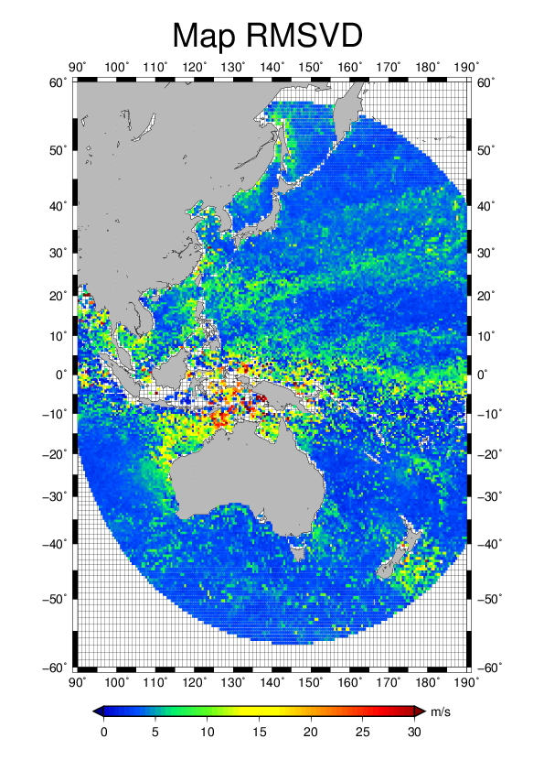
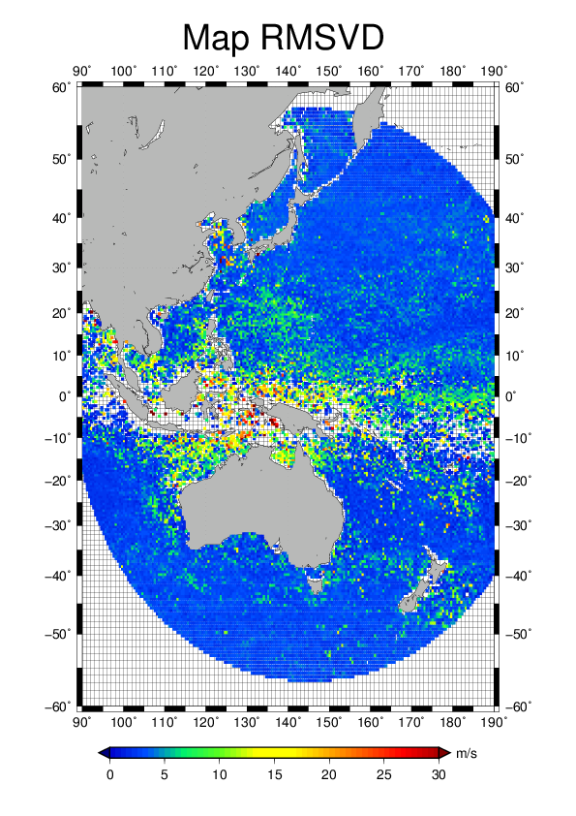
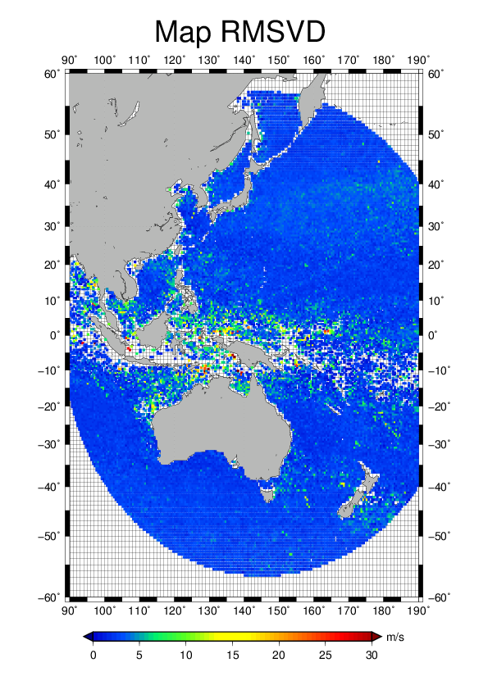
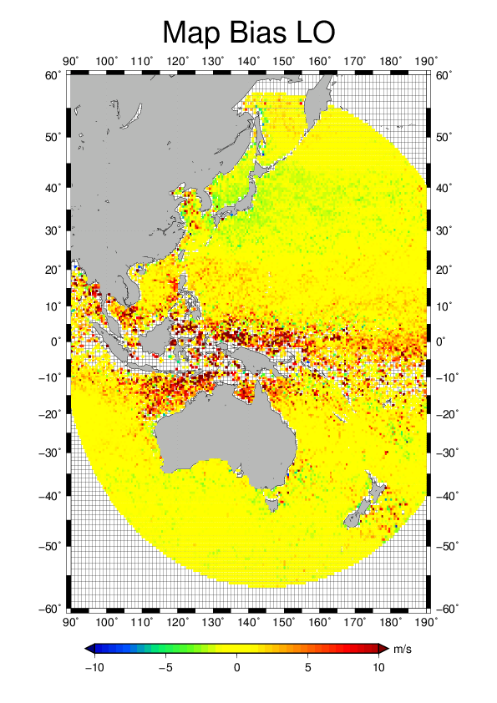
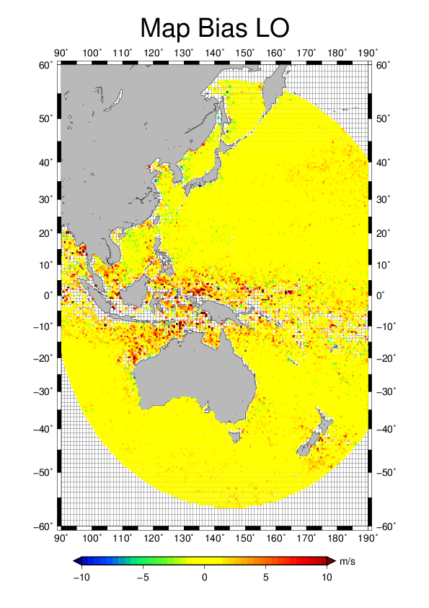
Comparison of MTSAT and Himawari-8 algorithm
IR lower level AMV on Jan. 2013
MTSAT algorithm
H8 algorithm #1
H8 algorithm #2

Slide 18
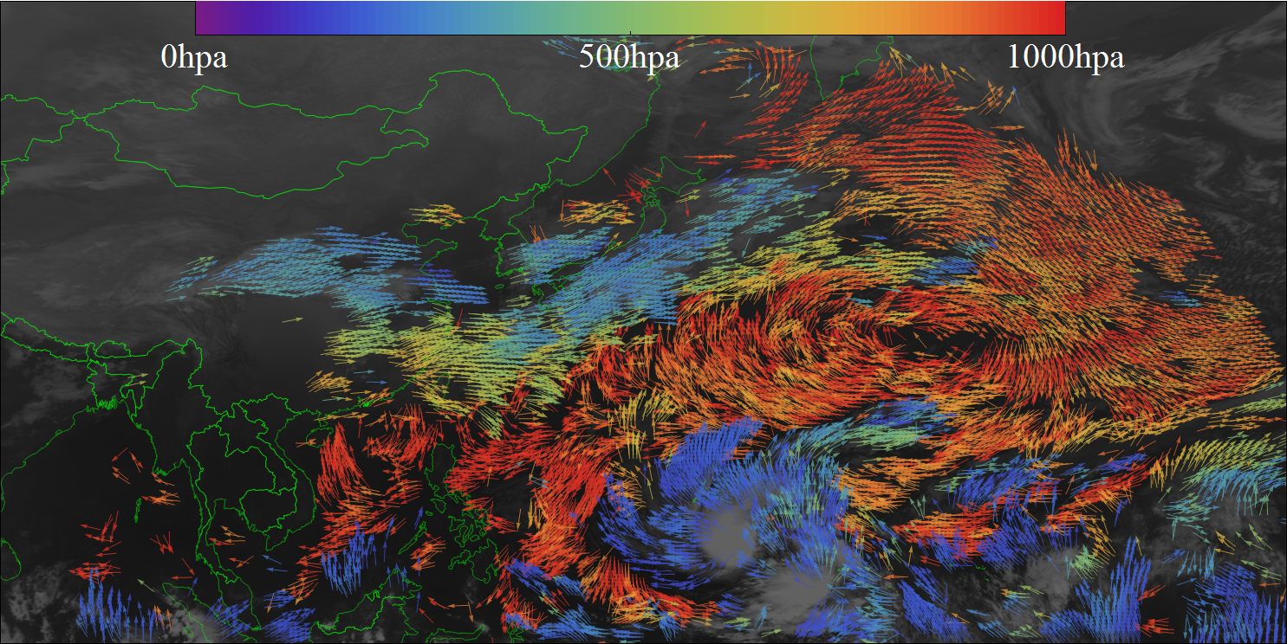
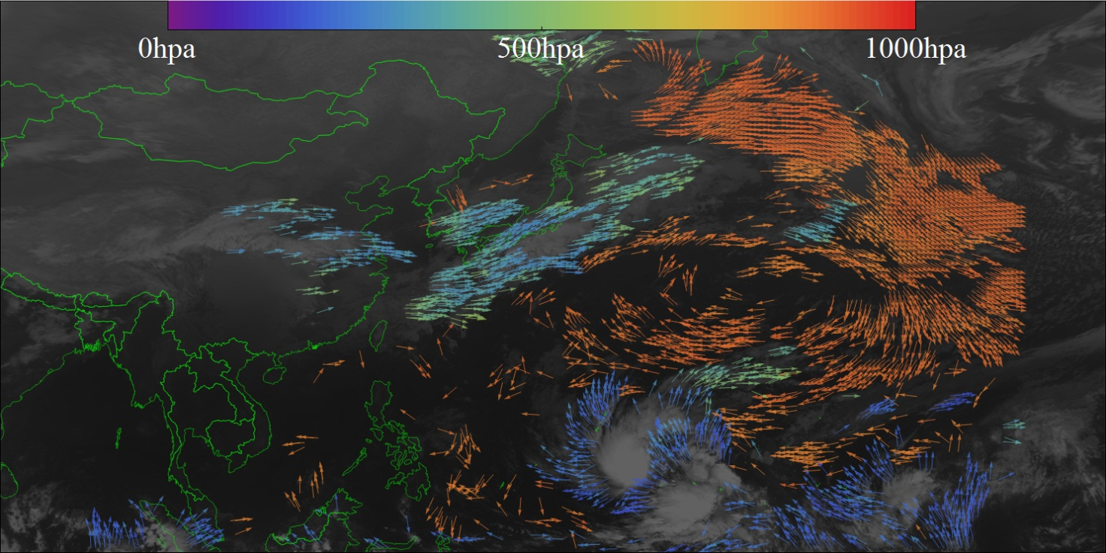
Improvement to spatial coverage
H8 AMV software
MTSAT IR AMV computed by Himawari-8 AMV software (QI>80) for 00UTC 02 March 2014
operational
MTSAT IR AMV computed by operational software (QI>80) for 00UTC 02 March 2014

Slide 19
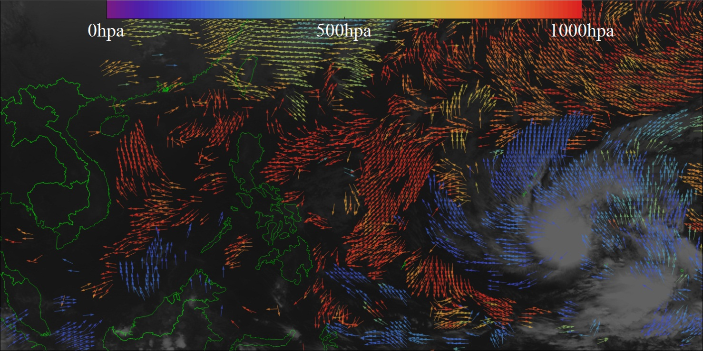
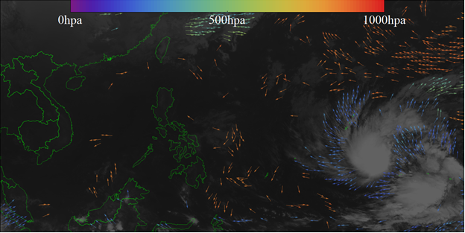
Improvement to spatial coverage over tropical region
H8 AMV software
MTSAT IR AMV computed by Himawari-8 AMV software (QI>80) for 00UTC 02 March 2014
operational
MTSAT IR AMV computed by operational software (QI>80) for 00UTC 02 March 2014

Slide 20
Summary
JMA will launch Himawari-8 around end of summer 2014.
operation of Himawari-8 (and relating products) will start from July 2015.
parallel dissemination of Himawari-8 AMV will start from April 2015 via JMA ftp server (as same as switchover from MTSAT-1R to MTSAT-2).
statistical quality and spatial coverage of Himawari-8 AMV will significantly change from that of MTSAT AMV.

