Slide 1
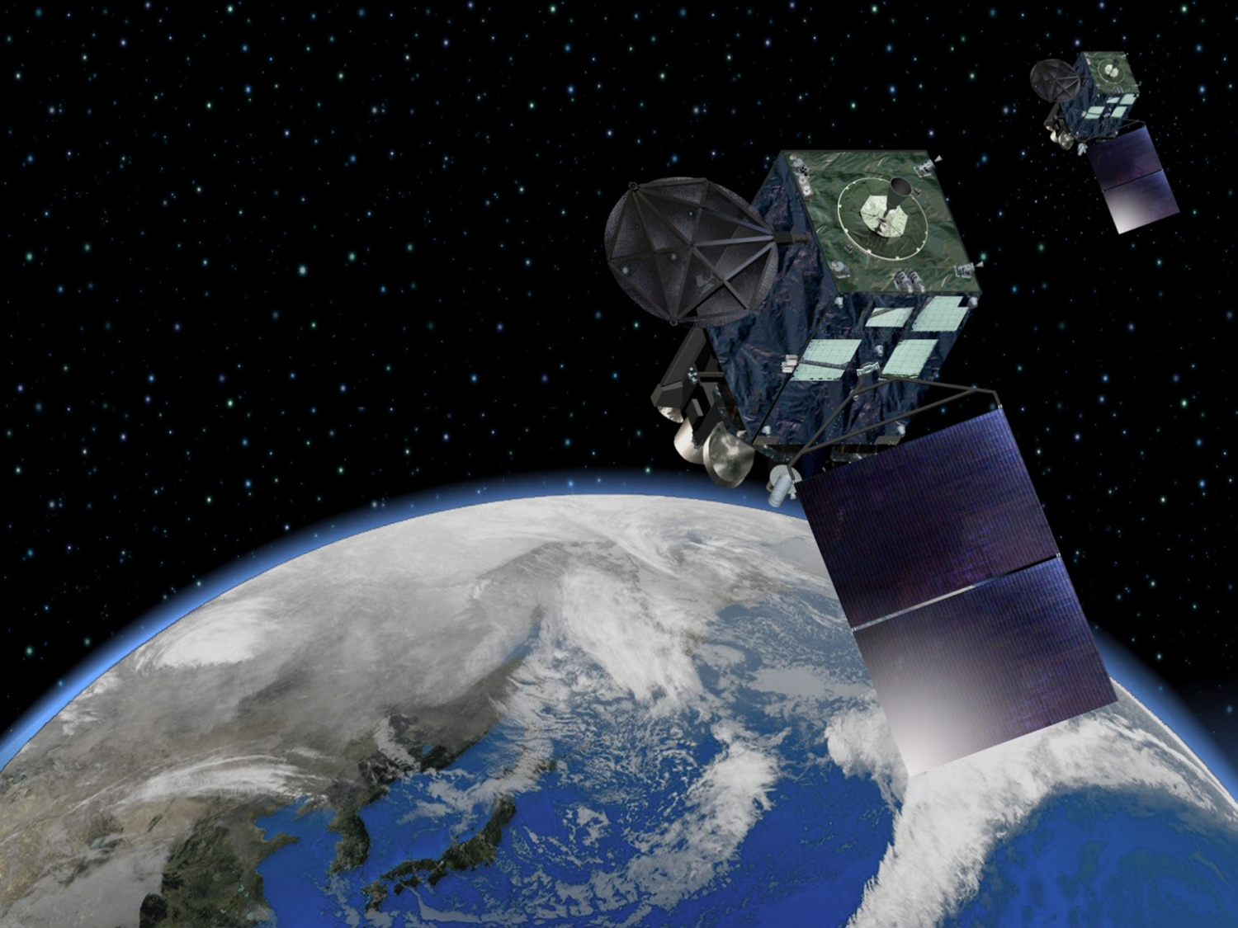
MOTION TRACKING AND CLOUD HEIGHT ASSIGNMENT METHODS FOR HIMAWARI-8 AMV
Kazuki Shimoji
Meteorological Satellite Center
Japan Meteorological Agency

Slide 2
Contents
Introduction to Advanced Himawari Imager (AHI)
Tracking algorithm
Cloud height assignment algorithm
Result by new algorithm
Summary

Slide 3
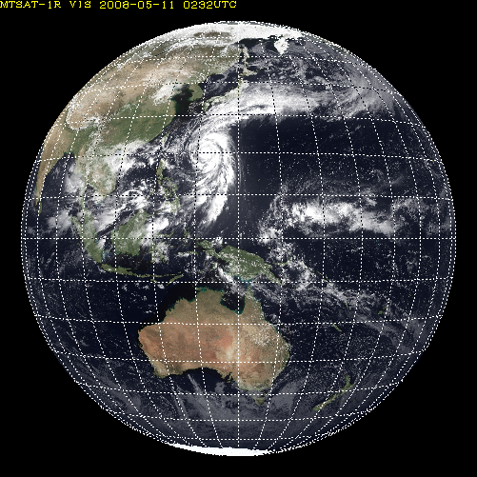
Specification of Advanced Himawari Imager (AHI)
HIMAWARI-8/9
Full disk
(every 10 minutes)
Band | Central Wavelength [μｍ] | Spatial Resolution
1 | 0.43 - 0.48 | 1Km
2 | 0.50 - 0.52 | 1Km
3 | 0.63 - 0.66 | 0.5Km
4 | 0.85 - 0.87 | 1Km
5 | 1.60 - 1.62 | 2Km
6 | 2.25 - 2.27 | 2Km
7 | 3.74 - 3.96 | 2Km
8 | 6.06 - 6.43 | 2Km
9 | 6.89 - 7.01 | 2Km
10 | 7.26 - 7.43 | 2Km
11 | 8.44 - 8.76 | 2Km
12 | 9.54 - 9.72 | 2Km
13 | 10.3 - 10.6 | 2Km
14 | 11.1- 11.3 | 2Km
15 | 12.2 - 12.5 | 2Km
16 | 13.2 - 13.4 | 2Km
RGB
rapidscan（every 2.5min）
Band | Central Wavelength [μｍ] | Spatial Resolution
1 | 0.55 – 0.90 | 1Km
2 | 3.50 – 4.00 | 4Km
3 | 6.50- 7.00 | 4Km
4 | 10.3 – 11.3 | 4Km
5 | 11.5 – 12.5 | 4Km
MTSAT-1R/2
Notes:
This is a introduce of himawari-8 specification.
As you can see, number of bands will be increased from 5 to 16.
Spatial and time resolution will be 2 km and 10minutes.

Slide 4
motivation to innovate new tracking and height assignment method
Effective use of increased temporal and spatial information
= higher resolution AMV requested
= target box size should be minified for avoiding overlapping
= tracking accuracy debased due to lack of target feature information
Effective use of increased bands information
= improvement to CTH estimation
= simultaneous use of multiple bands needed
= JMA has no methods better than IR-WV intercept and EBBT for CTH estimation

Slide 5
Contents
Introduction to Advanced Himawari Imager (AHI)
Tracking algorithm
Cloud height assignment algorithm
Result by new algorithm
Summary

Slide 6
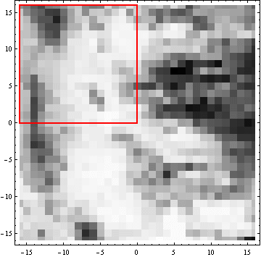
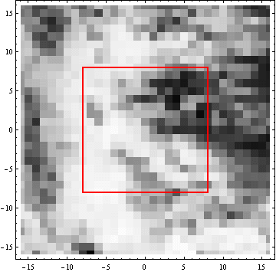
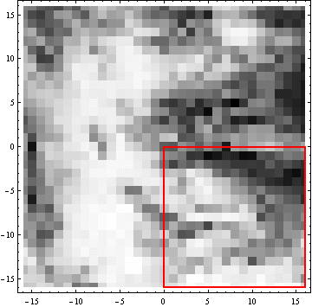
Cross-Correlation Tracking for MTSAT AMV
Searching Backward
Target Area
Searching forward
Image A (T = t0-1)
Image B (T = t0)
Image C (T = t0+1)
Correlation surface
of backward motion
Correlation surface
of forward motion
backward motion vector
used for consistency check
forward motion vector
final output vector

Slide 7
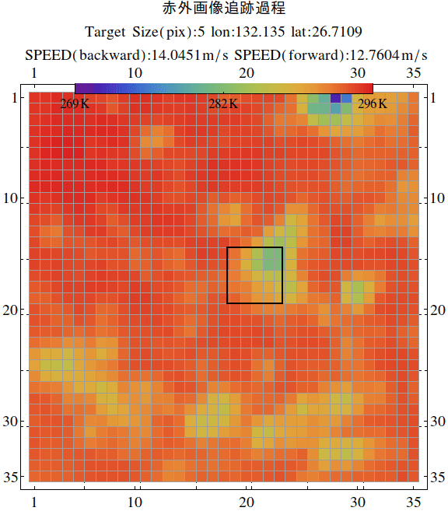
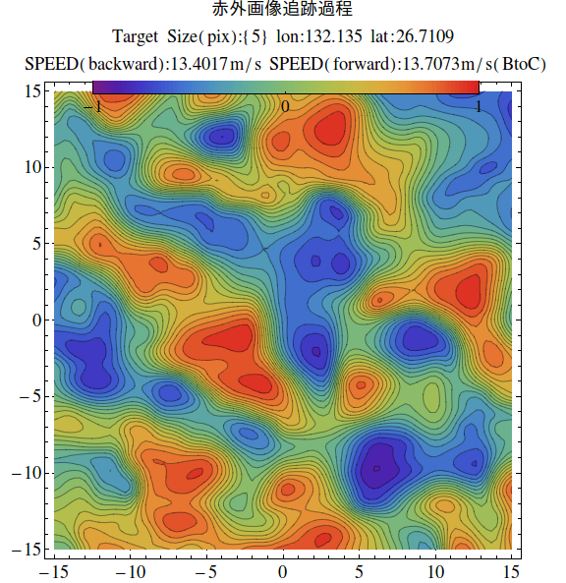
Correlation Surface from small target box
many peaks = many similar patterns ->
Information included in target feature is not enough to determine wind vector accurately.
correlation surface with small target box
(5x5 pixels)

Slide 8
motion vector estimation from forward matching
set of
probable motion vectors
in forward matching
motion vector which maximize cross-correlation in forward matching is selected as an “best” forward motion vector
motion vector is determined only by forward matching information
set of potential motion vector

Slide 9
motion vector estimation from backward matching
set of
probable motion vectors
in backward matching
motion vector which maximize cross-correlation in backward matching is selected as an “best” backward motion vector
motion vector is determined by forward matching information only
set of potential motion vector

Slide 10
Simultaneous use of matching information
set of
probable motion vectors
in forward matching
set of
probable motion vectors
in backward matching
“best” vector in forward matching , but unlikely in backward matching
if difference between forward and backward motion vector is large, purged by temporal consistency check
= tracking failure
set of potential motion vector

Slide 11
Simultaneous use of matching information
set of
probable motion vectors
in forward matching
set of
probable motion vectors
in backward matching
Optimal motion vector should be selected from this intersection
temporally inconsistent vector should not be selected from the beginning
set of potential motion vector

Slide 12
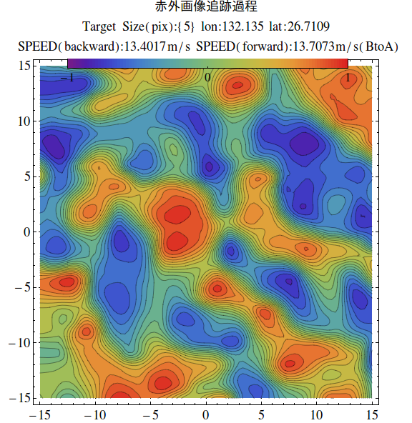
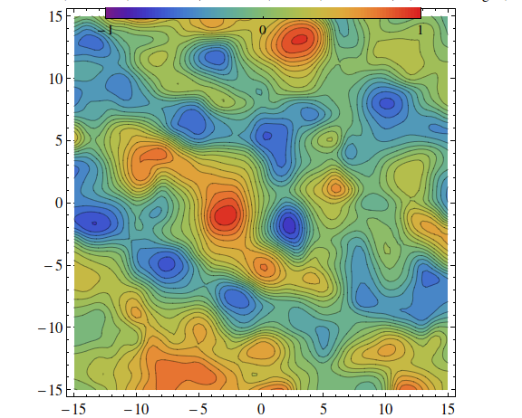
Maximum Likelihood Estimation Approach for small Scale AMV
To equate cross-correlation with log likelihood function
To compute average of two log likelihood function surface from forward and backward matching
To search vector which maximize the averaged log likelihood function
auxiliary information
Correlation surface from backward motion
probabilistic inference
to regard correlation surface as log likelihood function
prior information
Correlation surface from forward motion
posterior information
averaged correlation surfaces

Slide 13
how to find temporally consistent vector
set of potential motion vector
set of
probable motion vectors
in forward matching
set of
possible backward motion vectors
reversed for averaging
prior information
correlation surface from forward matching
auxiliary information
correlation surface from backward matching
posterior information
averaged correlation surfaces

Slide 14
how to search temporally consistent vector
set of potential motion vector
set of
probable motion vectors
in forward matching
set of
possible backward motion vectors
reversed for averaging
Peak position on averaged surface corresponds to large CC points on both of FW and BW surfaces
prior information
correlation surface from forward matching
auxiliary information
correlation surface from backward matching
posterior information
averaged correlation surfaces

Slide 15
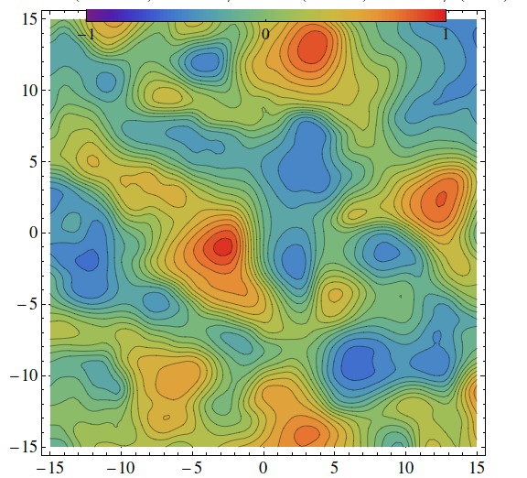
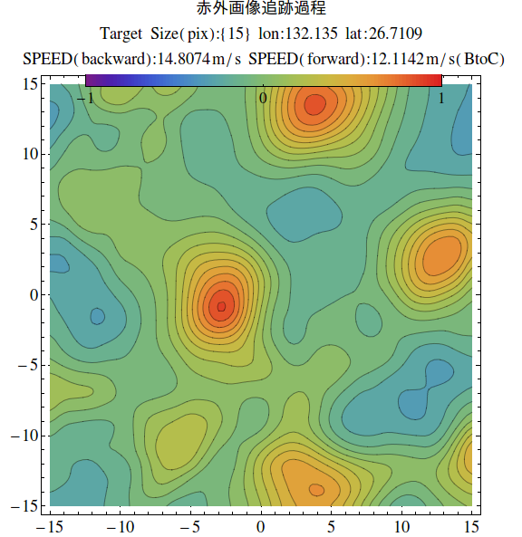
Application to spatially consistent vector
set of potential motion vector
set of
possible small scale motion vectors
(similarity high)
prior information
correlation surface
from small target box
set of
possible large scale motion vectors
(similarity high)
posterior information
averaged correlation surfaces
auxiliary information
correlation surface
from large target box

Slide 16
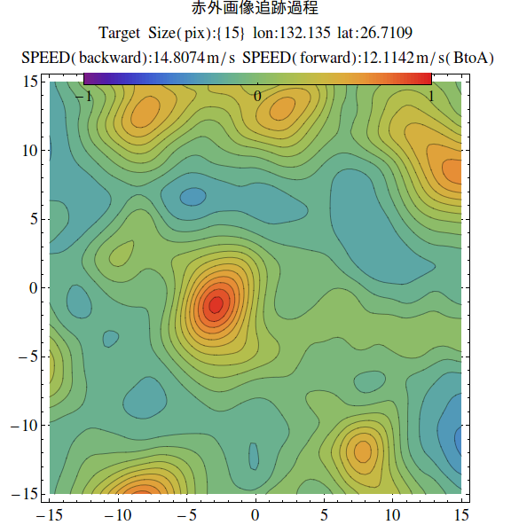
Likelihood estimation
by temporal and spatial information
forward motion small scale
backward motion
small scale
forward motion large scale
backward motion
large scale
Notes:
Information should be used separatelly

Slide 17
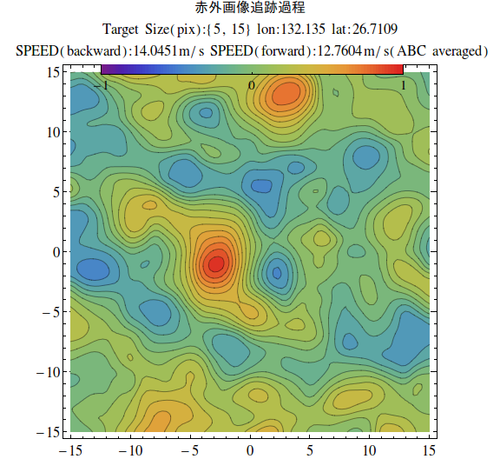
Likelihood estimation
by temporal and spatial information
forward motion small scale
backward motion
small scale
forward motion large scale
backward motion
large scale

Slide 18
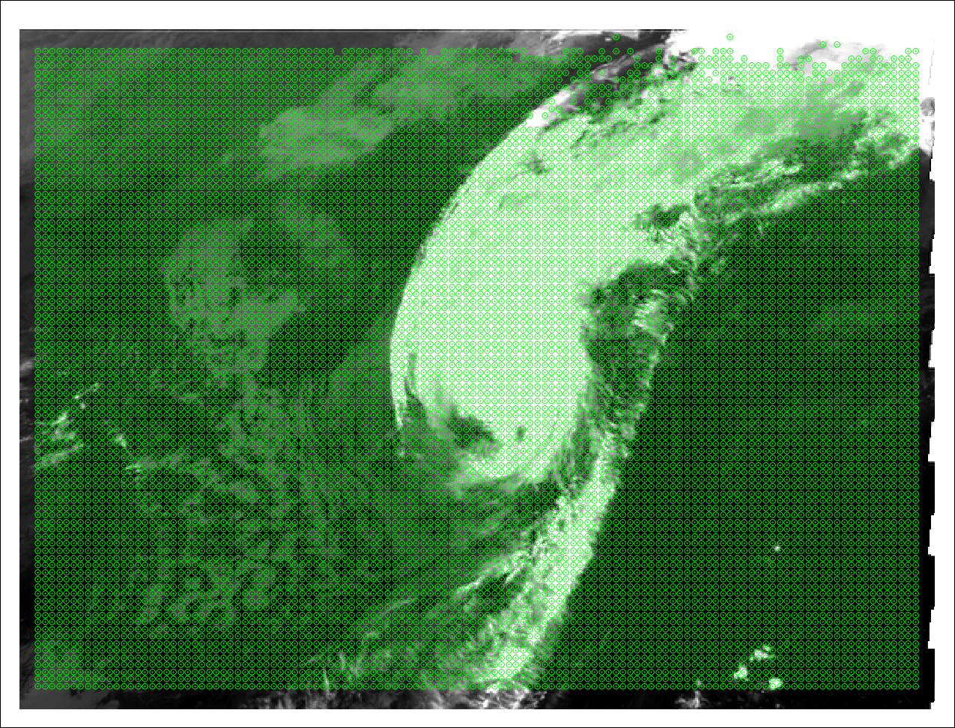
Target motion trajectories with small target box
sat:MTSAT-1R
Channel:IR10.8
time interval:5min
target size:5x5pix
tracking: normal
Green: natural
Red: noisy track

Slide 19
comparison to rapid scan tracking methods
by checking cloud trajectory
sat:MTSAT-1R
Channel:IR10.8
time interval:5min
target size:
5x5pix,15x15pix
tracking: time and space MLE
Green: natural
Red: noisy track

Slide 20
Contents
Introduction to Advanced Himawari Imager (AHI)
Tracking algorithm
Cloud height assignment algorithm
Result by new algorithm
Summary

Slide 21
simultaneous use of radiance and motion vector
for cloud height estimation
EBBT method
Using single band radiance information
NWP profile is needed for conversion to pressure and considering atmospheric effects to observed radiance
IR channel radiance
NWP profile data

Slide 22
simultaneous use of radiance and motion vector
for cloud height estimation
IR-WV intercept method
Using IR-WV bands radiance information
NWP profile is needed for conversion to pressure and considering atmospheric effects to observed radiance
IR channel radiance
WV channel radiance
NWP profile data

Slide 23
simultaneous use of radiance and motion vector
for cloud height estimation
Best fit level method
Using motion vector information
NWP profile is needed for minimizing difference between AMV and NWP wind
motion vectors
NWP profile data

Slide 24
simultaneous use of radiance and motion vector
for cloud height estimation
Maximum Likelihood Estimation
for cloud height assignment
Usable information for height assignment are radiance, motion vector and NWP profile data
Likelihood function to be maximized must be defined (no convenient information such as correlation surface)
Optimization algorithm required for searching optimal cloud height
IR channel radiance
WV channel radiance
motion vectors
NWP profile data

Slide 25
Forward model
Radiance rationing of from high, middle, low and ground layer
10.5, 12.0 and 6.7 micro meter imagery are used
Averaged radiance in target box (5x5) is used
$$R (ρ_{high},ρ_{mid},ρ_{low},h_{high},h_{mid},h_{low})=$$
$$ρ_{high} ε_{high}\left(ch\right)Rad\left(h_{high}\right)+$$
$$ρ_{mid} ε_{mid}\left(ch\right)Rad\left(h_{mid}\right)+$$
$$ρ_{low} ε_{low}\left(ch\right)Rad\left(h_{low}\right)+$$
$\left(1−(ρ_{high}+ρ_{mid}+ρ_{low})\right)ε_{ground}\left(ch\right)Rad(ground)$
$$\prod_{ch}^{N}{e^{−\frac{{(R_{obs}−R (ρ_{high},ρ_{mid},ρ_{low},h_{high},h_{mid},h_{low})\text{)} }^{2}}{2 σ^{2}}}}$$
ground

Slide 26
usability of motion vectors for cloud height estimation
wind vectors derived from VIS, IR and WV imagery are available
Information of visible imagery is also available for height assignment by using VIS wind vector
$$\vec{v_{obs}}=\vec{v_{nwp}}\left(h_{high}\right)$$
OR
$$\vec{v_{obs}}=\vec{v_{nwp}}\left(h_{mid}\right)$$
OR
$$\vec{v_{obs}}=\vec{v_{nwp}}\left(h_{low}\right)$$
$$\prod_{ch}^{N_{ch}}{\left(1−\prod_{layer}^{N_{layer}}{\left(1−e^{−\frac{{\left(\vec{v_{obs}}−\vec{v_{nwp}}\left(h_{layer}\right)\right)}^{2}}{2 σ^{2}}}\right)}\right)}$$
ground

Slide 27
Optimization Strategy
Not to minimize cost function but to maximize likelihood function which is set to 0-1 for handling not only “equation” but also “inequality” and fuzzy inference theory.
Likelihood function maximization
(available for simultaneous equation and inequality system and propositional logic)
Limit of cost function minimization (available for only simultaneous equation system)
.EQ.
$$f\left(x\right)=y+σ → L\left(f\left(x\right)=y+σ\right)= Exp(\frac{−{(f(x)−y)}^{2}}{2 σ^{2}})$$
.AND.
$$P and Q → L\left(P\right) × L(Q)$$
$$f\left(x\right)>y+σ → L(f\left(x\right)>y+σ)= \frac{1}{2}\left(1+Erf\left(\frac{f\left(x\right)−y}{\sqrt{2}σ}\right)\right)$$
.GT.
.NOT.
$$not P → 1−L(P)$$
.OR.
$$P or Q =not( not\left(P\right) and not\left(Q\right) ) → 1−(1−L(P))( 1−L(Q))$$
IF THEN
$if P then Q = not\left( P and not\left(Q\right)\right) → 1−L(P)$(1- $L(Q)$)
In real computation, Cauchy distribution (and its CDF) used instead of normal distribution for searching optimal latent variables

Slide 28
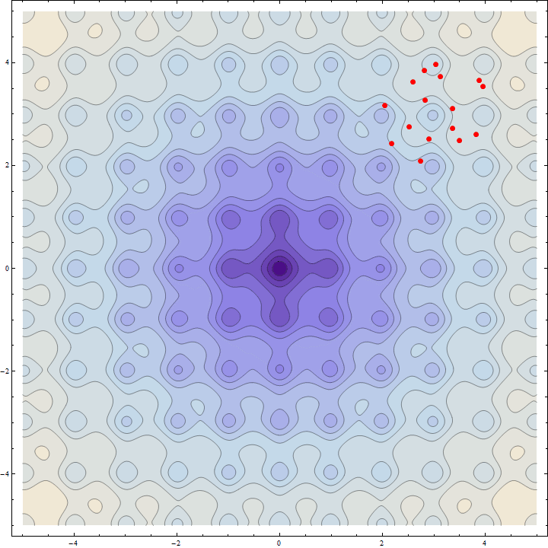
Optimization method - Differential Evolution method
Test function : Ackley's function
Too many local minima
⇒difficult to find optimal parameter by methods using derivative function
initial points are changed by iteration of
mutation evolution
crossover
survival of the fit
operations .
global minimum
Storn, R.; Price, K. (1997). "Differential evolution - a simple and efficient heuristic for global optimization over continuous spaces". Journal of Global Optimization 11: 341–359

Slide 29
Contents
Introduction to Advanced Himawari Imager (AHI)
Tracking algorithm
Cloud height assignment algorithm
Result by new algorithm
Summary

Slide 30
AMV derivation experiment using new tracking and HA technique
Satellite : MTSAT-2
Period : January 2013 (winter)
RTN
Target selection : MTSAT operational method
Tracking : Cross-Correlation
Height assign : operational method
TEST1
Target selection : MTSAT operational method
Tracking : Cross-Correlation, MLE using 5x5 and 15x15 pixels
Height assign : MLE height estimation using only radiance information
TEST2
Target selection : MTSAT operational method
Tracking : Cross-Correlation, MLE using 5x5 and 15x15 pixels
Height assign : MLE height estimation using radiance and tracked motion
Temporal information for tracking is not used in this experiment
for simplifying comparison using QI (consistent vector shows high quality even case that temporal QI is low)

Slide 31
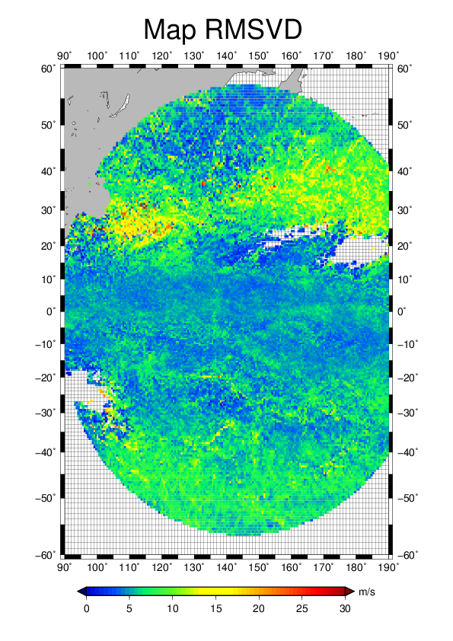
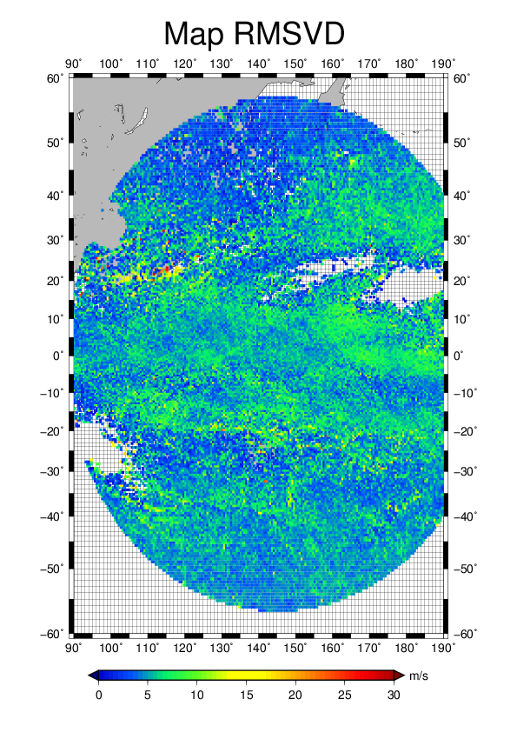
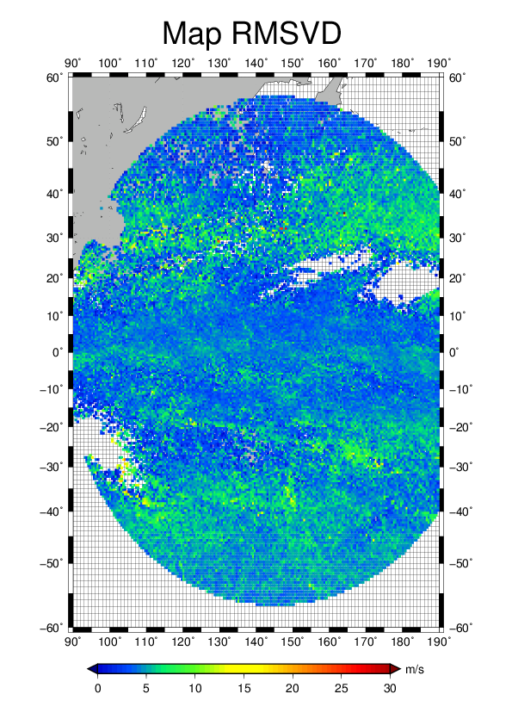
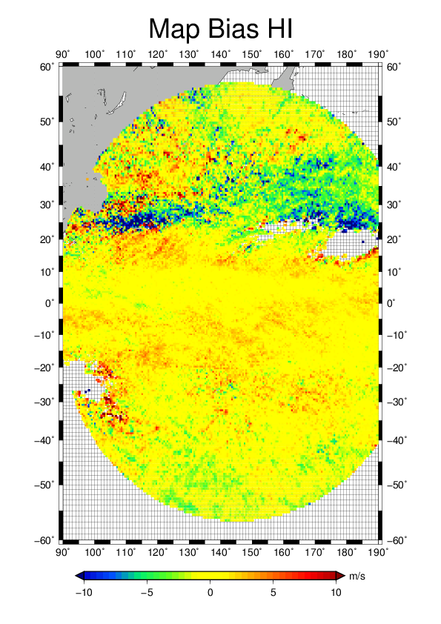
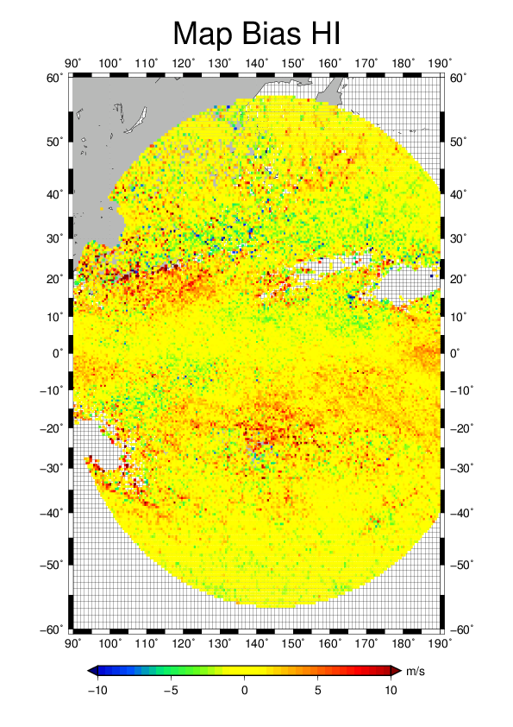
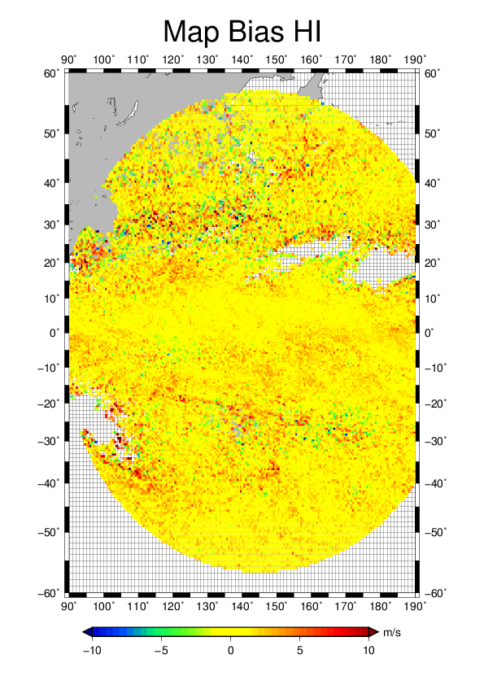
IR upper level AMV O-B statistic for January 2013
operation
TEST1 : radiance only
TEST2 : radiance and motion
QI>80
QI>80
QI>80
QI>80
QI>80
QI>80

Slide 32
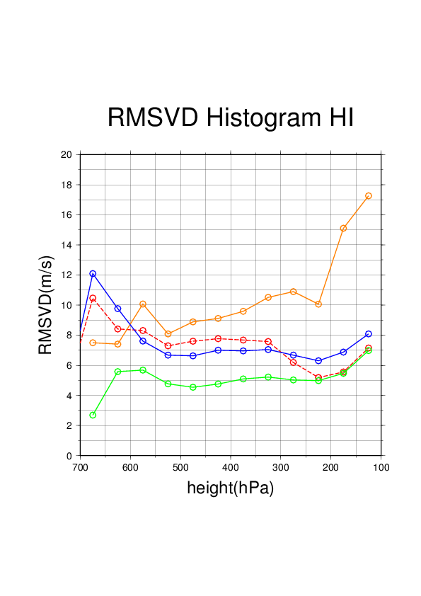
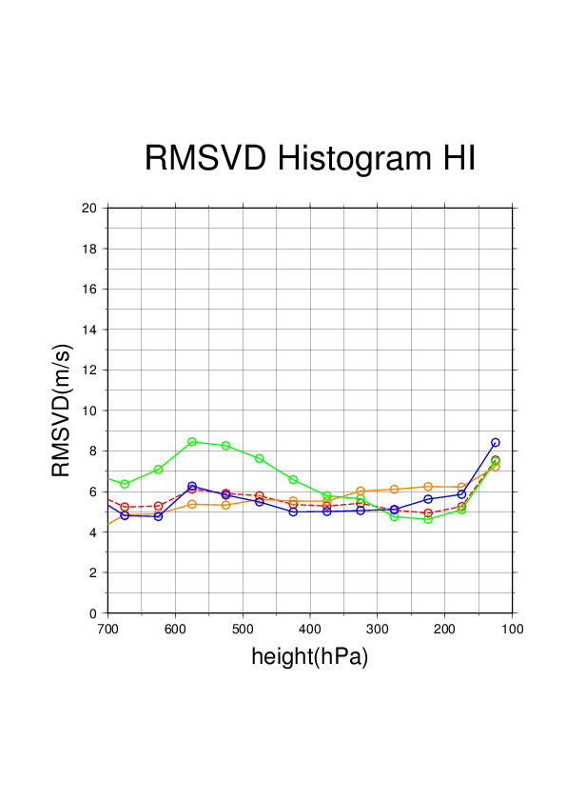
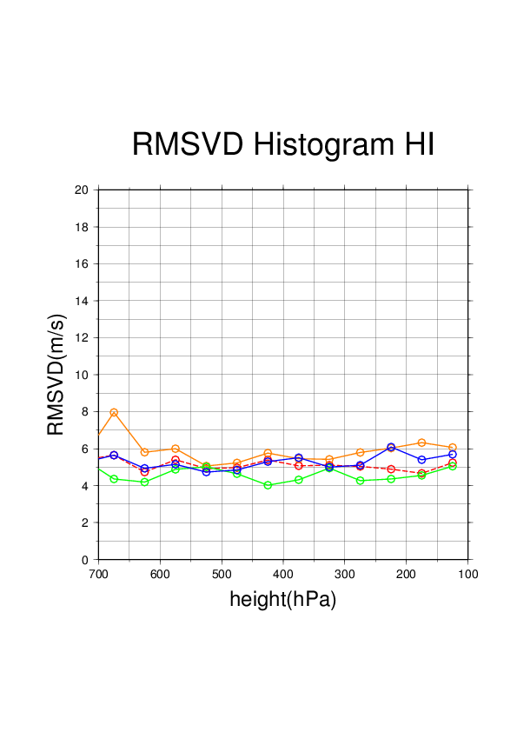
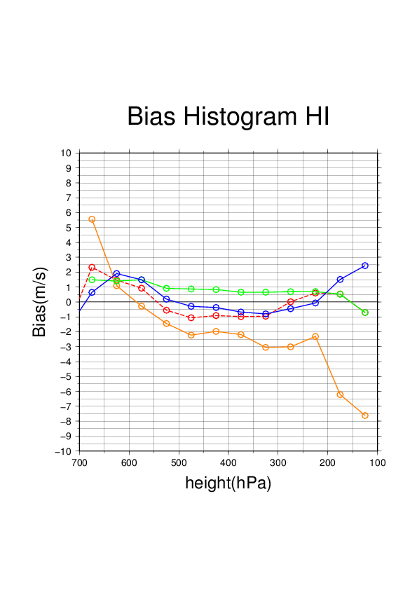
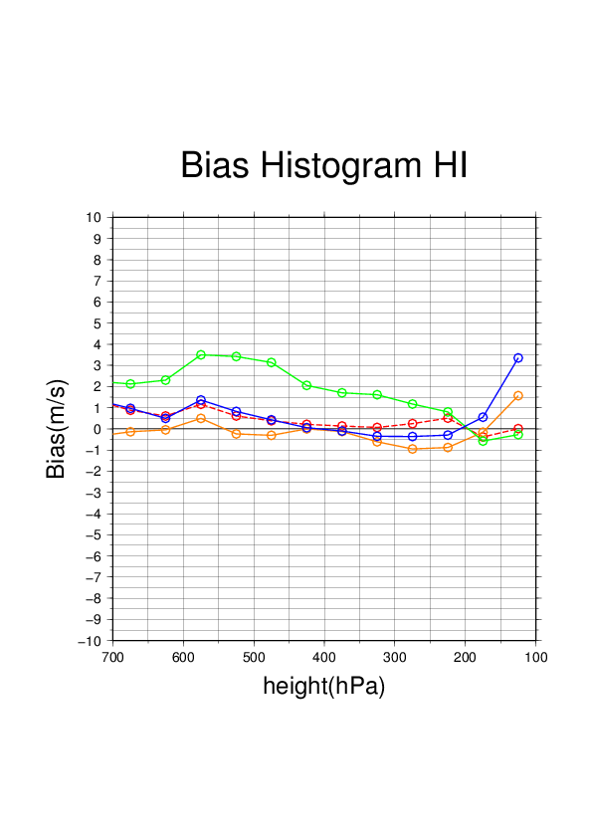
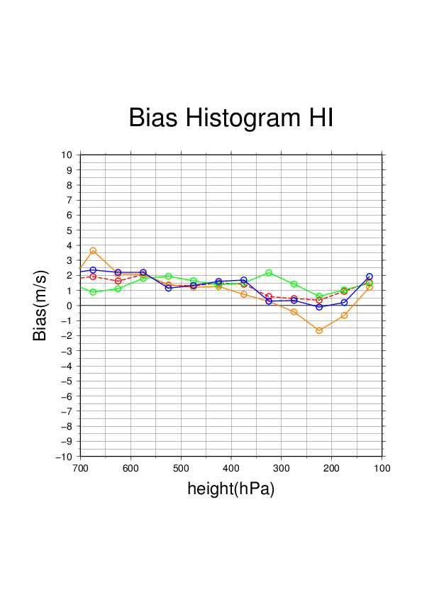
IR upper level AMV O-B statistic for January 2013
TEST1 : radiance only
TEST2 : radiance and motion
Full Disk
NH
TROP
SH
QI>80
QI>80
QI>80
0 m/s

Slide 33
IR upper level AMV sonde statistics for January 2013
Only radiance information used
RTN
TEST1
HIGH LEVEL
 | FULL DISK | NH | TROP | SH |  |  | FULL DISK | NH | TROP | SH
MVD | 4.81 | 7.22 | 4.45 | 5.48 |  | MVD | 5.88 | 6.34 | 5.77 | 5.91
RMSVD | 5.79 | 8.65 | 5.23 | 6.63 |  | RMSVD | 7.15 | 7.57 | 7.06 | 6.99
BIAS | -0.7 | 0.31 | -0.94 | 0.71 |  | BIAS | -1.34 | -1.20 | -1.53 | 0.31
SPD | 15.09 | 35.40 | 11.78 | 23.73 |  | SPD | 18.31 | 36.90 | 13.27 | 25.84
MEDIUM LEVEL
 | FULL DISK | NH | TROP | SH |  |  | FULL DISK | NH | TROP | SH
MVD | 6.17 | 6.57 | 3.93 | 5.28 |  | MVD | 5.28 | 5.50 | 3.76 | 5.27
RMSVD | 7.74 | 8.23 | 4.54 | 6.04 |  | RMSVD | 6.4 | 6.67 | 4.21 | 6.20
BIAS | -1.67 | -2.08 | 0.01 | -0.01 |  | BIAS | -0.69 | -0.85 | -0.17 | 0.29
SPD | 21.38 | 23.14 | 9.43 | 19.65 |  | SPD | 22.02 | 23.94 | 9.74 | 19.84
Method : Comparison of rawinsonde winds with AMV
winds within 150 km radius of a RAOB site
Filters : VERT. DIST.(>=700hPa) < 50 (hPa)
VERT. DIST.(<700hPa) < 35 (hPa)
QUALITY >= 85
0.5*0.5 deg. latitude/longitude grid point data
SPEED DIFF. < 30 (m/s) - DIRECTION DIFF. < 90 (deg)

Slide 34
IR upper level AMV sonde statistics for January 2013
Both of radiance and motion vector information used
RTN
TEST2
HIGH LEVEL
 | FULL DISK | NH | TROP | SH |  |  | FULL DISK | NH | TROP | SH
MVD | 4.81 | 7.22 | 4.45 | 5.48 |  | MVD | 5.04 | 6.51 | 4.63 | 5.96
RMSVD | 5.79 | 8.65 | 5.23 | 6.63 |  | RMSVD | 6.03 | 7.79 | 5.45 | 6.98
BIAS | -0.7 | 0.31 | -0.94 | 0.71 |  | BIAS | -0.34 | -1.04 | -0.21 | 0.04
SPD | 15.09 | 35.40 | 11.78 | 23.73 |  | SPD | 19.26 | 37.21 | 14.42 | 27.57
MEDIUM LEVEL
 | FULL DISK | NH | TROP | SH |  |  | FULL DISK | NH | TROP | SH
MVD | 6.17 | 6.57 | 3.93 | 5.28 |  | MVD | 5.06 | 5.29 | 3.89 | 6.14
RMSVD | 7.74 | 8.23 | 4.54 | 6.04 |  | RMSVD | 6.05 | 6.30 | 4.53 | 7.13
BIAS | -1.67 | -2.08 | 0.01 | -0.01 |  | BIAS | 0.85 | 1.06 | -0.59 | 2.88
SPD | 21.38 | 23.14 | 9.43 | 19.65 |  | SPD | 21.16 | 23.82 | 10.11 | 25.78
Method : Comparison of rawinsonde winds with AMV
winds within 150 km radius of a RAOB site
Filters : VERT. DIST.(>=700hPa) < 50 (hPa)
VERT. DIST.(<700hPa) < 35 (hPa)
QUALITY >= 85
0.5*0.5 deg. latitude/longitude grid point data
SPEED DIFF. < 30 (m/s) - DIRECTION DIFF. < 90 (deg)

Slide 35
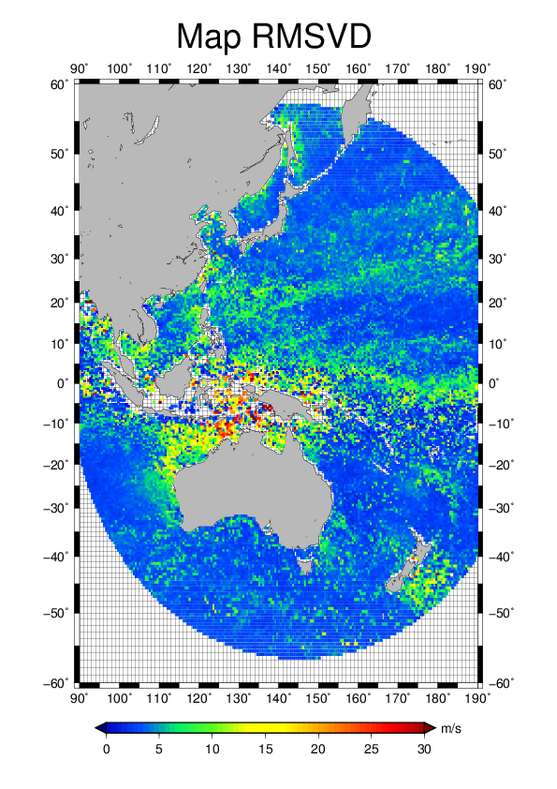
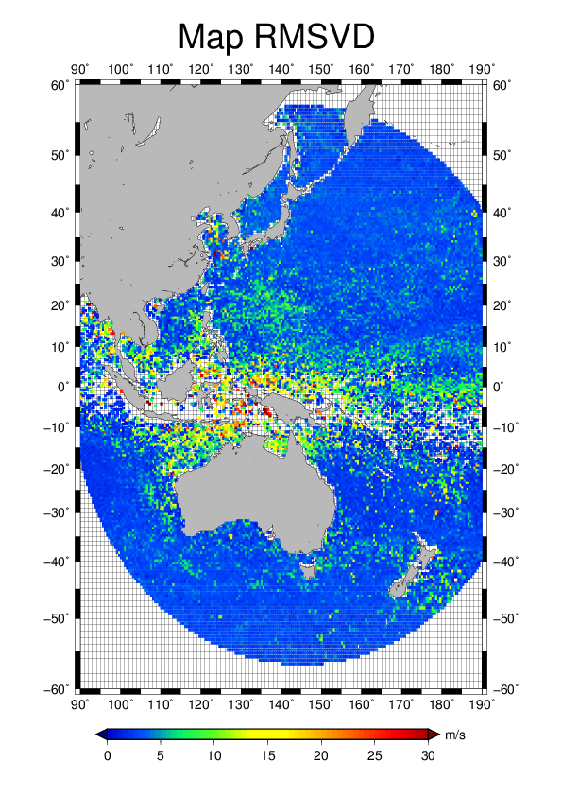
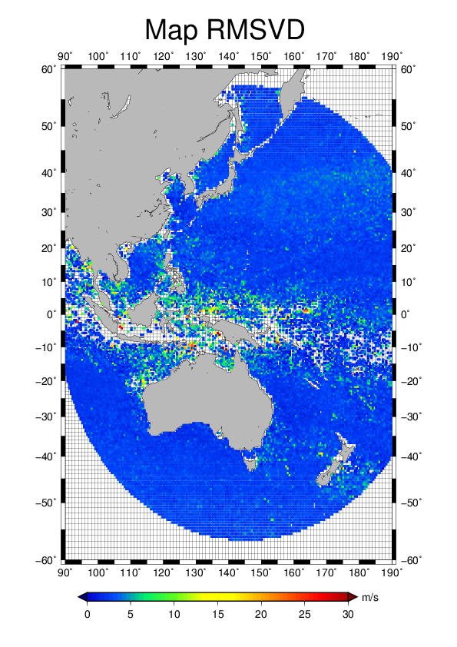
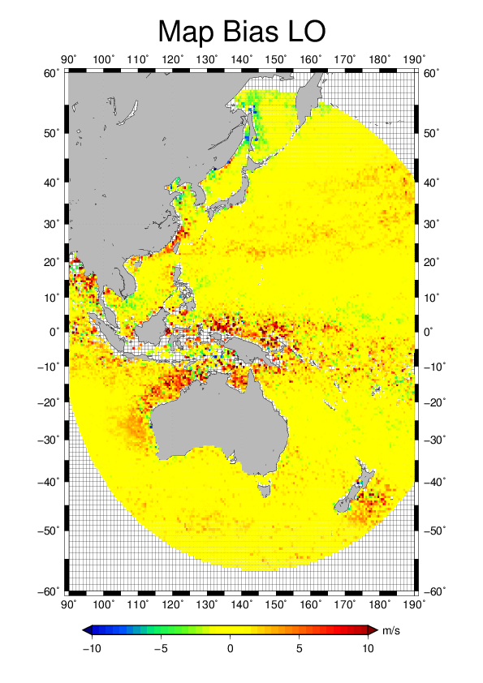
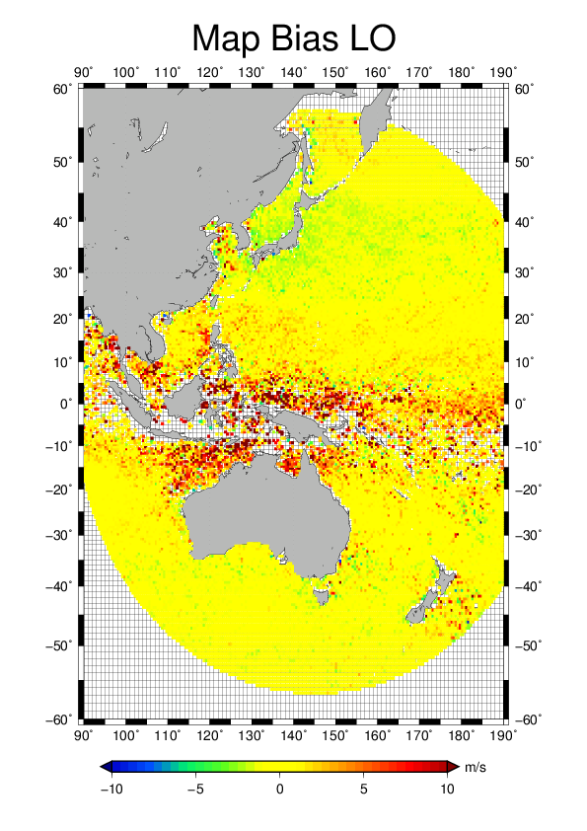
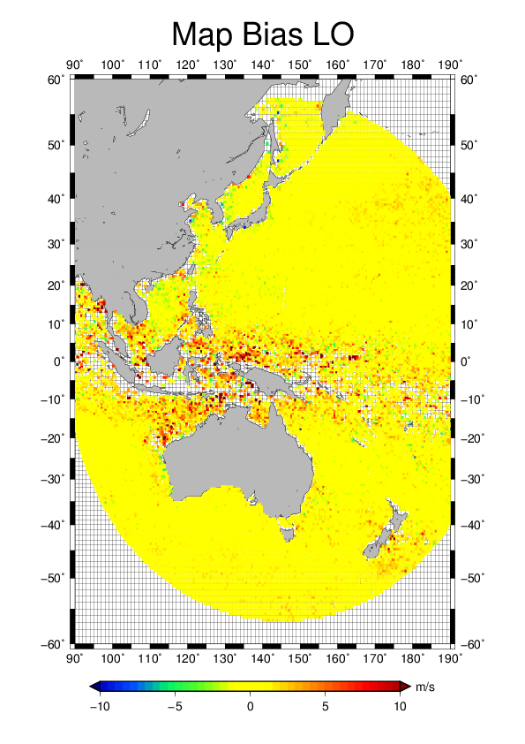
IR lower level AMV O-B statistic for January 2013
operation
TEST1 : radiance only
TEST2 : radiance and motion
QI>80
QI>80
QI>80
QI>80
QI>80
QI>80

Slide 36
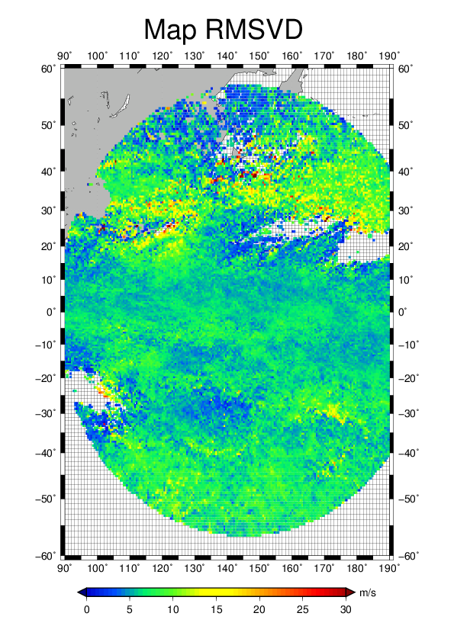
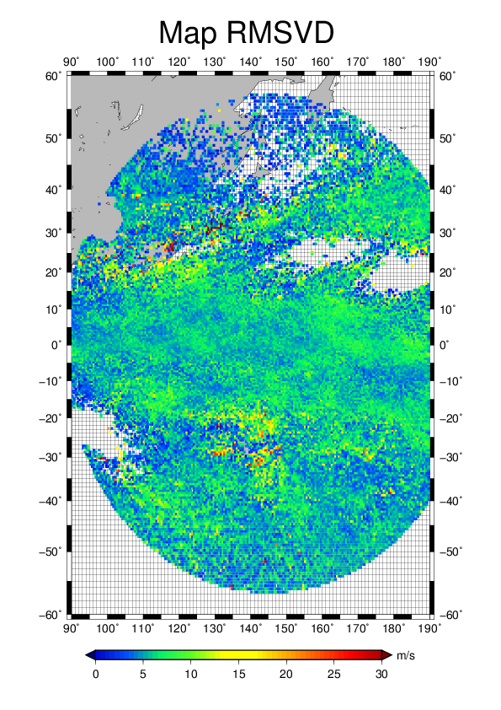
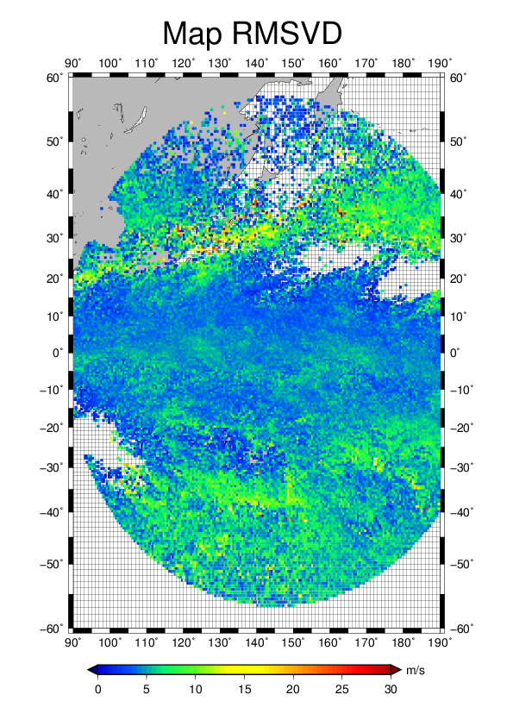
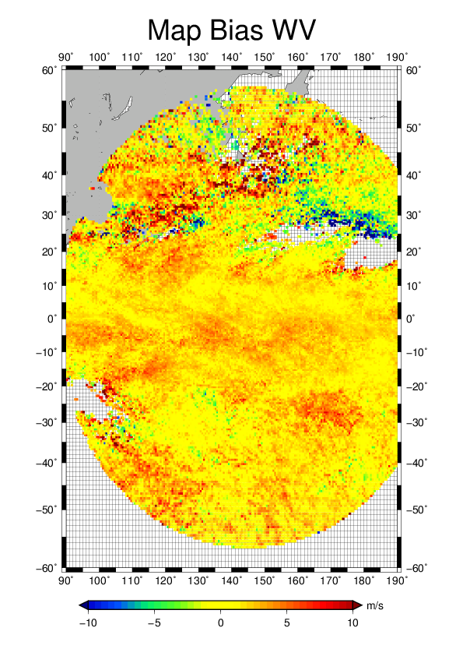
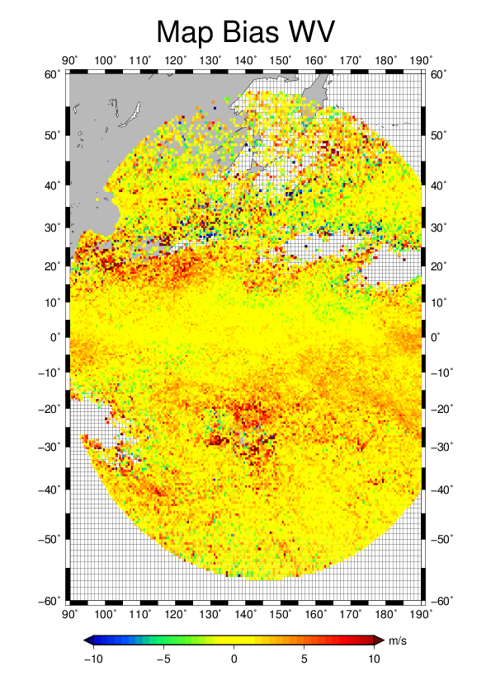
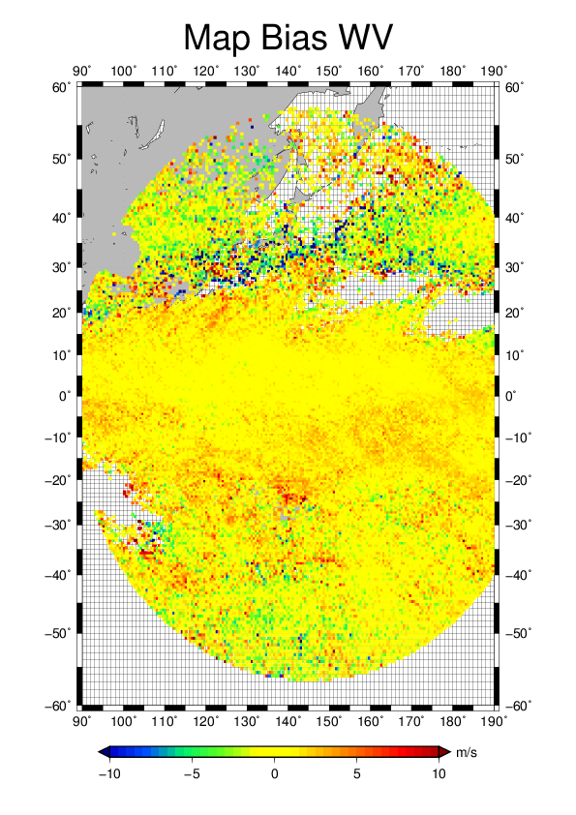
WV cloudy AMV O-B statistic for January 2013
operation
TEST1 : radiance only
TEST2 : radiance and motion
QI>80
QI>80
QI>80
QI>80
QI>80
QI>80

Slide 37
Summary
By deriving motion vectors from sum of four correlation surfaces derived from small, large target boxes, and from forward and backward matching, Tracking accuracy was improved.
BIAS and RMSVD of MTSAT IR AMV are totally improved by proposal height assignment method in case to use only radiance information. But as for BIAS, quality debased over tropical region.
As a result to use motion vector as auxiliary information for height assignment, error and its homogeneity are improved, but positive BIAS can be seen in southern hemisphere.

