Slide 1
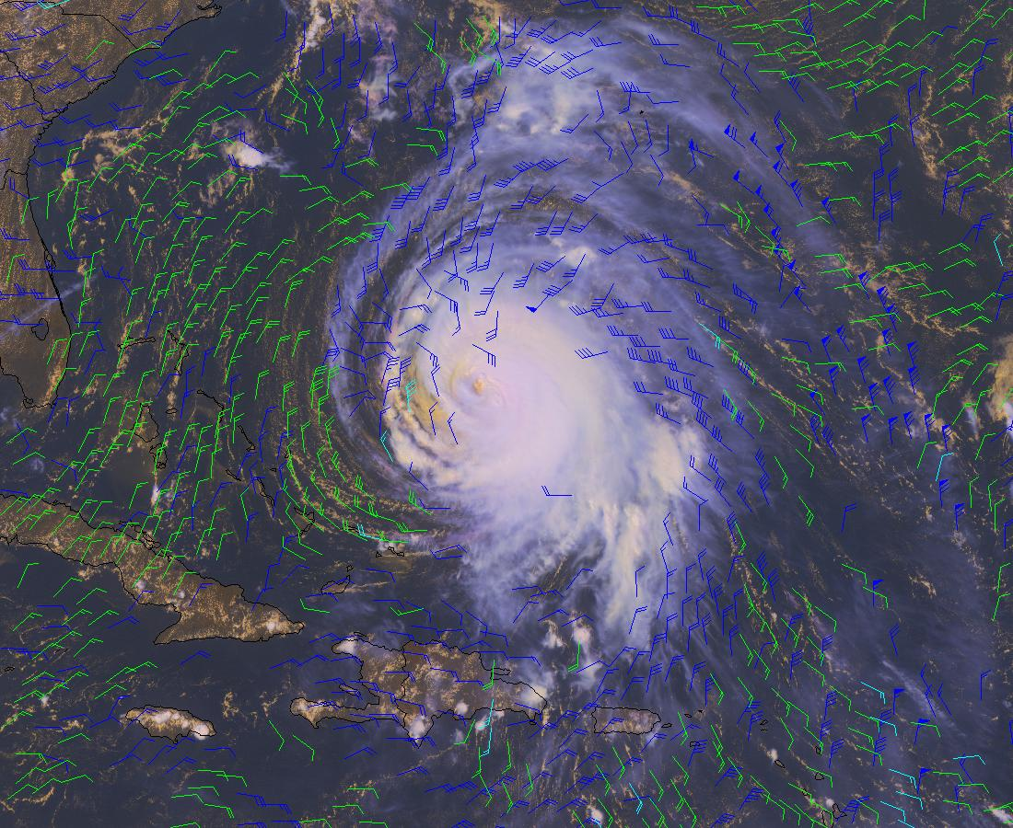
Assimilation of GOES Hourly and Meteosat winds in the NCEP Global Forecast System (GFS)
Xiujuan Su, Jaime Daniels, John Derber, Yangrong Lin, Andy Bailey, Wayne Bresky, Hongming Qi
JCSDA 11th Workshop on Satellite Data Assimilation
Notes:
1

Slide 2
Outline
Review of Effort and Goals
Evaluation of winds: data quality
Experimental Setup and Approach
Results
Next Step
Notes:
- brief intro to IWWG group (what covered by group)
how we operate (biennial workshops, website/wiki, iwwg email list, collaborative projects)
how we currently interact with CGMS (cgms->workshops, iwwg/workshops->cgms, role of rapporteur)
suggestions for how to improve interaction...

Slide 3
Review of Effort and Goals
Assimilate GOES hourly winds in the NCEP/GFS
Infrared cloud drift and water vapor cloud top winds (Task 1)
Visible and short-wave infrared winds (Task 2)
Improve the quality control procedures associated with assimilation of satellite derived winds
Transition updates into the next official GFS build for operations
3

Slide 4
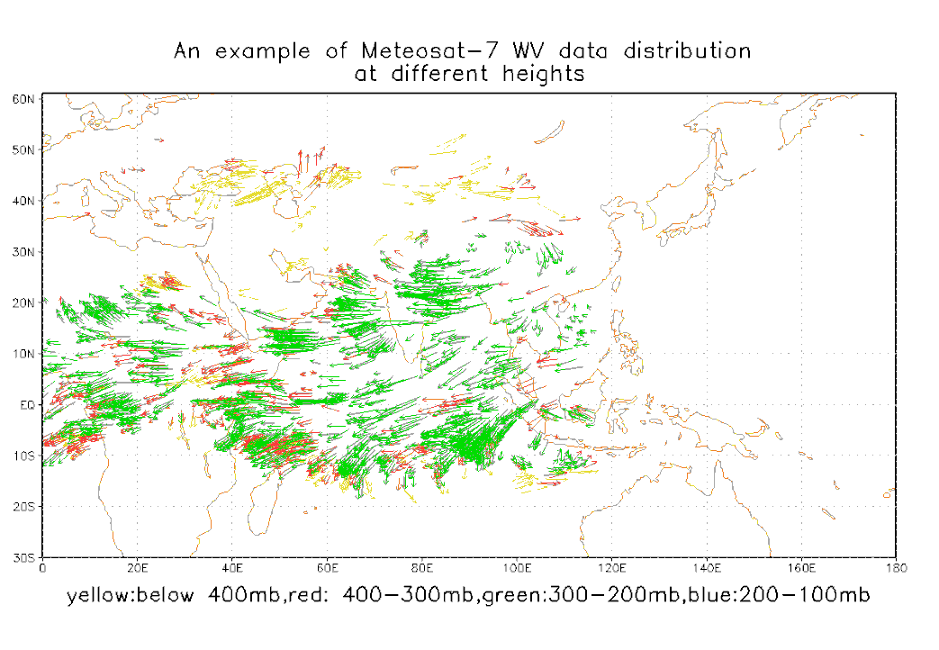
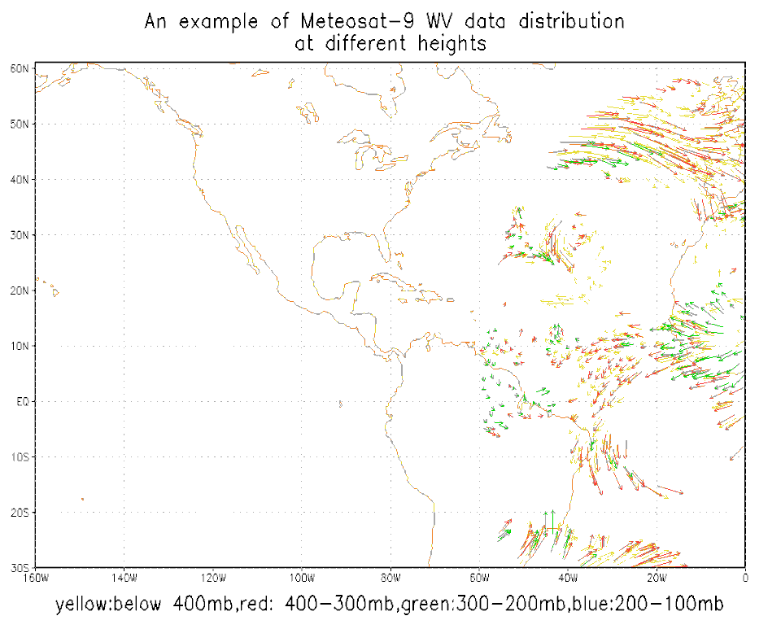
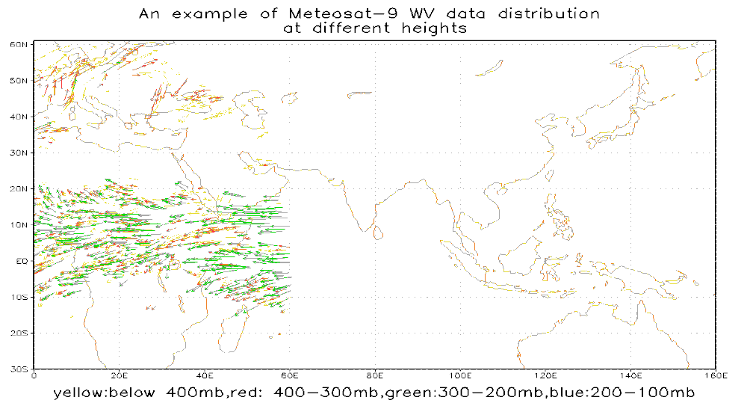
Meteosat WV Cloud Top Winds
Meteosat -7 and 9 (current 10) satellite winds are one of high quality winds, covering Indian ocean and Atlantic ocean sounding area.
GOES-15
GOES-14
4

Slide 5
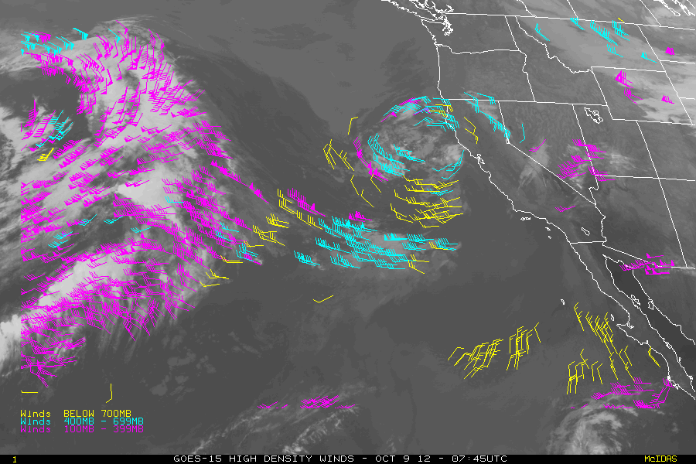
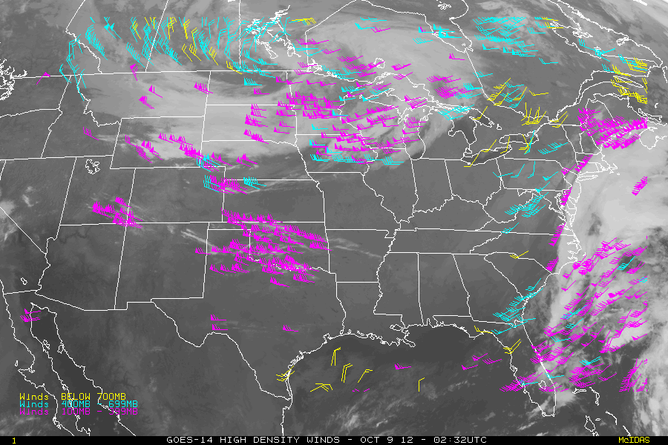
GOES Hourly Winds
Same winds retrieval algorithm with a few updates
Improved height assignment of low level AMVs over ocean when a low level temperature inversion is detected
Image scan line time defines the time for each satellite wind observation
BUFR files contain the Expected Error (EE) and QI quality indicators
More timely, reduced latency (15-30 minutes)
GOES-15
GOES-14
5

Slide 6
Evaluation of Winds
Time window about cycle time used in GSI
Half hour window for current operational GOES winds (3-hourly)
Three hour window used for GOES hourly winds
and Meteosat WV cloud top winds
Data count: About 4 to 6 times of current 3 hourly GOES winds. About 7000 counts after 200kmx200kmx100mb thinning for Meteosat winds
The evaluation of data quality
‒ Two weeks data to study O-B statistics, relationship between O-B statistics and quality marks QI and EE.
6

Slide 7
Data Quality: Summary (GOES
Hourly wind)
GOES hourly winds have similar quality as current operational GOES winds
The relative hour from cycle time do not impact the data quality
The RMS of O-B winds decrease with higher values of quality marks of QI at all levels
RMS of O-B increases linearly with normalized EE (normalized EE=original EE/speed).
Most winds have QI values higher than 85 (about 75%) at all levels.
7

Slide 8
Data Quality: Summary (Meteosat winds)
The data quality is similar to GOES cloud top water WV winds, O-B RMS slight larger than O-B RMS of GOES cloud top WV winds
About 55 percent of winds with QI values over 85.
8

Slide 9
Current Assimilation Strategy
Based on above O-B statistics results, the quality control schemes and observation errors were determined for GOES hourly IR and WV cloud top and Meteosat WV cloud top winds
The several parallel experiments were set up to assimilate these winds into NCEP data assimilations and forecast system. First, the parallel experiments from July 1 to August 15 and from November 15 to December 31,2012 were set up to assimilate each product respectively, then another experiment was set up from July 10 to August 31 to assimilate the two products (plus JMA profiler winds).
9

Slide 10
Current Assimilation Strategy
• QI greater than 85 as a filter for both satellite
winds
Normalized EE as a filer for GOES hourly winds
The first several experiments use March 1 2013 GSI version and current operational forecast system with T574L64 for individual product test
The combined parallel experiment uses beginning of April 2013 version GSI (version number 27524) and current forecast system.
10

Slide 11
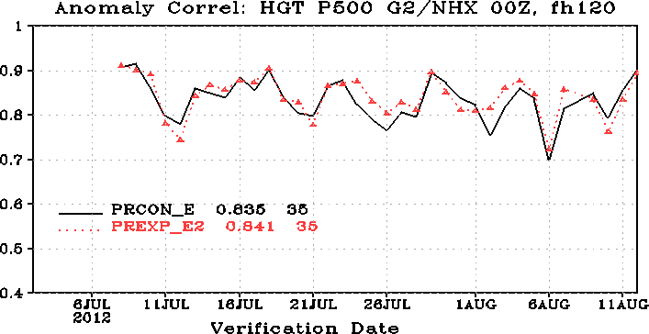
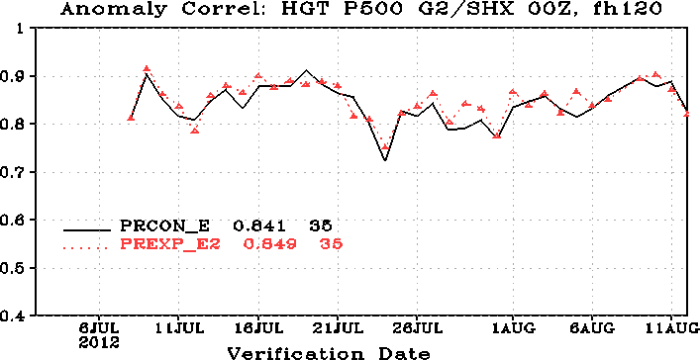
Results
The result from individual tests(the results from both period are similar)
1. Results from assimilation of Meteosat cloud top winds
11

Slide 12
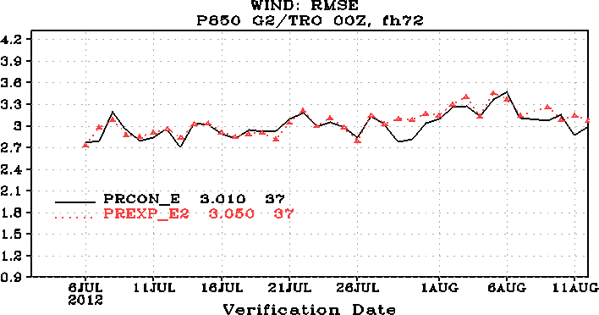
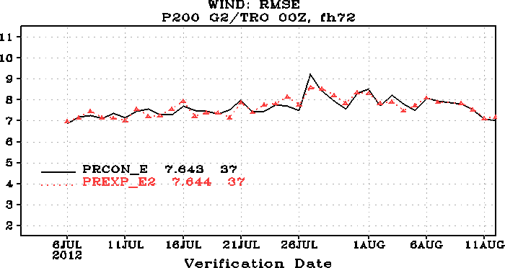
Results
12

Slide 13
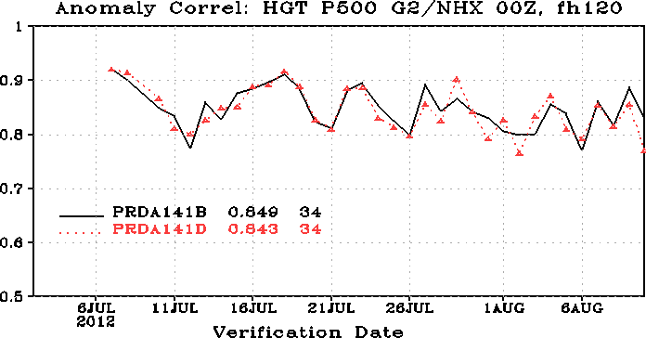
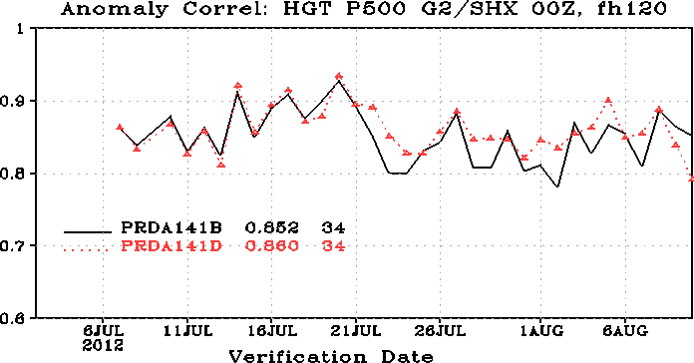
Results
2. The results from assimilation of GOES hourly winds
13

Slide 14
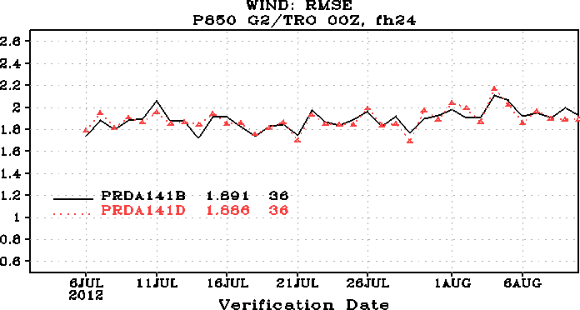
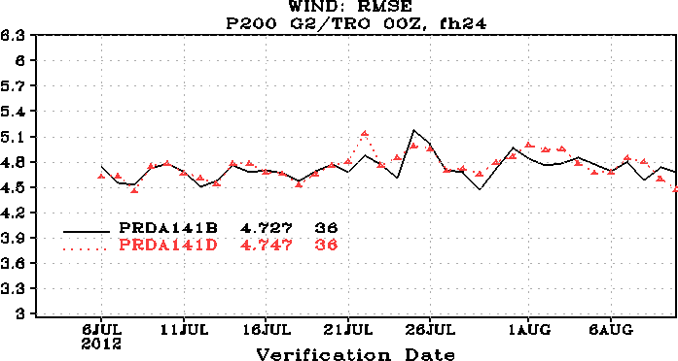
Results
14

Slide 15
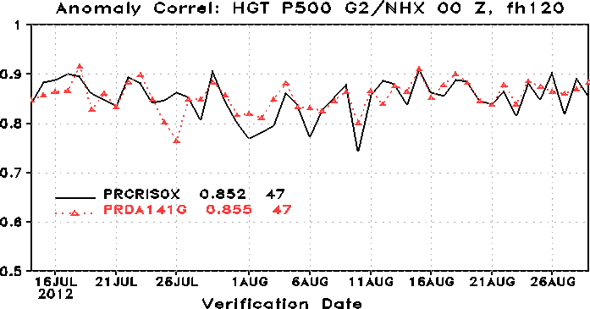
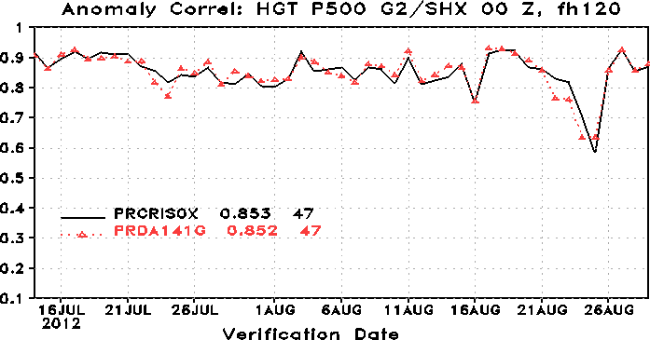
Results
The results from assimilation of both Meteosat, GOES
hourly winds, and JMA profiler winds, include bug fix
15

Slide 16
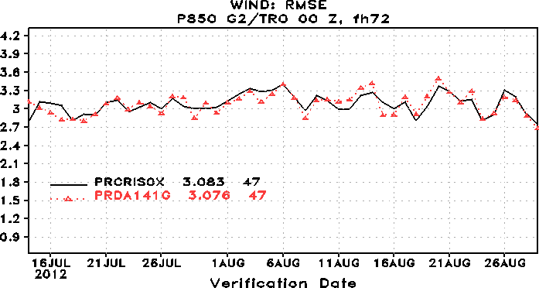
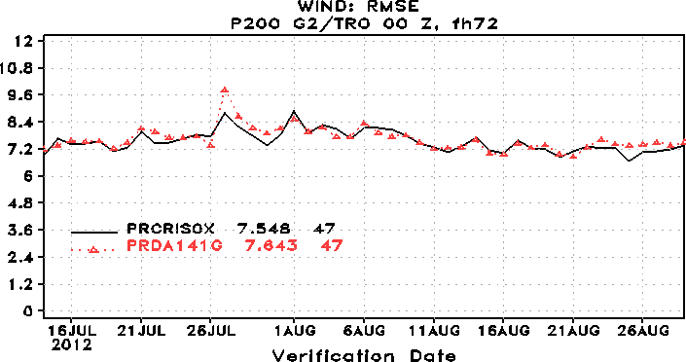
Results
16

Slide 17
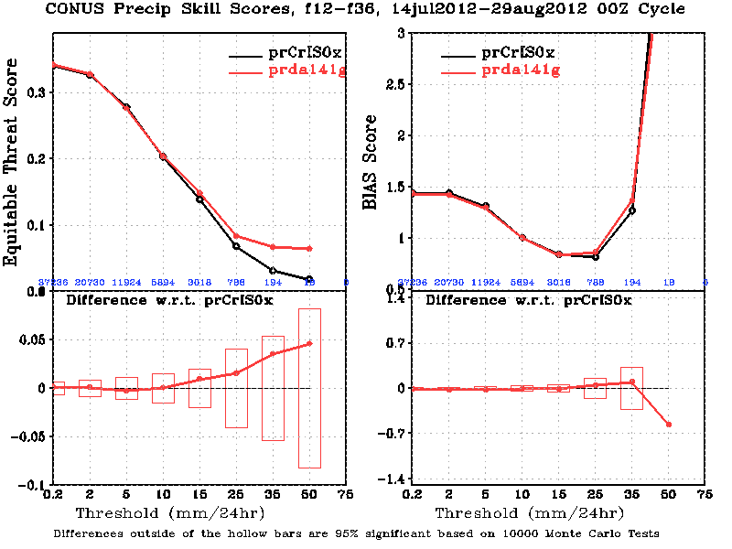
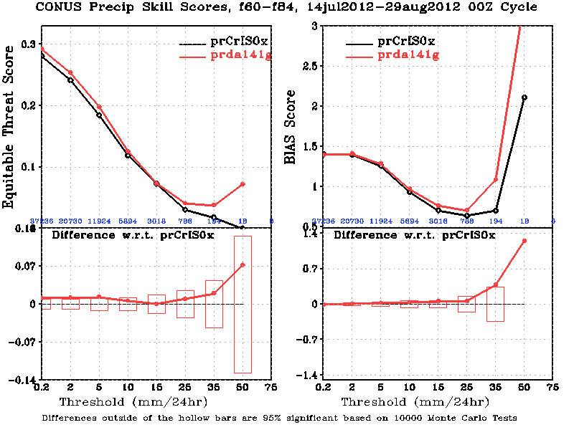
Results
17

Slide 18
Results
Assimilation of GOES hourly and Meteosat winds, JMA profiler winds has little impacts on conventional observation fits, most noticeable impacts for observation fits for satellite winds
18

Slide 19
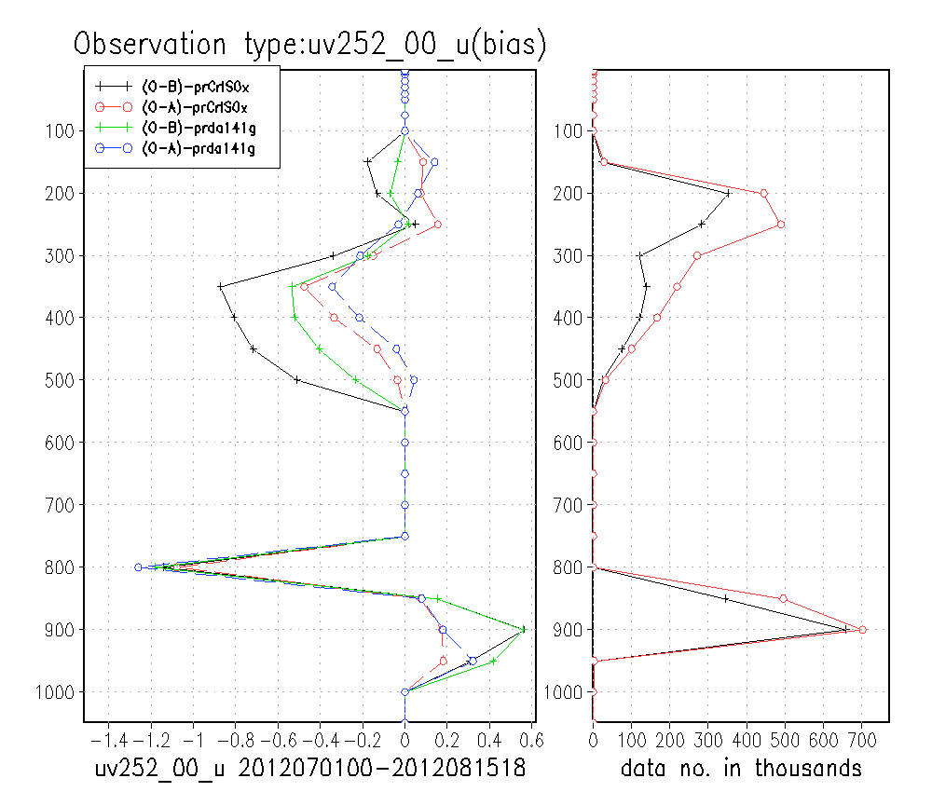
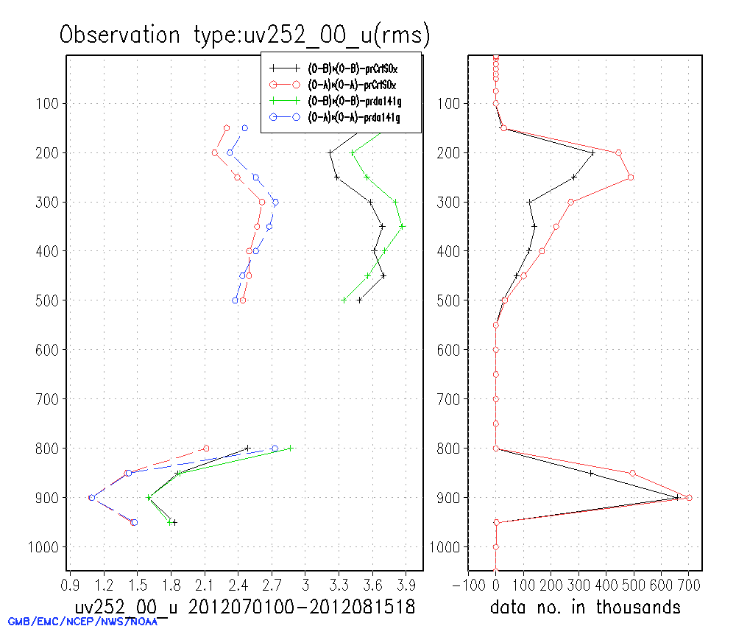
Results
1. JMA satellite winds
IR winds
19

Slide 20
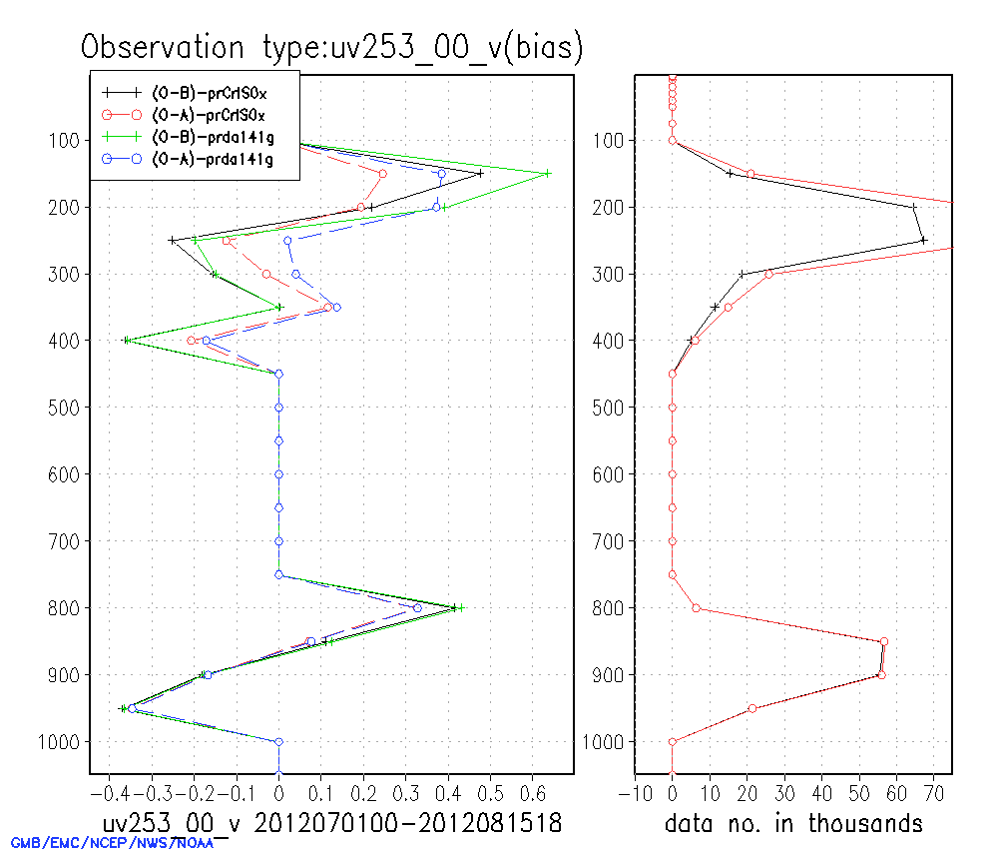
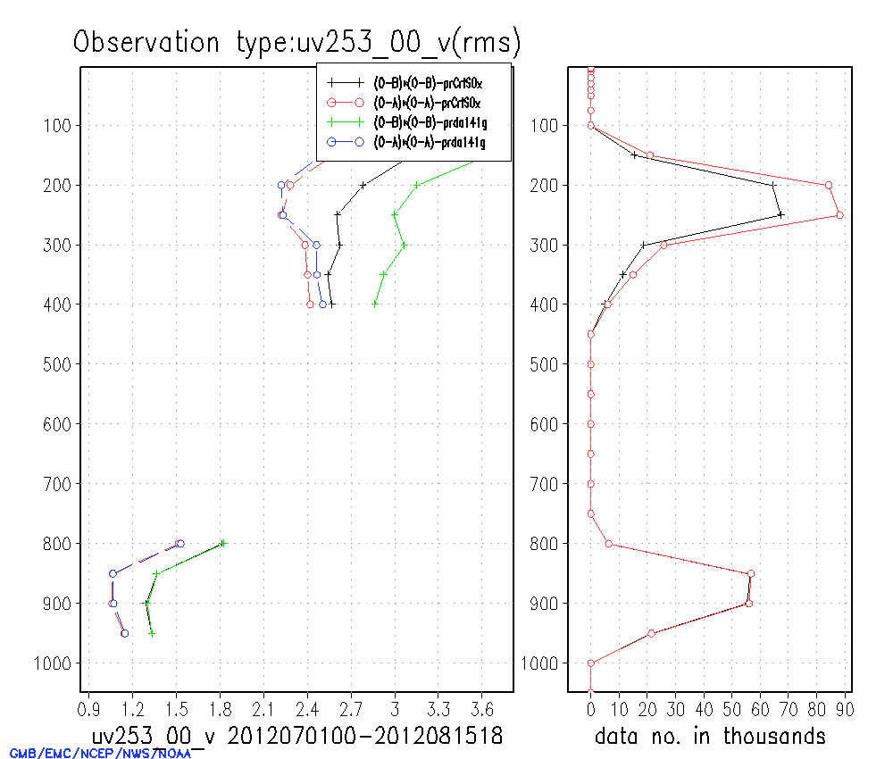
Results
2. Meteosat satellite winds
IR winds
20

Slide 21
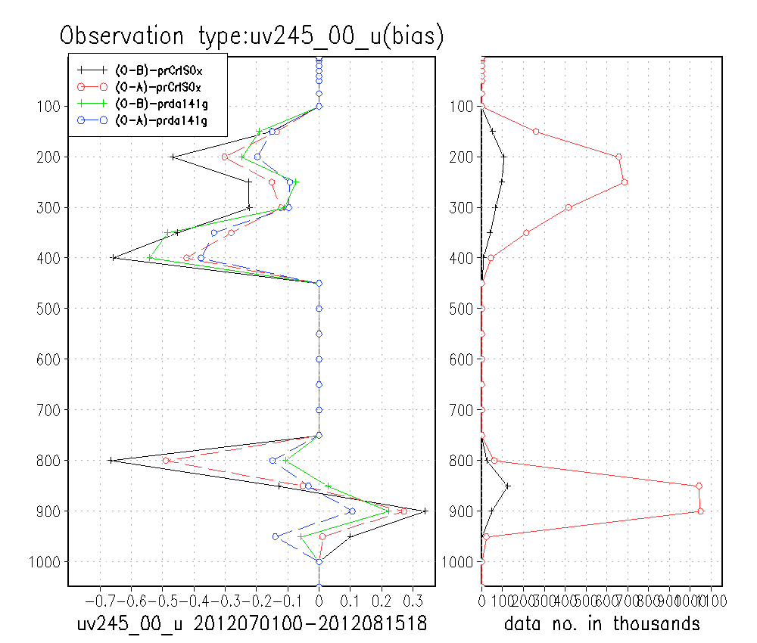
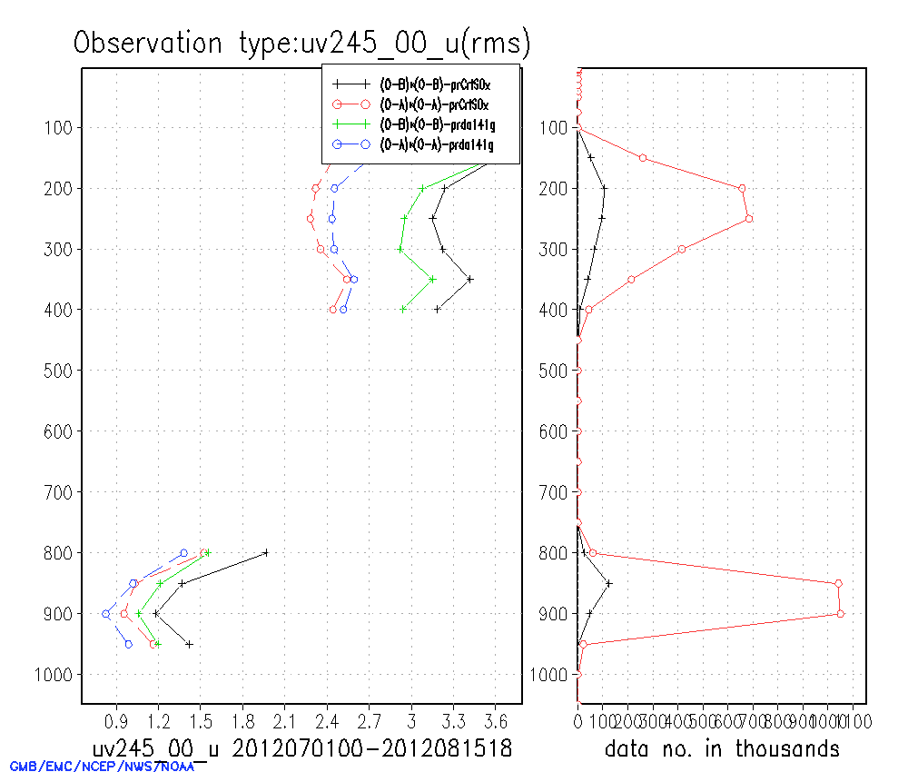
Results
GOES winds
IR winds
21

Slide 22
Results
GOES winds,
IR winds
22

Slide 23
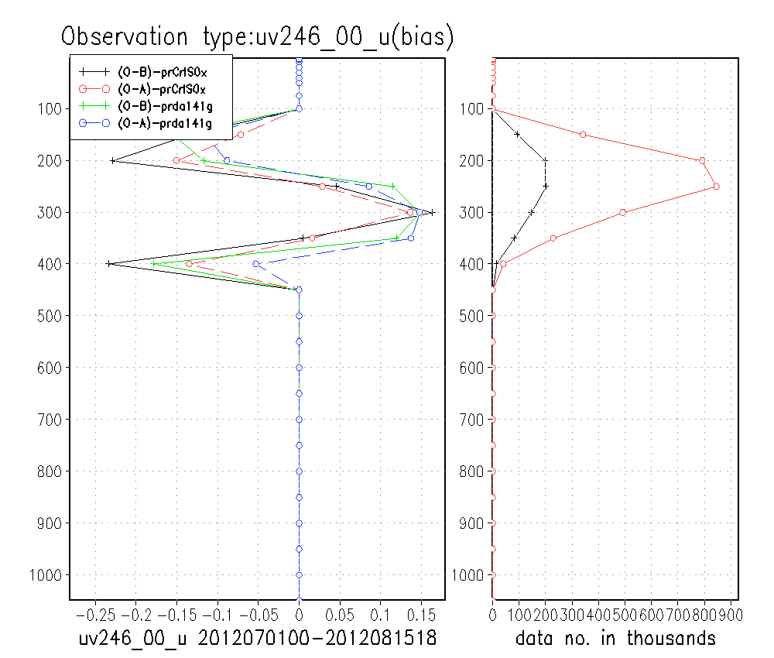
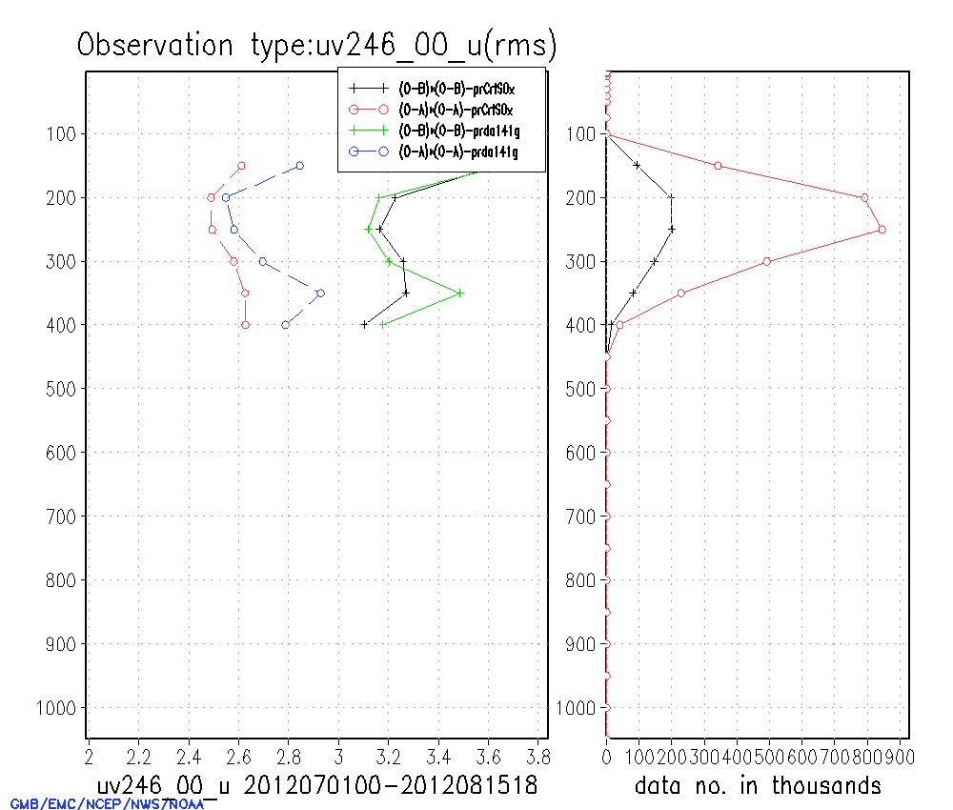
Results
WV winds
23

Slide 24
Summary
The O-B statistics characteristics were studied for GOES hourly IR, WV cloud top winds and Meteosat WV cloud top winds.
Based on these studies, the observation errors and quality control schemes were defined to assimilate these winds
The forecast impacts for individual product assimilation were neutral toward slight positive over both hemispheres and neutral over tropical region.
24

Slide 25
Summary
The forecast impacts from adding all winds into system were mixing, neutral toward positive at both hemisphere and low level at tropical region, slight negative at higher level tropical region, neural towards positive for
precipitation forecast.
Assimilation of these winds improve most satellite winds observation fits except Meteosat IR winds, O-B for U component is larger
25

Slide 26
Next Steps
Continue working on improve usage of GOES hourly winds in GSI system
Working on assimilation of GOES short wave and visible satellite winds produced from GOES-R algorithm.
Evaluation of 4-D thinning algorithm applied on EUMETSAT hourly winds
26

