Slide 1
Observing System Experiment of MTSAT-1R Rapid Scan AMV using the JMA operational NWP system from 2011 to 2013
Koji Yamashita
Japan Meteorological Agency
kobo.yamashita@met.kishou.go.jp

Slide 2
Outline
AMV Satellite Status update for NWP use of JMA
NWP system for Observing System Experiment (OSE)
Verification of Rapid Scan AMVs (RS-AMVs)
OSE for RS-AMVs
  Using Global NWP system in 2013
  Using Meso-scale NWP system in 2011 and 2012
  Using Local NWP system in 2012 ( Not shown, only the summary )
Summary and future plan

Slide 3
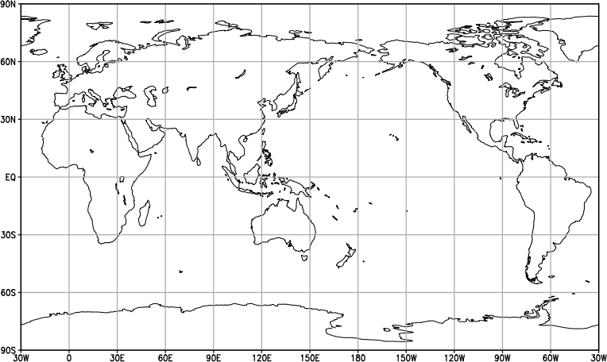
AMV Satellite Status update for NWP use of JMA
NESDIS and CIMSS MODIS polar winds (Terra and Aqua) from 28 May 2004
AVHRR polar winds from 1 Jul. 2013*
LEO-GEO winds from 1 Jul. 2013*
N60
METEOSAT-10
METEOSAT-7
MTSAT-2
GOES-15
(Hourly)
GOES-13
(Hourly)
From 18 Feb. 2013
EQ
From 5 Feb. 2007
From 10 Aug. 2010
From 6 May 2014
From 6 May 2014
S60
Same as the North Pole region
※ 28 Nov. 2013 Assimilation of Metop-B/AVHRR and ASCAT data started.
* K.Yamashta 2014: Introduction of LEO-GEO and AVHRR Polar Atmospheric Motion Vectors into JMA’s Operational Global NWP System. CAS/JSC WGNE Res. Activ. Atmos. Oceanic Model, Submitted.
In near future plan
  VIIRS polar winds from Suomi-NPP

Slide 4
NWP system FOR OSE

Slide 5
NWP system for OSE
**Not used in OSE | Global | Meso-Scale | Local
Purposes | Short- and medium-range forecasts | Very-short-range forecasts, aviation forecasts
Forecast domain | Globe | Japan and its surrounding areas | Japan and its surrounding areas
Grid size | 20 km | 5 km | 2 km
Vertical levels/Top | 60/0.1 hPa | 50/21.8 km | 60/20.2 km
Forecast range (Initial time) | 84 hours (00, 06, 18 UTC)** 264 hours (12 UTC) | 39 hours (00, 03, 06, 09, 12, 15, 18, 21 UTC) | 9 hours (hourly)
Initial condition | 4D-Var Analysis | 4D-Var Analysis | 3D-Var Analysis
Time window | 6-hour | 3-hour | 3D-Var analyses and 1-h forecasts are repeated in turn for 3 hours.
Inner-loop model res. | 55 km | 15 km | 5 km

Slide 6
Verification of RS-AMVs

Slide 7
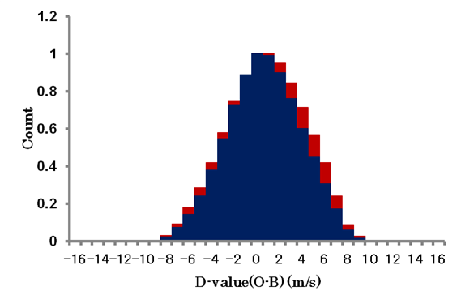
Summary for verification of RS-AMVs in 20N-45N and 120E-150E ( Japan area )
Wind speeds of RS-AMVs with the intervals of 5 or 10 minutes were compared to operational AMVs (OPE-AMVs) with 15 or 30 minutes in summer between 2011 and 2013 in GSM first-guess departure (O-B) statistics.
  Positive bias above 400 hPa in water vapor AMVs ( WV-AMVs )
  Large standard deviation in all sensor AMVs
  Small spatial observation error correlation
    Spatial error correlation distances of RS-AMVs and OPE-AMVs were estimate to about 100 km and 200 km respectively when correlation under 0.2 is ignored empirically.
(Ex.) O-B normalized histograms of WV-AMVs
From Jun. to Sep. 2012
OPE-AMV
RS-AMV

Slide 8
OSE for RS-AMVs
USING global NWP system
Back ground
JMA/MSC specially produced RS-AMVs from the satellite images with the intervals of 10 minutes for 24 hours from 2 to 18 October 2013.

Slide 9
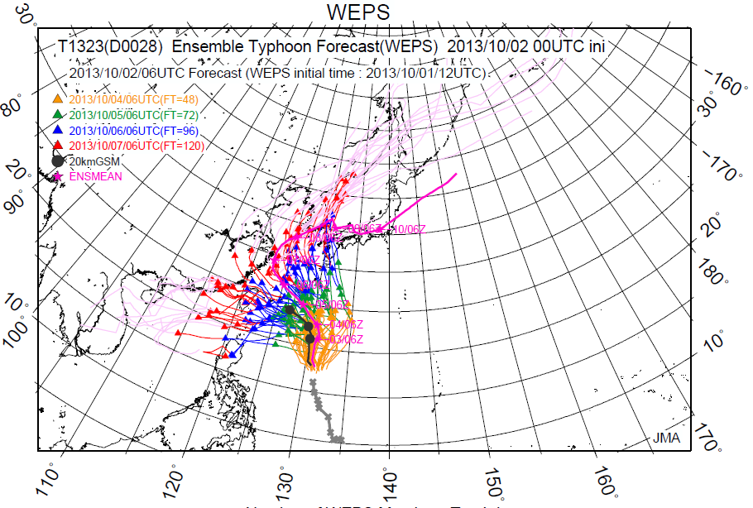
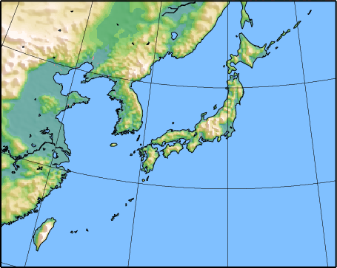
Motivation
To decrease uncertainty of typhoon forecasts such as seen for the typhoon “FITOW”
To decrease the positional forecast errors of 6 Typhoons (SEPAT, FITOW, DANAS, WIPHA, FRANCISCO and LEKIMA) which were passed around Japan
Blue area for RS_AMV
FITOW EPS at 00UTC 2 October 2013
6 Typhoons tracks in October 2013

Slide 10
Experimental Design
Name | Specification
OPE | A scheme of the 200 km thinning of OPE-AMVs in the 6 hour time window
2STP | 2-step thinning scheme A combination scheme of the 100 km thinning of RS-AMVs in 2 hour time window and the 200 km thinning of OPE-AMVs in 6 hour time window
100kmSPOB | Super-observation procedure ( combination scheme ) Average of AMVs (RS-AMVs) directions and speeds with 100 km intervals in hourly time window and the 200 km thinning of OPE-AMVs in 6 hour time window Averaging about time, level, space, wind directions and speeds
RS-AMVs(100km thin.)
OPE-AMVs(200km thin.)
RS-AMVs(SPOB)
OPE-AMVs(200km thin.)
Period:
  Assimilation : From 2 to 28 October 2013 ( including RS-AMV from 2 to 16 October )
  Forecast : From 2 to 16 October 2013

Slide 11
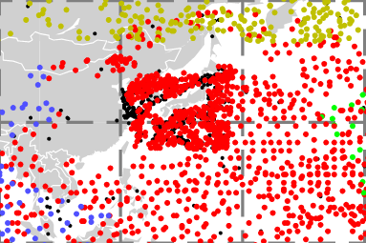
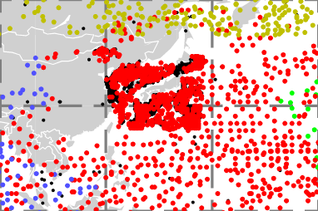
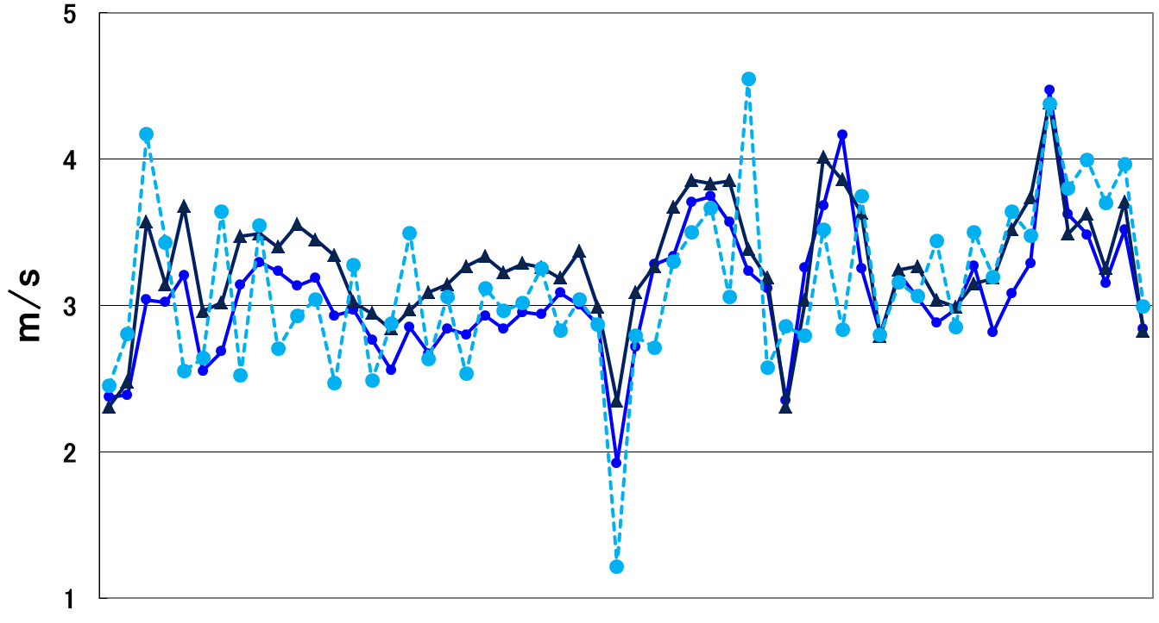
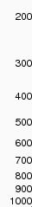
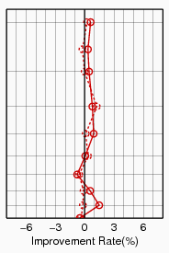
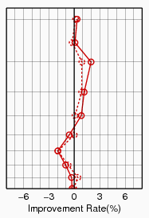
Data coverage and normalized RMSE difference
100kmSPOB
2STP
●MTSAT
●GOES-15
●MET-7
●LEOGEO
12 UTC 6 October 2013
12 UTC 6 October 2013
Worse
Better
Worse
Better
2STP
Ave. 3.27 (2932)
( Number of data)
Better
100kmSPOB
2STP
100kmSPOB
OPE
Ave. 3.07(595)
Ave. 3.13 (34)
3/10/2013
16/10/2013
Normalized RMSE difference on v-component wind of the first-guess (solid red line) and analysis (dashed red line) fields against aircraft observation over NH
Standard deviation time series of O-B wind speeds above 400 hPa in 20N-45N and 120E-150E（blue rectangle )

Slide 12
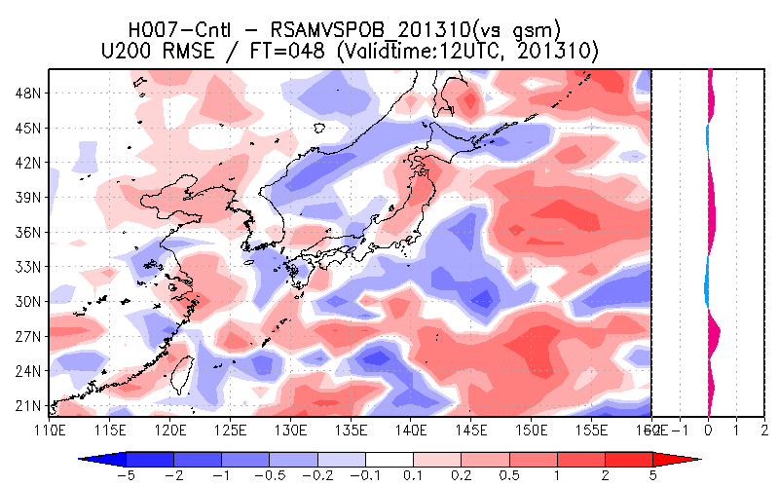
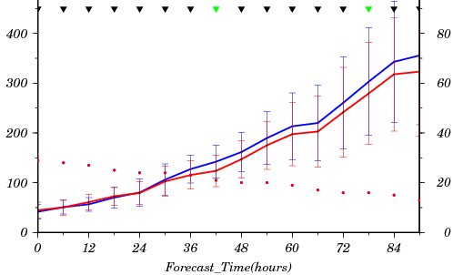
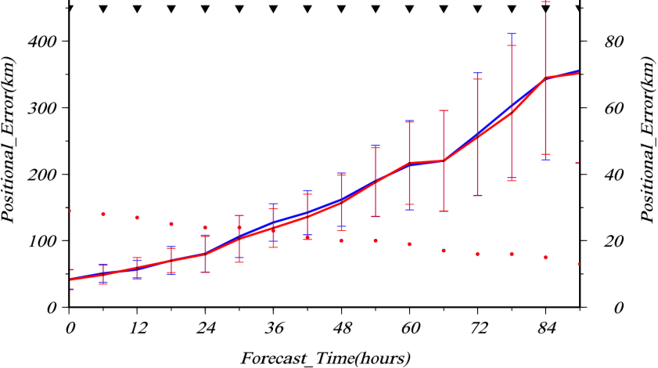
Results of OSE
Error map of 200hPa u-component wind for 100kmSPOB against OPE
Average of typhoon positional errors
Positional Error (km)
Statistically significant ：▼
(significance level : 0.05)
Mean reduction rate about 8% (FT30～）
Count
Number of sample
100kmSPOB OPE
Worse
Better
Super-observation method with RS-AMVs
Positional Error (km)
2STP OPE
Reduction of observation errors in vicinity of Japan
Neutral
Count
Improvement of mean typhoon positional errors
OPE – Without RS-AMVs

Slide 13
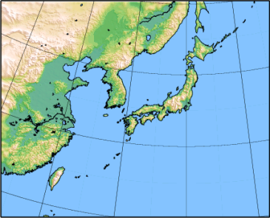
OSE for RS-AMVs
USING MESO-SCALE NWP system
(MSM)

Slide 14
Experimental Design
Name | Specification
OPE | A scheme of the 200 km thinning of OPE-AMVs in the 3 hour time window
2STP | 2-step thinning scheme A combination scheme of the 100 km thinning of RS-AMVs in 2 hour time window and the 200 km thinning of OPE-AMVs in 3 hour time window
100kmSPOB （OPE-AMVs＋RS-AMVｓ） | Super-observation procedure Average of AMVs (RS-AMVs) directions and speeds with 100 km intervals in hourly time window Averaging about time, level, space, wind directions and speeds
200kmSPOB | Same as 100kmSPOB, but average of AMVs with 200 km intervals
RS-AMVs(100km thin.)
OPE-AMVs(200km thin.)
Case study ① Typhoon MA-ON (T1106) hit Murotomisaki and heavy Rain in
Niigata and Fukushima ( Not shown )
② Baiu front with heavy rain
Period : Data assimilation (DA) and Forecast
① From 15 July 2011 to 31 July 2011 ( 17 days : Not shown )
② From 22 June 2012 to 29 July 2012 ( 38 days )

Slide 15
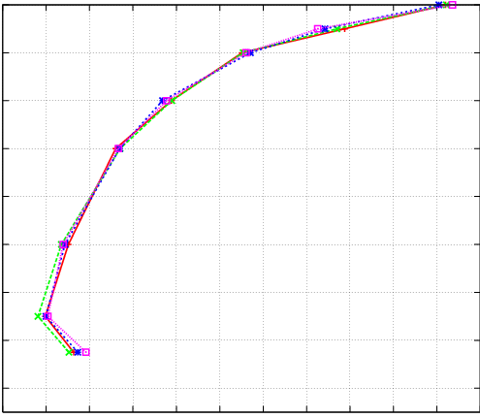
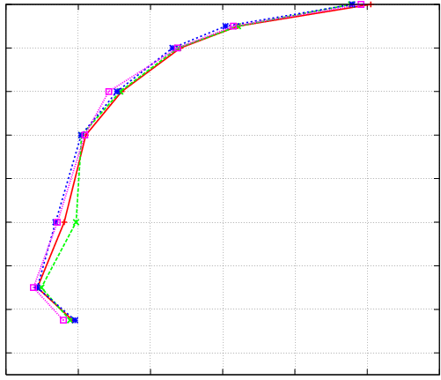
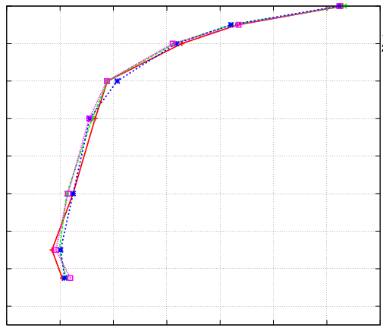
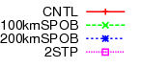
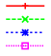
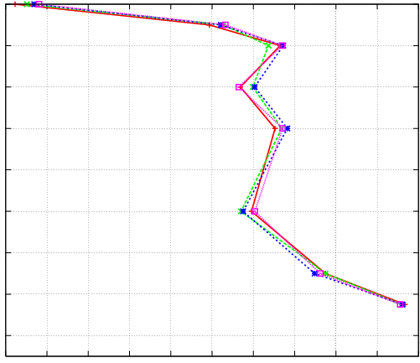
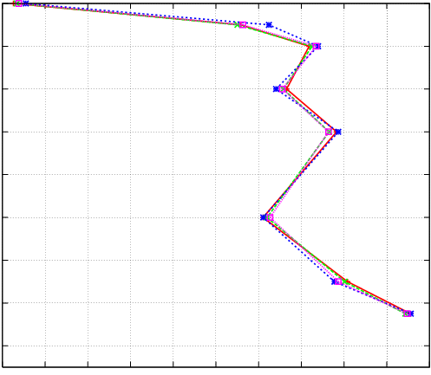
RMSE and ME of forecasts against Japan radiosonde wind speeds in 2012
（hPa)
200
200
200
300
RMSE
300
300
FT=3
FT=9
FT=15
400
400
400
500
500
500
600
600
Small wind speed forecast errors using RS-AMVs
600
OPE
700
2STP
700
700
800
100kmSPOB
800
800
900
200kmSPOB
900
900
1000
1000
1000
2.0
2.4
2.8
3.2
3.6
4.0
2.0
3.0
4.0
5.0
2.0
3.0
4.0
5.0
(m/s)
(m/s)
(m/s)
（hPa)
200
200
200
300
ME
300
300
400
400
400
500
500
500
600
600
600
700
700
700
800
800
800
900
900
900
1000
1000
1000
- 1.0
0.0
(m/s)
- 1.0
0.0
(m/s)
- 1.0
0.0
(m/s)
FT: Forecast time

Slide 16
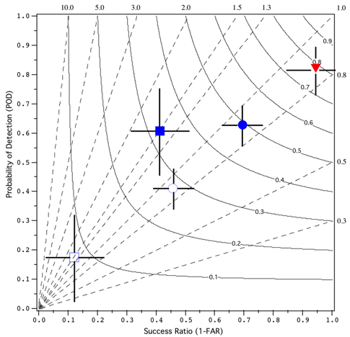
Performance diagram
 | Obs. (Yes) | Obs. (No)
Fct. (Yes) | FO | FX
Fct. (No) | XO | XX
BS
Better
To use a 2 x 2 contingency table which is constructed from dichotomous (yes–no) forecasts and observations
To exploit the geometric relationship between four measures of dichotomous forecast performance:
  Probability of detection (POD)
  False alarm ratio or its opposite, Success ratio (SR)
  Bias (BS)
  Critical success index (CSI; also known as the threat score (TS) )
Better
Hit rate (FO/FO+XO)
TS
(1-FX/(FX+FO))
For good forecasts, POD, SR, bias and CSI approach unity, such that a perfect forecast lies in the upper right of the diagram.
Roebber, P.J., 2009: Visualizing multiple measures of forecast quality. Wea. Forecasting, 24, 601-608.

Slide 17
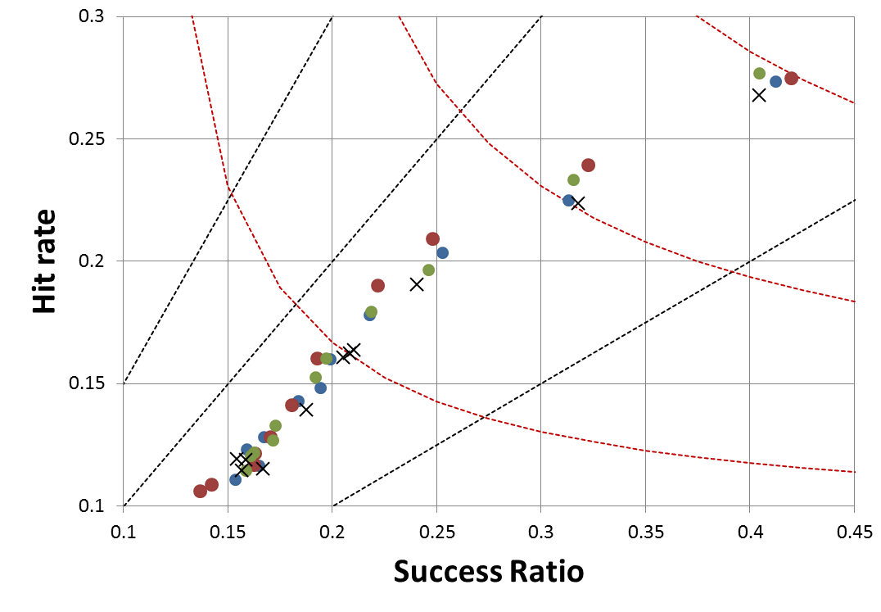
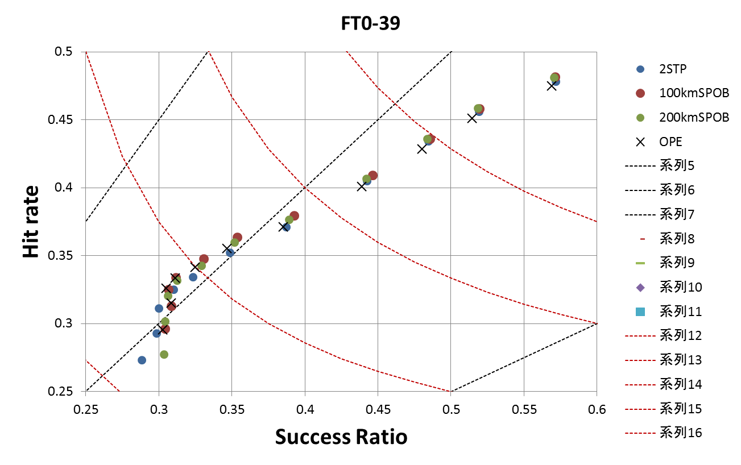
Score for Precipitation Forecasts (FT=3-39) in Japan area
( Performance diagram in 2012 : ex. 20 mm/3-hour )
Condition
  Initial forecast time : 00,03,06,09,12,15,18 and 21 UTC
  Resolution of validation in grid size : 10 km
BS = (FO+FX)/(FO+XO)
TS = FO/(XO+FO+FX)
Good Performance
20 mm/3hr
TS 0.2
BS 1.5
BS 1.0
FT3
FO/(FO+XO)
BS 0.5
FT6
FT12
FT9
TS 0.15
FT15
TS 0.1
FT: Forecast time
1-FX/(FX+FO)
（Roebber,2009）

Slide 18
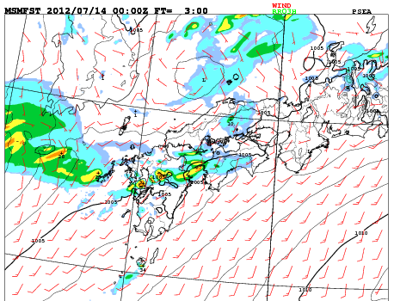
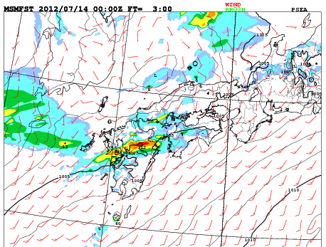
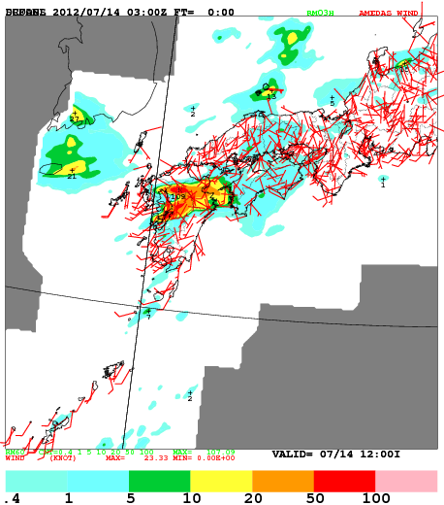
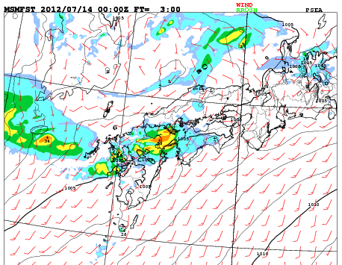
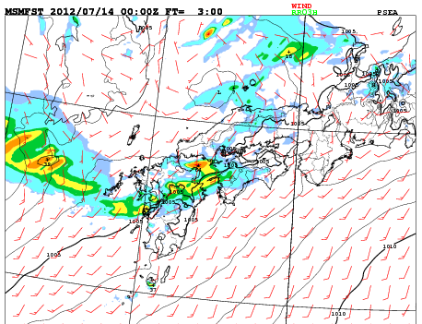
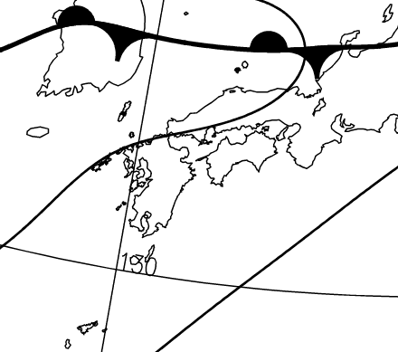
Case study of Baiu front heavy rain in July 2012
（Initial forecast time : 00 UTC 14 July, 2012）
OPE（200km thinning）
100kmSPOB
OBS（R/A）
FT=3
FT=3
Similar to the observed precipitation pattern of 100kmSPOB
NO RS-AMV
FT=3
FT=3
1004 hPa
1008 hPa
200kmSPOB
2STP
Weather Chart

Slide 19
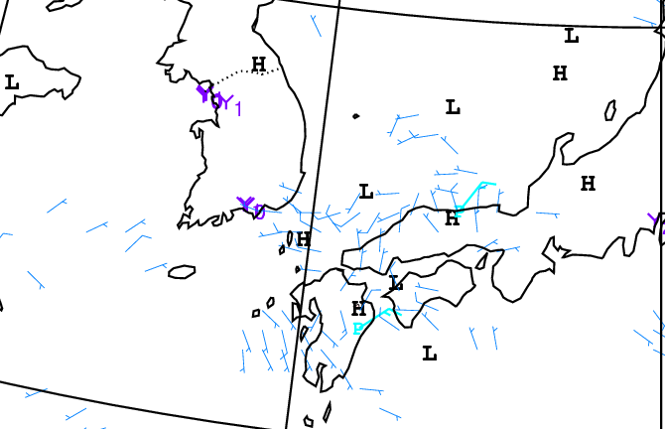
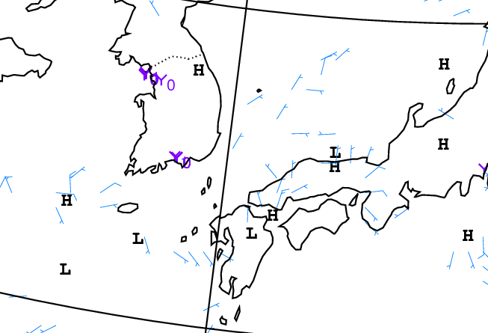
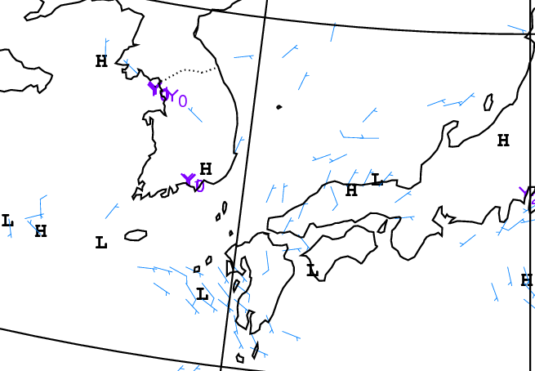
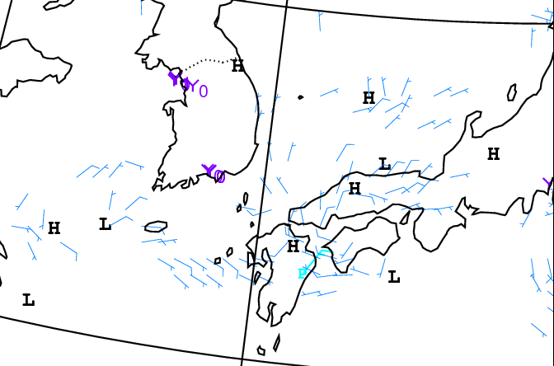
Increment of geopotential height and winds for 850 hPa at 00 UTC 14 July 2012
No impact
Strengthened convergence winds in northern Kyushu
Effect of lower AMV
Effect of upper AMV
100kmSPOB
OPE
No impact
Strengthened convergence winds in Setouchi area
200kmSPOB
2STP

Slide 20
Summary
OSEs of RS-AMV using the global, meso-scale and local operational NWP system from 2011 to 2013 were performed. The results showed:
  In the global NWP system from 2 to 16 October 2013
    Reduction of observation errors in vicinity of Japan using super-observation ( SPOB ) method with RS-AMVs
    Improvement of mean typhoon positional errors
  In the meso-scale NWP system in 2011 and 2012
    Small wind speed forecast errors ( RMSE ) in almost all level in first half forecast using SPOB against sonde observations
    Good precipitation 100kmSPOB forecasts in first half forecast ( until 12-hours )
  In the local NWP system from 00 UTC 3 to 23 UTC 12 July 2012
    No impact for RS-AMVs
    3D-Var system not including the flow-dependent background error covariances
    Good precipitation forecasts using all AMVs without thinning, but bad wind speed forecast errors ( RMSE ) in this case study

Slide 21
Future plan
We plan to perform more OSEs for MTSAT RS-AMVs to confirm performance of procedures and to prepare for usage of the next Himawari satellites. As the 2-step thinning scheme of RS-AMVs does not bring the improvement of the analysis and forecast through the results of OSEs, we will remove the scheme.
  Consideration of super-observation procedure in the appropriate area and grid size
    in vicinity of Japan etc. and 100 km or 200 km etc.

Slide 22

Thank you for your attention

Slide 23
Back up

Slide 24
OSE for RS-AMVs
USING MESO-SCALE NWP system
(MSM)

Slide 25
Experimental Design
Name | Specification
OPE | A scheme of the 200 km thinning of OPE-AMVs in the 3 hour time window
2STP | 2-step thinning scheme A combination scheme of the 100 km thinning of RS-AMVs in 2 hour time window and the 200 km thinning of OPE-AMVs in 3 hour time window
100kmSPOB （OPE-AMVs＋RS-AMVｓ） | Super-observation procedure Average of AMVs (RS-AMVs) directions and speeds with 100 km intervals in hourly time window Averaging about time, level, space, wind directions and speeds
200kmSPOB | Same as 100kmSPOB, but average of AMVs with 200 km intervals
RS-AMVs(100km thin.)
OPE-AMVs(200km thin.)
Case study ① Typhoon MA-ON (T1106) hit Murotomisaki and heavy Rain in
Niigata and Fukushima ( Not shown )
② Baiu front with heavy rain
Period : Data assimilation (DA) and Forecast
① From 00UTC 15 July 2011 to 21UTC 31 July 2011 ( Not shown )
② From 00UTC 22 June 2012 to 21UTC 29 July 2012

Slide 26
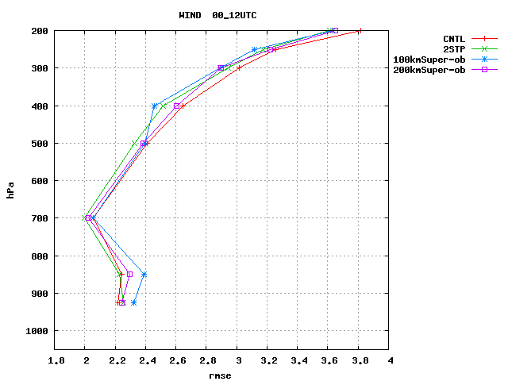
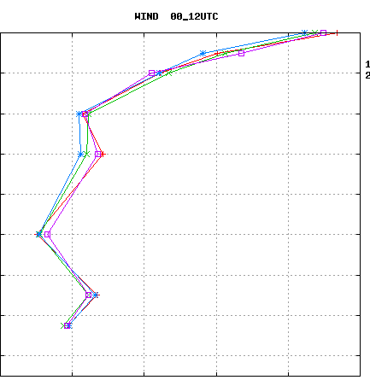
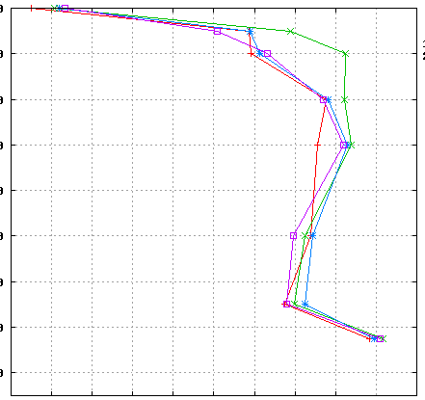
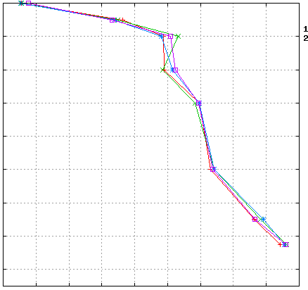
RMSE and ME of forecasts against Japan radiosonde wind speeds in 2011
FT=03( 3 hours forecasts )
FT=09
（hPa)
（hPa)
200
200
OPE
2STP
100kmSPOB
200kmSPOB
300
300
400
400
500
500
600
600
700
700
800
RMSE
800
900
900
RMSE
1000
1000
2.0
2.4
2.8
3.2
3.6
4.0
2.0
2.5
3.0
3.5
4.0
4.5
(m/s)
200
(m/s)
200
300
300
400
400
（hPa)
500
500
600
600
700
700
800
ME
800
ME
900
900
1000
1000
-0.5
0.0
(m/s)
-1.0
0.0
(m/s)

Slide 27
Score for Precipitation Forecasts (FT=3-33) in Japan
～Performance diagram in 2011 ～
Condition
  Initial forecast time : 03,09,15 and 21 UTC
  Resolution of validation in grid size : 10 km
BS = (FO+FX)/(FO+XO)
TS = FO/(XO+FO+FX)
Good Performance
1 mm/3hr
BS 1.5
2 mm/3hr
BS 1.0
3 mm/3hr
FO/(FO+XO)
5 mm/3hr
15 mm/3hr
TS 0.3
10 mm/3hr
 | Obs. ○ | Obs. ×
Fct. ○ | FO | FX
Fct. × | XO | XX
20 mm/3hr
TS 0.25
BS 0.5
TS 0.2
1-FX/(FX+FO)
（Roebber,2009）

Slide 28
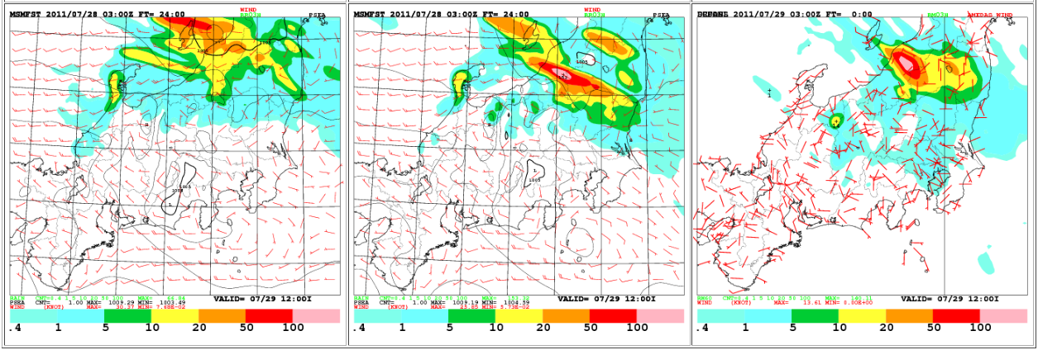

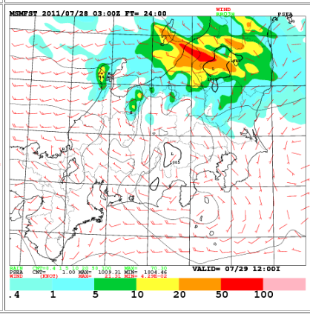
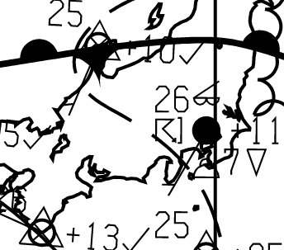
Case study of Niigata and Fukushima heavy rain in July 2011
（Initial forecast time : 03 UTC 28 July, 2011）
OPE（200km thinning）
100kmSPOB
OBS（R/A）
FT=24
Similar to the precipitation pattern of RS-AMV use
NO RS-AMV
FT=24
Weather Chart
200kmSPOB
2STP

Slide 29
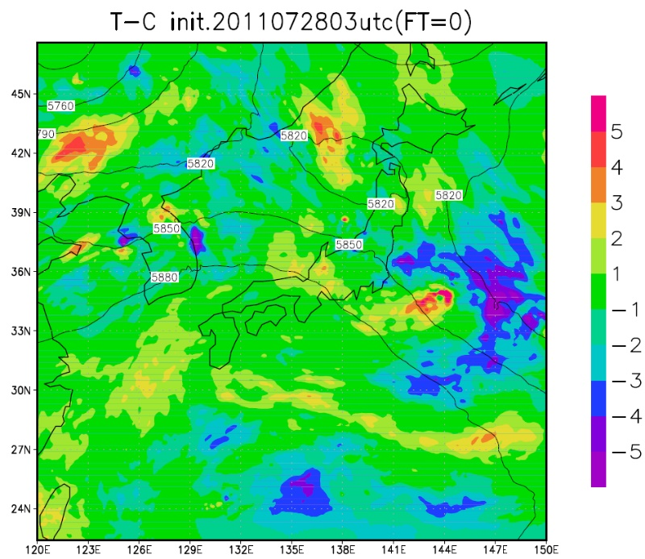
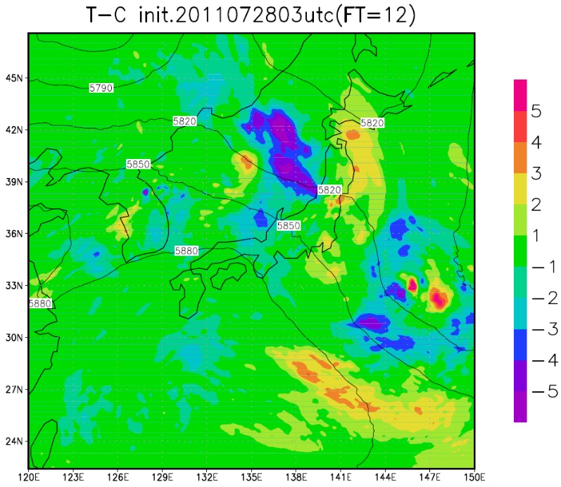
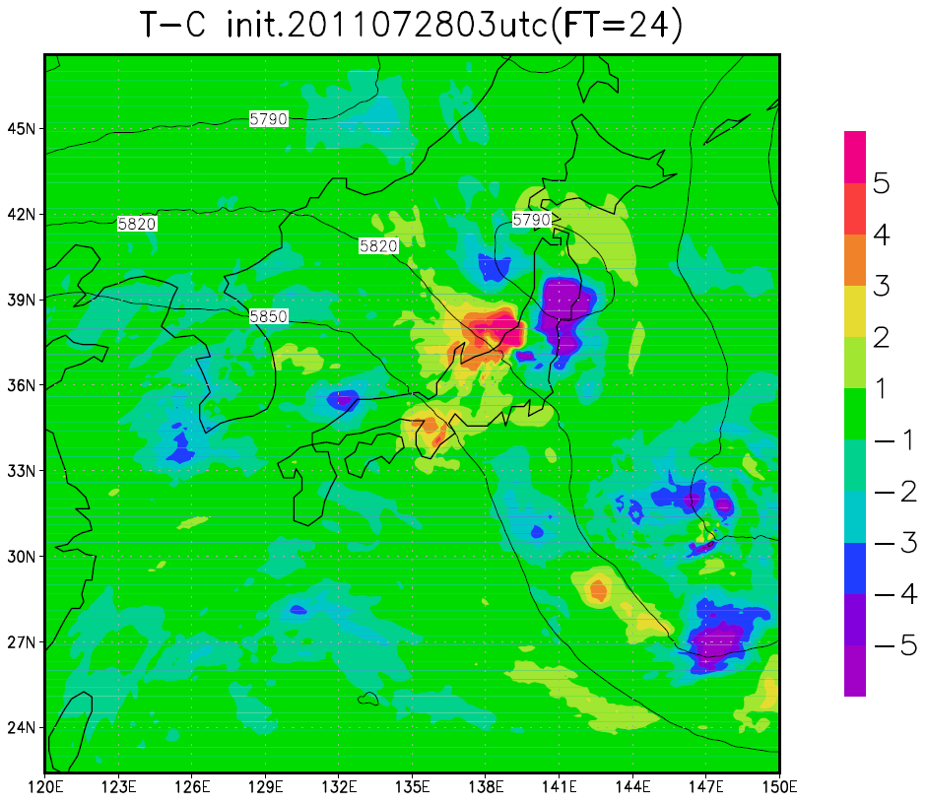
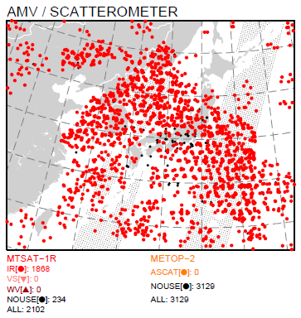
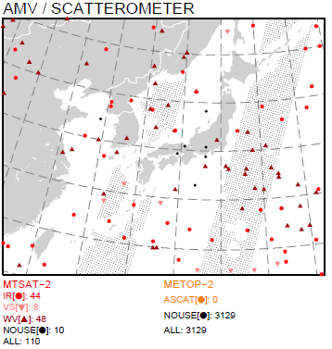
Difference between TEST(100kmSuper-ob) and CNTL(OPE) of T+0,12,24 forecasts for 500 hPa Geopotential Height (m)
（Initial forecast time : 03 UTC 28 July, 2011）
TEST（100kmSuper-ob）
CNTL（OPE）
Coverage for AMV

Slide 30
Case study of Baiu front heavy rain in July 2012
（Initial forecast time : 00 UTC 14 July, 2012）
OPE（200km thinning）
100kmSPOB
OBS（R/A）
FT=3
FT=3
Similar to the precipitation pattern of 100kmSPOB
NO RS-AMV
FT=3
FT=3
1004 hPa
1008 hPa
200kmSPOB
2STP
Weather Chart

Slide 31
OSE for RS-AMVs
USING LOCAL NWP system

Slide 32
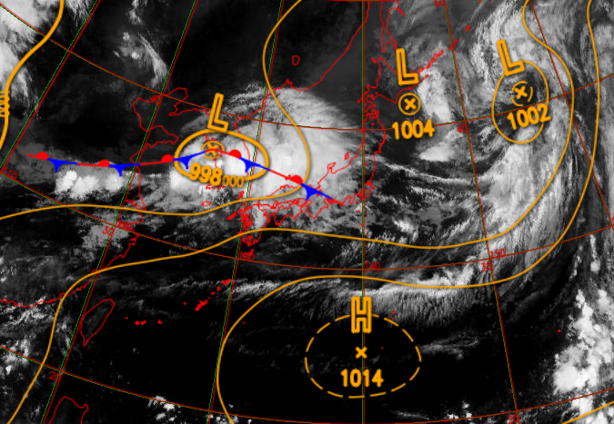
Experimental Design
Name | Specification
OPE | Not used all AMVs
AMV_NO_THIN | Used AMVs ( QI>=60: Not used RS-AMVs )
AMV_200kmTHIN | A scheme of the 200 km thinning of RTN-AMVs in the 3 hour time window ( QI >= about 84: Not used RS-AMVs )
100kmSPOB（AMV＋RS-AMV） | Super-observation procedure (QI >= about 86） Average of AMVs (RS-AMVs) directions and speeds with 100 km intervals in hourly time window Averaging about time, level, space, wind directions and speeds
Period: Assimilation and Forecast : From 00 UTC 3 to 23 UTC 12 July 2012
Case study of Baiu front with heavy rain
00UTC 6/7/2012

Slide 33
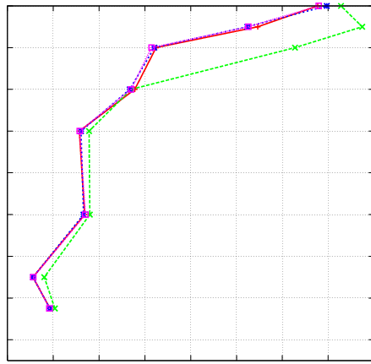
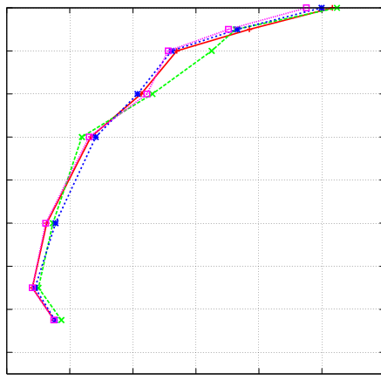
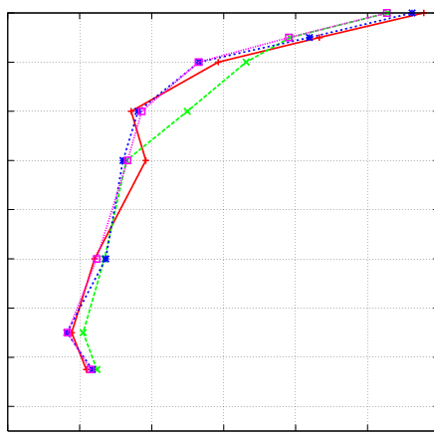



RMSE and ME of forecasts against Japan radiosonde wind speeds
（hPa）
FT0
（hPa）
FT3
（hPa）
FT6
200
RMSE
200
200
300
300
300
400
400
400
500
500
500
600
600
600
Larger wind speed forecast errors
700
700
OPE（NO AMV）
700
800
800
AMV_NO_THIN
800
AMV_200kmTHIN
900
900
100kmSPOB
（AMV+RS-AMV）
900
1000
1000
1000
1.4
2.0
2.6
（m/s）
2.0
3.0
4.0
（m/s）
2.0
3.0
4.0
（m/s）
（hPa）
（hPa）
（hPa）
200
200
200
300
ME
300
300
400
400
400
500
500
500
600
600
600
700
700
700
800
800
800
900
900
900
1000
1000
1000
- 1.0
0.0
- 1.0
0.0
- 1.0
0.0
（m/s）
（m/s）
（m/s）

Slide 34


Score for Precipitation Forecast in Japan area
Performance diagram （TS/BS：5mm/h）
 | Obs. ○ | Obs. ×
Fct. ○ | FO | FX
Fct. × | XO | XX
BS = (FO+FX)/(FO+XO)
TS = FO/(XO+FO+FX)
Good Performance
Better forecasts from FT=1 to 3
BS 1.5
FT=2
FT=3
TS 0.225
BS 1.0
TS 0.2
FO/(FO+XO)
FT=4
TS 0.125
TS 0.175
FT=5
FT=1
FT=6
FT=7
BS 0.5
FT=8
TS 0.15
FT=9
FT: Forecast time
1-FX/(FX+FO)
（Roebber,2009）

Slide 35
Difference of forecast accuracy by MTSAT AMVs generated from 5,10,15 or 30 minutes interval rapid scan images using the global ( GSM ) and Meso-scale NWP system ( MSM )

Slide 36
Purpose
To find an optimum AMV in high resolution NWP system
  What should be the method for evaluation ?
    Analysis fields
      First-guess departure (O-B) statistics for AMVs
    Forecast fields
      RMSE and ME of forecasts against sonde observations and the others
      Precipitation forecast
      Tropical Cyclone positional errors etc.
  We tried to investigation about red color characters previously-shown.

Slide 37
Verification and Experimental design
      Verification of AMVs from rapid scan images in first-guess departure (O-B) statistics for AMVs
  Target : AMVs generated from 5,10,15 or 30 minutes
  interval rapid scan images
  Region : 20N-45N and 120E-150E ( Japan area )
  Using the global NWP system ( GSM )
Experimental design of OSE
  Target : AMVs generated from 5,10 or 30 minutes
  interval rapid scan images
  Period : From 22 June 2012 to 29 July 2012 ( 38 days )
  AMV usage : 100 and 200 km Super-observation procedure
  ( hereafter as 100kmSPOB and 200kmSPOB respectively )

Slide 38
Verification of AMVs in 20N-45N and 120E-150E ( Japan area )
Wind speeds of AMVs with the intervals of 10, 15 or 30 minutes ( hereafter as 10minAMV, 15minAMV or 30minAMV respectively ) from rapid scan observations were compared to AMVs with 5 minutes ( 5minAMV ) in GSM ( Grid size : 20 km ) first-guess departure (O-B) statistics.
IR: infrared sensor
VS: visible sensor
WV: water vapor
HL: 0-400 hPa
ML: 400-700 hPa
LL: 700-1000 hPa
Standard Deviation (STD)
< 30minAMV < 15minAMV < 10minAMV< 5minAMV

Slide 39


RMSE of forecasts against Japan radiosonde wind speeds ( ex. FT=9 )
200
RMSE
200
300
FT9
300
FT9
400
400
500
500
600
600
（hPa）
（hPa）
700
700
800
800
900
900
1000
1000
2.0
3.0
4.0
（m/s）
2.0
3.0
4.0
（m/s）
5kmMSM+100kmSPOB
5kmMSM+200kmSPOB
Smallest wind speed forecast errors ( RMSE ) above 850 hPa in 5minAMV
until 9-hours
No impact wind speed forecasts errors

Slide 40



Score for Precipitation Forecast in Japan
Performance diagram in 2012（ex. TS/BS：20mm/h）
Good
Good
TS 0.3
TS 0.3
BS 1.5
BS 1.0
BS 1.5
TS 0.2
BS 1.0
FT3
TS 0.1
FT3
FT6
TS 0.2
FT9
FT6
FT12
FT12
FT9
BS 0.5
TS 0.1
BS 0.5
5kmMSM+100kmSPOB
5kmMSM+200kmSPOB
    Best precipitation forecasts in first half forecast ( until 12-hours ) using 5minAMV
    Best precipitation forecasts in first half forecast ( until 12-hours ) using 30minAMV

Slide 41
Summary (2/2)
Difference of forecast accuracy by MTSAT AMVs generated from 5,10,30 minutes interval images using the global and Meso-scale NWP system from 00UTC 22 June 2012 to 21UTC 29 July 2012 The results showed:
  20kmGSM O-B statistics
    Small STD in the order of AMVs from longest time to shortest time interval images
  100kmSPOB method
    Best precipitation forecasts in first half forecast ( until 12-hours ) using AMV with the interval images of 5 minutes ( 5minAMV )
  200kmSPOB method
    Best precipitation forecasts in first half forecast ( until 12-hours ) using 30minAMV
  Maybe holding forecast accuracy relationship between usage of AMVs ( grid size etc. ) and the interval of satellite images of AMVs by results of precipitation forecasts
Standard Deviation (STD)
< 30minAMV < 15minAMV < 10minAMV< 5minAMV

Slide 42
Future plan
We plan to perform more OSEs for MTSAT RS-AMVs to confirm performance of procedures and to prepare for usage of the next Himawari satellites. As the 2-step thinning scheme of RS-AMVs does not bring the improvement of the analysis and forecast through the results of OSEs, we will remove the scheme.
  Consideration of super-observation procedure in the appropriate area and grid size
    in vicinity of Japan etc. and 100 km or 200 km etc.
I’m investigating difference of forecast accuracy by MTSAT AMVs generated from 5,10,30 minutes interval images using the global and Meso-scale NWP system.
To find an optimum AMV in high resolution NWP system, we plan to perform more OSEs to clarify the forecast accuracy relationship between usage of AMVs and the interval of satellite images of AMVs.

