Slide 1
IWW input to the CGMS Baseline
IWW-12, Copenhagen, June 16-20 2014
Dr. Lars Peter Riishojgaard,
WIGOS Project Manager, WMO Secretariat

Slide 2
WIGOS and the CGMS Baseline
WMO Integrated Global Observing System (WIGOS): a framework for integrating all WMO observing systems under one umbrella (GOS + WMO Hydrological Observing Systems, observing components of GAW and GCW)
Regulatory Material is under development, with the aim of submitting it to WMO Congress in May 2015
Manual on WIGOS includes a description of the space-based component; this is provided by the CGMS Baseline (included as an attachment to the manual)

Slide 3
The CGMS Baseline
The CGMS Baseline for the Operational Contribution to the GOS is a document adopted by CGMS-39 in 2011
The opening paragraphs reads:
‘In support of the programmes coordinated or co-sponsored by WMO for weather and climate, CGMS Members plan to maintain the operational capabilities and services described below, that constitute the “CGMS baseline for the operational contribution to the GOS”.’
WMO

Slide 4
The CGMS Baseline (II)
The Baseline describes the GEO sub-system (the “Constellation in Geostationary Orbit”) as follows:
“At least six geostationary satellites shall be operated at evenly distributed locations with in orbit redundancy, and perform the following missions:
Advanced visible and infrared imagery (at least 16 spectral channels, 2km resolution) over the full disc at least every 15 minutes
Infrared sounding (hyperspectral on some positions)
Lightning detection
Data collection
Space environment monitoring”
WMO

Slide 5
The CGMS Baseline (III)
… and it continues to say:
“On selected positions, the following missions shall be performed:
Earth Radiation Budget monitoring
High spectral resolution UV sounding
Solar activity monitoring
What about satellite winds?
WMO

Slide 6
Impact of AMVs
The Final Report of the Fifth WMO Workshop on the Impact of Various Observing Systems on Numerical Weather Prediction (Sedona, Arizona, USA, 22-25 May 2012) contains the following summary sentence:
“There is broad consensus amongst the global NWP centres that the same observation types tend to be the highest-ranked contributors to forecast skill: AMSU-A (microwave temperature sounder), AIRS/IASI (hyper-spectral infrared temperature and humidity sounders), radiosondes, aircraft observations and atmospheric motion vectors (AMVs) from geostationary and polar orbiting satellites, although not necessarily uniformly in this order.”
WMO

Slide 7
Potential issue
The CGMS Baseline talks about “operational capabilities and services”, and although AMVs are now recognized by WMO as a very important data-type, winds is not listed as a mission for the geostationary constellation
Could (should?) be considered a driver for the design and operation of the constellation, in terms of e.g.
Orbital spacing
Scan mode (full-disc versus rapid)
Data processing (temporal and spatial density,…)
Data dissemination
…
WMO

Slide 8
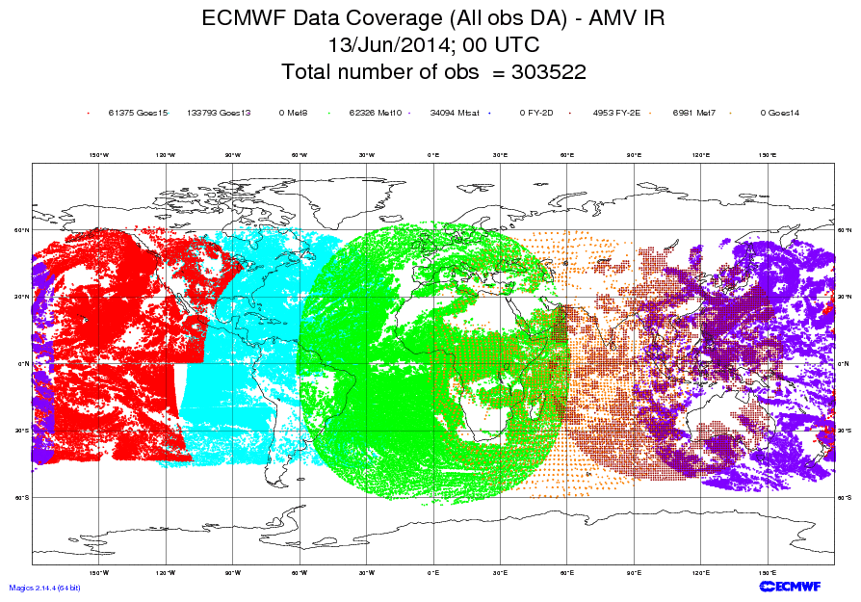

Slide 9
Suggestion for IWW-12
Keep the wording of the CGMS Baseline in mind as you discuss product generation and data usage for AMVs during the Workshop
Consider whether making explicit a wind mission for the geostationary constellation could help strengthen this element of the GOS in terms of data quality, data availability and homogeneity across the operators
If necessary, provide any recommendations the IWG Co-Chairs and the CGMS Rapporteur, so that the CGMS Baseline can be amended and updated where needed.
WMO

