Slide 1
IMPROVING THE USE OF RADIOSONDE AND SATELLITE-DERIVED WINDS AT THE METEOROLOGICAL SERVICE OF CANADA
Stéphane Laroche
Judy St-James
Iriola Mati
Réal Sarrazin
IWW-12, Copenhagen
17 June 2014

Slide 2
Outline
Why does the 4D position of radiosonde data now matter for NWP
Estimation of the horizontal position and time of radiosonde data
Impact of 4D radiosonde position on:
NWP
Collocation of AMV and radiosonde data
Impact of AMV data at MSC
Future plans

Slide 3
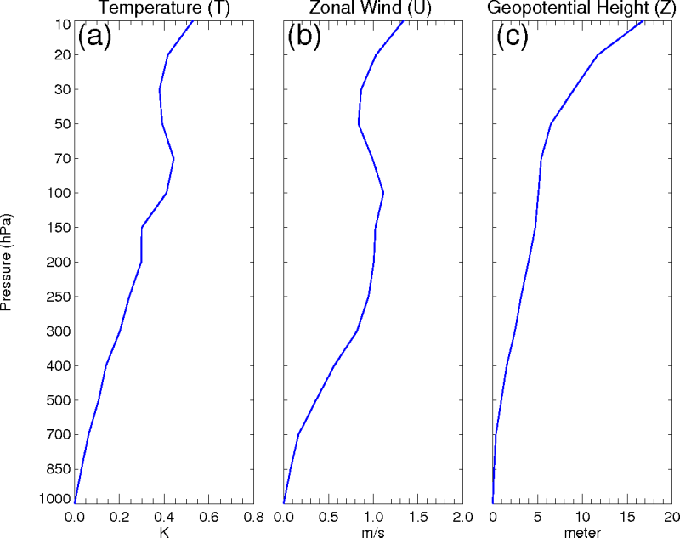
Why does the 4D Position of Radiosonde Data now Matter for NWP
Radiosondes can drift as far as 200 km away from the upper-air station location before bursting in the stratosphere, typically 1.5 to 2 h after its launch.
The atmospheric state along the radiosonde trajectory can be significantly different from the vertical profile above the upper-air station at a given time due to the spatial and temporal variability of meteorological fields, as shown in the figure. This is especially true over the Northern Hemisphere extratropics in winter where the horizontal drift in the atmospheric circulation can be significant.
With the increasing accuracy and horizontal resolution of NWP models, which is of the order of 20 km in global forecast systems and as high as 1 km in limited area mesoscale systems, accurate position and time of observations are now important to take into account.
Standard deviation of differences between atmospheric variables along the balloon trajectory and over the upper-air station obtained from simulated observations at 5 degree lat/lon intervals in the Northern Hemisphere extratropics over oceans for January 2009.

Slide 4
Radiosonde Data Reception and Pre-Processing
Radiosonde observations are available on the GTS in alphanumeric codes (TEMP or PILOT), and more recently in BUFR. Information about the position and time of observations (i.e 4D trajectory) can now be reported in BUFR code, which is not possible in TEMP/PILOT codes.
Unfortunately, many radiosonde reports in BURF are currently transmitted without the horizontal position and time of observations.
When the full 4D trajectory is not transmitted, this information can be estimated from the wind profile and the elapsed ascent time (or ascent speed).
This pre-processing allow us to feed our data assimilation systems with the 4D trajectory of all radiosonde profiles.
GTS
30%
50%
20%
PILOT/TEMP
No 4D Trajectory
BUFR
No 4D Trajectory
BUFR
4D Trajectory
Retrieval of
4D Trajectory
Data Assimilation
Systems
Radiosonde Data Pre-Processing

Slide 5
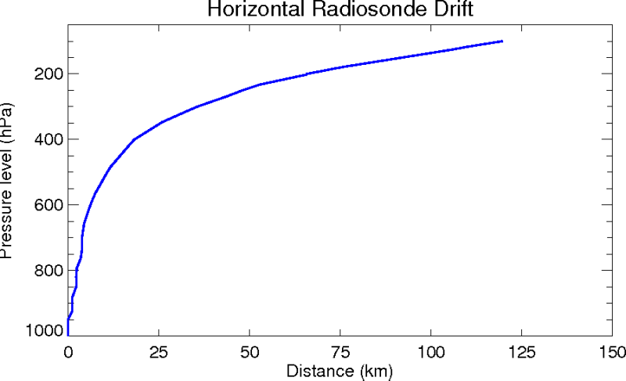
Estimation of the Horizontal Position and Time of Radiosonde Data
$$∆p$$
$$∆x≅\overline{u}∆t$$
$∆t≅\frac{1}{\overline{w}}$ $∆z$ $≅\frac{R\overline{T}}{g\overline{w}} ∆ln⁡(p)$
or
$$∆t≅representative elapsed$$
ascent $time difference$

Slide 6
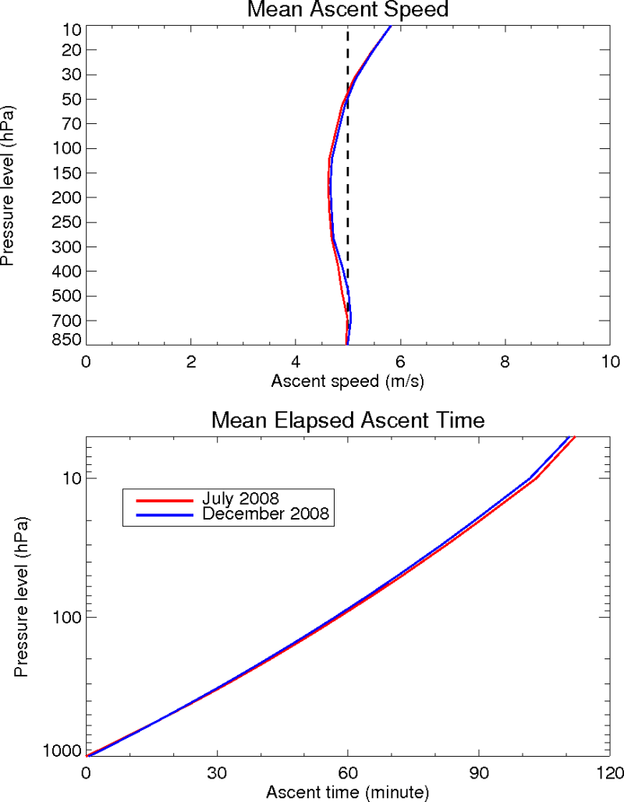
Mean Ascent Time and Speed Estimates
To estimate the mean ascent elapsed time and speed of radiosondes , we used the SPARC dataset in which radiosonde profiles with high resolution 4D positions are available.
We selected data from a subset of 20 stations over North America in July and December 2008.
We can see that the mean ascent time and speed for the summer and winter seasons are similar. The mean ascent rate is fairly constant with height and varies around 5 m/s, which is the ascent rate used at NCEP for estimating the horizontal drift position of radiosonde data. These results suggest that the mean of all ascent profiles can be used to estimate the horizontal displacement for all seasons.

Slide 7
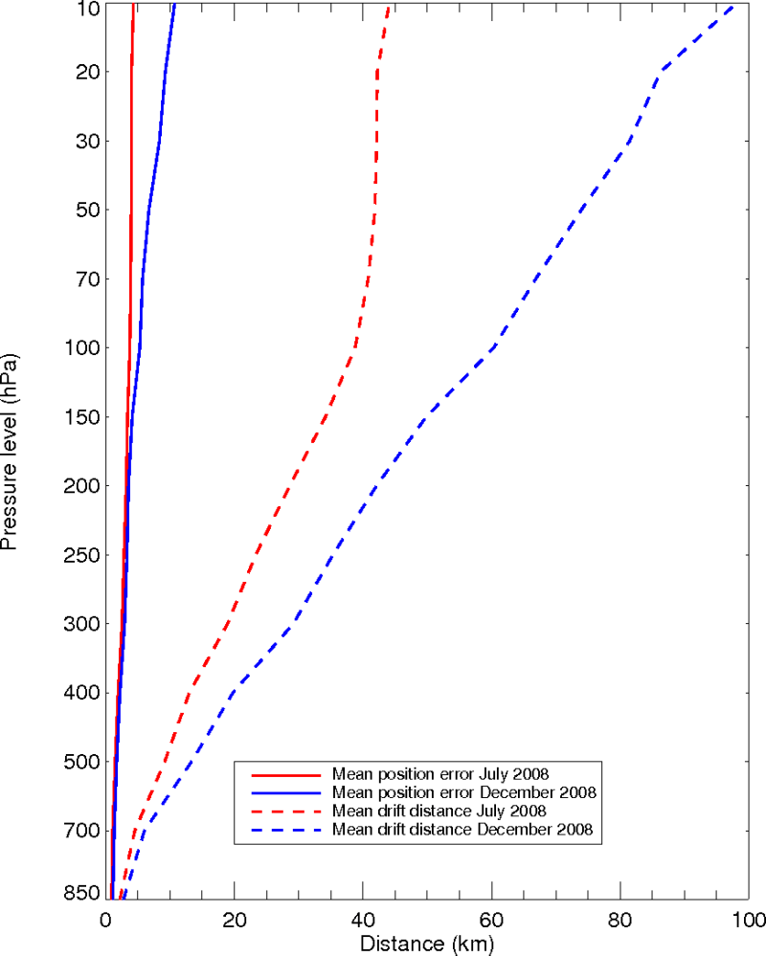
Mean Drift Distance and Position Error
The position errors are calculated by comparing the retrieved positions with the actual positions from the SPARC dataset, which are obtained from the GNSS.
The mean horizontal drift distance steadily increases with height and reaches 45 km at 10 hPa for July 2008 and close to 100 km for December 2008.
Overall, the mean retrieved position is about 10% of the mean balloon drift distance.

Slide 8
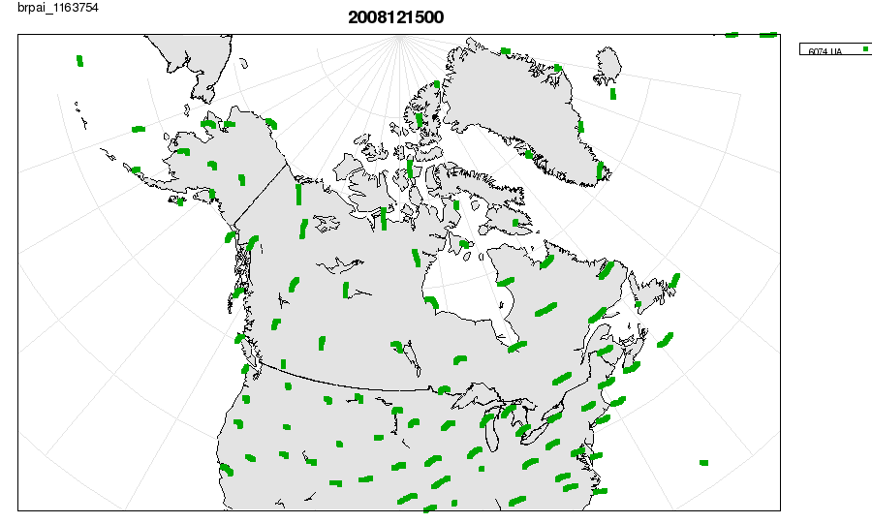
Retrieved Horizontal Position of Radiosonde Profiles over North America
1200 UTC 15 December 2008

Slide 9
Experiments with the Global Deterministic Prediction System (GDPS)
Model : Operational GDPS (25 km horizontal resolution)
Data assimilation system
4D-EnVar (analysis increments at 50 km resolution)
Hybrid background error statistics (50% NMC, 50% EnKF)
Observations
All operational data from conventional and satellite platforms
Period : 1 February – 31 March 2011
Control : Time and horizontal position at the launch location are assigned to all radiosonde data
Trial : Retrieved 4D trajectory for all radiosonde data

Slide 10
Residual and Innovation Statistics (February and March 2011)
Verification scores against radiosonde data for wind components for the control (blue) and the trial (red) over the Northern Hemisphere extratropics.
The bias (dashed) and standard deviation (solid) are shown.
As expected the impact of the horizontal drift become significant above 300 hPa.
U component
V component
Observation - Analysis
Observation - Background
Control : Time and Horizontal Position at the Launching site
assigned to all Radiosonde Data
Trial : Retrieved 4D trajectory for all Radiosonde Data

Slide 11
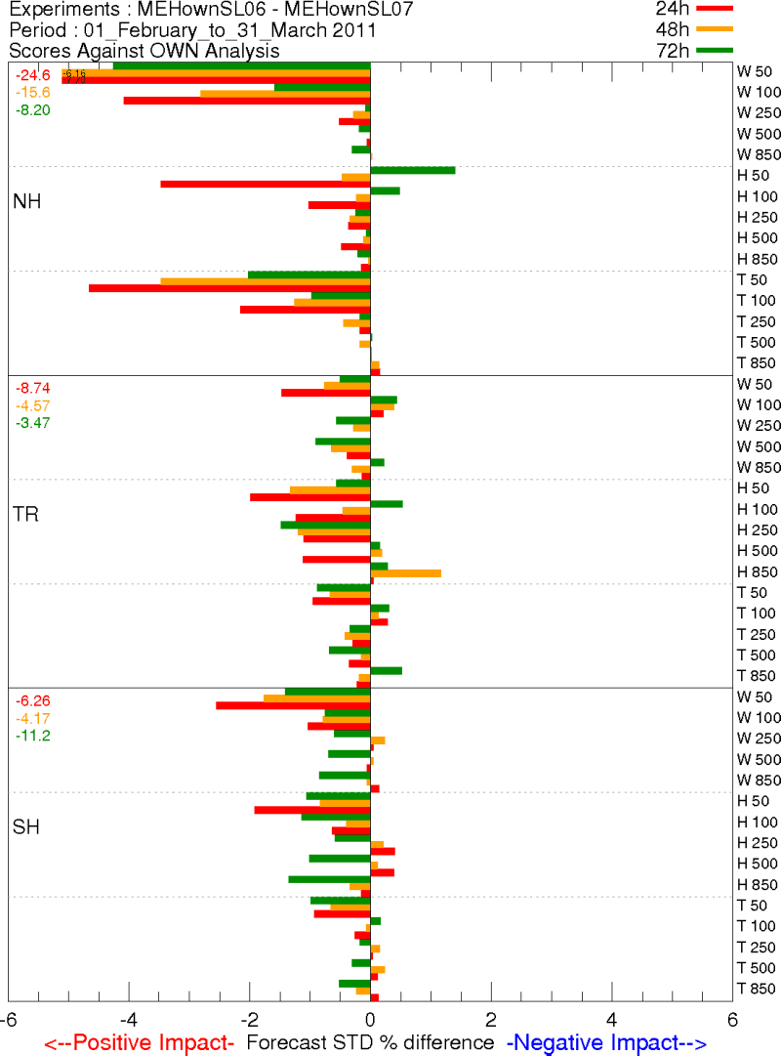
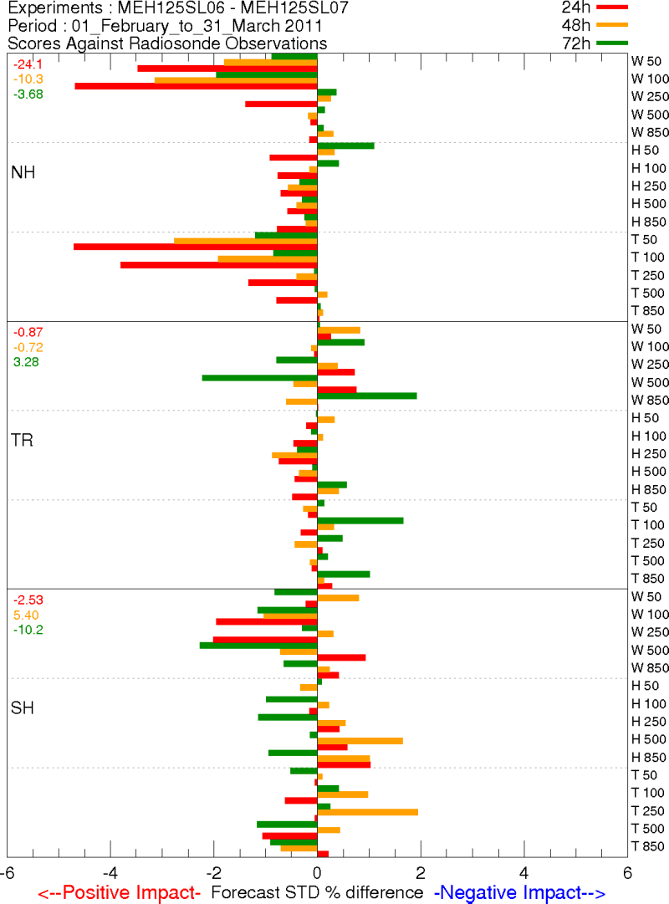
Impact of Radiosonde Horizontal Position and Time on Day-1 to Day-3 Forecasts over the Northern Hemisphere
Against Own Analysis
Against Radiosonde data
W
W
H
H
T
T
W
W
H
H
T
T
W
W
H
H
T
T

Slide 12
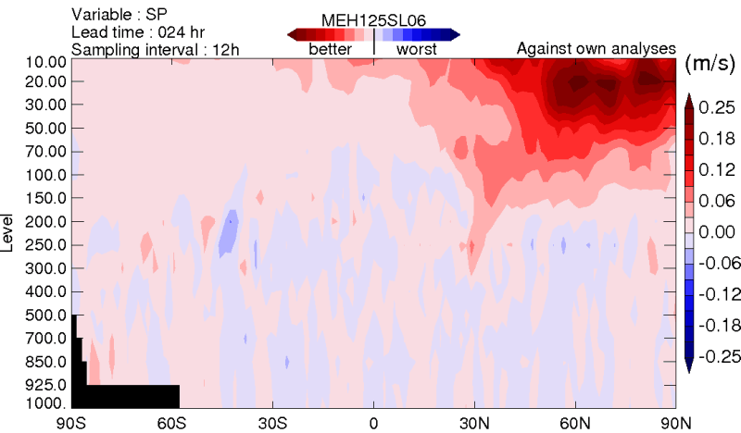
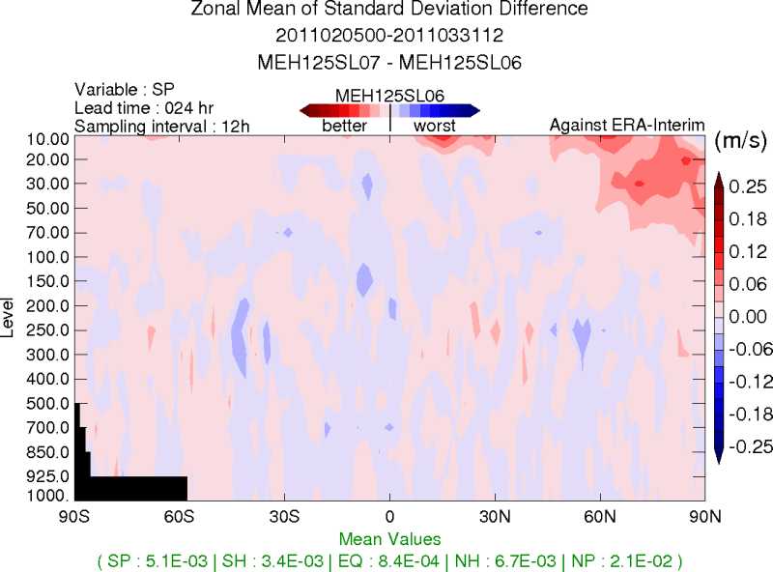
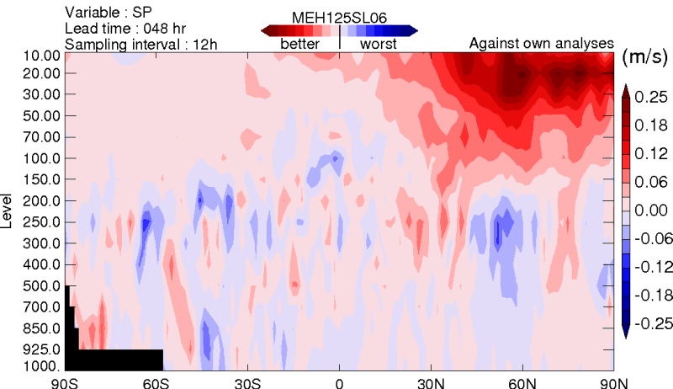
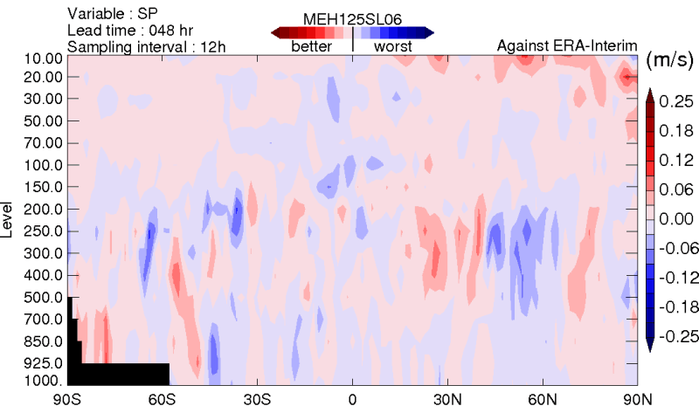
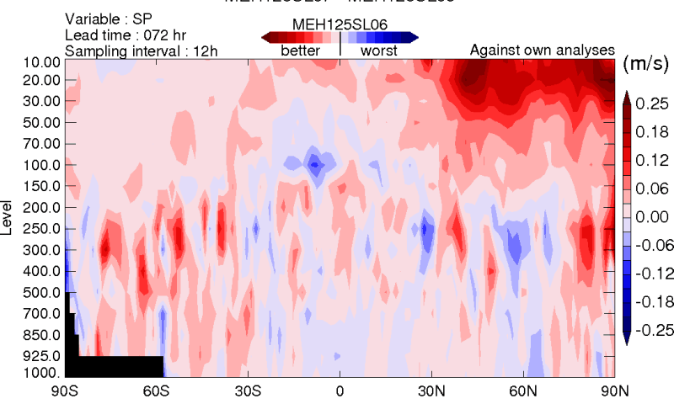
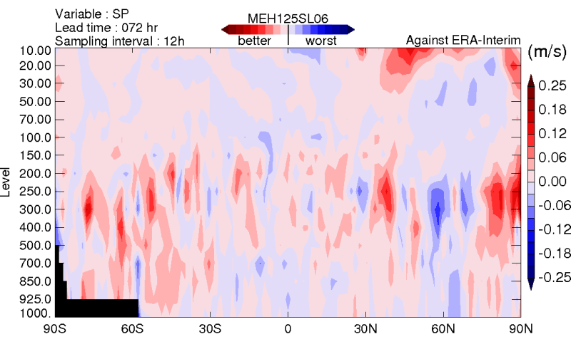
Impact of Radiosonde Horizontal Position and Time Day-1 to Day-3 Zonal Mean STD Error Difference for Wind Speed (Control – Trial)
Against Own Analysis
Against ERA-Interim Analyses
Day-1
Positive impact
Day-2
Negative impact
Day-3

Slide 13
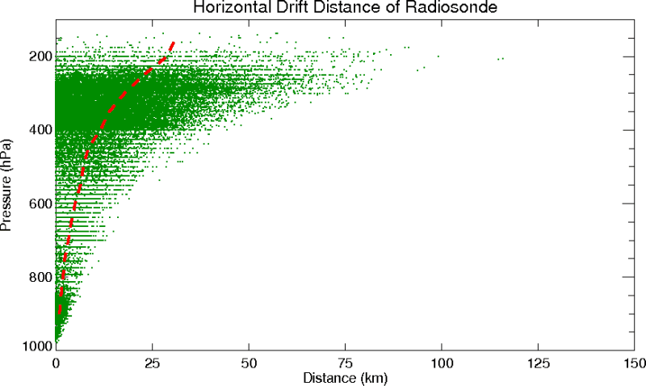
Impact of the Horizontal Position of Radiosonde on the Comparison between Radiosonde and AMV Data
To assess the impact of the horizontal drift on collocation statistics, we use collocated radiosonde and AMV data (both IR and WV that passed the quality check) from all geostationary satellites available in February and March 2011.
Radiosonde data are vertically interpolated at the reported AMV levels.
Only data that match within 150 km and 1 hour from both the launch and radiosonde positions and times are retained.
Only data north of 30N and within the 400-100 hPa layer are considered.
With all these criteria, a total of 8274 matches are found for the two-month period.
RAOB (Balloon position)
AMV
Drift Distance
Collocation Radius
150 km
RAOB (Launch position)

Slide 14
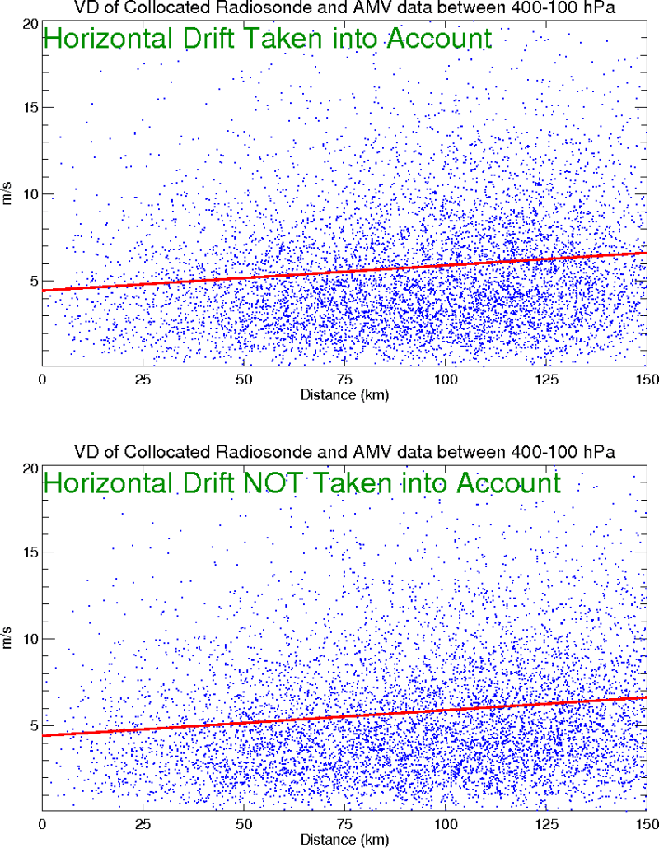
Impact of the Horizontal Position of Radiosonde on the Comparison between Radiosonde and AMV Data
All collocated vector root-mean-square differences are plotted as a function of separation distance between AMV and radiosonde data, when the actual radiosonde position is used (upper panel) and when the launch position is used (lower panel).
By construction, the mean value is the same in both cases. However the zero intercept is expected to be smaller when the actual position of the radiosonde is employed.
However, the zero intercepts are here the same, suggesting that the position error of radiosonde data is small compared to other sources of error (e.g. AMV tracking, vertical and horizontal positions of both observation types, etc.).
Mean = 5.8 m/s
Intercept = 4.5 m/s
Mean = 5.8 m/s
Intercept = 4.5 m/s

Slide 15
AMV Usage at MSC
Platforms
GEO : GOES 13/15 ; Meteosat 7/10 ; MTSAT-2
POLAR : AVHRR NOAA 15/18/19 Metop A/B; MODIS Terra/Aqua
Spatial thinning/screening
1.5 degrees for GEO AMVs; 180 km for POLAR AMVs
11 vertical layers; zenith angle < 55 degrees
No GEO AMVs over Land North of 25N (20N for GOES)
Temporal thinning
2-hourly for GEO AMVs; no temporal thinning for POLAR AMVs
Quality control
QI > 85 ; RFF > 60 to 80 for GOES and MODIS
Background check and Var-QC
Observation errors
Static for all AMVs
Level (hPa) | Error (m/s)
100 | 6.0
150 | 5.5
200 | 5.5
250 | 5.5
300 | 5.0
400 | 4.5
500 | 4.0
700 | 3.0
850 | 2.5
925 | 2.5
1000 | 2.5

Slide 16
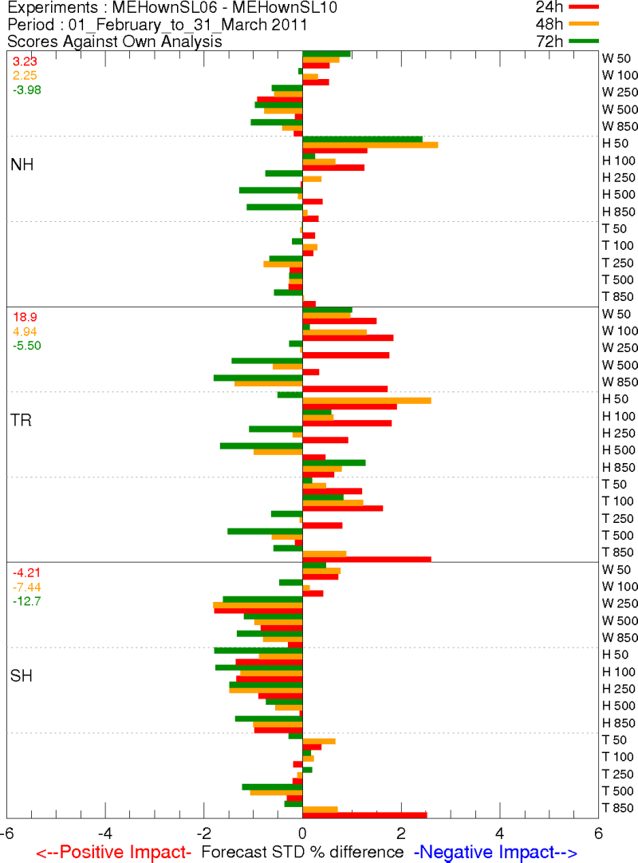
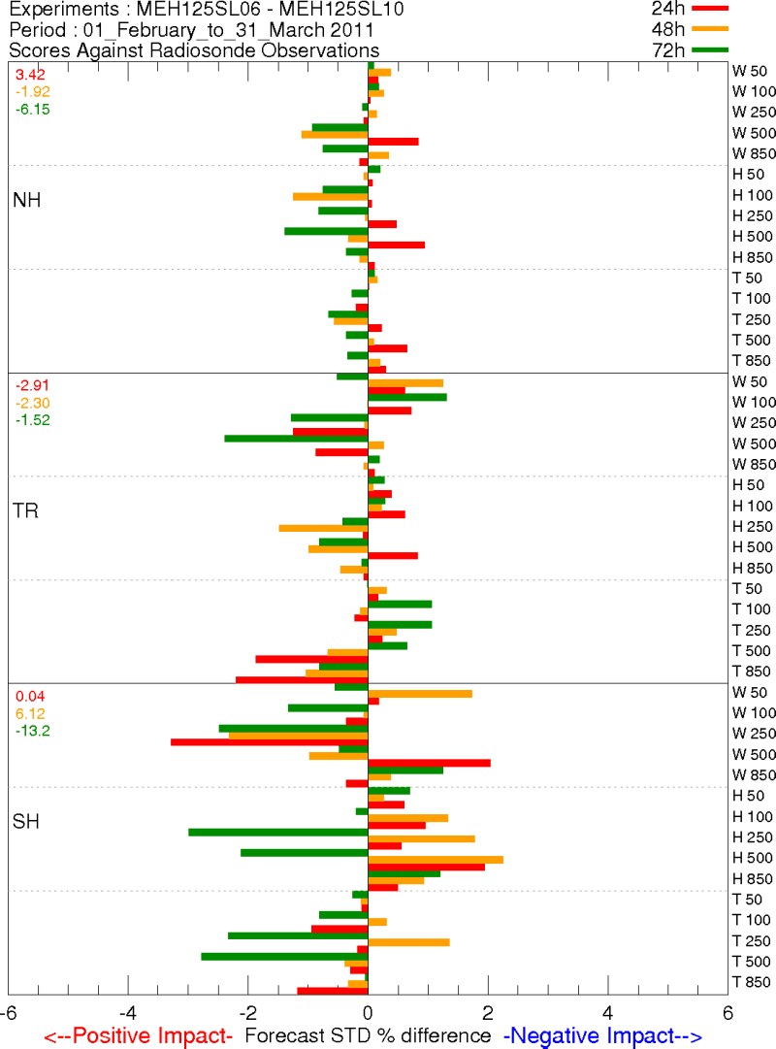
Impact of AMV Data on Day-1 to Day-3 Forecasts over the Northern Hemisphere (February-March 2011)
Against Own Analysis
Against Radiosonde data
W
W
H
H
T
T
W
W
H
H
T
T
W
W
H
H
T
T

Slide 17
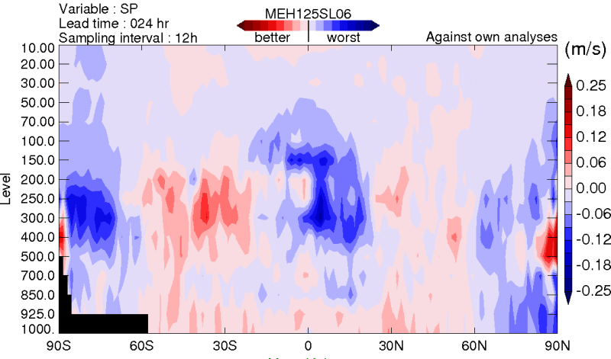
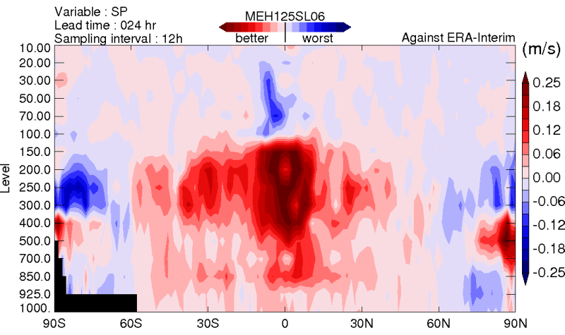
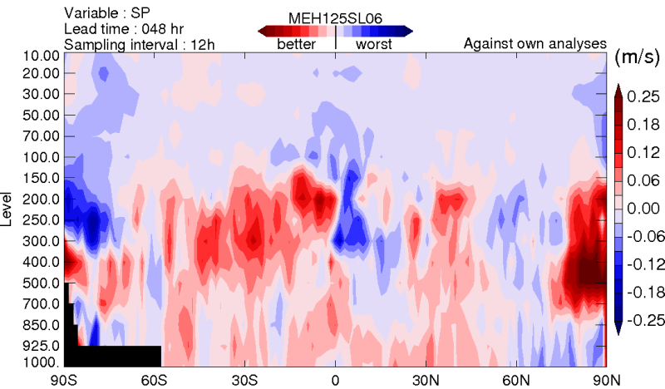
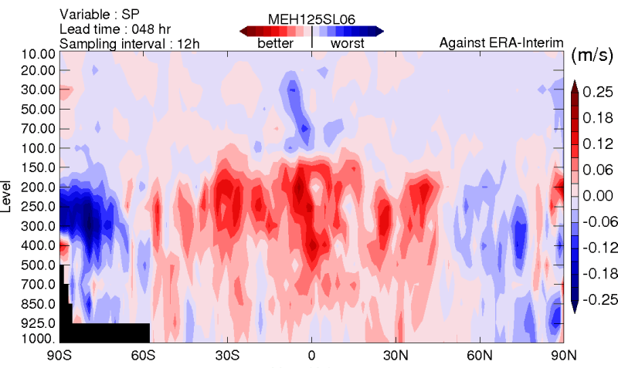
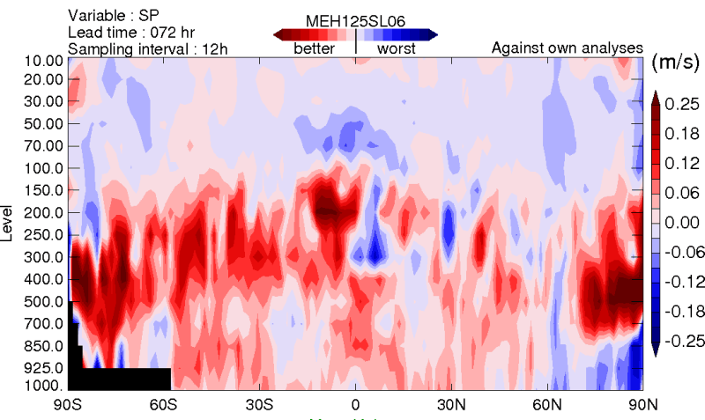
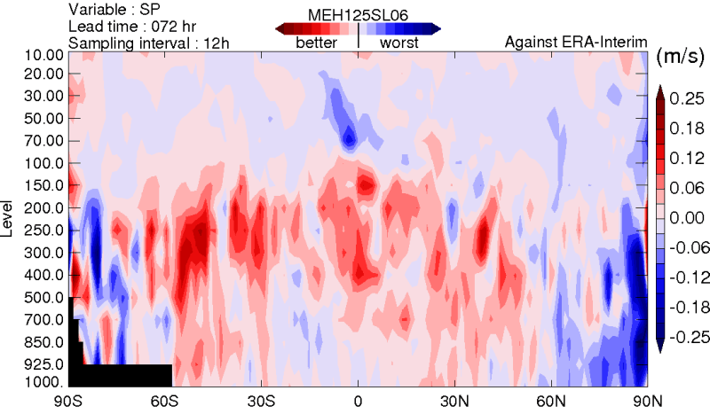
Impact of AMV Data Day-1 to Day-3 Zonal Mean STD Error Difference for Wind Speed (Control – No AMV)
Against Own Analysis
Against ERA-Interim Analyses
Day-1
Positive impact
Day-2
Negative impact
Day-3

Slide 18
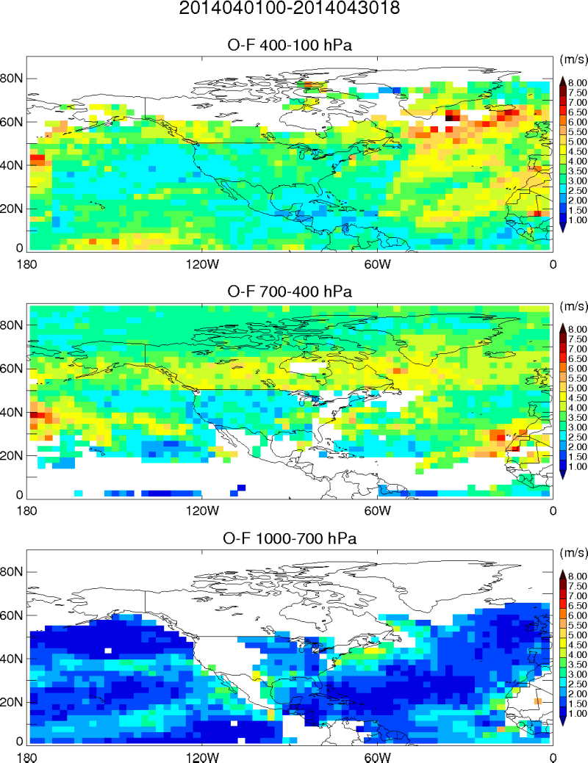
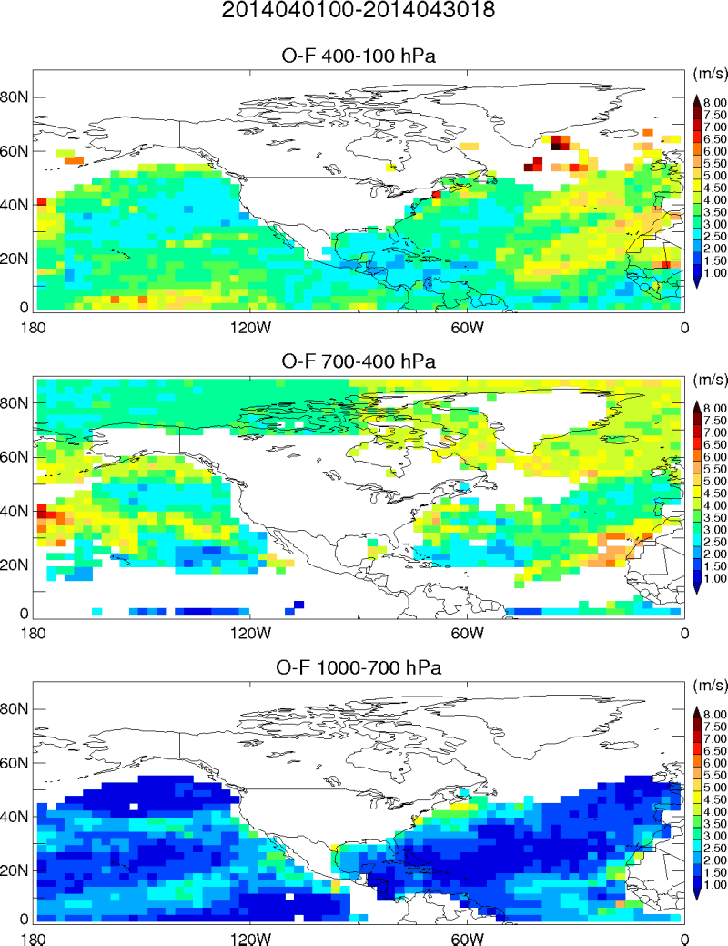
Plans for Improving AMV Usage at MSC
Examine the consistency between AMVs and short-range wind forecasts over the Tropics.
Assimilate additional AMVs with zenith angle beyond 55, those over Land North of 20N, and from other data providers.
Revisit the spatial and temporal thinning strategies based on observation error correlation estimates.
Improve the quality control processing.
Upgrade the observation error statistics (static vs situation dependent).

