Slide 1
Current status of COMS AMV
in KMA/NMSC
E.J. CHA, H.K. JEONG, E.H. SOHN, S.J. RYU
Satellite Analysis Division National Meteorological Satellite Center
Korea Meteorological Administration
-

Slide 2
Contents
1. Introduction 2. Application for Operational Forecast
3. Current Research Activity
4. Summary & Future Plan

Slide 3
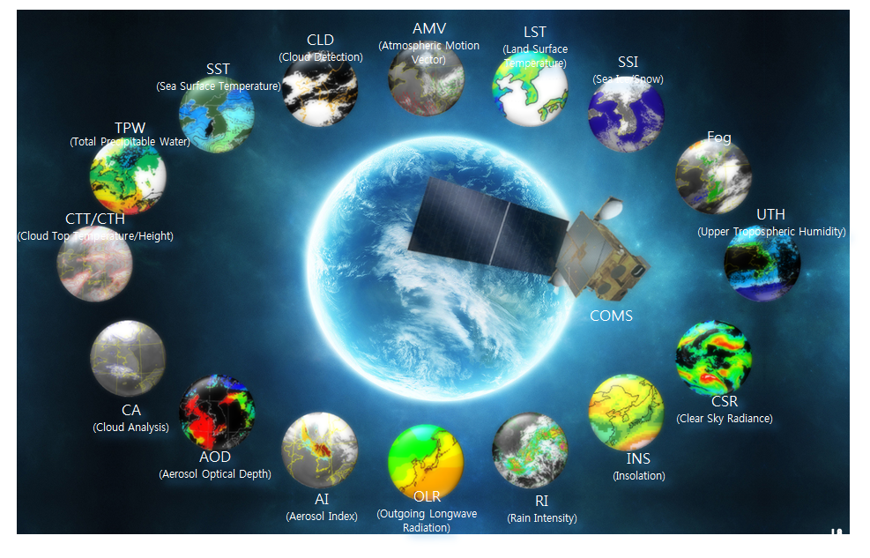
1. Introduction Perspective
* Historical Perspective of AMV
1. 2000 : Introduction of algorithm from JMA(GMS data, Terascan SW) 2. 2003~2007 : Development of CMDPS (COMS Meteorological Data Processing System) Basic algorithm from EUMETSAT(Holmlund, 1998) 3. 2011 : Operational service - 4 channel : IR(10.8), WV(6.75), SWIR(3.75) VIS(0.65) - 29~30 times/daily 4. Dec. 2011 : Use for KMA NWP data assimilation
5. 2014 : Distribute via GTS (ongoing process with JMA)

Slide 4
2. Application for Operational Forecast
* Process of COMS AMV
[COMS]
[RTM]
Domain setting for MPI
TBB for opaque cloud at given pressure (IR1, WV, channel)
Transmittance for opaque cloud at given pressure (WV channel)
Read Namelist files
Static input data
Lat/Lon(COMS)
Ls mask(COMS)
Lat/Lon(NWP)
Determine Day/Night
COMS Level 1b
(4km) IR1, IR2, WV, SWIR,
(1km->4km)VIS(IR-resolution)
[NWP]
u, v, T, RH, P
CMDPS CLD%mask
Target Analysis
Select Target Location
Regular Target selection (Target size: 24 x 24, grid: 12)
AMV Run
Height Assignment
Wind field(NWP) > 20m/s
Dynamic Search Area
Cross Correlation
Vector Estimation
1. IR1: EBBT(Equivalent Black-Body Temperature)
STC(Semi-Transparent Correction)
IR/WV Intercept
2. WV: EBBT, NTC(Normalized Total Contribution)
NTCC(Normalized Total Cumulative Contribution)
3. SWIR: EBBT
4. VIS: EBBT, IR/WV Intercept
Holmlund, k., 1998
1. Temporal direction consistency
2. Temporal speed consistency
3. Temporal vector consistency
4. Spatial vector consistency
5. Temporal forecast consistency
Quality control

Slide 5
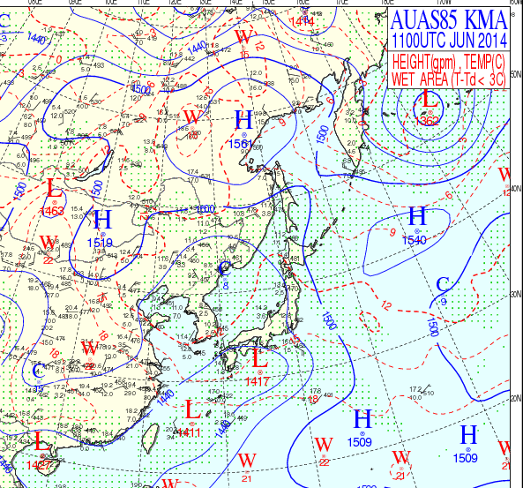
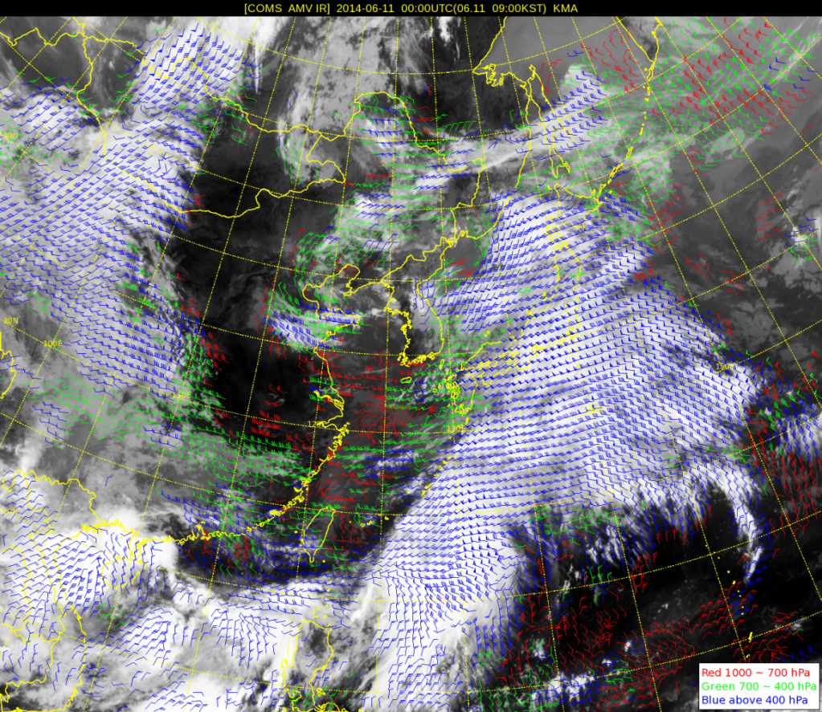
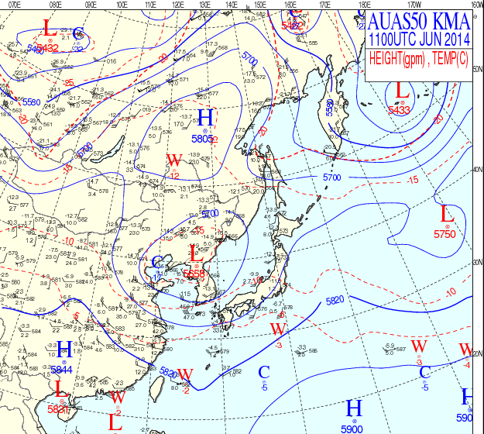
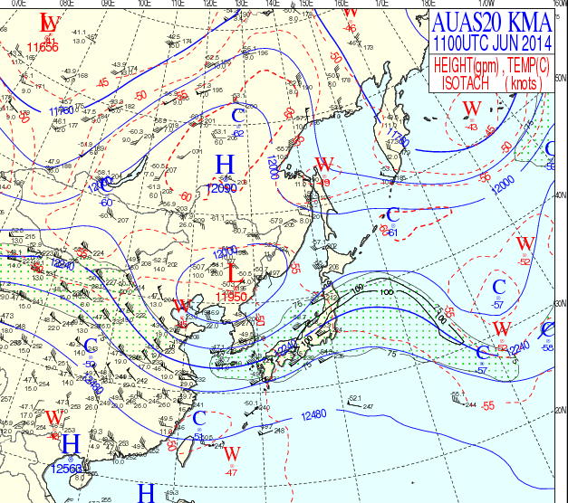
2. Application for Operational Forecast
850 hPa
* Example of COMS AMV IR1(10.8) - 00UTC 11 June 2014 -
500 hPa
200 hPa
- Red : 1000~700 hPa - Green : 700~400 hPa - Blue : above 400 hPa

Slide 6
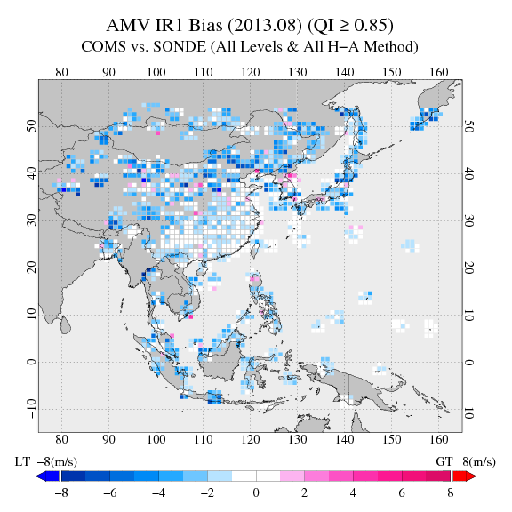
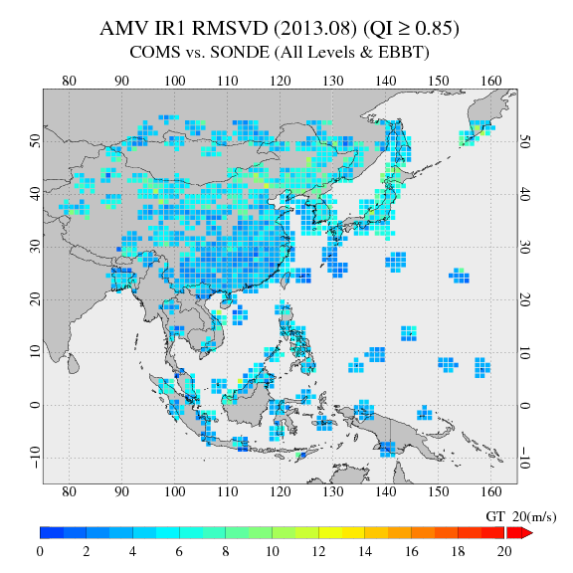
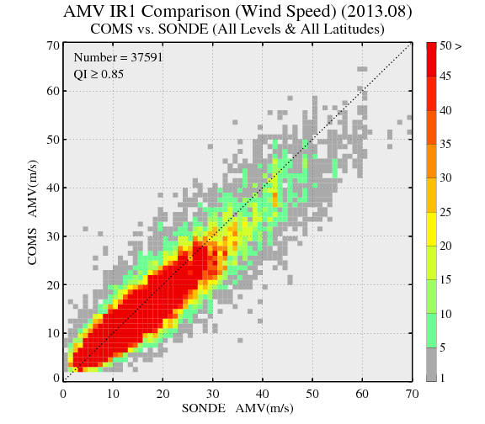
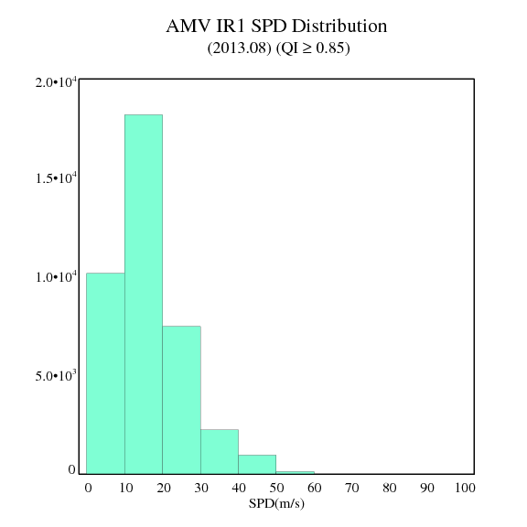
2. Application for Operational Forecast - Example of Product validation & Quality Monitoring web site
Statistical Result Map
AMV IR1 Bias
AMV IR1 RMSVD
AMV IR1 Density Plot
AMV IR1 Bar Plot
Notes:
COMS 16 secondary products are validated with ground based observation data or polar orbit satellite derived products etc. and reported periodically.

Slide 7
2. Application for Operational Forecast
* Effect of COMS AMV : 1% accuracy upgrade
Dominant effect
over East Asia

Slide 8
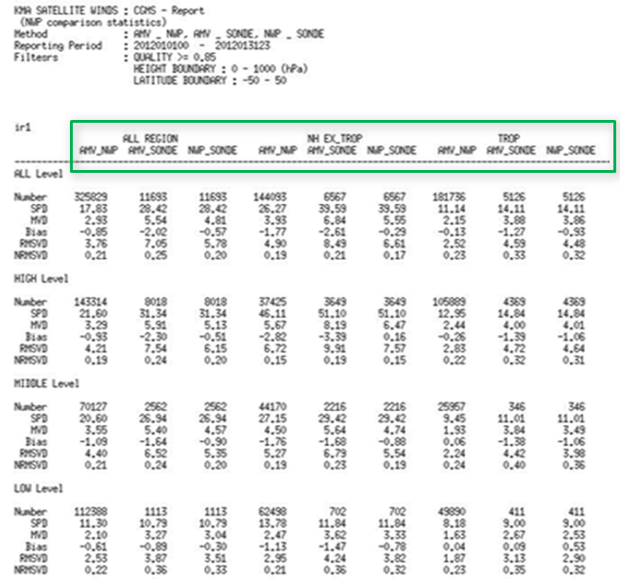
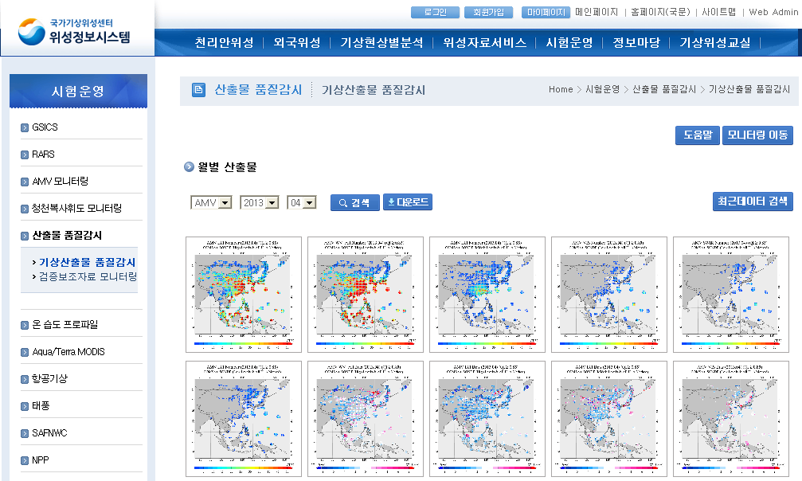
2. Application for Operational Forecast - Example of Product validation & Quality Monitoring web site
* Monthly product
* Statistical Result

Slide 9
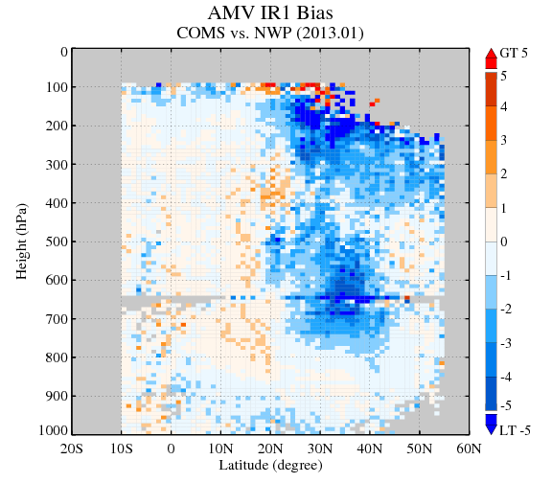
2. Application for Operational Forecast
January 2013
* Preliminary Validation Result
1. Data : Rawin-Sonde wind observation
2. Area : Northern Hemisphere 3. Statistical Index : Bias, RMSE, RMSVD 4. Period : 1year(May 2012 – April 2013) 5. Quality indicator of AMV 5.1 Wind speed(Sonde) difference < 30m/s 5.2 Wind direction difference < 90 degree 5.3 Quality Index >= 0.85
6. Characteristics 6.1 negative bias upper level of higher than 20 degree in N.H. (AMV slow trend) 6.2 large Bias, RMSE[RMS(Vector Difference)] in winter

Slide 10
3. Current Research Activity
* Inter comparison study
 | Design for Test
1. COMS (Operational) | Target size : 24 x 24, grid : 12 Target selection : Regular target selection Vector estimation : CC Height assignment : EBBT, STC, IR/WV Intercept, NTC, NTCC
2. COMS_CCC | Target size : 24 x 24, grid : 12 Target selection : Regular target selection Vector estimation : CC Height assignment : CCC
3. COMS_Nested* | Target size : 24 x 24, grid : 12 Target selection : Regular target selection Vector estimation : Nested tracking Height assignment : Nested tracking
4. COMS (research) | Target size : 24 x 24, grid : 6 Target selection : Optimal target selection Vector estimation : CC Height assignment : EBBT, STC, IR/WV Intercept, NTC, NTCC
5. PGE09_HRW | Target size : 24 x 24, grid : 6 Target selection : Optimal target selection Vector estimation : CC Height assignment : CCC
* Not shown in this slide

Slide 11
3. Current Research Activity
* Preliminary result of inter comparison
1. Data : (1) Sonde, (2) KMA Global NWP result 2. Period : January, July 2013 3. Validation result - Seasonal variation of RMSE(RMSVD) : winter > summer - Geographical variation of RMSE(RMSVD) : high lat. > low lat. - altitude variation of RMSE(RMSVD) : upper level > lower level - HRW (bias), COMS Operational(RMSVD)

Slide 12
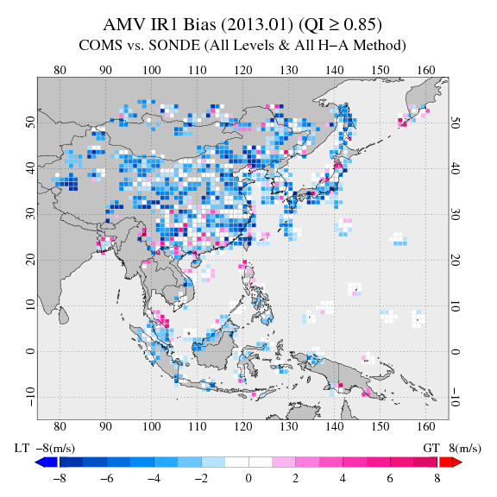
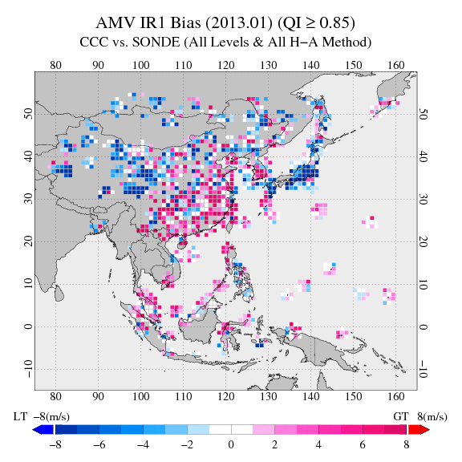
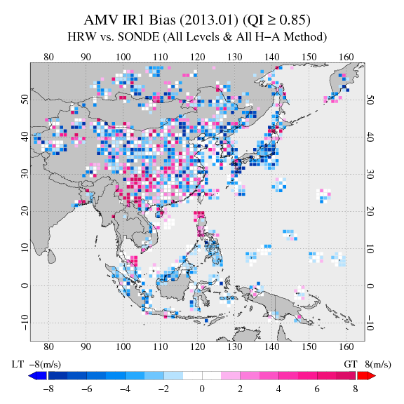
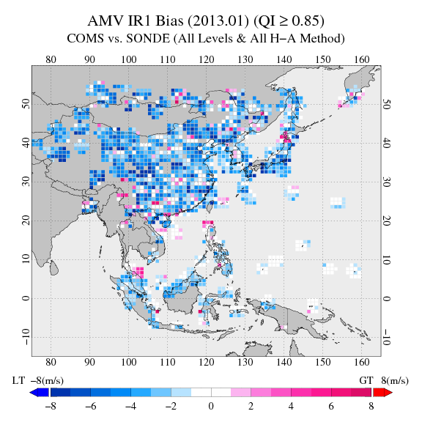
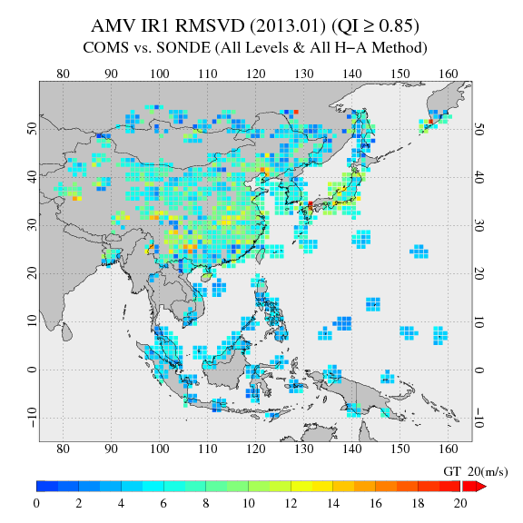
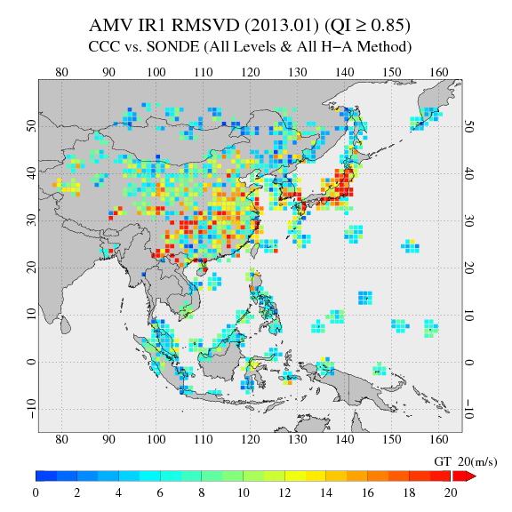
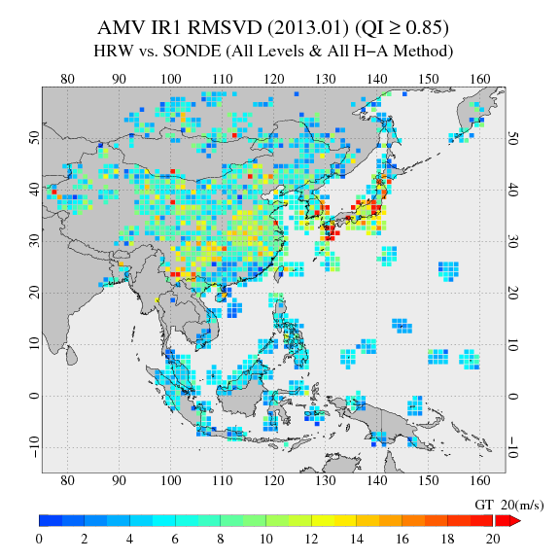
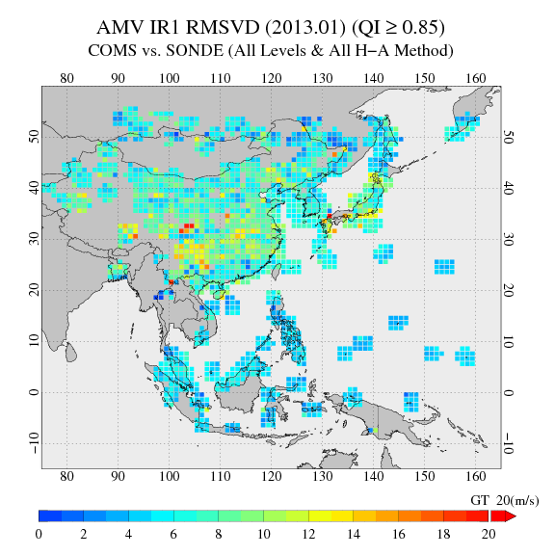
3. Current Research Activity
* Preliminary Comparison Result(January 2013, IR1), Sonde
1. COMS_Operational
2. COMS_CCC
3. PGE09_HRW
4. COMS_Research
Bias
RMSVD

Slide 13
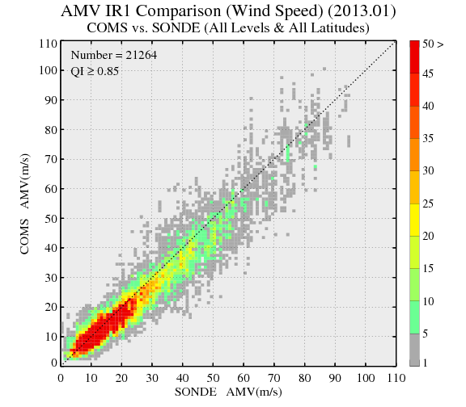
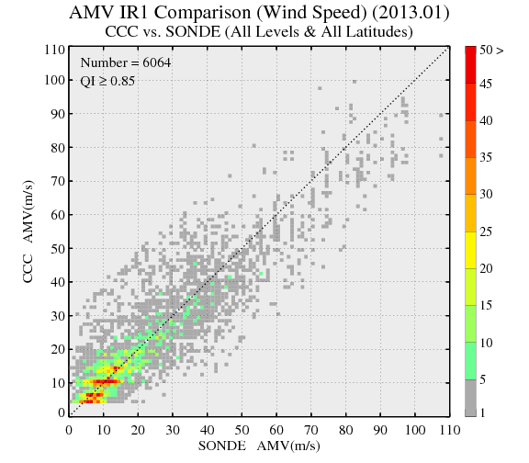
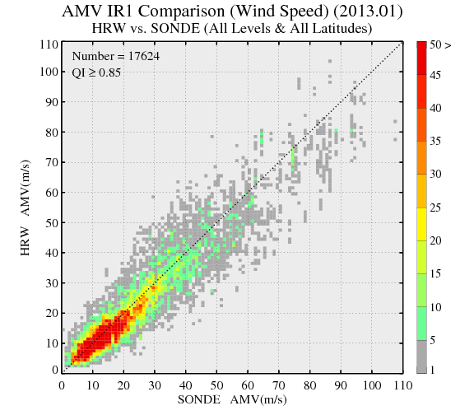
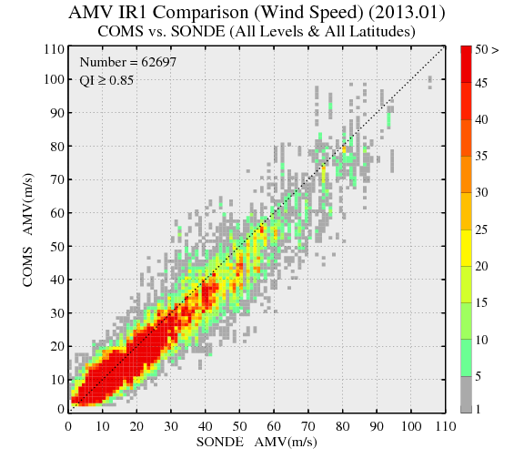
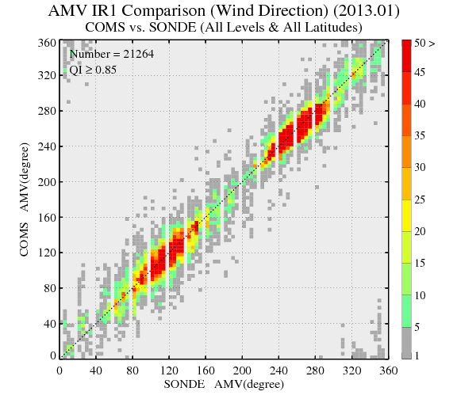
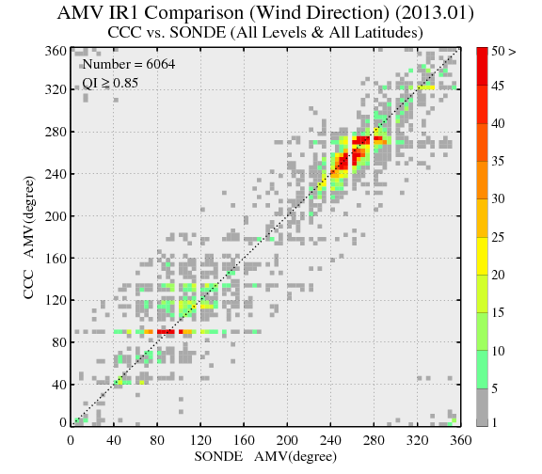
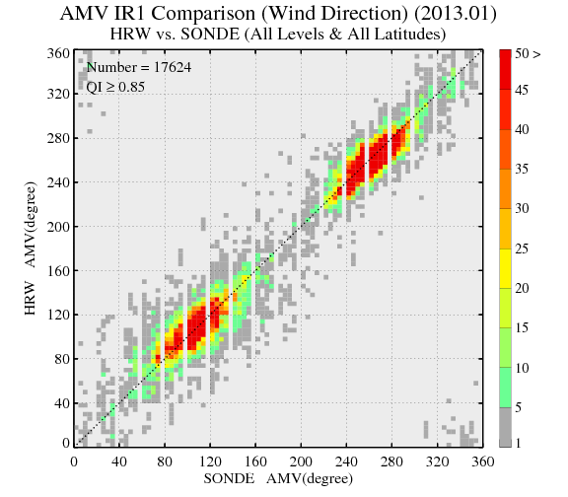
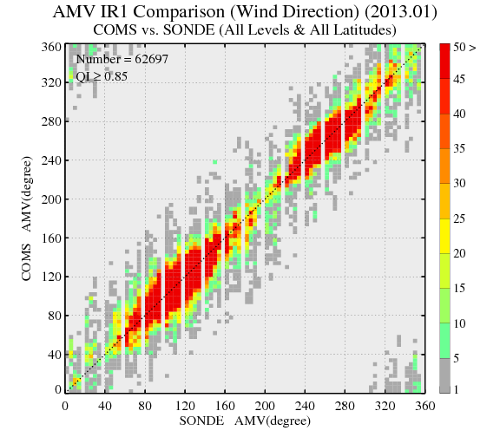
3. Current Research Activity
* Preliminary Comparison Result(January 2013, IR1), Sonde
1. COMS_Operational
2. COMS_CCC
3. PGE09_HRW
4. COMS_Research
Wind
speed
Wind
direction

Slide 14
3. Current Research Activity
* Preliminary Comparison Result(January 2013, IR1)
January | Height (hPa) | COMS_Operational |  | HRW |  | CCC |  | COMS_Research
 |  | AMV-NWP | AMV-SONDE | AMV-NWP | AMV-SONDE | AMV-NWP | AMV-SONDE | AMV-NWP | AMV-SONDE
Number | All (100~1000 hPa) | 319509 | 21264 | 481335 | 17624 | 256077 | 6064 | 1781650 | 62697
 | High (100~400 hPa) | 140914 | 15140 | 235497 | 12109 | 52800 | 2842 | 820071 | 45121
 | Mid (400~700 hPa) | 56911 | 2989 | 102971 | 3958 | 91077 | 1789 | 342170 | 9090
 | Low (700~1000 hPa) | 121684 | 3135 | 142867 | 1557 | 112200 | 1433 | 619409 | 8486
Bias | All (100~1000 hPa) | -0.69 | -1.70 | -0.59 | -1.13 | -0.74 | 0.13 | -0.77 | -2.00
 | High (100~400 hPa) | -0.72 | -2.00 | -0.64 | -1.61 | -0.84 | -2.23 | -0.81 | -2.31
 | Mid (400~700 hPa) | -1.21 | -1.31 | -0.07 | 0.06 | -0.79 | 3.27 | -1.29 | -1.35
 | Low (700~1000 hPa) | -0.42 | -0.65 | -0.89 | -0.44 | -0.64 | 1.47 | -0.43 | -0.99
RMSVD | All (100~1000 hPa) | 3.54 | 6.32 | 4.75 | 7.34 | 3.70 | 9.76 | 3.77 | 6.39
 | High (100~400 hPa) | 3.88 | 6.73 | 5.24 | 7.76 | 4.21 | 10.70 | 4.05 | 6.72
 | Mid (400~700 hPa) | 4.54 | 6.22 | 5.36 | 6.97 | 3.93 | 10.20 | 4.76 | 6.39
 | Low (700~1000 hPa) | 2.43 | 3.94 | 3.17 | 3.79 | 3.22 | 6.82 | 2.58 | 4.31
Notes:
(

Slide 15
3. Current Research Activity
* Preliminary Comparison Result(July 2013, IR1)
July | Height (hPa) | COMS_Operational |  | HRW |  | CCC |  | COMS_Research
 |  | AMV-NWP | AMV-SONDE | AMV-NWP | AMV-SONDE | AMV-NWP | AMV-SONDE | AMV-NWP | AMV-SONDE
Number | All (100~1000 hPa) | 272070 | 33703 | 403622 | 25694 | 260268 | 9085 | 1648997 | 105673
 | High (100~400 hPa) | 197504 | 30230 | 320676 | 22717 | 87113 | 5572 | 1228498 | 95262
 | Mid (400~700 hPa) | 33430 | 2360 | 74383 | 2767 | 128834 | 2958 | 214448 | 7199
 | Low (700~1000 hPa) | 41136 | 1113 | 8563 | 210 | 44321 | 555 | 206051 | 3212
Bias | All (100~1000 hPa) | -0.29 | -1.11 | -0.04 | -0.68 | -0.44 | 1.66 | -0.40 | -1.36
 | High (100~400 hPa) | -0.45 | -1.22 | -0.14 | -0.81 | -0.62 | 0.72 | -0.57 | -1.48
 | Mid (400~700 hPa) | 0.11 | -0.55 | 0.39 | 0.42 | -0.37 | 3.43 | 0.08 | -0.71
 | Low (700~1000 hPa) | 0.13 | 0.85 | 0.06 | -0.51 | -0.27 | 1.62 | 0.07 | 0.60
RMSVD | All (100~1000 hPa) | 2.85 | 5.61 | 3.47 | 6.35 | 3.10 | 8.40 | 3.06 | 5.72
 | High (100~400 hPa) | 3.11 | 5.76 | 3.63 | 6.46 | 3.40 | 7.77 | 3.32 | 5.86
 | Mid (400~700 hPa) | 2.36 | 4.48 | 2.82 | 5.53 | 3.04 | 9.71 | 2.56 | 4.58
 | Low (700~1000 hPa) | 1.69 | 3.13 | 2.02 | 3.57 | 2.64 | 6.95 | 1.59 | 3.13
Notes:
(

Slide 16
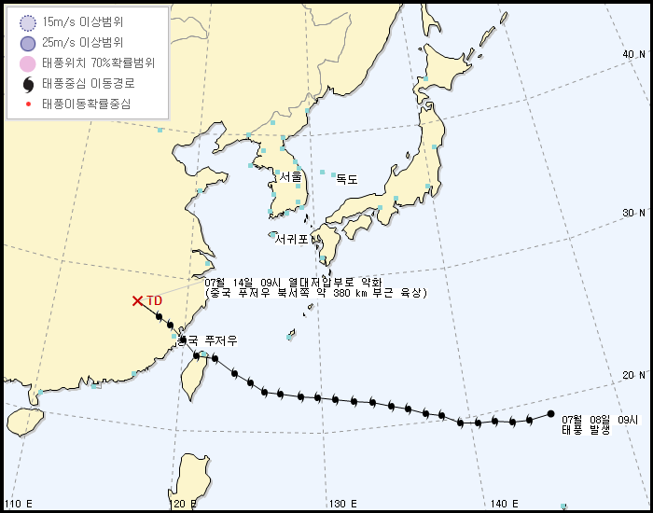
3. Current Research Activity
* Comparison study : 2013 7th Typhoon SOULIK
00UTC 10 July (mature stage, eye type)

Slide 17
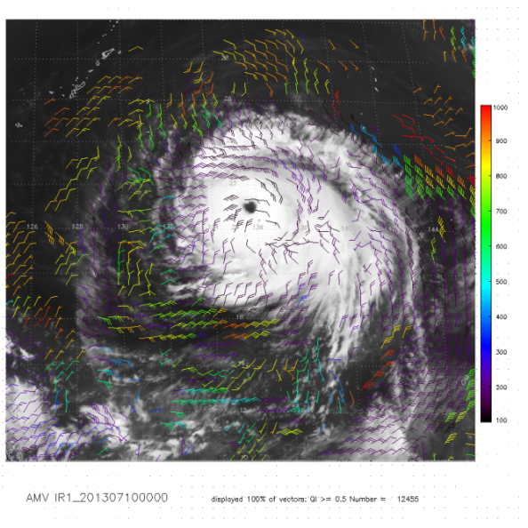
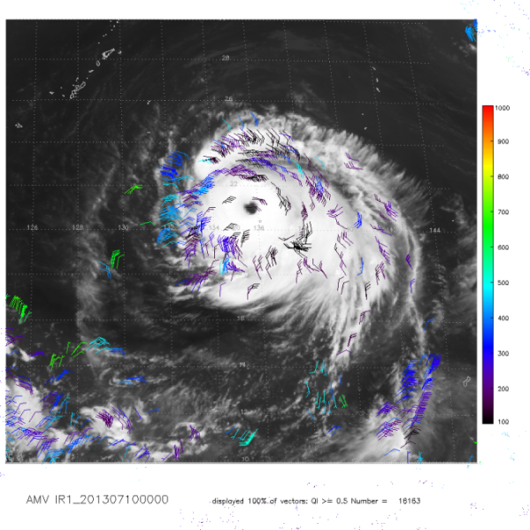
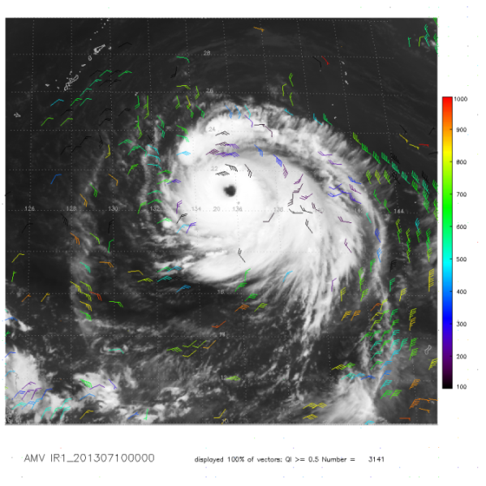
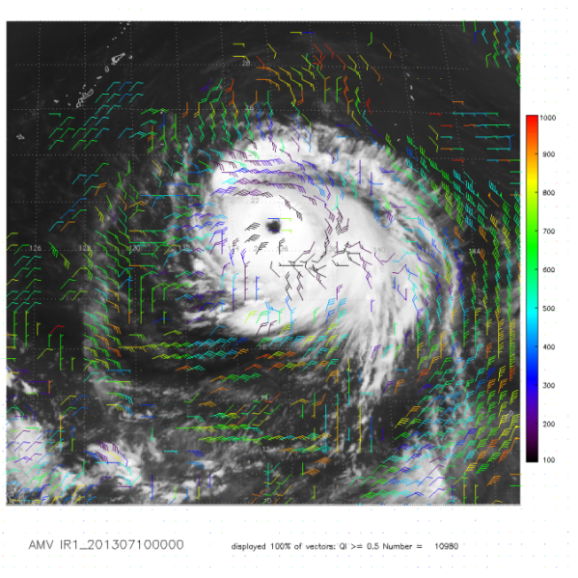
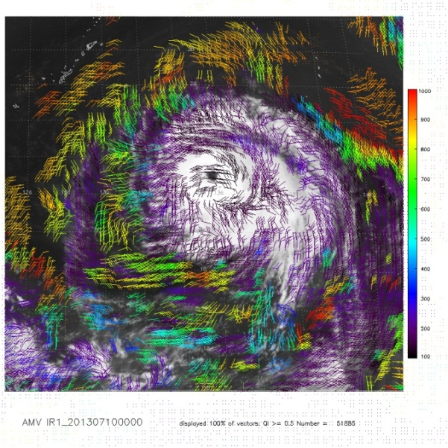
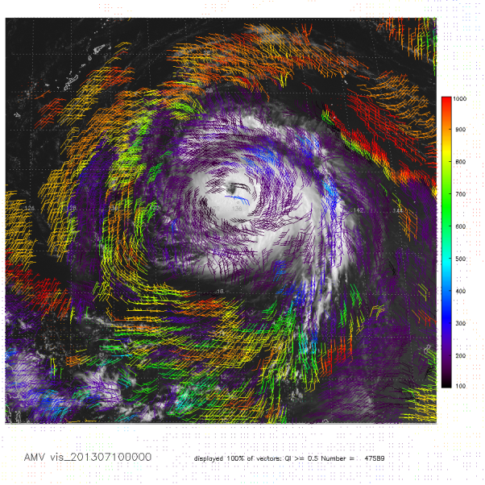
3. Current Research Activity
* Case study : 2013 7th Typhoon SOULIK - 00UTC 10 July 2013(QI > 0.5) -
1. COMS_Operational
2. COMS_CCC
3. COMS_Nested
1,000hPa
100hPa
4. PGE09_HRW
5. COMS_Research
6. COMS_Research(VIS)
Notes:
5번 : 상층순환이 뚜렷, 6번 : 하층순환이 뚜렷, 태풍의 하층 수렴과 상층 발산이 선명하게 보이게 함

Slide 18
4. Summary and Future Plan
1. COMS AMV(operational) :
(1) Target size : 24 x 24, grid : 12
(2) Target selection : Regular target selection
(3) Vector estimation : CC
(4) Height assignment : EBBT, STC, IR/WV Intercept, NTC, NTCC
(5) 4 channel, 29~30 times/daily (6) Validation result - Seasonal variation of RMSE(Bias) : winter > summer - Geographical variation of RMSE(Bias) : high lat. > low lat. - altitude variation of RMSE(Bias) : upper level > lower level 2. Research Activity : (1) Comparison study : 5 different design (2) Case study : Tropical cyclone
3. Future Plan : Development of GEO-KOMSAT-2A
(1) launch in 2018
(2) 16 channels : 4 visible, 2 near-infrared and 10 infrared channels
(3) 52 meteorological products : Cloud, Precipitation, AMV, Aerosol, Land surface

Slide 19
Thank you

