Slide 1
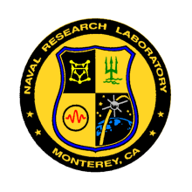
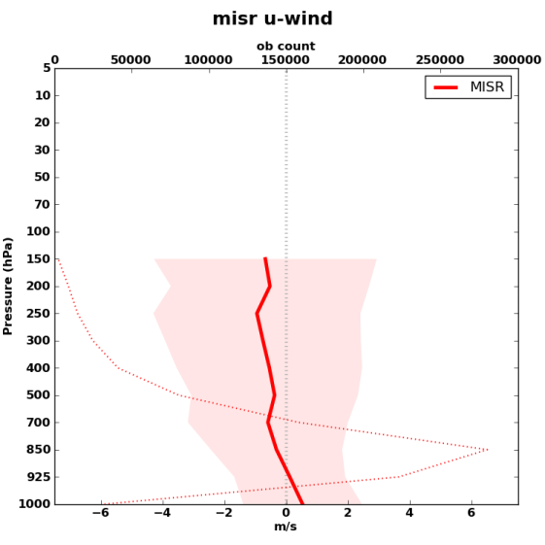
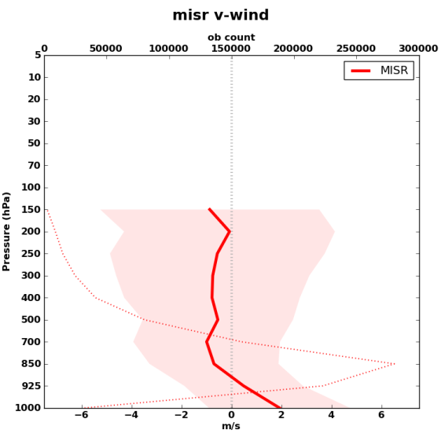
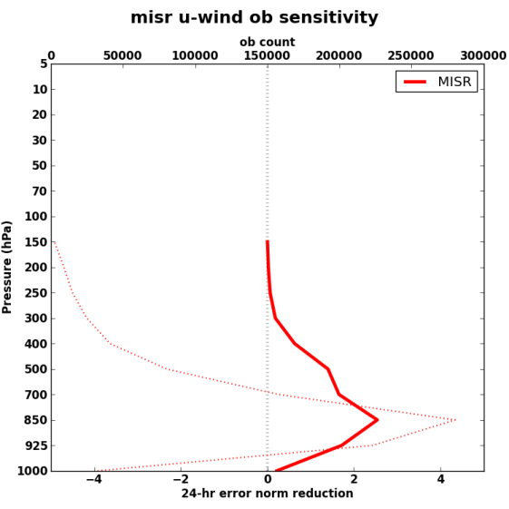
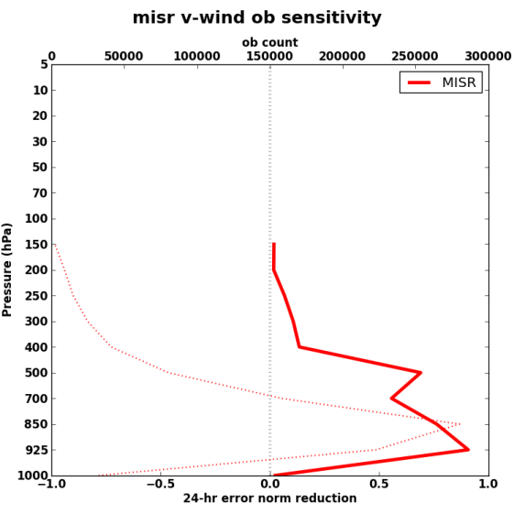
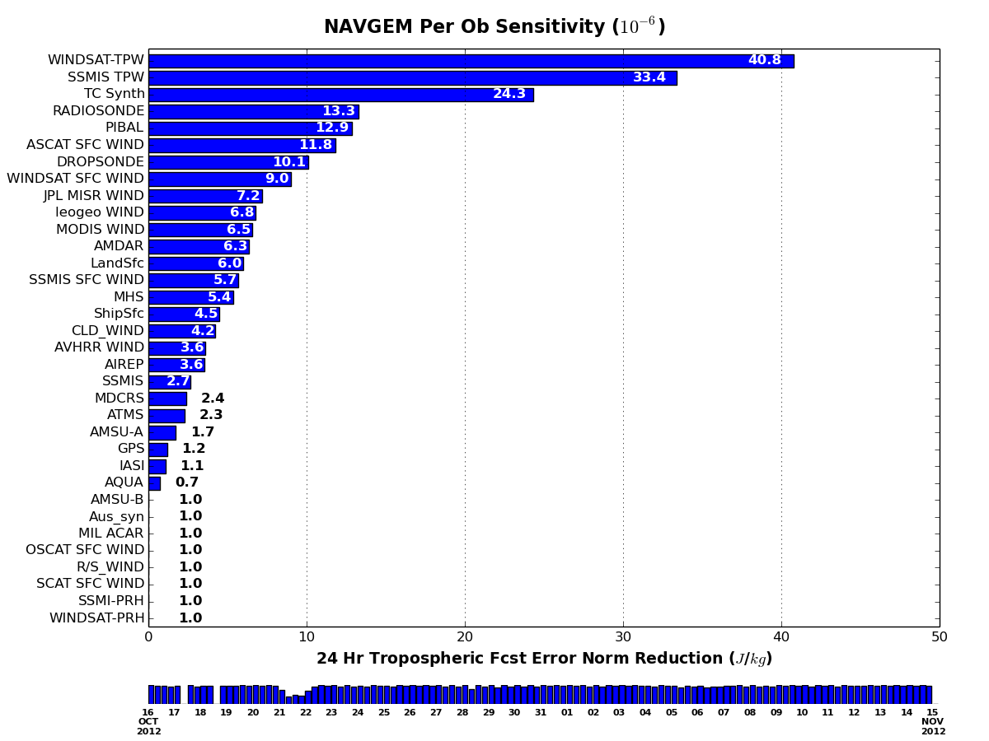
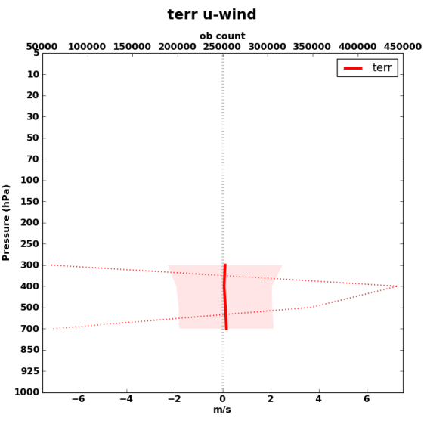
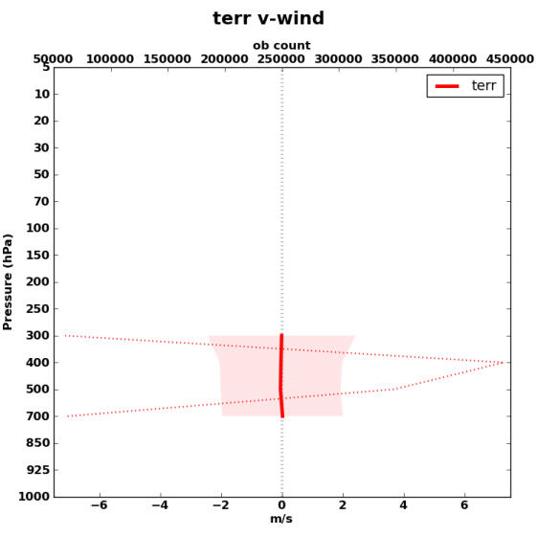
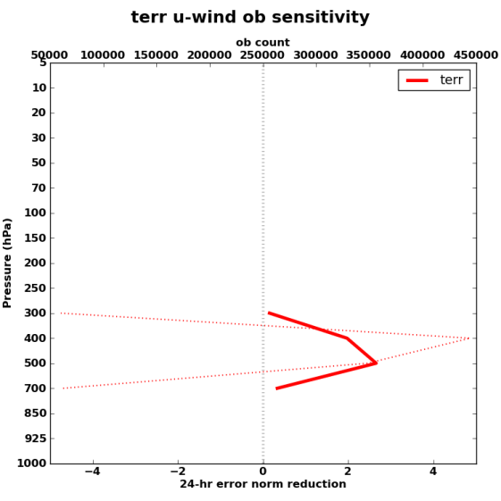
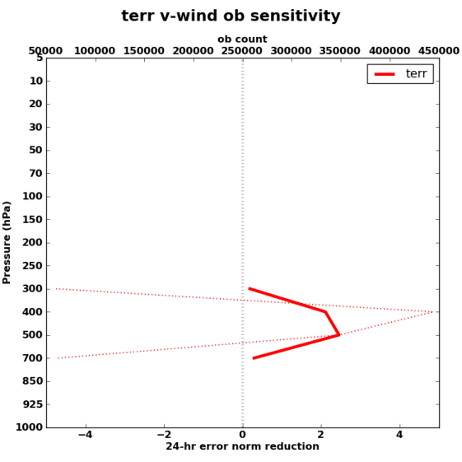
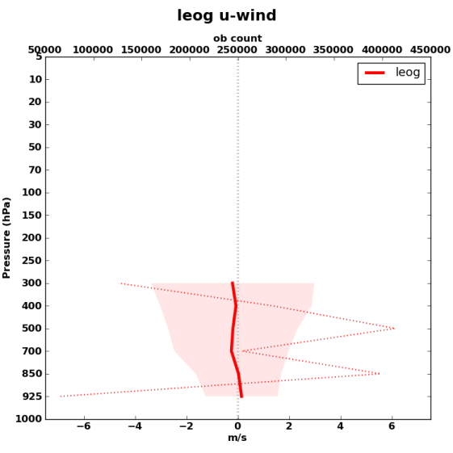
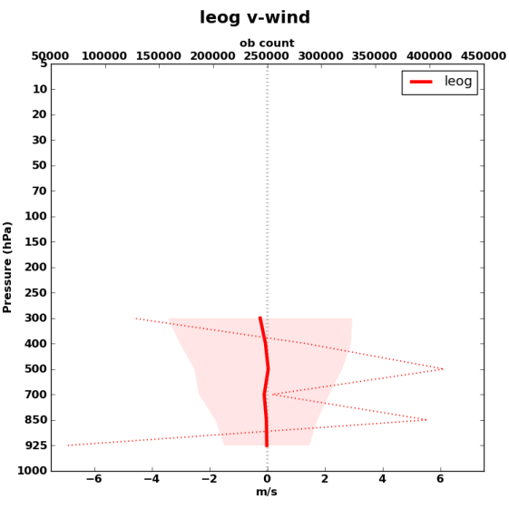
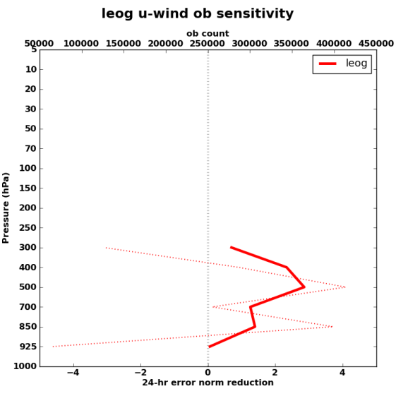
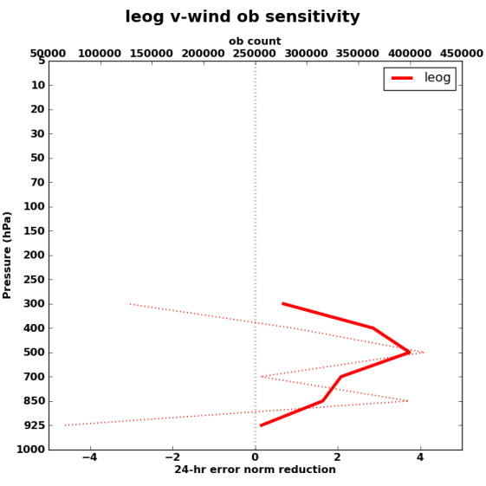
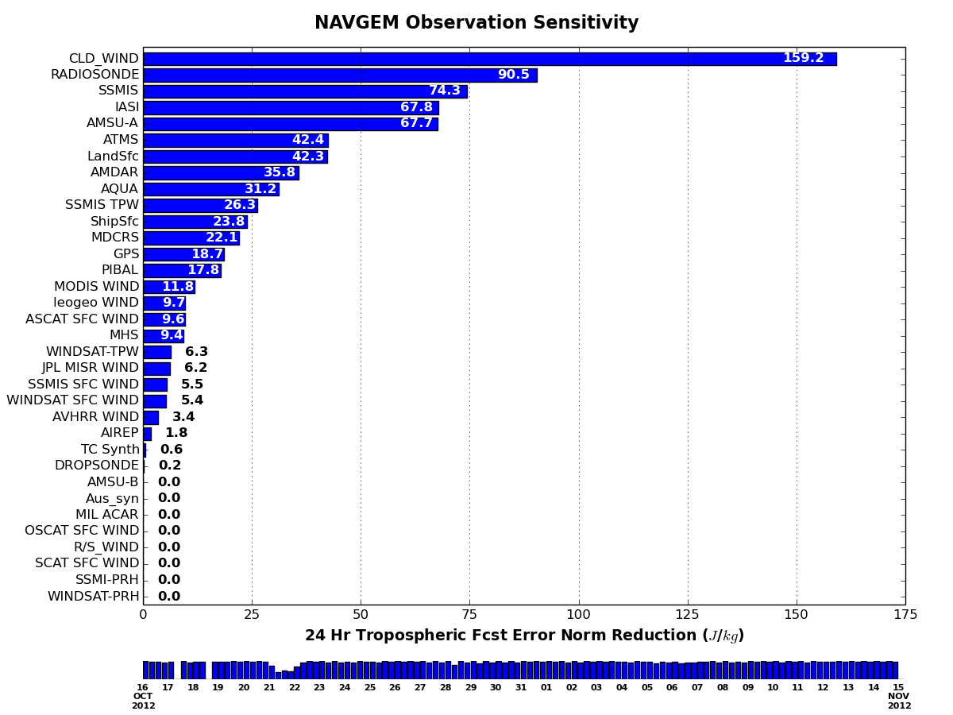
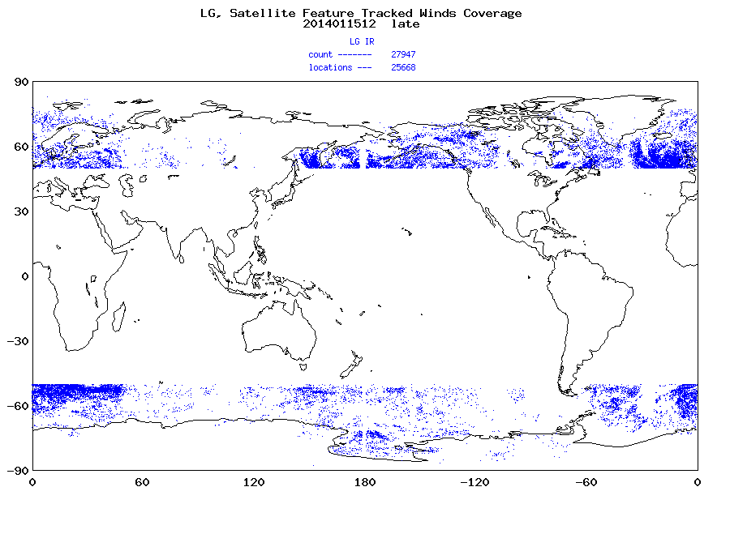
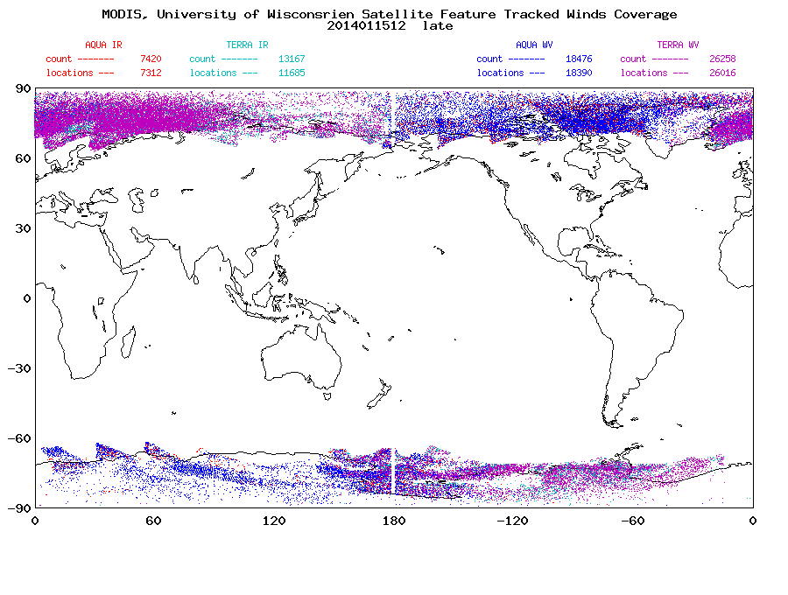
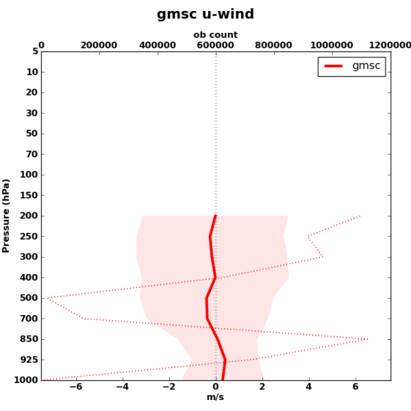
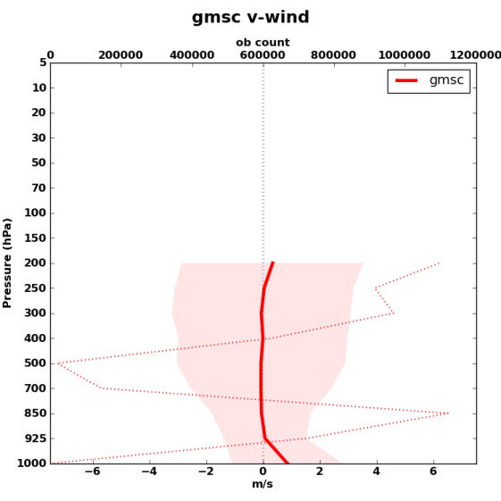
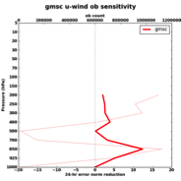
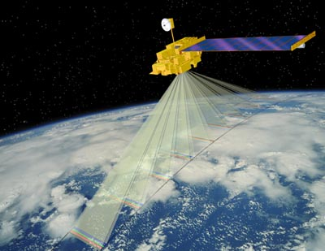
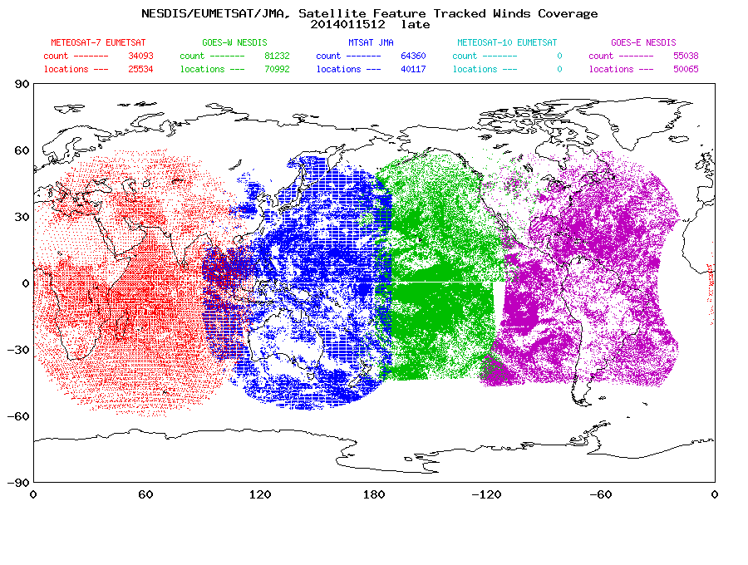
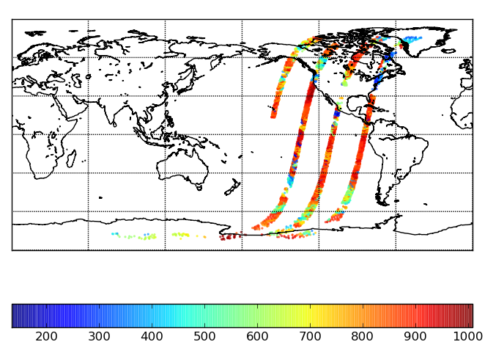
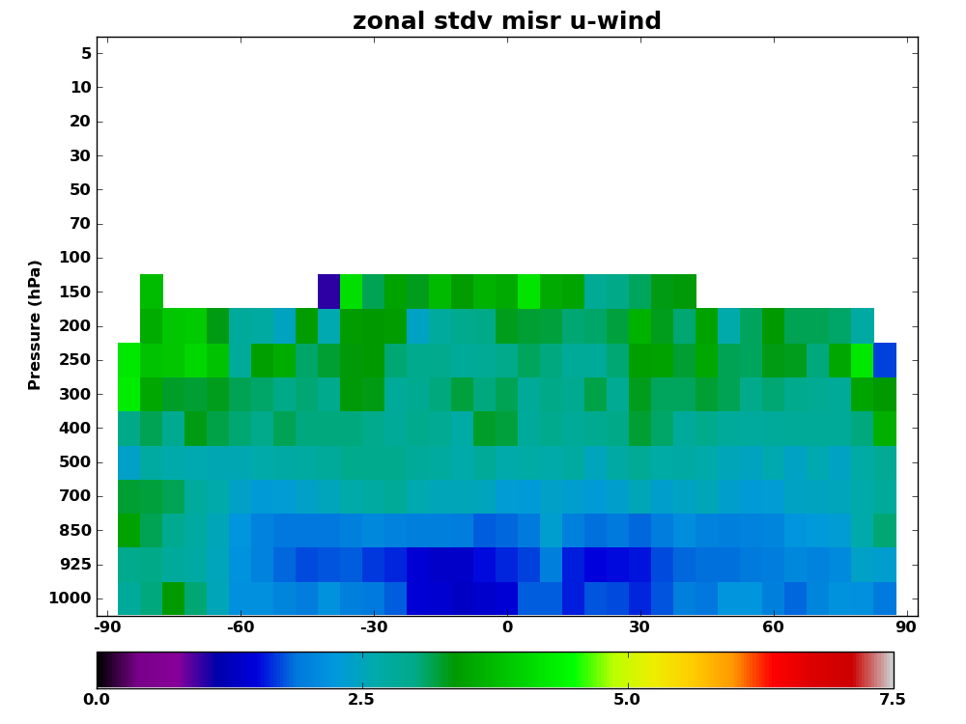
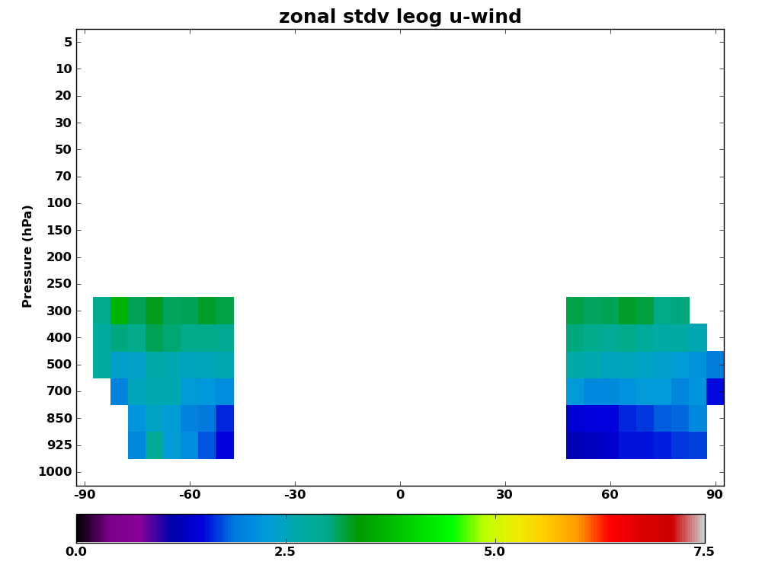
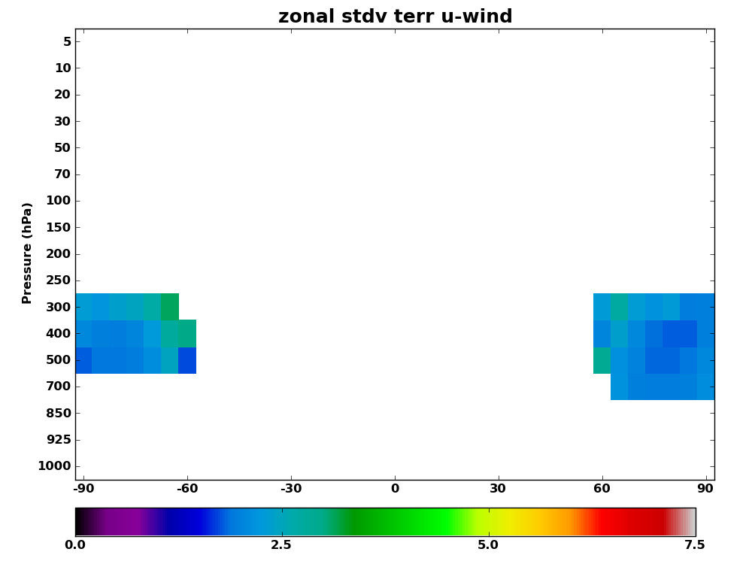
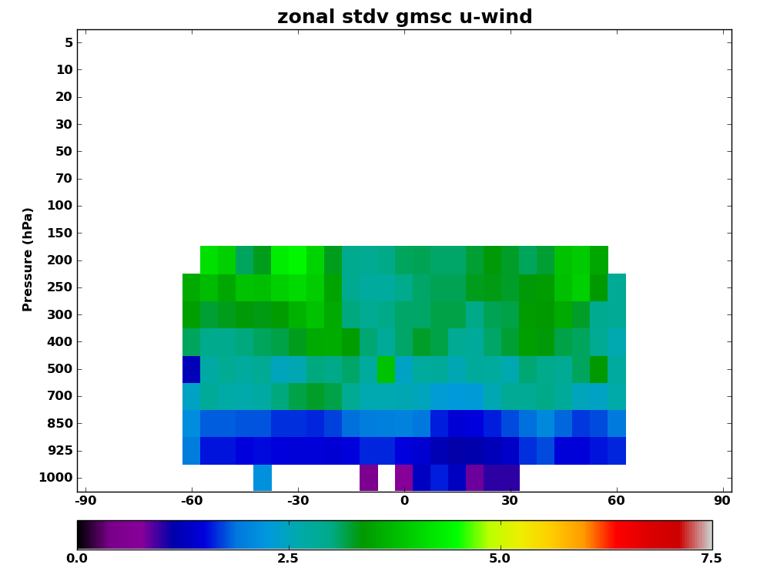
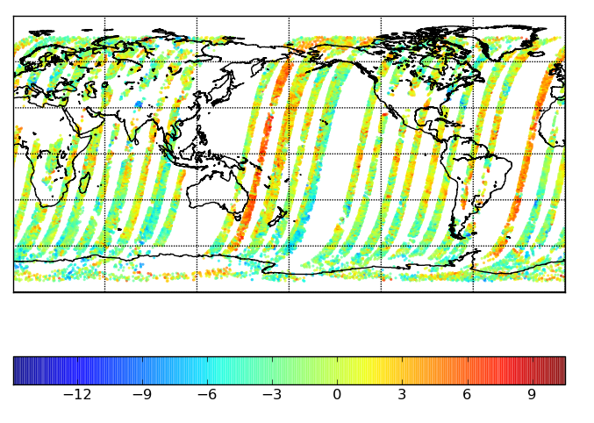
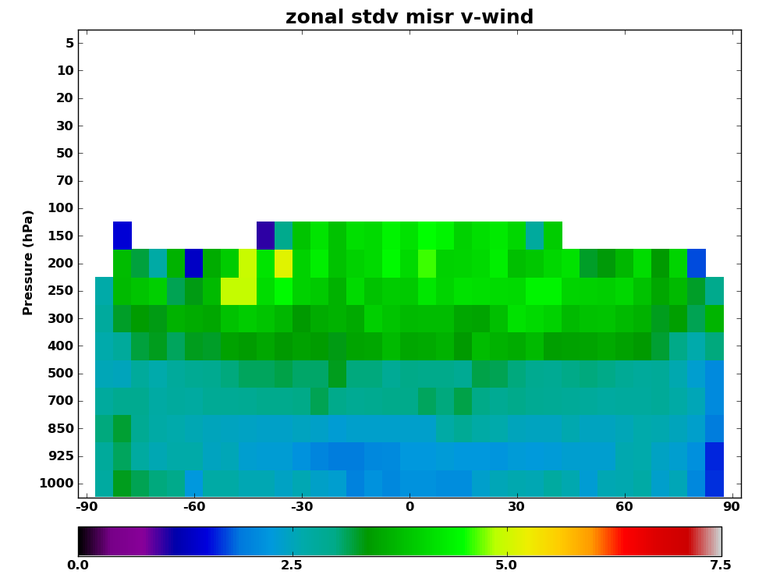
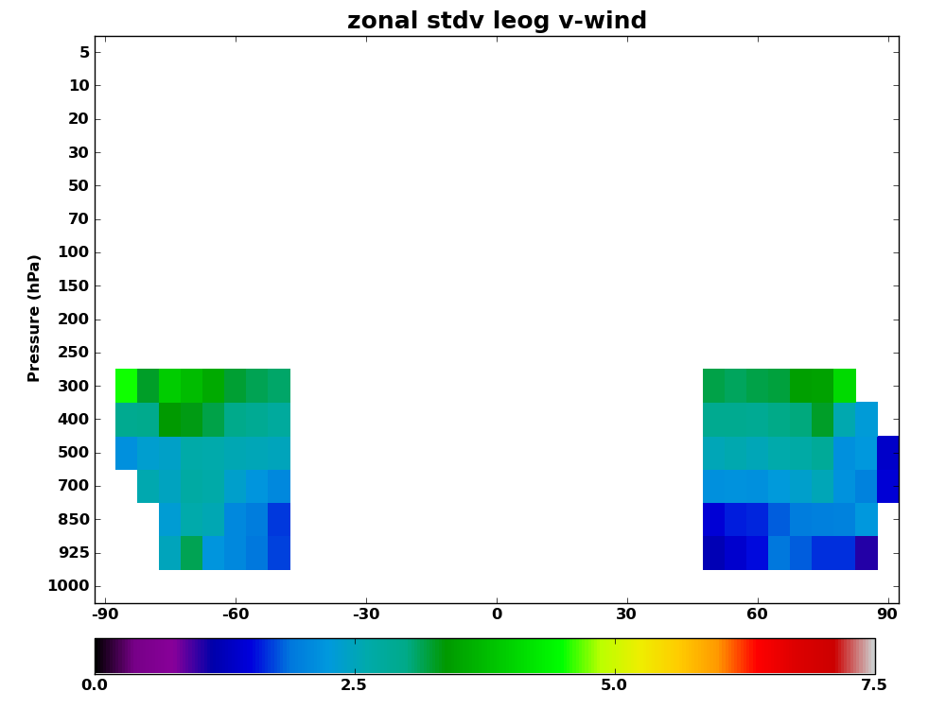
An Assessment of the Impact of the Assimilation of NASA TERRA MISR Atmospheric Motion Vectors on the NRL Global Atmospheric Prediction System
￼
Nancy Baker¹, , Pat Pauley¹ , Rolf Langland^{1,} Kevin Mueller² and Dong Wu³
¹Marine Meteorology Division, Naval Research Laboratory, Monterey, CA
²Jet Propulsion Laboratory, Pasadena, CA
³NASA/Goddard Space Flight Center, Greenbelt, MD
Experiment Design
Forecast Model: NAVGEM v1.2.1 (planned spring 2014)
T359L50, model top 0.04 hPa (around 70 km), horizontal resolution ~ 37 km
Semi-Lagrangian/Semi-Implicit dynamical core, forecast model, explicit clouds
Data Assimilation: NAVDAS-AR
4D-Var solved using accelerated representer technique
T359 outer loop, T119 (~ 111 km) inner loop resolution
Approximately 2.6 million obs/6 hrs (late data cut)
Radiance bias correction using variational bias correction approach
Began with zero bias coefficients (August 1, 2012)
Summer/Fall 2012 case : 15 August - 15 November, 2012
5-day forecasts at 00, 12 UTC
Observation impact computed every 6 hrs
NAVDAS-AR: NRL Atmospheric Variational Data Assimilation System – Accelerated Representer
NAVGEM: Navy Global Environmental Model
MISR Assimilation Experiment Results
Observation Impact with MISR CMVs
ABSTRACT
In this study, we examine the impact of atmospheric motion vectors (AMV) derived using imagery from the MISR (Multi-angle Imaging SpectroRadiometer) instrument flown onboard the EOS-Terra satellite.
AMVs derived from the MISR instrument have several unique strengths that are especially relevant for NWP applications. First, the integrated height retrievals are insensitive to radiometric calibration or atmospheric temperature profiles, giving a more accurate height assignment for the AMVs. Second, the cameras capture motion over a 200 second interval, providing an effective 17.6 km gridded resolution. Finally, MISR gives good global coverage up to 85o (depending upon the season (sunlight)), much further poleward than geostationary AMVs.
The MISR winds were assimilated using the global atmospheric prediction system developed by the Naval Research Laboratory. This system is composed of NAVDAS-AR (NRL Atmospheric Variational Data Assimilation System—Accelerated Representer), and the newly-operational Navy Global Environment Model (NAVGEM).
The adjoint-based observation impacts were computed for each 6-hr update cycle, using a global tropospheric moist total energy error norm. For NAVDAS-AR/NAVGEM, Atmospheric Motion Vectors from geostationary satellites dominate the reduction in the 24-hr forecast error. Even so, the MISR AMVs were ranked as seventh most important on a per-observation basis.
MOTIVATION
Evaluate TERRA MISR cloud motion vectors (CMV) impact on NWP
The status of MISR CMV retrievals was presented at the 11th International Winds Working Group meeting in Auckland, NZ.
We (NRL scientists) expressed an interest in assessing the value of these winds using our global NWP system
Since our global system already assimilates a large number of satellite AMVs, what additional benefit can be obtained from the MISR wind retrievals?
How are new observations complementary to the existing observations? Are they redundant, or do they fill a gap?
EOS TERRA MISR Instrument
MISR: Multi-angle Imaging SpectroRadiometer
On EOS-Terra, launched in 1999, sun-synchronous orbit
Observations expected to continue until 2020
Global coverage up to 85º, including traditional gap region between 50º-70º N/S for the sunlit pole
Nine cameras for stereoscopic imaging and cloud pattern matching
MISR Cloud Motion Vectors
Visible channel (670 nm)
Parallax of stereoscopic images used to determine cloud top height
Displacement in the 9 consecutive images is used to retrieve winds
Retrievals are insensitive to atmospheric temperatures, radiometric calibration and complex surface types
17.6 km horizontal resolution, vertical resolution of ~500 m
JPL provided a dataset that included only the highest quality CMVs (based on quality indicator and cloud confidence flags)
CMVs with wind speed greater than 50 m/s were excluded
Daytime only, no diurnal sampling
Swath width ~ 400 km ➔longer revisit times (global coverage every 9 days)
Anticipate latency could be < 3 hrs
TERRA/MISR (top) and TERRA/MODIS (bottom) mean u and v wind innovations (ob-bk) (ms⁻¹) - left panels total u and v forecast error reduction (Jg⁻¹) - right panels data for 2012091512 – 2012111512; ob counts dashed lines
Sept 15th, 00 UTC through Nov 15th, 12 UTC
Percent Reduction in Moist Error Norm
Observation Impact computed every 6 hrs
Peaks ~ 850 hPa
MISR
NRL Processing of JPL MISR Winds
Cloud top heights are converted to pressures using methods applied for pibals and airborne wind lidar
Winds super-obs are generated using NRL method
Assimilated winds up to 100 hPa
Super-ob prism size was 1.0 degrees
Vertical bin set to 50 hPa
Default ob errors (same as for geostationary winds)
Low wind speed threshold of 7.071 ms-1 applied
Peaks ~ 500 hPa
Mean u-wind innovation
Mean v-wind innovation
u-wind ob impact
v-wind ob impact
Leo/Geo (top) and MTSAT (bottom); from CIMSS mean u and v wind innovations(ob-bk) (ms⁻¹) total u and v ob impact (Jg⁻¹)
data for 2012091512 – 2012111512; ob counts dashed lines
Per observation impact (J/kg)
CIMSS LEO-GEO/MODIS/GEO/MISR Winds coverage diagrams do not shown distribution in height and time
Peaks ~ 500 hPa
Observation counts are given by dashed red lines; note very low data counts at some levels
MISR
Peaks ~ 850 hPa
CIMSS Leo/Geo
CIMSS MODIS
Mean u-wind innovation
Mean v-wind innovation
u-wind ob impact
v-wind ob impact
Percent reduction per observation type
Innovation by latitude and pressure
CONCLUSIONS AND FUTURE WORK
We see good overall impact from MISR winds
Low-level MISR winds appear to fill a data gap
Need to revisit quality control & assimilation procedures
Higher ob error variance for v-component winds
Carry JPL quality index along with the observation
Super-ob vs. thinning to capture MISR resolution
What is the optimum observation density?
Ongoing Efforts
Implemented check for geo-registration issues
Compute mean v-wind innovation for each orbit, reject if threshold is exceeded
Testing different observation error variances for u and v-wind components (50-60% smaller for u-wind component)
Innovation u-wind StDev(Sept. 15-Nov 15)
NESDIS/EUMETSAT/JMA Winds
JPL MISR - 2012102818
Observation Impact Methodology
Mathematical technique using NAVDAS-AR and NOGAPS adjoint models
Use a moist total energy error norm
Observation impact products generated operationally 4x per day
Results are used to refine observation usage
evaluate observation quality, satellite channel selection and tune observation reject lists
MISR v-wind innovation
2012102700 - 2012102906
Orbit 301.08: geo-registration issues?
Innovation v-wind StDev (Sept. 15-Nov 15)
The impact of observation subsets (e.g., separate channels, or separate satellites) can be easily quantified
Computation always involves entire set of observations; changing properties of one observation changes the scalar measure for all other observations
NLB, PMP and RHL gratefully acknowledge support from the Naval Research Laboratory under program element 0601153N.

