Slide 1
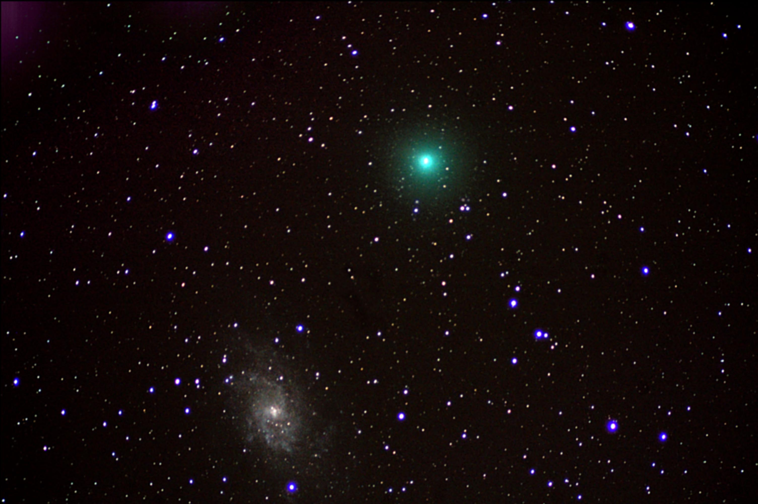
Tests of Lorentz and CPT Violation with Neutrinos
Teppei Katori
Queen Mary University of London
NExT meeting, University of Southampton, UK, Nov. 27, 2013

Slide 2
Tests of Lorentz and CPT Violation with Neutrinos
Teppei Katori
Queen Mary University of London
NExT meeting, University of Southampton, UK, Nov. 27, 2013

Slide 3
Tests of Lorentz and CPT Violation with Neutrinos
outline 1. Spontaneous Lorentz symmetry breaking 2. What is Lorentz and CPT violation?
3. Modern test of Lorentz violation
4. Test for Lorentz violation with MiniBooNE experiment
5. Test for Lorentz violation with Double Chooz experiment
6. Conclusion
Teppei Katori
Queen Mary University of London
NExT meeting, University of Southampton, UK, Nov. 27, 2013

Slide 4
1. Spontaneous Lorentz symmetry breaking
2. What is Lorentz and CPT violation? 3. Modern test of Lorentz violation
4. Test of Lorenz violation with MiniBooNE
5. Test of Lorentz violation with Double Chooz
6. Conclusion

Slide 5
1. Spontaneous Lorentz symmetry breaking (SLSB)
Every fundamental symmetry needs to be tested, including Lorentz symmetry.
After the recognition of theoretical processes that create Lorentz violation, testing Lorentz invariance becomes very exciting
Lorentz and CPT violation has been shown to occur in Planck scale theories, including:
- string theory
- noncommutative field theory
- quantum loop gravity
- extra dimensions
- etc
However, it is very difficult to build a self-consistent theory with Lorentz violation...

Slide 6
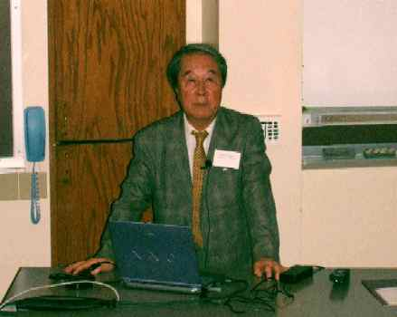
1. Spontaneous Lorentz symmetry breaking (SLSB)
Every fundamental symmetry needs to be tested, including Lorentz symmetry.
After the recognition of theoretical processes that create Lorentz violation, testing Lorentz invariance becomes very exciting
Lorentz and CPT violation has been shown to occur in Planck scale theories, including:
- string theory
- noncommutative field theory
- quantum loop gravity
- extra dimensions
- etc
However, it is very difficult to build a self-consistent theory with Lorentz violation...
Spontaneous Symmetry Breaking (SSB)!
Y. Nambu
(Nobel prize winner 2008),
picture taken from CPT04 at Bloomington, IN

Slide 7
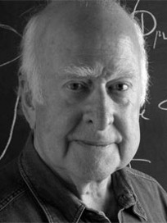
1. Spontaneous Lorentz symmetry breaking (SLSB)
vacuum Lagrangian for fermion
e.g.) SSB of scalar field in Standard Model (SM)
- If the scalar field has Mexican hat potential
SSB
φ

Slide 8
1. Spontaneous Lorentz symmetry breaking (SLSB)
vacuum Lagrangian for fermion
e.g.) SSB of scalar field in Standard Model (SM)
- If the scalar field has Mexican hat potential
φ
SSB
φ
Particle acquires mass term!

Slide 9
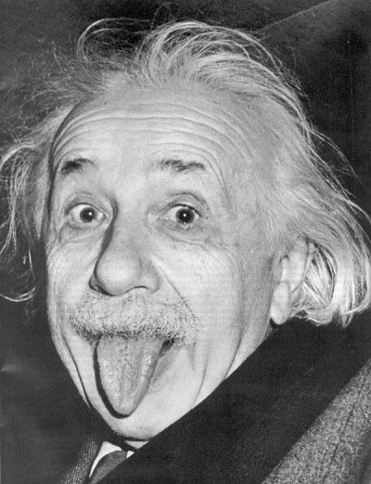
1. Spontaneous Lorentz symmetry breaking (SLSB)
Kostelecký and Samuel
PRD39(1989)683
vacuum Lagrangian for fermion
e.g.) SSB of scalar field in Standard Model (SM)
- If the scalar field has Mexican hat potential
e.g.) SLSB in string field theory
- There are many Lorentz vector fields
- If any of vector field has Mexican hat potential
φ
SSB
φ
φ
SLSB
a^{μ}

Slide 10
1. Spontaneous Lorentz symmetry breaking (SLSB)
Kostelecký and Samuel
PRD39(1989)683
vacuum Lagrangian for fermion
e.g.) SSB of scalar field in Standard Model (SM)
- If the scalar field has Mexican hat potential
e.g.) SLSB in string field theory
- There are many Lorentz vector fields
- If any of vector field has Mexican hat potential
φ
SSB
φ
φ
a^{μ}
SLSB
Lorentz symmetry is spontaneously broken!
a^{μ}

Slide 11
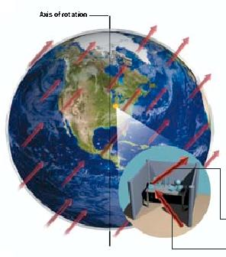
1. Spontaneous Lorentz symmetry breaking
Test of Lorentz violation is to find the coupling of these background fields and ordinary fields (electrons, muons, neutrinos, etc); then the physical quantities may depend on the rotation of the earth (sidereal time dependence).
background fields of the universe
vacuum Lagrangian for fermion
Scientific American (Sept. 2004)
PM 6:00
AM 6:00

Slide 12
1. Spontaneous Lorentz symmetry breaking
Test of Lorentz violation is to find the coupling of these background fields and ordinary fields (electrons, muons, neutrinos, etc); then the physical quantities may depend on the rotation of the earth (sidereal time dependence).
Sidereal time dependence
The smoking gun of Lorentz violation is the sidereal time dependence of the observables.
Solar time: 24h 00m 00.0s
sidereal time: 23h 56m 04.1s
Sidereal time dependent physics is often smeared out in solar time distribution
→ Maybe we have some evidence of Lorentz violation but we just didn’t notice?!
Target scale
Since it is Planck scale physics, either >10¹⁹GeV or <10⁻¹⁹GeV is the interesting region. >10¹⁹GeV is not possible (LHC is 10⁴GeV), but <10⁻¹⁹GeV is possible.
background fields of the universe
vacuum Lagrangian for fermion

Slide 13
1. Spontaneous Lorentz symmetry breaking
2. What is Lorentz and CPT violation? 3. Modern test of Lorentz violation
4. Test of Lorenz violation with MiniBooNE
5. Test of Lorentz violation with Double Chooz
6. Conclusion

Slide 14
2. What is Lorentz violation?
y
x

Slide 15
2. What is Lorentz violation?
hypothetical background vector field
moving particle
Einstein
(observer)
y
x

Slide 16
2. What is Lorentz violation?
Under the particle Lorentz transformation:
y
x

Slide 17
2. What is Lorentz violation?
Under the particle Lorentz transformation:
Lorentz violation is observable when a particle is moving in the fixed coordinate space
y
Lorentz violation!
x
Notes:
particle motion depends on direction

Slide 18
2. What is Lorentz violation?
Under the particle Lorentz transformation:
Under the observer Lorentz transformation:
Lorentz violation is observable when a particle is moving in the fixed coordinate space
y
y
x
x

Slide 19
2. What is Lorentz violation?
Under the particle Lorentz transformation:
Under the observer Lorentz transformation:
Lorentz violation is observable when a particle is moving in the fixed coordinate space
y
y
x
x

Slide 20
2. What is Lorentz violation?
Under the particle Lorentz transformation:
Under the observer Lorentz transformation:
Lorentz violation cannot be generated by observers motion (coordinate transformation is unbroken)
all observers agree for all observations
Lorentz violation is observable when a particle is moving in the fixed coordinate space
y
y
x
x
Notes:
Lorentz violating effect in one frame is conserved in other frame

Slide 21
2. CPT violation implies Lorentz violation
Greenberg, PRL(2002)231602
Lorentz invariance
Lorentz invariance of quantum field theory
CPT
CPT violation implies Lorentz violation in interactive quantum field theory.
t
t
Lorentz invariance
Lorentz invariance
causality
x
x

Slide 22
1. Spontaneous Lorentz symmetry breaking
2. What is Lorentz and CPT violation? 3. Modern test of Lorentz violation
4. Test of Lorenz violation with MiniBooNE
5. Test of Lorentz violation with Double Chooz
6. Conclusion

Slide 23
3. Test of Lorentz violation
Lorentz violation is realized as a coupling of particle fields and background fields, so the basic strategy to find Lorentz violation is:
(1) choose the coordinate system
(2) write down the Lagrangian, including Lorentz-violating terms under the formalism
(3) write down the observables using this Lagrangian

Slide 24
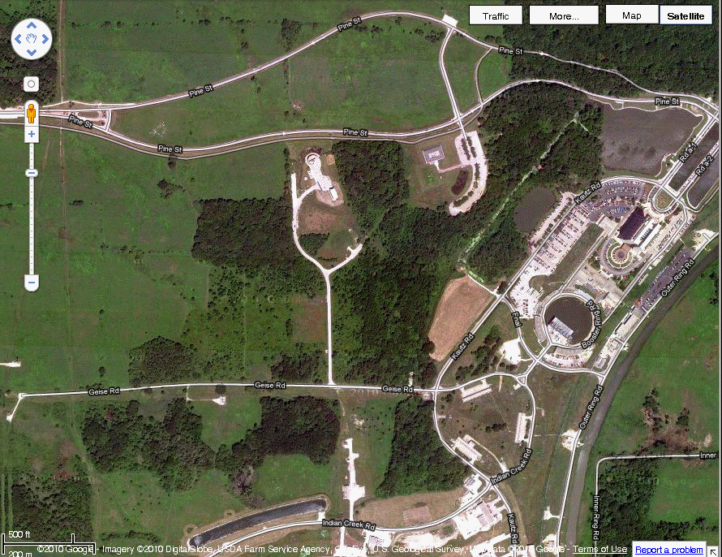
3. Test of Lorentz violation
Lorentz violation is realized as a coupling of particle fields and background fields, so the basic strategy to find Lorentz violation is:
(1) choose the coordinate system
(2) write down the Lagrangian, including Lorentz-violating terms under the formalism
(3) write down the observables using this Lagrangian
- Neutrino beamline is described in Sun-centred coordinates
Z
Vernal equinox
Fermilab Google© map
Winter
solstice
Earth
MiniBooNE
Sun
Y
541m
Summer
solstice
MI12
X
Autumn equinox
MiniBooNE beamline
Notes:
MiniBooNE experiment at Fermilab which I will discuss later

Slide 25
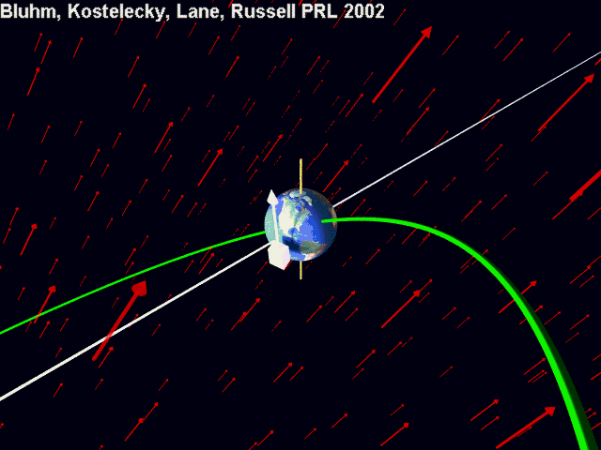

Slide 26
3. Test of Lorentz violation
Kostelecký and Mewes
PRD69(2004)016005
Lorentz violation is realized as a coupling of particle fields and background fields, so the basic strategy to find Lorentz violation is:
(1) choose the coordinate system
(2) write down the Lagrangian, including Lorentz-violating terms under the formalism
(3) write down the observables using this Lagrangian
Standard Model Extension (SME) is the standard formalism for the general search for Lorentz violation. SME is a minimum extension of QFT with Particle Lorentz violation
SME Lagrangian in neutrino sector
SME coefficients

Slide 27
3. Test of Lorentz violation
Kostelecký and Mewes
PRD69(2004)016005
Lorentz violation is realized as a coupling of particle fields and background fields, so the basic strategy to find Lorentz violation is:
(1) choose the coordinate system
(2) write down the Lagrangian, including Lorentz-violating terms under the formalism
(3) write down the observables using this Lagrangian
Standard Model Extension (SME) is the standard formalism for the general search for Lorentz violation. SME is a minimum extension of QFT with Particle Lorentz violation
SME Lagrangian in neutrino sector
SME coefficients
CPT odd
CPT even

Slide 28
3. Test of Lorentz violation
Kostelecký and Mewes
PRD70(2004)076002
Lorentz violation is realized as a coupling of particle fields and background fields, so the basic strategy to find Lorentz violation is:
(1) choose the coordinate system
(2) write down the Lagrangian, including Lorentz-violating terms under the formalism
(3) write down the observables using this Lagrangian
Various physics are predicted under SME, but among them, the smoking gun of Lorentz violation is the sidereal time dependence of the observables
solar time: 24h 00m 00.0s
sidereal time: 23h 56m 04.1s
Lorentz-violating neutrino oscillation probability for short-baseline experiments
sidereal frequency
sidereal time

Slide 29
3. Test of Lorentz violation
Kostelecký and Mewes
PRD70(2004)076002
Lorentz violation is realized as a coupling of particle fields and background fields, so the basic strategy to find Lorentz violation is:
(1) choose the coordinate system
(2) write down the Lagrangian, including Lorentz-violating terms under the formalism
(3) write down the observables using this Lagrangian
Various physics are predicted under SME, but among them, the smoking gun of Lorentz violation is the sidereal time dependence of the observables
solar time: 24h 00m 00.0s
sidereal time: 23h 56m 04.1s
Lorentz-violating neutrino oscillation probability for short-baseline experiments
Sidereal variation analysis for short baseline neutrino oscillation is 5-parameter fitting problem
sidereal frequency
sidereal time
time independent amplitude sidereal time dependent amplitude

Slide 30
3. Modern tests of Lorentz violation
Dedicated group of people formed a meeting since 1998.
http://www.physics.indiana.edu/~kostelec/faq.html

Slide 31
3. Modern tests of Lorentz violation
http://www.physics.indiana.edu/~kostelec/faq.html
Topics:
* experimental bounds on CPT and Lorentz symmetry from
measurements on K, B, and D mesons
precision comparisons of particle and antiparticle properties
(anomalous moments, charge-to-mass ratios, lifetimes, etc.)
spectroscopy of hydrogen and antihydrogen
clock-comparison tests
properties of light
other tests
* theoretical descriptions of and constraints on possible violations

Slide 32
3. Modern tests of Lorentz violation
The second meeting was in 2001.
http://www.physics.indiana.edu/~kostelec/faq.html

Slide 33
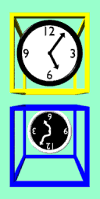
3. Modern tests of Lorentz violation
The third meeting was in 2004.
http://www.physics.indiana.edu/~kostelec/faq.html

Slide 34
3. Modern tests of Lorentz violation
The third meeting was in 2004.
http://www.physics.indiana.edu/~kostelec/faq.html
Steve King

Slide 35
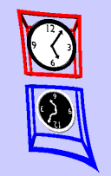
3. Modern tests of Lorentz violation
The fourth meeting was in 2007.
http://www.physics.indiana.edu/~kostelec/faq.html
Notes:
poster session starts from 2007

Slide 36
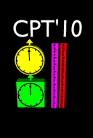
3. Modern tests of Lorentz violation
The fifth meeting was in 2010.
http://www.physics.indiana.edu/~kostelec/faq.html
Notes:
poster session starts from 2007

Slide 37
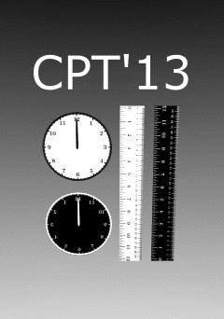
3. Modern tests of Lorentz violation
The latest meeting was in June 2013
http://www.physics.indiana.edu/~kostelec/faq.html
Notes:
We took the first group photo

Slide 38
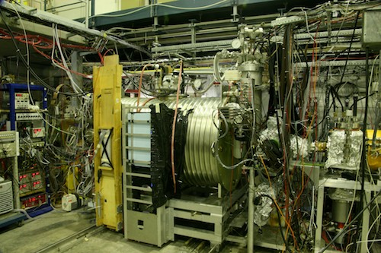
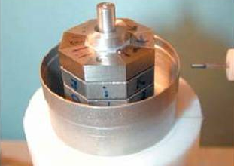
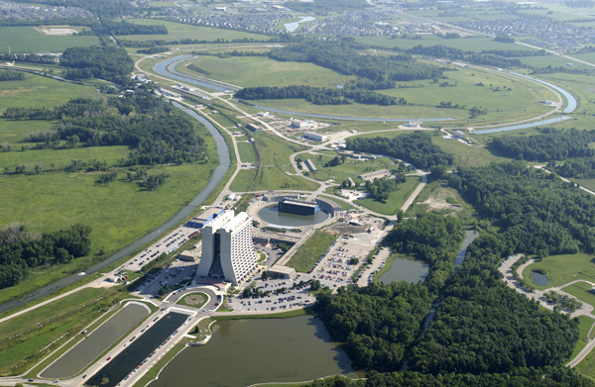
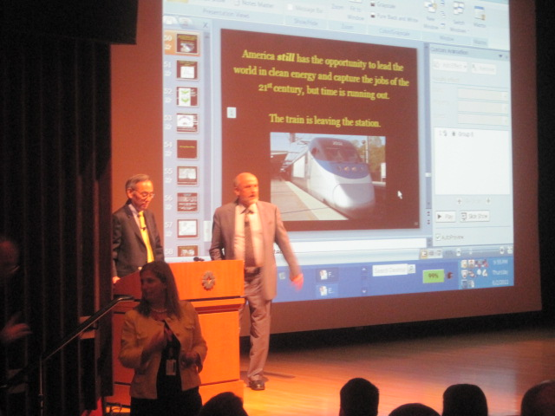
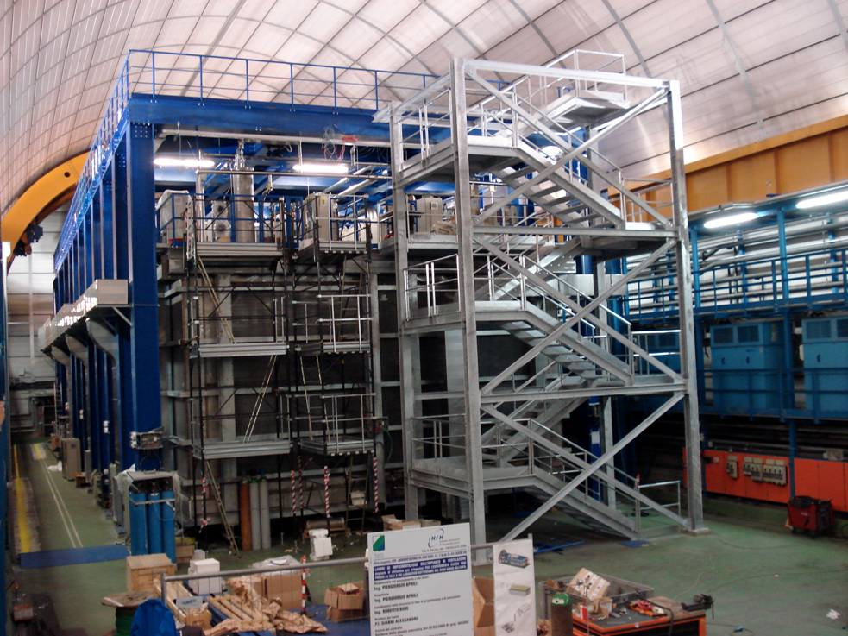
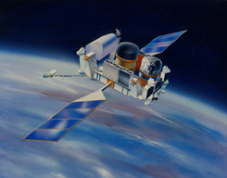
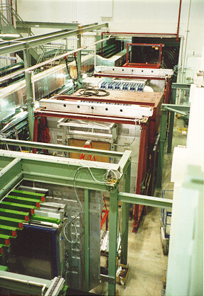
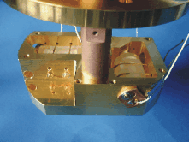
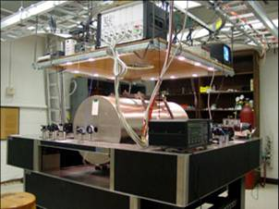
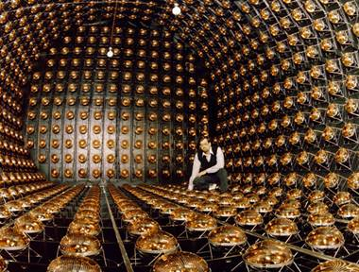
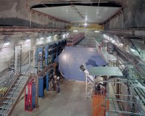
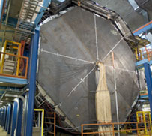
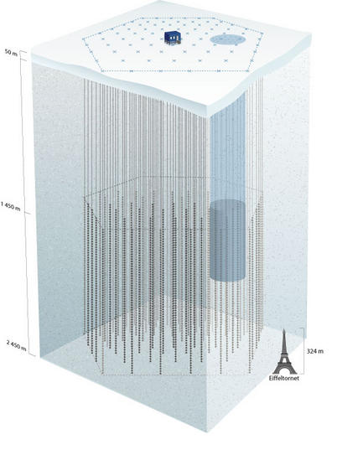
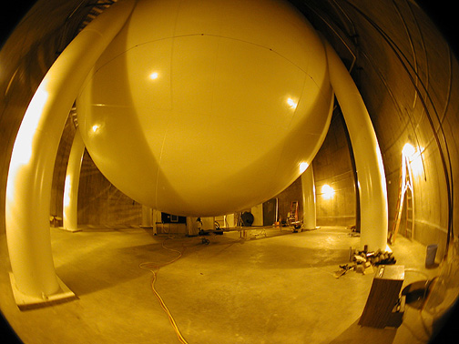
4. Modern tests of Lorentz violation
CERN Antiproton Decelerator
(M_{p}-M_{p})/M_{p}<10⁻⁸
Spin torsion pendulum
b_{e}<10⁻³⁰ GeV
Tevatron and LEP
-5.8x10⁻¹²<κ_{tr}-4/3c_{e}⁰⁰<1.2x10⁻¹¹
Atomic Interferometer
(a,c)^{n,p,e} <10⁻⁶
Steven Chu
http://www.physics.indiana.edu/~kostelec/faq.html
Topics:
experimental and observational searches for CPT and Lorentz violation involving
accelerator and collider experiments
atomic, nuclear, and particle decays
birefringence, dispersion, and anisotropy in cosmological sources
clock-comparison measurements
CMB polarization
electromagnetic resonant cavities and lasers
tests of the equivalence principle
gauge and Higgs particles
high-energy astrophysical observations
laboratory and gravimetric tests of gravity
matter interferometry
neutrino oscillations and propagation, neutrino-antineutrino mixing
oscillations and decays of K, B, D mesons
particle-antiparticle comparisons
post-newtonian gravity in the solar system and beyond
second- and third-generation particles
sidereal and annual time variations, compass asymmetries
space-based missions
spectroscopy of hydrogen and antihydrogen
spin-polarized matter
time-of-flight measurements
theoretical and phenomenological studies of CPT and Lorentz violation involving
physical effects at the level of the Standard Model, General Relativity, and beyond
origins and mechanisms for violations
classical and quantum field theory, particle physics, classical and quantum gravity, string theory
mathematical foundations, Finsler geometry
Nature419(2002)456
PRL97(2006)021603
PRL102(2009)170402
PRL106(2011)151102
Neutrino TOF
(v-c)/c <10⁻⁵
GRB vacuum birefringence
κ_{e+}, κ_{o-}<10⁻³⁷
KTeV/KLOE (strange)
Δa_{K}<10⁻²² GeV
FOCUS (charm)
Δa_{D}<10⁻¹⁶ GeV
BaBar/Belle (bottom)
Δm_{B}/m_{B}<10⁻¹⁴
Limits from all these experiments >50 page tables!
Rev.Mod.Phys.83(2011)11
ArXiv:0801.0287v6
PRD76(2007)072005
JHEP11(2012)049
PRL97(2006)140401
Test of Lorentz invariance with neutrino oscillation is very interesting, because neutrinos are the least known standard model particles!
Double gas maser
b_{n}(rotation)<10⁻³³GeV
b_{n}(boost)<10⁻²⁷GeV
Cryogenic optical resonator
Δc/c<10⁻¹⁶
LSND MINOS ND MINOS FD IceCube MiniBooNE Double Chooz
PRD72(2005)076004 PRL101(2008)151601 PRL105(2010)151601 PRD82(2010)112003 PLB718(2013)1303 PRD86(2013)112009
PLB556(2003)7
PRL100(2008)131802
PRL105(2010)151604
PRL107(2010)171604
PRL99(2007)050401
Notes:
Chu’s paper is 2011 (when he is DOE secretary)
meson oscillation is the only way to test Lorentz violation for second and third generation quarks

Slide 39
1. Spontaneous Lorentz symmetry breaking
2. What is Lorentz and CPT violation? 3. Modern test of Lorentz violation
4. Test of Lorenz violation with MiniBooNE
5. Test of Lorentz violation with Double Chooz
6. Conclusion

Slide 40
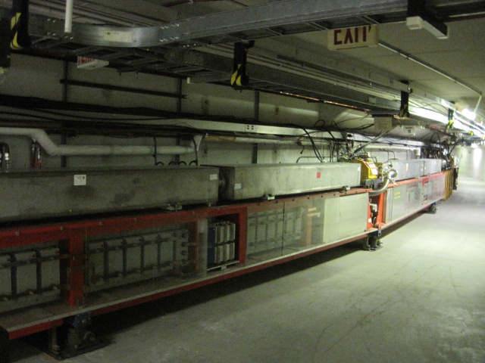
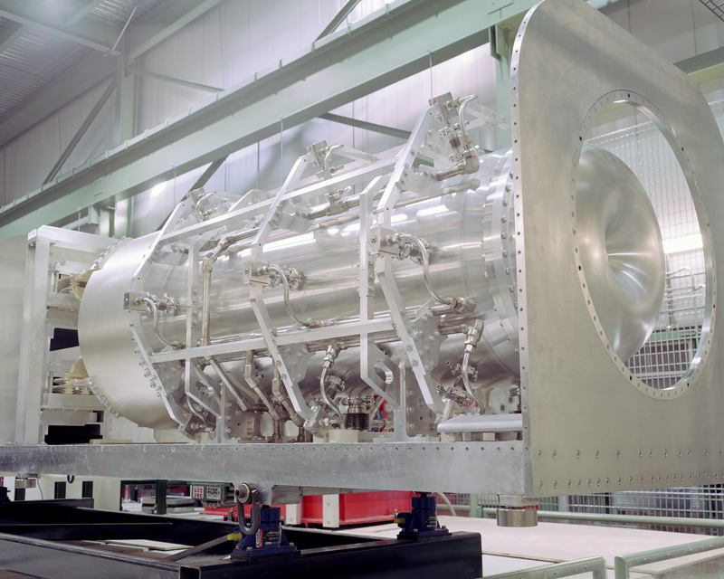
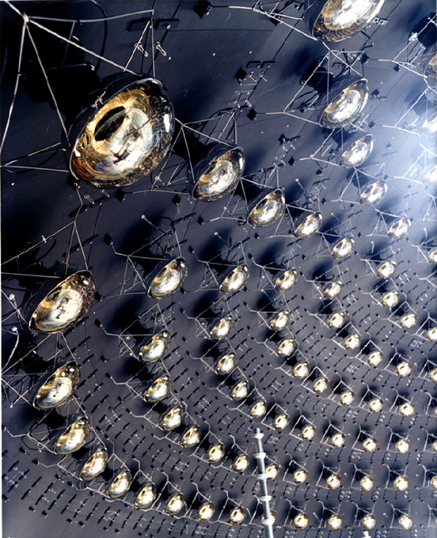
4. MiniBooNE experiment
MiniBooNE collaboration,
PRD79(2009)072002
NIM.A599(2009)28
MiniBooNE is a short-baseline neutrino oscillation experiment at Fermilab.
Booster Neutrino Beamline (BNB) creates ~800(600)MeV neutrino(anti-neutrino) by pion decay-in-flight. Cherenkov radiation from the charged leptons are observed by MiniBooNE Cherenkov detector to reconstruct neutrino energy.
FNAL Booster
Magnetic focusing horn
MiniBooNE detector
~520m
primary beam
secondary beam
tertiary beam
(8 GeV protons)
(1-2 GeV pions)
(800 MeV ν_{μ} , 600 MeV anti-ν_{μ})
1280 of 8” PMT

Slide 41
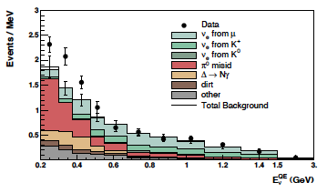
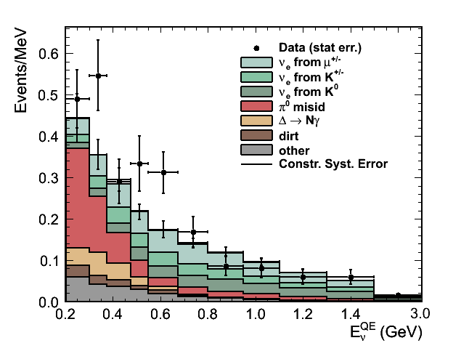
4. MiniBooNE experiment
MiniBooNE collaboration,
PRL102(2009)101802,
PRL105(2010)181801
MiniBooNE is a short-baseline neutrino oscillation experiment at Fermilab.
Neutrino mode analysis: MiniBooNE saw the 3.0σ excess at low energy region
Antineutrino mode analysis: MiniBooNE saw the 1.4σ excess at low and high energy region
MiniBooNE low E ν_{e} excess
MiniBooNE anti-ν_{e} excess
475MeV
475MeV
low energy high energy
low energy high energy

Slide 42
4. Lorentz violation with MiniBooNE neutrino data
MiniBooNE collaboration,
PLB718(2013)1303
MiniBooNE is a short-baseline neutrino oscillation experiment at Fermilab.
Neutrino mode analysis: MiniBooNE saw the 3.0σ excess at low energy region
Antineutrino mode analysis: MiniBooNE saw the 1.4σ excess at low and high energy region
Neutrino mode
Electron neutrino candidate data prefer sidereal time independent solution (flat)
Electron antineutrino candidate data prefer sidereal time dependent solution, however statistical significance is marginal
We find no evidence of Lorentz violation
Antineutrino mode

Slide 43
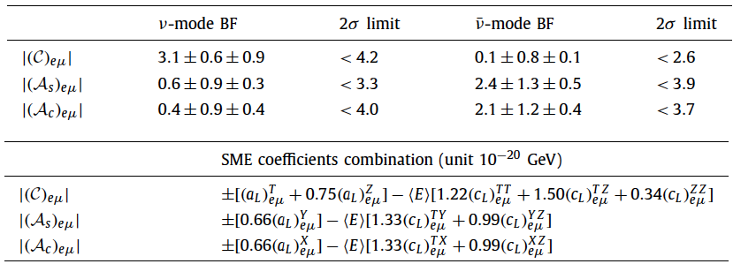
4. Lorentz violation with MiniBooNE neutrino data
MiniBooNE collaboration,
PLB718(2013)1303
MiniBooNE is a short-baseline neutrino oscillation experiment at Fermilab.
Neutrino mode analysis: MiniBooNE saw the 3.0σ excess at low energy region
Antineutrino mode analysis: MiniBooNE saw the 1.4σ excess at low and high energy region
Since we find no evidence of Lorentz violation, we set limits on the combination SME coefficients.

Slide 44
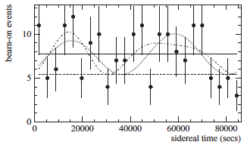
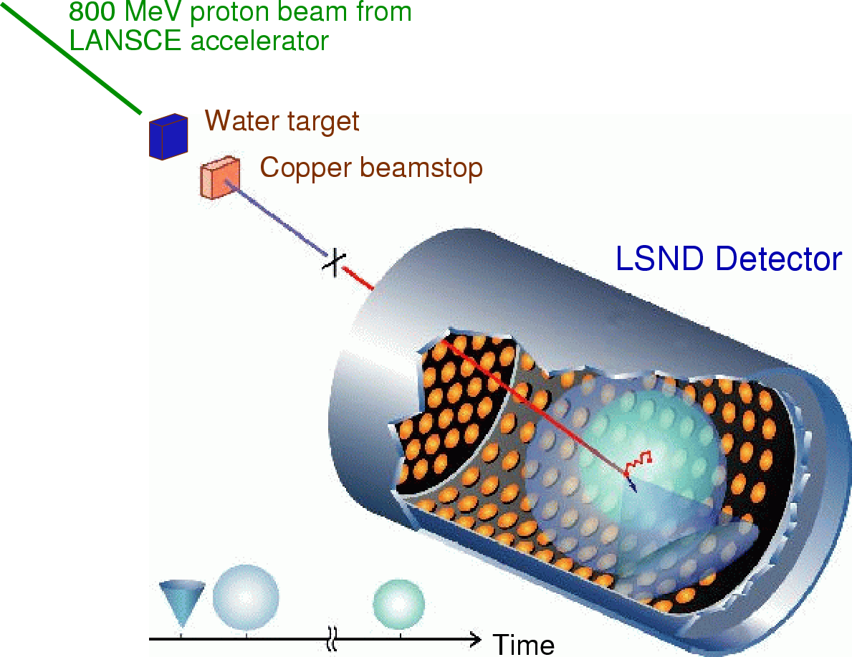
4. Summary of results
LSND collaboration,
PRD72(2005)076004
LSND experiment
LSND is a short-baseline neutrino oscillation experiment at Los Alamos.
LSND saw the 3.8σ excess of electron antineutrinos from muon antineutrino beam; since this excess is not understood by neutrino Standard Model, it might be new physics
Data is consistent with flat solution, but sidereal time solution is not excluded.
LSND oscillation candidate sidereal time distribution
L/E~30m/30MeV~1
data
flat solution
3-parameter fit
5-parameter fit
~10⁻¹⁹ GeV CPT-odd or ~10⁻¹⁷ CPT-even Lorentz violation could be the solution of LSND excess

Slide 45
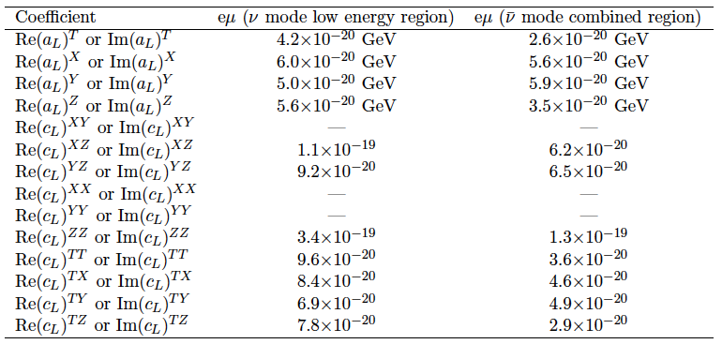
4. Summary of results
TK,
MPLA27(2012)1230024
Since we find no evidence of Lorentz violation from MiniBooNE analysis, we set limits on the SME coefficients.
These limits exclude SME values to explain LSND data, therefore there is no simple Lorentz violation motivated scenario to accommodate LSND and MiniBooNE results simultaneously
Notes:
By the way now we have twice more data for antineutrino so I am thinking update of this analysis.

Slide 46
1. Spontaneous Lorentz symmetry breaking
2. What is Lorentz and CPT violation? 3. Modern test of Lorentz violation
4. Test of Lorenz violation with MiniBooNE
5. Test of Lorentz violation with Double Chooz
6. Conclusion

Slide 47
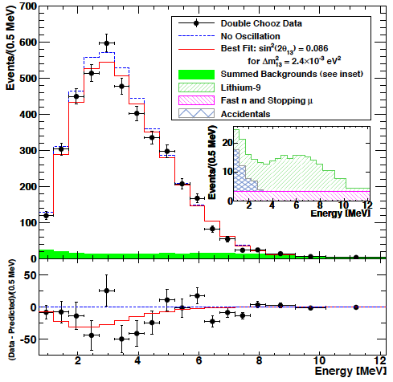
5. Double Chooz experiment
Double Chooz collaboration
PRL108(2012)131801
Reactor electron antineutrino disappearance experiment
- The first result shows small anti-ν_{e} disappearance!
Double Chooz reactor neutrino candidate
Notes:
Say I am invited for Double Chooz analysis

Slide 48
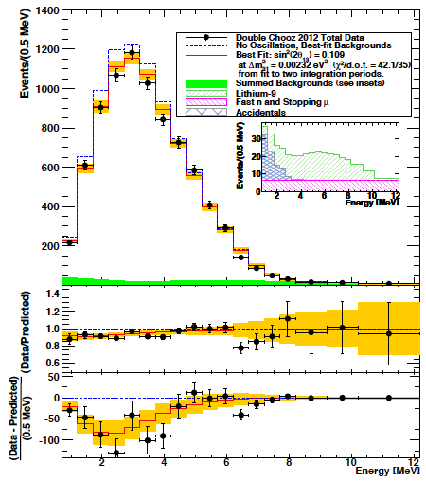
5. Double Chooz experiment
Double Chooz collaboration
PRL108(2012)131801
PRD86(2012)052008
DayaBay collaboration
PRL108(2012)171803
RENO collaboration
PRL108(2012)191802
Reactor electron antineutrino disappearance experiment
- The first result shows small anti-ν_{e} disappearance!
- The second result reaches 3.1σ signal
- DayaBay and RENO experiments saw disappearance signals, too
Double Chooz reactor neutrino candidate
Notes:
Say I am invited for Double Chooz analysis

Slide 49
5. Double Chooz experiment
Reactor electron antineutrino disappearance experiment
- The first result shows small anti-ν_{e} disappearance!
- The second result reaches 3.1σ signal
- DayaBay and RENO experiments saw disappearance signals, too
Double Chooz reactor neutrino candidate
The Big Bang Theory (CBS)
Notes:
Say I am invited for Double Chooz analysis

Slide 50
5. Double Chooz experiment
Reactor electron antineutrino disappearance experiment
- The first result shows small anti-ν_{e} disappearance!
- The second result reaches 3.1σ signal
- DayaBay and RENO experiments saw disappearance signals, too
- This small disappearance may have sidereal time dependence
Double Chooz reactor neutrino candidate
The Big Bang Theory (CBS)
Leonard: What do you think about the latest Double Chooz result?
Sheldon: I think this is Lorentz violation..., check sidereal time dependence
Notes:
Say I am invited for Double Chooz analysis

Slide 51
5. Double Chooz experiment
Double Chooz collaboration,
paper in preparation
So far, we have set limits on
1. ν_{e}↔ν_{μ} channel: LSND, MiniBooNE, MINOS (<10⁻²⁰ GeV)
2. ν_{μ}↔ν_{τ} channel: MINOS, IceCube (<10⁻²³ GeV)
The last untested channel is ν_{e}↔ν_{τ}
It is possible to limit ν_{e}↔ν_{τ} channel from reactor ν_{e} disappearance experiment
P(ν_{e}↔ν_{e}) = 1 - P(ν_{e}↔ν_{μ}) - P(ν_{e}↔ν_{τ}) ~ 1 – P(ν_{e}↔ν_{τ})
The Big Bang Theory (CBS)
Leonard: What do you think about the latest Double Chooz result?
Sheldon: I think this is Lorentz violation..., check sidereal time dependence
Notes:
Say I am invited for Double Chooz analysis

Slide 52
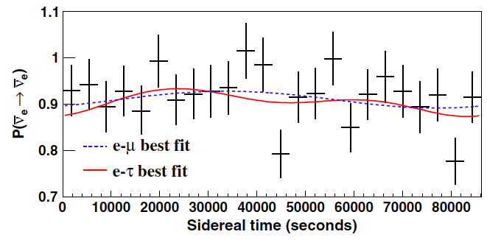
5. Double Chooz experiment
Double Chooz collaboration,
PRD86(2012)112009
So far, we have set limits on
1. ν_{e}↔ν_{μ} channel: LSND, MiniBooNE, MINOS (<10⁻²⁰ GeV)
2. ν_{μ}↔ν_{τ} channel: MINOS, IceCube (<10⁻²³ GeV)
The last untested channel is ν_{e}↔ν_{τ}
It is possible to limit ν_{e}↔ν_{τ} channel from reactor ν_{e} disappearance experiment
P(ν_{e}↔ν_{e}) = 1 - P(ν_{e}↔ν_{μ}) - P(ν_{e}↔ν_{τ}) ~ 1 – P(ν_{e}↔ν_{τ})
Double Chooz reactor neutrino data/prediction ratio
Small disappearance signal prefers sidereal time independent solution (flat)
We set limits in the e-τ sector for the first time; ν_{e}↔ν_{τ} (<10⁻²⁰ GeV)
Notes:
Say I am invited for Double Chooz analysis

Slide 53
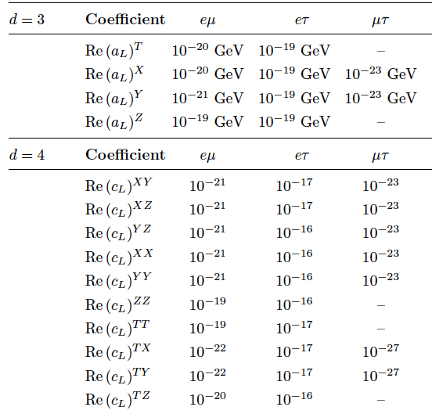
5. Double Chooz experiment
Kostelecký and Russel
Rev.Mod.Phys.83(2011)11
ArXiv:0801.0287v6
MiniBooNE Double Chooz IceCube
MINOS ND MINOS FD
By this work, Lorentz violation is tested with all neutrino channels
Chance to see the Lorentz violation in terrestrial neutrino experiments will be very small
Notes:
Say I am invited for Double Chooz analysis

Slide 54
5. Anomalous energy spectrum
Díaz, Kostelecký, Mewes
PRD80(2009)076007
Sidereal variation is one of many predicted phenomena of Lorentz violating neutrino oscillations.
Lorentz violation predicts unexpected energy dependence of neutrino oscillations from standard neutrino mass oscillations.
Effective Hamiltonian for
neutrino oscillation
This is very useful to differentiate 2 effects:
- massive neutrino oscillation
- sidereal time independent Lorentz violating neutrino oscillation
Double Chooz released its energy spectrum (with full error matrix). We use this to test time independent Lorentz violating neutrino oscillation.
massive neutrino oscillation Lorentz violating neutrino oscillation
Notes:
Say I am invited for Double Chooz analysis

Slide 55
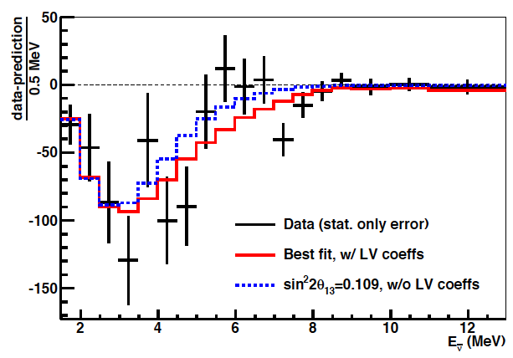
5. Double Chooz spectrum fit
Díaz, TK, Spitz, Conrad
PLB727(2013)412
Neutrino-Antineutrino oscillation
- Most of neutrino-neutrino oscillation channels are constraint from past analyses
- Here, we focus to test neutrino-antineutrino oscillation (conservation of angular momentum)
ex) anti-ν_{e}→ν_{e} oscillation fit with Double Chooz data
These fits provide first limits on neutrino-antineutrino time independent Lorentz violating coefficients
Notes:
Say I am invited for Double Chooz analysis

Slide 56
Conclusion
Lorentz and CPT violation has been shown to occur in Planck-scale theories.
There is a world wide effort to test Lorentz violation with various state-of-the-art technologies.
MiniBooNE sets limits on Lorentz violation on ν_{μ}→ν_{e} oscillation coefficients. These limits together with MINOS exclude simple Lorentz violation motivated scenario to explain LSND anomaly.
MiniBooNE, LSND, MINOS, IceCube, and Double Chooz set stringent limits on Lorentz violation in neutrino sector in terrestrial level.
Thank you for your attention!

Slide 57
backup

Slide 58
2. Comment: Is there preferred frame?
As we see, all observers are related with observer’s Lorentz transformation, so there is no special “preferred” frame (all observer’s are consistent)
But there is a frame where universe looks isotropic even with a Lorentz violating vector field. You may call that is the “preferred frame”, and people often speculate the frame where CMB looks isotropic is such a frame (called “CMB frame”).
However, we are not on CMB frame (e.g., dipole term of WMAP is nonzero), so we expect anisotropy by lab experiments even CMB frame is the preferred frame.

Slide 59
2. What is CPT violation?
CPT symmetry is the invariance under the CPT transformation
P: parity transformation
T: time reversal
C: charge conjugation

Slide 60
2. What is CPT violation?
Jost, Helv.Phys.Acta.30(1957)409
CPT symmetry is the invariance under the CPT transformation
CPT is the perfect symmetry of the Standard Model, due to CPT theorem
CPT theorem
If the relativistic transformation law and the weak microcausality holds in a real neighbourhood of a Jost point, the CPT condition holds everywhere.
number of Lorentz indices
→ always even number
CPT phase = (-1)^{n}

Slide 61
2. What is CPT violation?
CPT symmetry is the invariance under the CPT transformation
CPT is the perfect symmetry of the Standard Model, due to CPT theorem
CPT-even
CPT-odd
QED
Weak
QCD

Slide 62
2. What is CPT violation?
CPT symmetry is the invariance under the CPT transformation
CPT is the perfect symmetry of the Standard Model, due to CPT theorem
CPT-even
CPT-odd
QED
Weak
QCD
Lorentz violation
CPT-odd Lorentz violating coefficients (odd number Lorentz indices, e.g., a^{μ} , g^{λμν} )
CPT-even Lorentz violating coefficients (even number Lorentz indices, e.g., c^{μν} , κ^{αβμν} )

Slide 63
4. Neutrino oscillations, natural interferometers
Neutrino oscillation is an interference experiment (cf. double slit experiment)
light source
slits
screen
ν₁
ν₂
interference pattern
For double slit experiment, if path ν₁ and path ν₂ have different length, they have different phase rotations and it causes interference.

Slide 64
4. Neutrino oscillations, natural interferometers
Neutrino oscillation is an interference experiment (cf. double slit experiment)
ν_{μ}
ν_{μ}
If 2 neutrino Hamiltonian eigenstates, ν₁ and ν₂, have different phase rotation, they cause quantum interference.

Slide 65
4. Neutrino oscillations, natural interferometers
Neutrino oscillation is an interference experiment (cf. double slit experiment)
ν_{μ}
U_{μ1}
ν₁
U_{e1}∗
ν₂
ν_{μ}
ν₂
ν₁
If 2 neutrino Hamiltonian eigenstates, ν₁ and ν₂, have different phase rotation, they cause quantum interference.
If ν₁ and ν₂, have different mass, they have different velocity, so thus different phase rotation.

Slide 66
4. Neutrino oscillations, natural interferometers
Neutrino oscillation is an interference experiment (cf. double slit experiment)
ν_{e}
ν_{e}
ν_{e}
ν_{μ}
U_{μ1}
ν₁
U_{e1}∗
ν₂
ν_{μ}
ν_{e}
If 2 neutrino Hamiltonian eigenstates, ν₁ and ν₂, have different phase rotation, they cause quantum interference.
If ν₁ and ν₂, have different mass, they have different velocity, so thus different phase rotation.
The detection may be different flavor (neutrino oscillations).

Slide 67
4. Lorentz violation with neutrino oscillation
Neutrino oscillation is an interference experiment (cf. double slit experiment)
ν_{μ}
ν_{μ}
If 2 neutrino Hamiltonian eigenstates, ν₁ and ν₂, have different phase rotation, they cause quantum interference.

Slide 68
4. Lorentz violation with neutrino oscillation
Neutrino oscillation is an interference experiment (cf. double slit experiment)
ν_{μ}
U_{μ1}
ν₁
U_{e1}∗
ν₂
ν_{μ}
ν₂
ν₁
If 2 neutrino Hamiltonian eigenstates, ν₁ and ν₂, have different phase rotation, they cause quantum interference.
If ν₁ and ν₂, have different coupling with Lorentz violating field, neutrinos also oscillate.
The sensitivity of neutrino oscillation is comparable the target scale of Lorentz violation (<10⁻¹⁹GeV).

Slide 69
4. Lorentz violation with neutrino oscillation
Neutrino oscillation is an interference experiment (cf. double slit experiment)
ν_{μ}
ν_{μ}
ν_{μ}
ν_{e}
ν_{e}
ν_{e}
ν_{μ}
U_{μ1}
ν₁
U_{μ1}∗
U_{e1}∗
ν₂
ν_{μ}
ν_{μ}
ν_{e}
If 2 neutrino Hamiltonian eigenstates, ν₁ and ν₂, have different phase rotation, they cause quantum interference.
If ν₁ and ν₂, have different coupling with Lorentz violating field, neutrinos also oscillate.
The sensitivity of neutrino oscillation is comparable the target scale of Lorentz violation (<10⁻¹⁹GeV).
If neutrino oscillation is caused by Lorentz violation, interference pattern (oscillation probability) may have sidereal time dependence.

Slide 70
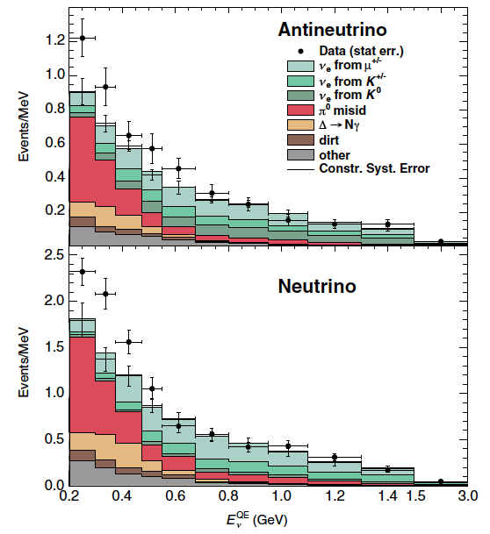
2. MiniBooNE
MiniBooNE collaboration,PRL110(2013)161801
MiniBooNE observed event excesses in both mode
Neutrino mode
162.0 ± 28.1 ± 38.7 (3.4σ)
Antineutrino mode
78.9 ± 20.0 ± 20.3 (2.8σ)

Slide 71
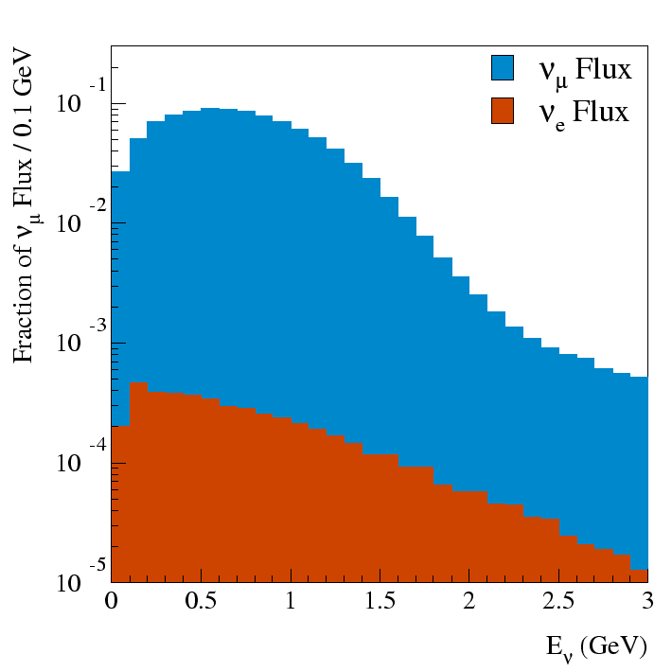
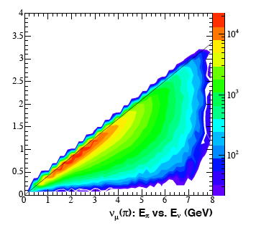
2. MiniBooNE
MiniBooNE collaboration,PRL110(2013)161801
MiniBooNE observed event excesses in both mode
Neutrino mode
162.0 ± 28.1 ± 38.7 (3.4σ)
Antineutrino mode
78.9 ± 20.0 ± 20.3 (2.8σ)
E_{ν} (GeV)
Eν-Eπ space
π → μ ν_{μ}
E_{ν} = 0.43 E_{π}
ν_{e} from μ decay is constrained from ν_{μ}CCQE measurement
μ → e ν_{μ} ν_{e}
E_{π}(GeV)

Slide 72
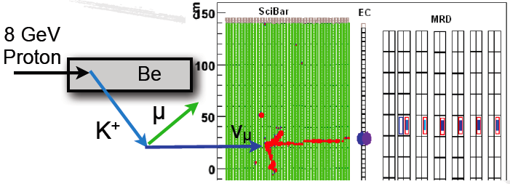
2. MiniBooNE
MiniBooNE collaboration,PRL110(2013)161801
SciBooNE 3 track event
MiniBooNE observed event excesses in both mode
Neutrino mode
162.0 ± 28.1 ± 38.7 (3.4σ)
Antineutrino mode
78.9 ± 20.0 ± 20.3 (2.8σ)
ν_{e} from μ decay is constrained from ν_{μ}CCQE measurement
SciBooNE collaboration
PRD84(2011)012009
ν_{e} from Κ decay is constrained from high energy ν_{μ} event measurement in SciBooNE

Slide 73
2. MiniBooNE
MiniBooNE collaboration,PRL110(2013)161801
1. LSND
2. MiniBooNE
3. OscSNS
4. MiniBooNE+
5. MicroBooNE
6. Sterile neutrino
Asymmetric decay
MiniBooNE observed event excesses in both mode
Neutrino mode
162.0 ± 28.1 ± 38.7 (3.4σ)
Antineutrino mode
78.9 ± 20.0 ± 20.3 (2.8σ)
π^{ο}
π^{ο}
NCπº event
ν_{e} from μ decay is constrained from ν_{μ}CCQE measurement
ν_{e} from Κ decay is constrained from high energy ν_{μ} event measurement in SciBooNE
Radiative Δ-decay (Δ→Nγ) rate is constrained from measured NCπº
Asymmetric πº decay is constrained from measured CCπº rate (πº→γ)

Slide 74
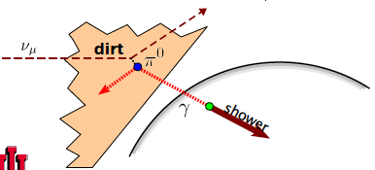
2. MiniBooNE
MiniBooNE collaboration,PRL110(2013)161801
1. LSND
2. MiniBooNE
3. OscSNS
4. MiniBooNE+
5. MicroBooNE
6. Sterile neutrino
MiniBooNE observed event excesses in both mode
Neutrino mode
162.0 ± 28.1 ± 38.7 (3.4σ)
Antineutrino mode
78.9 ± 20.0 ± 20.3 (2.8σ)
ν_{e} from μ decay is constrained from ν_{μ}CCQE measurement
dirt rate is measured from dirt enhanced data sample
ν_{e} from Κ decay is constrained from high energy ν_{μ} event measurement in SciBooNE
Radiative Δ-decay (Δ→Nγ) rate is constrained from measured NCπº
Asymmetric πº decay is constrained from measured CCπº rate (πº→γ)

Slide 75
2. MiniBooNE
MiniBooNE collaboration,PRL110(2013)161801
1. LSND
2. MiniBooNE
3. OscSNS
4. MiniBooNE+
5. MicroBooNE
6. Sterile neutrino
MiniBooNE observed event excesses in both mode
Neutrino mode
162.0 ± 28.1 ± 38.7 (3.4σ)
Antineutrino mode
78.9 ± 20.0 ± 20.3 (2.8σ)
ν_{e} from μ decay is constrained from ν_{μ}CCQE measurement
dirt rate is measured from dirt enhanced data sample
ν_{e} from Κ decay is constrained from high energy ν_{μ} event measurement in SciBooNE
Radiative Δ-decay (Δ→Nγ) rate is constrained from measured NCπº
All backgrounds are measured in other data sample and their errors are constrained!
Asymmetric πº decay is constrained from measured CCπº rate (πº→γ)

Slide 76
6. Lorentz violation with MiniBooNE
Kostelecký and Mewes
PRD70(2004)076002
Sidereal variation of neutrino oscillation probability for MiniBooNE (5 parameters)
Expression of 5 observables (14 SME parameters)
coordinate dependent direction vector (depends on the latitude of FNAL, location of BNB and MiniBooNE detector)
Notes:
You can at most find 5 constraint for 14 free parameters

