Slide 1






PRECISION COSMOLOGY AND NEW PHYSICS
$$ν_{s}$$
$$a$$
$$N_{eff}$$
$$r$$
$$f(r)$$
$$f_{NL}$$
STEEN HANNESTAD, AARHUS UNIVERSITY
NExT, SOUTHAMPTON, 27 NOVEMBER 2013

Slide 2
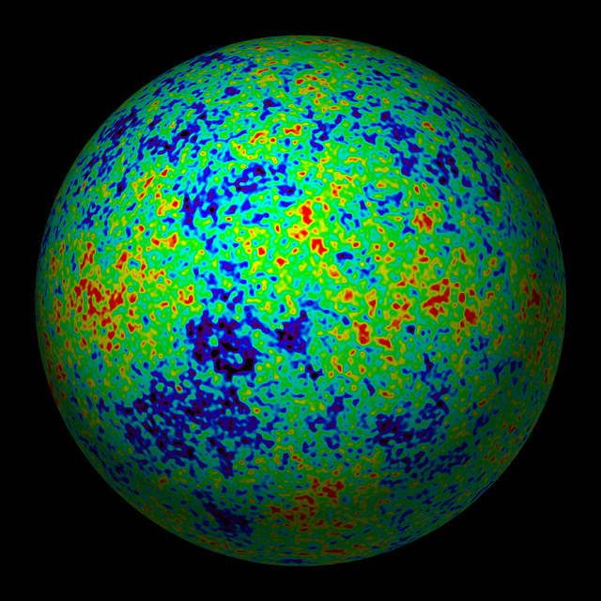
THE COSMIC MICROWAVE BACKGROUND
CMB TEMPERATURE MAP

Slide 3
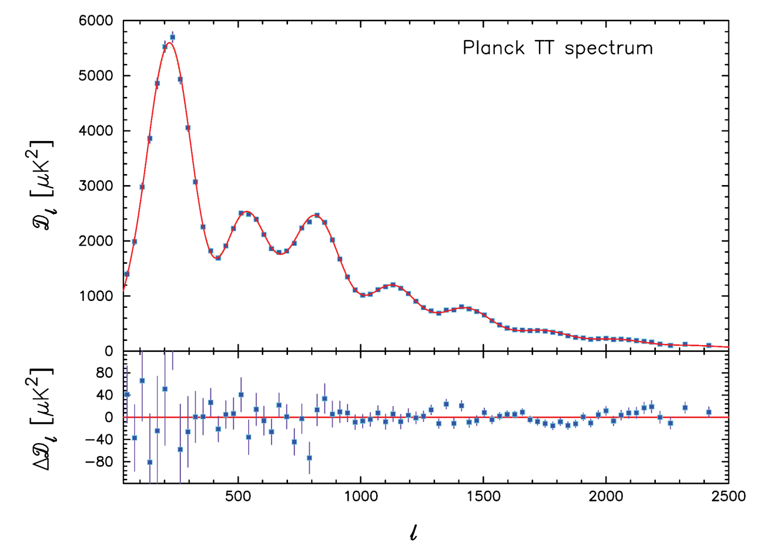
PLANCK TEMPERATURE POWER SPECTRUM
ADE ET AL, ARXIV 1303.5076
ADDITIONAL DATA ON SMALLER SCALES FROM
ATACAMA COSMOLOGY TELESCOPE (Sievers et al. 2013)
SOUTH POLE TELESCOPE (Hou et al. 2012)

Slide 4
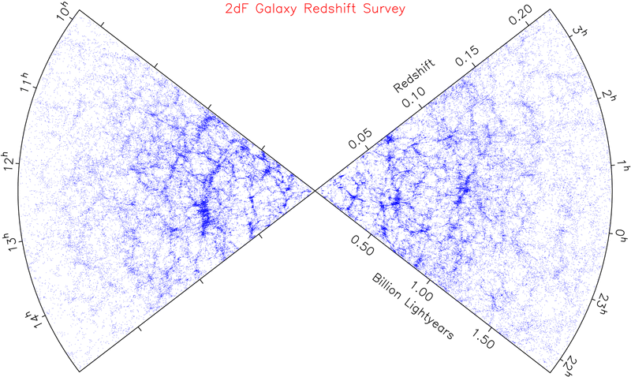
LARGE SCALE STRUCTURE SURVEYS - 2dF AND SDSS

Slide 5
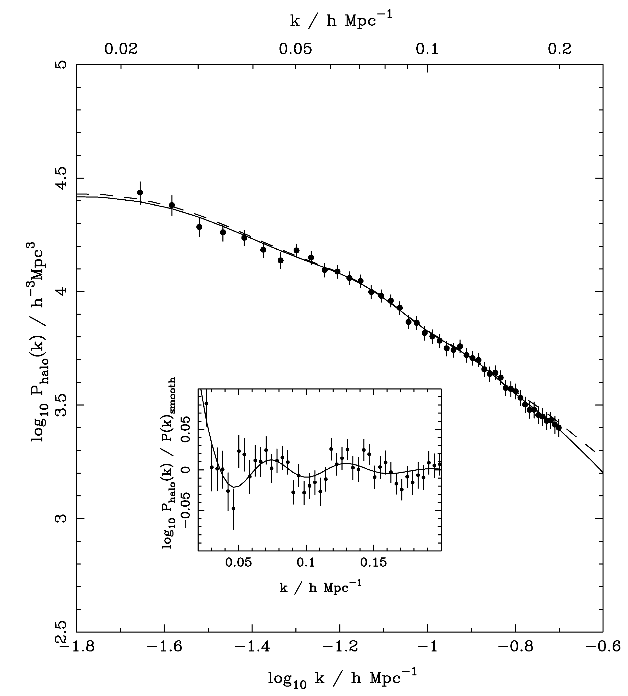
SDSS DR-7
LRG SPECTRUM
(Reid et al ’09)

Slide 6

Energy content of the early universe
Dark radiation
Early dark energy
Neutrinos
Axions
Energy content of the late universe
Dark matter
Dark energy
Neutrinos
Gravity in the late universe
$f(r)$ gravity etc
New physics
Gravity in the early universe
ADD, Randall-Sundrum etc
Initial conditions/
Inflation
Matter power spectrum
Non-Gaussianity
Tensor modes

Slide 7
Fermion Mass Spectrum
Q = −1/3
d
s
b
Q = +2/3
u
c
t
Charged Leptons
e
μ
τ
All flavors
Neutrinos
ν₃
1
10
100
1
10
100
1
10
100
1
10
100
1
10
100
1
meV
eV
keV
MeV
GeV
TeV

Slide 8
NEUTRINO MIXING
FLAVOUR STATES
PROPAGATION STATES
MIXING MATRIX (UNITARY)

Slide 9
FLAVOUR STATES
PROPAGATION STATES
MIXING MATRIX (UNITARY)
LATE-TIME COSMOLOGY IS (ALMOST)
INSENSITIVE TO THE MIXING STRUCTURE

Slide 10
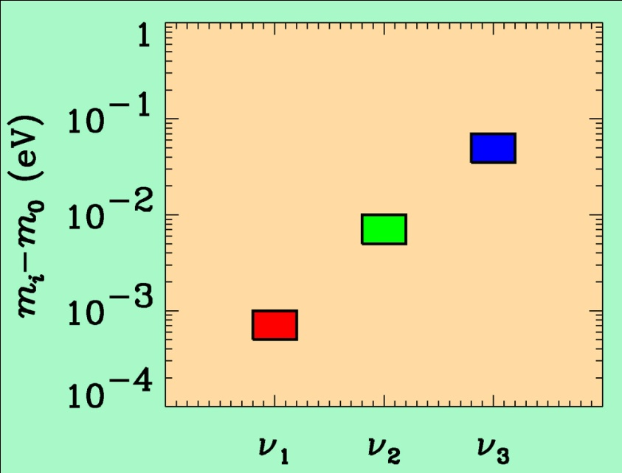
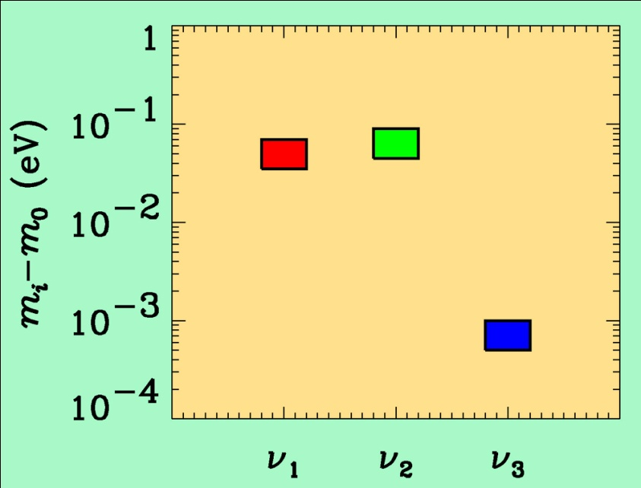
If neutrino masses are hierarchical then oscillation experiments
do not give information on the absolute value of neutrino masses
ATMO. ν
K2K
MINOS
SOLAR ν
KAMLAND
Normal hierarchy
Inverted hierarchy
However, if neutrino masses are degenerate
no information can be gained from such experiments.
Experiments which rely on either the kinematics of neutrino mass
or the spin-flip in neutrinoless double beta decay are the most
efficient for measuring m₀

Slide 11
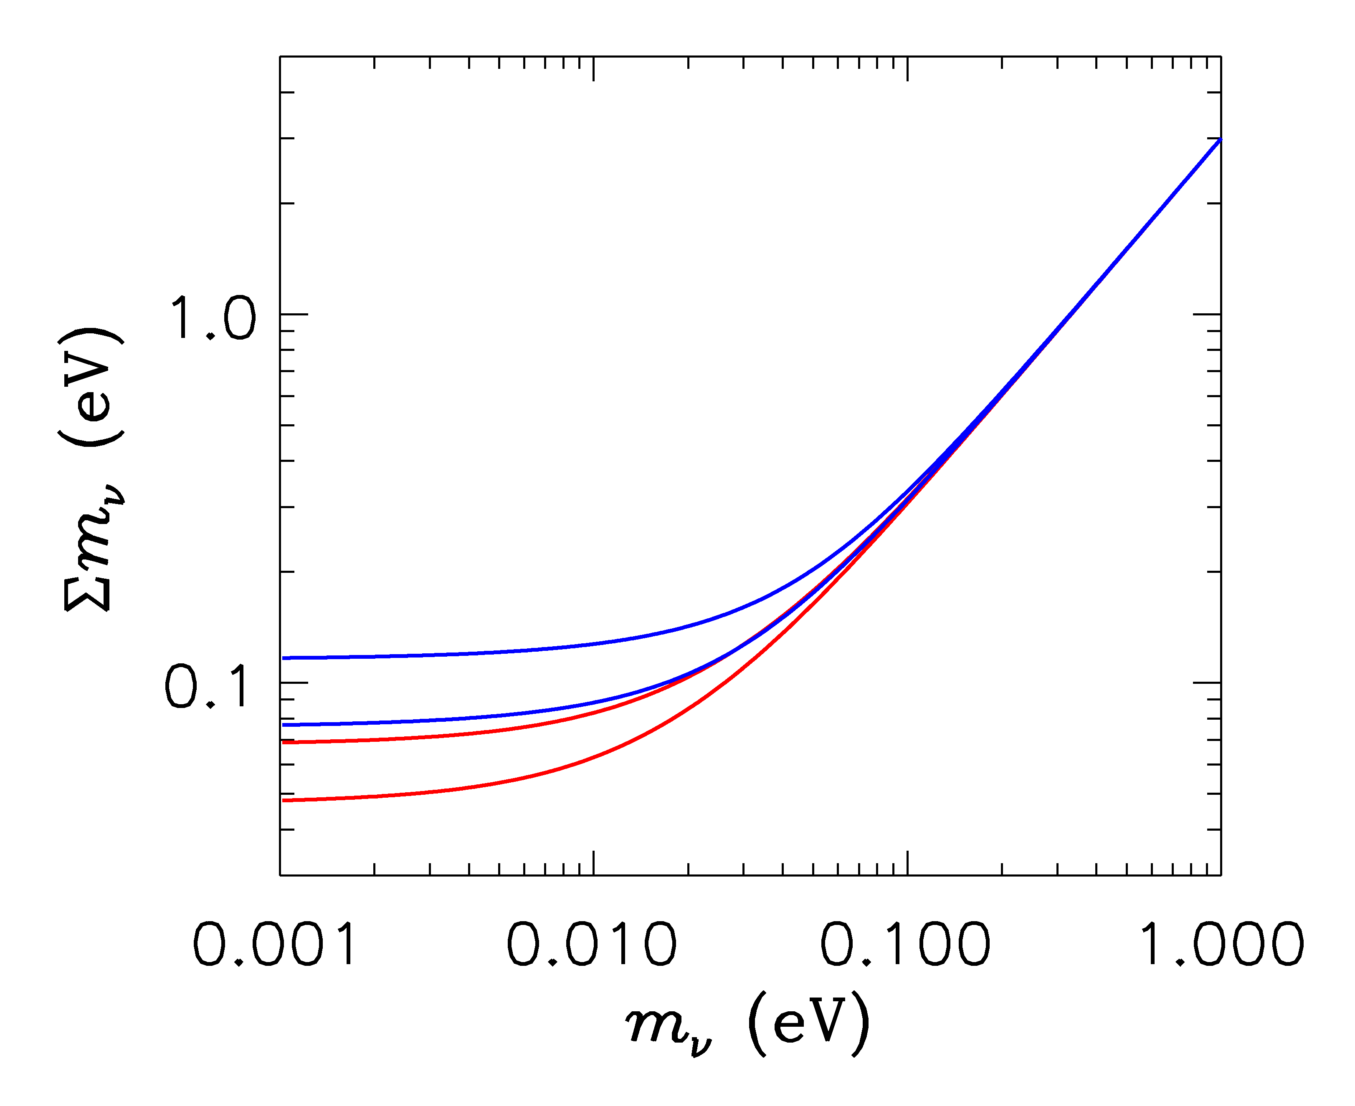
HIERARCHICAL
DEGENERATE
INVERTED
NORMAL
LIGHTEST

Slide 12
Tritium decay endpoint measurements have provided limits
on the electron neutrino mass
Mainz experiment, final analysis (Kraus et al.)
This translates into a limit on the sum of the three mass
eigenstates
This sensitivity will be improved by at least an order of
magnitude by KATRIN

Slide 13
NEUTRINO MASS AND ENERGY DENSITY
FROM COSMOLOGY
NEUTRINOS AFFECT STRUCTURE FORMATION
BECAUSE THEY ARE A SOURCE OF DARK MATTER
(n ~ 100 cm⁻³)
FROM
HOWEVER, eV NEUTRINOS ARE DIFFERENT FROM CDM
BECAUSE THEY FREE STREAM
SCALES SMALLER THAN d_{FS} DAMPED AWAY, LEADS TO
SUPPRESSION OF POWER ON SMALL SCALES

Slide 14
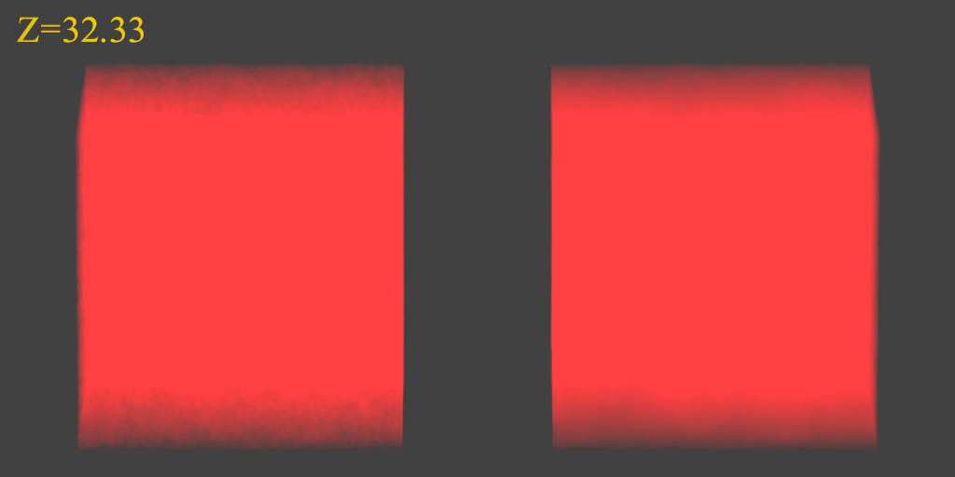
N-BODY SIMULATIONS OF ΛCDM WITH AND WITHOUT
NEUTRINO MASS (768 Mpc³) – GADGET 2
256
Mpc

Slide 15
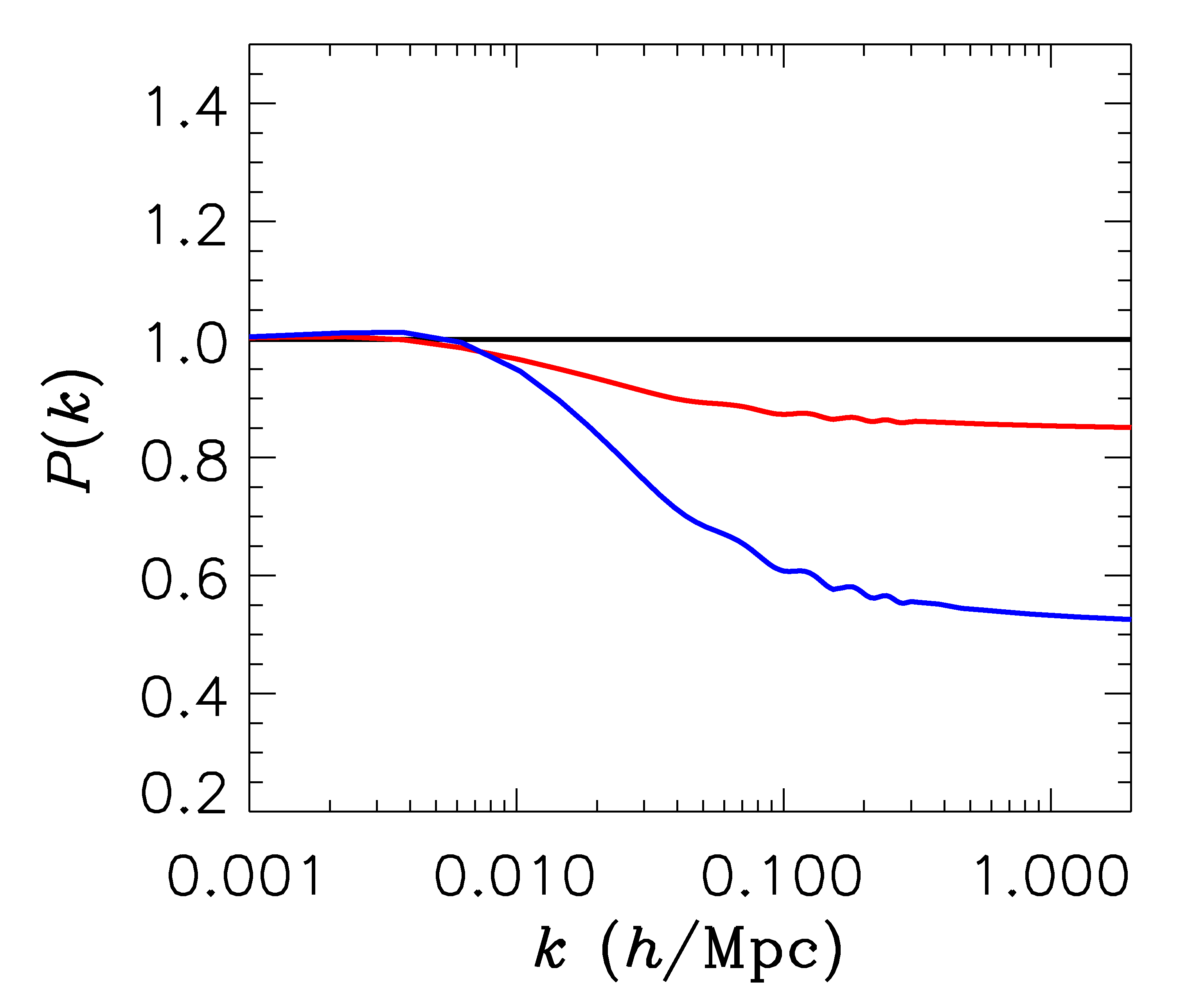
FINITE NEUTRINO MASSES SUPPRESS THE MATTER POWER
SPECTRUM ON SCALES SMALLER THAN THE FREE-STREAMING
LENGTH
Sm = 0 eV
P(k)/P(k,m_{ν}=0)
Sm = 0.3 eV
Sm = 1 eV

Slide 16

WHAT IS THE PRESENT BOUND ON THE NEUTRINO MASS?
DEPENDS ON DATA SETS USED AND ALLOWED PARAMETERS
THERE ARE MANY ANALYSES IN THE LITERATURE. THE BOUND
APPLIES TO ANY NEUTRINO-LIKE PARTICLE WHICH IS LIGHT
arXiv:1303.5076 (Planck)

Slide 17
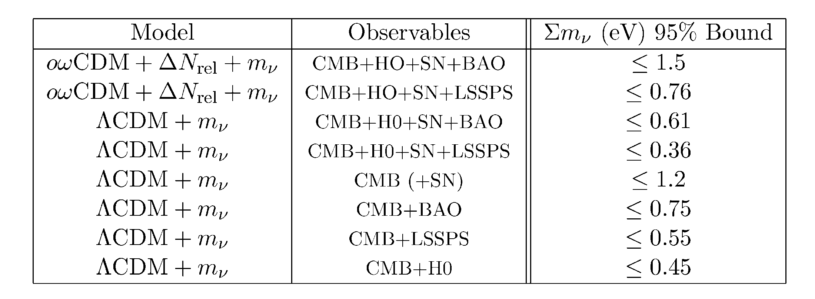
Gonzalez-Garcia et al., arxiv:1006.3795

Slide 18
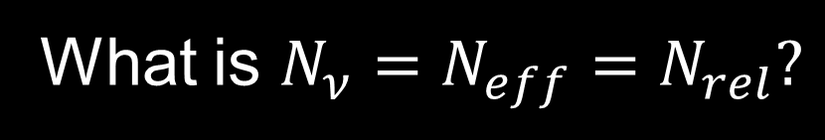
What is $N_{ν}=N_{eff}=N_{rel}?$
A MEASURE OF THE ENERGY DENSITY IN NON-INTERACTING
RADIATION IN THE EARLY UNIVERSE
THE STANDARD MODEL PREDICTION IS
Mangano et al., hep-ph/0506164
BUT ADDITIONAL LIGHT PARTICLES (STERILE NEUTRINOS,
AXIONS, MAJORONS,…..) COULD MAKE IT HIGHER

Slide 19
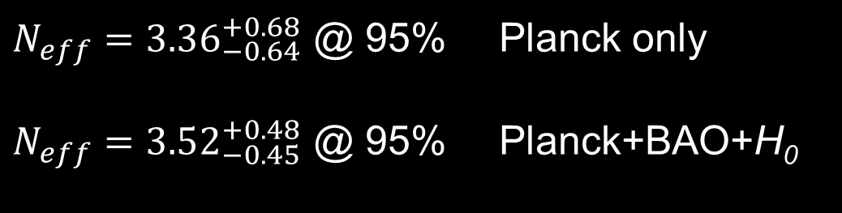
$N_{eff}={3.36}_{−0.64}^{+0.68}$ @ 95% Planck only
$N_{eff}={3.52}_{−0.45}^{+0.48}$ @ 95% Planck+BAO+H₀
THE SITUATION IS (UNFORTUNATELY) NOT YET RESOLVED….

Slide 20
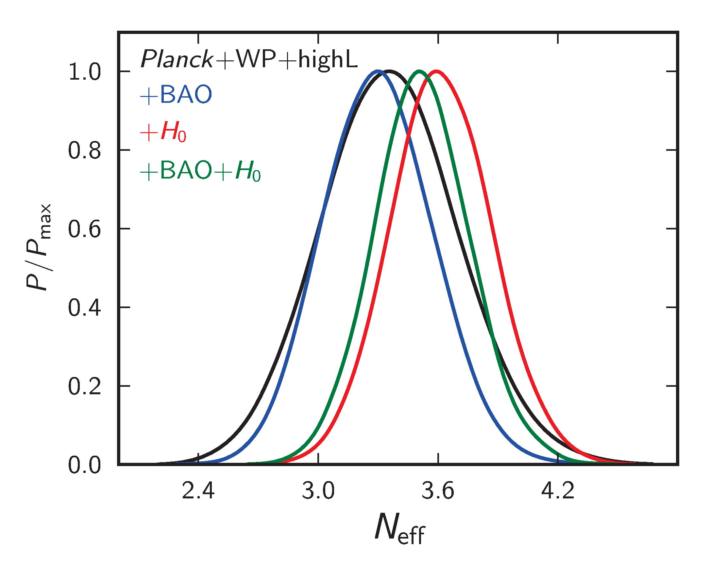
ADE ET AL. 2013

Slide 21
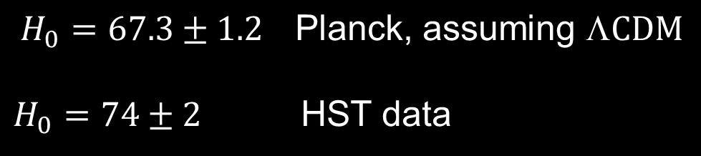
THE CULPRIT IS THE HUBBLE PARAMETER
MEASUREMENT
$$H_{0}=67.3±1.2 \text{Planck}\text{, }\text{assuming} \text{L}\text{CDM}$$
$H_{0}=74±2$ HST data
CAN BE MADE (MORE) CONSISTENT PROVIDED THERE IS ”DARK RADIATION”

Slide 22
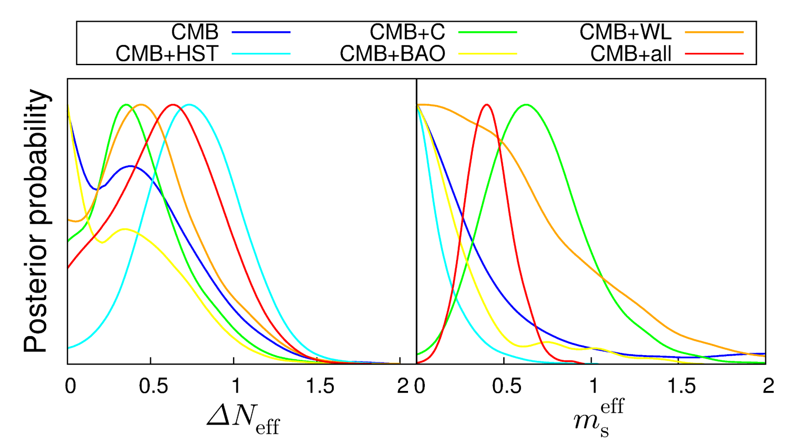
HAMANN & HASENKAMP 2013

Slide 23
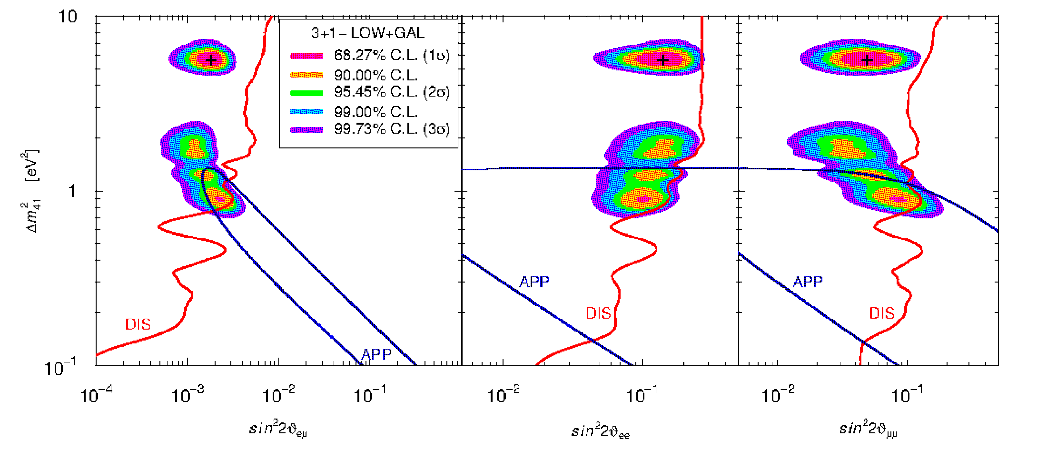
THERE ARE A NUMBER OF HINTS FROM EXPERIMENTS THAT A
FOURTH, eV-MASS STERILE STATE MIGHT BE NEEDED:
LSND, MiniBoone, reactor anomaly, Gallium
Giunti & Laveder 2011

Slide 24
ASSUMING A NUMBER OF ADDITIONAL STERILE STATES OF
APPROXIMATELY EQUAL MASS, TWO QUALITATIVELY DIFFERENT
HIERARCHIES EMERGE. IN ANALOGY WITH THE STANDARD
MODEL NEUTRINO HIERARCHY WE CAN CALL THEM NORMAL
AND INVERTED HIERARCHY
ν_{s}
ν_{A}
ν_{A}
ν_{s}
3+N (NORMAL)
N+3 (INVERTED)

Slide 25
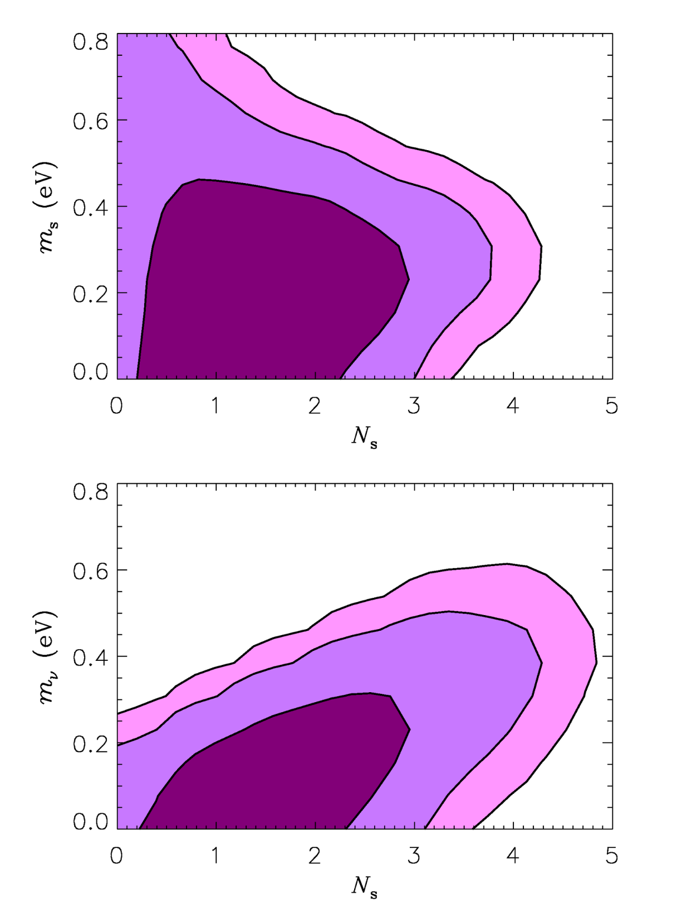
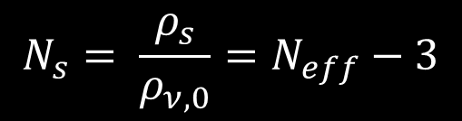
Hamann, STH, Raffelt, Tamborra,
Wong, arxiv:1006.5276 (PRL)
”3+N”
WDM LIMIT
$$N_{s}= \frac{ρ_{s}}{ρ_{ν,0}}=N_{eff}−3$$
N+3
See also
Dodelson et al. 2006
Melchiorri et al. 2009
Acero & Lesgourgues 2009
Hamann et al 2011
Joudaki et al 2012
Motohashi et al. 2012
Archidiacono et al 2012, 2013
and many others

Slide 26
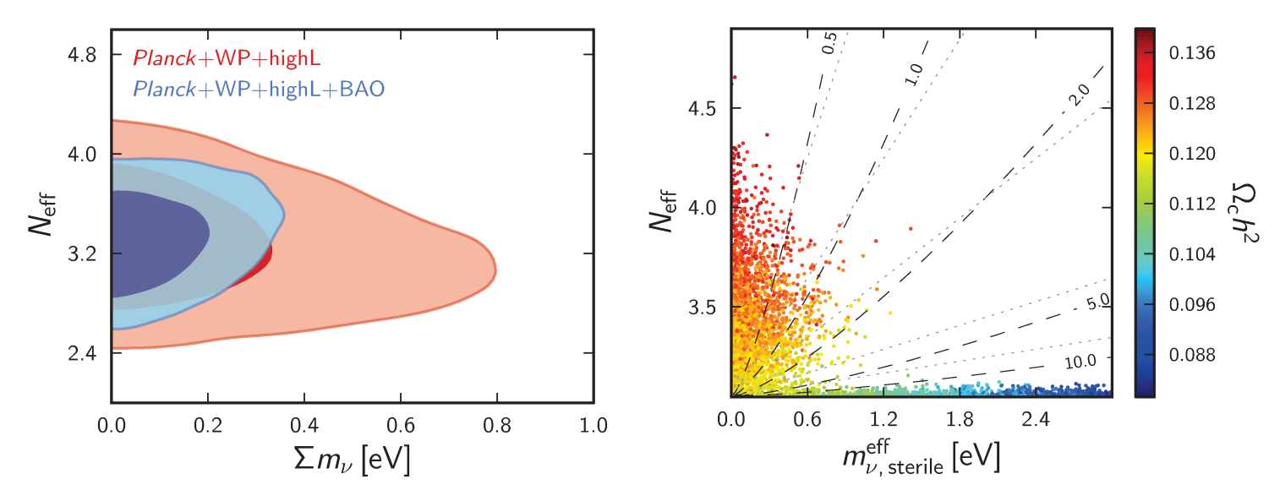

$$N_{eff}= \frac{ρ_{s}+ρ_{a}}{ρ_{ν,0}}$$
ADE ET AL. 2013 (WITHOUT HUBBLE DATA!)

Slide 27
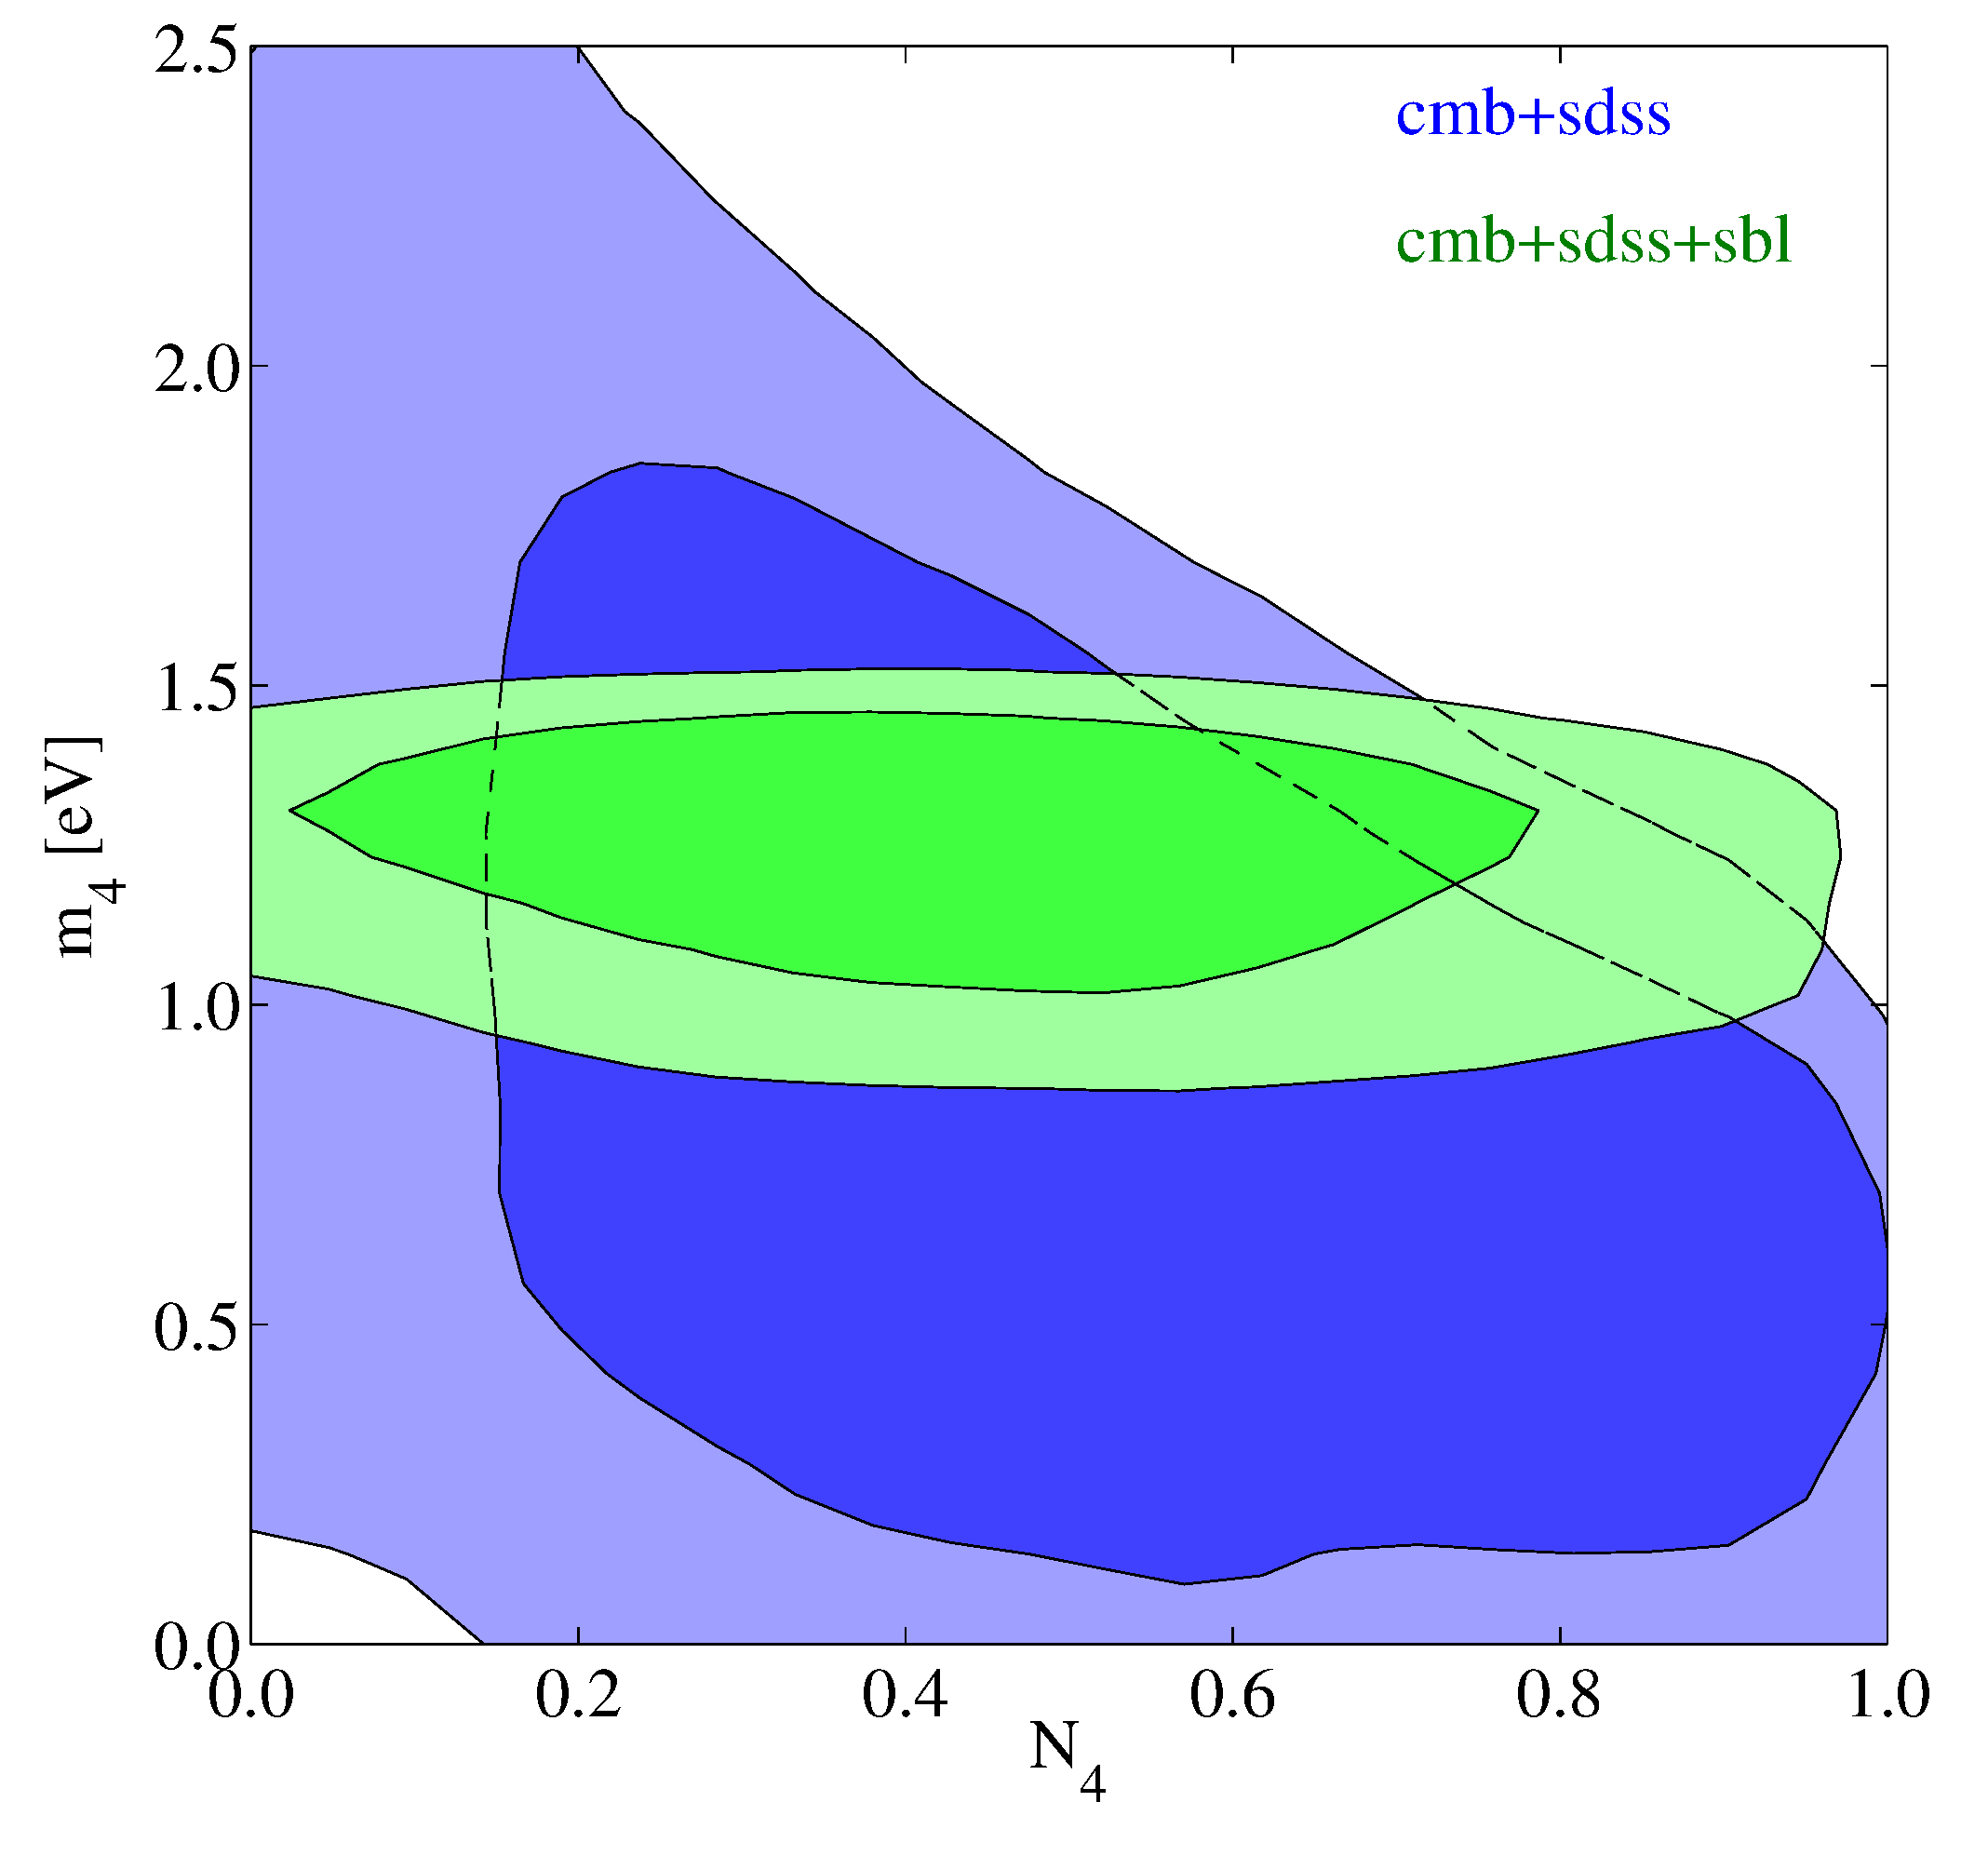
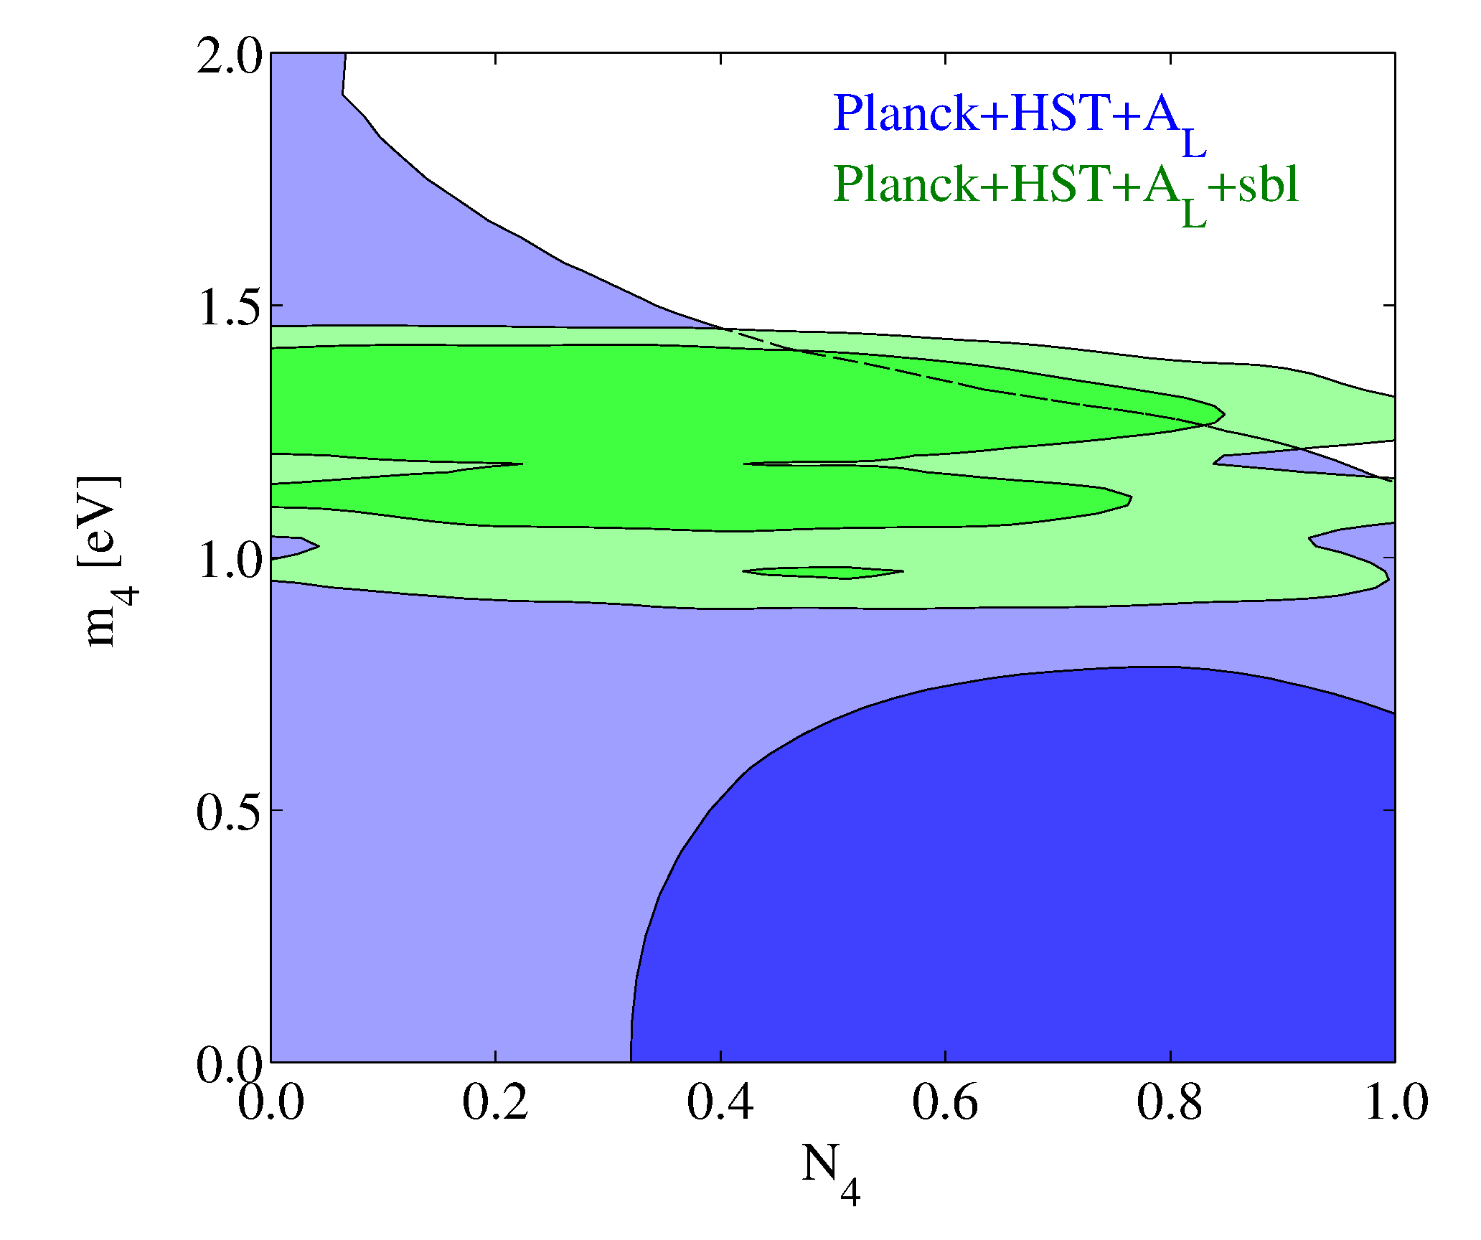
Archidiacono, Fornengo, Giunti, STH, Melchiorri, arXiv:1302.6720 (PRD)

Slide 28
Bottom line: Sterile neutrinos in the
mass range preferred by SBL data
can be accomodated by cosmology,
but ONLY if they are not fully
thermalised

Slide 29
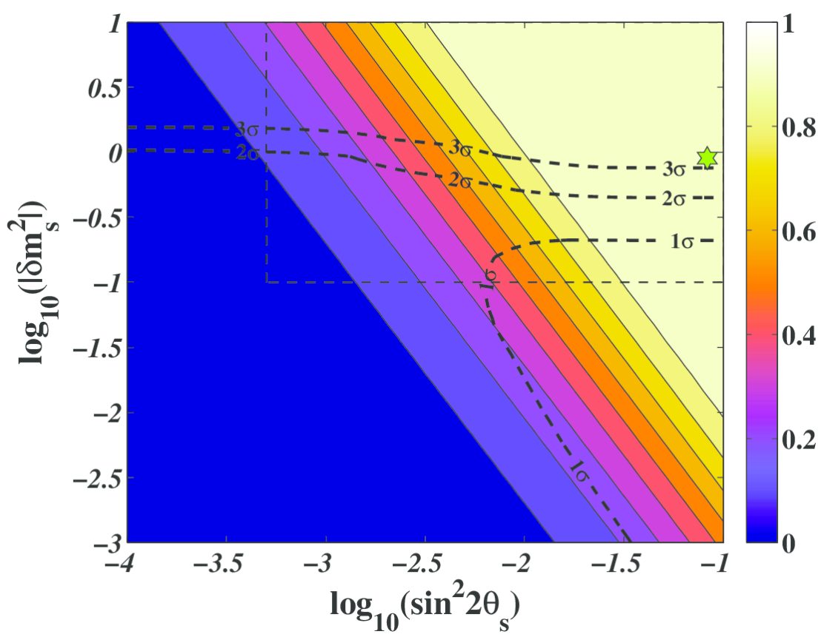
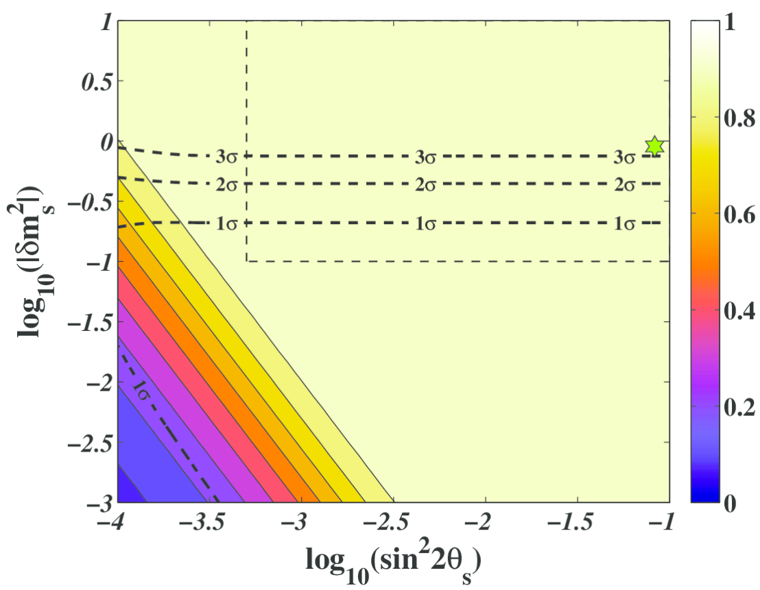
STERILE NEUTRINO THERMALISATION WITH ZERO LEPTON ASYMMETRY
NH
IH
STH, Tamborra, Tram 2012 (arXiv:1204.5861)

Slide 30
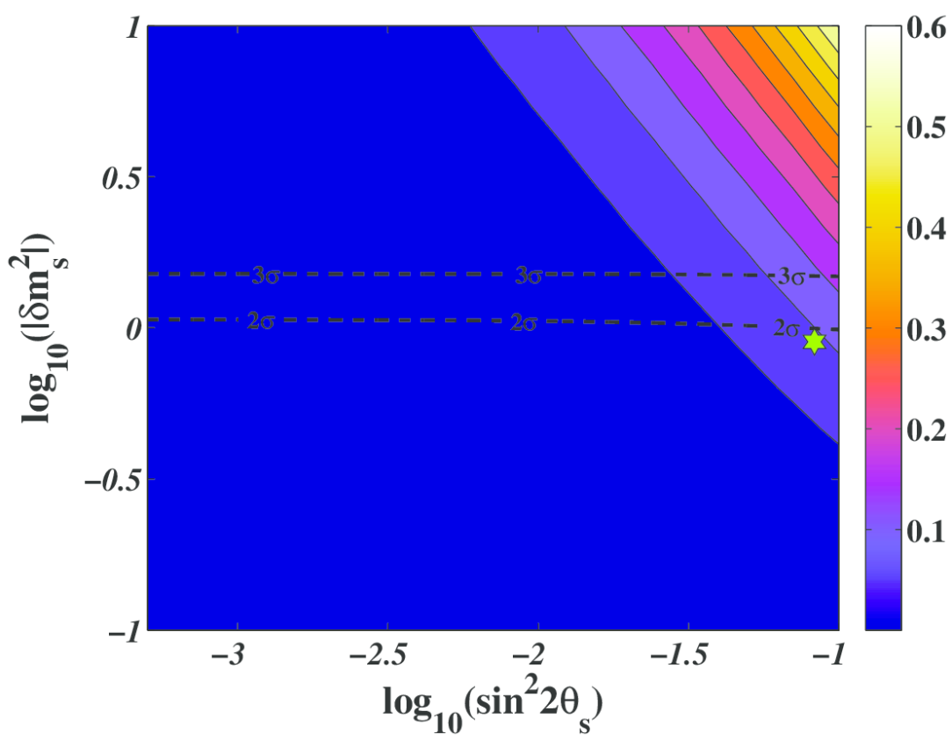
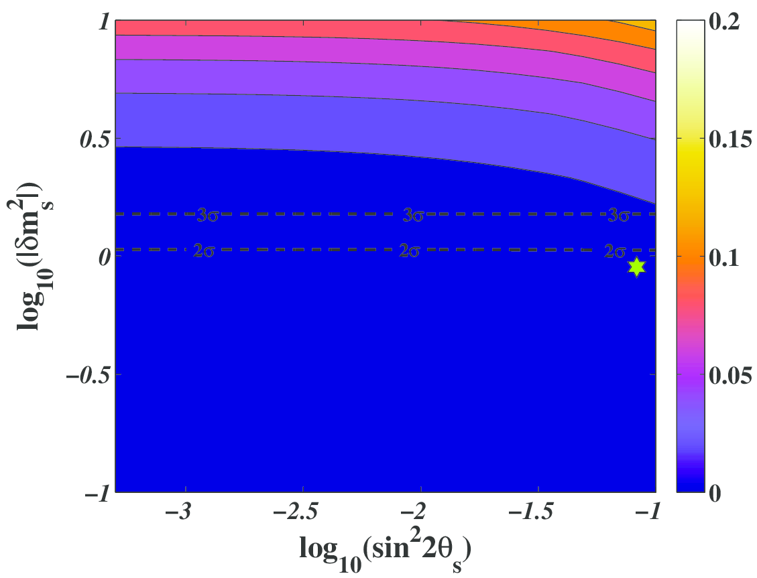
STERILE NEUTRINO THERMALISATION WITH LARGE LEPTON ASYMMETRY
3σ
3σ
STH, Tamborra, Tram 2012 (arXiv:1204.5861)
(see also Saviano et al. arXiv:1302.1200

Slide 31
The presence of a significant asymmetry can block the production
of steriles and make them compatible with cosmology.
However, from a model building perspective the generation of
the asymmetry is difficult because it must be done at low energy
Could there be another way of modifying the matter potential?
YES! Non-standard interactions for either active or sterile neutrinos
Interactions must be relatively strong and for active neutrinos
they might be excluded.
Sterile neutrino self-interactions are possible, and perhaps even
natural.

Slide 32
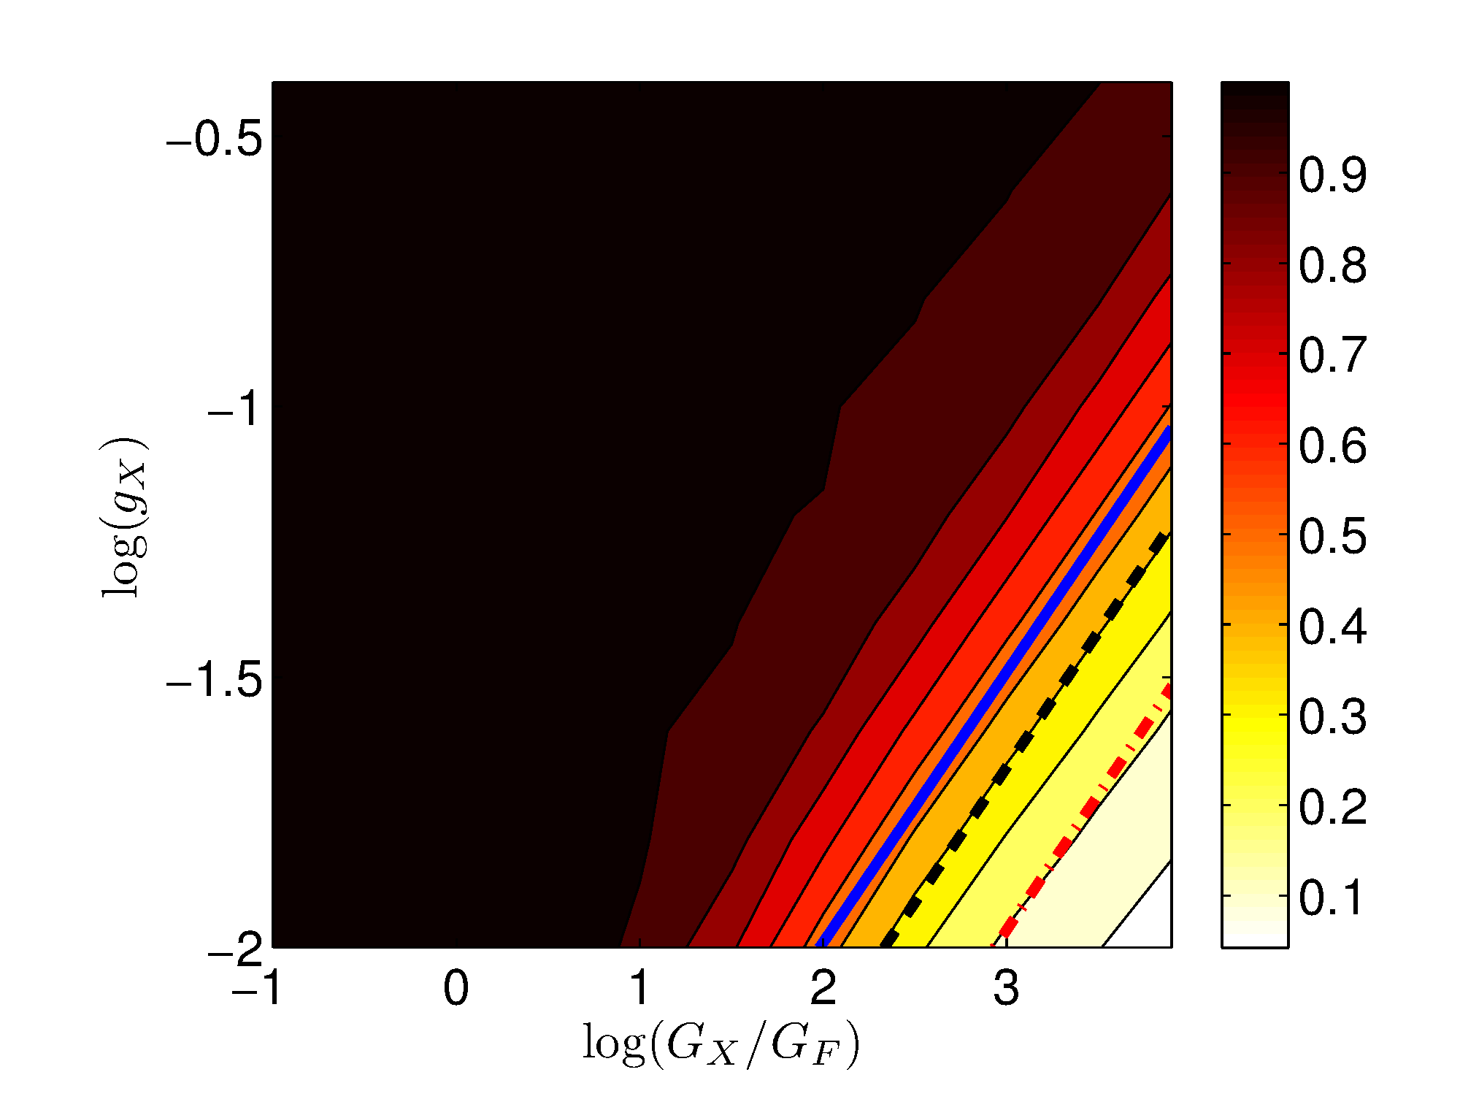

$$∆N_{eff}$$
Hannestad, Hansen, Tram, 2013 (arXiv:1310.5926)

Slide 33
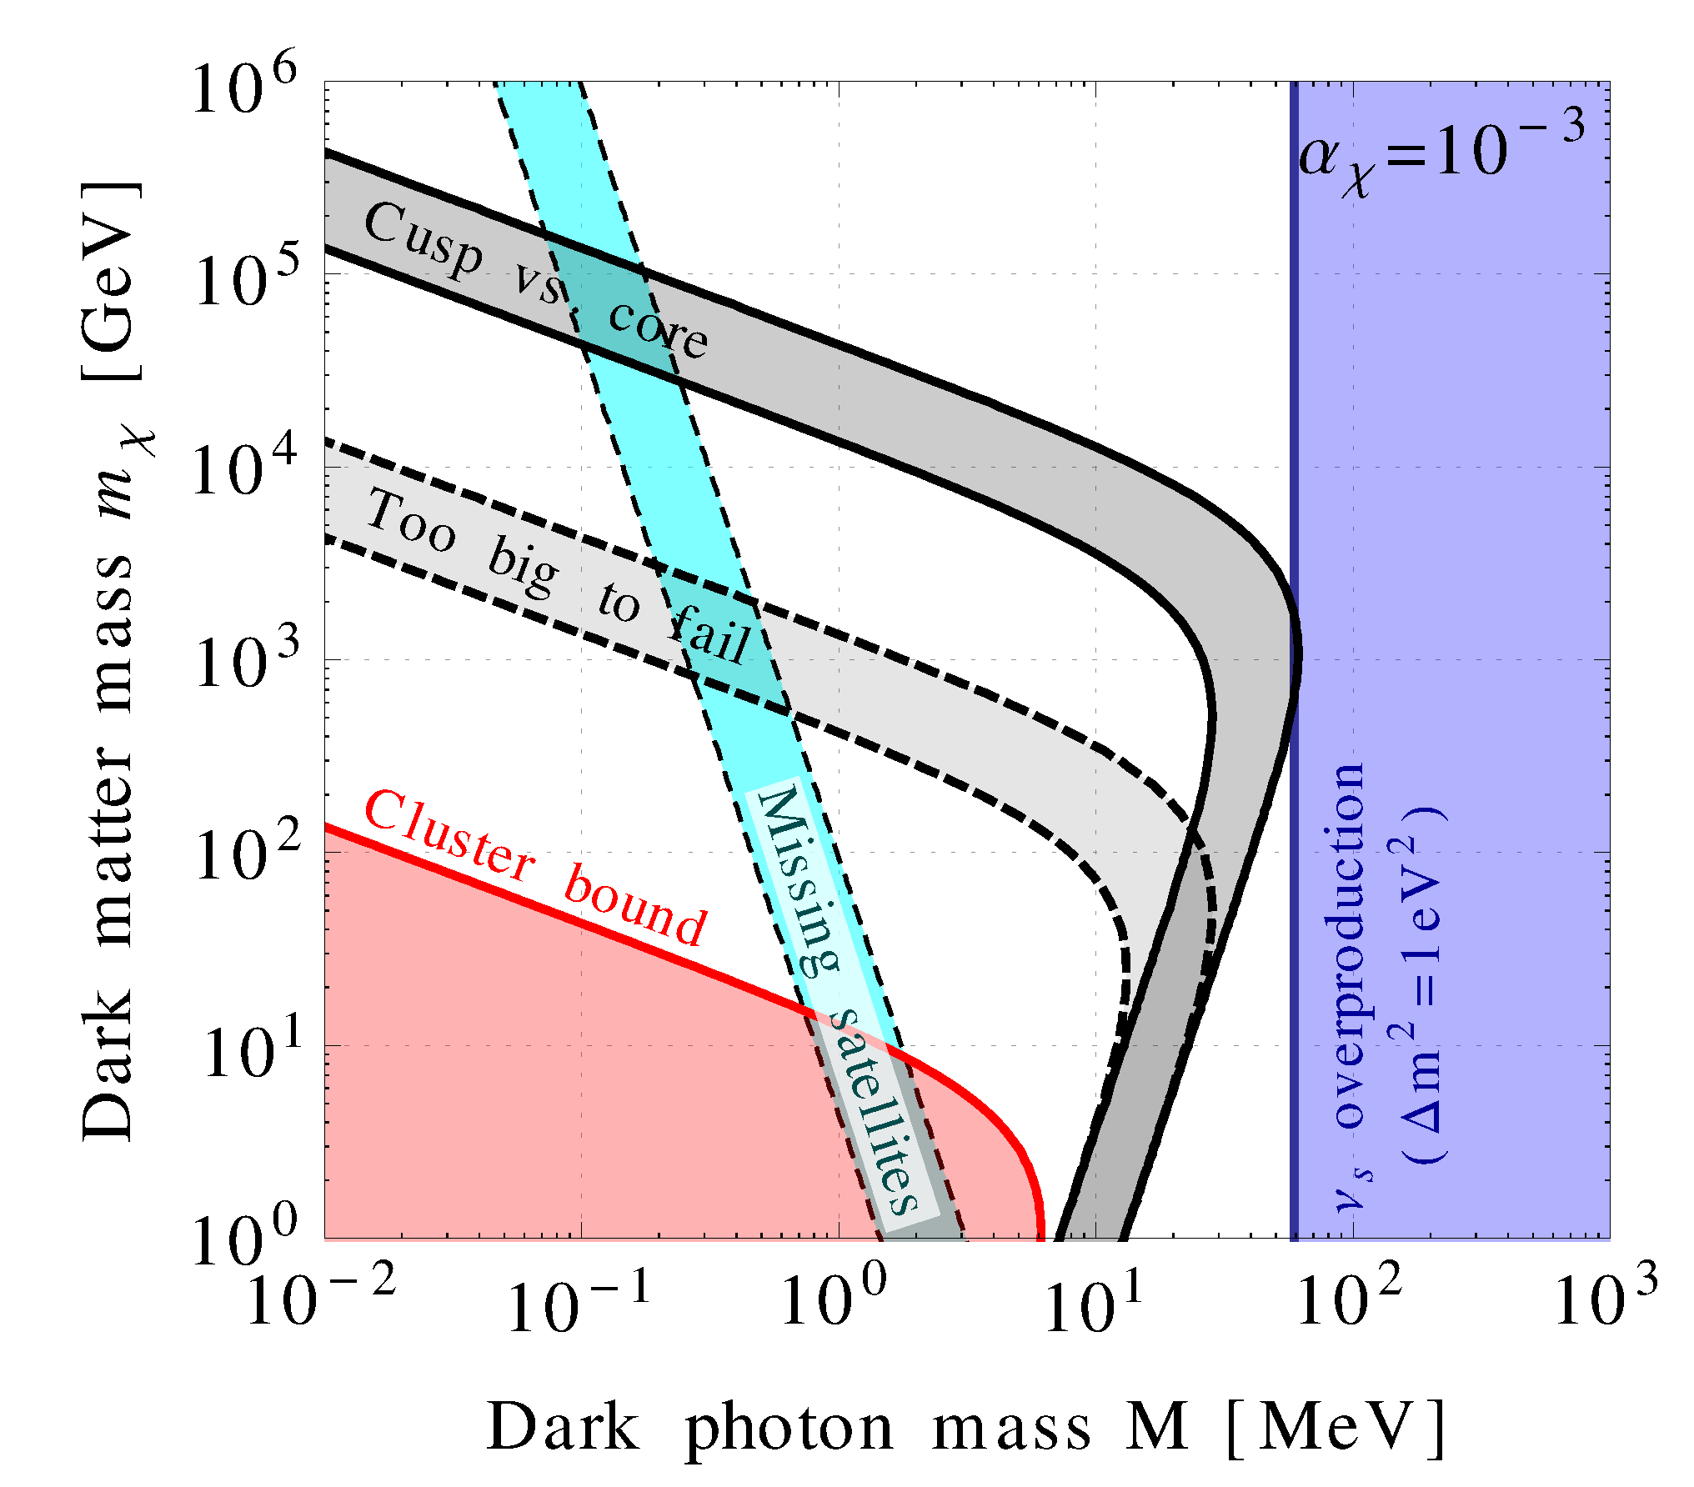
If dark matter couples to the new vector boson it causes self-interactions
which have implications for structure formation
Dasgupta & Kopp 1310.6337

Slide 34
WHAT IS IN STORE FOR THE FUTURE?
BETTER CMB POLARIZATION MEASUREMENTS
(PLANCK)
LARGE SCALE STRUCTURE SURVEYS AT HIGHER
REDSHIFT AND IN LARGER VOLUMES
MEASUREMENTS OF WEAK GRAVITATIONAL LENSING
ON LARGE SCALES

Slide 35
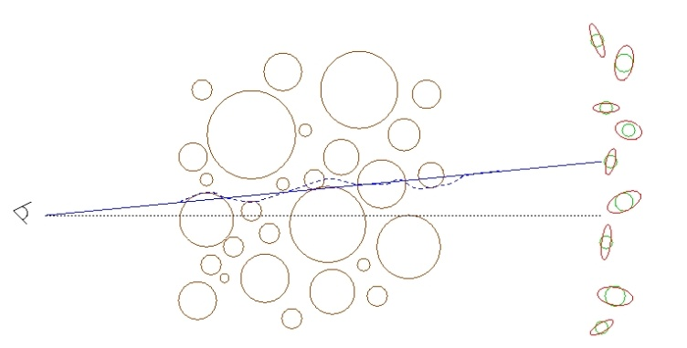
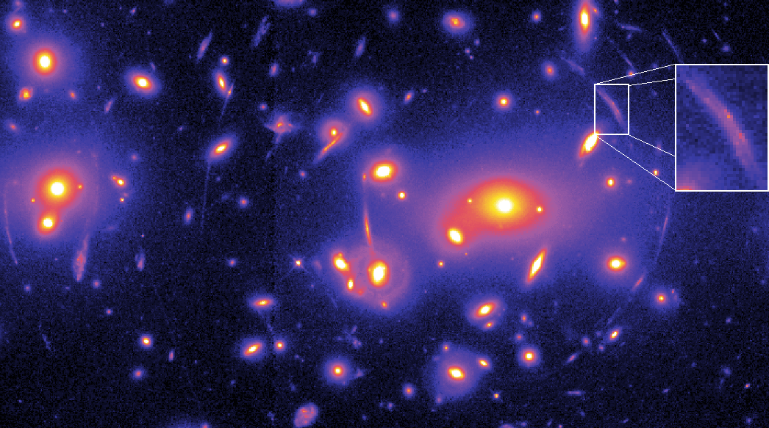
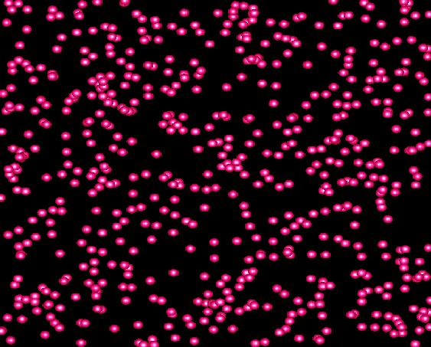
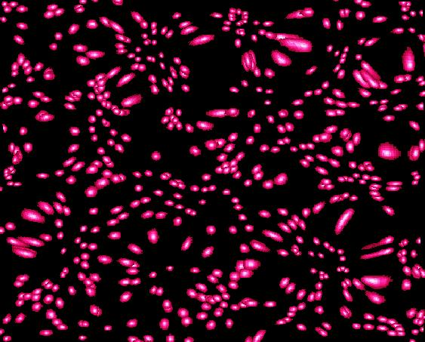
WEAK LENSING – A POWERFUL PROBE FOR THE FUTURE
Distortion of background images by foreground matter
Unlensed Lensed

Slide 36
FROM A WEAK LENSING SURVEY THE ANGULAR POWER SPECTRUM
CAN BE CONSTRUCTED, JUST LIKE IN THE CASE OF CMB
MATTER POWER SPECTRUM (NON-LINEAR)
WEIGHT FUNCTION
DESCRIBING LENSING
PROBABILITY
(SEE FOR INSTANCE JAIN & SELJAK ’96, ABAZAJIAN & DODELSON ’03,
SIMPSON & BRIDLE ’04)

Slide 37
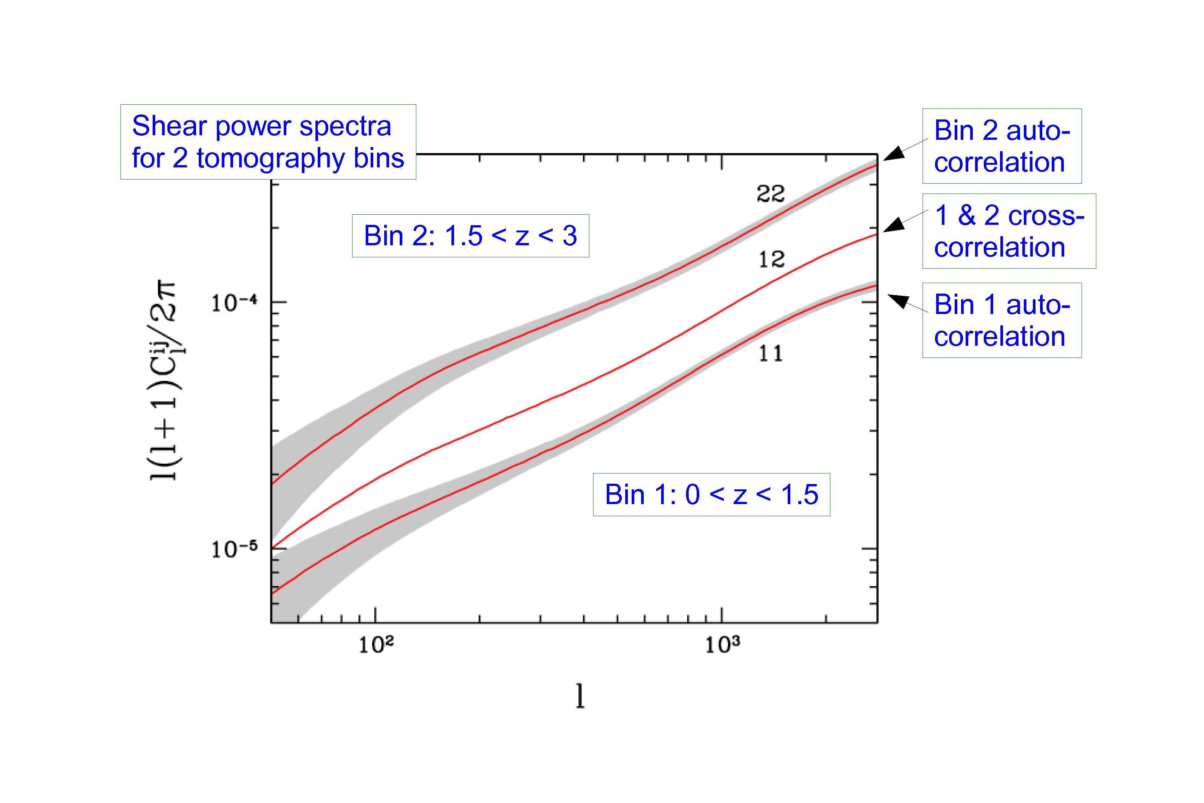
STH, TU, WONG 2006

Slide 38
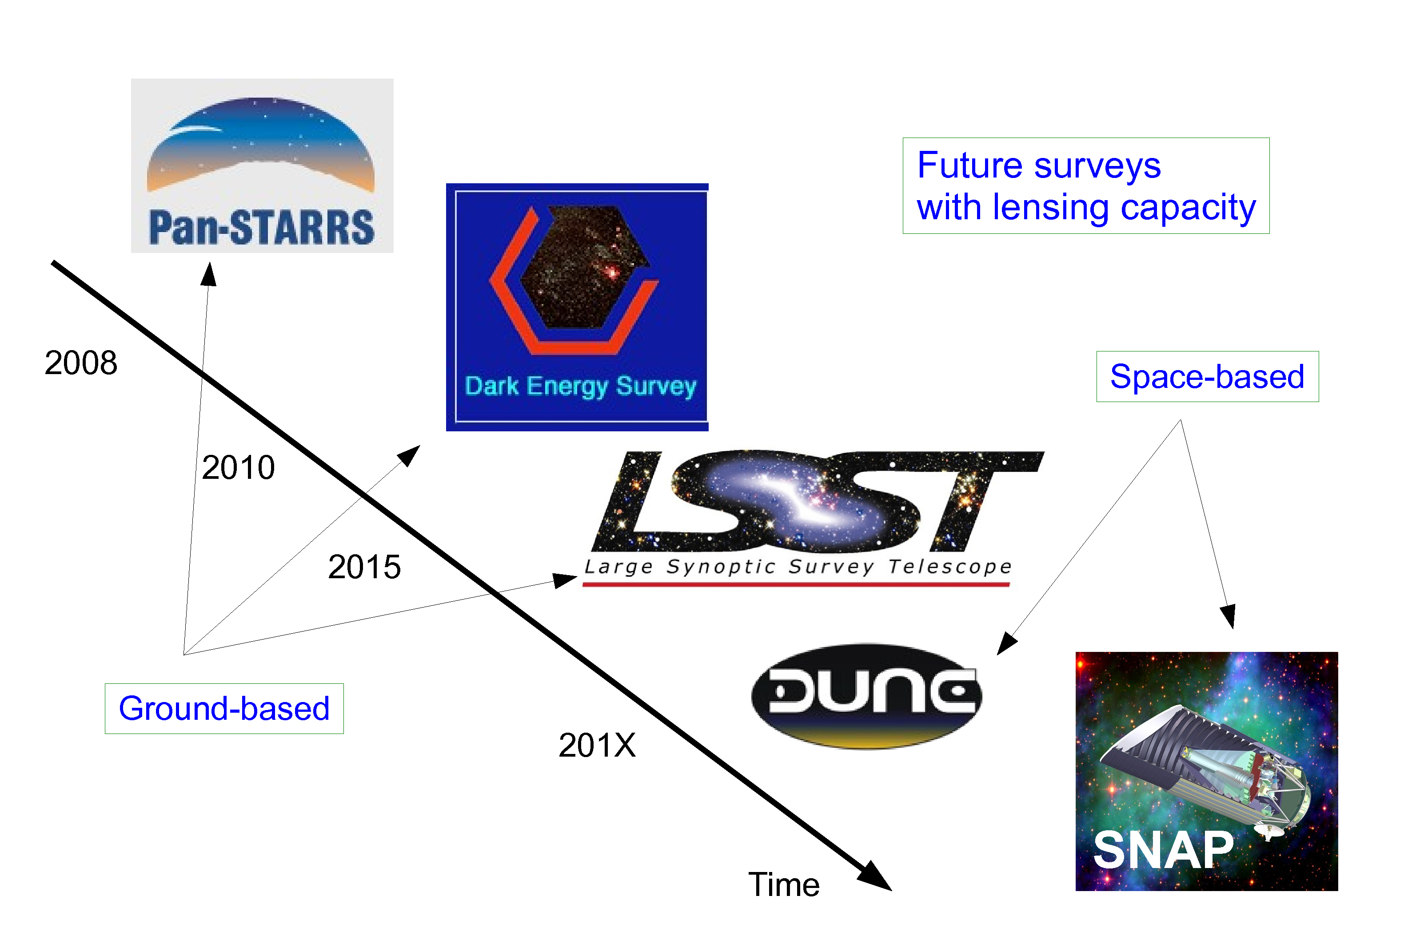
EUCLID
ESA M-CLASS MISSION
2019
SELECTED OCTOBER 2011

Slide 39
EUCLID WILL FEATURE:
A WEAK LENSING MEASUREMENT OUT TO z ~ 2, COVERING
APPROXIMATELY 20,000 deg²
(THIS WILL BE MAINLY PHOTOMETRIC)
A GALAXY SURVEY OF ABOUT few x 10⁷ GALAXIES (75 x SDSS)
A WEAK LENSING BASED CLUSTER SURVEY

Slide 40
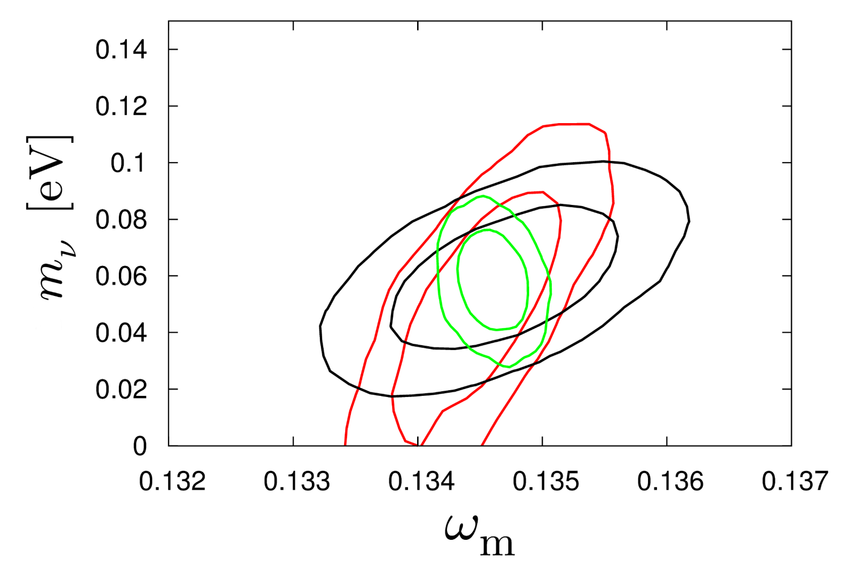
HAMANN, STH, WONG 2012: COMBINING THE EUCLID WL AND GALAXY
SURVEYS WILL ALLOW FOR AT A 2.5-5σ DETECTION OF THE NORMAL
HIERARCHY (DEPENDING ON ASSUMPTIONS ABOUT BIAS)
CMB+WL
CMB+WL+GAL
CMB+GAL
arXiv:1209.1043

Slide 41
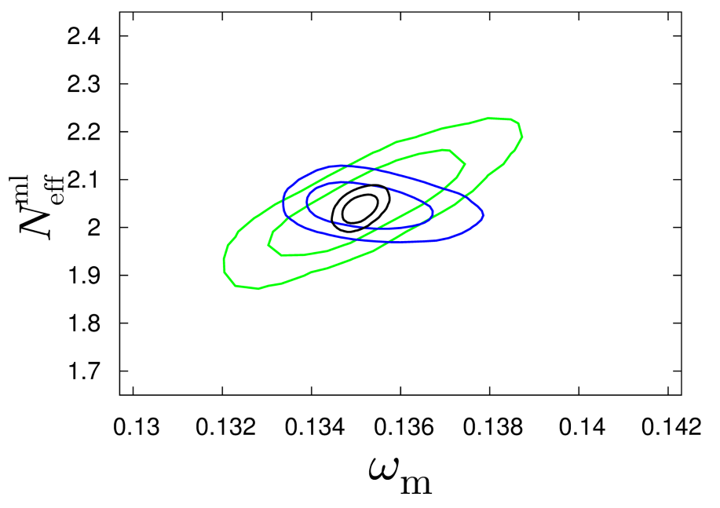
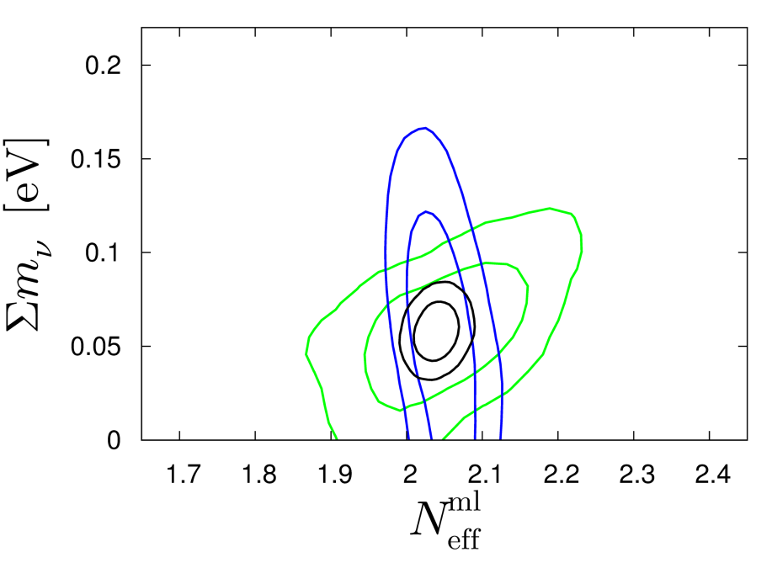
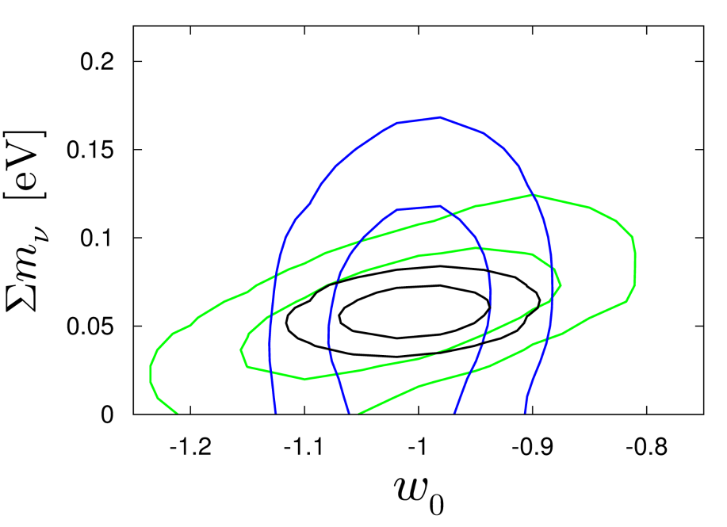
Basse, Bjælde, Hamann, STH, Wong 2013: Adding information on the
cluster mass function will allow for a 5σ detection of non-zero neutrino
mass, even in very complex cosmological models with time-varying
dark energy
arXiv:1304.2321
(JCAP)
CMB+CL
CMB+GAL+WL
ALL

Slide 42
CONCLUSIONS
COSMOLOGY HAS MANY ACCESSIBLE WINDOWS TO PHYSICS
BEYOND THE STANDARD MODEL
THE WINDOW TO NEW LIGHT DEGREES OF FREEDOM IS
ONE OF THE MOST INTERESTING ONES
COSMOLOGICAL DATA MIGHT ACTUALLY BE POINTING TO
PHYSICS BEYOND THE STANDARD MODEL IN THE FORM OF
STERILE NEUTRINOS
NEW DATA FROM EUCLID WILL PROVIDE A
POSITIVE DETECTION OF A NON-ZERO NEUTRINO MASS

