Slide 1
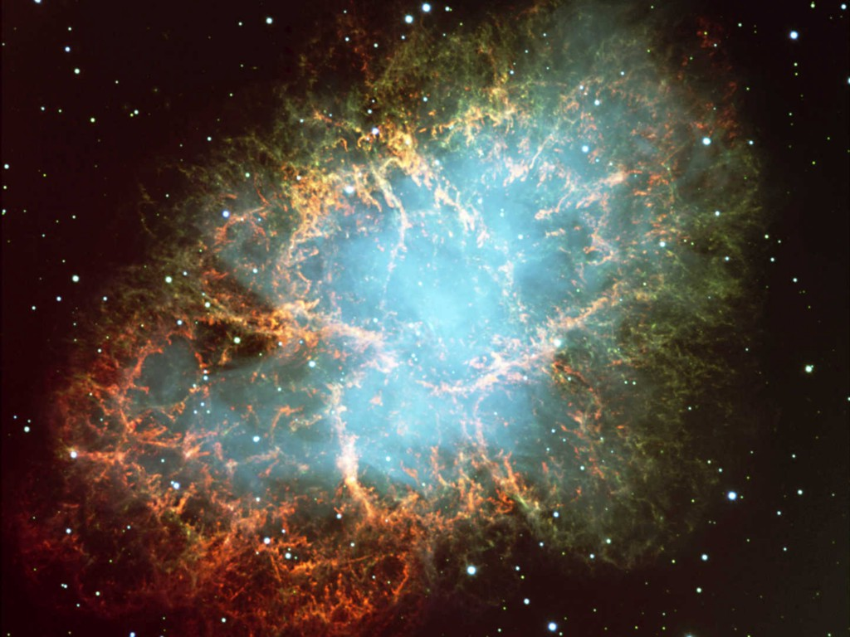
Crab Nebula
Neutrinos
in Astrophysics and Cosmology
Supernova Neutrinos
Georg G. Raffelt
Max-Planck-Institut für Physik, München, Germany

Slide 2
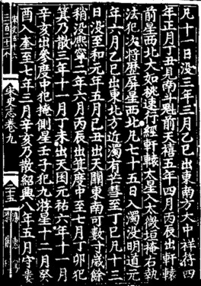
Crab Nebula

Slide 3
Crab Nebula
The Crab Pulsar
Chandra x-ray images

Slide 4
Stellar Collapse and Supernova Explosion
Onion structure
Collapse (implosion)
Main-sequence star
Helium-burning star
Degenerate iron core:
ρ ≈ 10⁹ g cm⁻³
T ≈ 10¹⁰ K
M_{Fe} ≈ 1.5 M_{sun}
R_{Fe} ≈ 3000 km
Hydrogen Burning
Helium
Burning
Hydrogen
Burning

Slide 5
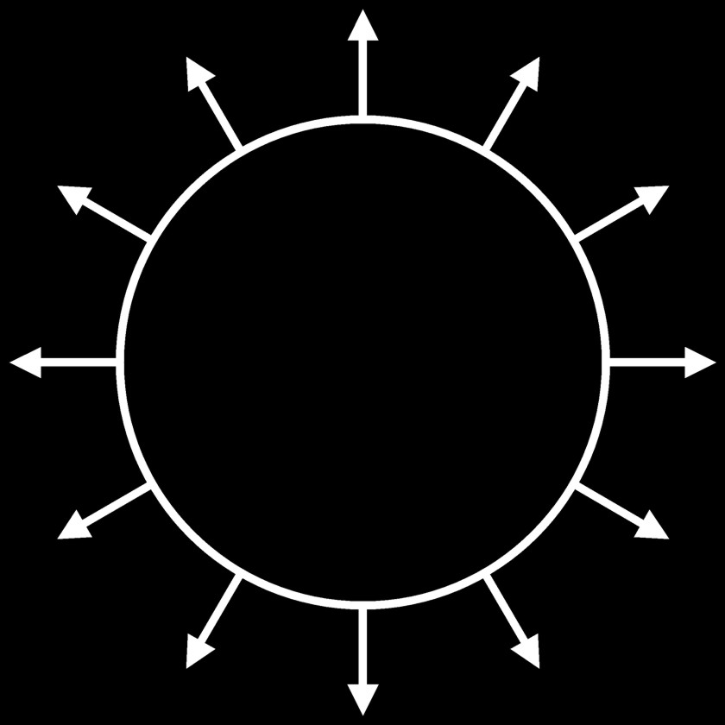
Stellar Collapse and Supernova Explosion
Newborn Neutron Star
Collapse (implosion)
Explosion
$\sim$ 50 km
Proto-Neutron Star
ρ $\sim$ ρ_{nuc} = 3 × 10¹⁴ g cm⁻³
T $\sim$ 10 MeV

Slide 6
Stellar Collapse and Supernova Explosion
Newborn Neutron Star
$\sim$ 50 km
Gravitational binding energy
E_{b} ≈ 3 × 10⁵³ erg ≈ 17% M_{SUN} c²
This shows up as
99% Neutrinos
1% Kinetic energy of explosion
0.01% Photons, outshine host galaxy
Neutrino luminosity
L_{ν} $\sim$ 3 × 10⁵³ erg / 3 sec
$\sim$ 3 × 10¹⁹ L_{SUN}
While it lasts, outshines the entire
visible universe
Neutrino
cooling by
diffusion
Proto-Neutron Star
ρ $\sim$ ρ_{nuc} = 3 × 10¹⁴ g cm⁻³
T $\sim$ 10 MeV

Slide 7
Neutrino Diffusion in a Supernova Core
Main neutrino
reactions
$$ν_{e}+n→p+e^{−}$$
$${\overline{ν}}_{e}+p→n+e^{+}$$
$$ν+N→N+ν$$
Electron flavor
All flavors
Neutral-current
scattering
cross section
$$σ_{νN}=\frac{C_{V}^{2}+3C_{A}^{2}}{π} G_{F}^{2}E_{ν}^{2}≈2×{10}^{−40}{\text{cm}}^{2}{\left(\frac{E_{ν}}{100 MeV}\right)}^{2}$$
Nucleon density
$$n_{B}=\frac{ρ_{nuc}}{m_{N}}≈1.8×{10}^{38} {\text{cm}}^{−3}$$
Scattering rate
$$Γ=σn_{B}≈1.1×{10}^{9} {\text{s}}^{−1}{\left(\frac{E_{ν}}{100 MeV}\right)}^{2}$$
Mean free path
$$λ=\frac{1}{σn_{B}}≈28 \text{cm} {\left(\frac{100 MeV}{E_{ν}}\right)}^{2}$$
Diffusion time
$$t_{diff}≈\frac{R^{2}}{λ}≈1.2 \text{sec} {\left(\frac{R}{10 km}\right)}^{2}{\left(\frac{E_{ν}}{100 MeV}\right)}^{2}$$

Slide 8
What Determines the Neutrino Energies?
Hydrostatic equilibrium (virial equilibrium)
$−\frac{1}{2}〈Φ_{grav}〉=〈E_{kin}〉=\frac{3}{2}k_{B}T$
Assume SN core is homogeneous sphere with
$M=1.5 M_{⊙}$, $ρ=ρ_{nuc}=3×{10}^{14}{\text{g}}/{{\text{cm}}^{3}}$, $R=13.4 \text{km}$
Gravitational potential of nucleon at center
$Φ_{grav}=−\frac{3}{2} \frac{G_{N}M_{core}m_{p}}{R}∼− 234 \text{MeV}$
For non-interacting and non-degenerate nucleons implies
$$T∼80 \text{MeV}$$
More realistic, nuclear equation-of-state dependent values
$T∼20$–40 MeV
Energy sale in the multi-10 MeV range set by gravitational potential

Slide 9
Supernovas the Power Supply for Cosmic Rays?
Required power supply L_{CR} = V_{D} r_{CR}/t_{res}
≈ 5 × 10⁴⁰ erg/s ≈ 10⁷ L_{Sun}
Disk volume V_{D} = π R² d ≈ π (15 kpc)² 200 pc
≈ 4 × 10⁶⁶ cm³
Energy density in CRs r_{CR} ≈ 1 eV / cm³
Residence time in galaxy t_{res} ≈ 6 × 10⁶ yrs
Suggestive of supernovae:
One SN explosion deposits ~ 3 × 10⁵¹ erg in kinetic energy of
ejecta into the interstellar medium (ISM)
Rate approx. 1 SN / 30 years / galaxy
Total average energy deposition: L_{SN} ≈ 3 × 10⁴² erg/s ≈ 50 L_{CR}
Efficiency of a few percent required

Slide 10
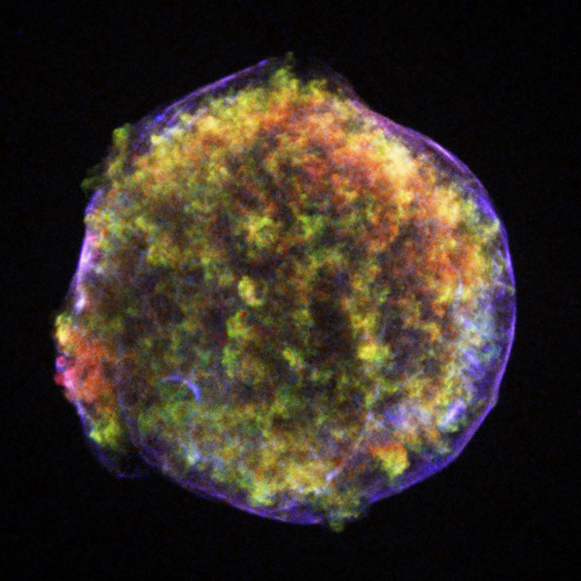
Tycho’s Supernova (1572) Remnant
2’
Chandra false-color
x-ray image
$∼$ 2.3 pc

Slide 11
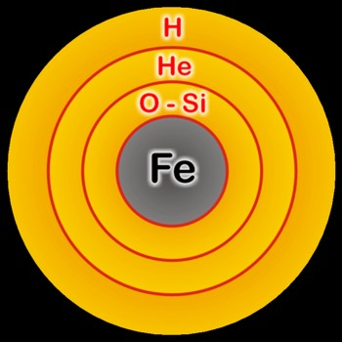
Thermonuclear vs. Core-Collapse Supernovae
Thermo-nuclear (Type Ia)
Core collapse (Type II, Ib/c)
Carbon-oxygen white dwarf
(remnant of
low-mass star)
Accretes matter
from companion
Degenerate iron core
of evolved massive star
Accretes matter
by nuclear burning
at its surface
Chandrasekhar limit is reached — M_{Ch} ≈ 1.5 M_{sun} (2Y_{e})²
C O L L A P S E S E T S I N
Nuclear burning of C and O ignites
→ Nuclear deflagration
(“Fusion bomb” triggered by collapse)
Collapse to nuclear density
Bounce & shock
Implosion → Explosion
Powered by nuclear binding energy
Powered by gravity
Gain of nuclear binding energy
$\sim$ 1 MeV per nucleon
Gain of gravitational binding energy
$\sim$ 100 MeV per nucleon
99% into neutrinos
Comparable “visible” energy release of $\sim$ 3 × 10⁵¹erg

Slide 12
Spectral Classification of Supernovae
Spectral Type
Ia
Ib
Ic
II
Spectrum
No Hydrogen
Hydrogen
Spectrum
No Hydrogen
Hydrogen
Spectrum
No Hydrogen
Hydrogen
Silicon
No Silicon
Silicon
No Silicon
Helium
No Helium
Physical
Mechanism
Nuclear
explosion of
low-mass star
Core collapse of evolved massive star
(may have lost its hydrogen or even helium
envelope during red-giant evolution)
Light Curve
Reproducible
Large variations
Neutrinos
Insignificant
∼ 100 × Visible energy
Compact
Remnant
None
Neutron star (typically appears as pulsar)
Sometimes black hole
Rate / h² SNu
0.36 ± 0.11
0.14 ± 0.07
0.71 ± 0.34
Observed
Total ∼ 6400 as of 2014 (Asiago SN Catalogue)

Slide 13
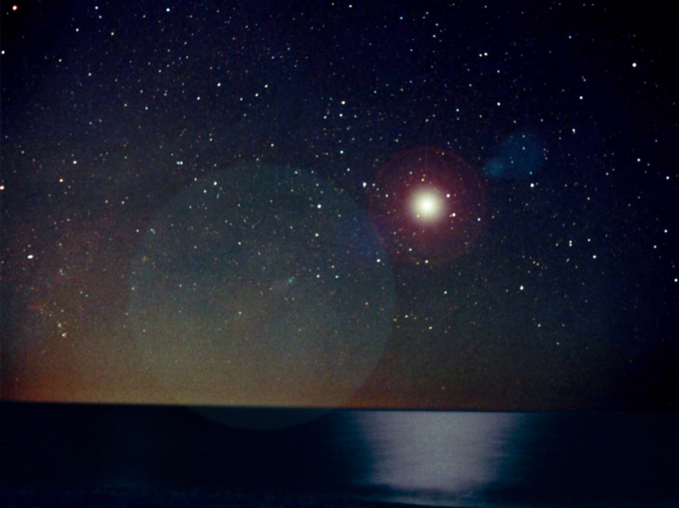
Flavor Oscillations
Explosion Mechanism

Slide 14
Why No Prompt Explosion?
0.1 M_{sun} of iron has a
nuclear binding energy
≈ 1.7 × 10⁵¹ erg
Comparable to
explosion energy
Undissociated Iron
Collapsed Core
Shock Wave
Dissociated
Material
(n, p, e, ν)
Shock wave forms
within the iron core
Dissipates its energy
by dissociating the
remaining layer of
iron

Slide 15
Shock Revival by Neutrinos
Stalled shock wave must
receive energy to start re-expansion against ram pressure of
infalling stellar core
Shock can receive
fresh energy from
neutrinos!
S
O
Si
ν
ν
PNS
ν
Shock
wave
Si
ISOUPS, Asilomar, 24–27 May 2013
Georg Raffelt, MPI Physics, Munich

Slide 16
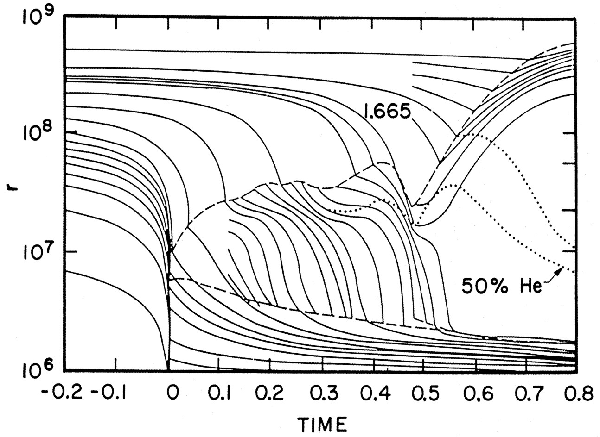
Delayed (Neutrino-Driven) Explosion
Wilson, Proc. Univ. Illinois Meeting on Num. Astrophys. (1982)
Bethe & Wilson, ApJ 295 (1985) 14

Slide 17
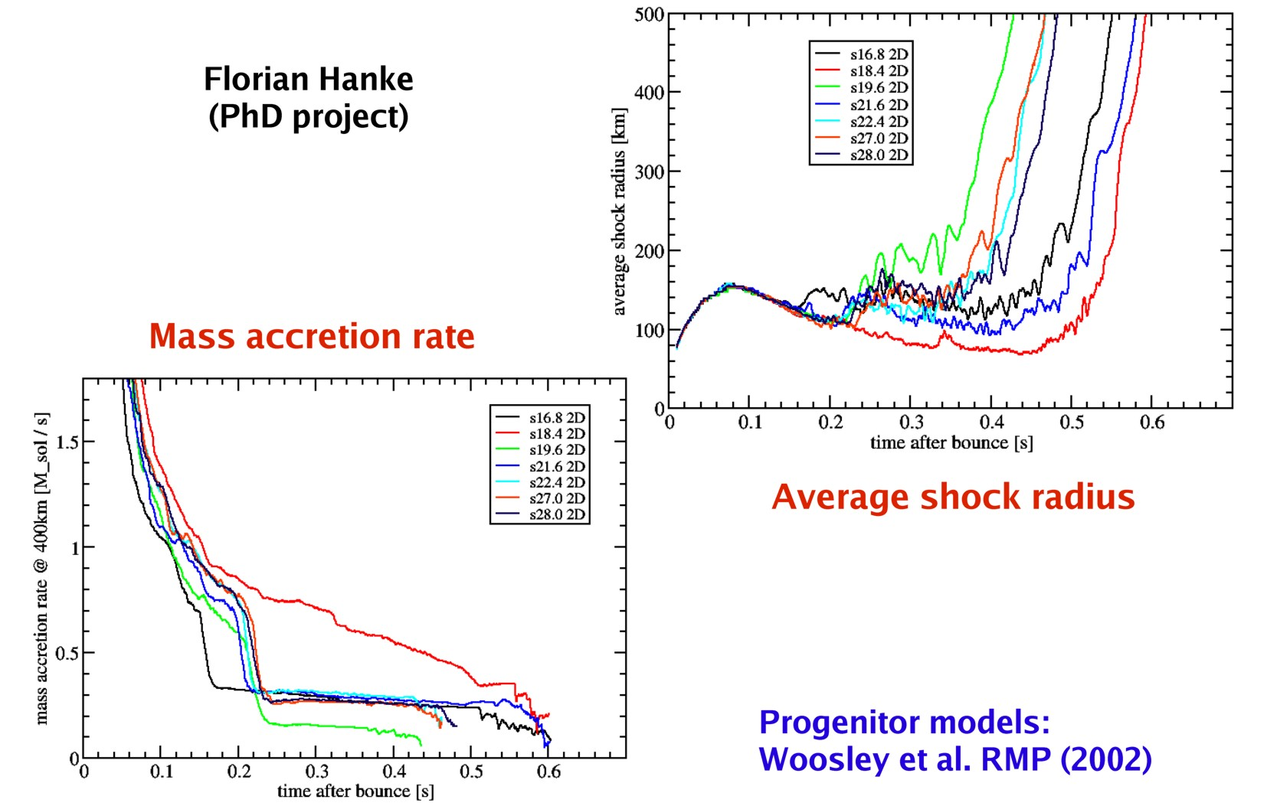
Growing Set of 2D Exploding Models
Florian Hanke, PhD Project
MPA, Garching, 2013
Slide from Thomas Janka at Fifty-One Ergs, NC State University, Raleigh, North Carolina, 13–17 May 2013

Slide 18
First Realistic 3D Simulation (27 ${\text{M}}_{⊙}$ Garching Group)

Slide 19
Summary Explosion Mechanism
• Standard paradigm for many years:
Neutrino-driven explosion (delayed explosion, Wilson mechanism)
• Numerical explosions ok for small-mass progenitors in 1D
(spherical symmetry)
• Numerical explosions ok for broad mass range in 2D
(axial symmetry)
• 3D studies only beginning – no clear picture yet
Better spatial resolution needed?
• Strong progenitor dependence? 3D progenitor models needed?

Slide 20
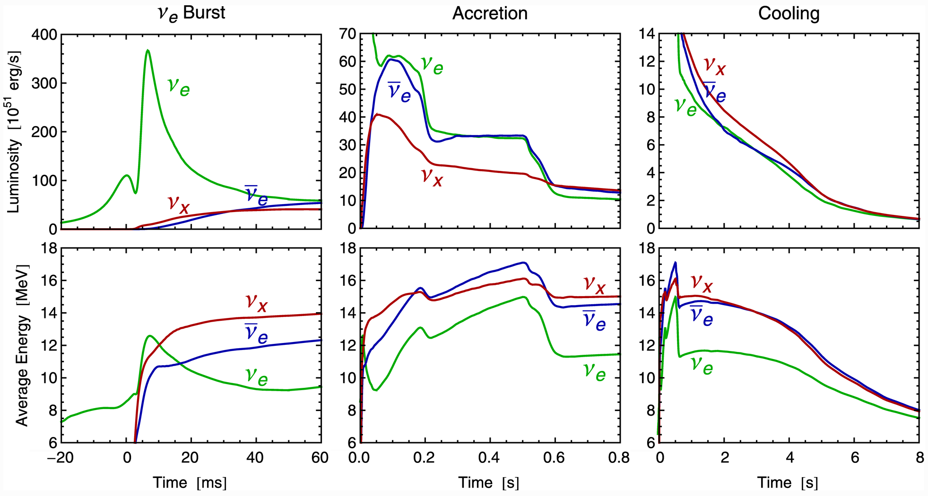
Three Phases of Neutrino Emission
Explosion
triggered
Cooling on neutrino
diffusion time scale
Shock breakout
De-leptonization of
outer core layers
Shock stalls $\sim$ 150 km
Neutrinos powered by
infalling matter
Spherically symmetric Garching model (25 M⊙) with Boltzmann neutrino transport

Slide 21
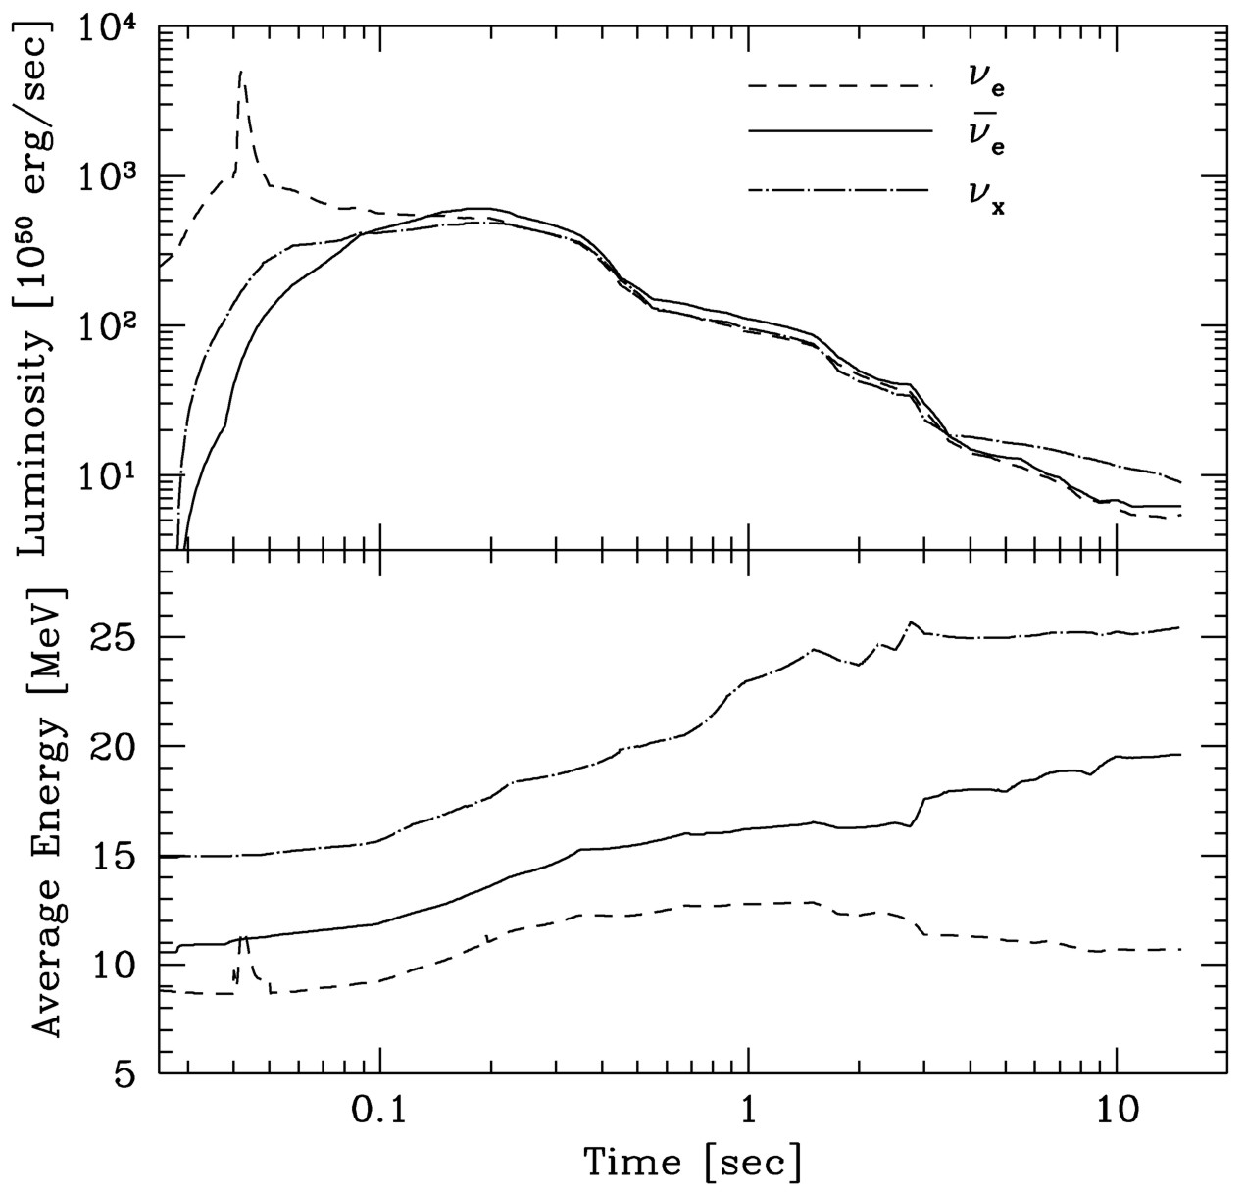
Livermore Fluxes and Spectra
Schematic transport of
ν_{μ} and ν_{τ}
Incomplete microphysics
Crude numerics to couple
neutrino transport with
hydro code
Prompt
$ν_{e}$ burst
$$ν_{x}$$
$${\overline{ν}}_{e}$$
$$ν_{e}$$
Livermore numerical model
ApJ 496 (1998) 216

Slide 22
Flavor Oscillations
Neutrinos from Supernova 1987A

Slide 23
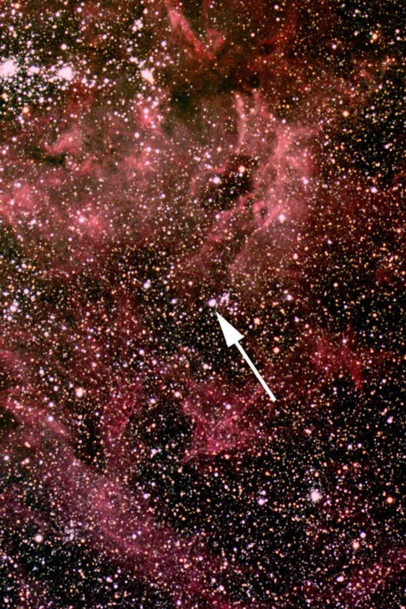
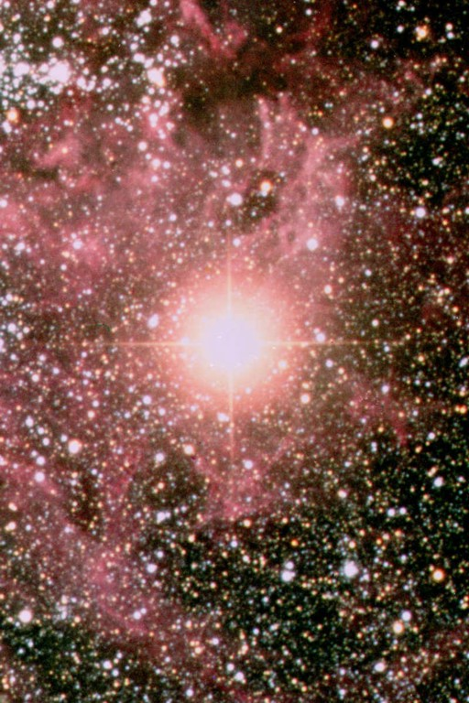
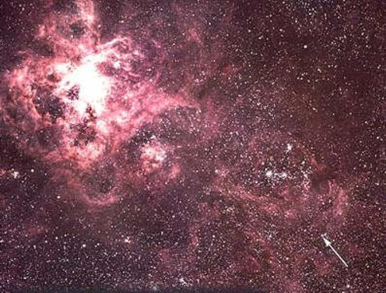
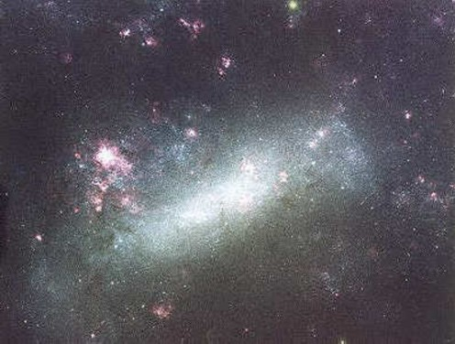
Sanduleak -69 202
Sanduleak −69 202
Supernova 1987A
23 February 1987
Tarantula Nebula
Large Magellanic Cloud
Distance 50 kpc
(160.000 light years)

Slide 24
SN 1987A Rings (Hubble Space Telescope 4/1994)
Foreground Star
Supernova Remnant
(SNR) 1987A
500 Light-days
Ring system consists of material ejected from
the progenitor star,
illuminated by UV flash from SN 1987A
Foreground Star

Slide 25
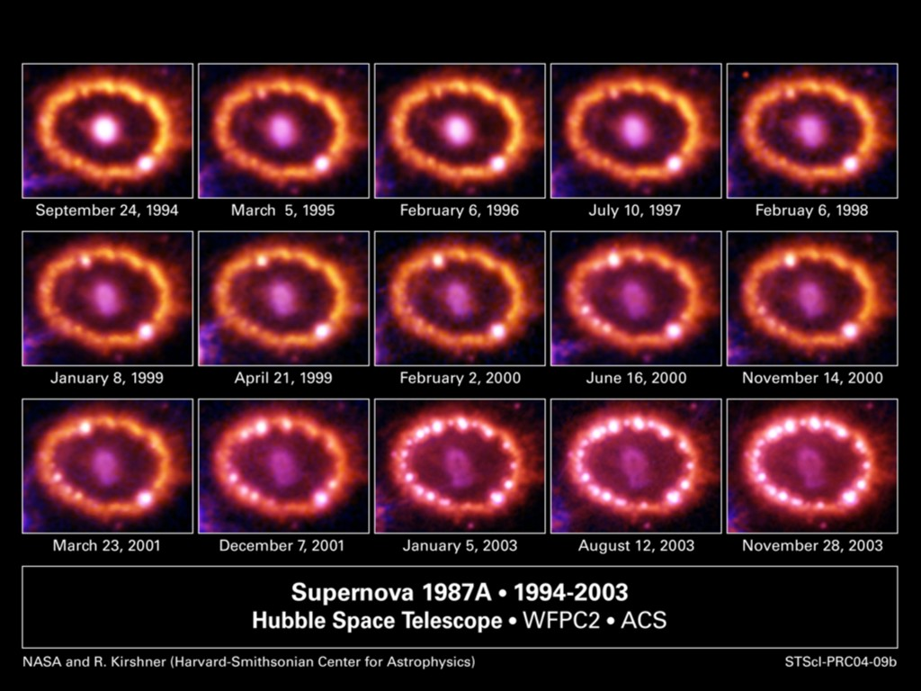
SN 1987A Explosion Hits Inner Ring

Slide 26
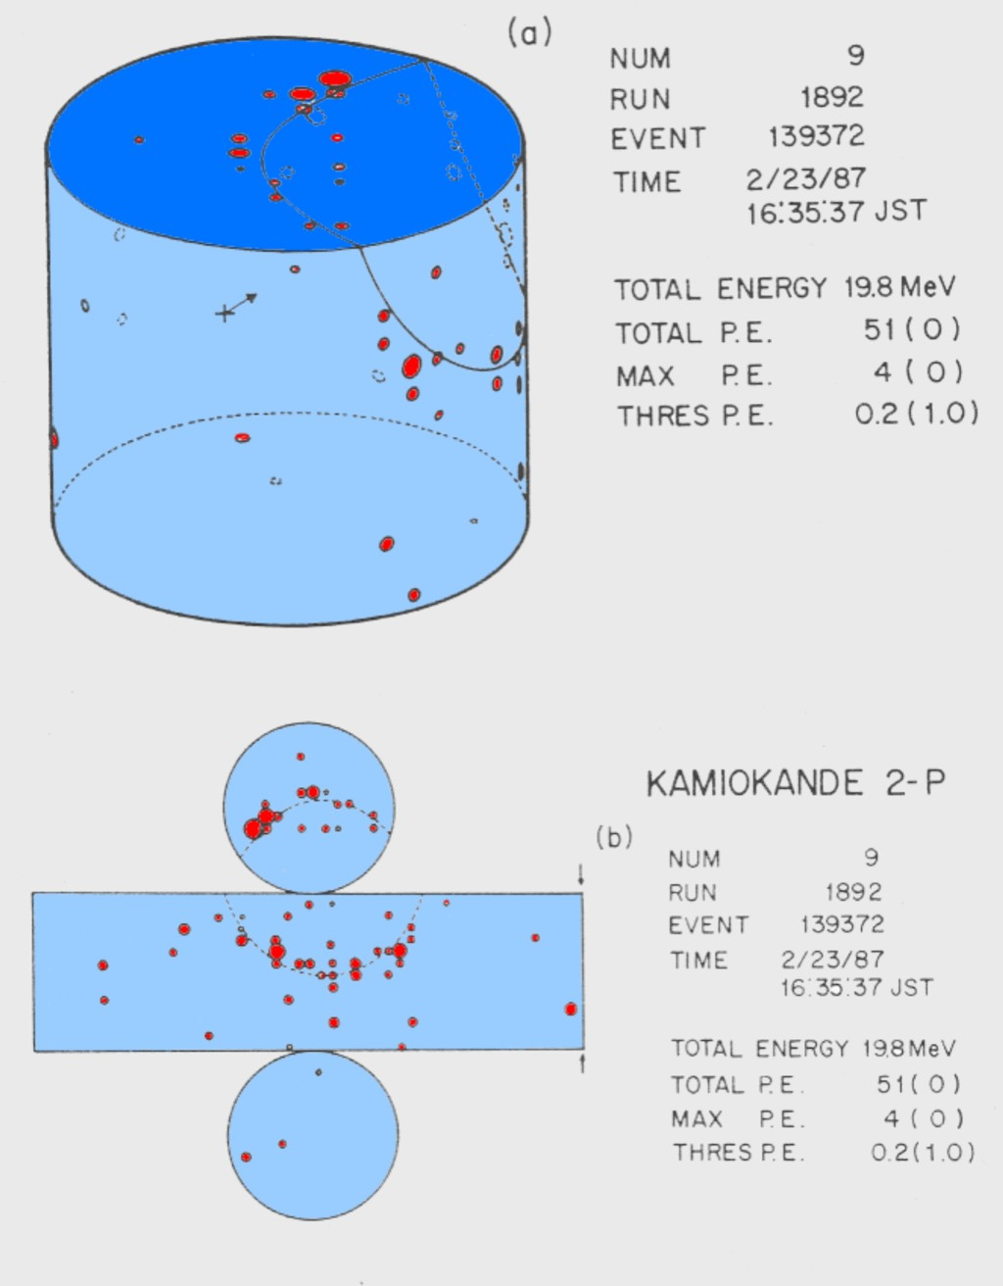
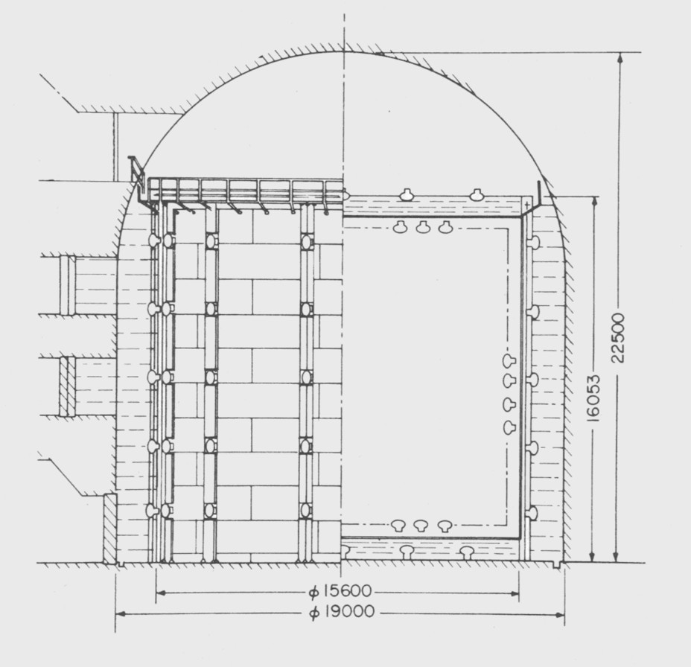
SN 1987A Event No.9 in Kamiokande
Kamiokande Detector
Hirata et al., PRD 38 (1988) 448

Slide 27
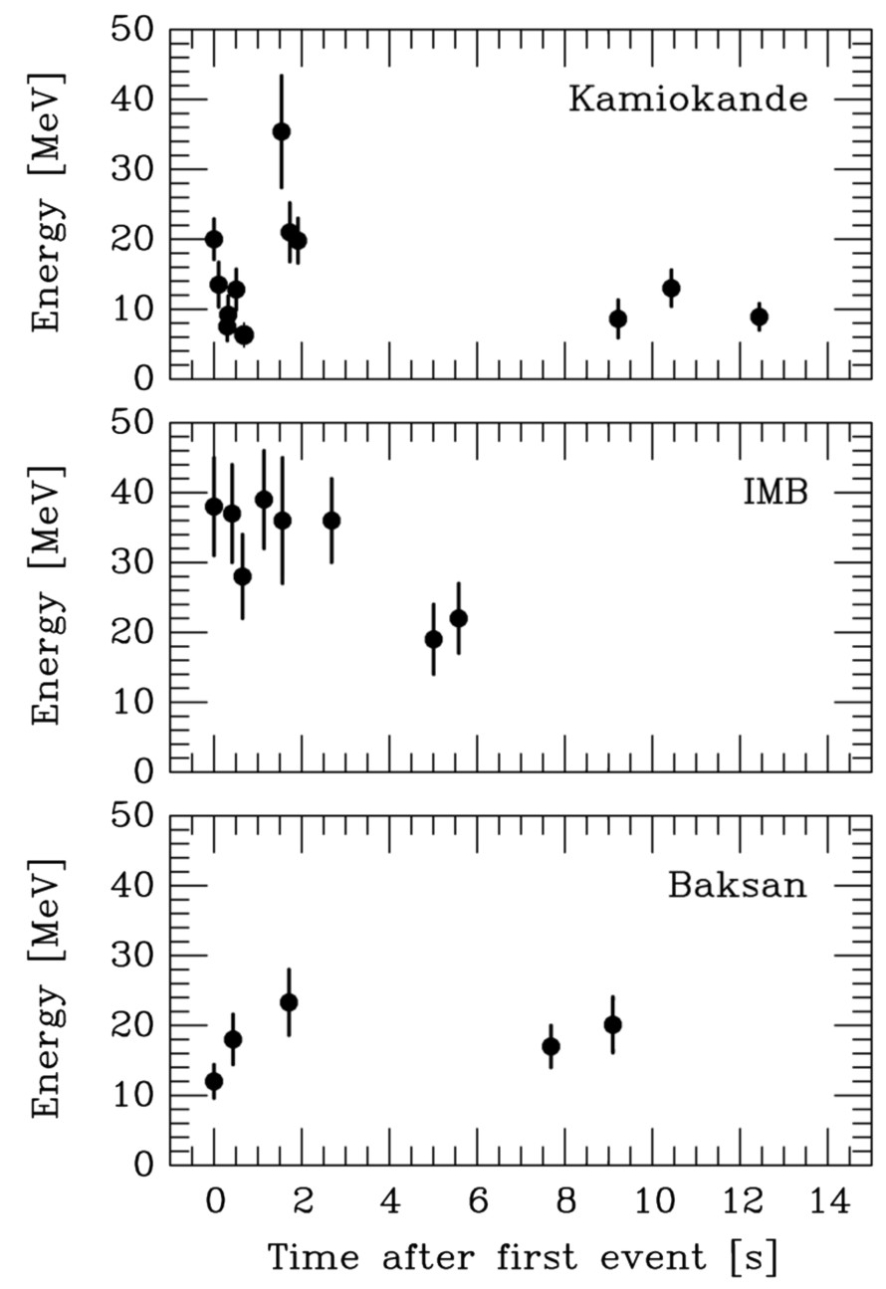
Neutrino Signal of Supernova 1987A
Kamiokande-II (Japan)
Water Cherenkov detector
2140 tons
Clock uncertainty ±1 min
Irvine-Michigan-Brookhaven (US)
Water Cherenkov detector
6800 tons
Clock uncertainty ±50 ms
Baksan Scintillator Telescope
(Soviet Union), 200 tons
Random event cluster $\sim$ 0.7/day
Clock uncertainty +2/−54 s
Within clock uncertainties,
all signals are contemporaneous

Slide 28
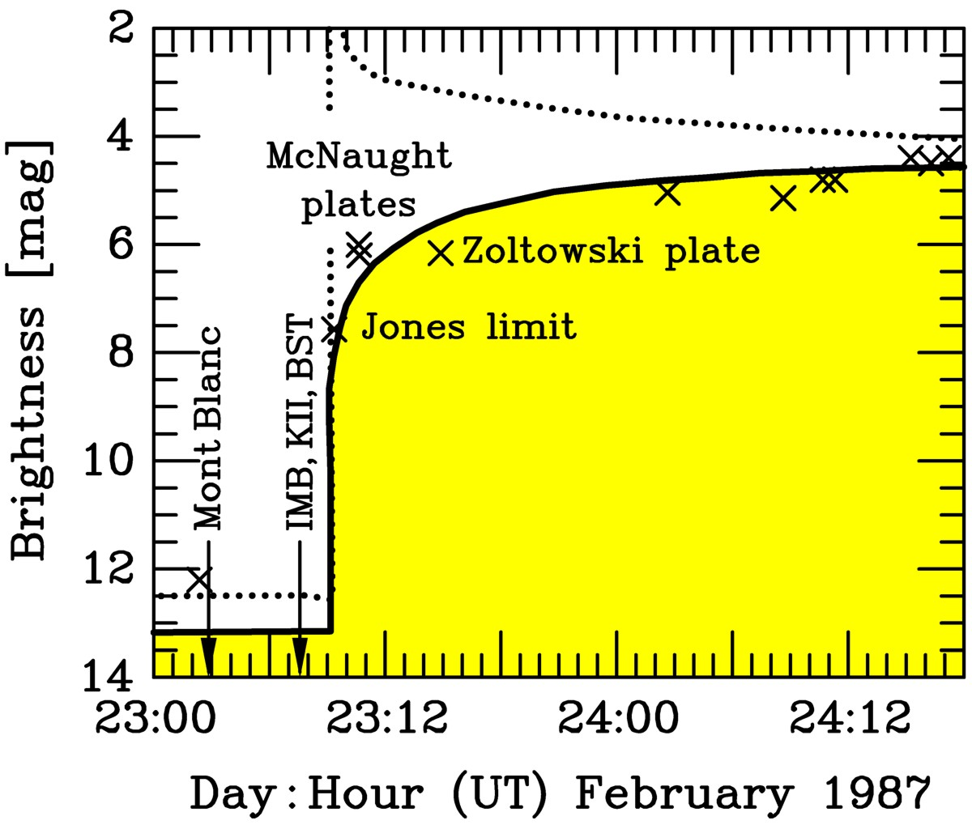
Early Lightcurve of SN 1987A
Expected bolometric
brightness evolution
Expected visual
brightness evolution
Neutrinos several
hours before light
Adapted from
Arnett et al.,
ARAA 27 (1989)

Slide 29
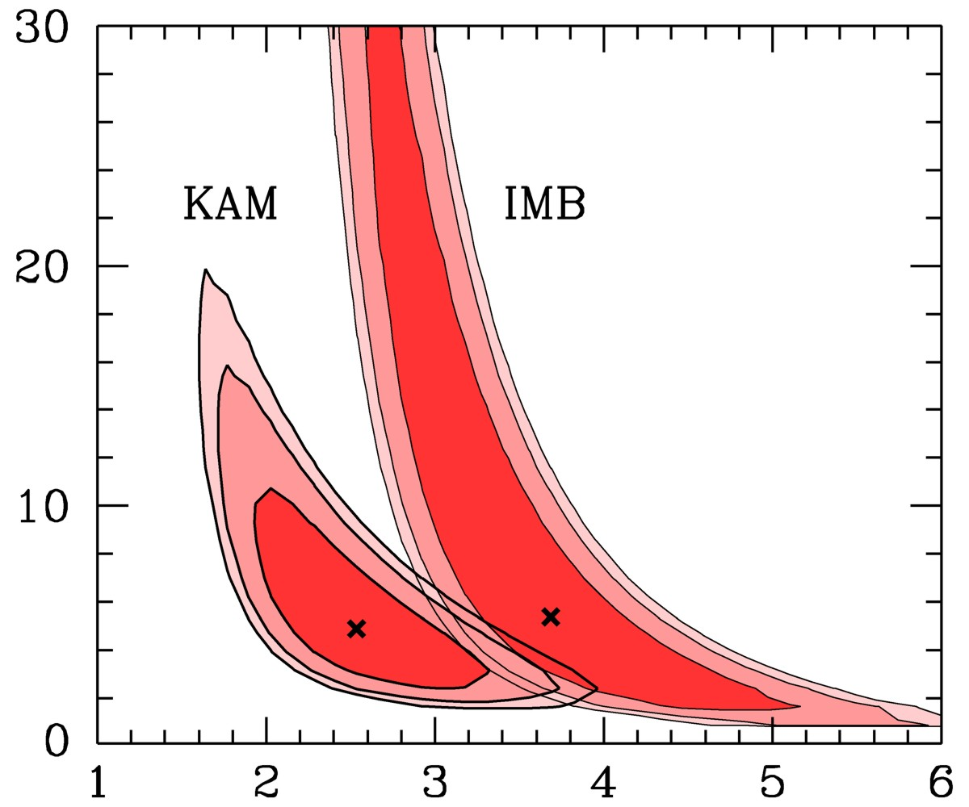
Interpreting SN 1987A Neutrinos
Assume
• Thermal spectra
• Equipartition of
energy between
$ν_{e}$, ${\overline{ν}}_{e}$, $ν_{μ}$, ${\overline{ν}}_{μ}$, $ν_{τ}$
and ${\overline{ν}}_{τ}$
Contours at CL
68.3%, 90% and 95.4%
Recent long-term
simulations
(Basel, Garching)
Binding Energy [${10}^{53}$ erg]
Jegerlehner,
Neubig & Raffelt,
PRD 54 (1996) 1194
Spectral ${\overline{ν}}_{e}$ temperature [MeV]

Slide 30
Flavor Oscillations
Particle-Physics Constraints

Slide 31
Neutrino Limits by Intrinsic Signal Dispersion
Time of flight delay by neutrino mass
“Milli charged” neutrinos
G. Zatsepin, JETP Lett. 8:205, 1968
Path bent by galactic magnetic field,
inducing a time delay
$$Δt=2.57\text{s} \frac{D}{50 kpc} {\left(\frac{10 MeV}{E_{ν}}\right)}^{2}{\left(\frac{m_{ν}}{10 eV}\right)}^{2}$$
$$\frac{Δt}{t}=\frac{e_{ν}^{2}{\left(B_{⊥}d_{B}\right)}^{2}}{6E_{ν}^{2}}<3×{10}^{−12}$$
SN 1987A signal duration implies
SN 1987A signal duration implies
$$m_{ν_{e}}≲20 \text{eV}$$
$$\frac{e_{ν}}{e}<3×{10}^{−17} \frac{1μG}{B_{⊥}} \frac{1 kpc}{d_{B}}$$
Loredo & Lamb
Ann N.Y. Acad. Sci. 571 (1989) 601
find 23 eV (95% CL limit) from detailed
maximum-likelihood analysis
Barbiellini & Cocconi,
Nature 329 (1987) 21
Bahcall, Neutrino Astrophysics (1989)
At the time of SN 1987A
competitive with tritium end-point
Today $m_{ν}<2.2 eV$from tritium
Cosmological limit today $m_{ν}≲0.2 \text{eV}$
Assuming charge conservation in
neutron decay yields a more
restrictive limit of about 3×10⁻²¹ e

Slide 32
Do Neutrinos Gravitate?
Early light curve of SN 1987A
Shapiro time delay for particles
moving in a gravitational potential
$Δt=−2\int_{A}^{B}{dt}Φ\left[r\left(t\right)\right]$
For trip from LMC to us, depending
on galactic model,
$Δt≈1$–5 months
Neutrinos and photons respond to
gravity the same to within
1–$4×{10}^{−3}$
Longo, PRL 60:173, 1988
Krauss & Tremaine, PRL 60:176, 1988
• Neutrinos arrived several hours
before photons as expected
• Transit time for $ν$ and $γ$ same
($160.000$ yr) within a few hours

Slide 33
Supernova 1987A Energy-Loss Argument
SN 1987A neutrino signal
Neutrino
sphere
Volume emission
of new particles
Neutrino
diffusion
Emission of very weakly interacting
particles would “steal” energy from the
neutrino burst and shorten it.
(Early neutrino burst powered by accretion,
not sensitive to volume energy loss.)
Late-time signal most sensitive observable

Slide 34
SN 1987A Axion Limits
Excluded
Free streaming
Trapping
Volume emission
of new particles
Axion
diffusion
Neutrino
diffusion
Neutrino
diffusion

Slide 35
Axion Bounds and Searches
[GeV] f_{a}
10³
10⁶
10⁹
10¹²
10¹⁵
keV
eV
meV
μeV
neV
m_{a}
Experiments
Tele
scope
CAST
Direct
searches
ADMX
(Seattle & Yale)
Too much
hot dark matter
String
DW
Too much CDM
(misalignment)
Too much cold dark matter
(re-alignment with Θ_{i} = 1)
Globular clusters
(a-γ-coupling)
Anthropic
Range
SN 1987A
Too many events
Too much
energy loss
Globular clusters (He ignition), WD cooling
(a-e coupling)

Slide 36
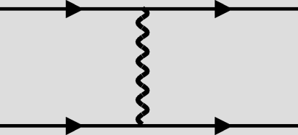
Dirac Neutrino Constraints by SN 1987A
If neutrinos are Dirac particles, right-handed states
exist that are “sterile” (non-interacting)
Couplings are constrained by SN 1987A energy-loss
Right-handed
currents
e
$$ν_{eR}$$
$$G_{R}≲{10}^{−5}G_{F}$$
$$W_{R}$$
p
n
Dirac mass
$$ν_{L}$$
$$ν_{eR}$$
$$m_{D}≲30 \text{keV}$$
$$Z^{0}$$
N
N
Dipole
moments
$$ν_{L}$$
$$ν_{eR}$$
$$μ_{ν}≲{10}^{−12}μ_{B}$$
$$γ$$
p
p
Milli charge
$${\overline{ν}}_{R}$$
$$e_{ν}≲{10}^{−9}e$$
$$γ$$
$$ν_{R}$$

Slide 37
Sterile Neutrino Emission from a SN Core
• Assume sterile neutrino mixed with $ν_{e}$, small mixing angle $Θ$
• Due to matter effect, oscillation length < mean free path (mfp),
(weak damping limit)
$ℓ_{osc}≪λ_{s}=Γ_{s}^{−1}$
• $ν_{e}$ appears as $ν_{s}$ on average with probability
$〈p_{ν_{e}→ν_{s}}〉=\frac{1}{2}\sin^{2}{2Θ}$
• Typical $ν_{e}$ interaction rate in SN core (inverse mfp)
$Γ_{e}∼{10}^{10} {\text{s}}^{−1}$
• Production rate (inverse mfp) relative to that of $ν_{e}$
$Γ_{s}=\frac{1}{2}\sin^{2}{(2Θ)}Γ_{e}∼\frac{1}{2}\sin^{2}\left(2Θ\right)×{10}^{10} {\text{s}}^{−1}$
• Avoiding fast energy loss of SN 1987A
$Γ_{s}<1 {\text{s}}^{−1}$
• Constrain mixing angle for masses $≳$ 30 keV (matter effect irrelevant)
$\sin^{2}{(2Θ)}≲{10}^{−10}$

Slide 38
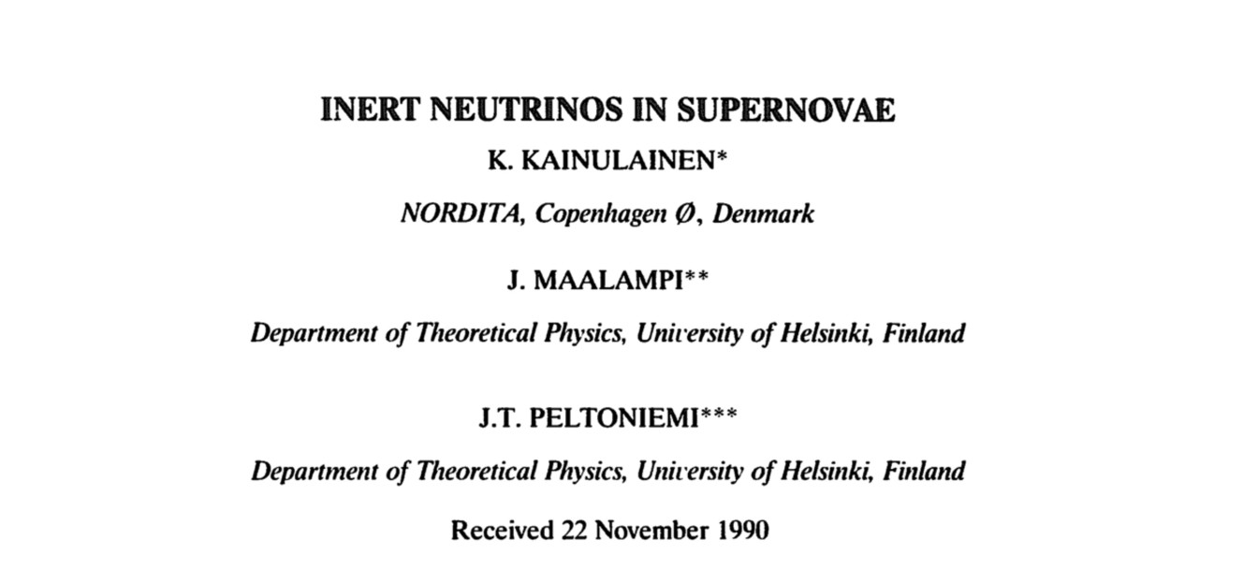
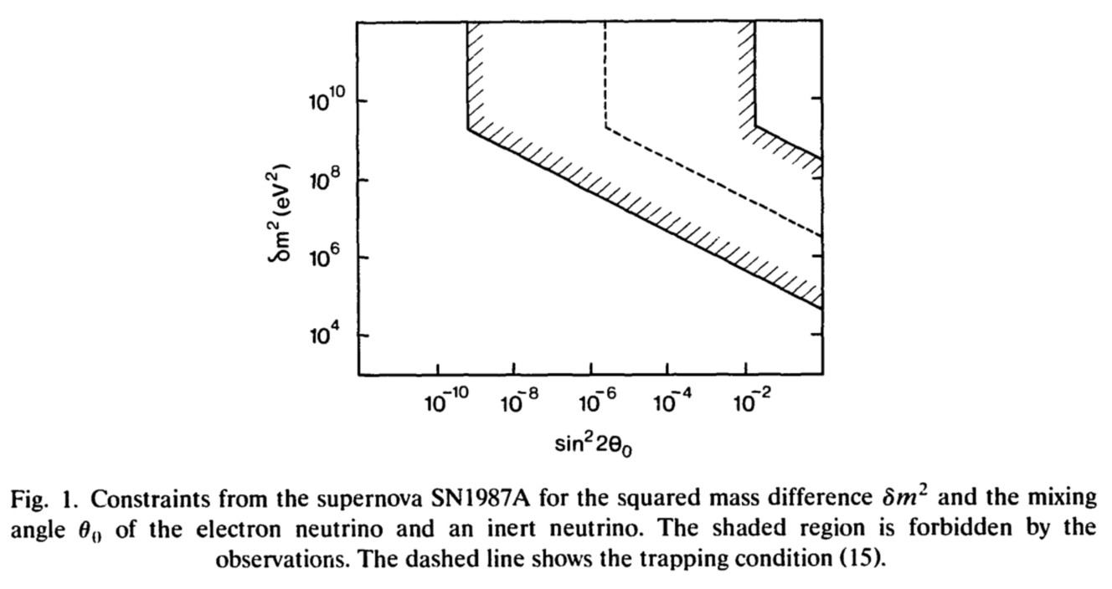
Sterile Neutrino Limits
See also:
Maalampi & Peltoniemi:
Effects of the 17-keV
neutrino in supernovae
PLB 269:357,1991
Raffelt & Zhou
arXiv:1102.5124
Hidaka & Fuller:
Dark matter sterile
neutrinos in stellar
collapse: alteration of
energy/lepton number
transport and a
mechanism for
supernova explosion
enhancement
PRD 74:125015,2006

Slide 39
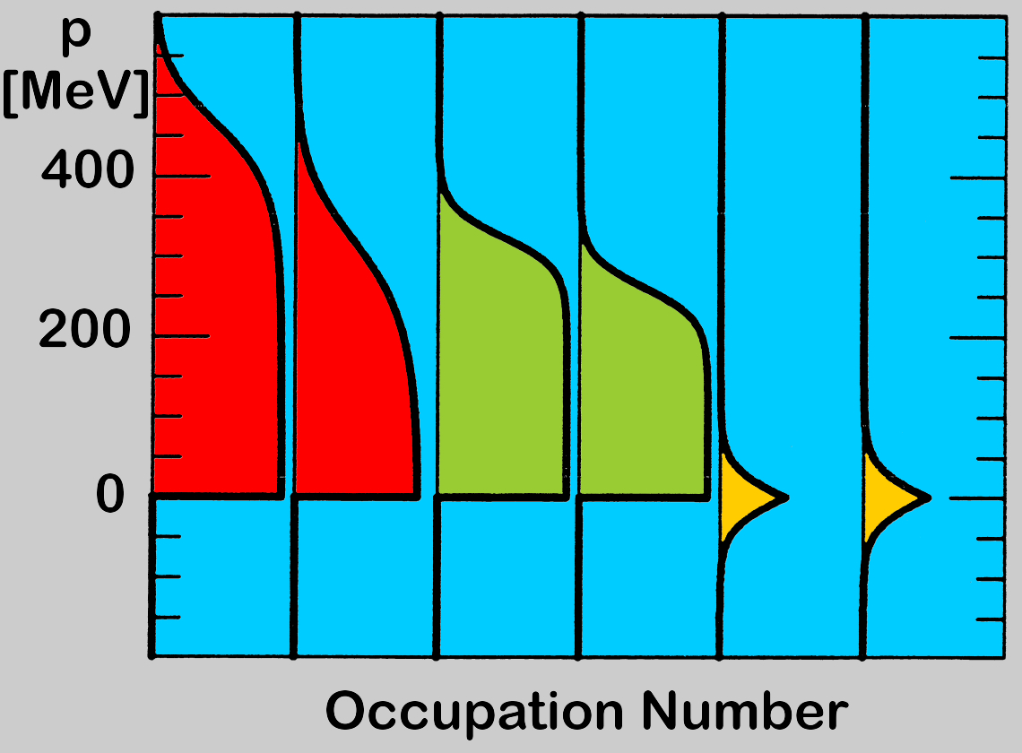
Degenerate Fermi Seas in a Supernova Core
Trapped lepton number
is stored in e⁻ and ν_{e}
Particles
n
p
e⁻
ν_{e}
ν_{μ}
ν_{τ}
Anti-
particles
In true thermal equilibrium with flavor mixing, only one chemical
potential for charged leptons and one for neutrinos.
No chemical potential for Majorana neutrinos (lepton number violation)

Slide 40
Degenerate Fermi Seas in a Supernova Core
Equilibration by flavor
lepton number violation,
but flavor oscillations
ineffective (matter effect)
Non-standard interactions
could be effective, most
sensitive environment
n
p
e⁻
ν_{e}
ν_{μ}
ν_{τ}
Consequences in core
collapse should be
studied numerically
Equilibration by lepton
number violation, but
Majorana masses too small
R-parity violating SUSY
interactions?
TeV-scale bi-leptons?

Slide 41
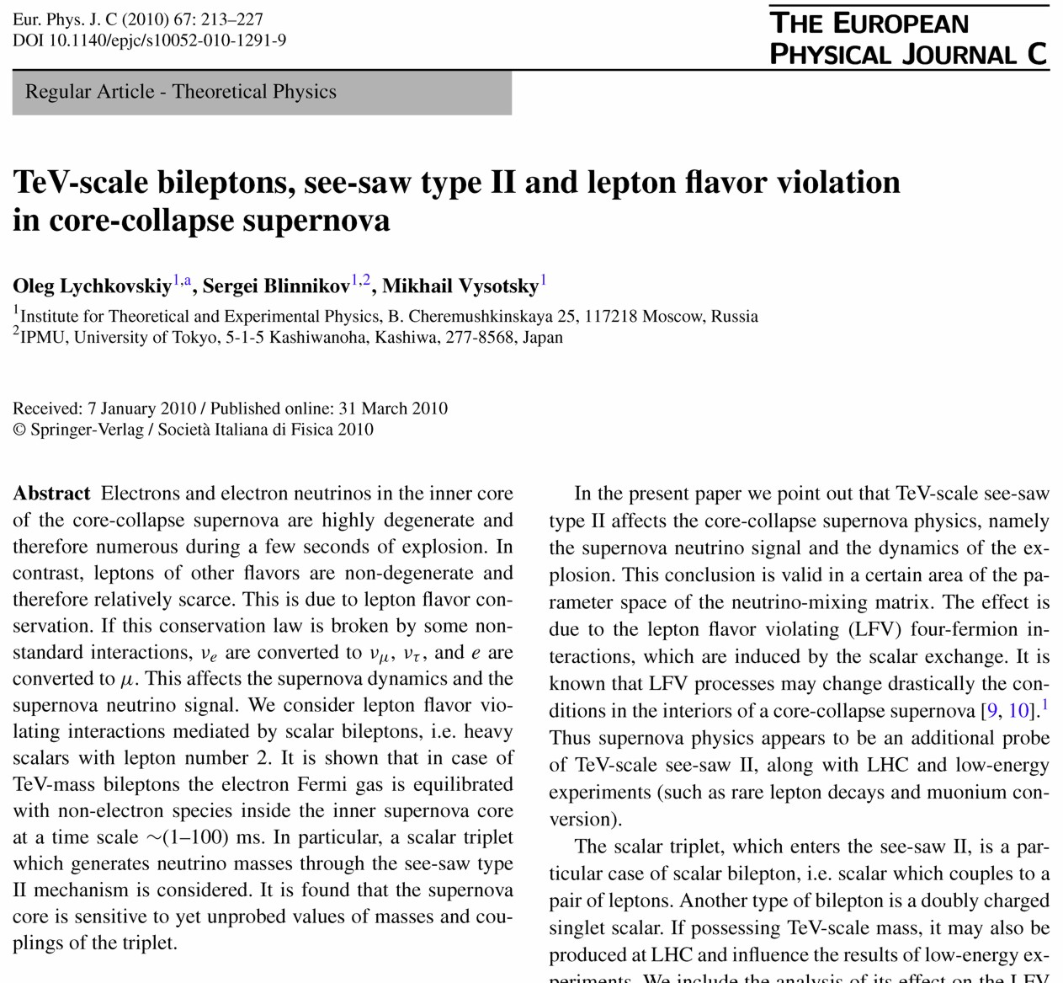
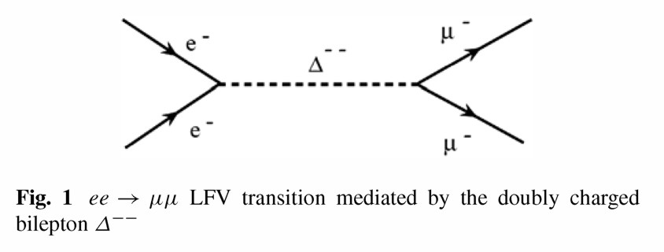
Bi-Leptons and Core Collapse

Slide 42
Flavor Oscillations
Neutrinos from Next Nearby SN

Slide 43
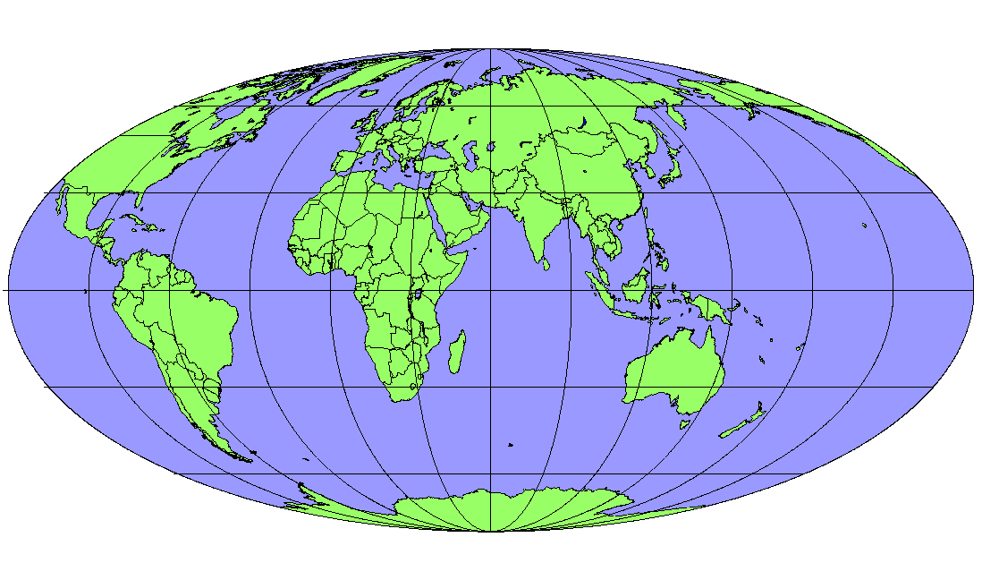
Operational Detectors for Supernova Neutrinos
MiniBooNE
(200)
HALO
(tens)
LVD (400)
Borexino (100)
Baksan
(100)
Super-K (10⁴)
KamLAND (400)
Daya Bay
(100)
In brackets events
for a “fiducial SN”
at distance 10 kpc
IceCube (10⁶)

Slide 44
SuperNova Early Warning System (SNEWS)
Early light curve of SN 1987A
http://snews.bnl.gov
Super-K
• Neutrinos arrive several hours
before photons
• Can alert astronomers several
hours in advance
IceCube
Coincidence
Server
@ BNL
Alert
LVD
Borexino

Slide 45
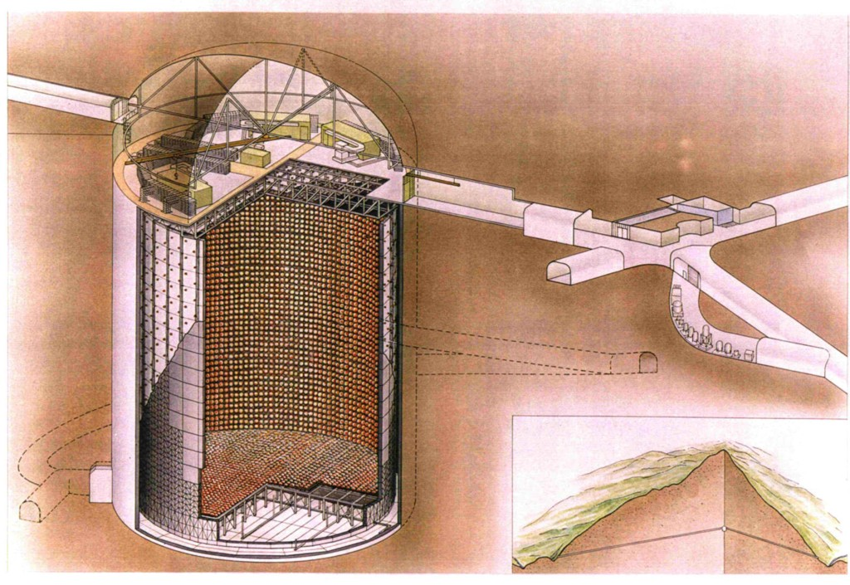
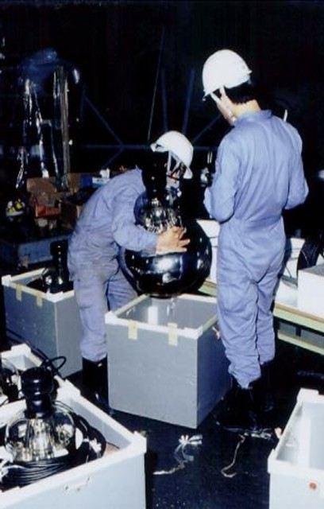
Super-Kamiokande Neutrino Detector (Since 1996)
42 m
39.3 m

Slide 46
Neutrino Cross Section in a Water Target
Cross section per water molecule
${\overline{ν}}_{e}+p→n+e^{+}$ dominates for SN neutrinos
$ν_{e}+e→e+ν_{e}$ dominates for solar neutrinos

Slide 47
Simulated Supernova Burst in Super-Kamiokande
Movie by C. Little, including work by S. Farrell & B. Reed,
(Kate Scholberg’s group at Duke University)
http://snews.bnl.gov/snmovie.html

Slide 48
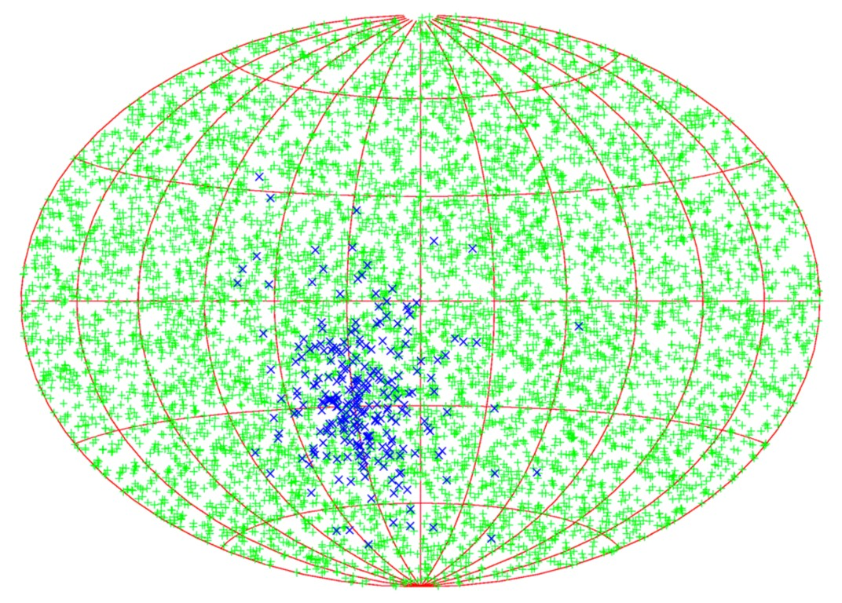
Supernova Pointing with Neutrinos
${\overline{ν}}_{e}p→ne^{+}$
Neutron tagging
efficiency
None
90 %
7.8°
3.2°
SK
1.4°
0.6°
SK × 30
$$νe→νe$$
95% CL half-cone
opening angle
Beacom & Vogel: Can a supernova be located by its neutrinos? [astro-ph/9811350]
Tomàs, Semikoz, Raffelt, Kachelriess & Dighe: Supernova pointing with low- and
high-energy neutrino detectors [hep-ph/0307050]

Slide 49
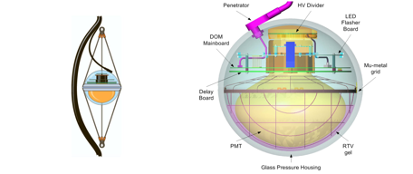
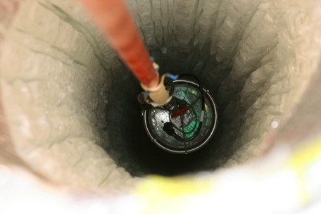
IceCube Neutrino Telescope at the South Pole
Instrumentation of 1 km³ antarctic
ice with $\sim$ 5000 photo multipliers
completed December 2010

Slide 50
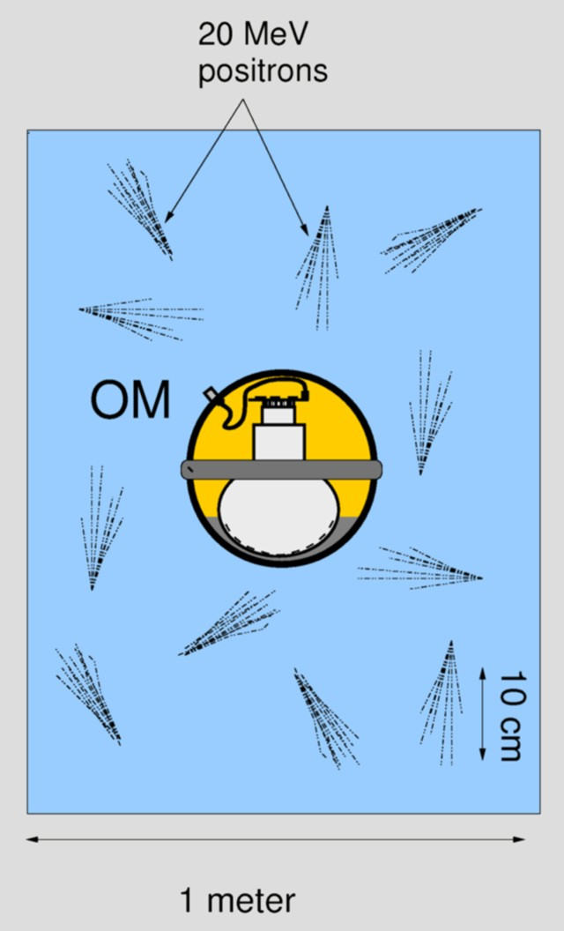
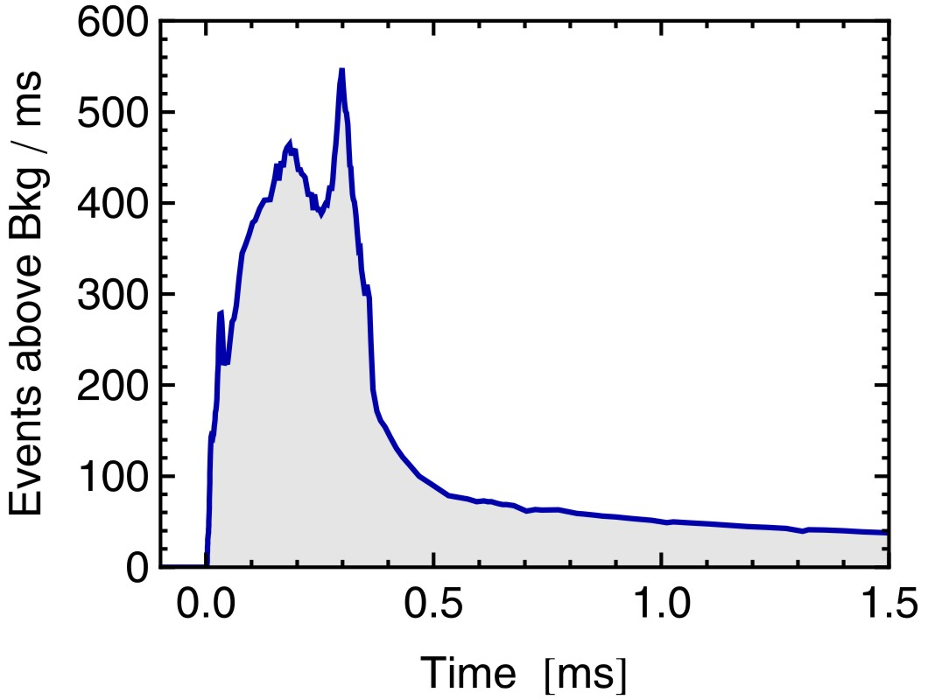
IceCube as a Supernova Neutrino Detector
SN signal at 10 kpc
10.8 M_{sun} simulation
of Basel group
[arXiv:0908.1871]
Accretion
Cooling
• Each optical module (OM) picks up Cherenkov light from its neighborhood
• $\sim$ 300 Cherenkov photons per OM from SN at 10 kpc, bkgd rate in one OM < 300 Hz
• SN appears as “correlated noise” in $\sim$ 5000 OMs
• Significant energy information from time-correlated hits
Pryor, Roos & Webster, ApJ 329:355, 1988. Halzen, Jacobsen & Zas, astro-ph/9512080.
Demirörs, Ribordy & Salathe, arXiv:1106.1937.

Slide 51
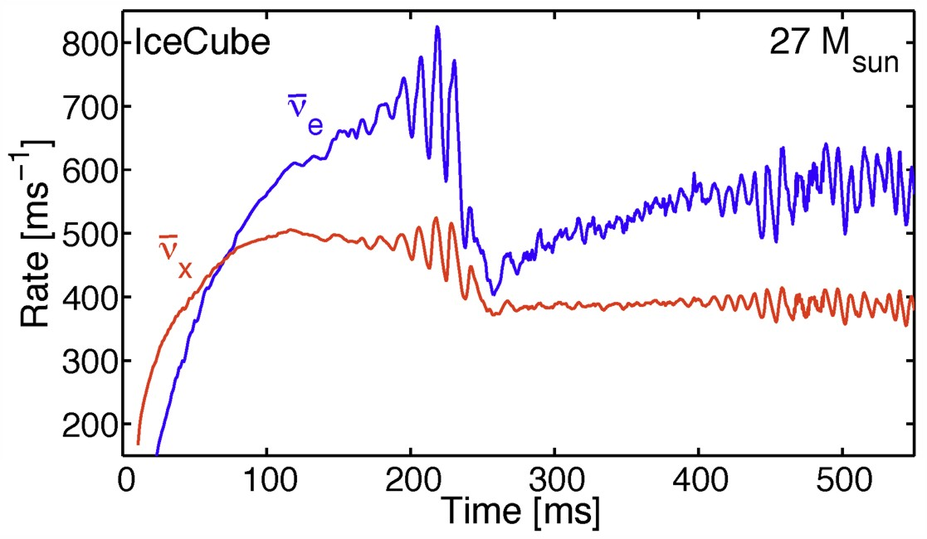
Variability seen in Neutrinos (3D Model)
Tamborra, Hanke, Müller, Janka & Raffelt, arXiv:1307.7936
See also Lund, Marek, Lunardini, Janka & Raffelt, arXiv:1006.1889

Slide 52
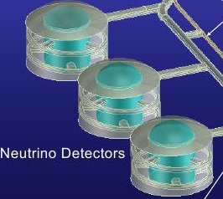
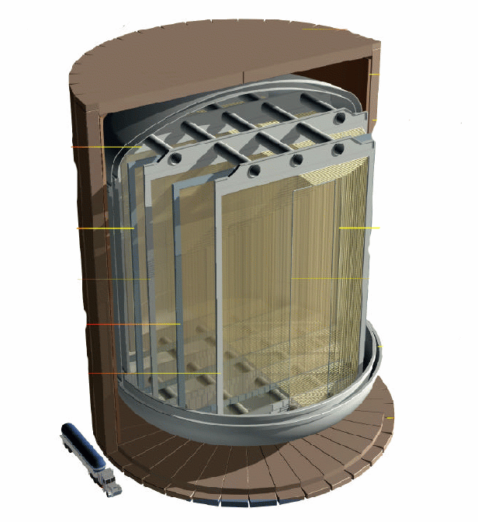
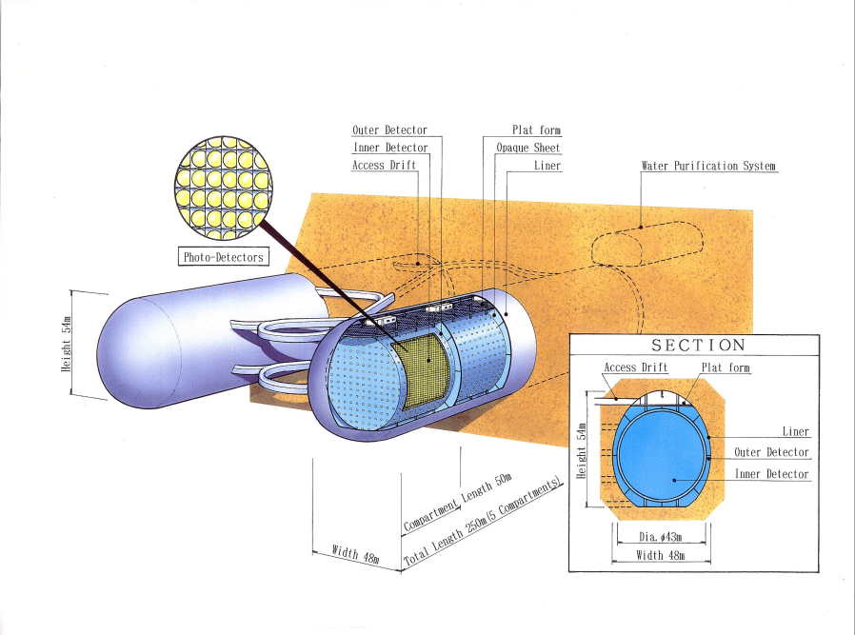
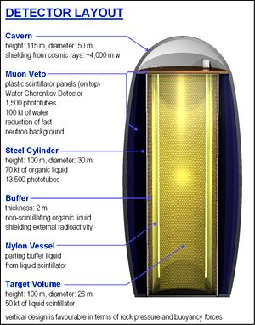
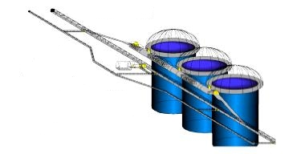
Next Generation Large-Scale Detector Concepts
5-100 kton
liquid Argon
DUSEL
LBNE
100 kton scale
scintillator
Hyper-K
Memphys
LENA
HanoHano
Juno
Megaton-scale
water Cherenkov

Slide 53
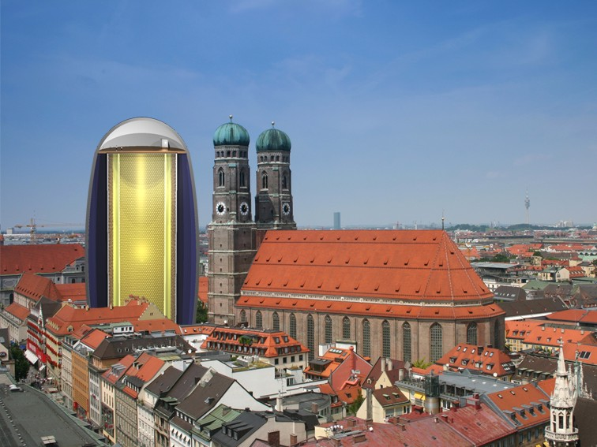
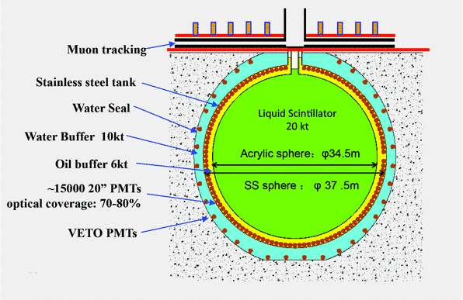
LENA: From Dream to Reality
JUNO (formerly Daya Bay II) Collaboration formed (2014)
20 kt scintillator detector
Hierarchy determination with reactor neutrinos
Excellent for low-energy neutrino astronomy
50 kt
Scintillator

Slide 54
Flavor Oscillations
Supernova Rate

Slide 55
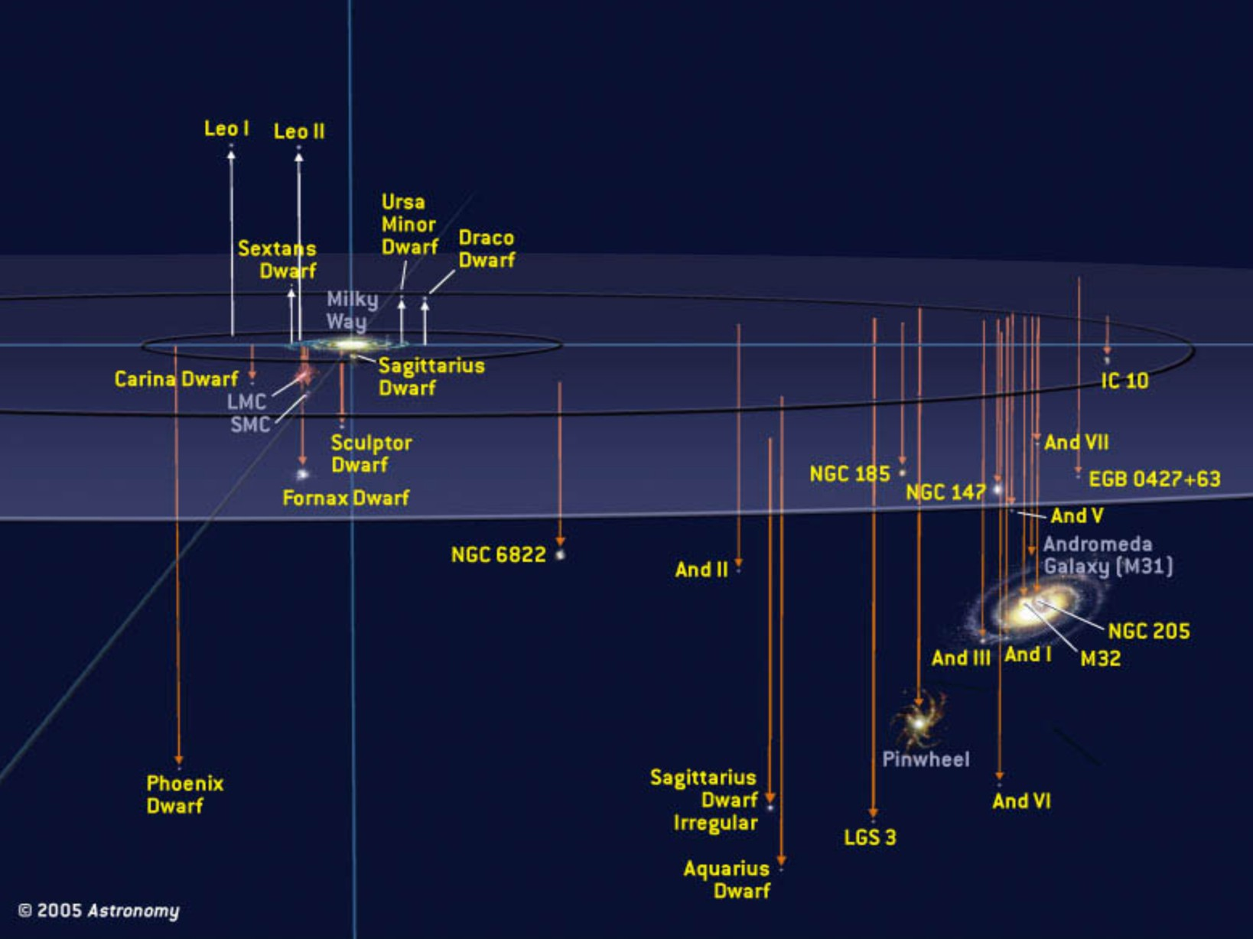
Local Group of Galaxies
With megatonne class (30 x SK)
60 events from Andromeda
Current best neutrino detectors
sensitive out to few 100 kpc

Slide 56
Core-Collapse SN Rate in the Milky Way
SN statistics in
external galaxies
van den Bergh & McClure
(1994)
Cappellaro & Turatto (2000)
Gamma rays from
²⁶Al (Milky Way)
Diehl et al. (2006)
Historical galactic
SNe (all types)
Strom (1994)
Tammann et al. (1994)
No galactic
neutrino burst
90 % CL (30 years)
Alekseev et al. (1993)
Core-collapse SNe per century
0
1
2
3
4
5
6
7
8
9
10
References: van den Bergh & McClure, ApJ 425 (1994) 205. Cappellaro & Turatto,
astro-ph/0012455. Diehl et al., Nature 439 (2006) 45. Strom, Astron. Astrophys. 288 (1994) L1.
Tammann et al., ApJ 92 (1994) 487. Alekseev et al., JETP 77 (1993) 339 and my update.

Slide 57
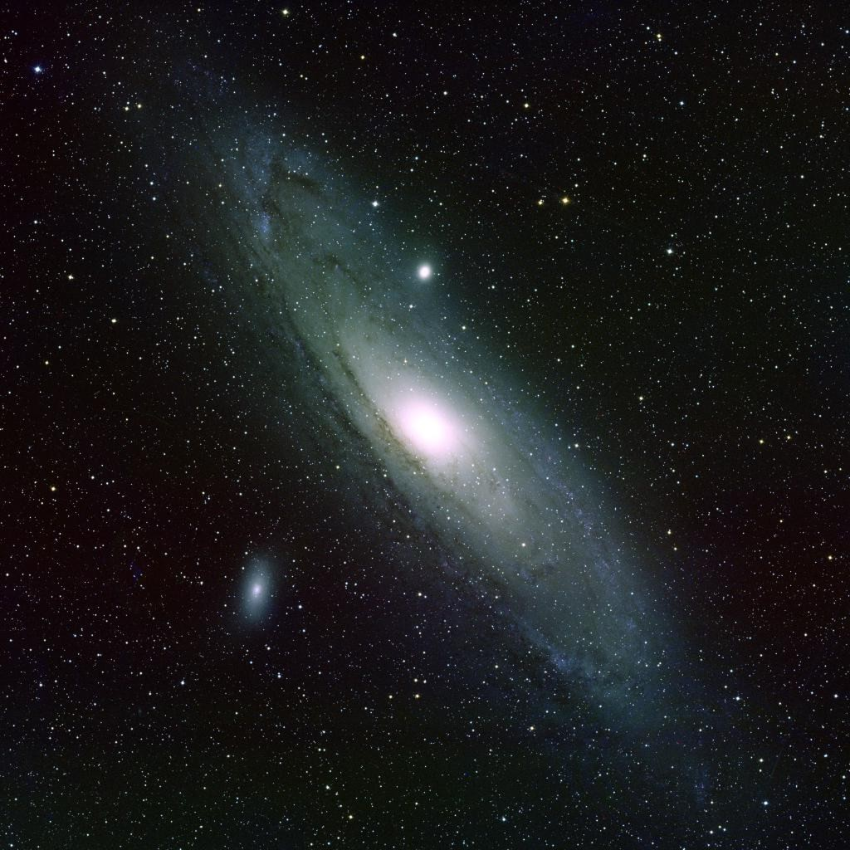
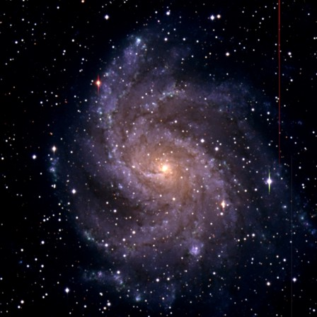
High and Low Supernova Rates in Nearby Galaxies
M31 (Andromeda) D = 780 kpc
NGC 6946 D = (5.5 ± 1) Mpc
Last Observed Supernova: 1885A
Observed Supernovae:
1917A, 1939C, 1948B, 1968D, 1969P,
1980K, 2002hh, 2004et, 2008S

Slide 58
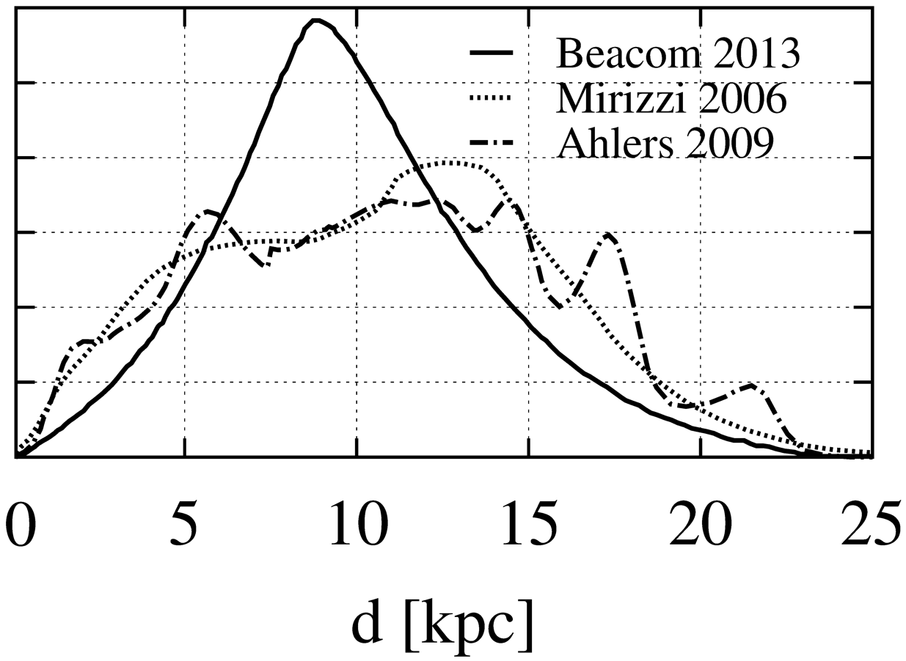
Expected Galactic SN Distance Distribution

Slide 59
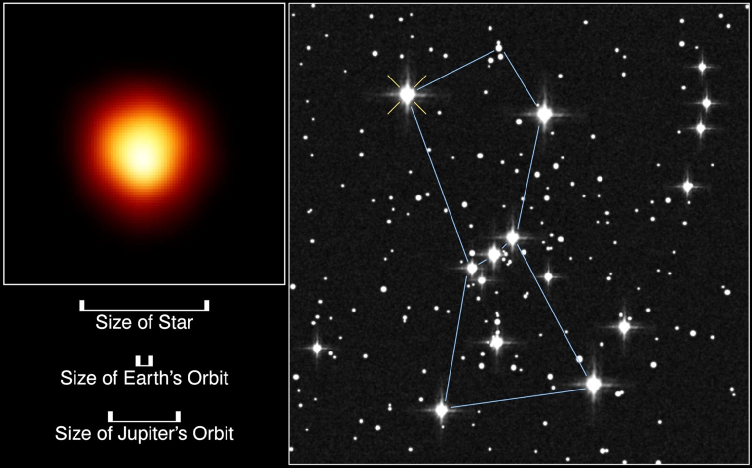
The Red Supergiant Betelgeuse (Alpha Orionis)
First resolved
image of a star
other than Sun
Distance
(Hipparcos)
130 pc (425 lyr)
If Betelgeuse goes Supernova:
6 ×10⁷ neutrino events in Super-Kamiokande
2.4 ×10³ neutrons /day from Si burning phase
(few days warning!), need neutron tagging
[Odrzywolek, Misiaszek & Kutschera, astro-ph/0311012]

Slide 60
Flavor Oscillations
Diffuse SN Neutrino Background

Slide 61
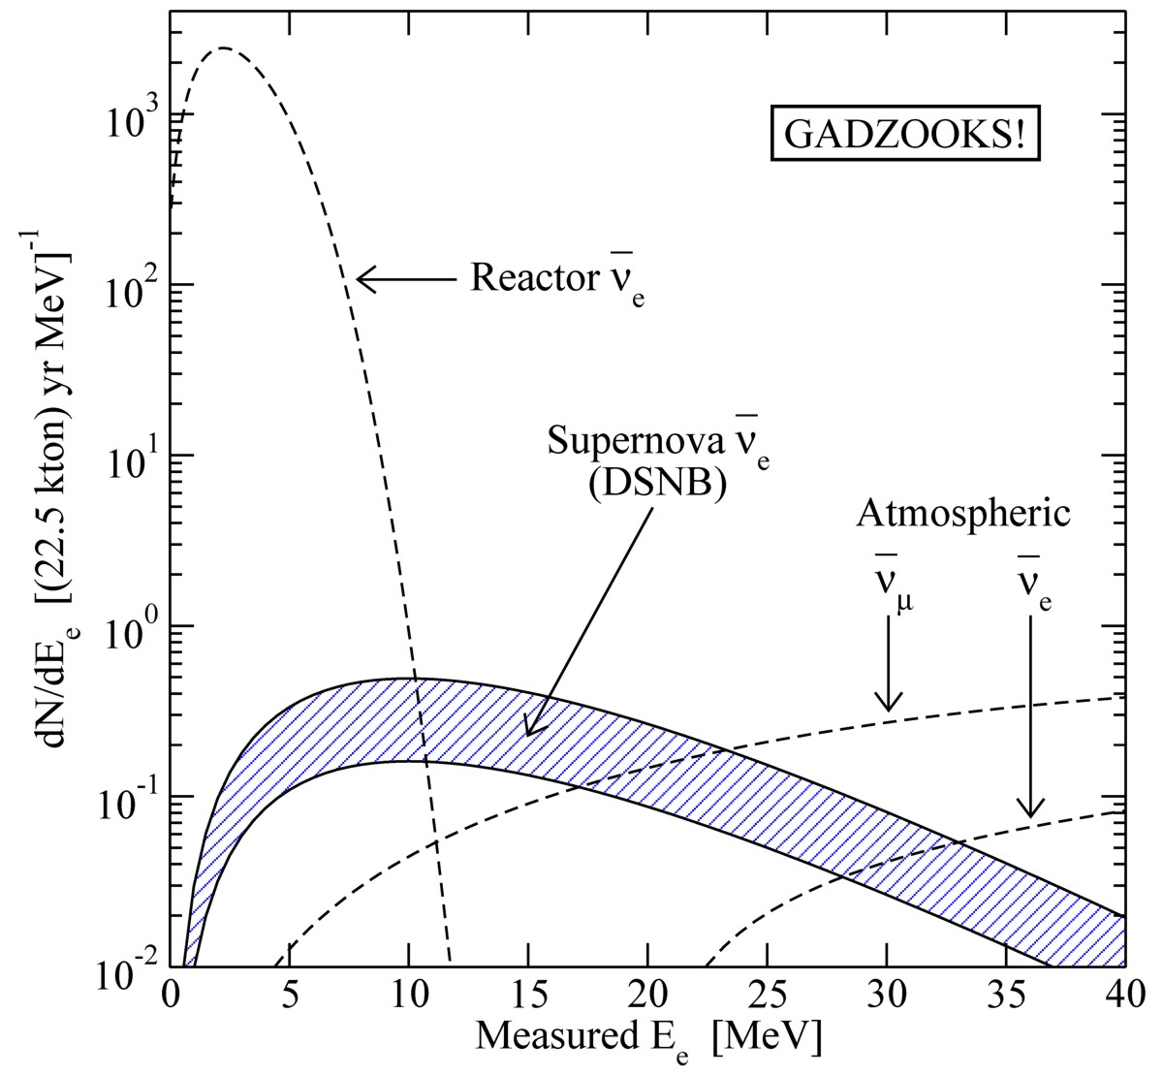
Diffuse Supernova Neutrino Background (DSNB)
• A few core collapses per second
in the visible universe
• Emitted $ν$ energy density
∼ extra-galactic background light
∼ 10% of CMB density
• Detectable ${\overline{ν}}_{e}$ flux at Earth
$∼10 {\text{cm}}^{−2} {\text{s}}^{−1}$
mostly from redshift $z∼1$
• Confirm star-formation rate
• Nu emission from average core
collapse & black-hole formation
• Pushing frontiers of neutrino
astronomy to cosmic distances!
Beacom & Vagins,
PRL 93:171101,2004
Window of opportunity between
reactor ${\overline{ν}}_{e}$and atmospheric $ν$ bkg

Slide 62
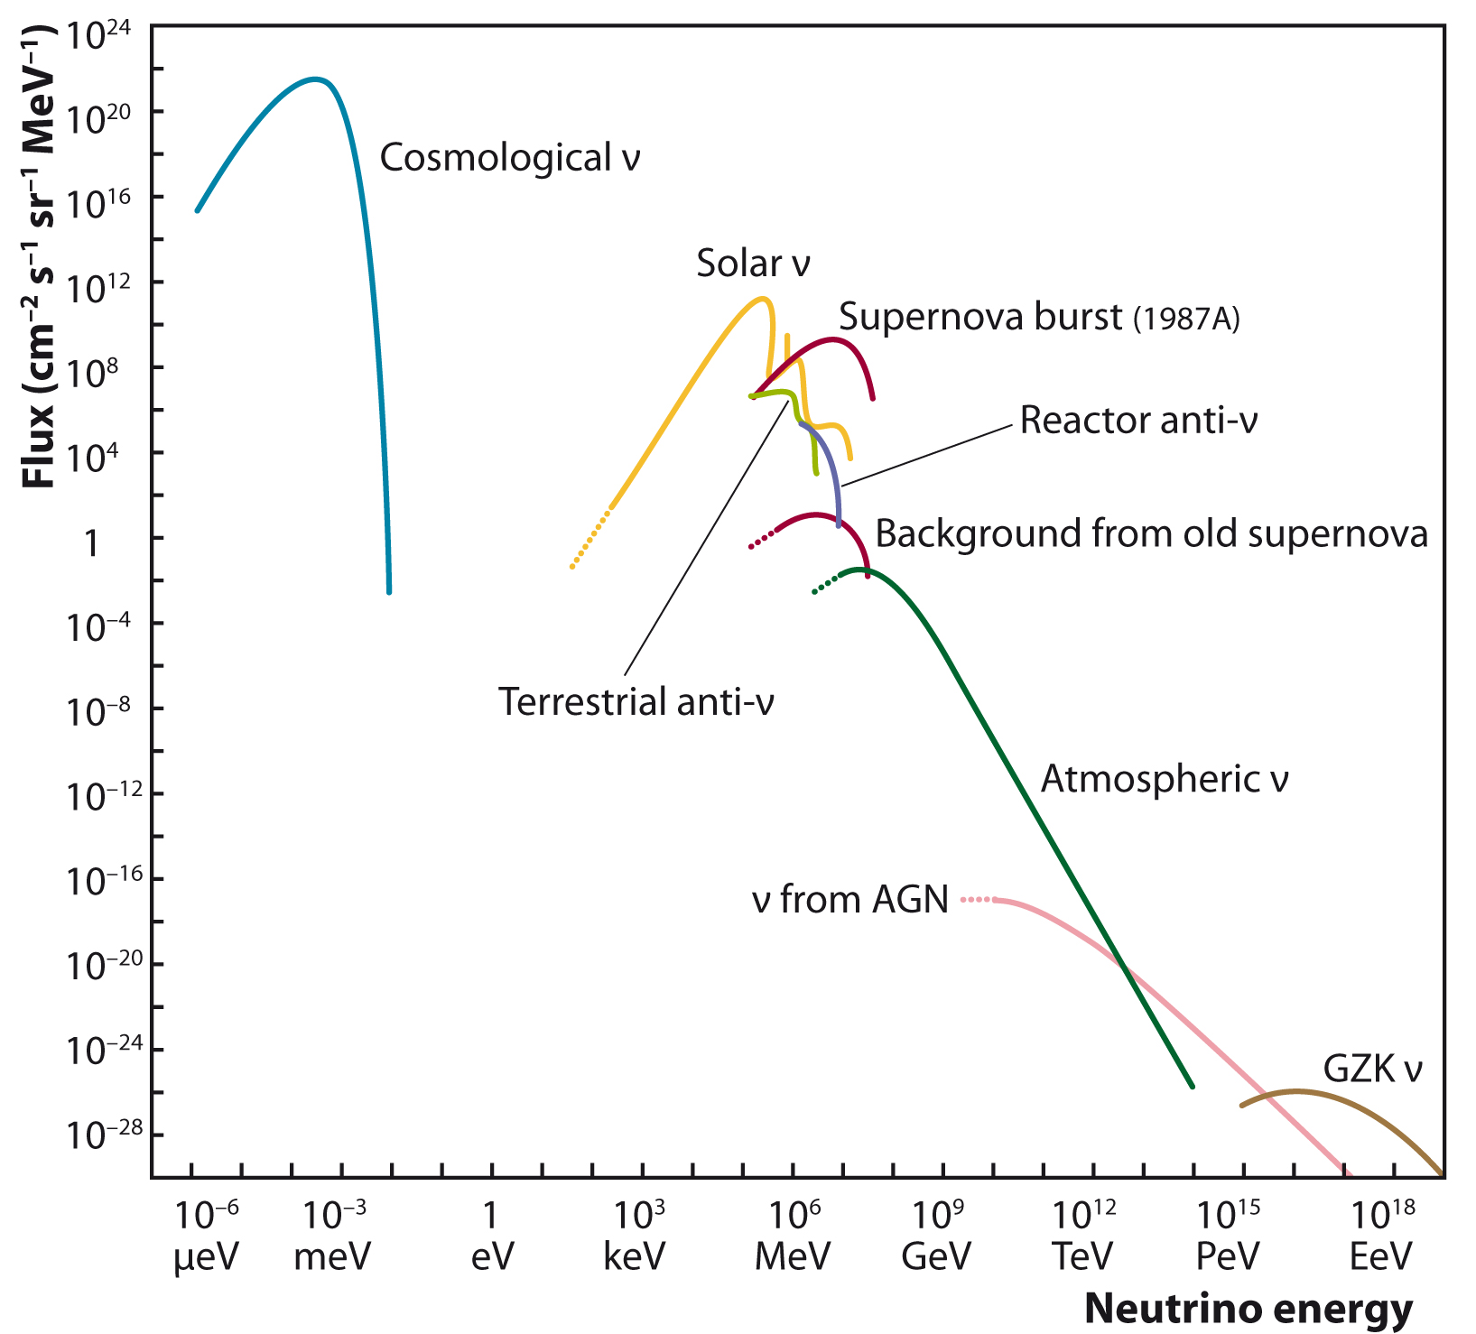
Grand Unified Neutrino Spectrum
Christian Spiering

Slide 63
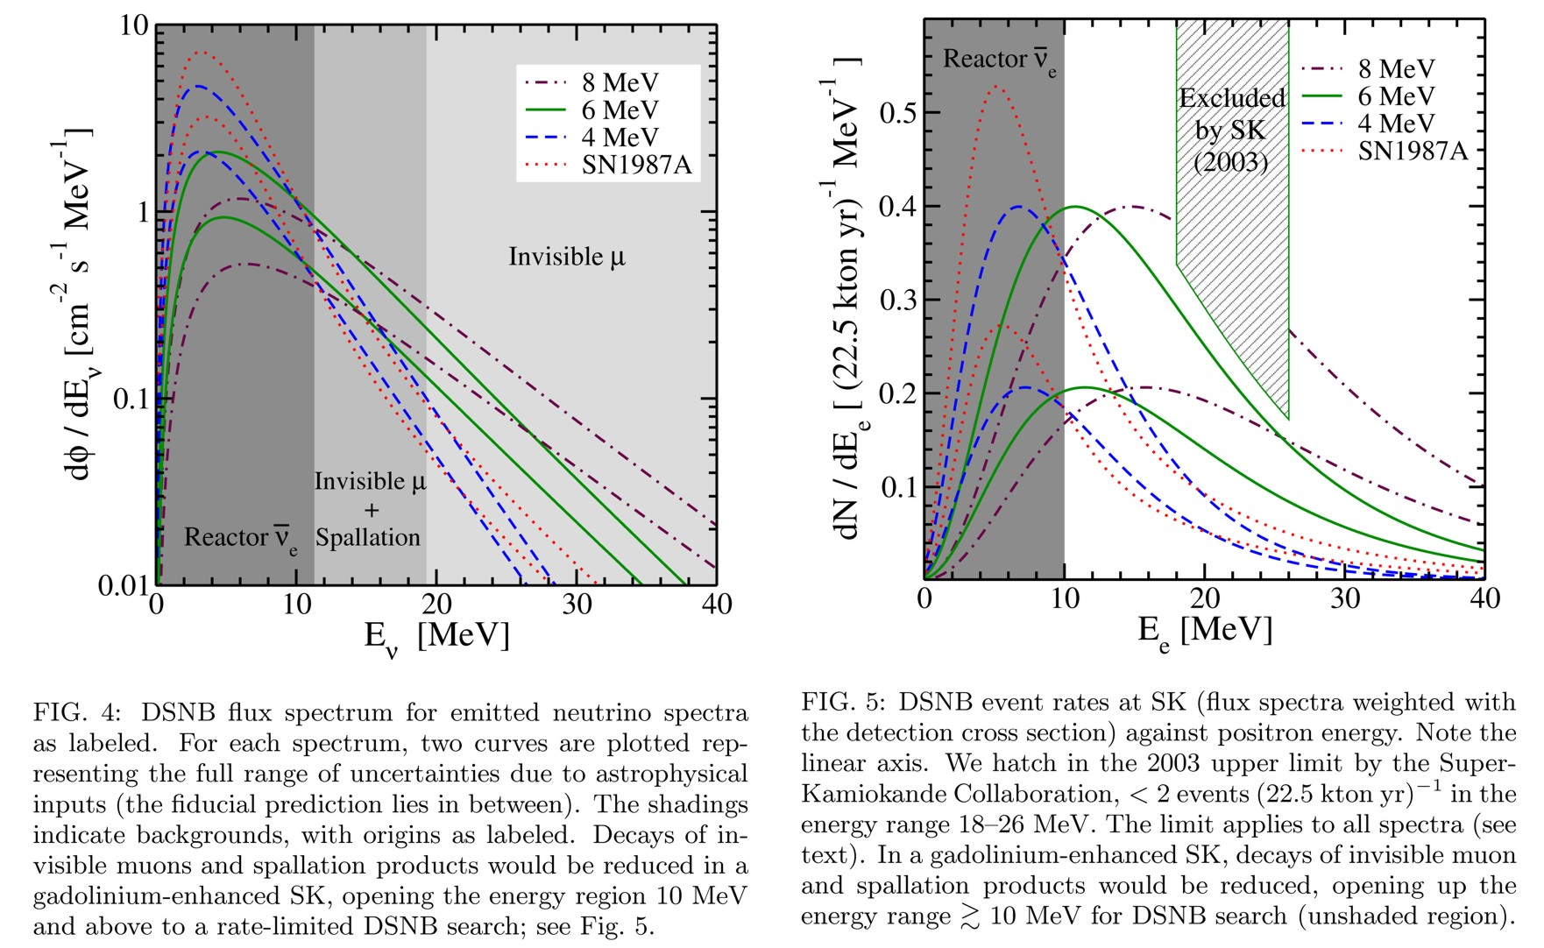
Realistic DSNB Estimate
Horiuchi, Beacom & Dwek, arXiv:0812.3157v3

Slide 64
Neutron Tagging in Super-K with Gadolinium
Background suppression: Neutron tagging in ${\overline{ν}}_{e}+p→n+e^{+}$
• Scintillator detectors: Low threshold for γ(2.2 MeV)
• Water Cherenkov: Dissolve Gd as neutron trap (8 MeV γ cascade)
• Need 100 tons Gd for Super-K (50 kt water)
EGADS test facility at Kamioka
• Construction 2009–11
• Experimental program 2011–2013
Mark Vagins
Neutrino 2010
Selective water & Gd
filtration system
200 ton
water tank
Transparency
measurement

Slide 65
Supernova vs. Star Formation Rate in the Universe
Measured SN rate about
half the prediction from
star formation rate
Many “dark SNe” ?
Horiuchi, Beacom, Kochanek, Prieto, Stanek & Thompson
arXiv:1102.1977

Slide 66
Flavor Oscillations
Neutrino Flavor Conversion

Slide 67
Neutrino Oscillations in Matter
3700 citations
Neutrinos in a medium suffer flavor-dependent
refraction
W
f
ν
ν
ν
Z
ν
f
$V_{\text{weak}}=\sqrt{2}G_{\text{F}}×\left\{\begin{matrix}N_{\text{e}}−{N_{\text{n}}}/2 \\ {{−N}_{\text{n}}}/2\end{matrix} \begin{matrix}\text{f}\text{or} { ν}_{\text{e}} \\ \text{f}\text{or} ν_{μ}\end{matrix}\right.$
Lincoln Wolfenstein
Typical density of Earth: 5 g/cm³
$$ΔV_{\text{weak}}≈2×{10}^{−13} \text{eV}=0.2 \text{peV}$$

Slide 68
Suppression of Oscillations in Supernova Core
Effective mixing angle in matter
$$\tan{2θ_{m}=}\frac{\sin{2θ}}{\cos{2θ}−{N_{e}2E\sqrt{2}G_{F}}/{Δm^{2}}}$$
Supernova core
$ρ=3×{10}^{14} \text{g} {\text{cm}}^{−3}$
$Y_{e}=0.35$
$N_{e}=6×{10}^{37} {\text{cm}}^{−3}$
$E∼100 \text{MeV}$
Solar mixing
$Δm^{2}∼75 {\text{meV}}^{2}$
$\sin{2θ∼0.94}$
Matter suppression effect
${N_{e}2E\sqrt{2}G_{F}}/{Δm^{2}∼2×{10}^{13}}$
• Inside a SN core,
flavors are “de-mixed”
• Very small oscillation
amplitude
• Trapped e-lepton
number can only
escape by diffusion

Slide 69
Flavor Oscillations in Core-Collapse Supernovae
Flavor eigenstates are
propagation eigenstates
Neutrino flux
Neutrino
sphere
MSW region

Slide 70
Mikheev-Smirnov-Wolfenstein (MSW) effect
Eigenvalues of Hamiltonian for
2-flavor mixing
Stanislav Mikheev & Alexei Smirnov

Slide 71
Three-Flavor Eigenvalue Diagram
Normal mass ordering (NH)
Inverted mass ordering (IH)
Vacuum
Vacuum
Dighe & Smirnov, Identifying the neutrino mass spectrum from a supernova
neutrino burst, astro-ph/9907423

Slide 72
SN Flavor Oscillations and Mass Hierarchy
• Mixing angle $Θ_{13}$ has been measured to be “large”
• MSW conversion in SN envelope adiabatic
• Assume that collective flavor oscillations are not important
Mass ordering
Normal (NH)
Inverted (IH)
$ν_{e}$ survival prob.
0
$$\sin^{2}{θ_{12}}≈0.3$$
${\overline{ν}}_{e}$ survival prob.
$$\cos^{2}{θ_{12}}≈0.7$$
0
${\overline{ν}}_{e}$Earth effects
Yes
No
• When are collective oscillations important?
• How to detect signatures of hierarchy?

Slide 73
Neutronization Burst as a Standard Candle
Different Mass
Neutrino Transport
Nuclear EoS
If mixing scenario
is known, can
determine SN
distance
(better than 5-10%)
Neutronization burst,
e.g. in LiAr detectors
Rise time & shape,
e.g. IceCube, Hyper-K
Kachelriess, Tomàs,
Buras, Janka,
Marek & Rampp,
astro-ph/0412082

Slide 74
Early Phase Signal in Anti-Neutrino Sector
Garching Models with M = 12–40 ${\text{M}}_{⊙}$
Average Energy
Luminosity
IceCube Signature
$${\overline{ν}}_{x}$$
$${\overline{ν}}_{x}$$
$${\overline{ν}}_{e}$$
$${\overline{ν}}_{e}$$
$${\overline{ν}}_{x}$$
$${\overline{ν}}_{e}$$
• In principle very sensitive to hierarchy, notably IceCube
• “Standard candle” to be confirmed beyond Garching models
Abbasi et al. (IceCube Collaboration) A&A 535 (2011) A109
Serpico, Chakraborty, Fischer, Hüdepohl, Janka & Mirizzi, arXiv:1111.4483

Slide 75
Neutrino Flavor Conversion
Neutrino-neutrino
refraction causes
collective flavor conversion
(flavor exchange
between different
parts of spectrum)
Many theoretical
challenges
remain to be
resolved!
Flavor eigenstates are
propagation eigenstates
Neutrino flux
Neutrino
sphere
MSW region

Slide 76
Flavor-Off-Diagonal Refractive Index
2-flavor neutrino evolution as an effective 2-level problem
$$\text{i}\frac{∂}{∂t}\left(\begin{matrix}ν_{e} \\ ν_{μ}\end{matrix}\right)=H\left(\begin{matrix}ν_{e} \\ ν_{μ}\end{matrix}\right)$$
$$ν$$
Effective mixing Hamiltonian
ν
Z
ν
$$H=\frac{M^{2}}{2E}+\sqrt{2}G_{F} \left(\begin{matrix}N_{e}−\frac{N_{n}}{2} & 0 \\ 0 & −\frac{N_{n}}{2}\end{matrix}\right)+\sqrt{2}G_{F}\left(\begin{matrix}N_{ν_{e}} & N_{{〈ν}_{e}|ν_{μ}〉} \\ N_{{〈ν}_{μ}|ν_{e}〉} & N_{ν_{μ}}\end{matrix}\right)$$
Mass term in
flavor basis:
causes vacuum
oscillations
Wolfenstein’s weak
potential, causes MSW
“resonant” conversion
together with vacuum
term
Flavor-off-diagonal potential,
caused by flavor oscillations.
(J.Pantaleone, PLB 287:128,1992)
Flavor oscillations feed back on the Hamiltonian: Nonlinear effects!

Slide 77
Collective Supernova Nu Oscillations since 2006
Two seminal papers in 2006 triggered a torrent of activities
Duan, Fuller, Qian, astro-ph/0511275, Duan et al. astro-ph/0606616
Balantekin, Gava & Volpe [0710.3112]. Balantekin & Pehlivan [astro-ph/0607527]. Blennow, Mirizzi & Serpico [0810.2297]. Cherry, Fuller, Carlson, Duan & Qian [1006.2175, 1108.4064]. Cherry, Wu, Fuller, Carlson, Duan & Qian [1109.5195]. Cherry, Carlson, Friedland, Fuller & Vlasenko [1203.1607]. Chakraborty, Choubey, Dasgupta & Kar [0805.3131]. Chakraborty, Fischer, Mirizzi, Saviano, Tomàs [1104.4031, 1105.1130]. Choubey, Dasgupta, Dighe & Mirizzi [1008.0308]. Dasgupta & Dighe [0712.3798]. Dasgupta, Dighe & Mirizzi [0802.1481]. Dasgupta, Dighe, Raffelt & Smirnov [0904.3542]. Dasgupta, Dighe, Mirizzi & Raffelt [0801.1660, 0805.3300]. Dasgupta, Mirizzi, Tamborra & Tomàs [1002.2943]. Dasgupta, Raffelt & Tamborra [1001.5396]. Dasgupta, O'Connor & Ott [1106.1167]. Duan [1309.7377]. Duan, Fuller, Carlson & Qian [astro-ph/0608050, 0703776, 0707.0290, 0710.1271]. Duan, Fuller & Qian [0706.4293, 0801.1363, 0808.2046, 1001.2799]. Duan, Fuller & Carlson [0803.3650]. Duan & Kneller [0904.0974]. Duan & Friedland [1006.2359]. Duan, Friedland, McLaughlin & Surman [1012.0532]. Esteban-Pretel, Mirizzi, Pastor, Tomàs, Raffelt, Serpico & Sigl [0807.0659]. Esteban-Pretel, Pastor, Tomàs, Raffelt & Sigl [0706.2498, 0712.1137]. Fogli, Lisi, Marrone & Mirizzi [0707.1998]. Fogli, Lisi, Marrone & Tamborra [0812.3031]. Friedland [1001.0996]. Gava & Jean-Louis [0907.3947]. Gava & Volpe [0807.3418]. Galais, Kneller & Volpe [1102.1471]. Galais & Volpe [1103.5302]. Gava, Kneller, Volpe & McLaughlin [0902.0317]. Hannestad, Raffelt, Sigl & Wong [astro-ph/0608695]. Wei Liao [0904.0075, 0904.2855]. Lunardini, Müller & Janka [0712.3000]. Mirizzi [1308.5255, 1308.1402]. Mirizzi, Pozzorini, Raffelt & Serpico [0907.3674]. Mirizzi & Serpico [1111.4483]. Mirizzi & Tomàs [1012.1339]. Pehlivan, Balantekin, Kajino & Yoshida [1105.1182]. Pejcha, Dasgupta & Thompson [1106.5718]. Raffelt [0810.1407, 1103.2891]. Raffelt, Sarikas & Seixas [1305.7140]. Raffelt & Seixas [1307.7625]. Raffelt & Sigl [hep-ph/0701182]. Raffelt & Smirnov [0705.1830, 0709.4641]. Raffelt & Tamborra [1006.0002]. Sawyer [hep-ph/0408265, 0503013, 0803.4319, 1011.4585]. Sarikas, Raffelt, Hüdepohl & Janka [1109.3601]. Sarikas, Tamborra, Raffelt, Hüdepohl & Janka [1204.0971]. Saviano, Chakraborty, Fischer, Mirizzi [1203.1484]. Väänänen & Volpe [1306.6372]. Volpe, Väänänen & Espinoza [1302.2374]. Vlasenko, Fuller Cirigliano [1309.2628]. Wu & Qian [1105.2068].

Slide 78
Spectral Split
Initial
fluxes at
neutrino
sphere
Figures from
Fogli, Lisi,
Marrone & Mirizzi,
arXiv:0707.1998
Explanations in
Raffelt & Smirnov
arXiv:0705.1830
and 0709.4641
Duan, Fuller,
Carlson & Qian
arXiv:0706.4293
and 0707.0290
After
collective
trans-
formation

Slide 79
Multi-Angle Matter Effect
Liouville form of oscillation equation
$${\dot{P}}_{ω,v}+(v⋅∇_{r}) P_{ω,v}=\left(ωB+λL+μP\right)×P_{ω,v}$$
Drops out for stationary solutions
$$\sqrt{2}G_{F}N_{e}$$
$$\sqrt{2}G_{F}N_{ν}$$
$$∂_{r}P_{ω,v}=\frac{ωB+λL+μP}{v_{r}}×P_{ω,v}$$
SN
core
Longer path to
same radial distance:
Larger matter effect
Self-induced conversion suppressed for $N_{e}≳N_{ν}$
Esteban-Pretel, Mirizzi, Pastor, Tomàs, Raffelt, Serpico & Sigl, arXiv:0807.0659

Slide 80
Multi-Angle Multi-Energy Stability Analysis
Tested $15 M_{⊙}$
accretion-phase
models (Garching)
are stable against
collective flavor conversion
Shock wave
Electron Density
Density profile
Contours of
growth rate
$$κ [{\text{km}}^{−1}]$$
Sarikas, Raffelt, Hüdepohl & Janka, arXiv:1109.3601

Slide 81
Three Phases – Three Opportunities
Standard Candle (?)
SN theory
Distance
Flavor conversions
Multi-messenger
time of flight
Strong variations
(progenitor, 3D effects,
black hole formation, …)
Testing astrophysics of
core collapse
Flavor conversion has
strong impact on signal
EoS & mass dependence
Testing Nuclear Physics
Nucleosynthesis in
neutrino-driven wind
Particle bounds from
cooling speed (axions …)

Slide 82
Neutrinos at the center
ν
Astrophysics & Cosmology
Elementary Particle Physics
Cosmic Rays

